Slide 1




Sub-aqueous Paleoseismology: Site Selection, Physiography, Sediment Supply, Current Dynamics and Temporal Considerations as Applied in Cascadia and Elsewhere
Goldfinger, C.¹
¹Oregon State University, College of Earth, Ocean and Atmospheric Sciences, 104 Ocean Admin. Bldg., Corvallis, Oregon 97331, USA. gold@coas.oregonstate.edu, 1+ 541 737 9622
With help from Jay Patton, Nathalie Feuillet, Steve Galer, Tark Hamilton, Rachel Hausmann, Bran Black, Jeff Beeson Ann Morey and many others.

Slide 2
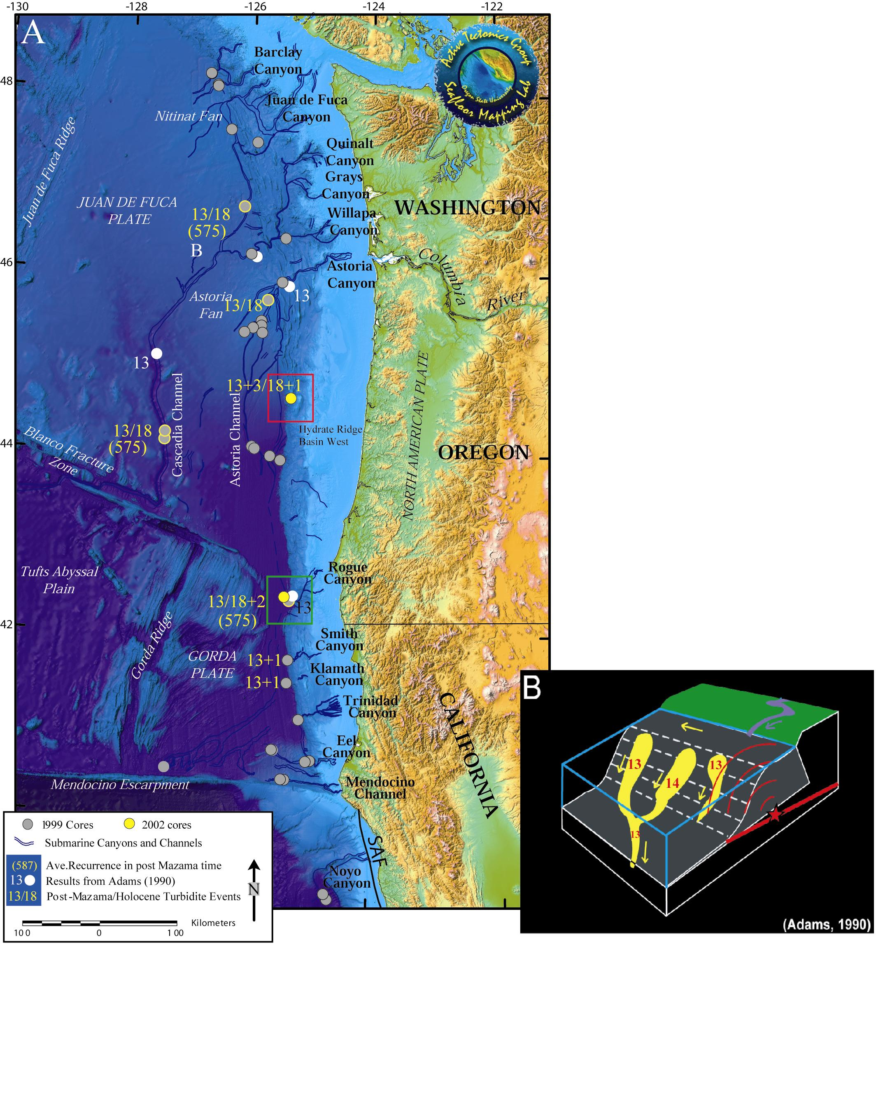
Numerous archive and new cores (~130) are being used to refine the paleoseismic record, test alternatives and segmentation
Notes:
In 1997, we wrote our first proposal to work on Cascadia turbidites. The idea was to prove John Adams wrong! We failed.
Relative dating tests, such as the “confluence test” at right, are the key to testing for earthquake origin, as radiocarbon can never provide enough precision to do that.

Slide 3
Northern Cascadia Margin bathymetry and canyon systems
relict
recharged
Notes:
In 1997, we wrote our first proposal to work on Cascadia turbidites. The idea was to prove John Adams wrong! We failed.
Relative dating tests, such as the “confluence test” at right, are the key to testing for earthquake origin, as radiocarbon can never provide enough precision to do that.

Slide 4
Barkley
Nitinat
Northern Cascadia: the confluence test
There are actually seven confluences
JDF
Relict Pleistocene sands
Quillayute
Quinault
Let’s examine some of the complexities in the Cascadia system, and how they can be used to advantage, (or not!)
All existing cores are shown, our primary cores (Professional Paper 1661-F) in white. Additional new and archive cores shown with colored dots
Mid shelf silt deposit
Grays
Guide
Willapa
Astoria

Slide 5
X
X
X
X
X
Notes:
Holocene sediment accumulation and post Mazama and Holocene turbidite counts, northern Washington margin and Nitinat Fan. Active Holocene turbidity current deposition sites in yellow, inactive fan sites in white. Red X’s indicate sites unusable for paleoseismology, but used in Atwater et al., 2014.

Slide 6
Bathymetry and backscatter views of the deformation front and passage of JDF canyon through the frontal ridge. The growth of the frontal thrust has partially blocked the canyon ponding Holocene sediment on the landward side. San deposition and erosion are found on the seaward side based on the backscatter and core data.

Slide 7
Sediment ponding upchannel and thinning downchannel of several slides along the JDF abyssal channel, shown in core diagram in the next slide.

Slide 8
Upstream (JDF) expanded
Slide
Downstream (JDF) thinned
Extra uncorrelated event

Slide 9
Monte Carlo search inversion for best fit to core stratigraphy. See Goldfinger et al. 2016 Marine Geology for more modeling examples.
Move 2014a based on Waltham et al., 2008
Notes:
Extensive hydrodynamic modelling is being used to test flow paths and alternatives, using search inversions to fit existing core stratigraphy. This sequence shows the best fitting model for Quinault Canyon following the mapped channel, and failing to follow an alternative pathway over the accretionary wedge proposed by Atwater et al. (2014). The sub-bottom profiles show that as shown in the models, the turbidite deposition thins rapidly westward on the flanks of several blocking anticlines (panel B.), and deposition is focused in a small wave field at the turn, shown in panel C.

Slide 10
Another alternative pathway: an artifact of missing data.
Notes:
Map view of modeled pathways light and dark arrows, supported by core and modeling data. Dashed lines show several alternatives proposed by Atwater et al. (2014). The pathway into Quillayute basin is not supported by modeling data. The southern pathway to the deformation front is an artifact of missing data in the grid used by Atwater (inset). The complete grid shows this pathway does not exist, being blocked by 200-300m anticlines.

Slide 11
Proximal records and local variability
The more subdued proximal records are illustrated here, with the ubiquitous giant T11, overlain by subtle but present T5-T10
Notes:
Proximal records in the northern Washington canyons are more fine grained in these relict systems that the sandier turbidites in the recharged system. Nonetheless, the relict and recharged canyons both have similar and correlable records, with consistent Holocene and post-Mazama turbidite counts.

Slide 12
North/Western systems
South/Eastern systems
New expanded analysis suggests a rather simple signal of 21-25 Holocene turbidites along the northern margin in independent canyon/channel systems, supporting the original confluence test. See Goldfinger et al. 2016 Marine Geology.

Slide 13
19/na
CPX/Hb <0.8 + Glaucophane, magnetite < 2%
The confluence:
A mixed signal.
20/15
>80
km
>13/11
Heavy mineral tracers distinguish northern and southern provenance sources and preclude significant input to JDF from Quinault Canyon.
>20/19
16/12
17/14
18/16
18/16
160
km
19/13
>20/13
>20/16
CPX/Hb> 1.3 + No Glaucophane, magnetite 5-10%
CPX/Hb ~1.0 1.0 + trace Glaucophane
Notes:
Northern provenance with Glaucophane (upper yellow box) indicated with green checks, Columbia River provenance (lower yellow box) without Glaucophane shown by red X’s. Mixed provenance with trace Glaucophane shown downstream of main JDF-Willapa confluence (left yellow box).

Slide 14
Well log (geophysical) and temporal correlation (radiocarbon) between Slipstream slide, Effingham Inlet, and other Cascadia data offshore, and onshore at Willapa Bay.
This study yields an independent corroborative result linking more southerly offshore work, and several onshore sites.
Slipstream Slide
Hamilton et al., 2015
Canadian Journal of Earth Sciences
Notes:
Good corroboration of the simple northern Cascadia signal at slipstream compared to Goldfinger and onshore site of Atwater. Very minor differences.

Slide 15
Several new cores off northern Oregon at a new site called Oceanus Basin have filled the largest paleoseismic gap in the offshore dataset, extending from Hydrate Ridge to Astoria Canyon.

Slide 16
True Scale
Simple correlation diagram between the new cores at Oceanus Basin and Hydrate Ridge

Slide 17
Flattened
Simple correlation diagram between the new cores at Oceanus Basin and Hydrate Ridge. This “Flattened” diagram shows the near identical stratigraphy found at these two isolated sites. Neither site receives terrestrially sourced sedimentation (other than hemipelagic mud).

Slide 18
Flattened

Slide 19
Preliminary correlation: Bull Run-Oceanus basin-Hydrate Ridge.
This diagram adds cores from Bull run Lake, on the flanks of Mt. Hood, suggestive of a possible linkage (work in progress).
True scale, with Bull Run Lake (at ~ same latitude) record flattened to each site.

Slide 20
The segmented “small events” of southern Cascadia (Green lines) corresponding to “Segment C” are extended northward to Oceanus basin and die out at or before Astoria Canyon.
These events were previously data limited to central Oregon.

Slide 21
The entire Cascadia margin is above the CCD, so any site will have datable material.
Around the world though, this is rare.
So the solution may be to sample slope basins.
We have used slope basins in Sumatra to get around this problem, and in Cascadia to add isolated sites to the mix.

Slide 22
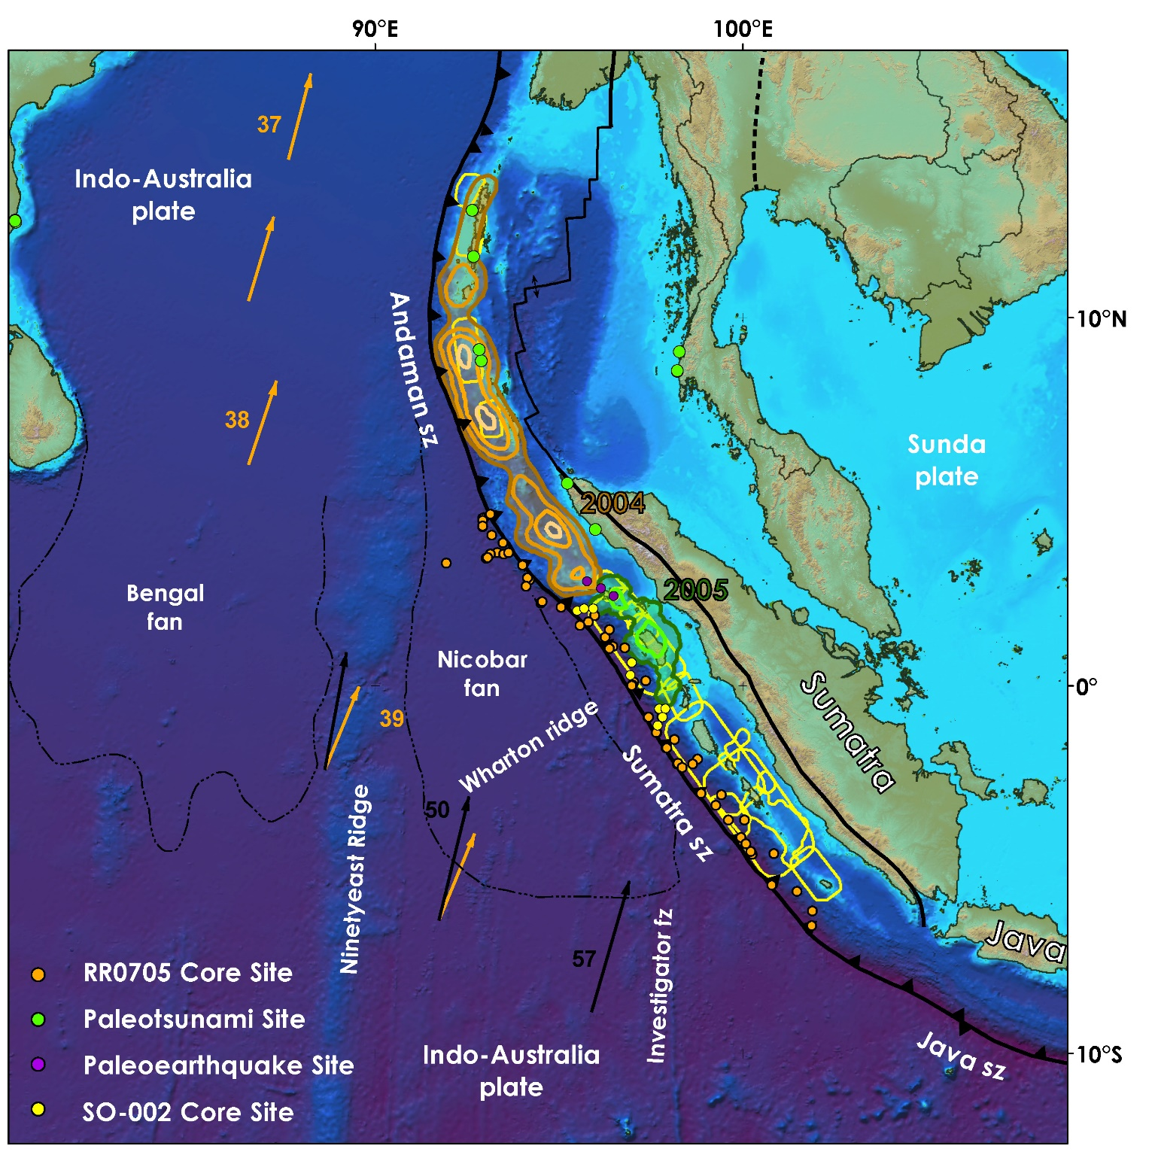
Notes:
SRTM bathymetry and topography is in shaded relief and colored vs. elevation (Smith and Sandwell, 1997).The India-Australia plate subducts northeastwardly beneath the Sunda plate (part of Eurasia) at modern rates (GPS velocity based on Nuvel-1A; Bock et al., 2003; Subarya et al., 2006): India/Australia are black vectors and Australia/Asia are orange vectors. Historic ruptures (Bilham, 2005; Malik et al., 2011) are plotted in grey, with years of rupture in white. Paleotsunami and paleoearthquake sites are plotted in green and labeled with a letter: a (Rajendran et al., 2007), b (Rajendran et al., 2007), c (Grand-Pre et al., 2008), d (Monecke wet al., 2008), e in purple (Meltzner et al., 2010), f (Jankaew et al., 2008), g (Rajendran et al., 2008), h (Nair et al, 2010), I (Rhodes et al., 2011), j (Malik et al., 2011). RR0705 cores are plotted in orange, SO-002 cores are plotted in yellow (Sumner et al., 2013). The location of Fig. 1-3 and Fig. S1-2 is shown as a black rectangle. Bengal and Nicobar fans cover structures of the India-Australia plate in the northern part of the map, are delimited on their southern boundary with dashed black lines (Stow et al., 1990).The 2004 and 2005 earthquake epicenters are plotted.

Slide 23
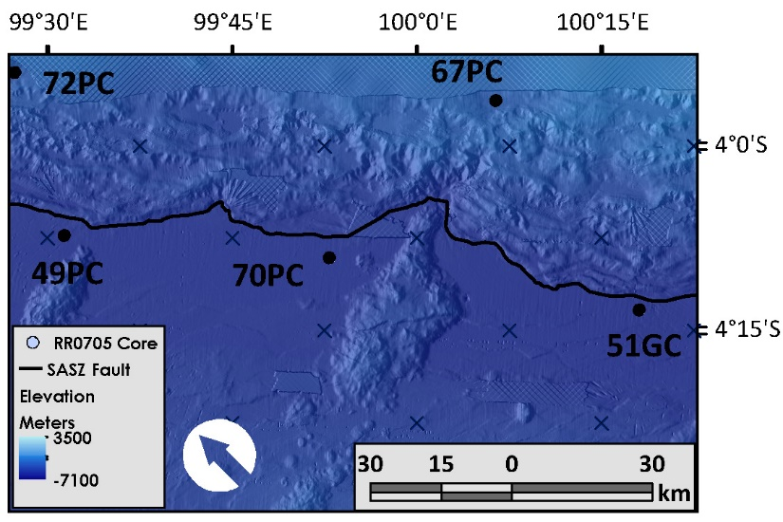
In Sumatra, we paired trench (undatable) and slope basin cores (datable), and made use of a compartmented trench that limited along strike sediment transport. Based on Cascadia, we hoped the two could be correlated.

Slide 24
Ideal basin sites (we reasoned) would be isolated, have steep local slopes, have no terrestrial sediment supply, and be above the CCD.
Significant canyons are rare (a few exist and several have connections to the islands), and activity was (and still is) poorly known.

Slide 25
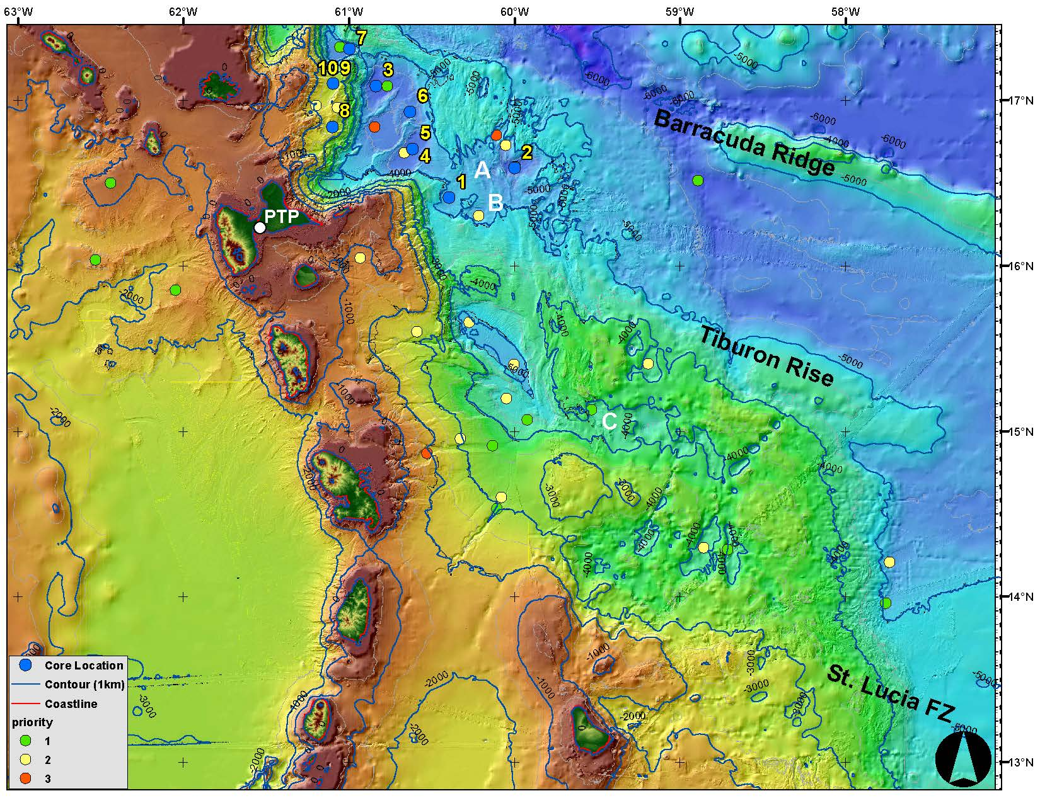
Notes:
A recent cruise to the Antilles subduction zone collected cores that will use this strategy to test for similar or dissimilar sequences in isolated slope basins.

Slide 26
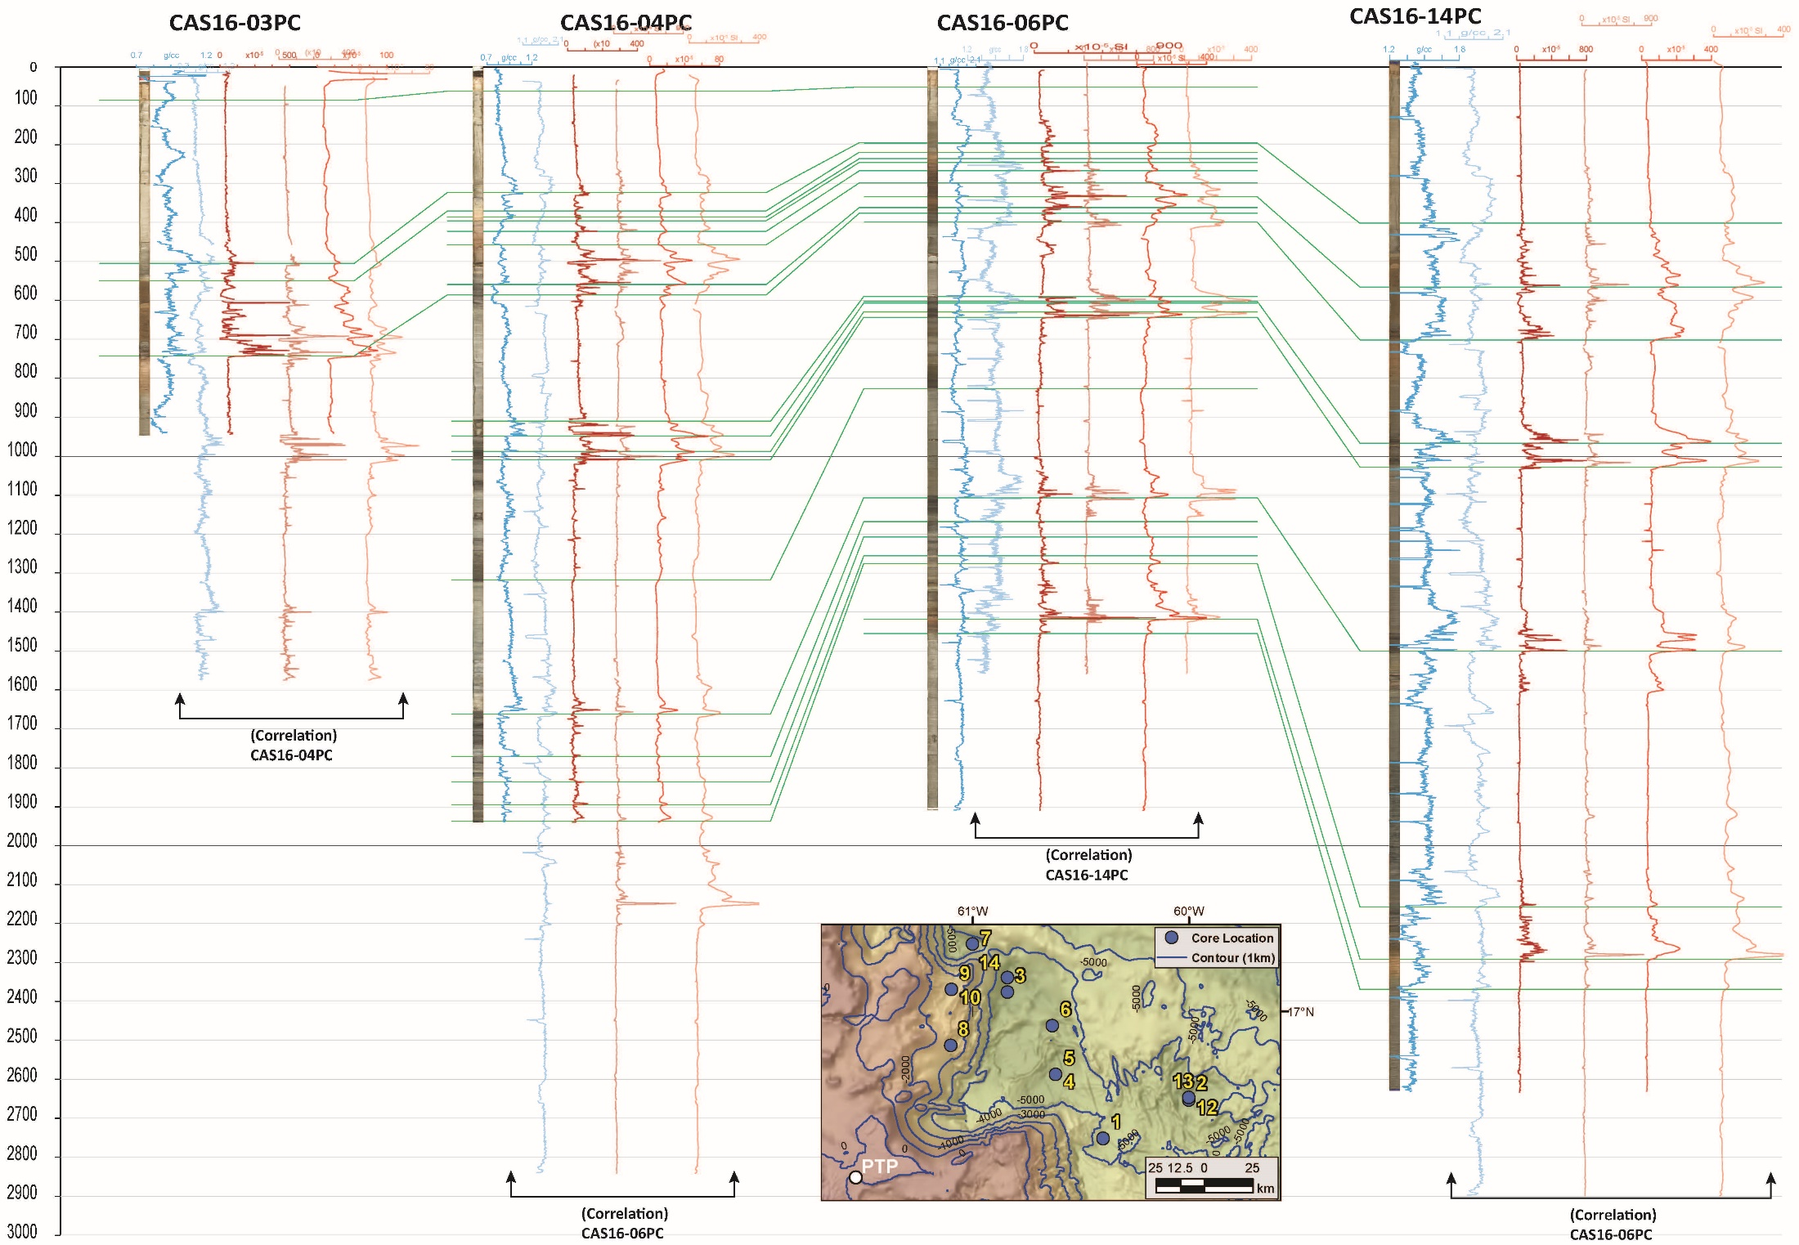
Notes:
Correlation between isolated sites in the Antilles is suggested in this in progress correlation diagram.

Slide 27
2015-16 update of segment boundaries, event counts.
“Extra” southern events may be present in Bradley Lake.
Notes:
Boundary changes with additional data have resulted in a revised segmentation diagram for Cascadia, based on additional data given in Goldfinger et al. (2013, 2016). This also resulted in recurrence time changes for the northern two segments, shown by white circles.

Slide 28
The reason for segmentation of the southern margin?
It could be as simple as sediment cover on the downgoing plate.
The north has much greater sediment thickness and has a smooth interface.
The thin cover in the south unmasks may seamounts and several aseismic subducting ridges, breaking up the smooth interface.
The north has much greater sediment thickness and has a smooth interface.

Slide 29
Structural control of segment boundaries?
Suggested by strong vs. weak upper plate deformation in map view, indicating strong and weak basal traction.
NB
Strong
coupling?
Uncoupled?
HB
Strong
coupling?
Notes:
Possible downdip edge indicated by red dashed line, possible updip coupling limit indicated by green dashed line. Blue line is the shelf edge. Strong coupling indicated by intense deformation of the major submarine banks, Nehalem, Heceta, and Coquille, and much less intense deformation of the interbank regions.

Slide 30
Seg. B
Structural segment model
Seg. C
Seg. C’
Seg. D?
Notes:
The entire model, excluding Canada.

Slide 31
Notes:
The structural coupling model (white line) shows strong similarities to the locking models of McCaffrey et al., and is compatible with the paleoseismic segmentation models shown in this presentation.

Slide 32
Conclusions
Understanding of channel pathways and their history and dynamics is critically important. Erroneous conclusions may be drawn from inappropriate sampling strategies and inadequate data.
Alternative pathways and turbidite counts in Washington are not supported by modern data or turbidity current physics.
Including ~ 130 new and archive cores including Effingham Inlet, the Slipstream Slide, onshore lakes and marsh sites suggest consistent record of ~ 21-24 significant events in the Holocene.
Short-term recharge of modern sediment supply is not required in Cascadia, Sumatra or the Caribbean.
Lacustrine records at similar latitudes are consistent with offshore records for Seattle and Portland respectively (shown previously)
Earthquake recurrence and probabilities are slightly revised for Washington to 430 years and 12-17% in 50 years, and 350 years and 17-21% for northern Oregon.

