Slide 1


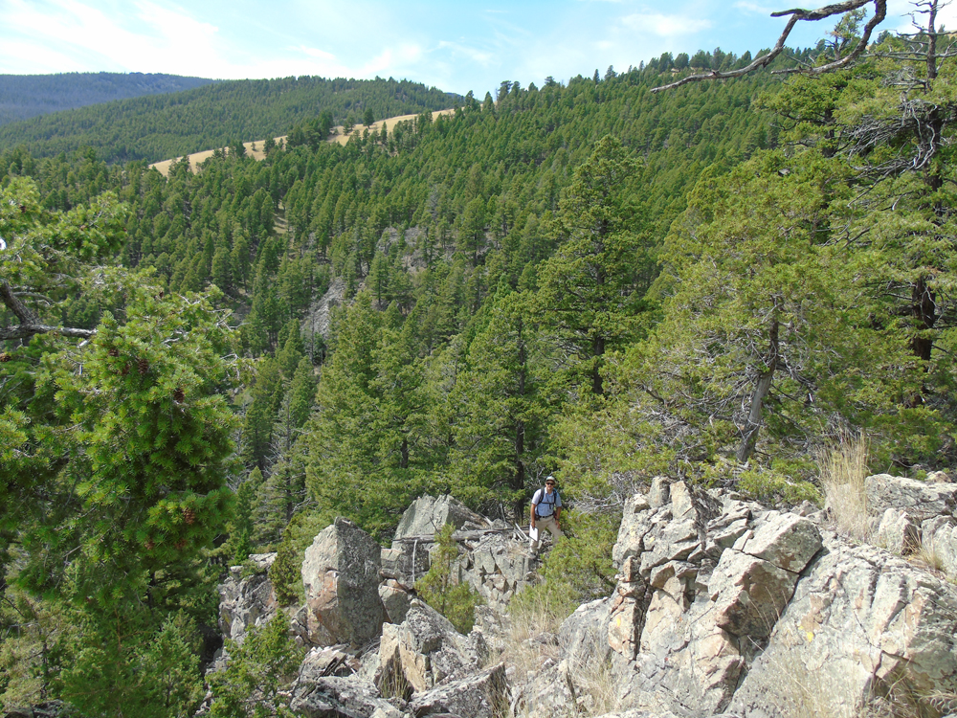
Large-volume pyroclastic deposits along the eastern edge of the Boulder Batholith, southwestern Montana
Ian Kallio: Oregon State University kallioi@oregonstate.edu
Kaleb Scarberry: Montana Bureau of Mines and Geology kscarberry@mtech.edu
Contributions by: Dilles, Olsen III, Older and Horton (OSU); Korzeb and English (MBMG). Support: STATEMAP/EDMAP (MBMG)(OSU)

Slide 2
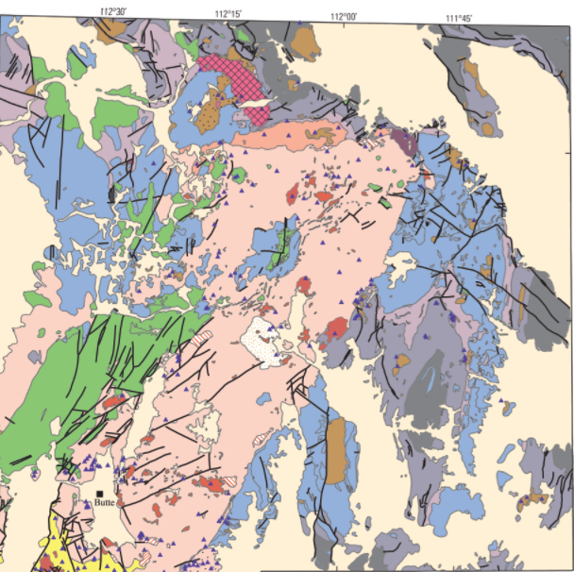
Outline
Elkhorn Mountains Volcanics
When did the ignimbrites form?
How many eruptions?
Are they continuous?
What are eruption volumes?
Conclusions: Large volume ignimbrites are continuous and traceable along the Boulder Batholith
Boulder Batholith

Slide 3
Igneous geology near Butte, MT
Elkhorn Mountains Volcanics
1:24,000 geologic mapping (EDMAP) in conjunction with 1:100,000 mapping (STATEMAP)
Late Cretaceous plutons (Boulder Batholith) and comagmatic volcanic cap (Elkhorn Mountains Volcanics)
Boulder Batholith
Pluton and volcanic cap represent exceptional record of continental magmatism

Slide 4
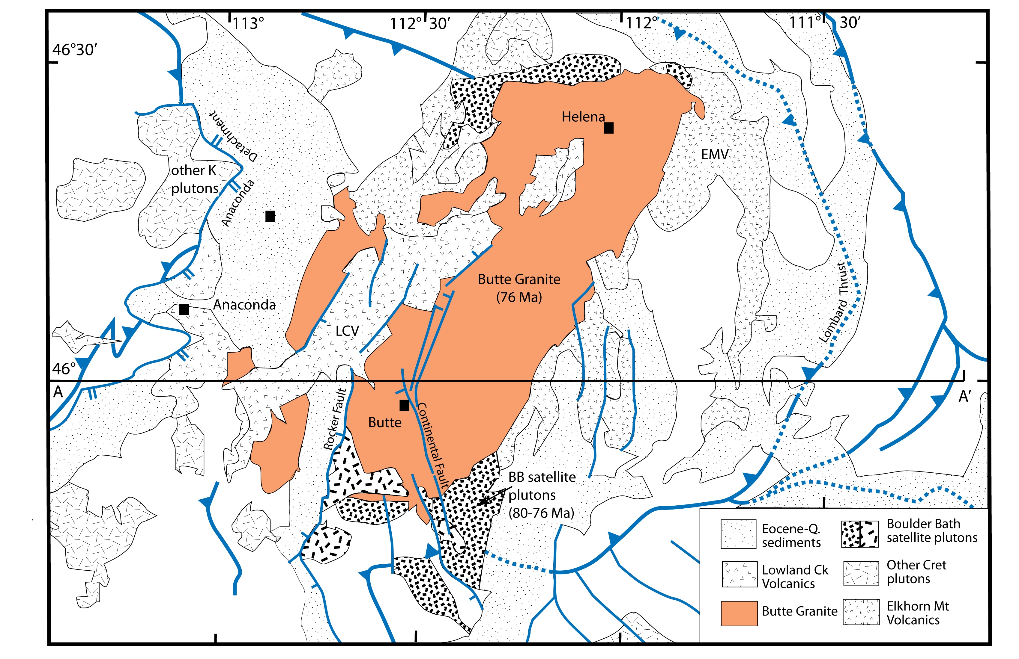
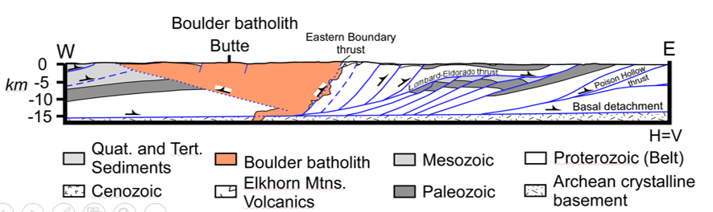
Cordilleran arc magmatism
Magmatism synchronous with shortening in Sevier Fold-Thrust belt
Volcanic products include basalt-andesite (lower member) overlain by voluminous dacitic ignimbrites (middle member)
Pluton emplaced into volcanic cap

Slide 5
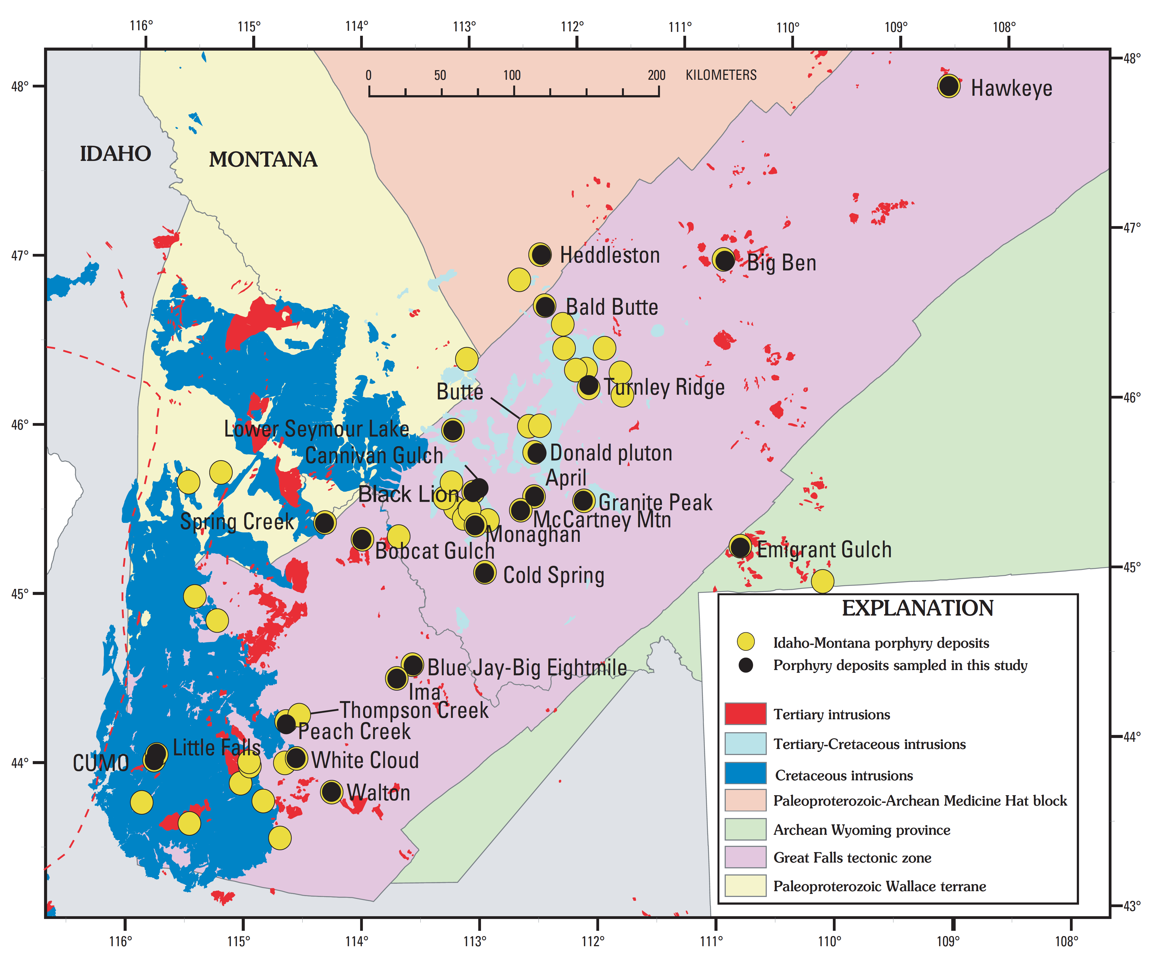
Multiple large mineral deposits associated with this late cretaceous magmatic system
Boulder Batholith

Slide 6
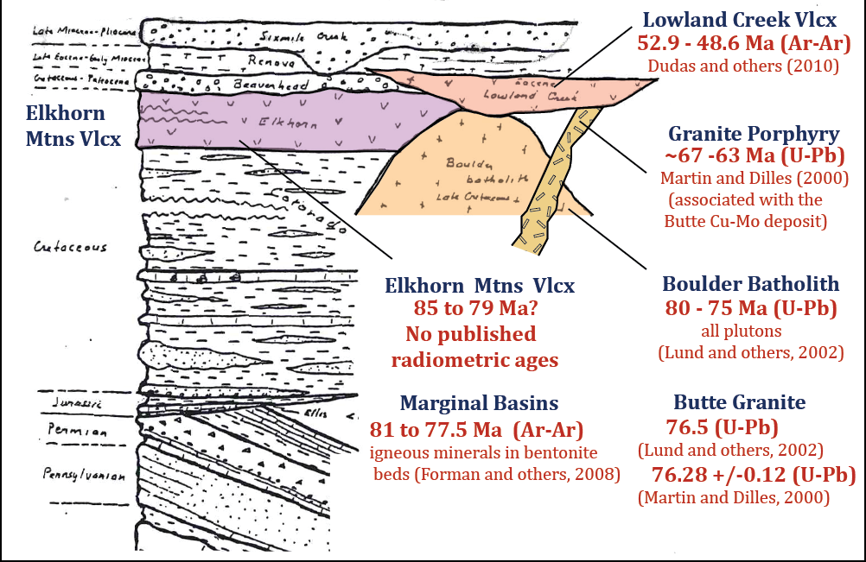
Late Cretaceous – Eocene igneous rock, SW Montana

Slide 7
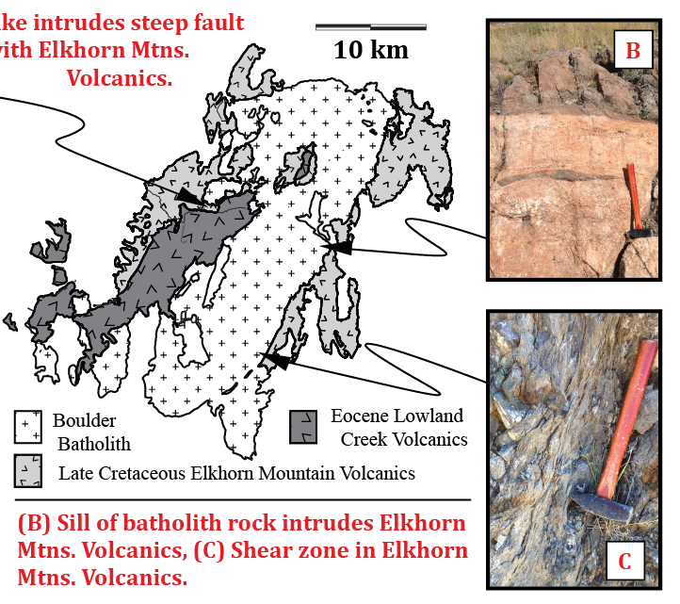

Field evidence for batholith emplacement
Elkhorn Mountain Volcanics
A
Boulder Batholith
Sheared and cooked contact
(A)
(B)
B

Slide 8
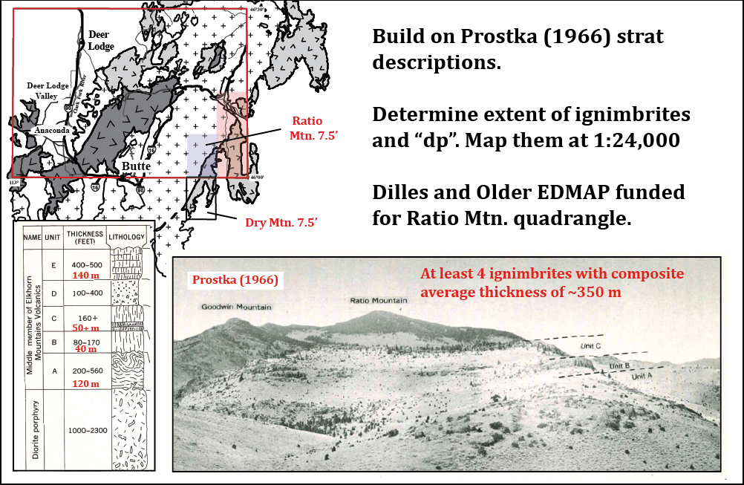
Late Cretaceous ignimbrites: Elkhorn Mountains Volcanics
Prostka mapped abc…

Slide 9
Results: ignimbrite section in Ratio Mountain
Found upper lower and middle member
50m
E2: Moderately-poorly welded, 20% plagioclase, 10% pyroxene and hornblende, 1-3% biotite, brown to grey
E1: Moderately welded, 25% plagioclase, 10% pyroxene and hornblende, 5-10%, green to white
D: Pyroclastic airfall/unwelded tuff
C: Sparsely rheomorphic, crystal poor, 10% plagioclase, 1-3% 1-2 mm biotite, large and abundant fiammé
B: Partially rheomorphic, 10-20% plagioclase, 3-10% 2-5 mm biotite, up to 2% hornblende, purple to brown
A: Strongly rheomorphic stretched 100:1, 5+% plagioclase, 1-3% altered biotite, grey to white
DP: Flow-banded dacite lavas and domes with plagioclase (20-25%),
and 10-12% augite, horblende, and minor biotite; 1-2% magnetite
60m
90m
Middle Member
100m
180 -200m
160m
>200m
Lower Member

Slide 10
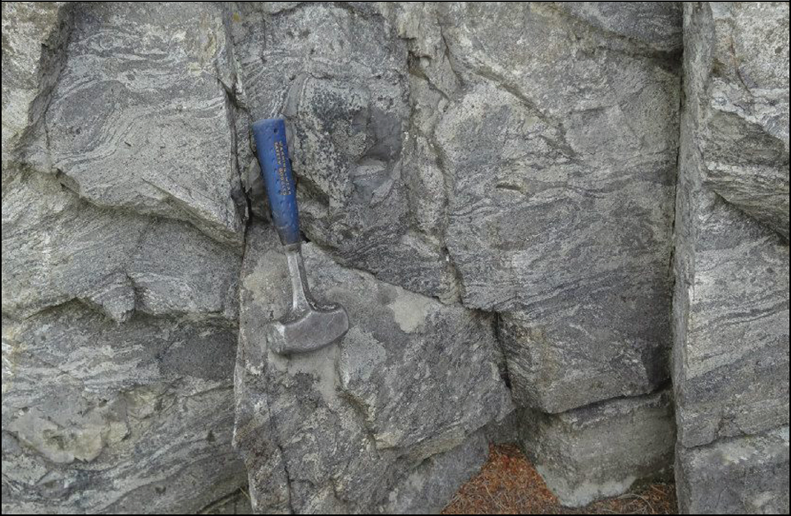
Results: EMV ignimbrites: regional rheomorphic unit “A”

Slide 11
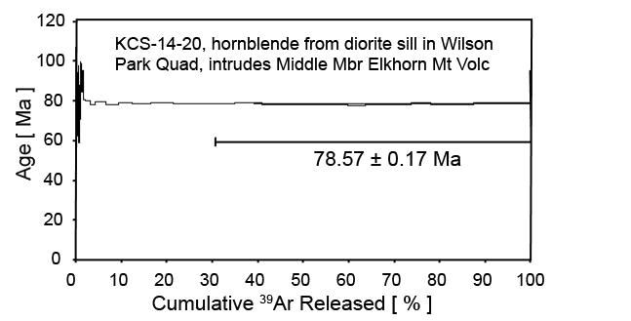
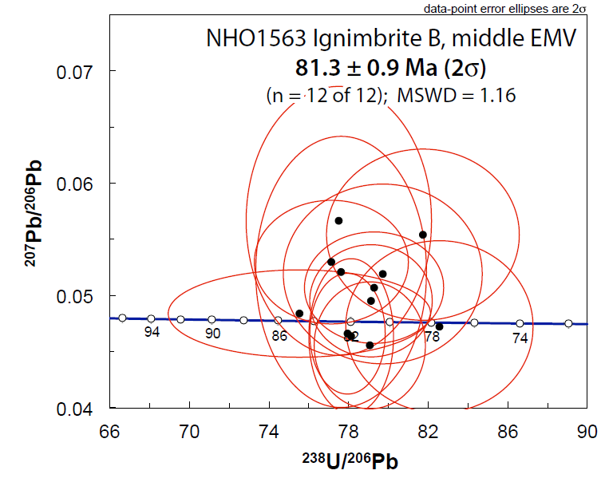
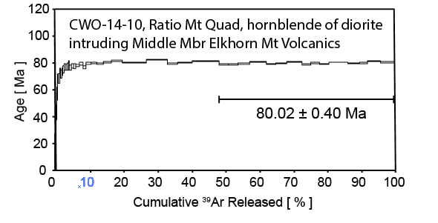
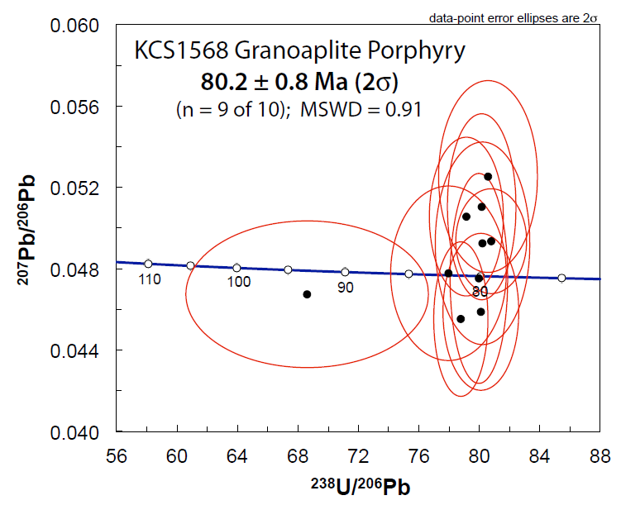
Results: How old is the section?
U/Pb ages conclude the B unit of the middle member to be 81.3 Ma
Granoapalite porphyry is the same age as the EMV
Intrusions in the EMV suggest that the middle member is older than 78.6 and 80 Ma

Slide 12
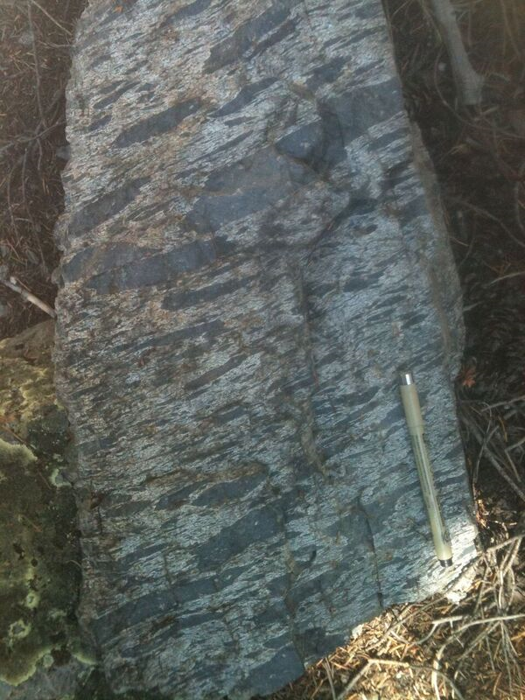
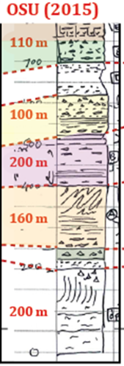

Results: They correlate over 50 km
We can trace individual ignimbrite sheets for ~50 km along the eastern contact with the Boulder Batholith
Unit C (Ratio Mtn)
OSU (2015)
MBMG/OSU (2015)
MBMG (2014)
?
80 m
100 m
100 m +

Slide 13
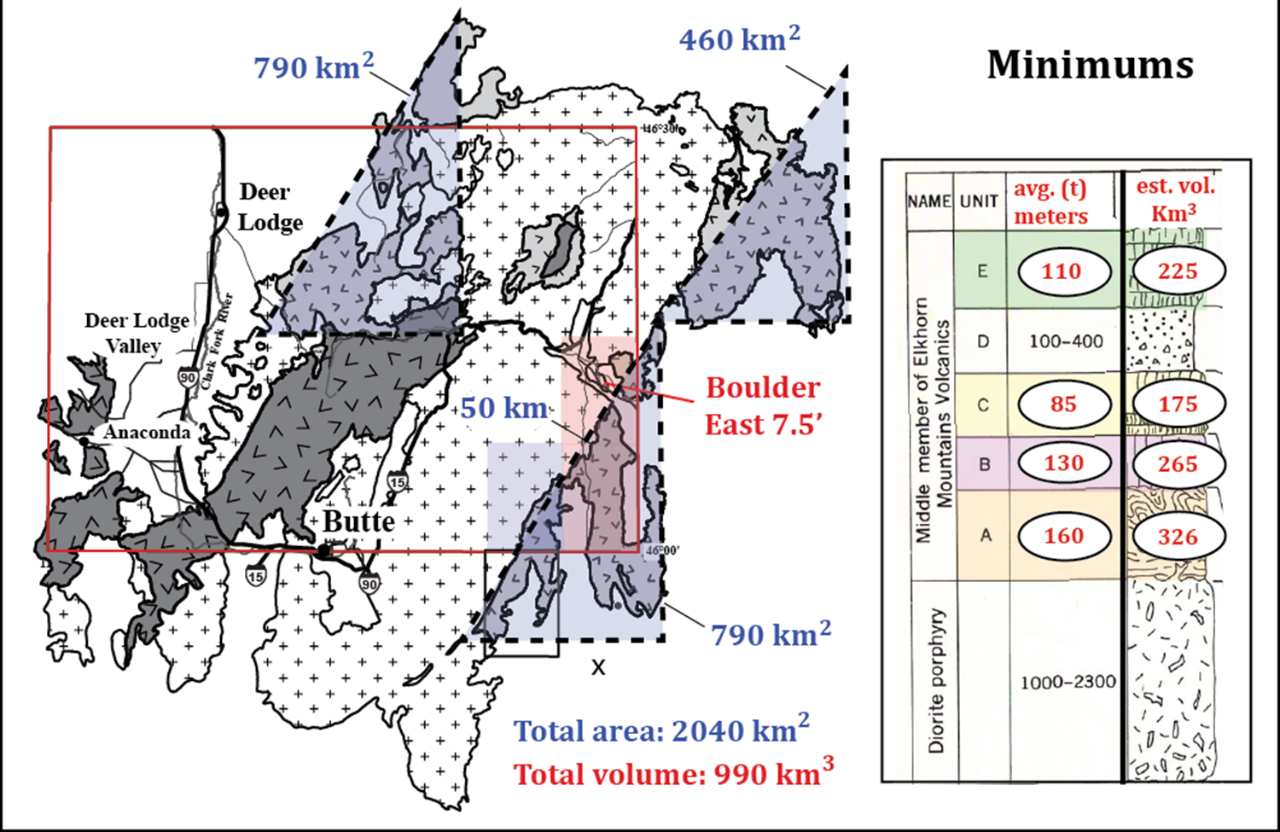
Results: EMV ignimbrites - Volume estimates
25 km
Ellipse area: 6000 km²
Ellipse volume: 2900 km³

Slide 14
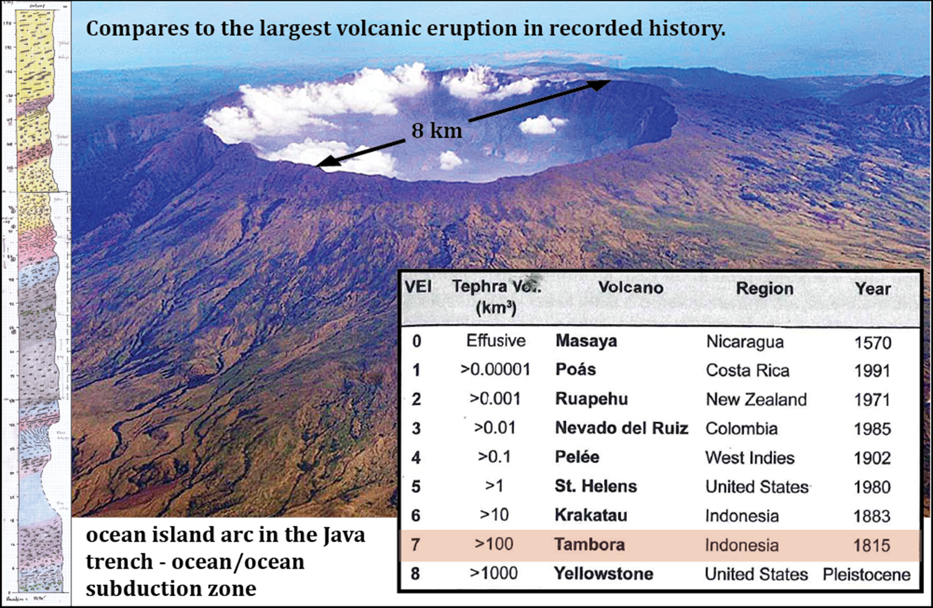
The EMV eruptions and modern analogues
C
B

Slide 15
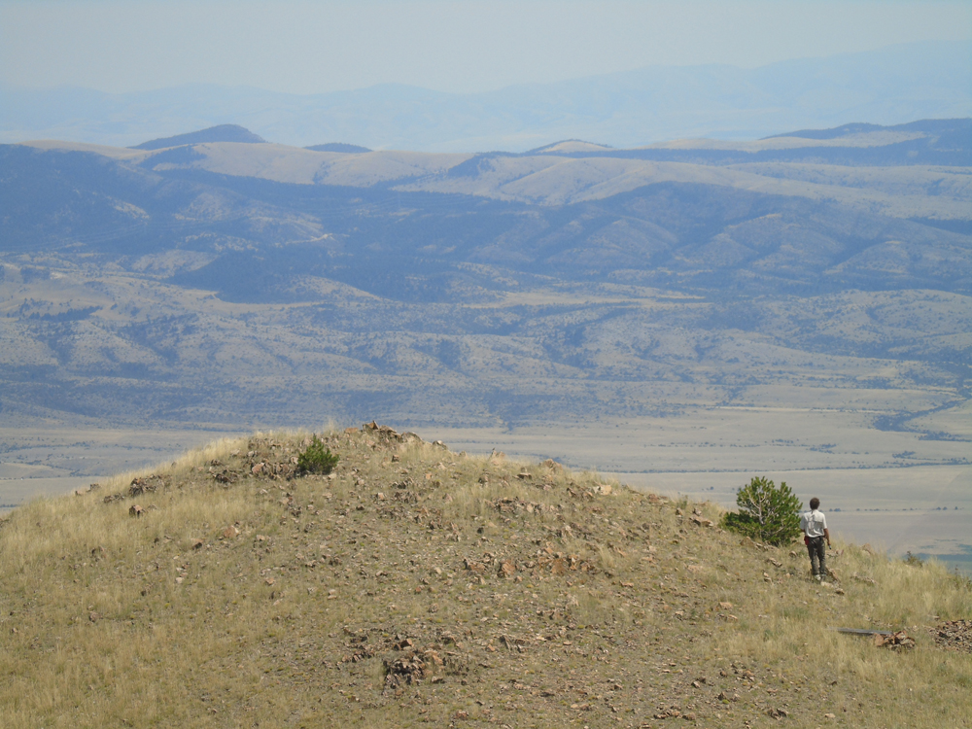
Conclusions
Our data say the middle member B unit is 81 Ma, and all the middle member erupted just before the emplacement of the first plutons
The middle member of the EMV contain at least 3 regional ignimbrites (units A, B and C) and can be correlated over 50 kilometers.
Volume estimates yield minimum volumes of 200-250 km³ for each of the 3 calk-alkaline ignimbrites

