Slide 1
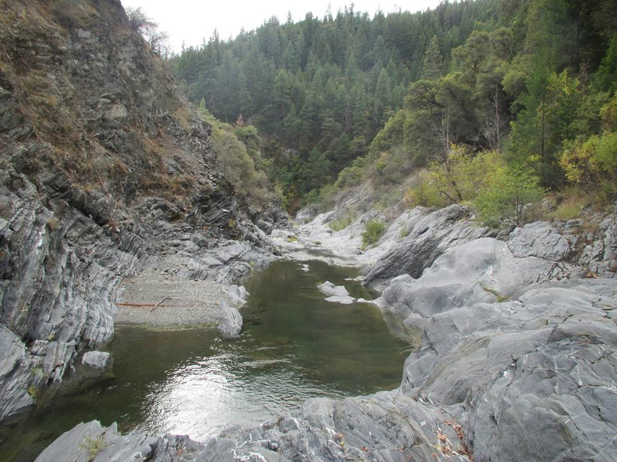
Eastern Belt, Franciscan

Slide 2
Adapted from Ernst and McLaughlin, 2012
Willows

Slide 3
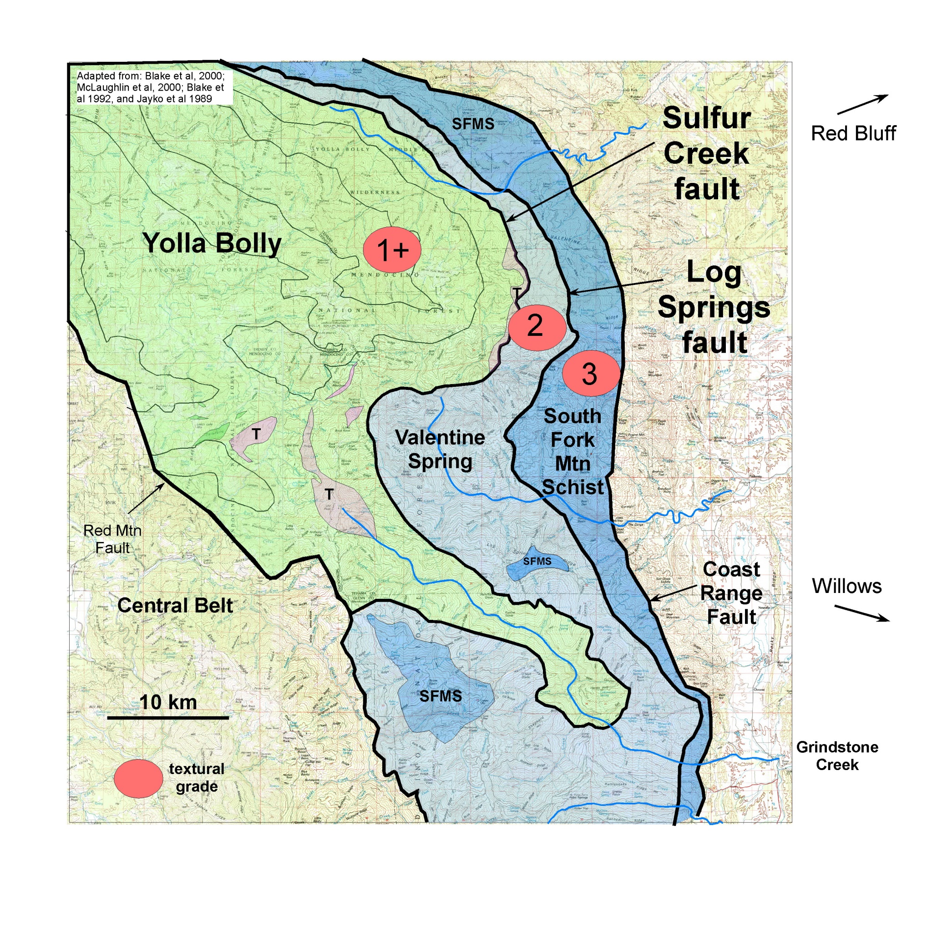
Red Bluff
CRO
Willows
Grindstone Creek

Slide 4
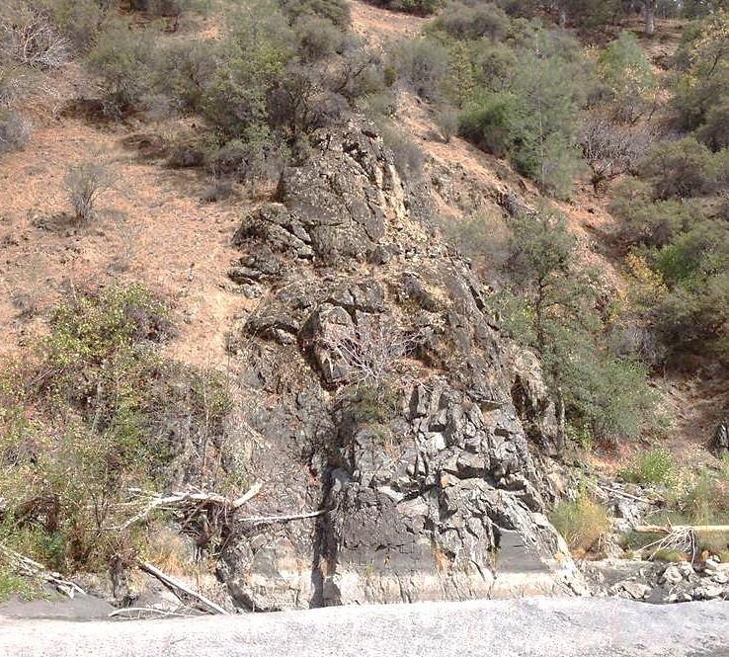
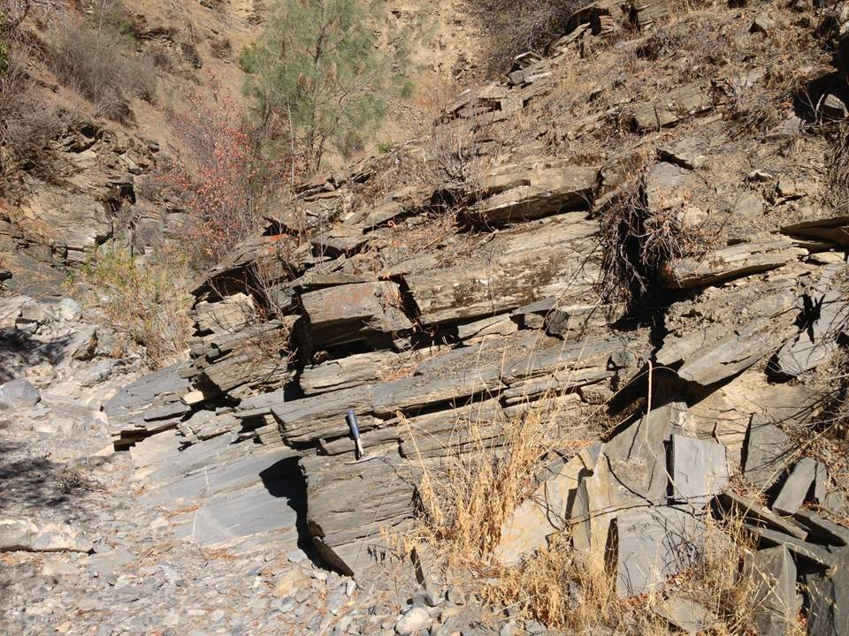
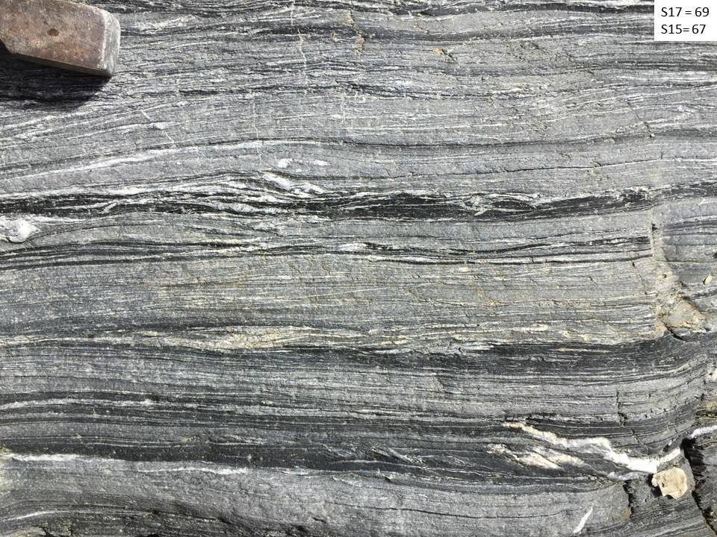
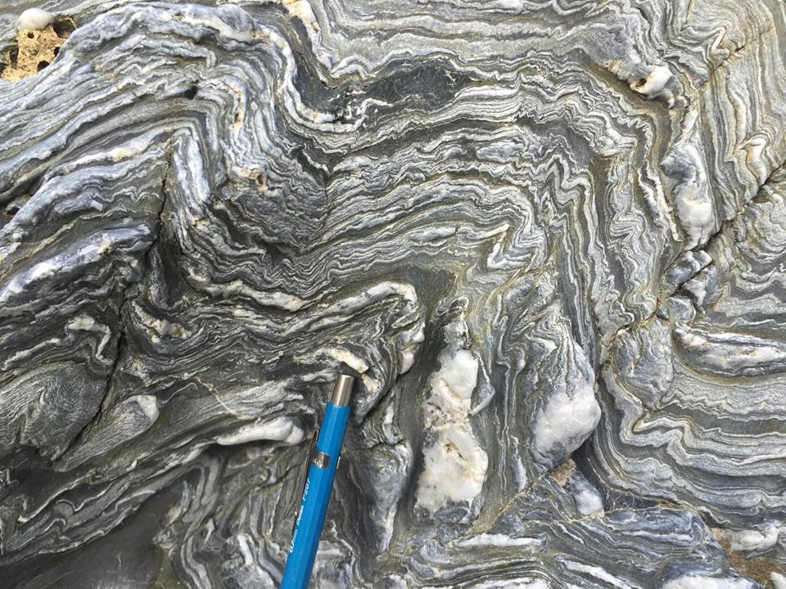
Yolla Bolly graywacke/argillite
1+
Valentine Spring
Semi-schistose graywacke & argilite
2
All units in Blueschist facies
3
SFMS, thin-bedded to laminated schistose sand and shale
3

Slide 5
CRO
A’
A

Slide 6
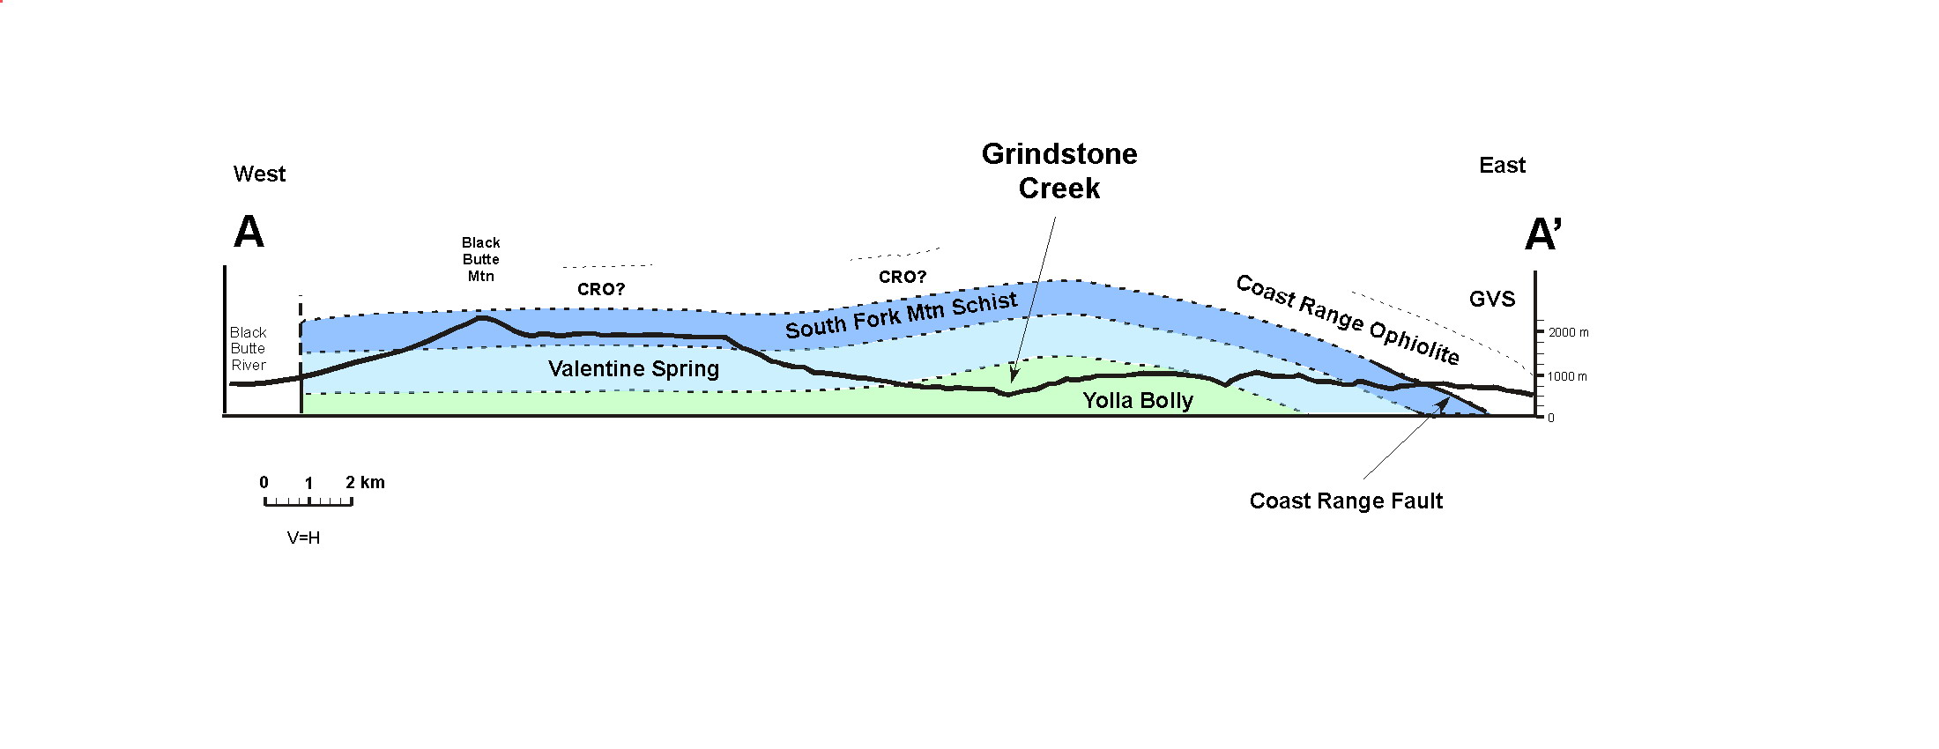
Log Spring Fault
3
2
1+
Sulfur Creek Fault
Fault interpretation drivers:
Belief in Age difference between SFMS & Franciscan
Post-metamorphic differential uplift

Slide 7
Arguments for faulting
Jump in metamorphic grade
Change in lithology and
structural fabric
Jump in textural grade
Arguments against
“metamorphic temperature was
not very different” across the Eastern belt
Brocker and Day, 1995
Sulfur Creek Fault and other YB faults
“vertical component of post-metamorphic fault offset was small (< few km), if any.”
Cloos and Copeland, 2005
Can be explained by
accretionary processes
Data not convincing
Faults not seen in outcrop*

Slide 8
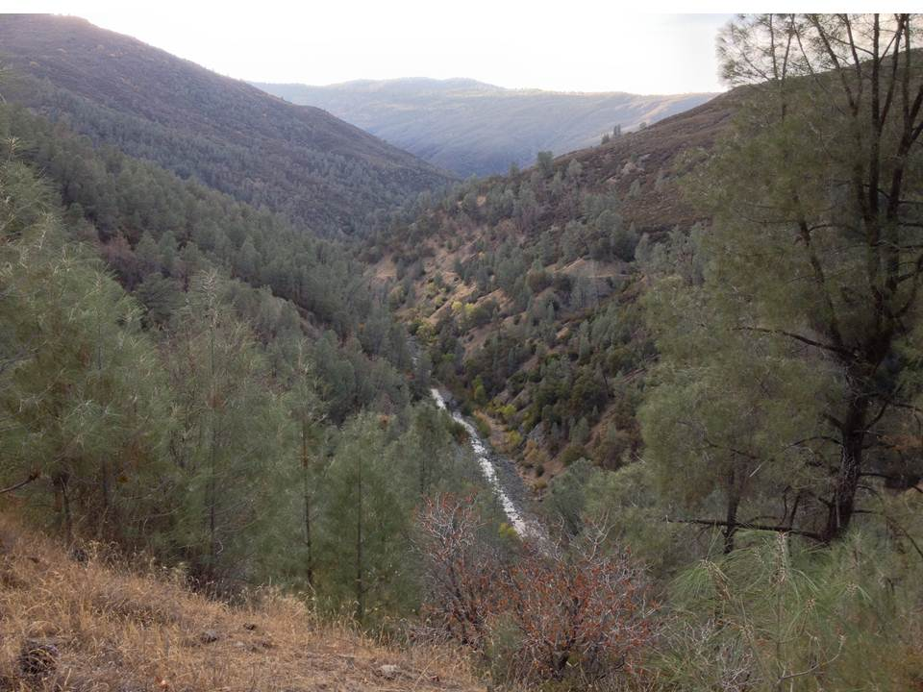
Grindstone Creek from Longpoint trail

Slide 9
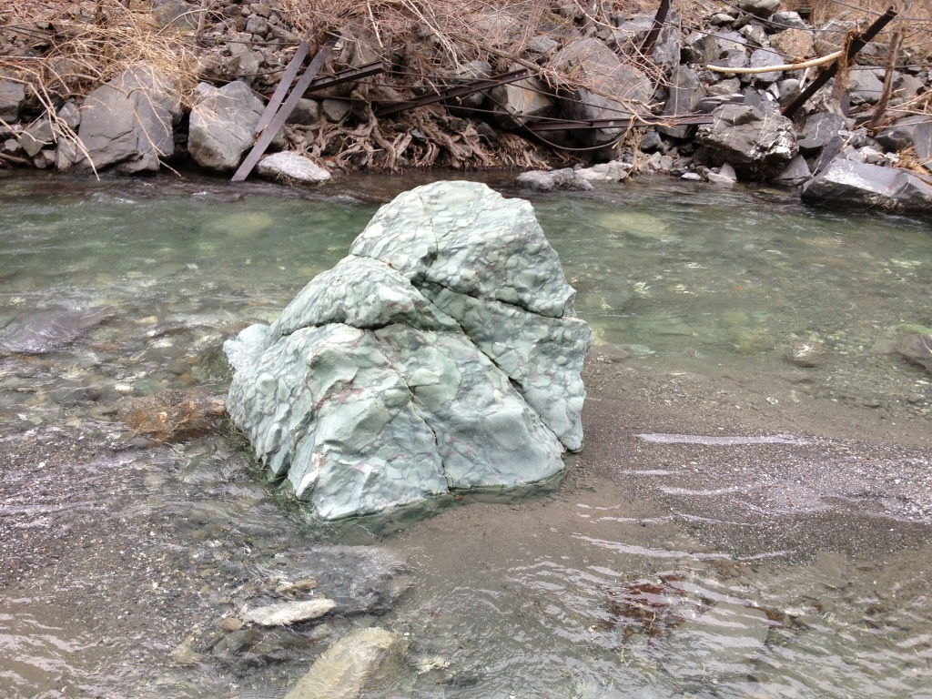

Slide 10
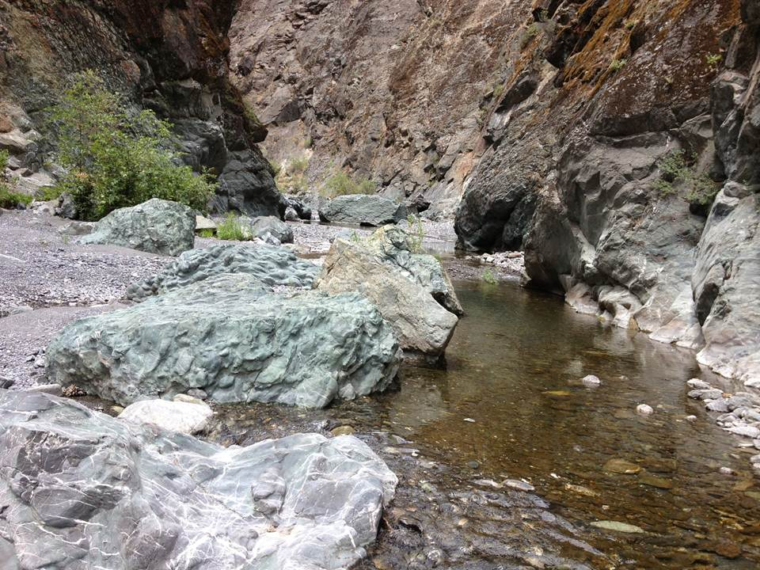
Grindstone Creek

Slide 11
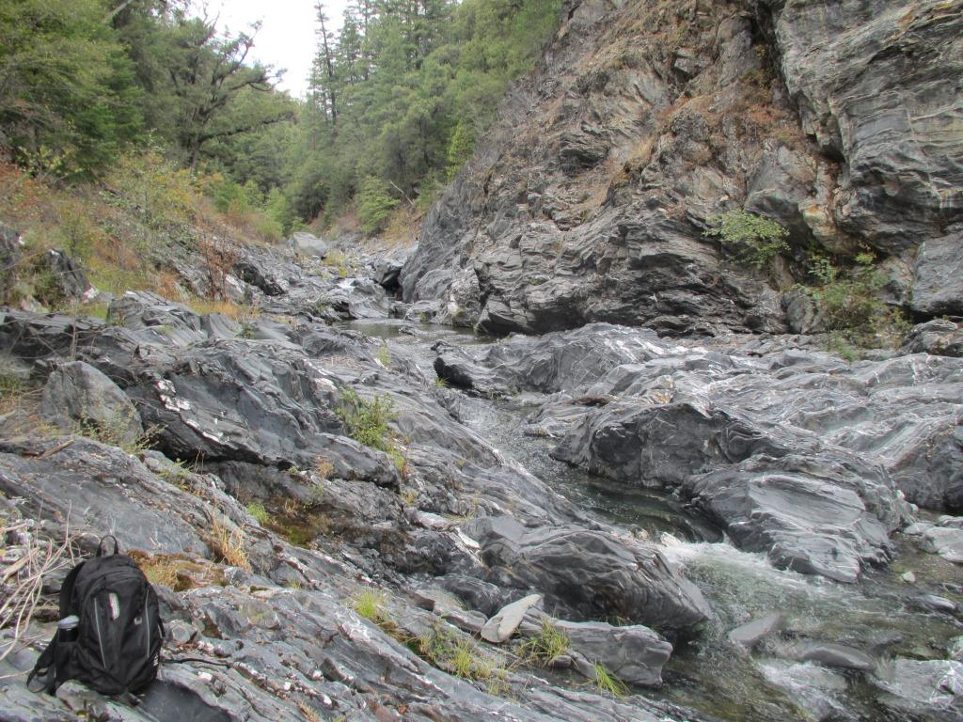
Thomes Creek

Slide 12
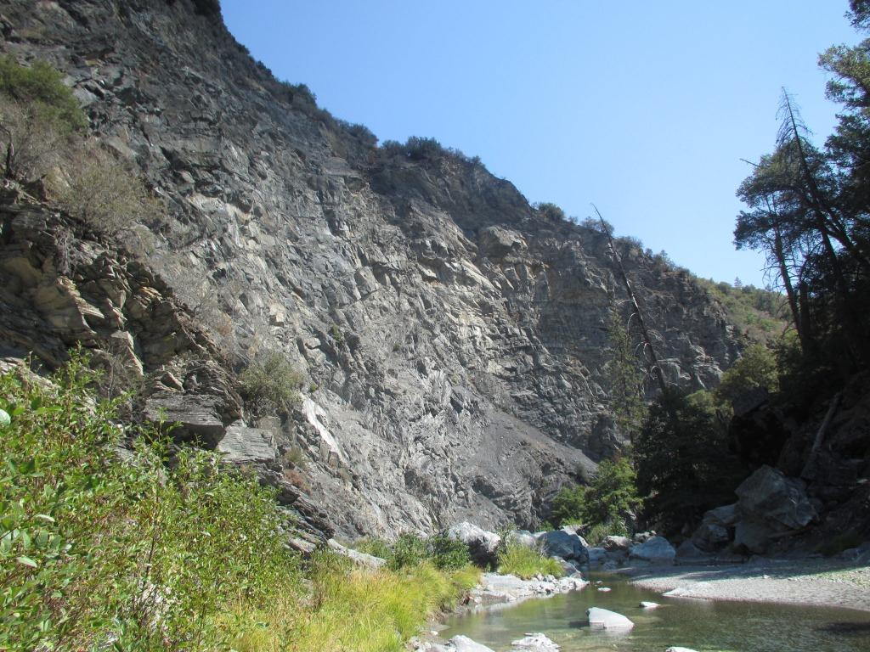
Thomes Creek

Slide 13
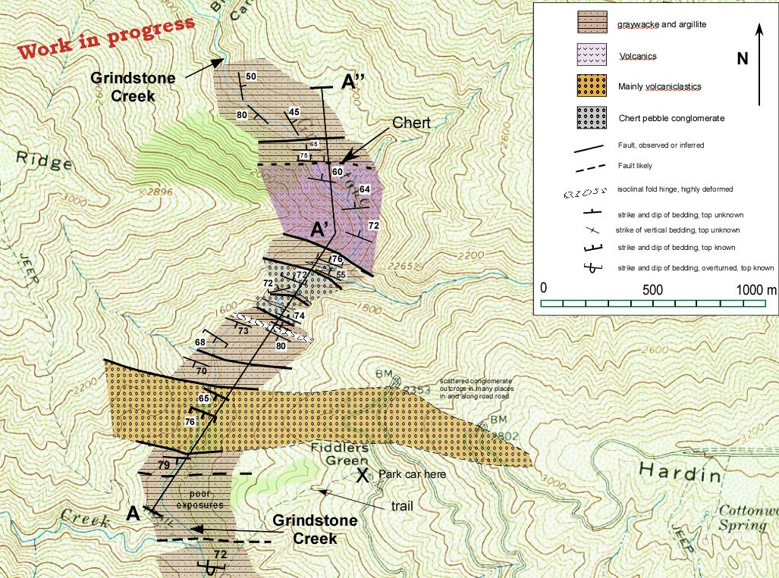
Subparallel faults spaced ~100 to 600 m apart
Change in lithology and structural fabric across faults
Grindstone Creek
1000 m

Slide 14
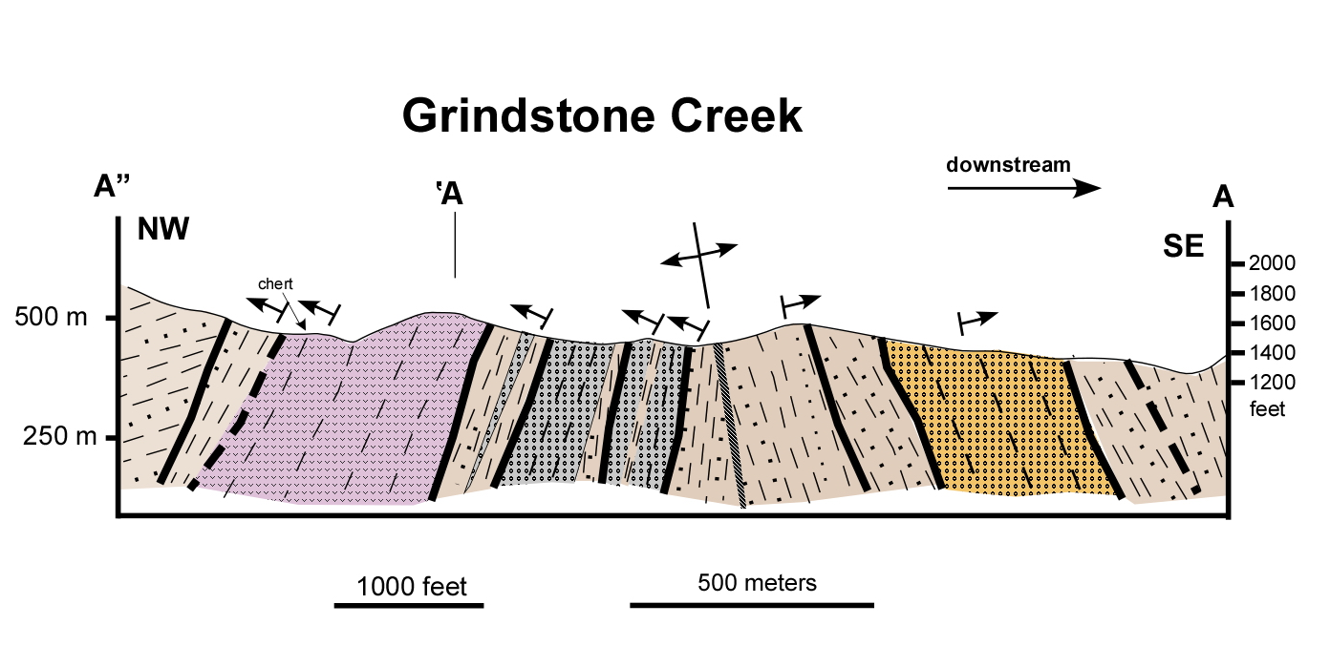
Across faults there is commonly:
a change in structural fabric (e.g. strike of bedding)
a change in lithology.

Slide 15
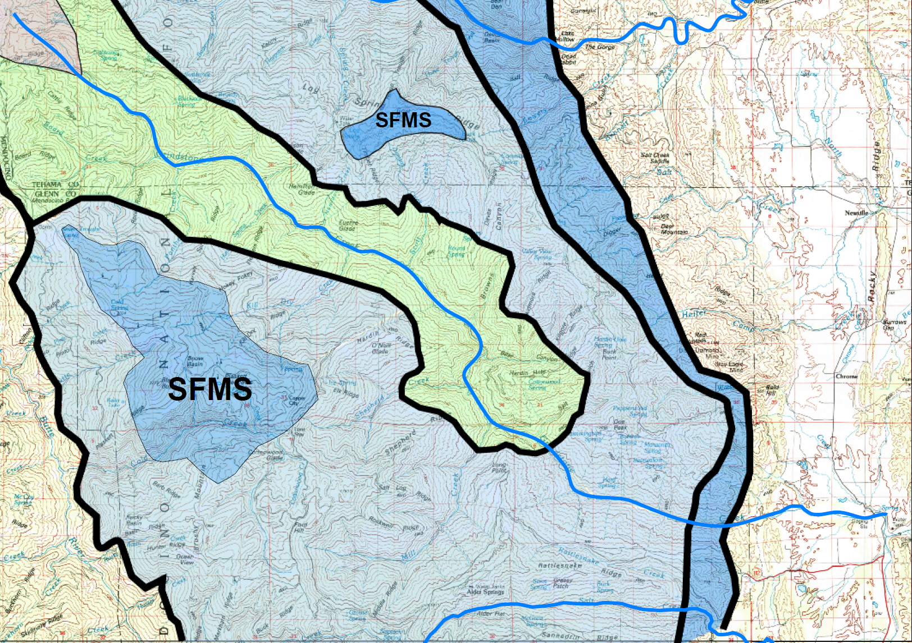
Grindstone Creek
Sulfur Creek Fault
B
B’
10 km

Slide 16
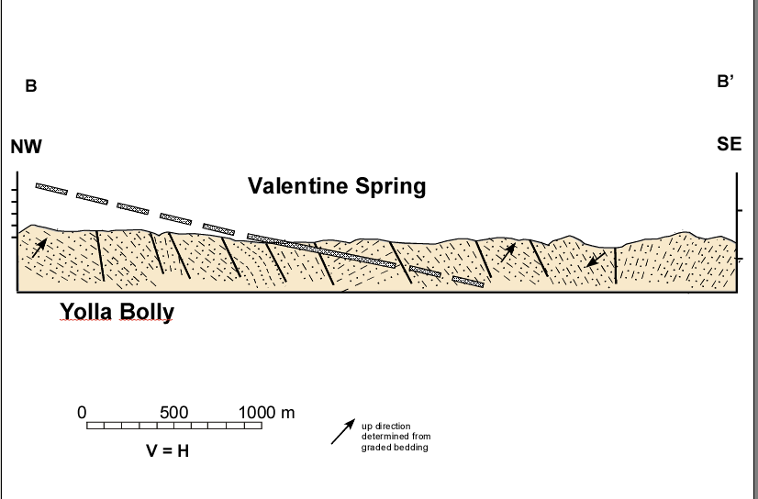
Sulfur Creek Fault
semischist
not schistose

Slide 17
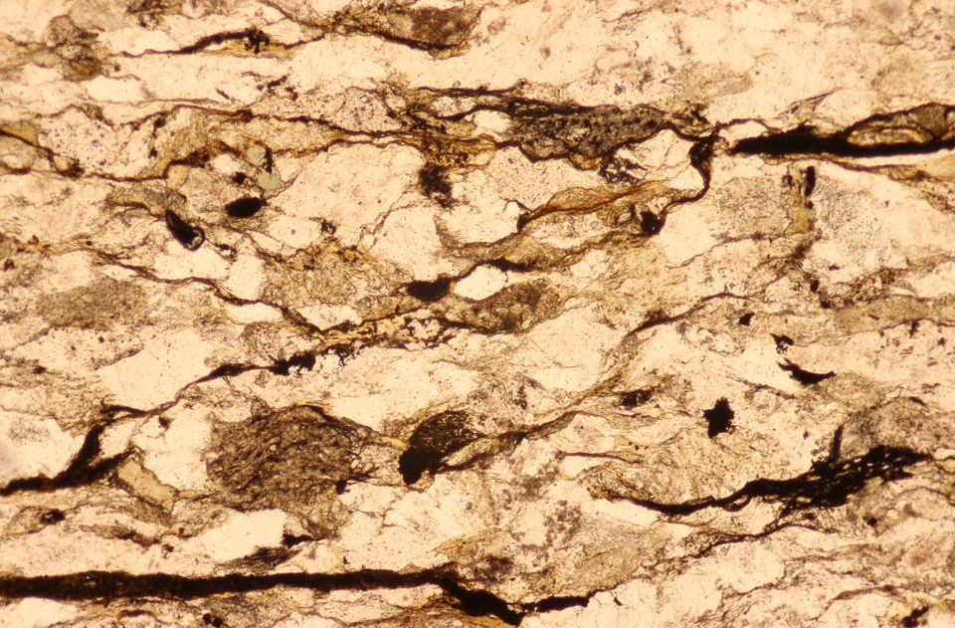
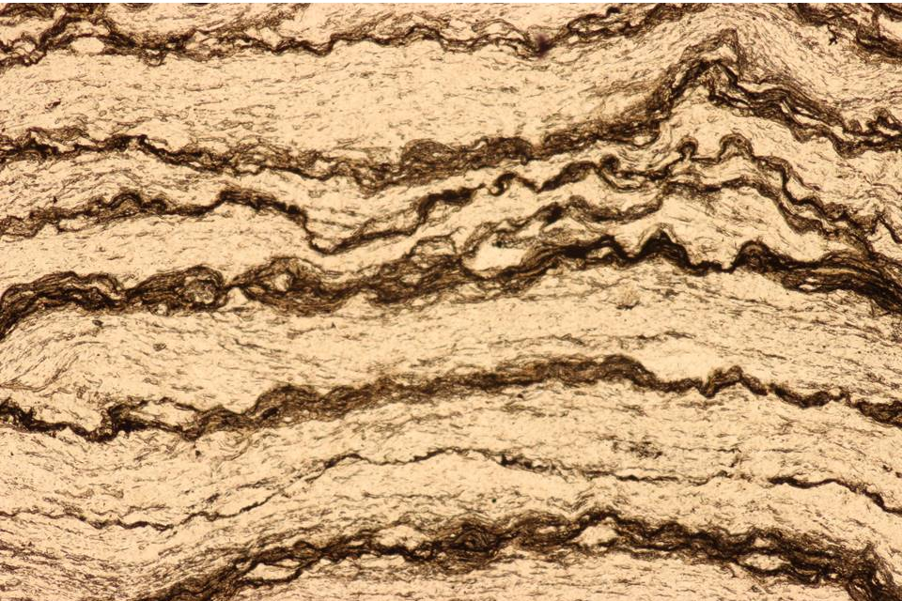
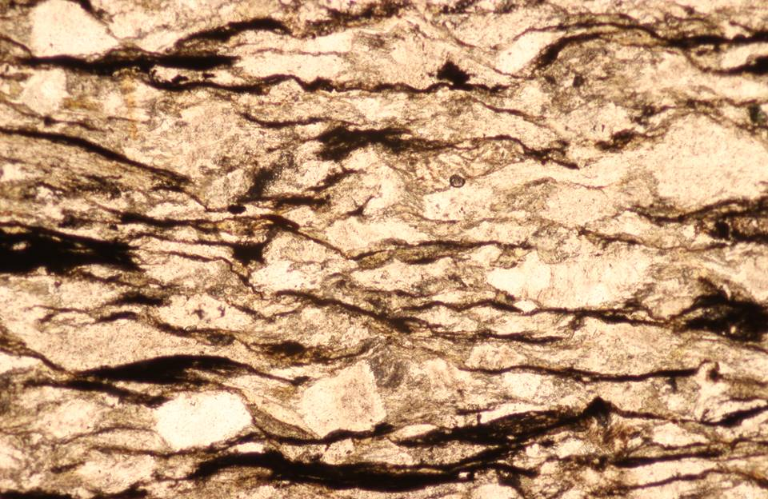
1+
Textural Grades
3
2

Slide 18
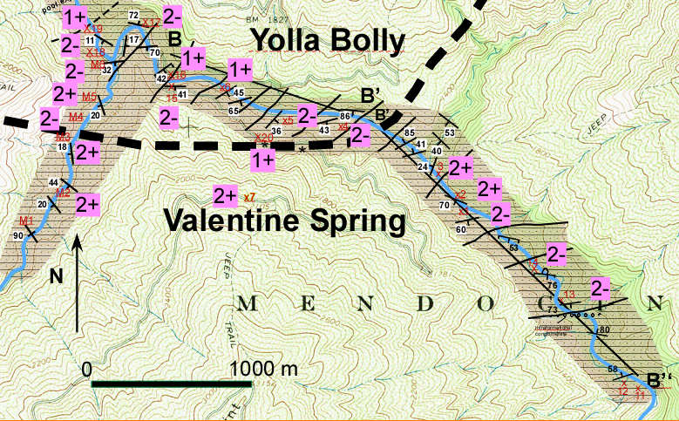
Sulfur Creek Fault

Slide 19
Log Springs Fault
A
A’
10 km
Grindstone Creek
B
B’
Salt Creek

Slide 20
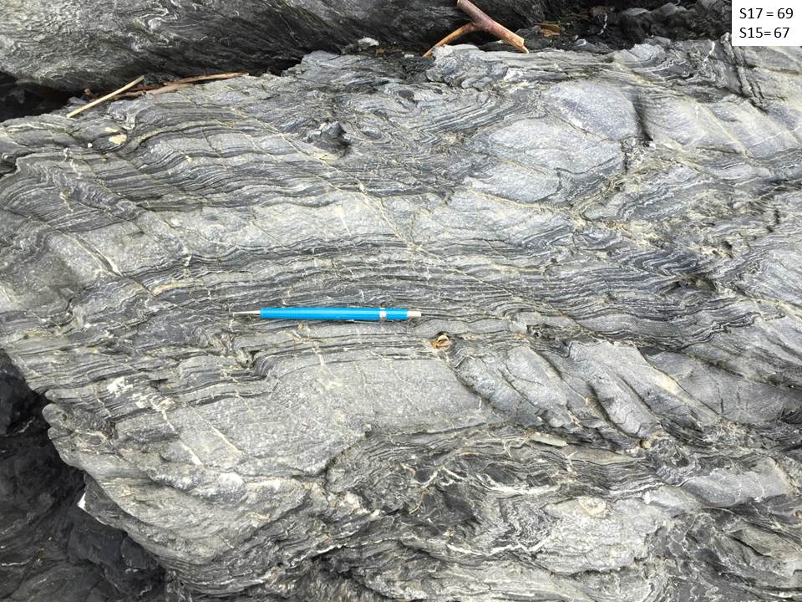
South Fork Mtn Schist
Grindstone Creek

Slide 21
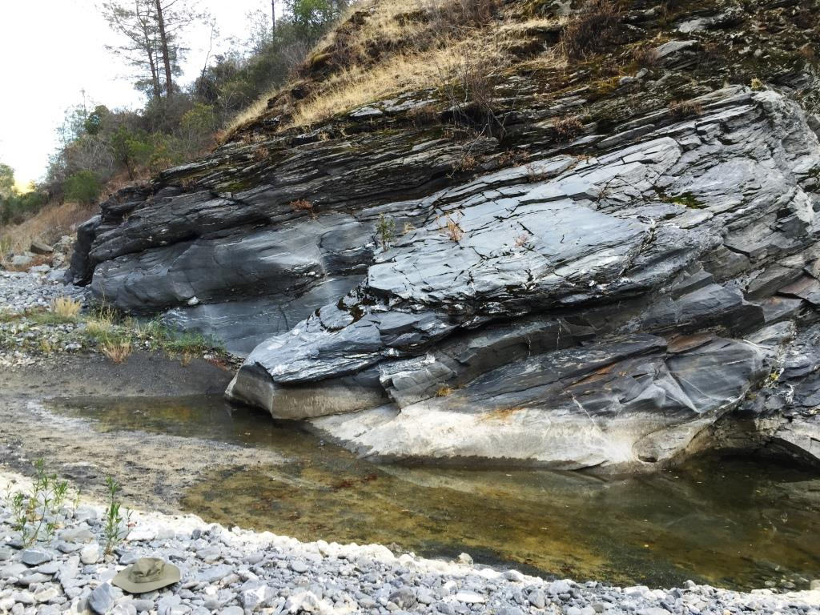
Valentine Spring
Grindstone Creek

Slide 22
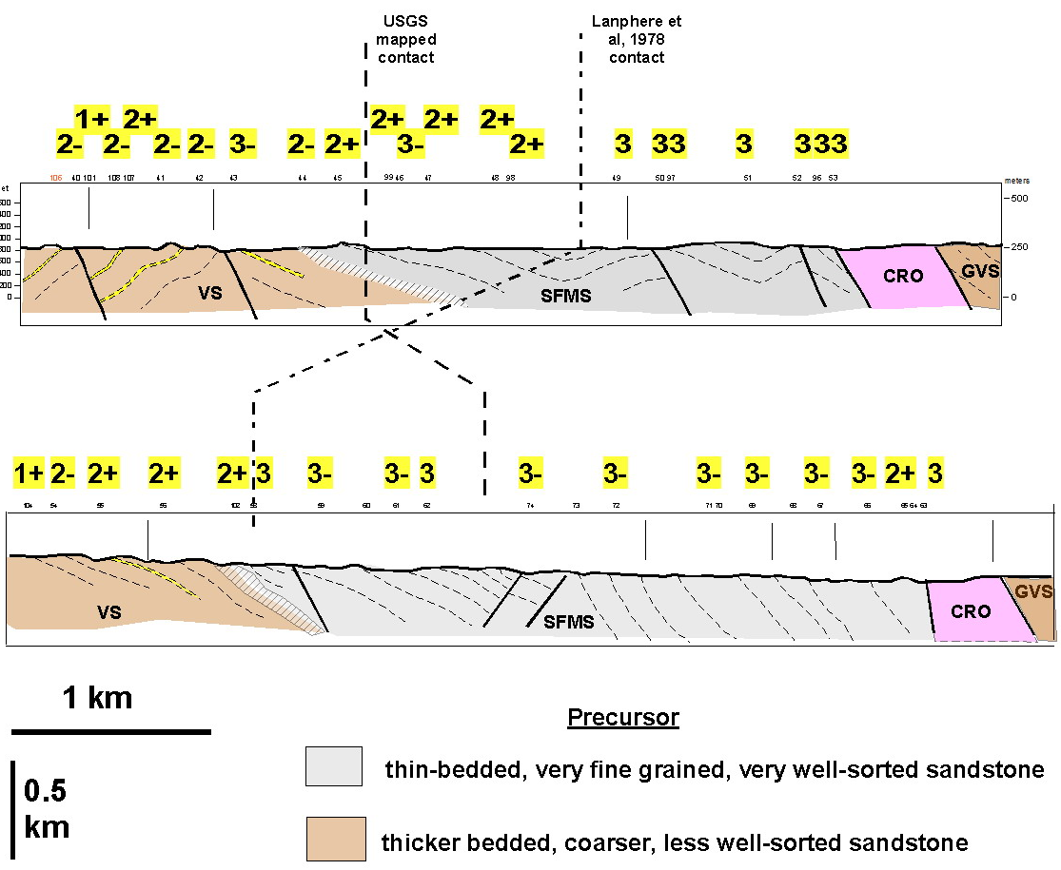
Grindstone Creek
Salt Creek
: Mudstone and….

Slide 23
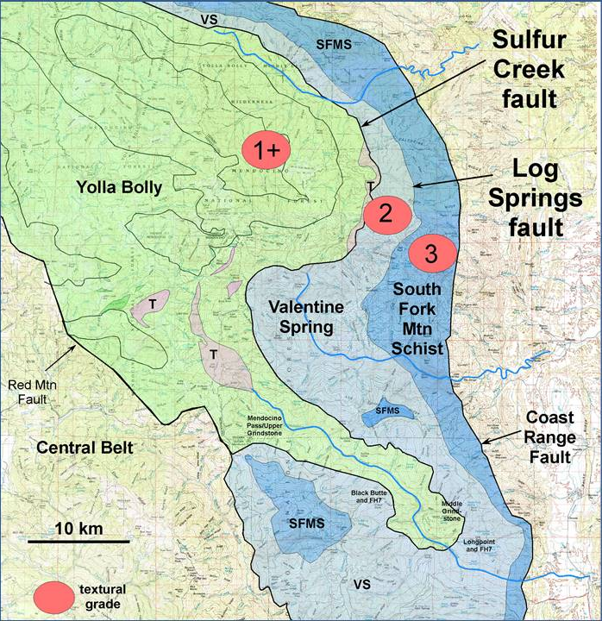
Grindstone Creek area
Contacts between units are gradational
There is a lithologic difference that roughly corresponds to the the transition from textural grade 3- to 2
Elsewhere in Eastern Belt
Gradational contacts…yes
Lithology similar…..no
Terminology???
The terms schist and semischist are useful and mappable
Origin of inverse metamorphic gradient?
No post-metamorphic differential uplift

