Slide 1
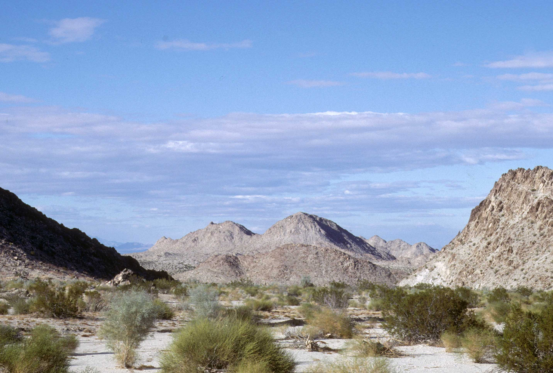
MESOZOIC AND TERTIARY PLUTON SOURCES
IN MOJAVE CONTINENTAL CRUST — ZIRCON U-Pb
AND Lu-Hf ISOTOPIC EVIDENCE
Keith Howard, Stirling Shaw,
Charlotte Allen, and Norman Pearson

Slide 2

MESOZOIC AND TERTIARY PLUTON SOURCES
IN MOJAVE CONTINENTAL CRUST — ZIRCON U-Pb
AND Lu-Hf ISOTOPIC EVIDENCE
Keith Howard, Stirling Shaw,
Charlotte Allen, and Norman Pearson
These are primarily results of my colleague and good friend Stirling Shaw (Macquarie University, Sydney).
Stirling Shaw
1933 – 2013

Slide 3
We use U-Pb-dated magmatic and
inherited zircons and their Hafnium isotope
ratios to address questions about arc
magmas that have intruded old Mojave crust
multiple times since the early Mesozoic:
How have the character and sources of arc magmas varied through time?
What can be learned about the deep Mojave crust?

Slide 4
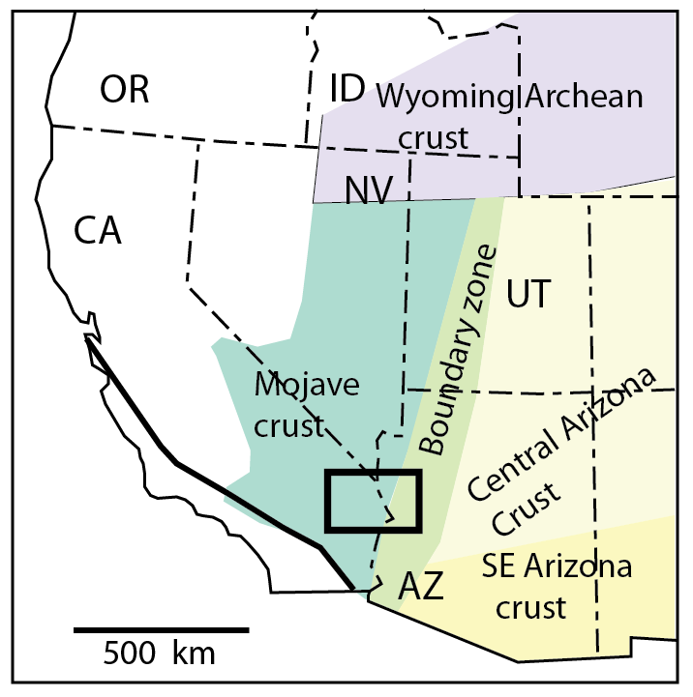
Mojave Crust
Dominantly 1.6–1.8 Ga Paleoproterozoic gneisses and granitoids; some 1.4-Ga plutons.
But Nd, Hf, and Pb isotopes reflect a cryptic older crustal component.
Some Paleoproterozoic supracrustal gneisses contain reworked 2–2.6 Ga zircons.
Early Proterozoic crustal provinces
of Wooden and DeWitt (1991).
Box is east Mojave study area.

Slide 5
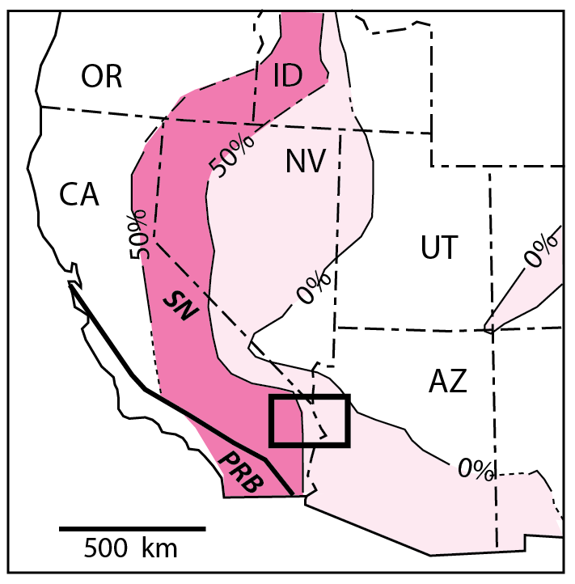
We examine a transect of plutons across the inboard side of the Phanerozoic arcs where they invaded the Mojave crust.
Contours are % Phanerozoic plutons
(Miller & Barton 1990).
Box is east Mojave study area.

Slide 6
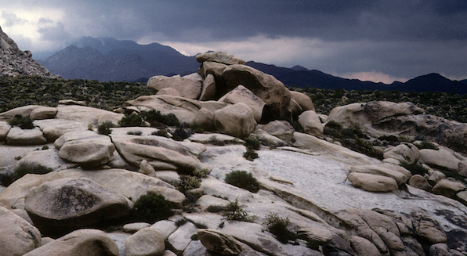
We sampled the 4 biggest magmatic episodes that intruded and partly recycled Precambrian continental crust in the eastern Mojave Desert.
Jurassic batholiths, 170–160 Ma.
Scattered mid-Cretaceous plutons, 110–90 Ma.
Late Cretaceous batholiths, 75 Ma.
Miocene extension-related plutons (arc-like), 20 Ma .

Slide 7
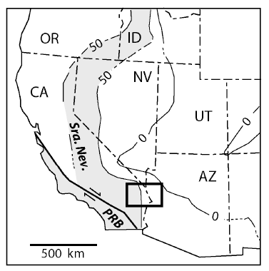
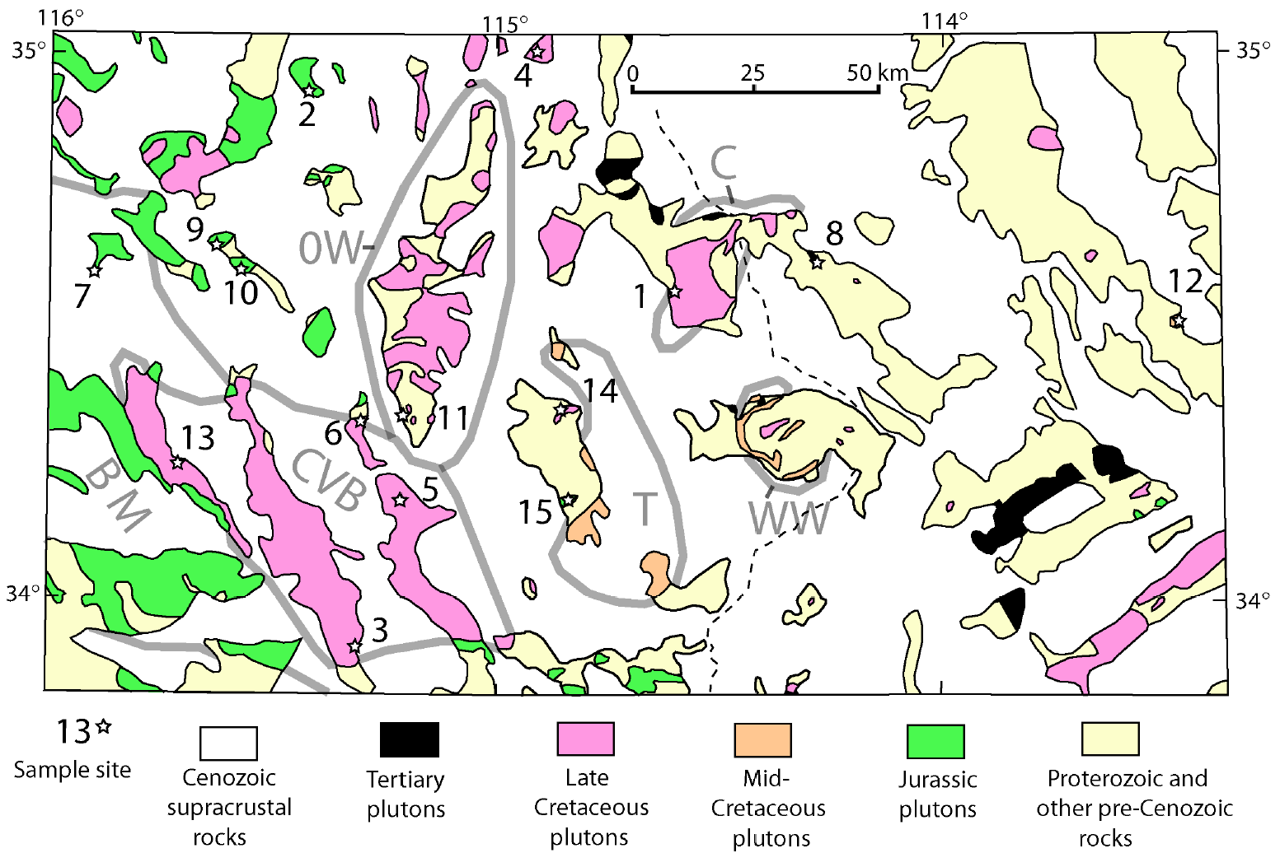
Proterozoic Mojave Crust is shown yellow.

Slide 8

Jurassic, Mid-Cretaceous, Late Cretaceous, and Miocene plutons.
20 Ma
75 Ma
100 Ma
165 Ma

Slide 9
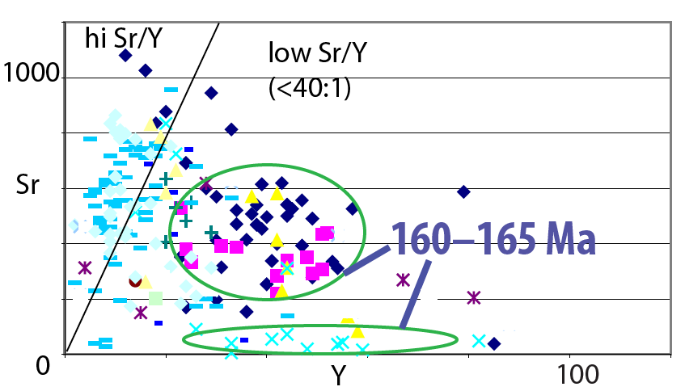
Temporal variations in the character of the magmatic rocks
Take Sr/Y for example, which can reflect depth of melting.
Sr/Y is low for most 160–165 Ma plutons.
JURASSIC
Notes:
Mention Jurassic rock types.

Slide 10
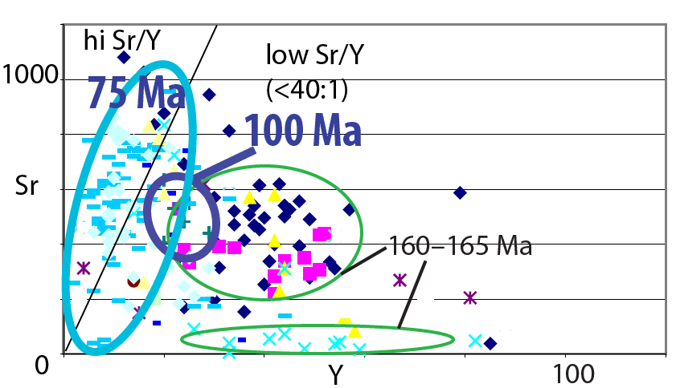
Temporal variations in the character of the magmatic rocks
Take Sr/Y for example, which can reflect depth of melting.
Sr/Y is low for most 160–165 Ma plutons.
Sr/Y is intermediate for ~100-Ma plutons, and high
(>40:1) for ~75-Ma plutons. Does this reflect progressive crustal thickening?
CRETACEOUS
Notes:
Mention mid-Cretaceous grd. and Late Cret. grd to highly peraluminous granite.
Hi Sr/Y implies melting in the deep crust where garnet is stable, plagioclase unstable.

Slide 11
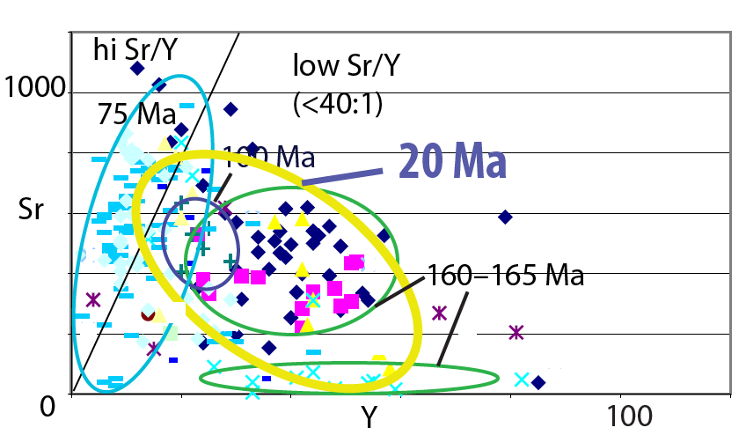
Temporal variations in the character of the magmatic rocks
Take Sr/Y for example, which can reflect depth of melting.
Sr/Y is low for most 160–165 Ma plutons.
Sr/Y is intermediate for ~100-Ma plutons, and high
(>40:1) for ~75-Ma plutons. Does this reflect progressive crustal thickening?
Miocene extension-related rocks are again lower in Sr/Y.
MIOCENE
Notes:
Miocene diorite to granite./
Sr/Y = Strontium/Yttrium

Slide 12
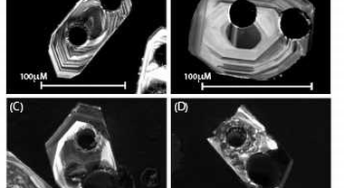
Laser sampling for U-Th-Pb and Lu-Hf (ICPMS) in zircon
Big holes sampled U-Th-Pb. Smaller holes sampled Lu-Hf.
Crystal zoning commonly is finer than the laser spots. So, U-Pb and Hf isotopic compositions can be composite.

Slide 13
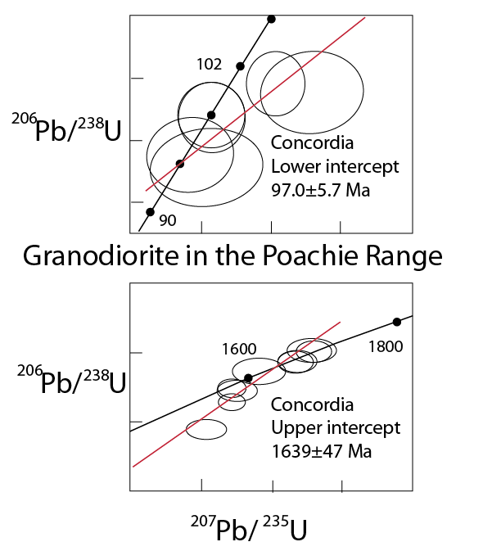
Magmatic and inherited ages

Slide 14
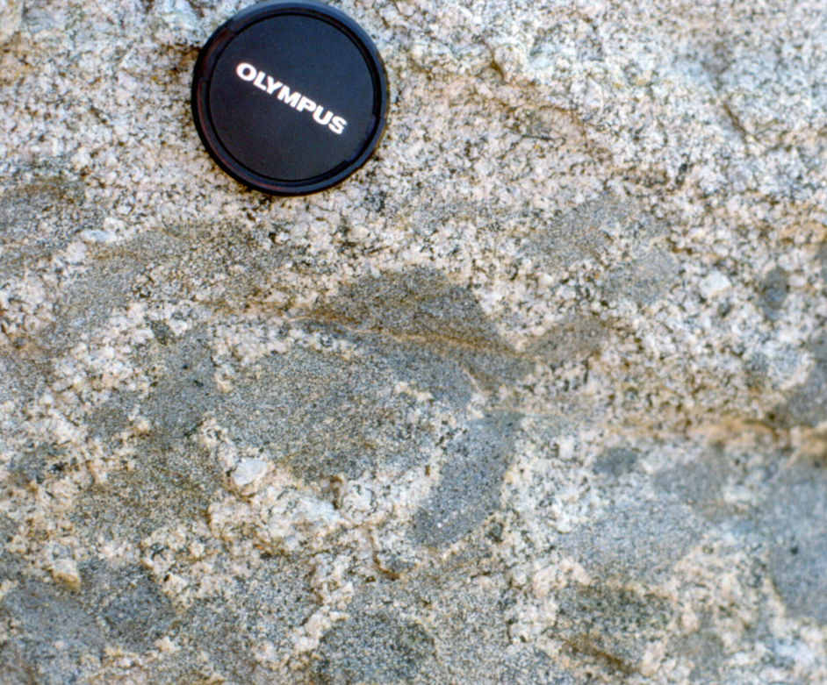
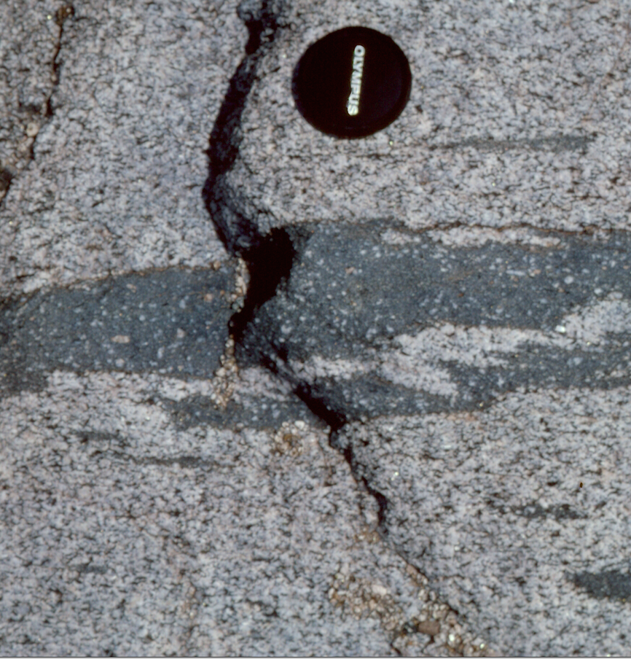
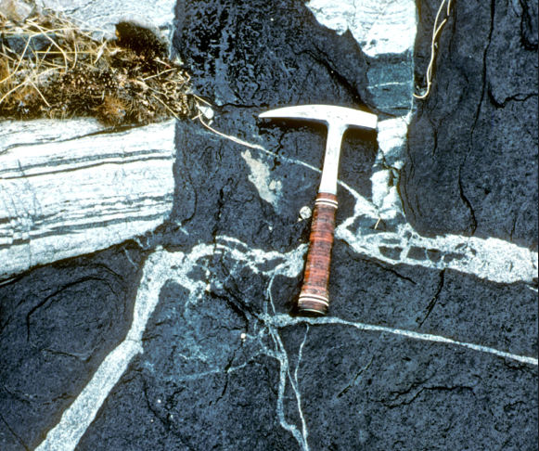
Inherited U-Pb-dated Precambrian zircon
Jurassic rocks—Inherited pC zircons are present in only 1 out of the 5 Jurassic plutons we studied. (Their relative absence implies hot magmas, >800°C)
Mid-Cretaceous rocks—Much inheritance (~1.6 Ga) in the 1 small pluton analyzed for this study. (Some inheritance is in the Turtle sequence—Allen et al., 1995).
Late Cretaceous rocks—Much pC inherited zircon (~1.6 Ga ± 170 Ma). Cool, wet magmas?
Miocene rocks—The 1 diorite we studied lacks inheritance. Some, but not all, other Miocene granitoids reported by others have pC inheritance.
L. Pearcy photo
J. Goodge photo

Slide 15
The presence of xenocrystic zircon tends to correlate to SiO2 content: granites tend to have the most.
Three mafic plutons were sampled
A Jurassic and a Cretaceous quartz diorite each have rare inherited older Jurassic grains and no pC grains.
(The Miocene diorite lacks inherited grains.)

Slide 16
Zircon Lu-Hf
Mafic plutons
Negative Epsilon Hf(t) values confirm that neither of the quartz diorites were primitive mantle melts.
The Miocene diorite is closer—its εHf range of -3 to -10 only slightly exceeds mantle-lithosphere values estimated by McDowell et al. (2016).
Maximum Hf model ages (TAM):
Jurassic quartz diorite (56% SiO2) 2.0 Ga
Late Cretaceous quartz diorite (59% SiO2) 2.0 Ga
Miocene diorite (53% SiO2) 1.5 Ga

Slide 17
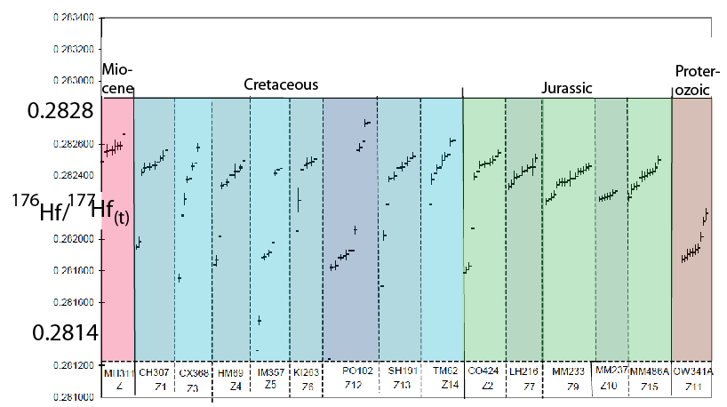
Hf ratios— pluton by pluton
(t)
All but 2 samples show a large range in values .
Notes:
NOTE THE MID-CRETACEOUS BIMODAL DISTRIBUTION

Slide 18
Hf ratios— pluton by pluton
(t)
Bimodal or 3 modes
in the mid-Cretaceous pluton
Notes:
NOTE THE MID-CRETACEOUS BIMODAL DISTRIBUTION

Slide 19
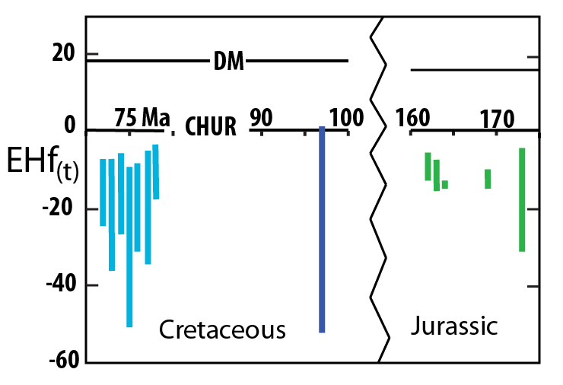
Pluton age vs. range of Epsilon Hf(t)
Age
A range in εHf in most sampled Mesozoic rocks indicates open-system melt collection and hybrids of crustal and juvenile sources.

Slide 20
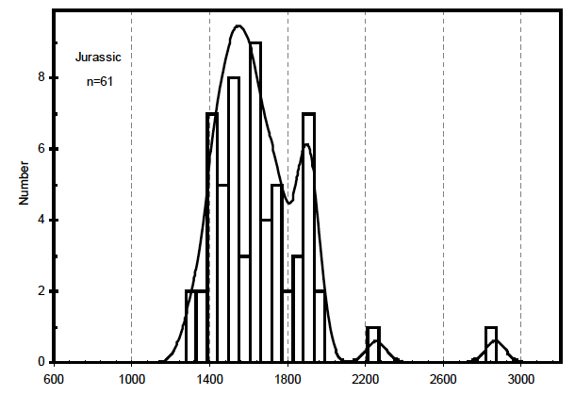
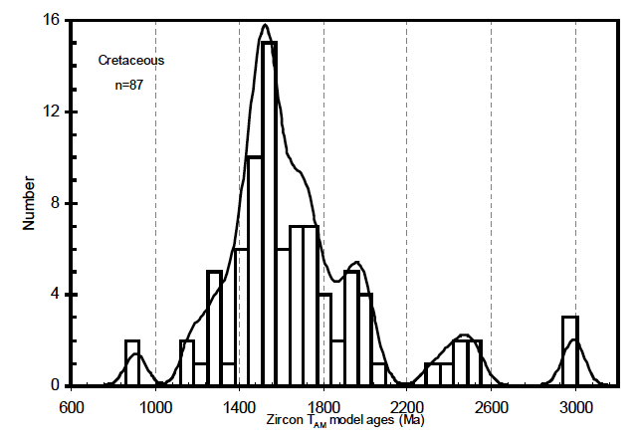
Hf model-age Histograms Hf model ages TAM cluster around 1.6 Ga for both Jurassic and Cretaceous plutons. This is consistent with U-Pb ages of Mojave- crust rocks—dominantly 1.6–1.8 Ga and some 1.4 Ga. Note some very high model ages, 3–4 Ga.
JURASSIC PLUTONS
CRETACEOUS PLUTONS
Two 4-Ga model
ages not shown
1 Ga 2 Ga 3 Ga

Slide 21
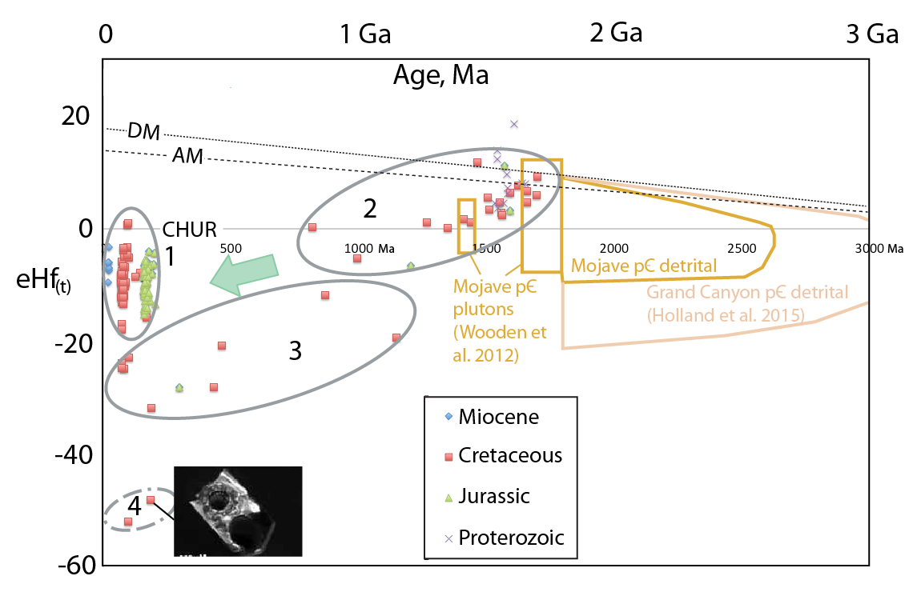
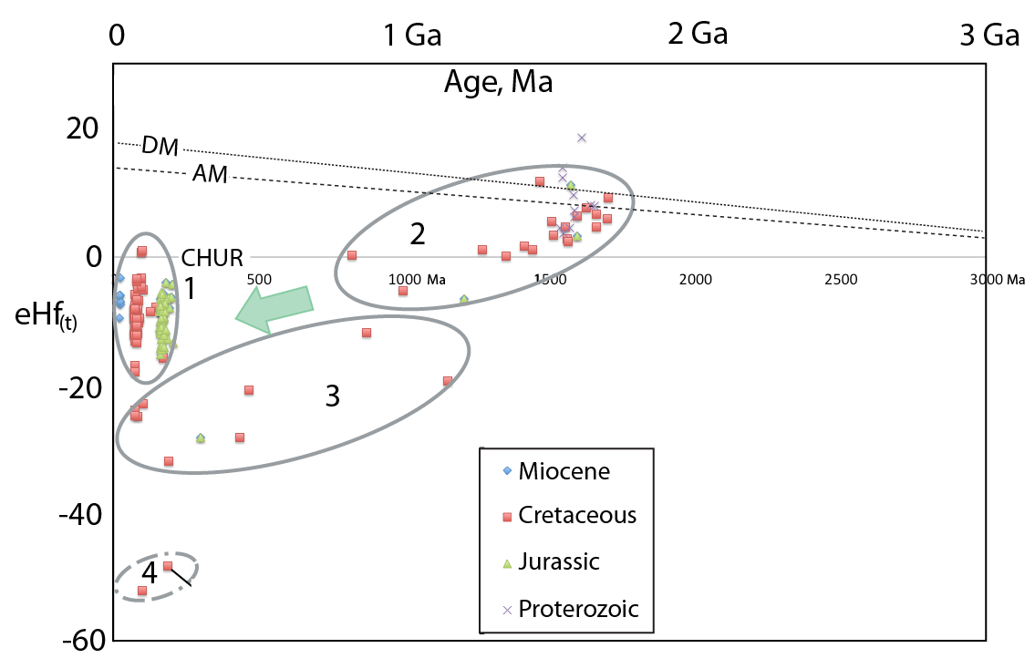
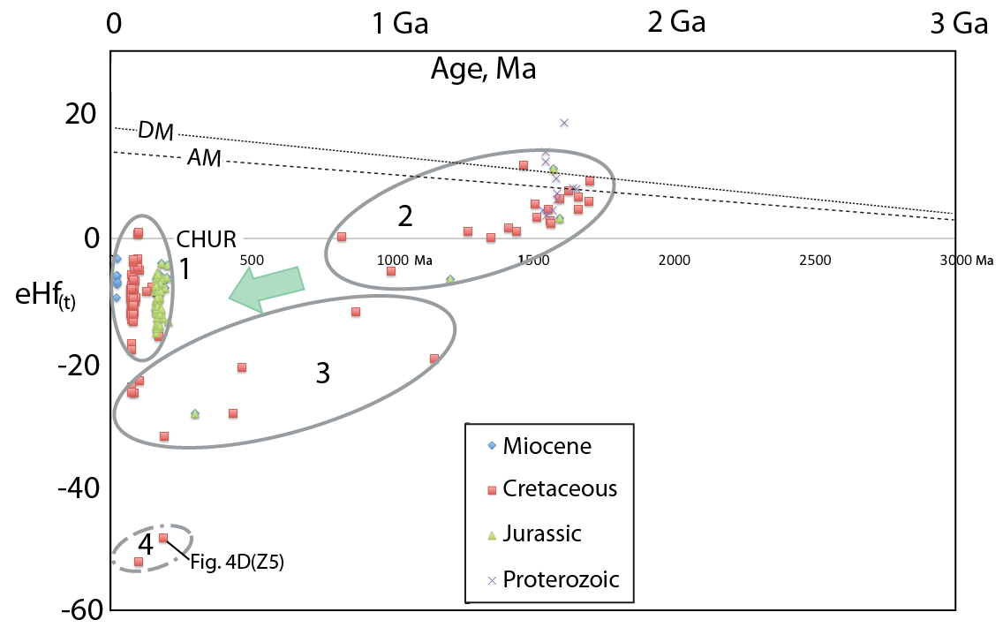
Epsilon Hf(t) vs. grain age
Magmatic zircons. Magma mix of
±1.7-Ga crust plus a smaller mantle-
derived component.
Assumes crustal
¹⁷⁶Lu/¹⁷⁷Hf = 0.015
(composite intermediate ages)

Slide 22
Rounded to irregular
inherited zircons.
(A Proterozoic metagranite)
Assumes crustal
¹⁷⁶Lu/¹⁷⁷Hf = 0.015
(composite intermediate ages)

Slide 23
Hf model ages ~2.1–3 Ga.
Discordant U-Pb ages.
The older Mojave crust
component?
Assumes crustal
¹⁷⁶Lu/¹⁷⁷Hf = 0.015
(composite intermediate ages)

Slide 24
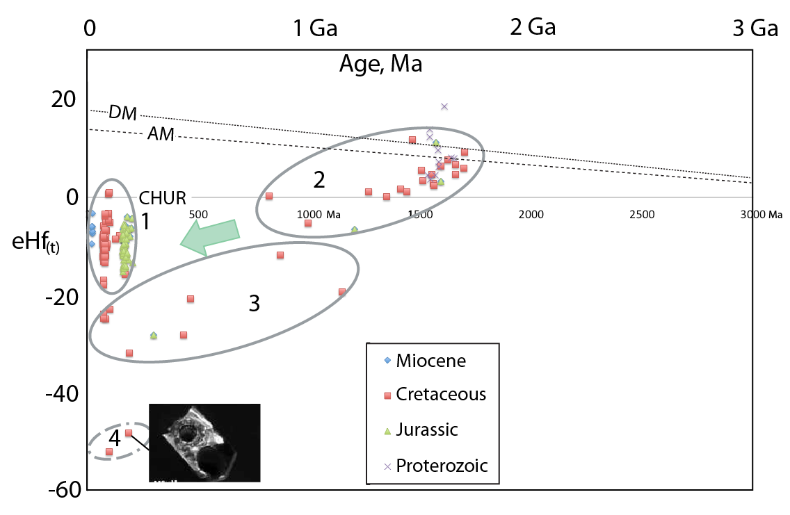
Whoa! Are these real?

Slide 25
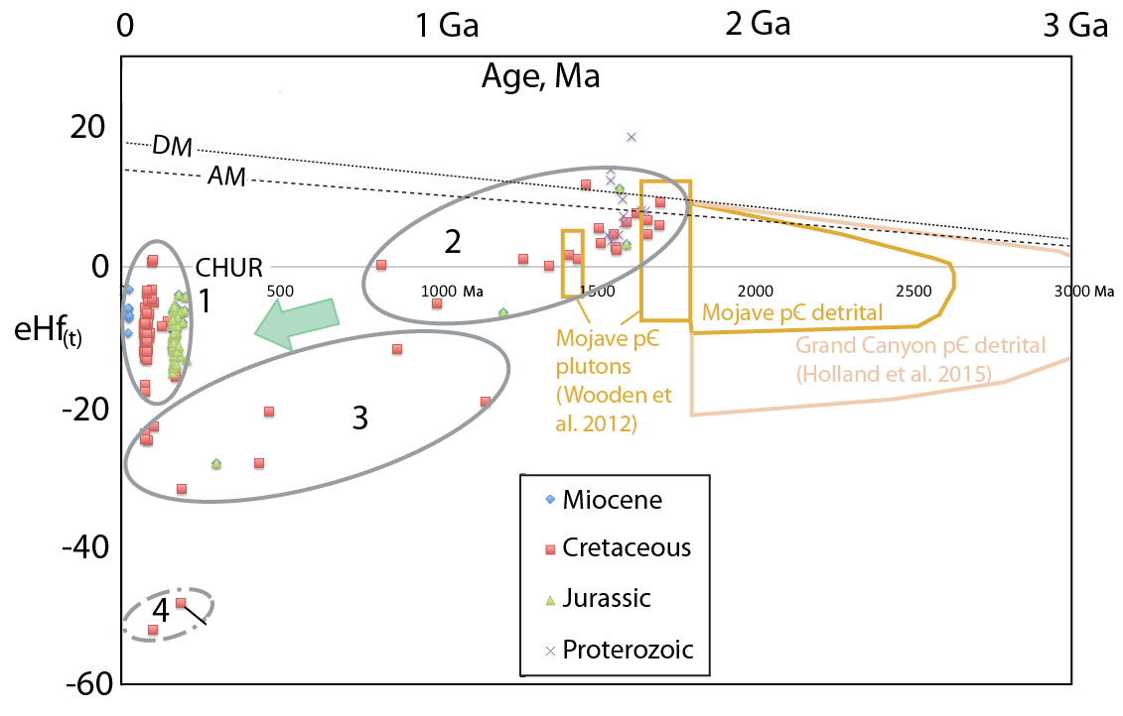
Potential sources in Mojave-province rocks

Slide 26
Aha! Potential
sources in
Archean detritus.

Slide 27
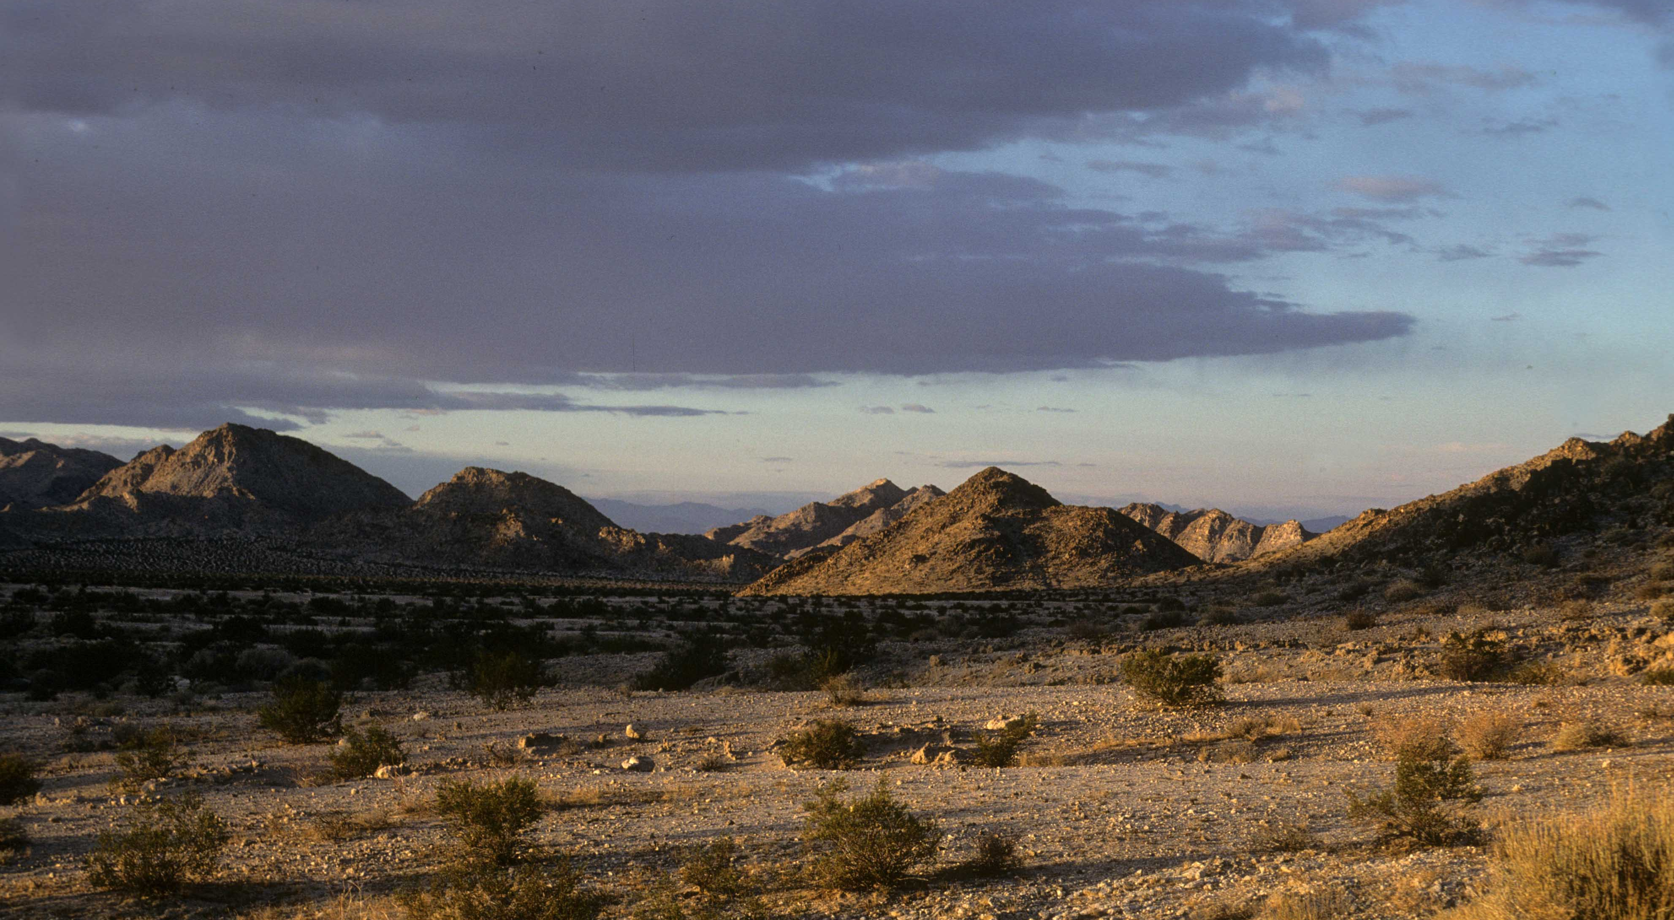
Summary—Mojave Crustal Sources
U-Pb-dated xenocrysts and zircon cores show that Mojave crustal sources included Late Paleoproterozoic ± Jurassic rocks.
Mojave sources also include older Archean material (sedimentary detritus?) expressed in ultra-low εHf(t) zircons. The most extreme values are comparable with detrital Archean zircons reported from the Vishnu Schist in Grand Canyon.

Slide 28
Summary—Plutonism Age Progression
A Middle Jurassic to Late Cretaceous age progression of increasing Sr/Y may track increasing depth of melting—and possibly crustal thickening—prior to Miocene extensional collapse (cf. Chapman et al., 2015).

Slide 29
Summary—Plutonism Age Progression
A Middle Jurassic to Late Cretaceous age progression of increasing Sr/Y may track increasing depth of melting—and possibly crustal thickening—prior to Miocene extensional collapse (cf. Chapman et al., 2015).
Inherited zircons and zircons having highly negative εHf(t) are present in one Jurassic pluton and are common in Cretaceous plutons. Deep-sourced from detrital rocks?

Slide 30
Summary—Plutonism Age Progression
A Middle Jurassic to Late Cretaceous age progression of increasing Sr/Y may track increasing depth of melting—and possibly crustal thickening—prior to Miocene extensional collapse (cf. Chapman et al., 2015),
Inherited zircons and zircons having highly negative εHf(t) are present in one Jurassic pluton but are common in Cretaceous plutons. Deep-sourced from detrital rocks?
Most Mesozoic plutons have hybrid sources partly from mantle
but mainly from a variety of Mojave crust materials. Cretaceous magmas sampled a greater variety of crustal sources than did most Jurassic magmas.

Slide 31
Summary—Plutonism Age Progression
An age progression of increasing Sr/Y may track increasing depth of melting from Middle Jurassic to Late Cretaceous time.
Does this pattern track crustal thickening, prior to Miocene extensional collapse (cf. Chapman et al., 2015)?
Inherited zircons and zircons having highly negative εHf(t) are present in one Jurassic pluton but are common in Cretaceous plutons. Deep-sourced from detrital rocks?
Most Mesozoic plutons have hybrid sourcs partly from mantle
but mainly from a variety of Mojave crust materials.
The sampled mid-Cretaceous pluton’s large range of Hf-isotope values include positive εHf(t) values, the most primitive of any of the Phanerozoic rocks. Could this mantle-like signature relate to these being small-volume plutons far from the main mid-Cretaceous arc (Allen et al., 1995)?

