Slide 1

ANTHROPOGENIC NUTRIENT TRANSFER WITHIN AN EPIGENIC KARST AQUIFER: GRAYSON-GUNNAR CAVE, SOUTHEASTERN KENTUCKY
Presented by: Gilles Tagne
Environmental Sciences PhD Candidate
Notes:
How we used nutrient, carbon and carbon isotope data to trace contaminants sources and pathways within a karst aquifer in Southeastern Kentucky

Slide 2
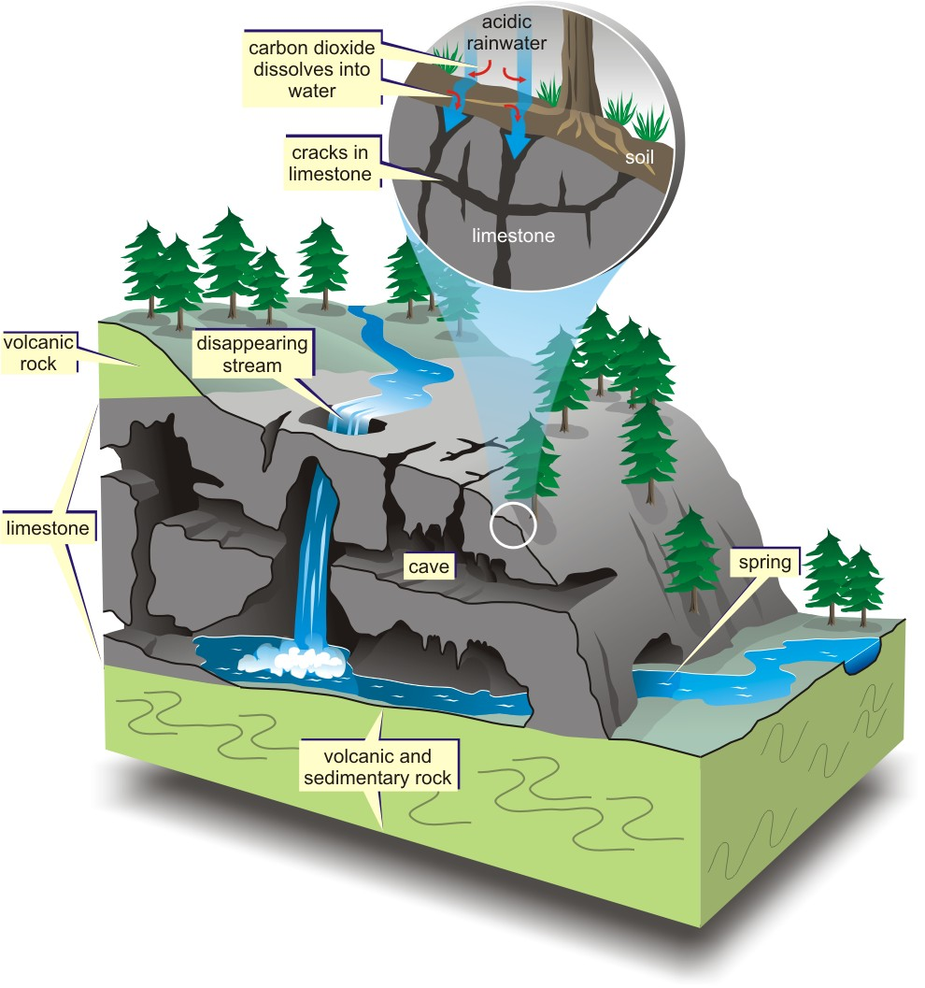
What is karst?
GSA 2016 North-Central, Champaign, IL.
4/18/2015
1
Karst is produced primarily from the dissolution of carbonates (limestone, dolomite) or evaporites.
25% of the world’s ice-free land surface
1/5 of the land area of the U.S.
25% of the global drinking water supply
Epigenic : physical, chemical and biologic processes happening at the interface associated with direct connection to the surface.
Notes:
Borrowed from the slovenian terminology “kras” which was used to described huge limestones plateau in the Northern part of the Adriatic sea (city of Trieste at the border of Italy and Slovenia).
Karst evolved to describe formations that results from the dissolution of carbonates rocks and evaporites (gypsum).
However, karst do not necessarily formed in calcite-types of formations. Some karsts are documented in more rigid types of formations
Karst is characterized by underground and subsurface drainage features like dissolution conduits, sinkholes.

Slide 3
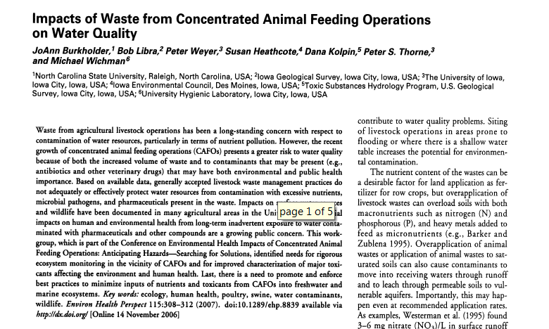

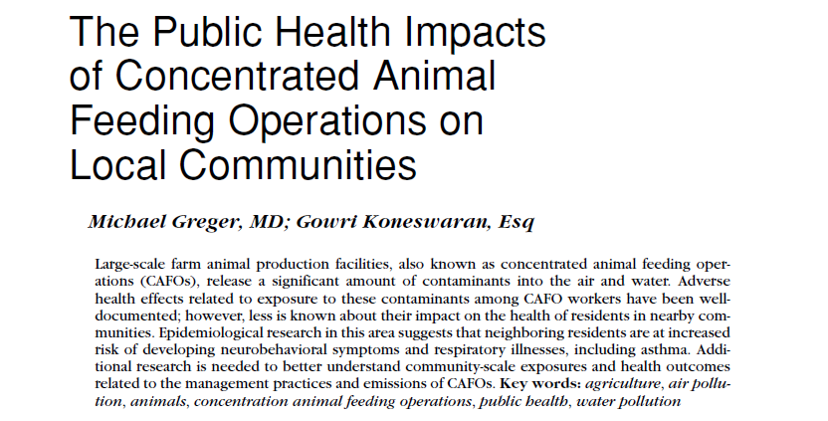
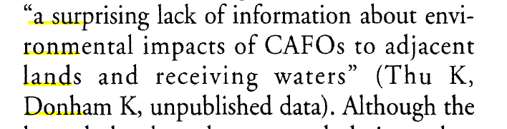
CAFO controvers0ry
GSA 2016 North-Central, Champaign, IL.
4/18/2015
2
Notes:
CAFOs issues and impacts:
CAFOs are facilities that have developped within the past 5 decades due to the industrialization of livestock, poultry and dairy production, which has been affecting main agricultural states like Iowa, Arkansas, Indiana, Wisconsin and Minnesota.
Issues:
Increase volume of wastes: issue for waste management and waste disposal
Excessive use of nutrients to sustain plants growth to feed animals
veterinary pharmaceuticals and antibiotics used to cure animals
Issue with heavy metals (especially Zn and Copper Cu) used as complementary micronutrients
Sanitary concerns due to microbial pathogens from animal wastes
Pesticides on sprayfields
Sprayfields=fields where animal wastes are used as fertilizers.
2) Impacts
Impacts on environment (water pollution, eutrophication and algal bloom)
Impacts on health (increasing rates of lung cancer on CAFO’s workers due to inhalation of highly volatile compounds esp. N2)
But also societal impact on communities (changes in agricultural and waste management practices, transition from family livestocks to indrustrial production).
Less documented impact of CAFOs in cave aquifers: how contaminants ae transported, how they interact together (pesticides might affect nutrient transfer), how they interact with other components of the system (rock), how does the geology affect, what are geochemical interactions in the epikarst, are there some relations with the flow dynamics or coreelation with precipitations and storm events (runoff)??

Slide 4
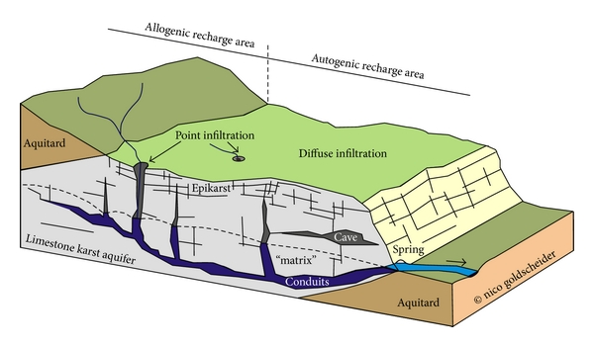
Karst aquifer vulnerability
GSA 2016 North-Central, Champaign, IL.
4/18/2015
3
external sources
Adapted from Goldscheider & Drew (2007)
Notes:
In addition to the dependence on discharge and climate conditions, karst aquifers are particularly vulnerable.
2 types of recharge:
-point-recharge through surface openings (sinkholes, sinking points): fast flow routes especially during high discharge events (excessive runoff and overflow, and high risk of contaminants transport inside the aquifer)
-diffuse recharge through soil and epikarst: slower routes (adsorption, delay in transfer)
The main concern with having those types of industrial facilities on karstic terranes, is dealing with fast infiltration routes from point recharge (sinkholes, sinking streams…) which are sometimes directly connected to the spring through main conduits.
Strong connection between surface water and groundwater
Identify and managing external sources

Slide 5
State of knowledge and limits
GSA 2016 North-Central, Champaign, IL.
4/18/2015
4
Many studies have tracked physical tracers of surface inputs (SpC, temperature) in relation to storm events.
Some studies have used qualitative dye tracing to assess cave aquifers’ connectivity with the surface.
Few quantitative dye trace studies provided an estimation of contaminant transfer time
Need to use new tracers (nutrients, DOM, pesticides, metals…)
Need to quantify contaminants inputs (concentrations, loads, fluxes)
Need to partition contributions from various potential sources.
Notes:
Dye tracers are good for qualitative analysis (look at potential flow routes of contaminants) but have shown poor results in qualitative interpretation (transfer time, fate of contaminants) b/c tracers do not necessarily have the same characteristics as known contaminants
We also know from previous reviews and as presented before, that the transfer of contaminants (nutrients) in concentrated farming and livestock area occurs mostly following precipitation and high discharge events, would be interesting to see nutrients behavior during or following storm events.
In area that have experienced recent changes in land use (CAFOs development) and where tehre are potentially more than one source of contamination, there is a need to partition the contribution from each source (Plants/forest, animal wastes, agriculture,…)
Those are questions and concerns we are trying to address in our study.

Slide 6
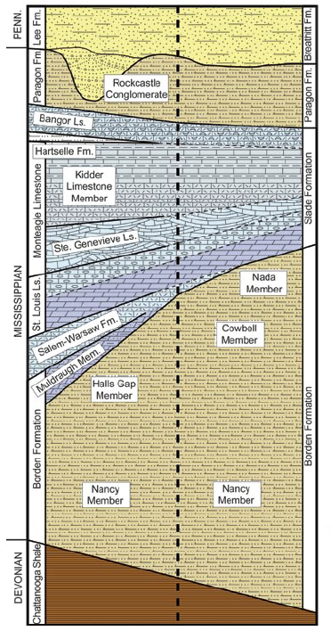
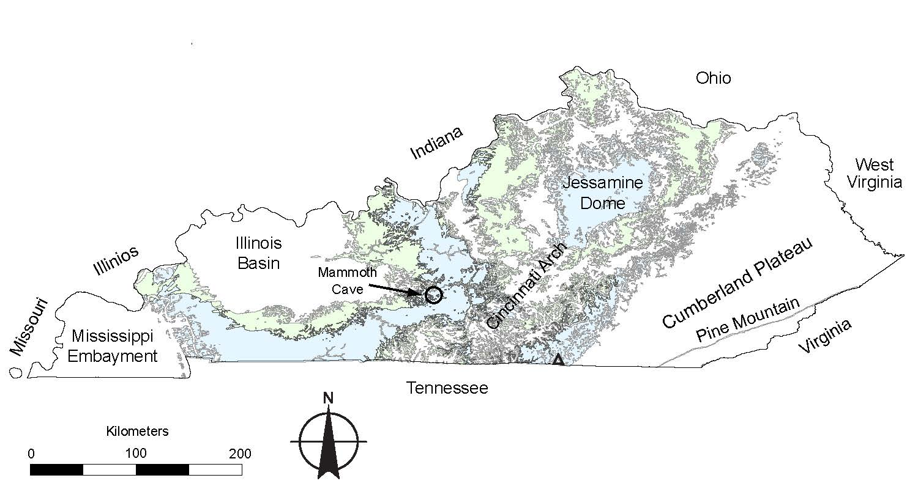
Study area
GSA 2016 North-Central, Champaign, IL.
4/18/2015
5
The Cumberland Plateau of E. Kentucky
~3,730 km² of carbonate exposure
Mississippian-age carbonates
Notes:
-The study area is located in a large gemorphological setting (4000 km2 of carbonates exposure) called the Cumberland Plateau. Not only limited to Eastern Kentucky but mountains extend from Pensylvania to Southern Tennessee and Alabama.
-Geology: Mississipian age carbonates covered by Pennsylvanian sediments (Rockcastle formation)
Springs located at the base of the St-Louis.

Slide 7
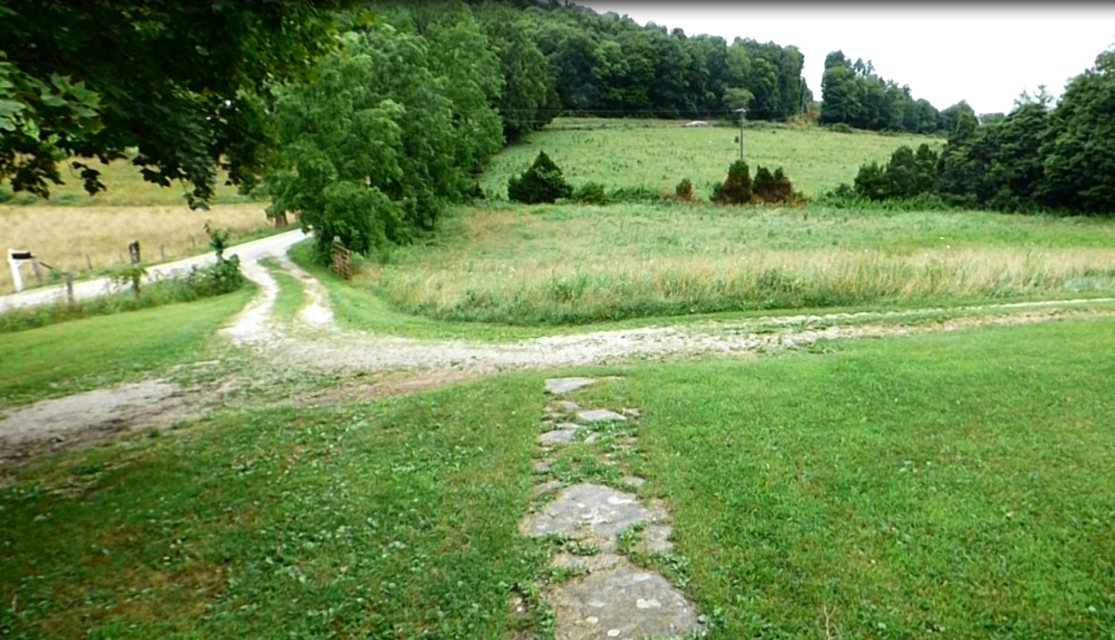
Land use
GSA 2016 North-Central, Champaign, IL.
4/18/2015
6
Secondary-growth forests (~70%)
Agricultural lands- corn fields (~30%).
Confined Animal Feeding Operations (CAFOs)
Notes:
Greenish area
sloped landscape
On the other side of the road, a steep slope that goes down to the cave spring
Up (KY 200), slope of aboyt 2% to the house
Grazing and pasture to the left (cows)
Animal housing to the right
Forest area (deers and snakes hanging out around)

Slide 8
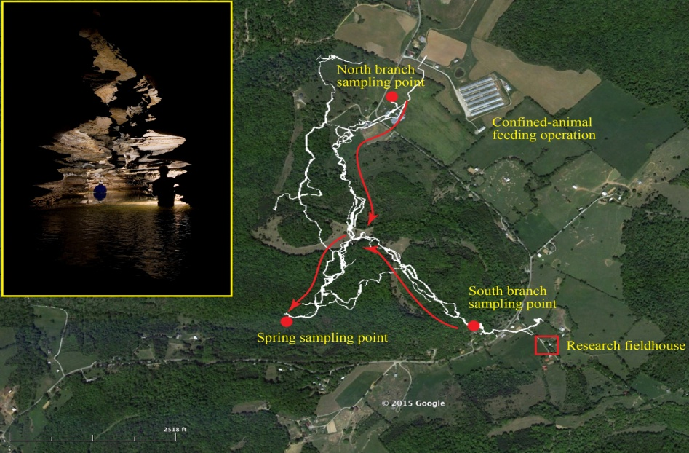
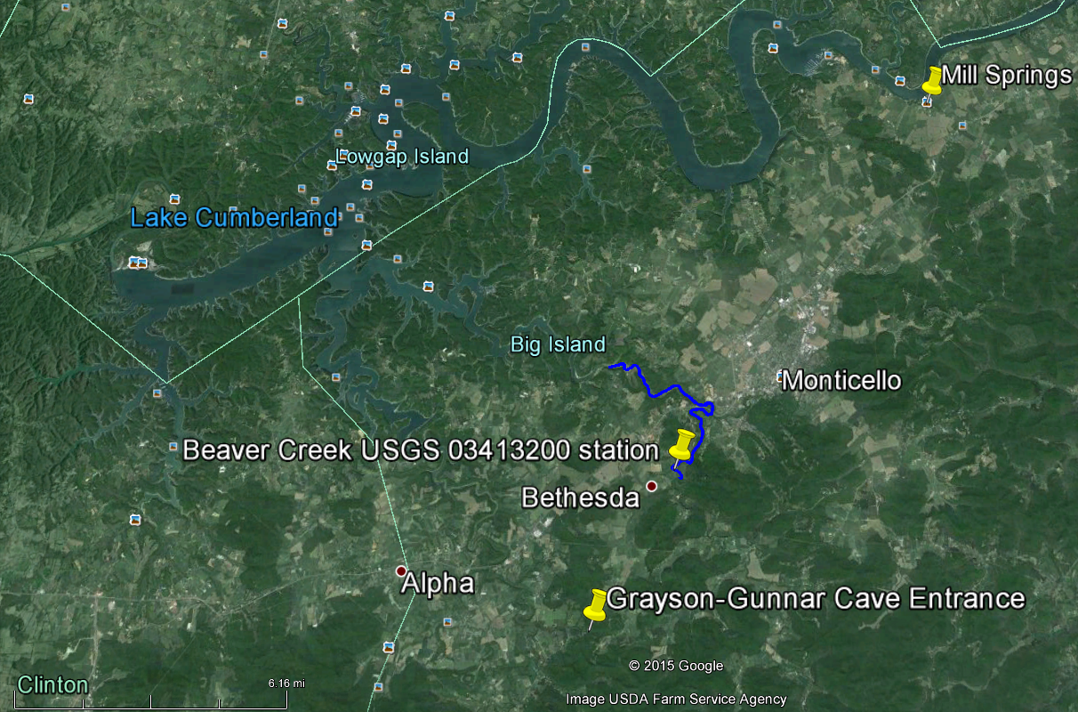
The Grayson Gunnar Cave System
GSA 2016 North-Central, Champaign, IL.
4/18/2015
7
N
Surveyed passages of Grayson-Gunnar Cave
Credit: NSS Greater Cincinnati Grotto
Photo Credit: Robert Coomer
Notes:
Our study specifically focuses on Grayson-Gunnar Cave, an 11-km-long cave system located in Southeastern Kentucky. Surveyed passages include two branches of an underground stream showing strong connections with the surface. The south branch of this watershed includes low-density grazing and residential septic tanks.
Lots of potential contaminant sources in what we expect to be the recharge area of our system
Point to the Cumberland River as the regional base level for all the streams and groundwater flowing from higher elevations.

Slide 9
Research objectives
GSA 2016 North-Central, Champaign, IL.
4/18/2015
8
Study the impact of changing land use on nutrients loads
  Impact of wastes from CAFO (Northern branch)
  Potential impact of septic tanks leakage and animal wastes from residential and low grazing area (South)
Ultimate goal = partition each source
Broader impact of change in water quality from local system to a regional scale (Cumberland River)

Slide 10
Data collection
GSA 2016 North-Central, Champaign, IL.
4/18/2015
9
  Discrete weekly sampling at the Spring (05/2015-08/2015)
    Major ions
    DOC and DIC
    Nitrogen & phosphorus speciation
    Carbon isotopes
    Spring discharge measurements
    Continuous (10 min-interval) monitoring near the Spring (05/2015-02/2016)
      EXO2 sonde: 14 parameters
      Aquatroll sonde: temperature, water depth, and conductivity.
  Goals:
    Look at long term patterns in our data (physical data)
    Capture the system’s response to specific storm events (nutrients)
Notes:
Note that the EXOII and the Aquatroll were displayed at a pool close to the spring.

Slide 11
Lab work and data analyses
GSA 2016 North-Central, Champaign, IL.
4/18/2015
10
Major ions analysis: Dionex IC
DOC and DIC: Sievers 900 C analyzer
Specific UV absorbance at 254 nm: SUVA analyzer
NO3, NH4 and PO4: DR 2800 Spectrophotometer
Alkalinity as CaCO3: Interpretation using the USGS ‘inflection point’ method.
Discharge calculations using the “mean-section” method provided by Rantz (1982).
DIC and DOC isotopes: PICARRO CRDS

Slide 12
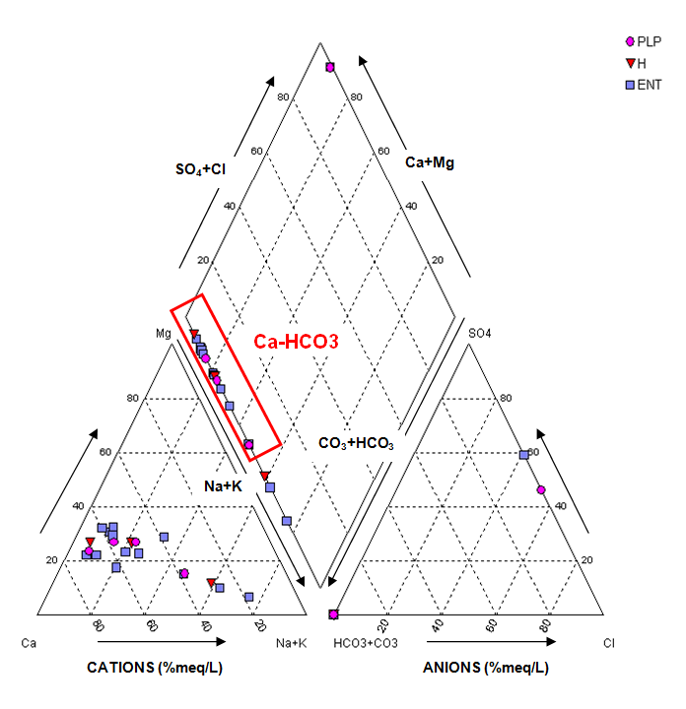
Piper diagram
Environmental Ph.D. Seminar
4/12/2015
11
Ca-HCO3 type = bedrock dissolution
Saturation index:
  -0.5<SI(calcite)<-0.8
  -1<SI(dolomite)<-2
  -5<SI(gypsum)<-6
Notes:
Basic chemical trends in our data
Ca-HCO3 type of water: the water type is basically the same for all sampling locations and all storm events: no spatial or temporal variation in the chemistry during storm events
SI do not vary too much among locations and among storms events independently of their intensities → water-rock equilibrium conditions do not vary that much according to discharge conditions
Generally undersaturated in respect to carbonate minerals= no equilibrium is reached between water and rock during storm events (expected)
Slightly undersaturated in respect to calcite (main mineral present in the bedrock), moderately undersaturated in respect to dolomite (not much dolomite), highly undersaturated in respect to gypsum (basically no gypsum in the system).

Slide 13
H-Q relationship
GSA 2016 North-Central, Champaign, IL.
4/18/2015
12

Slide 14
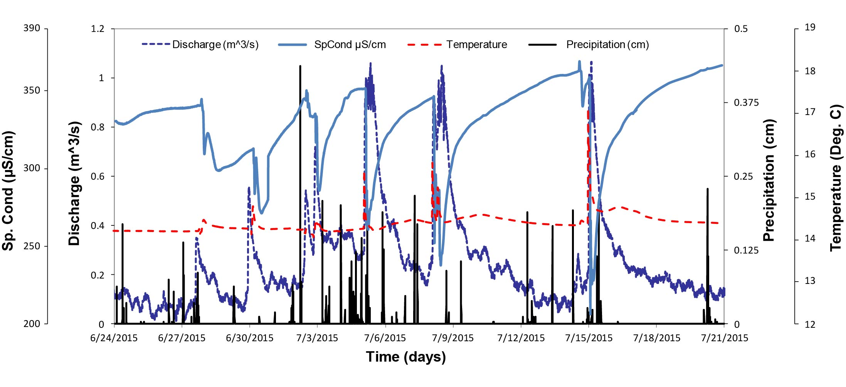
Long-term patterns
GSA 2016 North-Central, Champaign, IL.
4/18/2015
13
Notes:
-Presenting EXO2 yields
-Sp. Cond: Rapid increase in Sp. conductivity after major precipitation events followed by a slow decrease. Old/high conductive water is pushed out of the system by fresh/low conductive water at the spring
-Temperature is overall constant. Slight increase in temperature (1 to 2°C) with the arrival of low conductive water ->Think about the surface water in equilibrium with atmospheric and soil CO2, and microbial activity in the superficial part of soils. Zooms show a rapid drop prior to the increase= storage water pushed out of the system prior to the arrival of surface water.
-Turbidity and fDOM show similar evolutionary patterns and increase with the arrival of surface water (suspended sediments and soil particles + fresh OM driven into the system by storm water).

Slide 15

“Twin peaks” pattern
GSA 2016 North-Central, Champaign, IL.
4/18/2015
14
Notes:
Zoom on Aquatroll data.
Twin peaks are observed for all the recorded storms.
The effect of the two contributing branches responding at a time interval from one another.
Two flow patterns with different rates: a faster conduit flow justifying early peaks and a slower diffuse flow justifying late peaks during the same flood event
Or a combination of both hypothesis

Slide 16
Lag times (P-SpC)
GSA 2016 North-Central, Champaign, IL.
4/18/2015
15
Storm date | Time to 1st peak (hours) | Delay to 2nd peak (hours) | Recession time (hours) | Total duration (hours) | Storm interval (days)
6/1/2015 | 4.32 | 4.32 | 15.36 | 24.00 | 7
6/8/2015 | 9.36 | 6.48 | 33.36 | 49.20 | 12
6/20/2015 | 13.92 | 19.20 | 45.6 | 78.72 | 7
6/27/2015 | 5.28 | 6.24 | 11.28 | 22.80 | 2
6/29/2015 | 4.32 | 2.88 | 5.76 | 12.96 | 3
8/10/2015 | 14.88 | - | - | - | 4
8/14/2015 | 12.24 | - | - | - | 5
8/19/2015 | 1.44 | 6.00 | 4.32 | 11.76 | -
Mean | 8.22 | 7.52 | 19.28 | 35.02 | 5.71
Storm date | Time to 1st peak (hours) | Delay to 2nd peak (hours) | Recession time (hours) | Total duration (hours) | Storm interval (days)
7/2/2015 | 0.00 | 1.20 | 0.72 | 1.92 | 0.1
7/2/2015 | 0.00 | 1.44 | 2.88 | 4.32 | 2
7/4/2015 | 0.00 | 2.40 | 1.2 | 3.60 | 3
7/7/2015 | 0.00 | 2.40 | 5.52 | 7.92 | 7
7/14/2015 | 2.16 | 1.44 | 1.92 | 5.52 | 0.04
7/14/2015 | 0.72 | 0.96 | 1.68 | 3.36 | 9
7/23/2015 | 0.00 | 2.16 | 2.88 | 5.04 | 18
Mean | 0.41 | 1.71 | 2.40 | 4.53 | 5.59
Notes:
We are looking at 15 storm events that happened between June and August
We separated those events based on the discharge into small or moderate storm events (<0.5 m3/s, 0.1-0.2 m3/s on average) and extreme events (max peak at 1 m3/s, >0.5 m3/s on average). It happened that those events were also well distributed in time (with extreme storms mainly in July).
We characterized our system’s dynamics using 5 parameters: Time to the 1st peak, delay to the 2nd peak, Recession time(= time between the last peak in conductivity and the trough in the conductivity curve. It is the time needed for the system to go back to the base flow dynamics (equilibrium)), the total duration of the storm, and the storm intensity.
Results show more aggressive storm events (flash storms) during extreme flow dynamics= higher volume of water is pushed through the system during lesser laps of time. Moderate storm events peak (below 0.5 m3/s, with an average discharge of 0.1 m3/s) show a storm average duration of 35 h (min=11.762h and max=78.72 h). Extreme storm events show peaks in discharge above 1 m3/s on average and last shorter than the previous (4.52 h on average, min= 1.92 h and max=7.92 h).
Interesting pattern to take into consideration for nutrient transfer since this duality of flow dynamics will affect flow speed (contaminant transfer times), water volumes (diluted signals) and probably sediments transport through the system (P transport). We should expect a variability in nutrient transfer that is dependent on storm intensity (discharge).
Storm intervals are the same= means that although storm intensities are higher during high regime, the frequency of storm events is quite constant.

Slide 17
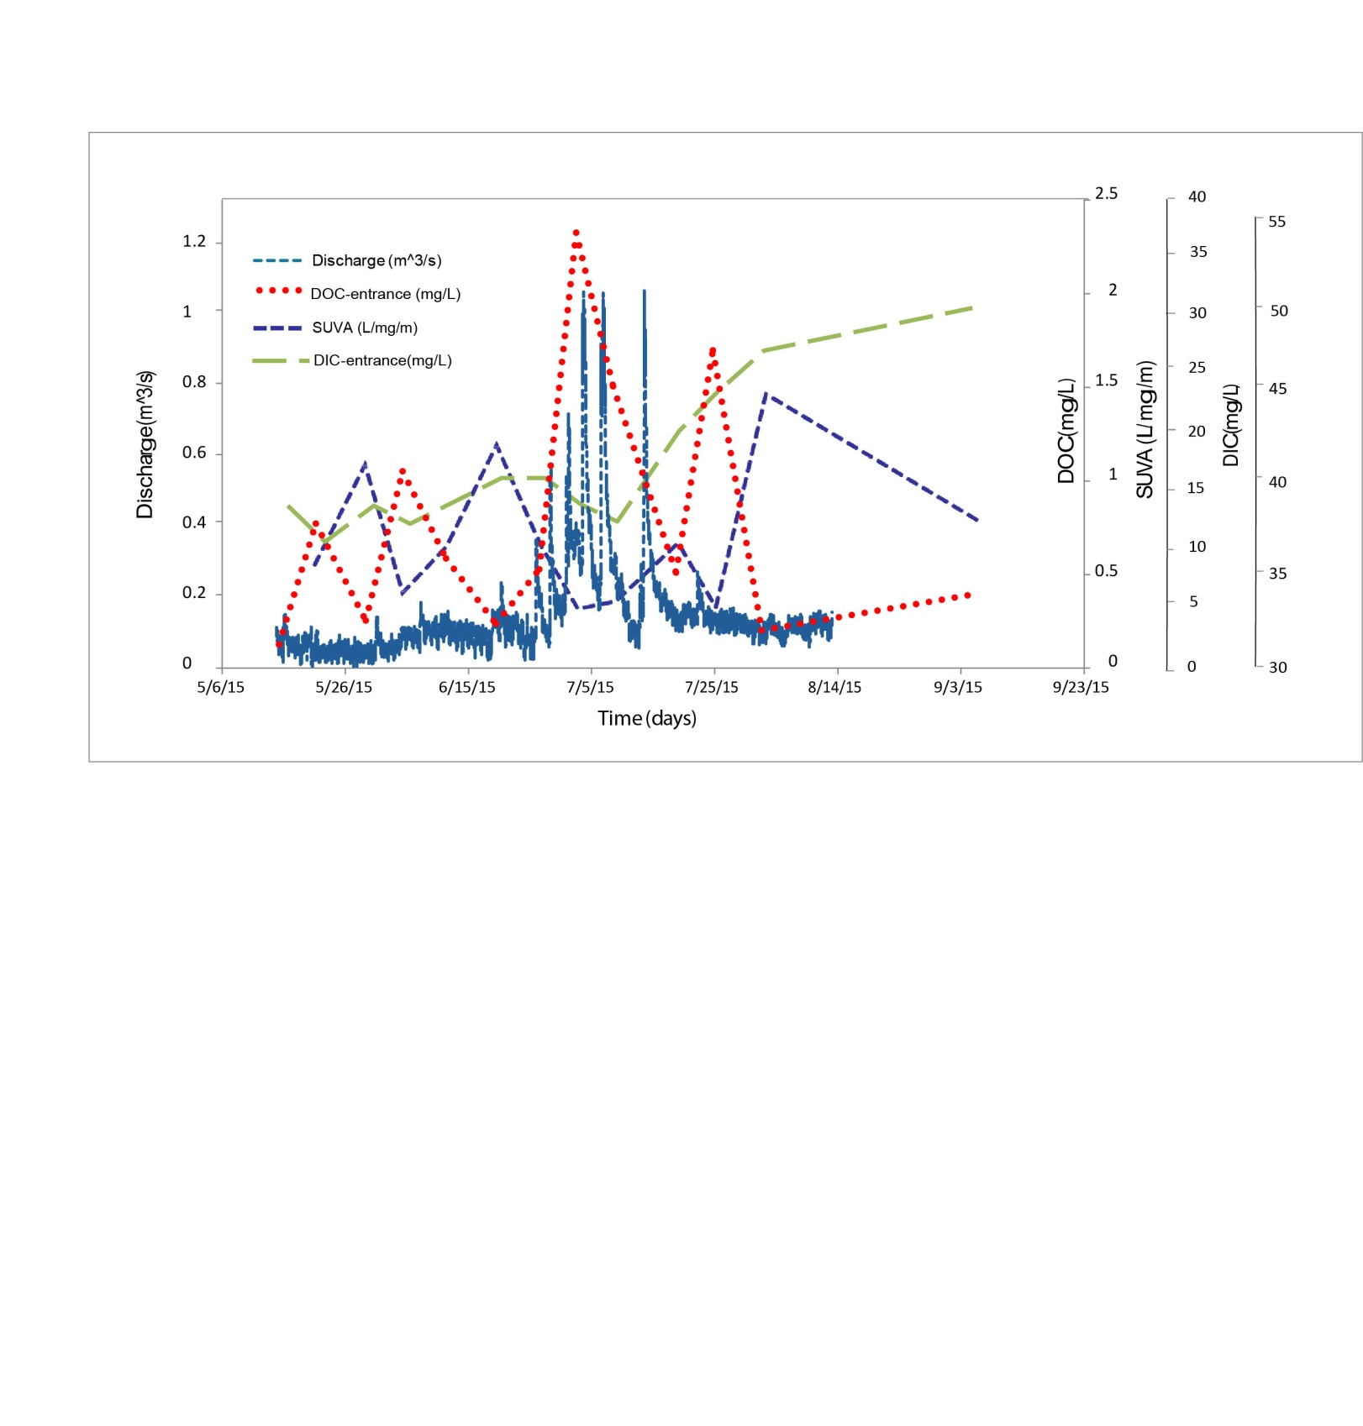
DOC and DIC
GSA 2016 North-Central, Champaign, IL.
4/18/2015
16
Notes:
-Discharge obtained usind H-Q linear correlation from the Aquatroll data, DOC and DIC from the Sievers, SUVA
-Focus on extreme storm events (July)
-DOC: A tendency toward a high DOC concentration during high discharge events with an average load of ~0.25 mg C/L during base flow and up to 2.5 mg C/ L during high discharge peak events in July.
-SUVA: A tendency of low SUVA associated with high DOC and high discharge periods, and high SUVA values associated with low DOC and lower to normal discharge periods.
SUVA= numerical value that represents the level of reflectivity of aromatic fractions towards UV light
High SUVA = highly decomposed organic matter= a lot of aromatic fraction in the sample (low and normal discharge) ; low SUVA= fresh organic matter flushed through the system during high recharge events (less aromatic chains)
Explain that low SUVA values do not mean there is no DOC into water but that the OM is not yet decomposed and therefore not reactive to UV light!!
Rapid transfer of DOM from surface with limited degradation during extreme flow events (flash storms)
-DIC: A tendency toward low DIC during high recharge: the water flushing through the system during high recharge may dissolve carbonates (depleting dissolved CO2 into water) but doesn't take time to equilibrate with carbonates (no additional IC recharge from rock). Refer to time span (4 hours in average) and SI values (undersaturation).
Also an effect of dilution of the reservoir water (high IC) by a high volume of incoming fresh water (low inorganic content) from storms -> Think in term of weight average DIC concentration.

Slide 18
Nutrients concentrations
GSA 2016 North-Central, Champaign, IL.
4/18/2015
17
Notes:
Major decrease in NO3 during storm event (dilution effect from incoming volume of surface water).
NH4 increase after the storm event.
Concentrations in PO4 increase prior to the storm event (P mobility is highly correlated to the ediments and organic content: flush of sediments through the system).
Concentrations in NO3 do not exceed the 10 mg/L EPA MCL, however do exceed the EPA background concentration of 2 mg/L. The excess is even higher during normal discharge periods, thus indicating a anthropogenic source that constantly feeds the NO3 background signal. Also, there is an effect of dilution of the background signal by storm water. However we cannot conclude on the source of NO3 (CAFO, corn fields).
Concentrations in NH4 exceed the EPA MCL for drinking water of 0.1 mg/L after the high discharge event.
Concentrations in PO4 exceed the EPA recommendation of 0.1 mg/L.
N.B:
MCL= maximum level of a contaminant in drinking water without adverse effects on human health
Recommended level= concentration that ensure lower risks for human health
Background level= concentration of a contaminant in area that is no longer affected by a contamination.

Slide 19
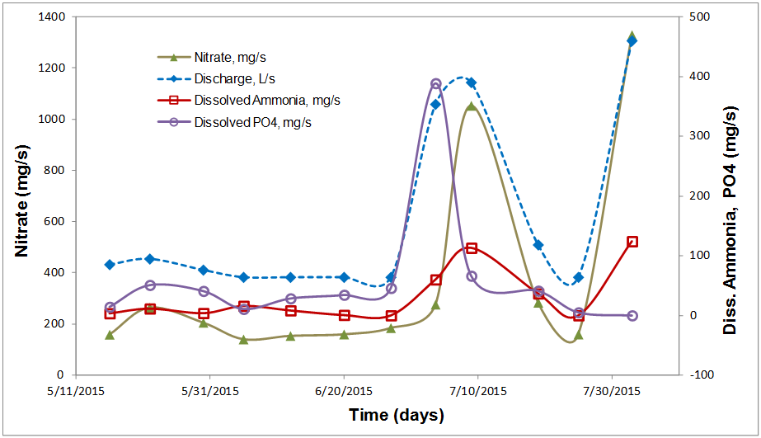
Nutrients loads
GSA 2016 North-Central, Champaign, IL.
4/18/2015
18
Notes:
Graph is obtained by multiplying the concentrations by the discharge
NO3 loads suggest higher surface inputs during storm and confirm the effect of dilution previously observed on concentration signal.

Slide 20
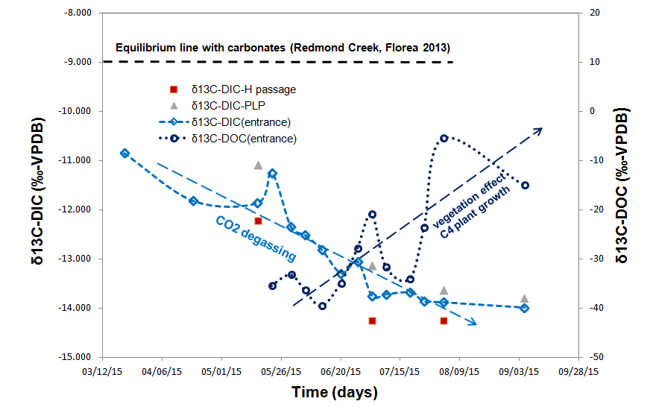
Carbon isotopes
GSA 2016 North-Central, Champaign, IL.
4/18/2015
19
Notes:
-Seasonal trends in isotopic composition both for Inorganic Carbon and Organic Carbon
-General decrease in DIC isotopic signature due to what we believe to be associated to CO2 degassing (associated to temperature and atmospheric pressure changes between seasons, will affect the equilibrium of CO2 in water)
Also, the isotopic signature of the spring water appears to be a combination of the two branches.
-Overall increase in DOC signature starting from May (spray of fertilizers that are highly depleted in C -30‰ and decomposed organic matter from the winter season -27‰) to September (peak in the growth of C4 plants-corn that fix less CO2 during photosynthesis, and peak in animal growth-higher amount of animal wastes -10‰). Overall evolution from more depleted sources to less depleted sources.

Slide 21
Conclusions
GSA 2016 North-Central, Champaign, IL.
4/18/2015
20
Major ions chemistry suggests limited bedrock dissolution (no equilibrium) during storm events with a major contribution of calcite like minerals.
Physical parameters (SpC) suggest surface water inputs with a dual response during storm events: few hours during extreme flow conditions (>1 m³/s) vs. few days during moderate storm events (<0.5 m3/s)
The ‘twin-peaks’ pattern is attributed to the effect of two contributing branches responding at a time interval from one another.
Nutrients concentrations suggest inputs from anthropogenic sources.
DOC and SUVA suggest a rapid and lateral transfer of organic matter from the land surface with limited degradation during storms.
Seasonal trends in carbon isotopes composition reveals the combination of various sources of carbon.

Slide 22
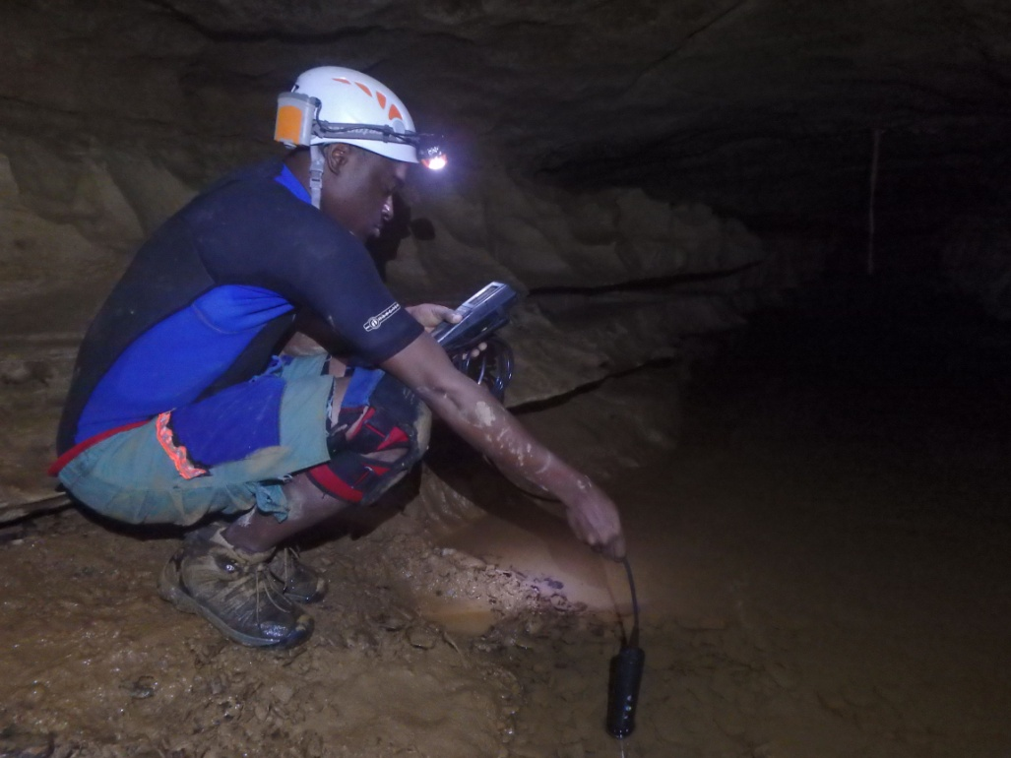
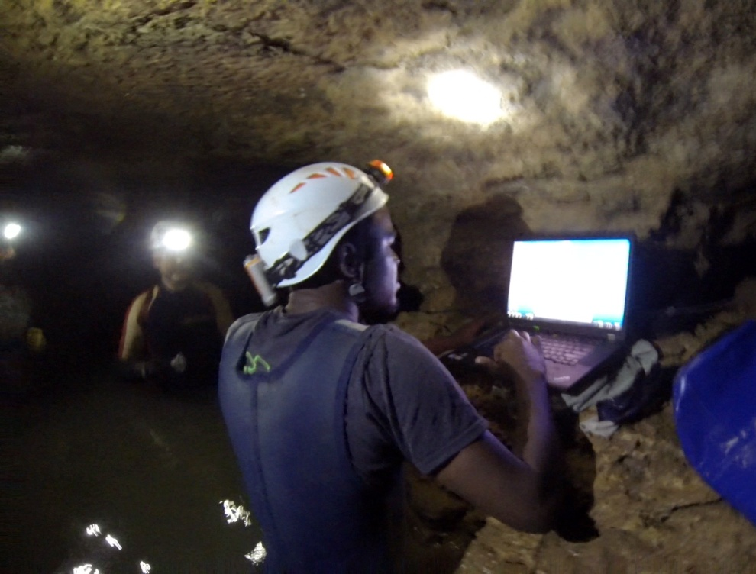

Slide 23
Acknowledgements
Environmental Ph.D. Seminar
4/12/2015
The Environmental Science Ph.D. program
The Organic Chemistry Lab
The Department of Geological Sciences
The Cave Research Foundation: 2015 Philip M. Smith Graduate Research Grant
The Geological Society of America: 2015 GSA Research Grant
The Geological Society of America: 2015 On To the Future- Diversity in Geosciences Grant
The National Speleological Society: 2015 Ralph W. Stone Graduate Fellowship
The Ball State Aspire Travel Grant.

