Slide 1
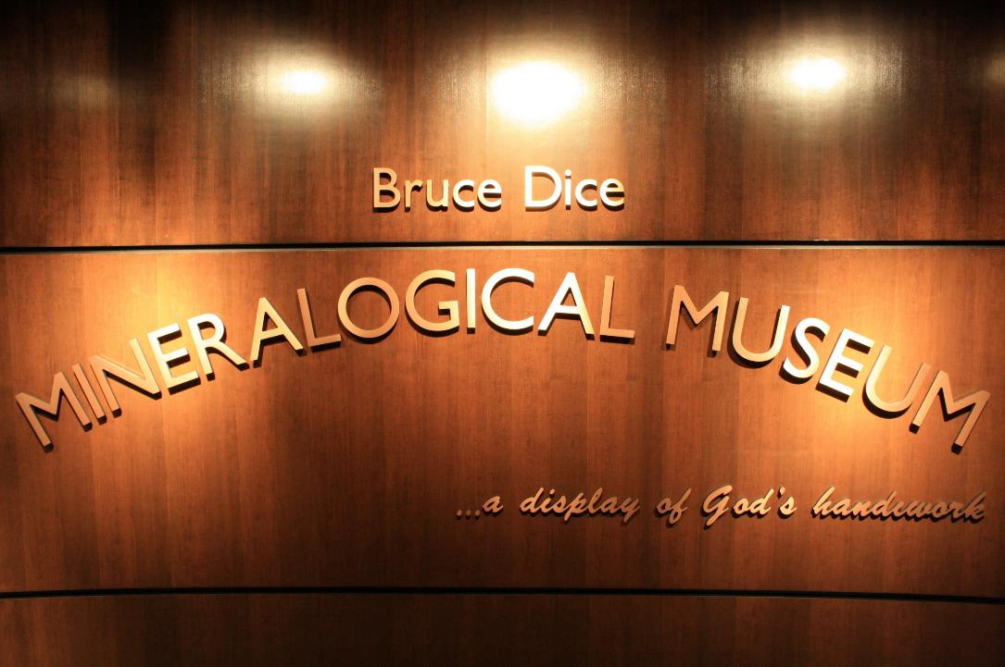
Commencement of a Museum
Department of geology, geography,
And environmental studies
Calvin College

Slide 2
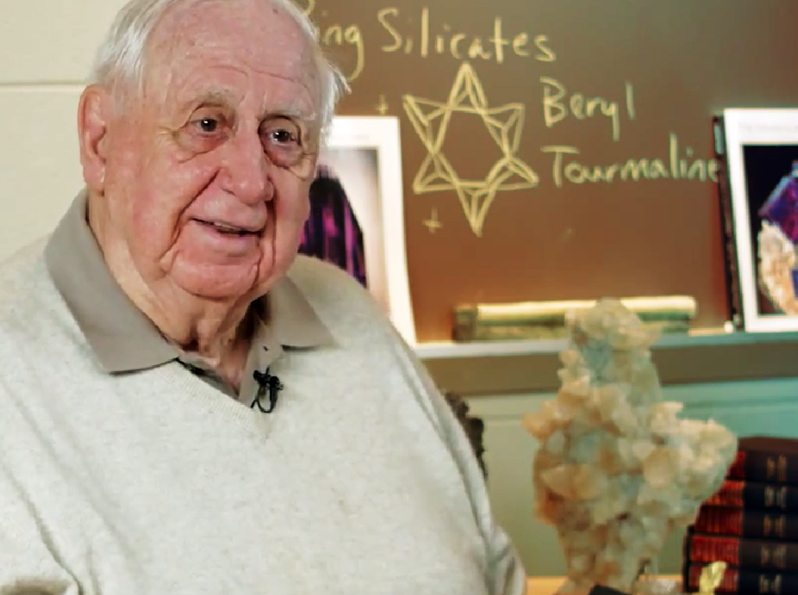
A man with a vision – Bruce Dice
Vision
Share the beauty of minerals
Share the rarity and uniqueness of other specimens
Pique interest and encourage students to pursue geology
Give of himself and his resources

Slide 3
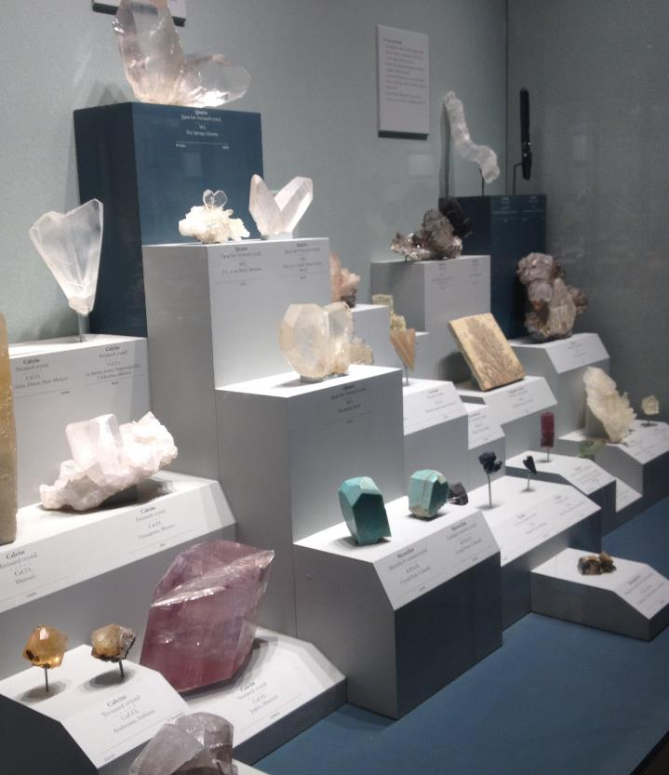
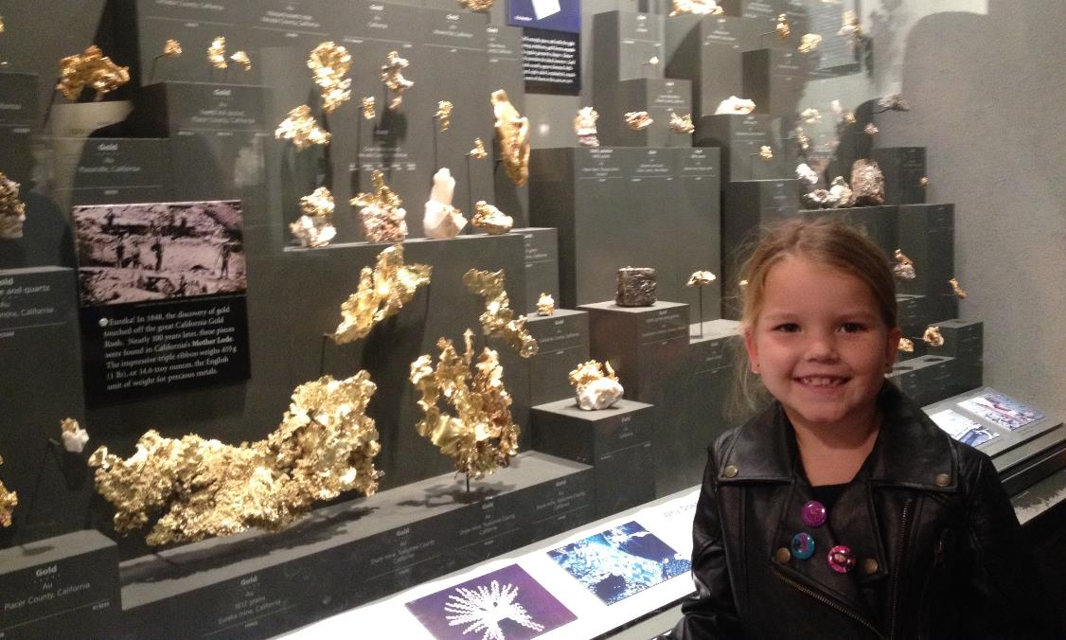
Smithsonian – Museum of Natural History Washington D.C.
A starting point
Gold Case
Crystal Habit and Form Case

Slide 4
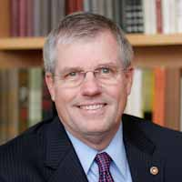
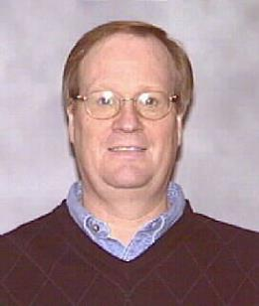
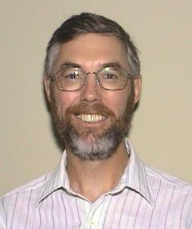
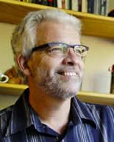
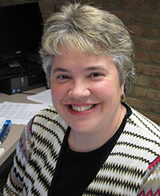
Development – Calvin College
Making the vision come to life
Foundation Officer and Senior Associate to the President – Bob Berkhof
Physical Plant – Phil Beezhold
Geology Faculty – Gerry Van Kooten
GEO Administration – Jonathan Bascom
GEO Administrative Support – Cheryl Hoogewind

Slide 5
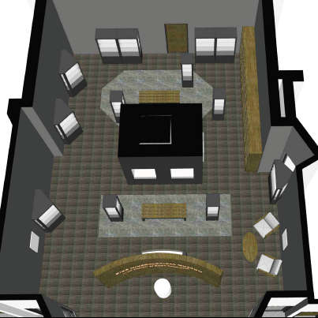
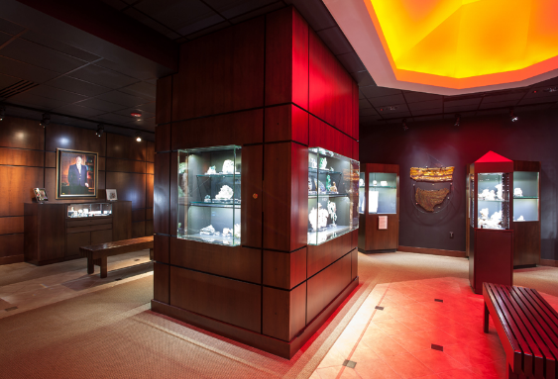
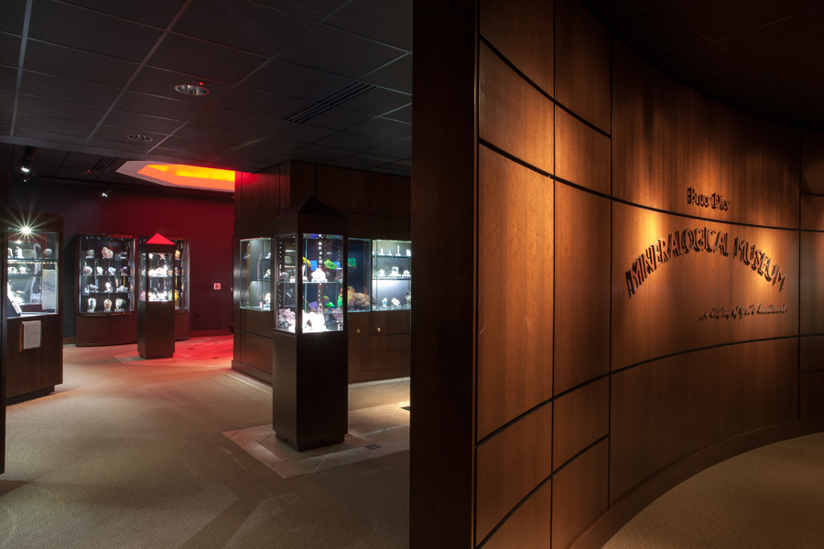
Development – Calvin College
Design
Completed Project
A
Photo Credit: Jason Reiffer
A
B
B

Slide 6
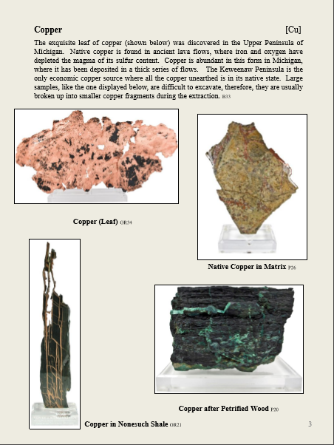
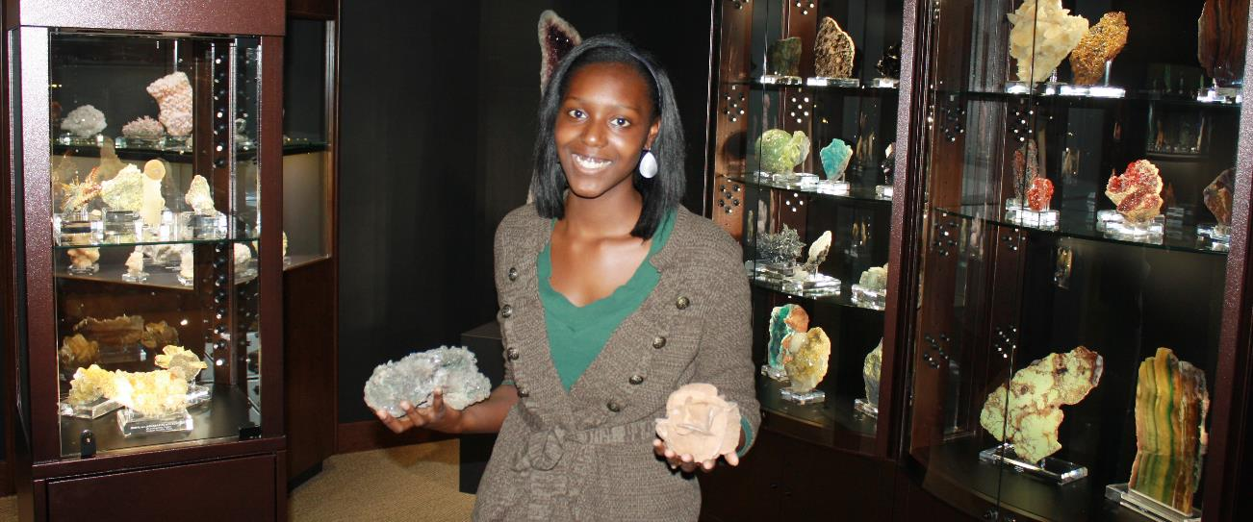
Development – Calvin College
Student Impact – Scholarship Recipients ($8.5 K/yr)
Brianna Marshall – 1st scholarship recipient
Catalog specimens
Photo documentation
Develop curation files and system
Sample page from catalog by Brianna Marshall and Jared Stratz

Slide 7
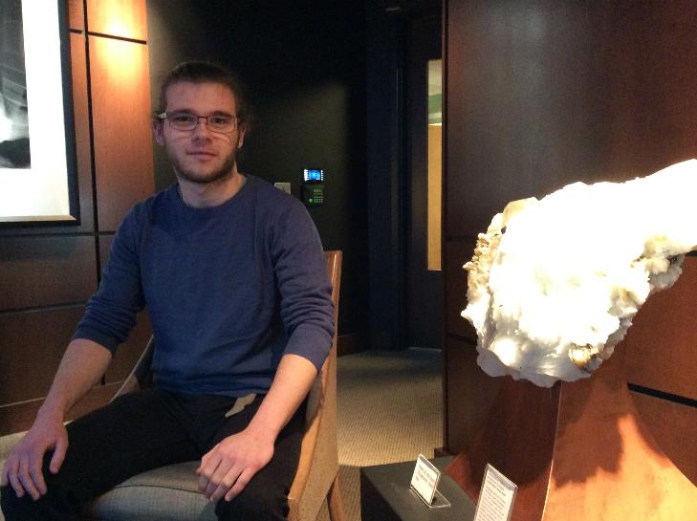
Management Plan
Data Supports Decisions
Approximately 10,000 visitors to date Nov. 2012-present
Average of 100 visitors each week – over half on Friday
Open hours set for 10.5 hrs/wk for 30 wk/yr
Tours and groups by scheduling
Outreach
Local Gem and Mineral Clubs
Local Schools and Homeschools
Student Involvement: Docents

Slide 8
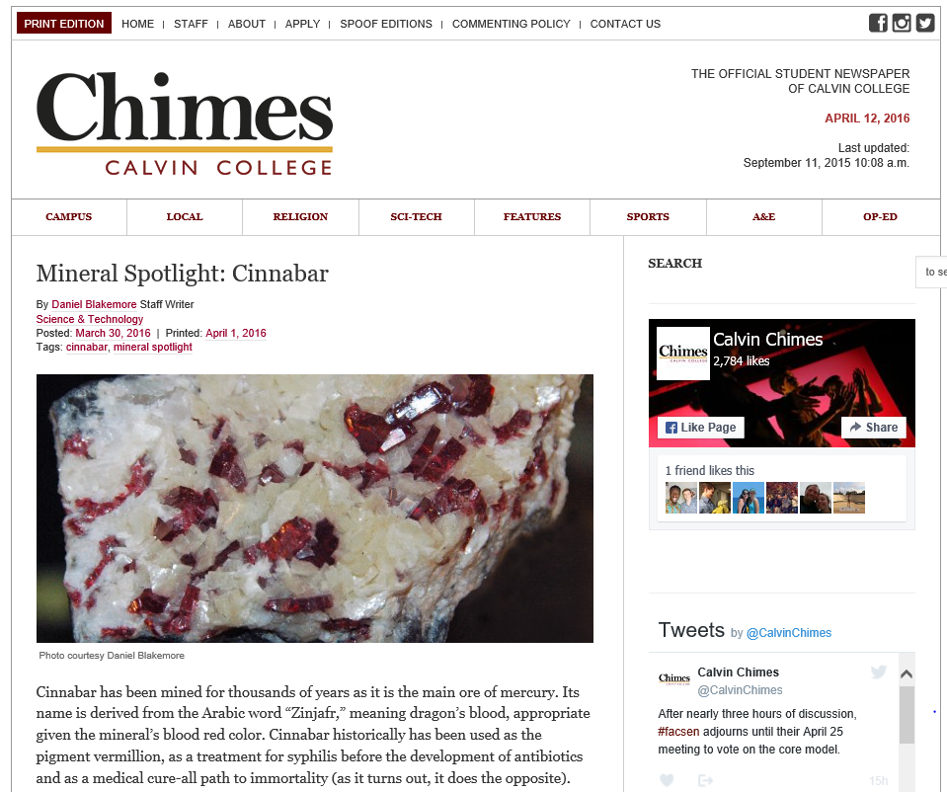
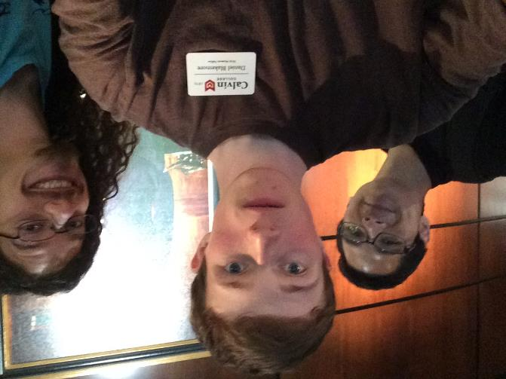
Development – Calvin College
Daniel Blakemore 2015-2017
Current scholarship recipient
iPad project
Weekly mineral highlight in the Chimes newspaper

Slide 9
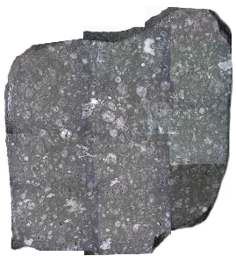
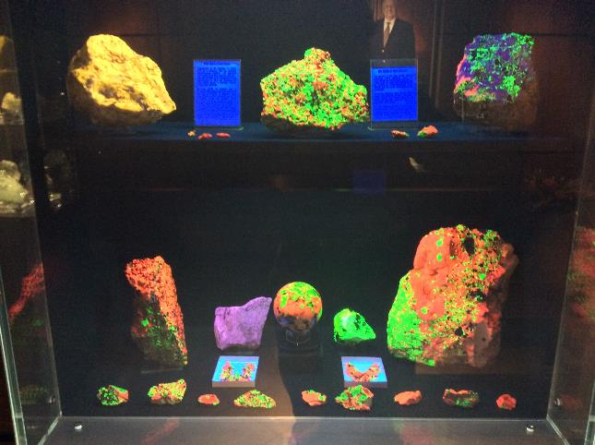
Management Plan
Permanent Displays
Allende Meteorite – Context of Time
Octopus Fossil – Very Rare
Fluorescent Case – Pique interest
Copper Case – Highlight Michigan Cu minerals
Several others: Amethyst Geode, Clevelandite, Banded Iron Formation, Gold Case

Slide 10
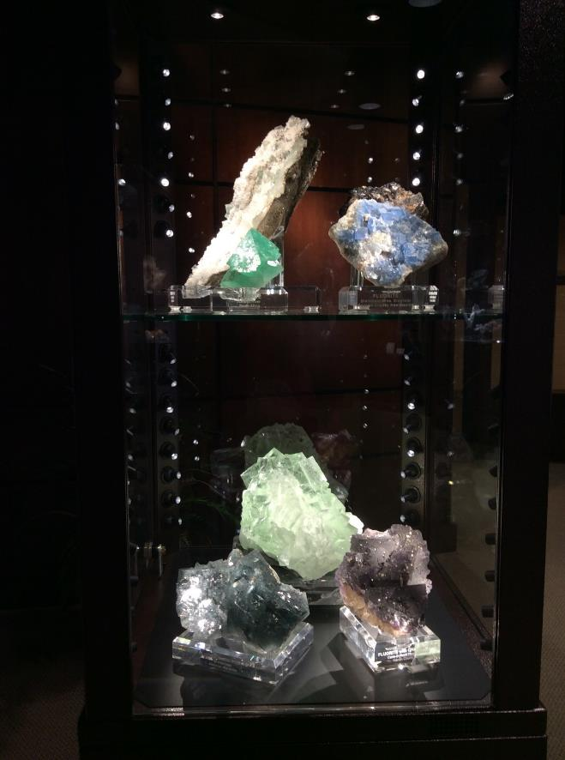
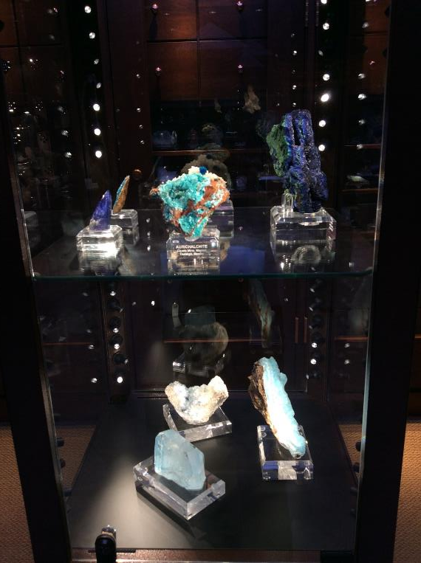
Management Plan
Rotating Displays – Current for this year
Minerals of the Bible
Fluorite case
Blue mineral case
Pink mineral case

Slide 11
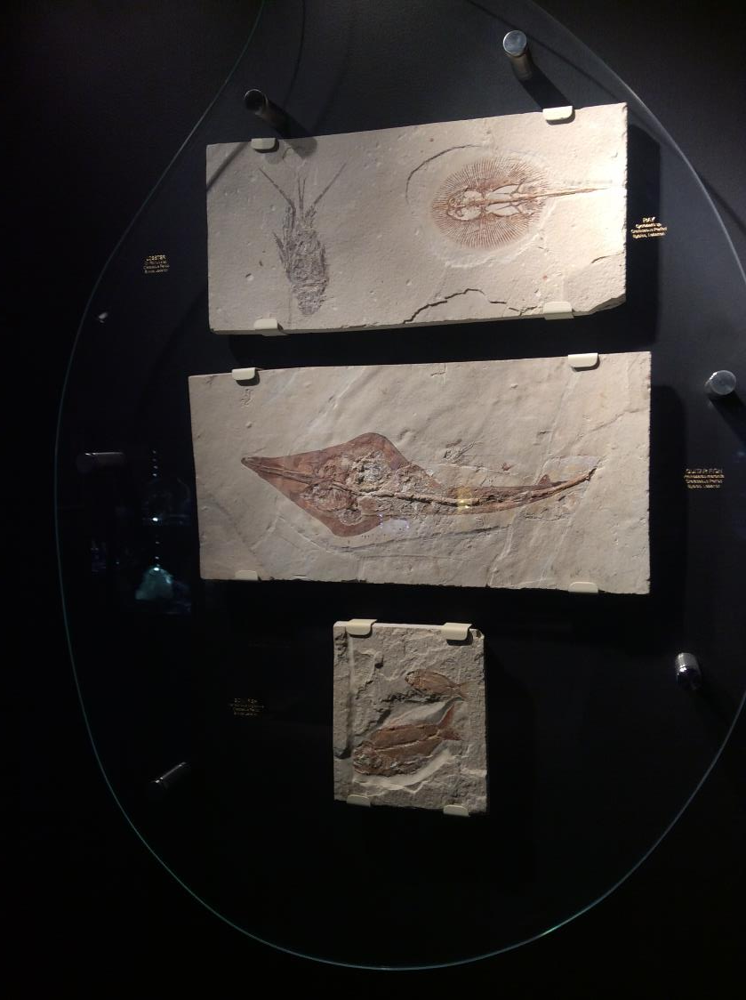
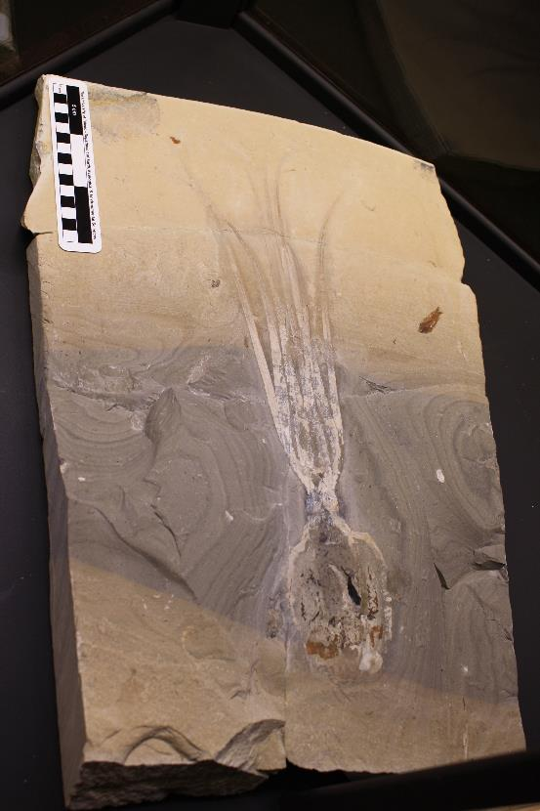
Management Plan
Work with Admissions
Fridays at Calvin tours
Passport Days

Slide 12
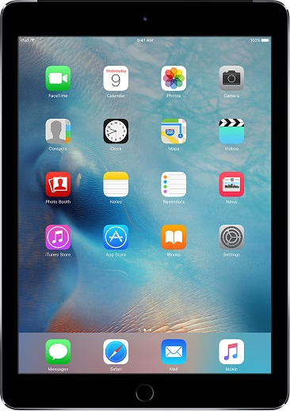
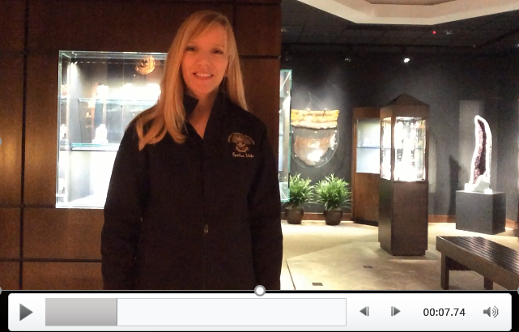
Forward Motion: Tours
iPad Project
Platform for Videos

Slide 13
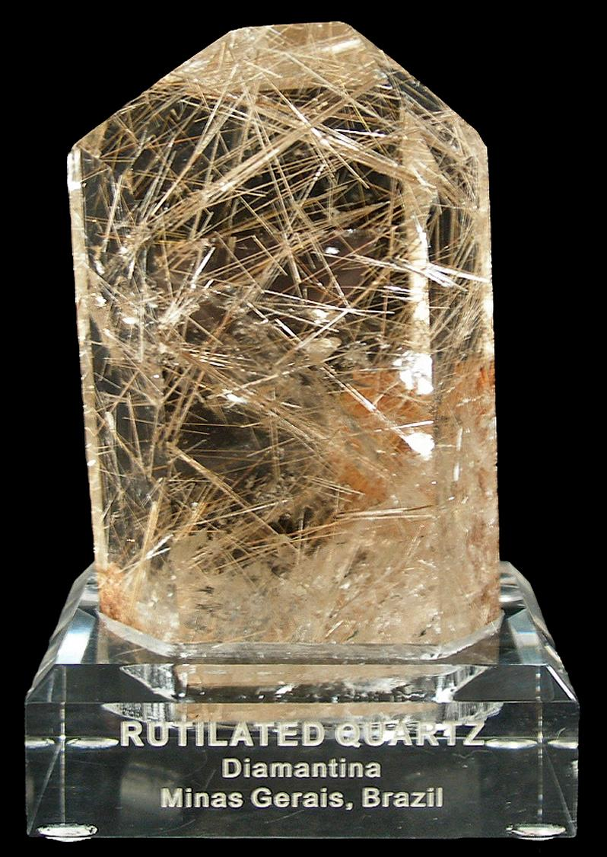
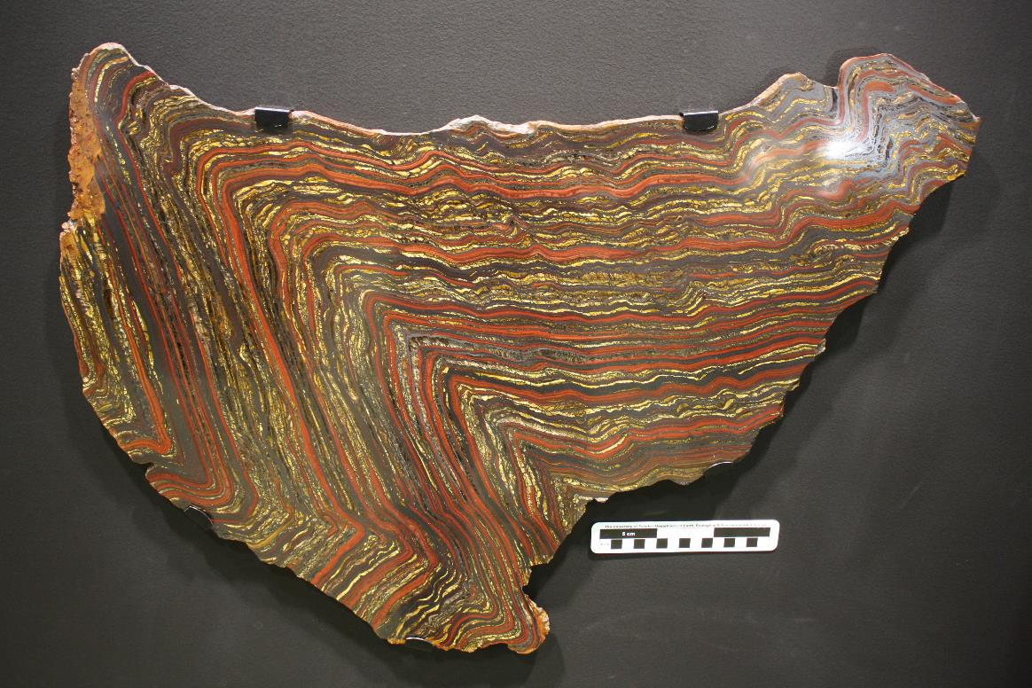

Slide 14
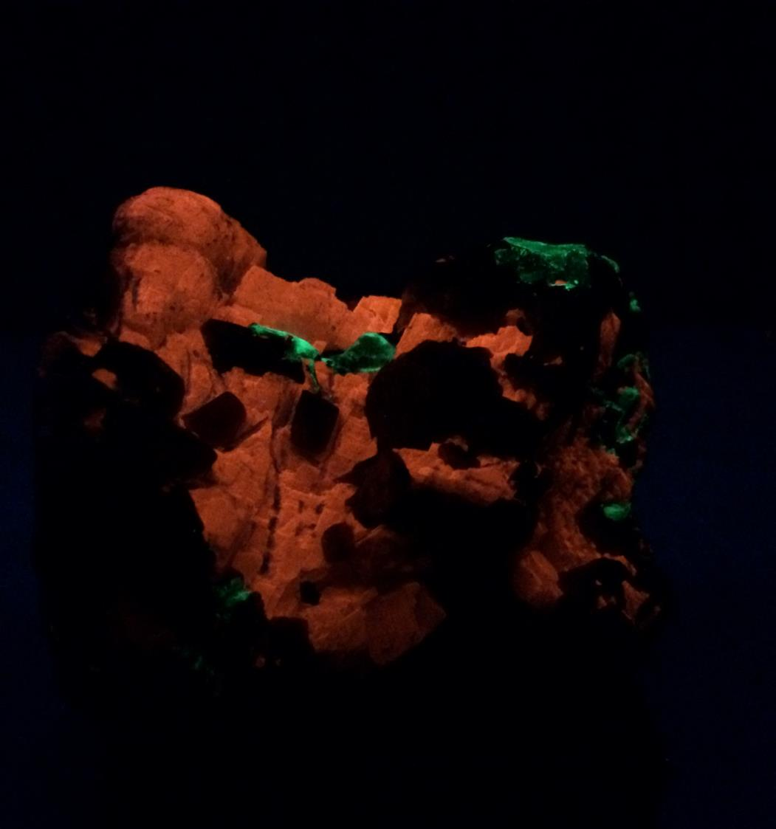
This Calcite glows red under UV light
CALCITE
CaCO₃
Location: Franklin, New Jersey
Class: Carbonates
Crystal System: Trigonal – Hexagonal
Distinguishing features:
Fizzes in acid
Cleaves in rhombohedral shapes

Slide 15
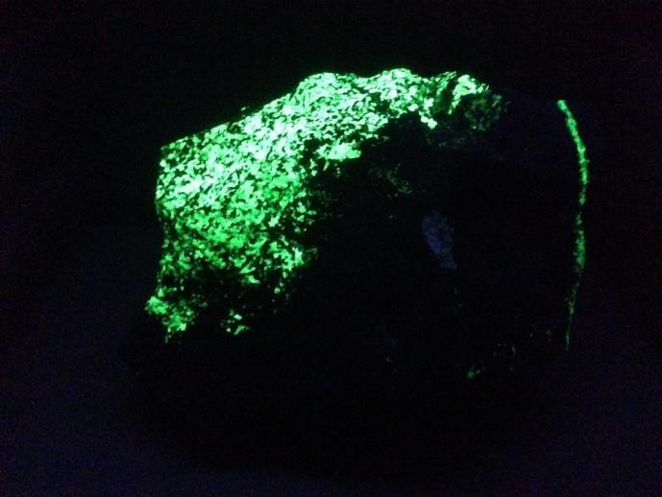
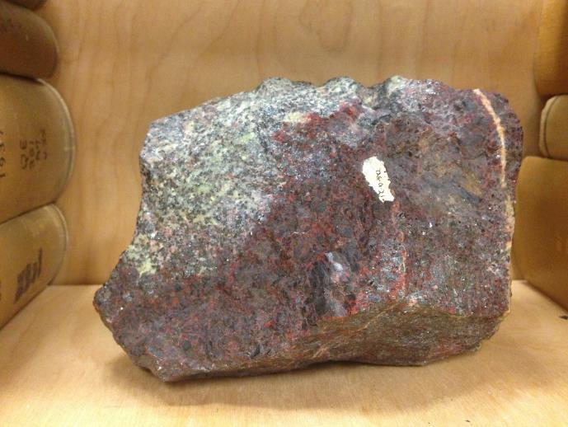
WILLEMITE
Location: Franklin, New Jersey
WILLEMITE
Zn₂SiO₄ (Zinc Silicate)
Class: Nesosilicates
Crystal System: Trigonal
Distinguishing features:
Willemite is the mineral glowing bright green in this piece (it is pale green in white light)
Strong Fluorescence, often phosphorescent

Slide 16
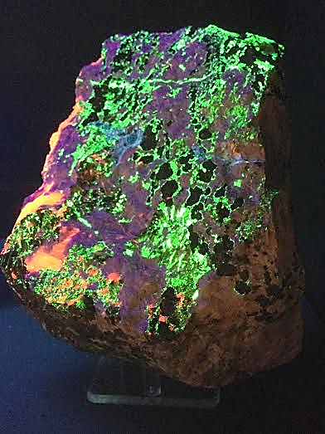
HARDYSTONITE
Location: Franklin, New Jersey
HARDYSTONITE
Ca₂ZnSi₂O₇ (Calcium zinc silicate)
Class: Disilicates
Crystal System: Tetragonal
Distinguishing features:
Fluoresces blue-purple
White in white light
Associated with other Franklin minerals
Only notable location is Franklin NJ
Hardystonite fluoresces blue-purple under UV light

Slide 17
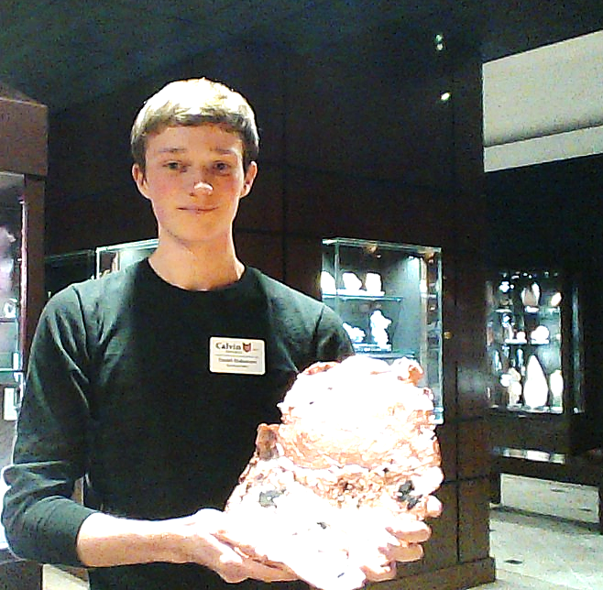
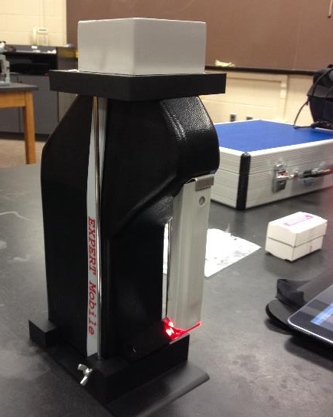
Forward Motion: Research
Research Team
Cation replacement
Trace element chemistry
Cu-bearing minerals
Summer 2016

Slide 18
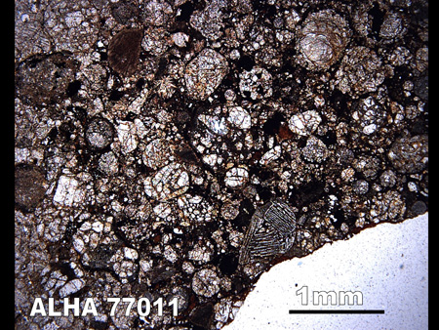
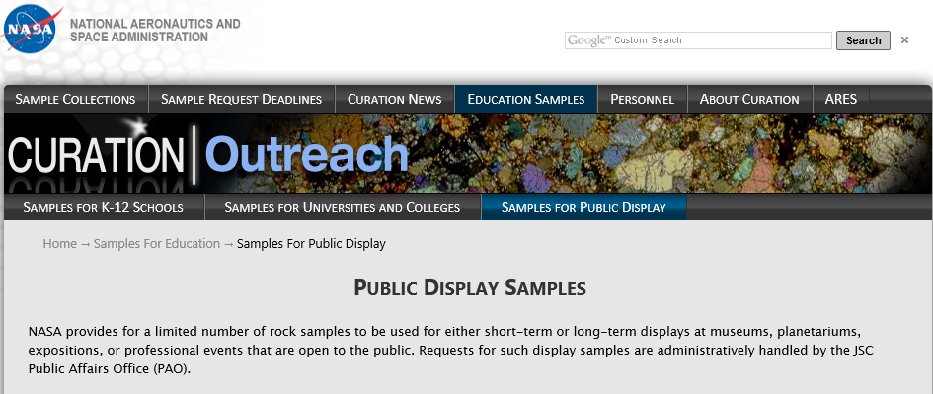
Forward Motion: Displays
NASA Meteorite Set
Petrographic Thin Sections – L3.5 Chondrite
Sample Discs
Limited Public Display Set
http://curator.jsc.nasa.gov/antmet/Samples/antmet_img.cfm?image=ALHA77011ppl.jpg&sample=ALH77011

Slide 19
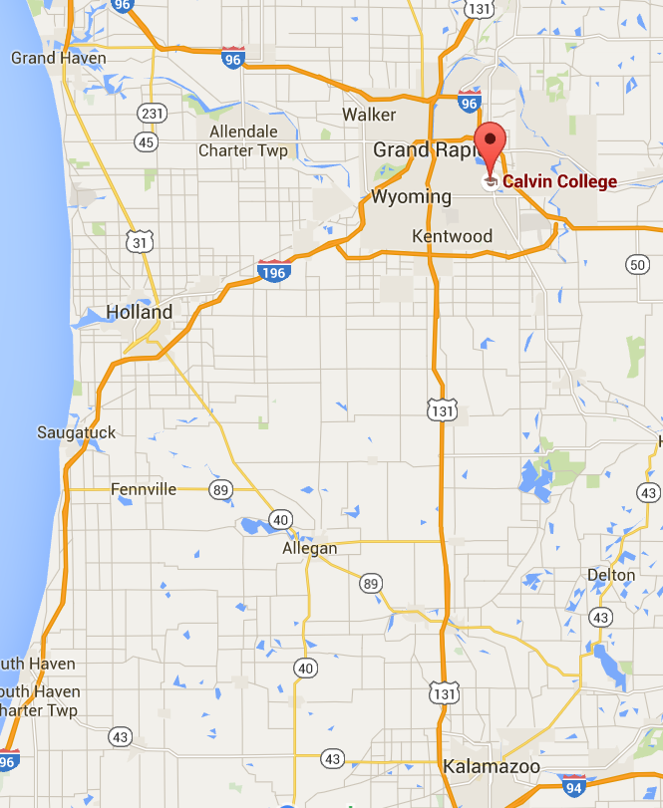
COME VISIT US…
If you are in or around Grand Rapids, we would love to have you schedule a visit or drop by during our open hours.
Email me or leave me a voice message.

Slide 20
Acknowledgements
Bruce Dice – Wadi Petroleum
Department of Geology, Geography, and Environmental Studies
Jason Van Horn
Deanna van Dijk
Stan Haan – Science Division Dean
Gerry Van Kooten
Cheryl Hoogewind
Students: Daniel Blakemore
Issac Jacques, Emily Barnaby, Dillon Breen, Brianna Marshall, Jared Stratz

