Slide 1


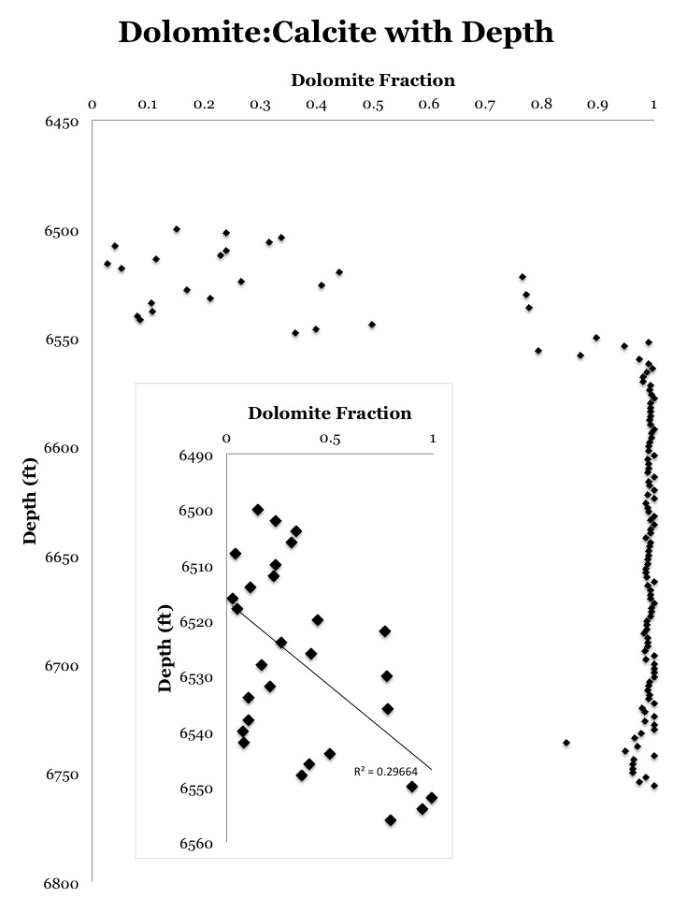
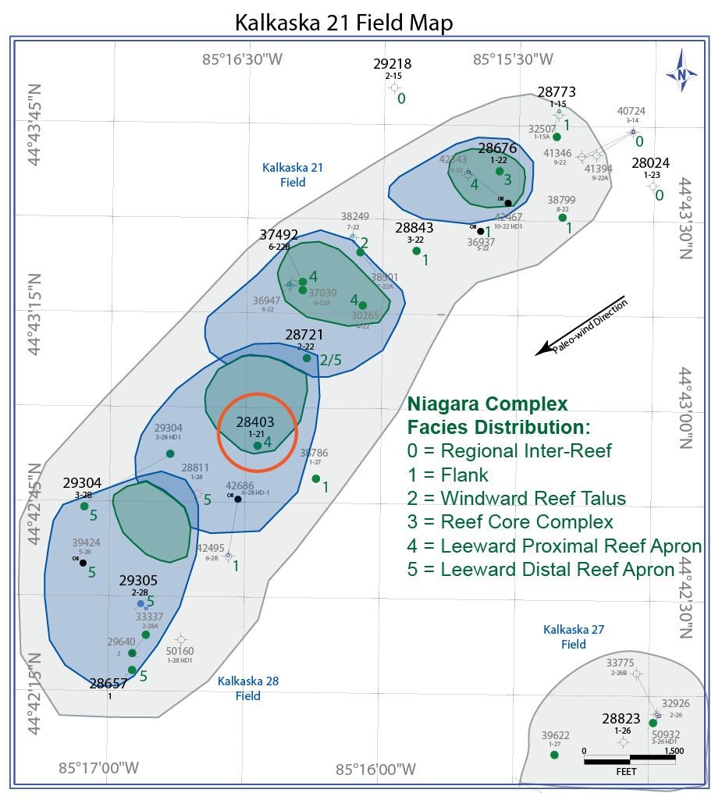
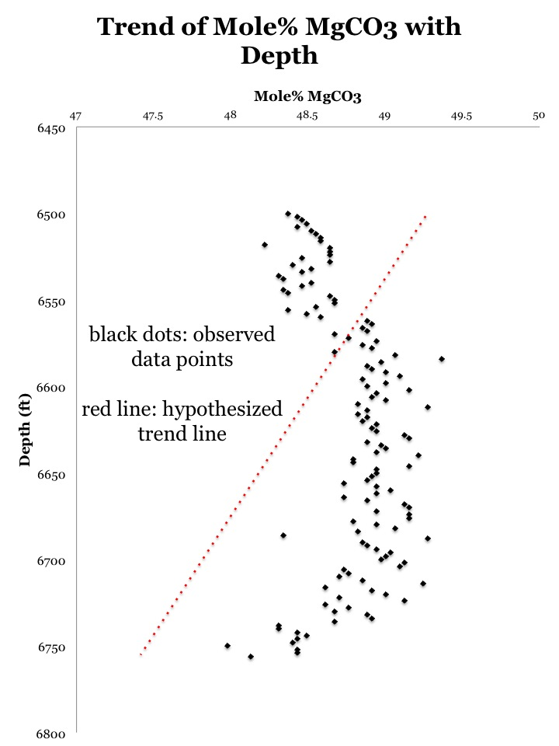
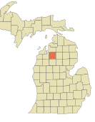
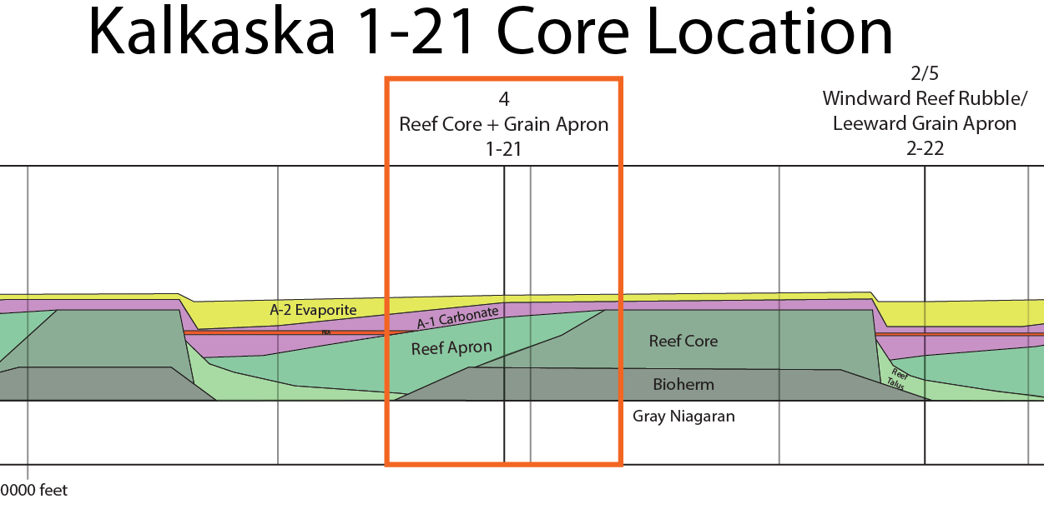
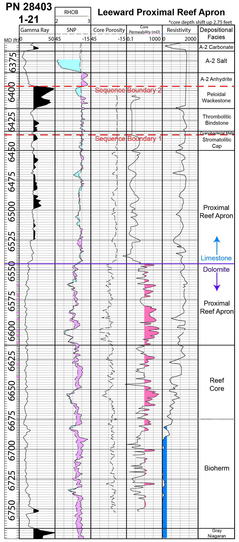
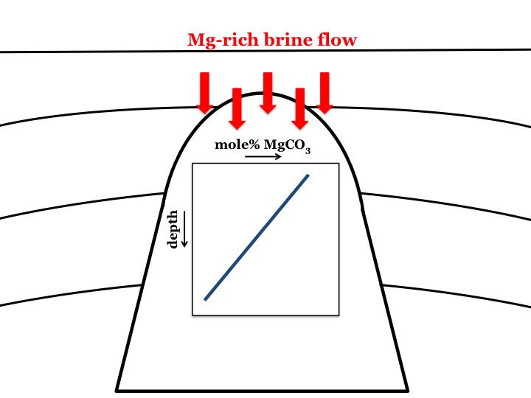
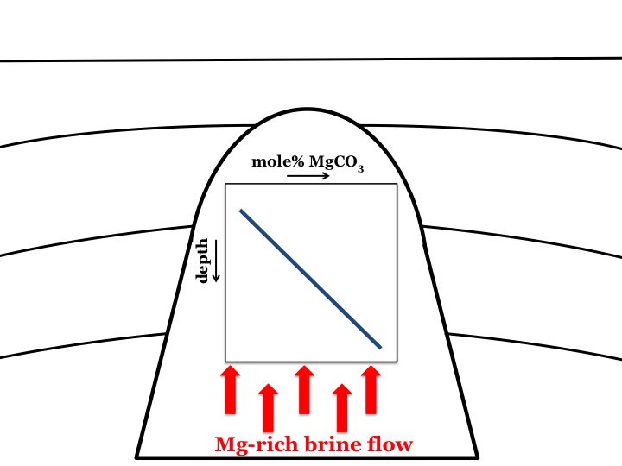
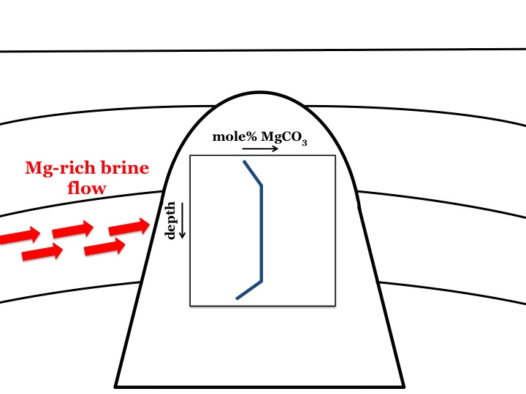
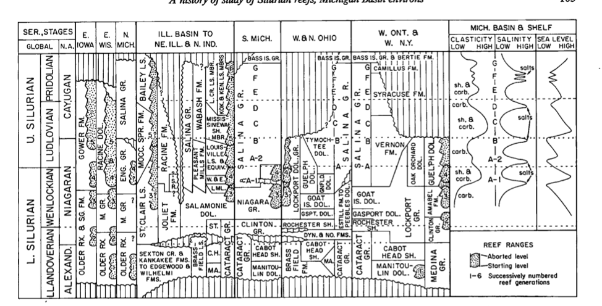
Testing the refluxing brine hypothesis with XRD-determined dolomite stoichiometry: A case study from the Silurian reefs of the Michigan Basin.
Jacqueline Snow ¹, Matthew Rine ², Rachael Agardy ¹, Stephen Kaczmarek ²
¹ Dept. of Earth and Atmospheric Sciences, Central Michigan University
² Dept. of Geosciences, Western Michigan University
Abstract
Results
Previous work suggests that the Silurian-age Niagaran-Salina reef complexes in the Michigan Basin were dolomitized by downward-refluxing brines. Using this diagenetic model, we presume that fluids should become progressively Mg-depleted down the flow path as dolomitization occurred. High-temperature experimental studies have shown that the Mg/Ca of the dolomitizing fluid is directly related to the stoichiometry (mole% MgCO3) of the dolomite. Thus, assuming that the dolomite has not been recrystallized, a systematic change in dolomite stoichiometry may be observable along the path of the dolomitizing fluids and therefore, dolomite stoichiometry can be used as a proxy for fluid flow during dolomitization. More specifically, dolomite nearer to the source of Mg-rich fluids (i.e. at shallower depths) should be more Mg-rich, and dolomite farther from the source (i.e. at deeper depths) should be more Ca-rich.
To test this hypothesis, we acquired a total of 129 samples from the Kalkaska 1-21 core (Kalkaska County, Michigan), sampling at a rate of every 2 ft between core depths of 6500 ft and 6756 ft below the surface. Powder x-ray diffraction analysis of these samples indicates that between 6500 ft and 6600 ft, dolomite stoichiometry increases linearly from ~48 to 49 mole% MgCO3. From 6600 ft to 6700 ft dolomite stoichiometry remains constant at ~49 mole% MgCO3. From 6700 ft to 6756 ft (the base of the core), dolomite stoichiometry decreases linearly to ~48 mole% MgCO3. Although we did not observe a decreasing MgCO3 trend as predicted, the results suggest that dolomite stoichiometry as a proxy for fluid flow may be possible. Furthermore, the results indicate that the dolomitization history of the Niagaran-Salina reef complexes in the Michigan Basin is more complicated than suggested by previous studies.
Figure 5:
Dolomite fraction over the first ~60 ft of core increases from 5 to 100% (R² = 0.29); below that the lithology is ~100% dolomite.
Figure 6:
Dolomite stoichiometry (mole% MgCO₃) increases from ~48.25% to 49% (6500 to 6600 ft), remains steady at ~49% (6600 to 6700 ft), and decreases again (6700 to 6756 ft) to 48%.
Study Area
Methods
Figure 1:
Field map of Kalkaska County displaying the Niagaran
Reef Complex’s distribution of facies. Kalkaska 1-21 core contains the both the reef core and the leeward proximal reef apron (Rine et al., in review).
129 bulk rock samples (~ 2.0 g) were collected from the 1-21 Kalkaska core at two-foot intervals (6500-6756 ft) using a power drill. An agate mortar and pestle was used to powder samples for X-ray diffraction analysis (Bruker D2 Phaser, 2nd Generation; CuKα radiation). Sample powders were press mounted into a zero-background, silicon sample holder. Fluorite was added as an internal standard to account for shifts in the position of principle dolomite [104] reflection resulting from small variations in sample height in the holder.
XRD scans were acquired from 20.0 to 55.0 ° 2θ with a step size of 8.09E-3 ° and count time of 0.150 s/step. Raw XRD patterns were smoothed and Kα 2 peak was subtracted using the Bruker Eva data analysis suite.
Intensities, 2θ values, and d-spacings for all reflections were recorded, and were normalized to the internal CaF₂ standard. Mole% MgCO₃ of the dolomite (i.e. stoichiometry) was determined from the dolomite d-spacing [104] using the following empirical equation from Lumsden (1979):
mole% MgCO₃ = 100-(333.33d – 911.99)
Figure 5
Future Research
Examining the dolomite crystals for signs of recrystallization that may have replaced the original compositional signature
Sampling from other cores in the area
Figure 2:
Cross section of the facies within the core and its relationship to the surrounding area (Rine et al., in review)
Figure 6
The 1-21 Kalkaska well is located in Kalkaska County, MI (Fig. 1) and is part of the Northern Michigan Reef Belt, which consists of numerous pinnacle reefs that are Silurian in age. The 1-21 well is positioned on one of these pinnacle reefs. Sears and Lucia (1979, 1980) suggested the dolomite bodies seen in these pinnacle reefs originated from downward refluxing brines that were rich in Mg (Fig. 7a).
Figure 7:
Three models of possible brine flow directions through a pinnacle reef and their hypothesized dolomite stoichiometry with depth.
(7a)
(7b)
(7c)
Kaczmarek, S.E. & Sibley, D.F., 2011. On the evolution of dolomite stoichiometry and cation order during high-temperature synthesis experiments: An alternative model for the geochemical evolution of natural dolomites. Sedimentology Geology, 240, 30-40.
Kaczmarek, S.E. & Sibley, D.F., 2014. Direct physical evidence of dolomite recrystallization. Sedimentology, 61, 1862–1882.
Lumsden, D.N., 1979. Discrepancy between thin-section and X-ray estimates of dolomite in limestone. Journal of Sedimentary Petrology, 49, 429–436.
Rine, M., Garrett, J., and Kaczmarek, S.E., in review, A new depositional model for the Silurian Niagara-Lower Salina “Pinnacle” Reef Complexes of the Michigan Basin, In: Advances in Characterization and Modeling of Complex Carbonate Reservoirs (Eds. A. MacNeil, J. Lonnee, and R. Wood) SEPM Special Publication
Sears, S.O. & Lucia, F.J., 1979. Reef-growth model for Silurian pinnacle reefs, northern Michigan reef trend.
Sears, S.O. & Lucia, F.J., 1980. Dolomitization of northern Michigan Niagara Reefs by brine refluxion and freshwater/seawater mixing. SEPM Special Publication, No. 28, 215-235.
Shaver, R., 1991. A history of study of Silurian reefs in the Michigan Basin environs. GSA Special Paper, 256, 101-138.
We’d like to thank the Michigan Geological Repository for Research and Education for allowing us to take samples from their core collection and both Western and Central Michigan Universities for funding this project.
References & Acknowledgements
Figure 3:
Annotated well log based on well log data and observations from core. Sampling began at 6500 ft and continued to the end of the core (Rine et al., in review).
Figure 4:
Stratigraphic column illustrating the Salina and Niagaran groups (Shaver, 1991).
Notes:
This poster represents a simple test of the Sears and Lucia hypothesis that refluxing brines dolomitized the rock. The data don’t support this. Explanations include:
Dolomite was recrystallized and so doesn’t retain original compositional signature
Model is incorrect
Sometimes a conceptual diagram showing how fluids could have flowed (all the different options) is helpful.
Fig 3 isn’t really related to testing the hypothesis but is interesting nonetheless. It shows the same independence between dol:cal and stoichiometry for rocks with <95% dolomite. This is from K and S 2011 and 2014.
future work: eliminate the 1st possibility, is it thin section work?

