Slide 1
Geoscience at the Library
Experiences in Student-Led Community Outreach

Slide 2

Dan Curtis Dr. Diane Burns & the EIU Geoscience Club

Slide 3
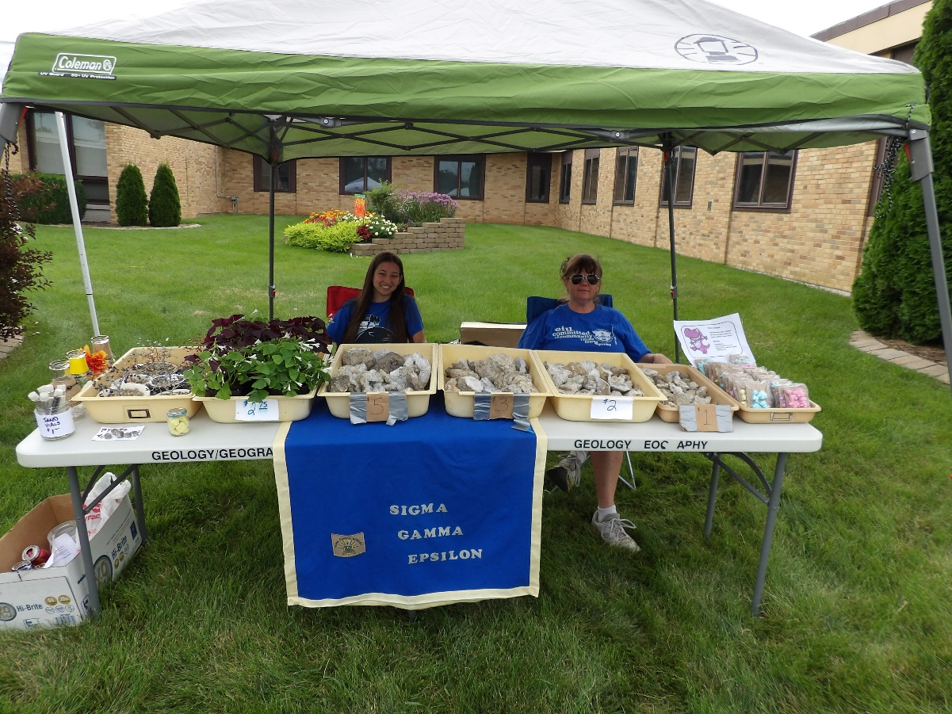
April 20, 2013
The program started from a chance encounter at a campus rock sale

Slide 4
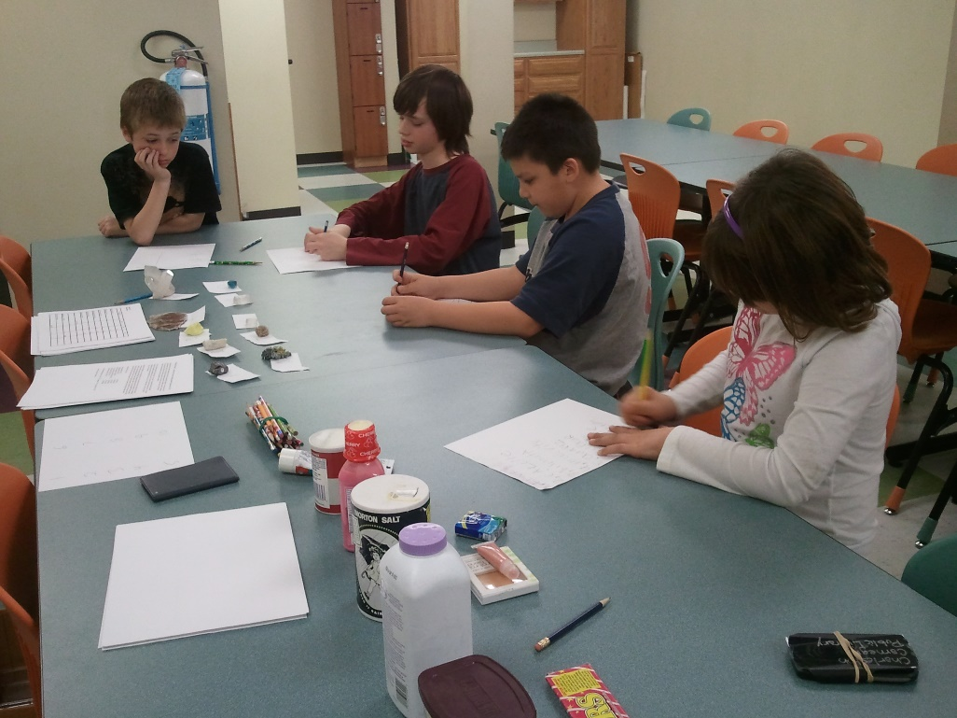
April 19, 2016
3 Years Later….
7 events
~40 children participated
Over 100 rocks and fossils distributed
6 Dino-boards made for the Library
1 Dinosaur constructed

Slide 5
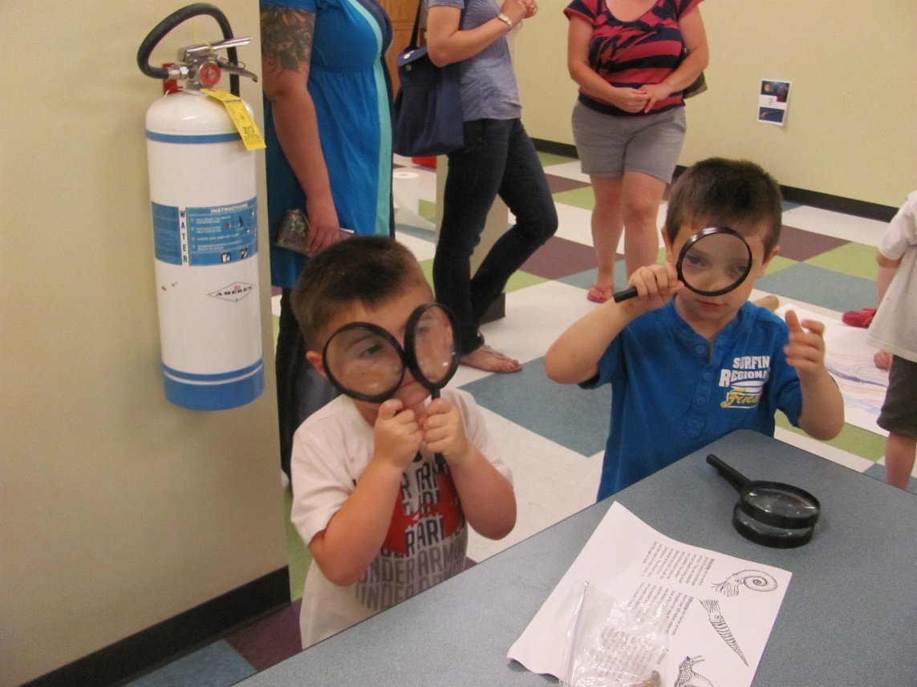
Program
First started during the Charleston library’s summer reading program, we provide geoscience education programs designed to be fun and engaging for the children; the primary purpose being to create interest in the geosciences

Slide 6
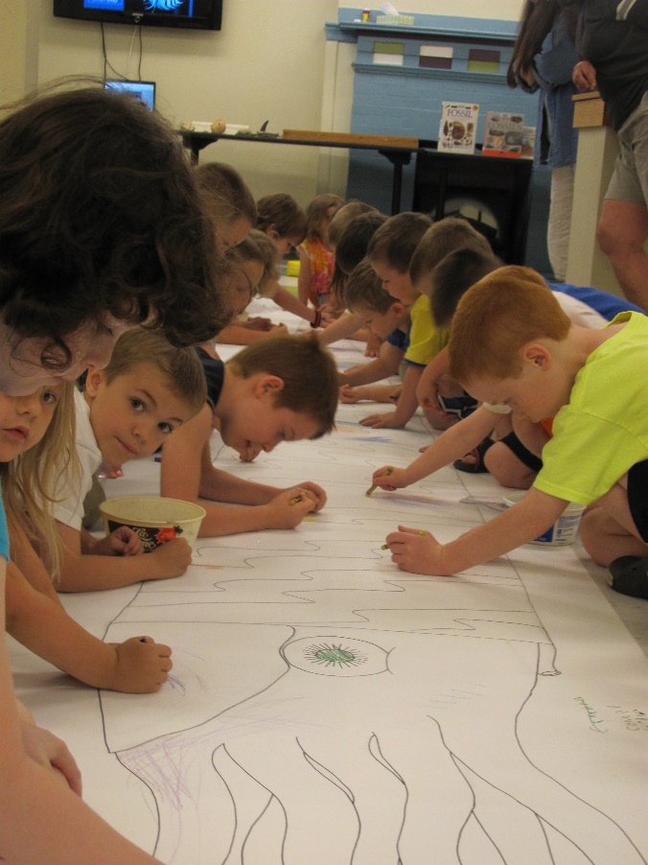
Program
Our presentations were designed around hands-on crafts and activities with minimal lecture, similar to interactive programs found at many museums.

Slide 7
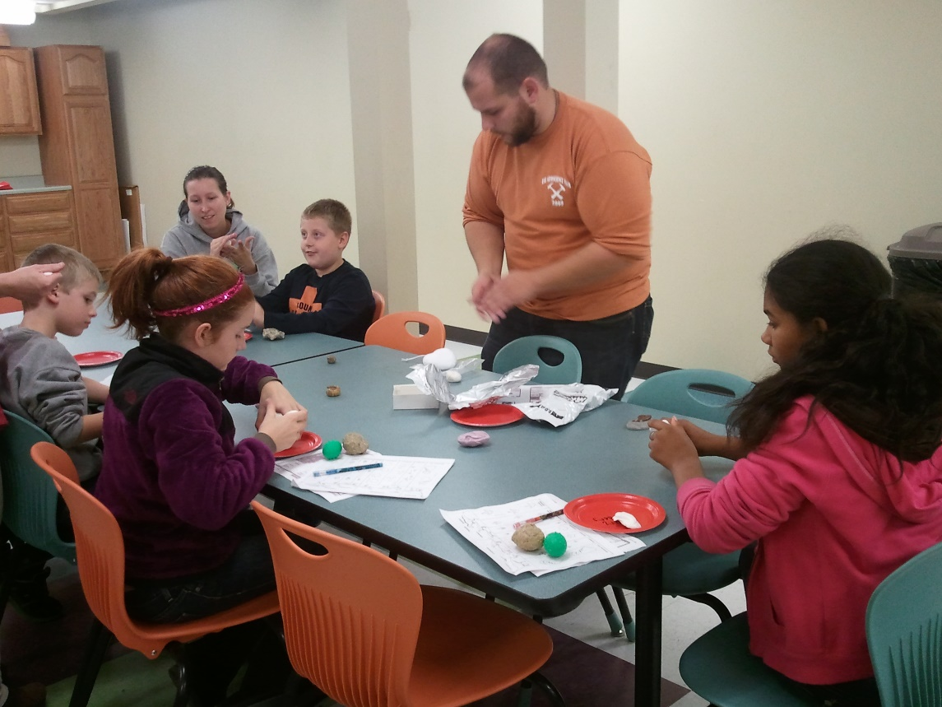
Program
Events included:
Digging for fossils and “gemstones”
Geo Scavenger Hunt
Mineral Properties
Unusual rocks
Building a Dinosaur

Slide 8
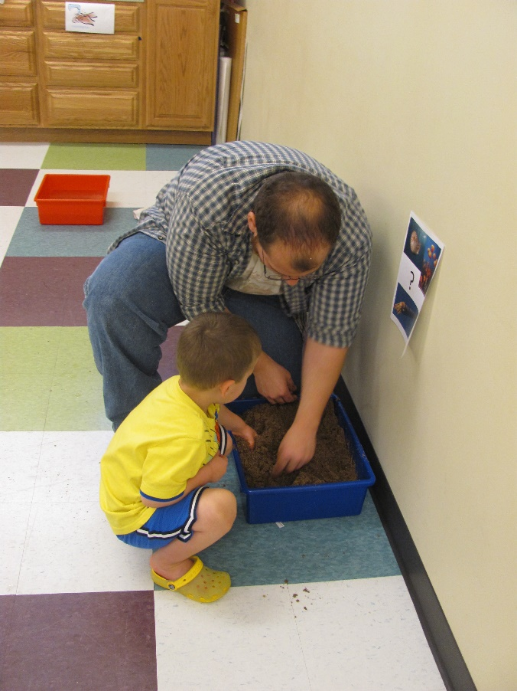
Activities
Summer 2013 – Fossils
How fossils are created from living creatures, and “excavating” their own fossil samples.
Kids also worked on coloring giant posters of prehistoric animals to decorate the library.

Slide 9
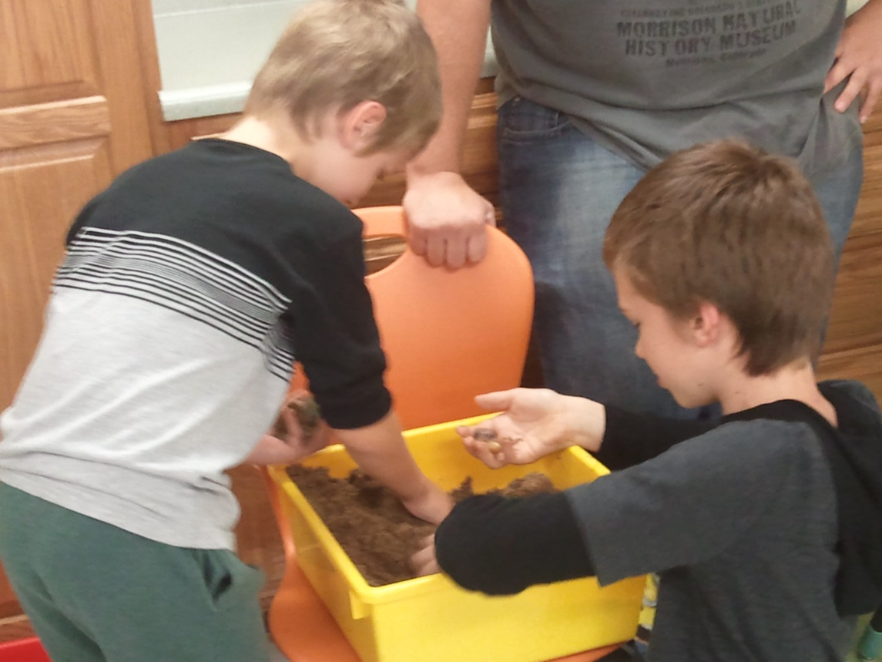
Activities
Summer 2013 – Minerals
Introduction to rocks and minerals, and mining for their own rock and mineral samples.
They also decorated their own boxes to hold their (growing) collection.

Slide 10
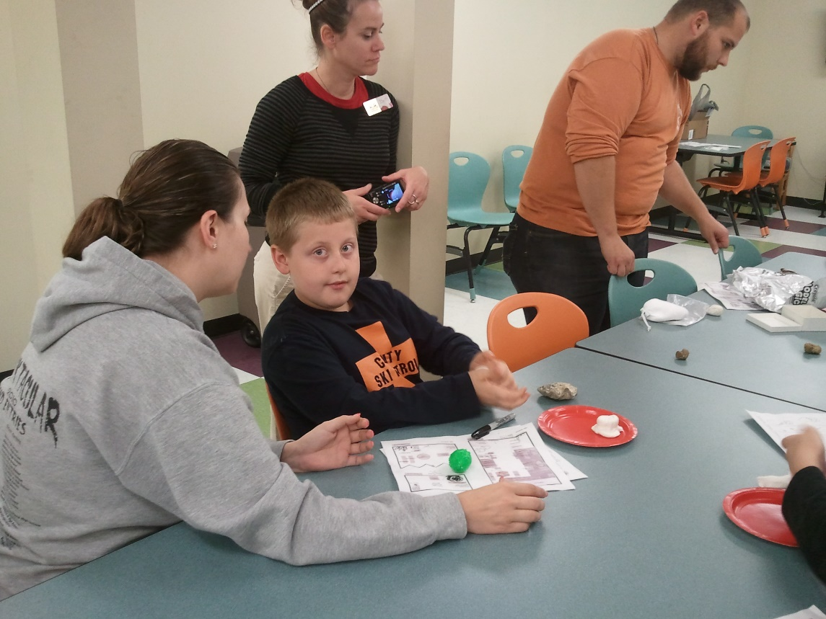
Activities
Fall 2013 – Scavenger Hunt
A scavenger hunt around the library to different stations.
Demonstrated were special traits of rocks and minerals like magnetism, density, phosphorescence; making trace fossils, and comparing dinosaurs via trackways.

Slide 11
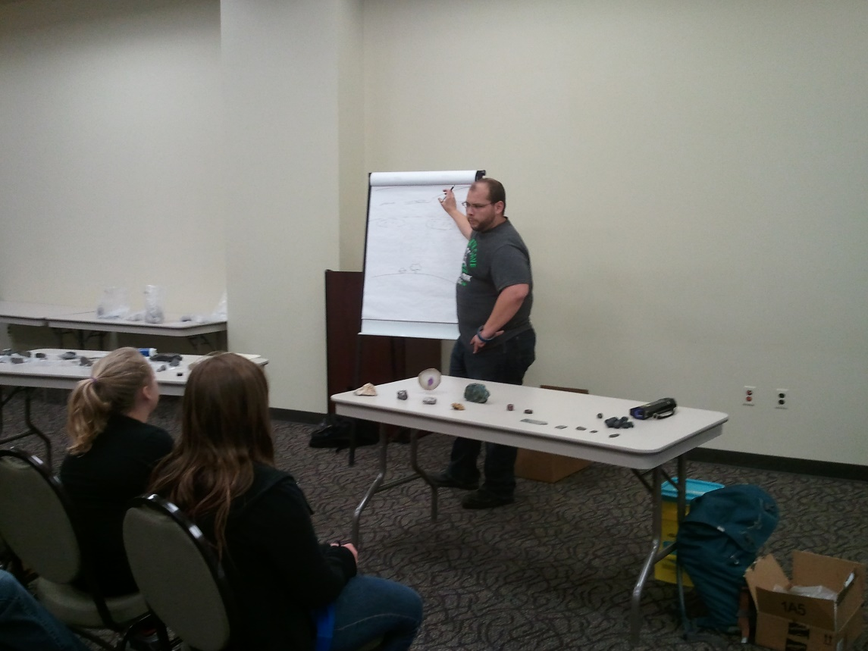
Activities
Spring 2014 – Rare and Unusual Rocks
Discussion and demonstration of various “unusual” rocks; including specimens from Antarctica, meteorites, and ultraviolet reactive rocks and minerals.

Slide 12
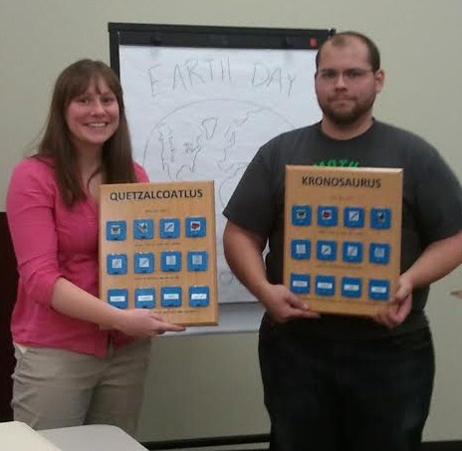
Activities
Spring 2014 – Dino-boards
Presented to the library at the Unusual Rock demo, these were permanent gifts to the library Kidspace. Each board was a kind of “guessing game” about that prehistoric animals traits or behavior.

Slide 13
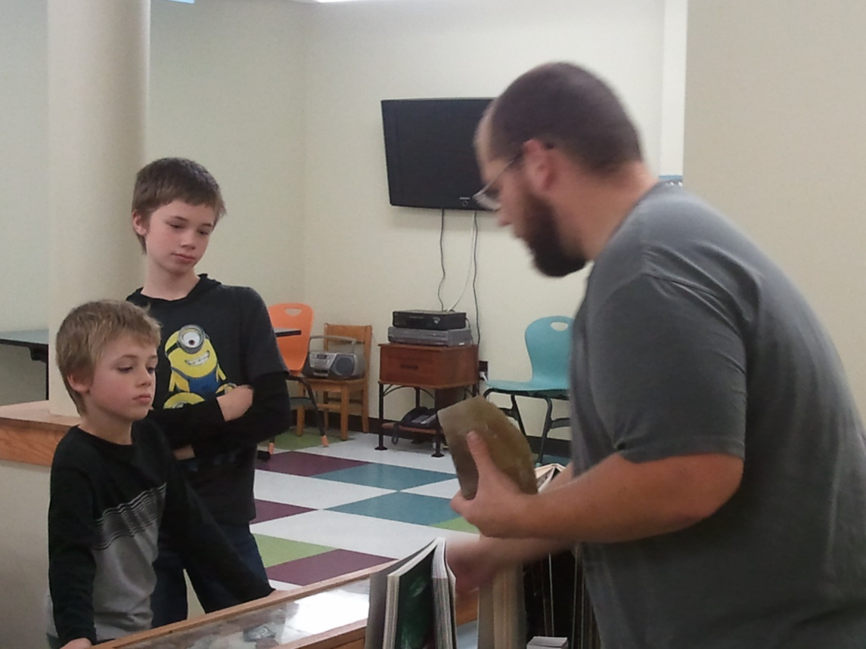
Activities
Fall 2014 – What’s a Mineral?
The difference between a rock and a mineral; how they are defined and classified, and constructing models of crystal habits.

Slide 14
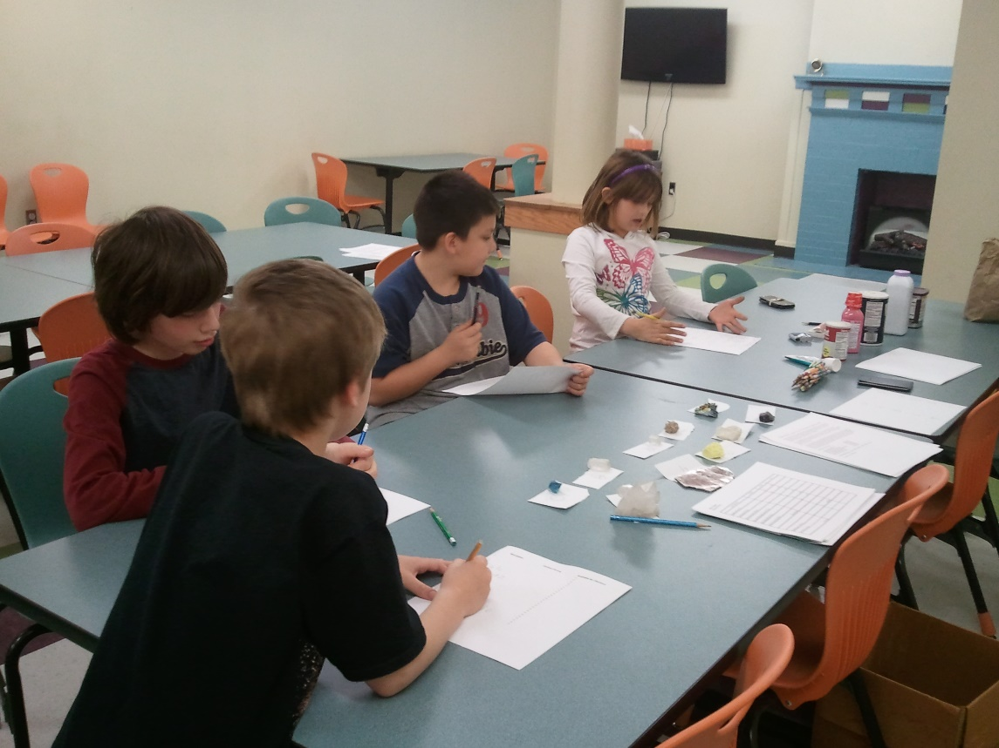
Activities
Spring 2015 – Minerals in Daily Life
How rocks and minerals are used in our daily lives, and how to discover what rocks are in what products.

Slide 15
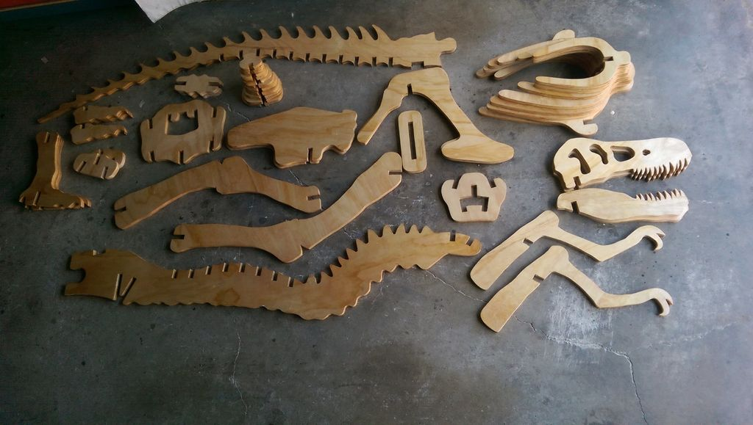
Activities
Spring 2016 – Building a Dinosaur
Upcoming presentation on how dinosaurs are put back together, and how we know what they look like.

Slide 16
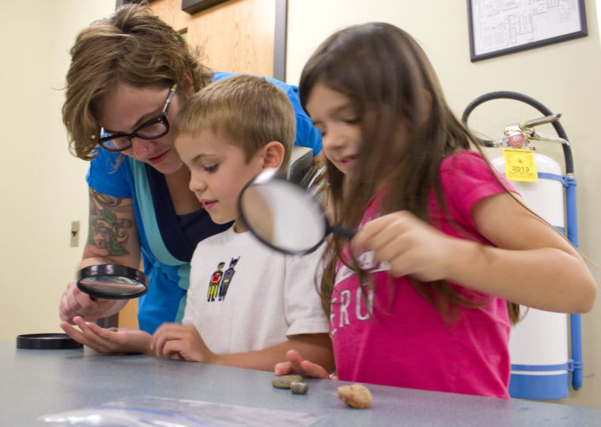
Results
Nearly 50 children participated in the program, many of which attended multiple events.
Participation was highest overall during the summer.
Though school year attendance was lower, there were more returning previous attendants.

Slide 17
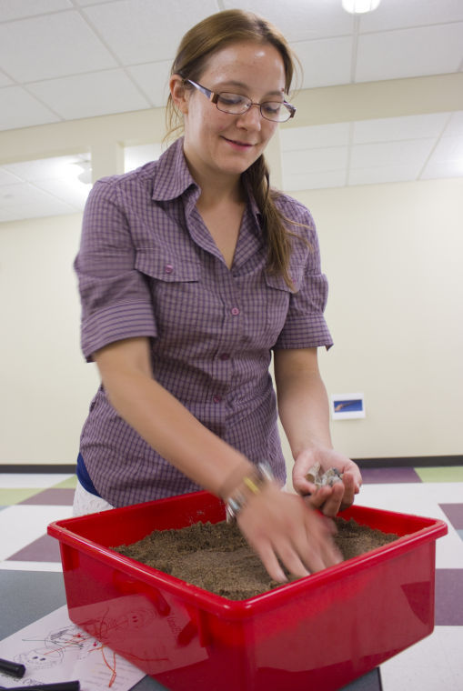
Results
By keeping the lesson plans flexible, we could tailor each event to children’s interests; occasionally changing our plan entirely if they weren’t engage.
Focus was on exploration and introduction to new topics, to generate general interest.

Slide 18
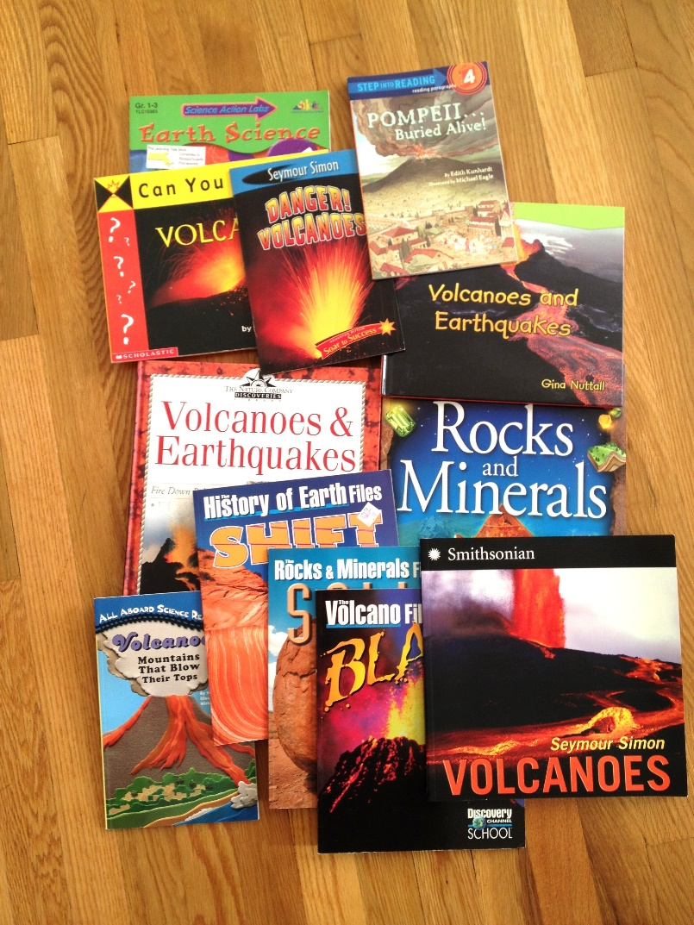
Results
Our involvement allowed the library a larger source of Geoscience information than they had alone.
Holding events for Earth Science Week and Earth Day provided a ready theme and even supplies from organizations like AGI.

Slide 19
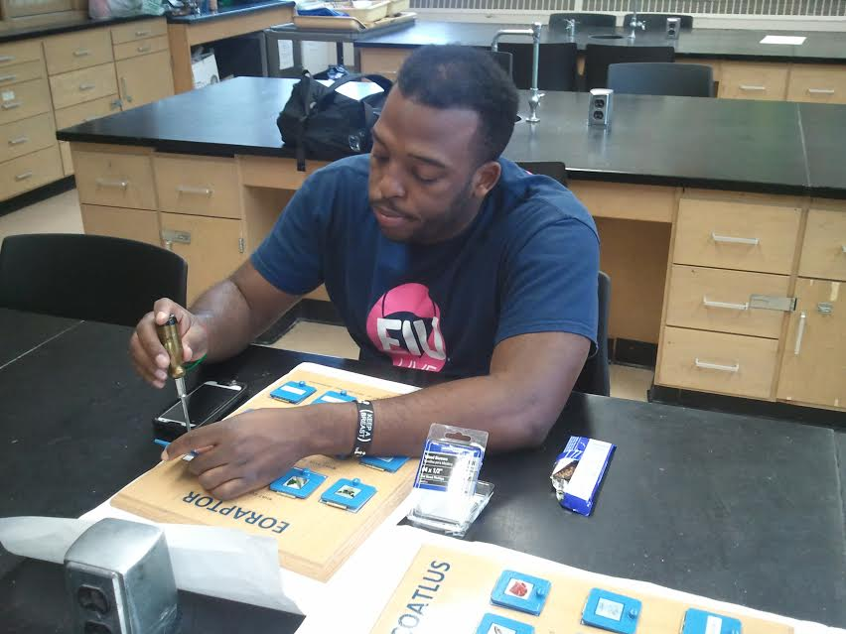
Results
Student Volunteers benefit from experience teaching in their field of study; a “taste” of being an educator before formal opportunities (practicum, grad school, etc).
By passing on what they’ve learned to others, they reinforce their own education.

Slide 20
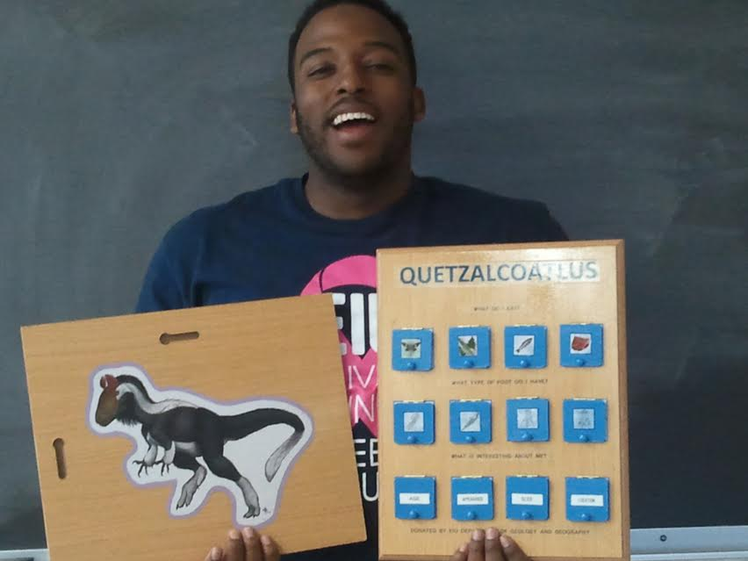
Results
Working with children offers volunteers an audience on which to practice public speaking that is at peak enthusiasm for dinosaurs and pretty rocks.

Slide 21
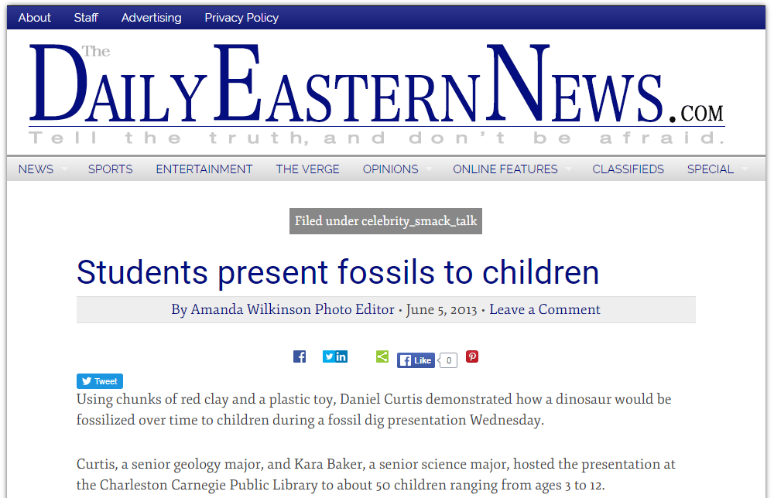
Results
By designing the program around existing lessons and supplies, there was little cost involved in the presentations.
For the school, this resulted in a large amount of positive attention to our department, without impacting our budget.

Slide 22
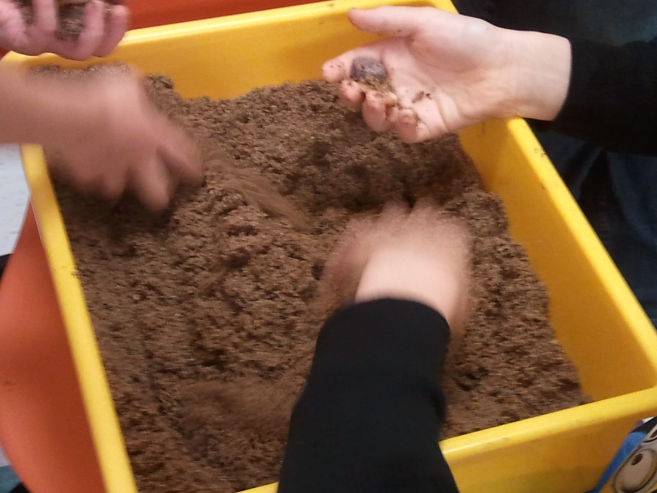
Results
The program also gave both our club and department greater exposure in the local community.
Future plans might expand to scout programs and 4H

Slide 23
Special thanks to Beth Lugar, Charleston Library Youth Services Director, and Dr. Mike Cornebise, Chair of the EIU Department of Geology and Geography, for their support and assistance with this project.

