Slide 1


The Missing Puzzle Piece in Determining Past Lake Level Conditions at the Only Unregulated Outlet in the Great Lakes Preserved in the Ipperwash Strandplain
Sean Morrison John Johnston Harry Jol
https://en.wikipedia.org/wiki/Lake_Huron#/media/File:Lake-huron-ipperwash-beach.jpg

Slide 2
Significance
of lake level
The Rise and Fall
of Lake Huron
Study Area
Filling in
the gap
Conclusion and Future outcomes
Objectives
To show there is a missing piece in our understanding of the post-Nipissing Great Lakes lake levels
2. To discuss how we plan to fill in the gap by creating a paleohydrograph for the Ipperwash Beach strandplain

Slide 3
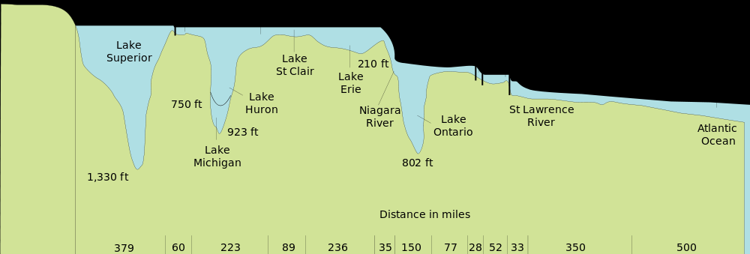
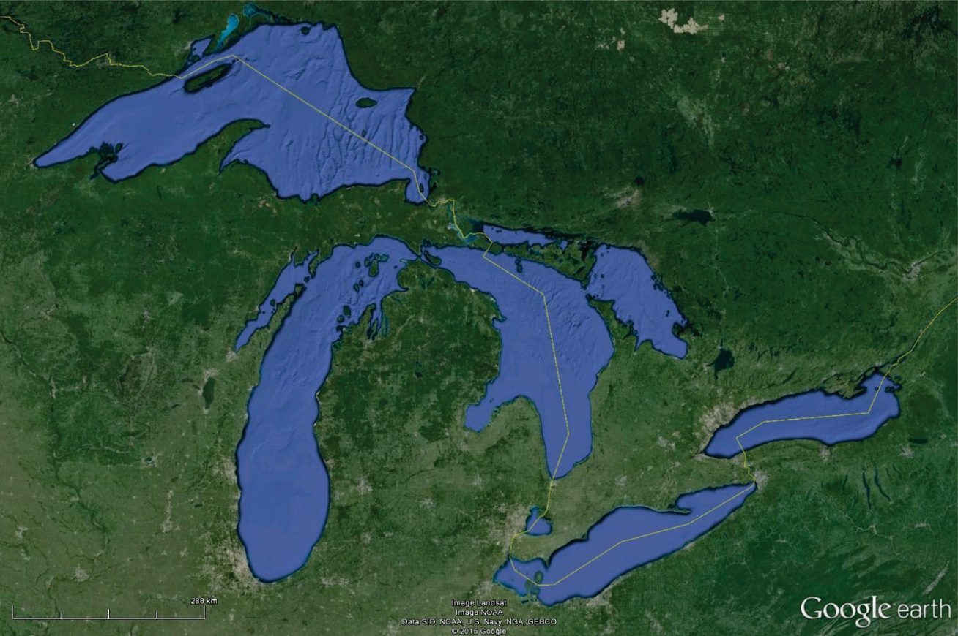
Significance
of Lake Level
https://en.wikipedia.org/wiki/Great_Lakes#/media/File:Great_Lakes.svg
Lake Superior
Canada
Lake Huron
USA
Lake Michigan
IBS
Lake Ontario
Lake Erie

Slide 4
Significance
of Lake Level
Managing the Great Lakes Important to:
Shipping Interests
Population Centers
Recreation
Hydropower

Slide 5
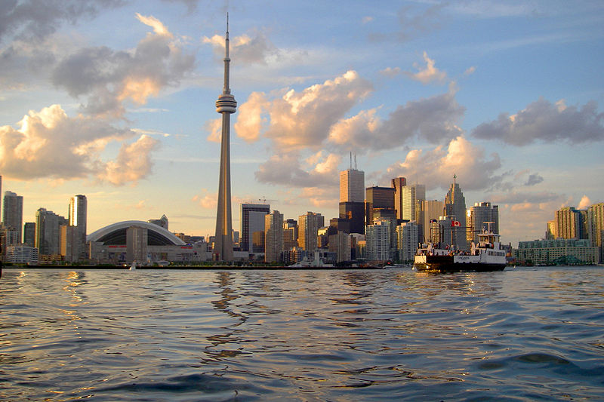
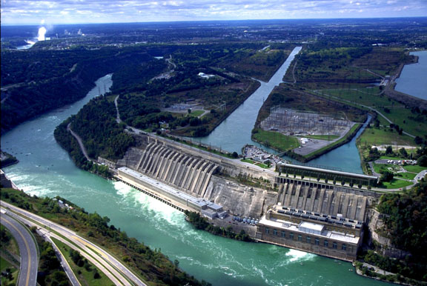
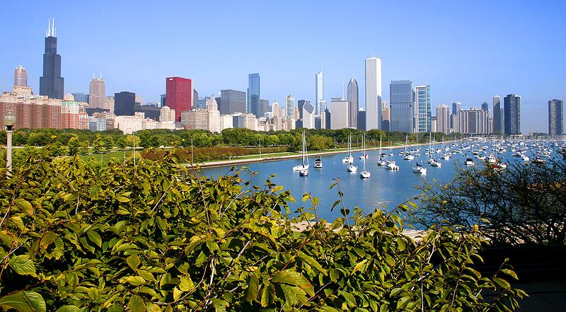
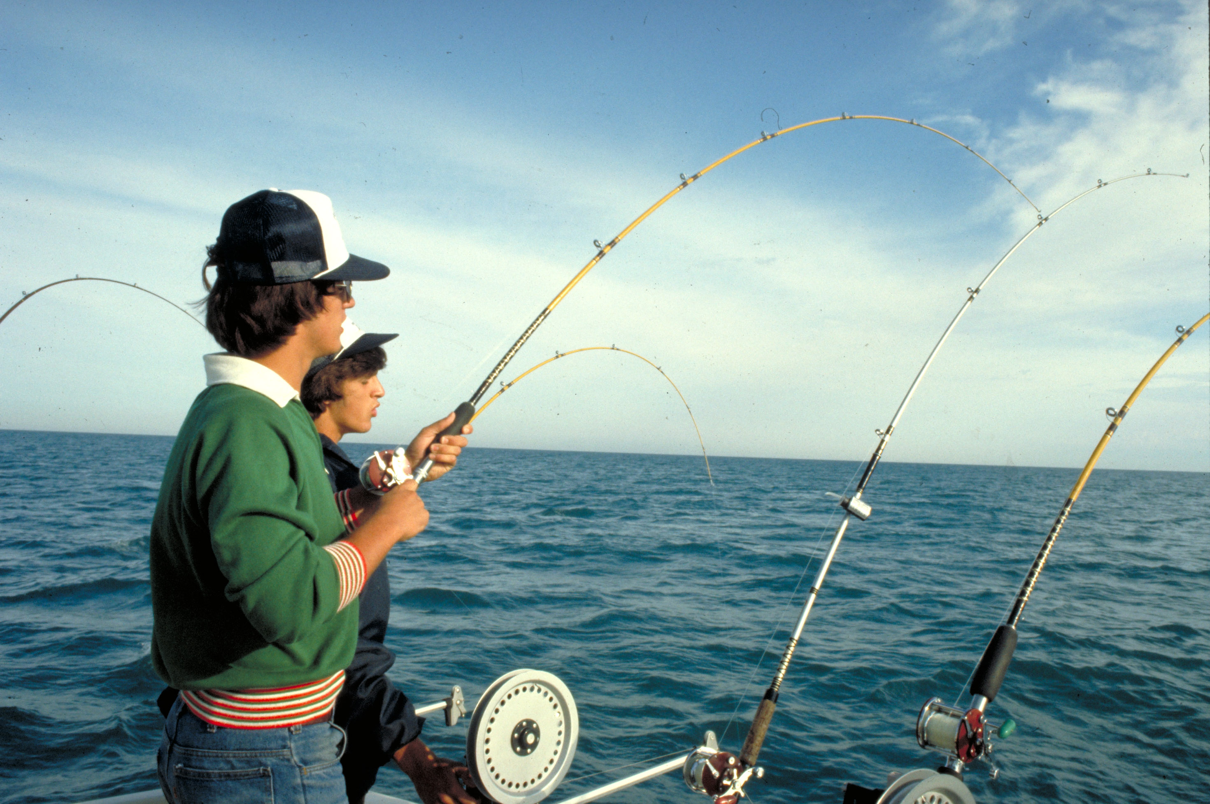
Significance
of Lake Level
Toronto
Power
https://en.wikipedia.org/wiki/File:Skyline_of_Toronto_viewed_from_Harbour.jpg
Chicago
http://www.opg.com/generating-power/hydro/projects/niagara-tunnel-project/Tunnel%20Image%20Gallery/Sir%20Adam%20Beck%20Generating%20Complex/com_4.jpg
Population
Recreation
https://en.wikipedia.org/wiki/File:2009-09-18_3060x2040_chicago_skyline.jpg
http://archive.epa.gov/greatlakes/image/web/jpg/394-2.jpg

Slide 6
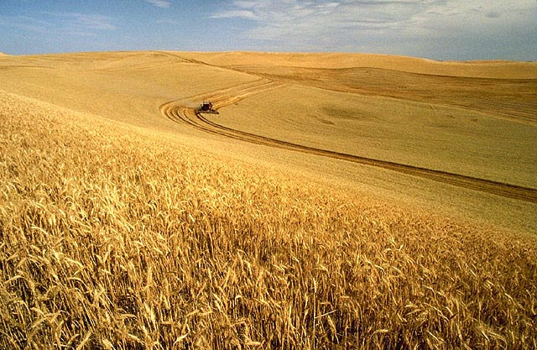
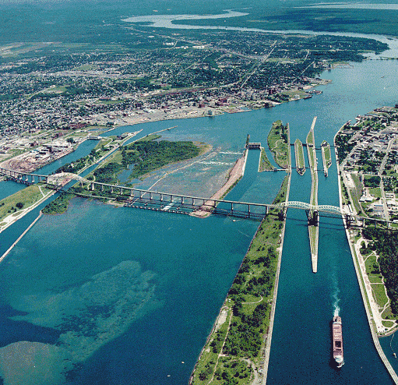
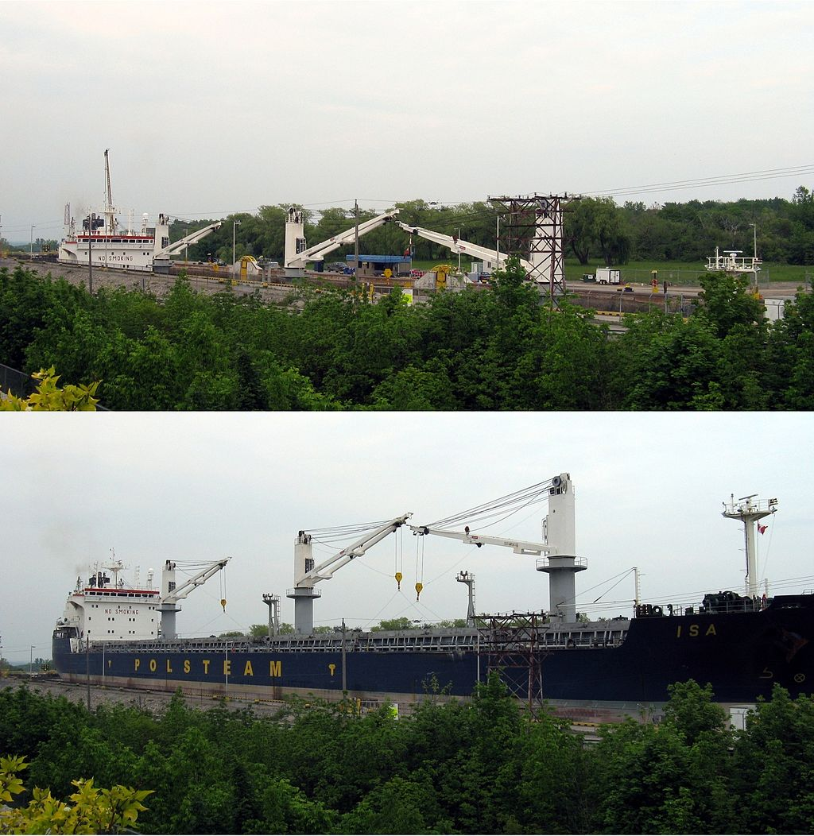
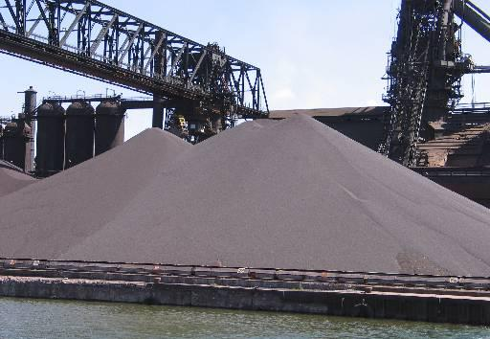
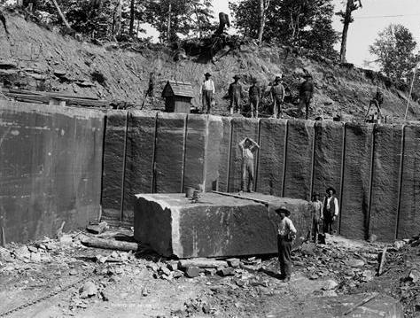
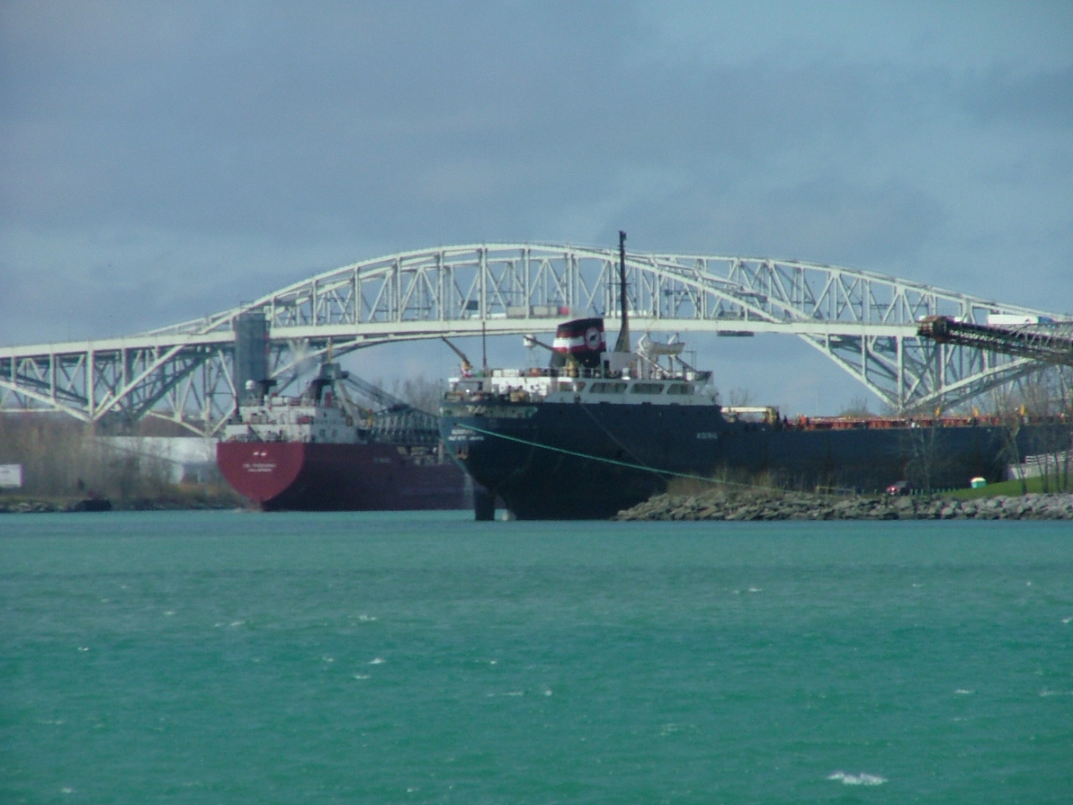
Significance
of Lake Level
https://en.wikipedia.org/wiki/File:Soo_Locks-Sault-
Ste_Marie.png
Welland Canal
https://en.wikipedia.org/wiki/File:Wheat_harvest.jpg
Sault Ste Marie Locks
https://en.wikipedia.org/wiki/Welland_Canal#/media/
File:MS_Isa_Welland_Canal_Lock_7.jpg
https://en.wikipedia.org/wiki/Iron_ore#/media/File:
LightningVolt_Iron_Ore_Pellets.jpg
Shipping
https://en.wikipedia.org/wiki/Jacobsville_Sandstone#/media/File:Kerber-Jacobs_quarry.jpg
St Clair and Detroit Rivers
https://en.wikipedia.org/wiki/Sarnia#/media/File:Two_Lake_Freighters_Loading_in_Sarnia.jpg

Slide 7
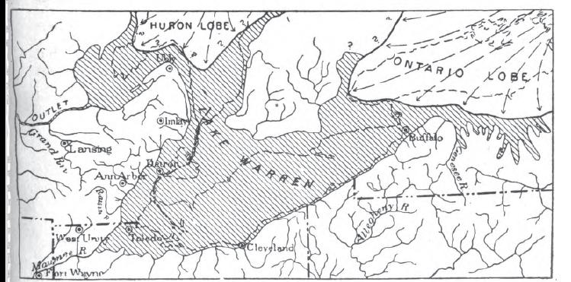
The Rise and
Fall of Lake Huron
Glaciers
Block Drainage
https://en.wikipedia.org/wiki/File:Lake_Warren_Fig_15.JPG

Slide 8
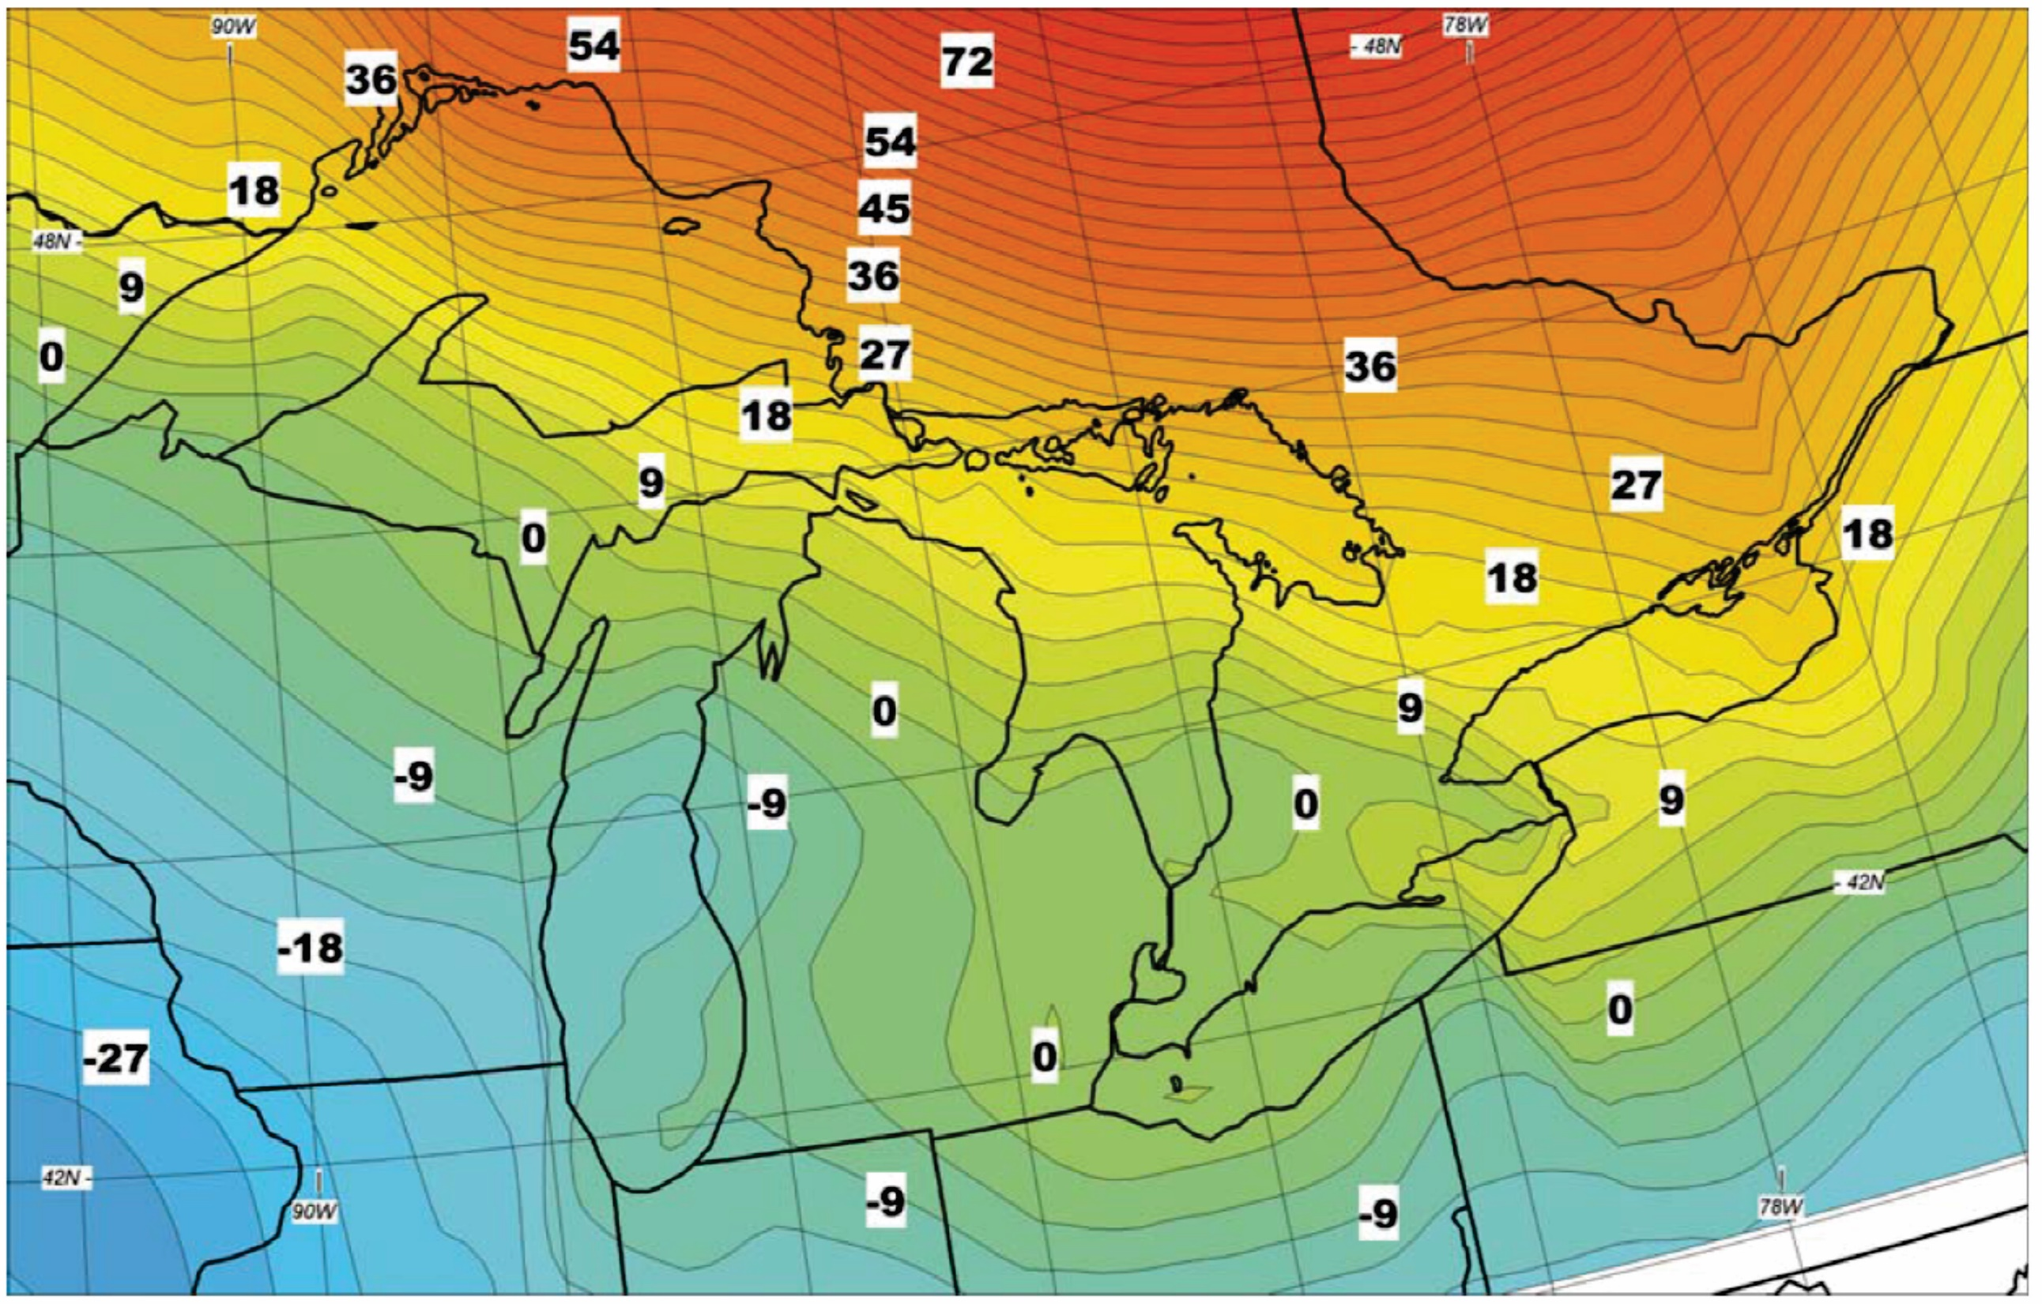
The Rise and
Fall of Lake Huron
Glaciers
Rising Land
Falling Land
Mainville and Caymer, 2005

Slide 9
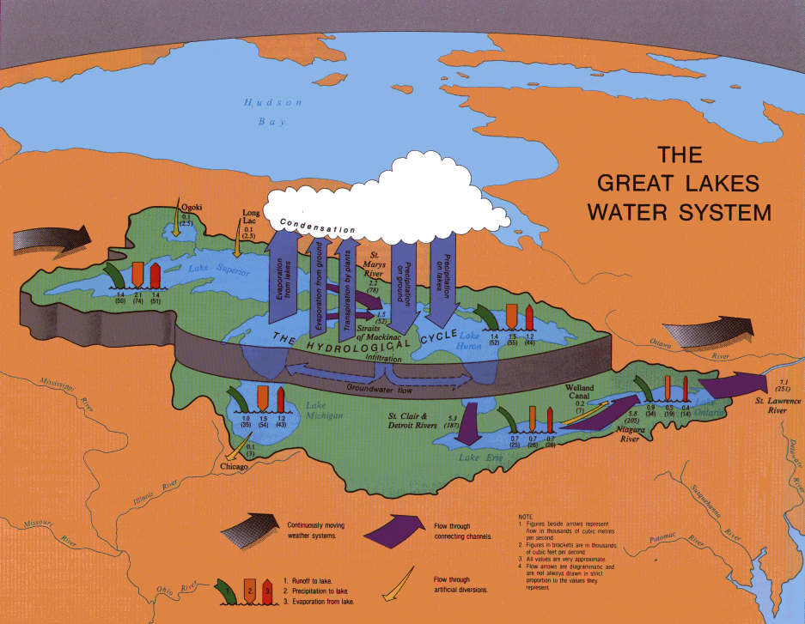
The Rise and
Fall of Lake Huron
Climate
http://changingclimate.osu.edu/assets/images/content/articles/060510-systems.png

Slide 10
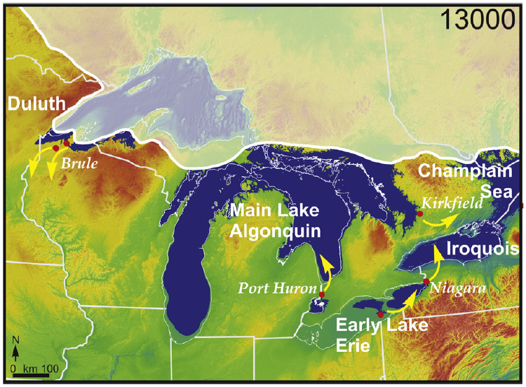
The Rise and
Fall of Lake Huron
Main Lake
Algonquin
Clark et al., 2012

Slide 11
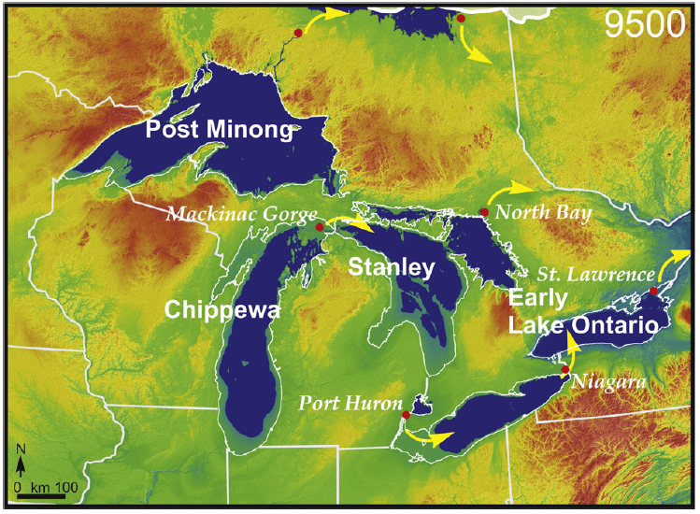
The Rise and
Fall of Lake Huron
Stanley
Lowstands
Clark et al., 2012

Slide 12
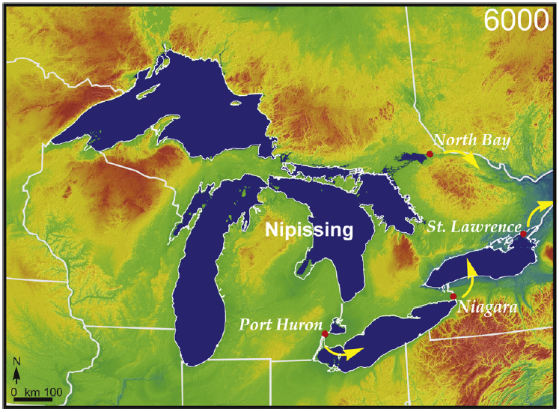
The Rise and
Fall of Lake Huron
Nipissing Highstand
Clark et al., 2012

Slide 13
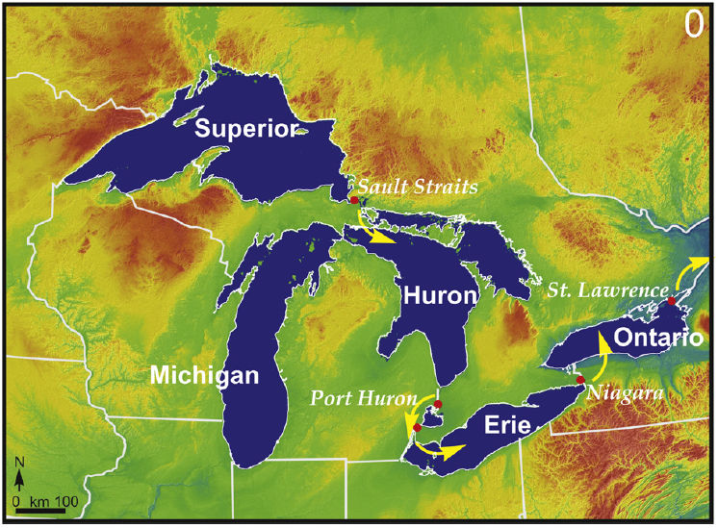
The Rise and
Fall of Lake Huron
Modern
Configuration
Clark et al., 2012

Slide 14
The Rise and
Fall of Lake Huron
Historic lake level record

Slide 15
The Rise and
Fall of Lake Huron

Slide 16
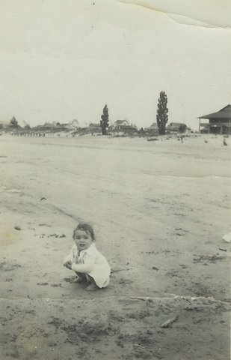
The Rise and
Fall of Lake Huron
Ipperwash Beach, 1934

Slide 17
The Rise and
Fall of Lake Huron

Slide 18
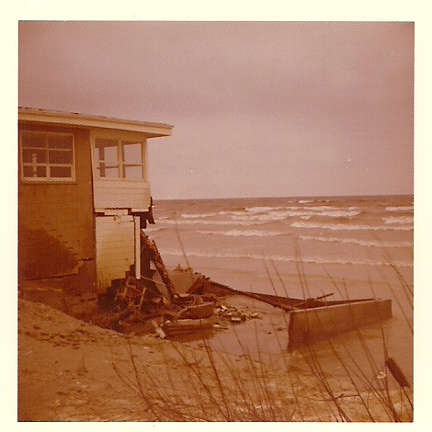
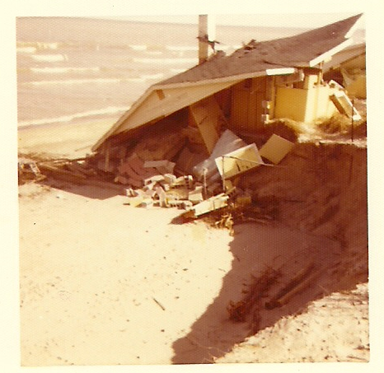
The Rise and
Fall of Lake Huron
Ipperwash Beach, 1973

Slide 19
The Rise and
Fall of Lake Huron

Slide 20
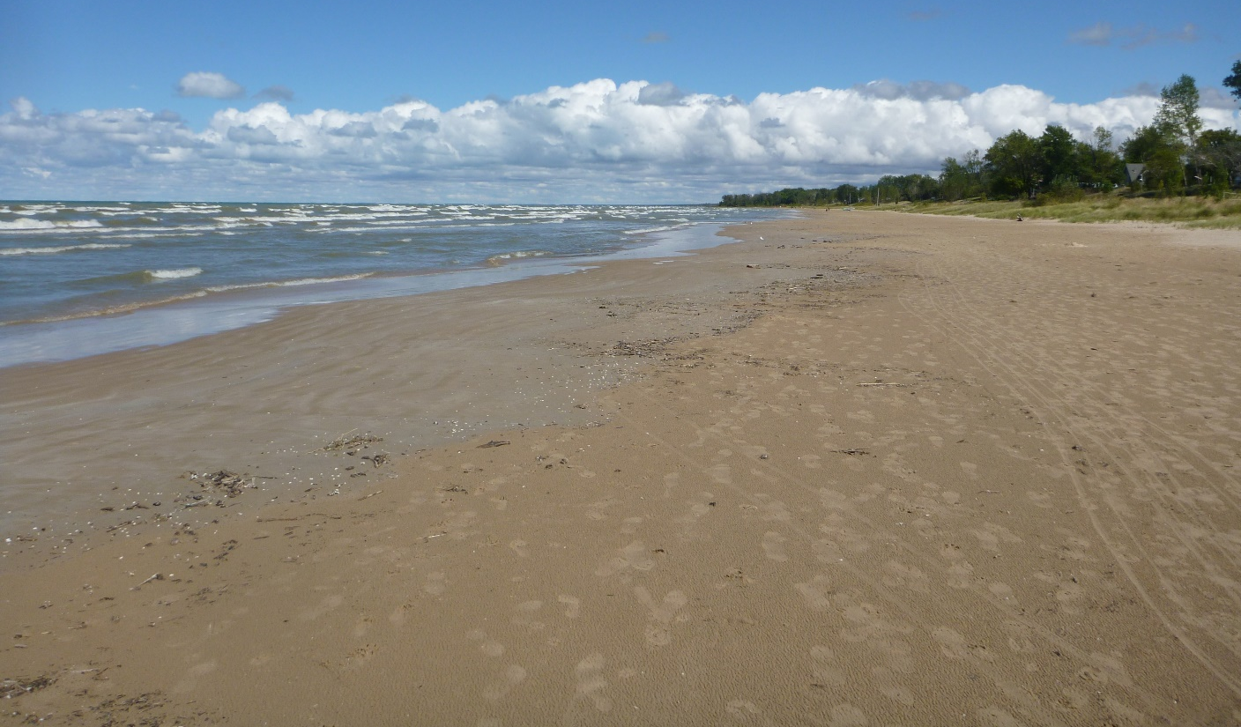
The Rise and
Fall of Lake Huron
Ipperwash Beach, 2012
http://www.lambtonshores.ca/en/things-to-do/resources/Ipperwash_SCRCA_2012.jpg

Slide 21
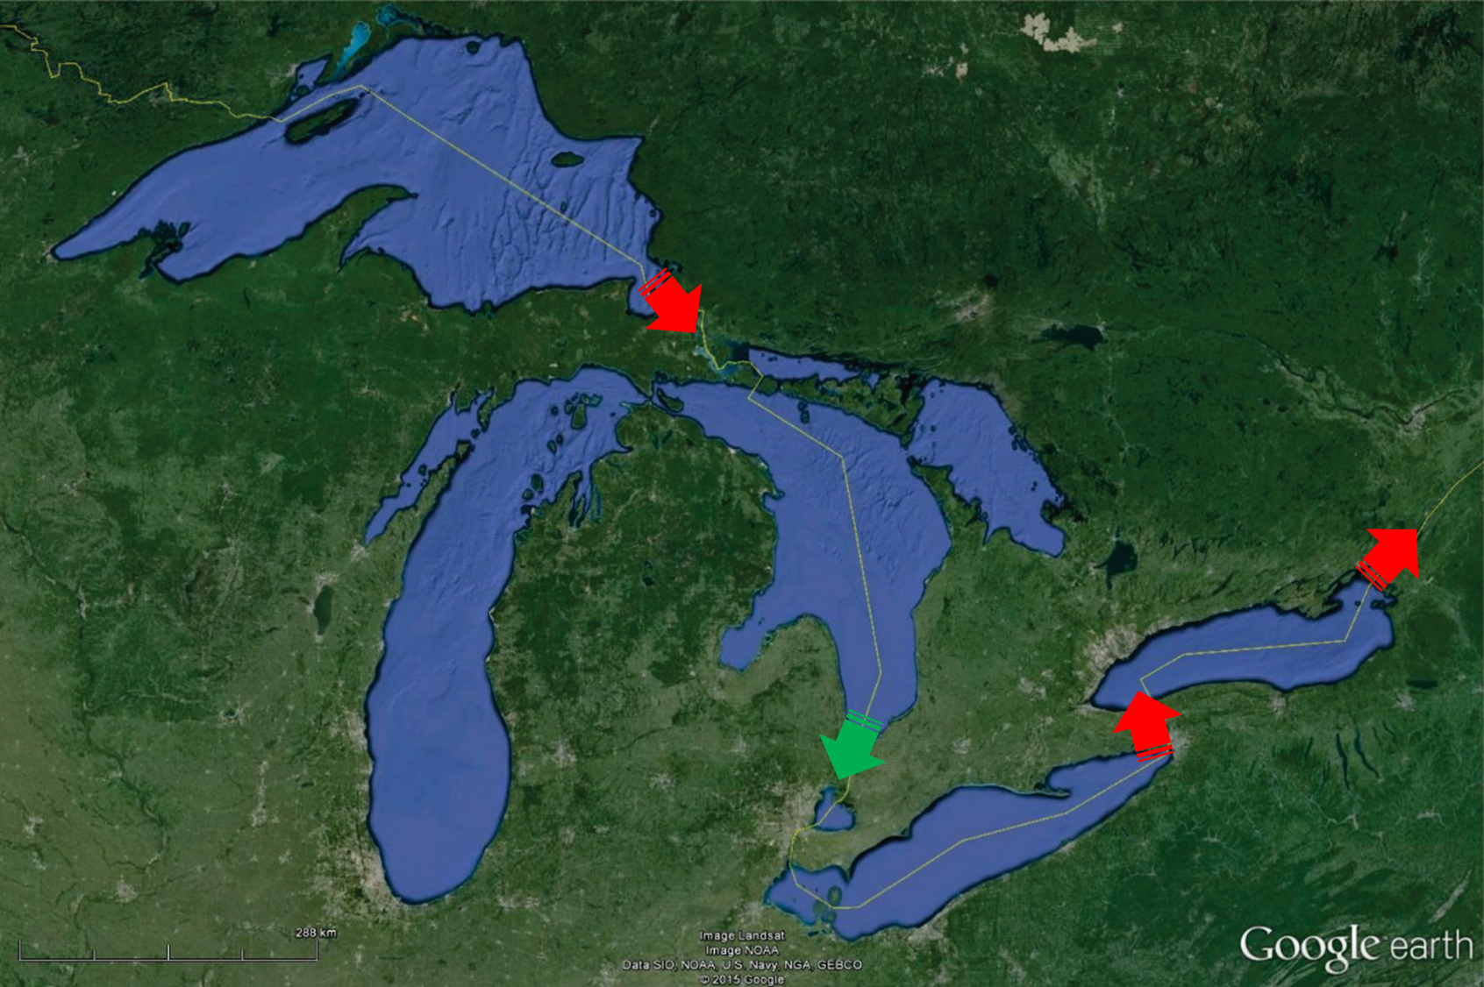
Study Area
No studied strandplain in Southern Lake Huron
Records lake level at the only unregulated outlet in the Great Lakes
Near 0 isobase, minimizing effects of GIA
Published strandplain paleohydrograph

Slide 22
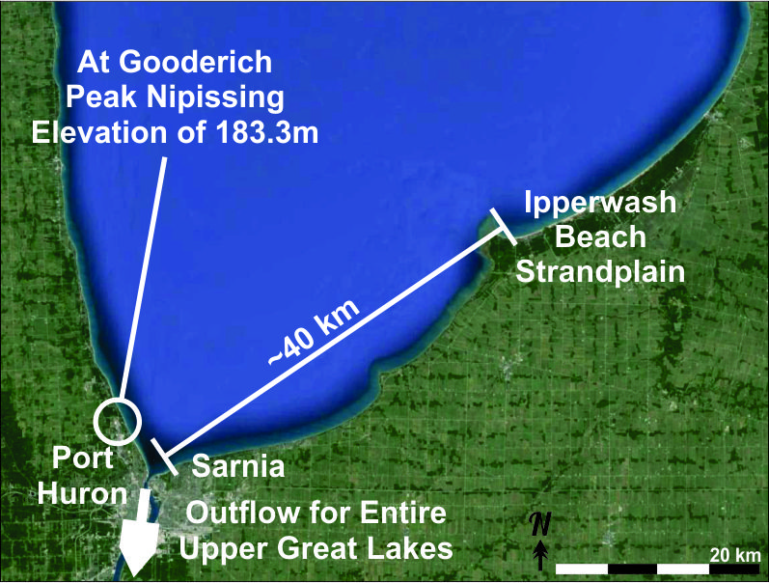
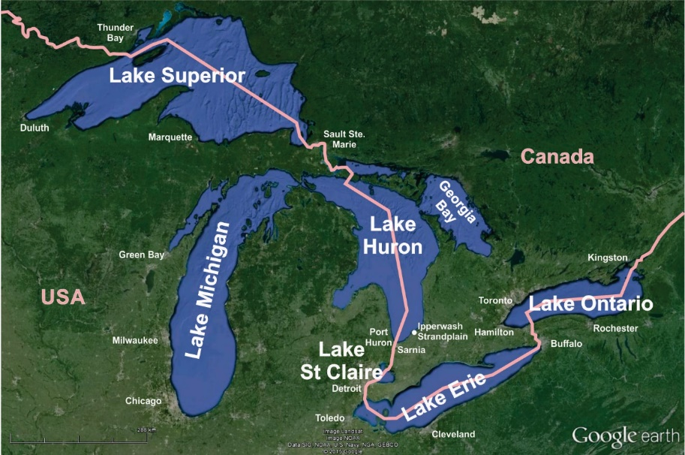
Study Area
Peak Nipissing elevation of 183.3 m at Fort Gratiot (Thompson et al., 2014)

Slide 23
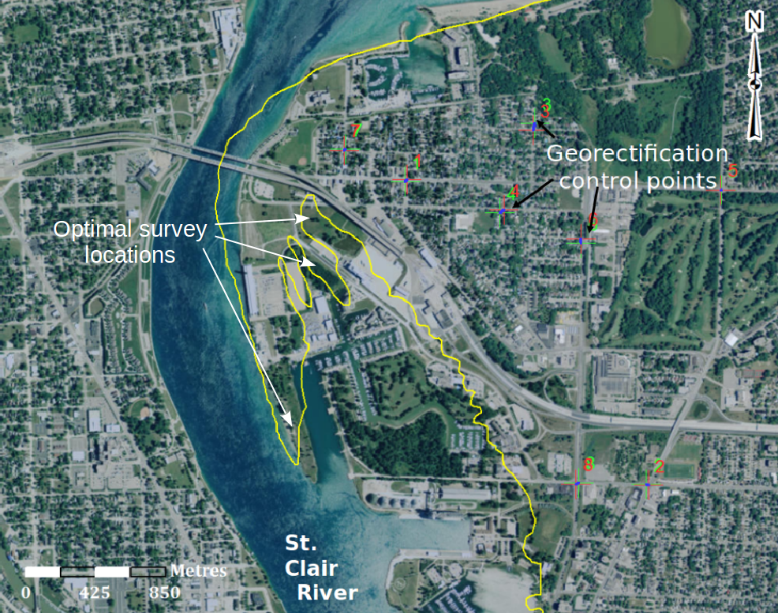
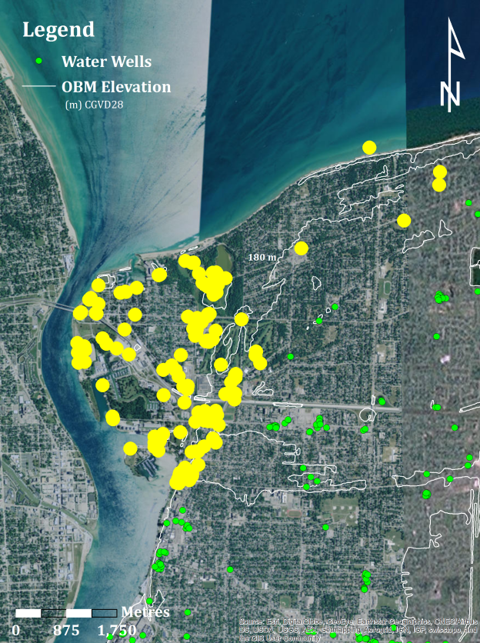
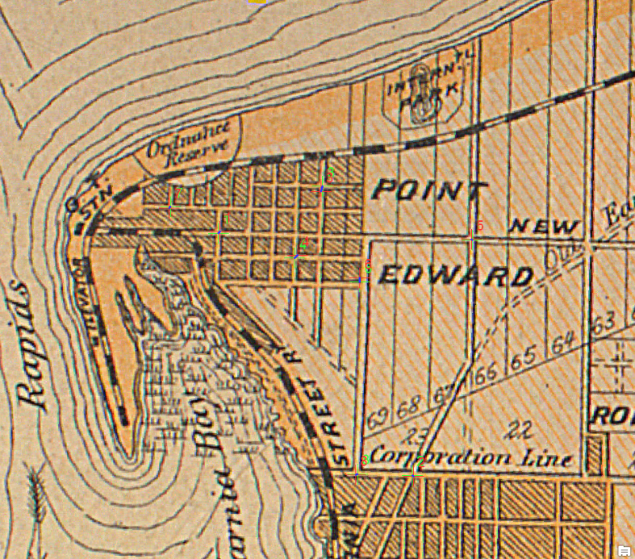
Study Area
B.Sc. By Wesley Campbell
The Outlet
Georeferenced on modern
Wells Investigated
1880 map

Slide 24
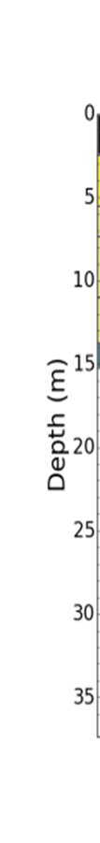
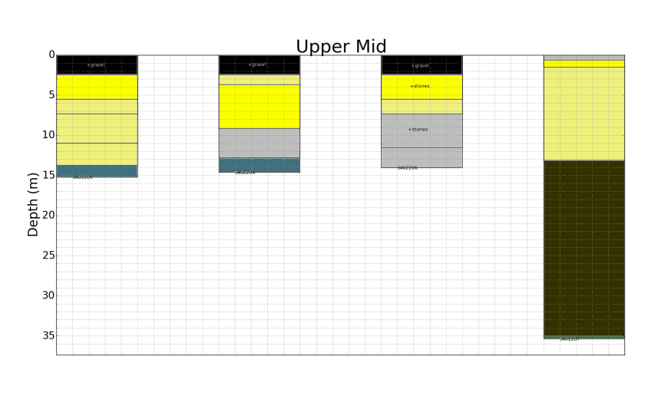
Study Area
Sands and gravels
Silt
Generalized stratigraphy suggest depositional area
Wells Investigated
Silt and Clay
Bedrock

Slide 25
Study Area
Georeferenced on modern

Slide 26
Study Area
Peak Nipissing elevation of 183.3 m at Fort Gratiot (Thompson et al., 2014)

Slide 27
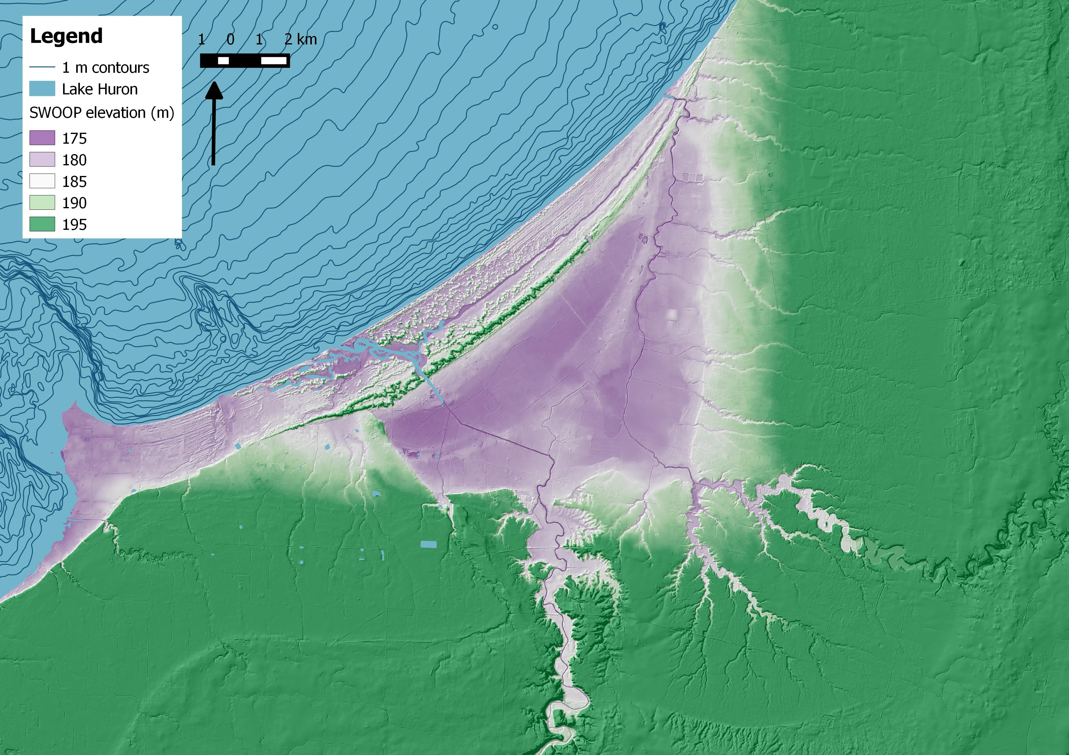
Study Area
Thedford
Embayment
Southwestern Ontario Orthoimagery Project

Slide 28
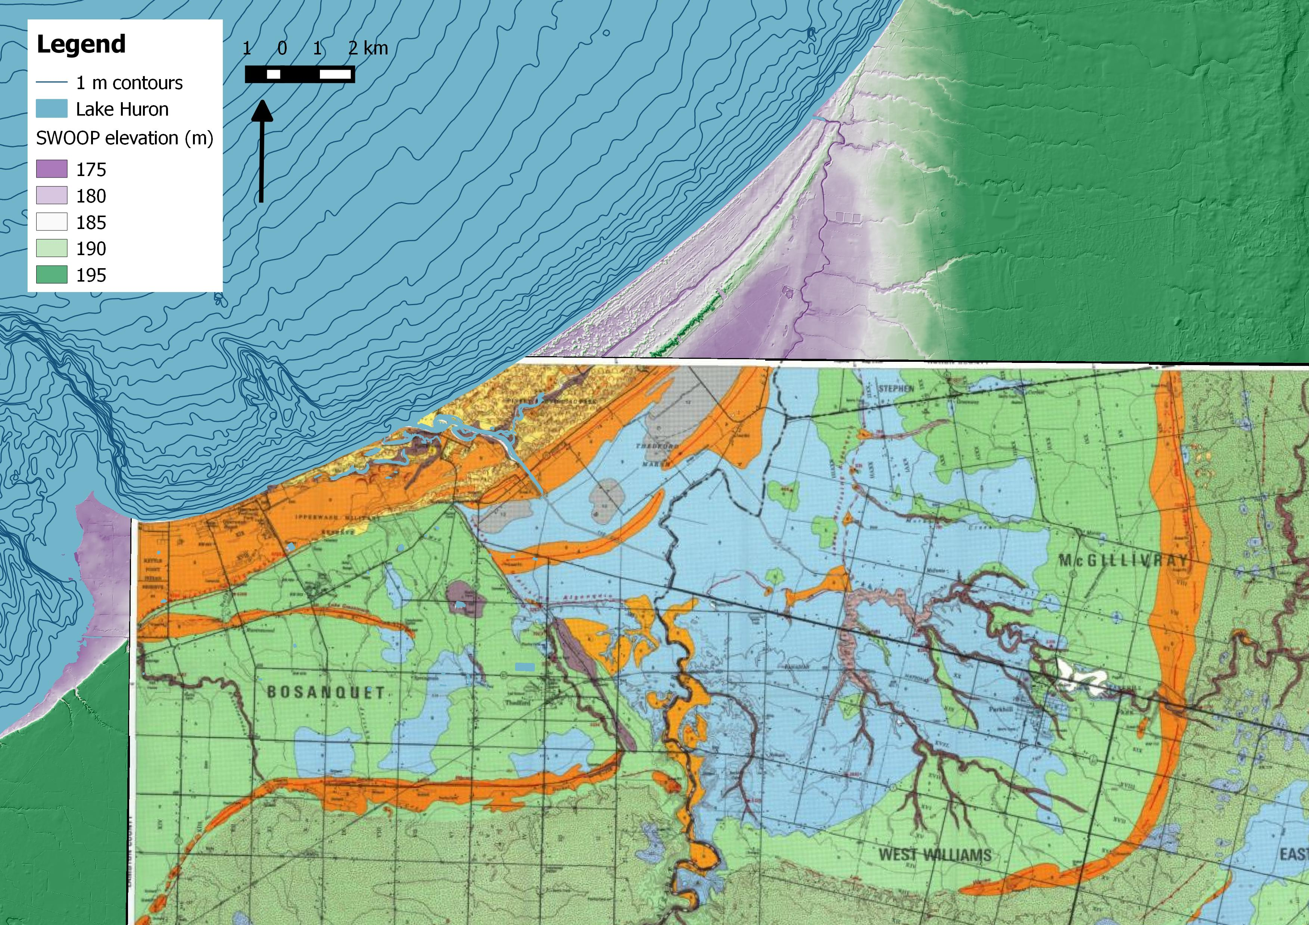
Study Area
Cooper, 1979

Slide 29
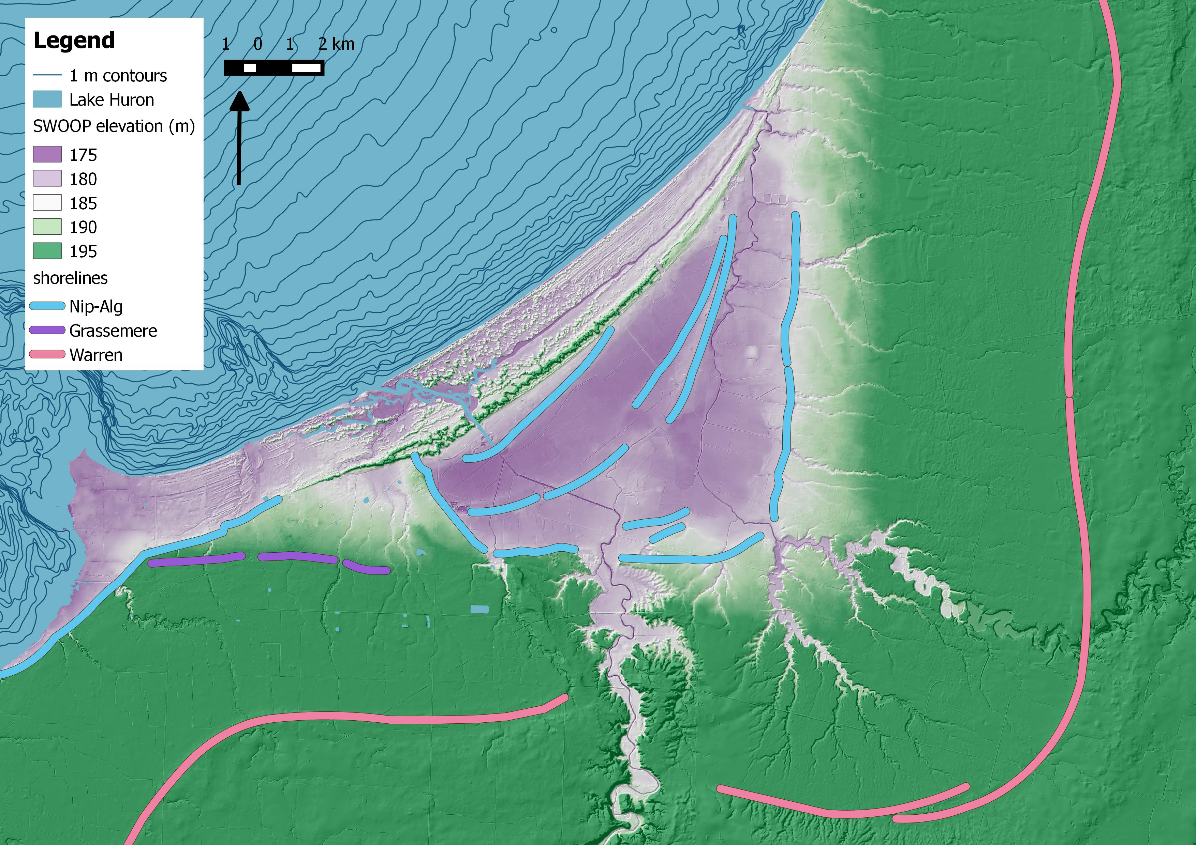
Study Area

Slide 30
Study Area

Slide 31
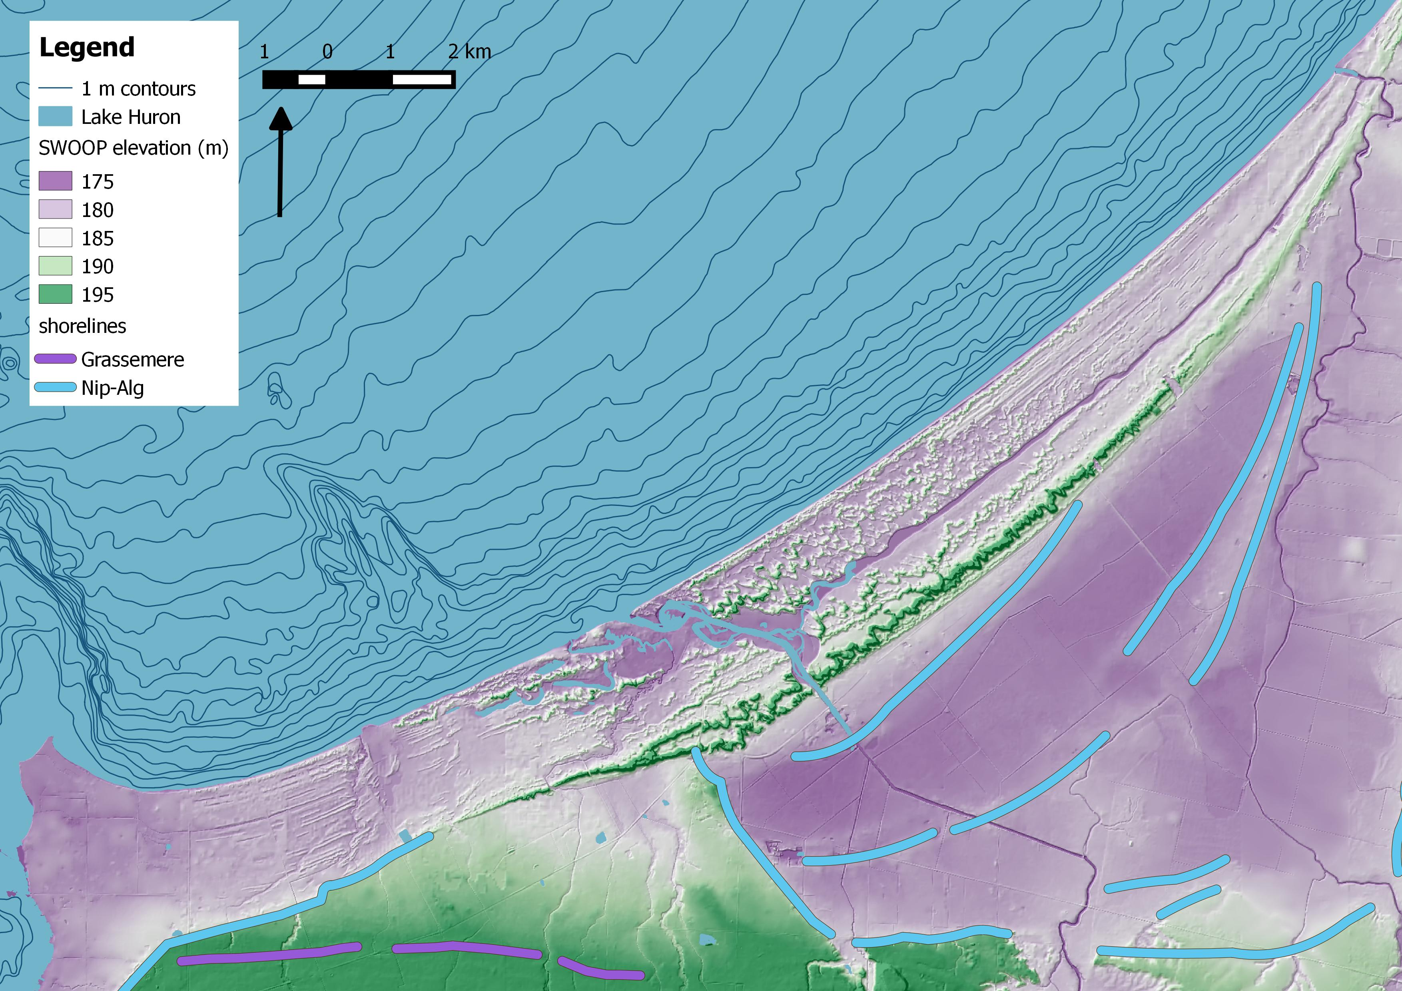
Study Area
Grand Bend
Strandplain
Dune Cover
Au Sable River
Strandplain
Bedrock
The Cut

Slide 32
Study Area
Secondary Objective
Main Objective
Ipperwash Beach
Strandplain

Slide 33
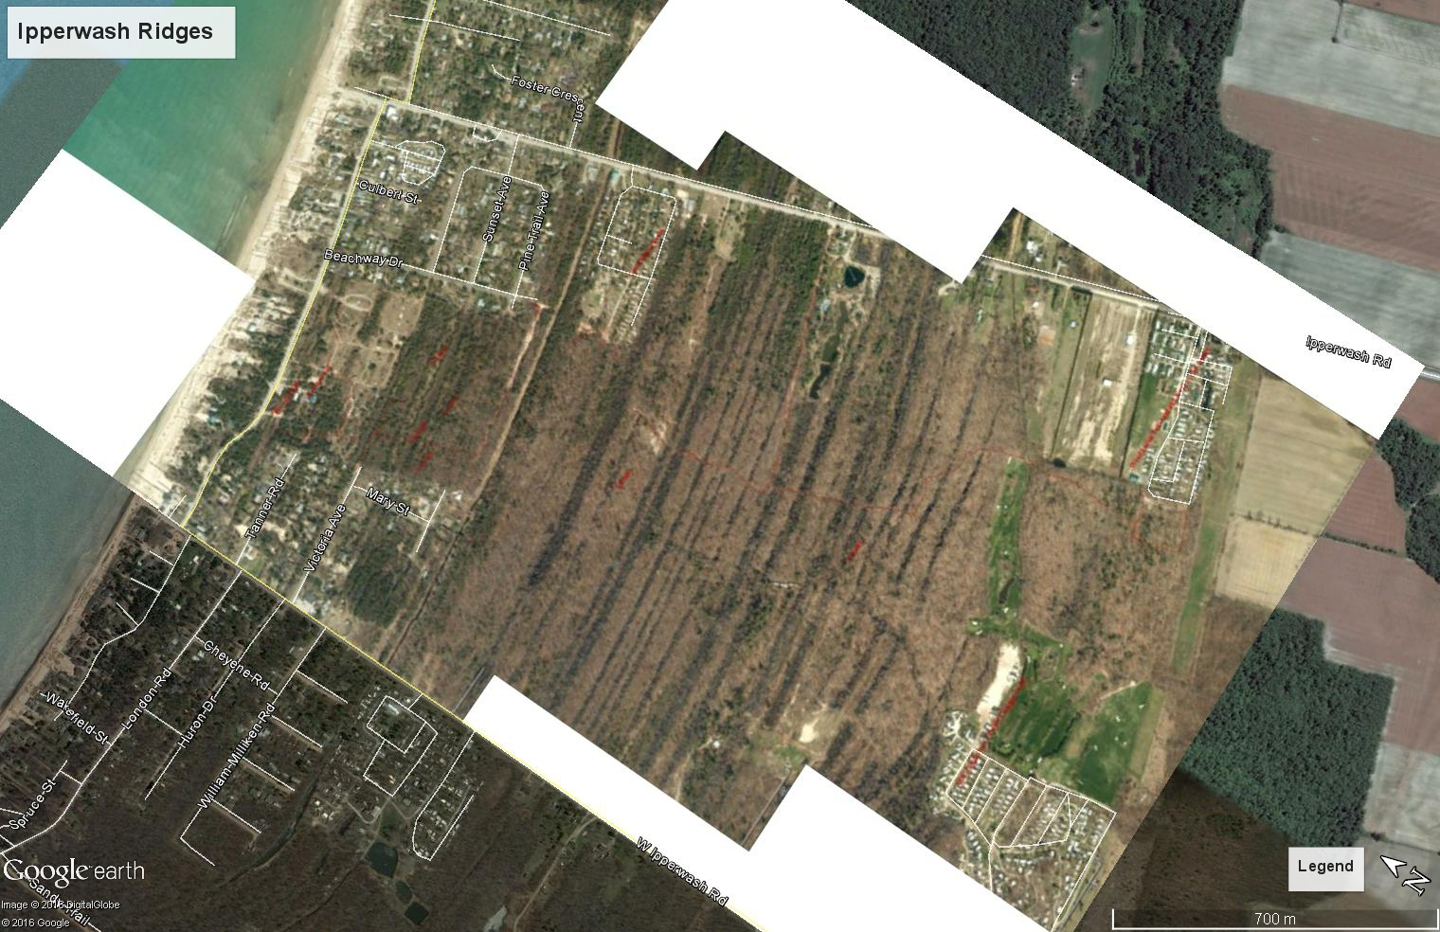
Study Area
Lambton County GIS

Slide 34
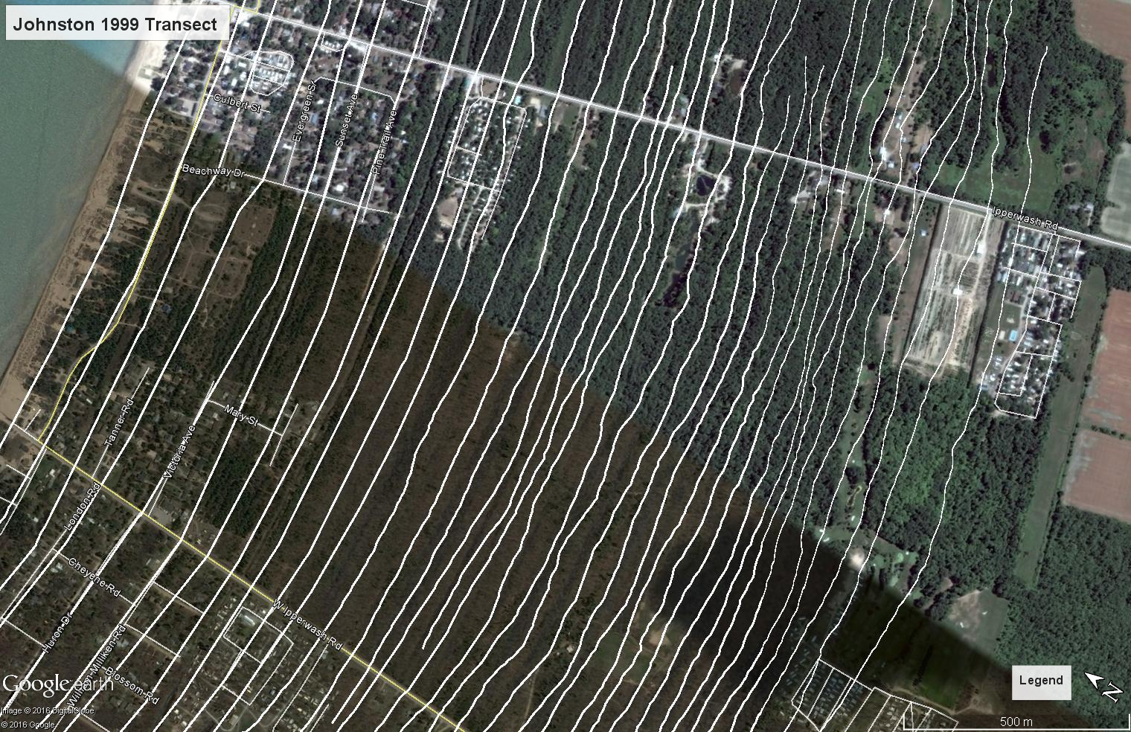
Study Area
Each ridge preserves shoreline position and lake level at the time of deposition

Slide 35
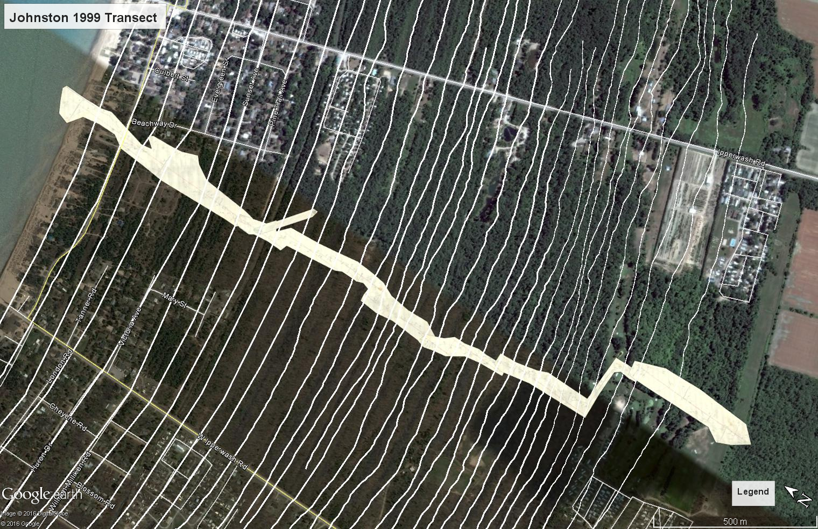
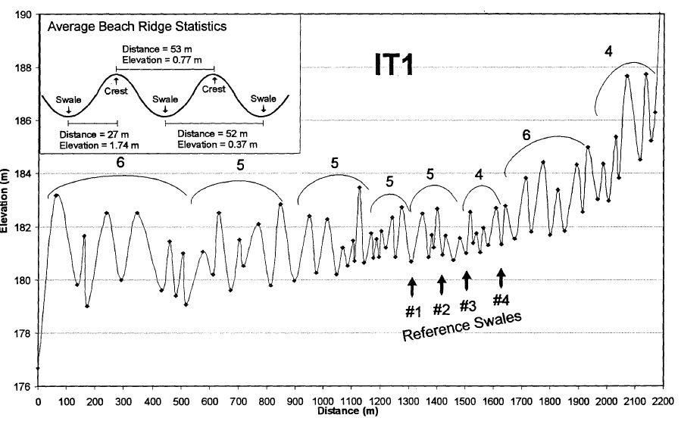
Study Area
Only Surface
No Subsurface
No Ages
Johnston, 1999

Slide 36
Filling in
the gap
To create a paleohydrograph for Ipperwash need:
Subsurface information
Ancient lake levels
Age constraints

Slide 37
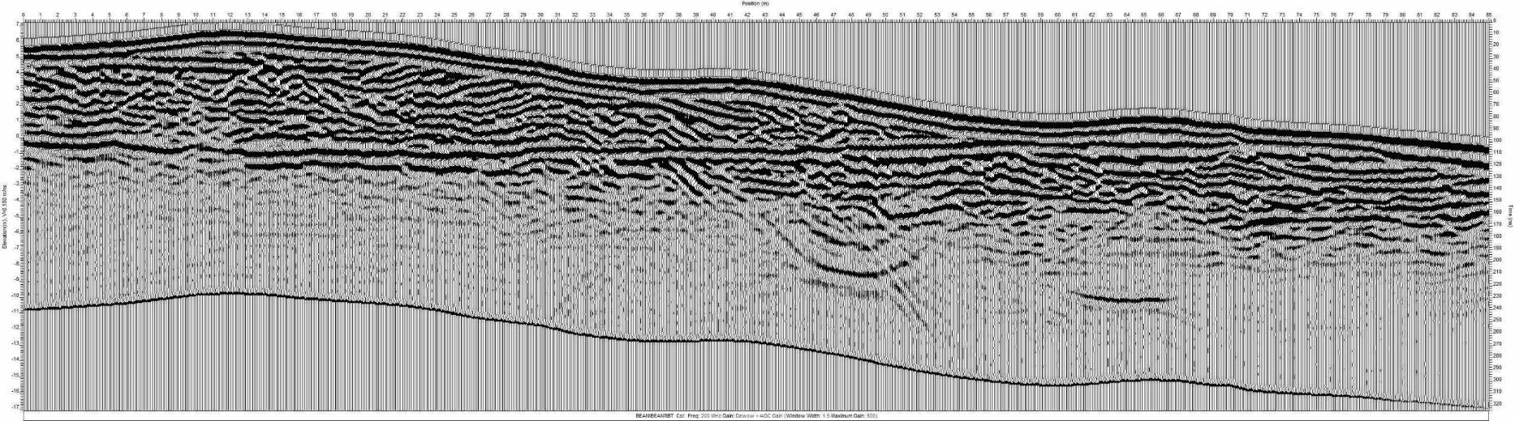
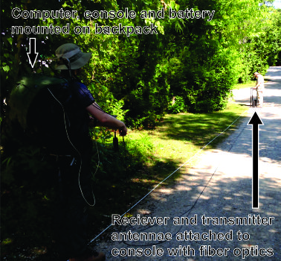
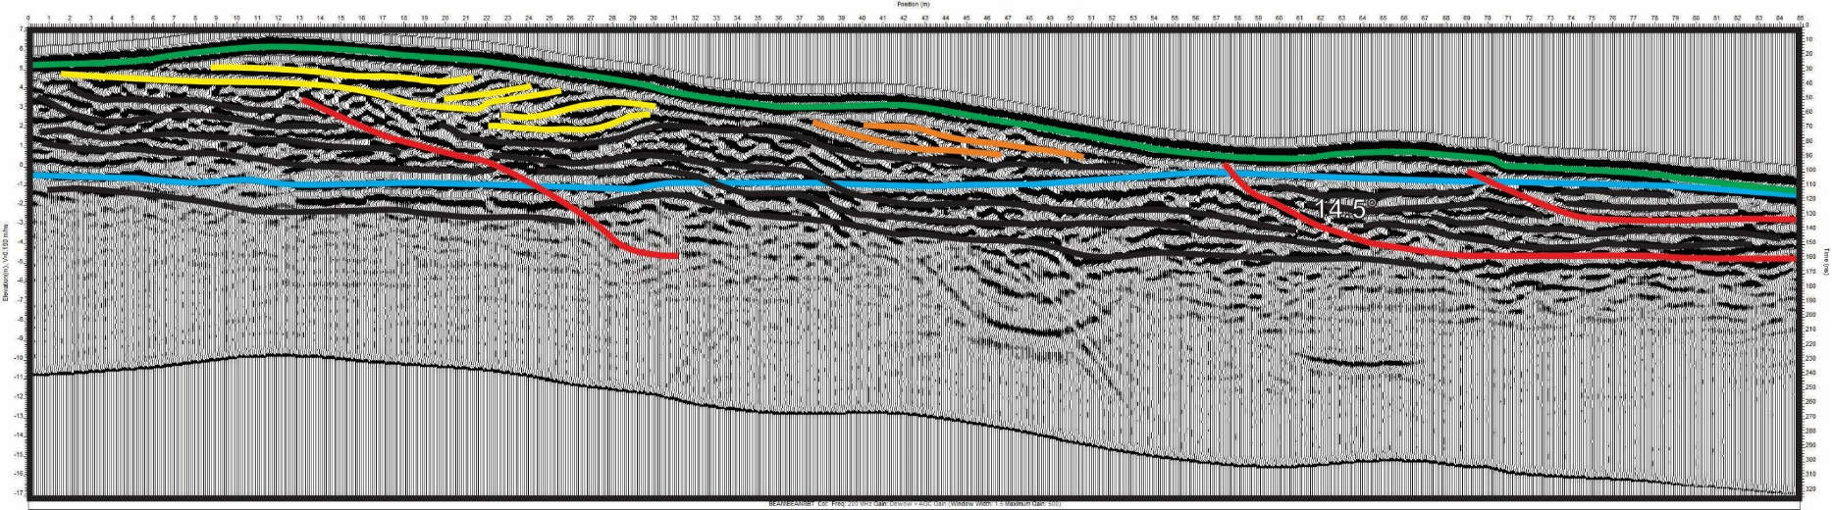
Filling in
the gap
Ground Penetrating Radar
For subsurface information
Completed August, 2015

Slide 38
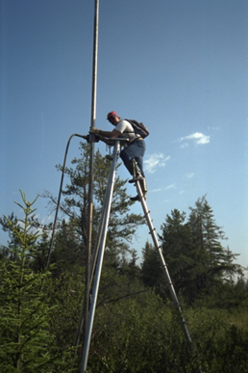
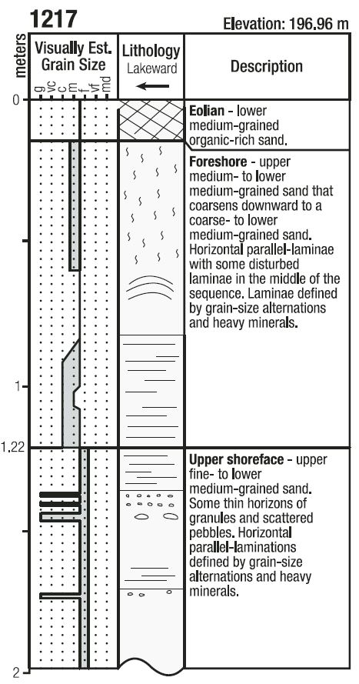
Filling in
the gap
Coring for ancient lake levels
Basal foreshore correlates with lake level at time of deposition
Scheduled May, 2016
Modified from Thompson et al., 2014

Slide 39
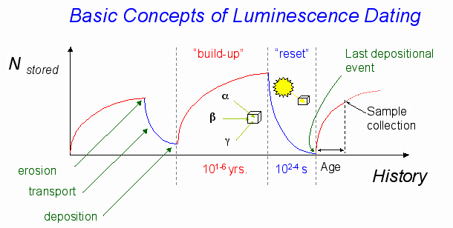

Filling in
the gap
OSL for age constraints
Scheduled May, 2016
http://gec.cr.usgs.gov/projects/lumlab/images/LumHist.jpg

Slide 40
Filling in
the gap
GPR
Ipperwash Beach Strandplain Paleohydrograph
Core
OSL
http://gec.cr.usgs.gov/projects/lumlab/images/LumHist.jpg

Slide 41
Conclusion and
Future Outcomes
Define post-Nipissing lake levels near the zero isobase and create paleohydrograph for Lake Huron
Differentiate Nipissing and Algonquin sediments in the Thedford Embayment
Better understand natural sedimentation patterns at the only unregulated outlet in the Great Lakes

Slide 42
Thank You
https://en.wikipedia.org/wiki/Lake_Huron#/media/File:Lake-huron-ipperwash-beach.jpg

