Slide 1
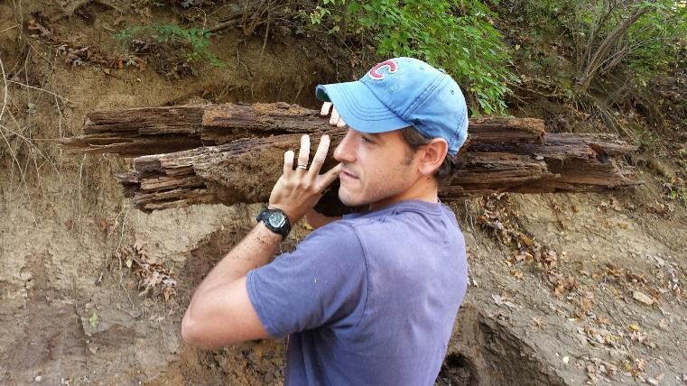
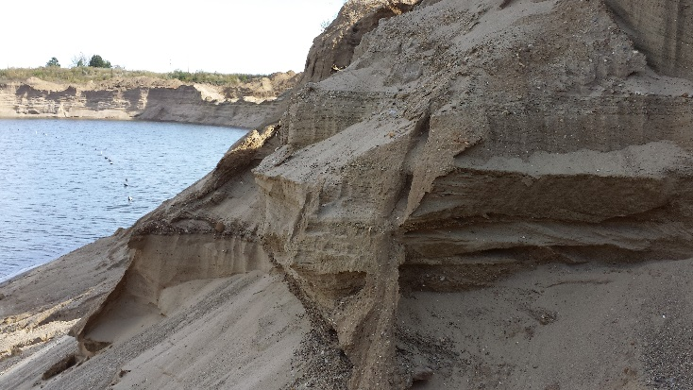
DECIPHERING THE LAST GLACIAL CHRONOLOGY, UPPER SANGAMON RIVER BASIN, ILLINOIS
David Grimley, Dana Labotka, Sebastian Huot, Jia Wang, Andrew Stumpf, Xiaodong Miao, Olivier Caron, and Hong Wang
Illinois State Geological Survey
Prairie Research Institute
University of Illinois

Slide 2
Acknowledgments: USGS-STATEMAP funding, matched by ISGS, provided support for age dating and field work. Thanks to mid-America Sand and Gravel Pit for providing access for sampling.

Slide 3
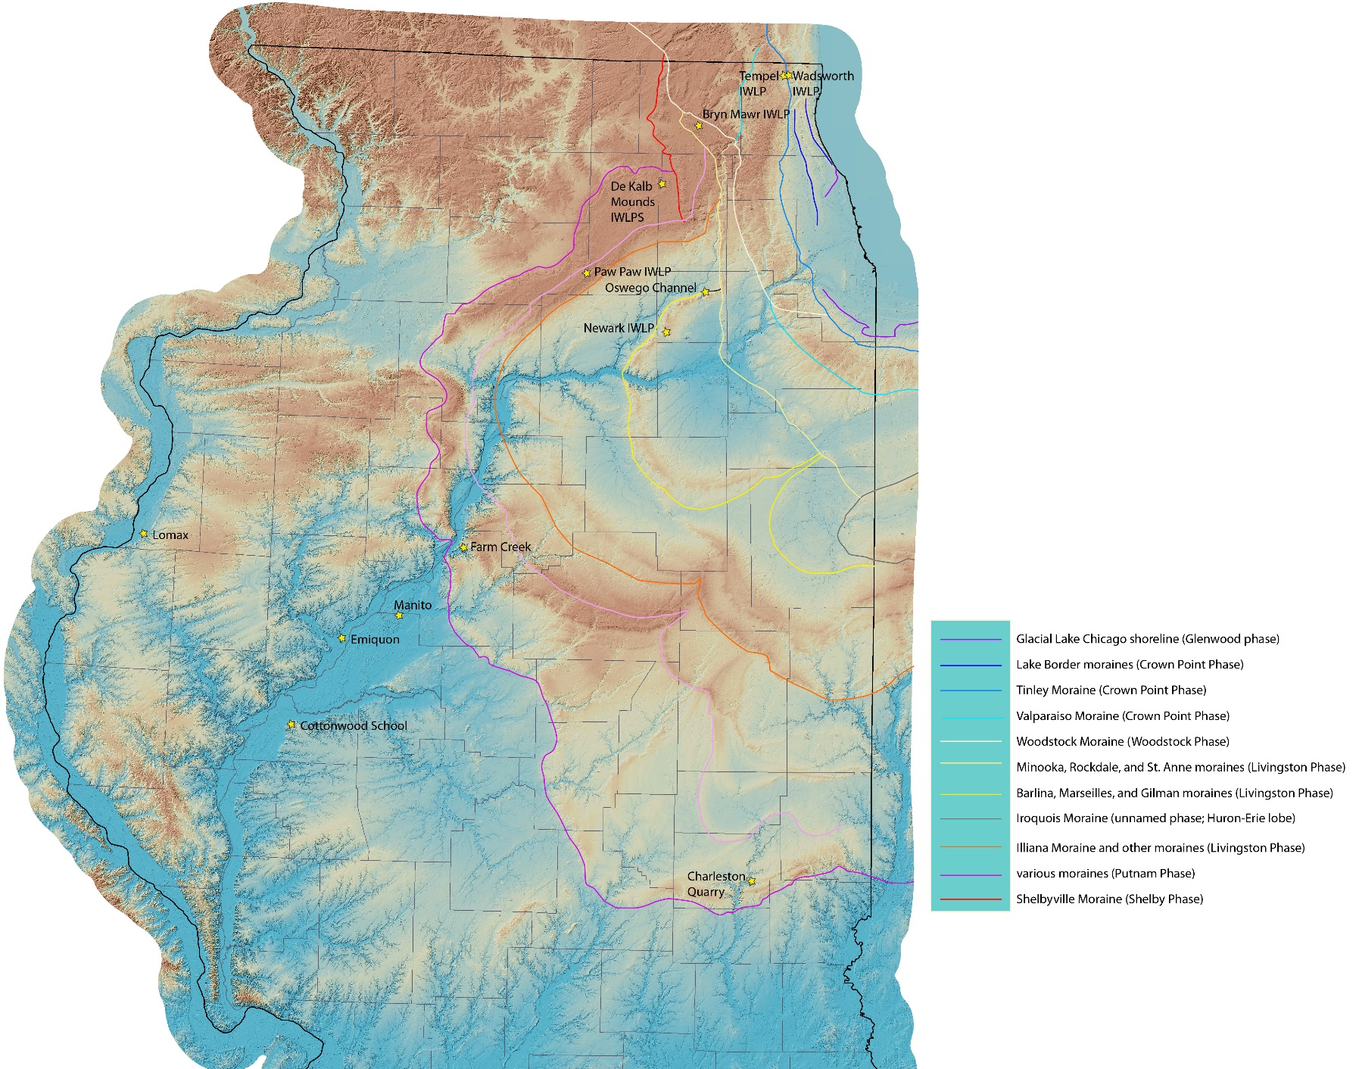
Lake Michigan Lobe:
central & NE Illinois
Champaign Moraine
Study area
CU
Cerra Gordo Moraine
Shelbyville Moraine (LGM)

Slide 4
Research Objective
Better understand the history and chronology of last glacial ice advance and recession from Upper Sangamon River Basin area (Mahomet Quadrangle)
Methods
Field descriptions and sampling (part of surficial mapping project)
Unit correlations based on lithology and stratigraphic position (prior to dating)
Radiocarbon dating of sub-fossil wood (below till)
Optical stimulated luminescence dating of outwash sand

Slide 5
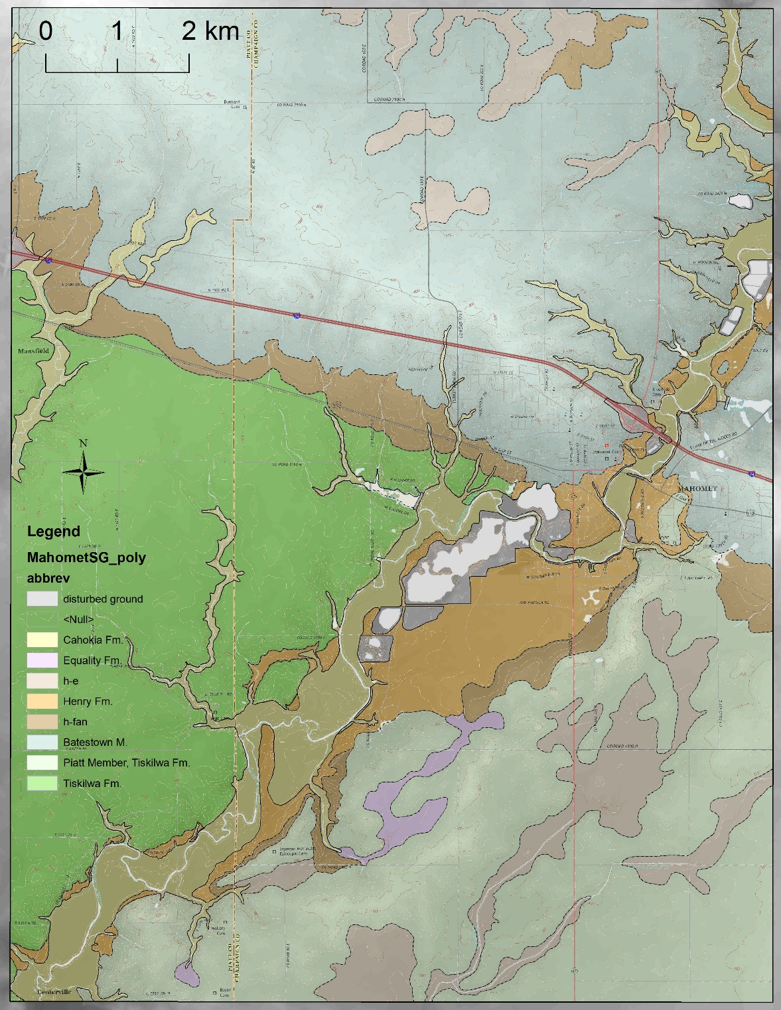
Mahomet Quadrangle
Surficial Geology Map (DRAFT)
D. Grimley, A. Stumpf, and J. Wang
Champaign Moraine
town of
Mahomet
Cerro Gordo Moraine
area of next slide
Sangamon River Valley

Slide 6
Sections with sub-fossil wood or organic material below Tiskilwa till (Mahomet area)
Champaign Moraine
Sangamon River V.
MHT-10f
MHT-6f
Leverett (1899)
gravel pit site
Champaign M.
MHT-4f
gravel pits
Cerro Gordo Moraine
Sangamon River Valley
portion of Mahomet 7.5-minute quadrangle
1 km
Elevations:
655 to 807 ft. asl

Slide 7
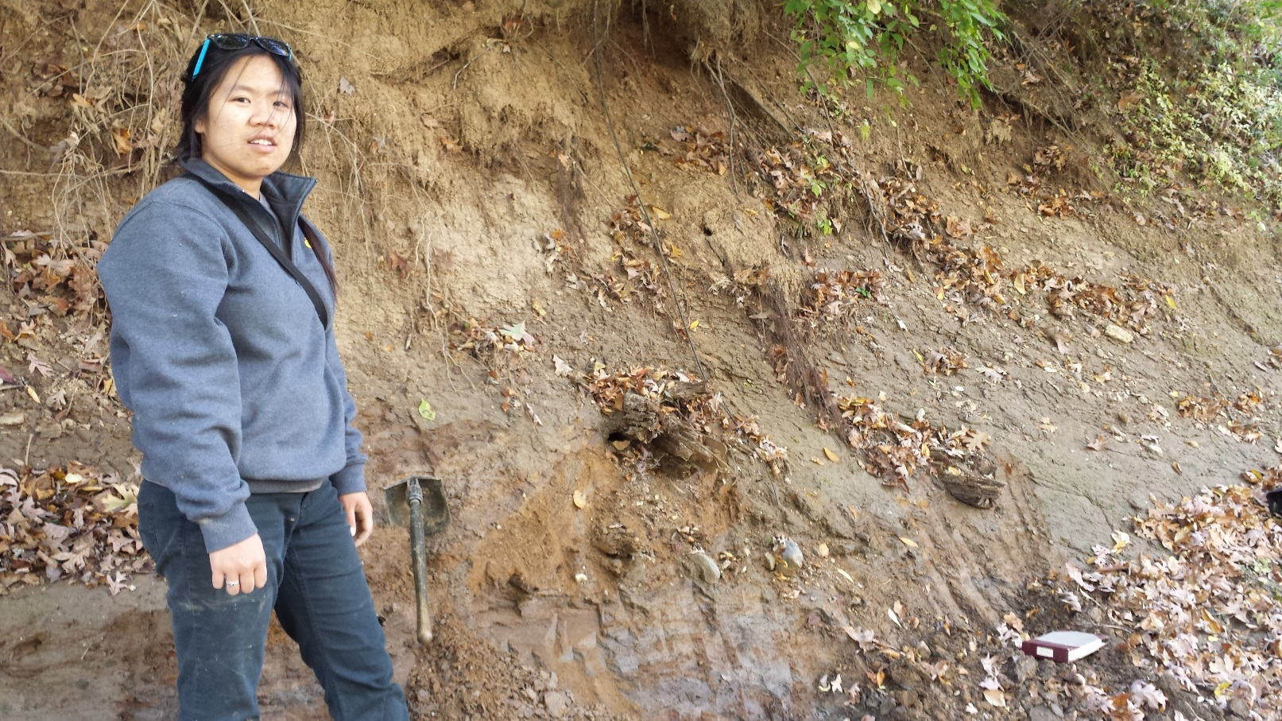

Slide 8
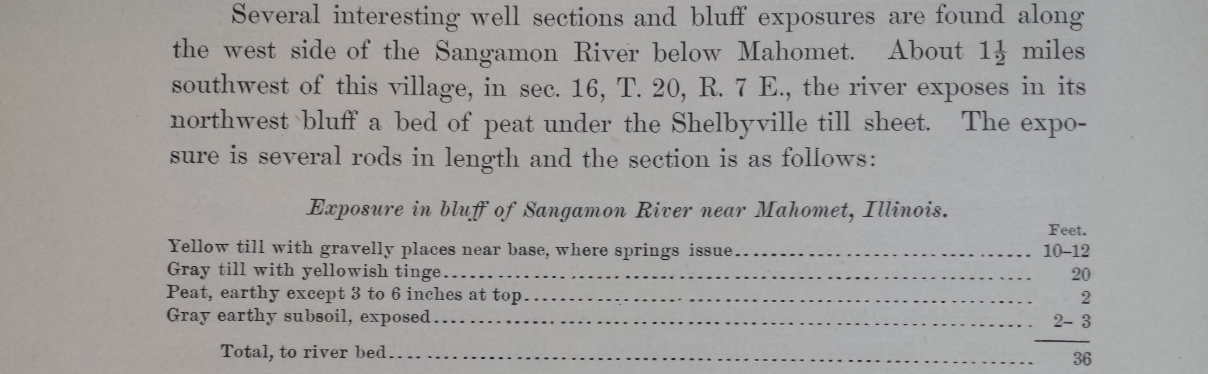
Sangamon River Bluff near Mahomet (Leverett, 1899)
(The Illinois Glacial Lobe, USGS Monograph v. 38)
Peat
Tiskilwa till (30 ft)
Robein M. (2 ft)
Sangamon G. (3 ft)
Insect fossils later found in peat (thought to be interglacial but actually interstadial); H.F. Wickham. 1917. Some fossil beetles from the Sangamon peat. American Journal of Science, v. 44:137-145.
Site also noted by Savage 1931, On the Geology of Champaign County

Slide 9
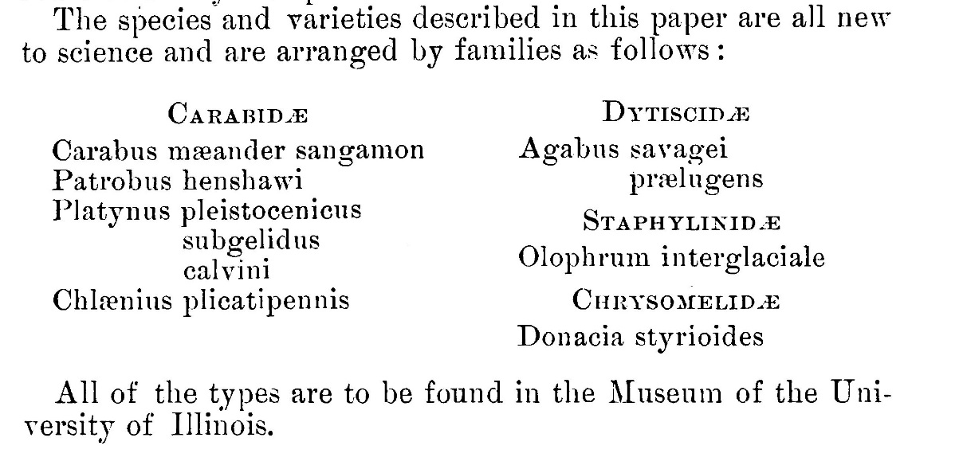
Fossil Beetles (Coleoptera): Wickham (1917)
“It is true that all of the genera are now living in Illinois but they also occur very far to the north, extending in part to the shores of the Arctic Ocean and we must take into account the entire absence of anything characteristically southern. A glance at the notes following the descriptions will show that the near relatives of all the fossils in this collection are of northern range.”
H.F. Wickham. 1917. Some fossil beetles from the Sangamon peat. American Journal of Science, v. 44:137-145.

Slide 10
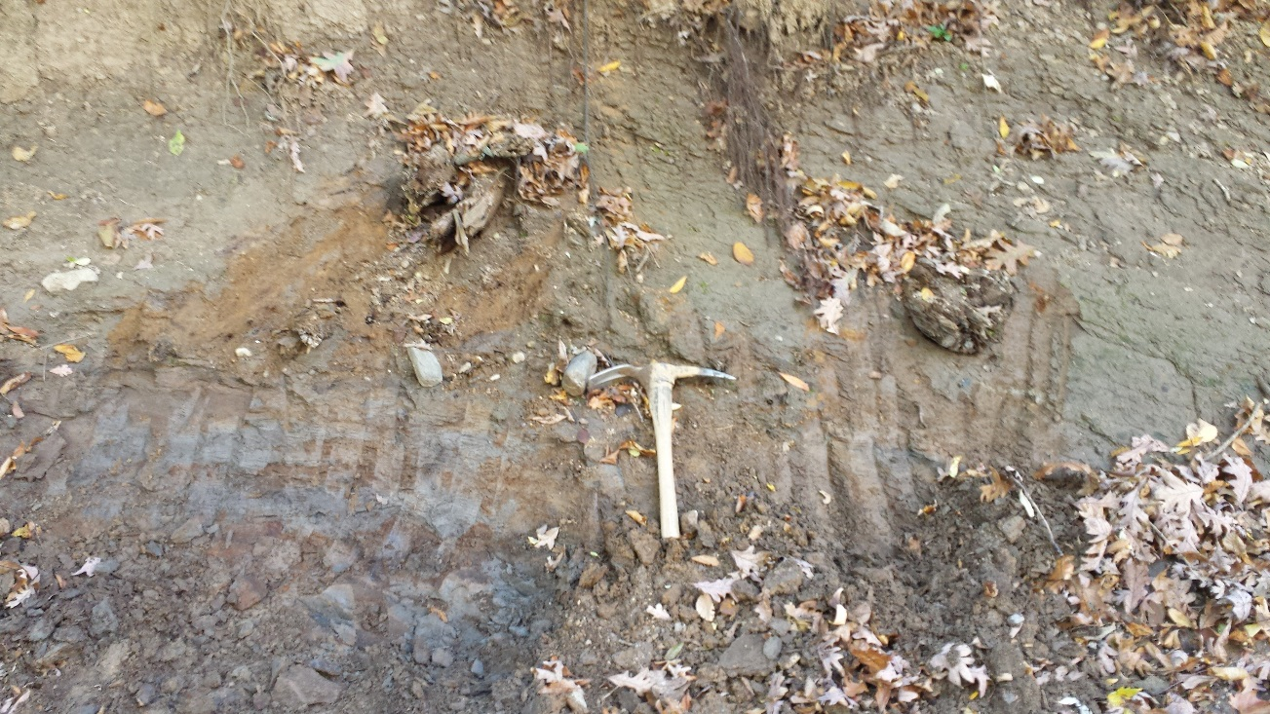
“This peat lies above the Illinoisan and below the Wisconsin drift. There is a slight development of loess or loess-like silt above the peat and below the Wisconsin, and Professor Savage considers that the reference of the bed to the Sangamon stage is rather definitely proven.”
Wickham compared Coleoptera fossils to those in Scarborough beds near Toronto, Ontario.
till
loessal sediment
organic silt and peat

Slide 11
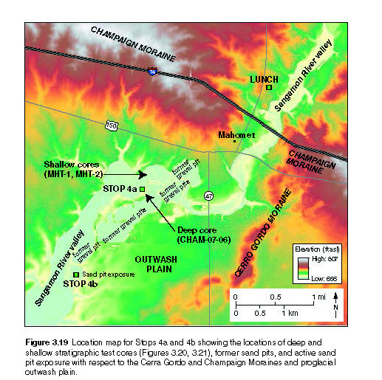
Location of Studied Sections (Mahomet Quadrangle)

Slide 12
New radiocarbon and luminescence ages from the Upper Sangamon River Basin in central Illinois have improved our understanding of Wisconsin Episode ice margin advances and glacial meltwater pulses. Yet, careful consideration was necessary in application of both methods. Radiocarbon dating of conifer wood in organic silt (Morton Tongue, Peoria Silt) below the Tiskilwa Formation was complicated by weathering effects, namely the presence of microscopic fungus (not realized initially). Two of four sub-fossil wood ages from the same stratigraphic position, but from different sites in the Mahomet area, were significantly younger than expected (~ 1 to 2 ka too young) for the initial advance of last glacial ice into this region. One sample, originally ~ 19.2 ¹⁴C ka (~ 23.1 cal ka), was redated from the same log to 19.9 ¹⁴C ka (~ 24.0 cal ka) using alpha cellulose extraction procedures to avoid any contamination. The two other wood samples with reasonable dates both yielded 20.2 ka ¹⁴C yrs (~ 24.3 ka). Based on this chronology, glacial ice advancing southwest to the Shelbyville Moraine terminus appears to have been rapid (streaming ?), covering ~ 65 km in perhaps a few hundred years. Two samples from a younger proglacial outwash deposit in the same area were dated by optically stimulated luminescence (OSL). The outwash is related to a younger till unit in the Champaign Moraine (Batestown Member, Lemont Fm.) and occurs stratigraphically above the Tiskilwa Formation. OSL was applied on quartz, a mineral more likely than feldspar to be well-bleached during its last sedimentary cycle. Measurements were performed on very small aliquots (~ 10 – 20 grains/aliquots) in order to increase the likelihood of isolating well-bleached grains from those carrying a residual dose. Both samples were found to be partially-bleached. Application of the minimum age model allowed us to calculate an age of ~ 21 – 22 ka for the outwash deposit; without using this model the calculated age would be significantly older. The new OSL ages are reasonable within the stratigraphic context and may provide a more accurate chronology for the Champaign Moraine and subsequent glacial recession (previously assumed ~ 24 to 20.5 ka).

Slide 13
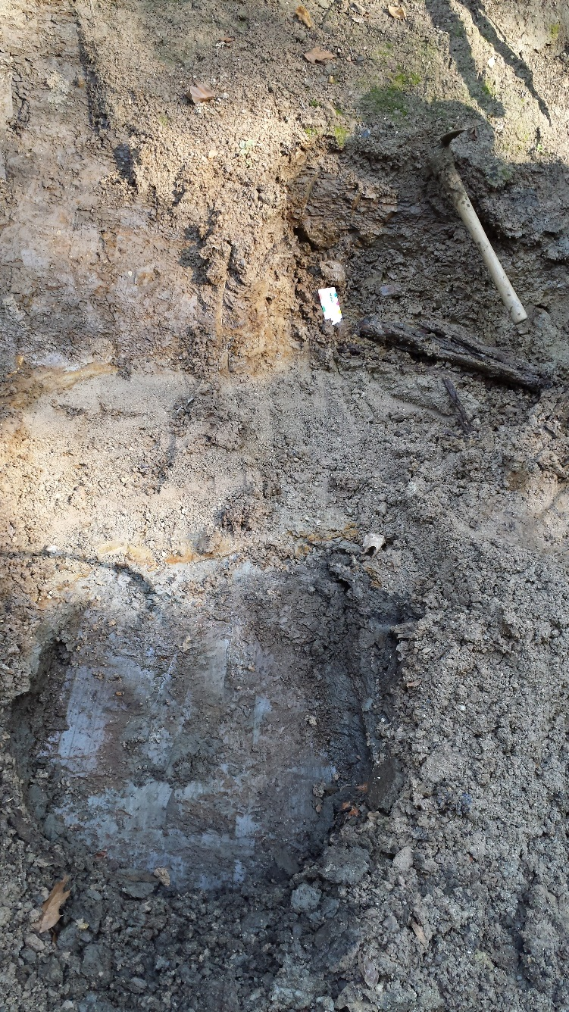
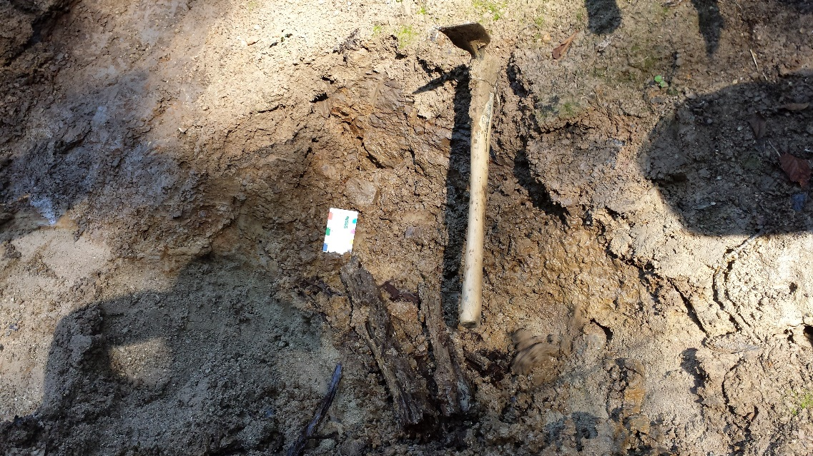
Tiskilwa Fm. (till)
Tiskilwa Fm. (till)
sand bed
sand bed
Morton Tongue (loess)
Sub-fossil Picea sp. log found in upper part of sand (immediately below Tiskilwa till) at site MHT-6f on east bank of Sangamon River

Slide 14
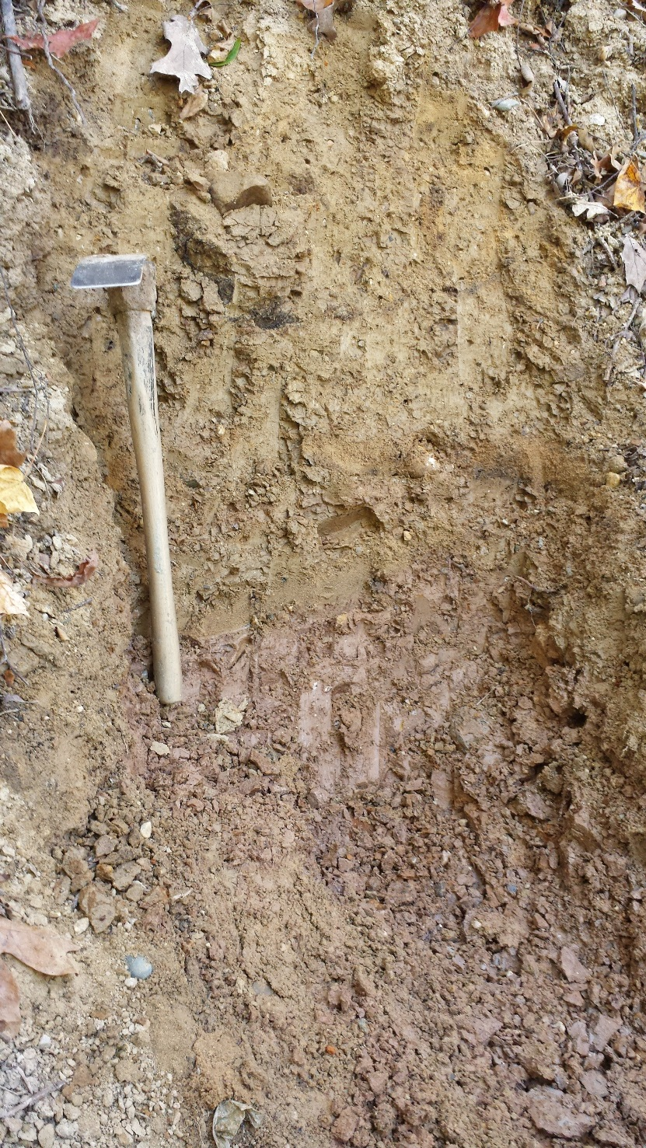
Batestown till
Tiskilwa till
Higher up in section (MHT-10f)

Slide 15
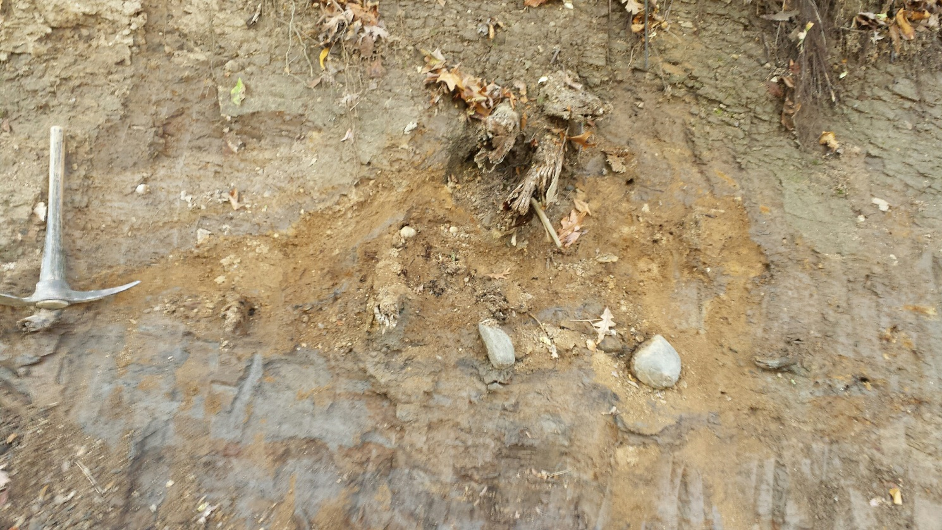
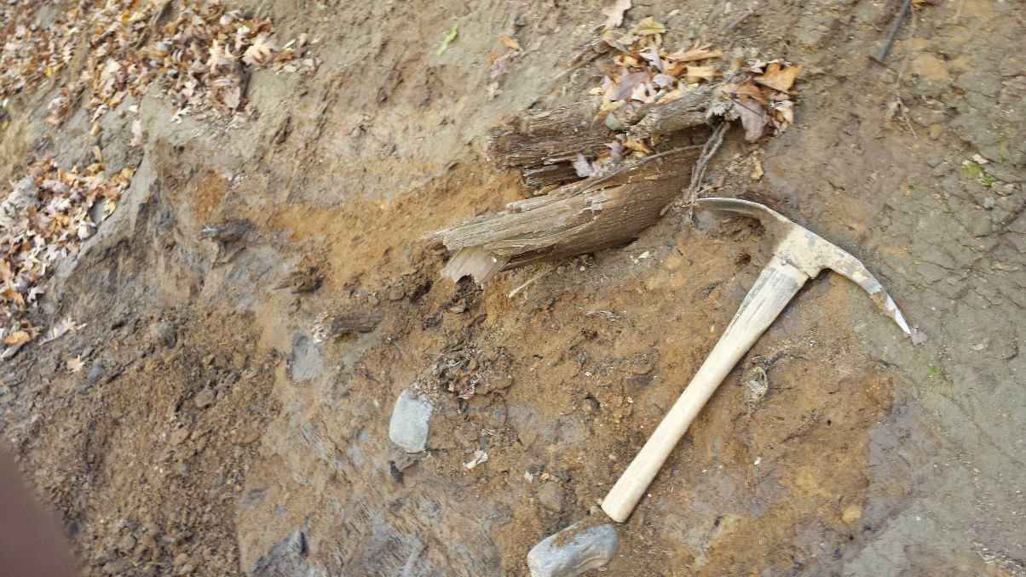
Tiskilwa till
Sub-fossil Picea sp. log
sand channel
Morton loess
Tiskilwa till
Picea logs embedded in sand or silt below Tiskilwa Fm. till at outcrop MHT-10f (bank of Sangamon River near Mahomet, IL)
Morton loess

Slide 16
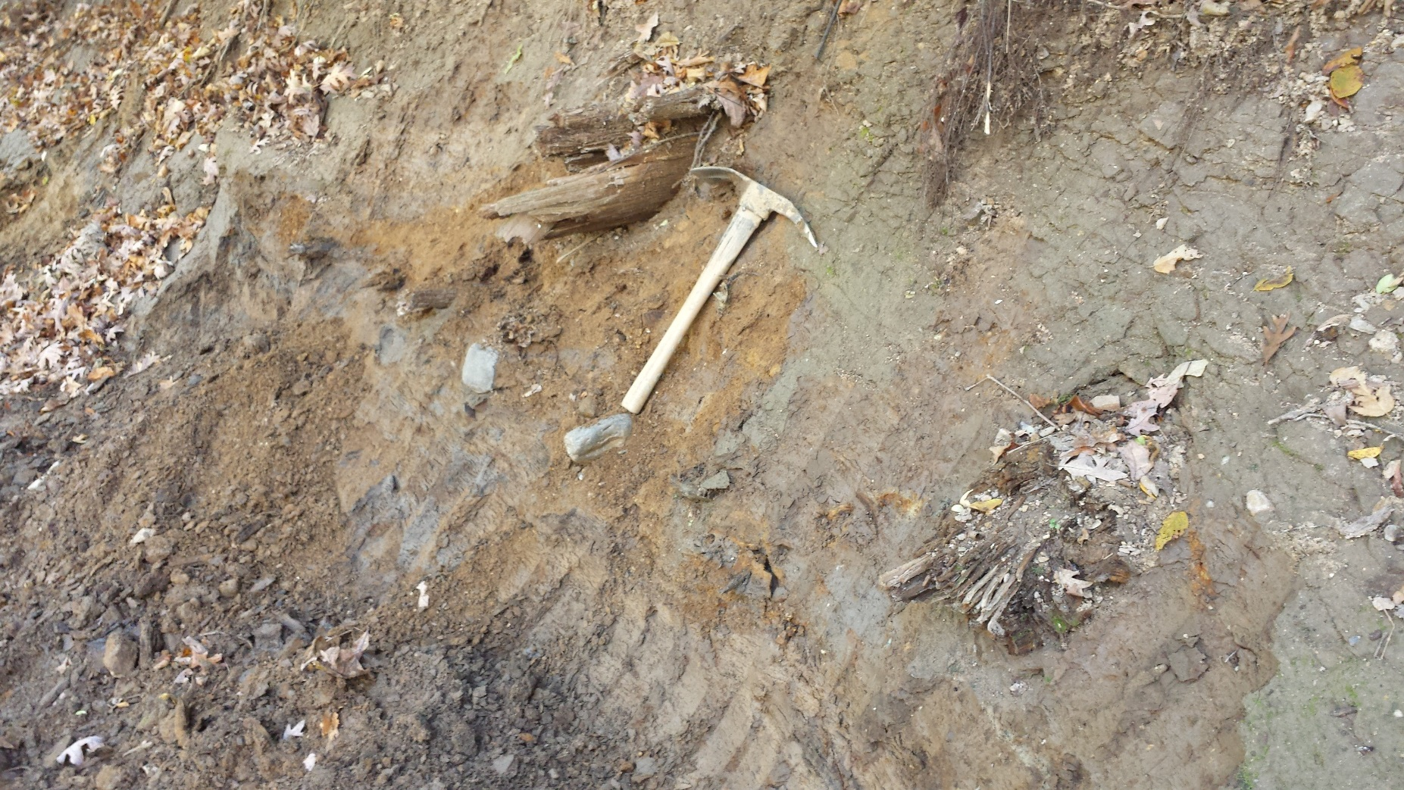
Tiskilwa till
sand
loessal silt, with organic zones

Slide 17
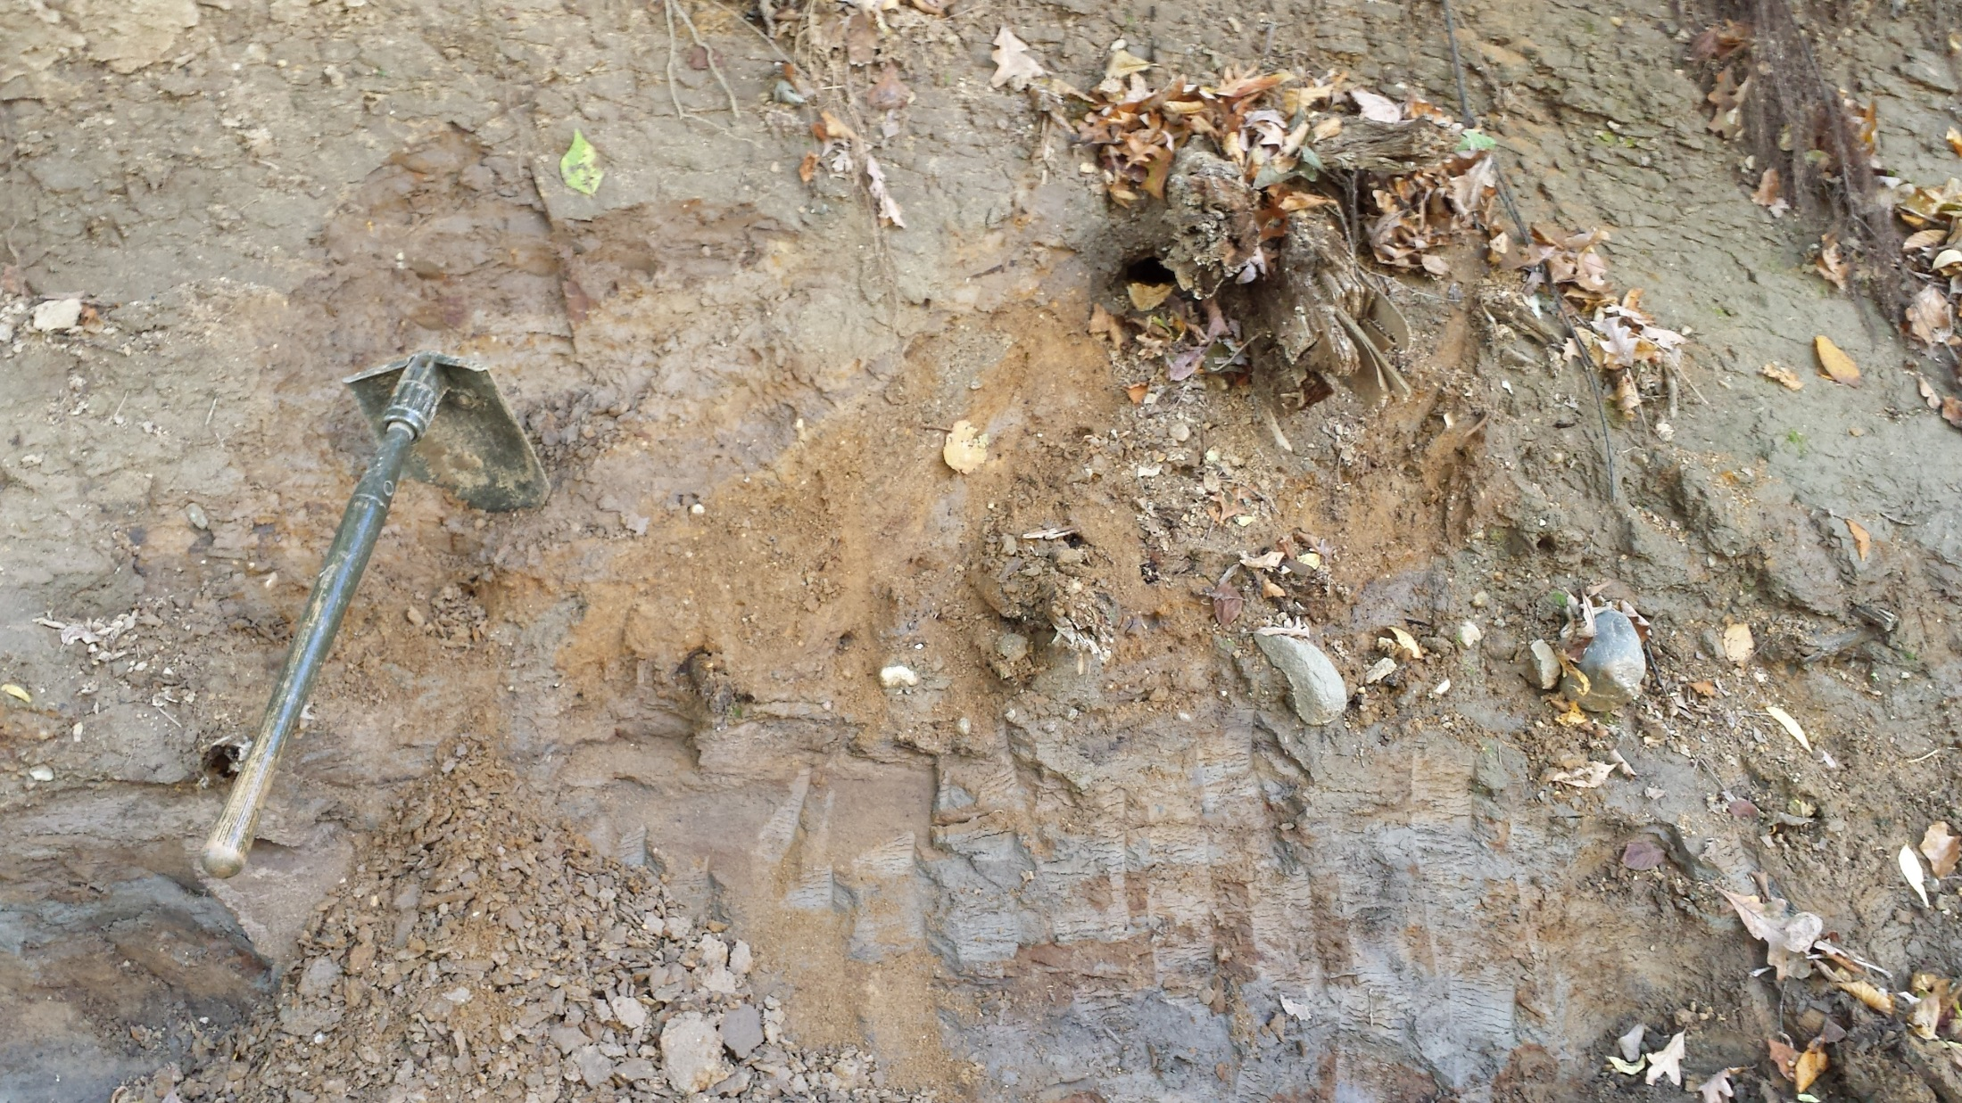

Slide 18
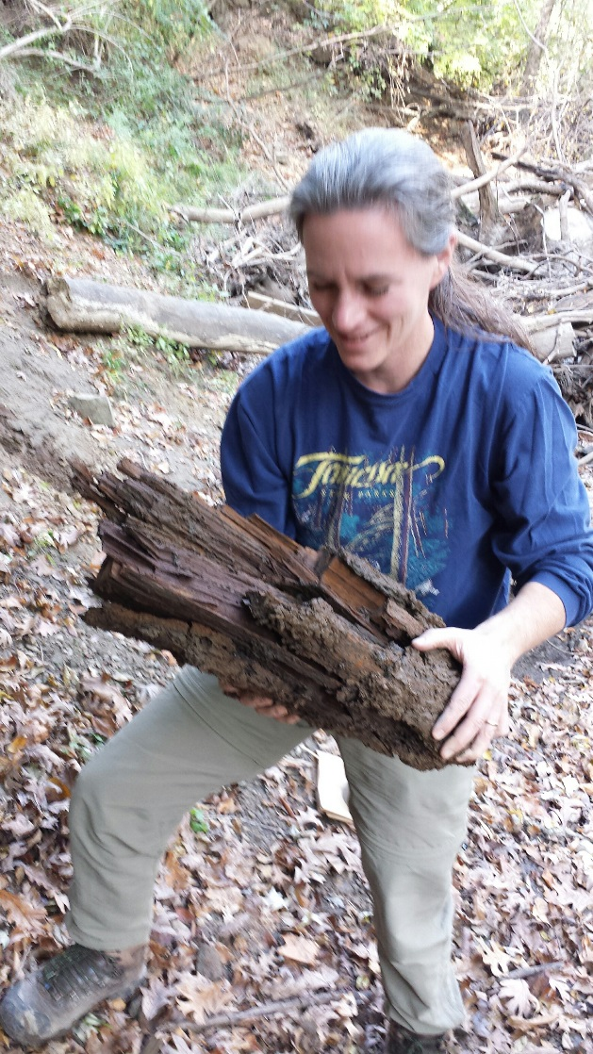


Slide 19
Radiocarbon ages on wood or organic material below Tiskilwa till
MHT-10f
20,180 +/- 130 (ISGS-7071) – canoe
19,220 +/- 140 (ISGS-7104)
Champaign Moraine
MHT-4f
21,670 +/- 130 (ISGS-79)
17,940 +/- 170 (ISGS-7105)
MHT-6f
20,220 +/- 140 (ISGS-7106)
gravel pits
Sangamon River Valley
1 km
Elevations:
655 - 807 ft. asl

Slide 20
Radiocarbon Table
Site | Unit | ISGS # | C14 Age | Calibrated Age | Comments
MHT-4f | Morton tongue | ISGS-79 | 21,670 +/- 130 | ~ 25.9 ka | reasonable (not at upper contact)
MHT-4f | Morton tongue | ISGS-7105 | 17,940 +/- 170 | ~ 21.7 ka | too young
MHT-6f | Morton tongue | ISGS-7106 | 20,220 +/- 140 | ~ 24.3 ka | reasonable
MHT-10f | Morton tongue | ISGS-7071 | 20,180 +/- 130 | ~ 24.2 ka | reasonable
MHT-10f | Morton tongue | ISGS-7104 | 19,220 +/- 140 | ~ 23.1 ka | too young
Some type of contamination on two samples ?
  Termites ?
  Fungus ?

Slide 21
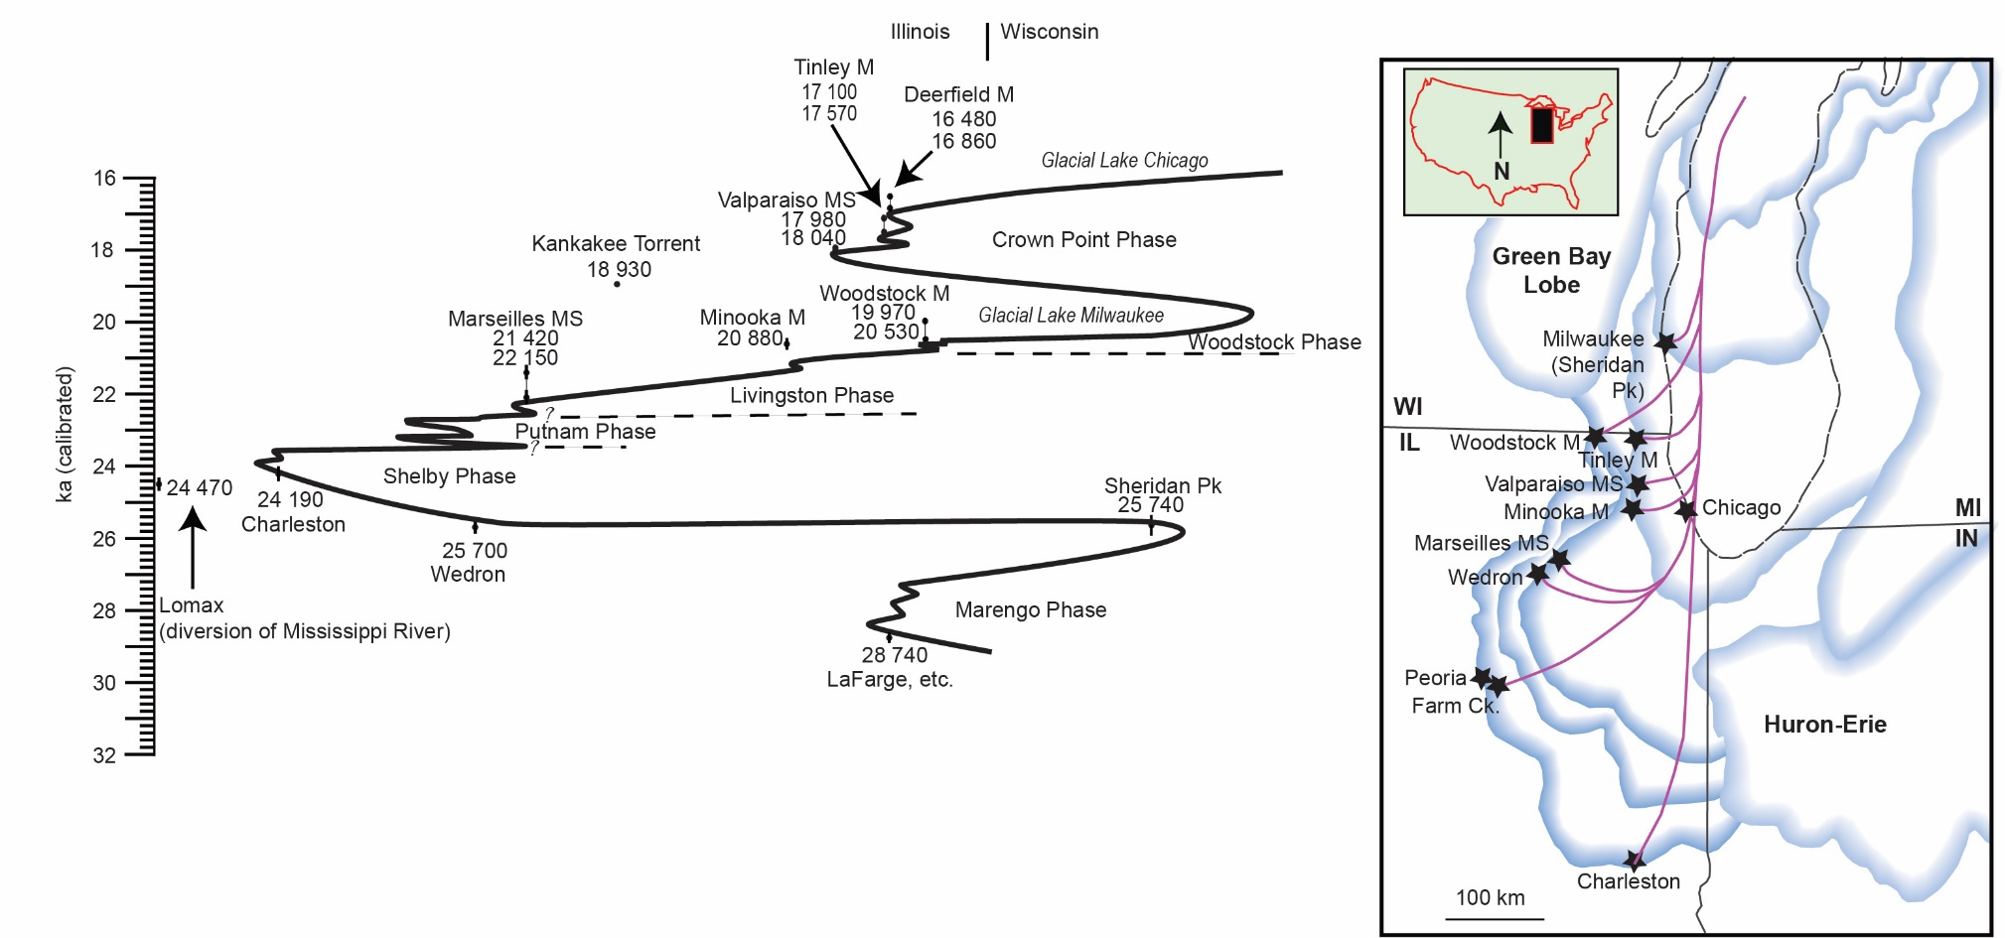
Time-Distance Diagram for Last Glacial Lake Michigan Lobe Ice Margin
Yorkville till
Batestown till
Tiskilwa till
Y
B
T
(Caron and Curry, 2016)
Tiskilwa till age is well known to be ~ 23.5 to 24.5 ka in southern Lake Michigan Lobe
LML achieved its maximum southern advance ~ 24.2 ka (Charleston Quarry)

Slide 22
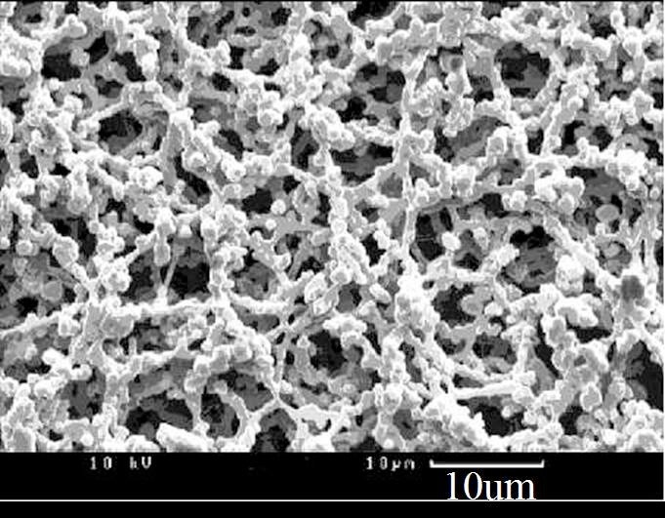
Alpha Cellulose Extraction
Alpha cellulose is the preferred constituent for isotope analysis since it is relatively immobile and forms in situ relative to the tree ring
Whole wood and hemicellulose contain mobile compounds (i.e. carbohydrates and starches) that can move across ring boundaries. Resins were removed using a mixture of toluene and reagent alcohol
Alpha-cellulose was extracted by methodology of Green (1963) and modified by Loader et al. (1997) for small batch processing using soxhlet thimbles:
Alpha Cellulose (C6H10O5)n

Slide 23
Radiocarbon Table (revised)
Site | Unit | ISGS # | C14 Age | Calibrated Age | Comments
MHT-4f | Morton tongue | ISGS-79 | 21,670 +/- 130 | ~ 25.9 ka | reasonable (not at contact)
MHT-4f | Morton tongue | ISGS-7105 ISGS-A3758 | 17,940 +/- 170 18,930 +/- 90 | ~ 21.7 ka ~ 22.8 ka | too young still too young
MHT-6f | Morton tongue | ISGS-7106 | 20,220 +/- 140 | ~ 24.3 ka | reasonable
MHT-10f | Morton tongue | ISGS-7071 | 20,180 +/- 130 | ~ 24.2 ka | reasonable
MHT-10f | Morton tongue | ISGS-7104 ISGS-A3701 | 19,220 +/- 140 19,880 +/- 110 | ~ 23.1 ka ~ 23.9 ka | too young reasonable
Reasonable ages in Morton tongue below Tiskilwa range between 23.9 and 25.9 ka. (25.9, 24.3, 24.2, and 23.9 ka); mean of 24.6 ka.
Average of 3 ages at basal contact with Tiskilwa till is 24.1 ka

Slide 24
Time-Distance Diagram for Last Glacial Lake Michigan Lobe Ice Margin
Tiskilwa till
Y
B
T
(Caron and Curry, 2016)
LML achieved its maximum southern advance ~ 24.2 ka (Charleston Quarry)
Average of 3 ages at basal contact with Tiskilwa till in Mahomet area is ~ 24.1 ka
Very rapid advance to the margin ? Surging ?

Slide 25
Optically stimulated luminescence (OSL) sample site: Mid-America sand and gravel pit
Champaign Moraine
Sangamon River V.
MHT-10f
MHT-6f
Leverett (1899)
old s&g pit
Champaign M.
MHT-4f
gravel pits
Cerro Gordo Moraine
outwash plain
Sangamon River Valley
Elevations:
655 to 807 ft. asl
OSL sample site
1 km

Slide 26
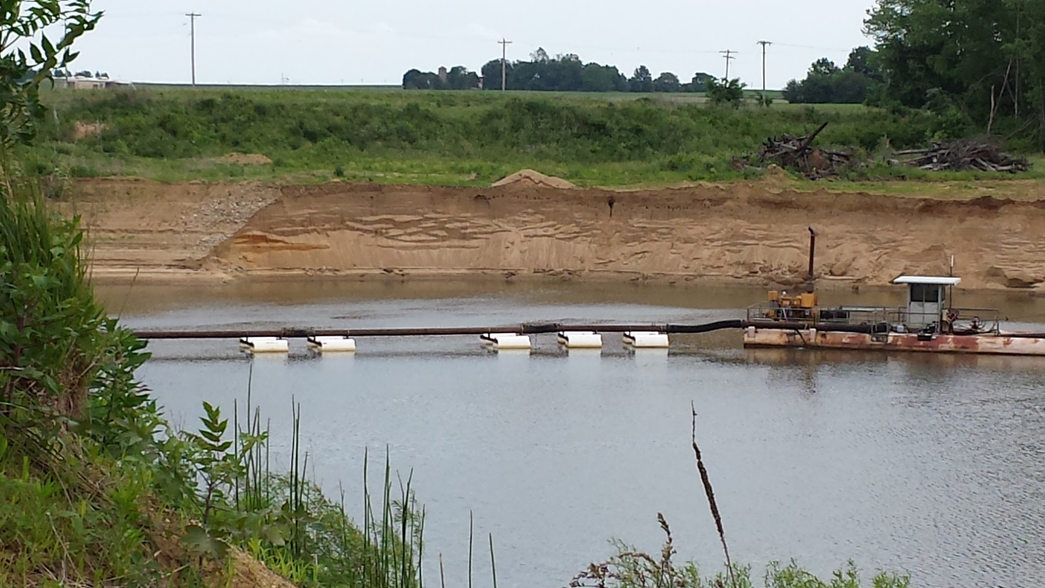
Mid-America Sand and Gravel Pit (Mahomet, IL)
pictured here at low water levels (due to sand pumping)
mainly outwash sand with about 5 % gravel;
used locally for cement / concrete

Slide 27

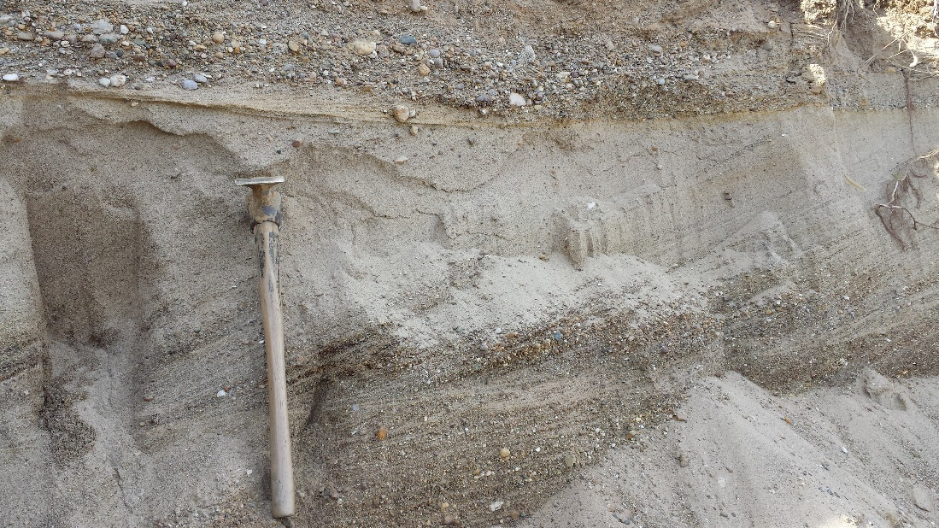

Slide 28
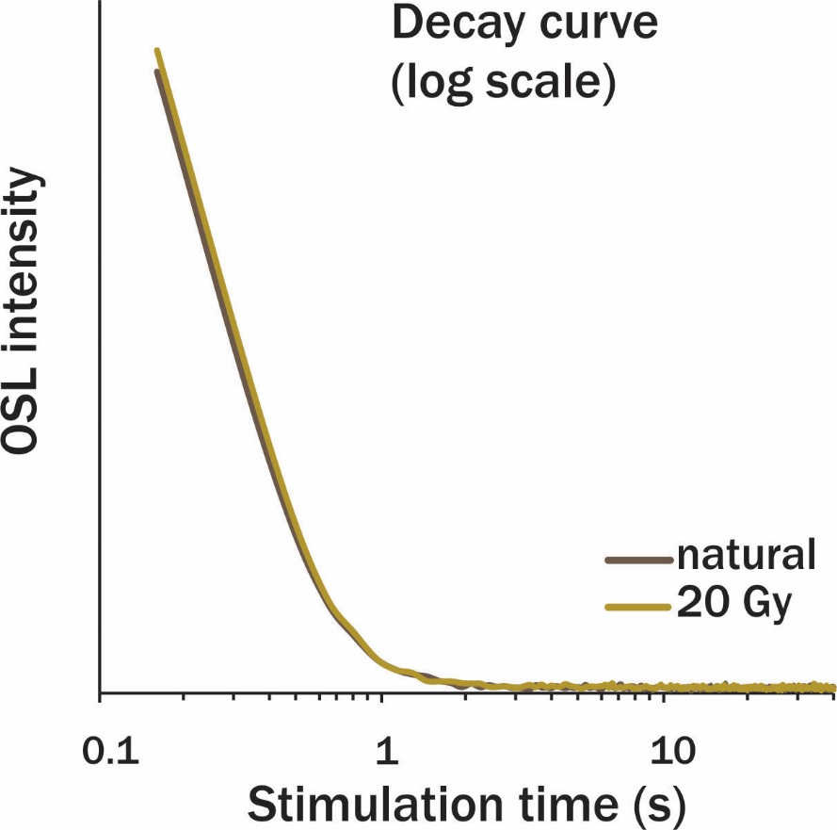
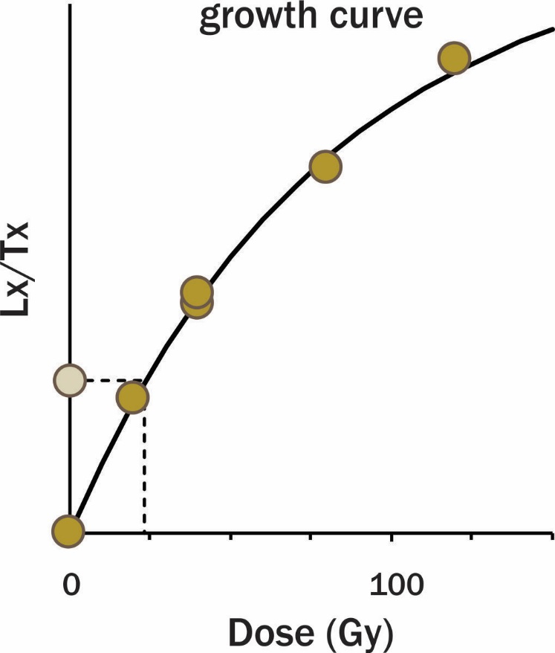
OSL dating of fine sand bed using quartz
sample: MHT-8F-OSL-1
150 – 250 μm grain size
very small aliquot (1 mm)
Notes:
2 samples were retrieved for luminescence dating. Quartz minerals were measured successfully.

Slide 29
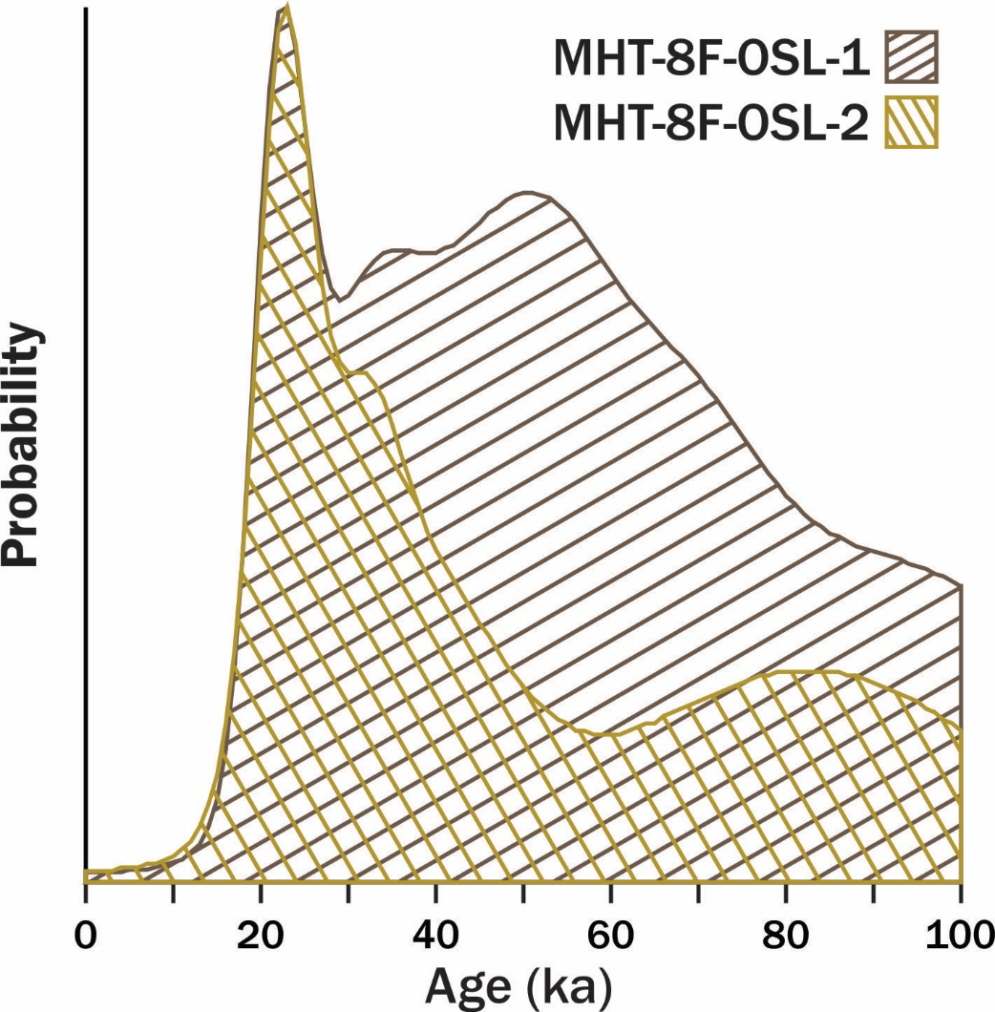
OSL results: average age model
  water content
  OSL-1: 15 % (4 m depth)
  OSL-2: 20 % (6 m depth)
  upper sample (OSL-1); ~ 63 ka
  lower sample (OSL-2); ~ 48 ka
  clearly too old based on stratigraphic position (surficial sand above Tiskilwa Fm.)
  samples are partially bleached
Notes:
The two samples shown pronounced sign of partial bleaching, with a skewed age distribution. The burial ages were calculated with a statistical model. Despite this, Both ages are very close to each other, which reinforced the age result.

Slide 30
OSL results: minimum age model
22.8 ± 1.6 ka (OSL-1; 4m depth)
23.3 ± 1.3 ka (OSL-2; 6 m depth)
  1-sigma
  random uncertainties only
  Weighted mean: 23.1 ± 1.2 ka
  (random + systematic uncertainties)
150 – 250 μm grain size
very small aliquot (1 mm)
minimium age model
Notes:
The two samples shown pronounced sign of partial bleaching, with a skewed age distribution. The burial ages were calculated with a statistical model. Despite this, Both ages are very close to each other, which reinforced the age result.

Slide 31
Lake Michigan Lobe Chronology
(B.B. Curry and others)
18 ka
21 ka
Marseilles Moraine
21.8 ka
Champaign Moraine
~ 23 ka
24.3 ka
Shelbyville Moraine (LGM)

Slide 32
Time-Distance Diagram for Last Glacial Lake Michigan Lobe Ice Margin
Yorkville till
Batestown till
Tiskilwa till
Y
B
T
Caron and Curry, 2016

