Slide 1

The Society of Exploration Geophysicists (SEG) Wiki
– a geoscience content resource for teachers and middle/high school students
http://wiki.seg.org/
Laura Guertin -- Penn State Brandywine (guertin@psu.edu)
Isaac Farley, Andrew Geary -- Society of Exploration Geophysicists

Slide 2

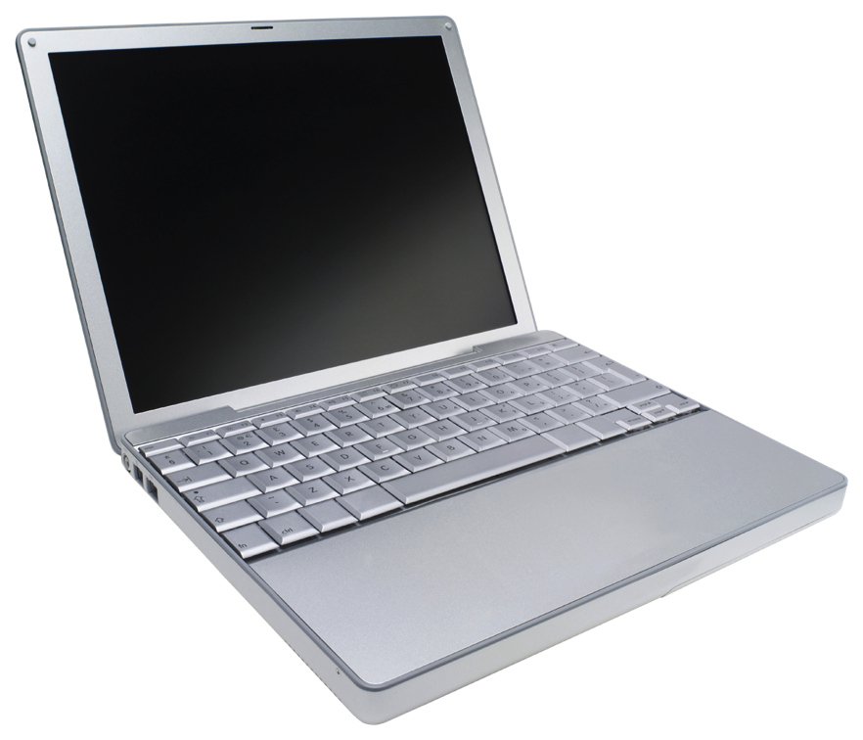
What we want
All students to have access to information that is:
Current
Reliable and relevant
Accessible and for the right audience
Point-of-view and purpose is clear
In print
Online

Slide 3
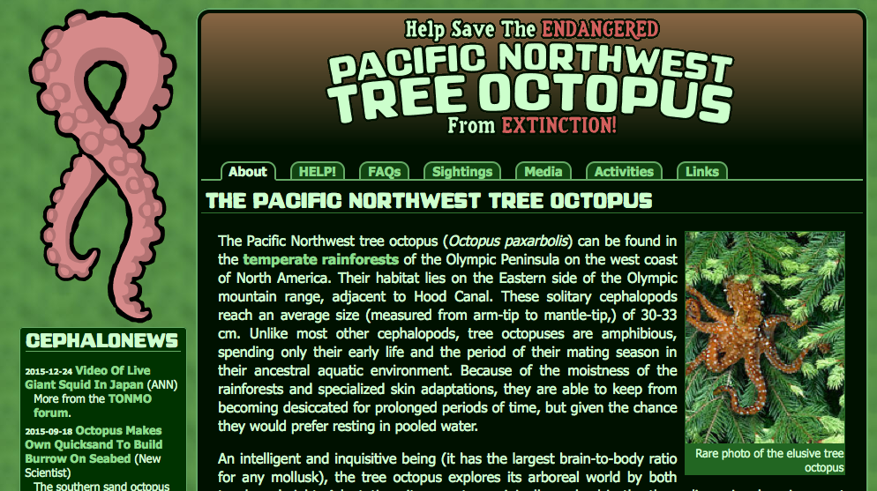
The challenges
Access to books/journals
School/public libraries closed
Not enough and/or dated material
Books cannot leave the classroom
Not enough covering Earth science
The Internet
Anyone can put anything online
Information literacy of students

Slide 4

Where do students go online?
Their “go-to” source
What comes up first/early in a search
… despite us telling them to NOT use Wikipedia
But do we tell them why?

Slide 5
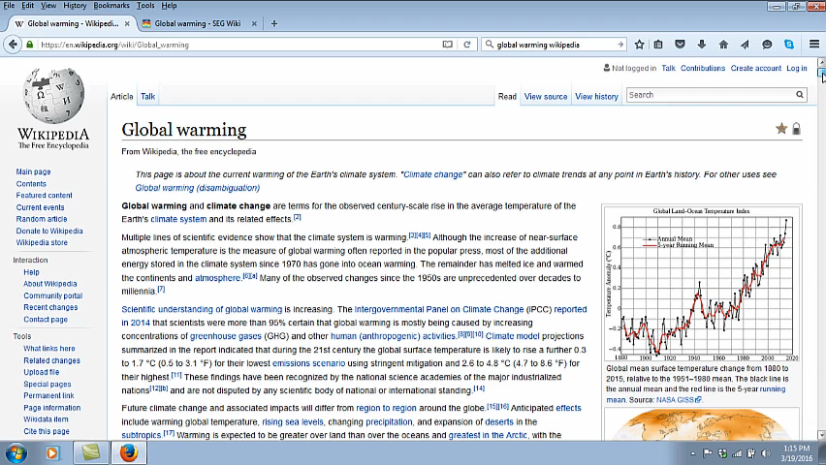
Examples – Wikipedia & SEG pages on Global warming

Slide 6
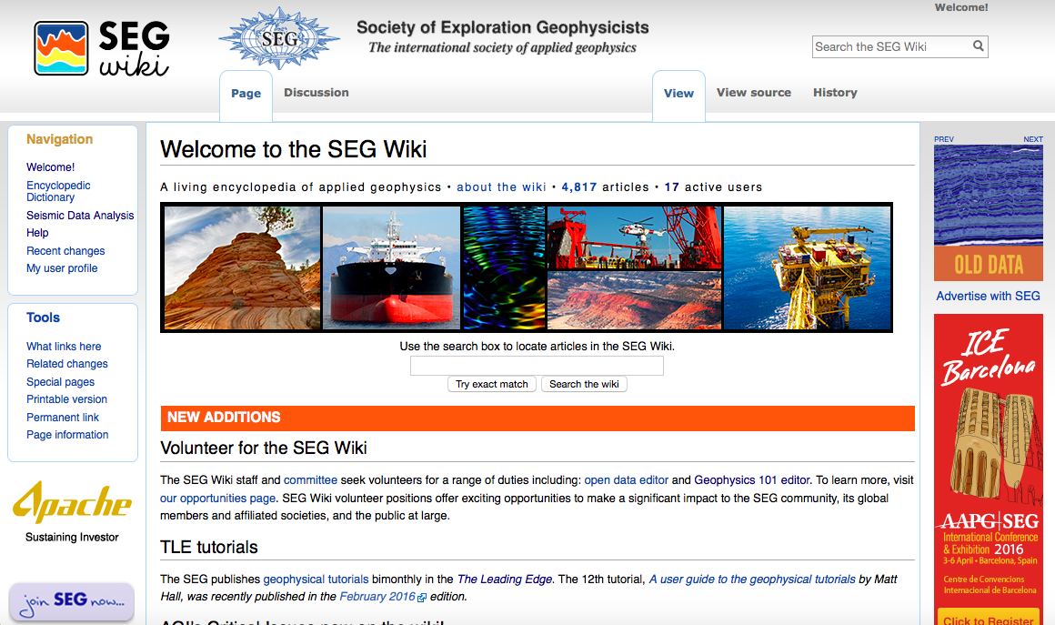
Introducing.. The SEG Wiki
Notes:
Review the history… purpose/objective

Slide 7
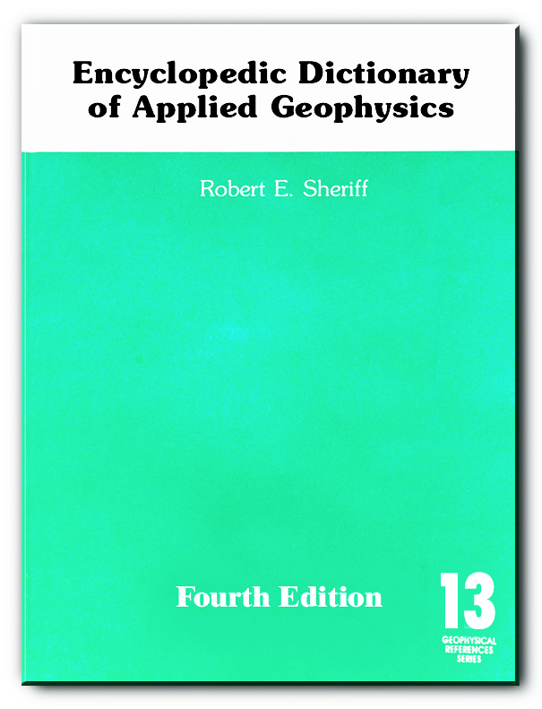
Facts about the SEG Wiki
In 2016, the SEG Wiki reached 10 million views (over 6 million in 2015 alone)
Over the last year, volunteers made 8,672 individual contributions and grew the number of pages in the wiki by 1,147
Editors register, content is monitored

Slide 8
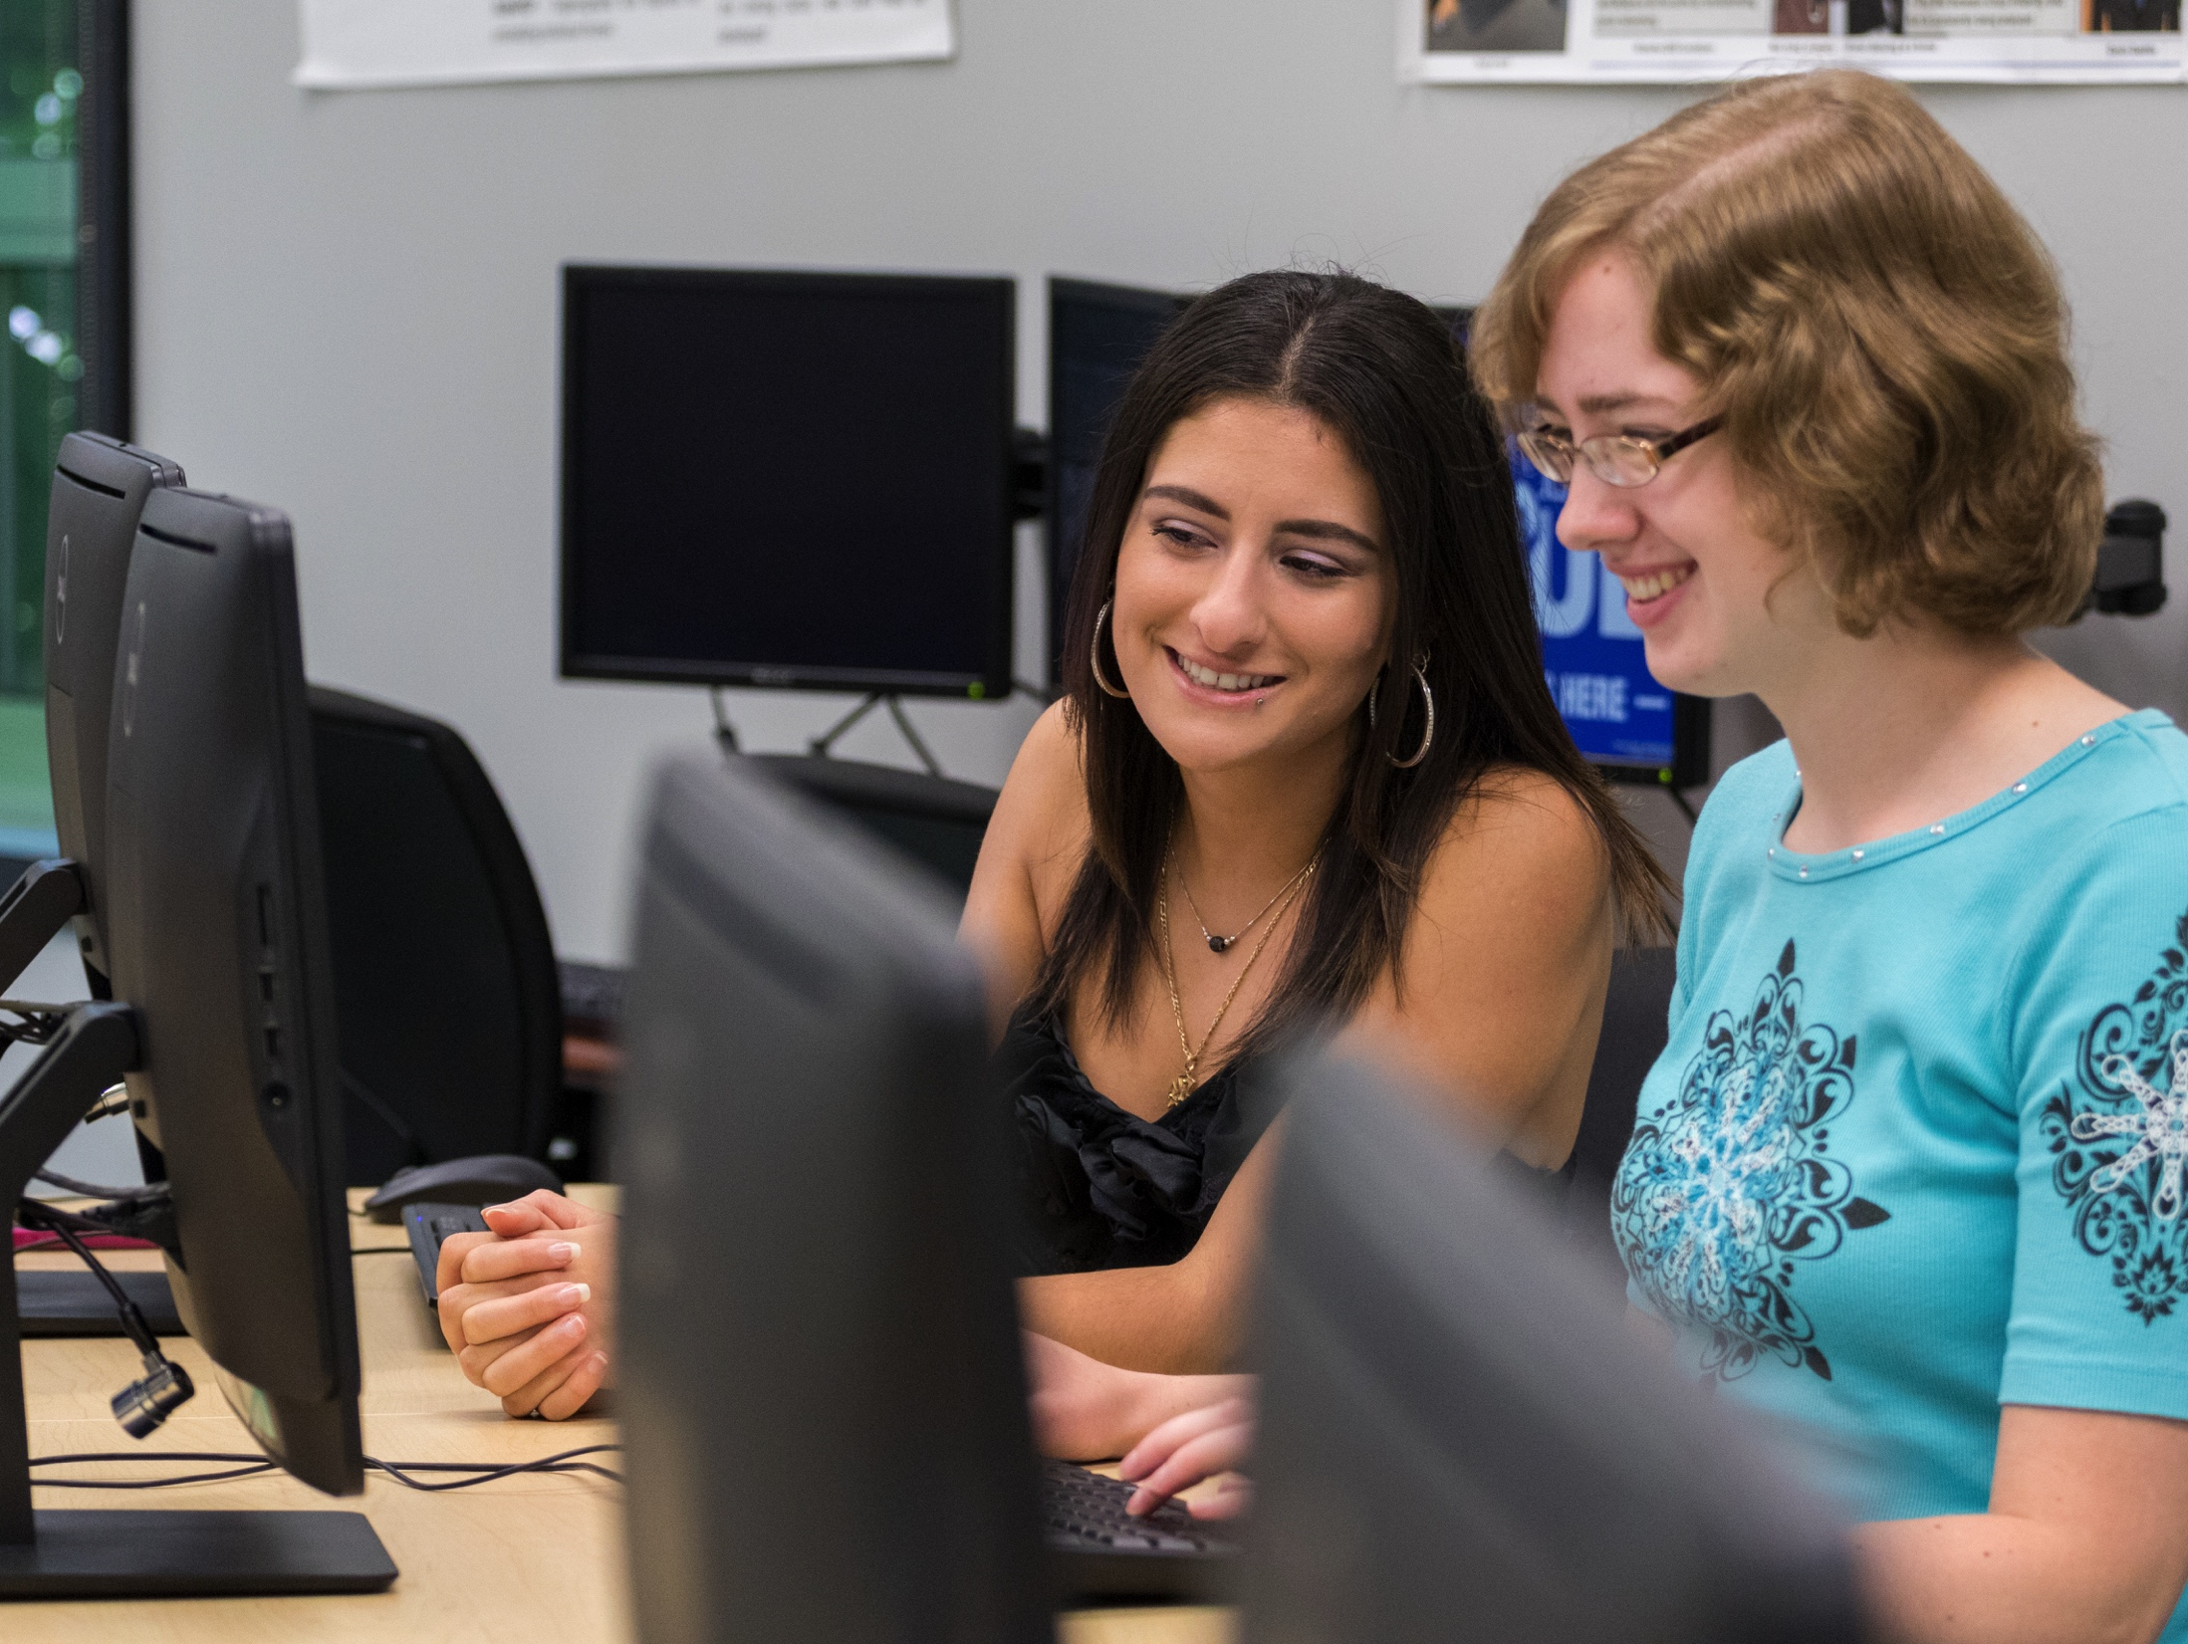
Who are the contributors?

Slide 9
How students react to the assignment…
“When I first heard that we were going to be putting together a wiki page, I didn’t understand why. All of my professors in the past told me that I couldn’t use them when doing research because they weren’t credible pages. I never looked at Wikipedia pages for information because of what I was told. Professors told me multiple times over the years that anyone could go onto the pages and change information. Nothing is credible when that happens, and if I did use Wikipedia for information, some professors would take points off or give a zero for that assignment all together. So after hearing everything the professors had to say about Wikipedia, I thought they were horrible sources.” -- Kelly Gallagher (De-Extinction)
Notes:
Kelly Gallagher

Slide 10
What are they contributing?
“Geology 101” wiki articles -- 52 and counting!
Algal bloom
Aquaculture
Aquifer
Avalanche
Biofuels
Clean energy
Coral bleaching
Desertification
Earth system science
Estuary
Fuel cells
Glacier
Greenhouse gases
Layers of the Earth
Mariana trench
Ocean acidification
Photovoltaic cells
Plate tectonics
Pollution
Smart grid
Solar energy
Tropical cyclone
Water cycle
Water scarcity
… plus 20 additional articles this semester

Slide 11

A structured assignment for student contributors
Part A -- Select wiki article topic
Part B -- Information literacy
CRAP test, Zotero, minimum 10 articles
Part C -- Prepare the wiki article
Review the page template
Peer review articles, how to find copyright-free images
Part D -- Generate the article
Review MediaWiki coding
Part E -- Write reflection

Slide 12
What university students say…
“The first time hearing about this wiki page I was honestly overwhelmed and thought it was going to take a lot of work and time, and boy was I right! I have never had any experience with an assignment like this before so I really didn’t know what to expect. Before I did this project I just assumed that people wrote a little bit on the website and boom, there was the page. However, I would come to realize that it takes much more work, time and coding than I ever anticipated and I have a greater respect for writers in general now.” -- Anthony Bianchini, Tropical Cyclones
Notes:
Anthony

Slide 13
What university students say…
“I was intrigued, albeit not particularly excited, when I first heard we were creating a wiki page. I figured anything was better than yet another research paper, though. The project has far exceeded my initial expectations, and it is definitely something you should continue having your students experience (not that you needed me to tell you that). My favorite thing about the project is that it is genuinely in place to help others educate themselves, and it has also helped me see Wikipedia in a different light.”
Notes:
Drew

Slide 14

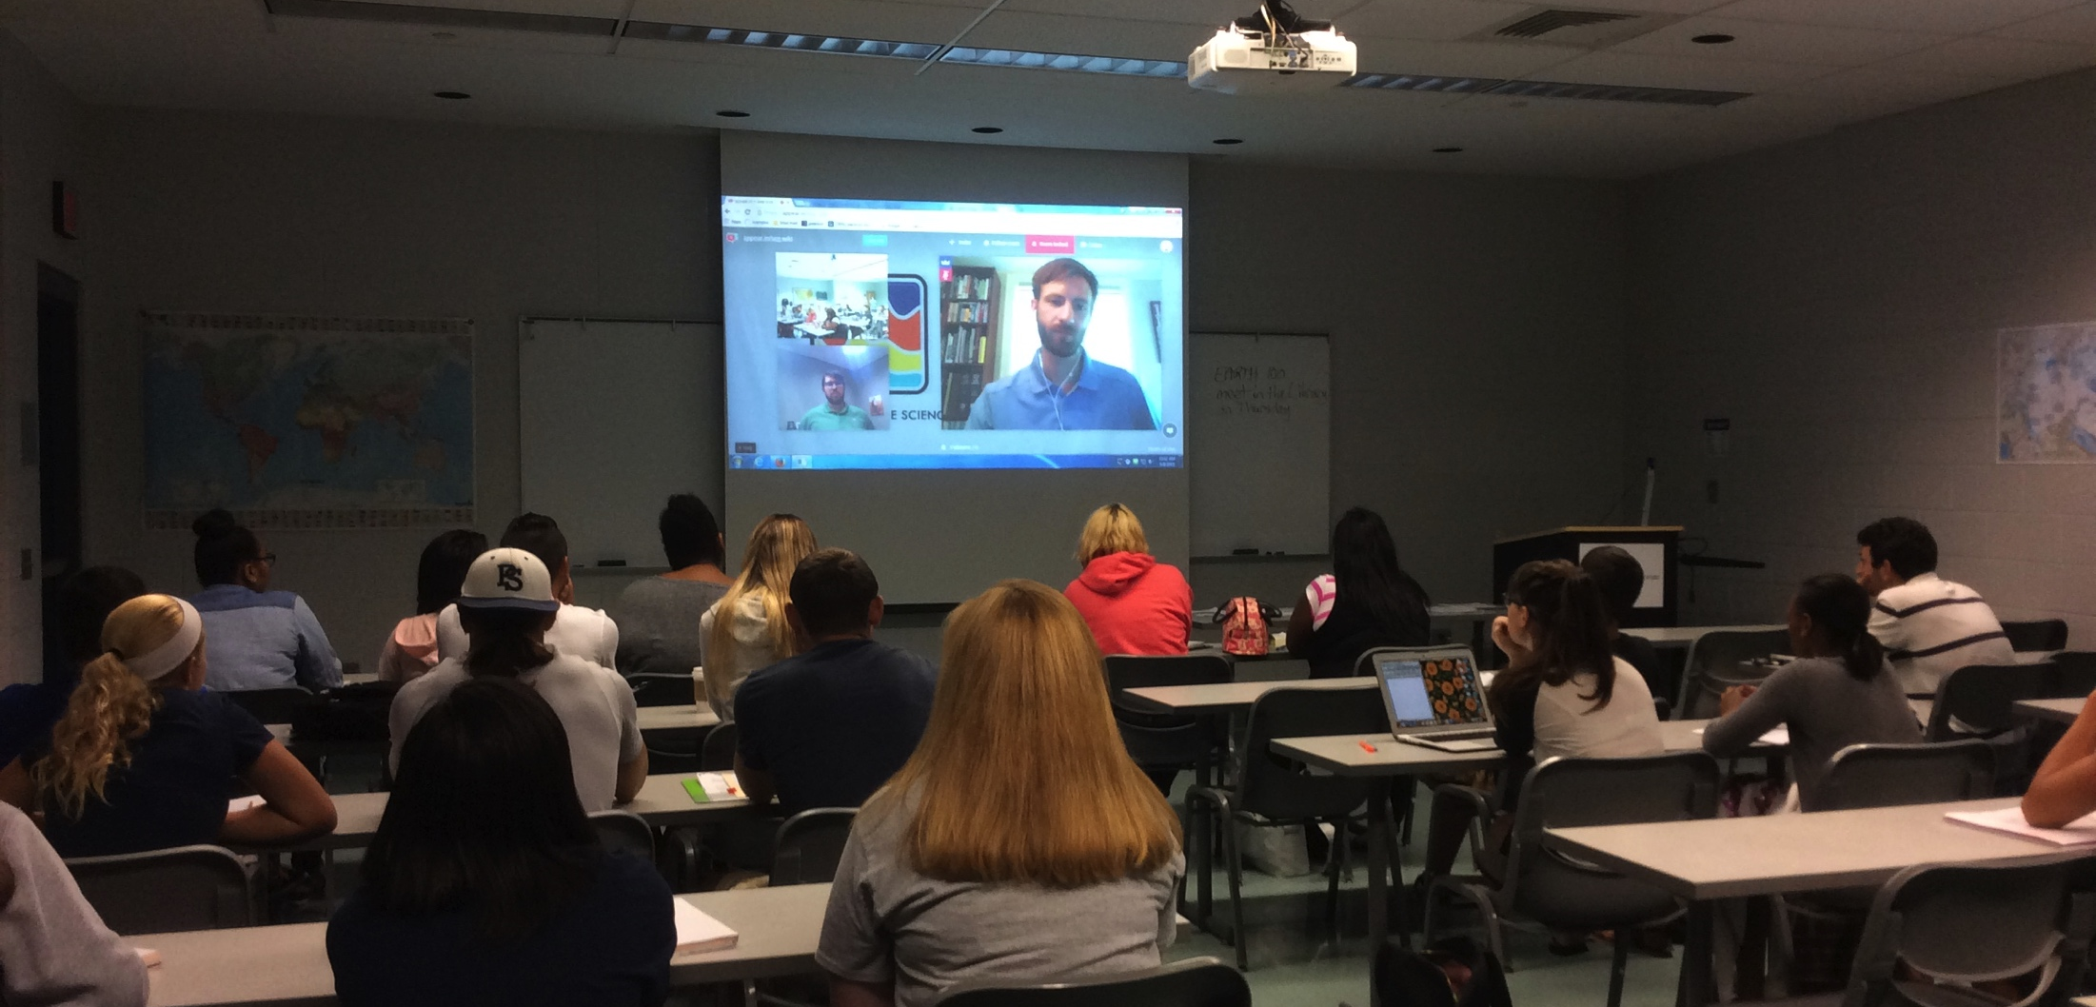
http://wiki.seg.org/
The SEG Wiki - a faculty assignment
http://sites.psu.edu/segwiki/for-faculty/
Questions? Contact guertin@psu.edu

