Slide 1
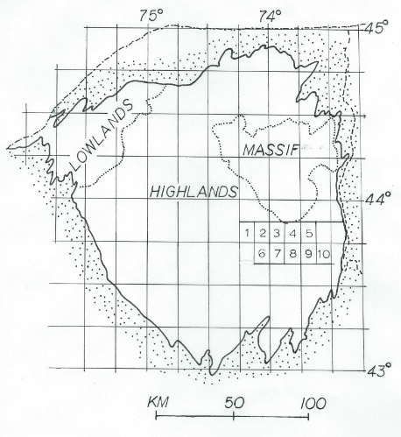
Turner and Geraghty – Fold Chronology and Stratigraphic Relations, SE Adirondacks
Location of some of the
quadrangles of interest:
  1 – Bad Luck Mtn
  2 – Dutton Mtn
  3 - Minerva
  4 – Schroon Lake*
  5 – Pharaoh Mtn*
  6 – Gore Mtn
  7 – North Creek
  8 – Chestertown*
  9 – Brant Lake*
  10 – Silver Bay
  * Quads in this talk

Slide 2
Turner and Geraghty – Fold Chronology and Stratigraphic Relations, SE Adirondacks
General geologic map of
four 7.5’ quadrangles

Slide 3
Turner and Geraghty – Fold Chronology and Stratigraphic Relations, SE Adirondacks
General geology with
charnockite and related
meta-igneous rocks
Removed.

Slide 4
Turner and Geraghty – Fold Chronology and Stratigraphic Relations, SE Adirondacks
Charnockite and related rocks, distribution in 4 domains.
  1 – offshoot from the main anorthosite massif
  2 – sills in Pharaoh Mtn and Merrill Hill
  3 – scattered intrusives
  4 – NW edge of the Lake George AMCG sill

Slide 5
Turner and Geraghty – Fold Chronology and Stratigraphic Relations, SE Adirondacks
Cross section F-2 folds on F-1 isoclines (interpretation)

Slide 6
Turner and Geraghty – Fold Chronology and Stratigraphic Relations, SE Adirondacks
Structure:
  Three sets of folds:
    F-1 isoclines in metasedimentary sections; granitic cores in antiforms; refolded.
    F-2 open to somewhat appressed similar folds in all rocks (metasedimentary and younger intrusives), E-W trend, shallow plunge.
    F-3 open folds, NNW trend, shallow plunge, create egg carton basins and domes with the F-2 folds.

Slide 7
Turner and Geraghty – Fold Chronology and Stratigraphic Relations, SE Adirondacks
Age relations
Metasedimentary rocks, 1210 Ma, Shawinigan
AMCG suite, 1155 +/- 6 Ma (McLelland et al., 2004)
  Charnockite sill near Schroon Lake, 1169 Ma (McLelland et al., 2004)
  Need dates on Lake George sill
Core of F-1 antiform near Brant Lake
  Rb/Sr whole rock age of 1144 +/- 11 Ma (Bickford and Turner, 1971)
  Needs new analysis
Brant Lake gneiss
  One of last events, anatexis, Ottawan phase (1090-1030 Ma)
  Post tectonic
  Rb/Sr whole rock age of 1119 +/- 39 Ma (Bickford and Turner, 1971)
  1090-1080 Ma within limits of Rb/Sr analytical error
  1050 Ma anatectic metapelite (Bickford et al., 2008) from nearby roadcut in Brace Hill (not Treadway Mtn)

Slide 8
Turner and Geraghty – Fold Chronology and Stratigraphic Relations, SE Adirondacks
General Field Observations
Metasedimentary rocks contain two generations of garnet:
  Tectonized, locally mylonitized, filled with dusty, opaque inclusions
  Clear, subhedral, non-tectonized garnet rims on above
Metasedimentary rocks intruded by AMCG suite of igneous rocks
Large ductile deformation zones, mylonite, marble mélange
Isoclinal F1 folds and likely ductile thrusts; F2 and F3 superimposed
Granitic cores of large F1 antiforms
  Compositionally layered
  Tectonic fabric
Much evidence of partial melting to complete anatexis locally

Slide 9
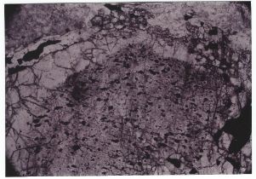
Turner and Geraghty – Fold Chronology and Stratigraphic Relations, SE Adirondacks
Photomicrograph, two garnets
in khondalite: inner core
filled with tiny opaque
inclusions, outer rim is clear
and not tectonized, often
showing subhedral faces

Slide 10
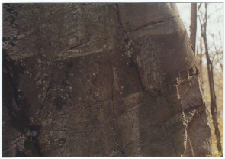
Turner and Geraghty – Fold Chronology and Stratigraphic Relations, SE Adirondacks
Jotunite dike in
khondalite

Slide 11
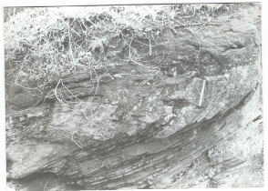
Turner and Geraghty – Fold Chronology and Stratigraphic Relations, SE Adirondacks
Isoclinal fold in para-
gneisses, west side of
Middle Mtn; approx.
120 meters beneath
AMCG sill.

Slide 12
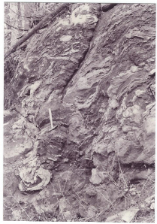
Turner and Geraghty – Fold Chronology and Stratigraphic Relations, SE Adirondacks
Marble mélange south of Swede Mtn,
near base of the Lake George AMCG
Sill.

Slide 13
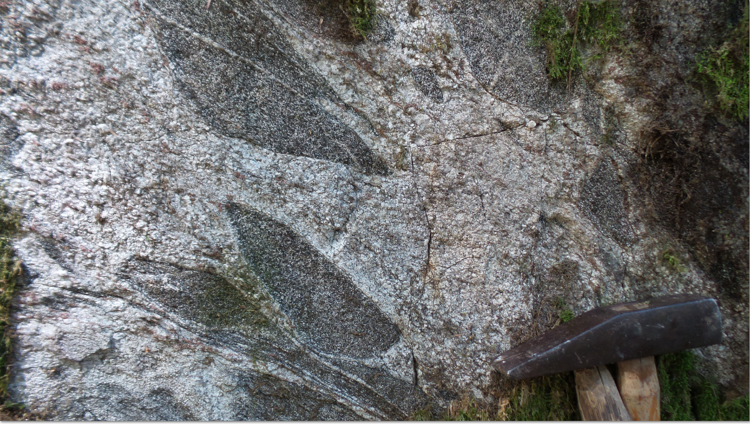
Turner and Geraghty – Fold Chronology and Stratigraphic Relations, SE Adirondacks
Agmatite from 500
meters east of Brant
Lake quadrangle, in
Silver Bay quad
beneath the AMCG
Sill.

Slide 14
Turner and Geraghty – Fold Chronology and Stratigraphic Relations, SE Adirondacks
Field Relations – Lake George AMCG Sill
Wide areal extend – approximately 25 km N-S and 25 km E-W
Thickness – 300-400 meters in area studied
Cross-cutting jotunite dikes in country rock
Inclusions of country rock
Igneous textures throughout most of body
Foliation only at margins (typically less than 1-meter zone)
Mylonitized country rock below and above the sill
Inverted pigeonite; pristine opx and cpx parallel growths
Clear, subhedral, non-tectonized garnets only
F2 and F3 folds – no F1 folds
Magmatic differentiation evidence

Slide 15
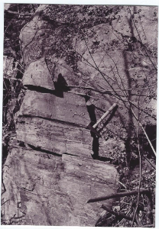
Turner and Geraghty – Fold Chronology and Stratigraphic Relations, SE Adirondacks
Basal contact of the AMCG sill with
mylonitized khondalite; hammer head is
at the knife-edge contact; west side of
Middle Mtn, Silver Bay quad; mafic
charnockite shows tectonic fabric in lower
1 meter only; mylonite and other sheared
rocks extend 100-120 meters beneath the
contact.

Slide 16
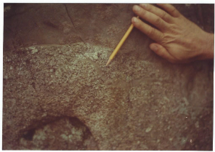
Turner and Geraghty – Fold Chronology and Stratigraphic Relations, SE Adirondacks
Anorthosite with an
apophysis of meta-
gabbro, AMCG sill,
Silver Bay quad
(Phil Whitney’s
hand)

Slide 17
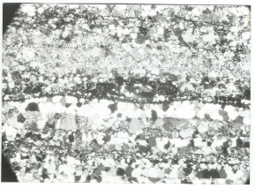
Turner and Geraghty – Fold Chronology and Stratigraphic Relations, SE Adirondacks
Photomicrograph of
ultramylonite near base of
AMCG sill, near Middle Mtn,
Silver Bay quad

Slide 18
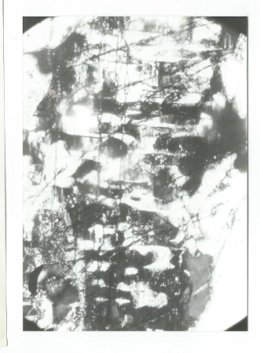
Turner and Geraghty – Fold Chronology and Stratigraphic Relations, SE Adirondacks
Inverted pigeonite; orthopyroxene
dark, exsolved clinopyroxene
lamellae light, {110} cleavages of opx
shows direction of c axis of opx, thus
lamellae parallel to (001); sample from
AMCG Lake George sill, Silver Bay quad

Slide 19
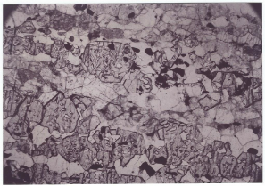
Turner and Geraghty – Fold Chronology and Stratigraphic Relations, SE Adirondacks
Subhedral, clear garnet in
meta-igneous sill, non-tectonized

Slide 20
Turner and Geraghty – Fold Chronology and Stratigraphic Relations, SE Adirondacks
Stratigraphy of Metasedimentary Rocks
  One marble versus two marble question:
    Geraghty sees two marbles in central Adirondacks.
    Turner sees one marble repeated by folding and ductile thrusting and complicated by chemical change along strike
  Stratigraphy is indeterminate:
    Repetition of compositional layers by isoclinal folding, intrafolial folds, positional thickening/thinning, and many ductile shear zones makes traditional stratigraphy virtually impossible to determine in some, but not all, locations.
    Percentage of Pleistocene cover and scale of mapping (1:24,000) do not permit sufficiently fine-grained studies.
    Anatexis of some metasedimentary rocks complicates identification and measurement.
    Either original facies changes and/or metasomatic compositional change complicate identification further.
  It would be more instructive to say that the metasedimentary strata in portions of the eastern and central Adirondacks are characterized by tectono-stratigraphy more than by a simple shelf sequence.

Slide 21
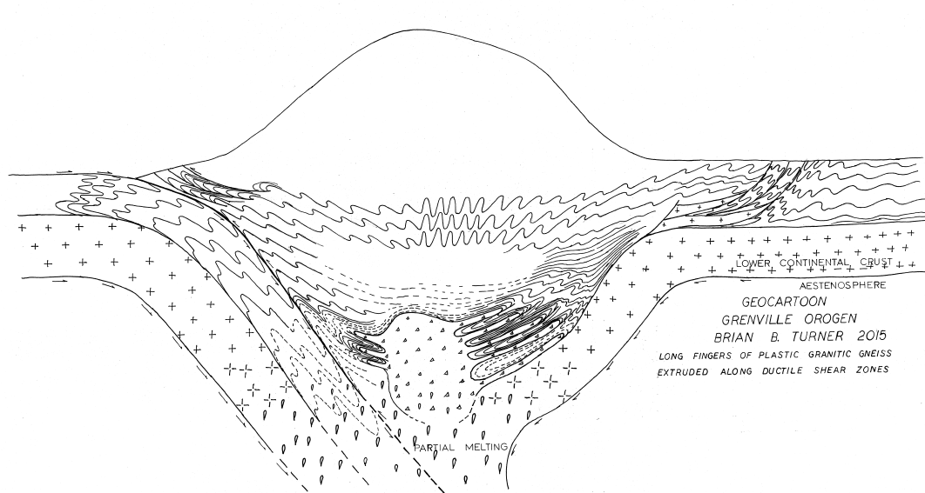
Turner and Geraghty – Fold Chronology and Stratigraphic Relations, SE Adirondacks

Slide 22
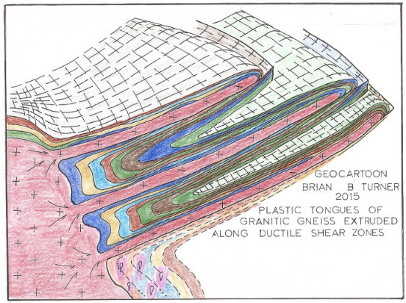
Turner and Geraghty – Fold Chronology and Stratigraphic Relations, SE Adirondacks

Slide 23
Turner and Geraghty – Fold Chronology and Stratigraphic Relations, SE Adirondacks
Conclusions
  Two high-grade metamorphic events produced different generations of garnet in metasedimentary rocks – Shawinigan and Ottawan.
  A massive sill of the AMCG association intruded country rock along a major ductile shear zone late in the Shawinigan phase, at perhaps 1155 +/- 6 Ma.
  The AMCG sill rocks were subjected to only the last metamorphic event.
  F-1 folds and ductile shear zones were produced in the metasedimentary rocks prior to intrusion of the AMCG association.
  Cores of major F-1 recumbent antiforms may represent granitic material produced deep inside the Grenville orogen that was squeezed out during orogenic collapse (c.f. Halls, 2015):
  “A mature stage of a collisional orogen is marked by widespread orogenic collapse when higher parts of the orogen (such as the Tibetan plateau) begin to collapse, accompanied by wholescale lateral escape of hot ductile crust beneath the cooler carapace.”

Slide 24
Turner and Geraghty – Fold Chronology and Stratigraphic Relations, SE Adirondacks
Conclusions, cont.
  F-1 granitic cores may be as young as 1144 +/- 11 Ma.
  F-2 and F-3 folds affected all rocks including the AMCG sill.
  The second metamorphic event occurred after the formation of F-2 and F-3 folds, producing non-tectonized subhedral garnet.
  The second metamorphic event was likely coeval with widespread anatexis at 1050 Ma (Bickford et al., 2008) and formation of mantled gneiss domes:
  If F-2 and F-3 folding is Ottawan, it must be constrained to the period 1090 to 1080 Ma.
  If F-2 and F-3 folding is late Shawinigan, it must be post 1155 +/- 6 Ma.
  Thus F-2 and F-3 folding is limited to the interval between 1155 Ma and 1080 Ma.
  Stratigraphy is indeterminate in many, but not all, locations of the 4 quadrangles discussed in this talk.

Slide 25
Turner and Geraghty – Fold Chronology and Stratigraphic Relations, SE Adirondacks

