Slide 1
Contaminant Transport and Remediation in an Extensional Fault Zone
Jack Breiner,
Bob Bond, PG, Kevin Kelly, PG
Session: T6. Integrating Structural Geology with Hydrogeology
Monday, 21 March 2016
Paper No. 5-3

Slide 2
Presentation Overview
Geologic Setting
Structural Features
Hydrogeology
Importance of
  Bedrock & overburden aquifer interaction
  Bedding plane vs. tectonic fractures
To assess
  Plume migration & delineation
  Risks to receptors

Slide 3
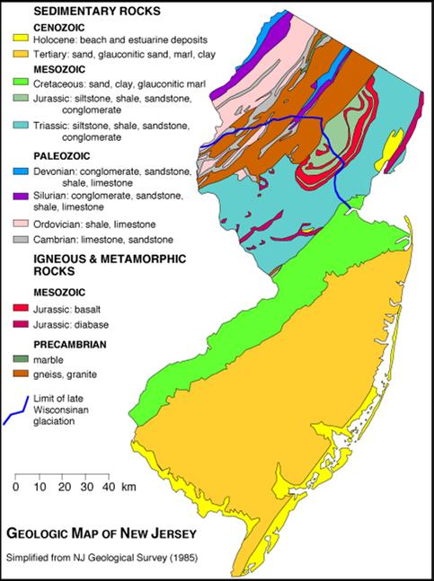
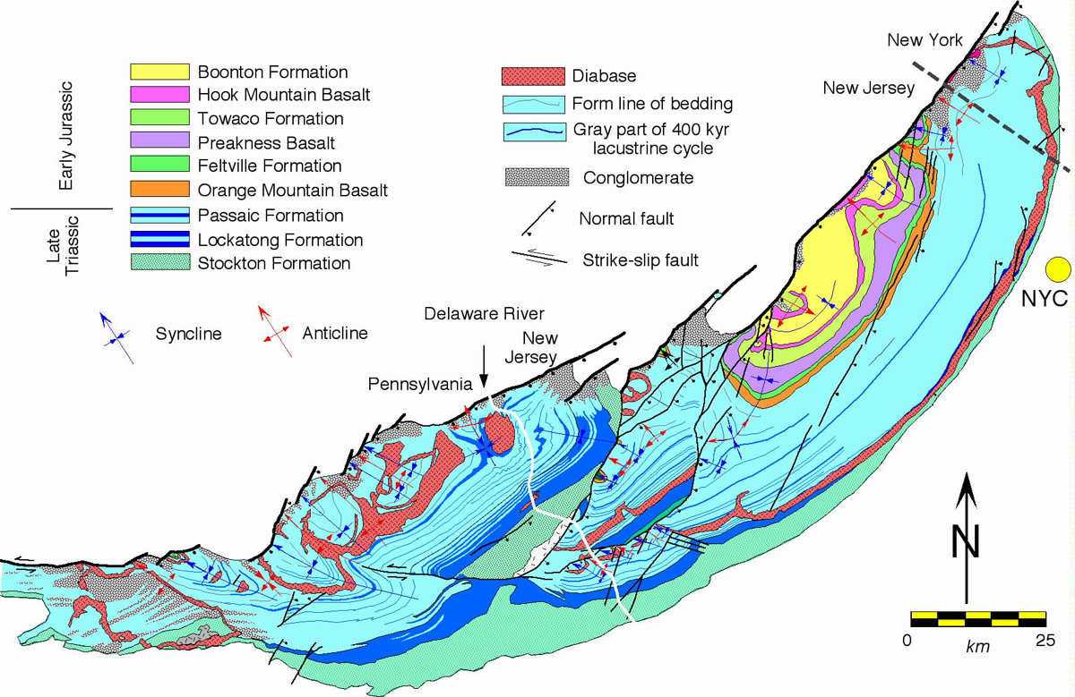
Geologic Setting – Newark Basin
Triassic Passaic Formation (Brunswick) in the Newark Basin of New Jersey
Site Location
SITE
Paul Olsen and others, Lamont-Doherty Geological Observatory and Roy Schlische, Rutgers University
Notes:
Start state-wide, regional, bring it back down to site-specific scale.
Newark Basin of New Jersey
Triassic Passaic Fm.

Slide 4
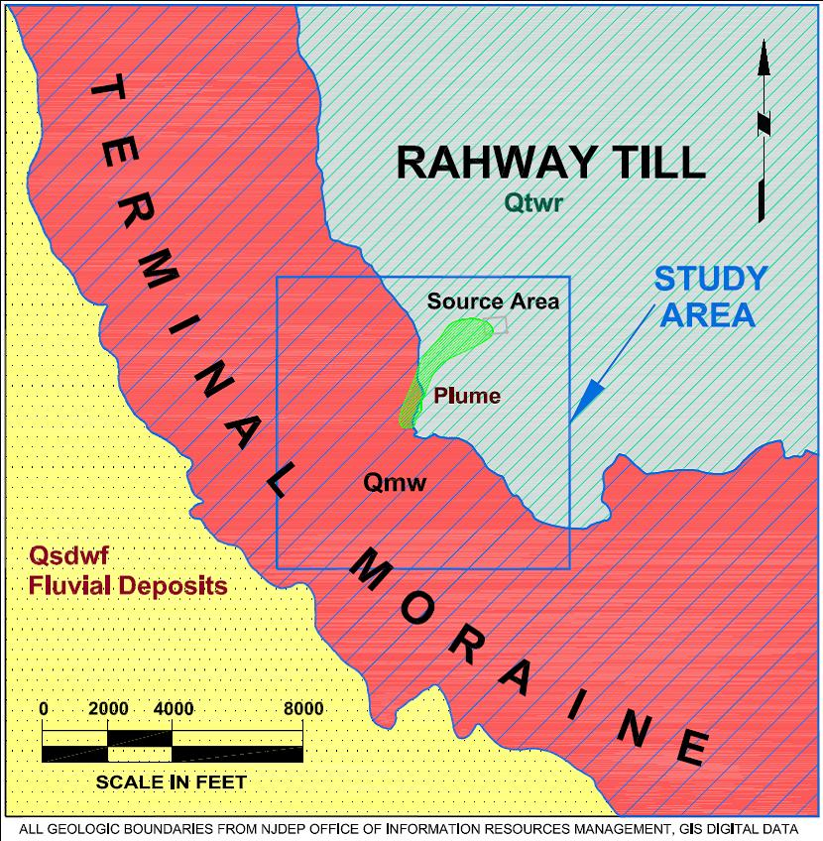
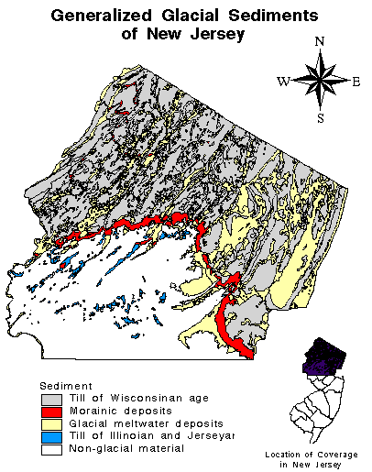
GEOLOGICAL SETTING – GLACIAL DEPOSITS
Notes:
Point out site location
Note that plume crosses the interface of Rahway Till/Terminal Moraine of Winsconsinan Glaciation

Slide 5
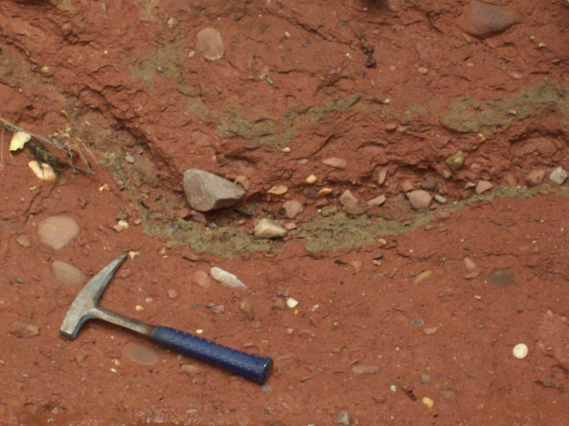
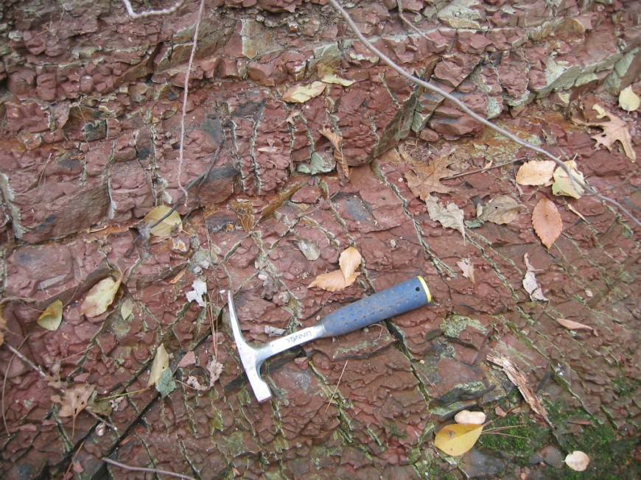
Geologic Setting
Overburden
Rahway Glacial Till
Terminal Moraine (Till)
Plainfield Outwash Deposits
Bedrock
Passaic Formation
Fractured Interbedded Shales, Siltstones and Mudstones
Homoclinal Structure,
Average Strike N45ºE
Dip 8^{o -} 12º NW in study area
Notes:
Site generally overlain by 20-40’ of Rahway Glacial Till and Outwash Deposits
Point out tills, glacial in origin, reference large cobbles with finer matrix shown in pictures
Homoclinal structure
Originally measured by NJGS and confirmed with geophysical surveys; determined that bedrock strikes NE-SW, right along N45W
Average of approximately 8-12 degrees dip to NW

Slide 6
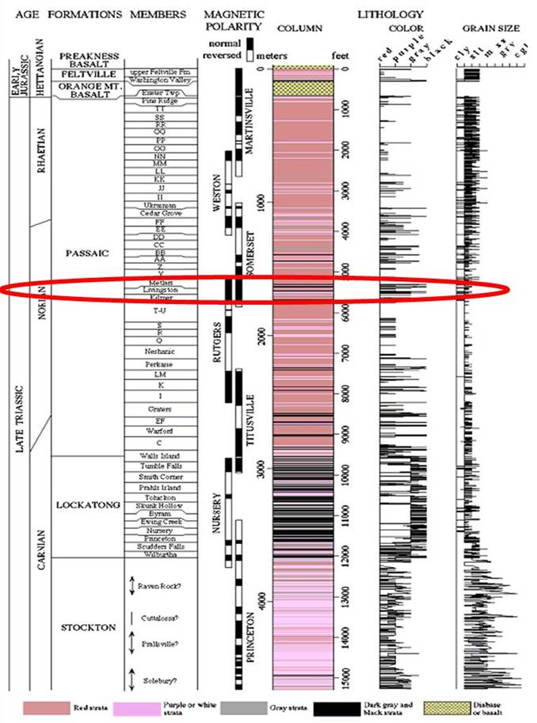
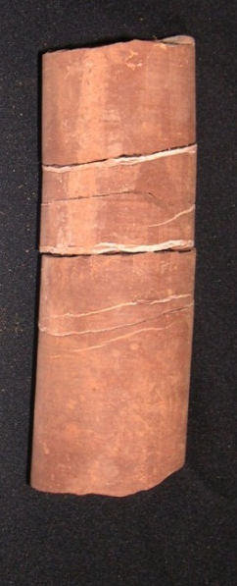
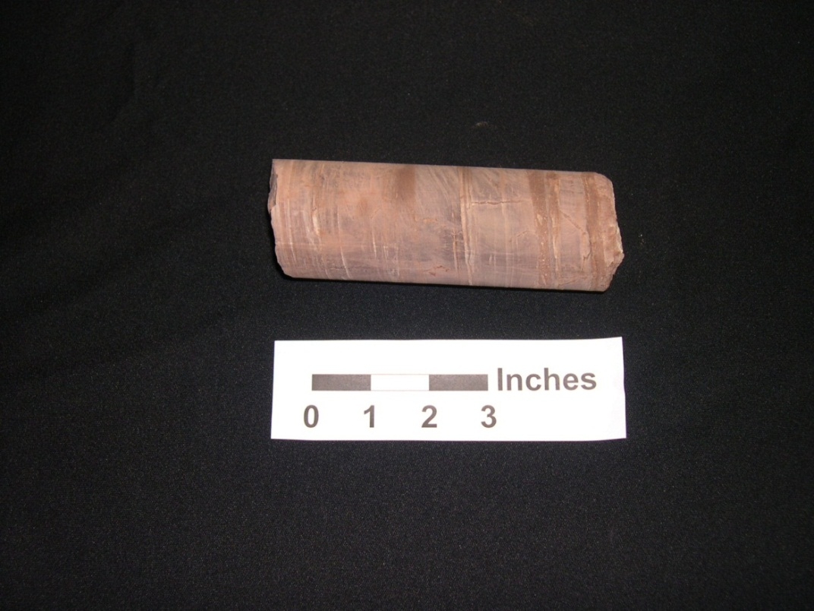
Geologic Setting - Bedrock
Late Triassic Passaic Formation
Livingston Member
Kilmer Member
Modified from Well Logging Results from the Newark Rift Basin Coring Project - D.S. Goldberg(1), D.J. Reynolds(1,3), C.F. Williams(2), W.K. Witte(1,4), P.E. Olsen(1) and D.V. Kent(1)
Notes:
Bedrock
Late triassic passaic fmn
Livingston and Kilmer members
Purple marker bed (left picture)
Red-brown mudstone, some iron leatching hard to see in picture but used as a correlation tool as well

Slide 7
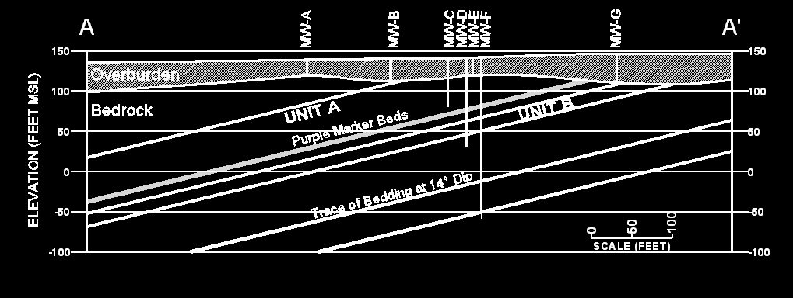
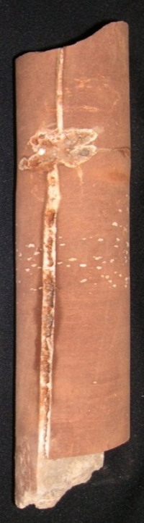
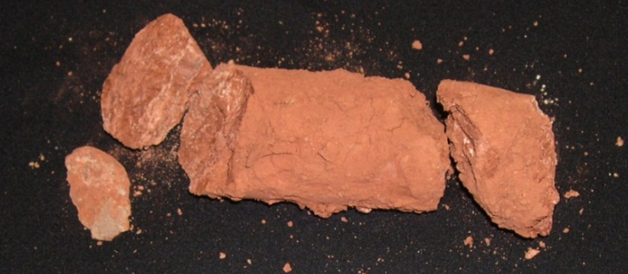
GEOLOGIC SETTING – CORE SAMPLES
Purple mudstone
Mineralized bedding partings
Intensely weathered bedding parting
Mineralized near-vertical fracture & root cast
Notes:
Bedrock Characteristics and Major Features
Coring completed in 2001?
Shows purple marker beds
Mineralized beddings plane partings indicative of water flow through that zone
Root casts and near vertical fractures
Help orient geophysical logs and identify offsets in fault zone

Slide 8
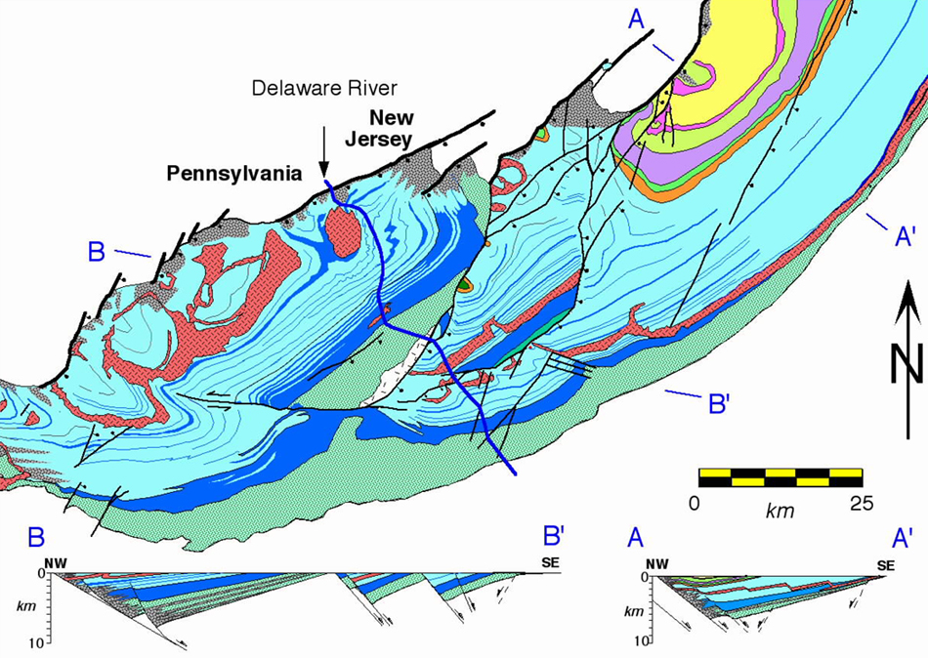

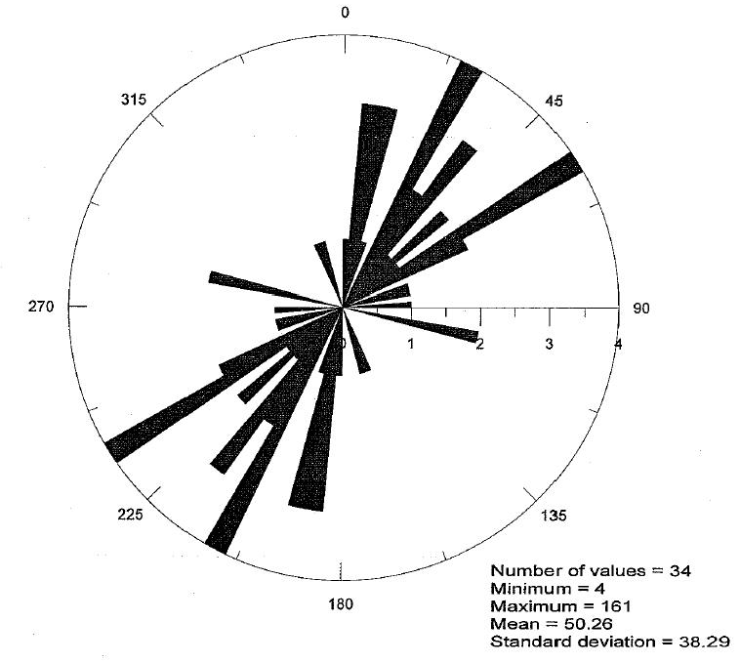
Structural Setting – Extensional Faults
SITE
0
10
km
FF
NBF
HF
WMPF
ACOUSTIC TELEVIEWER DATA - STRIKE OF FRACTURES IN SITE AREA
NAWC
Modified from Paul Olsen and others, Lamont-Doherty Geological Observatory and Roy Schlische, Rutgers University
Notes:
Regional location
Point out NAWC (Naval Air Warfare Center)
Point out faults
Flemington Fault
Hopewell Fault
New Brunswick
Weston Mills Pond Fault
Un-named fault on-site, Edison nammed in 2006 GSA paper as Farmhaven Brook Fault by BB/KK
Diagram shows both bedding and tectonic fractures, strikes of fractures in rose diagram line up very well to the orientation of the fault but there are some outliers…we’ll discuss that more later

Slide 9
Major Planar Features
Tectonic Fractures
Tectonic Fractures
Tectonic Fractures
Tectonic Fractures
Tectonic Fractures
Bedding
Tectonic Fractures
Tectonic Fractures
Bedding
Bedding
Notes:
Bread and butter of the talk
Beddding plane partings and tectonic fractures
Conjugate jointing where the joints are intersections at less than 90 degrees

Slide 10
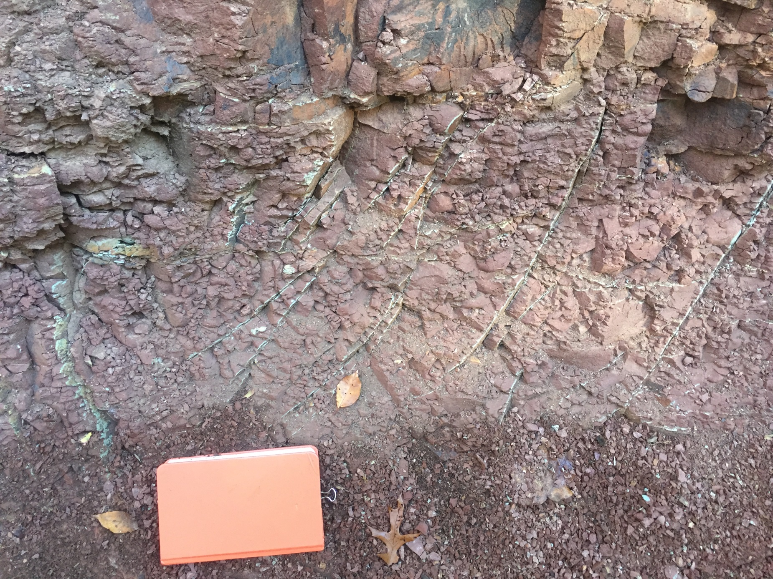
Notes:
More recent picture from outcrop in streambed
Same principle over larger scale
Can see mineralizations in bedrock

Slide 11
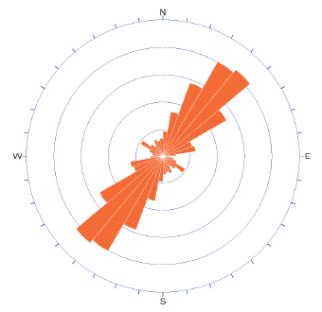
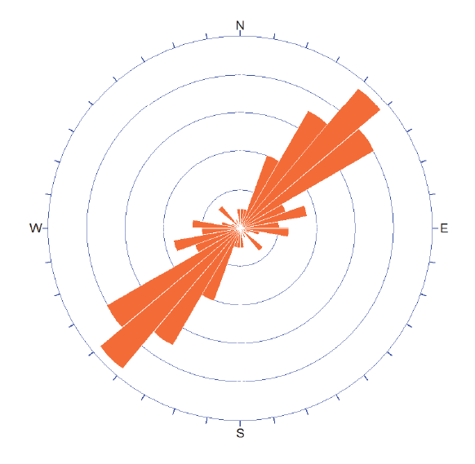
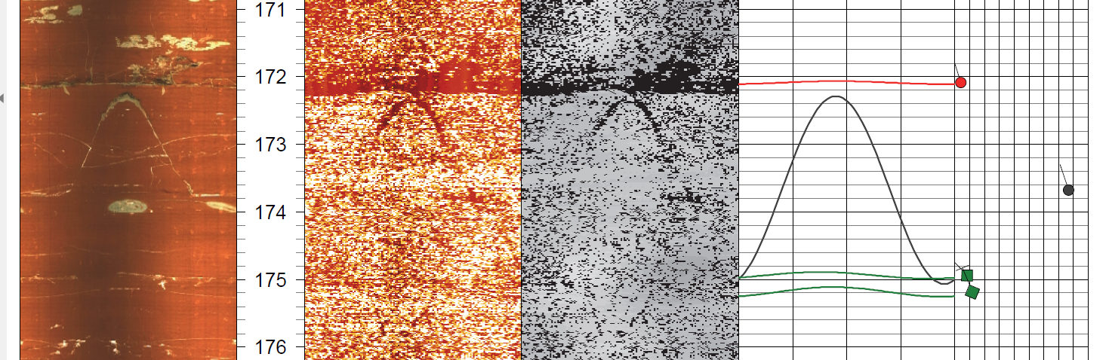
Water-Bearing Fractures
Fractures
  Bedding-plane partings
  Steeply dipping tectonic extension fractures
  Other moderately to gently inclined fractures of various origins
Bedding
Notes:
OTV/ATV shows steeply dipping fractures and bedding plane partings, point out each for those that are unaware

Slide 12
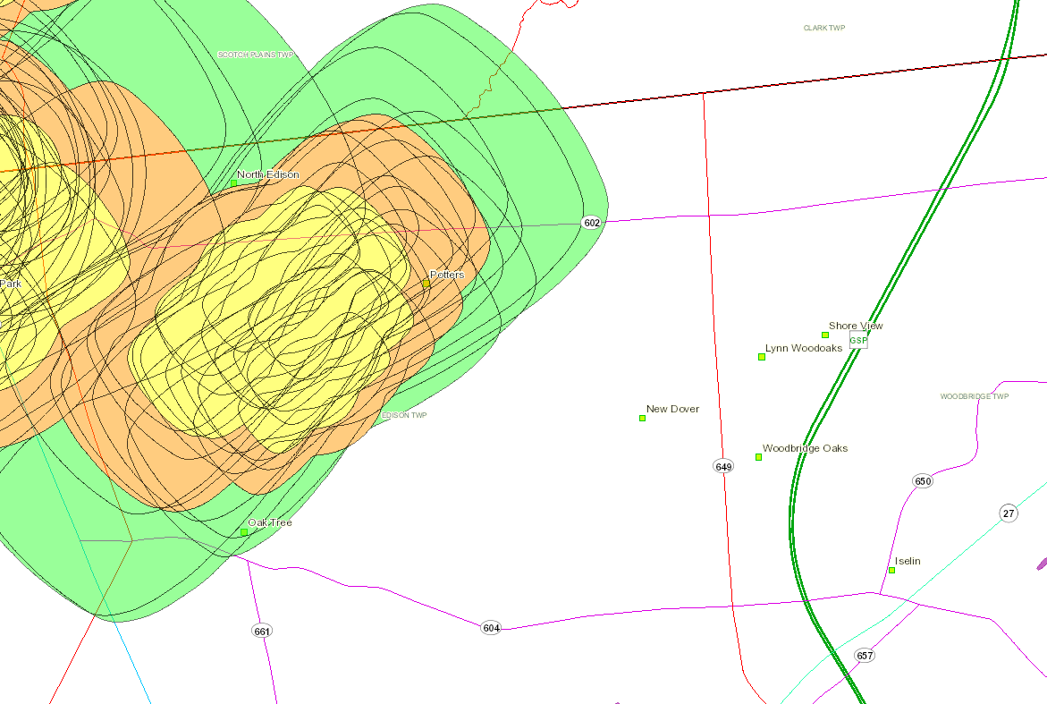
Anisotropic Response to Pumping
Site
Notes:
From Geoweb
Regional view
Shows Well Head Protection Areas around municipal wells, three tiers of color based on travel times to the wells
2,5,12 years
Correlates to general strike of bedding for the Basin

Slide 13
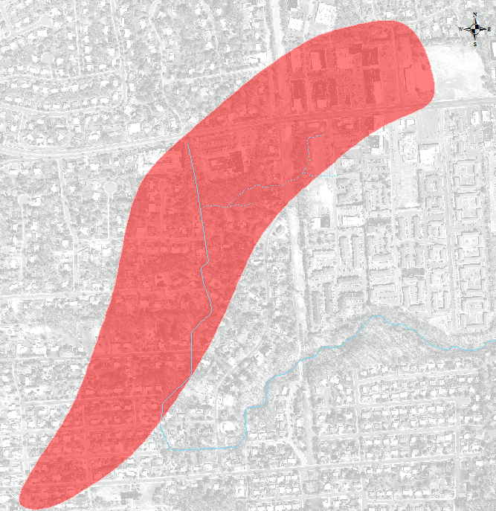
BEDROCK PLUME
110-acre (44 hectare) plume
TCE generally <1,000 ug/L
Plume “bends” to the south
Numerous off-site sources contributing
Upwelling
5,300 feet
TCE Plume Map

Slide 14
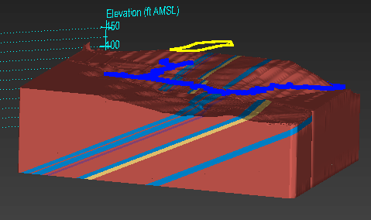
BEDROCK SEQUENCE STRATIGRAPHY
Notes:
Technique originated in oil industry that is used to document offsets in stratigraphic column
Fault block diagram showing horizontal offset, vertical offset is approx 60’, horizontal offset is 700’
Technically a oblique-slip fault model with left-lateral strike-slip
3D project work in EVS and MVS
Major water bearing zones and marker beds

Slide 15
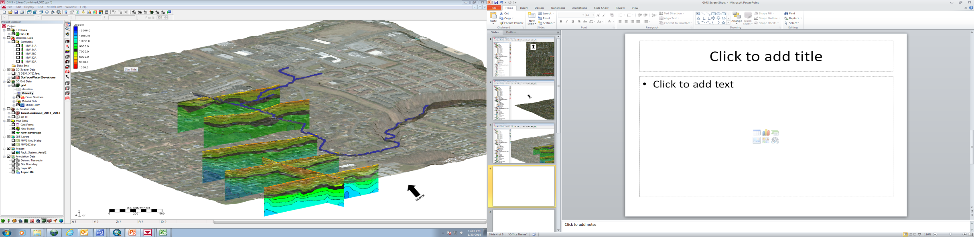
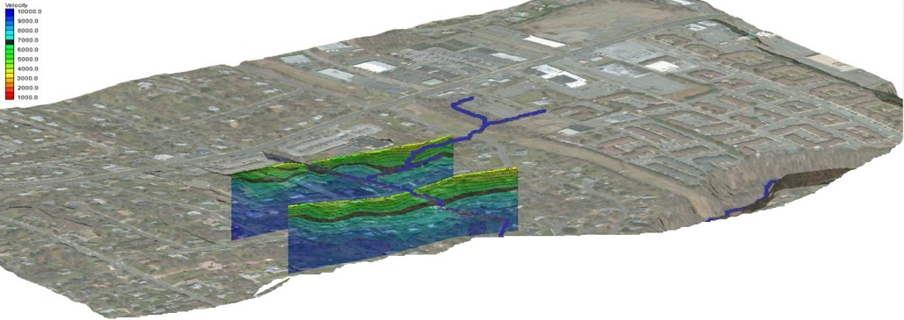

SEISMIC REFRACTION TRANSECTS
Notes:
Seismic transects
Fault Zone
Pre-glacial drainage chanel
Completed by KK, previously presented

Slide 16
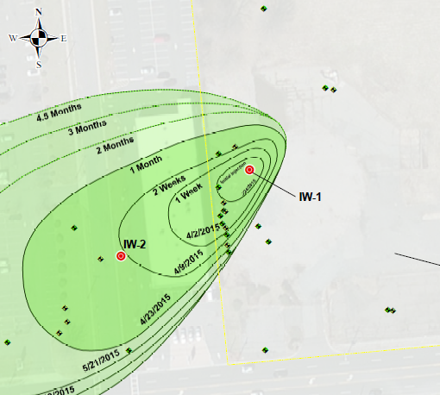
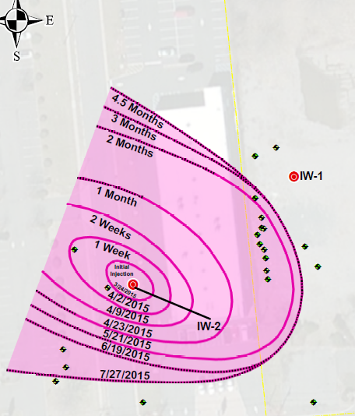
Different Dye Distribution Pathways
Notes:
Impact on contaminant mobility and distribution
Introduce the idea of two different mechanisms of transport
In IW-1 the tracers moved along the bedding plane partings, along strike (~5-20ft/day depending on depth), with some downdip component (~2ft/day)
IW-2 has little movement along bedding planes and more movement perpendicular to strike
What is the reason for this…

Slide 17
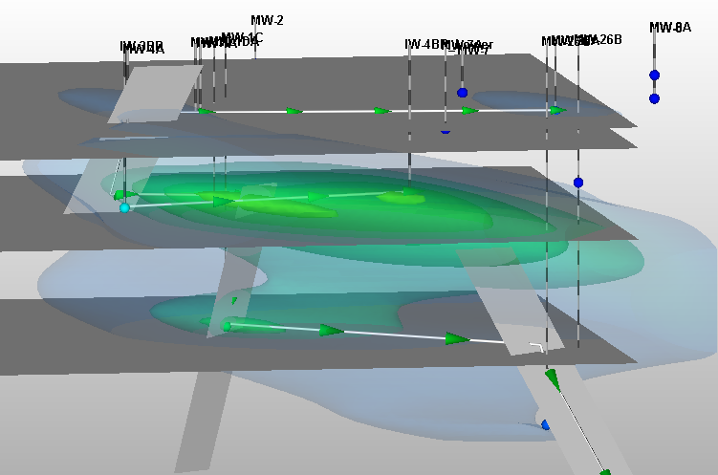
Fluorescein Distribution (3-D)
Notes:
Down-dip distribution of FLC
Evident that bedding planes (dark grey) are main mechanism for transport in this borehole

Slide 18
Different Dye Distribution Pathways
Notes:
Impact on contaminant mobility and distribution
Introduce the idea of two different mechanisms of transport
In IW-1 the tracers moved along the bedding plane partings, along strike (~5-20ft/day depending on depth), with some downdip component (~2ft/day)
IW-2 has little movement along bedding planes and more movement perpendicular to strike
What is the reason for this…

Slide 19
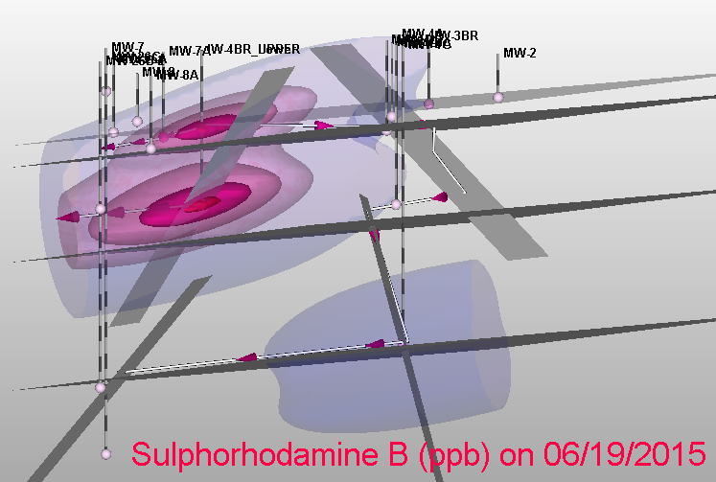
SRB Distribution (3-D)
Notes:
Along strike cross section
Although some movement along bedding planes, you can see more of the dye is contained in the fracture planes (light grey) than in the bedding planes

Slide 20
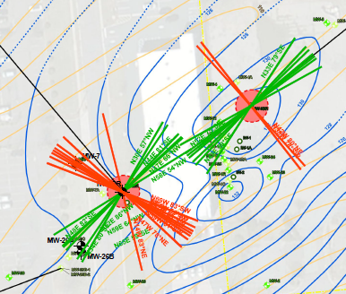
Open Tectonic Fractures
(>45º dip) All Depths
IW-1
Two open tectonic fractures Ⱶ to strike
IW-2
Eight open tectonic fractures Ⱶ to strike
Notes:
Telling graphic for bedding plane vs. fracture plane movement of dyes discussed in the previous slides
Reason for dual transport is tectonic fractures
Mapped bedding planes (green) vs. tetonic fractures (red)
IW-1 has only 2 fractures perpendicular to strike where IW-2 has 8 tectonic fractures perpendicular to strike
This is why we’re seeing up-gradient movement of the contaminants back toward site in IW-2
Mention 3D modeling to achieve conclusions, in interest of brevity left those figures out

Slide 21
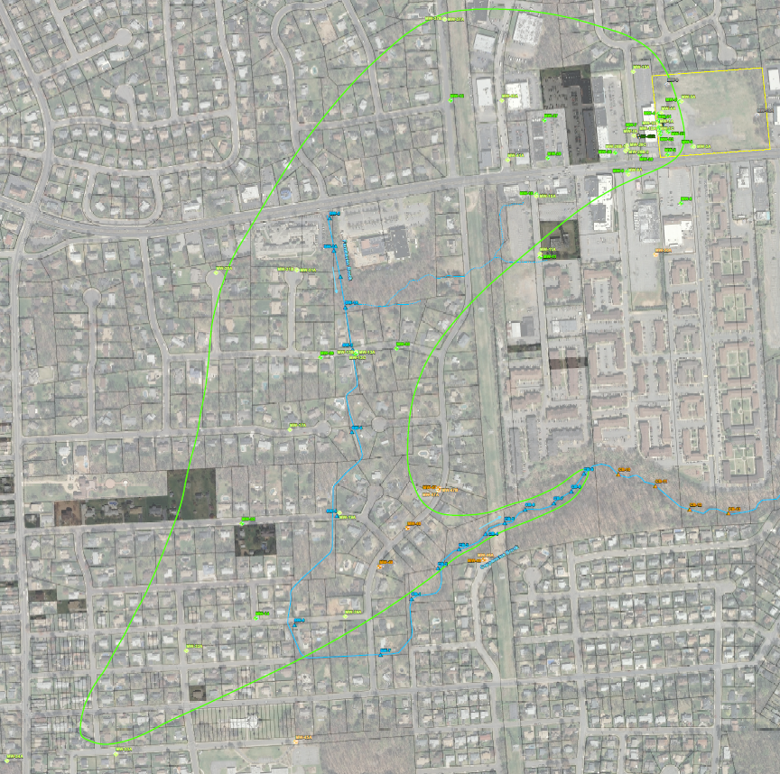
TCE Plume in bedrock aquifer to 1 ppb
En echelon fault system
Bedding Strike (N45E)
Stream reach parallel to bedding
Pre-glacial drainage channel
Notes:
Big Picture
Essentially this is a review slide of what we’ve talked about so far and a set-up slide to get into the BR draining to stream
Overall plume
Follows along strike until hits en echelon fault system and turns south
Not shown in great detail here due to scale
Bedding strike direction
Pre-glacial drainage channel and current drainage channel align with site-wide strike
Stream incises our section
OB-clean, to be expected from OB investigation
Shallow BR-contaminated, but just above regulatory levels
Deep BR- main contamination pathway, elevated TCE in surfacewater’
Hook in plume…interesting characteristic
Due to recent surface water sampling
Bedrock draining to surface water body can act as delineation boundary, sampled for delineation, WENT WRONG because TCE came up in the stream

Slide 22
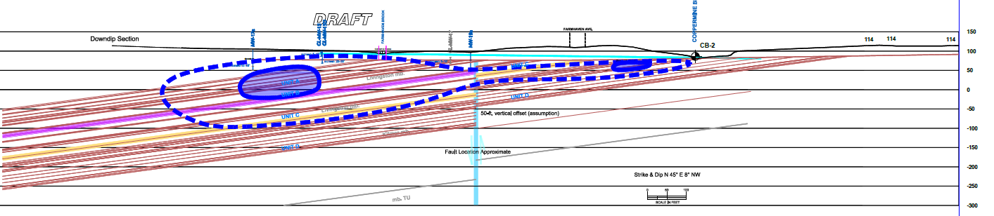
Down-Dip Cross Section

Slide 23
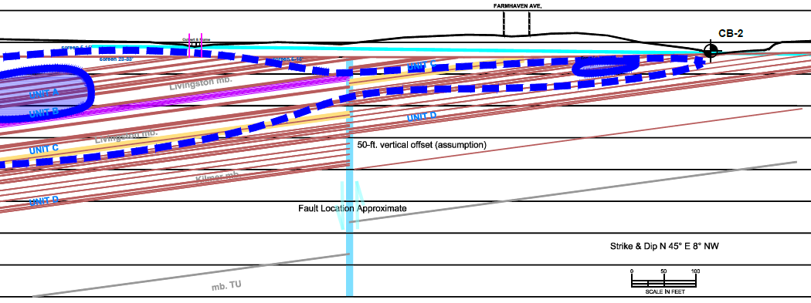
Down-Dip Cross Section
Notes:
Note units draining to surface water
Units D drains into Coppermine Brook
Point out fault off-set
Soil gas survey conducted presents no VI risk
Also showed 1) the presence of PCE downstream, near CB-11 with;
2) the cut of of chloroform near CB-2 and CB-3 so;
3) we can draw our plume ending near CB-4 and contribute the PCE to already-known offsite sources
Pre-glacial channel (streambed) covered by till (evidenced in OB above BR in streambed, photo) and cut back down during glacial retreat
Acts as groundwater divide
Two new wells installed on southern bank of stream and screened in both overburden and shallow bedrock both show no signs of contamination crossing streambed

Slide 24
Take-Aways
Bedding plane partings and tectonic fractures govern contaminant migration
  Delineation and Protection of Potential Receptors
  Helped develop an appropriate remedial strategy
Contaminant plume moves through a previously undiscovered en-echelon extensional fault system
Bedrock outcrops in and drains to stream, a major hydrogeologic divide.

Slide 25

Questions?
Jack Breiner
215-491-6500
jbreiner@langan.com

