Slide 1
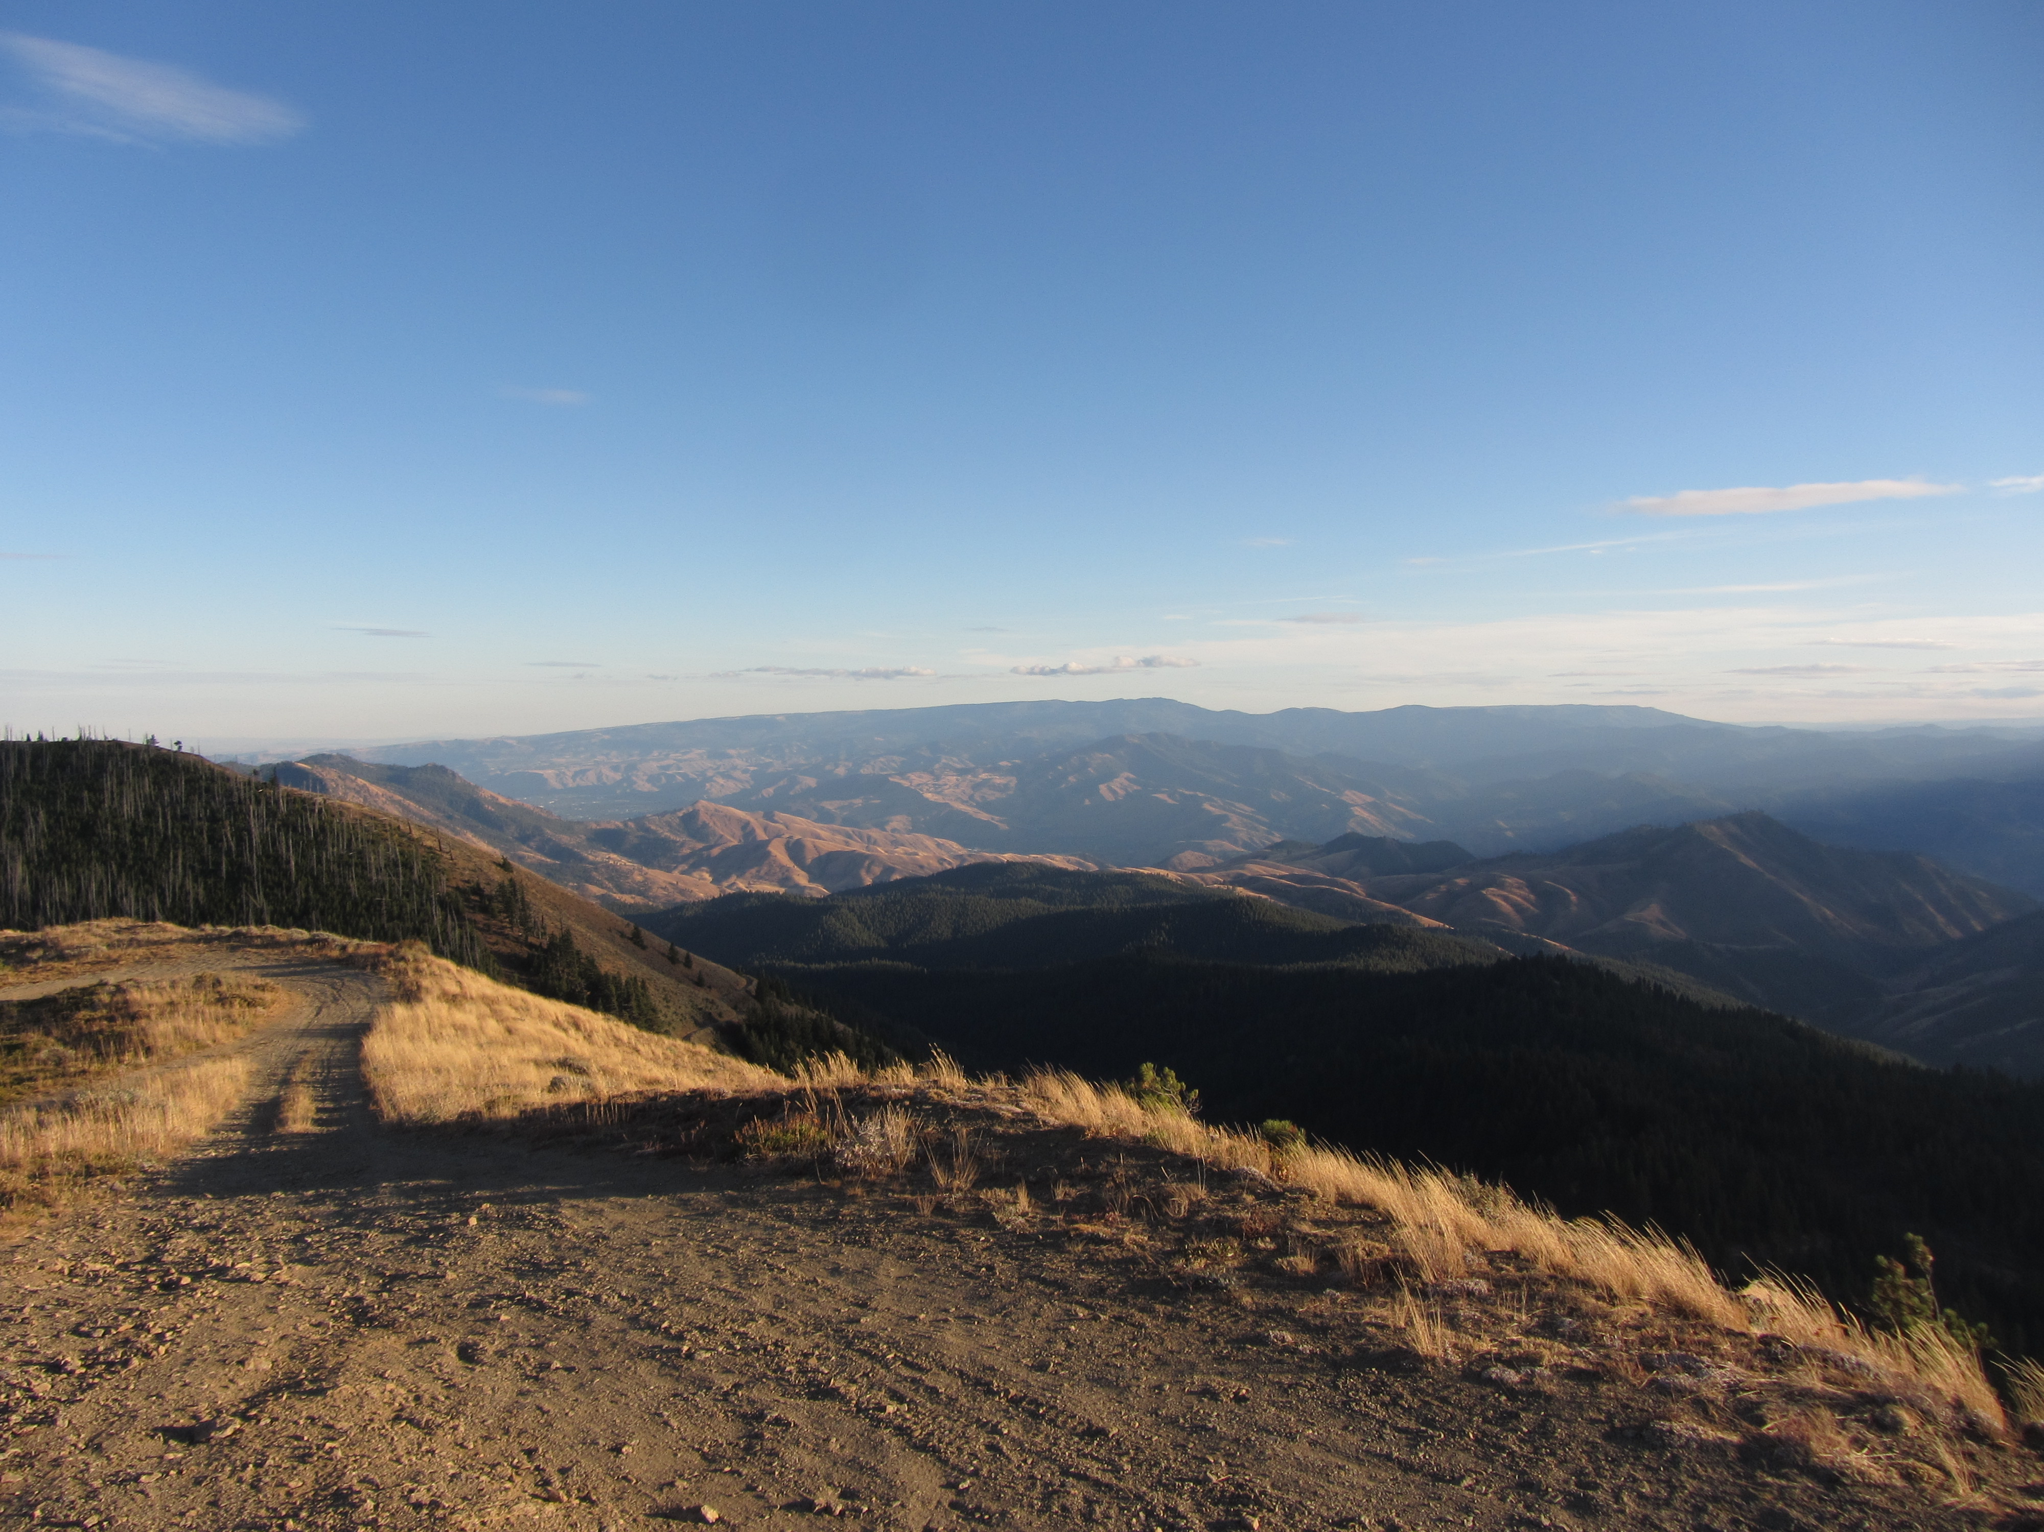





Holocene reactivation of an Eocene bedrock fault in the eastern Cascade Mountains, Washington
Benjamin Carlson, E.R. Schermer, C.B. Amos
Western Washington University 516 High St. MS 9080 Bellingham, WA 98225

Slide 2
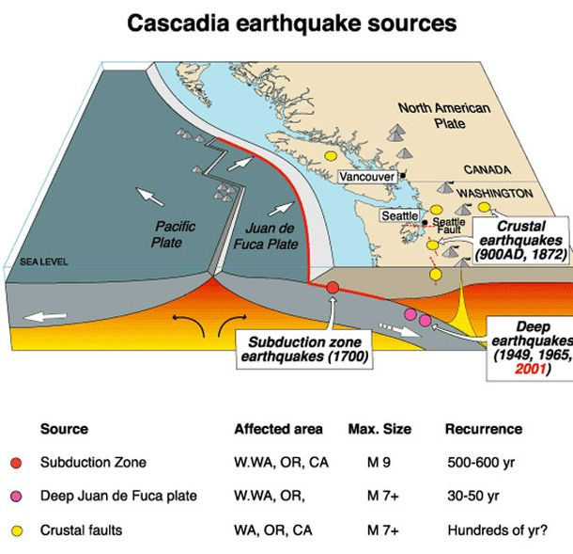
USGS
Notes:
PNW/Washington is a very seismically active part of North America
Subduction zone megathrust
Deep Eqs in downgoing slab
Crustal Eqs (infrequent, small, can occur over a large area) → These exist due to the interesting tectonic framework of western North America

Slide 3
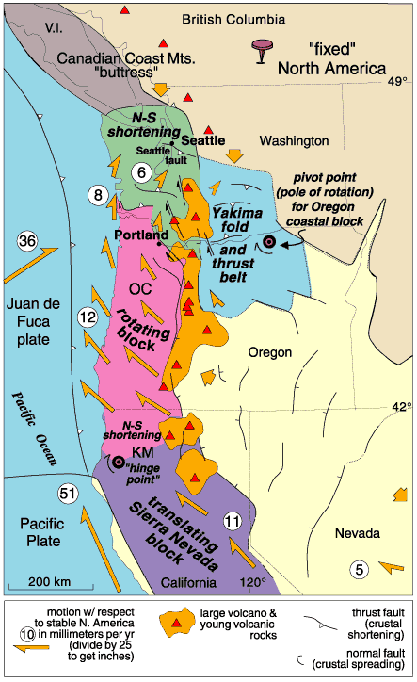
Tectonic framework
Clockwise rotation of rigid tectonic blocks
Driven by NW movement of the Pacific plate relative to North America
N to NE shortening in Washington
Wells et al., 1998
Notes:
Geodetic data show Northward movement of the PAC plate relative to NA imparts northward translation and clockwise rotation of rigid crustal blocks along western North America
This results in compression of WA, composed of relatively deformable rocks, between Oregon and BC
HOW DOES THAT MANIFEST?

Slide 4
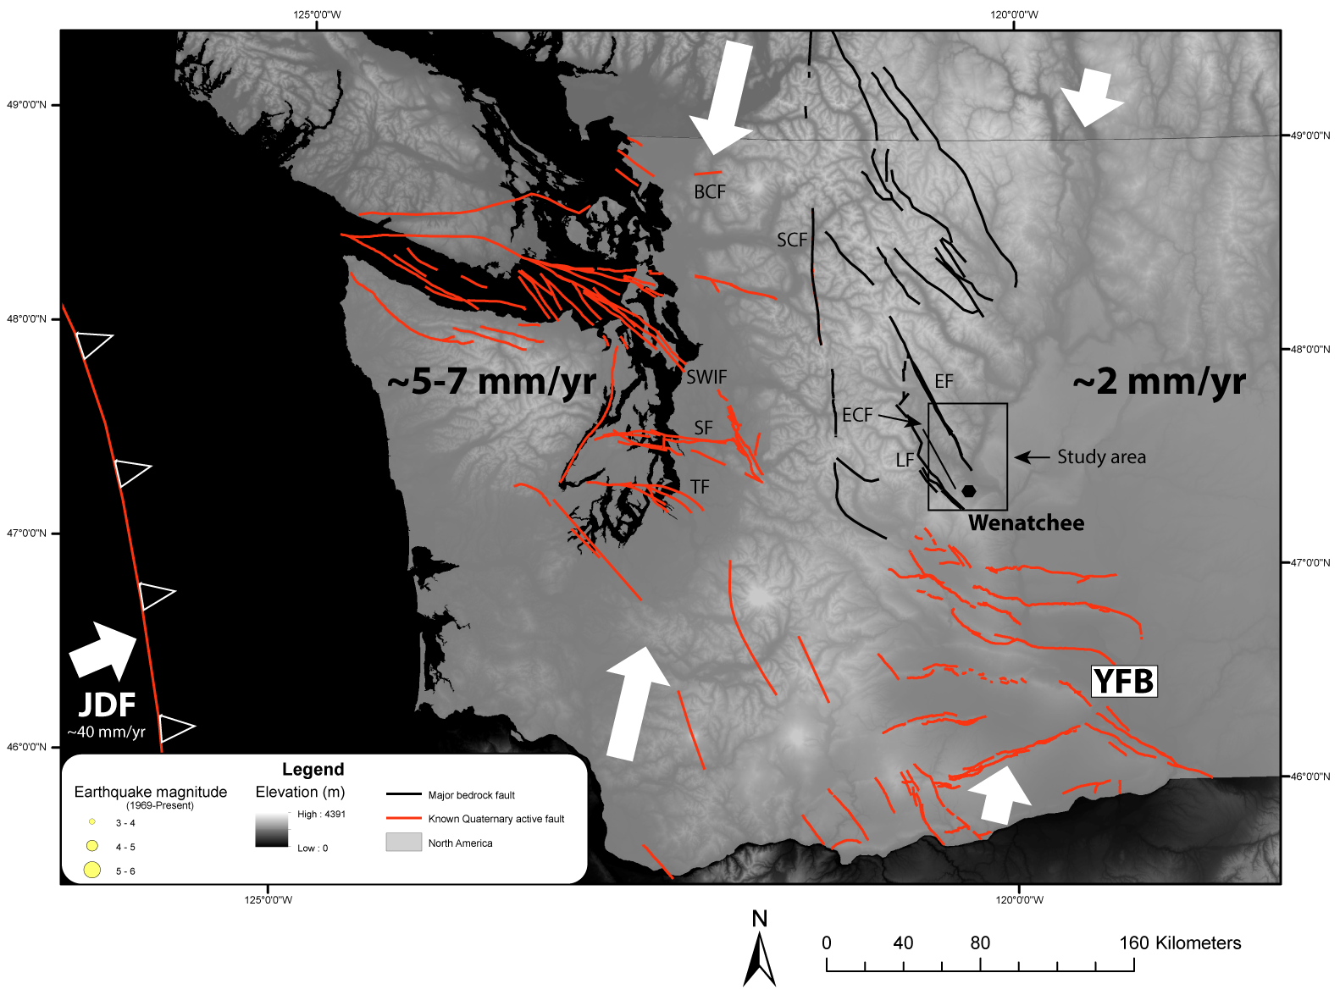
Notes:
How does this manifest?
~5-7 mm/yr shortening west of the Cascades, ~2 mm/yr to the east
Extensive paleoseismic work in W WA has uncovered Shortening is accommodated on many NW-trending reverse faults (red), identification of which has been much improved thanks to LIDAR technology
Population and more rapid shortening rates have made western WA the focus of crustal paleoseismic work (except YFB)
Still 2 mm/yr of shortening east of the cascades. Where is it being accommodated?
There are multiple Eocene bedrock faults capable of accommodating slip as reverse and dextral SS motion

Slide 5
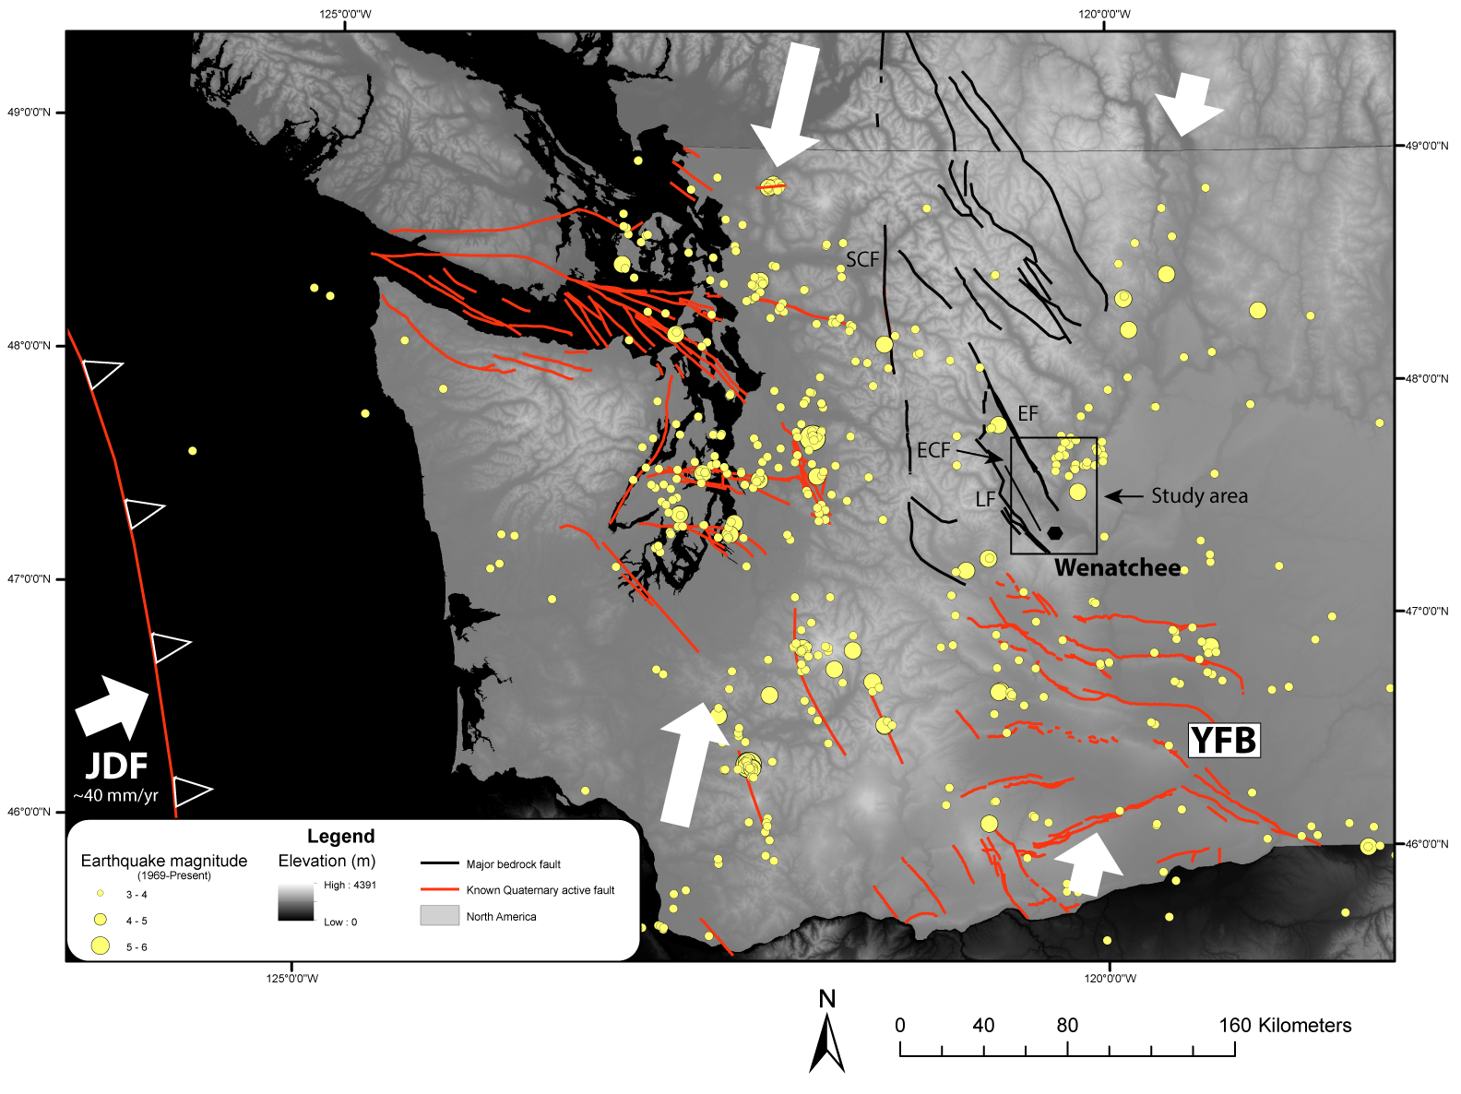
Notes:
If we overlay crustal EQs over the last 50 years, we see significant EQ activity in particular near the southern Entiat Fault
If overlay USGS EQs, can see lots of small EQs in the last 50 years
-largely focused around previously ID’d faults
-interesting swarm near the southern Entiat Fault → this area will be the focus of our study

Slide 6
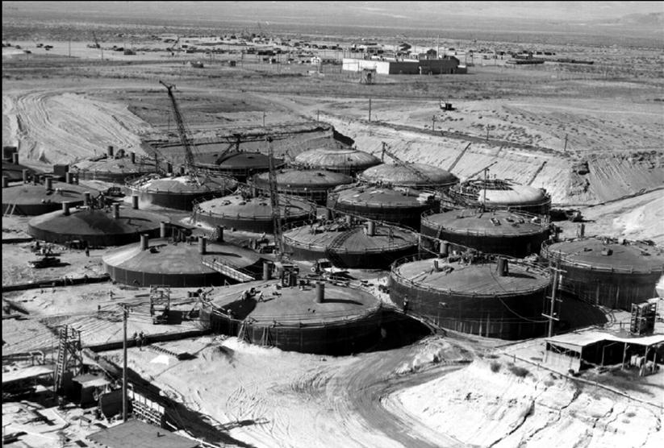
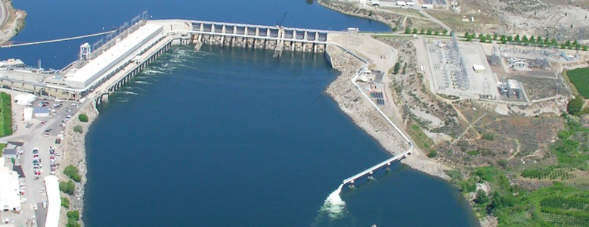
Motivating Questions
Where is shortening accommodated?
Is modern shortening reactivating bedrock faults?
  If so, what is chronology of slip since the late Pleistocene?
  Is deformation localized on discrete structures or is shortening also accommodated by regional folding?
Rocky Reach Dam ⬇ Hanford Nuclear Site ➔
U.S. Dept. of Energy
U.S. Dept. of Energy
Methods
Geomorphic mapping
Trenching
Channel steepness analysis
Notes:
Given the known shortening rates, we would like to know:
1)
2)
To start addressing these questions, we use a combination of...

Slide 7
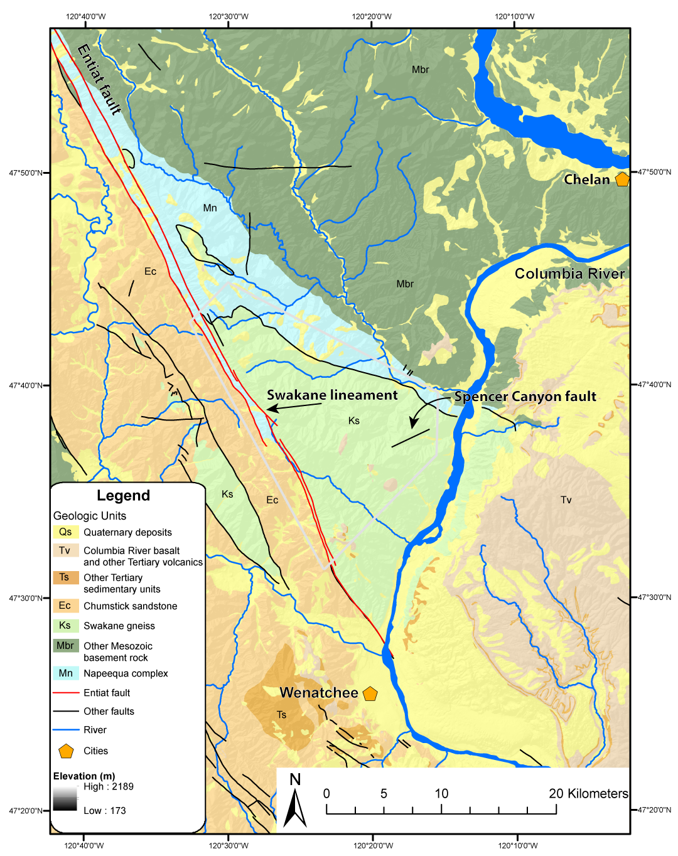
LOCATION
Entiat fault juxtaposes pre-Tertiary metamorphic rock (light green/blue) and Eocene sedimentary rock (orange)
Tertiary history of normal, reverse and oblique motion
Area not impacted by Missoula floods
Notes:
We focused on the southern Entiat fault, mapped as a steeply SW-dipping normal which places mesozoic metamorphic rocks of the Swakane gneiss and Napeequa complex above the Eocene Chumstick basin.
Tertiary history of primarily normal motion, researchers suggest periods of reverse and oblique motion
2014, Brian Sherrod and others (USGS) located the Spencer Canyon fault, holocene active reverse fault likely responsible for 1872 M6.8 EQ
If the Entiat is being reactivated, we would expect some combination of reverse and RL oblique motion
We use the same LIDAR swath to look for geomorphic evidence of recent fault offset → located one lineament of particular interest

Slide 8
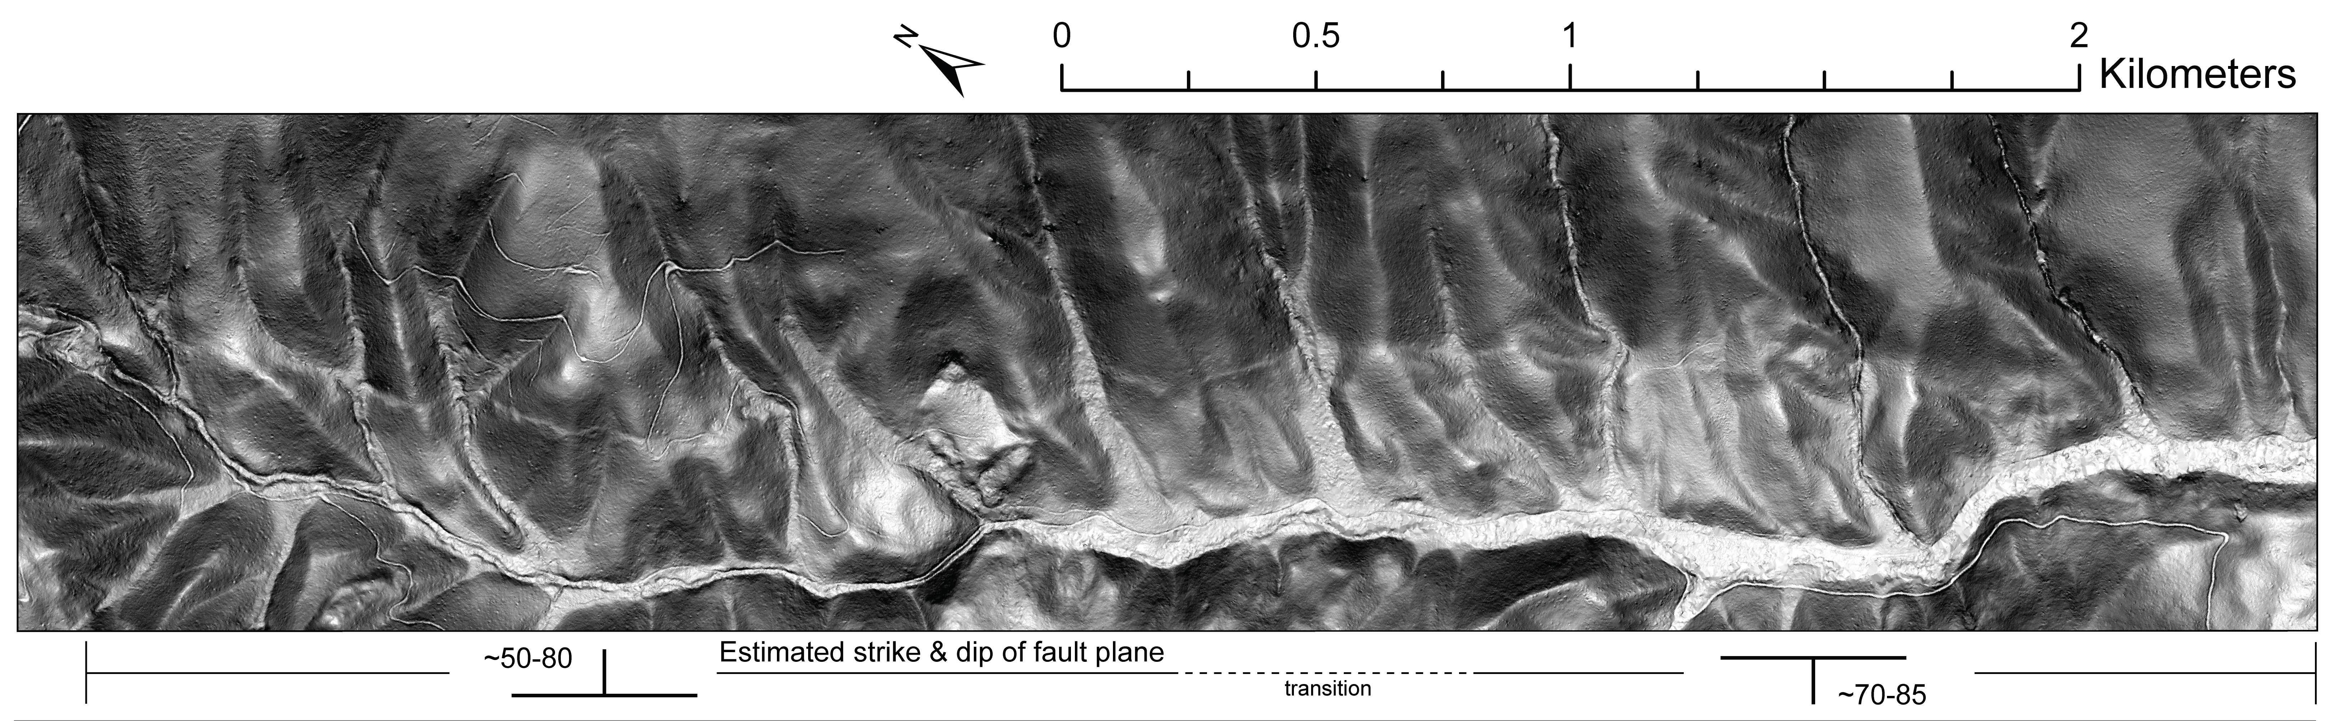
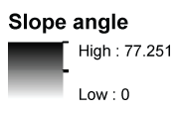
What is generating this feature?
Differential erosion across Swakane internal contact
Quaternary or recent tectonic deformation
°
°
Notes:
Here it is
5 km long SW-side-up lineament cutting across the north side of Swakane Canyon
Two possibilities for what is generating this linement
1) Differential erosion
2) Tectonic deformation

Slide 9
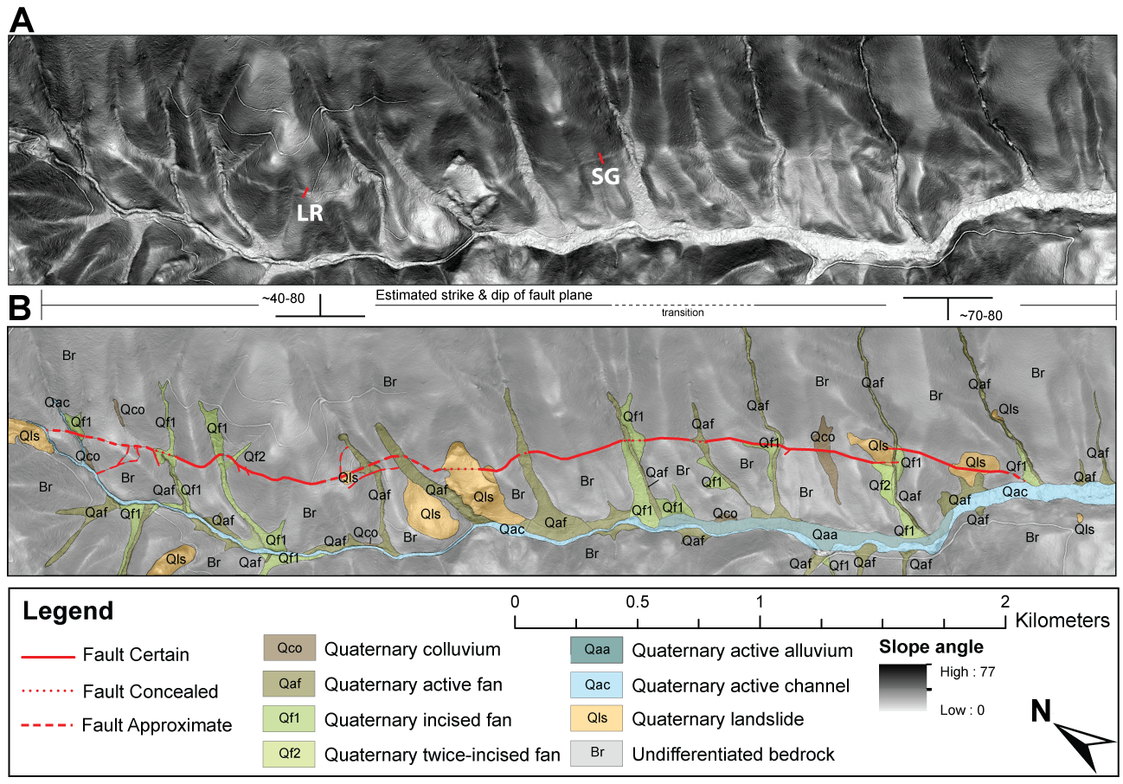
MAPPING/BENCH DESCRIPTION
Notes:
More detailed geomorphic mapping reveals:
SW-side up throughout
Most prominent on ridge crests and side-hills
Obscured in channels beneath Quaternary colluvial deposits, if they are offset, its impossible to tell
Obscured by landslides
3-pt problems suggests a structure who’s dip changes across its length (SW in SE, NE in NW)
No resolvable lateral offset
Field mapping never showed Swakane on the lineament but outcrops above and below suggest a relatively uniform composition
To try to identify the source of this lineament, we trenched, selecting two locations shown on the map based on narrow surface expression, hopefully giving us the best chance at excavating along the fault
I will focus on the SG trench for this talk, best stratigraphic exposure

Slide 10
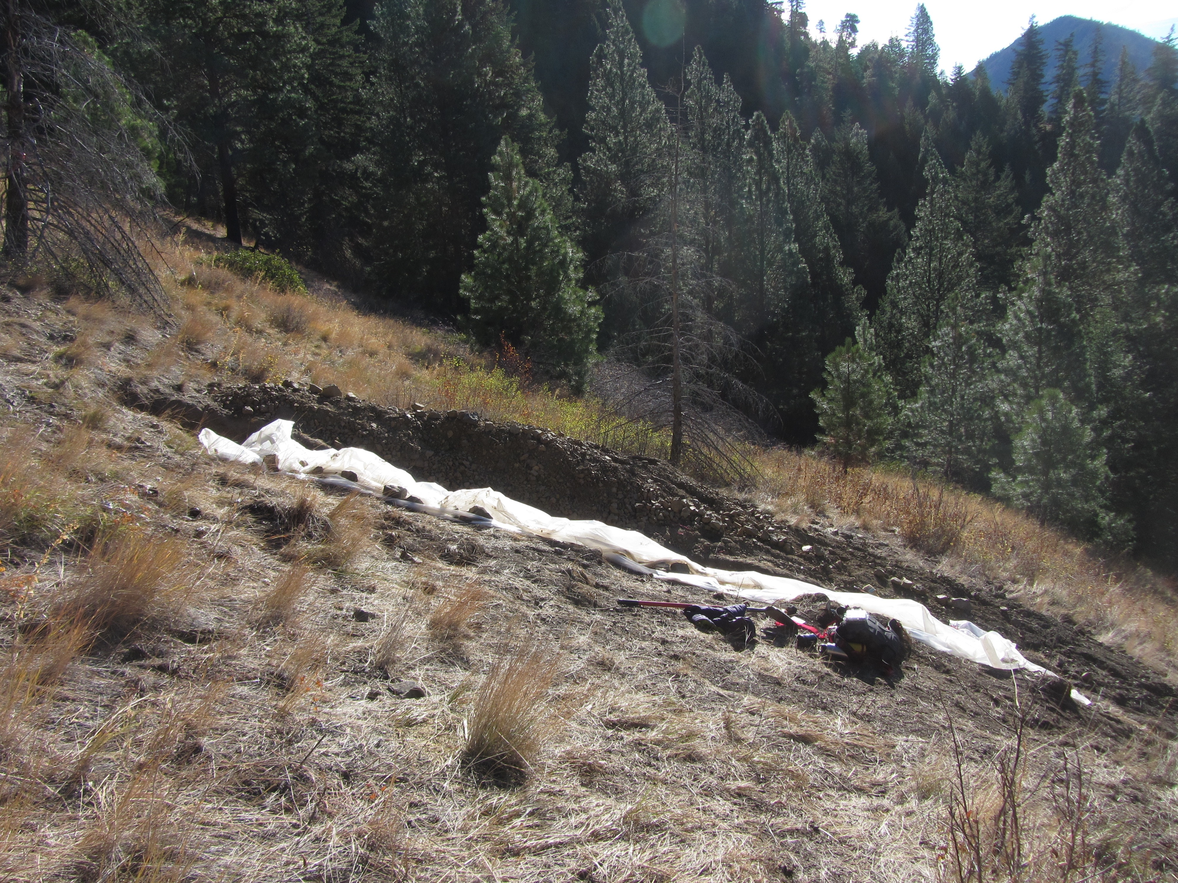
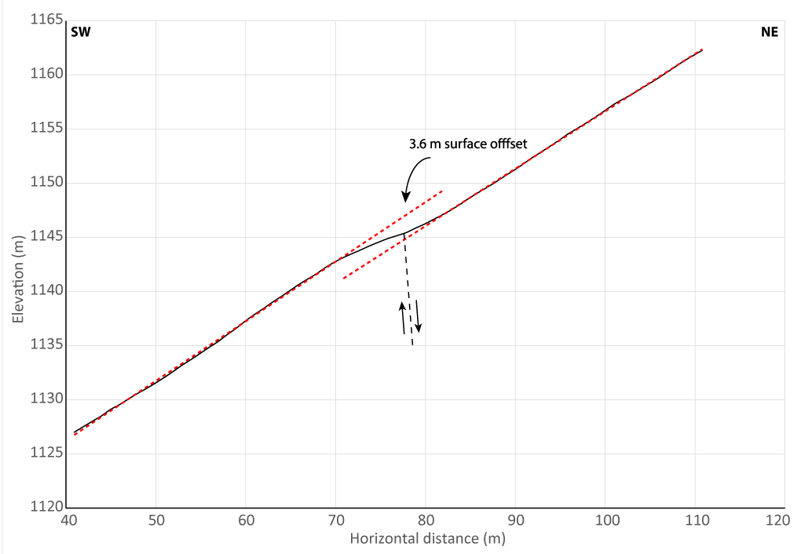
Slick Grass Trench
Slope break
Slope break
Looking SE
Notes:
We hand dug a trench (~8x0.5x2)
-excavation was limited by very clay-rich layer we could not dig through
-topographic profile shows ~3.6 m of surface offset at the trench location

Slide 11
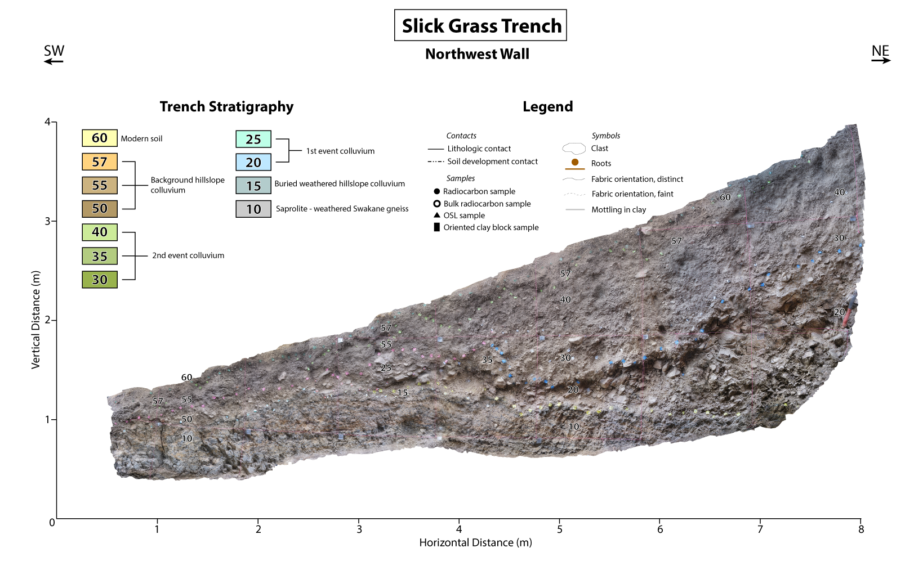
Notes:
Here is a photomosaic of the NW wall of the trench. If we overlay a simplified trench log...

Slide 12
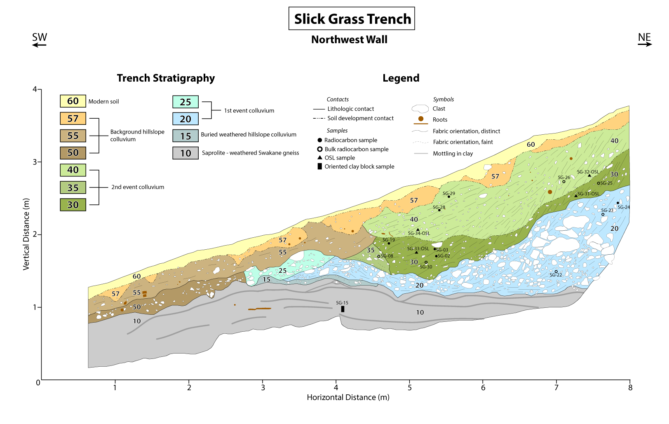
Notes:
NO FAULT!, at least not that daylights at the surface here
Saprolite derived from the local gneiss bedrock
We identified 2 distinct colluvial units with wedge shaped geometry, sharp lower contacts and a downslope dipping depositional fabric consistent with slope-derived colluvium, deposited into accommodation space generated by earthquakes on the Entiat Fault
Distinct lithologies between the upper and lower colluvia as well as the warped geometry of the lower colluvium support multiple earthquakes and subsequent periods of deformation
Downslope deposits likely represent background diffusive hillslope colluvium
PE
Topography in saprolite likely caused by blind faulting
We’d expect it to follow hillslope
Ages of colluvium suggest its deposition is relatively young (< 3 kyr)
Lower colluvium deposited, externally derived
sharp contact, could not have weathered out in place
downslope fabric (infilling?)
Wedge geometry consistent with filling accommodation space
Upper contact does not appear erosional (wouldn’t you expect some deposition of finer material between coarse clasts?)
MRE
warping of lower colluvium (hard to imagine it could have been deposited with that geometry, no evidence of erosion)
Upper colluvium deposited, externally derived
sharp contact, deposits not related
wedge geometry
downslope fabric (infilling)
Propagating weathering front delineating deposits in upper colluvium
Other deposits just related to background diffusive hillslope processes
Thin modern soil

Slide 13
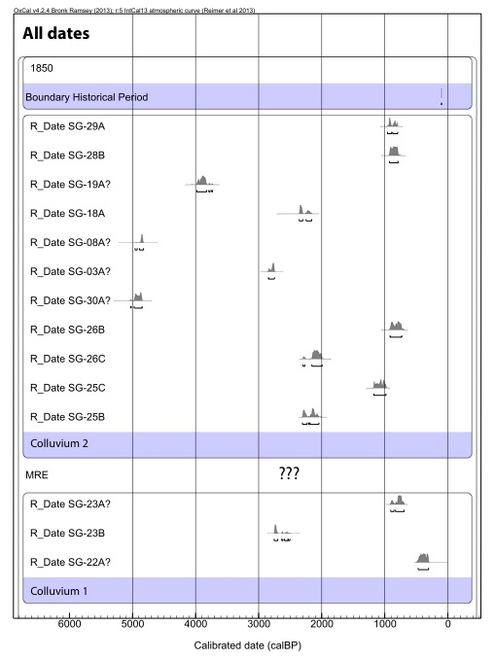
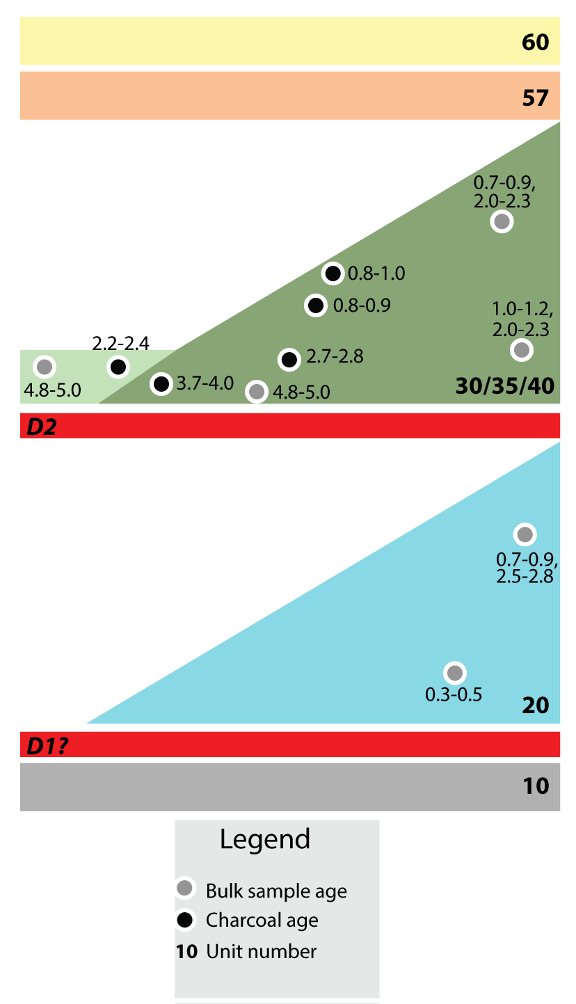
MRE
PE
Notes:
To try to constrain the timing of this deformation, we sampled both discrete charcoal where possible as well as bulk sediment for radiocarbon dating
Looking at all ages, as is common with radiocarbon dates, there is significant variability in age
Charcoal is highly susceptible to both burrowing by roots and animals (abnormally young) and recycling from previously deposited units upslope (abnormally old)
We can at least say that all deposition here is probably younger than 5000 cal yr B.P.

Slide 14
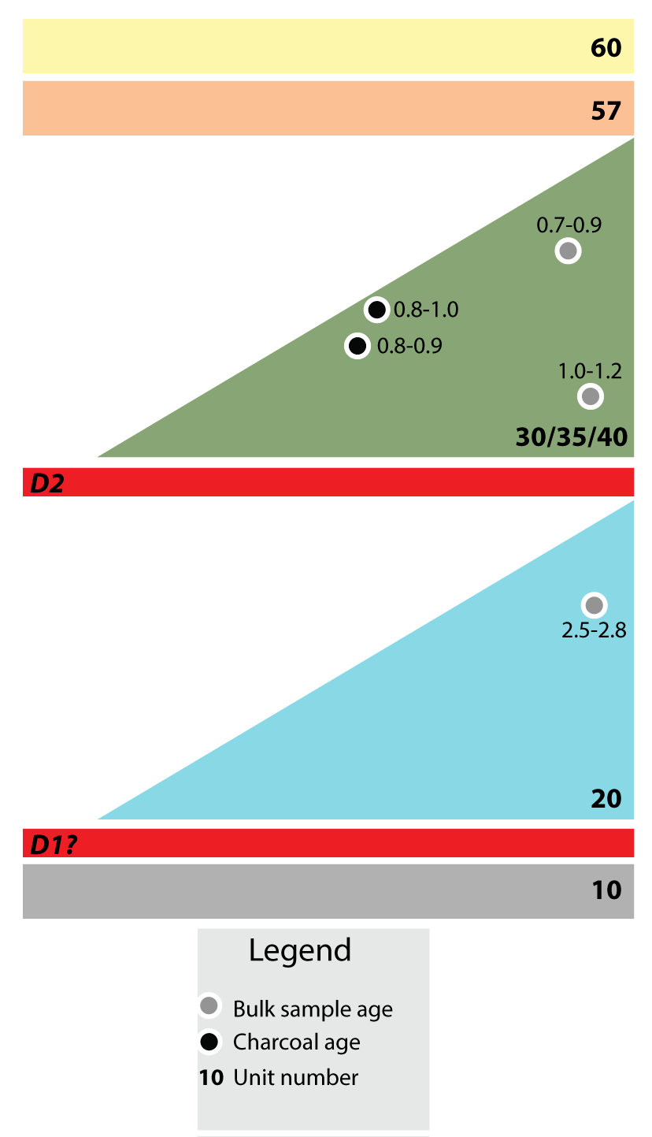
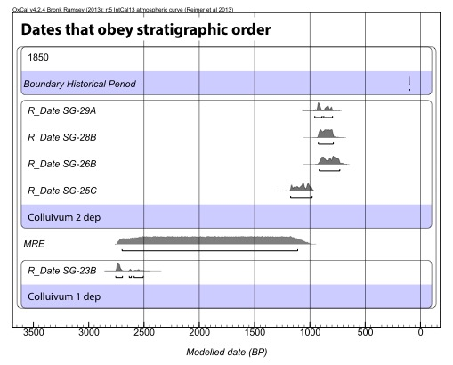
MRE
PE
Notes:
If we only select ages that obey simple stratigraphic order, we are left with:
Deposition of colluvium 1 ~2500 yrs
MRE between 1100-2500 yrs
Deposition of colluvium 2 ~700-1000 years

Slide 15
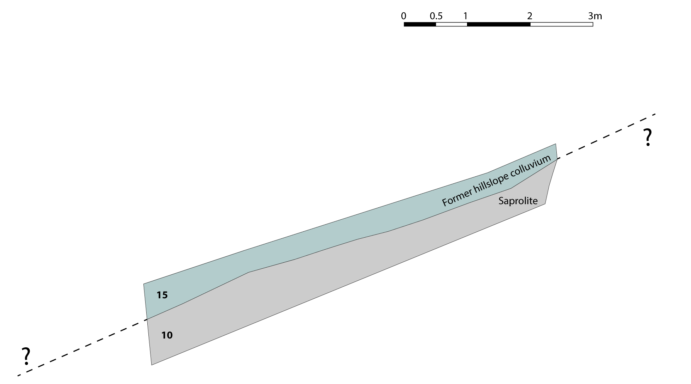
SW
Ancestral hillslope
NE
?
Notes:
To get a sense of the progression of events we believe to have occurred at the Slick Grass trench, I constructed a rough retrodeformation sequence.
Limited constraint on saprolite geometry leaves significant question marks regarding the total deformation magnitude of the saprolite, but GPR does suggest the saprolite is significantly offset at depth.

Slide 16
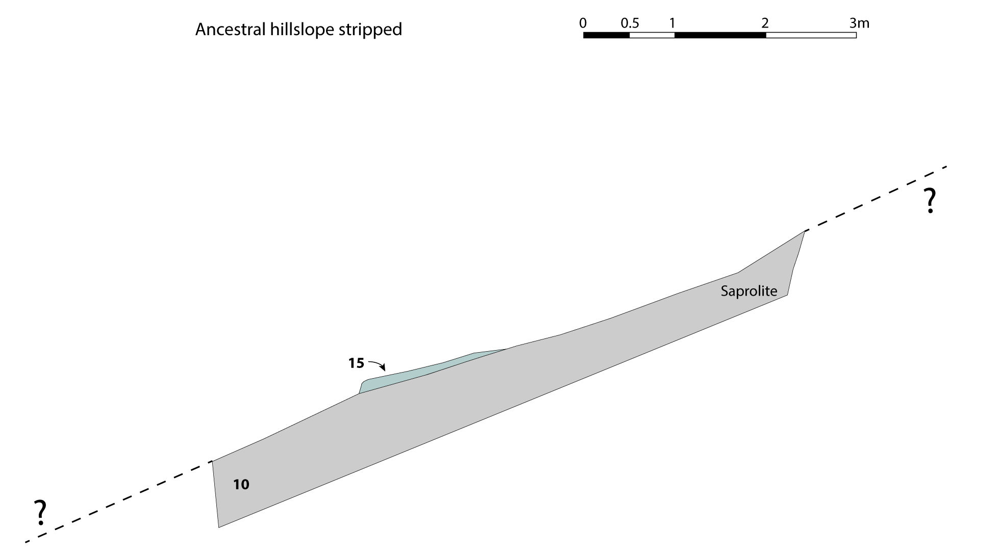
SW
NE
Notes:
Sometime prior to subsequent deposition, nearly all of the overlying sediment was stripped with only a small remnant of unit 15 left

Slide 17
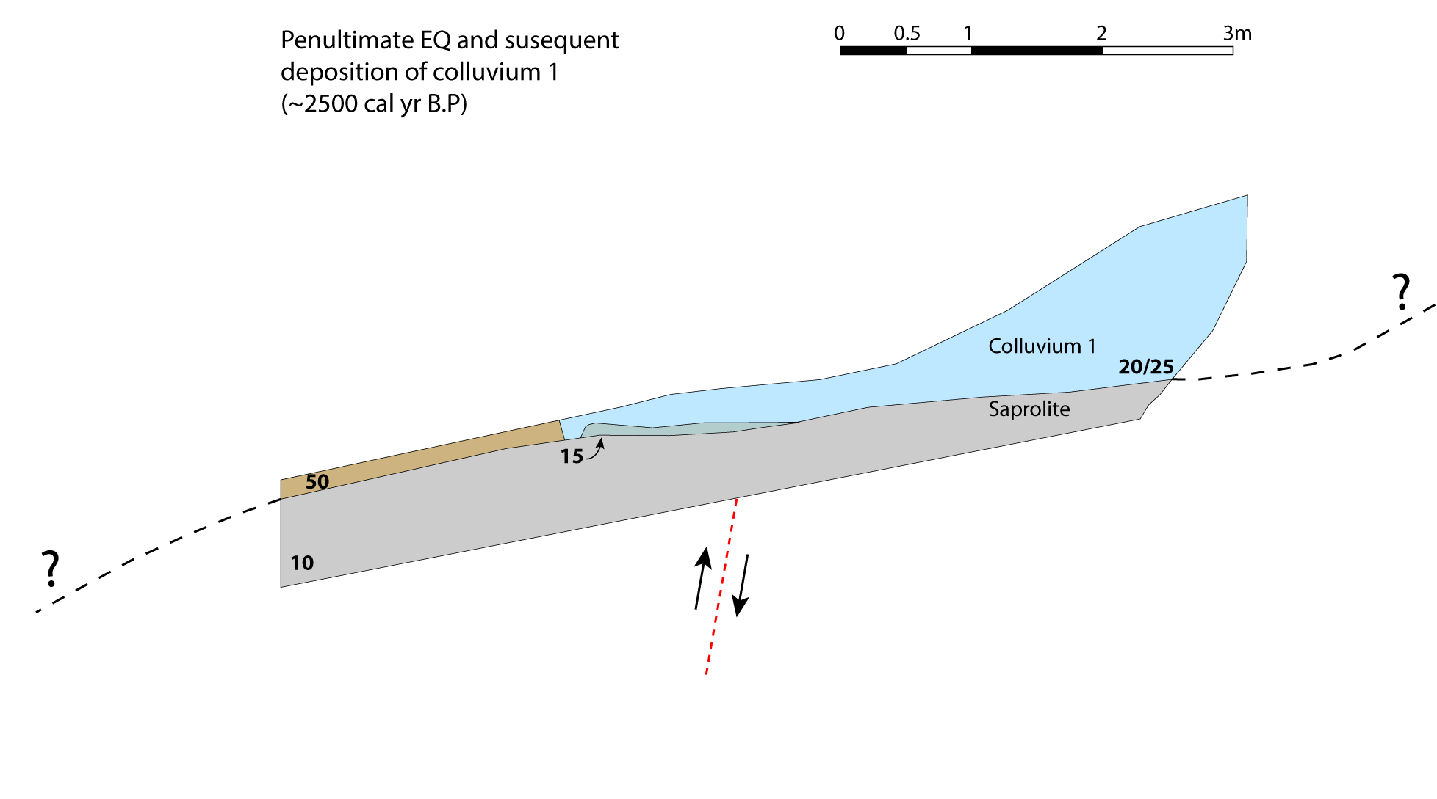
SW
NE
Notes:
The PE caused SW-side-up deformation, generating accommodation space into which Colluvium 1 was deposited ~2500 yr ago

Slide 18
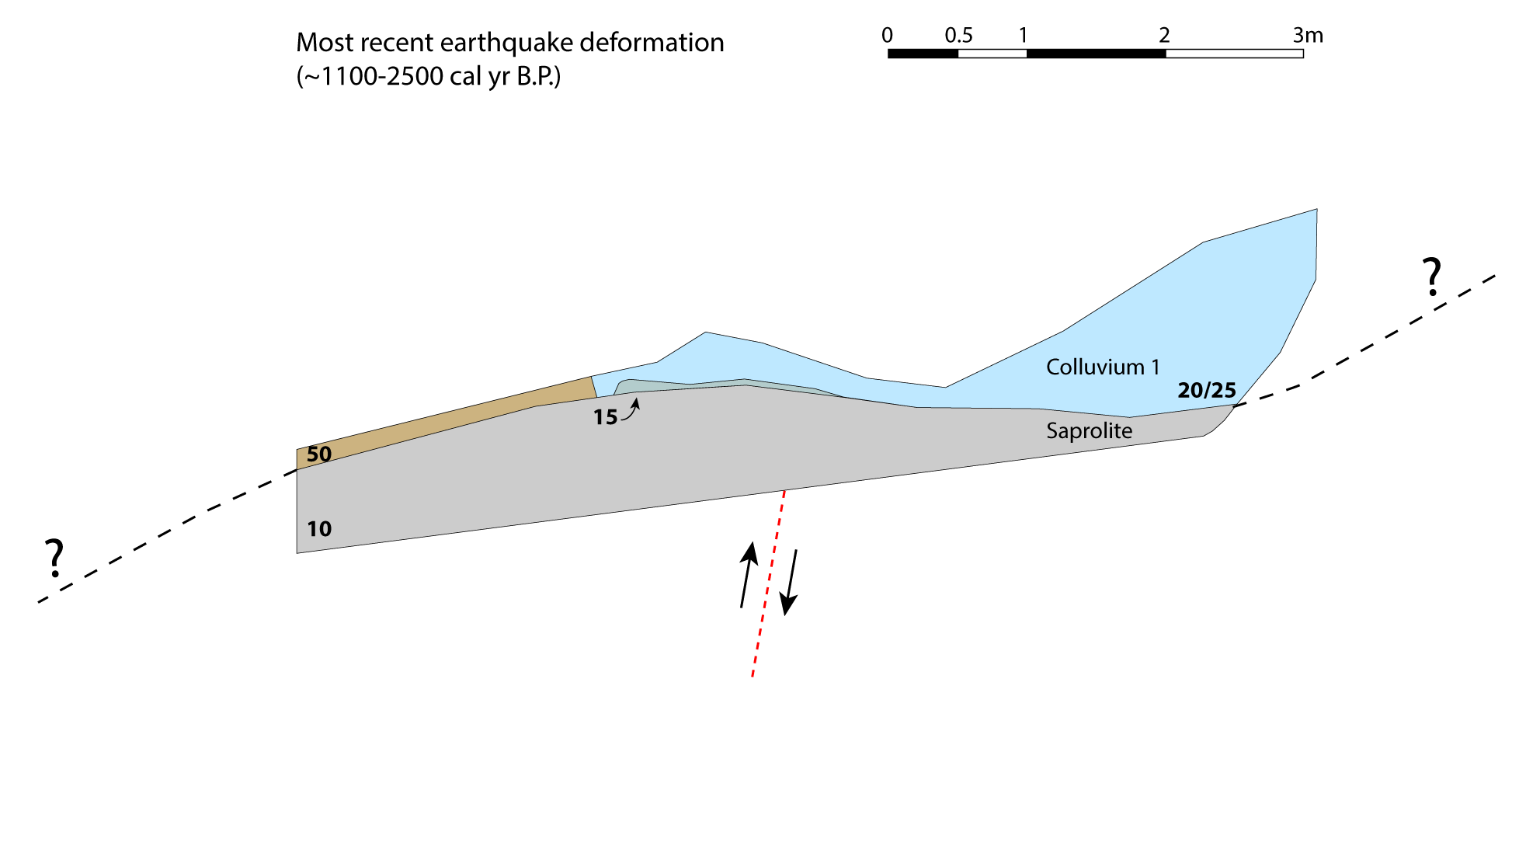
SW
NE
Vertical separation ~1 m
Notes:
The MRE enhanced that existing fold between 1100-2500 yr ago, accounting for ~1 m of observed surface offset, generating additional accommodation space

Slide 19
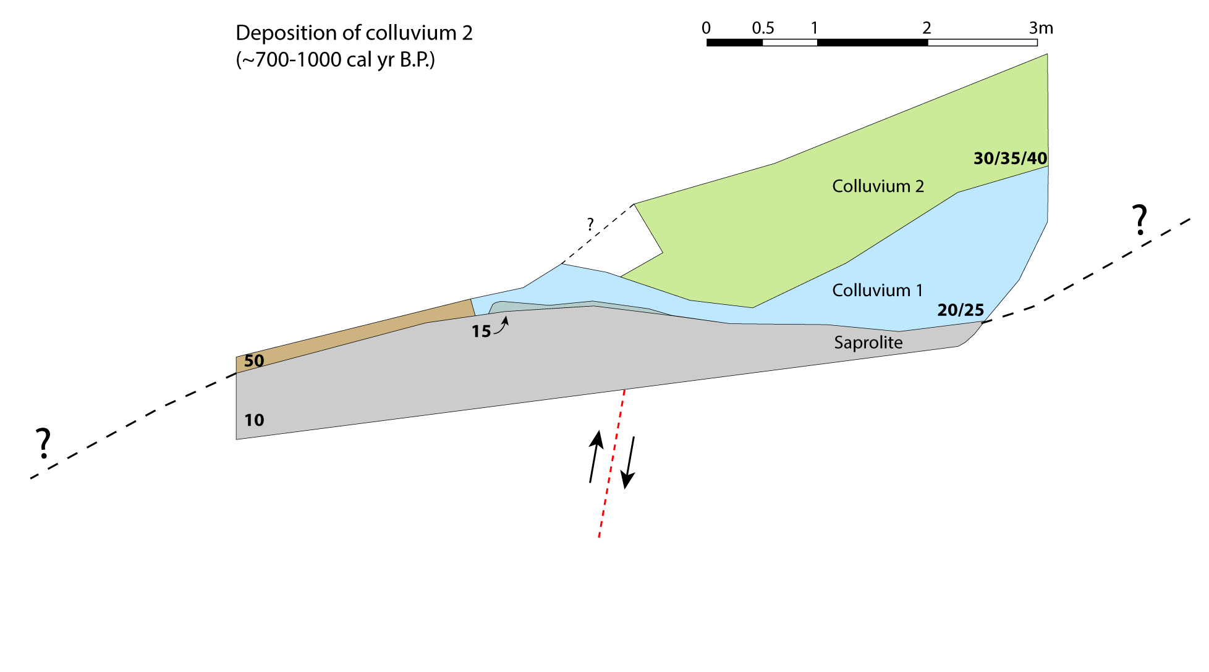
SW
NE
Notes:
Into which Colluvium 2 was deposited ~700-1000 yrs ago

Slide 20
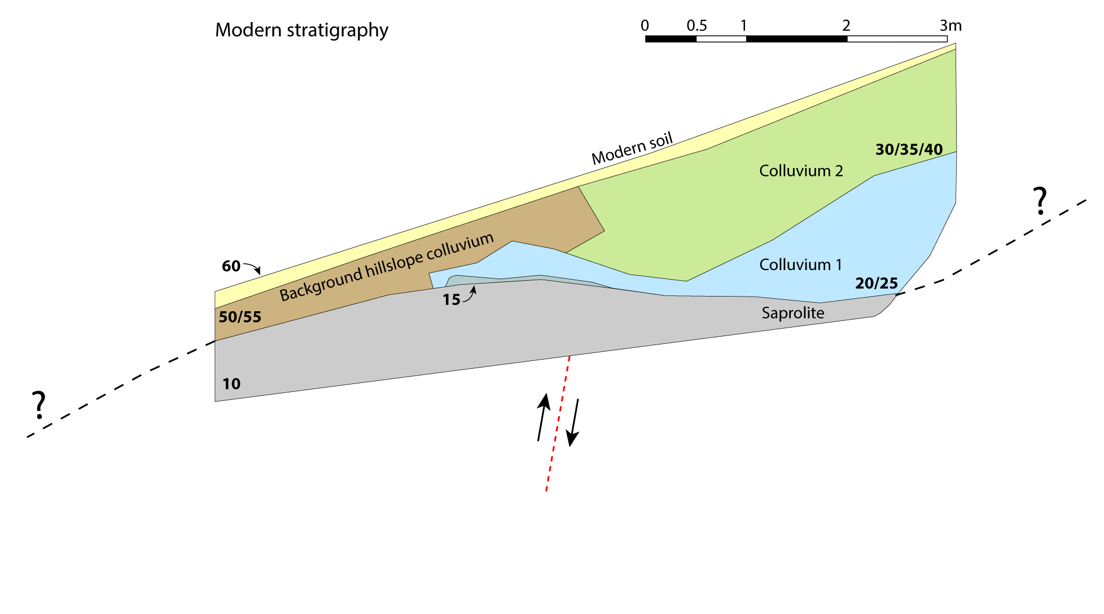
SW
NE
Notes:
Weathering and hillslope diffusion produce the landscape we see today

Slide 21
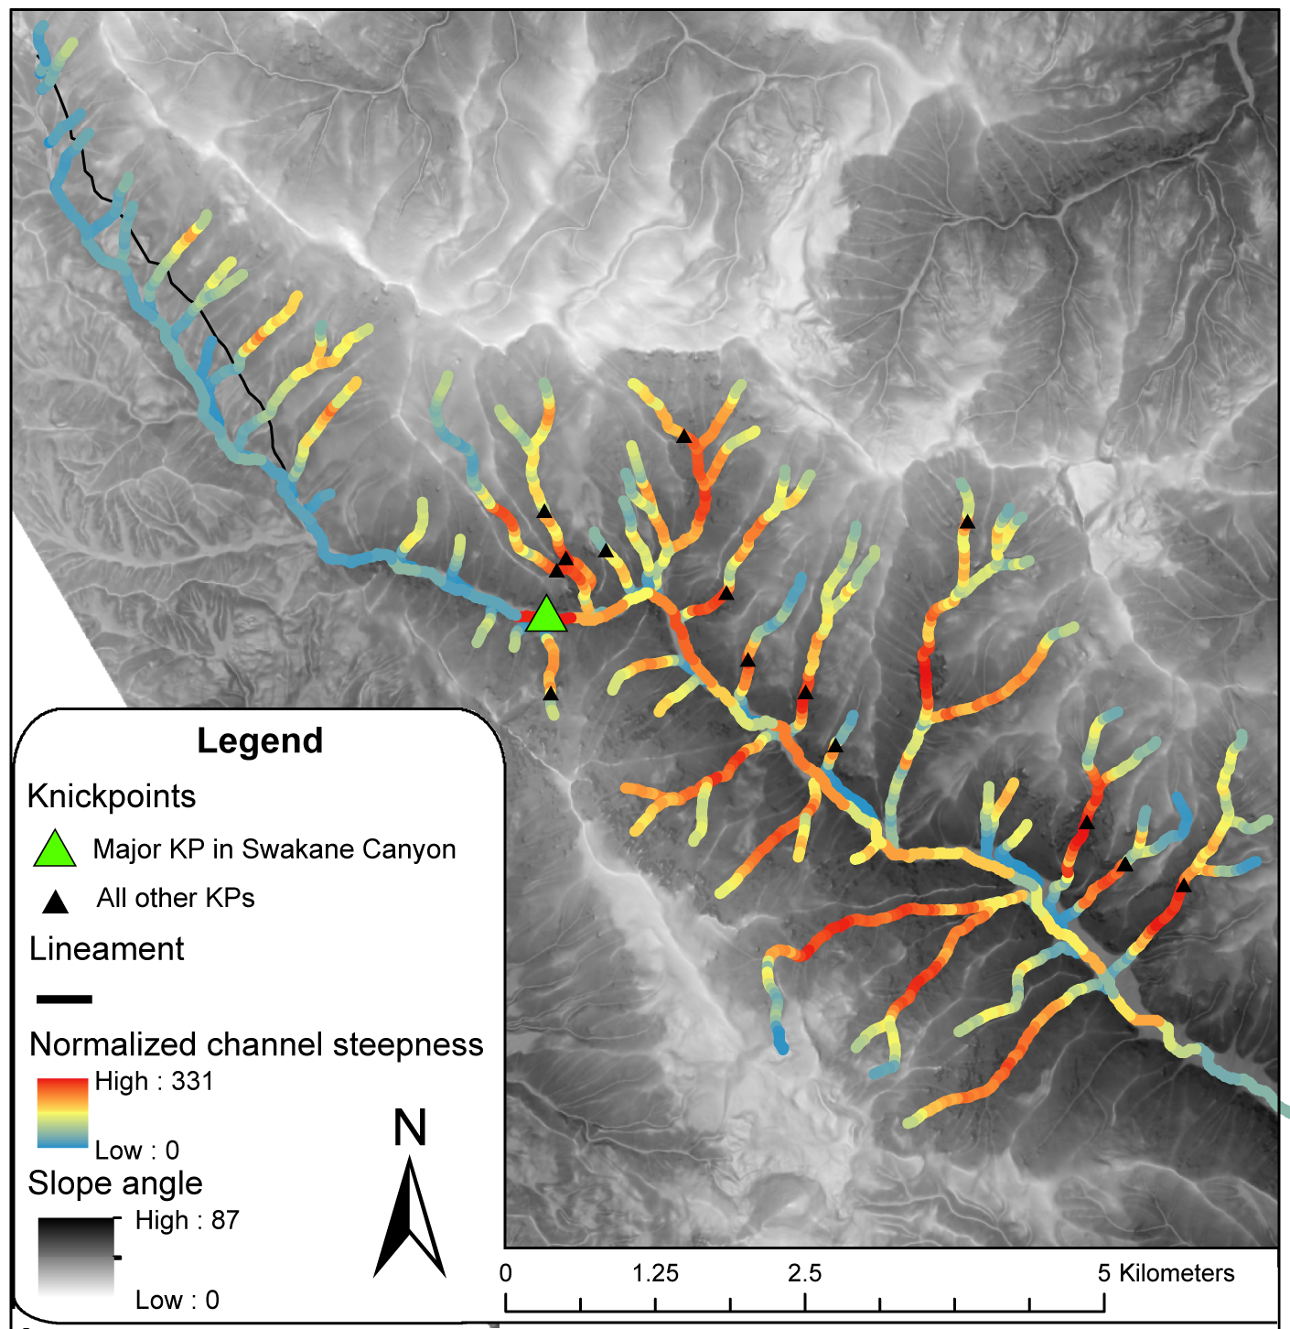
Swakane canyon channels
Upper channels not impacted by assumed faulting
  Reflects change from colluvial hollow to fluvial channel
Lower channels steeper due to migrating knickpoint
Knickpoint may be related to differential uplift of Mesozoic rock relative to Columbia River
Notes:
We also wanted to explore holocene deformation in this area using stream channel steepness.
We normalize steepness by drainage area so we can only look for systematic changes in steepness, important because channel steepness has been shown to indicate differential uplift (typically more rapid incision and steeper channels in areas of greater uplift)
Upper channels that cross the lineament do not appear to indicate uplift
channels likely too small (<10^6 drainage area)
actually seeing the colluvial/fluvial transition
Lower channel significantly steeper, downstream of major knickpoint in Swakane Creek
Regional analysis to look for broad deformation is ongoing

Slide 22
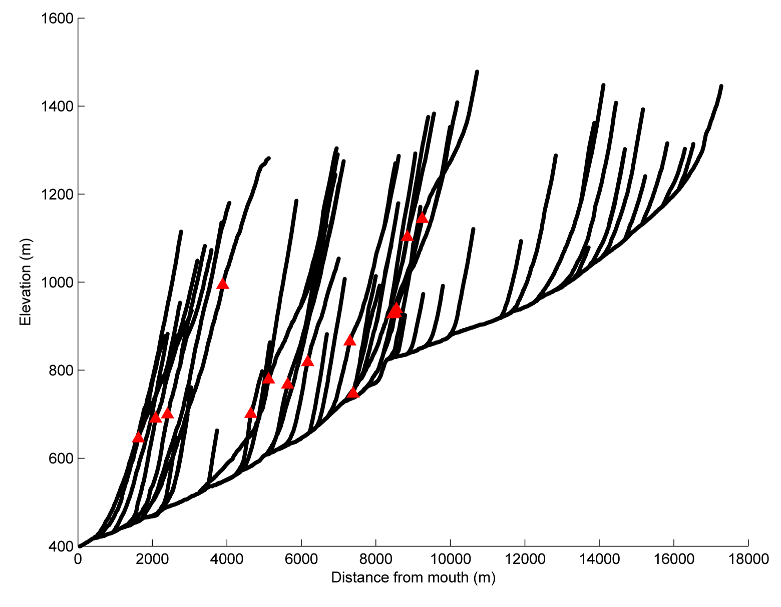
Swakane canyon channels
Upper channels not impacted by assumed faulting
  Reflects change from colluvial hollow to fluvial channel
Lower channels steeper due to migrating knickpoint
Knickpoint may be related to differential uplift of Mesozoic rock relative to Columbia River
Notes:
We we look at these channels almost in cross section here, we can also see an interesting spatial pattern in KPs in the tributaries, very consistent with upstream migration of that major knickpoint, progressively lowering each streams local base level, causing more rapid incision and steeper channels to reattain equilibrium
This propagating wave of incision could be the result of differential uplift of this region relatively to Swakane Creek’s base level, the Columbia River
Regional analysis of channel steepness will continue to work to identify whether this signal is present regionally, potentially defining a zone of regional uplift

Slide 23
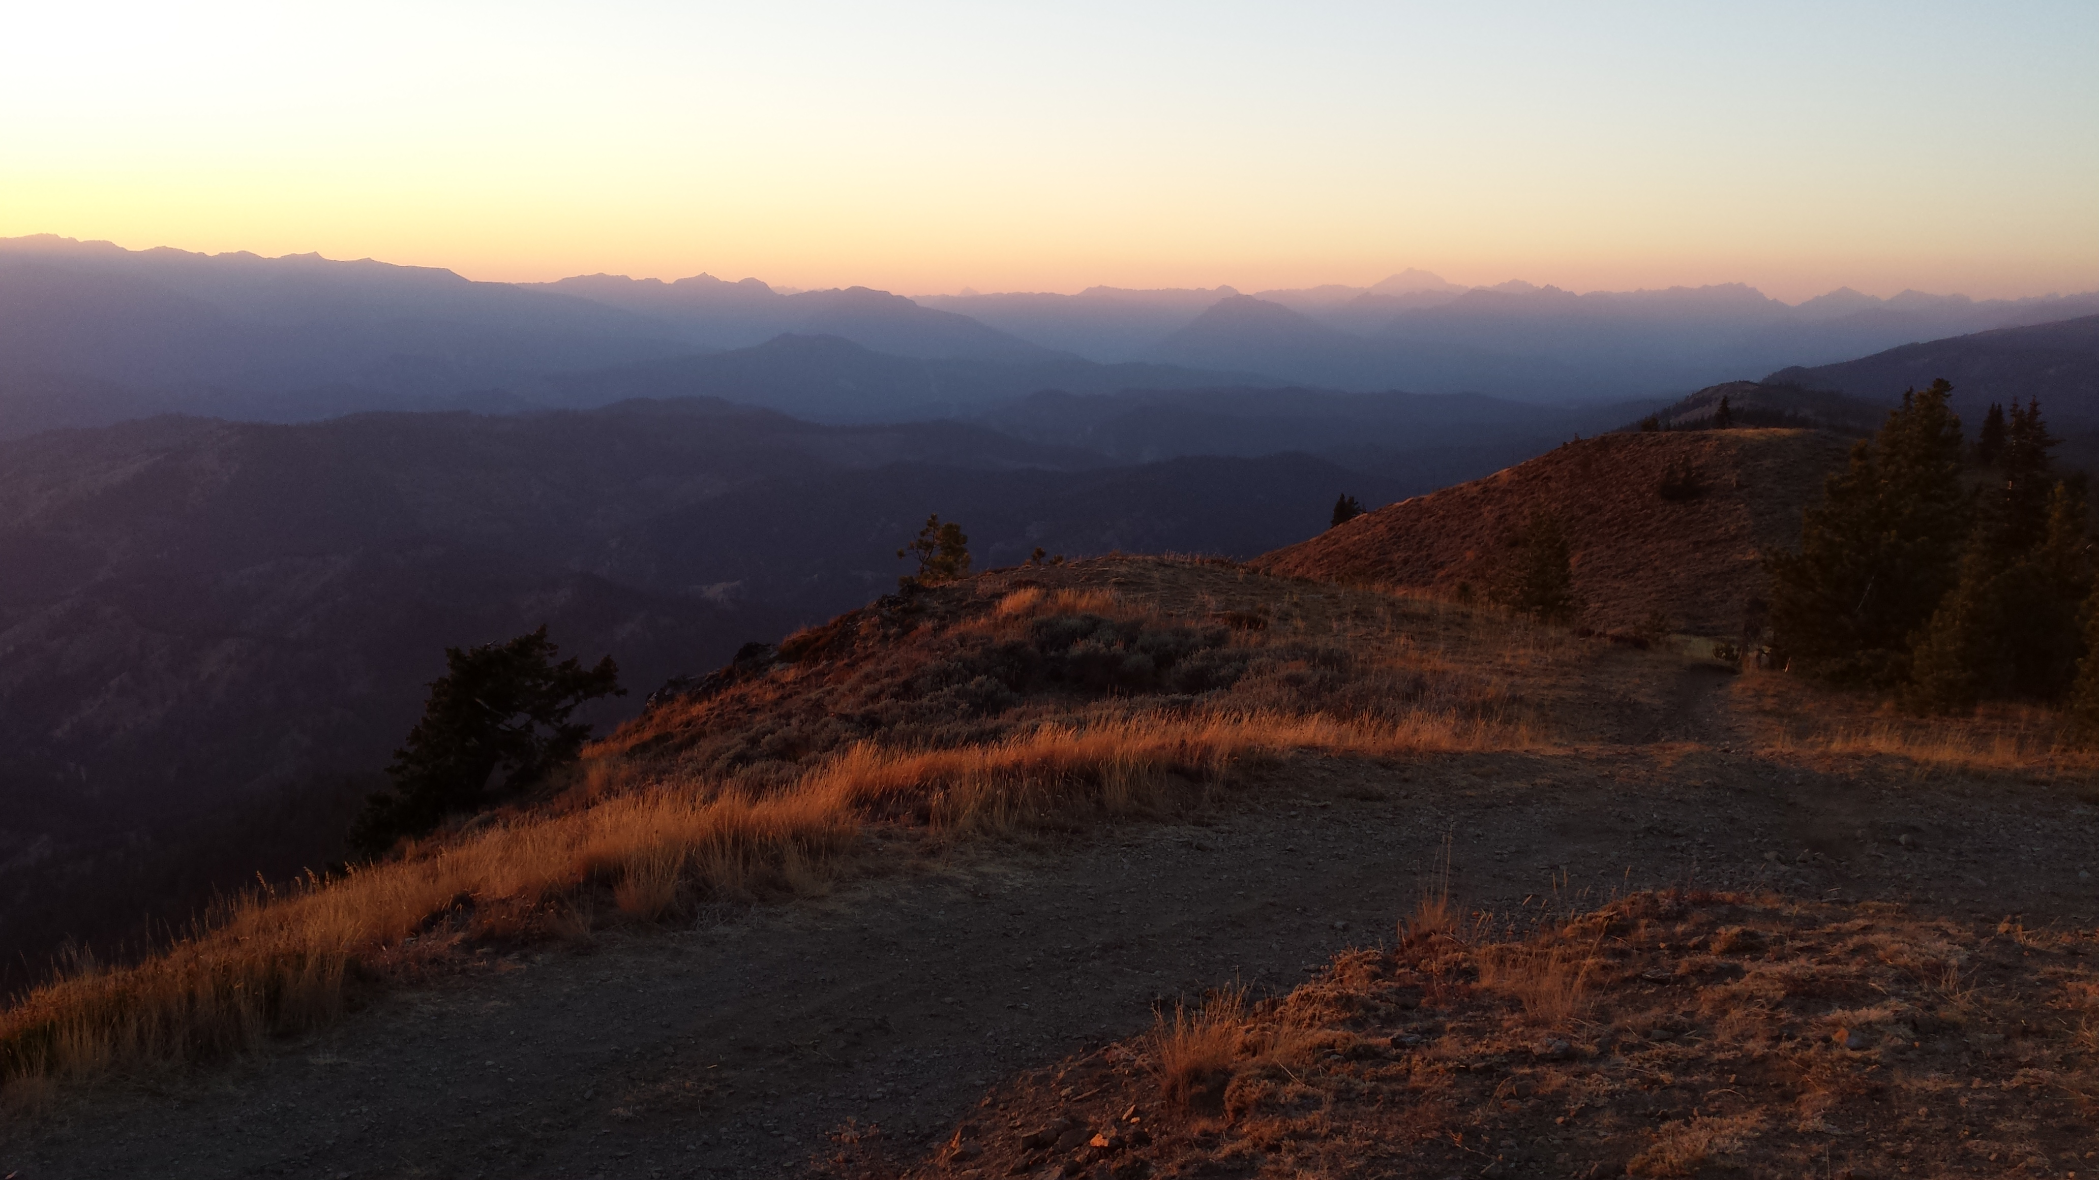
Questions?
CONCLUSIONS
Stratigraphic evidence for 2 EQs
Radiocarbon dates indicate all colluvial deposition younger than 5000 cal yr B.P.
  MRE 1100-2500 cal yr B.P.
Channel steepness suggests potential for ongoing regional deformation
Additional lidar data would allow rapid initial investigation of eastern Cascade bedrock faults, lead to further field studies.

Slide 24
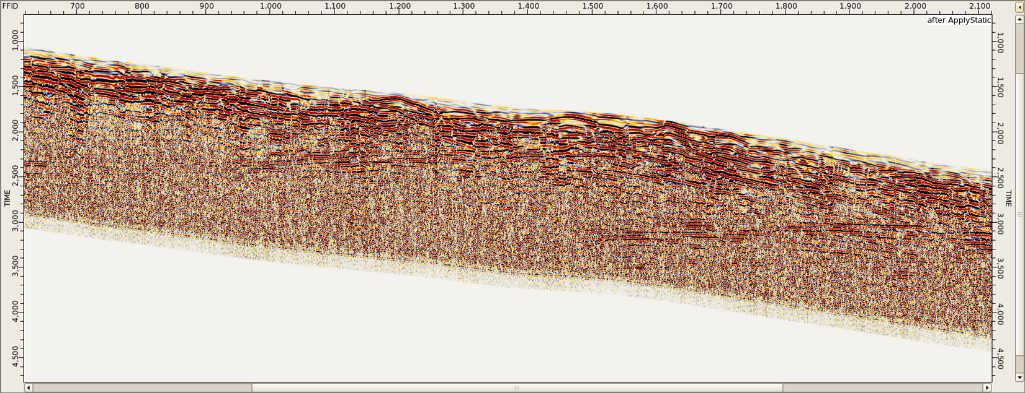
Ground Penetrating Radar

Slide 25
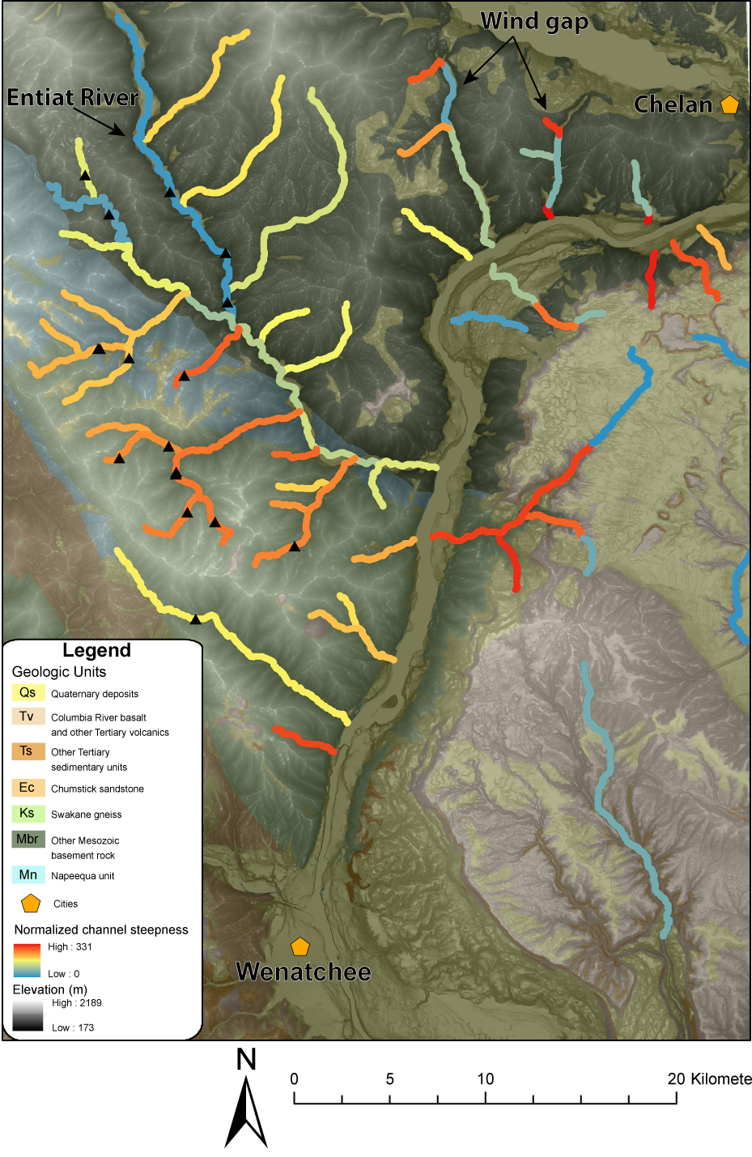
Regional channels
Channels in Swakane/Napeequa are 37% steeper than channels in Entiat pluton (Mbr)
  60% steeper if wind gaps are ignored
Evidence for post-emplacement faulting along Entiat pluton/Napeequa contact (Tabor et al., 1987)

