Slide 1
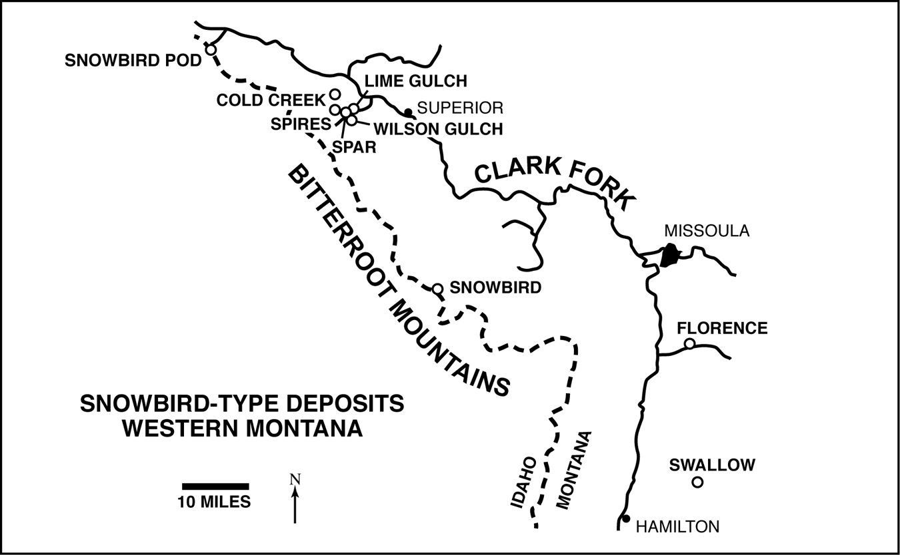
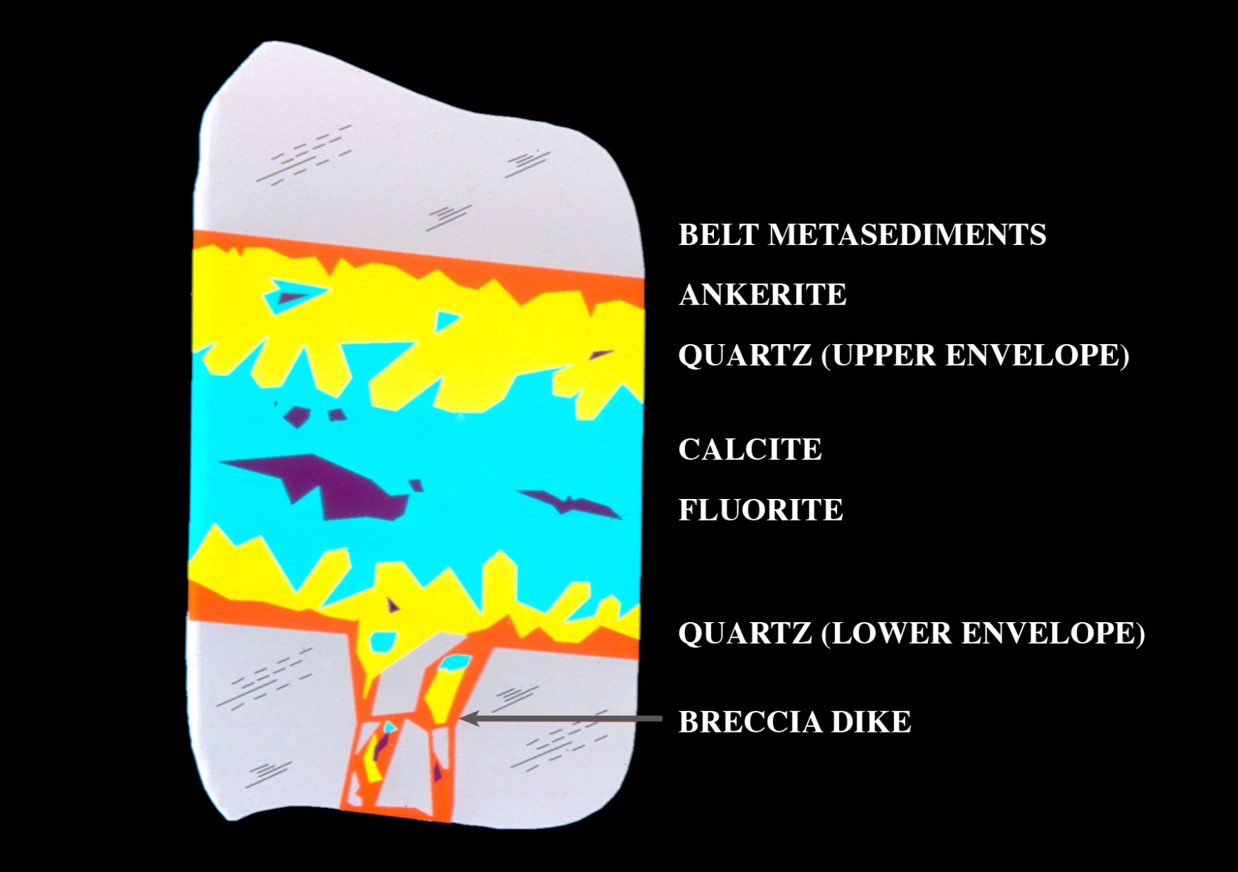
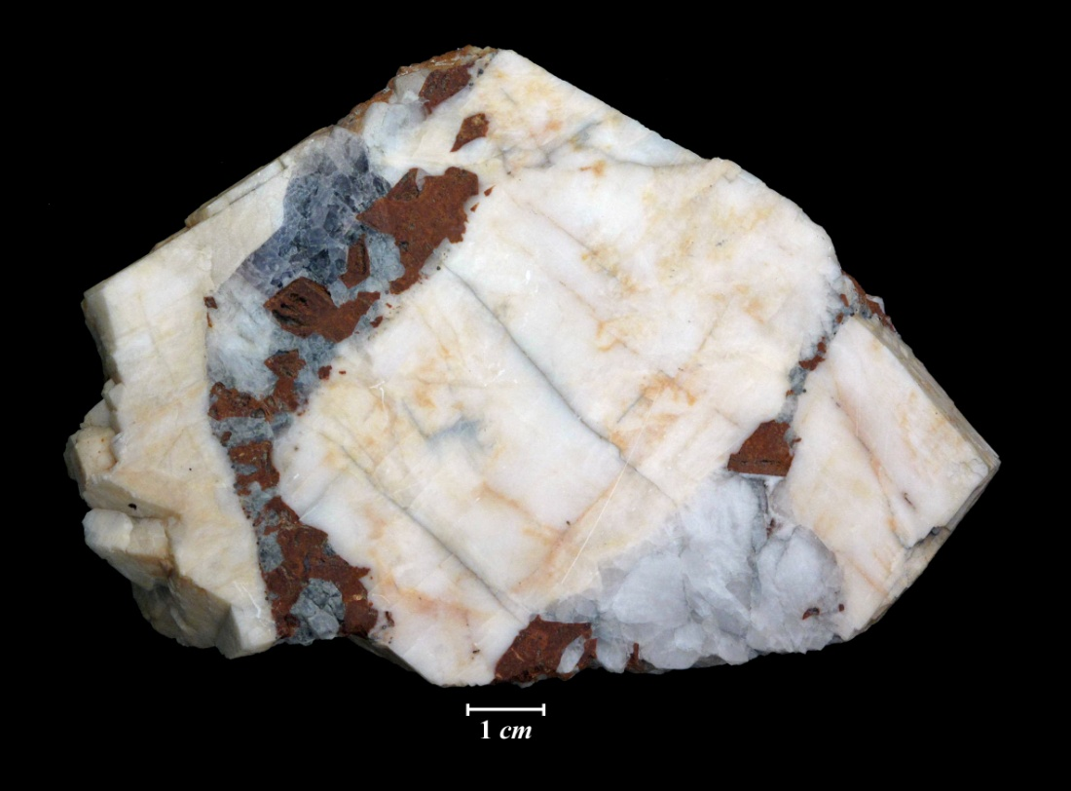
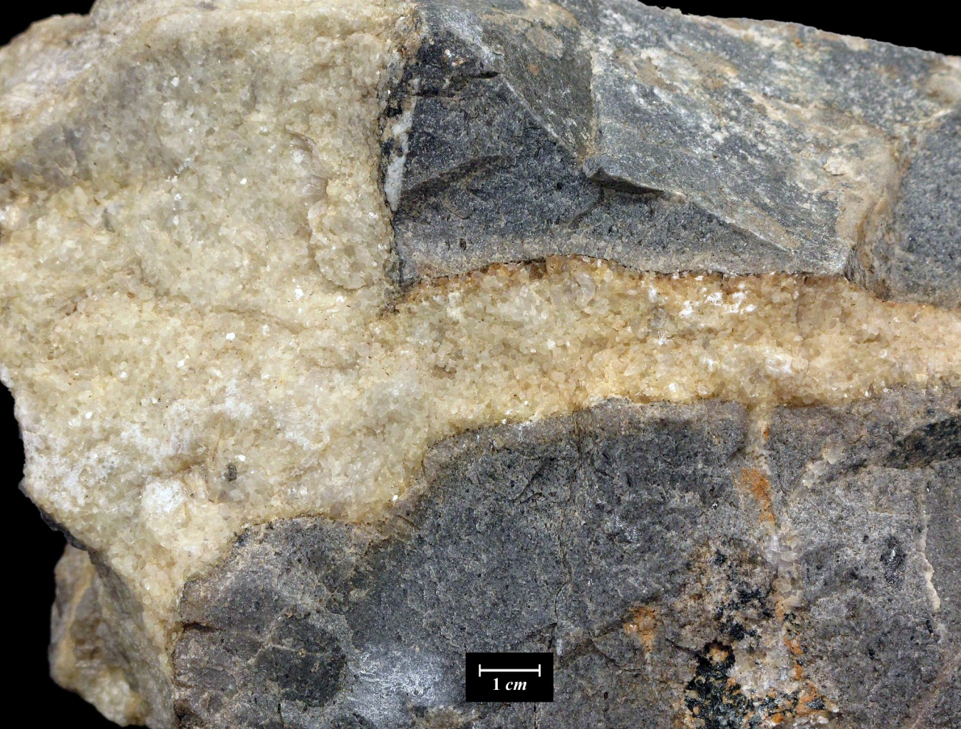
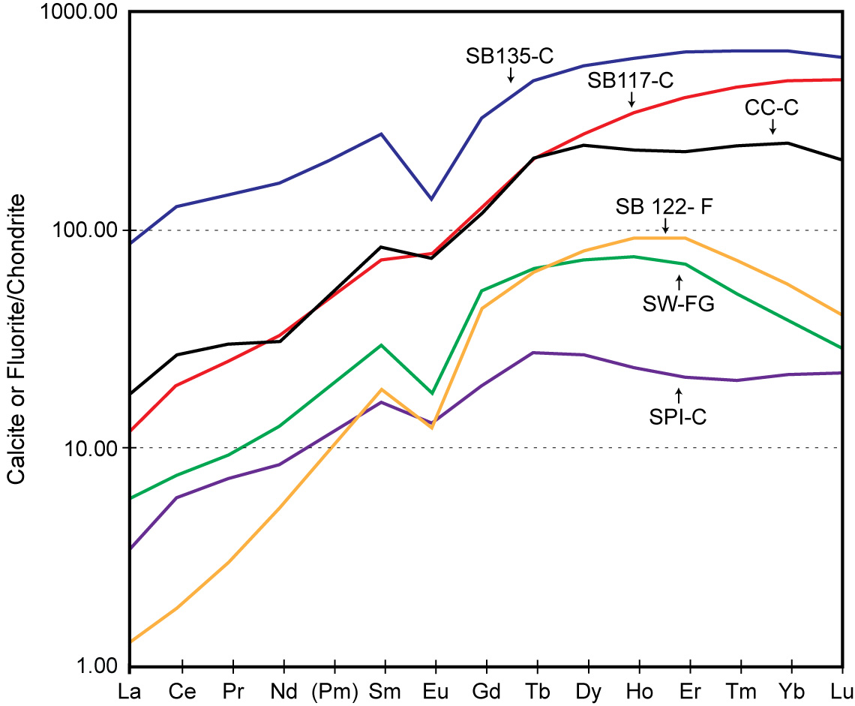
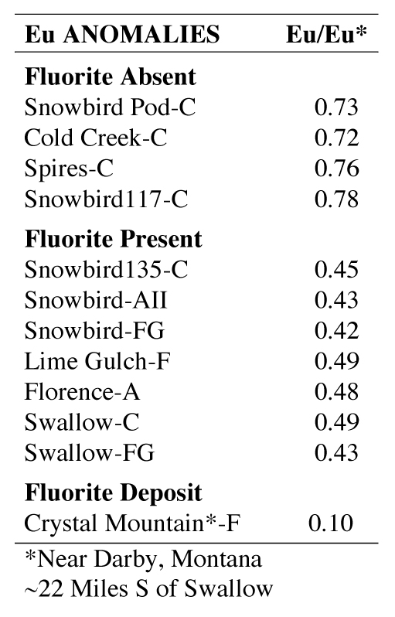
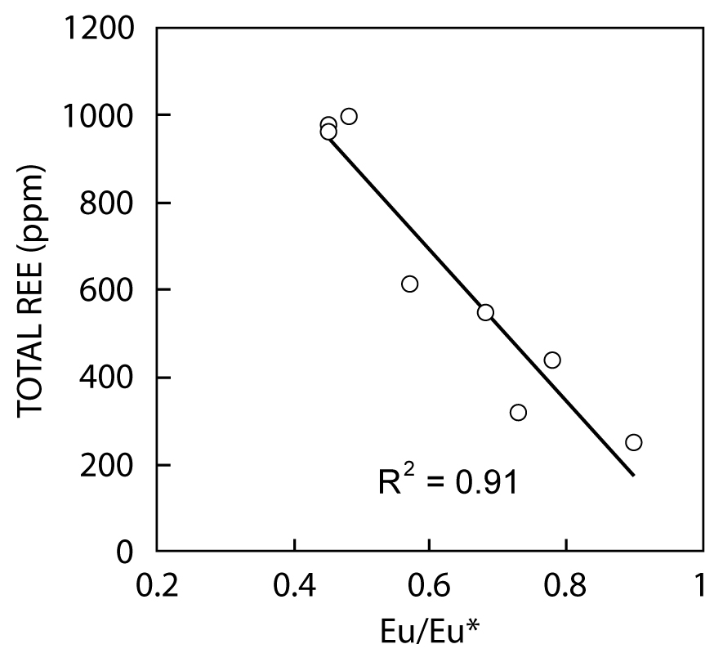
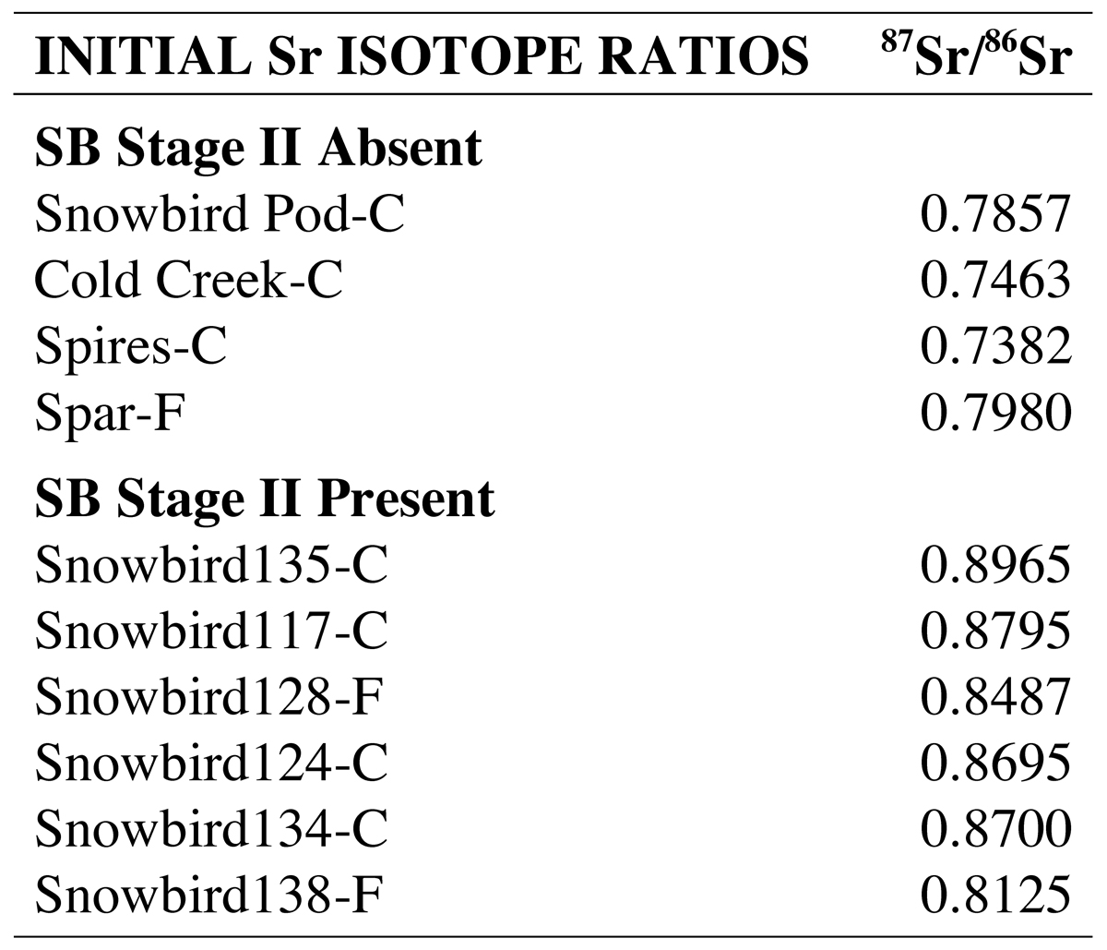
AGE AND ORIGIN OF FLUORITE-BEARING, SNOWBIRD-TYPE VEINS, WESTERN MONTANA.
Rosenberg, Philip E., (rosenberg@wsu.edu) and Wilkie, Kurtis M., School of the Environment, Washington State University, Pullman. WA, 99164-2812
Introduction
The Snowbird-type deposits are a series of hydrothermal, quartz-carbonate veins that intrude Belt metasediments, on a strike line extending NW-SE from the Coeur d’Alene Mining District along the Idaho-Montana border toward the Idaho Batholith. These include the Snowbird Pod (SBP), Cold C reek (CC), Spires (SPI). Spar (SP), Snowbird (SB), Florence (FL) and Swallow (SW) (Fig. 1).
In the northwest they are Proterozoic (Ramos and Rosenberg 2012), open space fillings with pegmatitic textures and similar parageneses: outer ankerite, peripheral, euhedral quartz up to 20 feet in length at SB and SPI, and massive calcite cores (Stage I). At least 4 of these deposits originated from breccia dikes (Fig. 2). SP and all deposits to the SE are characterized by later fluorite-bearing assemblages (Stage II) . Stage I and II mineralization are both present only at the SP and SB deposits.
a magmatic signature (Sawkins per. com., 1972; Norman and Sawkins., 1987) supporting the conclusion that F-bearing fluids, derived from the Idaho Batholith, intruded and metasomatized pre-existing Proterozoic veins, precipitated fluorite-bearing assemblages and contributed additional REEs to both calcites and fluorites (Fig. 10).
Fig. 3. Massive calcite transected by vein of fluorite, ankerite and quartz, SB deposit.
Strontium isotope ratios
Initial ⁸⁷Sr/ ⁸⁶Sr ratios of carbonates are <0.80 for Stage I mineralization but are >0.80 where fluorite is present (Stage II) (Table 2). Thus, early mineralization could be due to Proterozoic leaching of Belt metasediments but later fluorite-bearing assemblages require a more recent source of radiogenic Sr, probably pre-Belt basement.
Fig. 1. Map showing locations of principal Snowbird-type deposits..
Fig. 2. Sketch of Cold Creek (Stage I) Vein (maximum vein width ~ 3’).
Conclusions
Snowbird –type veins were deposited during at least two time periods; Mesoproterozoic, Stage I and Cretaceous to Eocene, Stage II. Brecciation preceded both stages.
During the Mesoproterozoic, fluids leached Belt metasediments, depositing ankerite, quartz and calcite in open spaces. Stage I veins are predominant to the NW of the Snowbird deposit.
During the Cretaceous , fluids derived from the intrusion of the Idaho Batholith, which leached pre-Belt basement and Belt metasediments, deposited ankerite (or calcite), quartz and fluorite (or parisite) resulting in Stage II mineralization . Stage II veins are predominant SE of the Snowbird deposit.
The Snowbird and Spar deposits display both Stage I and Stage II mineralization; late fluids partially replaced and metasomatized the earlier Stage I mineral assemblages.
Laser ablation
Laser ablation studies of xenotime in calcite associated with fluorite have yielded several concordia ages for the fluorite-bearing assemblages. At the SB deposit the massive calcite core is transected by veins of quartz, ankerite and purple fluorite (or parisite) (Fig. 3). An age of 72±1.0 Ma (MSWD=0.57) for this assemblage (Fig. 4) is in agreement with the U-Th-Pb parisite age, 71.1±1.0 Ma, reported by Metz et al. (1985). An approximate concordia age of 72±2.7 Ma was also recorded for a purple fluorite assemblage near SP. At the SB the green fluorite was found to have an age of 65.58±0.61 Ma (MSWD=2.4) (Fig. 5) while at SW (Fig. 6) an age of 61.5±5.1 Ma (MSWD=2.2) (Fig. 7) was obtained. Thus the massive white to green fluorite, the ore mineral at the SB deposit, is Cretaceous to Eocene in age. This suggests that fluorite precipitated from F-bearing fluids derived from the Idaho Batholith approximately 22 miles south of the SB trend.
Fig. 4. Concordia diagram for xenotime in calcite associated with purple fluorite, ankerite and quartz. SB deposit. Age 72 ± 1 Ma (MSWD = 0.57). Data-point error ellipses are 2σ.
Fig. 5. Concordia diagram for xenotime in calcite associated with white to green fluorite. SB deposit. Age 65.58 ± 0.61 Ma (MSWD = 2.4). Data-point error ellipses are 2σ.
Fig. 6. Breccia intruded by clear to grayish white fluorite and calcite. SW deposit.
Sample number
Fig. 7. Concordia diagram for xenoime in calcite associated with green fluorite, SW deposit. Age, 61.5 ± 5.1 Ma (MSWD = 2.2). Data-point error ellipses are 2σ.
Fig. 8 Chondrite-normalized rare-earth element variations in SB-type veins. Sample numbers from Metz et al., 1985.
Table 1. Table of Eu anomalies. Sample numbers from Metz et al., 1985.
REE
Carbonates are generally LREE depleted, HREE enriched, and retain negative Eu anomalies (Fig. 8). Early carbonates Eu/Eu*>0.7, late carbonates and all fluorites Eu/Eu*<0.5. (Table 1). Normalization of SB deposit calcite REE patterns to those of adjacent Belt wall rocks results in a similar REE distribution and virtually no Eu anomaly implying that REEs from Belt metasediments were scavenged by fluids responsible for early carbonates (Ramos and Rosenberg, 2012). Ar/He/N₂ ratios of fluid inclusions in late quartz reflect
Sample number
References
METZ, M.C., BROOKINS, D.C., ROSENBERG, P.E. AND ZARTMAN,R.E. (1985) ECON. GEOL., 80, 394-409.
NORMAN. D.I. and SAWKINS, F.J. (1987). Chem. Geol, 61, 1-10.
RAMOS, F. C. AND ROSENBERG, P. E. (2012) ECON. GEOL., 107. 1321-1339.
Acknowledgement
We thank Charles Knaack and Chris Fisher of the GeoAnalytical Lab Washington State University for technical assistance.
Note: Sample numbers from Metz et al., 1985
Fig. 10. Variation of total REE (ppm) with Eu/Eu*.
Table 2. Initial Sr isotope ratios. Sample numbers from Metz et al., 1985.

