Slide 1


Enigmatic amphibolite located north of the Stillwater Complex, Montana
M. Christopher Jenkins¹, Jennifer A. Thomson¹, Michael L. Zientek²
¹ Eastern Washington University
² U.S. Geological Survey

Slide 2
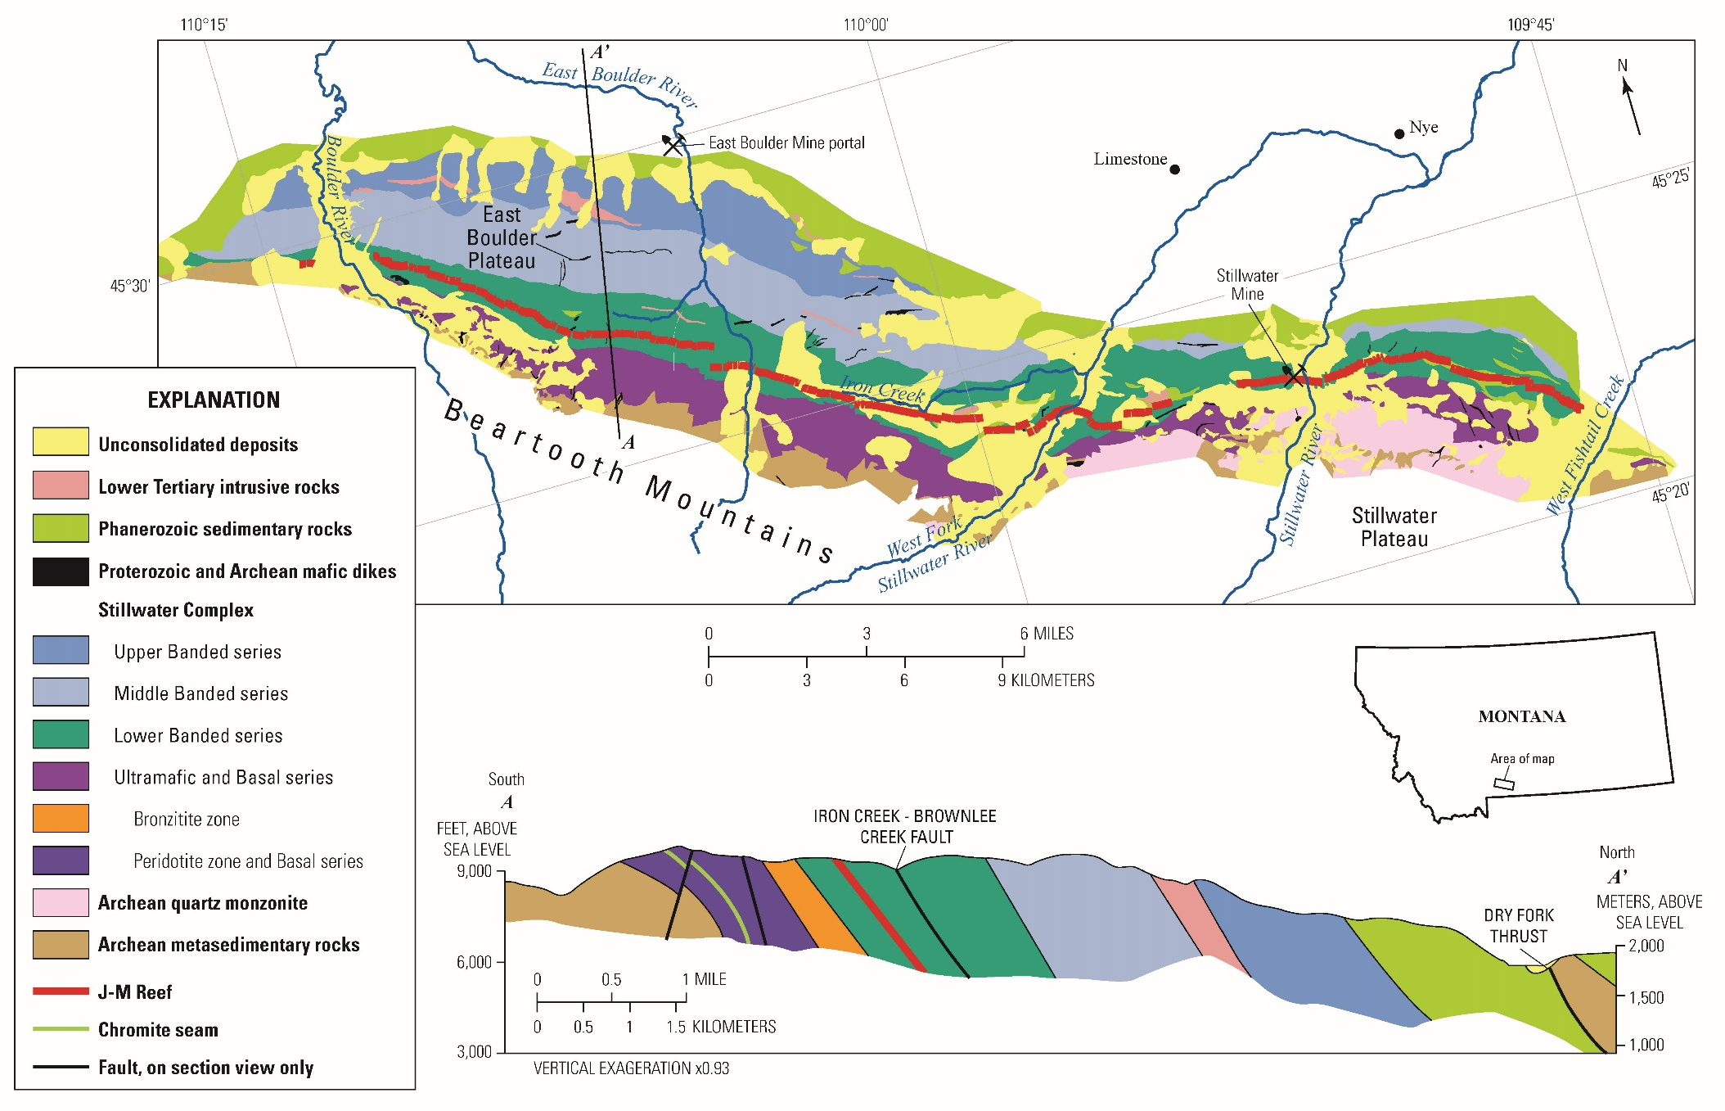
Notes:
The Stillwater Complex is a layered mafic to ultramafic intrusion located here in south central Montana along the flank of the Beartooth Mountains. The complex is about 30 miles long five miles wide.
Historically, the complex was a source of chromium for the federal government between 1941-1943 (Anaconda Copper Mining Co.) and 1952-1961 (American Chrome Co.) (Chromite seam is shown in green on the cross section). Today, the complex is mined at two locations for palladium and other platinum group elements by the Stillwater Mining Company located here at Stillwater Mine and here at the East Boulder Project. The complex’s JM Reef orebody is the only known significant source of platinum group metals (shown here in red) in the US.
While the JM Reef hosts only 150 million tons of ore--compared to the nearly 5 billion tons in the Merensky Reef at the Bushveld Complex in South Africa—the ore at Stillwater is much richer at around 16.6 g/ton PGE+Au compared to 5 g/ton PGE+Au for the Merensky.
This background provides economic context for the significance of the complex.
This project will examine rocks found north of the complex along the East Boulder River, on this cross section they have been labeled Archean metasedimentary rocks. They are the only known rocks of Precambrian age located to the north of the Dry Fork thrust fault in the area.

Slide 3
Previous hypotheses
Vale (1955)
  Amphibolite schist
  Metamorphosed:
    Floor rocks(?)
    Roof rocks(?)
    Stillwater cumulates(?)
Erslev & Sutter (1990)
  Extension of the Madison mylonite zone(?)
Geraghty (2013)
  Schistose mylonite
Notes:
In a 1955 master’s thesis Vale hypothesized that the rocks in the Long Mountain area could be: (1) Metamorphosed floor rocks below the complex, (2) metamorphosed roof rocks from above the complex, or (3) metamorphosed rocks from the complex itself. Vale described the rocks as a amphibolite schist composed primarily of amphibole and clinozoisite with minor amounts of quartz, calcite, chlorite, and epidote.
Erslev and Sutter thought that these rocks could be part of a northern extension of the Proterozoic Madison mylonite zone.
Geraghty simply called the Long Mountain rocks a schistose mylonite on his 2013 geologic map of the Stillwater Complex.

Slide 4
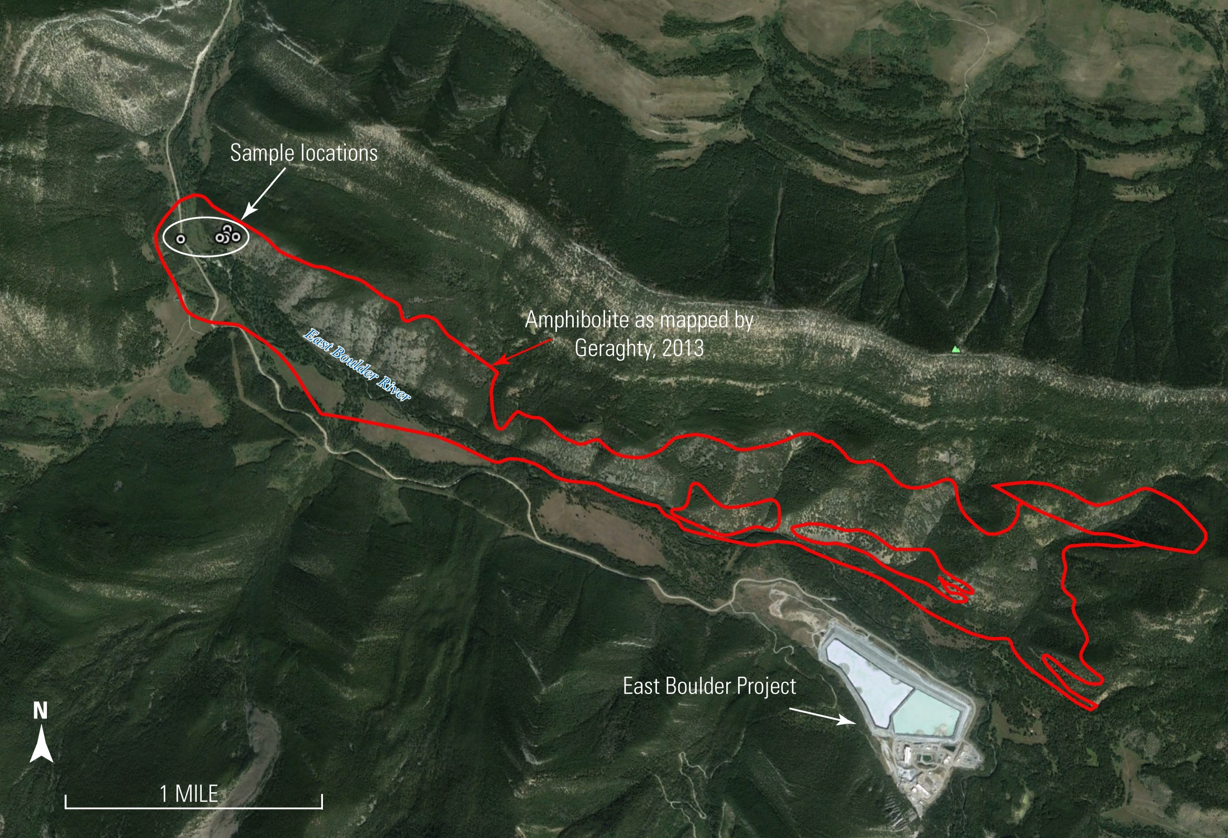
Notes:
The East Boulder Project is located here on the south side of the East Boulder River. Red polygon on this figure is the outline of the Precambrian mylonite unit as mapped by Ennis Geraghty for his 2013 Stillwater Map. The mylonite has an slight arcuate shape and covers an area of about 4.5km^2.

Slide 5
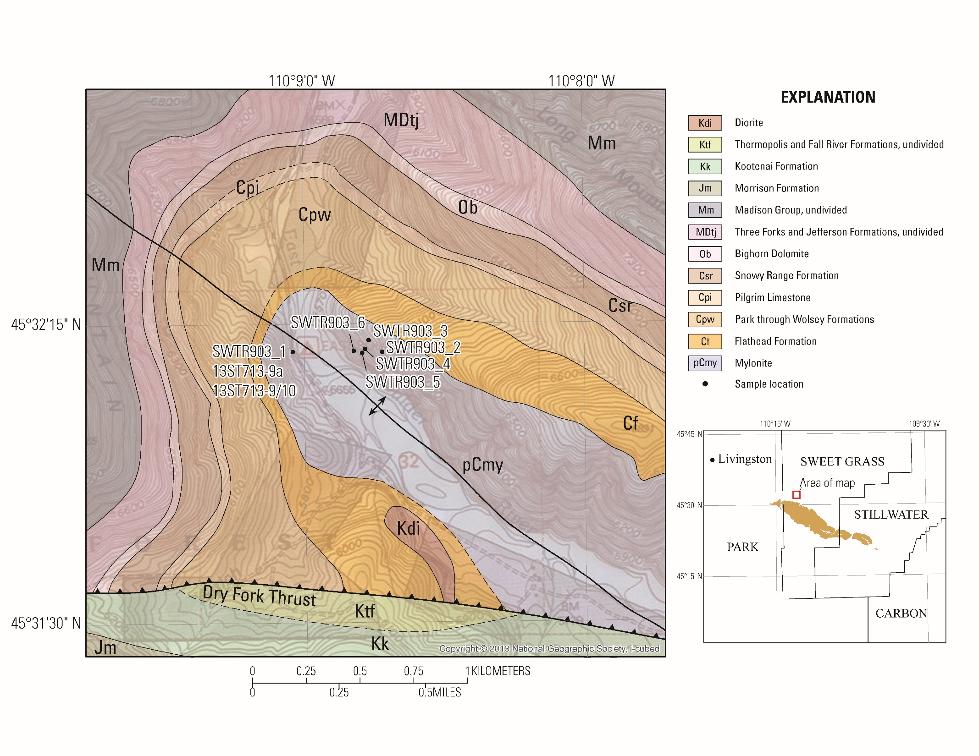
Notes:
Here is a zoomed in look at our sample locations. The geology is from Geraghty 2013. The Dry Fork Thrust is located at the bottom of this map shows the Cretaceous sedimentary rocks thrust on top of the Paleozoic sedimentary rocks. In the middle of this anticline are our Long Mountain rocks, labeled here as a Precambrian mylontite. Again, the Long Mountain rocks are the only known Precambrian rocks north of the Dry Fork Thrust.
We collected eight samples as shown here. Three samples were collected along the road here, and another five were collected on the other side of the river here.

Slide 6
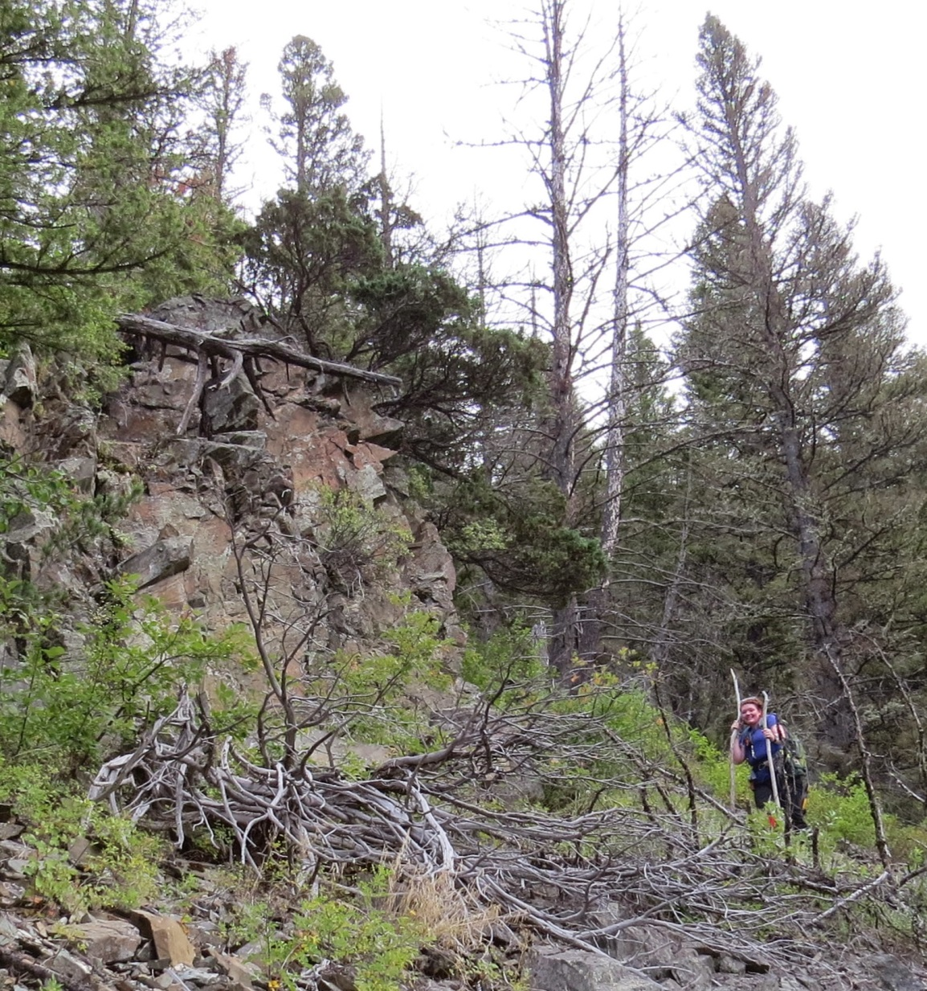
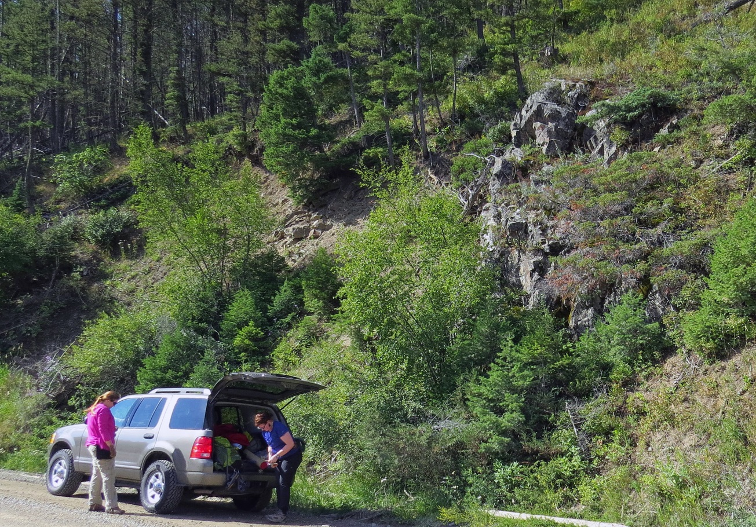
Notes:
The top left corner shows an outcrop of the Long Mountain rocks . The hillside here is very steep.
It was much easier to collect samples down here along the road as shown in the bottom right image. In addition to the eight samples that we collected for the analyses included in this presentation, we filled a five gallon bucket with samples to be sent off for Uranium-Lead dating, but the sample did not yield sufficient zircon or baddeleylite.

Slide 7
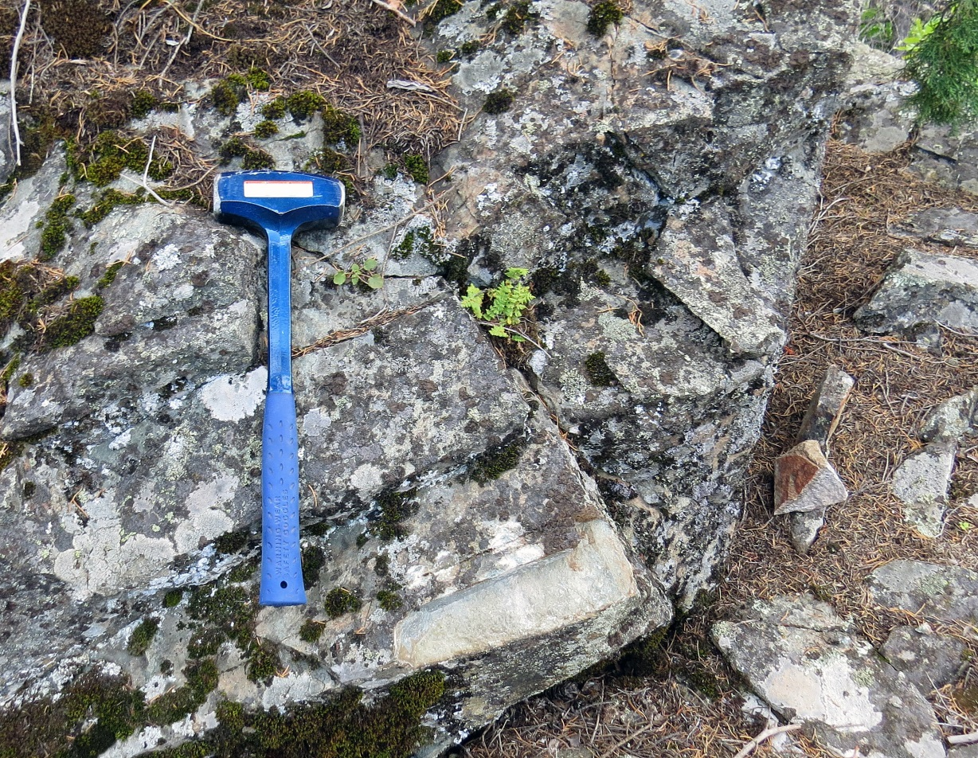
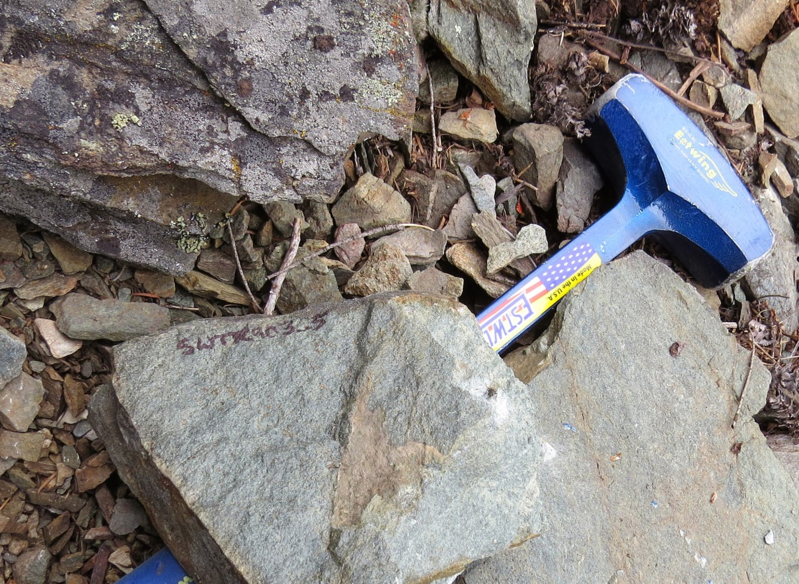
Notes:
Here are images of the hand samples. They are fine-grained, some show foliation, some do not. They are all light gray on their fresh surfaces and weather to a light brown.
I looked up a way to describe these rocks. These rocks can be described as “Extremely strong” or requiring “great difficulty in breaking with hammer”. As you can see here we carried these long crack hammers with us and even still, getting good hand samples was difficult.

Slide 8
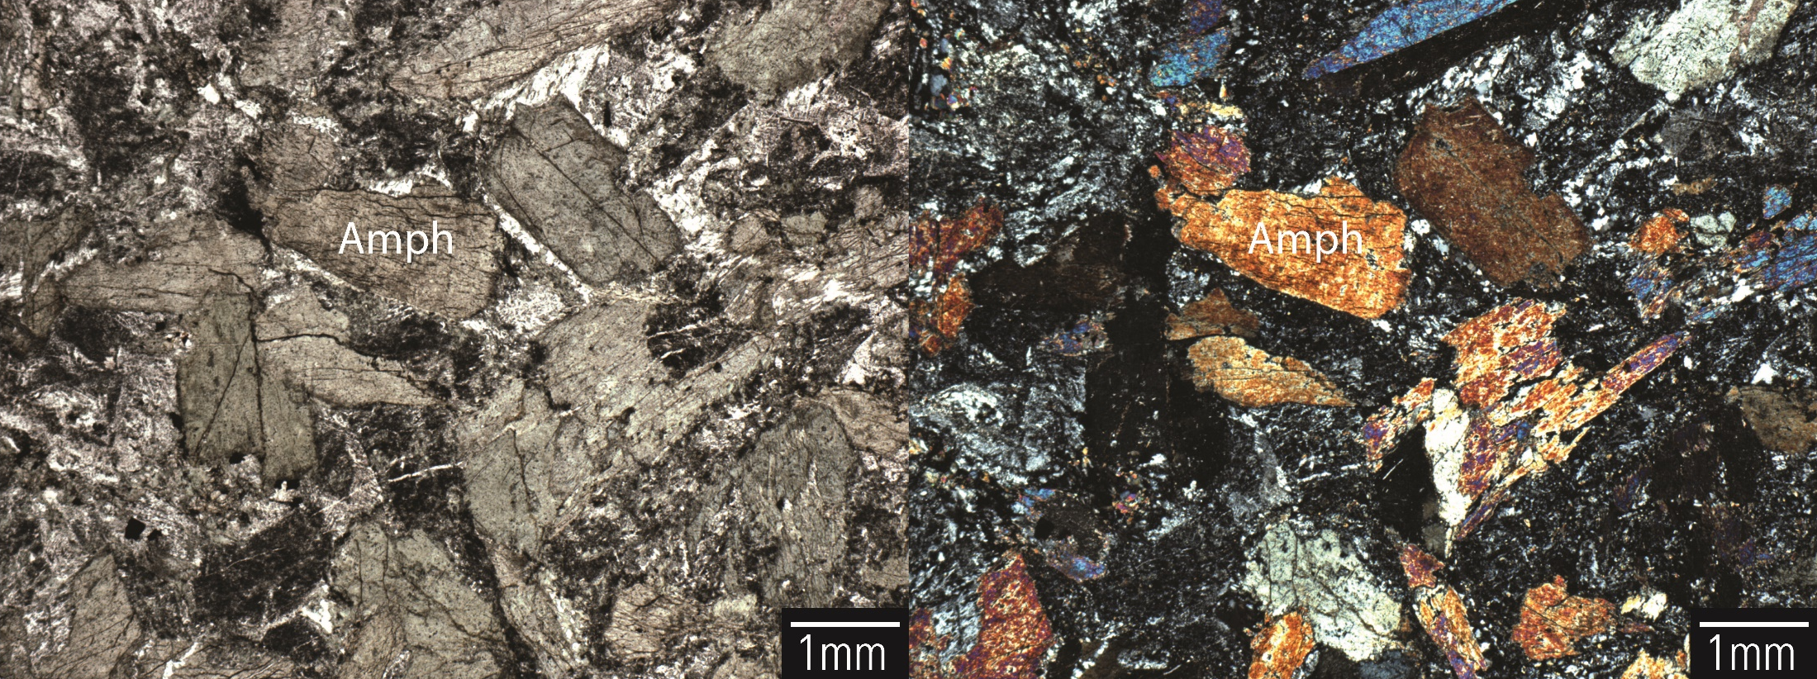
Relict igneous texture
Thin section photomicrographs of sample SWTR903_3 showing relict igneous texture.
Left (PPL), Right (XPL).
Notes:
Here is an example of one of the Long Mountain samples that did not have any sort of foliation or mylonitic fabric. The plagioclase and amphiboles are tattered and altered, but in general the sample still has an the appearance of an igneous rock.
Mostly amphiboles, but we also see plagioclase, epidote, chlorite, some minor calcite.

Slide 9
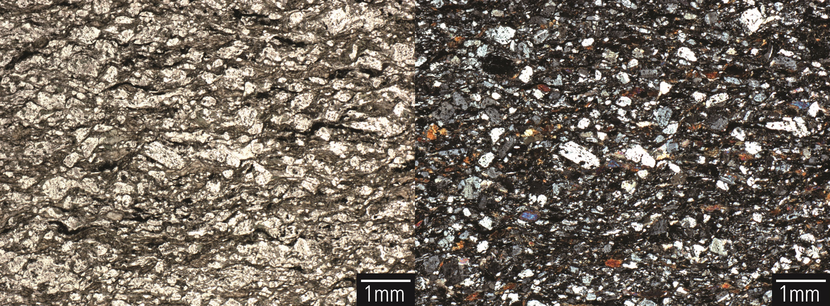
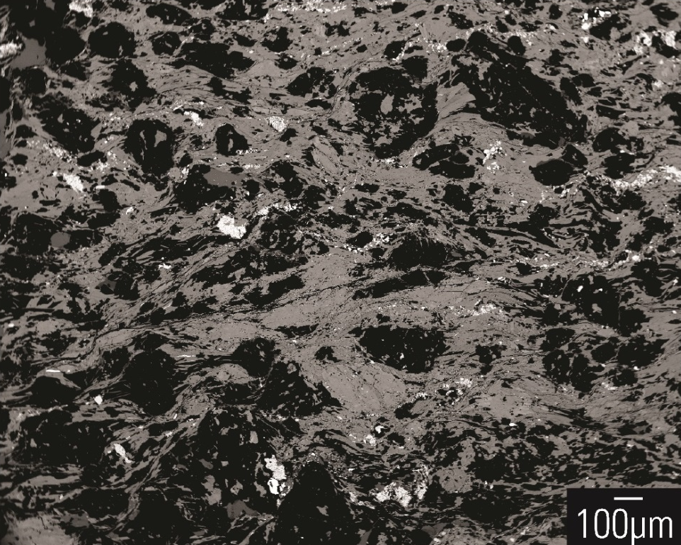
Mylonitic fabric
TOP: Thin section photomicrographs of sample
SWTR903_5 showing mylonitic fabric.
Left (PPL), Right (XPL)
RIGHT: Back-scattered electron (BSE) image
showing mylonitic fabric of sample
SWTR903_5
Notes:
Here is another sample from Long Mountain that clearly shows a mylonitic fabric. The extent of these top two images is the same as in the previous slide.
The grain size has been reduced and grains appear to have been pinched and rolled. These samples are very fine-grained and mineral identification with a transmitted light microscope was difficult, we did have access to the microprobe at Washington State University and we did verify that the mineralogy between the mylonitic samples and the relict-igneous samples was uniform between the two metamorphic textures.

Slide 10
Notes:
Here’s a comparison of the two very different textures. These images were taken at the same scale. Relict-igneous texture on top, mylonitic fabric on bottom.

Slide 11
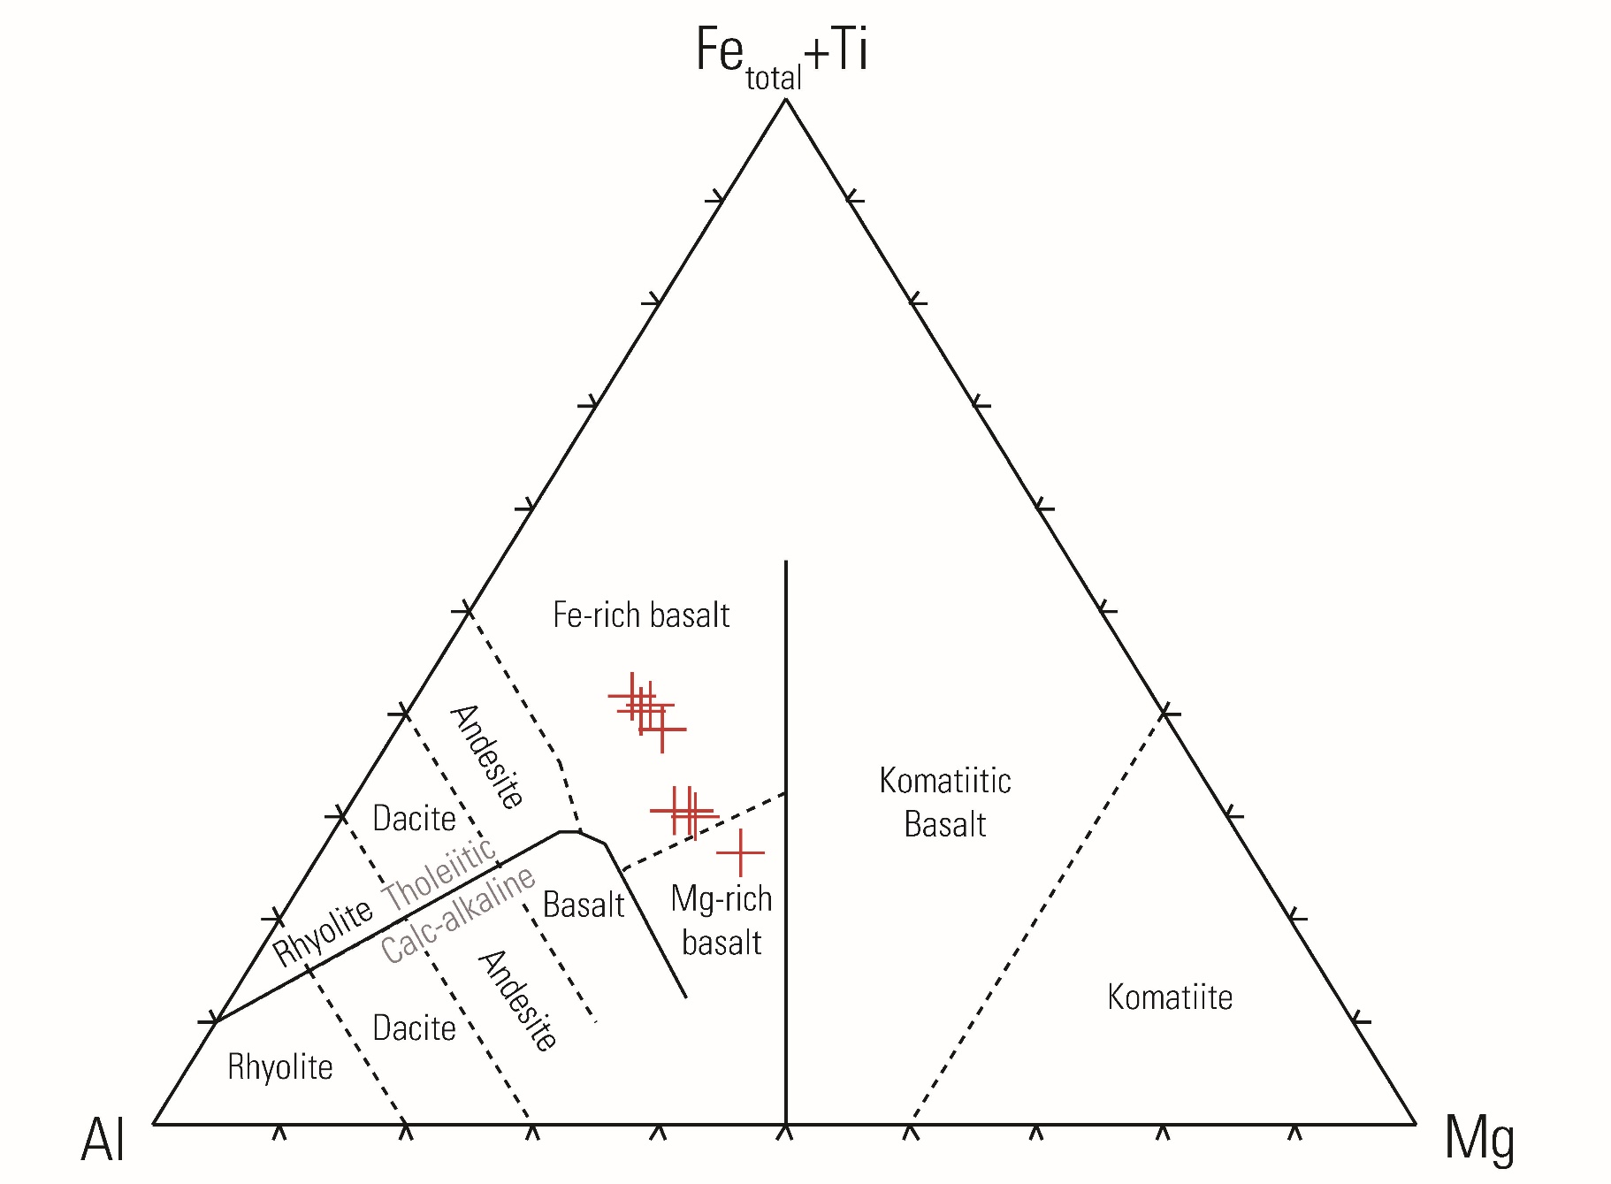
Jensen classification
Notes:
To give these samples a classification we plotted them on a Aluminum vs Magnesium vs total iron + titanitum ternary diagram called the Jensen cation plot for classifying sub-alkalic volcanic rocks. Most Long Mountain rocks plot in the iron-rich basalt with a few samples are plotting closer to the mg-rich basalt, and one sample plotting in the mg-rich basalt field.

Slide 12
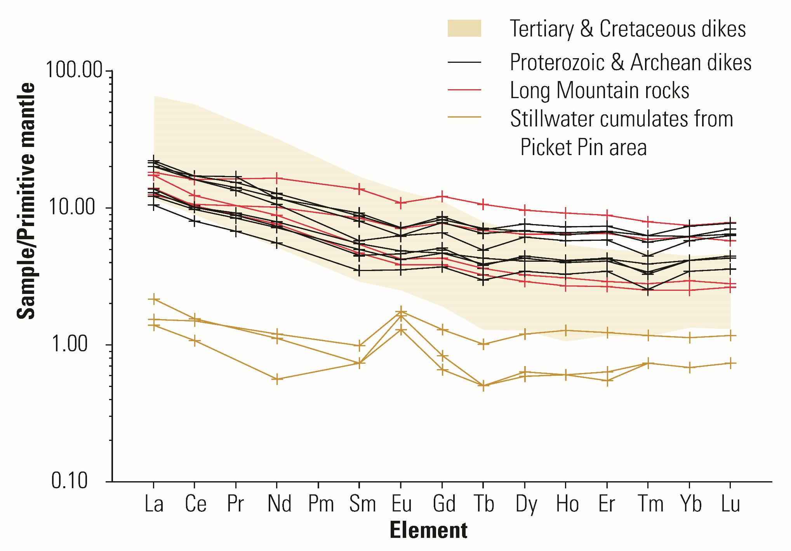
REE Primitive Mantle Normalized
Notes:
To compare our Long Mountain Samples against other previously analyzed samples in the area of the complex, we used trace element geochemistry. We plotted the rare earth element concentrations of our samples, normalized against the primitive mantle.
Stillwater cumulates collected from the Picket Pin area plot here in yellow on this spider diagram. They have lower abundances of REE across the board than the other samples and show a positive europium anomaly not shown in the other samples.
We plotted the Tertiary and Cretaceous dikes as a polygon in this buff color. The REE abundances are higher on the left side of the graph for lanthanum and cerium and lower on the right side of the graph than the Long Mountain samples.
The samples with the REE abundances most similar to the Long Mountain samples are the Proterozoic and Archean dikes that cut the complex. The dikes are shown in black and the Long mountain samples are shown in red.
While the trace element chemistry of the dikes and the Long Mountain rocks appear similar, their shape and size are very different. The dikes tend to be a few meters in thickness, while the Long Mountain rocks make up a much larger and more continuous body.

Slide 13
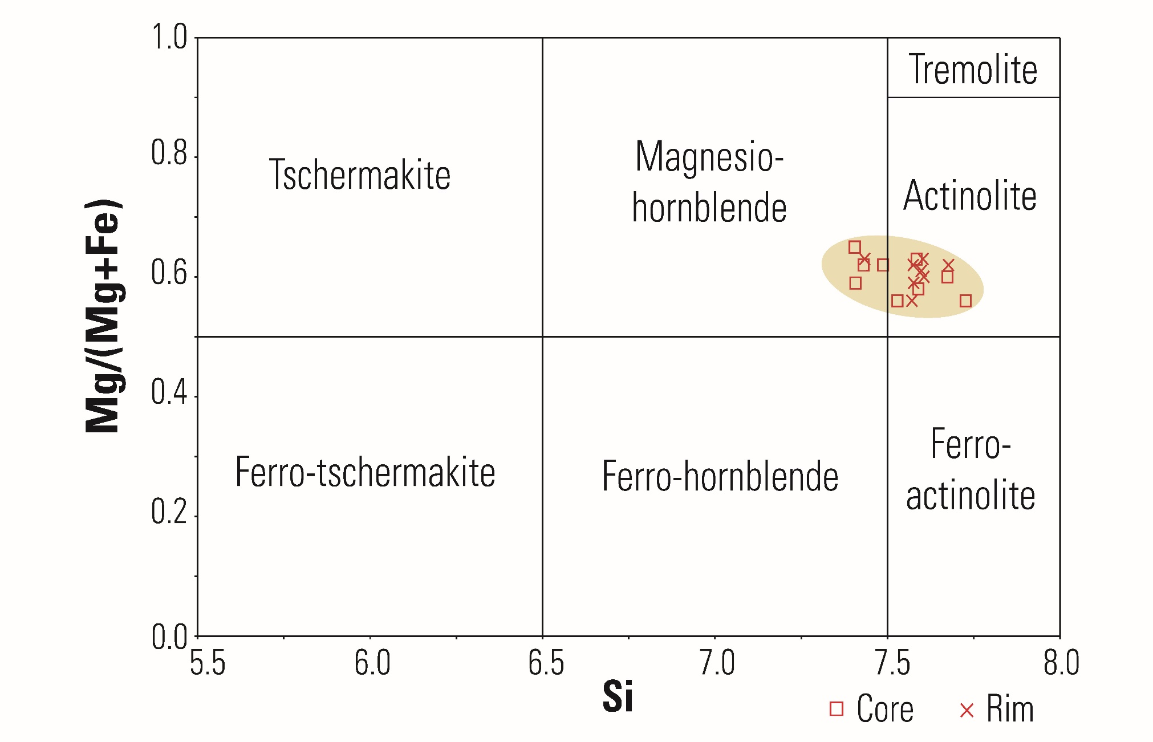
Mineral chemistry—Amphibole
Notes:
Using the microprobe at Washington State University, we analyzed the rim and core of three of the Long Mountain samples including the two that were shown in photomicrographs earlier. Three core points and three rim points were analyzed for each sample. We used PROBE-AMPH, a spreadsheet program used to classify microprobe-derived amphibole analyses by Tindle and Webb (1993) to process the raw data and then we plotted the results on this amphibole classification diagram.
The cores of the samples are shown by squares and the rims by crosses. There was no recognizable difference between the cores and the rims when we plotted them on this diagram, but we do see that in the amphiboles plot in the actinolite and magnesio-hornblende fields of the diagram.

Slide 14
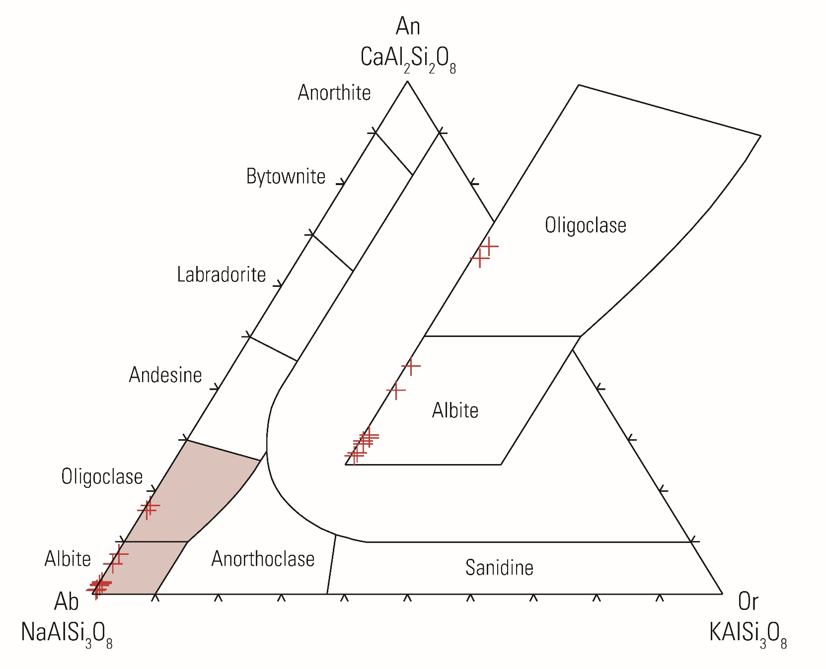
Mineral chemistry—Plagioclase
Notes:
Similarly, for plagioclase, we analyzed three samples using the microprobe. For two samples, we analyzed three cores and three times, but for the third sample, the plagioclase was so tattered that we took four single point measurements in different locations on the thin section.
We used PLAGCALC, a spreadsheet for processing microprobe plagioclase data by gabbrosoft.org (2011), to calculate albite-anorthite-orthoclase ratios. Next, we plotted our results on a feldspar ternary diagram.
These two red fields have been blown up here. We see that our plagioclase is mostly albite, with a few samples plotting in the oligoclase field.

Slide 15
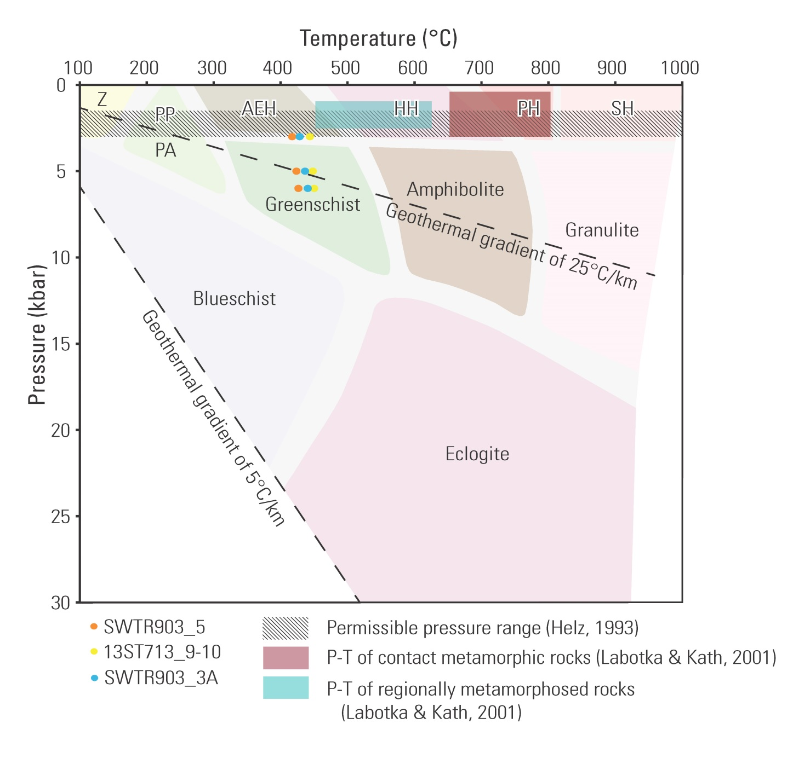
Constraints on P-T conditions
Notes:
We used our amphibole and plagioclase mineral chemistry to constrain temperature conditions using Holland and Blundy (1994). We plotted our results using pressures of 3, 5, and 6 kbar on a metamorphic facies diagram. They are plotting within the albite-epidote hornfels and greenschist facies. Which is consistent with the mineralogy we would expect to see if we took a basalt and metamorphosed it to greenschist facies (albite, epidote, actinolite, chlorite).
The range of possible temperatures of contact metamorphism of rocks beneath the complex is shown in the hornblende-hornfels and pyroxene-hornfels field rocks that Labotka and Kath called a hypersthene hornfels at temperatures of 650 to 800 C and pressures of .5 to 3 kilobar. Regionally metamorphosed biotite schist outside of the contact aureole was formed at temperatures of 450-625 C and 1 to 2.5 kbar.
The crosshatched pattern shows the permissible pressure range (Helz, 1993) of the Stillwater magma chamber (1.5-3 kbar).
This point shows the average PT conditions of the hornfels and melt gneiss in the contact aureole beneath the complex (Thomson, 2008).
The diagram has been modified from Klein and Philpotts (2013).

Slide 16
Conclusions
Relict igneous texture to mylonitic fabrics.
REE abundances similar to Proterozoic and Archean dikes.
  Not floor rocks.
  Not Stillwater cumulates.
  No known roof rocks have been identified.
Thermobarometry of coexisting plagioclase and amphibole constrain temperatures to between 417-450°C at pressures of 3, 5, and 6 kbar.
  Albite-epidote hornfels to greenschist-facies mafic meta-igneous rocks.
Notes:
The long mountain rocks exhibit a range of metamorphic textures from relict igneous texture to mylonitic fabric.
Harkening back to Vail’s three hypotheses:
These are dissimilar from the greywacke and iron formation that underlie the complex. Not metamorphosed floor rocks.
Roof rocks above the complex have not been identified, so we cannot make a comparison to the Long Mountain rocks.
REE spiderdiagram shows REE abundances dissimilar from Stillwater cumulates, so these are not metamorphosed cumulates.
They have similar REE abundances to the Precambrian dikes that cut the complex, but they do not resemble the dikes in size or shape. 4.5 km^2 vs linear dikes (10m) in width.

Slide 17
Further research
Uranium-lead radiometric dating of zircon.
  Laser ablation(?)
Collecting a wider suite of samples.
Notes:
As mentioned before, samples were collected for dating, but no zircons or baddeleyites were recovered. We did see zircons using the microprobe. The Archean mafic dikes that cut the complex have been dated to 2.709 Ga or roughly equivalent in age to the complex.
In addition, the terrain and the amount of daylight that we had (We went in September when the days were shorter) prevented us from collecting a representative set of samples from Long Mountain.

Slide 18
Acknowledgements
Thanks to Heather Parks (USGS) and Shyla Hatch (EWU)for their assistance in the field.
Special thanks to:
  EWU Alumni-funded Undergraduate Research Grant
  U.S. Geological Survey
  Dr. Owen Neill and Washington State University

