Slide 1


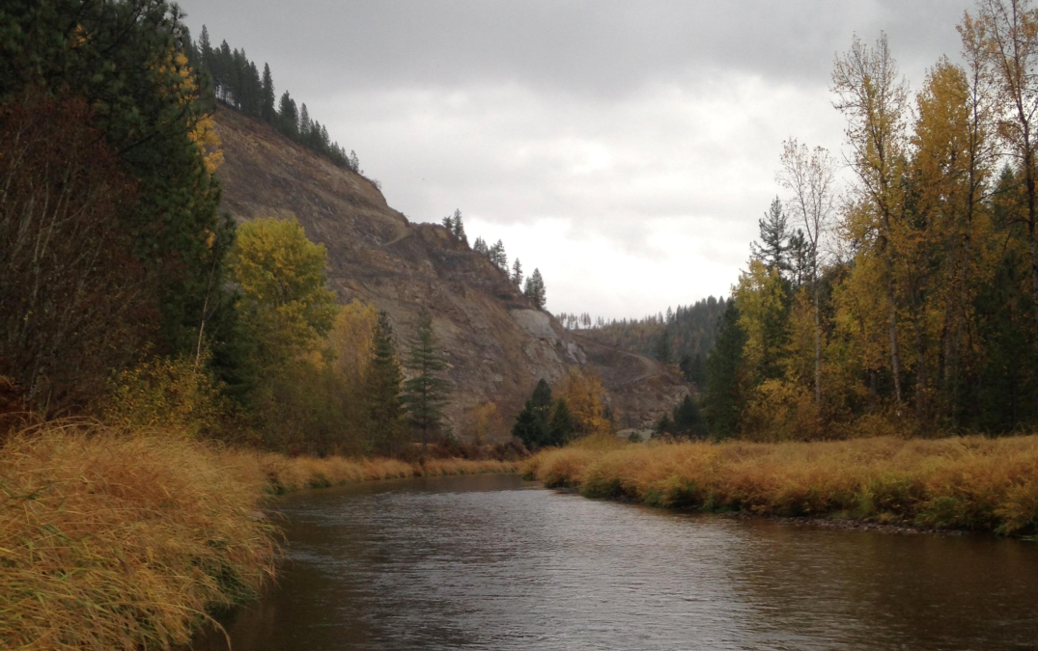
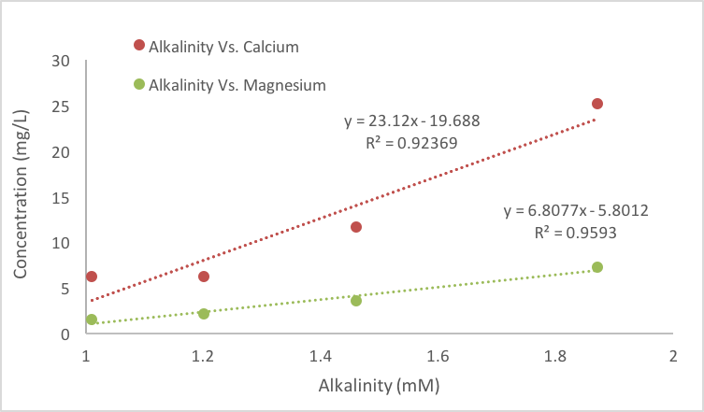
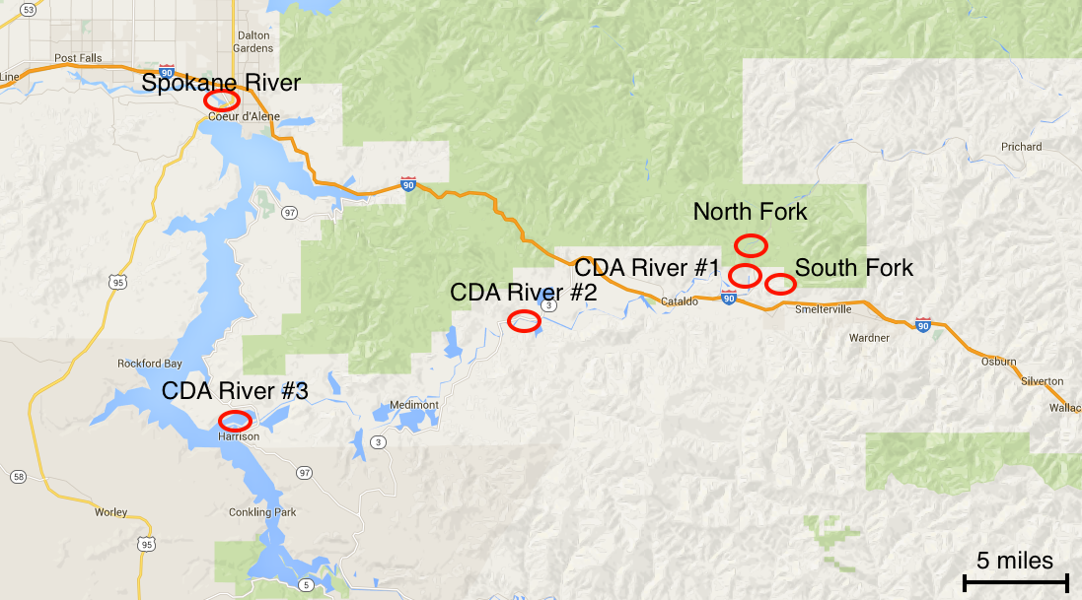
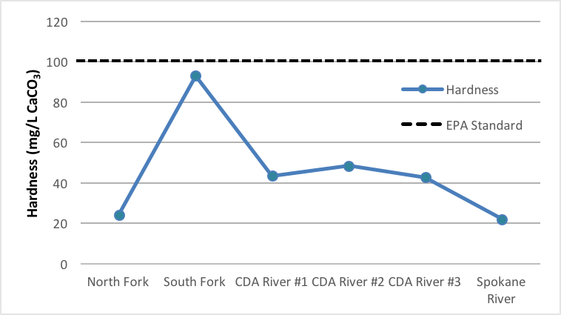
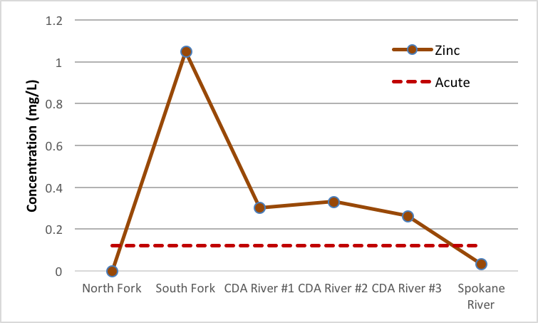
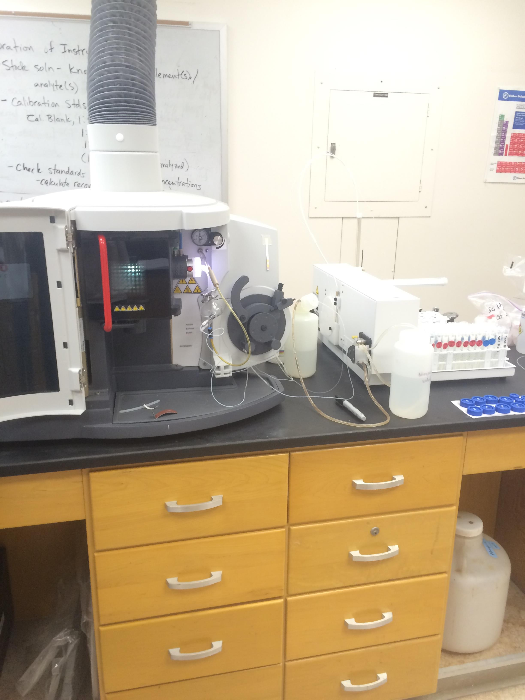
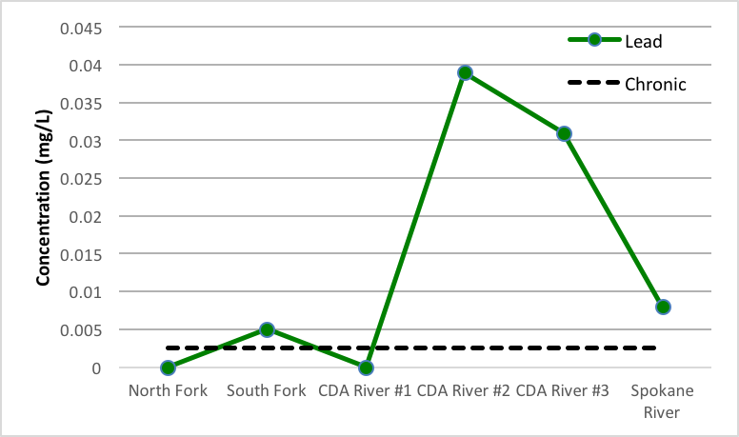
Heavy Metal Contaminants in River Water; Coeur d’Alene, Idaho
Kyle A. Duckett; Justin L. Donahue; Carmen A. Nezat
Department of Geology and Environmental Science, Eastern Washington University
Abstract
Sampling Sites
Over a century of unregulated mining practices within the Silver Valley of Idaho and Montana, has led to the introduction of waste material containing heavy metal contaminants (As, Cd, Fe, Mg, Pb, Zn). The presence of many of these elements in large abundance can have inadvertent effects on aquatic life and associated biota. Water samples were collected from multiple locations within the Coeur d’Alene River basin, as well as the source of the Spokane River. Heavy metal concentrations were analyzed using an Inductively Coupled Plasma-Optical Emissions Spectrometer. Toxic levels of zinc and cadmium were found within both the South Fork of the Coeur d’Alene River as well as three locations after the confluence of the river. Lead concentrations were surprisingly highest in the samples closest to Lake Coeur d’Alene, downstream from the South Fork. High concentrations of these heavy metals in within the river system indicate a possibility for negative impacts on the stream ecosystem. Cadmium and zinc concentrations within river water showed the largest potential threat to aquatic life.
N
Figure 3. Looking east along the South Fork of the Coeur d’Alene River, in northern Idaho, at our first sample location.
Figure 2.. The Coeur d’Alene River basin, with sample locations along the Coeur d’Alene and Spokane Rivers highlighted with red circles.
Figure 8. Concentrations of recorded calcium and magnesium plotted versus the alkalinity values calculated for the South Fork, North Fork, CDA #1, and Spokane River test locations.
Figure 4. Justin sampling along the bank of the North Fork of the CDA River.
Discussion
Results
Zinc levels were found to be double the amount classified as dangerous for Aquatic Life Criteria, at each location except within the North Fork and Spokane River. Besser et al (2007) found levels of zinc above 0.30 mg/L to be toxic for both sculpins and rainbow trout, causing 100% mortality rates. We contribute the chronically toxic levels of lead within CDA River #2 and CDA River #3 to the amount of lead accumulated in sediments within the river basin. As opposed to related studies (Balistrieri et al 2003) arsenic was not found in significant concentrations within the water column present at any of our six test locations along the CDA river system. Cadmium concentrations also appeared to higher than chronic and acute toxicity levels (data not shown). High concentrations of cadmium inhibit the uptake of calcium in fish, and was found to effect foraging ability in trout (Zelikoff et al 1995). Overall our study shows the most significant danger is posed by zinc and lead. Zinc occurs most prevalently in the South Fork of the River, while lead shows the greatest concentrations downstream of the rivers confluence.
Introduction
Figure 5. Hardness levels in river water samples. Hardness values were calculated using concentrations of calcium and magnesium present at each test location. Hardness = Ca×2.497＋Mg×4.118. Increased water hardness inhibits the uptake of heavy metals in fish, decreasing negative effects. Hardness within our samples was lower than those used by the EPA to standardize toxicity levels in aquatic species (100 mg/L).
Previous studies have shown elevated concentrations of various heavy metal constituents (As, Cd, Fe, Mg, Pb, Zn) within the Coeur d’Alene river system (Balistrieri et al 2002 & 2003). Heavy metals accumulate in sediments, biofilm, vegetation, and macro and micro-invertebrates (Toevs et al 2008 and Faraq et al 1998). This has led to high mortality rates on both fish (Faraq et al 1998) and waterfowl (Chupp and Dalke 1964). We hypothesize elevated concentrations of these heavy metal constituents within the water column throughout the system, with the highest levels being present within the South Fork.
Methods
Water temperature, atmospheric temperature and pH were collected and recorded at each sample location. Samples were collected in acid-washed bottles and acidified with trace-metal grade nitric acid to a pH<2. Analyte concentrations (As, Ca, Cd, Fe, Mg, Na Pb, Si, Sr, Zn) were determined using an Inductively Coupled Plasma Optical Emission Spectrometer (ICP-OES). Alkalinity was determined by titration of samples collected in water-washed bottles.
Figure 6. Zn concentrations in river water samples. Zinc levels were higher than the chronic and acute Aquatic Life Criteria, which are both set at 0.12 mg/L for a hardness of 100 mg/L. Only the North Fork and Spokane Rivers did not exceed these values. However, because the hardness of the sites are lower than 100 mg/L (Figure 5), toxicity levels for aquatic levels are actually higher than 0.12 mg/L.
Conclusion
High concentration of heavy metals were found throughout the system stemming from the South Fork of the Coeur d’Alene River. Further research is required to improve accuracy and precision of concentrations measured near or below the method detection limit (MDL). Establishing relationships between seasonal changes in the water level and trace metals will also assist in understanding variation in water chemistry. In order to examine the biologic impact more thoroughly, levels of heavy metals could be measured and quantified within sediments as well as organisms from varying levels of the food chain.
Bibliography
Figure 7. Pb concentrations in river water samples. The largest levels of lead were found within the river water collected from the CDA River #2 location at 0.039 mg/L and from CDA River #3 at 0.031 mg/L. Levels were also above the chronic limit within the South Fork of the river. The chronic toxicity for aquatic life criteria as set by the EPA is represented by the dashed line.
Balistrieri, L.S., Box, S.E., Tonkin J.W. (2003) Modeling Precipitation and Sorption of Elements during Mixing of River Water and Porewater in the Coeur d’Alene River Basin. Journal of Environmental Science and Technology. 37, 4694-4701
Balistrieri, L.S., Box, S.E., Bookstrom A.A., Hooper R.L., Mahoney J.B. (2002) Impacts of historical mining in the Coeur d’Alene River Basin. Pathways of Metal Transfer from Mineralized Sources to Bioreceptors. US Geological Survey Bulletin. 2191, 1-34
Chupp N.R. and Dalke P.D. (1964) Waterfowl mortality in the Coeur d’Alene River, Idaho. Journal of Wildlife Management. 50, 692-702
Faraq A.M., Woodward D.F., Goldstein J.N., Brumbaugh W., and Meyer J.S. (1998) Concentrations of metals associated with mining in sediments, biofilm, benthic macroinvertebrates, and fish from the Coeur d’Alene River basin, Idaho. Archives of Environmental Contamination and Toxicology. 34, 119-127
Toevs G., Morra M.J., Winowiecki L., Strawn D., Polizzotto M.L., Fendorf S. (2008) Depositional Influences on Porewater Arsenic in Sediments of a Mining-Contaminated Freshwater Lake. Journal of Environmental Science and Technology. 42, 6823-6829
Zelikoff J.T., Bowser D, Squibb K.S., Frenkel K. (1995) Immunotoxicity of low level cadmium exposure in fish: An alternative animal model for immunotoxicological studies. Journal of Toxicology and Environmental Health. 45, 235-248
Figure 1. The ICP-OES used to analyze heavy metals in water samples taken from the Coeur d’Alene River system.

