Slide 1
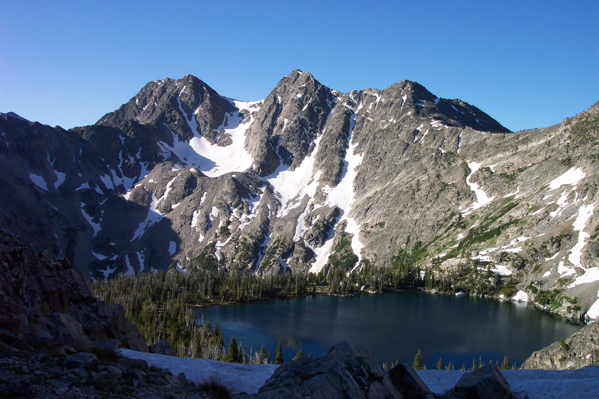
Mesoproterozoic Lemhi strata represent immense alluvial aprons that prograded northwest into the Belt Sea, Idaho and Montana:
Where do the Belt Supergroup and the Lemhi Group meet? Is this contact structural or stratigraphic? If stratigraphic, how do the units correlate?
Jeff Lonn
Russ Burmester
Reed Lewis
Mark McFaddan

Slide 2
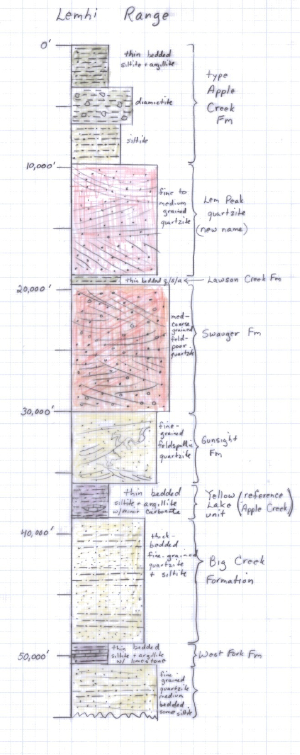
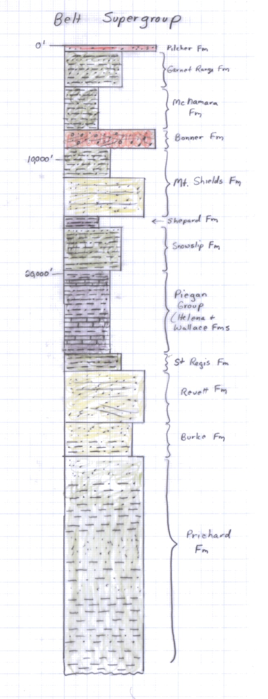

Slide 3
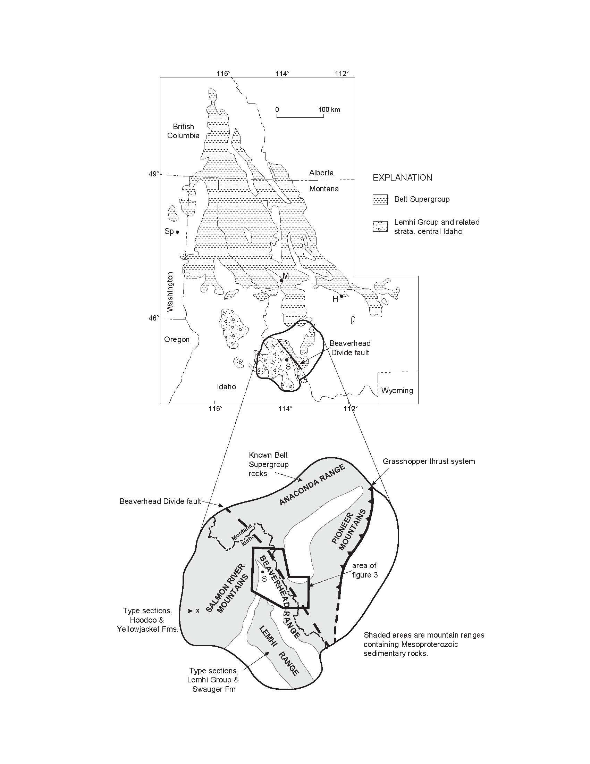

Slide 4
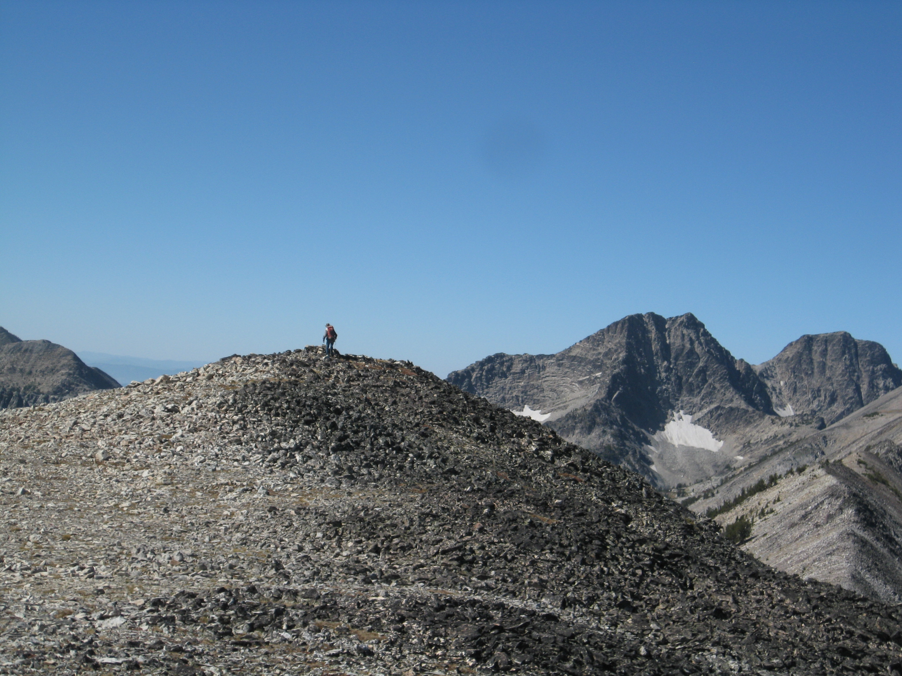

Slide 5
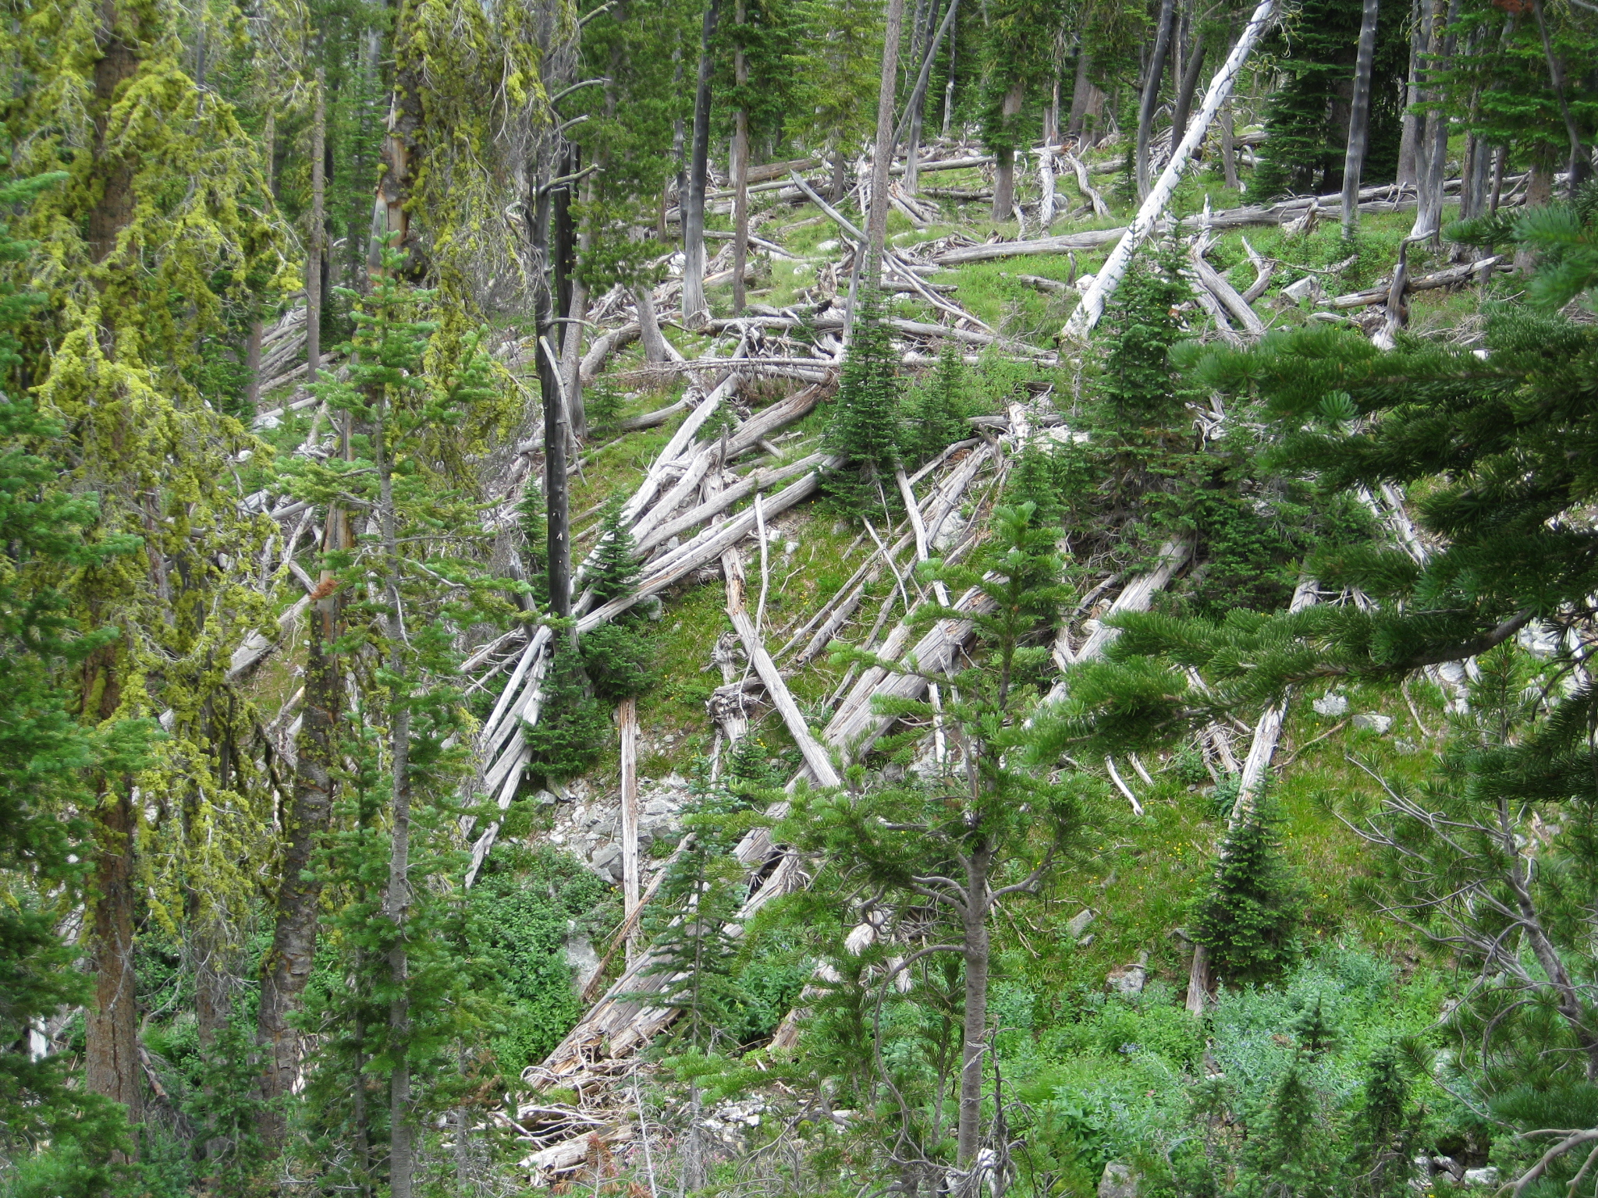

Slide 6
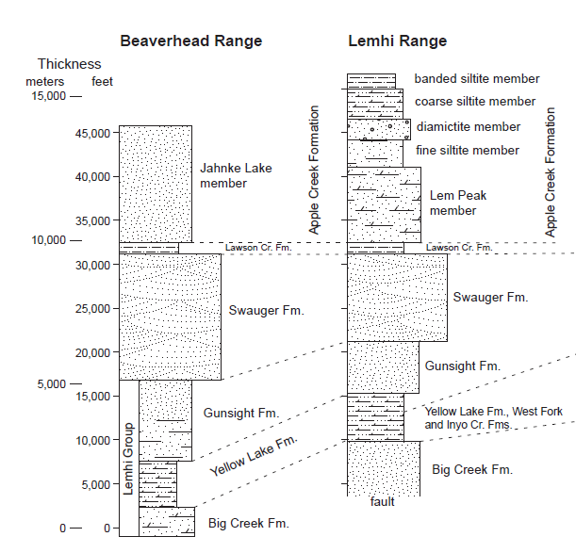

Slide 7
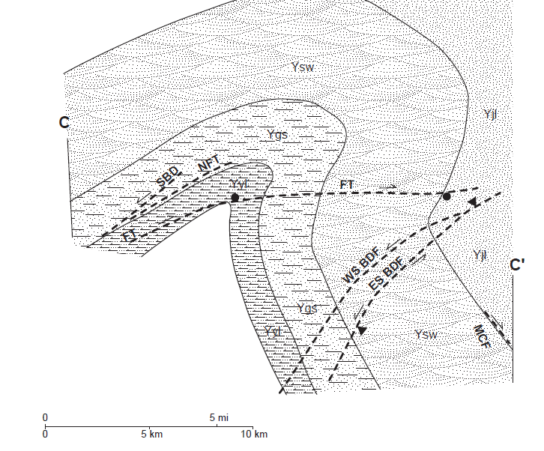
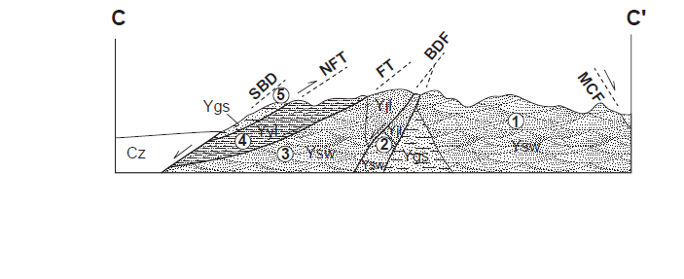
SW
NE

Slide 8
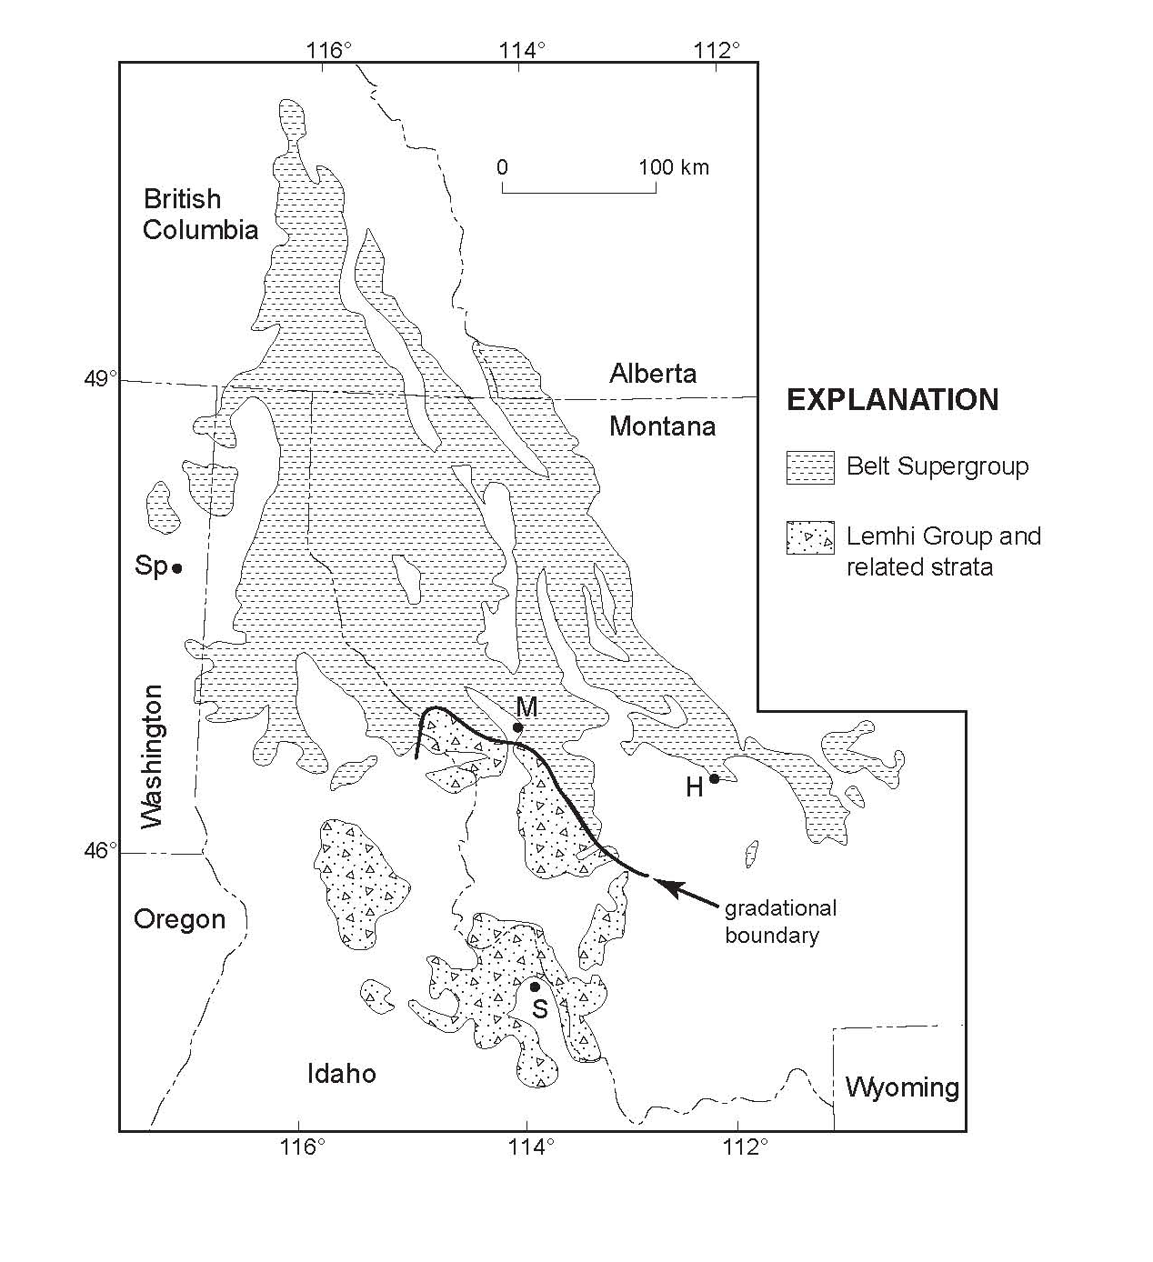

Slide 10
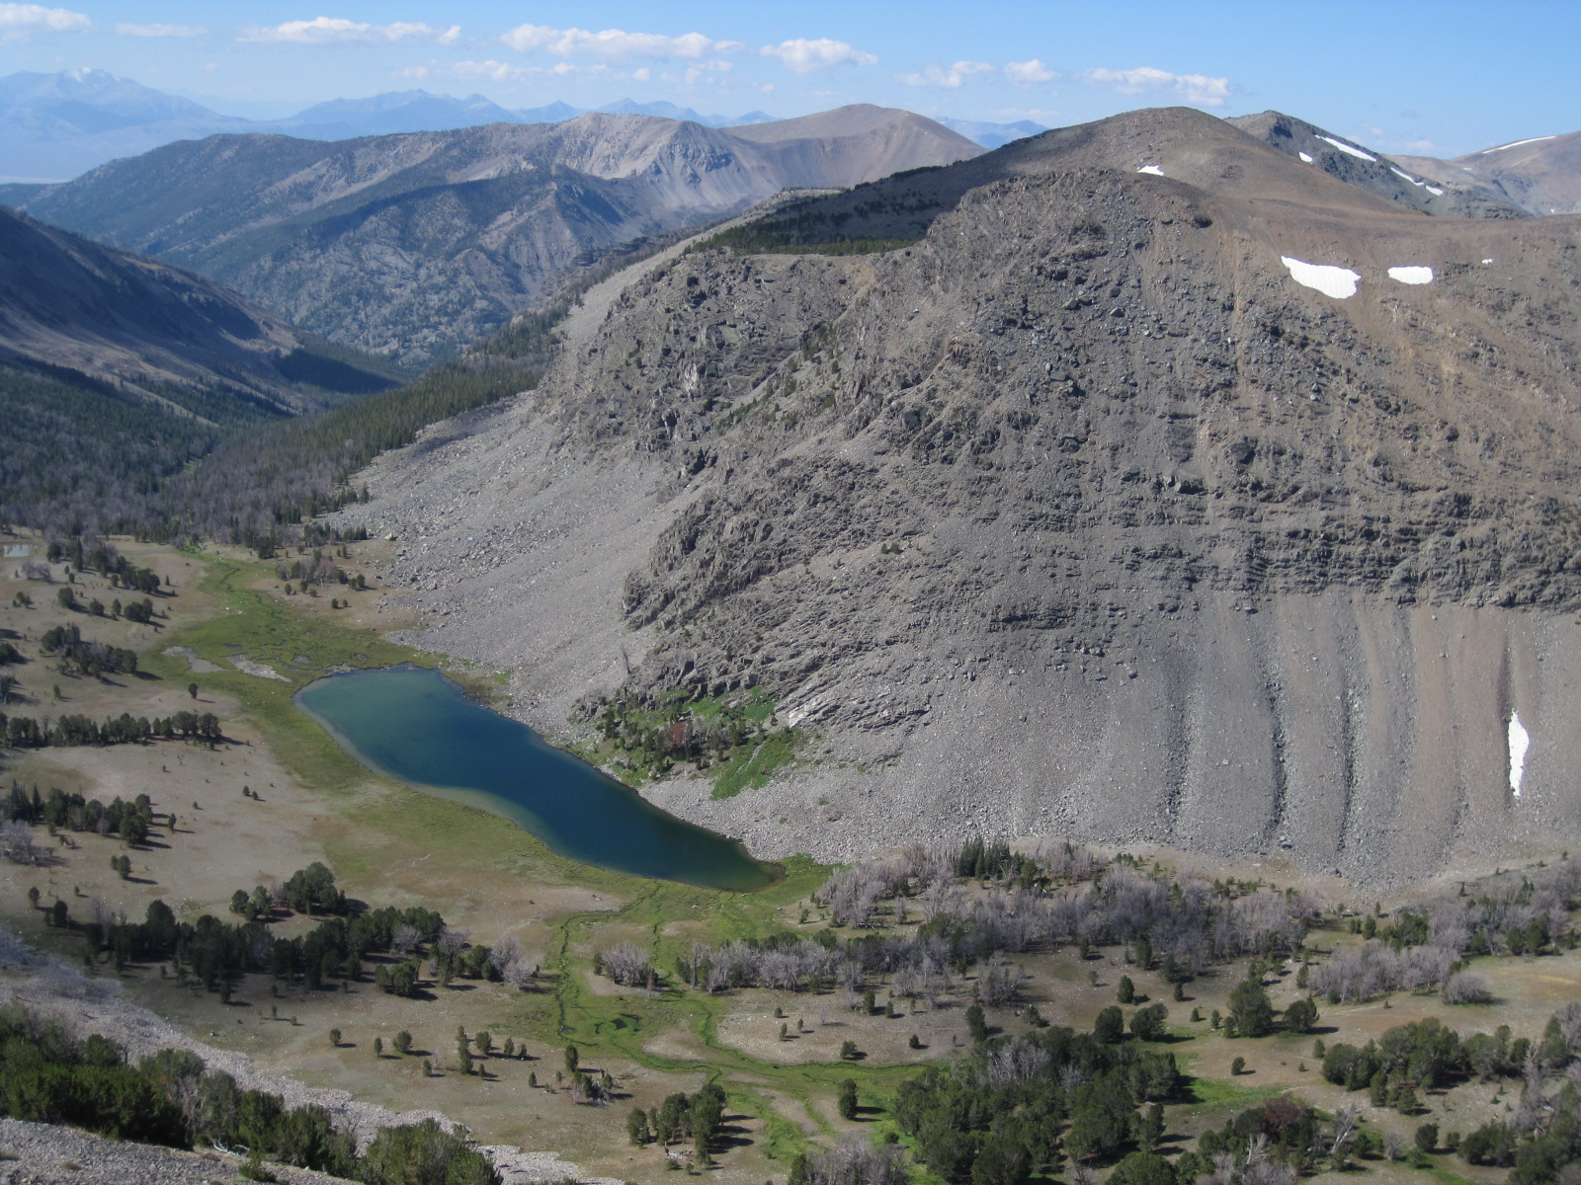

Slide 11
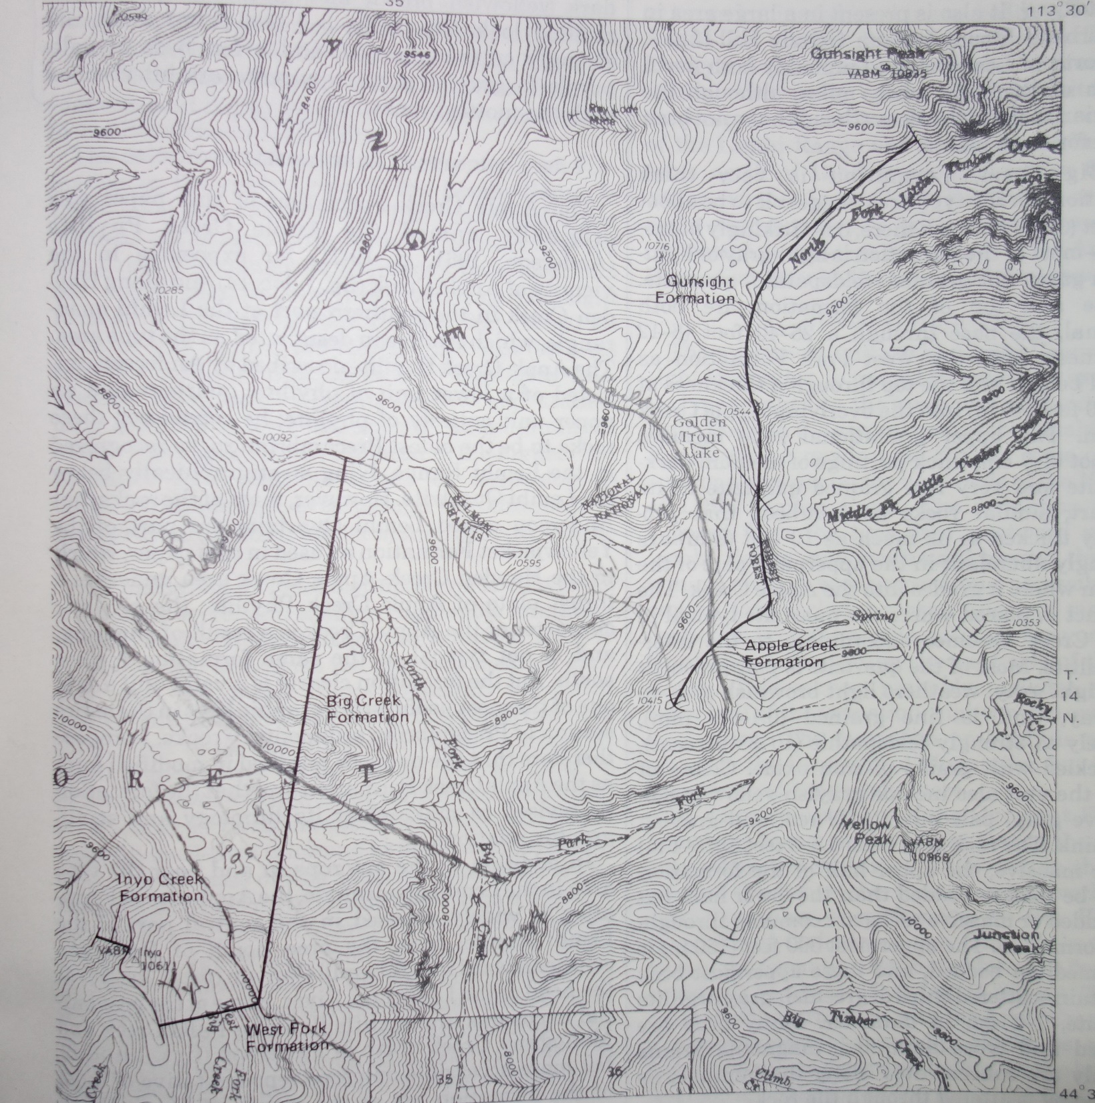
Ruppel, 1975

Slide 12
Ruppel, 1975
Ygs
Yyl
Yyl
Ybc
Ybc
Yyl
Ygs
Ybc
Yyl

Slide 14
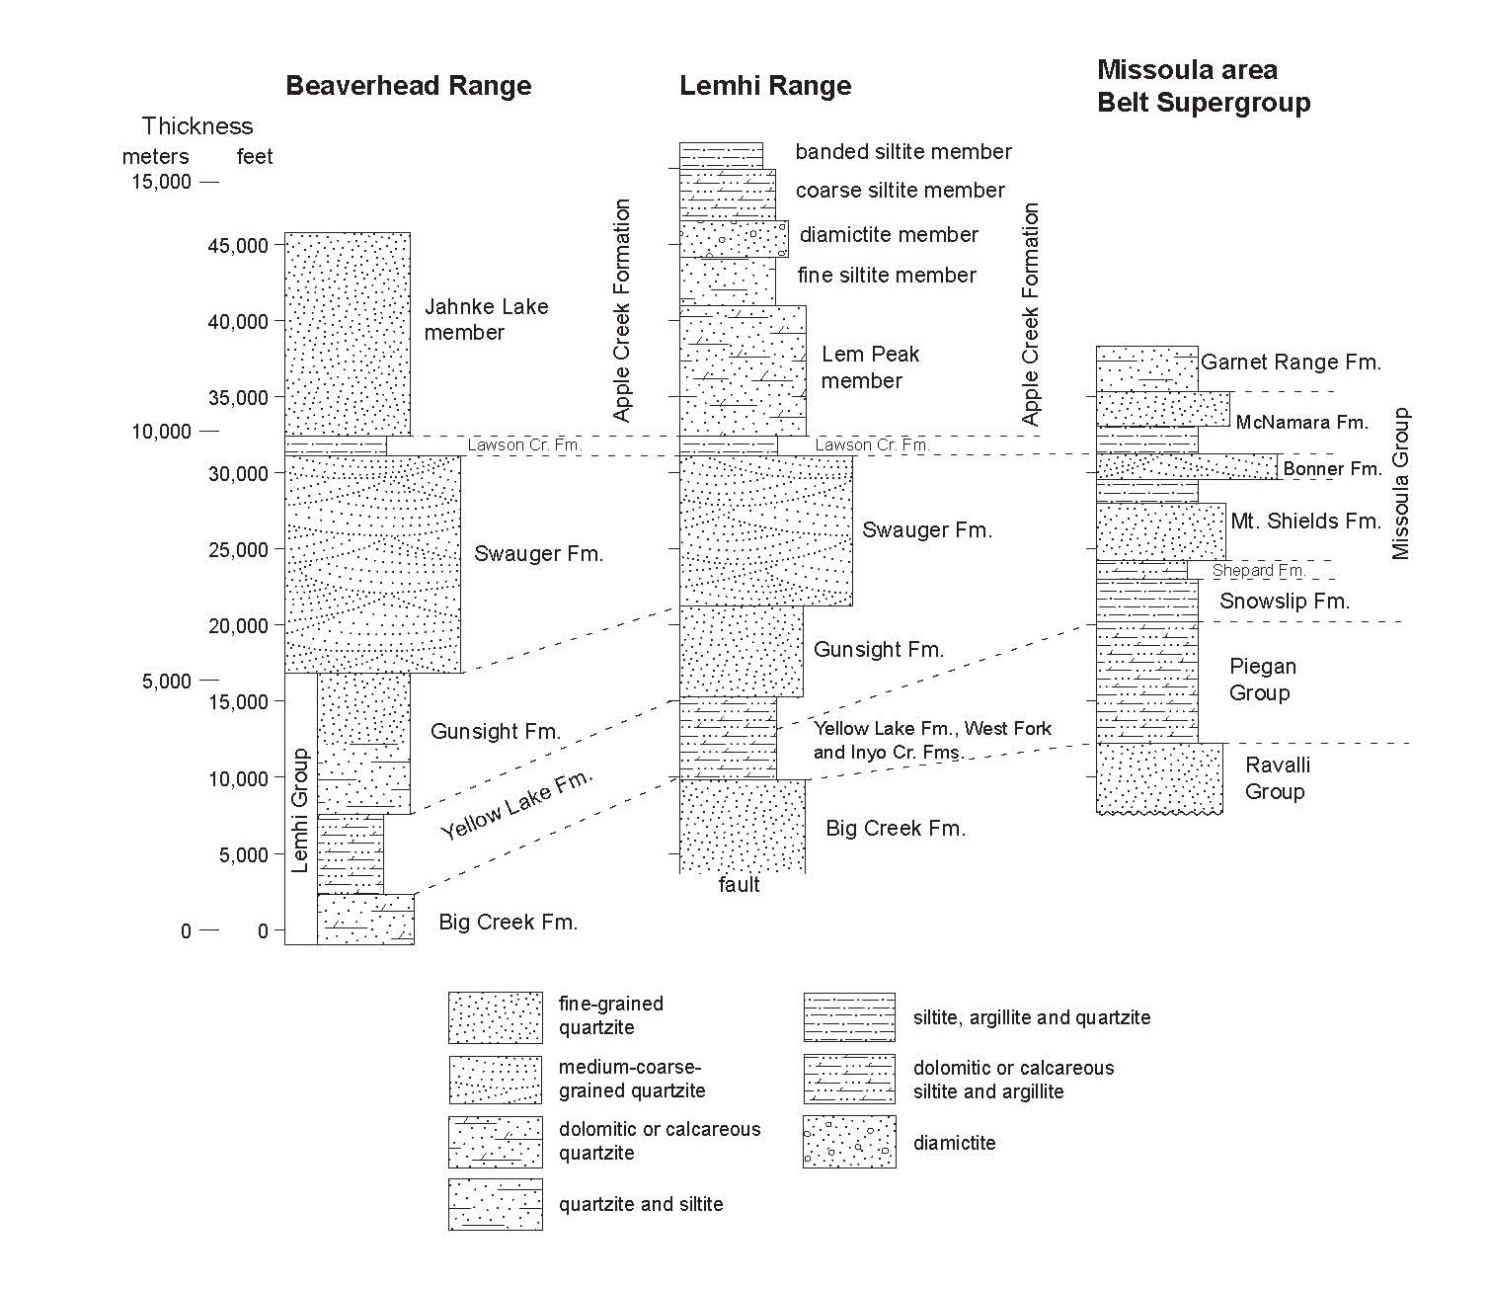

Slide 15

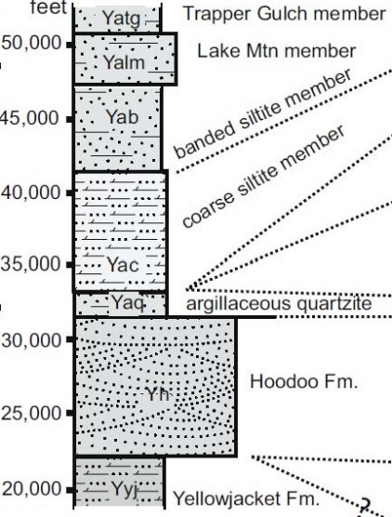
Yellowjacket-Blackbird
(Burmester et al., 2016)
Yyj

Slide 16
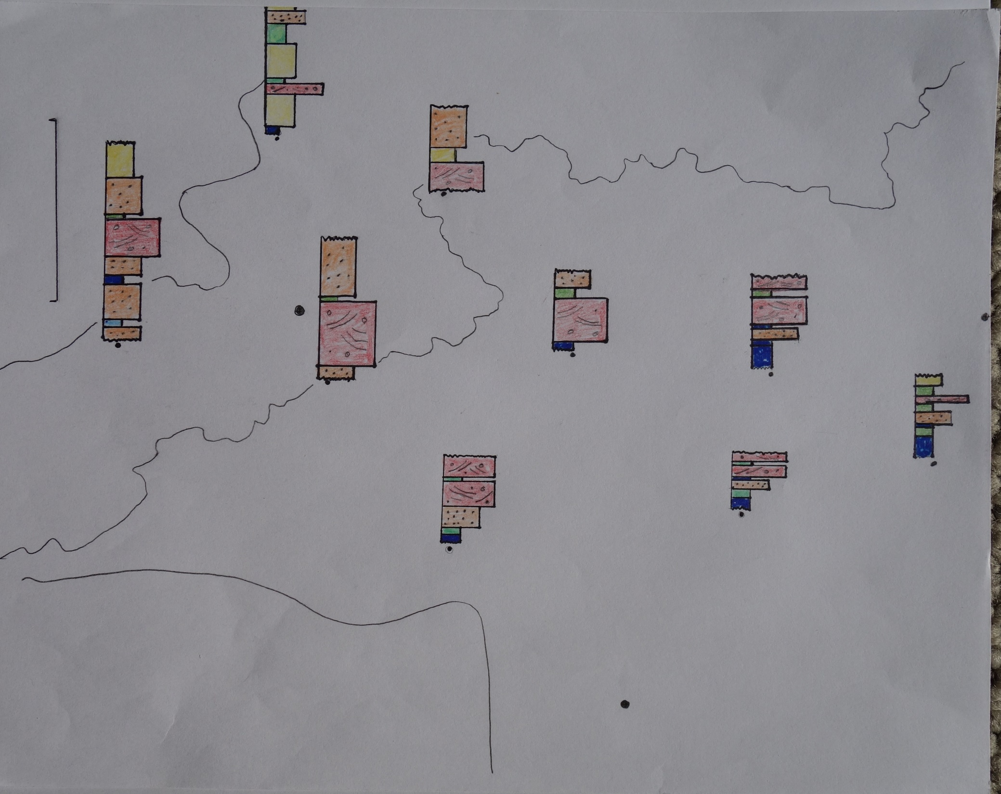
Yellowjacket
Blackbird
Idaho
50,000 feet
WF Bitterroot
Montana
Salmon
Missoula
Lemhi Range
Southern
Sapphire Mtns
Beaverhead Range
Central
Sapphire Mtns
Missoula
Group
Philipsburg
Pioneer Mtns
Dillon Block
N
Butte

Slide 17
Yellowjacket
Blackbird
Idaho
50,000 feet
WF Bitterroot
Montana
X
Salmon
Missoula
Lemhi Range
Southern
Sapphire Mtns
Beaverhead Range
Central
Sapphire Mtns
Missoula
Group
Philipsburg
Pioneer Mtns
Dillon Block
N
Butte

Slide 18
Yellowjacket
Blackbird
Idaho
50,000 feet
WF Bitterroot
Montana
X
Salmon
Missoula
Lemhi Range
Southern
Sapphire Mtns
Beaverhead Range
Central
Sapphire Mtns
Missoula
Group
Philipsburg
Pioneer Mtns
Dillon Block
N
Butte
Bottom of McNamara/Lawson Creek

Slide 19
Yellowjacket
Blackbird
Idaho
50,000 feet
WF Bitterroot
Montana
X
Salmon
Missoula
Lemhi Range
Southern
Sapphire Mtns
Beaverhead Range
Central
Sapphire Mtns
Missoula
Group
Philipsburg
Pioneer Mtns
Dillon Block
N
Butte
Top of Piegan Group

Slide 20
Yellowjacket
Blackbird
Idaho
50,000 feet
WF Bitterroot
Montana
X
Salmon
Missoula
Lemhi Range
Southern
Sapphire Mtns
Beaverhead Range
Central
Sapphire Mtns
Missoula
Group
Philipsburg
Pioneer Mtns
Dillon Block
thick Swauger-Bonner
N
Butte

Slide 21
Yellowjacket
Blackbird
Idaho
50,000 feet
WF Bitterroot
Montana
X
Salmon
Missoula
Lemhi Range
Southern
Sapphire Mtns
Beaverhead Range
Central
Sapphire Mtns
Missoula
Group
Philipsburg
Pioneer Mtns
Thick fine-grained quartzite
Gunsight, Apple Creek,
Mt Shields
Dillon Block
N
Butte

Slide 22
Yellowjacket
Blackbird
Idaho
50,000 feet
WF Bitterroot
Montana
X
Salmon
Missoula
Lemhi Range
Southern
Sapphire Mtns
Beaverhead Range
Central
Sapphire Mtns
Missoula
Group
Philipsburg
Pioneer Mtns
Dillon Block
N
Butte

Slide 23
Yellowjacket
Blackbird
Idaho
50,000 feet
WF Bitterroot
Montana
X
Salmon
Missoula
Lemhi Range
Southern
Sapphire Mtns
Beaverhead Range
Central
Sapphire Mtns
Missoula
Group
Philipsburg
Pioneer Mtns
Dillon Block
N
Butte

Slide 24
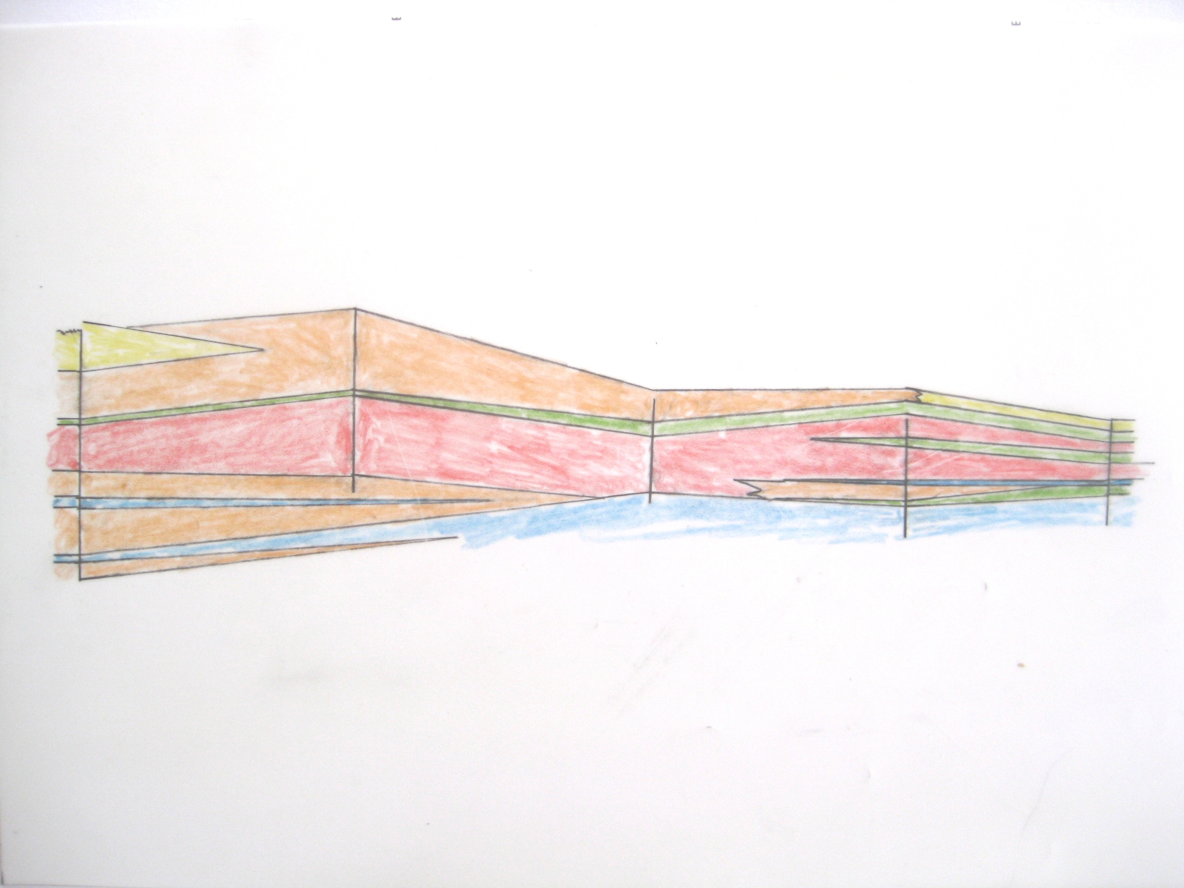
Lemhi
Range
Beaverhead
Mtns
southern
Sapphire Mtns
type
Apple Cr
central
Sapphire Mtns
Missoula
area
Lem Pk
Lawson Cr
Garnet Rg
Swauger
McNamara
Bonner
Gunsight
Mt Shields
Shepard
Yellow Lk
Snowslip
Wallace
Big Creek
X
West Fork
Inyo Creek
south
north

Slide 25
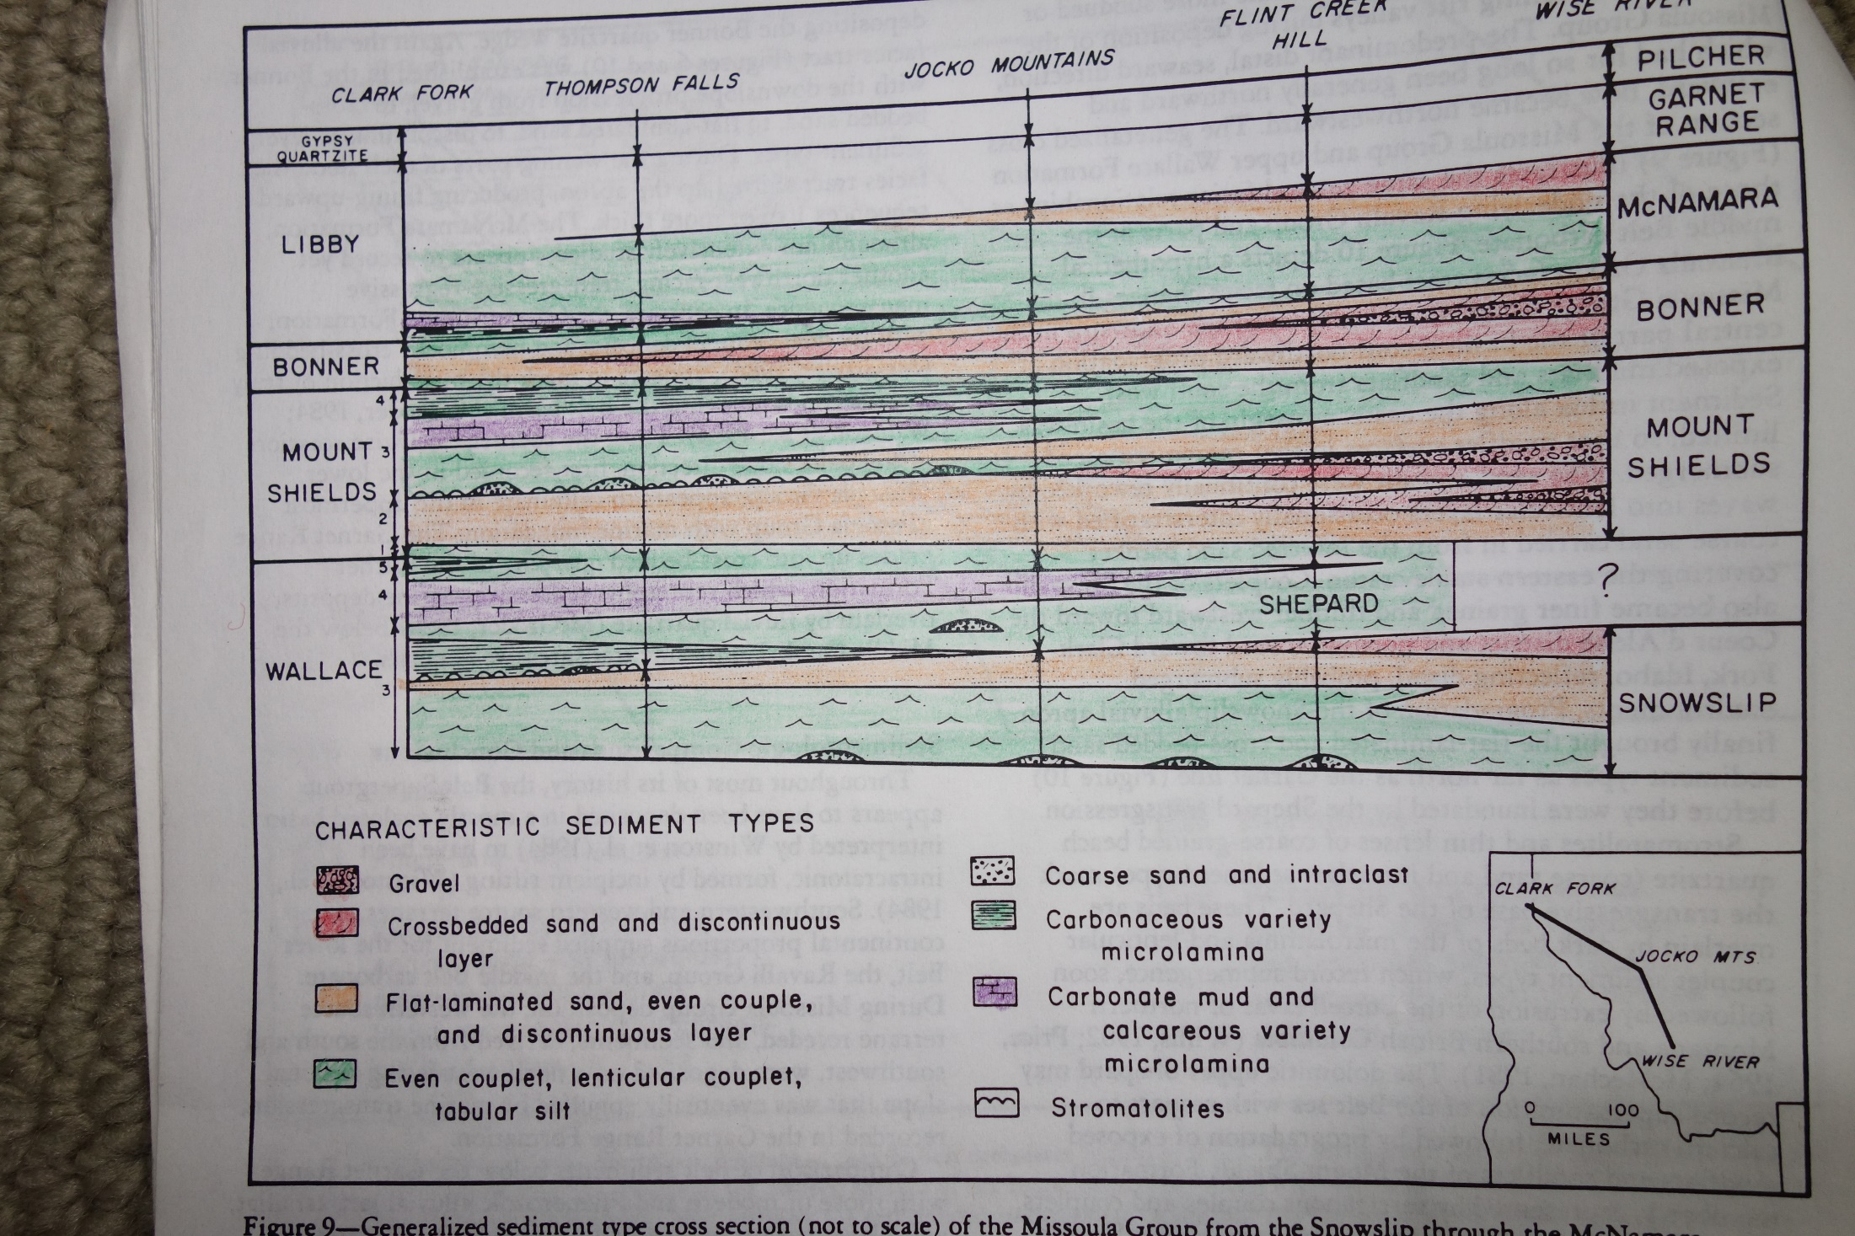
From Winston, 1986

Slide 26
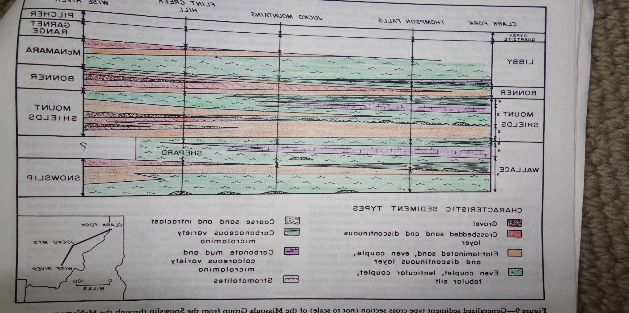

Slide 27
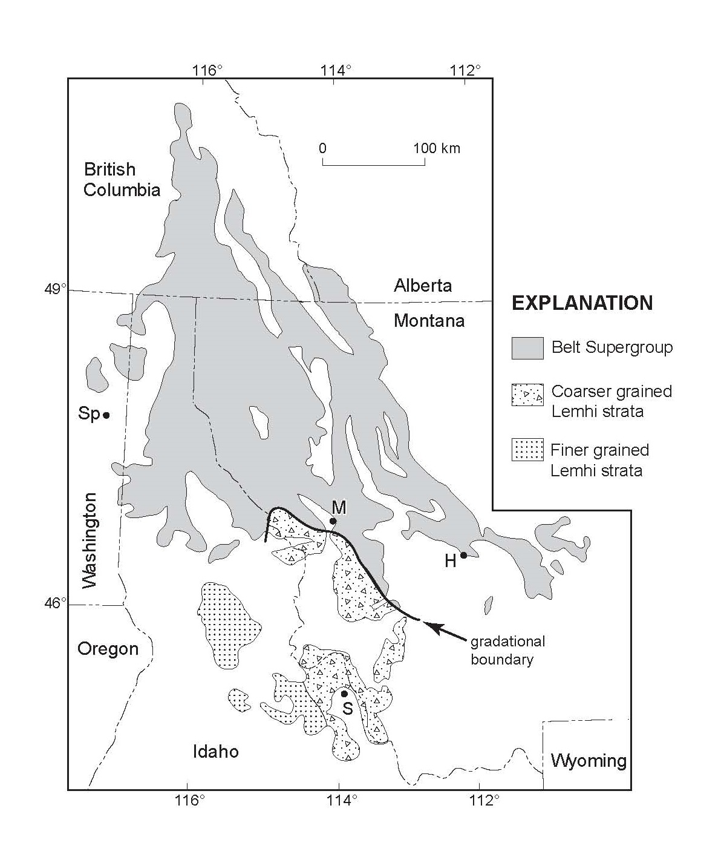

Slide 28
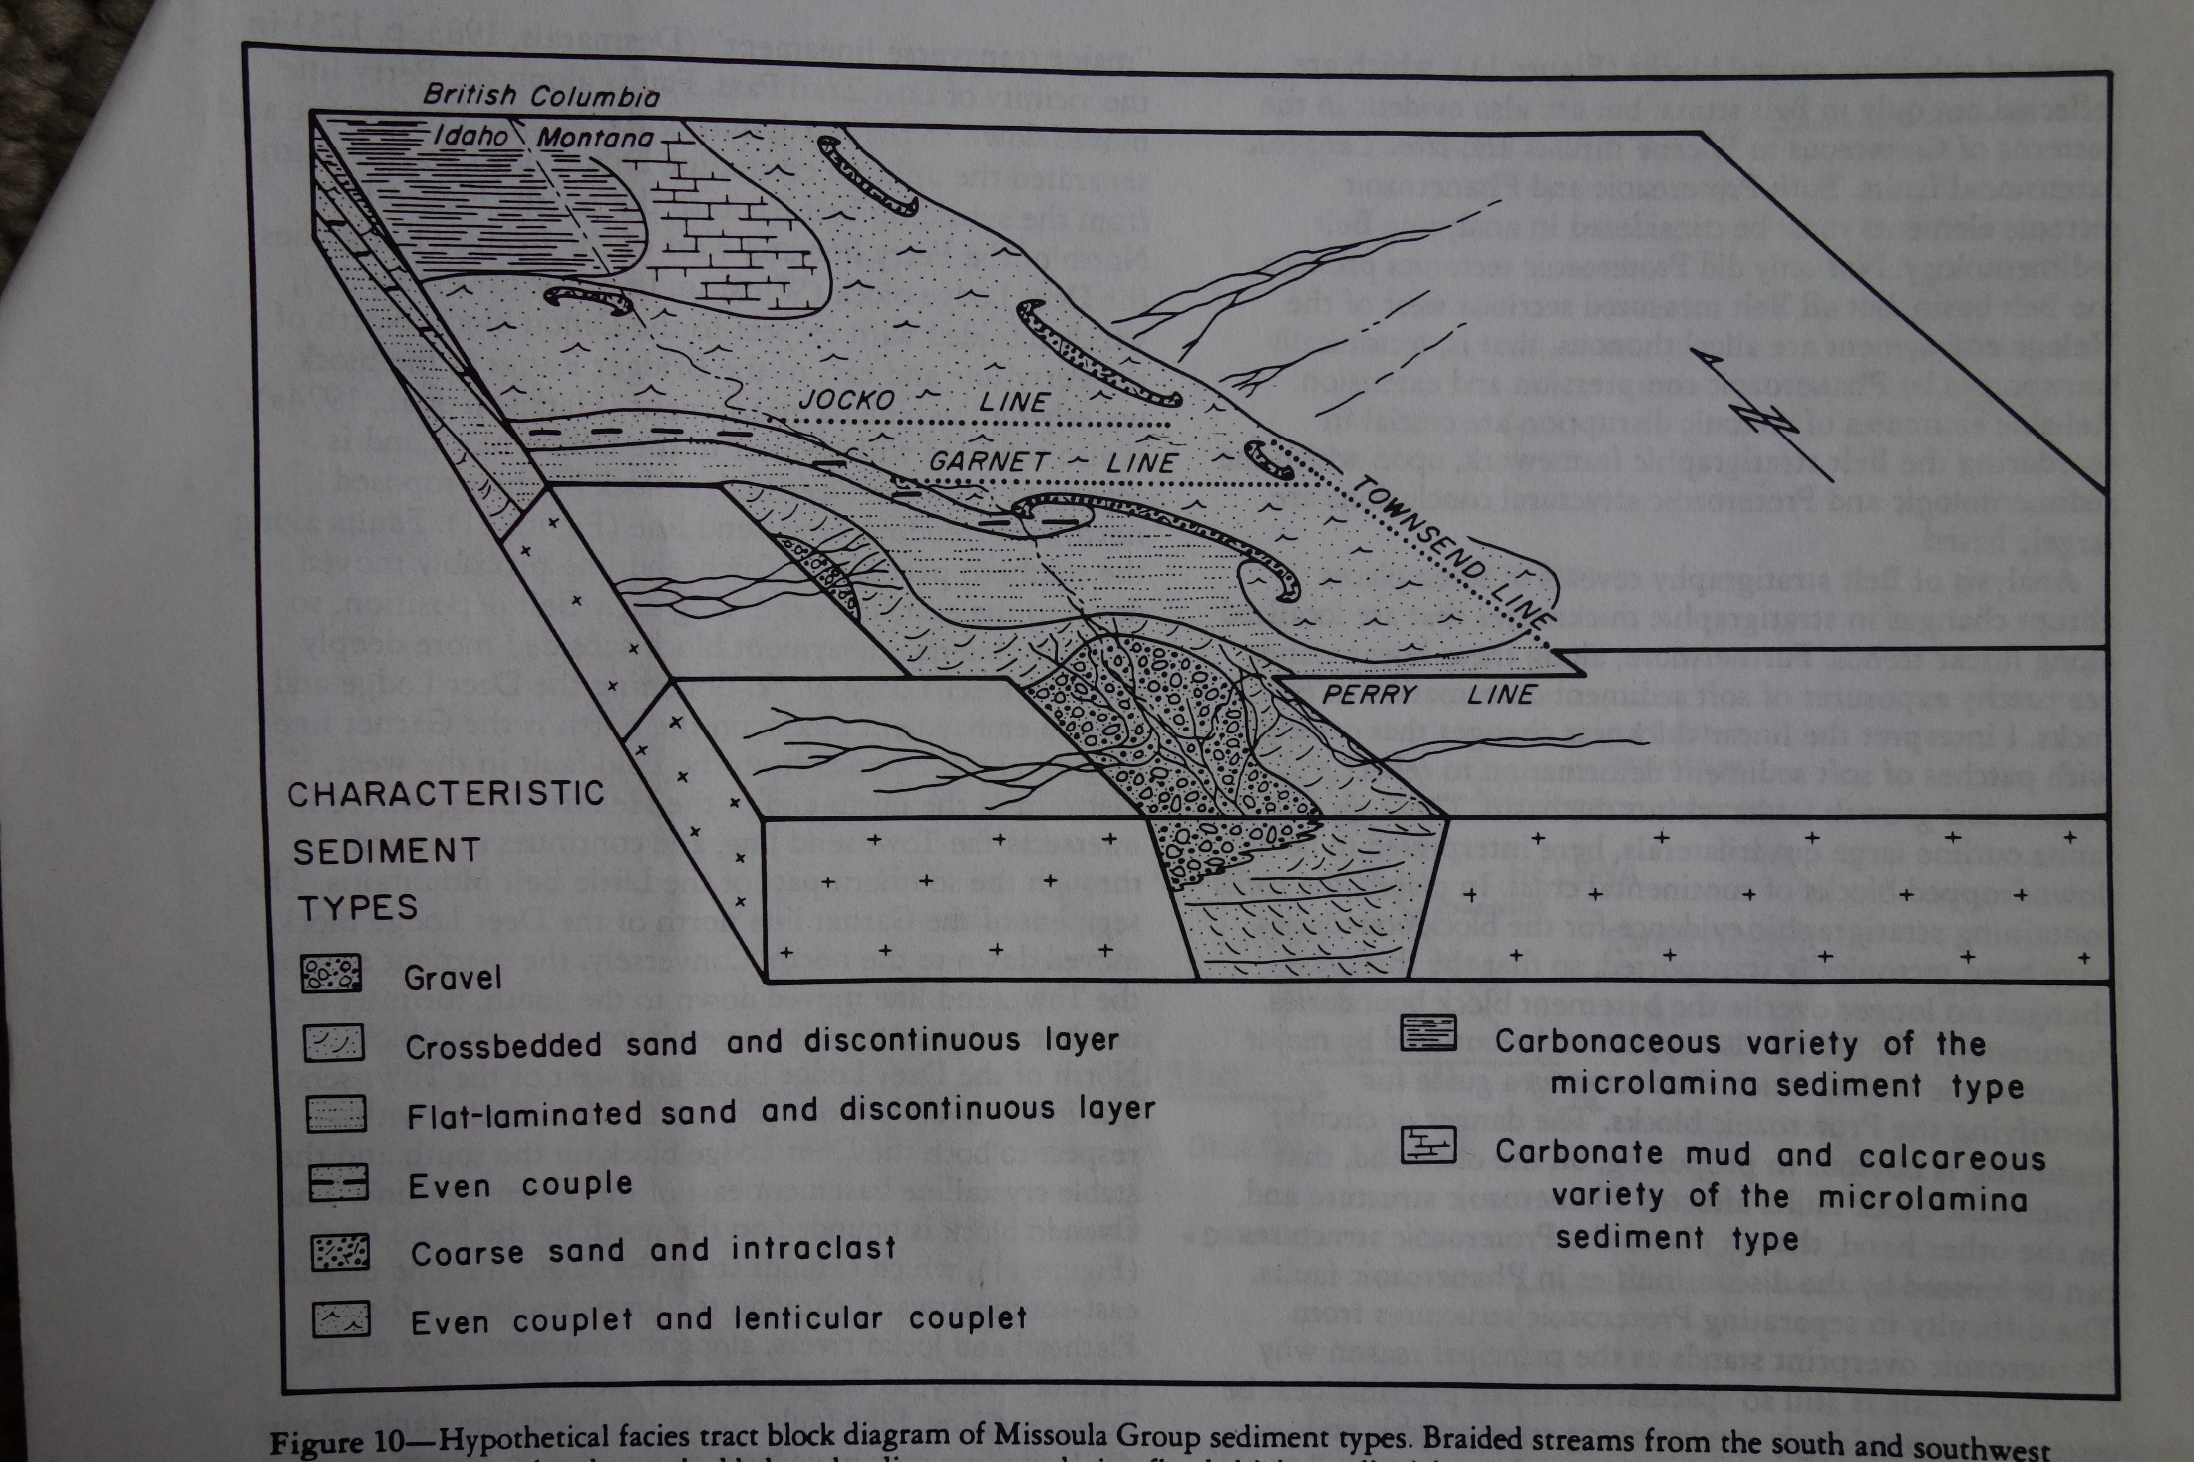
From Winston,1986

Slide 29
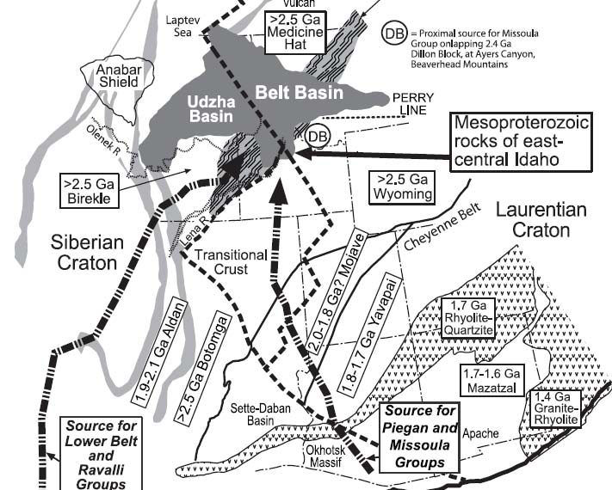
From Link et al., 2007

Slide 30
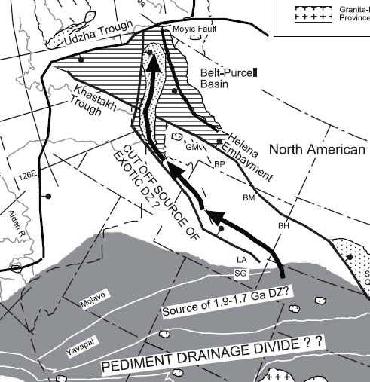
From Sears, 2007

Slide 32
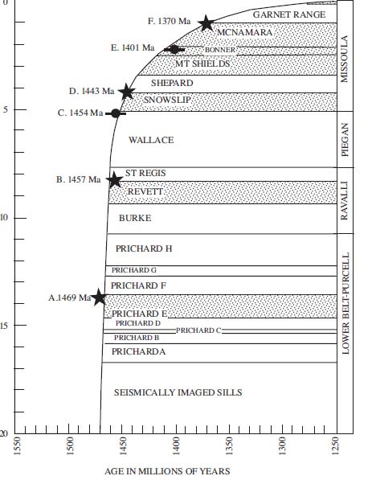
From Sears, 2007

Slide 33
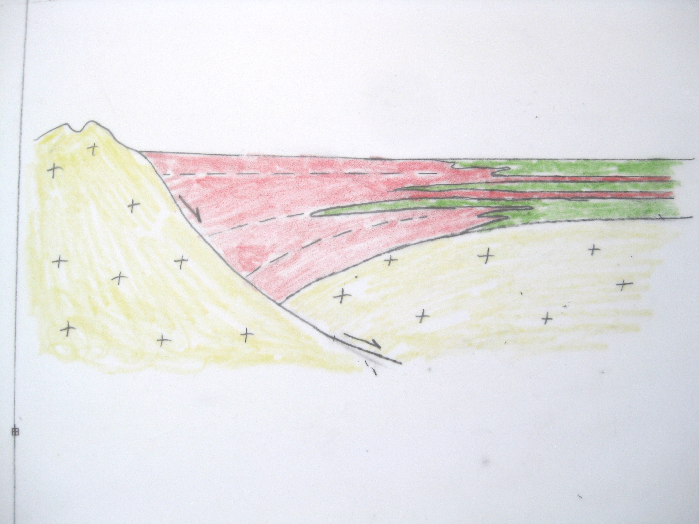
south
north

Slide 34
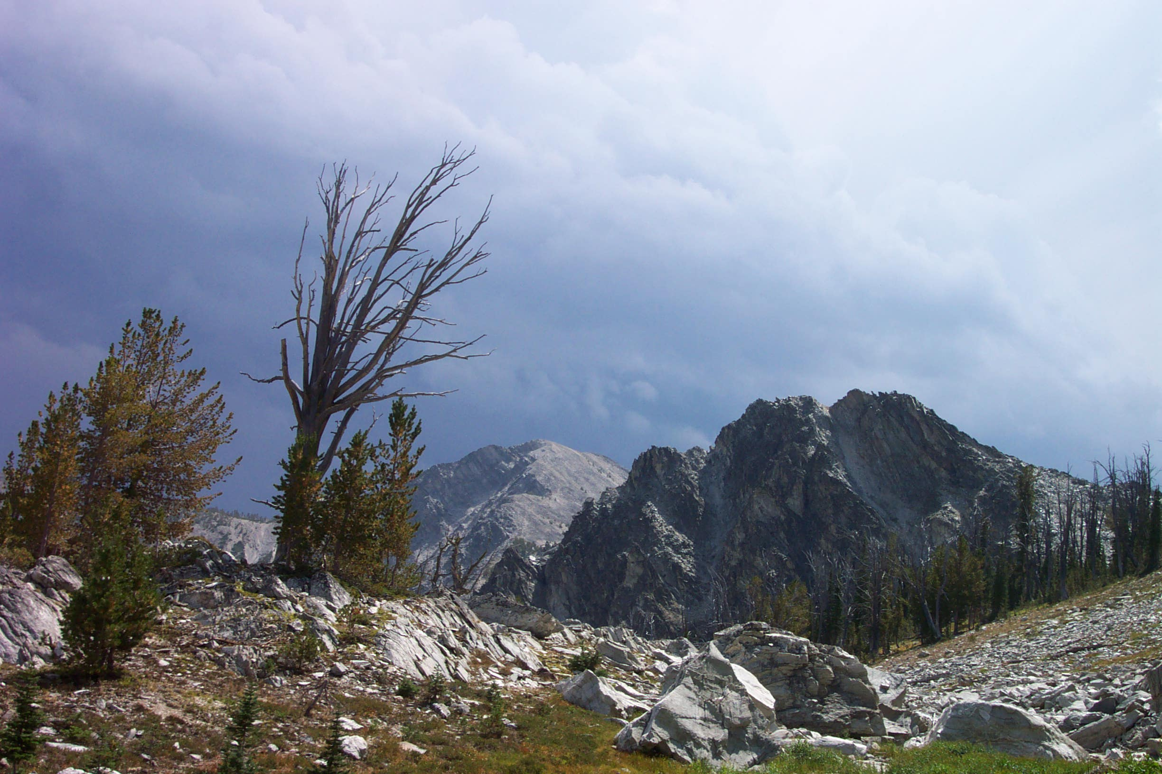
Conclusions:
Most of the Lemhi strata correlate with the Missoula Group
Sandy Lemhi strata are relicts of the southeastern, upstream ends of immense alluvial
aprons that prograded NW into the Belt Sea
Subsidence of the Lemhi subbasin was significantly faster than that of the main Belt
basin during this time

Slide 35
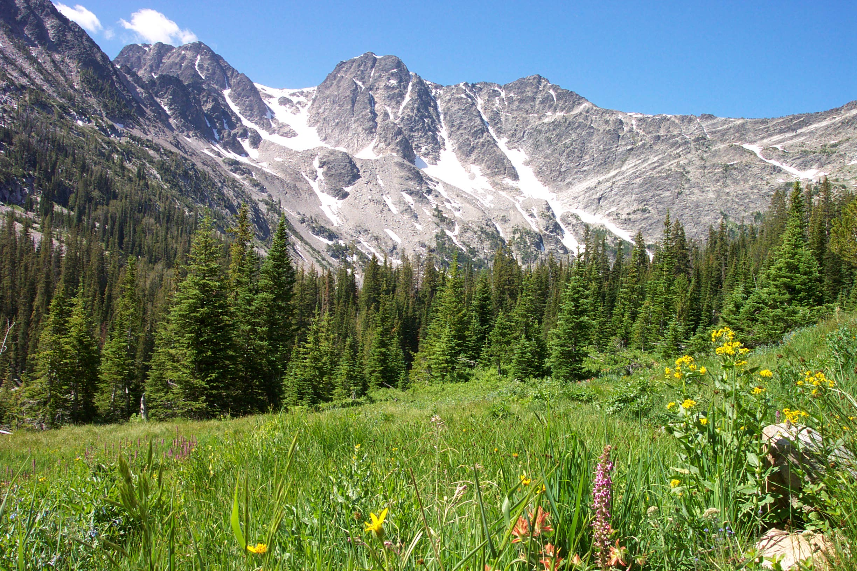
Questions? Arguments?

