Slide 1
Mine Overburden and Mine Waste as a Renewable Energy Storage Play
BOR, S.¹, NIELSEN, C.², HIGLE-RALBOVSKY, J.², SONG, I.S.², BEESE, E.², NGUYEN, D.², SALUD, F.², SONG, I.², SPJUT, E.², AREHART, G.³ and DONELICK, RAY⁴,
(1)Pomona College, (2)Harvey Mudd College, (3)Univ. of Nevada - Reno, (4)BiMBy Power Co.

Slide 2
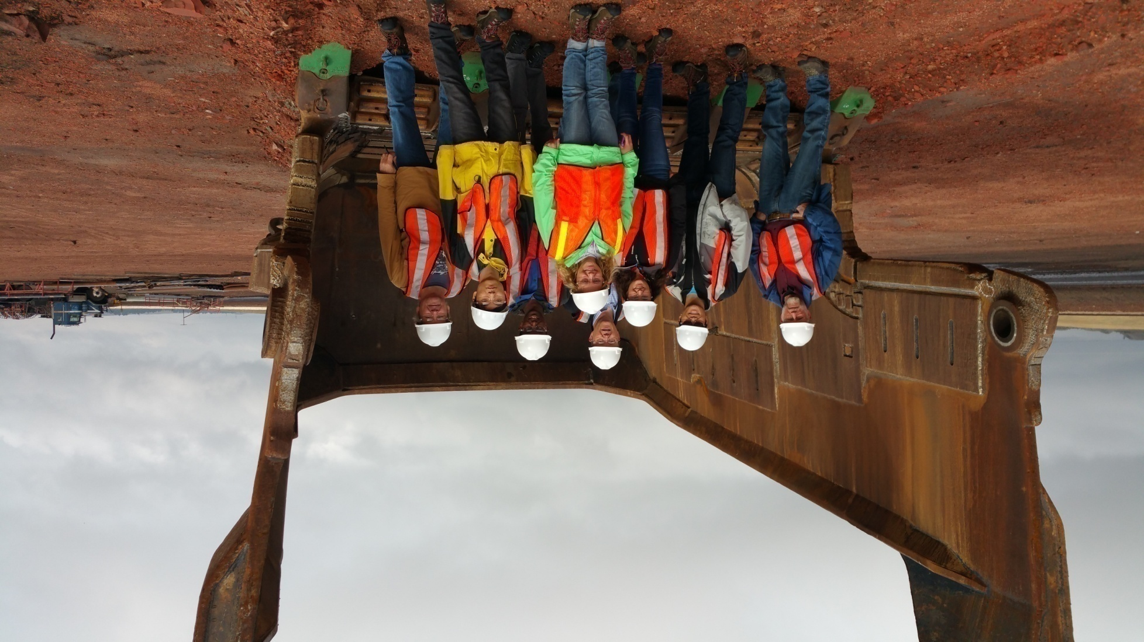
Thanks to Harvey Mudd College Engineering Clinic...
BiMBy Team at Rosebud Coal Mine near Colstrip, MT, October 2015

Slide 3
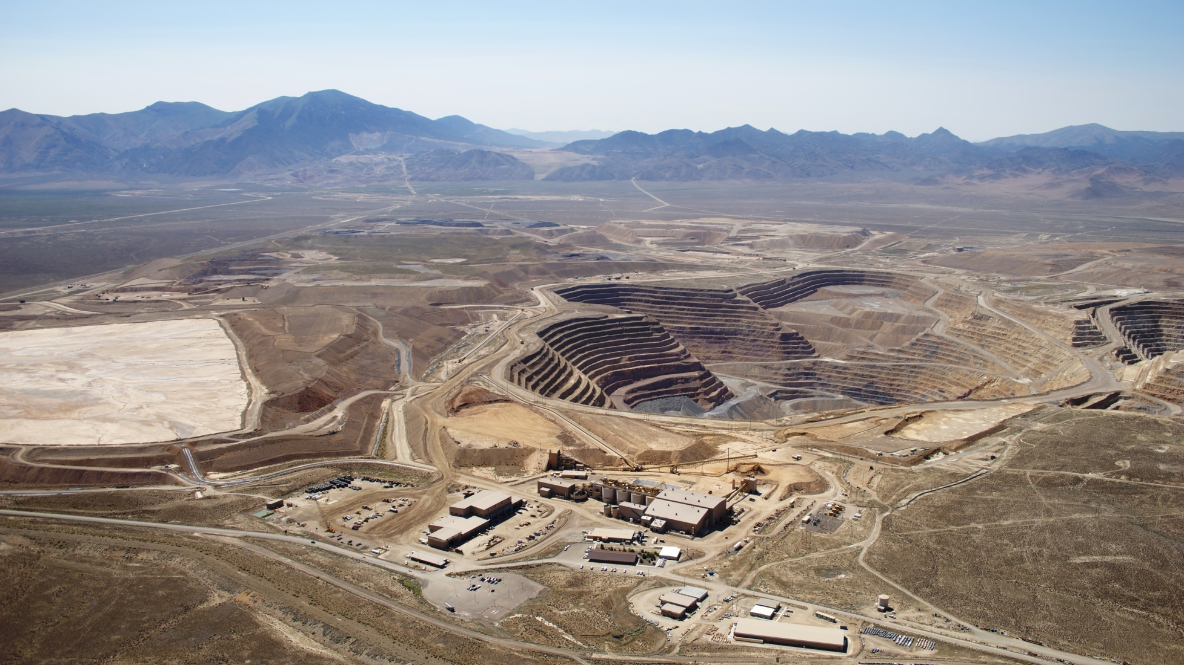
The Play: Mine Waste Rock
Pipeline pit
waste rock
Cortez Gold Mine, Landers Co., NV; http://www.royalgold.com/property-portfolio/producing/cortez-pmc/default.aspx

Slide 4
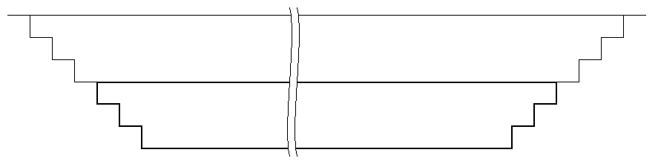
The Device: A Big Mass Battery (BiMByTM)
CAES device using active and inactive mines

Slide 5
Our Idea: A Big Mass Battery (BiMByTM)
CAES device using active and inactive mines
bottom half = pressure vessel (mine waste)
low-permeability container (clay, geomembrane)
low-
permeability
pressure vessel

Slide 6
Our Idea: A Big Mass Battery (BiMByTM)
CAES device using active and inactive mines
top half = applies pressure to pressure vessel
bottom half = pressure vessel (mine waste)
low-permeability container (clay, geomembrane)
applies pressure
low-
permeability
pressure vessel

Slide 7
Production of Mine Waste
USA
1,600 Mt per year (t=1,000 kg; FHAdmin, 2013)
50,000+ Mt historical

Slide 8
Production of Mine Waste
USA
1,600 Mt per year (t=1,000 kg; FHAdmin, 2013)
50,000+ Mt historical
Worldwide
20,000-25,000 Mt annually (Lottermoser, 2010)

Slide 9
Properties of Mine Waste
General
associated with disturbed, industrial areas
widely distributed geographically

Slide 10
Properties of Mine Waste
General
associated with disturbed, industrial areas
widely distributed geographically
Mine-Specific
mass: 1s-100s Mt per year
porosity: 10-30%
permeability to air: moderate (clays) to high

Slide 11
Mine Types
Large Coal Strip Mine
Rosebud Mine, Colstrip, MT (power to Moscow, ID)
10s of these in U.S.A. and Canada

Slide 12
Mine Types
Large Coal Strip Mine
Rosebud Mine, Colstrip, MT (power to Moscow, ID)
10s of these in U.S.A. and Canada
Open Pit Mine
active, Cortez Gold Mine, Landers Co., NV

Slide 13
Mine Types
Large Coal Strip Mine
Rosebud Mine, Colstrip, MT (power to Moscow, ID)
10s of these in U.S.A. and Canada
Open Pit Mine
active, Cortez Gold Mine, Landers Co., NV
inactive, Anaconda Mine, Yerington, NV
10s of each these in U.S.A. and Canada

Slide 14
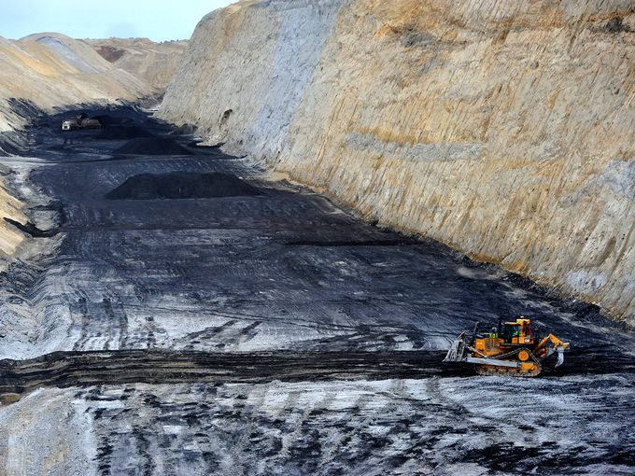
Rosebud Mine near Colstrip, MT: Coal Strip Mine, active
http://www.gannett-cdn.com/-mm-/ce7244b210fb5fe4ff17fbb38073556a95a5a36c/c=365-0-3557-2400&r= x513&c=680x510/local/-/media/2016/02/24/GreatFalls/GreatFalls/635919509858843213-02042016-rosebud-mine-l5.jpg

Slide 15
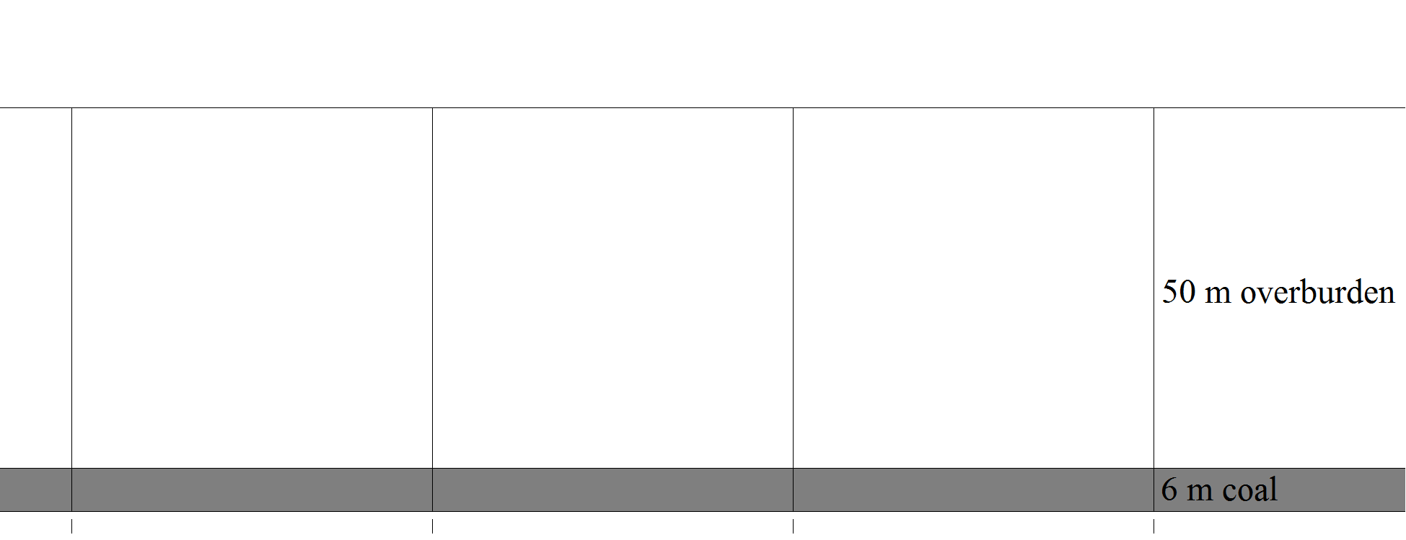
Rosebud Mine analog
before mining

Slide 16
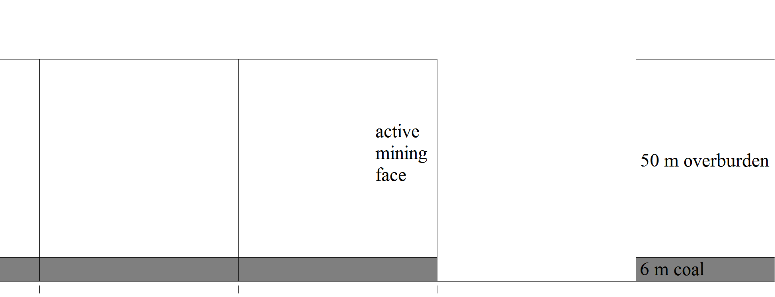
Rosebud Mine analog
after mining first strip
before pressure vessel

Slide 17
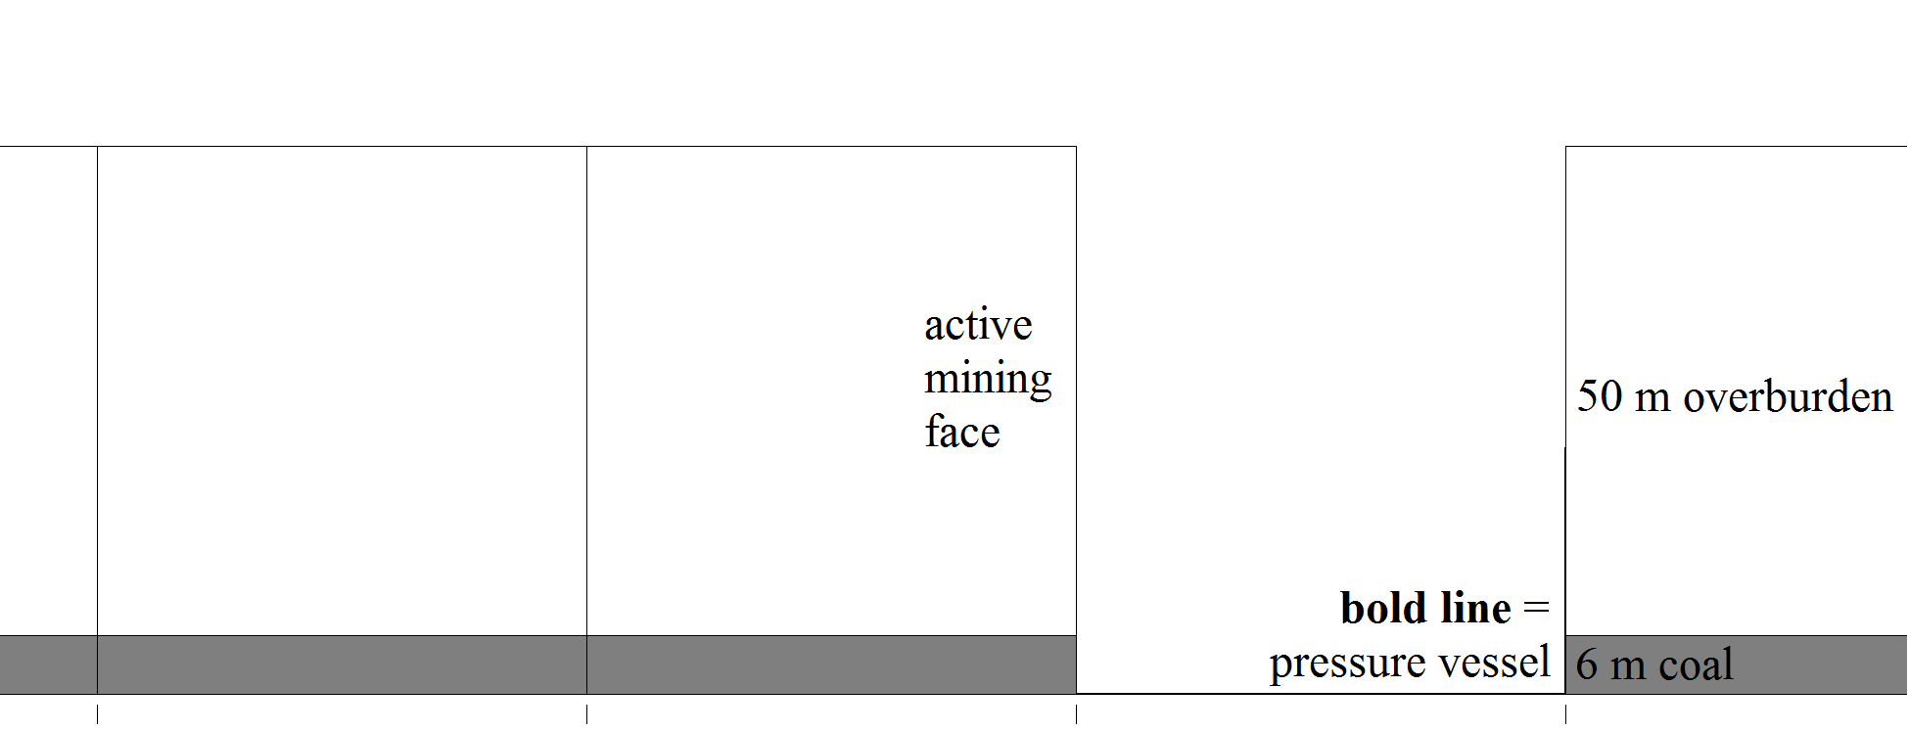
Rosebud Mine analog
after mining first strip
after pressure vessel

Slide 18
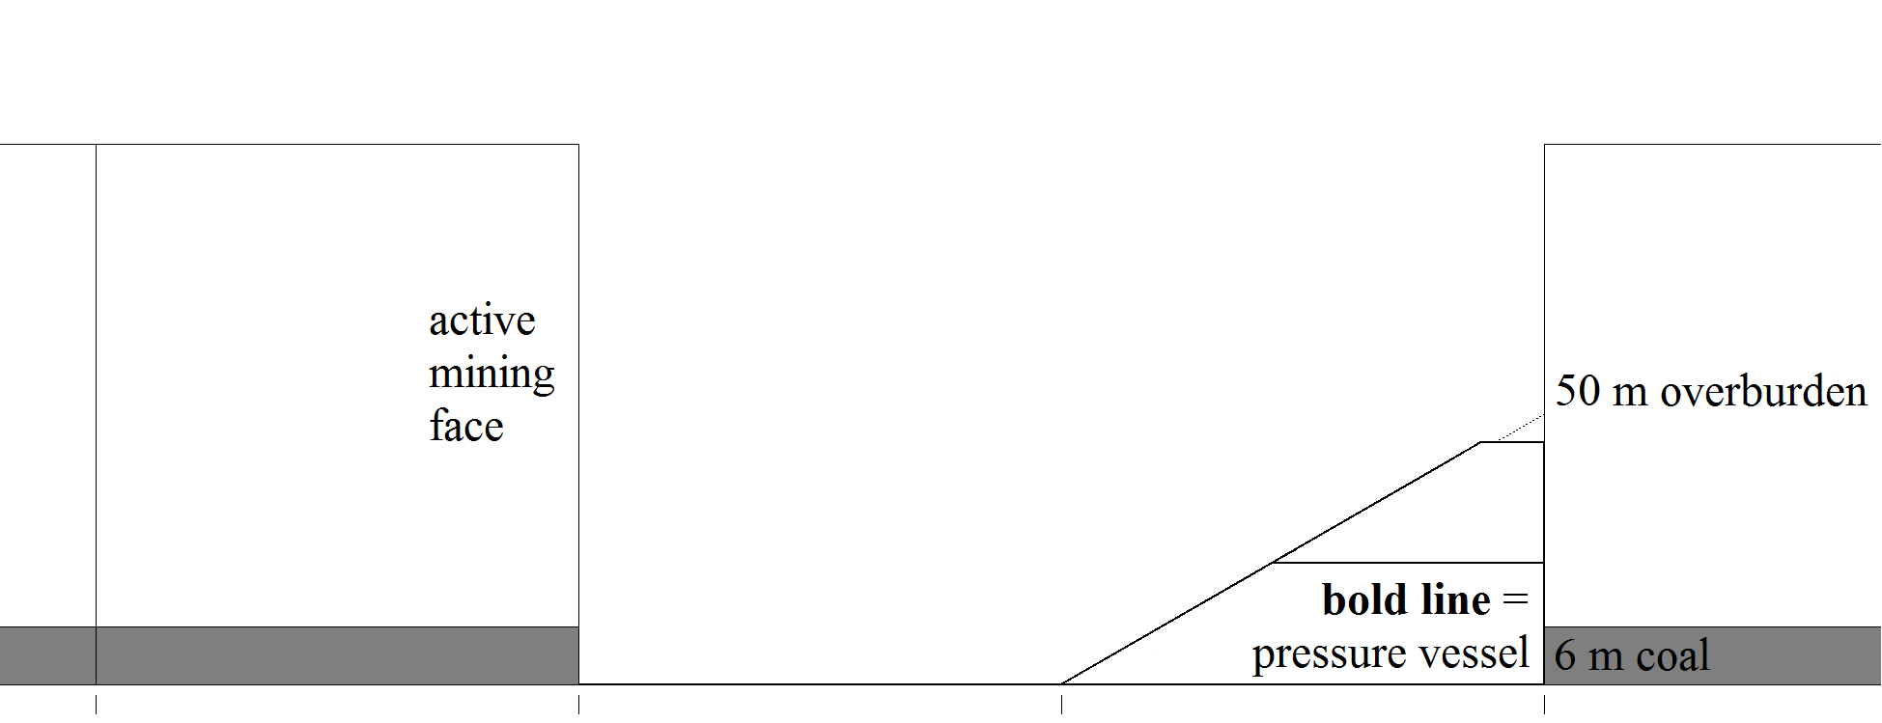
Rosebud Mine analog
after mining second strip
after pressure vessel

Slide 19
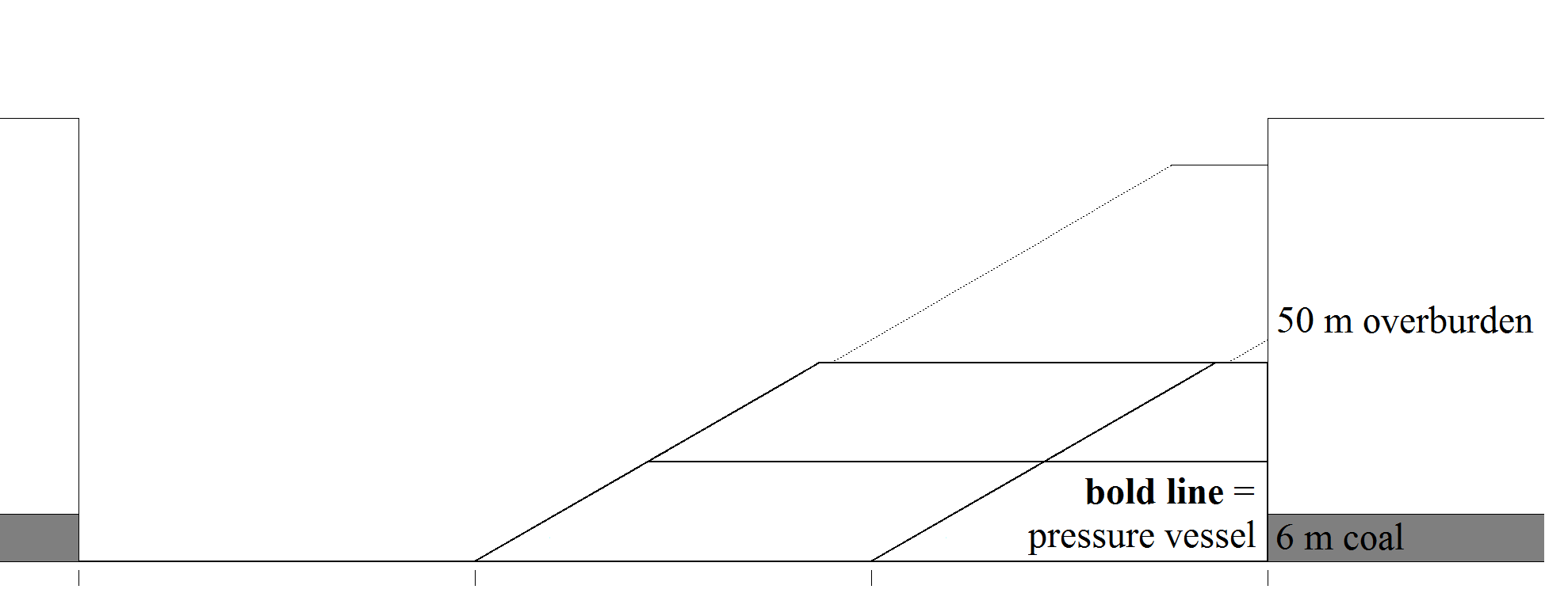
Rosebud Mine analog
after mining third strip
after pressure vessel

Slide 20
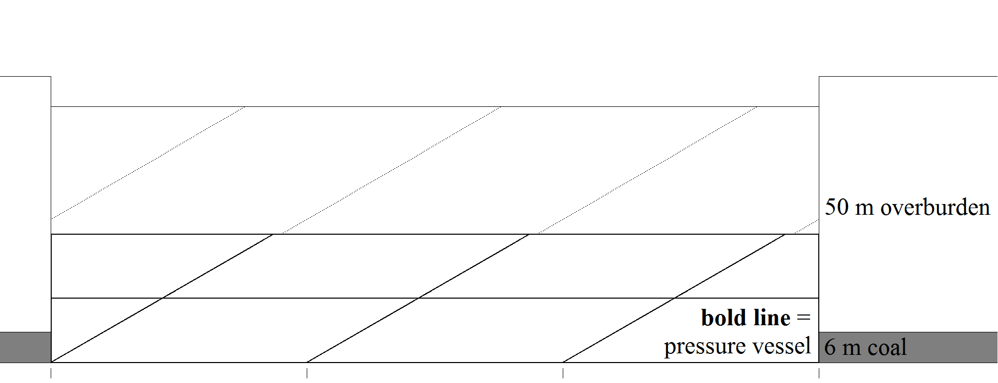
Rosebud Mine analog
after mining
energy stored = efficiency ∙ P ∙ V
25 m overburden
P = pressure = ρgh
25 m overburden
V = pore volume = vφ

Slide 21
Rosebud Mine analog
Top Layer (applies pressure)
P = pressure = 1,750 kg/m³ ∙ 9.8 m/s² ∙ 25 m
P = pressure = 0.43 MPa (about 4.2 atm)

Slide 22
Rosebud Mine analog
Top Layer (applies pressure)
P = pressure = 1,750 kg/m³ ∙ 9.8 m/s² ∙ 25 m
P = pressure = 0.43 MPa (about 4.2 atm)
Bottom Layer (pressure vessel)
V = pore volume = 1 m² ∙ 25 m ∙ 0.30
V = pore volume = 7.5 m³ (per m² of device)

Slide 23
Rosebud Mine analog
Operational Parameters
η = efficiency = 0.5 (assumed)
area = 1,000 m ∙ 1,000 m (about 2 years Rosebud)
300 cycles/year (solar)

Slide 24
Rosebud Mine analog
Operational Parameters
η = efficiency = 0.5 (assumed)
area = 1,000 m ∙ 1,000 m (about 2 years Rosebud)
300 cycles/year (solar)
Energy Yield
E = 0.5 ∙ 0.43 MPa ∙ 7.5 m³ ∙ area = 450 MWh/cycle
E = 15 MW = 12,300 US households (EIA 2014)

Slide 25
BiMBy at mines like Rosebud? jobs, orderly economic transition
http://www.gannett-cdn.com/-mm-/ce7244b210fb5fe4ff17fbb38073556a95a5a36c/c=365-0-3557-2400&r= x513&c=680x510/local/-/media/2016/02/24/GreatFalls/GreatFalls/635919509858843213-02042016-rosebud-mine-l5.jpg

Slide 26
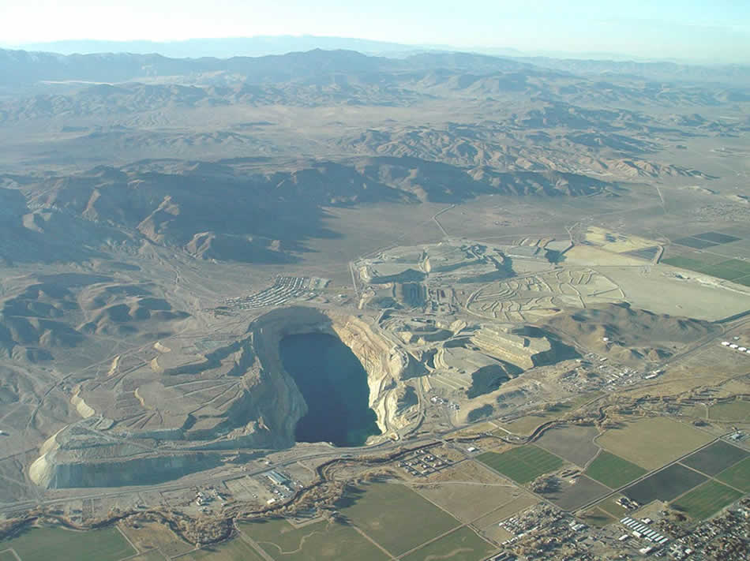
Anaconda Mine near Yerington, NV: Open Pit Mine, inactive
OU-4
sulfide tailings
OU-2
Yerington pit lake
OU-8
heap leach pad
OU-5
waste rock area
http://ndep.nv.gov/bca/anaconda/images/anaconda-large.jpg

Slide 27
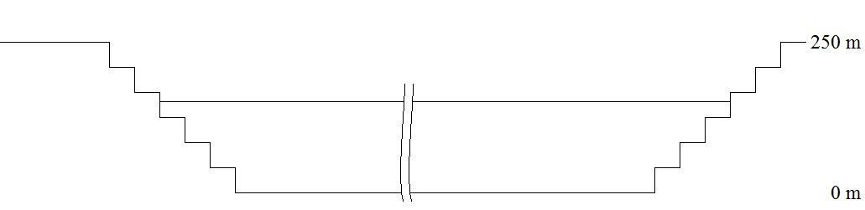
Anaconda Mine analog
after mining
pit 250 m deep
pit lake 150 m deep
360 Mt removed from pit

Slide 28
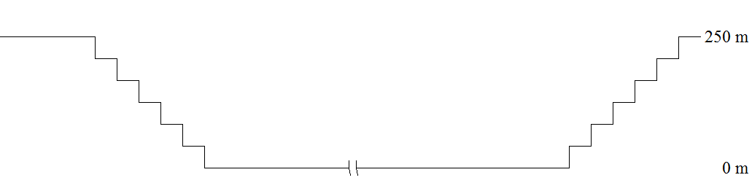
Anaconda Mine analog
pump out pit lake
stabilize pit slopes

Slide 29
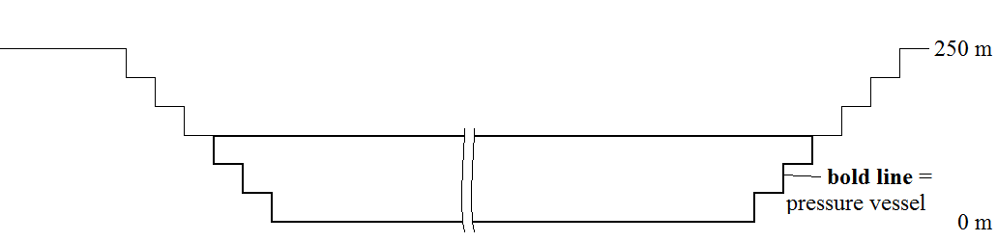
Anaconda Mine analog
build pressure vessel

Slide 30
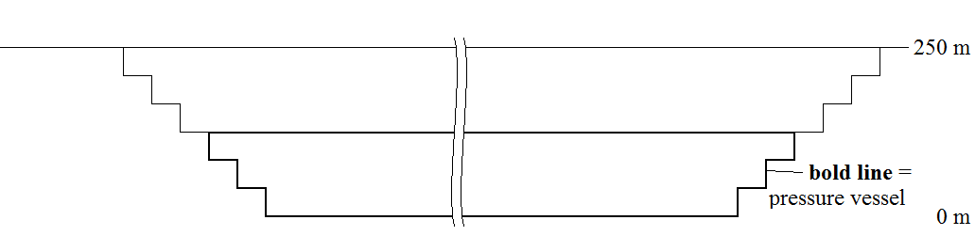
Anaconda Mine analog
pressurize pressure vessel
125 m waste rock
P = pressure = ρgh
125 m overburden
V = pore volume = vφ

Slide 31
Anaconda Mine analog
Top Layer (applies pressure)
P = pressure = 2,125 kg/m³ ∙ 9.8 m/s² ∙ 125 m
P = pressure = 2.60 MPa (about 26 atm)

Slide 32
Anaconda Mine analog
Top Layer (applies pressure)
P = pressure = 2,125 kg/m³ ∙ 9.8 m/s² ∙ 125 m
P = pressure = 2.60 MPa (about 26 atm)
Bottom Layer (pressure vessel)
V = pore volume = 1 m² ∙ 125 m ∙ 0.15
V = pore volume = 18.75 m³ (per m² of device)

Slide 33
Anaconda Mine analog
Operational Parameters
η = efficiency = 0.5 (assumed)
area = 500 m ∙ 1,000 m
300 cycles/year (solar)

Slide 34
Anaconda Mine analog
Operational Parameters
η = efficiency = 0.5 (assumed)
area = 500 m ∙ 1,000 m
300 cycles/year (solar)
Energy Yield
E = 0.5 ∙ 2.60 MPa ∙ 18.75 m³ ∙ area = 3500 MWh/cycle
E = 120 MW = 95,000 US households (EIA 2014)

Slide 35
In Summary
The Renewable Energy Storage Play
Strip Mine: 0.15 MW storage per Mt
Open Pit Mine: 0.35 MW storage per Mt
USA Annual
¼ ∙ 0.25 MW/Mt ∙ 1,600 Mt/year = 100 MW/year
USA Historical
¼ ∙ 0.25 MW/Mt ∙ 50,000 Mt = 3,125 MW

Slide 36
BiMBy at mines like Anaconda? jobs, positive air pressure encapsulation
OU-4
sulfide tailings
OU-2
Yerington pit lake
OU-8
heap leach pad
OU-5
waste rock area
http://ndep.nv.gov/bca/anaconda/images/anaconda-large.jpg

Slide 37

‘And did you know the hole’s only natural enemy is the pile?’ Bart Simpson
The Simpsons, ‘Special Edna’, Season 14, Episode 7, Fox

Slide 38
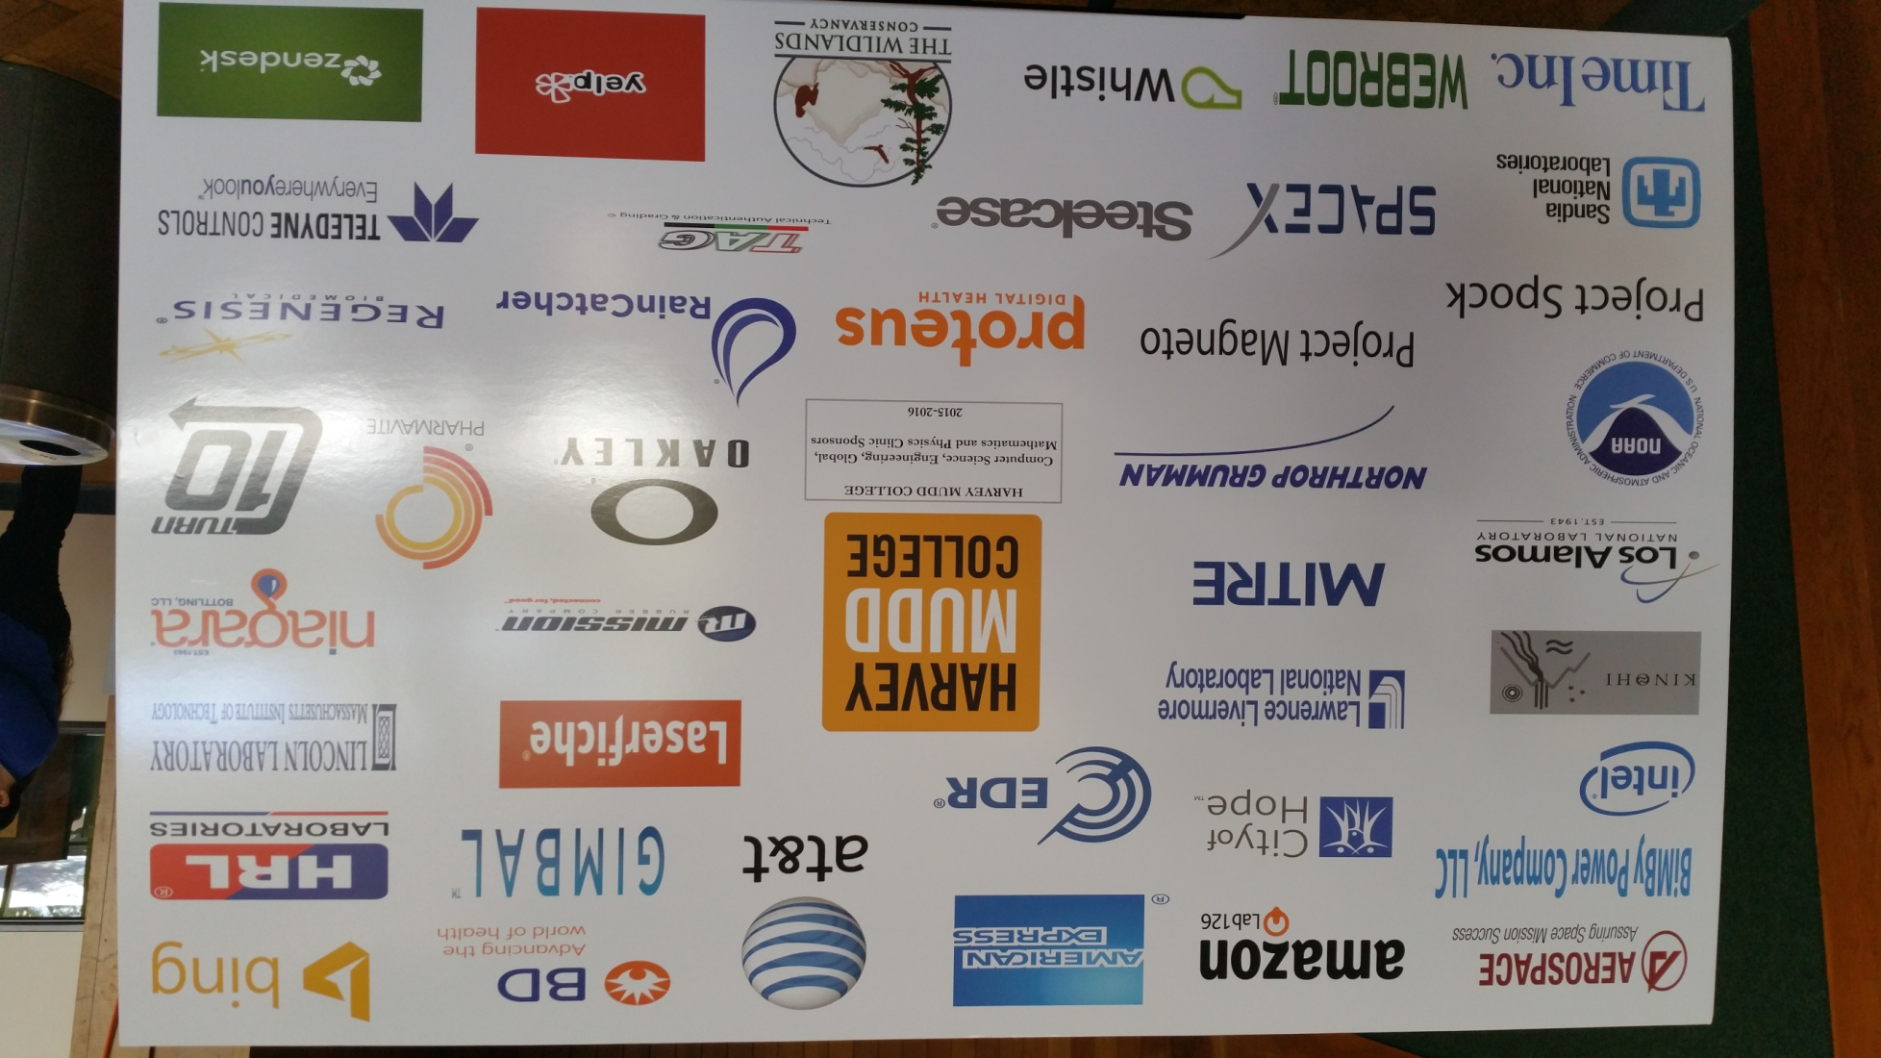
BiMBy-Sponsored Project HMC Engineering Clinic 2015-2016

