Slide 1


THE MIDDLE MIOCENE CLIMATE TRANSITION IN LOUISIANA: PALEOENVIRONMENTAL EVIDENCE FROM UNGULATE ENAMEL STABLE ISOTOPES
Grant Stanley Boardman, Ph.D.
Trivium Preparatory Academy, Goodyear, AZ
gboardman@triviumprep.org
Travis Atwood
University of Alaska, Anchorage, AK
Notes:
Hi Lindsey, Thanks again for agreeing to present this talk for Travis and I.
You could quip about how you are neither Me nor Travis here I suppose.
*I have left in a lot of the basic isotope background partly to pad out presentation time, but also because many in the session may not be very familiar with what isotopes can tell us.*
If anyone has questions at the end, please direct them to email me…

Slide 2
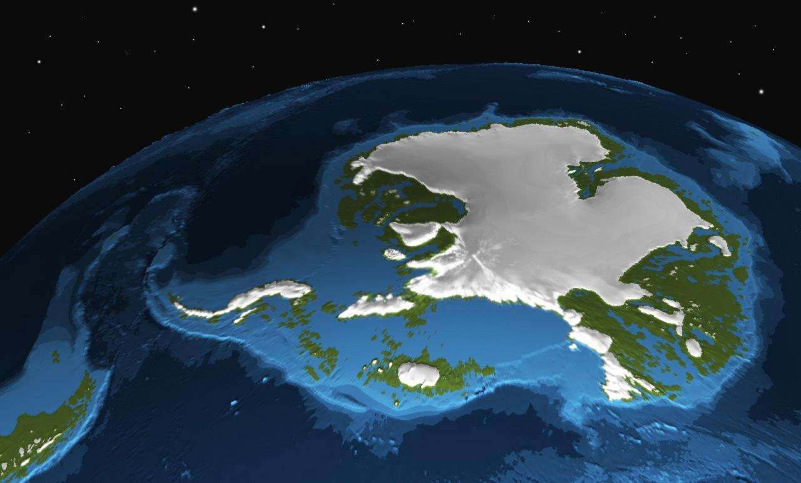
Middle Miocene Climate Transition (MMCT; ~14.5-13.0 Ma)
Pronounced cooling
East Antarctic Ice Sheet
Graphic courtesy of Edward Gasson, UMass Amherst
Notes:
The Middle Miocene Climate Transition (MMCT; ~14.5-13.0 Ma) was a pronounced episode of cooling associated with the reestablishment and advance of the Eastern Antarctic ice sheet following the warmest interval since Middle Eocene times. The impacts of this interval of climate change from the warmest since the middle Eocene, to the icehouse regime of the late Miocene to Pleistocene, have been recorded in marine and non-marine sections worldwide and have been especially well characterized in the Southern Ocean, Antarctica, and in Europe.
In Spain’s Madrid Basin, for instance, the MMCT seemed to trigger a drop in temperature and an increase in aridity based on enamel and bone isotope values from ungulates.

Slide 3
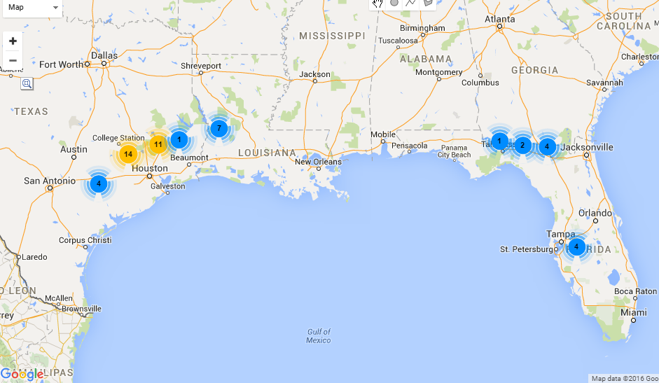
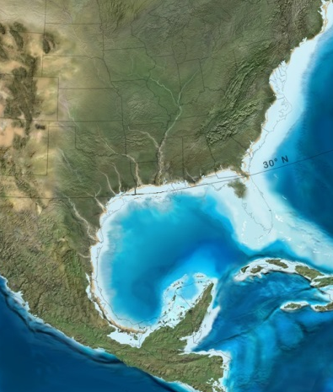
Gulf Coast during the MMCT?
Produced using Berkeley Mapper on MioMap website.
Modified from © Ron Blakey, Colorado Plateau Geosystems
Notes:
What can we say about the impact of the MMCT on the Gulf Coast? There are a plethora of relevant localities (see MioMap figure on slide), but few have been given much treatment beyond alpha taxonomy and geochronological placement.

Slide 4
Major Questions
What types of vegetative biomes were present?
What was the δ¹⁸O of meteoric precipitation?
What was the temperature seasonality?
What was the mean annual precipitation and was it seasonal?
Notes:
We have many questions about the non-marine environments of the Gulf Coast during this interval, including:
What types of vegetative biomes were present?
What was the δ18O of meteoric precipitation? Which might give us an idea about the primary source of water vapor, during this interval (be it Gulf, Atlantic, or Pacific).
What was the temperature seasonality? This interval was still warmer on balance than today, would it have been more tropical-like then?
What was the mean annual precipitation (MAP), and was it seasonal? This is a supposedly arid interval, how does it compare to the Gulf Coast today?

Slide 5
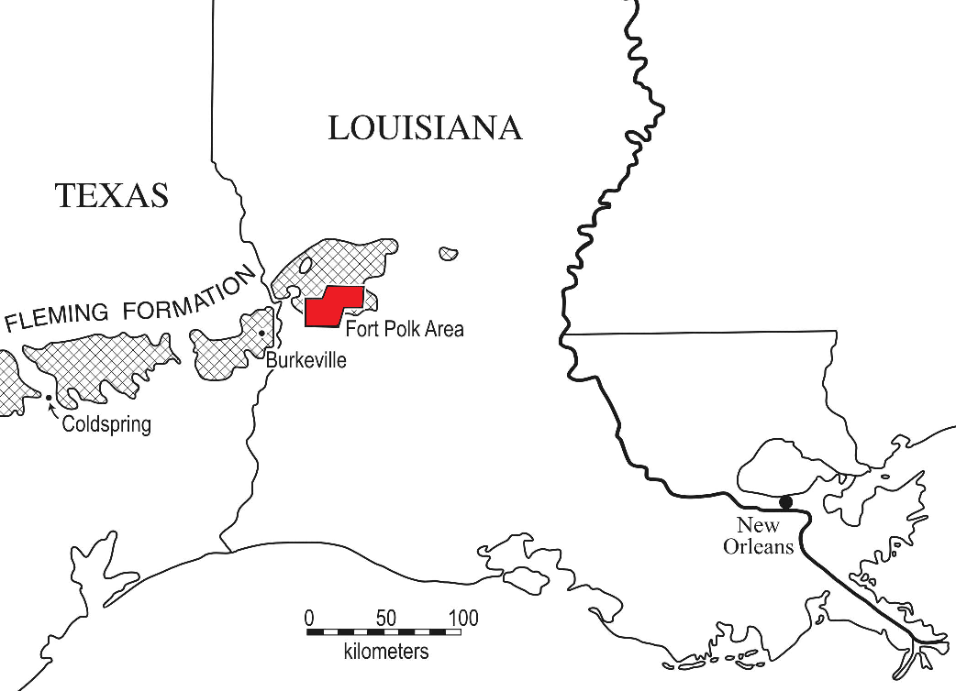
MMCT Sites in Louisiana
DISC Cluster
DISC site
TVOR Cluster
TVOR SE
TVOR S
Modified from Schiebout, 1997
Notes:
The sites in this study include two clusters (the DISC Cluster, which includes the DISC site; and the TVOR Cluster, which includes the TVOR SE and TVOR S sites) located on Fort Polk, a U.S. Army installation in Vernon Parish, Louisiana. All three sites sit within the Castor Creek Member of the Fleming Formation (FIGURE ON SLIDE); paleomagnetic data from cores indicate a late Barstovian (13.5 to 14 Ma) age for these sites (Jones et al., 1995; Gose et al., 2008). The bulk of fossils from these sites were recovered from conglomeratic beds and lenses interpreted as having been concentrated from the weathering of interfluves (Schiebout et al., 1997). These sites, as with the bulk of the Castor Creek Member, are primarily coastal, non-marine based on sedimentological, paleontological, and geochemical evidence, with the exception of TVOR SE, which has an in situ oyster reef (Schiebout, 1994; Schiebout et al., 1997; Jones et al., 1995; Hinds, 1999; McCulloh and Heinrich, 2000). Hinds (1999) suggested that the Castor Creek Member was deposited primarily during a regression, which fits expectations for the MMCT.
Previous paleoecological work done at Fort Polk, based on pollen and phytolith data, indicate a mosaic habitat at most sites, with mixed hardwood including pine and areas of savanna grassland (Stromberg in Schiebout, 1997; Wrenn in Schiebout, 1997; Schiebout and Ting, 2001)

Slide 6
Study Sites
Castor Creek Member of Fleming Formation
Conglomeratic beds and lenses concentrated by weathering of interfluves
Coastal, nonmarine
TVOR SE in situ oyster reef
Regressive sequence
Sampled 29 specimens
  Horses, rhinos, protoceratid
Notes:
we analyzed recovered from three sites in two clusters (the DISC Cluster, which includes the DISC site; and the TVOR Cluster, which includes the TVOR SE and TVOR S sites) located on Fort Polk, a U.S. Army installation in Vernon Parish, Louisiana. All three sites sit within the Castor Creek Member of the Fleming Formation (FIGURE ON SLIDE); paleomagnetic data from cores indicate a late Barstovian (13.5 to 14 Ma) age for these sites (Jones et al., 1995; Gose et al., 2008). The bulk of fossils from these sites were recovered from conglomeratic beds and lenses interpreted as having been concentrated from the weathering of interfluves (Schiebout et al., 1997). These sites, as with the bulk of the Castor Creek Member, are primarily coastal, non-marine based on sedimentological, paleontological, and geochemical evidence, with the exception of TVOR SE, which has an in situ oyster reef (Schiebout, 1994; Schiebout et al., 1997; Jones et al., 1995; Hinds, 1999; McCulloh and Heinrich, 2000). Hinds (1999) suggested that the Castor Creek Member was deposited primarily during a regression, which fits expectations for the MMCT.
tooth enamel carbonate from 29 ungulates specimens (horses, rhinos, and the protoceratid, Prosynthetoceras francisi)
Previous paleoecological work done at Fort Polk, based on pollen and phytolith data, indicate a mosaic habitat at most sites, with mixed hardwood including pine and areas of savanna grassland (Stromberg in Schiebout, 1997; Wrenn in Schiebout, 1997; Schiebout and Ting, 2001)

Slide 7
Taxa
Sampled 29 specimens
  Horses, rhinos, protoceratid
  Merychippus
  Cormohipparion
  Prosynthetoceras
Notes:
we analyzed recovered from three sites in two clusters (the DISC Cluster, which includes the DISC site; and the TVOR Cluster, which includes the TVOR SE and TVOR S sites) located on Fort Polk, a U.S. Army installation in Vernon Parish, Louisiana. All three sites sit within the Castor Creek Member of the Fleming Formation (FIGURE ON SLIDE); paleomagnetic data from cores indicate a late Barstovian (13.5 to 14 Ma) age for these sites (Jones et al., 1995; Gose et al., 2008). The bulk of fossils from these sites were recovered from conglomeratic beds and lenses interpreted as having been concentrated from the weathering of interfluves (Schiebout et al., 1997). These sites, as with the bulk of the Castor Creek Member, are primarily coastal, non-marine based on sedimentological, paleontological, and geochemical evidence, with the exception of TVOR SE, which has an in situ oyster reef (Schiebout, 1994; Schiebout et al., 1997; Jones et al., 1995; Hinds, 1999; McCulloh and Heinrich, 2000). Hinds (1999) suggested that the Castor Creek Member was deposited primarily during a regression, which fits expectations for the MMCT.
tooth enamel carbonate from 29 ungulates specimens (horses, rhinos, and the protoceratid, Prosynthetoceras francisi)
Previous paleoecological work done at Fort Polk, based on pollen and phytolith data, indicate a mosaic habitat at most sites, with mixed hardwood including pine and areas of savanna grassland (Stromberg in Schiebout, 1997; Wrenn in Schiebout, 1997; Schiebout and Ting, 2001)

Slide 8
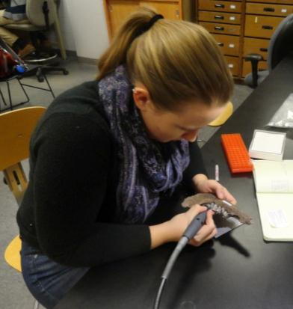
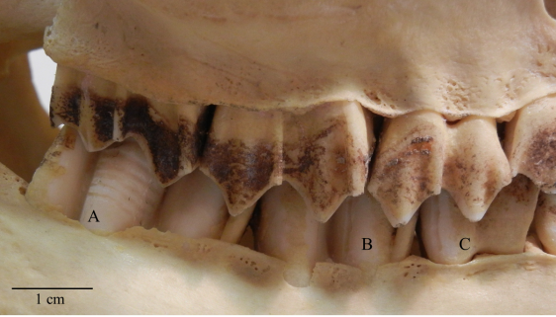
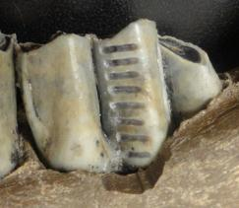
Stable isotopes
Stable isotope analysis (more to come)
Bulk sampling
  One sample
  Parallel to growth axis
Serial sampling
  Multiple samples
  Perpendicular to
  growth axis
LTYann

Slide 9
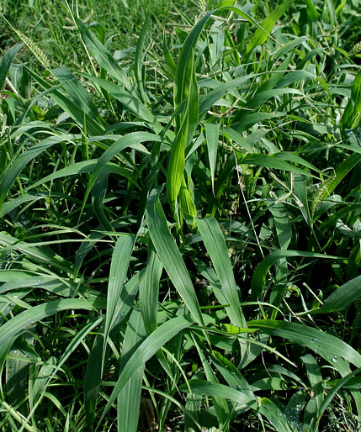
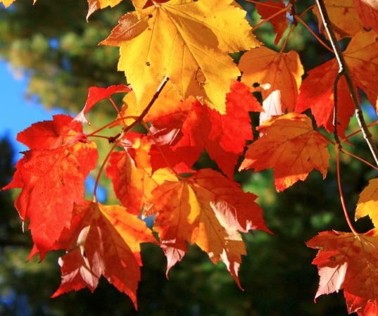
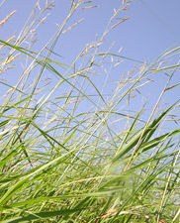
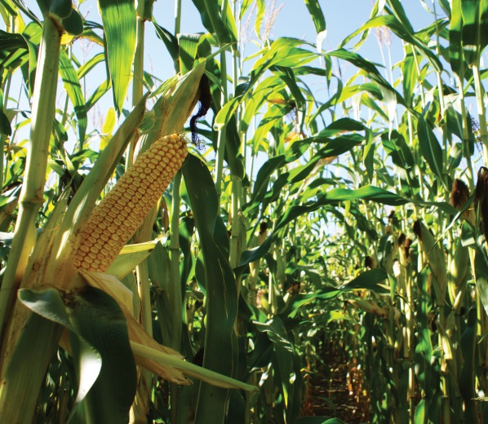
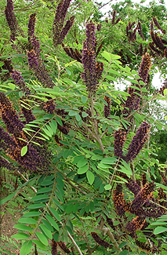
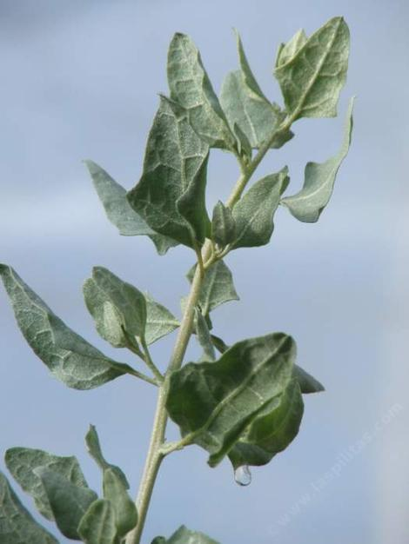
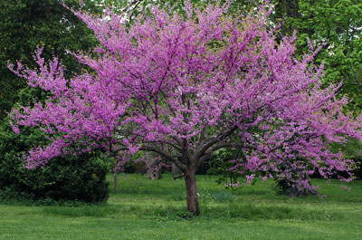
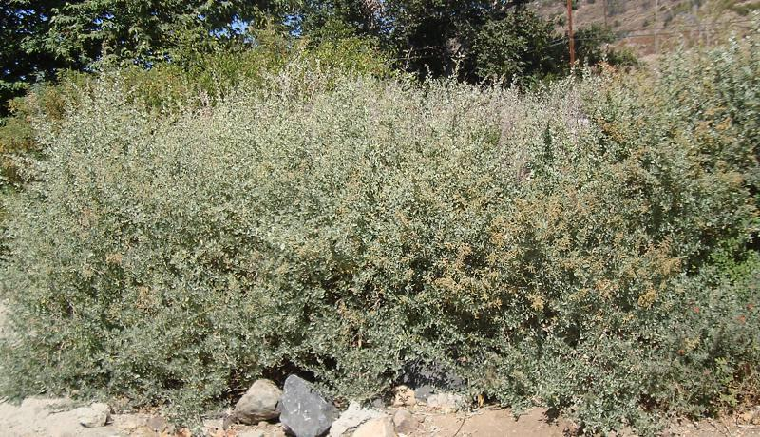
Carbon Isotopes - Photosynthesis Matters
C₃ Plants
Cool season grasses
Trees
Shrubs
C₄ Plants
Warm season grasses
Rare shrubs
LTYann
Notes:
Why does photosynthesis matter? Well the way plants take in carbon dioxide - or Carbon – varies based on the photosynthetic pathway.
I am interested in C3 and C4 plants but there are also CAM plants like cacti.
C3 plants are cool season grasses, trees like Oklahoma’s state tree-the redbud, and shrubs and during photosynthesis a chain of 3 carbons is produced
C4 plants are warm season grasses and a few shrubs such as corn and salt bush

Slide 10
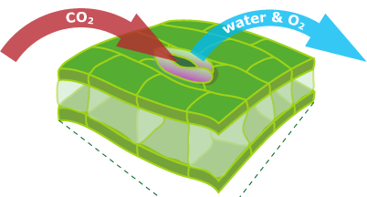
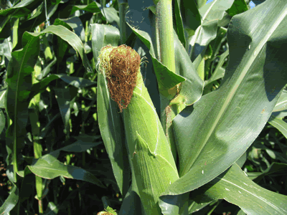

Carbon Isotopes - Photosynthesis Matters
¹²C
¹²C
¹²C
¹²C
¹²C
Our atmosphere
¹²C
¹²C
¹²C
¹²C
¹²C
¹²C
¹²C
¹²C
¹²C
¹²C
¹²C
¹²C
¹²C
¹²C
¹²C
¹²C
¹²C
¹²C
¹²C
¹²C
¹²C
¹²C
¹²C
¹²C
¹²C
¹²C
¹²C
¹²C
¹²C
¹²C
¹²C
¹²C
¹³C
¹²C
¹²C
¹²C
¹²C
¹²C
¹²C
¹²C
¹²C
¹²C
¹²C
¹²C
¹²C
¹²C
¹²C
¹²C
¹²C
¹²C
¹²C
¹²C
¹²C
¹²C
¹²C
¹²C
¹²C
¹²C
¹²C
¹²C
¹²C
¹²C
¹²C
¹²C
¹²C
¹²C
¹²C
¹²C
¹²C
¹²C
¹²C
¹²C
¹²C
¹²C
¹²C
¹²C
¹²C
¹²C
¹²C
¹²C
¹²C
¹²C
¹²C
¹²C
¹²C
¹²C
¹²C
¹²C
¹²C
¹²C
¹²C
¹²C
¹²C
CO₂
Water
+ Oxygen
LTYann
Notes:
Ok C3 and C4 plants are different. Great. But why should I care? It turns out C

Slide 11
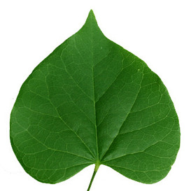
Carbon Isotopes - Photosynthesis Matters
¹²C
¹²C
¹²C
¹²C
¹²C
Our atmosphere
¹²C
¹²C
¹²C
¹²C
¹²C
¹²C
¹²C
¹²C
¹²C
¹²C
¹²C
¹²C
¹²C
¹²C
¹²C
¹²C
¹²C
¹²C
¹²C
¹²C
¹²C
¹²C
¹²C
¹²C
¹²C
¹²C
¹²C
¹²C
¹²C
¹²C
¹²C
¹²C
¹³C
¹²C
¹²C
¹²C
¹²C
¹²C
¹²C
¹²C
¹²C
¹²C
¹²C
¹²C
¹²C
¹²C
¹²C
¹²C
¹²C
¹²C
¹²C
¹²C
¹²C
¹²C
¹²C
¹²C
¹²C
¹²C
¹²C
¹²C
¹²C
¹²C
¹²C
¹²C
¹²C
¹²C
¹²C
¹²C
¹²C
¹²C
¹²C
¹²C
¹²C
¹²C
¹²C
¹²C
¹²C
¹²C
¹²C
¹²C
¹²C
¹²C
¹²C
¹²C
¹²C
¹²C
¹²C
¹²C
¹²C
¹²C
¹²C
¹²C
¹²C
GULPS in air
Reflects ratio of
¹³C to ¹²C in air
Slowly brings in air
Favors the smaller ¹²C
C₃ plant
Redbud
C₄ plant
Corn
LTYann
Notes:
Ok C3 and C4 plants are different. Great. But why should I care? It turns out C

Slide 12
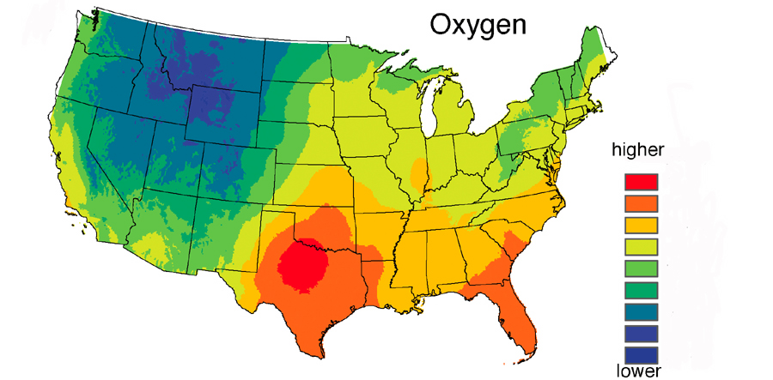
Oxygen Isotopes –
Location, Location, Location
Very negative
About 0
LTYann
Ehleringer, 1999

Slide 13
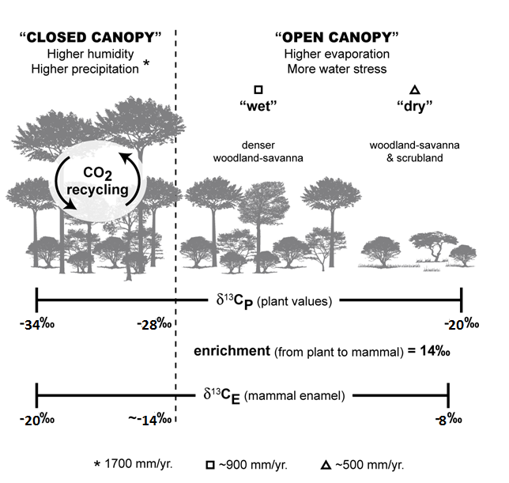
Mammal Tooth Enamel and Stable Isotopes
Stable Carbon Isotopes
Reconstructing biomes.
Illustrative habitat model modified from Boardman et al. (2013)
Notes:
Carbon isotope compositions in plants are primarily a function of the photosynthetic pathway utilized in fixing atmospheric CO2 for metabolism
Distinguishing between mammals feeding on C3 vegetation (trees, most shrubs and herbs, and cool-season grasses) and C4 (some shrubs and herbs, and warm-season grasses) is fairly readily accomplished because C4 plants have higher δ13C values than C3 plants, and have a nearly non-overlapping range
The late Barstovian fauna used in this study occurred before the expansion of C4 grasslands therefore the variation in carbon isotope values in C3-dominated biomes is necessary for characterizing the vegetative environment in this study. δ13C values in plants generally increase from denser and wetter habitats to more open and drier ones, due to differences in light intensity, temperature, nutrient availability, and water stress (Ehleringer et al., 1986; Heaton, 1999; Diefendorf et al., 2010; Kohn, 2010). This trend is exhibited in the tooth enamel of herbivorous mammals, with low δ13CE values representing more closed, wetter habitats and high δ13CE values representing more open, drier habitats (O’Leary et al., 1992; Koch, 1998; Cerling and Harris, 1999; Feranec, 2003, 2007; Nelson, 2007).

Slide 14
Mammal Tooth Enamel and Stable Isotopes
Stable Carbon Isotopes
Reconstructing biomes.
1700 mm/yr
Illustrative habitat model modified from Boardman et al. (2013)
Notes:
Using indicated model results (Model on Slide), we base biome interpretations for the late Barstovian at Fort Polk on the following boundaries and ranges for mean δ13CE faunal values:
closed canopy forest (rainforest and monsoon forest): ≤–14.1‰;

Slide 15
Mammal Tooth Enamel and Stable Isotopes
Stable Carbon Isotopes
Reconstructing biomes.
~900
mm/yr
~500
mm/yr
Illustrative habitat model modified from Boardman et al. (2013)
Notes:
open canopy biomes (“dry” and “wet” woodland-savanna, “dry” woody scrubland, “dry” forest, and “dry” C3 grassland): >–14.1‰ to –8.3‰;

Slide 16
Mammal Tooth Enamel and Stable Isotopes
Stable Carbon Isotopes
Reconstructing biomes.
Illustrative habitat model modified from Boardman et al. (2013)
Notes:
mixed C3/C4 biomes: –8.3‰ to 0.5‰; and pure C4 grasslands: ≥0.5‰. Following the logic outlined in Kita et al. (2014), it is possible that a component of C4 vegetation could be included in the diets of ungulates with values lower than –8.3‰, ranging to about –10.5‰. In this study, only values exceeding –8.3‰ will be attributed to a component of C4 in the diet.

Slide 17
Mammal Tooth Enamel and Stable Isotopes
Stable Carbon Isotopes
Reconstructing Mean Annual Precipitation
Model factors
  Effect of latitude
  Effect of elevation
  Diet-enamel enrichment
  Atmospheric CO₂
Illustrative habitat model modified from Boardman et al. (2013)
Notes:
A model was developed following Boardman and Secord (2013) and Kita et al. (2014) to predict expected δ13CE values in herbivores for a variety of late Barstovian biomes. Data from extant plants were used as the basis of this model because the full range of δ13C values in extant mammals is not adequately documented.
Diet enameFactors incorporated in this model were: (1) The effects of latitude on δ13C values in vegetation; 31°N, the approximate latitude of Vernon Parish, Louisiana
(2) The effects of elevation on δ13C values in vegetation; normalized to 0.0 km, as all Fort Polk sites were at or very near sea-level during the late Barstovian
(3) Diet-enamel enrichment; 14.1‰ was used,
(4) Changes in composition of atmospheric CO2 between the late Barstovian and present day. determined that late Barstovian atmospheric δ13C was ~1.1‰ more positive than present day. Partial pressure of atmospheric CO2 has also been postulated to have an impact on model interpretation, it has recently been shown to be negligible.

Slide 18
Mammal Tooth Enamel and Stable Isotopes
Precipitation
Key factor controlling vegetative biome distribution.
Reconstructing Mean Annual Precipitation (MAP) based on biome.
Serial sampling of tooth enamel can give us an idea about precipitation seasonality for the same reasons.
High variability
High seasonality
Low variability
Low seasonality
Notes:
As precipitation is a key factor controlling vegetative biome, Mean Annual Precipitation (MAP) can be calculated based on δ¹³C_{E} using the following equation provided by Kohn (2010) and rearranged by Kohn and McKay (2012):
$$MAP \left(\frac{mm}{yr}\right)= {10}^{−\left(\frac{{δ^{13}C}_{C3}+10.29+(0.0124 × Abs. Latitude)−(1.9×{10}^{−4 }× Altitude)}{5.61}\right)}−300.$$
Using a value of 14.1‰ for the enrichment between enamel and diet for the ungulates sampled, and offsets of 1.1‰ between the δ¹³C of modern and late Barstovian CO₂ (Tipple et al., 2010) to determine δ¹³C_{C3} (i.e. δ¹³C_{C3} = δ¹³C_{E} –14.1‰ – 1.1‰), a value of 31.1° for the Abs. Latitude (absolute latitude) and 0 m for the altitude, we could calculated a MAP value for the late Barstovian of Louisiana. *Resolution of this large range of calculation-related uncertainty and lower than expected MAP values in open habitats requires further resolved modern study and perhaps considerably larger fossil sample sizes.*
We can use serial δ13CE values to observe seasonal variability in vegetative biome δ13C, which can give us an idea about the potential for seasonality of precipitation. Though at this point this is purely qualitative.

Slide 19
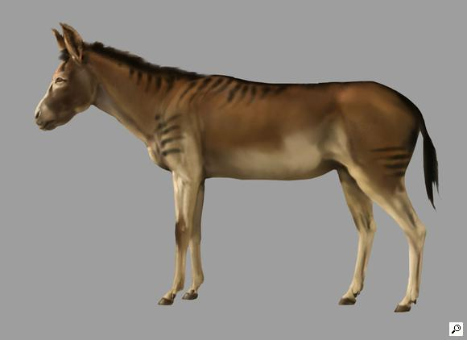
Mammal Tooth Enamel and Stable Isotopes
Stable Oxygen Isotopes
Determine meteoric water values and source of water vapor.
Picture © by Karen Carr
Based on the physiology of modern taxa, we assume Equids to be obligate drinkers, and thus Evaporation Insensitive (EI).
Notes:
Oxygen isotopes in tooth enamel have seen wide use in reconstructing aspects of continental paleoclimate based on the correlation between the oxygen isotope composition of local meteoric precipitation and the composition of mammalian tooth enamel. Composition of meteoric precipitation at mid-latitudes correlates with a number of factors including mean annual temperature (MAT), source of water vapor mass, and the trajectories of said masses. A number of other factors have an effect on δ18OE; the most critical of these factors appears to be the degree of water dependence of the animal (Kohn, 1996; Levin et al., 2006). Obligate drinkers have δ18OE values tracking the composition of meteoric precipitation, whereas non-obligate drinkers usually have much higher values because they get most of their water from the plants they eat, which are more affected by enrichment due to evapotranspiration. Obligate drinkers are “evaporation insensitive” (EI), whereas non-obligate drinkers are “evaporation sensitive” (ES) because enrichment is inversely proportional to relative humidity (Levin et al., 2006).
In this study, we use the δ18OE of perissodactyls (horses and rhinos), which we assume to be EI following Levin et al. (2006) and Kohn and Fremd (2007), to reconstruct the composition of meteoric precipitation in Louisiana during the MMCT. Given the many factors besides MAT affecting precipitation δ18O, we do not use δ18OE to estimate MAT during the late Barstovian in Louisiana. Instead, we use serial δ18OE values to estimate seasonal variability in precipitation δ18O, which can in turn be equated to temperature seasonality (Fricke et al., 1998; Zanazzi et al., 2007, 2015).

Slide 20
Mammal Tooth Enamel and Stable Isotopes
Stable Oxygen Isotopes
Determine meteoric water values and source of water vapor.
Determine temperature seasonality, and even mean annual temperature when used with other proxies.
Picture © by Karen Carr
Based on the physiology of modern taxa, we assume Equids to be obligate drinkers, and thus Evaporation Insensitive (EI).
Notes:
Oxygen isotopes in tooth enamel have seen wide use in reconstructing aspects of continental paleoclimate based on the correlation between the oxygen isotope composition of local meteoric precipitation and the composition of mammalian tooth enamel. Composition of meteoric precipitation at mid-latitudes correlates with a number of factors including mean annual temperature (MAT), source of water vapor mass, and the trajectories of said masses. A number of other factors have an effect on δ18OE; the most critical of these factors appears to be the degree of water dependence of the animal (Kohn, 1996; Levin et al., 2006). Obligate drinkers have δ18OE values tracking the composition of meteoric precipitation, whereas non-obligate drinkers usually have much higher values because they get most of their water from the plants they eat, which are more affected by enrichment due to evapotranspiration. Obligate drinkers are “evaporation insensitive” (EI), whereas non-obligate drinkers are “evaporation sensitive” (ES) because enrichment is inversely proportional to relative humidity (Levin et al., 2006).
In this study, we use the δ18OE of perissodactyls (horses and rhinos), which we assume to be EI following Levin et al. (2006) and Kohn and Fremd (2007), to reconstruct the composition of meteoric precipitation in Louisiana during the MMCT. Given the many factors besides MAT affecting precipitation δ18O, we do not use δ18OE to estimate MAT during the late Barstovian in Louisiana. Instead, we use serial δ18OE values to estimate seasonal variability in precipitation δ18O, which can in turn be equated to temperature seasonality (Fricke et al., 1998; Zanazzi et al., 2007, 2015).

Slide 21
Mammal Tooth Enamel and Stable Isotopes
Stable Oxygen Isotopes
Determine meteoric water values and source of water vapor.
Determine temperature seasonality, and even mean annual temperature when used with other proxies.
Water dependence
  Evaporation sensitive
  Evaporation insensitive
Picture © by Karen Carr
Based on the physiology of modern taxa, we assume Equids to be obligate drinkers, and thus Evaporation Insensitive (EI).
Notes:
Oxygen isotopes in tooth enamel have seen wide use in reconstructing aspects of continental paleoclimate based on the correlation between the oxygen isotope composition of local meteoric precipitation and the composition of mammalian tooth enamel. Composition of meteoric precipitation at mid-latitudes correlates with a number of factors including mean annual temperature (MAT), source of water vapor mass, and the trajectories of said masses. A number of other factors have an effect on δ18OE; the most critical of these factors appears to be the degree of water dependence of the animal (Kohn, 1996; Levin et al., 2006). Obligate drinkers have δ18OE values tracking the composition of meteoric precipitation, whereas non-obligate drinkers usually have much higher values because they get most of their water from the plants they eat, which are more affected by enrichment due to evapotranspiration. Obligate drinkers are “evaporation insensitive” (EI), whereas non-obligate drinkers are “evaporation sensitive” (ES) because enrichment is inversely proportional to relative humidity (Levin et al., 2006).
In this study, we use the δ18OE of perissodactyls (horses and rhinos), which we assume to be EI following Levin et al. (2006) and Kohn and Fremd (2007), to reconstruct the composition of meteoric precipitation in Louisiana during the MMCT. Given the many factors besides MAT affecting precipitation δ18O, we do not use δ18OE to estimate MAT during the late Barstovian in Louisiana. Instead, we use serial δ18OE values to estimate seasonal variability in precipitation δ18O, which can in turn be equated to temperature seasonality (Fricke et al., 1998; Zanazzi et al., 2007, 2015).

Slide 22
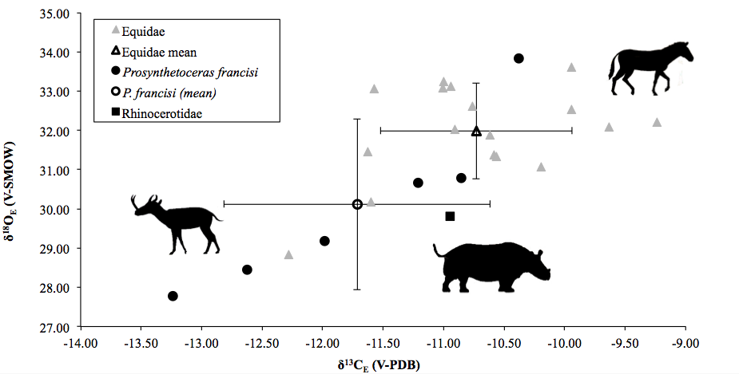
Bulk Isotope Results
Bulk results from DISC Locality
Notes:
The δ13CE data presented in this study are consistent with a pure C3 diet for all investigated ungulates. The sampled fauna as a whole has a range of δ13CE values consistent with feeding in an open C3 biome, such as “dry” woodland-savanna or C3 grassland according to our model. This interpretation is concordant with previous biome interpretations for Fort Polk during the late Barstovian indicative of fairly open habitats (Schiebout, 1997; Schiebout and Ting, 2001; Schiebout et al., 2004). Though there was not a statistically significant difference between Prosynthetoceras francisi and equid δ13CE values at DISC, there is some separation, suggesting that P. francisi preferred a slightly more closed habitat by comparison.
Mean Annual Precipitation (MAP) can be calculated based on δ13CE using an equation provided by Kohn (2010); in this case upper end estimates from the calculation yield values around 500 mm/yr…which is considerably lower than 1400 mm/yr the area experiences today, but well within expectations based on biome interpretation.

Slide 23
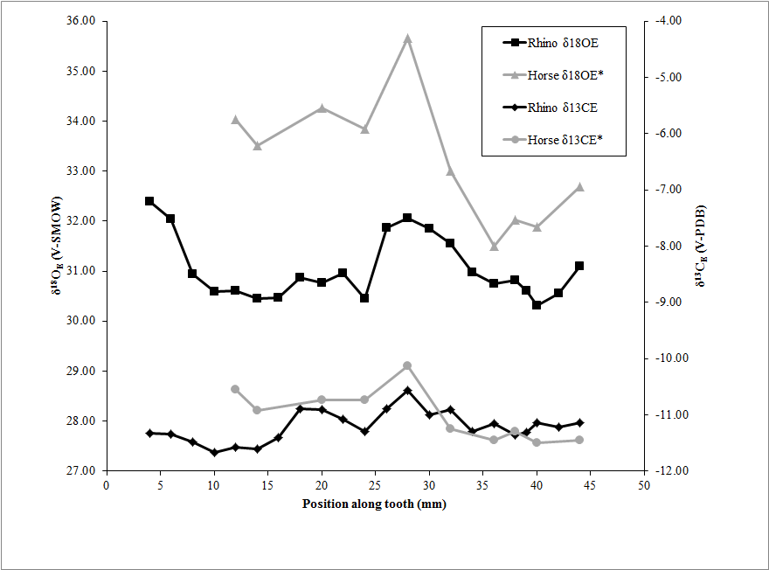
Serial Isotope Results
Notes:
The low variability in serial δ13CE for both horses (1.37‰) and rhinos (0.79‰) from Fort Polk may suggest little seasonal variation in precipitation in the region during the MMCT.
In this study we used the relationship between rainwater δ18O and δ18OE calculated for modern horses from Zanazzi et al., 2007 to estimate a value for rainwater δ18O in Louisiana during the MMCT.
Using this equation, the mean δ18OE for horses (31.99±1.22‰, n=17), yields a value for local water δ18O in Louisiana of 0.71‰ during the MMCT. Variability in serial δ18OE for both horses and rhinos is marked, suggesting either temperature seasonality or seasonal changes in water vapor source. If we attribute this variability solely to temperature seasonality, we can utilize the following equation provided by Zanazzi et al. (2015) to estimate MART.
Using the 5-95 percentile interval for Fort Polk perissodactyls (r=3.53‰), we estimate a MART for Louisiana during the MMCT of 12.55°C. This range is more than 6°C lower than the thirty-year average for the area (18.80°C; IAEA/WMO, 2006), suggesting considerably more tropical-like seasonality during the MMCT compared to today, though we should note uncertainty associated with this estimate is large.

Slide 24
Serial Isotope Results
Low variability
0.79‰
1.37‰
Notes:
The low variability in serial δ13CE for both horses (1.37‰) and rhinos (0.79‰) from Fort Polk may suggest little seasonal variation in precipitation in the region during the MMCT.
In this study we used the relationship between rainwater δ18O and δ18OE calculated for modern horses from Zanazzi et al., 2007 to estimate a value for rainwater δ18O in Louisiana during the MMCT.
Using this equation, the mean δ18OE for horses (31.99±1.22‰, n=17), yields a value for local water δ18O in Louisiana of 0.71‰ during the MMCT. Variability in serial δ18OE for both horses and rhinos is marked, suggesting either temperature seasonality or seasonal changes in water vapor source. If we attribute this variability solely to temperature seasonality, we can utilize the following equation provided by Zanazzi et al. (2015) to estimate MART.
Using the 5-95 percentile interval for Fort Polk perissodactyls (r=3.53‰), we estimate a MART for Louisiana during the MMCT of 12.55°C. This range is more than 6°C lower than the thirty-year average for the area (18.80°C; IAEA/WMO, 2006), suggesting considerably more tropical-like seasonality during the MMCT compared to today, though we should note uncertainty associated with this estimate is large.

Slide 25
Serial Isotope Results
δ ¹⁸O_{E} = 31.99 ± 1.22‰
δ ¹⁸O_{w} = 0.71‰
Mean annual range in temperature: 12.55℃
Notes:
The low variability in serial δ13CE for both horses (1.37‰) and rhinos (0.79‰) from Fort Polk may suggest little seasonal variation in precipitation in the region during the MMCT.
In this study we used the relationship between rainwater δ18O and δ18OE calculated for modern horses from Zanazzi et al., 2007 to estimate a value for rainwater δ18O in Louisiana during the MMCT.
Using this equation, the mean δ18OE for horses (31.99±1.22‰, n=17), yields a value for local water δ18O in Louisiana of 0.71‰ during the MMCT. Variability in serial δ18OE for both horses and rhinos is marked, suggesting either temperature seasonality or seasonal changes in water vapor source. If we attribute this variability solely to temperature seasonality, we can utilize the following equation provided by Zanazzi et al. (2015) to estimate MART.
Using the 5-95 percentile interval for Fort Polk perissodactyls (r=3.53‰), we estimate a MART for Louisiana during the MMCT of 12.55°C. This range is more than 6°C lower than the thirty-year average for the area (18.80°C; IAEA/WMO, 2006), suggesting considerably more tropical-like seasonality during the MMCT compared to today, though we should note uncertainty associated with this estimate is large.

Slide 26
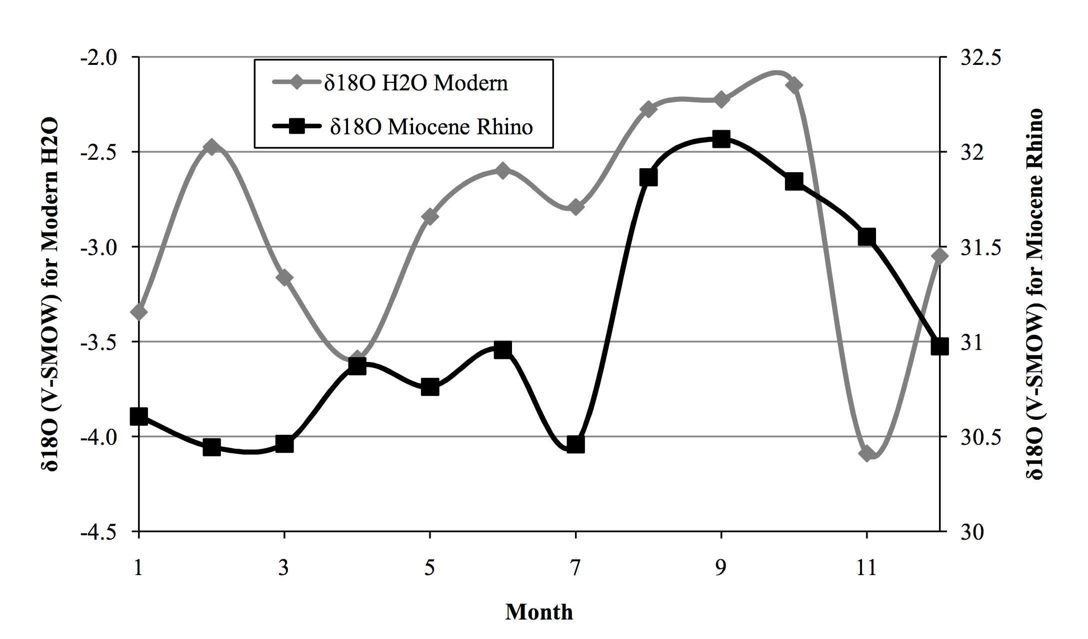
Serial Isotope Results

Slide 27
Gulf Coast during the MMCT
Fort Polk environment
  Mosaic “dry” Woodland-savanna
  Low mean annual precipitation (~300-500 mm/yr) with no marked “dry” season.
  Experiencing more tropical-like temperature seasonality than today.
Notes:
In summation, our preliminary isotopic work indicate that the area in and around Fort Polk during the MMCT was likely covered in mosaic Woodland-savanna, experiencing low MAP with no defined dry season and more tropical-like temperature seasonality than today. Considerably more work is needed to fully characterize the area during this interval, and we hope to extend study to other coeval localities across the Gulf Coast.

Slide 28
Acknowledgments
We thank:
  Drs. B.J. MacFadden, J. Curtis, and G. Kamenoc (University of Florida) for assistance with sample analysis,
  Dr. A. Engel (formerly of Louisiana State University) for use of lab space and equipment during sampling and pretreatment
  Drs. H.-M. Bao, B. Dutrow, and S.-Y. Ting (Louisiana State University) for helpful comments on this project.
  We also thank J. Grafton (formerly at Fort Polk) and other environmental staff that have worked at Fort Polk over the years for their assistance in collecting fossils.
  Funding was provided to T. Atwood by the Gulf Coastal Association of Geological Societies, LSU Museum of Natural Science, and the LSU Department of Geology and Geophysics.
  Dr. Yann (Oklahoma State University Center for Health Sciences) for giving this presentation.
Notes:
Any Questions may be addressed to Dr. Boardman…

