Slide 1
Gulf of Mexico Basin Structure: Where is the Basin’s Northeastern Boundary and What are the Sabine and Monroe Uplifts?
Gary L. Kinsland
Nicholas Loundagin
Robert Ivy
University of Louisiana at Lafayette

Slide 2
Here we are about 50 years after Plate Tectonics was accepted as the explanation for most of the features of the Earth’s surface. Even though the Gulf of Mexico Basin (GoMB) has the greatest concentration of geologists and geophysicists in the world we still do not have an accepted Plate Tectonic explanation for the structures of the northern rim of the GoMB.

Slide 3
DATA VS MODELS
FROM DATA WE CREATE MODELS…INTERPRETATIONS ARE MODELS
WITH MODELS WE INTERPRET DATA…MODELS ARE NOT DATA
WE MUST BE CAREFUL LEST WE BEGIN TO THINK MODELS ARE FACT

Slide 4
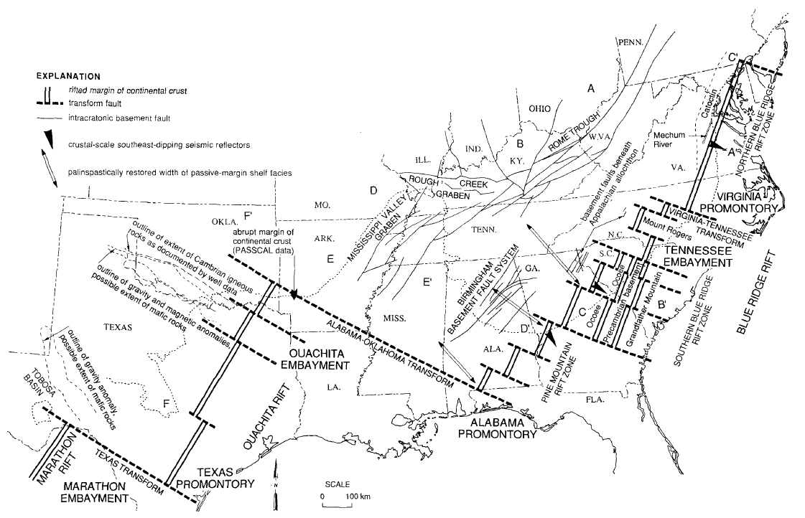
Here we have an example of a plate tectonic model the basis of which has been widely utilized since the 1970s [Thomas (1973, 1976)] transform
NOTE!
Outline map of interpreted Late Precambrian-early Paleozoic continental margin as bounded by rift segments and transform faults. Thomas (2015)

Slide 5
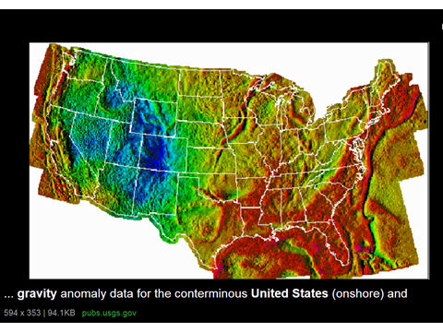
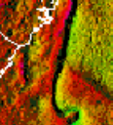
RIFT PASSIVE MARGIN SIGNATURE IN GRAVITY DATA
Continental/Ocean Boundary (COB) near where arrows point

Slide 6
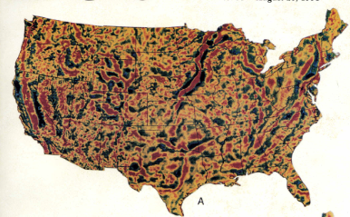
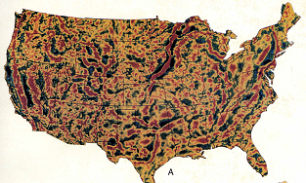
HERE IS ANOTHER INTERPRETATION/MODEL
KINSLAND (1984)
Rift Passive Margin Signatures from Iapetian rifiting…buried by present mountains…Ouachitas/Appalachians
Gravity map filtered to remove wavelengths longer than 250 km
Hildenbrand et al. (1982)
BLACK LINE IS APPROXIMATE LOCATION OF AN INTERPRETED IAPETIAN TRANSFORM FAULT

Slide 7
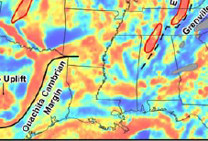
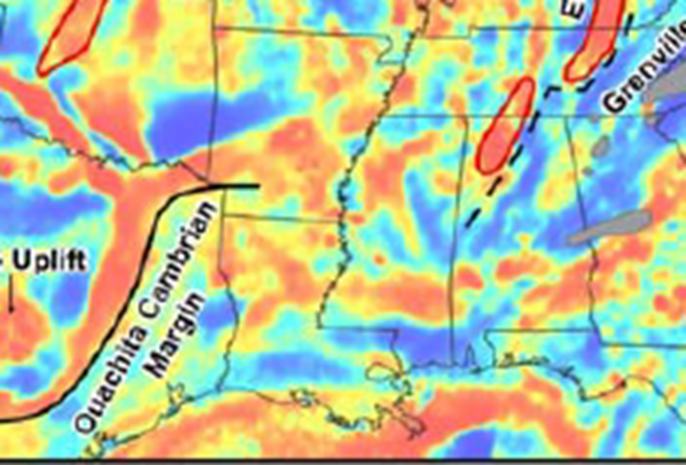
Example from another, very recent, data set.
Computed by upward continuing complete Bouguer anomaly (CBA) data to 40 km and subtracting result from CBA,
Stein et al. (2015)Was the Mid-Continent Rift part of a successful seafloor-spreading episode?

Slide 8
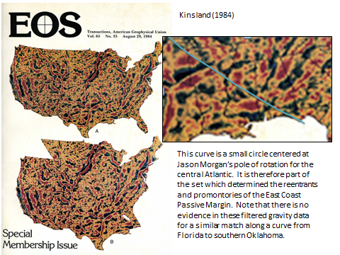

Slide 9
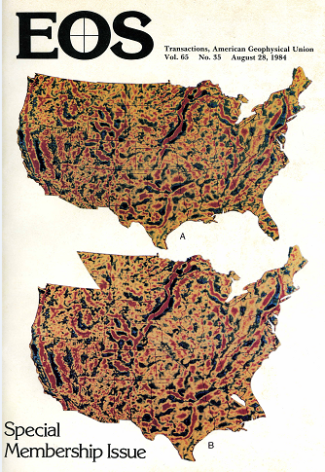
The center for this arc is essentially the same as the pole of rotation Jason Morgan found for the central Atlantic fracture zones/transform faults. Linking this interpretation to plate tectonics.
DATA
MODEL/INTERPRETATION
I have said before [Kinsland (1984)] that the reconstruction shown here may be correct for the Gulf of Mexico (GoM) northeastern margin and completely crazy for the rest of the arc. Today I am defending only the GoM part.

Slide 10
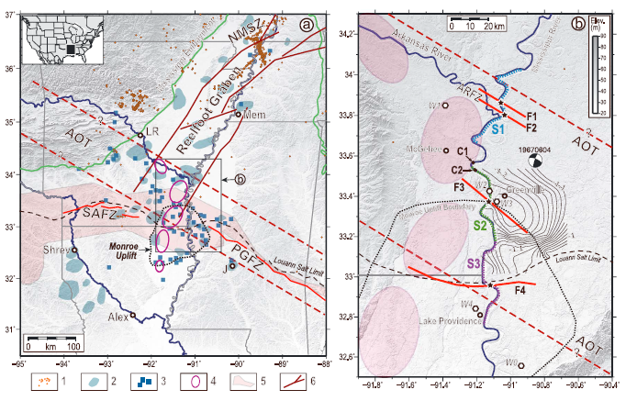
AOT = Alabama Oklahoma Transform which the authors seem to interpret as a broad zone lying north of the AOT in the previous figure…to enable the AOT to be an explanation for F1, F2 and F3????
THE BLACK LINE IS THE APPROXIMATE LOCATION OF THE BLACK LINE TWO AND THREE SLIDES PREVIOUSLY AND THE CUT IN THE PREVIOUS SLIDE…ALSO A POSSIBLE EXPLANATION FOR THE FAULTS.
Hao et al. (2014)

Slide 11
LET’S SEE HOW THESE MODELS COMPARE TO THE DATA IN REGION OF THE NORTHEASTERN BOUNDARY OF THE GULF OF MEXICO BASIN!

Slide 12
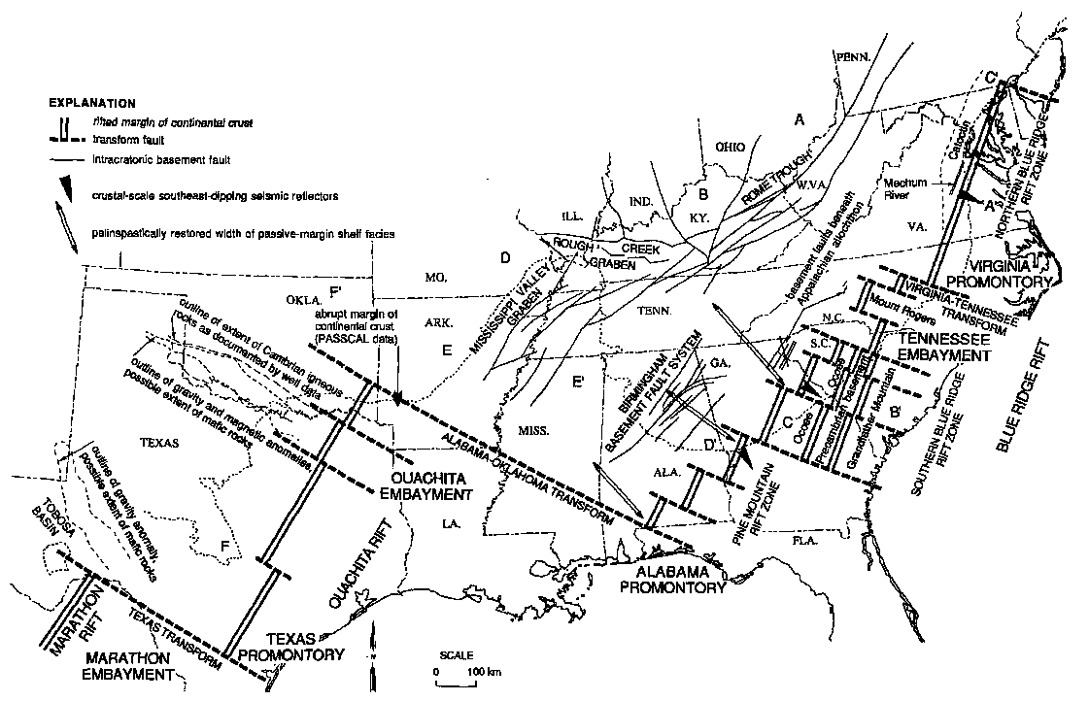
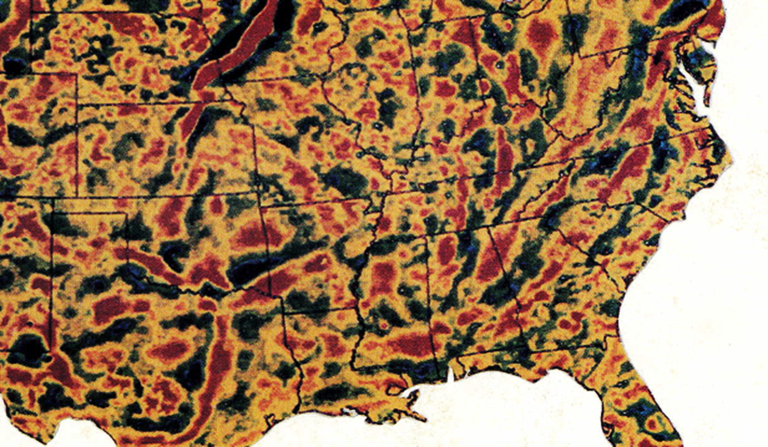

SUPERPOSITION OF THE THOMAS MODEL ON THE FILTERED GRAVITY DATA
Outline map of interpreted Late Precambrian-early Paleozoic continental margin as bounded by rift segments and transform faults. Thomas (2015)

Slide 13
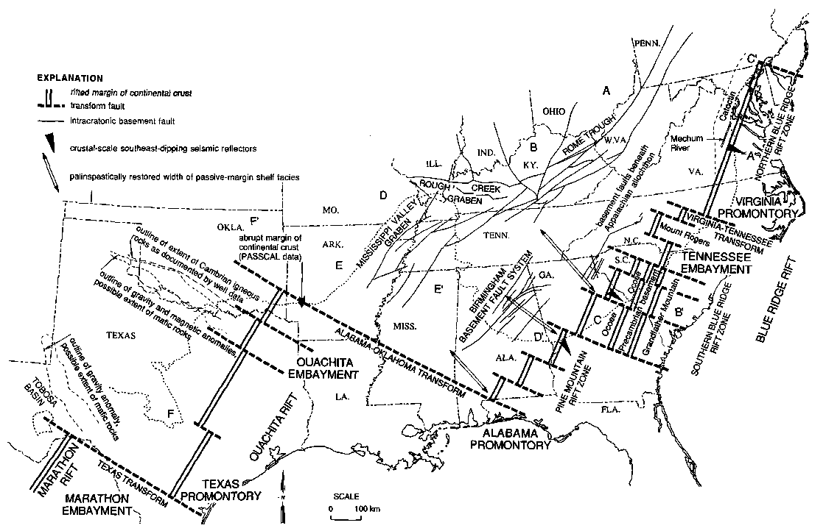
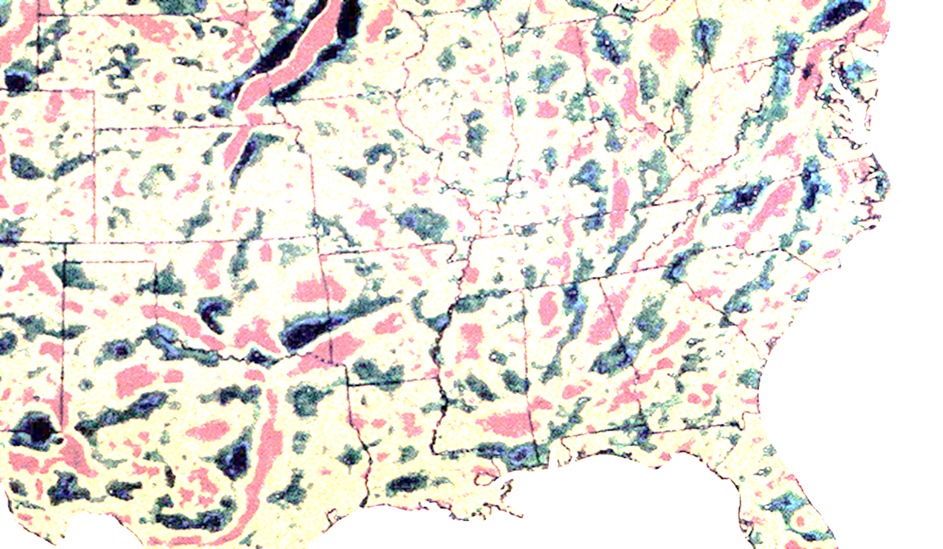
AOT cuts RPM signature. Thomas RPM at 45 degrees to gravity RPM. Abrupt margin comment corresponds to gravity RPM location.

Slide 14
Red line is interpreted transform offsetting Ouachita RPM and Appalachian RPM during Iapetian rifting.

Slide 15
The two models agree that the northeastern boundary of the Gulf of Mexico Basin is a transform fault from the Iapetian rifting. There are several other data sets which may be interpreted to try to determine the orientation/ location of the northeastern boundary of the Gulf of Mexico Basin.

Slide 16
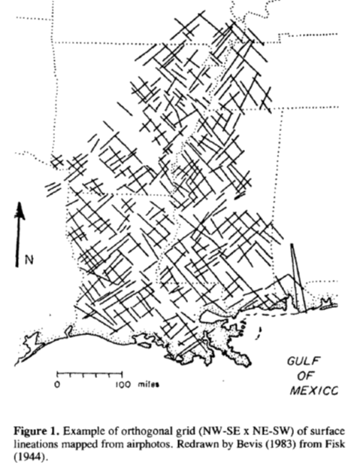
The two proposals superimposed on the photo-lineaments of Fisk(1944)

Slide 17
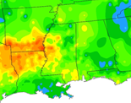
SMU Geothermal Laboratory Heat Flow Map of the Conterminous United States, 2011
Blackwell et al. (2011)

Slide 18
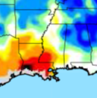
Crustal thickness map…red thins – blues thicks
Weisen Shen personal communication 2015.

Slide 19
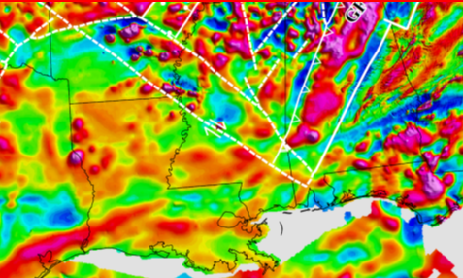
From: Preliminary Precambrian Basement Structure Map of Continental United States – An interpretation of geologic and aeromagnetic data P.K. Sims, R.W. Saltus and E.D. Anderson, 2005

Slide 20
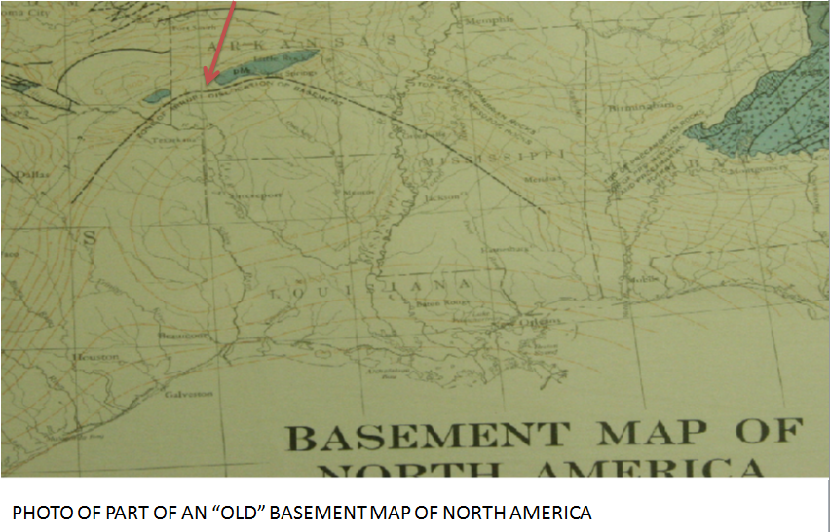
Zone of Abrupt Dislocation of Basement

Slide 21
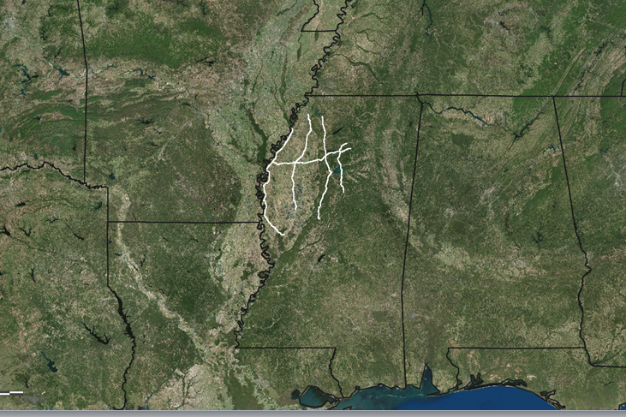
LOCATION OF WESTERN GEOPHYSICAL SEISMIC DATA (NOW SEISMIC EXCHANGE DATA) NICHOLAS LOUNDAGIN HAS BEEN GIVEN PERMISSION TO UTILIZE AT UL LAFAYETTE FOR HIS MASTERS THESIS WITH PROPOSED BOUNDARIES

Slide 22
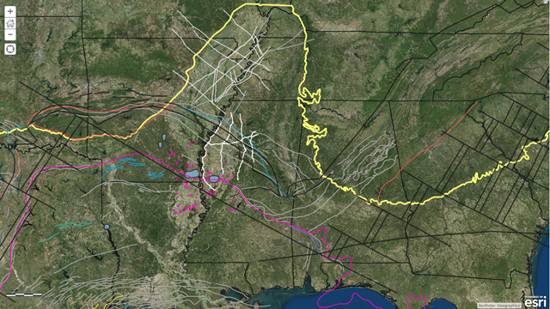
FIGURE PREPARED BY LOUNDAGIN ILLUSTRATING THAT THE BOUNDARY QUESTION INVOLVES MORE PROPOSALS THAN THE TWO DEALT WITH ABOVE.

Slide 23
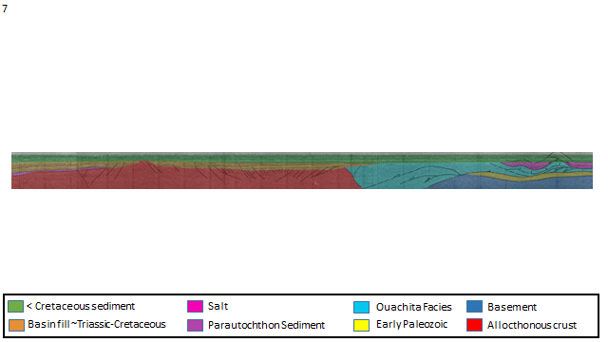
PRELIMINARY INTERPRETATION OF THE WESTERNMOST SEISMIC LINE BY LOUNDAGIN
POSSIBLE NE BOUNDARY
S
N

Slide 24
OTHER CONTROVERSIAL/UNEXPLAINED FEATURES IN THE GULF OF MEXICO BASIN
IN LOUISIANA
SABINE UPLIFT (SU) Island arc??? Exotic Terrane??? Incipient Metamorphic
Core Complex (IMCC)???
MONROE UPLIFT (MU) Island arc??? Exotic terrane??? Deep Intrusion???
Incipient Metamorphic Core Complex (IMCC)
ANGELINA-CALDWELL FLEXURE (A-C F) Edge of Continental Block??? Edge of
Ramp from Thin Slab Rifting???
LASALLE ARCH (LA) Corrugation from Thin Slab Rifting???
IN MISSISSIPPI
WIGGINS UPLIFT (WU) Exotic Terrane???
MORE POSSIBILITIES…?

Slide 25

MU
SU
LA
WU
A-CF

Slide 26
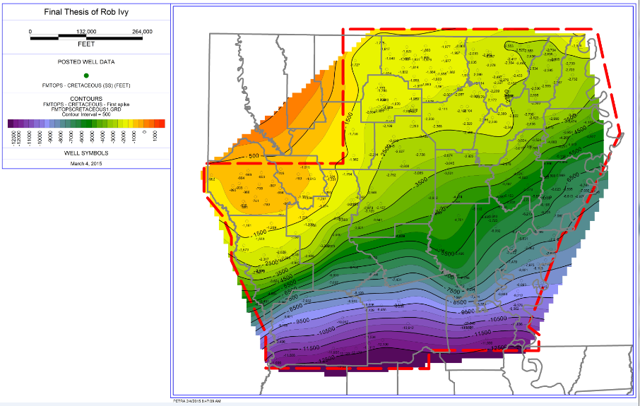

Slide 27
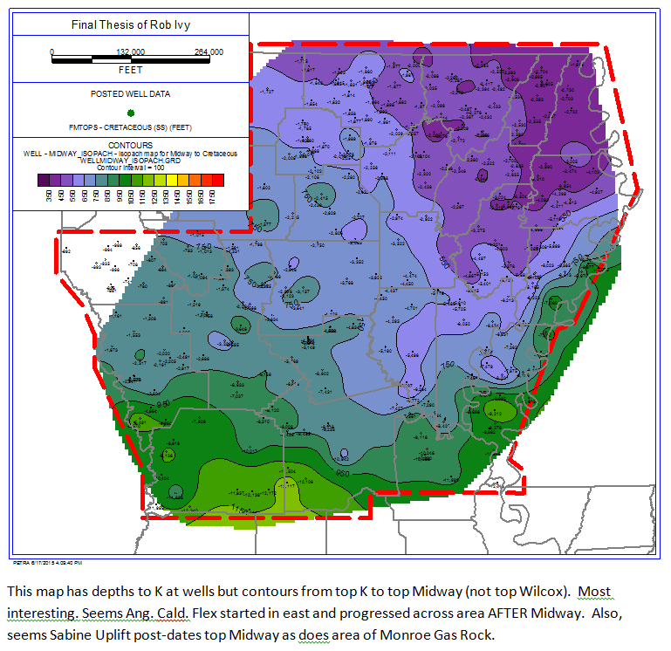
TOP OF CRETACEOUS “HUNG” ON TOP OF THE MIDWAY.
YIELDING TOPO-
GRAPHY AT TIME OF TOP OF CRETACEOUS.
NOTE: NO SABINE UPLIFT, MONROE UPLIFT EXISTS,
NO ANGELINA-
CALDWELL FLEXURE AND NO LASALLE ARCH.

Slide 28
The fact that the previous map, the isochore of the Midway Shale, contains no evidence of the Sabine Uplift, the Angelina-Caldwell Flexure or the LaSalle Arch means that these features did not exist at K/Pg time. Therefore, the proposal of mine (Kinsland, 2015…SC GSA ) that these features might be the result of thin slab rifting and related to incipient metamorphic core complex formation is not tenable as such structural features would have had to have started forming in the early Mesozoic.
WHAT ARE THESE FEATURES?
ARE THEY RELATED TO THE FOUNDERING OF THE FARALLON PLATE WHICH LOWERED THE EASTERN SIDE OF THE CONTINENT AND REDIRECTED DRAINAGE INTO THE GULF (WILCOX DEPOSITION) IN THE LATE PALEOCENE.

Slide 29
I AM LOOKING FORWARD TO DISCUSSING THE GULF OF MEXICO BASIN TECTONICS AT THE POST MEETING WORKSHOP.
SEE YOU THERE.

Slide 30
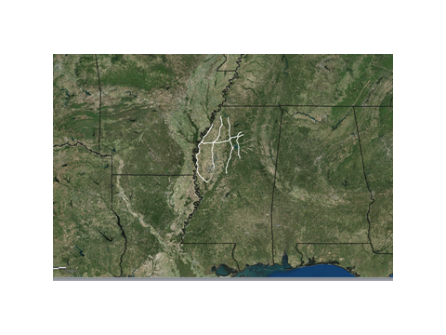

Slide 31
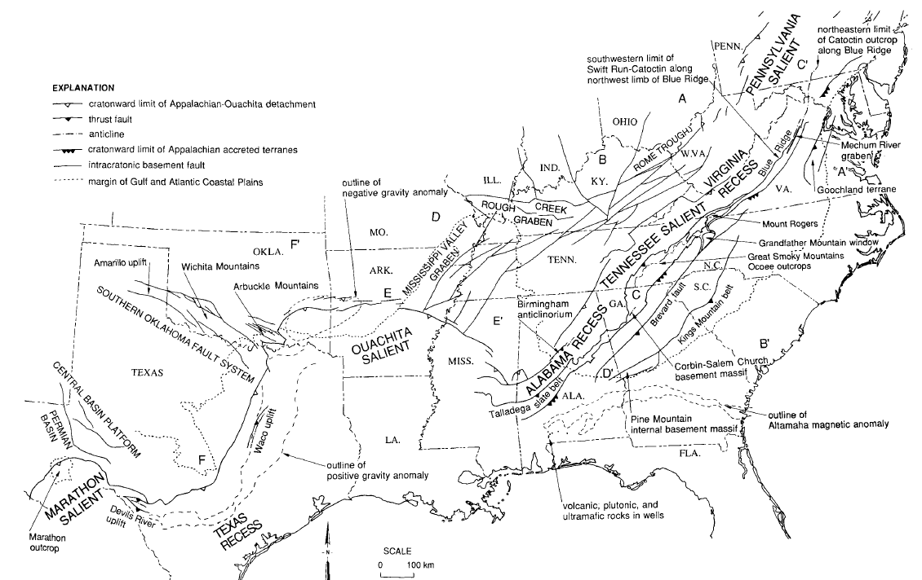
Outline map of Appalachian-Ouachita orogenic belt and intracratonic fault systems. Locations of rift-related rocks are shown in present structural position. Thomas (2015)

Slide 32
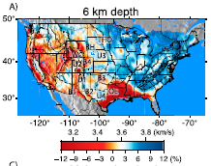
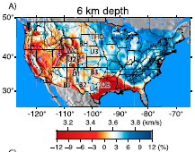


Slide 33
Outline map of interpreted Late Precambrian-early Paleozoic continental margin as bounded by rift segments and transform faults. Thomas (2015)

Slide 34
SUPERPOSITION OF THE THOMAS MODEL ON THE FILTERED GRAVITY DATA
Outline map of interpreted Late Precambrian-early Paleozoic continental margin as bounded by rift segments and transform faults. Thomas (2015)

Slide 35
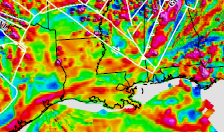

Slide 36
Outline map of interpreted Late Precambrian-early Paleozoic continental margin as bounded by rift segments and transform faults. Thomas (2015)

Slide 37
