Slide 1

Using a Topographic Residual Envelope Map as a Rapid Identification Technique for Tectonic Deformation within Quaternary Terraces of the Saline River Fault Zone in South-Central Arkansas
Eric Gamble, Randel Tom Cox, Daniel Larsen, and Cody Wallace
Presented by: Eric Gamble

Slide 2
Presentation
Goals and Background
Previous Research
Methods
Discussion
Summary

Slide 3
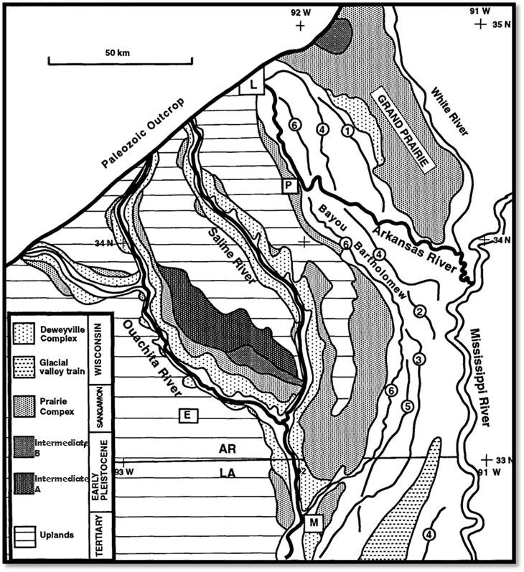
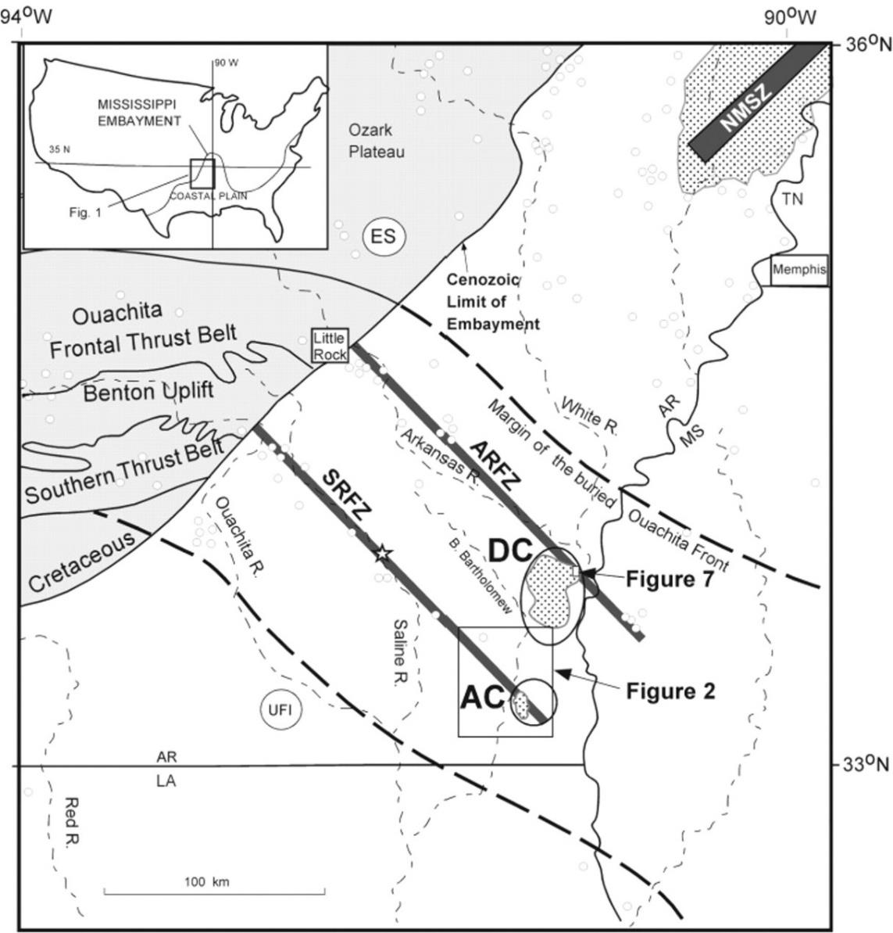


Goal of the Current Work
Regional trend of Seismicity following the Oklahoma-Alabama Transform Zone
Terraces of the Saline and Ouachita River Valleys
Saline River fault zone (SRFZ) (strike = 135°) trends along the Oklahoma-Alabama Transform Zone.
Faults within this zone offset Pleistocene to Holocene alluvial terraces
Terraces consist of Pleistocene-aged Intermediate Complex terraces, the Sangamon-aged Prairie Complex terraces, the Wisconsin-aged Deweyville Complex terraces, and the active and abandoned Holocene terraces.

Slide 4
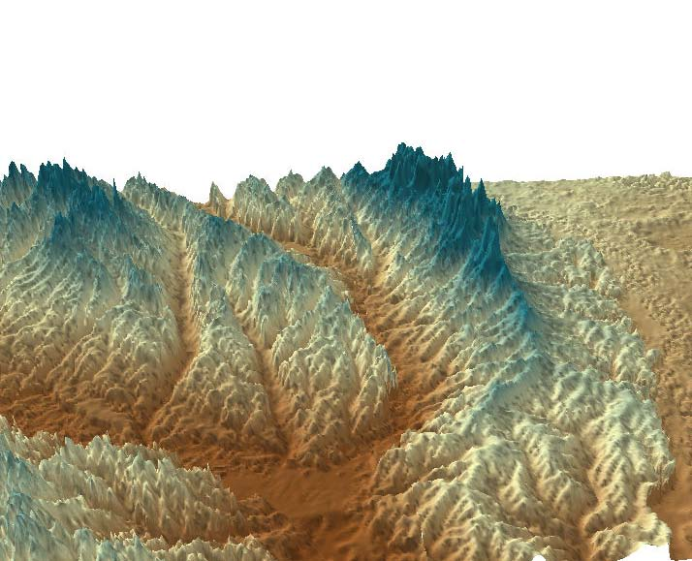
Goal of the Current Work
100x Vertical Exaggeration
N
Saline River
Ouachita River
70 km
The goal of the current work is to restore terraces to their geometry before dissection and erosion.
This involves creating a residual topographic envelope map.
This surface will help measure the difference between their uneroded geometry and their idealized geometry.

Slide 5
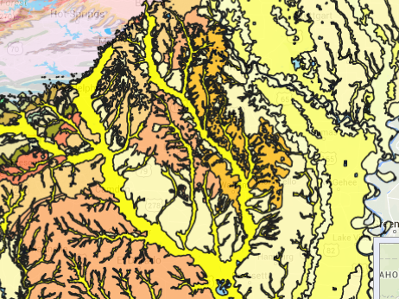
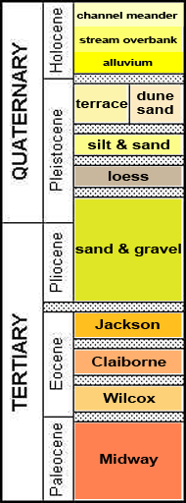
Previous Research:
Stratigraphy and Local Geology
Figure 5: Areal distribution of geology in mapping area. Mapping area outlined in red.
Figure 6: Stratigraphic correlation charts for West Gulf Coastal Plain and Mississippi River Alluvial Plain sub-regions of the Gulf Coastal Plain of Arkansas

Slide 6
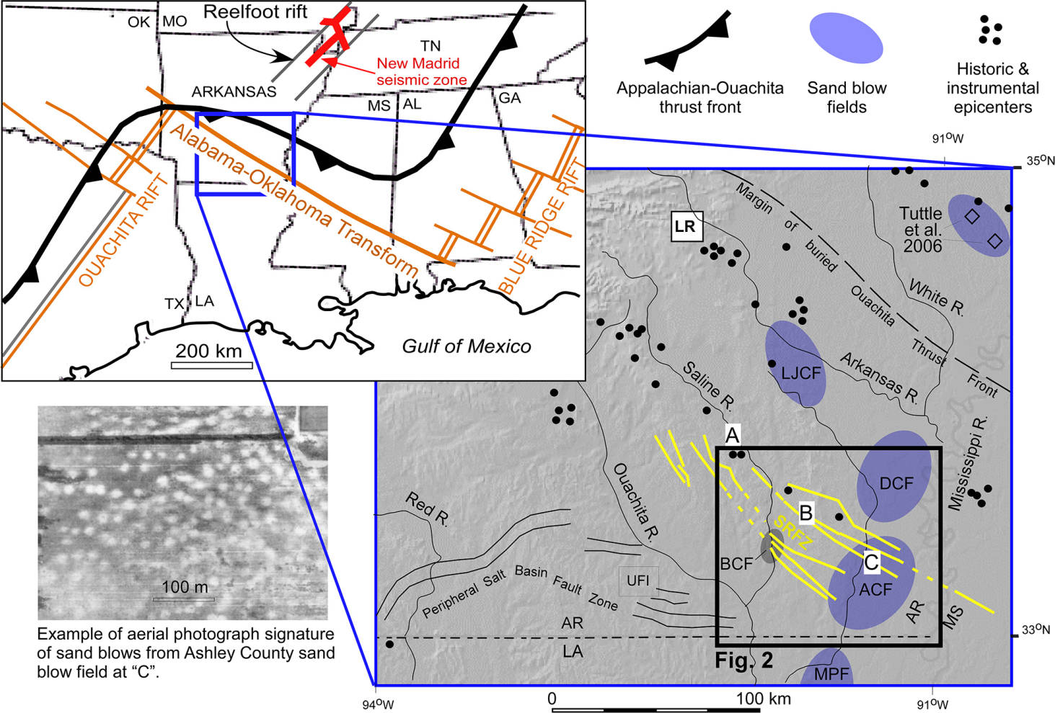
Previous Research: Quaternary Paleo-seismology
From (Cox et al., 2014). Location map showing the general tectonic setting (upper left), a shaded-relief map showing the study area, and an aerial Photograph of sandblow deposits and faulting
Sinistral faulting evidenced by left-slip flower structure bounded by components of both normal and reverse faults documented on the periphery of the flower (Cox et al., 2000).)

Slide 7
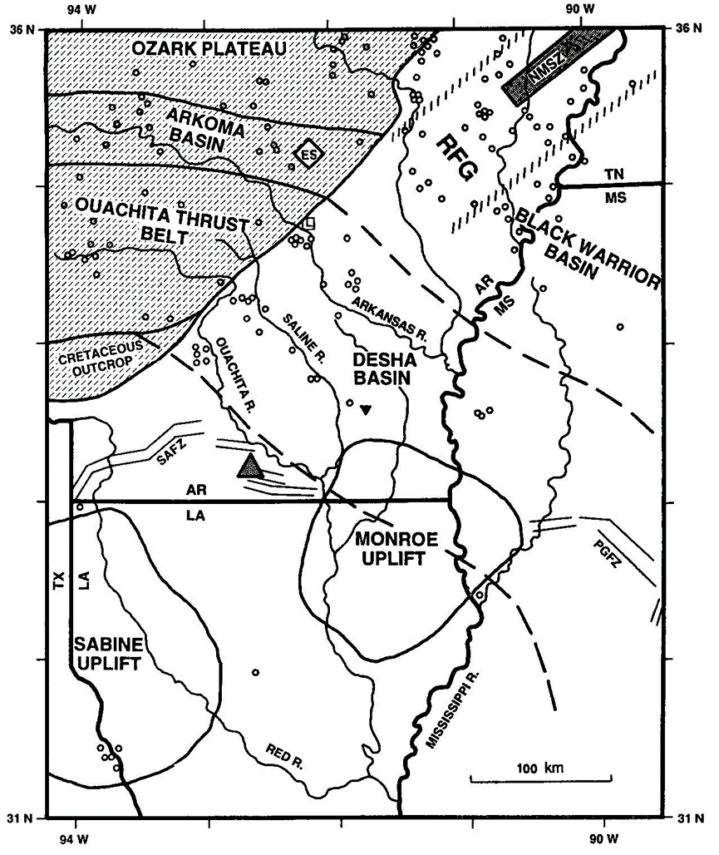
Previous Research: Cenozoic Uplifts
Saline and Ouachita River Valleys and their locations with respect to the Mesozoic/Cenozoic Sabine and Monroe uplifts.
Sabine uplifts contributed to terrace formation and possible deformation.
Above note overlap between the Monroe uplift and the study area

Slide 8
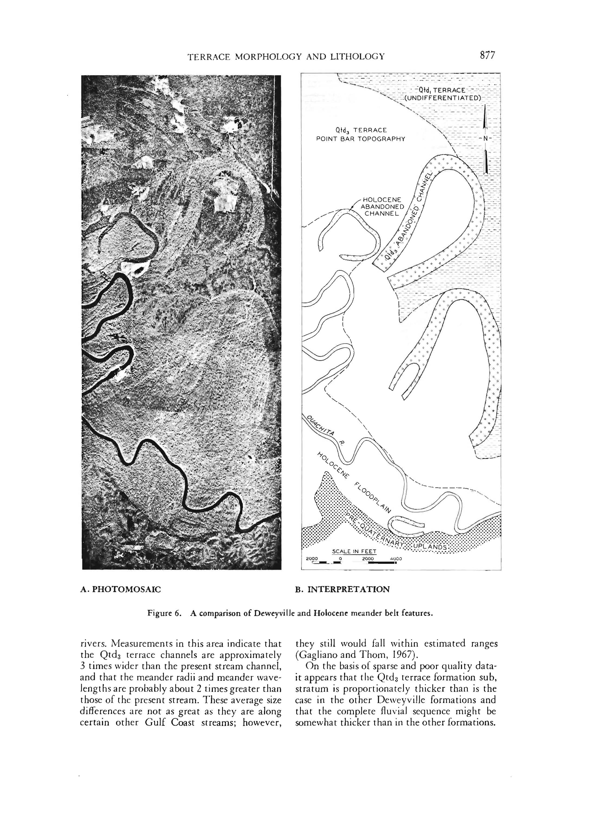
Previous Research: Terrace Identification
From Saucier and Fleetwood, (1970) showing expected channels scars within Deweyville III Complex terrace from satellite view.
Other criteria used for previous terrace identification includes: Identification of terrace riser and tread geometries, and soil development.

Slide 9
Methods
Methods I: Creating a Residual Topographic Envelope Map of Tributary Watershed Divides perpendicular to the main channels.
Divides are the least eroded portion in a watershed. Divides perpendicular to the main channel cross terraces. These tributary divides preserve terrace geometries with least amount of erosion.
Methods II: Outlining terrace boundaries as defined on the continuous terranes
Methods III: Mapping out residuals from deformation of these individual terraces and a best-fit plane.
Methods IV: Looking for trends in residual deformation
Methods V: Selecting boring locations for a study on soil development according to soil chrono-sequence studies as outlined by the USGS
(This is forthcoming and the samples are still being interpreted in the lab for a study of soil development in the B horizon. Currently it appears that most older terraces has a prominent development of sesquioxides in the B horizon.)

Slide 10
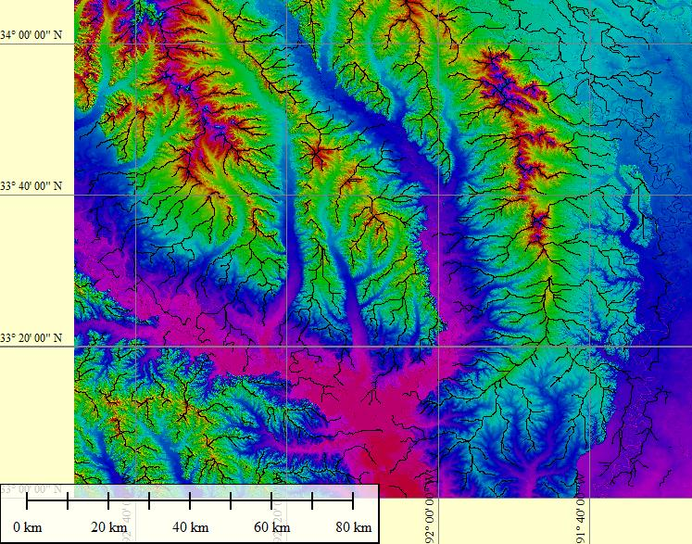
Methods I:
Creating a Terrane of the Ridgeline to subtract erosion
Saline River
Ouachita River
Map showing ridgelines/tributary divides within the mapping. These are the least eroded surfaces within the basins and preserve the main channel terrace geometry prior to erosion.

Slide 11
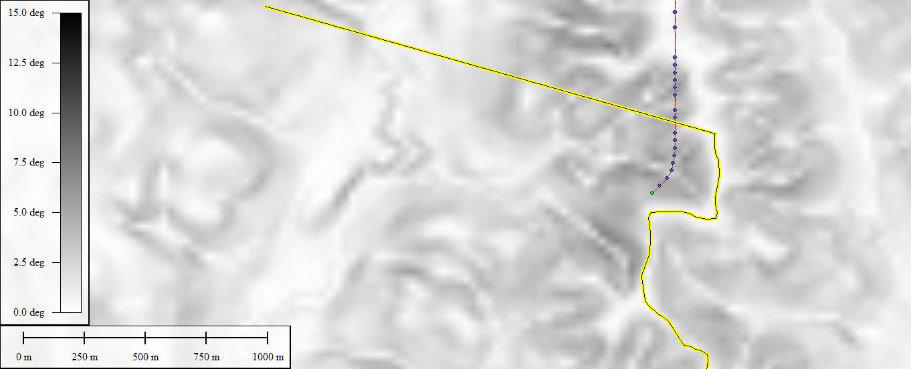
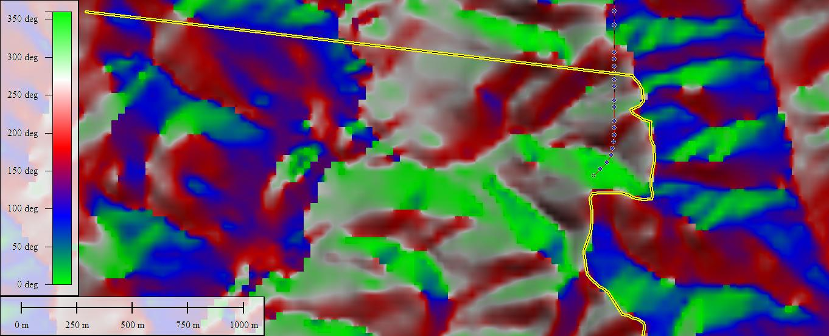
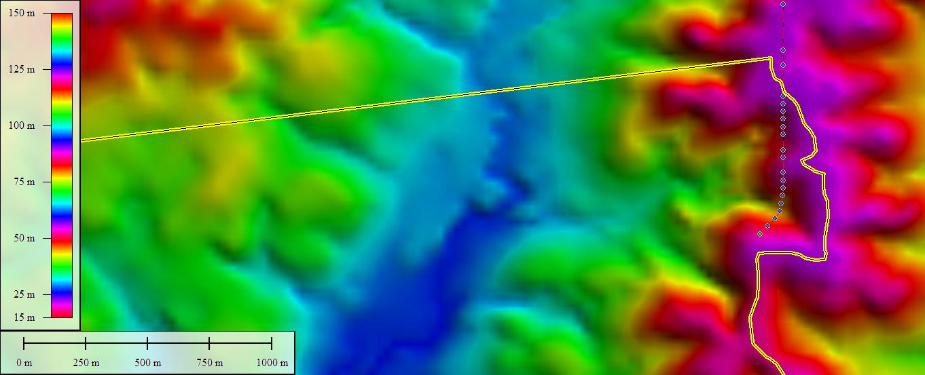
Methods I:
Parameters for Delineating Ridgelines/Divides
Slope Density
Slope Aspect (Azimuth)
Elevation Density

Slide 12
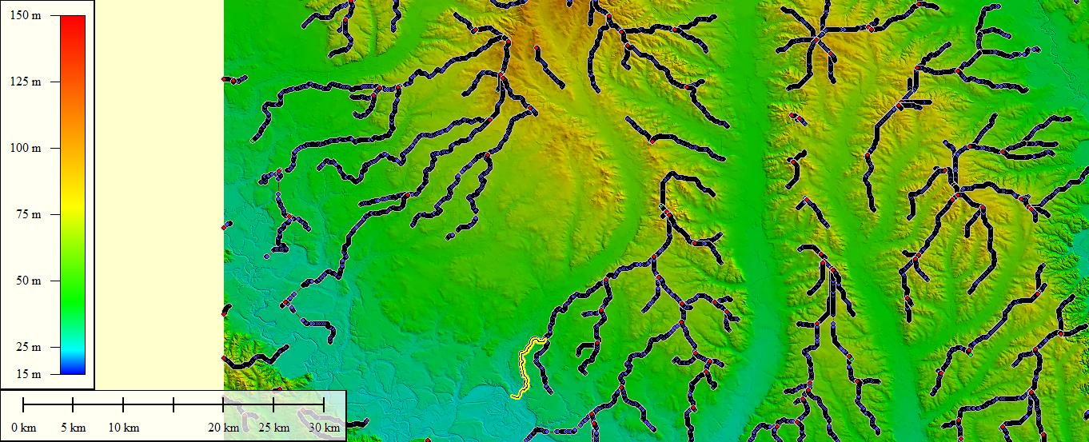
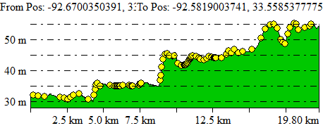
Methods I:
Examples of input for terrane
N
30 km
Example above showing profile of ridgeline input into continuous terrane with 100x vertical exaggeration.
Ridgelines selected using slope density elevation density and slope aspect.
Ridgelines were cherry-picked for those best defining terrace riser and tread geometries.

Slide 13
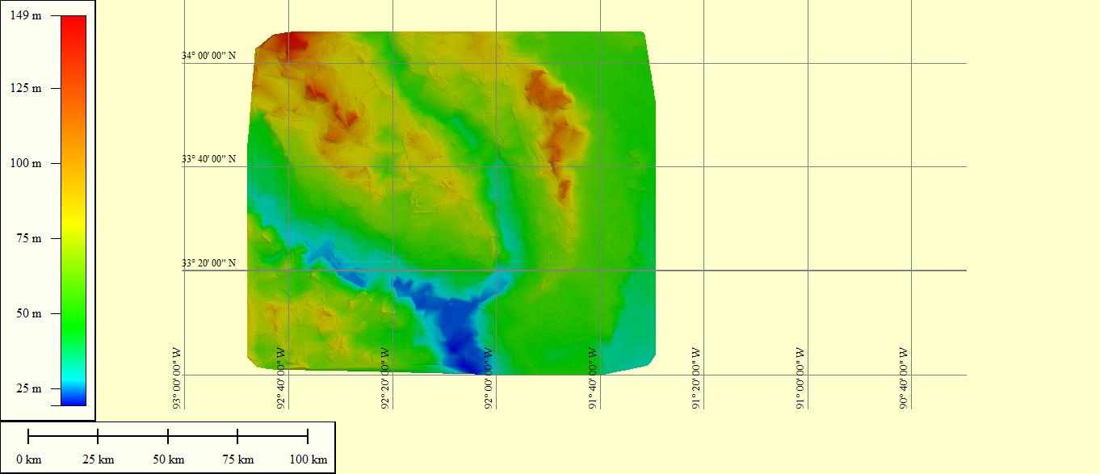
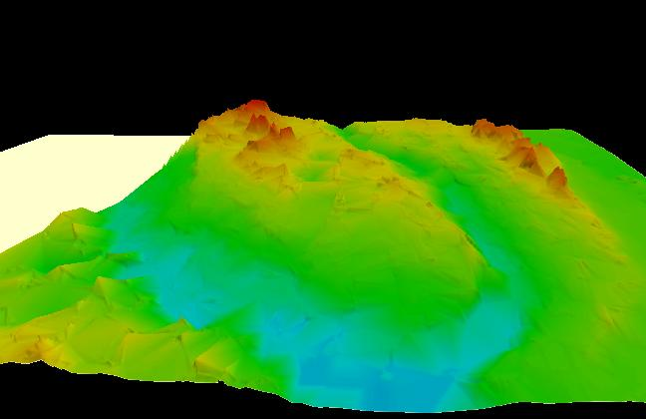
Methods I:
Triangulated Irregular Network (TIN)/Delaunay Triangulation
(problematic for identification of terrace riser and tread geometries)
N
N
Saline River
Saline River
Ouachita River
Ouachita River
Map view of TIN constructed from ridgeline X, Y, Z features (lat, long, elevation)
3-D model of TIN constructed from input from ridgeline X, Y, Z features.

Slide 14
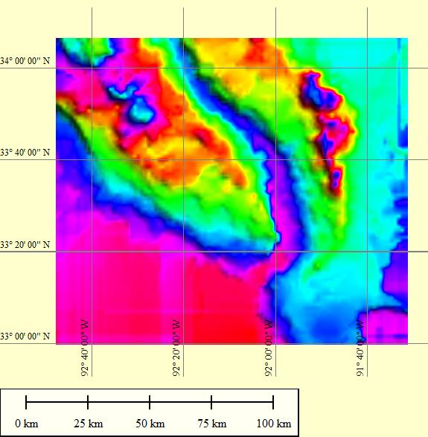
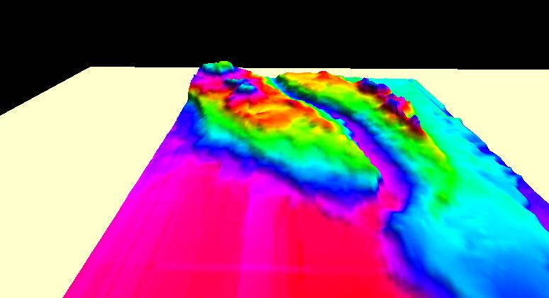
Methods I:
Kriging/Gaussian Process Regression
(best fit)
Saline River
N
Saline River
N
Ouachita River
Ouachita River
Map view of envelope map constructed by Kriging in Surfer Program
3-D depiction of envelope map created using Kriging. Shown with 100x vertical exaggeration.

Slide 15
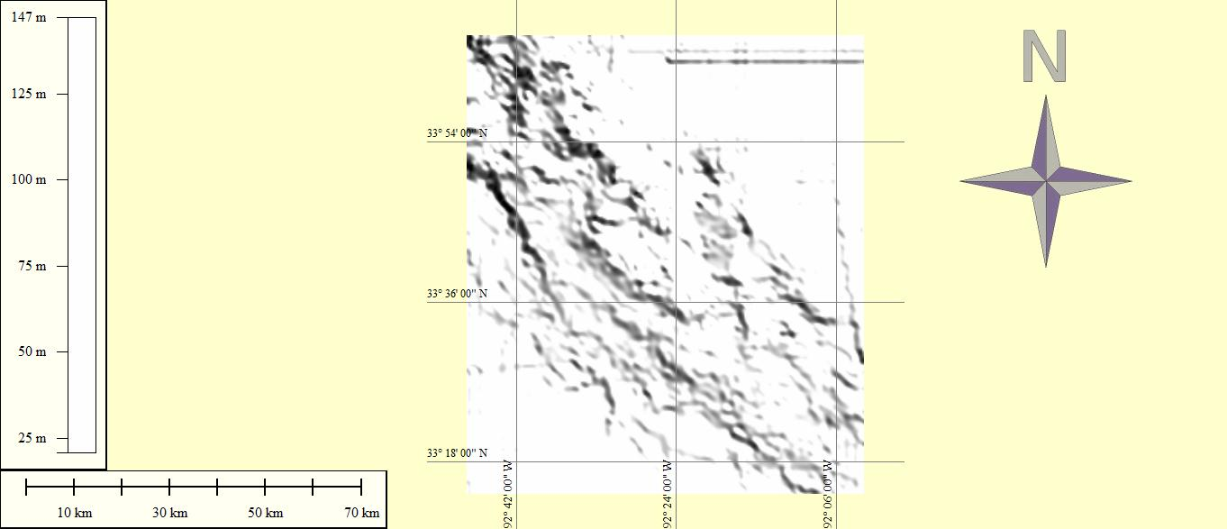
Methods II:
Delineating terrace boundaries from envelope map
Ouachita River
1. To identify terraces, hillslope shader was used with sunlight at a 45° angle. This illuminates terrace boundaries due to the shadow along the terrace riser.

Slide 16
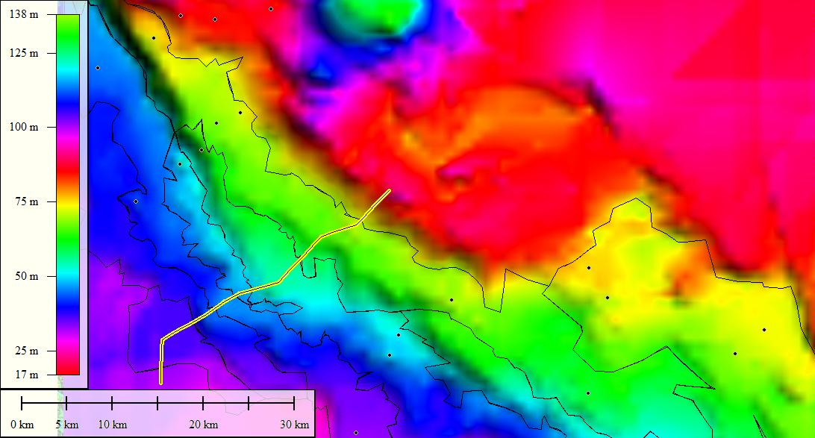
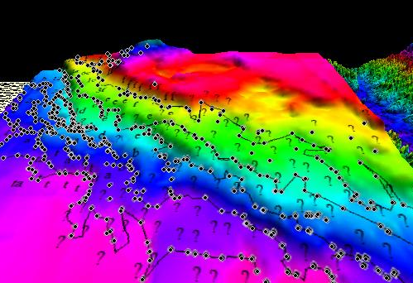
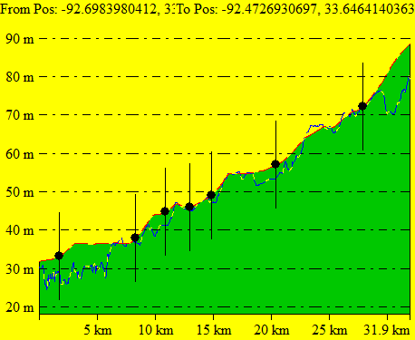
Methods II:
Delineating terrace boundaries from envelope map
Transverse Profile C (map-view)
Transverse Profile C
Ouachita River
3. Once the general trend of terraces is understood these are checked against profiles of terrace riser and tread geometries and aerial extents. Connecting this point data outlines the terrace boundaries.
100x vert. exagg.
2. Transverse Profile C Example of delineating terrace boundaries from scarp/riser tread geometries

Slide 17
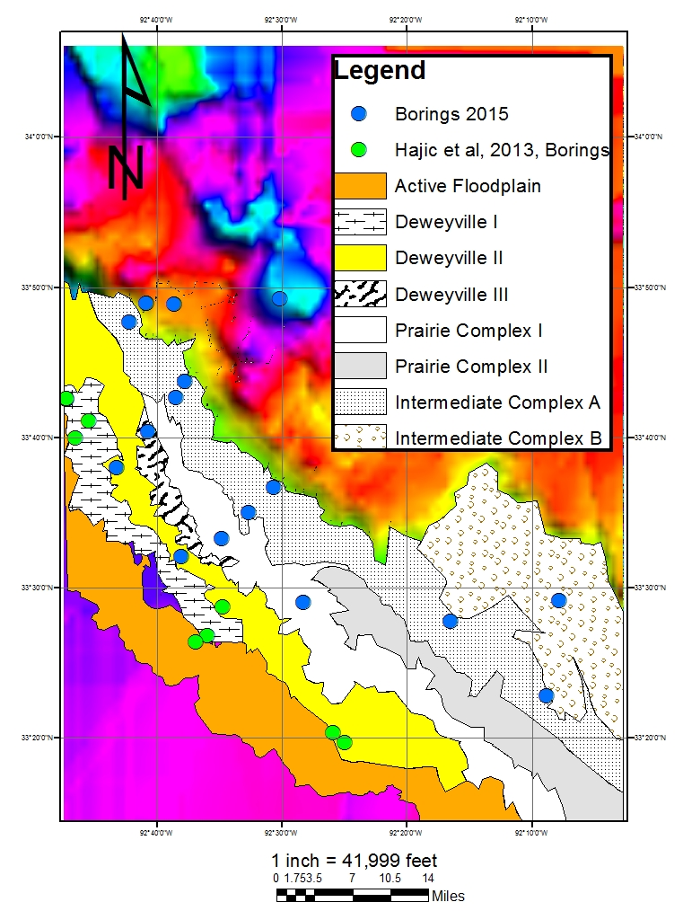
Terraces
of the Ouachita River Valley
Valley delineated from Residual Topographic Envelope Map of Ridges using Kriging method.
Terrace Riser and tread geometries were identified in cross-section.
B
A
Ouachita River

Slide 18
Methods III
Extract individual terraces
Converted lat/long to meters in excel.
Find a best fit plane using polynomial regression modelling (This is the retro-deformed terrace)
Measure differences between best fit plane and terrace in its current geometry by calculating residuals. (This will give a residual. A positive residual will rise above the best fit plane and a negative residual will occur where the current terrace declines in elevation below this best fit plane)
R² Values reflect the confidence of the best fit planes. R² values with ≥ 0.80 were determined to have a high confidence. Planes below reflect highest confidence in R² values. Terraces with high confidence were used for modelling.

Slide 19

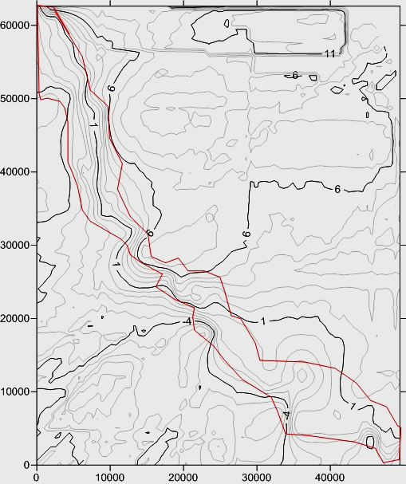
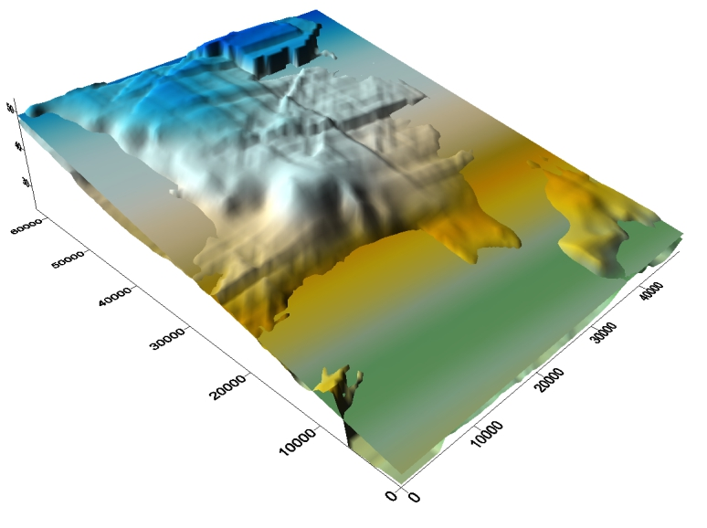
Deweyville Complex II
(Lacustrine Beach Bench Terrace of Wisconsin Lake Monroe. R² = 0.843990173892)
N
-4
N
6
1
Trend of positive residuals
Trend of negative residual
values
-4
Trend of positive residuals
Value
Trend of negative residua
Value

Slide 20
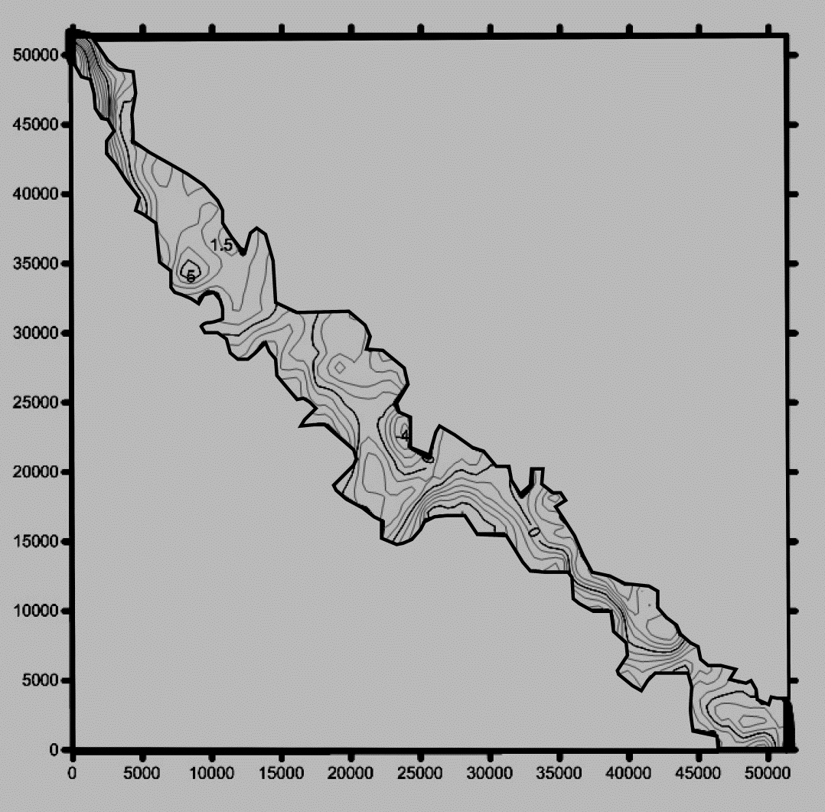
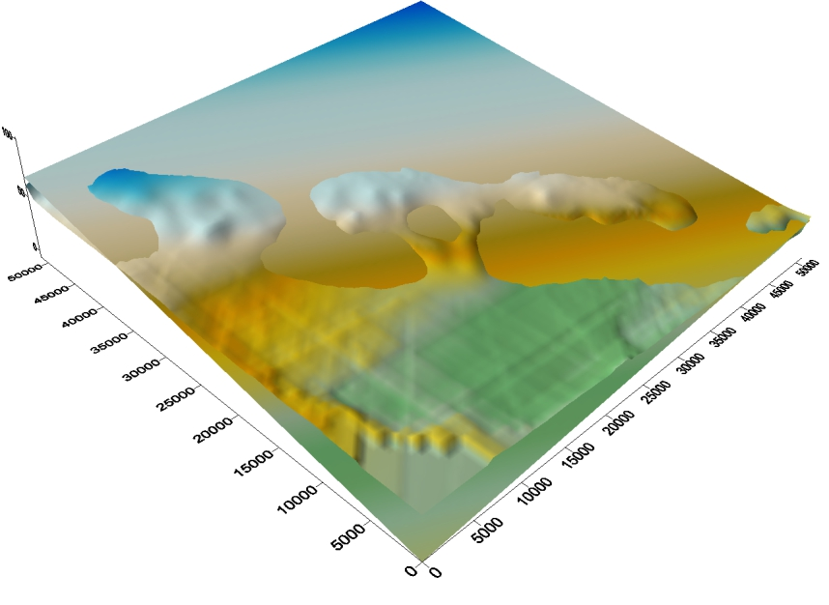
Prairie Complex I
(Typically amorphous riser and tread geometry. Created during mid-late Sangamon during maximum valley alluviation in aged. Saucier Fleetwood (1970) argued for the possibility of differentiation. R² = 0.91724333585).
N
N
0
0
0
Trend of positive residuals
Trend of negative residual
values
Trend of positive residuals
Value
Trend of negative residua
Value
0

Slide 21
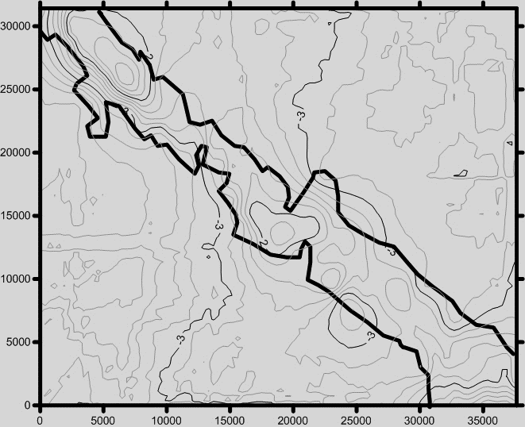
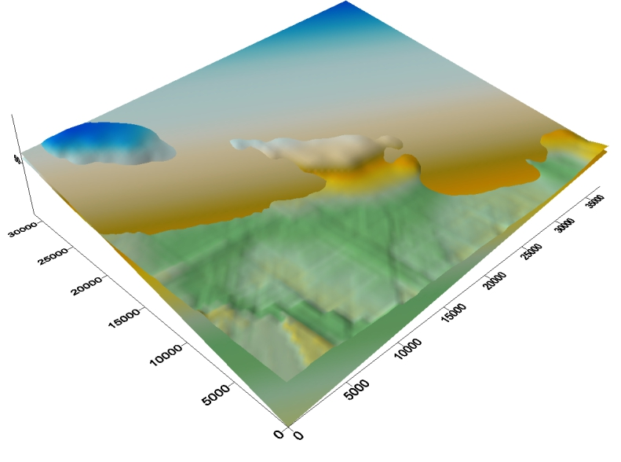
Prairie Complex II
(NEW!!! Saucier Fleetwood (1970) argued for the possibility of differentiation of Prairie Complex Terrace. This is difficult to identify without an envelope map due to the amorphous tread of the Prairie complex terrace. R² = 0.896434405459).
N
2
N
-2
Trend of positive residuals
Trend of negative residual
values
-3
-3
Trend of positive residuals
Value
Trend of negative residua
Value
-3

Slide 22
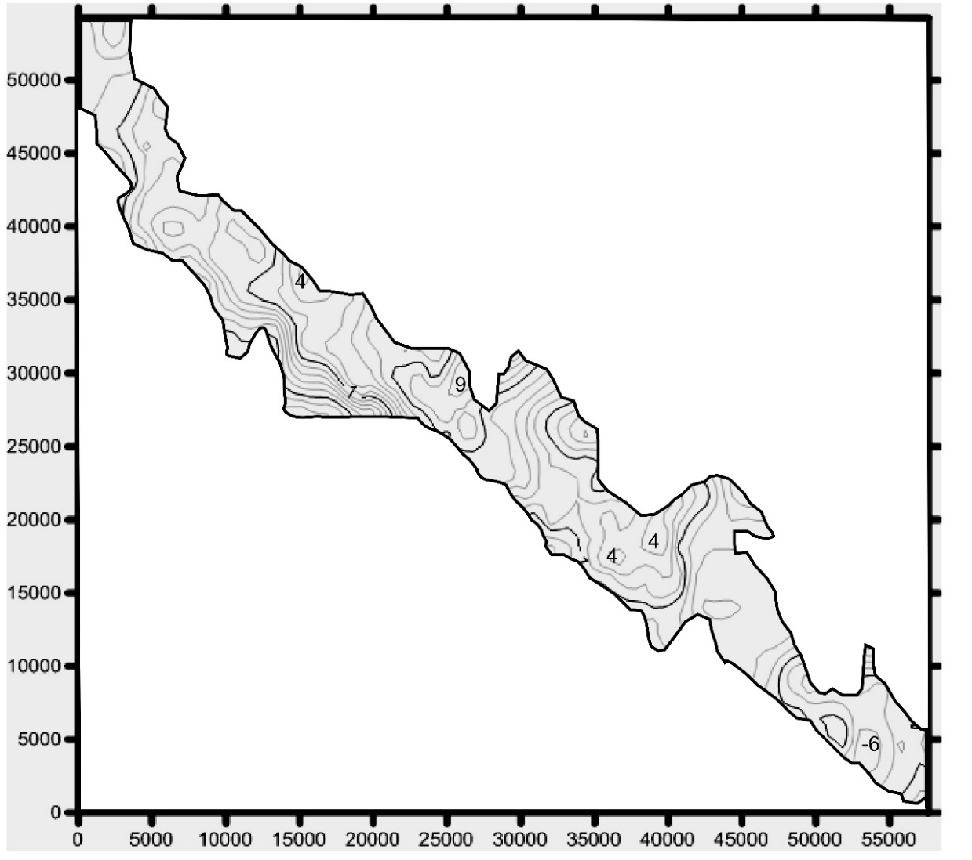
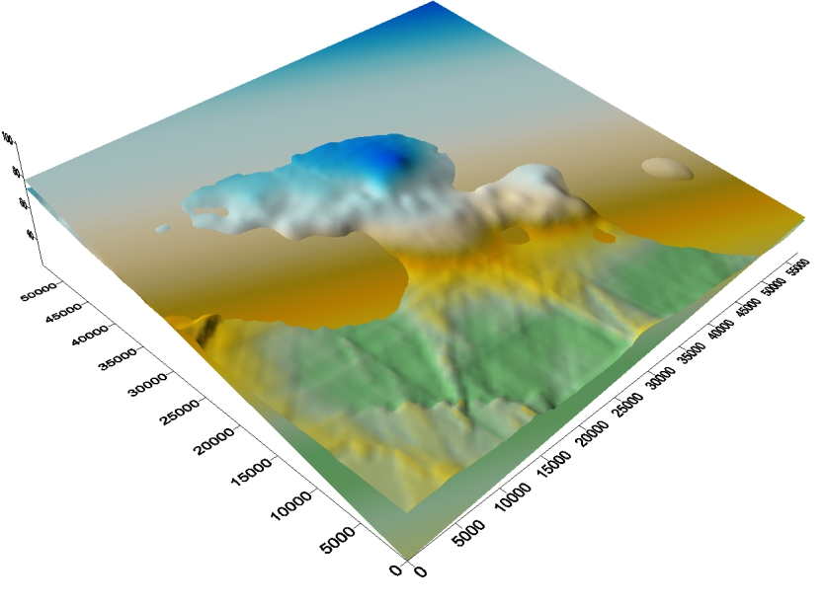
Intermediate Complex B
(Strath Terrace of Upland Complex Gravel/Lafayette Sand and Gravel Mid-Pleistocene, Formerly Montgomery Erosional Terrace)
N
Trend of positive residuals
Trend of negative residual
values
N
Trend of positive residuals
Value
Trend of negative residua
Value

Slide 23
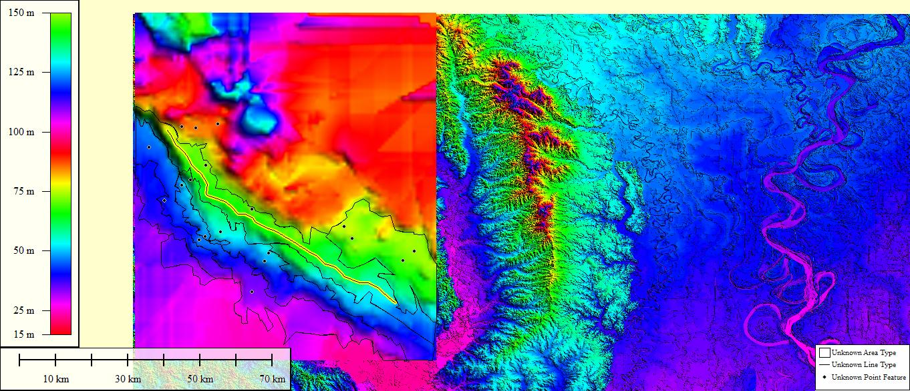
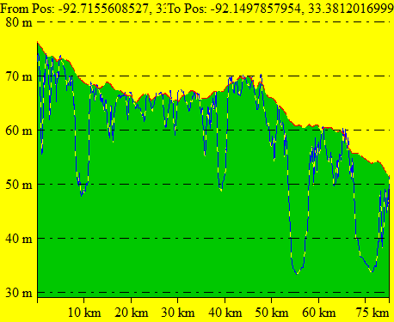
Intermediate Complex B
Longitudinal Profile
Ouachita River

Slide 24
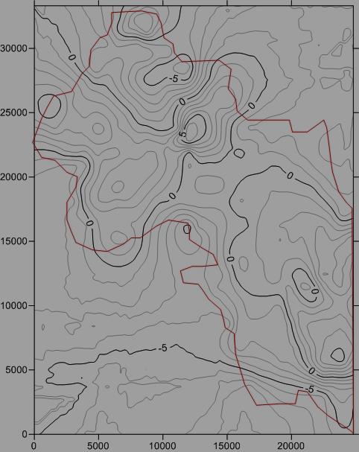
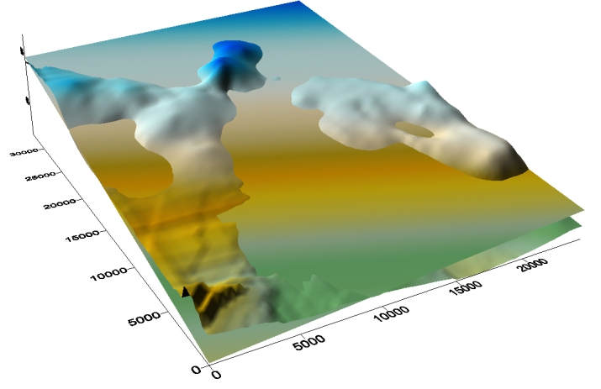
Intermediate Complex A
(Strath terrace of Upland Complex Gravel/Lafayette Sand and Gravel. Formerly known as Bentley Erosional terrace)
-5
N
Trend of positive residuals
Value
Trend of negative residua
Value
Trend of positive residuals
Trend of negative residual
values
N

Slide 25

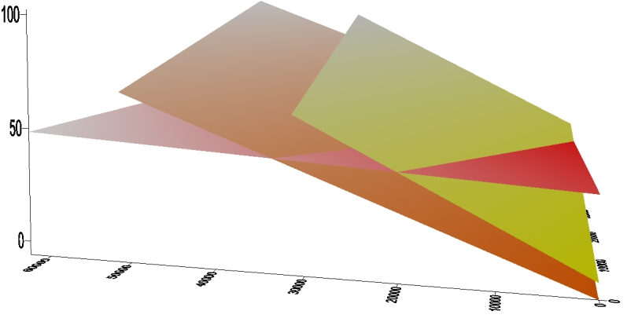
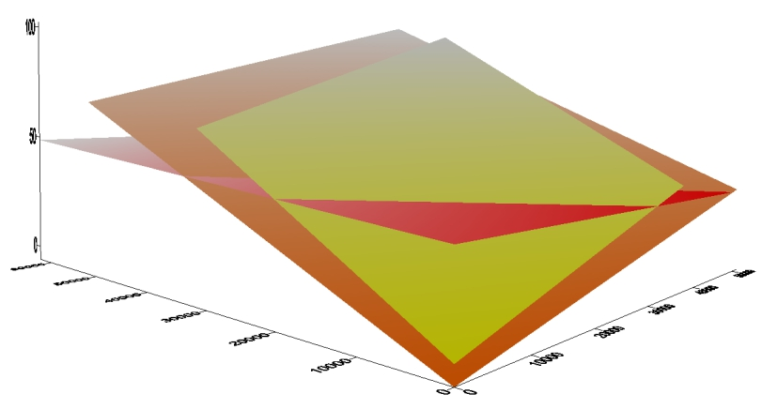
Ouachita River Valley Terraces Best-fit Planes compared
(Terraces with high R² values shown in relationship to age. Progressive southwestward tilting is apparent over time.)
N
N
2
2
1 (Oldest)
1 (Oldest)
3
3
3 = (Youngest) Deweyville II 096 °; 0.021° SW
2 = Prairie I
115°; 0.092° SW
1= (Oldest) Prairie II
116°; 0.229° SW
3 = (Youngest) Deweyville II 096 °; 0.021° SW
2 = Prairie I
115°; 0.092° SW
1= (Oldest) Prairie II
116°; 0.229° SW

Slide 26
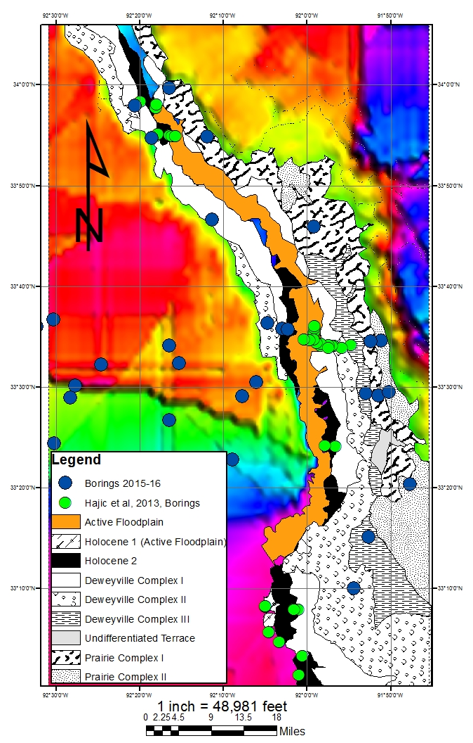
Terraces
of the Saline River Valley
Valley delineated from Residual Topographic Envelope Map of Ridges using Kriging method.
Terrace Riser and tread geometries were identified in cross-section.

Slide 27
Discussion
Ouachita terraces may have experienced tectonic deformation or erosional beveling
To test which has occurred borings will be gathered from the edge of terrace margins to study soil development
Less developed soils may have been erosionally beveled. Well developed soils may have experienced tectonism.

Slide 28
Summary
Preliminary modeling indicates some trends within the landscape in the Ouachita River Valley may have experienced tectonic influences.
Best fit planes appear to be progressively tilting to the southwest.
Some older terraces appear to be more tilted than younger terraces. This becomes most apparent in longitudinal profiles of the Deweyville Complex and Prairie Complex Terraces in the Ouachita River Valley.
Work is ongoing in the Saline River Valley.

Slide 29
Acknowledgements
Dr. Don Bragg
U.S. Forestry Department
Dr. Mitch Withers
David Steiner
Chris McGouldrich
Ed Hajic
Dr. Roy Van Arsdale
Center for Earthquake Research and Information
GSA

