Slide 1

Deep Earthquakes Spatial Distribution: Numerical Modeling of Stresses within the Subducting Lithosphere
Prasanna Gunawardana
Advisor - Dr. Gabriele Morra
Department of Physics

Slide 2
Earthquake Distribution with the depth
Earthquakes hypocenters have been detected from the surface to the maximum depth of 650km to 700km
Hypocenters form a 2D surface zone (“Wadati-Benioff”) within subducting slabs (Isacks & Molnar 1971)
It appears that there are no earthquakes in the lower mantle (Stark & Frohlich 1985)

Slide 3
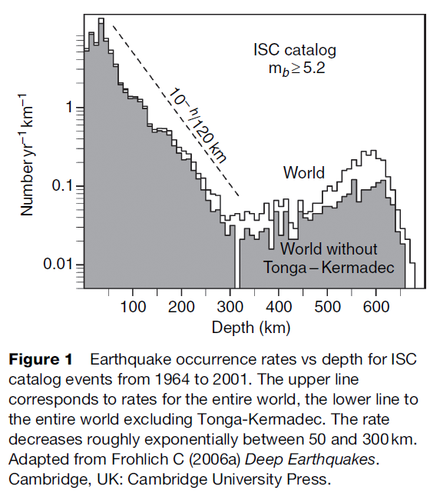
Bi-model Nature of the earthquake Distribution
Long-time interest in the bi-model distribution of earthquake hypocenter depth
Frequency vs depth :
  50 to 300 km -> exponential decay
  300 to 450 km -> low level plateau (Heidi Houston, 2007)
  450 to 650 km -> increase (Frohlich, 2006)
(Houston H. 2007)

Slide 4

Visco-Elastic Nature
Solid materials are generally "visco-elastic.“
Transition time (“Maxwell Time”, $T_{m}$) = Shear Viscosity/Shear Modulus.
$T_{m}(upper mantle)= {{10}^{22}}/{{10}^{11}}={10}^{11}$ seconds ~ 3,000 years.
$T_{m}\left(lithosphere\right)=300Kyrs to 3Myrs$
On geological timescales subduction process takes~10 Myrs >> $T_{m}$
Viscous approximation holds.

Slide 5
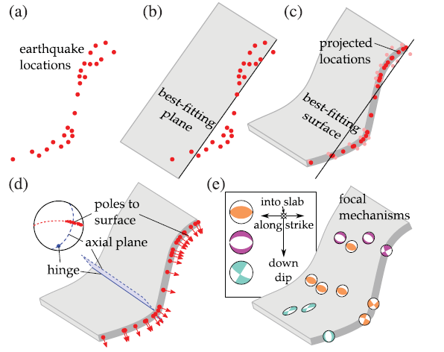
Why we look at the stresses and the Elastic energy
(Myhill, 2012)
Earthquake activity: a source of stress and a material that can experience unstable strain localization.
Stress due to a single earthquake -> not enough information for viscous deformation.
Need to explore stresses and stored elastic energy distribution in subducting lithosphere.

Slide 6
Methodology

Slide 7


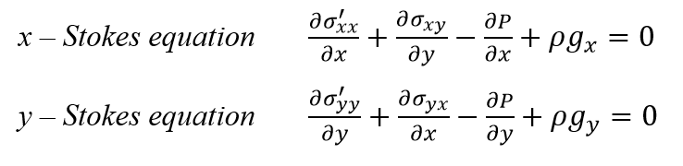



Governing equations
Incompressibility continuity equation
Stokes Equation for slow flow(2D)
Strain rate, stress and energy

Slide 8
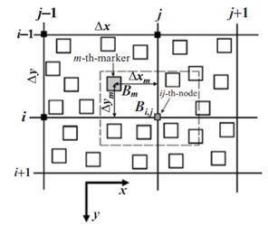



Applying Marker in cell method with the finite different scheme
(Tars Gerya 2003)
Bi,j – Physical property (density or viscosity) of the ij ^{th} node of the lattice
Bm – Physical property (density or viscosity) of the m ^{th} marker
Wm - statistical weight of the m ^{th} marker at the ij ^{th} node
Rm
Xm and Ym are the distances from the m ^{th} marker to the ij ^{th}-node

Slide 9
Work Flow of the Algorithm
1) Create the initial matrix (Lattice)
2) Insert particles
3) Initialize particles: density and viscosity values
4) Particle density and viscosity are projected to the Lattice
8) Advect particles: 2nd order Runge -Kutta scheme
7) Project velocities and pressure to the particles
6) Find strain rate and the stress
5) Solve the Continuity and Stokes equations to find the shear velocities and the pressure in the lattice
9) Find new density and viscosity of particles
10) Project particle density and viscosity back to the lattice
11) Solve the Continuity and Stokes equations again

Slide 10
Benchmarks to verify the Model

Slide 11
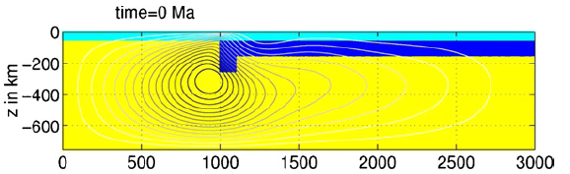
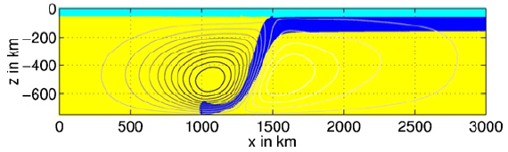
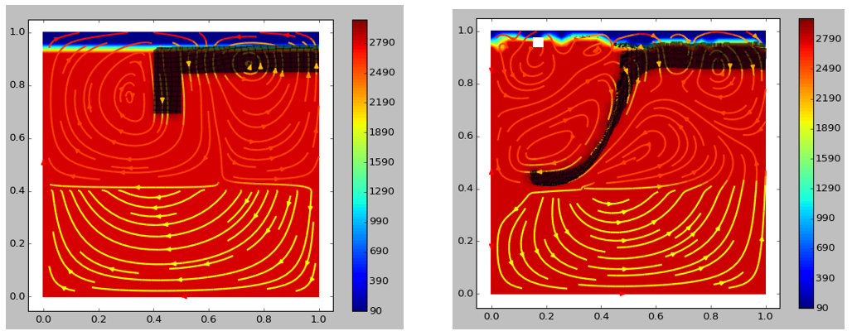
Schmeling H. 2008 Model comparison

Slide 12
New Results
1) Modified Schemling H. 2008 model
2) Slab stagnation at 520km to 670km depth
3) Stress implementation in subducting lithosphere
4) Stored elastic energy distribution in subducting lithosphere

Slide 13
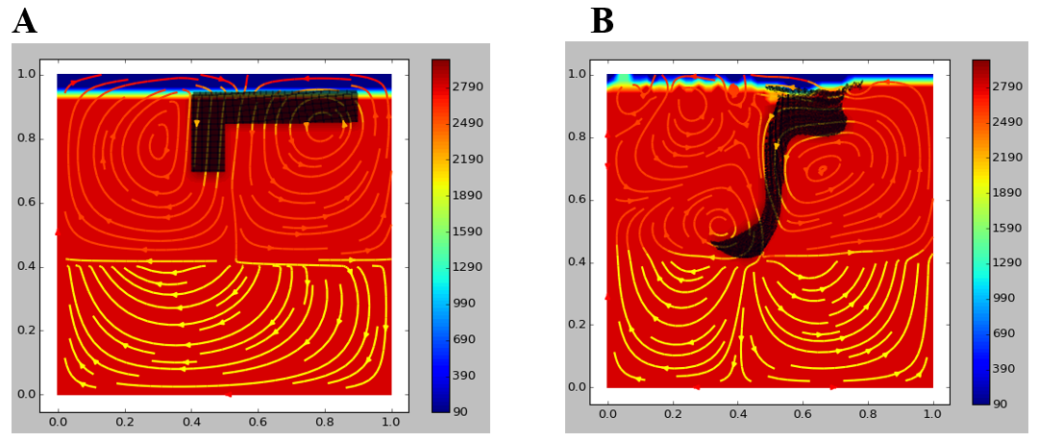
Modified Schemling H. Model

Slide 14
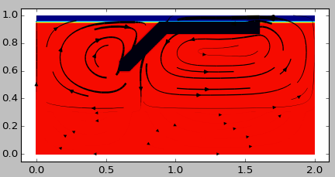
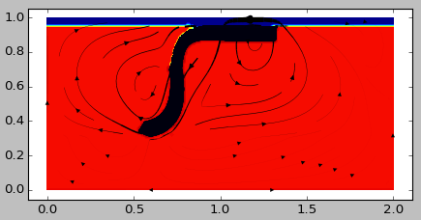
Slab stagnation At 520km to 670km depth

Slide 15
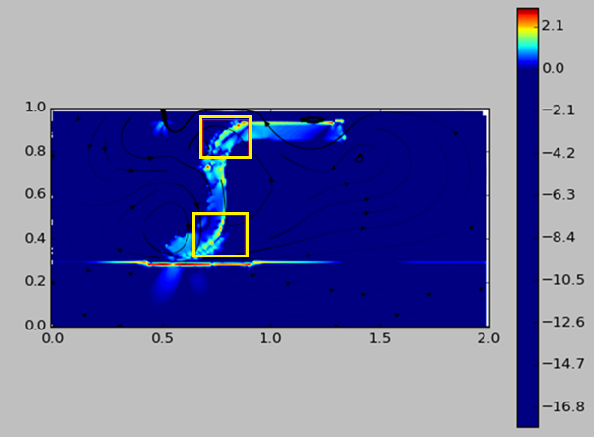
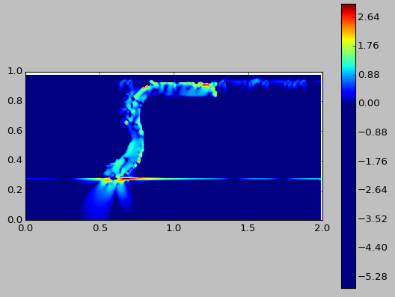




Stress Implementation
#Viscosity
$$ɳ_{OceanicLayer}=1×{10}^{3}$$
$$ɳ_{UpperMantle}=1×{10}^{4}$$
$$ɳ_{LowerMantle}=1×{10}^{7}$$
#Density
$$ρ_{Mantle}=2800.0$$
$$ρ_{Lithosphere}=3000.0$$
$$ρ_{OceanicLayer}=1000.0$$
$$ɳ_{Litho}=2×{10}^{6}$$
$$ɳ_{Litho}=6×{10}^{6}$$

Slide 16
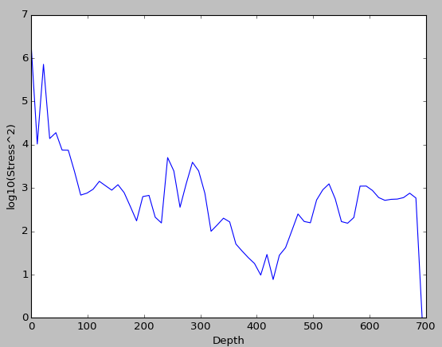
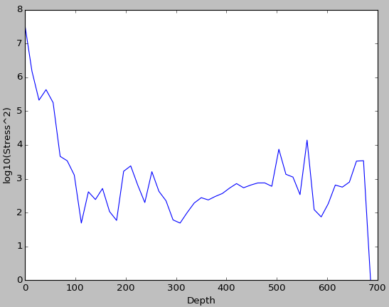
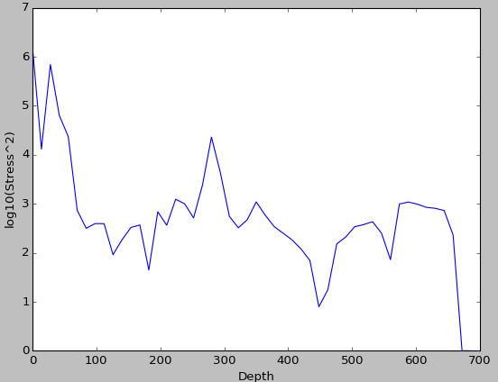


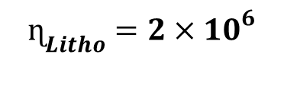
Stored Elastic Energy Distribution
$$ɳ_{Litho}=2×{10}^{6}$$
$$ɳ_{Litho}=18×{10}^{6}$$
$$ɳ_{Litho}=6×{10}^{6}$$

Slide 17
Future works
Implementation of the Subducting Lithosphere with a Stiff core to reduce the noises
Effect of Wadsleyite layer on the Subduction process
Implementation of the model in 3D

Slide 18
Conclusion
Earthquakes distribution with the depth
Deep earthquakes cannot be explained using brittle fracturing process
Therefore we need to implement the stress and stored elastic energy distribution in the subducting lithosphere to identify the deep earthquake distribution
Used the ‘Marker-in-Cell Method’ with finite-difference scheme to solve Continuity and Stokes Equations in 2D
Python and Numpy Packages were used
Benchmarked the model using Schemling H. 2008 model
Main results:
  Slab stagnation at the 520km to 650 km depth
  Stress and energy distribution in the subducting lithosphere

Slide 19
References
Frohlich C (2006a)., Deep Earthquakes. Cambridge, UK: Cambridge University Press.
Houston, H., 2007. Deep earthquakes. In: Schubert, G. (Ed.), Treatise on Geophysics, vol.4. Elsevier, pp.321–350.
Isacks, B. & Molnar, P., 1971. Distribution of stresses in the descending lithosphere from a global survey of focal-mechanism solutions of mantleearthquakes, Rev. geophys. Space Phys., 9, 103–174.
Myhill R. 2012., Slab buckling and its effect on the distributions and focal mechanisms of deep-focus earthquakes Schemling H., Kaus B. J. P., Morra G., Schmalholz S. M., 2008, A benchmark comparison of spontaneous subduction models - Towards a free surface.
Schubert G., Romanowics B., Dziewonski A., Treatise on GeoPhysics chapter4.13
Stark, P.B.& Frohlich, C., 1985. The depths of the deepest deep earthquakes, J. geophys. Res., 90, 1859–1870.
Taras V. Gerya , David A. Yuen, 2003, Characteristics-based marker-in-cell method with conservative finite-differences schemes for modeling geological flows with strongly variable transport properties. Physics of the Earth and Planetary Interiors 140 (2003) 293–318

Slide 20
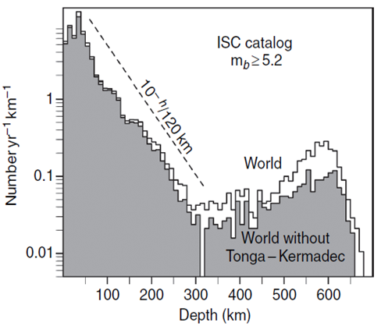
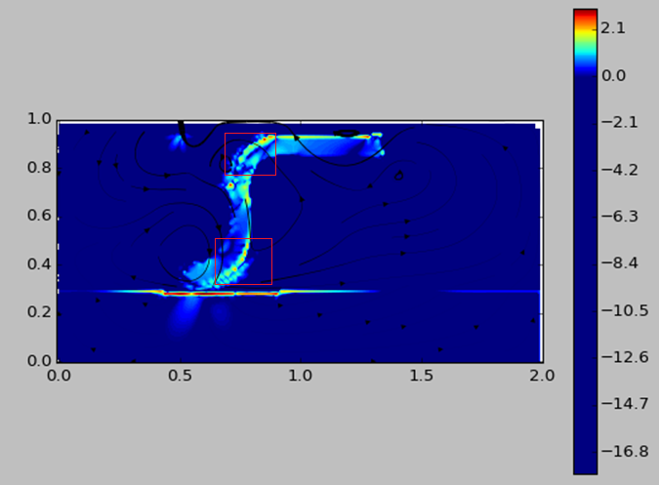
Thank you & Questions?

