Slide 1
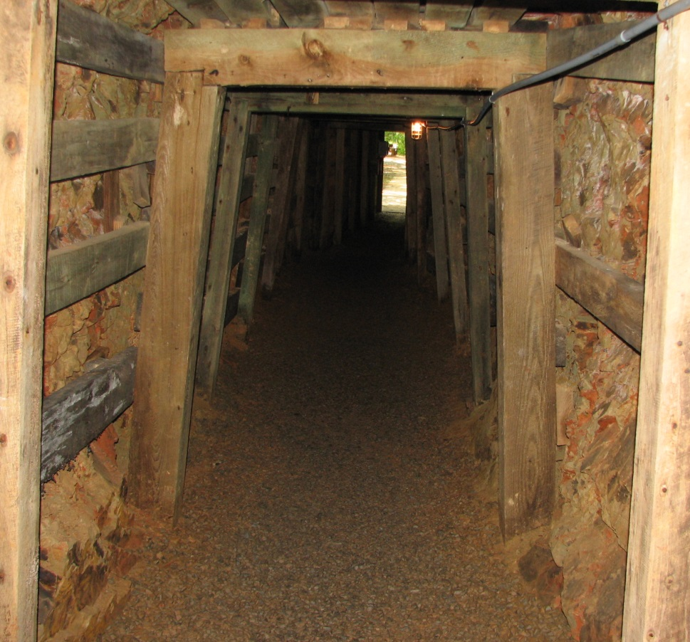
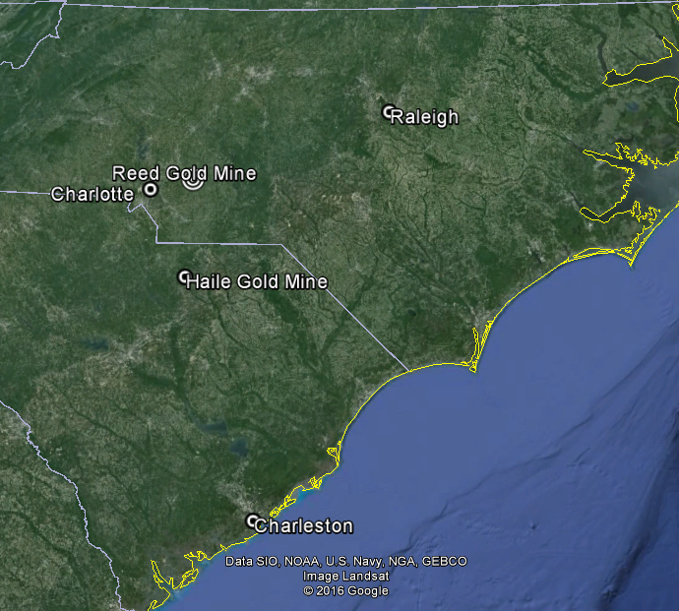
Structural and Regional Setting of the Reed Gold Mine
Stephen Challener and
James Hibbard

Slide 2
Why Now
Gold prices have made Carolina gold economically interesting again
  Repeated inquiries from prospectors
  Reopening of the Haile
Recent research has illuminated regional context (Hibbard et al 2012, Pollock and Hibbard 2010)

Slide 3
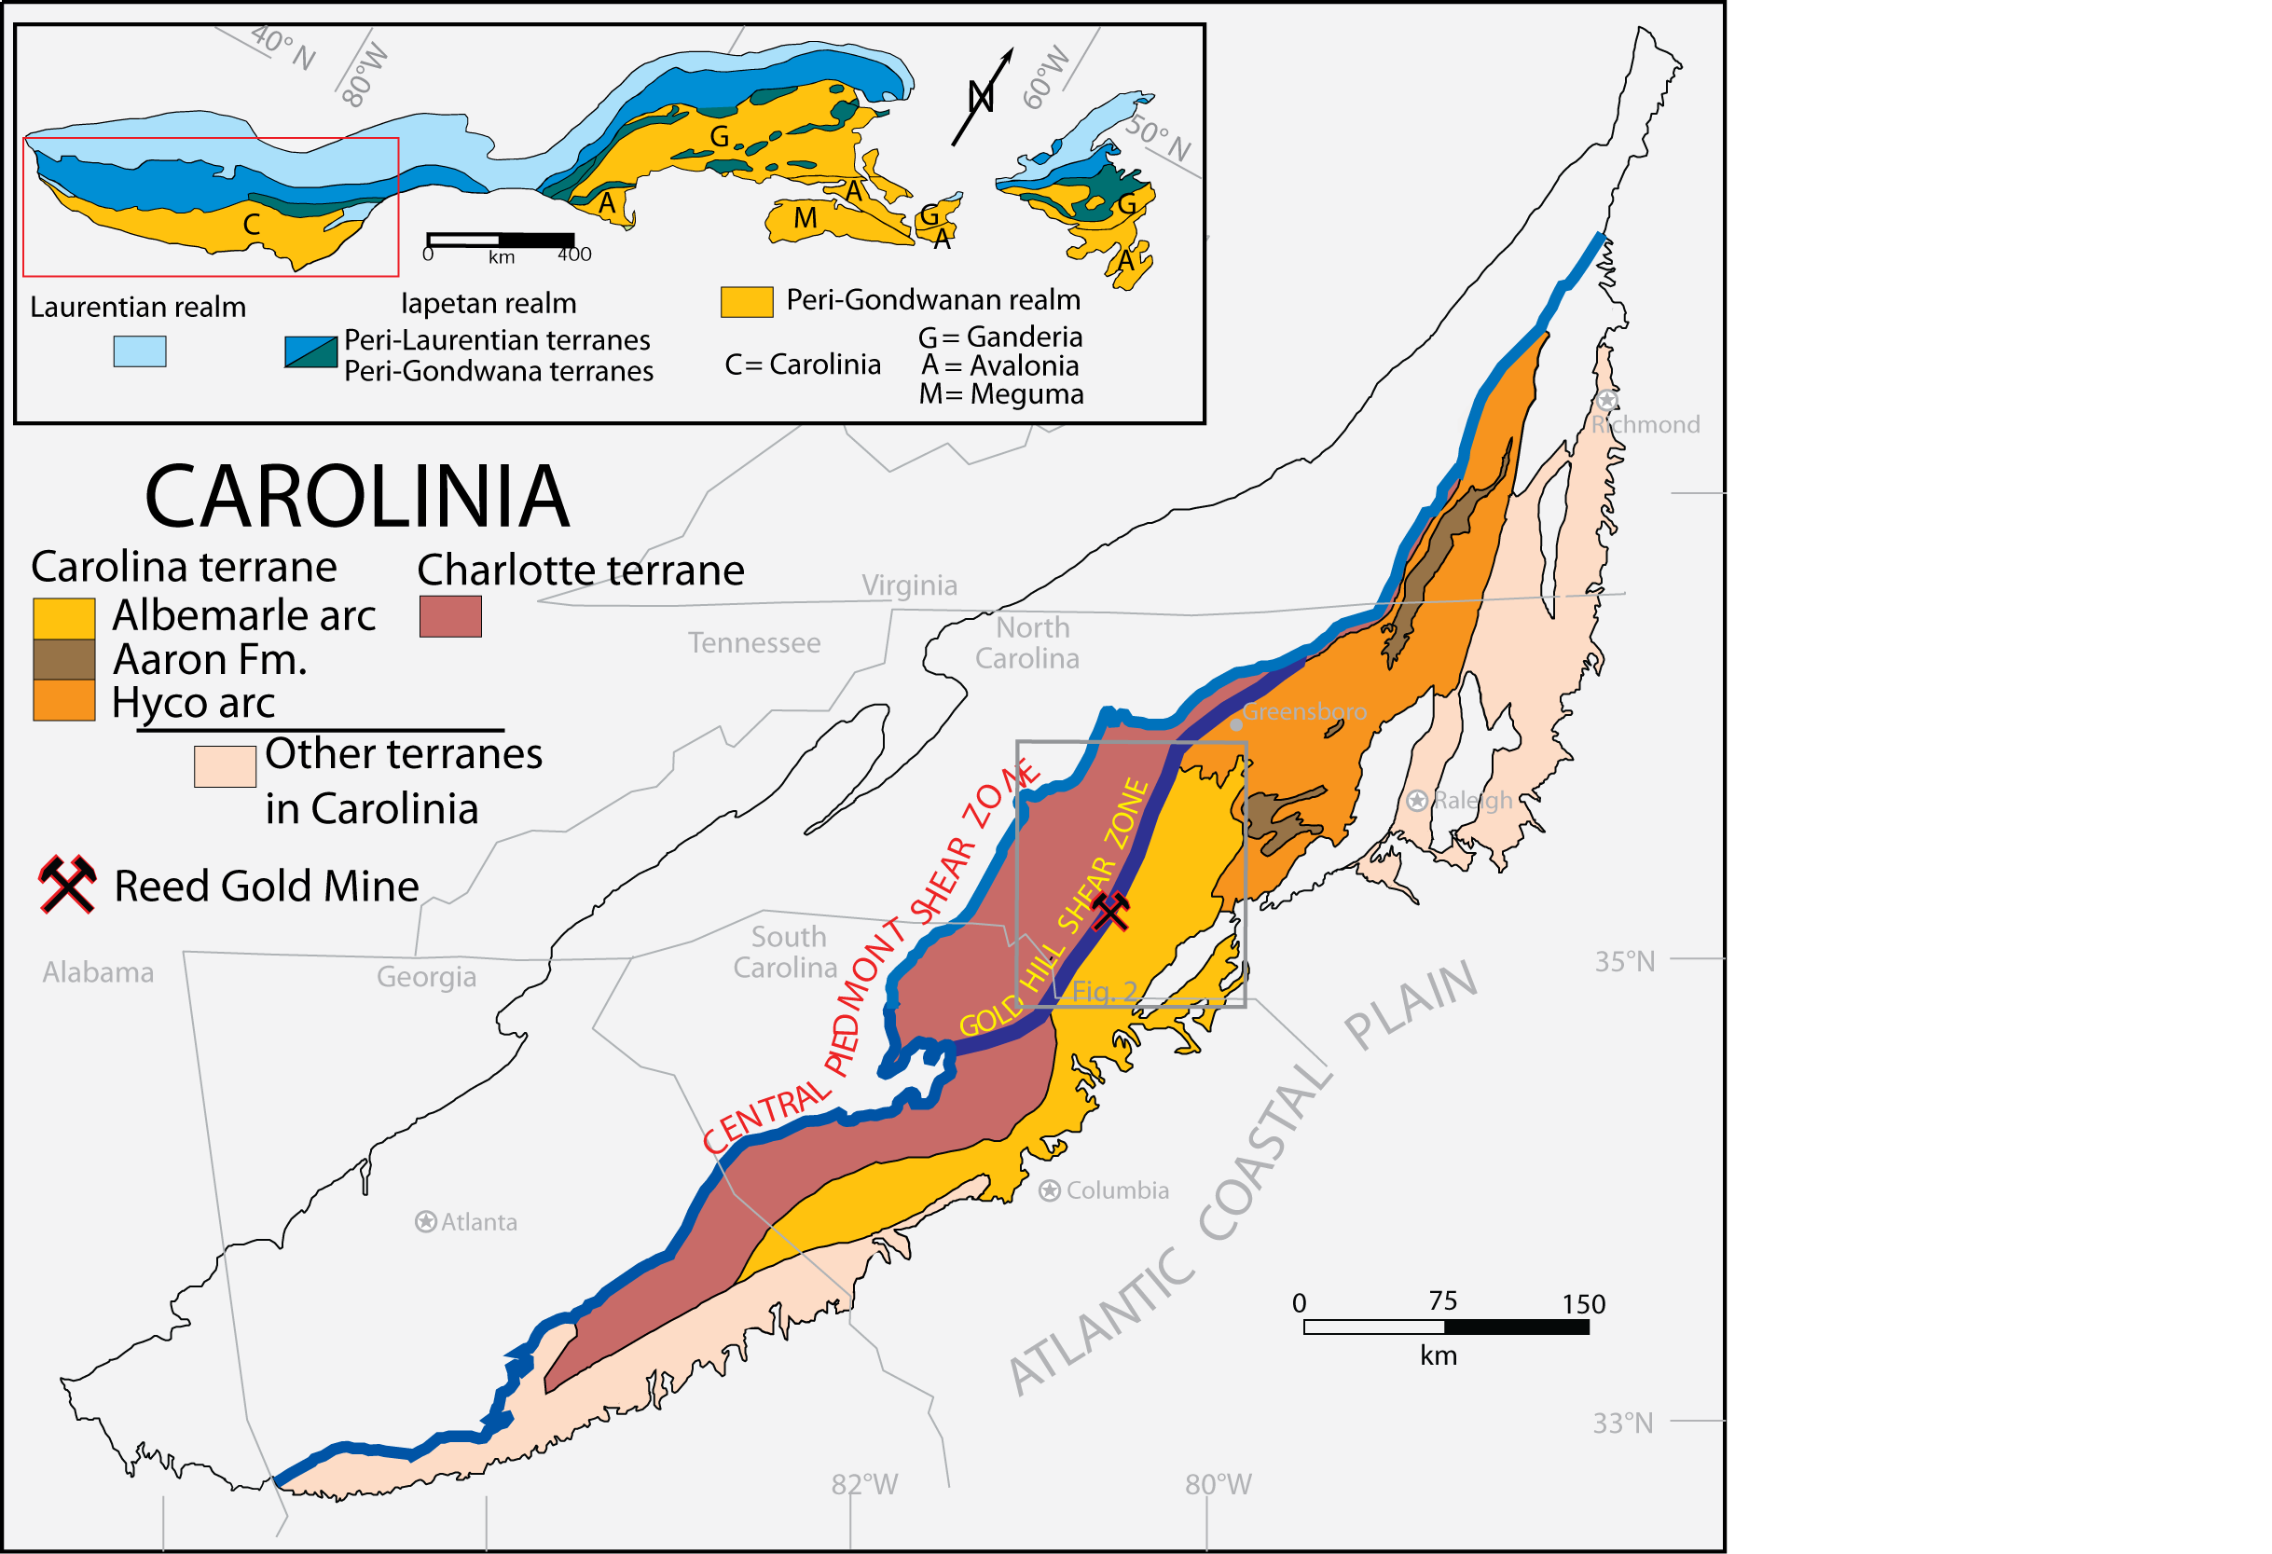
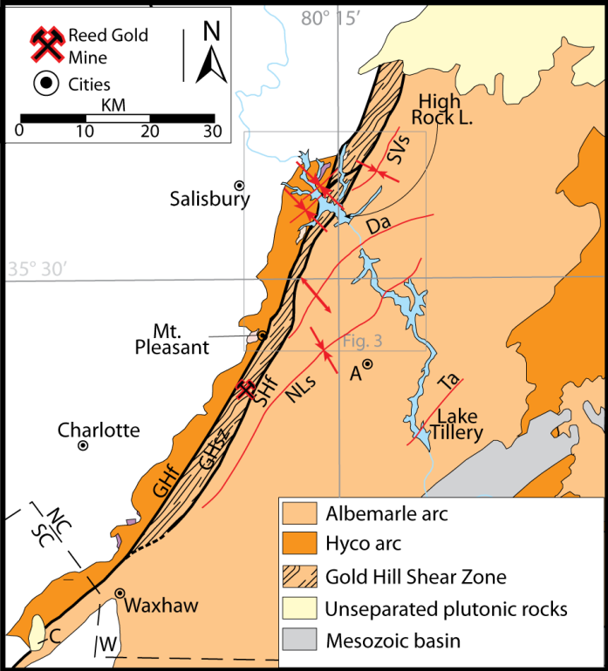

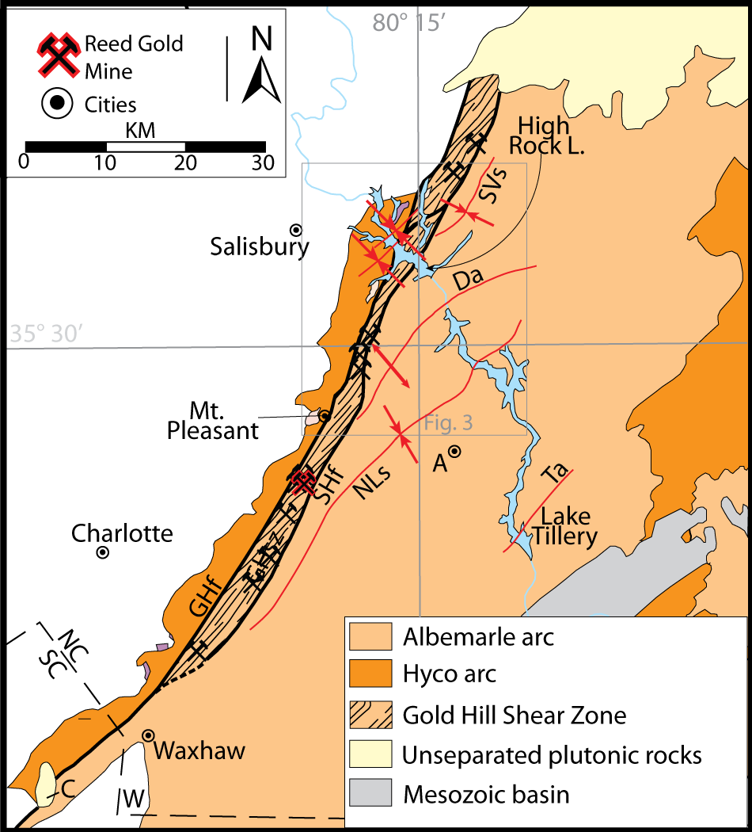
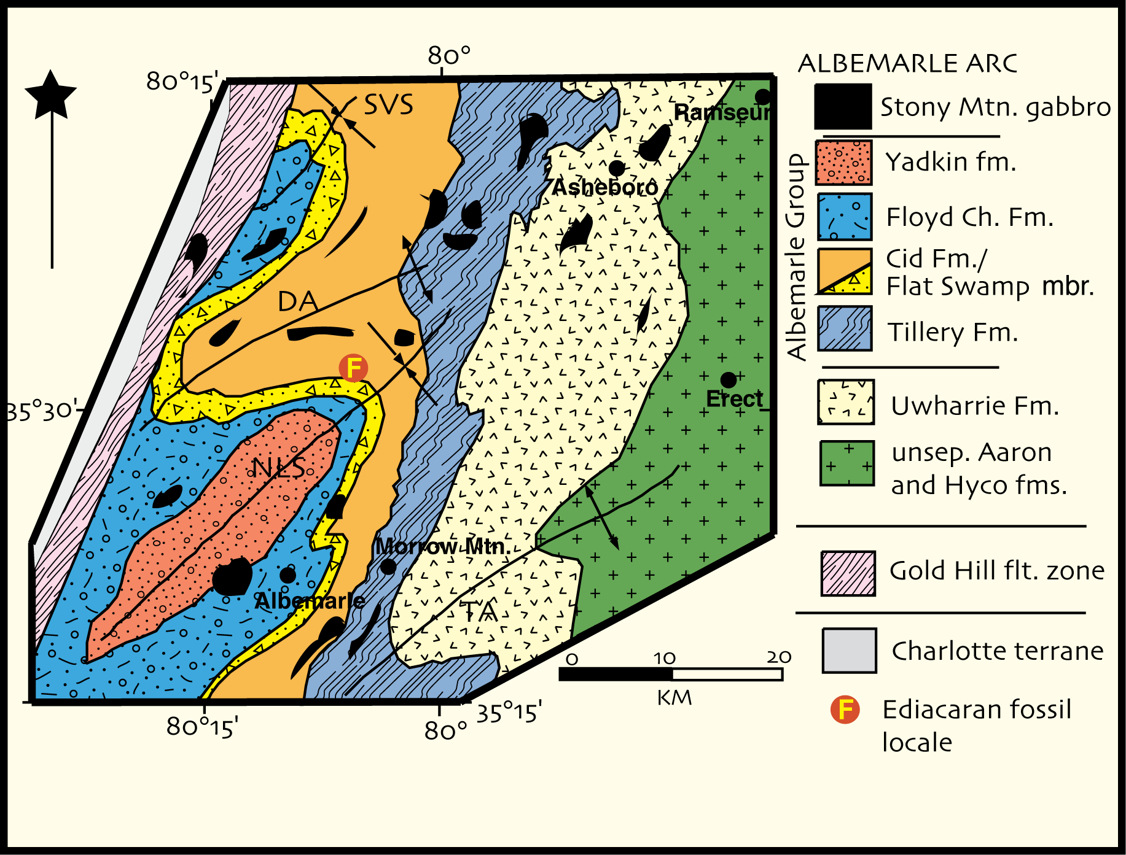
Regional Context
530-550 my
610-630 my
Adapted from Hibbard
et al 2012

Slide 4
What do we want to know?
Source of Mineralizing Fluids
Path for Fluid Mobilization
Nature of Depositional Sink

Slide 5
Understanding the Sink
Structural Geology
Mapping
Geophysics
Geochemistry

Slide 6
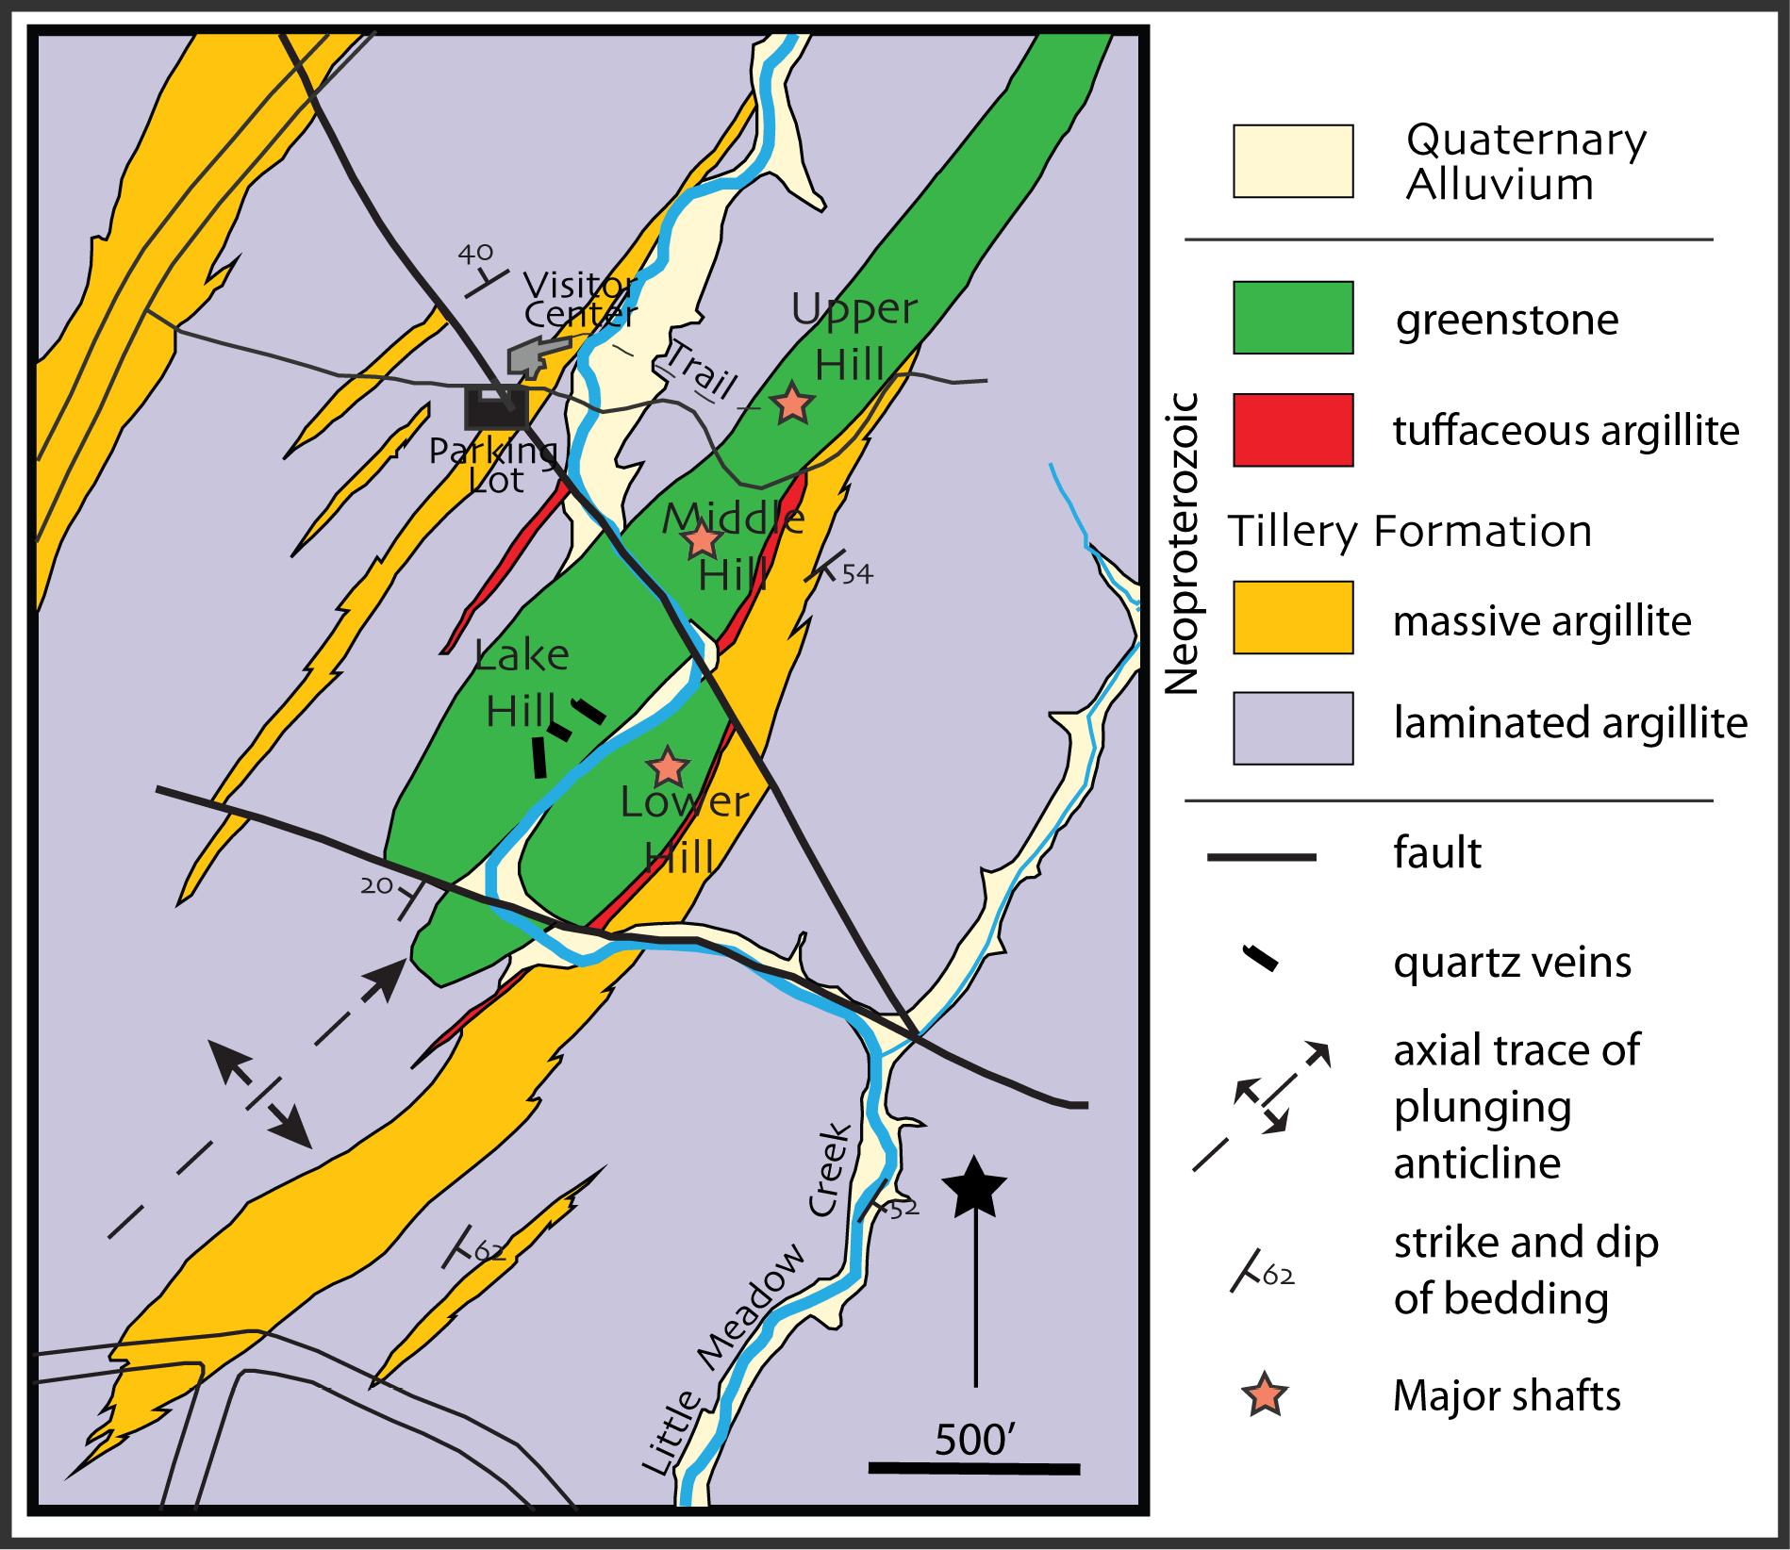

Slide 7
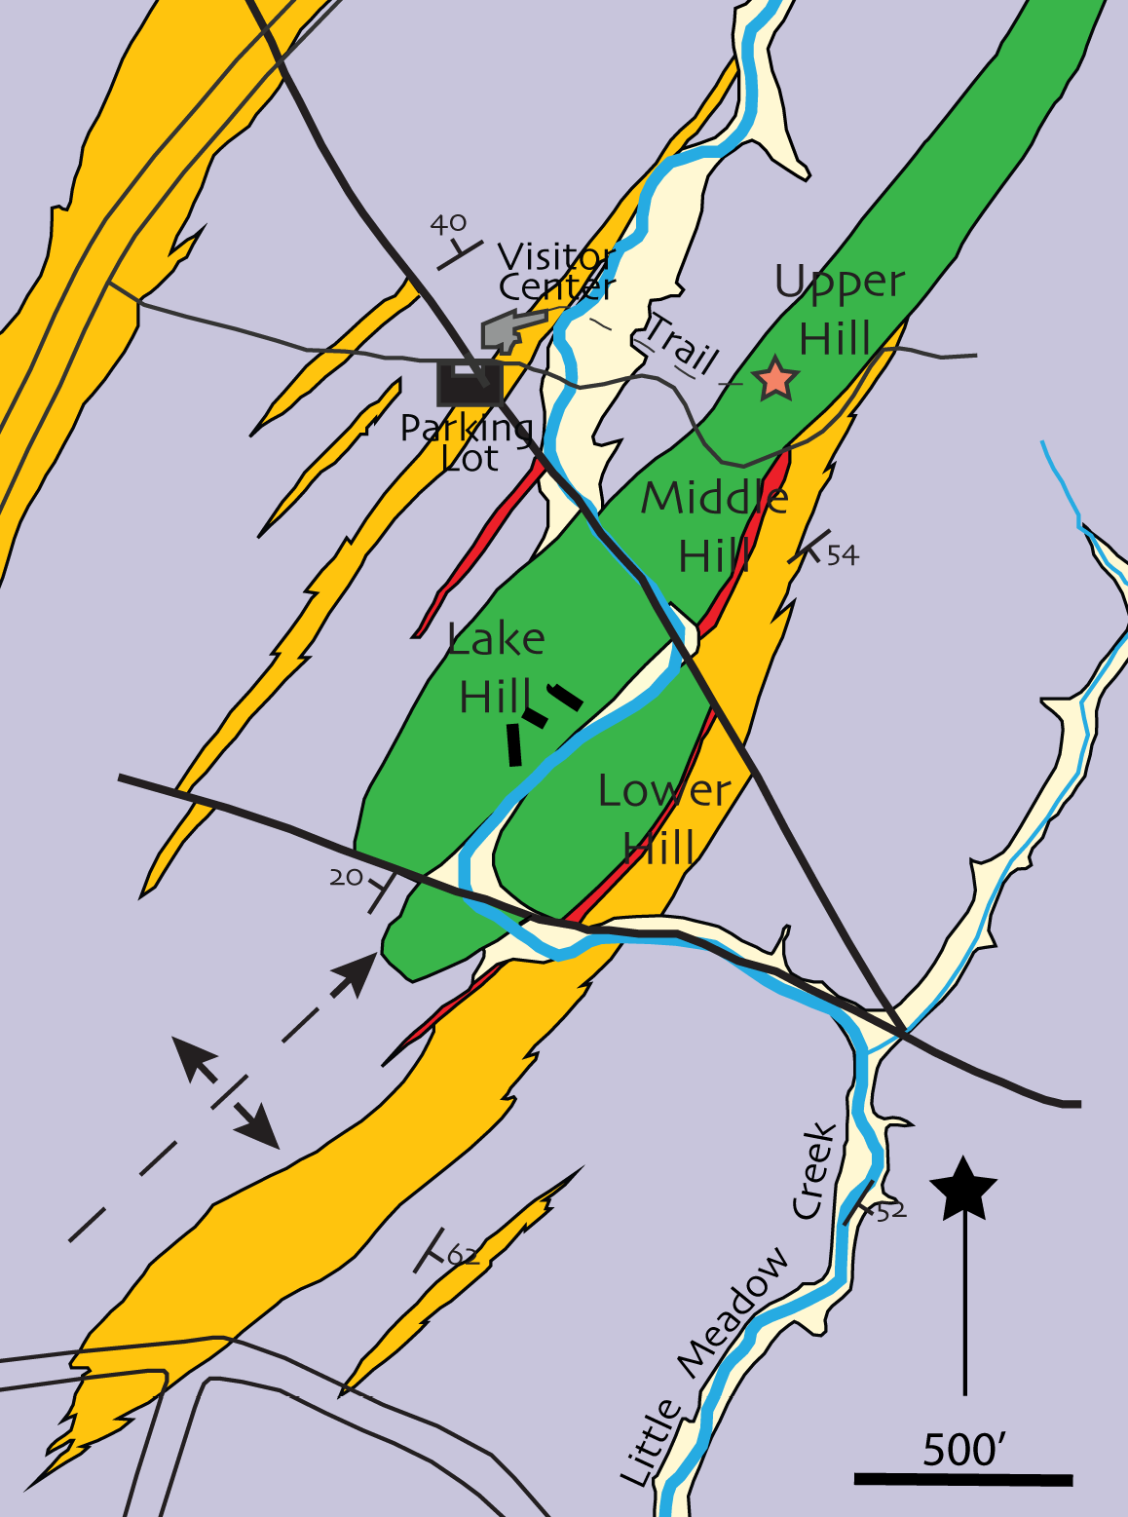
Structural models
Nitze and Hanna 1896
El Samani 1978

Slide 8
Pardee and Park 1948

Slide 9
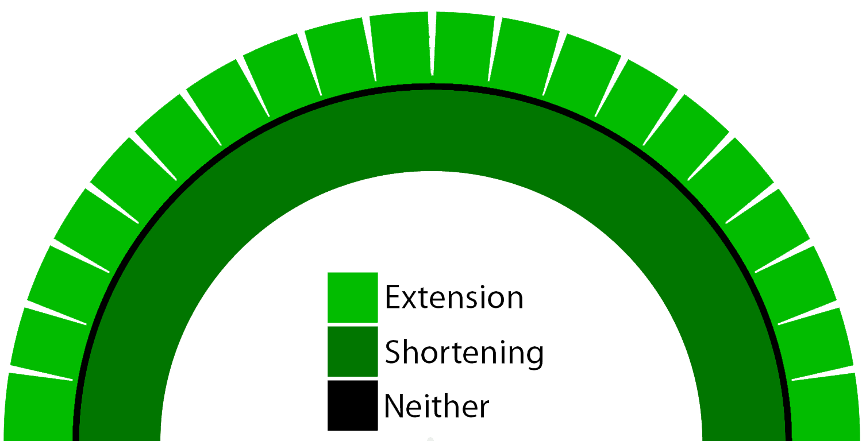
Vein Formation by Neutral Surface Folding

Slide 10
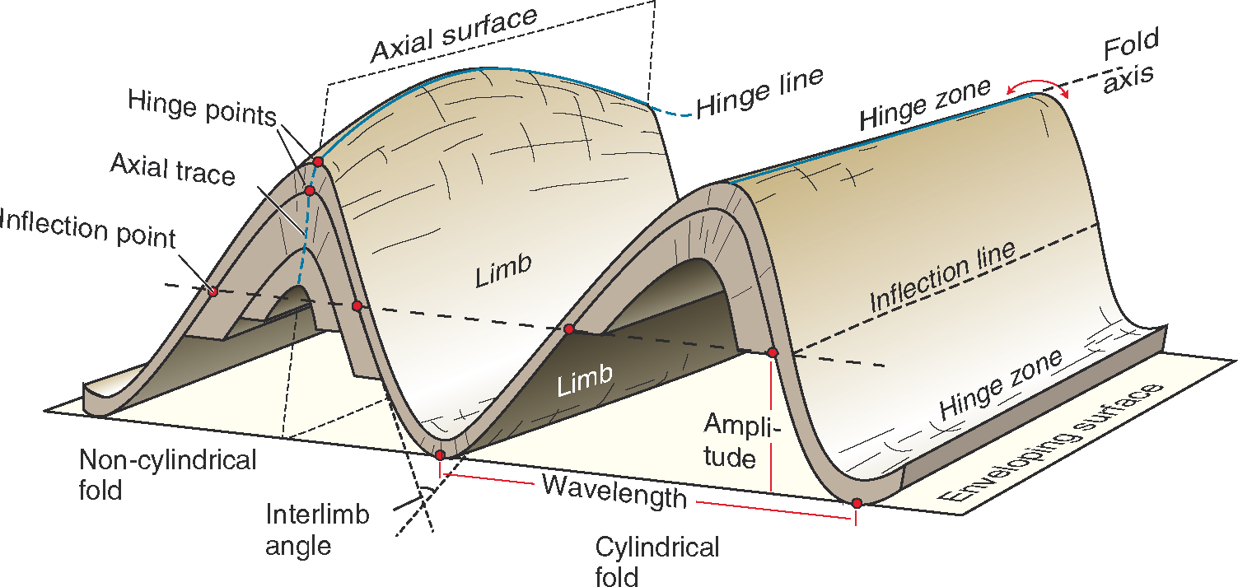
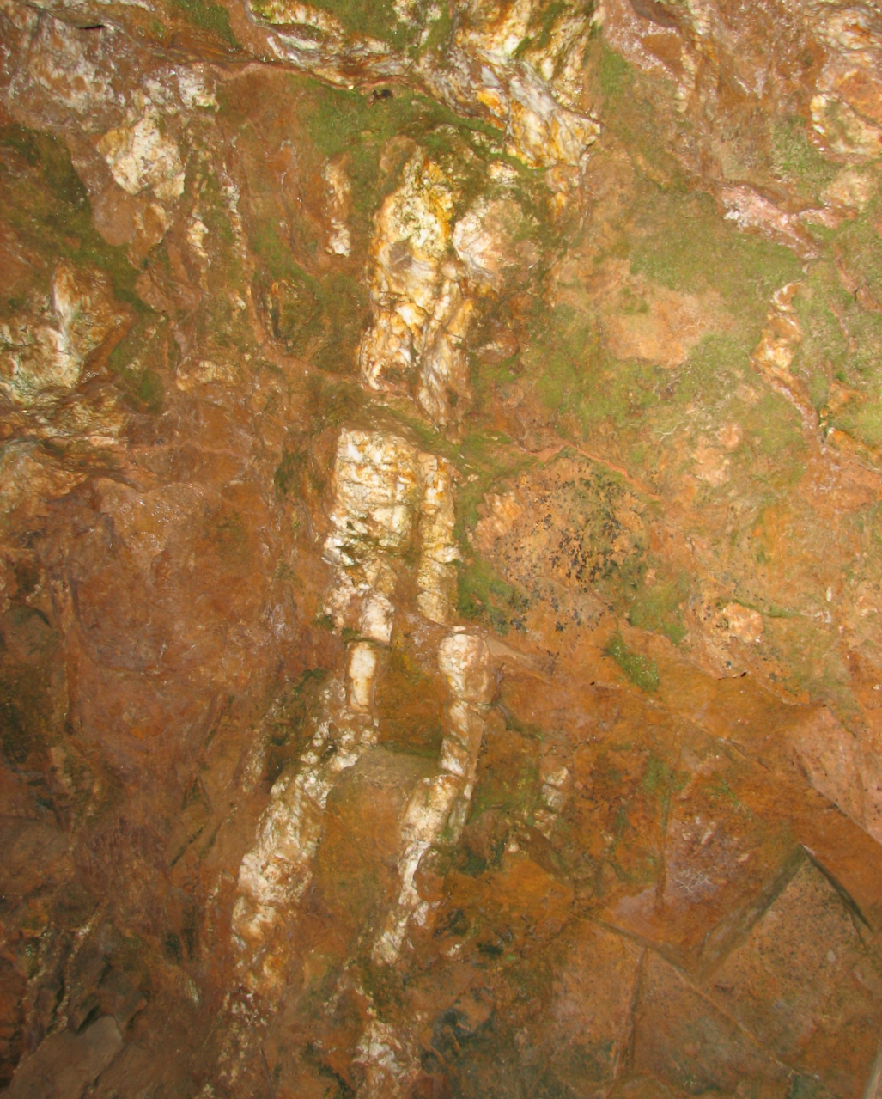
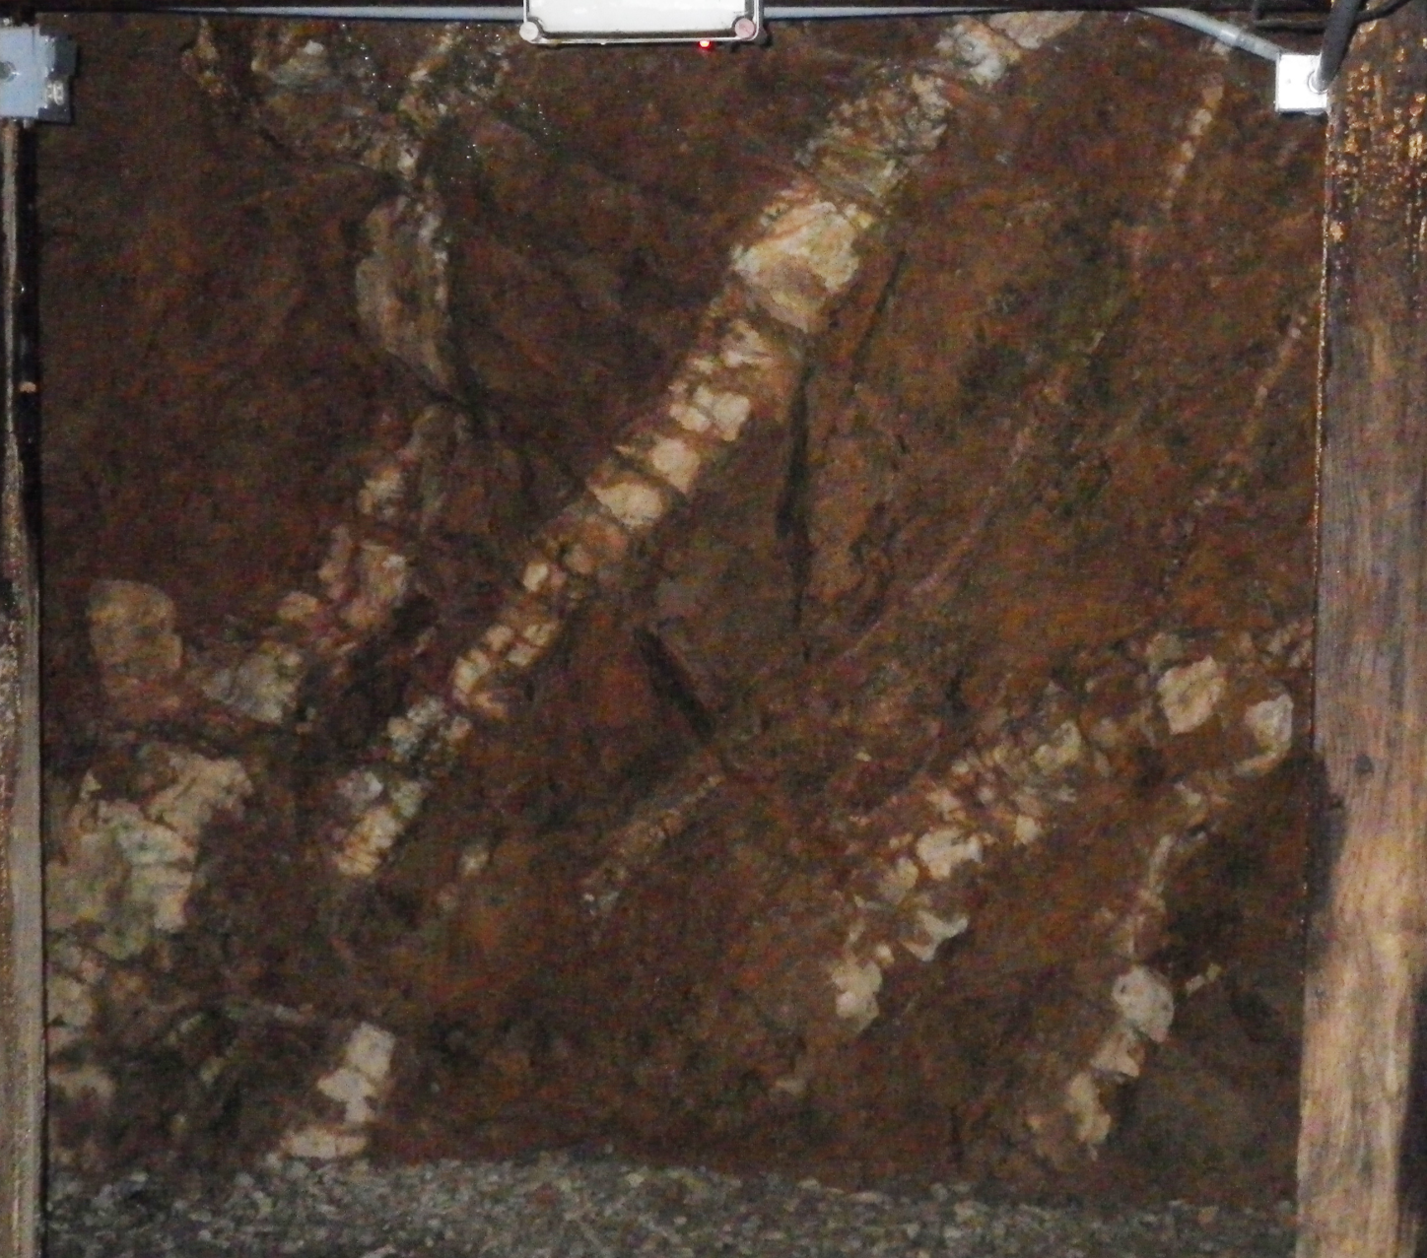
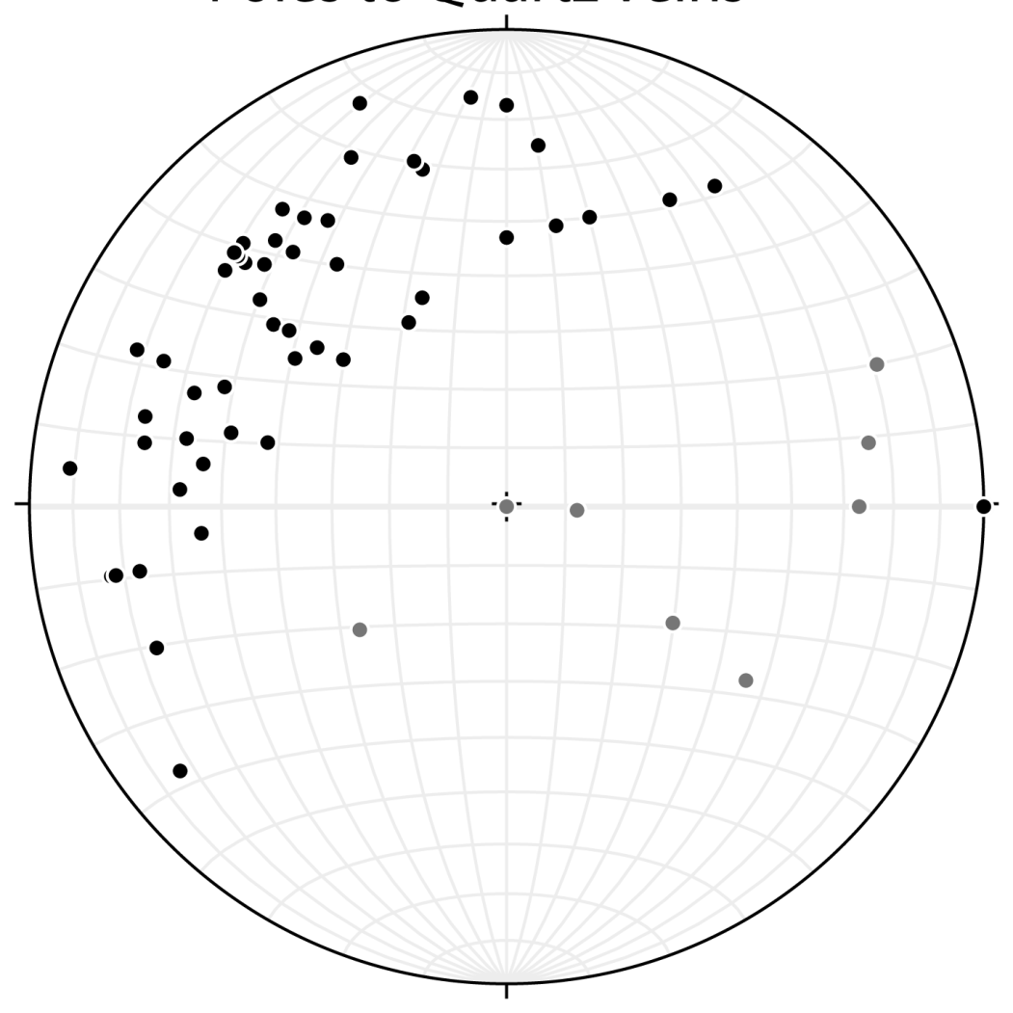
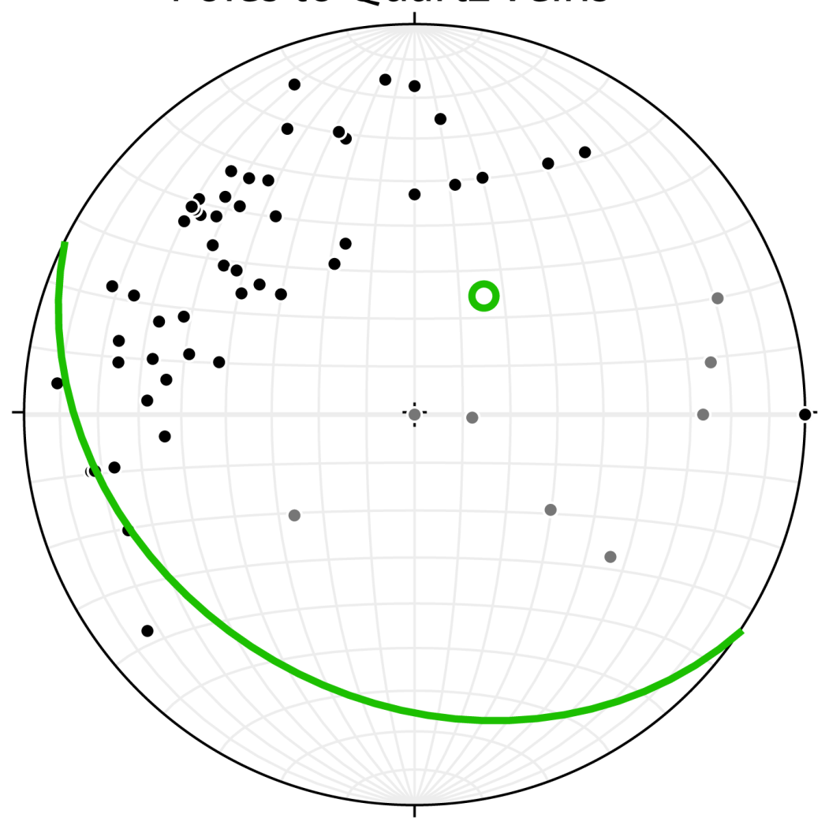
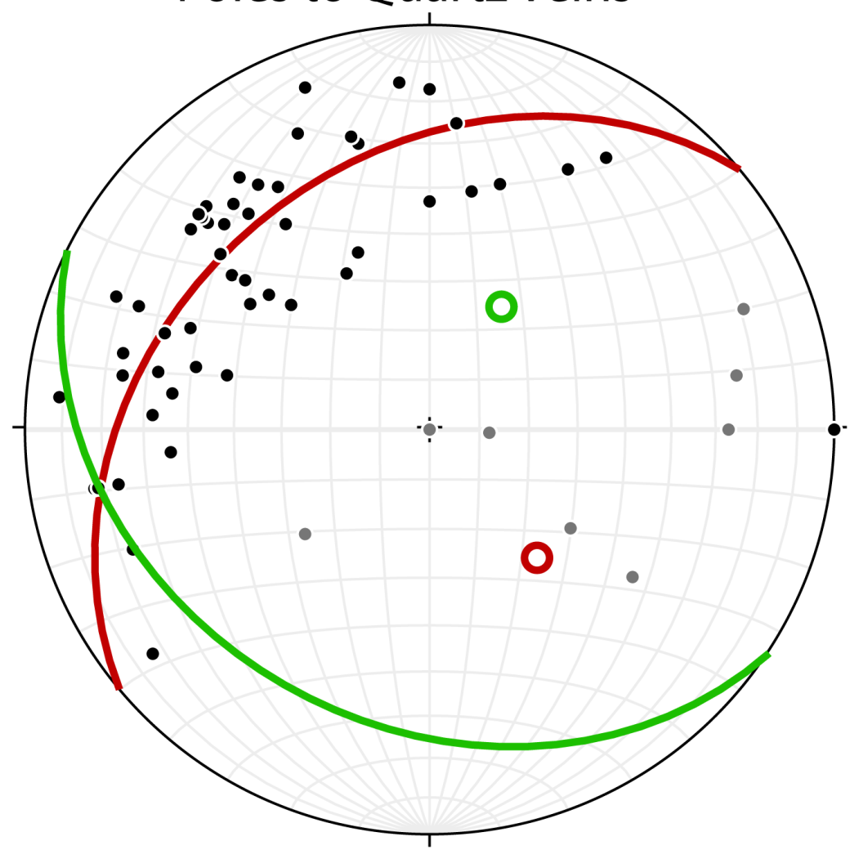
Testing The Models
Poles to Quartz Veins
If it is a dike, vein formation is not related to folding
If it is a folded sill, vein orientation should be related to folding
n=60

Slide 11
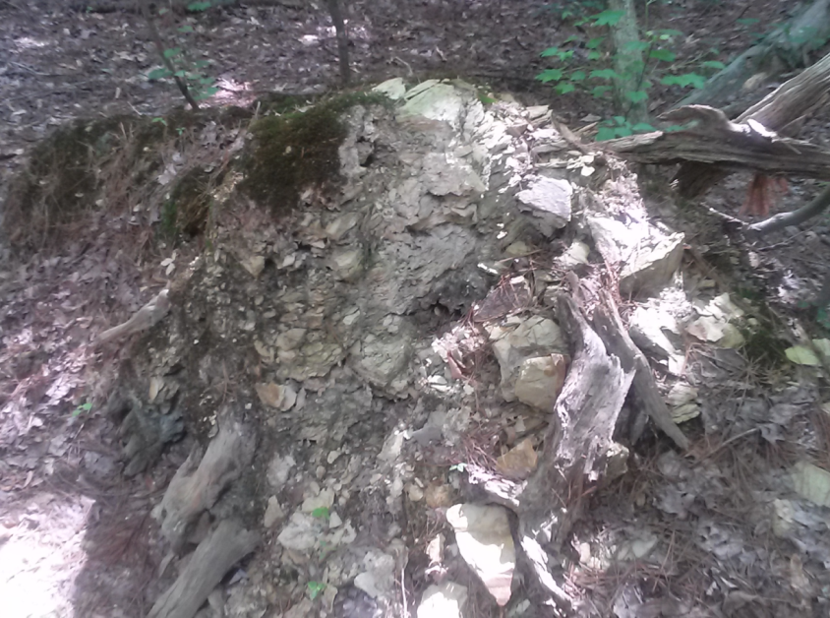
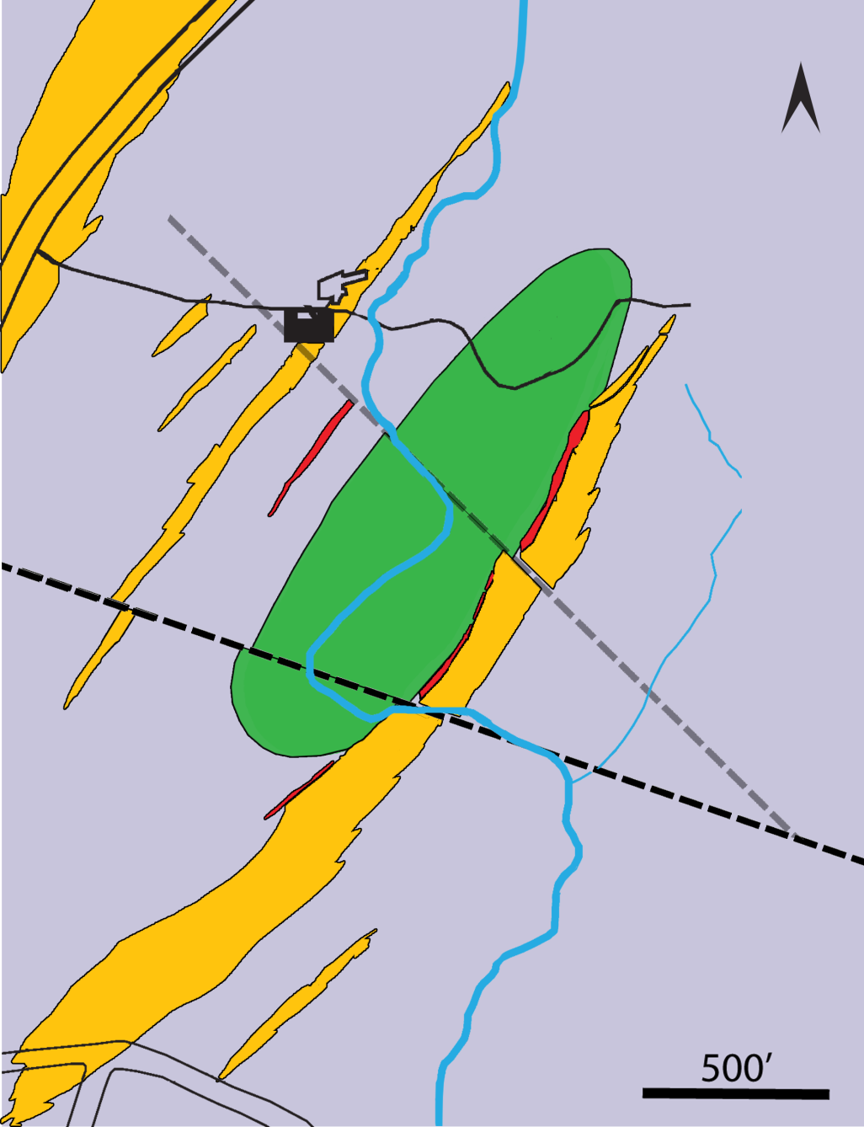
Mapping

Slide 12
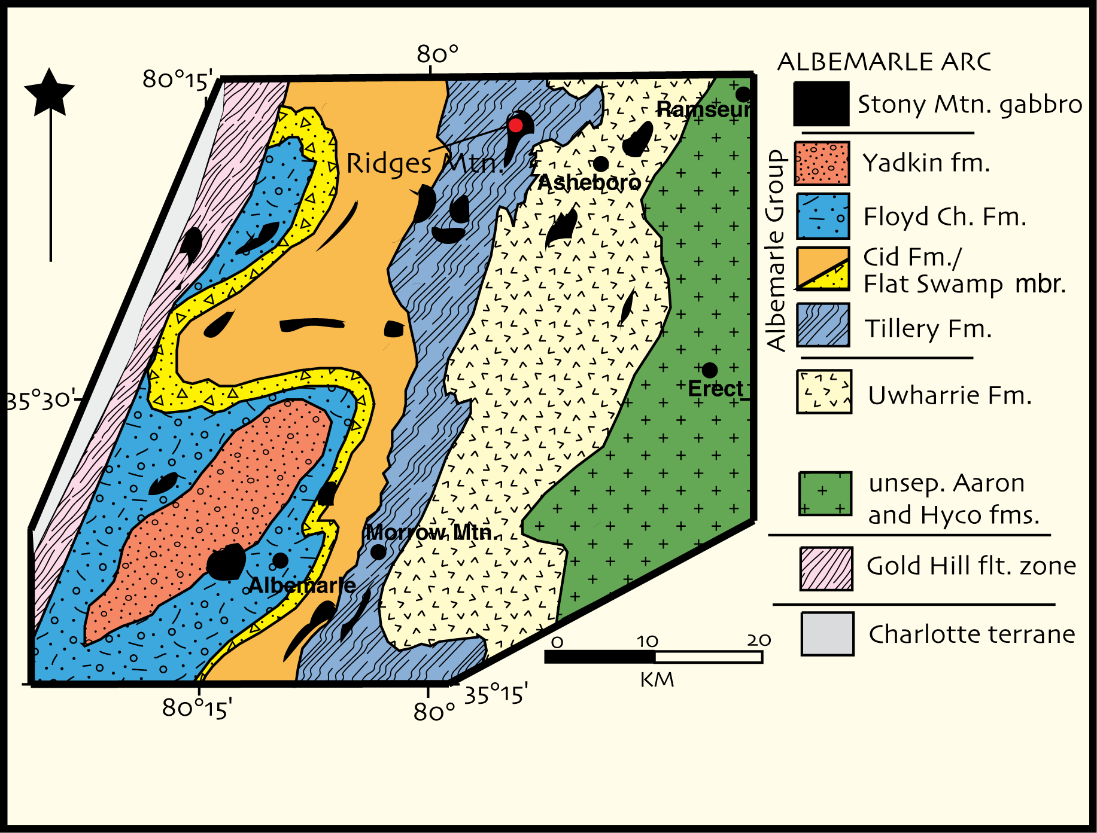
Conclusions
The outcrop pattern of the greenstone is consistent with a doubly-plunging folded sill
Gold mineralization is likely related to and likely synchronous with folding.
My future research: geophysical modeling, geochemical and U-Pb geochronological fingerprinting of sink host

Slide 13
Acknowledgments
Many thanks to Dr. Hibbard, Dr. Bohnenstiehl an Dr. Coleman, the GSA for their generous support of this project, and to the staff of the Reed Gold Mine for their assistance.

