Slide 1
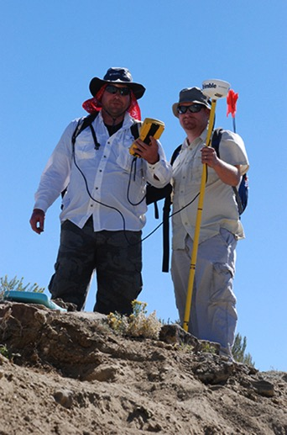
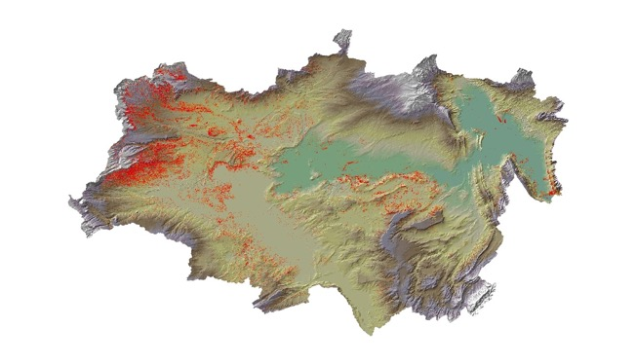

Geospatial Paleontology: Developing and Testing New Approaches to Locating Vertebrate Fossils
Robert L. Anemone
Department of Anthropology
University of North Carolina
Greensboro, NC
SEGSA
Columbia, SC
April 1, 2016

Slide 2
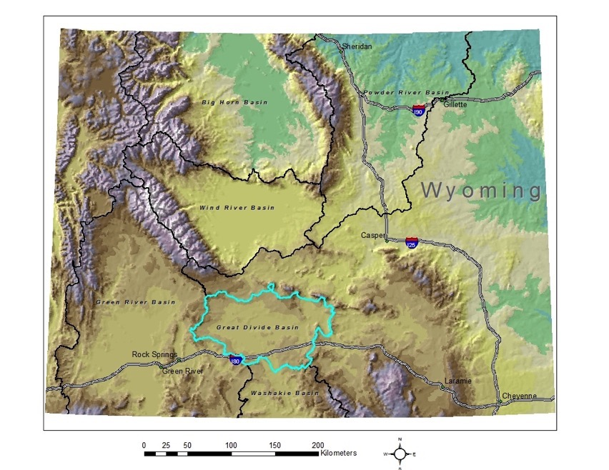
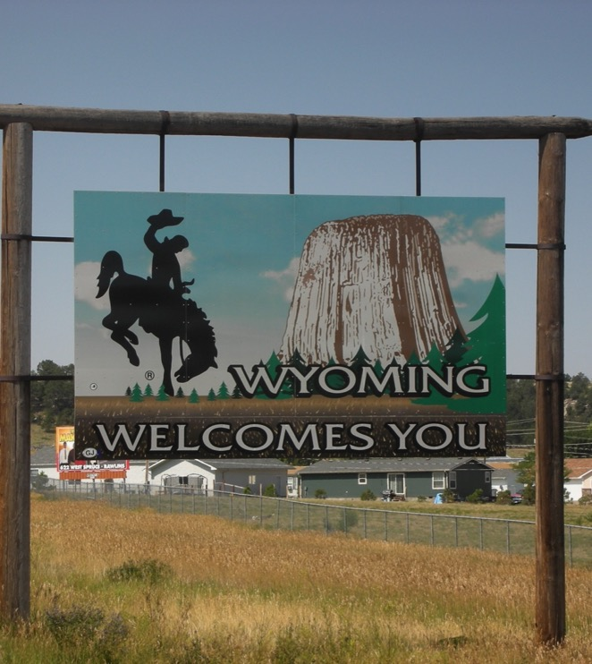
Great Divide Basin Project
Notes:
1994-2014 Sweetwater Co, Wy, just north of I-80 between Rawlins and Rock Springs, part of Greater Green River Basin (along with Bridger, Washakie, and Sand Wash Basin)
Internal drainage sedimentary basin, 10K square kilometers in extent surrounded by the continental divide that splits at South Pass and rejoins south of Rawlins.
Several thousand meters of variably exposed sedimentary rocks including Cretaceous (Mesaverde Group) and Paleogene (Fort Union, Wasatch, Washakie, Green River Fms.)
Also Plio-Pleistocene volcanics (Leucite Hills,), and Quaternary alluvium.
Paleogene rocks cross PE boundary, and we work mostly in the latest Paleocene and earliest Eocene (Clarkforkian and Wasatchian NALMAS). First worked by CL Gazin of the Smithsonian in the 1950s and 60s, who identified 4 or 5 mediocre localities and published small (several hundred specimens) Wasatchian mammalian faunas from these localities. In nearly 20 years of fieldwork we have identified more than 125 localities and catalogued more than 10,000 mammalian specimens.

Slide 3
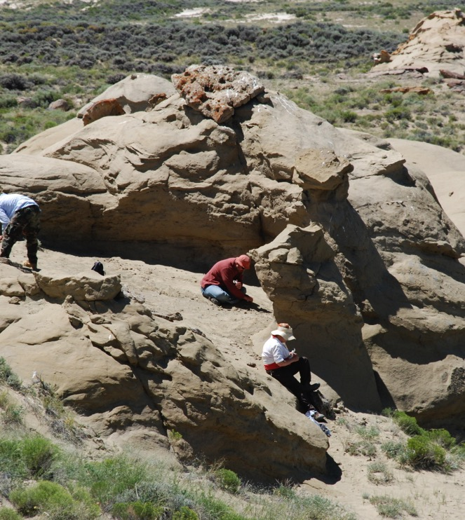
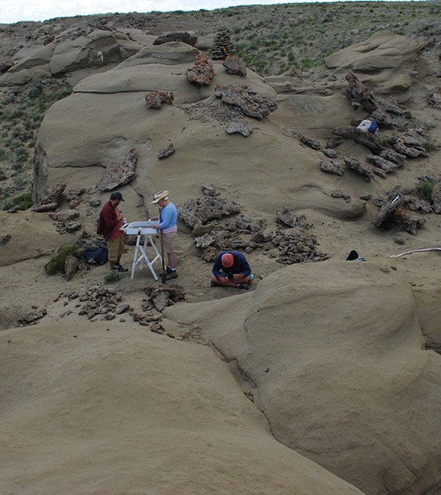

Slide 4
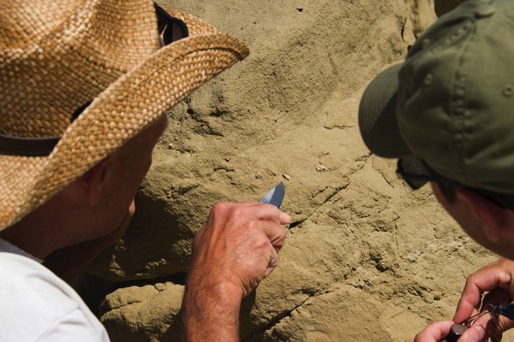
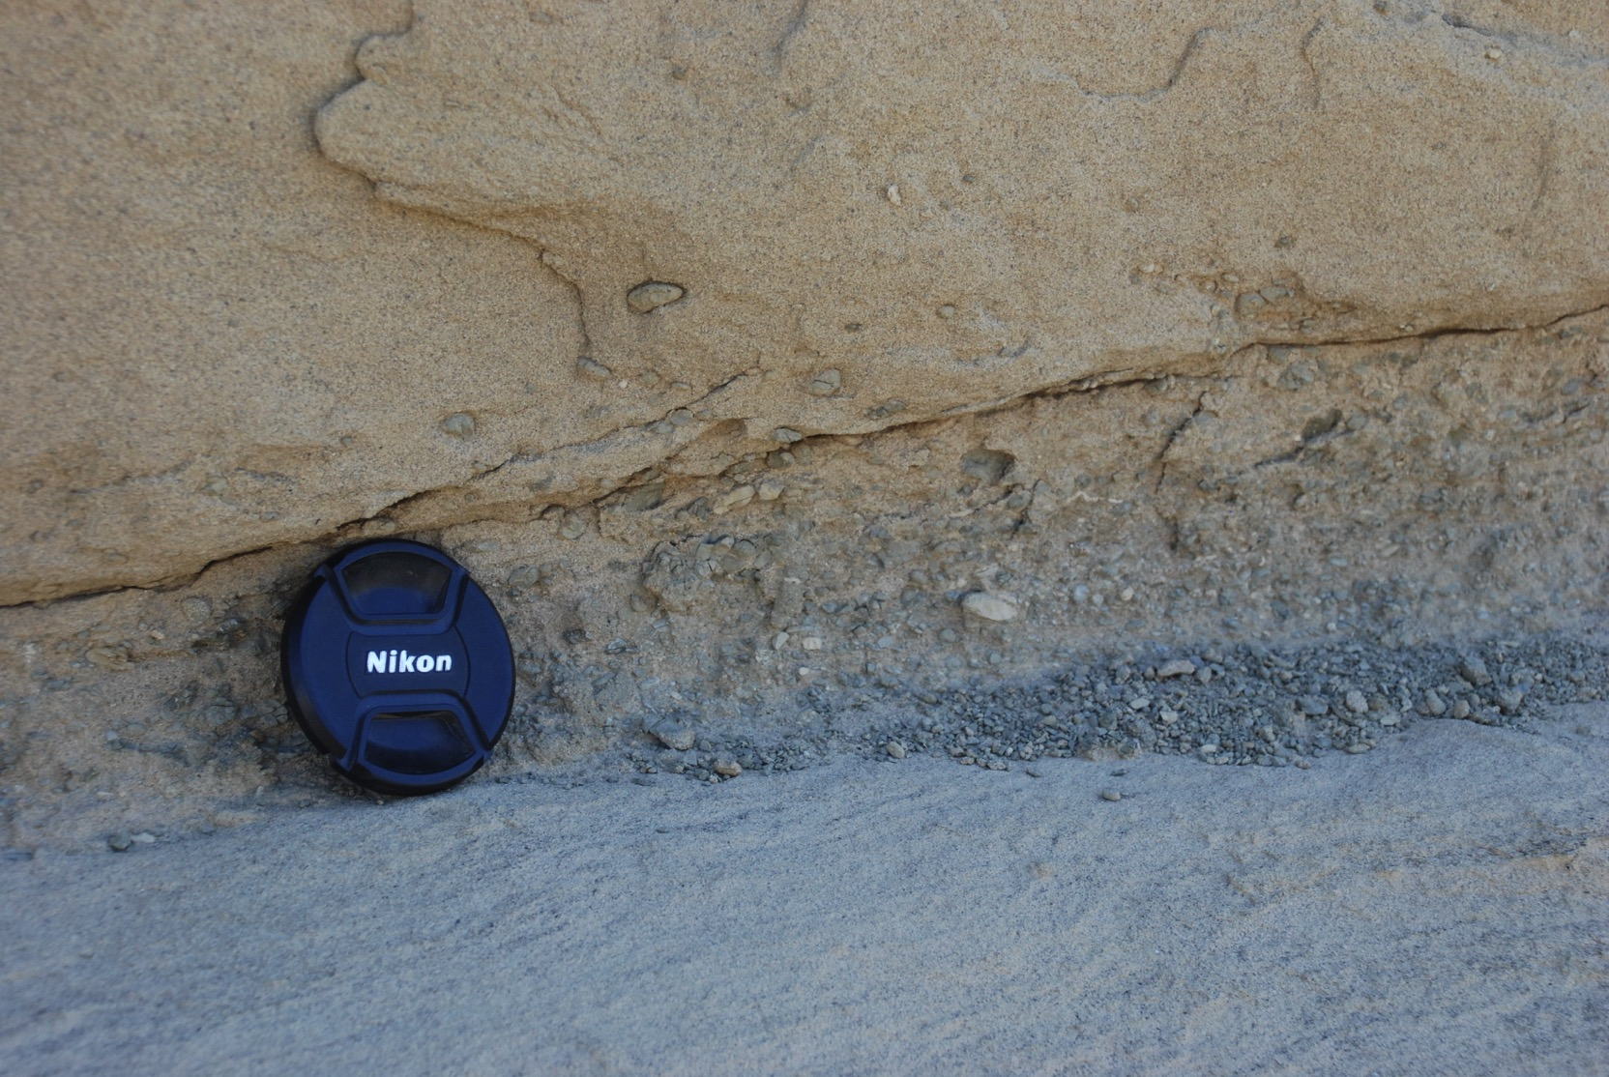
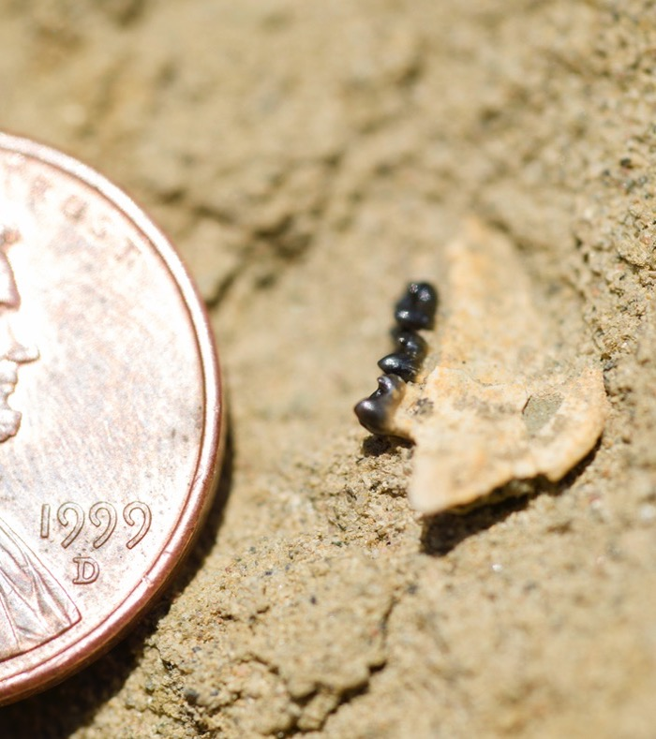
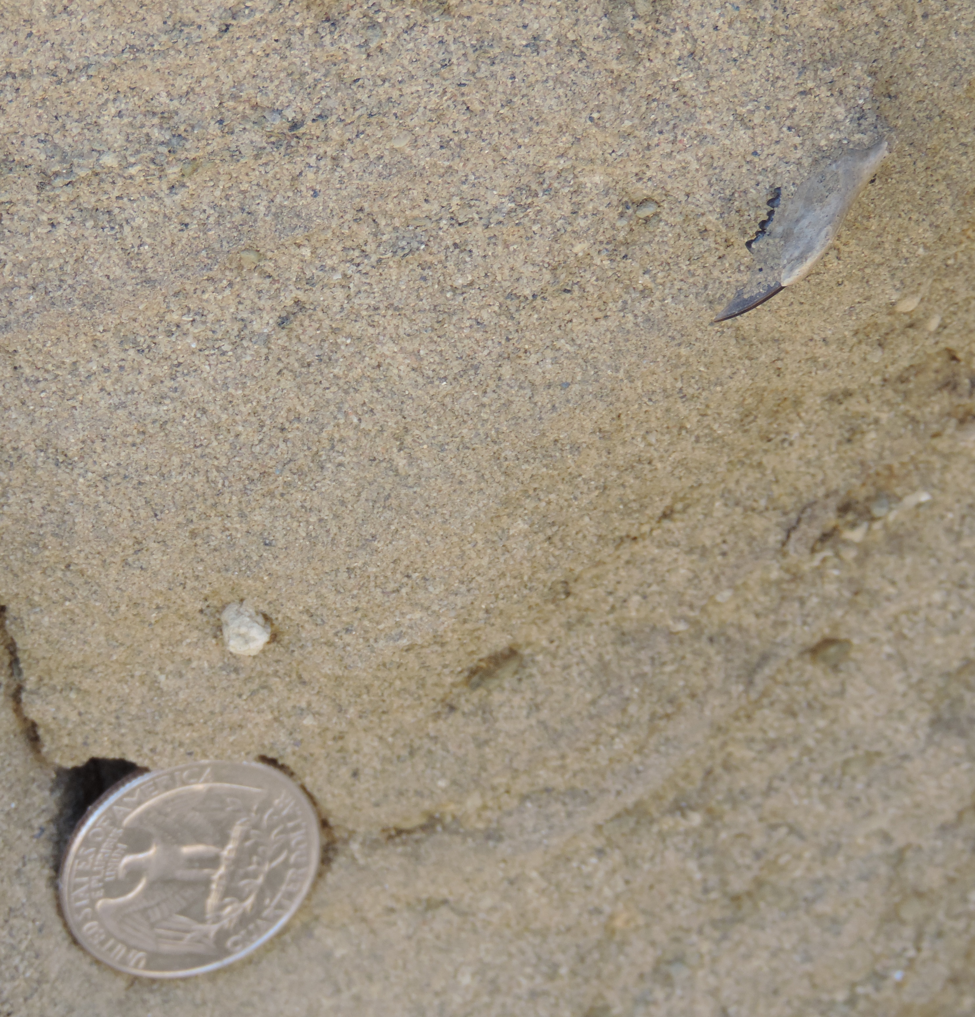
Tim’s Confession

Slide 5
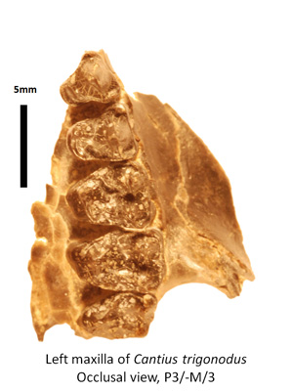
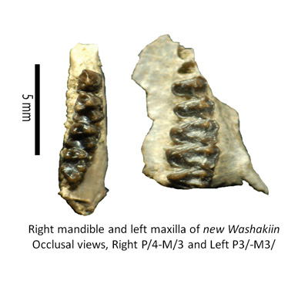
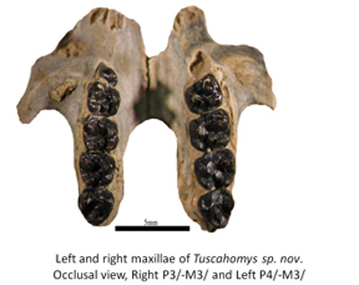
The Smiley Draw Mammalian Fauna
Total Number of Localities in GDB = 100…Total Number of Catalogued Specimens = 9900

Slide 6
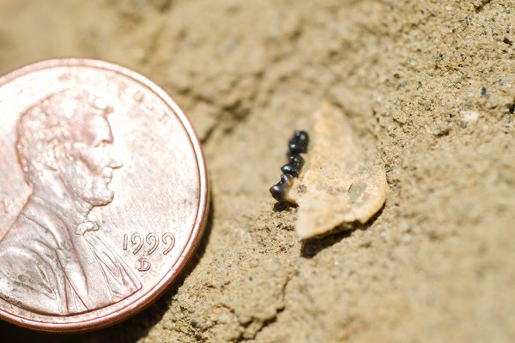
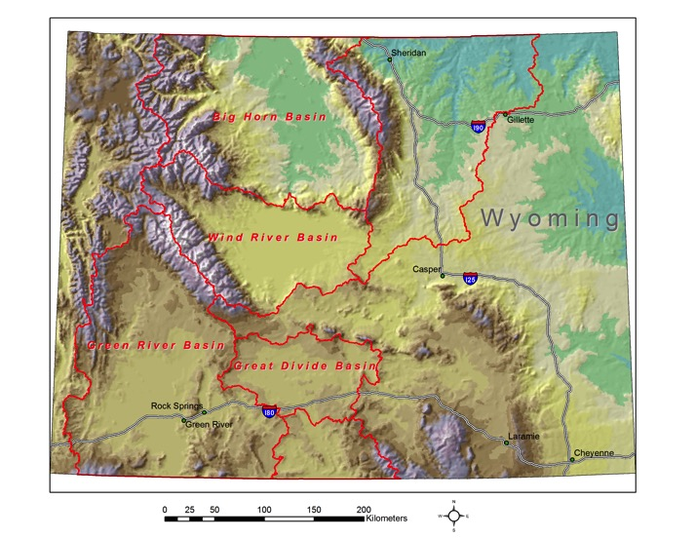
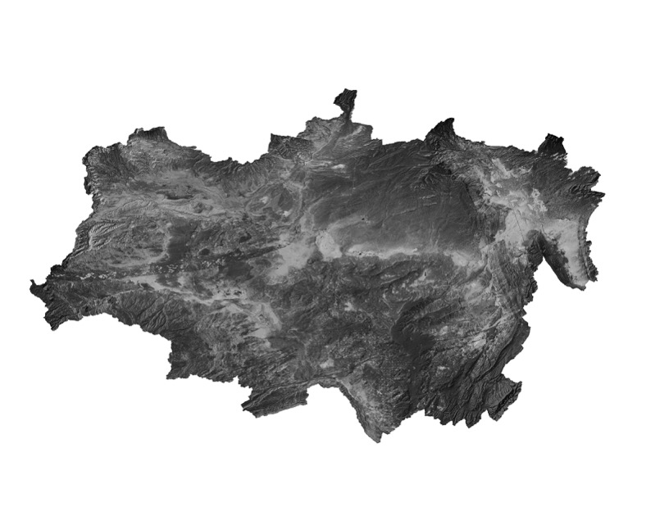
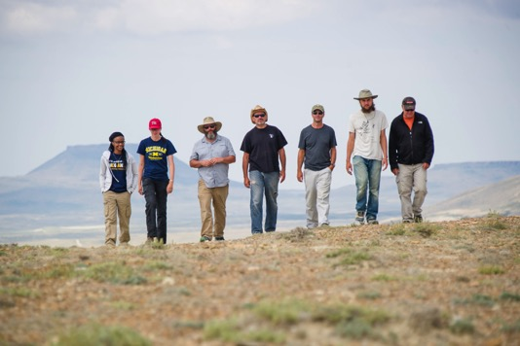
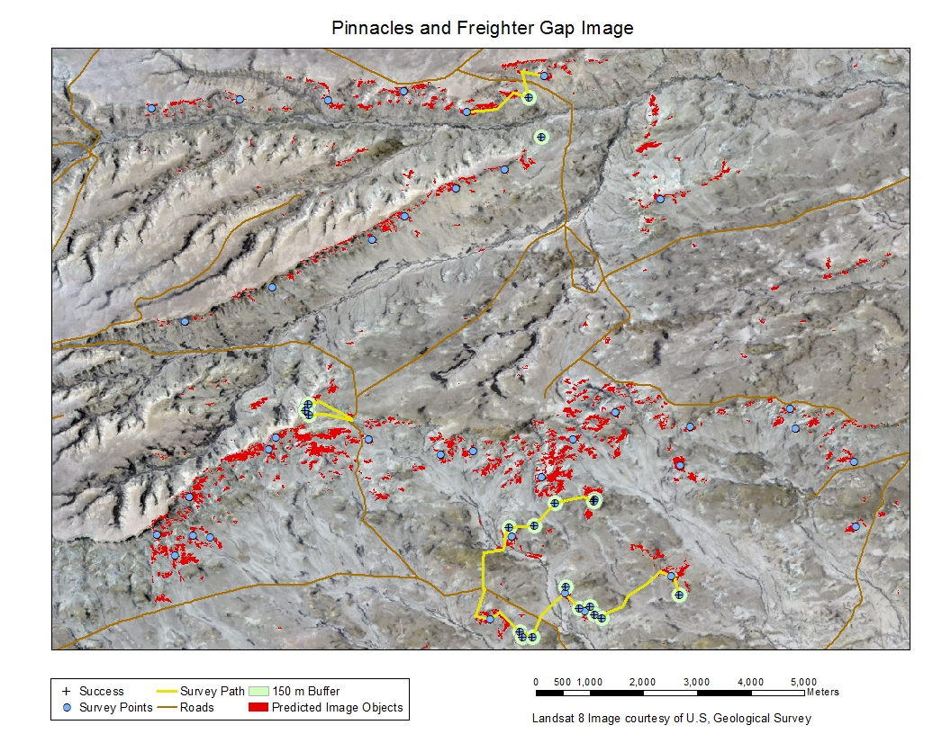
Geospatial Paleontology
Notes:
We like to refer to our work as Geospatial Paleontology since it brings together a number of approaches, tools and analytical methods, and datasets from the geospatial sciences and applies them to paleoanthropology and paleontology, also with clear applications in many other disciplines in which data are distributed geospatially. We have been developing and testing these models mostly in our fieldwork in Paleocene and Eocene deposits in the Great Divide Basin of SW Wyoming, where we have been doing fieldwork for 20 years.

Slide 7
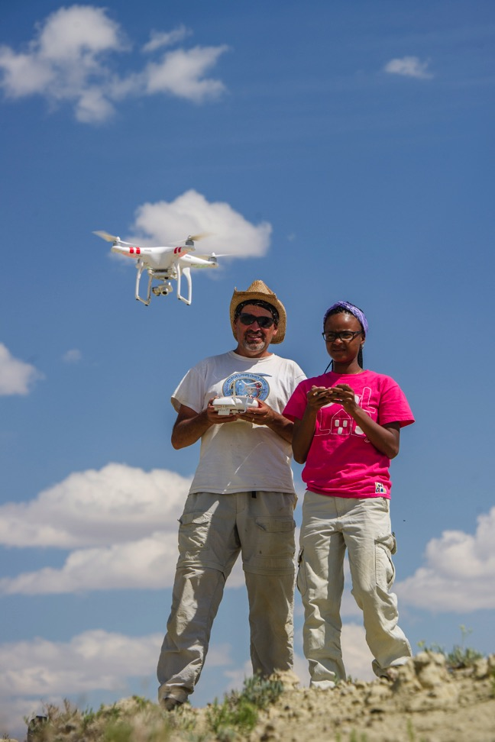
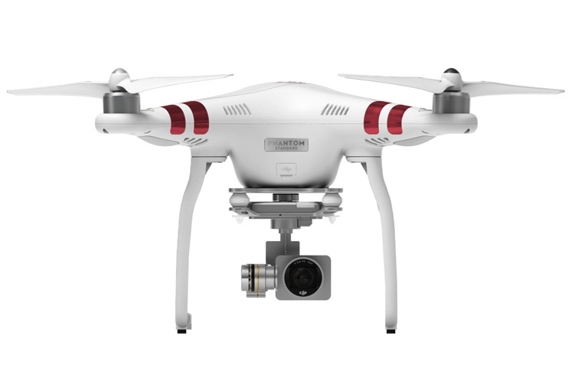
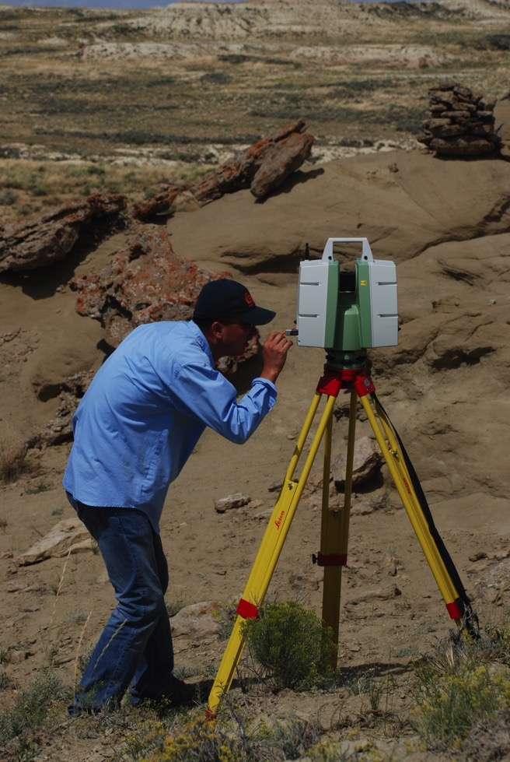
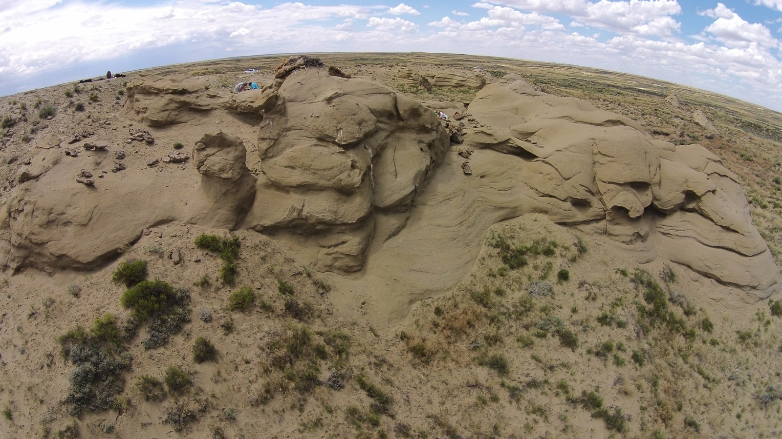
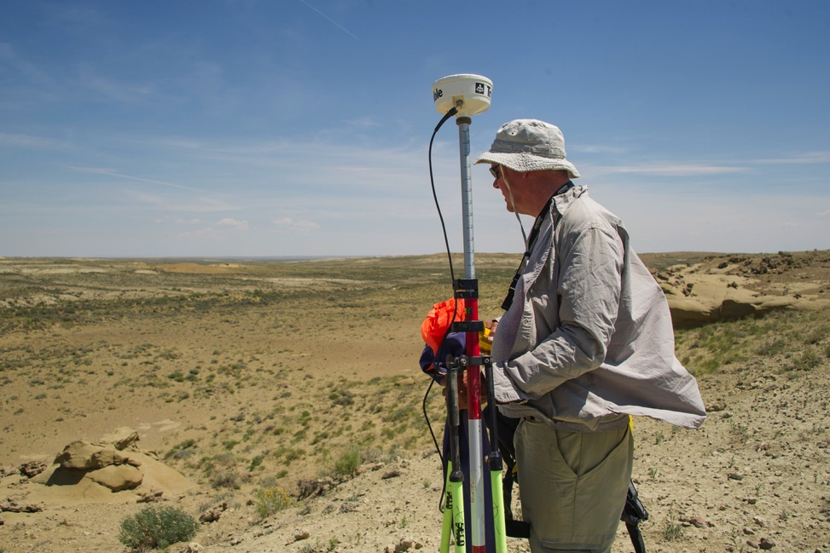
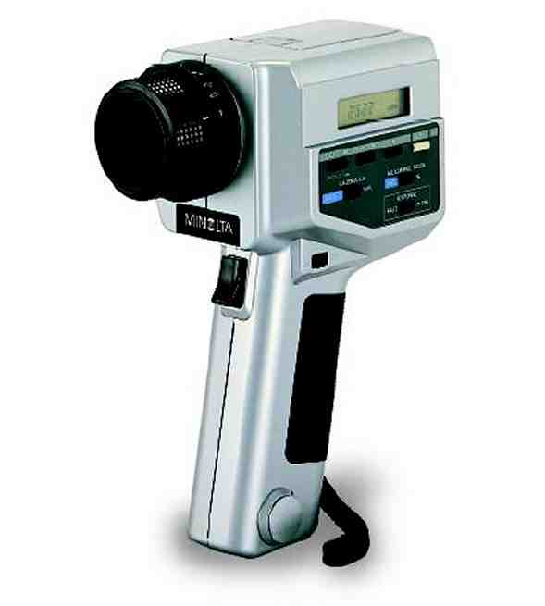
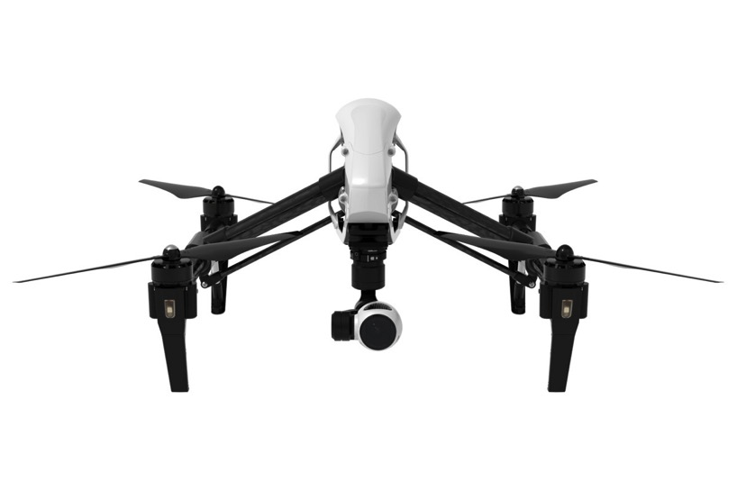
Geospatial Tools
Notes:
Tools: Differential GPS receivers and base stations, hand-held spectral radiometer, Unmanned aerial vehicles (UAVs), photogrammetry and terrestrial laser scanning

Slide 8
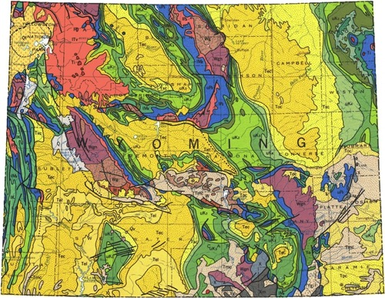

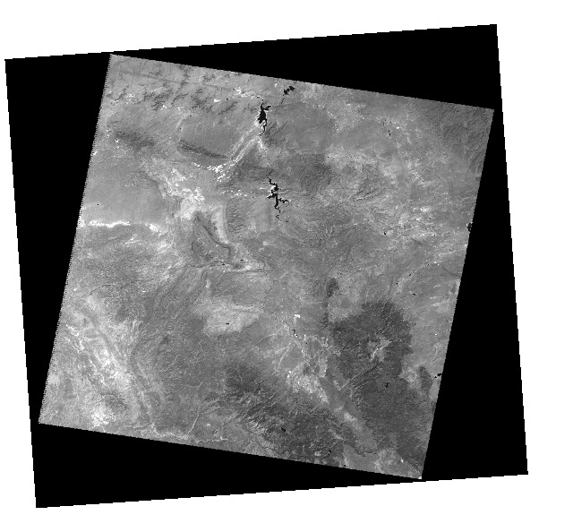
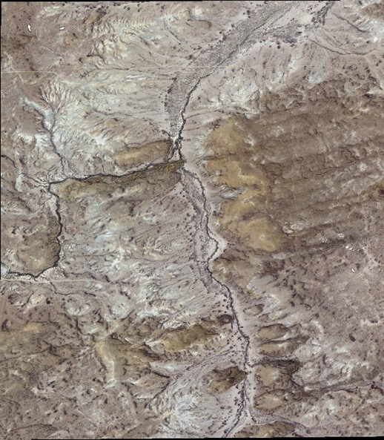
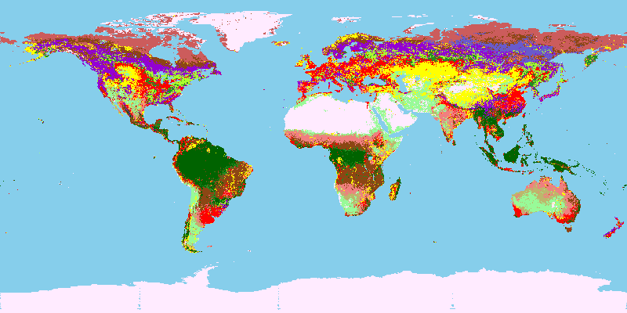
Geospatial Datasets
Notes:
Datasets: GIS data including land cover maps, DEMs, geological maps, satellite imagery at multiple scales and resolutions, including free med. res. (Landsat 7 and 8), and commercial (=expensive) hi res. Imagery from Quickbird and Worldview. This allows us a multi-scale approach, with basin wide medium resolution imagery and detailed hi res imagery of smaller areas within the basin.

Slide 9
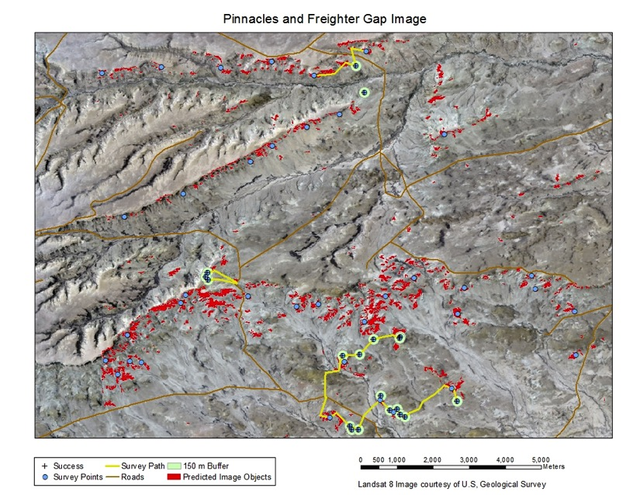
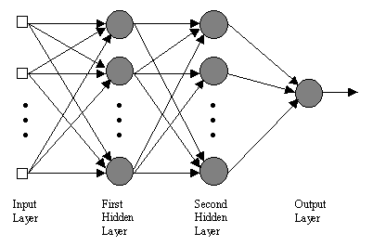
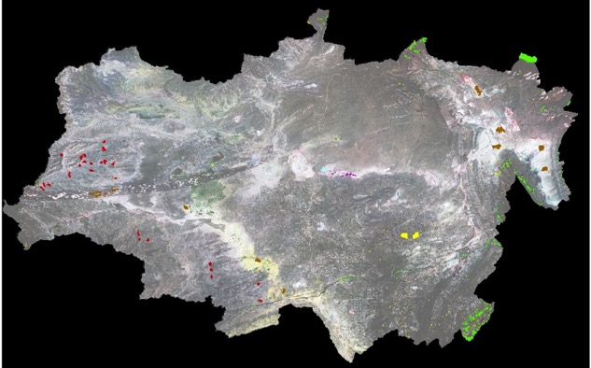

Geospatial Methods
Notes:
Methods: classification of satellite imagery, artificial intelligence approaches, development and ground-truthing of predictive models

Slide 10
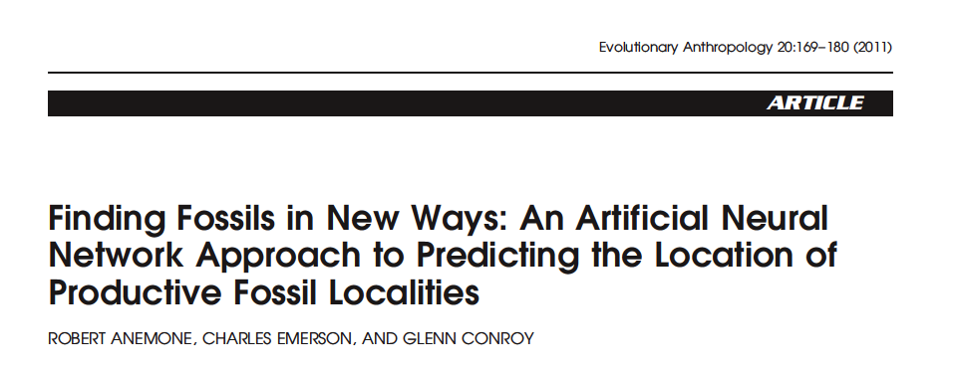

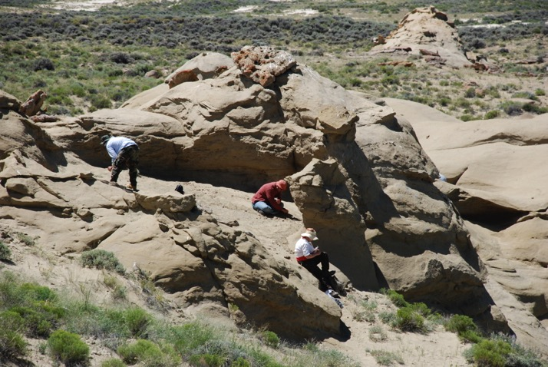
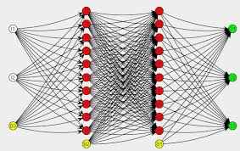

Slide 11

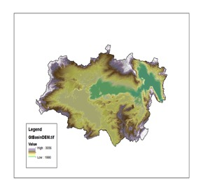
Components of the Predictive Model
Remote Sensing Imagery (RS)
  Landsat 7 ETM+ sensor
  USGS EROS Data Center
Artificial Neural Network (ANN)
  ENVI 4.7 Geospatial Software
  Definiens Professional 5.0
Geographic Information System (GIS)
  Digital Elevation Model (DEM)
  ArcGIS 10
  National Elevation Database

Slide 12
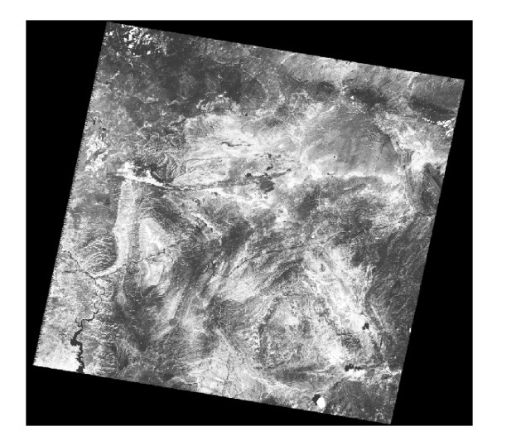
Landsat 7 ETM+ Imagery
Visible, Blue 0.45-0.52mm
Visible, Green 0.52-0.60mm
Visible, Red 0.63-0.69mm
Near Infrared 0.76-0.90mm
Mid-Infrared 1.55-1.75mm
7. Mid-Infrared 2.08-2.35mm
Imagery from USGS EROS Data Center http://eros.usgs.gov/

Slide 13
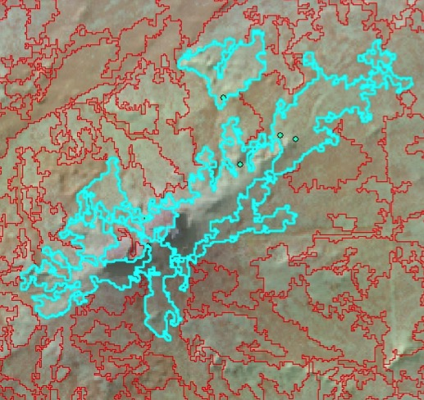
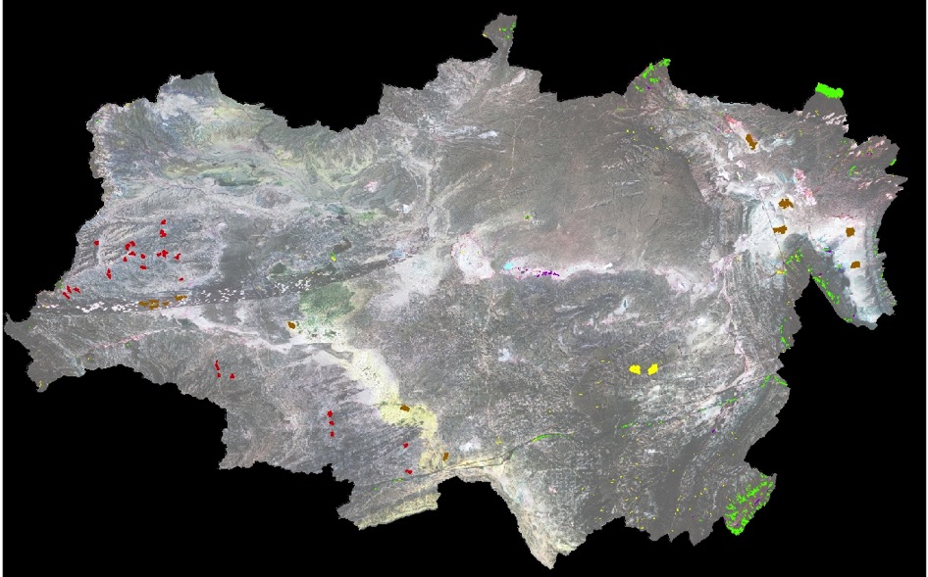
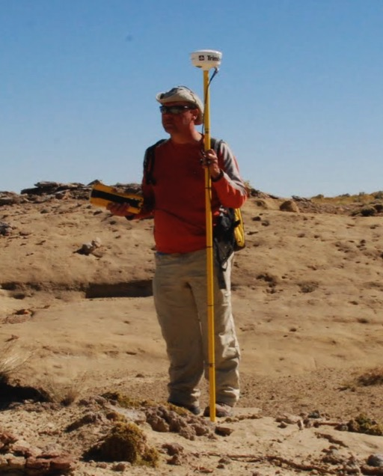
Training the Neural Network
With ENVI 4.7
Supervised Image classification with Definiens
Sand
Localities
Forest
Collecting GPS coordinates for Localities

Slide 14
The Neural Network Model
Back-Propagation, Feed-Forward, Multilayer Perceptron
Rule Image for each Output Layer
2 Hidden Layers
Analytical “Black Box”
Localities
Forest
Barren
Wetland
Scrubland
6 input nodes
Landsat Bands 1-5,7
10 original land classes collapsed to 5 output nodes

Slide 15
Classification Results
Percent Correctly Classified |  |  | 84.21% | Kappa Coefficient |  |  | 0.7744
 |  |  | Ground Truth
Class | Barren | Forest | Localities | Scrubland | Wetland | Total | User's Acc.
Barren | 2411 | 19 | 1035 | 114 | 20 | 3599 | 66.99%
Forest | 0 | 2402 | 23 | 193 | 18 | 2636 | 91.12%
Localities | 35 | 6 | 5525 | 22 | 1 | 5589 | 98.85%
Scrubland | 12 | 238 | 408 | 1429 | 50 | 2137 | 66.87%
Wetland | 0 | 5 | 0 | 6 | 11 | 22 | 50.00%
Total | 2458 | 2670 | 6991 | 1764 | 100 | 13983
Producer's Acc. | 98.09% | 89.96% | 79.03% | 81.01% | 11.00%

Slide 16
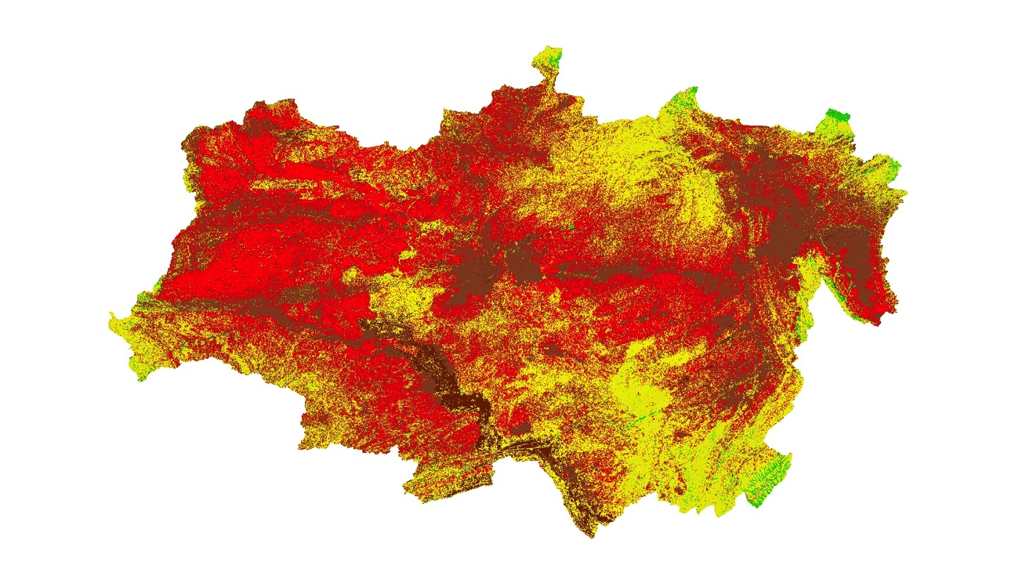
ANN Results: The Classified Image
Localities Barren Scrubland Forest Wetland

Slide 17
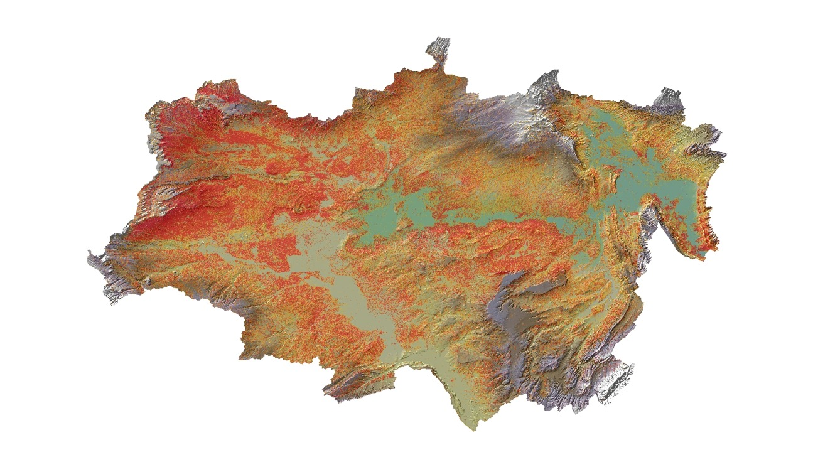

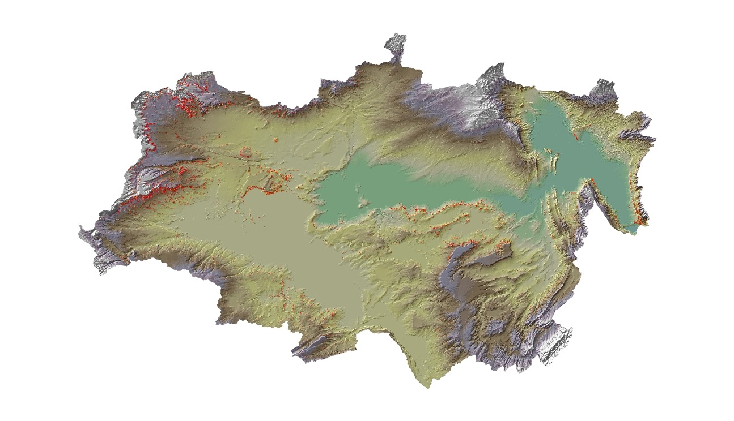
Locality Rule Image
Locality Rule Image: 95% Selection
Locality Rule Image: 95% & >5% Slope

Slide 18
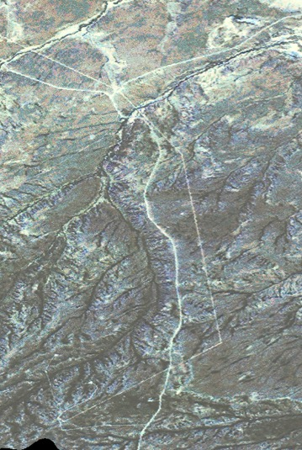
A High Resolution Approach
World View 2 & Quickbird 2 Imagery: .5-2 m pixels, 8 bands
GEographic Object Based Image Analysis
Notes:
We used eCognition software and an approach known as GEOBIA; Geographic Object Based Image Analysis to segment and classify high resolution RS imagery. The analysis breaks up an image by setting out a number of random seeds. Spectrally similar pixels adjacent to the seeds are added together to form objects until the spectral value of the pixels exceeds a threshold value, establishing a boundary for that object. A “scale parameter” is specified to determine the density of the random seeds and this influences the size of the resulting image objects. A large scale parameter yields a relatively large number of small image objects, and vice versa. Large objects can then be broken into smaller ones through a process of hierarchical segmentation…if you continue this process, you can get back to the original pixels.

Slide 19
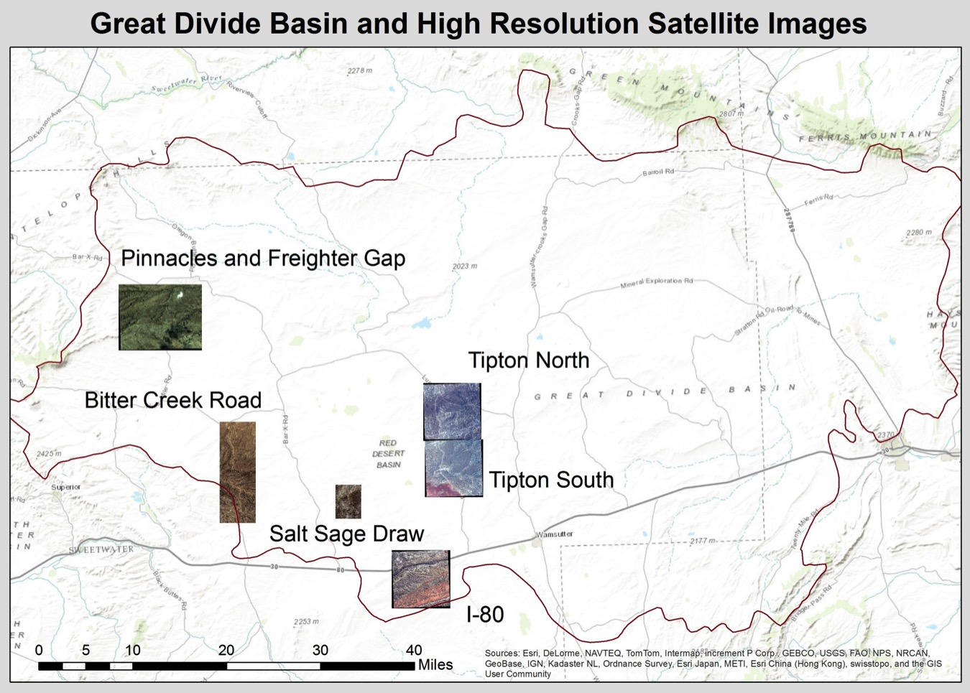
Notes:
Pinn and FG was a Quickbird 2 image: the others are Worldview

Slide 20
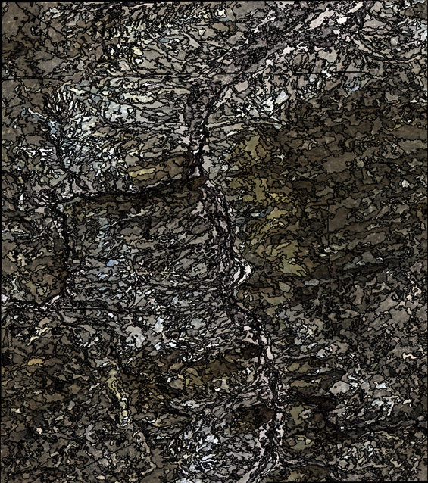
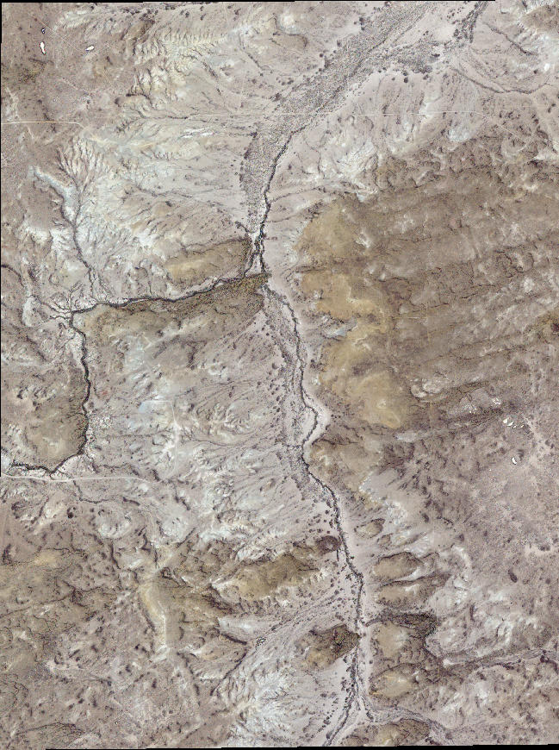
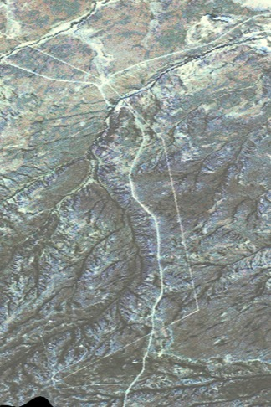
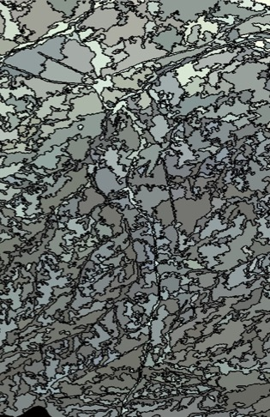
Unites individual pixels into multi-pixel image objects based on similarity and proximity
Hi Res World View 2 Images: Segmented on right
Notes:
We used eCognition software and an approach known as GEOBIA; Geographic Object Based Image Analysis to segment and classify high resolution RS imagery. The analysis breaks up an image by setting out a number of random seeds. Spectrally similar pixels adjacent to the seeds are added together to form objects until the spectral value of the pixels exceeds a threshold value, establishing a boundary for that object. A “scale parameter” is specified to determine the density of the random seeds and this influences the size of the resulting image objects. A large scale parameter yields a relatively large number of small image objects, and vice versa. Large objects can then be broken into smaller ones through a process of hierarchical segmentation…if you continue this process, you can get back to the original pixels.

Slide 21
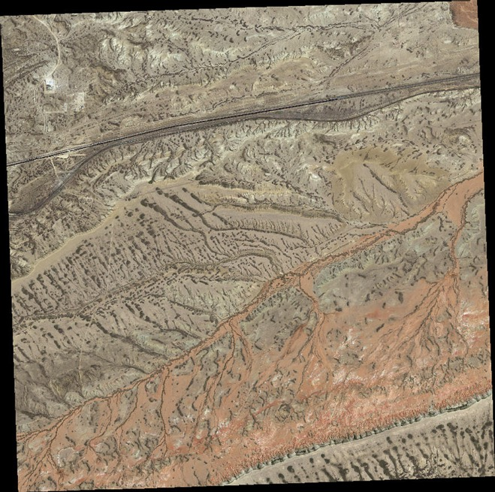

Supervised Classification
Legend
Purple | Areas of low slope <6%
Red | Areas of high slope >6%
Green | Vegetation by NDVI
Black | Highway/Road for exclusion
Blue | Predicted Image Objects
“Divide & Conquer”
feature extraction
Raw image on left: segmented and classified image on right
Notes:
We used a “divide and conquer” feature extraction procedure to eliminate unsuitable areas from consideration. Thus areas of low slope (<6%), roads, and areas covered by vegetation (high Normalized Difference Vegetation Index= difference between the green and near infrared bands divided by the sum) were excluded. We then used the “brightness” value of one well-characterized and productive sandstone locality (Tim’s Confession) to train a classifier (Supervised Classification) to select objects with similar brightness values. The brightness values that were sought were a weighted average of the blue, green, red and near infrared bands. When we tested this approach on a nearby area with 12 known sandstone localities, it correctly hit 11 of them.

Slide 22

Notes:
We had out best success in the Pinnacles/Freighter Gap area where each of 8 survey points yielded vertebrate fossils and a total of 17 new localities were identified.

Slide 23
Ground Truthing Results
2013 Results
  31 Points/Polygons were surveyed
    Vertebrate fossils were found at 13 (42%)
  Some Survey Points yielded multiple localities
    A total of 25 new localities were recorded
    10 localities yielded fossil mammals
2014 Results
  7 Points/Polygons were surveyed
    Vertebrate fossils were found at 5 (71%)
    9 new localities were recorded
    7 localities yielded fossil mammals

Slide 24
Ground Truthing Conclusions
Both models successfully identify sandstones
  Sandstone is our most productive lithology
Quality of training sites is critical (ANN)
  A priori knowledge is required for training
A limitation is the quality of geological maps
  Formational contacts are often not as mapped
False positives remain a problem
Both ANN and GEOBIA models increase likelihood of finding fossils

Slide 25


Slide 26
3D Digital Outcrop Models (DOMs)
3 dimensional, georeferenced in silico models of outcrops, localities, terrains
  Reservoir modeling and flow simulation in hydrocarbon and aquifer systems
  Seismic modeling
  High-precision facies characterizations
  Stratigraphic and Taphonomic models in 3 D
Bellian et al. (2005) Digital Outcrop Models: Applications of terrestrial scanning Lidar technology in stratigraphic modeling. J. Sed. Res., 75: 166-176
Notes:
3 dimensional digital outcrop models have become increasingly popular among geologists and have been used to explore a variety of different empirical questions in combination with traditional work on the outcrops.
We suggest that these approaches are potentially informative in paleontological contexts to explore mapping, stratigraphic, and taphonomic aspects of vertebrate fossil deposits, and we have begun to explore this potential in the GDB using two different approaches: Photogrammetry and Terrestrial laser scanning (LiDAR).

Slide 27


Photogrammetry
Drone-based photography
  DJI Phantom 2 Vision+
  DJI Inspire 1
Software
  Agisoft Photoscan
Velodyne Puck
Notes:
We have used 2 different quadcopter drones in the field, the DJI Phantom 2 Vision+ (ca. $1000) and the DJI Inspire 1 (ca. $3000). Phantom has a f2.8 lens and can take video (1080p 30fps video) or still imagery (14MP sensor, Raw or jpeg), 3-axis gimbel for stable images,90 degree tilt on camera lens (forward to down), live video feed on iPhone or iPad, and software that allows programmed flight paths by waypoints. Inspire 1 does everything the Phantom does but a little better, including 4K video @24-30 fps, as well as takes off and lands automatically! It also has the potential to carry diffferent payloads…for example a small LiDAR scanner like the Velodyne Puck, a 16 channel LiDAR scanner that weighs 600 grams and costs $8000.
Photoscan is a software tool for photogrammetry, but the “term of art” for this approach is known as “Structure from Motion” by the many archaeologists and cultural resource managers who use it to generate digital 3D models of artifacts, objects of art, and partial or entire archaeological sites. Professional edition is normally $3500, but educational discount is about $500…the standard edition (with less functionality) is ca. $50 for educators. Our sense is that, while there are dozens of competitors in the photogrammetry marketplace, Photoscan is becoming the de facto standard for archaeologists, art historians and museum personnel, paleoanthropologists and geologists…and we find it to be an amazingly powerful product with a very simple and intuitive workflow that works very well both in the lab for developing 3D models of bones or artifacts that are a bit too big for the NextEngine scanner) and, as we show in this talk, in the field. Sparse to dense point cloud, with good editing tools, to mesh and solid, with lots of options for exporting to different file types for printing or additional 3D modeling.

Slide 28

Notes:
Image from a high resolution Photoscan solid model created from ca. 300 georeferenced (12MP) photos taken with Inspire 1 drone, took all weekend to run on laptop. A fully textured and georeferenced 3D model that can be exported as a kml file for use with Google Earth or as an orthophoto or DEM, or as a obj or stl model for printing. The model and 3D pdf show remarkable detail and have great potential for in silico analysis of a vertebrate locality. We are particularly interested in using 3D measuring tools to measure surface areas, high resolution facies mapping, and detailed mapping of fossil distributions.

Slide 29



LIDAR

Slide 30

Summing Up
Potential Gains from Geospatial Paleontology
  3D Digital Outcrop Models of fossil localities
  Geologic, Stratigraphic and Taphonomic Analyses
  Development and Testing of Predictive Models
  New Workflows in the Field and Lab
Further Down the Line
  Remote reconnaissance and mapping with UAVs
  Regional scale mapping and model building
  Improved Predictive Models for Fossil Location

Slide 31

Acknowledgements
Funded by NSF BCS-1227329
Field Permits courtesy of BLM (WY-287-PA)
  Brent Breithaupt (BLM, Cheyenne, Wy)
Cory Henderson for work in digital imaging lab
Junshan Liu & Tyler Jones, Auburn University, for LiDAR scanning in the field
David Wilson, field photographer extraordinaire
GDB Field Crews, past and present

