Slide 1
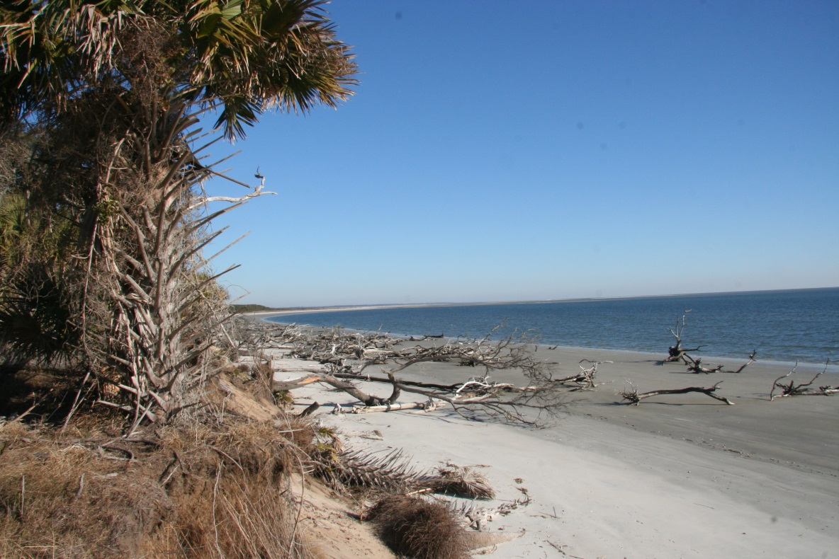
Evidence of Deep-Seated, Vertical Groundwater Pathways within the Georgia Coastal Plain James Reichard, R. Kelly Vance, and Brian Meyer; Dept. of Geology and Geography Georgia Southern University and Dept. of Geosciences, Georgia State University
Notes:
Thanks XXXX. Again, the title of my talk is…..

Slide 2
Outline
Geologic Setting.
Evidence for reactivated basement faults propagating up through the coastal plain.
Notes:
Today I’m going to first describe the basic geologic setting of the coastal plain, particularly the deep basement.
Then I’ll describe several lines of evidence that indicate reactivated basement faults have propagated up through the coastal plain sequence, creating permeable pathways for the vertical movement of groundwater.

Slide 3
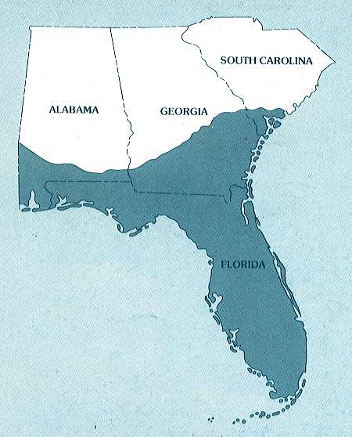
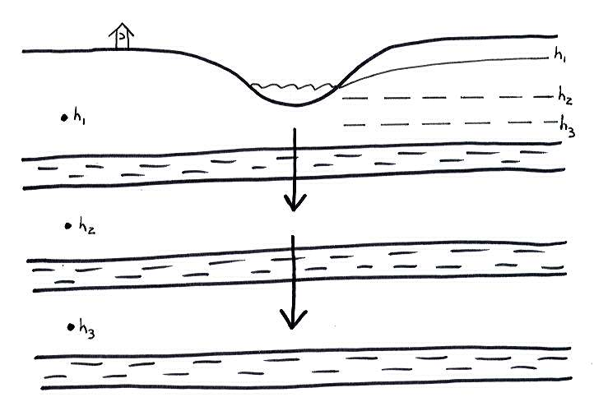
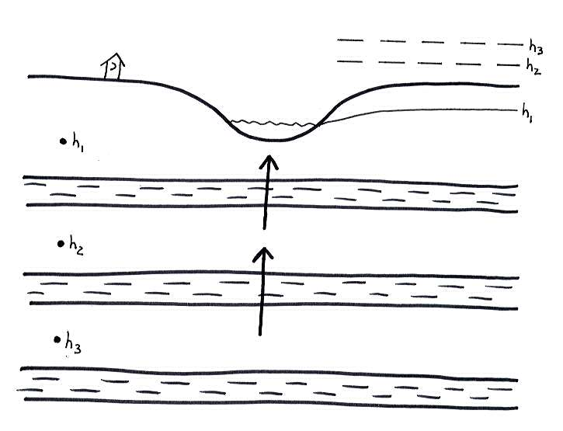
Regional Hydrogeology
(Miller, 1986)
Notes:
1) With respect to the geologic setting, the Coastal Plain of Georgia is underlain by a thick sedimentary sequence that contains multiple aquifer systems.
2) The most significant of these is the Floridan aquifer, which is a highly conductive series of Eocene and Oligocene age carbonate units.
3) Most of the recharge enters the system along the outcrop area (show) where vertical gradients are downward, then flows laterally beneath the coastal plain, eventually discharging into the coastal environment (show) where vertical gradients historically have been upwards.

Slide 4
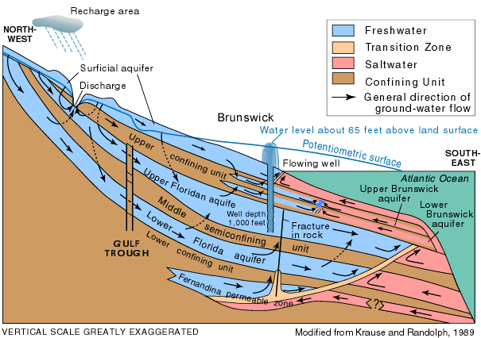
Floridan Aquifer System
(USGS, 2001)
Notes:
1) This is a simplified USGS cross-section through the Georgia Coastal Plain showing the 3 main permeable zones (show) within the Floridan aquifer system (show). The upper Floridan serves as the regional water supply
2) Clastic units overlying the upper confining layer (show) make up what we call the surficial aquifer. Note that the offshore barrier islands also have a surficial aquifer that overlies the regional artesian system.
3) Also note how the potentiometric surface of Upper Floridan was above land surface prior to major pumping withdraws. Thus, we used to have free-flowing artesian conditions up and down the coast.

Slide 5
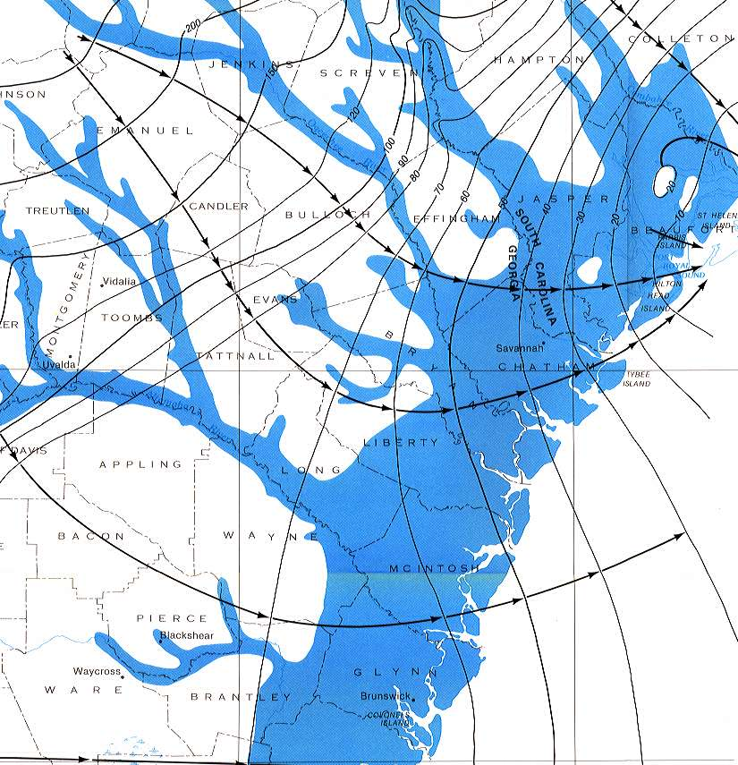
1880 Conditions
(Krause and Randolph, 1989)
Notes:
This is a USGS map showing the potentiometric surface of the Upper Floridan aquifer prior to major development, with the blue areas showing where free-flowing artesian conditions existed in 1880.

Slide 6
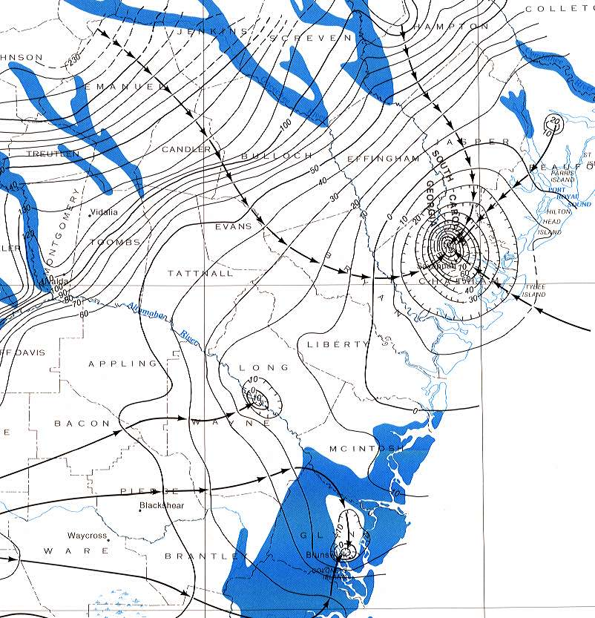
1986 Conditions
(Krause and Randolph, 1989)
Notes:
Here’s a map of the heads in 1986. Note the large cone-of-depression that has developed as a result of industrial and municipal withdrawals from the aquifer near the city of Savannah.
2) Within the cone of depression, vertical the gradient has been reversed, thereby reducing the area of free-flowing artesian conditions, shown in blue.

Slide 7
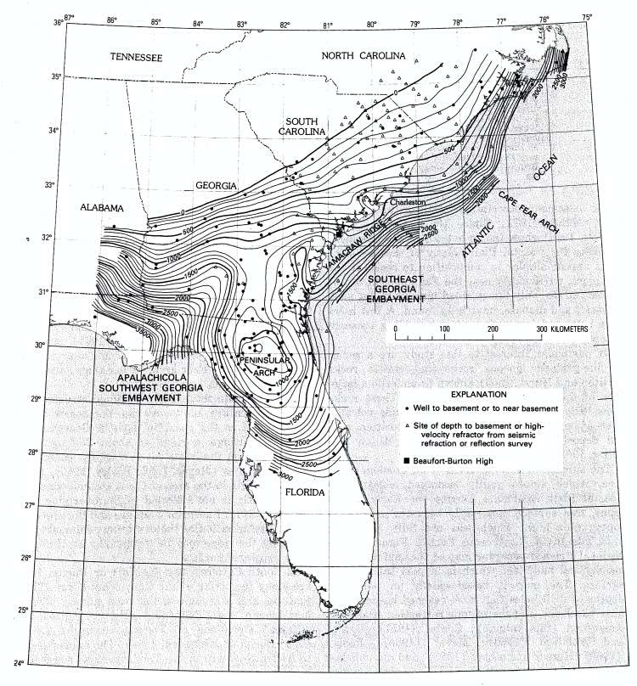
Basement Structure
(Miller, 1986)
Notes:
1) With respect to the deep structure, the coastal plain sedimentary sequence (show) is draped over the surface of the basement rocks (show) which has considerable relief.
2) The structure contour map of the basement (SHOW) was generated as part of a USGS effort in the late 70s and early 80s investigating the cause of the 1886 Charleston earthquake.
3) This effort included gravity, magnetic and seismic surveys along with drilling numerous boreholes into the basement.

Slide 8
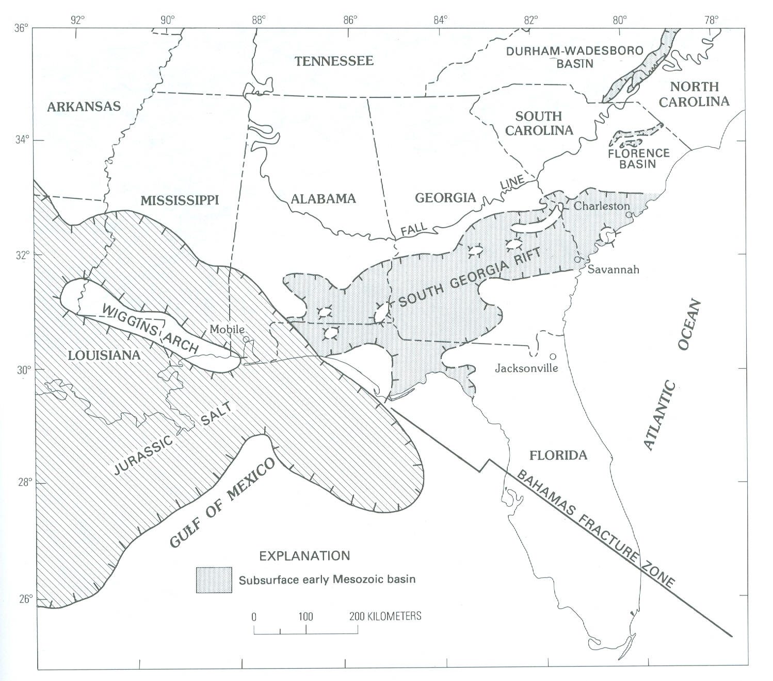
(Daniels, Zietz, and Popenoe, 1983)
Notes:
1) These USGS studies revealed the presence of Mesozoic rift structures beneath the coastal plain, collectively referred to as the South Georgia Rift (SHOW).

Slide 9
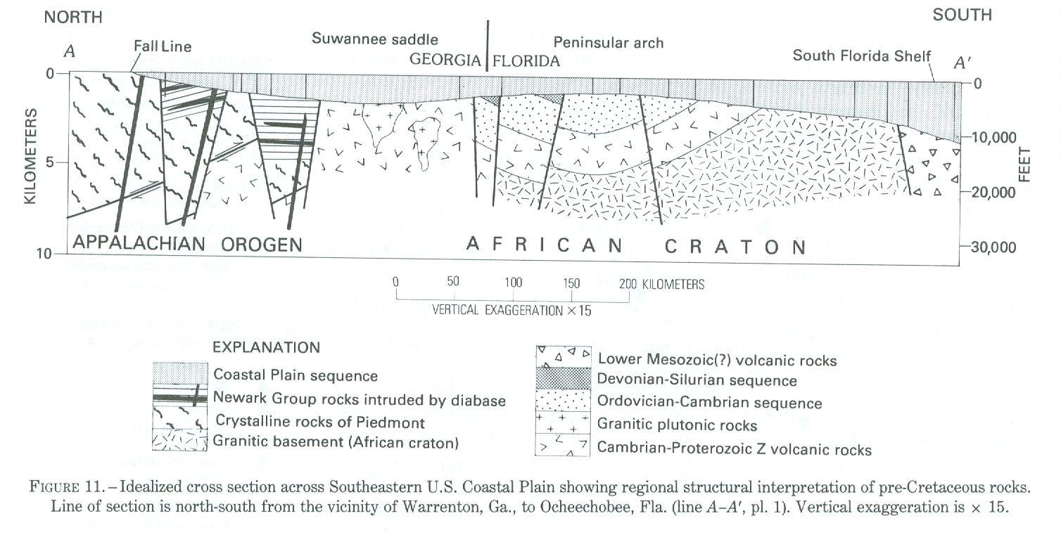
(Chowns and Williams, 1983)
Notes:
1) For example, as interpreted by Chowns and Williams, this N-S section from Georgia to Florida shows complex pre-cretaceous structures buried beneath the coastal plain (SHOW).
2) Note the grabens here (SHOW) containing Triassic redbeds and diabase intrusions.

Slide 10
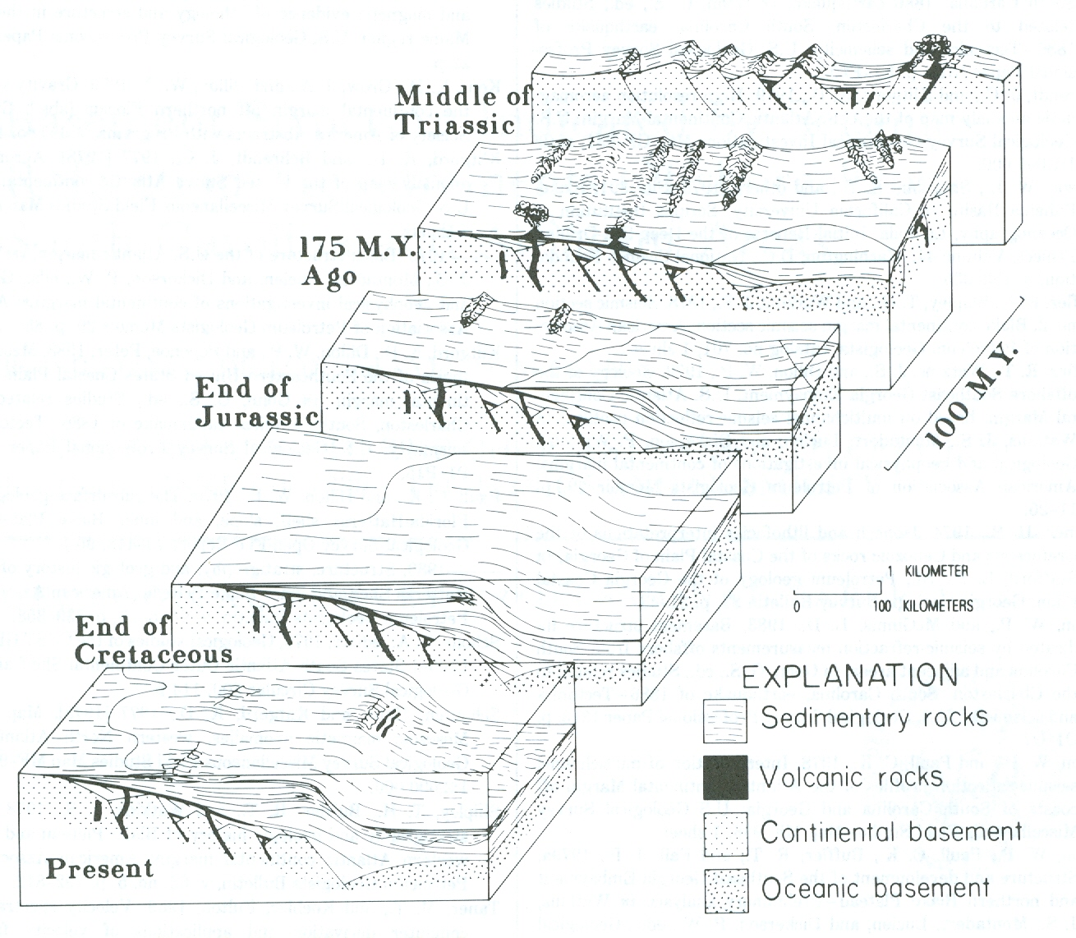
(Dillon, Klitgord, and Paull, 1983)
Notes:
Our hypothesis is that these buried faults (show 1st panel), which are associated with Mesozoic rifting and opening of the Atlantic, have been re-activated at various times and have propagated upwards, creating permeable pathways for the vertical movement of groundwater within the coastal plain (show 1st panel).

Slide 11
Evidence for Reactivated Faulting Within the Coastal Plain
Brunswick, GA
Little Blue Springs, GA
Confluence of Ogeechee & Canoochee rivers
St. Catherines Island
Notes:
Now I’ll describe some specific sites where basement faulting appears to have propagated up through the coastal plain sequence.
We’ll begin with Brunswick, Georgia.

Slide 12
Brunswick, Georgia
(Krause and Randolph, 1989)
Notes:
1) Here I want to draw your attention to the relatively small drawdown cone at the city of Brunswick (show), where industrial and municipal withdrawals have caused vertical saltwater intrusion within the Floridan aquifer system.

Slide 13
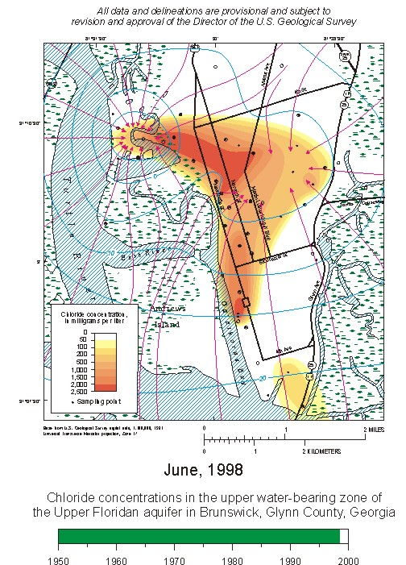
(USGS, 2001)
Notes:
1) This is a USGS map showing the major pumping centers at Brunswick (show) along with chloride concentrations in the upper Floridan – groundwater flowpaths are in red, head contours in blue.
2) Based largely on the relationship of the plume geometry to the pumping centers, the USGS has interpreted that high angle faults, or fracture zones, (SHOW) have allowed hyper-saline water from depth to move up into the upper Floridan.
3) Once in the aquifer, the saltwater then moves laterally towards the pumping wells

Slide 14
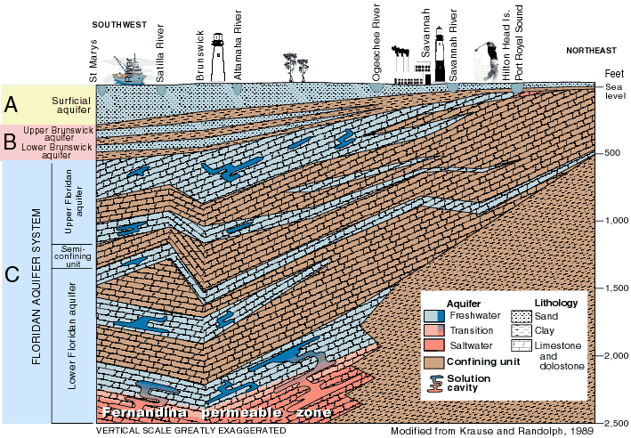
Brunswick
Hilton Head
(USGS, 2001)
Notes:
1) This is a section parallel to coast, from Florida to South Carolina, that better illustrates the vertical intrusion at Brunswick (show).
2) Here (SHOW) is the carbonate sequence of the Floridan Aquifer system (show UFA and LFA) along with the overlying younger clastic units.
3) Based on geochemical and isotopic data, the USGS identified the source of saltwater at (show) to be the Fernandina permeable zone (show).
4) This means that there must be faults and/or solution conduits at least 2000 feet in length.
5) Our hypothesis is that due to their length, these features are related to reactivated basement faulting that has propagated up through the coastal plain.
We also suspect that features like this are probably more common throughout the coastal plain than previously suspected.
An interesting question is, do any of these propagate all the way to the surface?

Slide 15
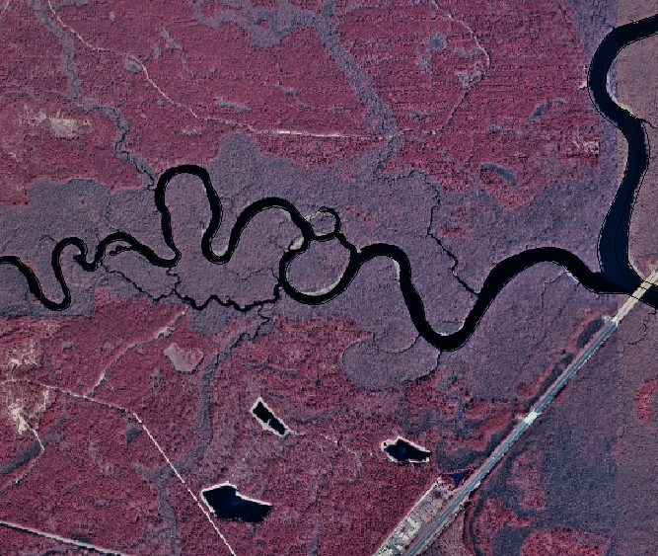
Ogeechee and Canoochee Confluence
compressed
meander zone
rectangular
drainage
lineament
scour pools
Notes:
One of the places where I suspect faulting may have propagated to the surface is at the confluence of the Ogeechee and Canoochee rivers – here is the I-95 bridge for reference.
On this infra-red, or false color image, we see rectangular surface drainage (SHOW) and a lineament within the tidal wetlands.
There is also a series of compressed meanders just upstream of this zone (SHOW), and immediately downstream (SHOW) we see deep scour pools in the river beds, indicating an abrupt increase in stream gradient.

Slide 16
Ogeechee and Canoochee Confluence
D
U
Notes:
Together these features suggest deep-seated fault or structural control of the rivers at this location (SHOW).
It’s worth noting here that fisheries biologists have documented that Atlantic and Shortnosed sturgeon congregate and seek refuge in these deep pools (show) during the heat of the summer.
Biologists have hypothesized that, in addition to the depth of the water, temperatures here were also cooler because of the presence of artesian springs.
However, we can’t test this hypothesis because this site now lies within the Savannah cone of depression where the vertical gradient has been reversed. So if there were artesian springs, they would have stopped flowing years ago.
In the future, we hope to use a floating side-scanning sonar unit to see if the sedimentary units beneath the riverbeds show any sign of faulting.

Slide 17
Magnolia and Little Blue Springs
(Krause and Randolph, 1989)
Notes:
Another site where basement faults may have propagated to the surface is at Magnolia and Little Blue Springs, located here (show).
Note that we still have positive artesian pressure in these river valleys.

Slide 18
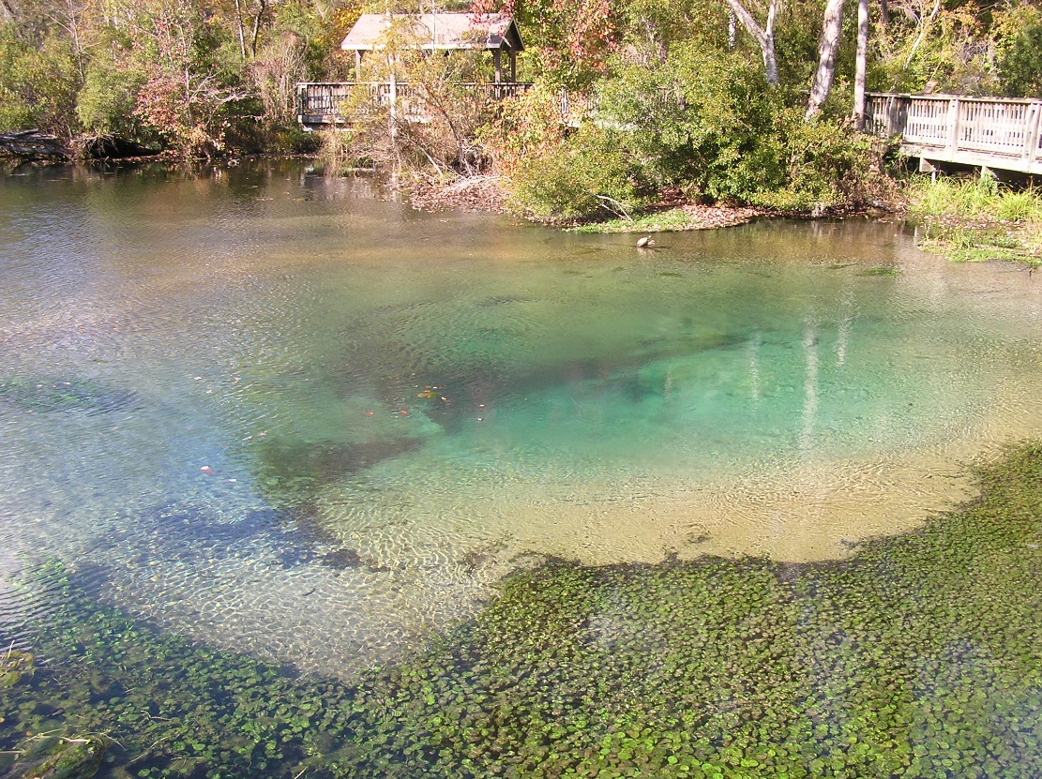
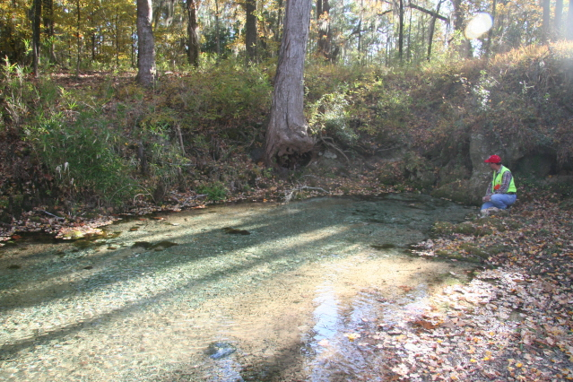
Magnolia and Little Blue Springs
Notes:
1) Here are photos of the spring heads at Magnolia and Little Blue Springs (SHOW).

Slide 19
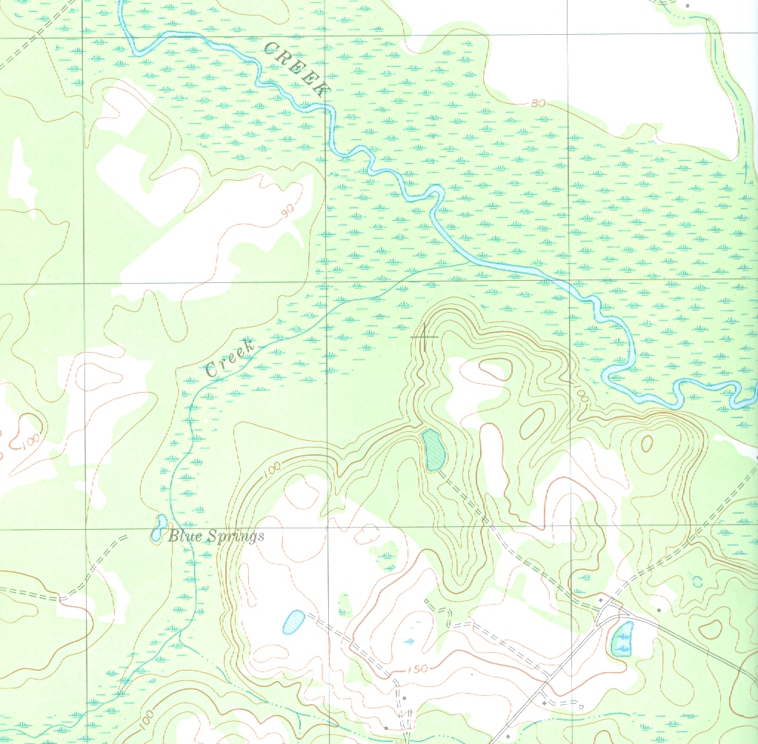
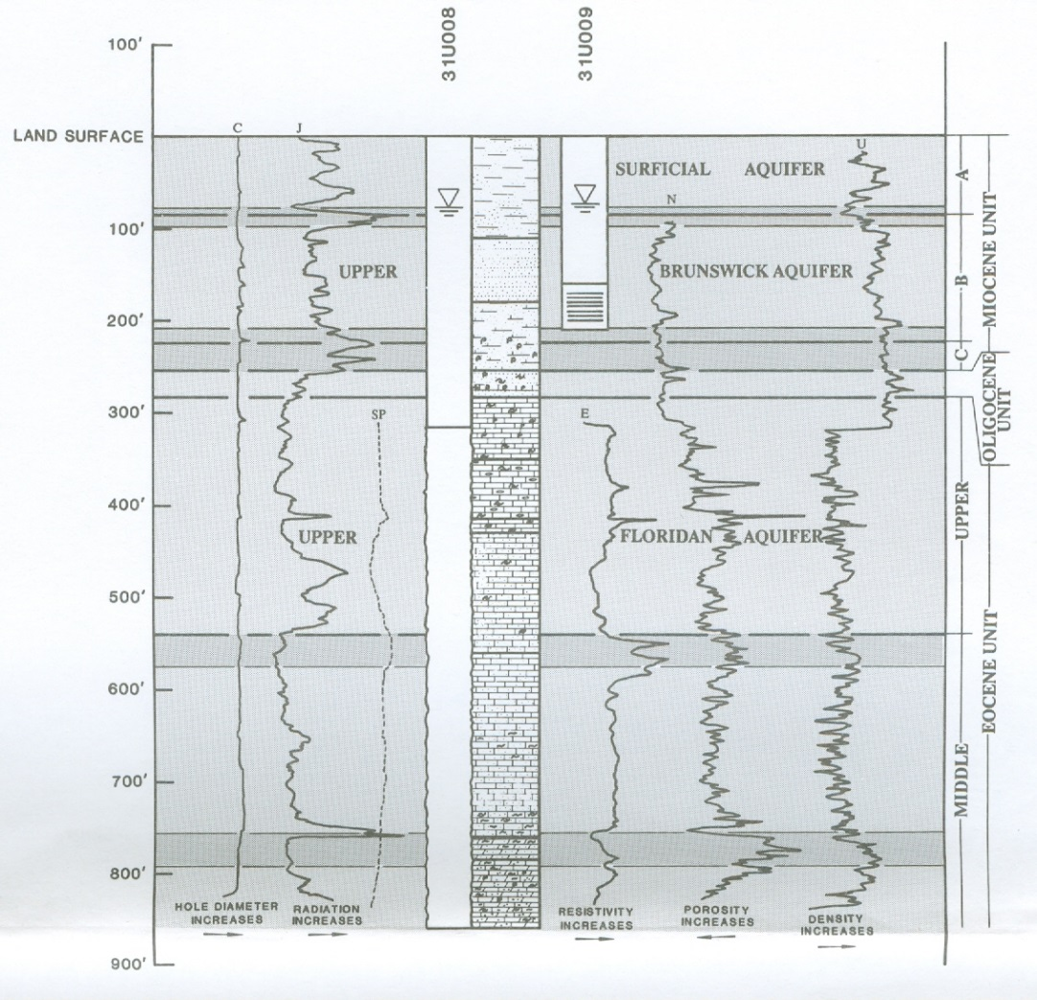
Little Blue Springs
spring
well
spring
well
(250 ft, 76 m)
(Clarke, Hacke, and Peck 1990)
Notes:
For this study, I compared the water chemistry of samples collected from the springs and from nearby deep wells (SHOW).
Of the two sites, Blue Springs proved to be the most interesting because we found limestone cropping out at the surface (SHOW map).
Based on fossil corals, the limestone was determined to be Oligocene in age (SHOW x-sect). This is important because all the outcrops in this part of the coastal plain are younger Miocene sands and clays (SHOW).
This means that 200-300 feet of the Miocene section is missing at Little Blue Springs.

Slide 20
Field and Chemical Data
Sample | temp (C) | %DO | sp. cond | pH | alk | F | Cl | NO₃ | SO₄ | Na | NH₄ | K | Mg | Ca | TDS
BS well | 21.6 | 13 | 268 | 7.62 | 2.6 | 0.07 | 2.0 | 0.08 | 8.3 | 3.3 | ND | 1.2 | 3.1 | 50.7 | 68.8
BS spring | 20.0 | 62 | 253 | 7.55 | 2.4 | 0.05 | 3.3 | 3.7 | 2.1 | 2.9 | ND | 1.0 | 2.8 | 47.7 | 63.7
MS well | 21.0 | 22 | 265 | 7.80 | 2.5 | 0.12 | 2.1 | 0.02 | 9.3 | 3.6 | 0.2 | 2.0 | 2.9 | 46.0 | 66.1
MS spring | 20.0 | 59 | 220 | 7.50 | 1.9 | 0.03 | 4.1 | 7.6 | 2.7 | 2.7 | ND | 0.8 | 1.5 | 39.1 | 58.6
Concentrations in mg/L
Alkalinity in mN
Notes:
1) Without getting into the details, what we found was that the springs and wells at both sites have very similar water chemistry.
2) If we look at the individual ions and total dissolved solids (SHOW), we see that the springs, shown in blue (SHOW) are actually dilute versions of their respective wells.
3) Also note that both springs are slightly cooler (SHOW temp) than the deep well water and have higher levels of dissolved oxygen (SHOW DO).

Slide 21
Field and Chemical Data
Sample | temp (C) | %DO | sp. cond | pH | alk | F | Cl | NO₃ | SO₄ | Na | NH₄ | K | Mg | Ca | TDS
BS well | 21.6 | 13 | 268 | 7.62 | 2.6 | 0.07 | 2.0 | 0.08 | 8.3 | 3.3 | ND | 1.2 | 3.1 | 50.7 | 68.8
BS spring | 20.0 | 62 | 253 | 7.55 | 2.4 | 0.05 | 3.3 | 3.7 | 2.1 | 2.9 | ND | 1.0 | 2.8 | 47.7 | 63.7
MS well | 21.0 | 22 | 265 | 7.80 | 2.5 | 0.12 | 2.1 | 0.02 | 9.3 | 3.6 | 0.2 | 2.0 | 2.9 | 46.0 | 66.1
MS spring | 20.0 | 59 | 220 | 7.50 | 1.9 | 0.03 | 4.1 | 7.6 | 2.7 | 2.7 | ND | 0.8 | 1.5 | 39.1 | 58.6
Concentrations in mg/L
Alkalinity in mN
Notes:
1) Also significant is that the springs contain relatively high concentrations of nitrate (SHOW) and slightly elevated levels of chloride - which is opposite the dilution trends of all the other species.
2) We interpret this to mean that the spring waters are originating from the same carbonate aquifer as the wells, but then undergo dilution as they mix with shallower groundwater that is rich in both nitrate and chloride.

Slide 22
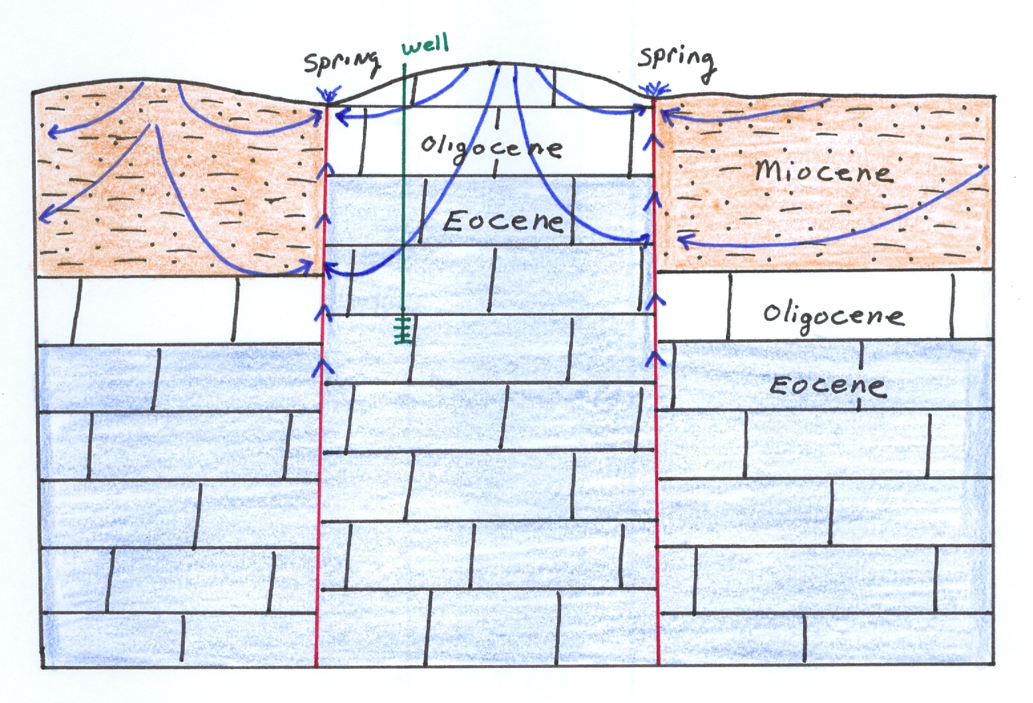
Conceptual Model
Notes:
Based on the stratigraphic and chemical data, we have developed this conceptual model.
Here, high-angle faults have brought Oliogocene and Eocene carbonate rocks in juxtaposition with the Miocene clastics.
3) This has created permeable pathways for deeper groundwater (SHOW) to move upwards and mix with shallow groundwater before discharging at the springhead.
4) What we don’t know is the depth of this faulting. But with at least 200 feet of displacement, it’s likely to be related to deep basement structures.

Slide 23
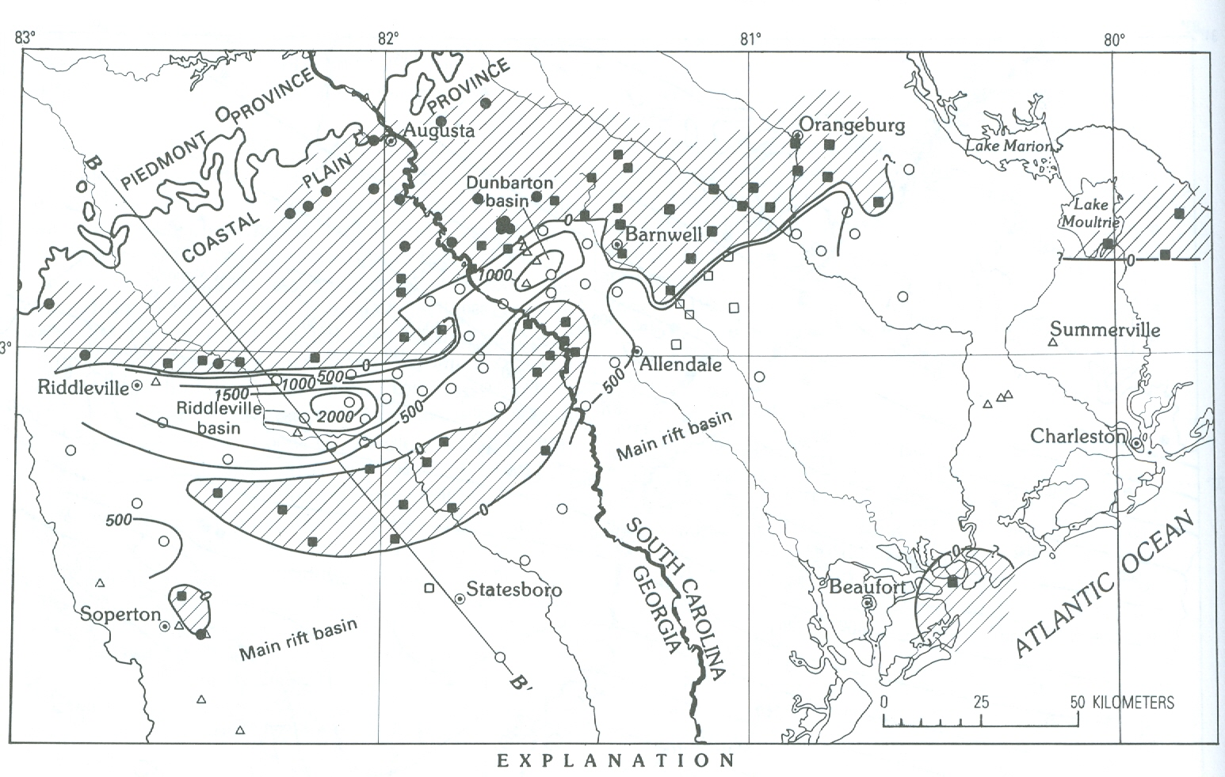
Magnolia Springs
Little Blue Springs
(Daniels, Zietz, and Popenoe, 1983)
Notes:
This interpretation is supported by the work of Daniels, Zietz and Popenoe, who mapped Mesozoic horst and graben structures in this area (SHOW) based on geophysical and deep well data.
2) Therefore, its quite plausible that renewed fault movement along these buried structures have propagated upwards through the coastal plain.

Slide 24
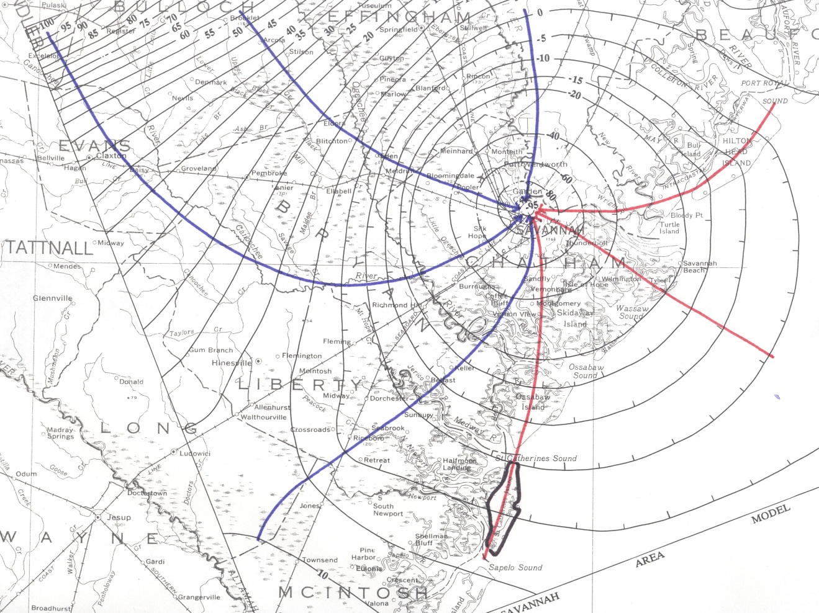
St. Catherines Island
(Modified after Garza & Krause, 1997)
Notes:
Finally, this brings us to our last site at St. Catherines Island, where we’ve been studying the hydrogeology of the island for the past 4 years.
Here I’ve outlined the island along with groundwater flowpaths on a potentiometric map of the Upper Floridan from a 1997 USGS modeling study.
Red flowpaths (show) indicate the areas with the potential for the lateral intrusion of modern seawater, similar to what is taking place at Hilton Head Island (SHOW).

Slide 25
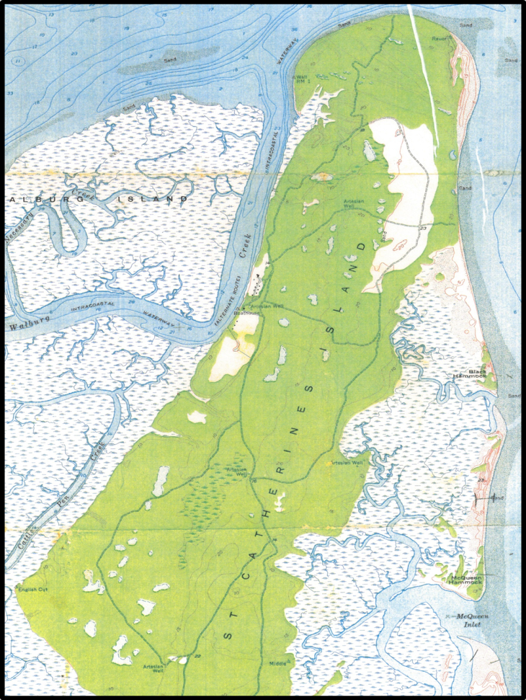
(USGS, 1954)
Notes:
My colleagues, Kelly Vance, Brian Meyer, Fred Rich, and Gale Bishop, have been working on the geology of St Catherines for about 10 years now. One of things that stood on older topographic maps was the linear alignment of freshwater ponds and wetlands on the island (SHOW).
They also found written accounts from the Colonial Period that indicated these freshwater bodies had been fed by artesian springs.

Slide 26
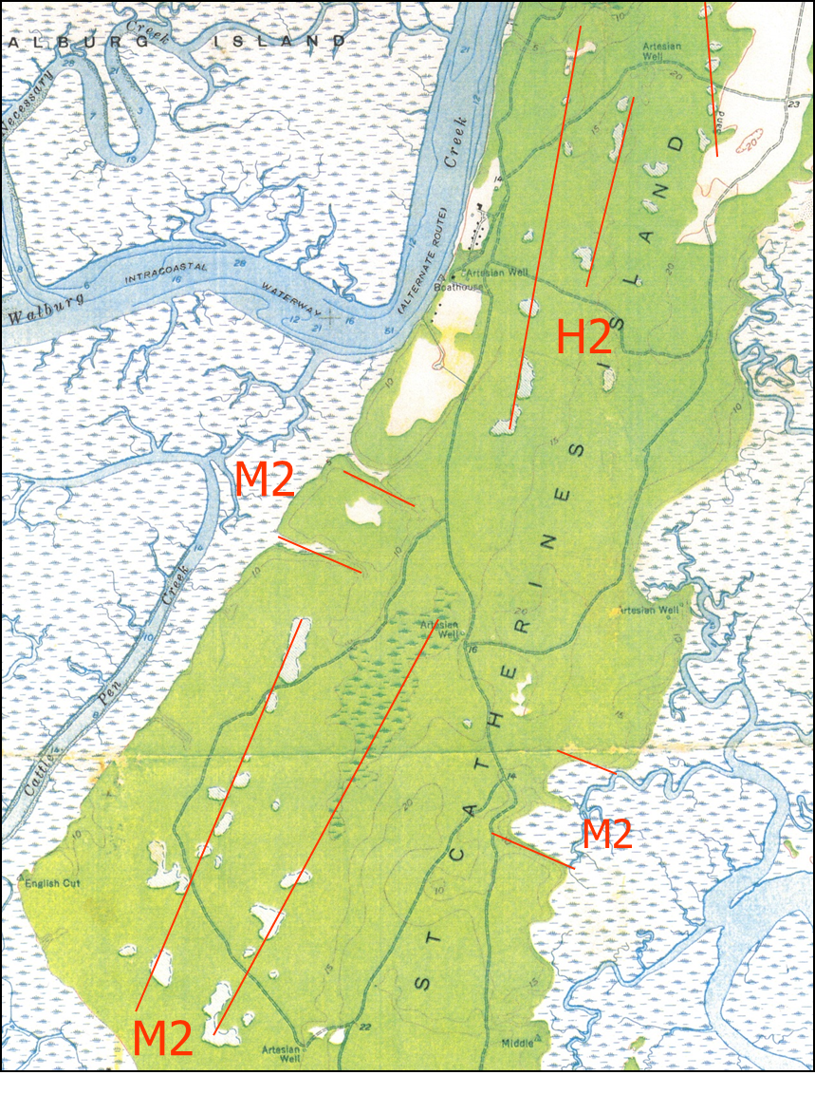
--- M2 (Miocene) and H2 (Quaternary) joint trends of Bartholomew et al., 2007
Notes:
1) The observed alignment of freshwater ponds and marshes turned out to line up with the systematic joint sets mapped by Bartholomew and others at various sites on the Coastal Plain of Georgia and South Carolina.

Slide 27
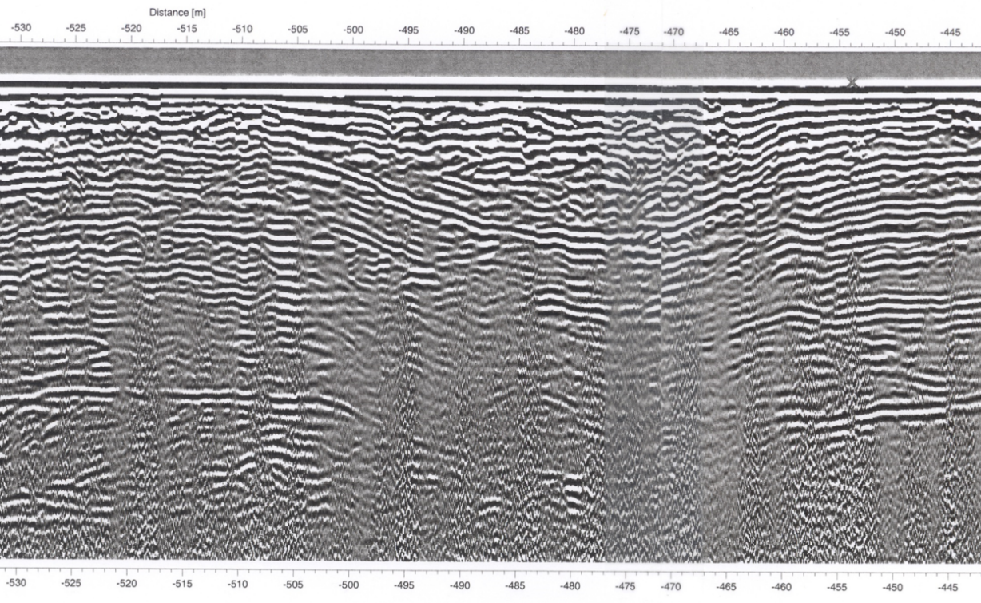
Ground Penetrating Radar
(Vance et al, 2013)
Notes:
My colleague Kelly Vance then began doing ground-penetrating radar surveys on the island to examine the shallow subsurface.
This is an example profile from Kelly’s work showing the presence of sag structures a few meters below the surface.
In contrast to cut and fill features that form by erosion and then in-filled by deposition, sag structures commonly form when subsurface void spaces collapse, causing the overlying layers to sag.

Slide 28
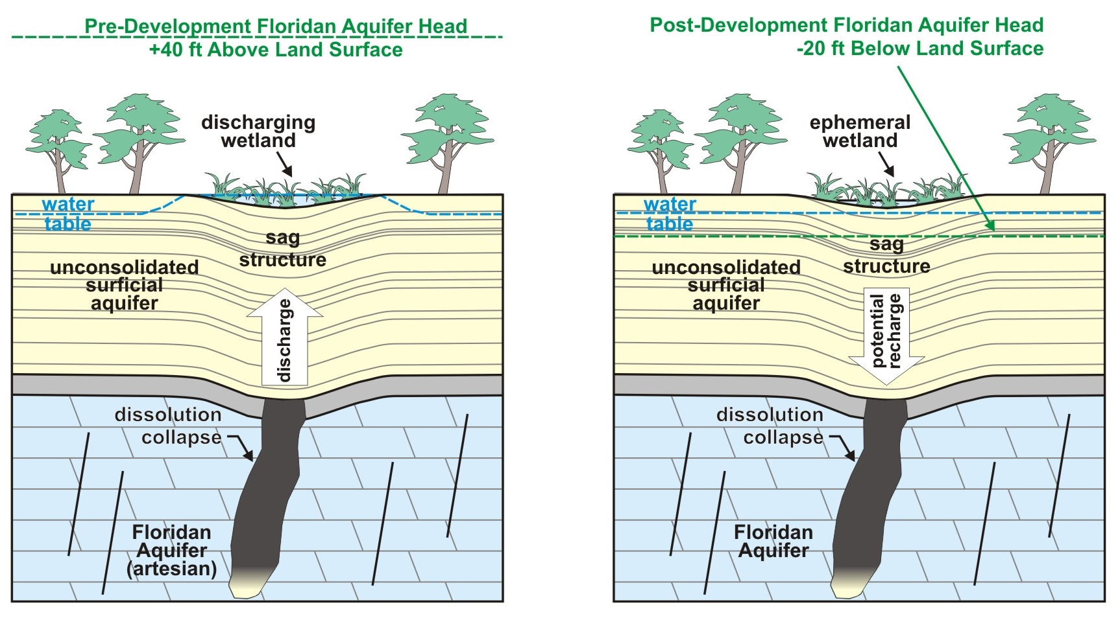
Development of Sag Structures
Notes:
Our working hypothesis is that prior to modern pumping withdrawals (SHOW left panel), artesian flow from the Floridan aquifer moved upward along joint systems, creating artesian springs at the surface.
Overtime, caverns or void spaces formed in the limestone. Some of these voids collapsed, creating sag structures in the overlying layers.
Today (SHOW right), because the island lies within the cone of depression, artesian water from the Floridan no longer flows upwards along these conduits. Instead, we have the potential for surficial groundwater to move down into the Floridan aquifer.

Slide 29
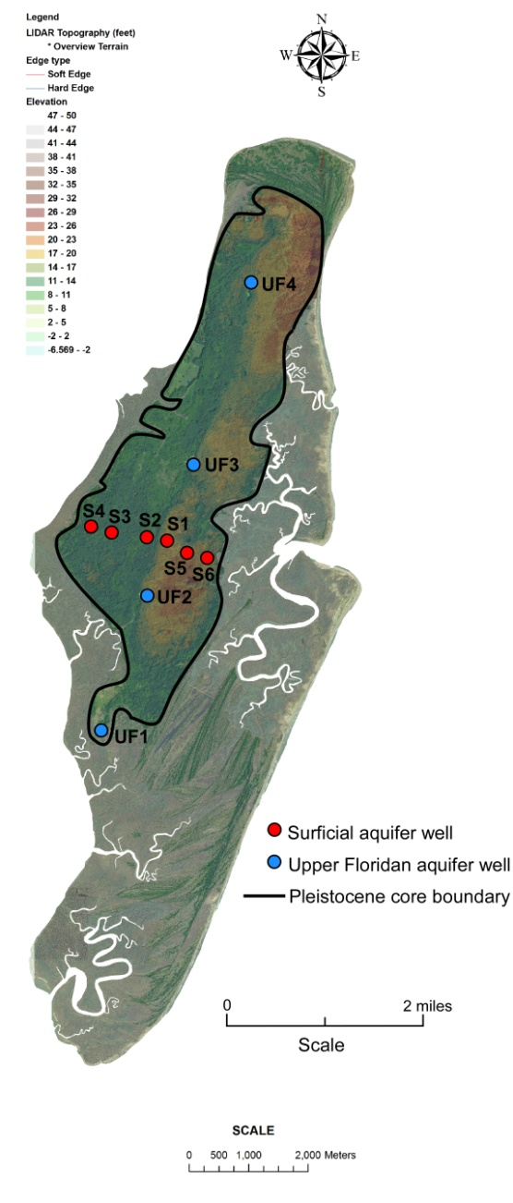
(after Meyer et. al. 2009)
Notes:
1) In 2011, we started studying the hydrogeology of St. Catherines.
2) Shown here’s is a LIDAR map where I marked the boundary of the island’s Pleistocene core along with two well transects.
3) We have a N-S transect of 4 wells in the Upper Floridan aquifer and an E-W transect of 6 wells that we installed in the surficial aquifer.

Slide 30
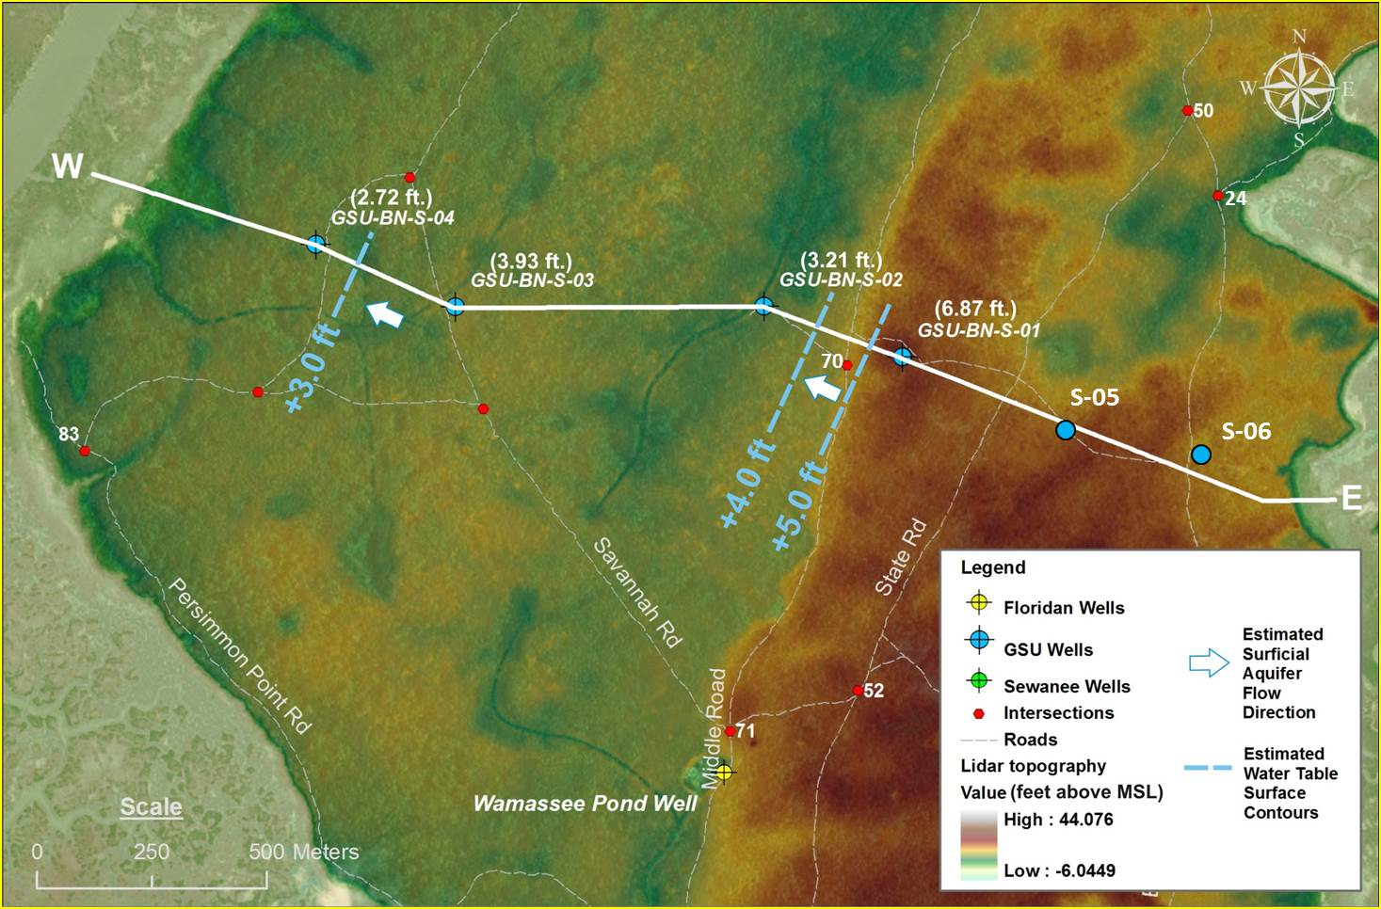
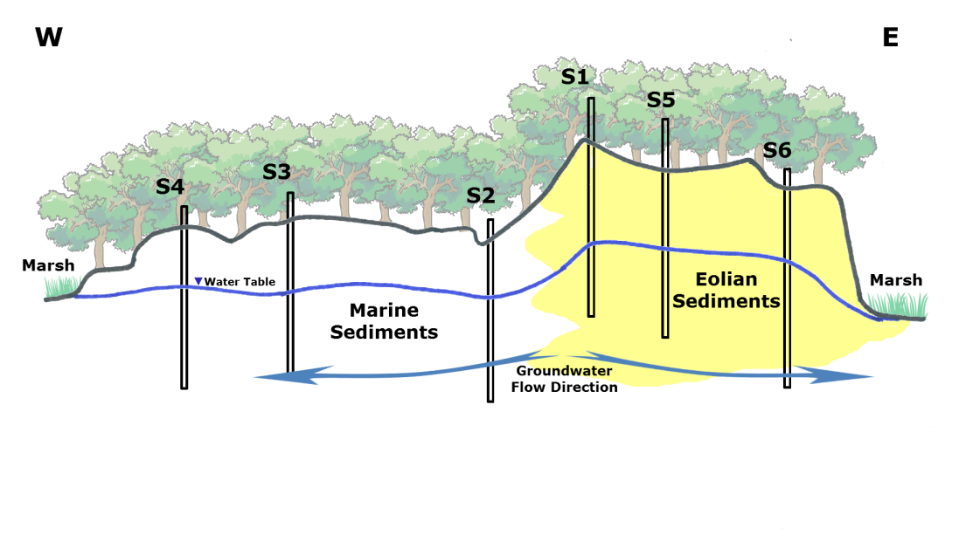
Notes:
1) This is a detailed view of the topography (SHOW top) along our E-W transect.
2) Initially we installed 4 wells (show bottom), with well #1 located on the crest of the topographic high, and well #4 to the west on the lagoon-side of the island.
3) Two years later we installed wells #5 and #6 to the east on the ocean-side, thereby completing our traverse across the island.

Slide 31
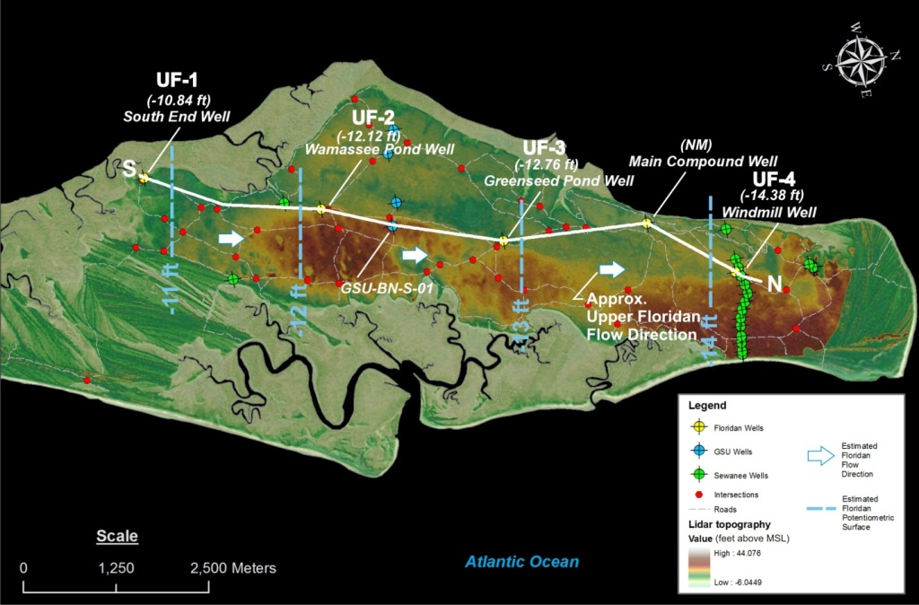
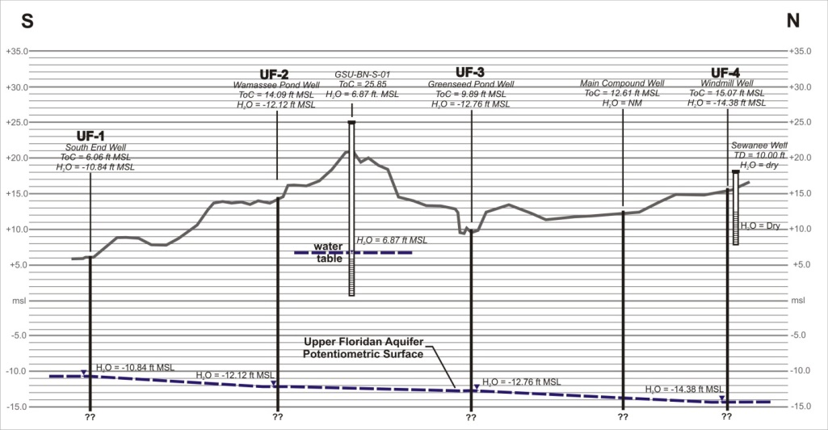

Sea Level
Notes:
1) Here’s a view (SHOW top) of the Floridan transect oriented from south to north, and below is a cross-section showing the artesian head in each well (SHOW).
2) Note that the artesian heads are all below sea level and that the horizontal gradient (SHOW) is to the north.
3) As you can see on the map, our Upper Floridan transect therefore coincides with a south to north flowpath into the Savannah cone-of-depression (SHOW).

Slide 32
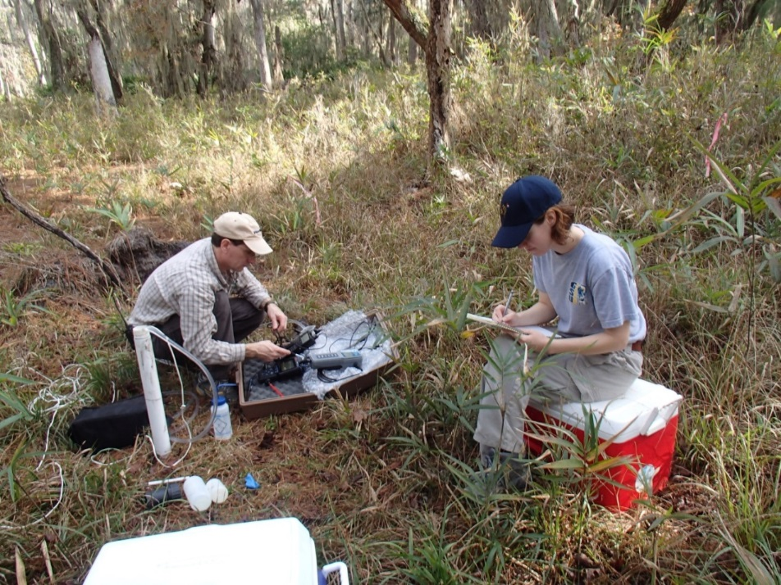
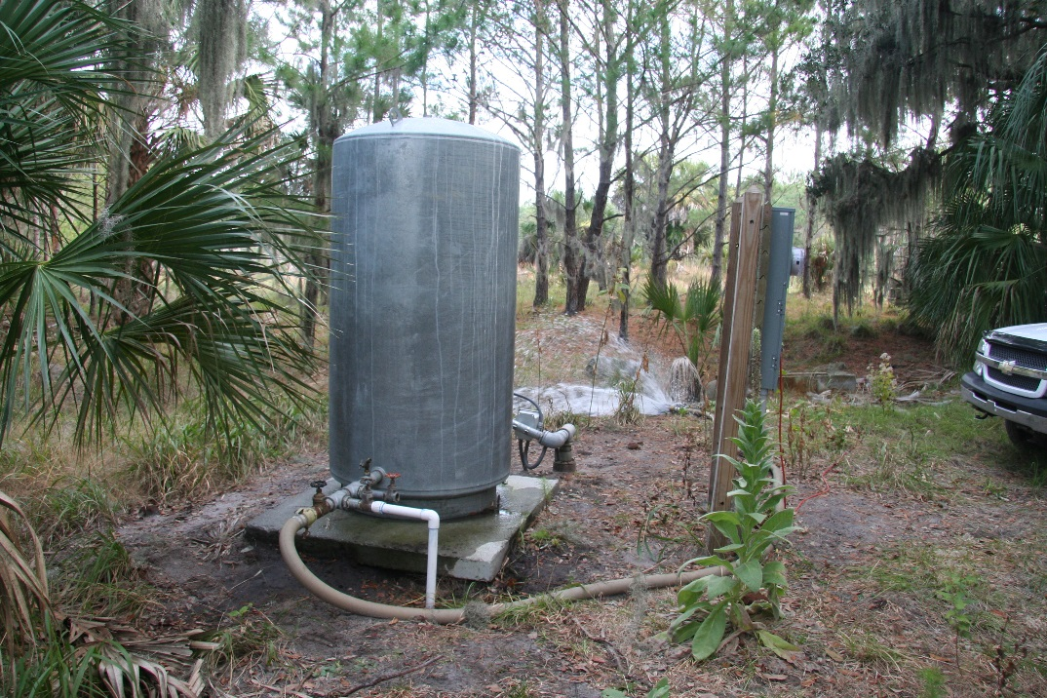
Field Data
Head, temp, DO, conductivity, pH, ORP, & alkalinity
Major ion chemistry
Na⁺, NH₄⁺, K⁺, Mg²⁺, Ca²⁺
F⁻, Cl⁻, NO₃⁻, PO₄³⁻, SO₄²⁻
Notes:
1) With respect to our well data, we collected field and chemistry data from both the deep and shallow aquifers on a monthly basis for the first year, then switched to quarterly sampling for the past 3 years.

Slide 33
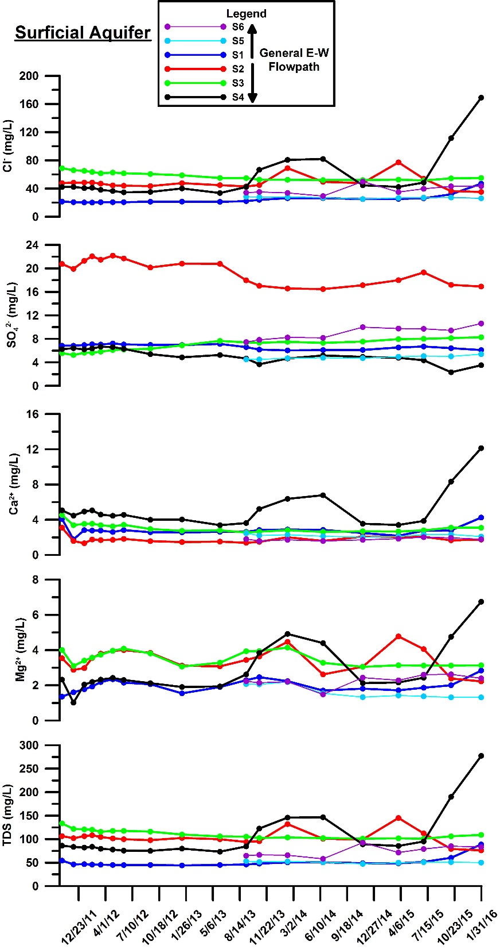
Surficial Aquifer Results
Notes:
This plot (show) shows some of our chemistry data from the surficial aquifer over the past 4 years. At the top (SHOW) is chloride, followed by sulfate, calcium, magnesium, and total dissolved solids.
Without getting into the details, the important thing here is the salinity spikes (SHOW TDS, Mg, Ca, Cl) in our most western well on the marsh side of island (SHOW map).
Although less pronounced, we see also see salinity spikes in the eastern well on the ocean side (SHOW TDS).
The most recent spike that we first saw on our Oct 10th sampling is clearly due to the Super Tide that occurred just 8 days earlier on October 2nd.

Slide 34
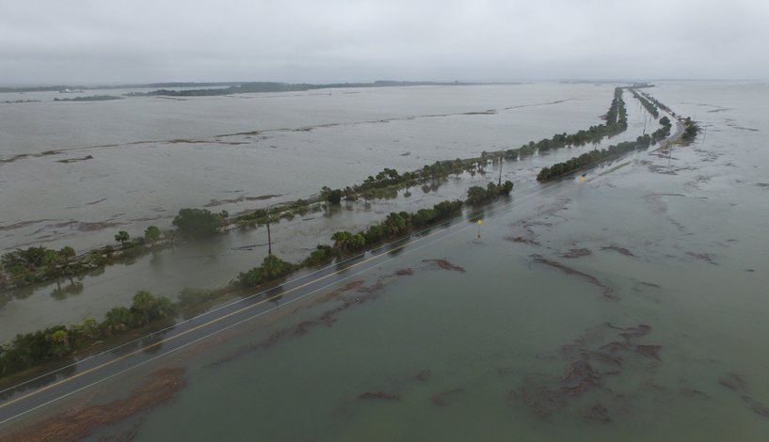
Notes:
Thus, what we’re seeing here on St. Catherines is lateral saltwater intrusion (SHOW TDS spikes) of the surficial aquifer associated with unusually high tides.
It’s too early to tell, but it appears that that the intrusion occurs more rapidly and is more pronounced (SHOW TDS spikes) on the marsh-side of island.

Slide 35
--- M2 (Miocene) and H2 (Quaternary) joint trends of Bartholomew et al., 2007
Notes:
We hypothesize that there are permeable pathways, perhaps joint related, that are allowing saltwater to intrude faster and further into the aquifer along the marsh side our transect.

Slide 36
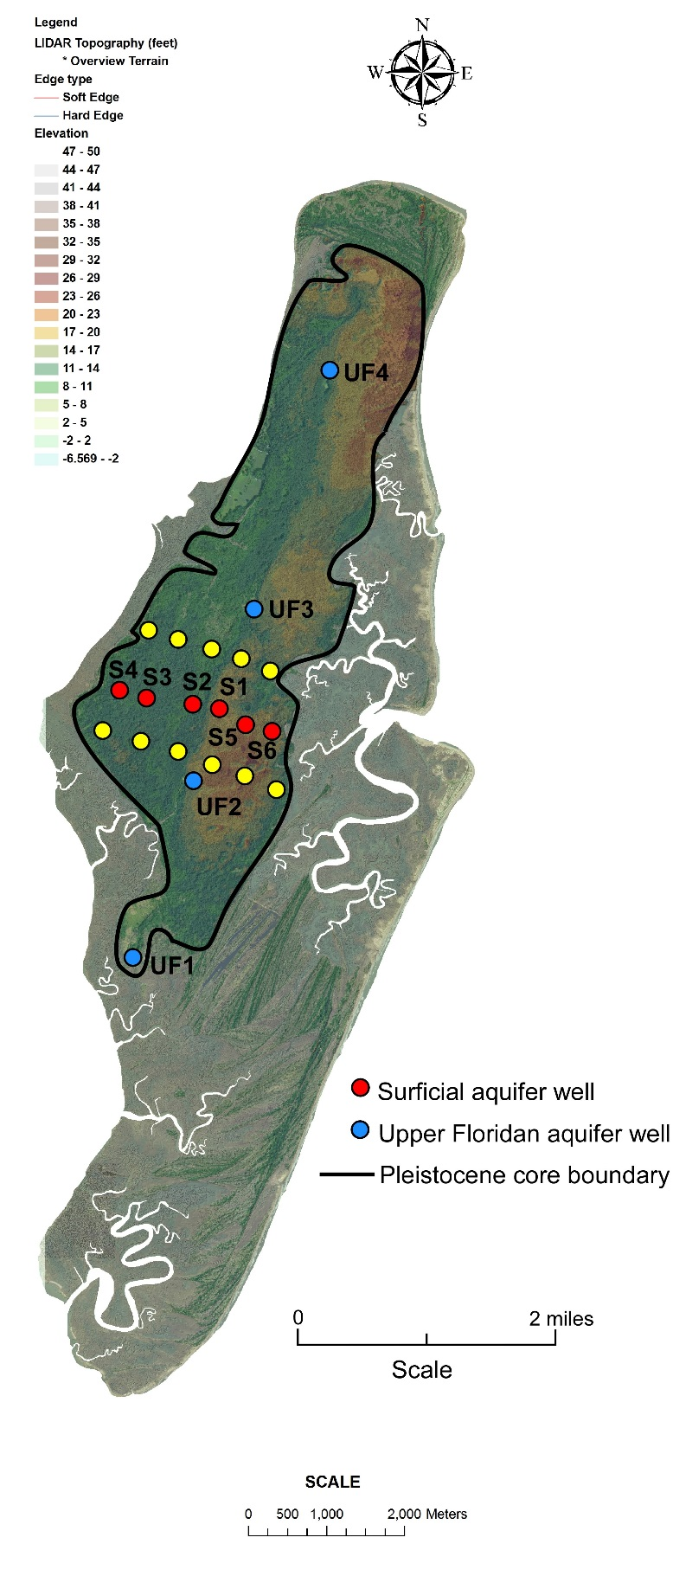
(after Meyer et. al. 2009)
Notes:
I should mention here that our research group was recently awarded a Georgia Sea Grant to install 2 more traverses (show yellow) into the surficial aquifer on St. Catherines.
We just completed the well installation 2 weeks ago and will be collecting our first set of samples in May.
The additional data should allow us to more accurately track the spatial distribution of the saltwater pulses as they move inland.

Slide 37
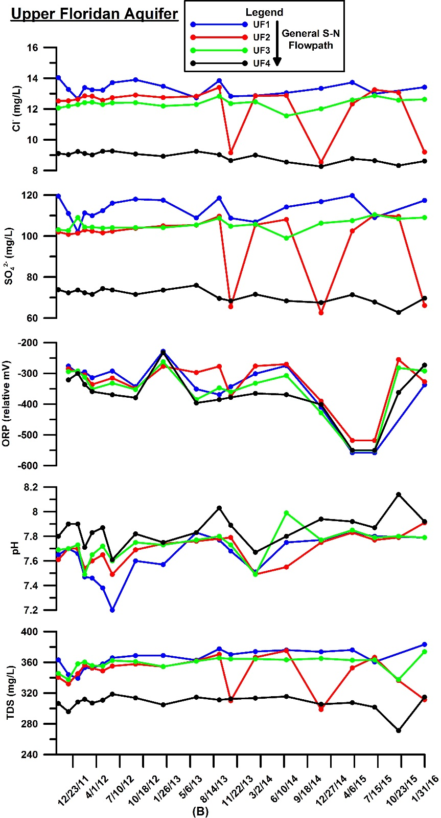


Upper Floridan Results
Sea Level
Notes:
1) With respect to data from the upper Floridan transect, here is a plot (SHOW) of chloride, sulfate, ORP, pH and TDS for the past 4 years.
2) The blue plot (SHOW legend) represents the most up-gradient well at the southern end of our transect (map), whereas black represents the most down-gradient well to the north.
3) What’s important here is how chloride concentrations (show graph) progressively decline as you move along the flowpath from south to north (SHOW x-sec).

Slide 38
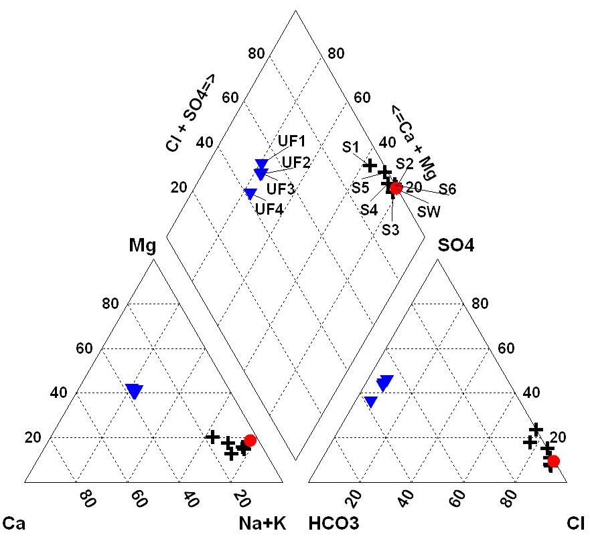
Piper Diagram Analysis
Notes:
1) To help interpret the data, we plotted the chemistry data on a ternary, or Piper diagram shown here. The average water chemistry of the surficial wells is shown by black crosses (show) and the deep artesian aquifer in blue.
2) Without getting into the details, this plot shows that Upper Floridan water is a Ca/Mg (show cation triangle) and HCO₃/SO₄ type water (show anion triangle), whereas the surficial groundwater is a strong Na-Cl type water with similar ion proportions as seawater, which is shown by the red circle.
3) What’s interesting here is how the Floridan samples appear to fall along a mixing line, with chloride concentrations decreasing along the flowpath.

Slide 39

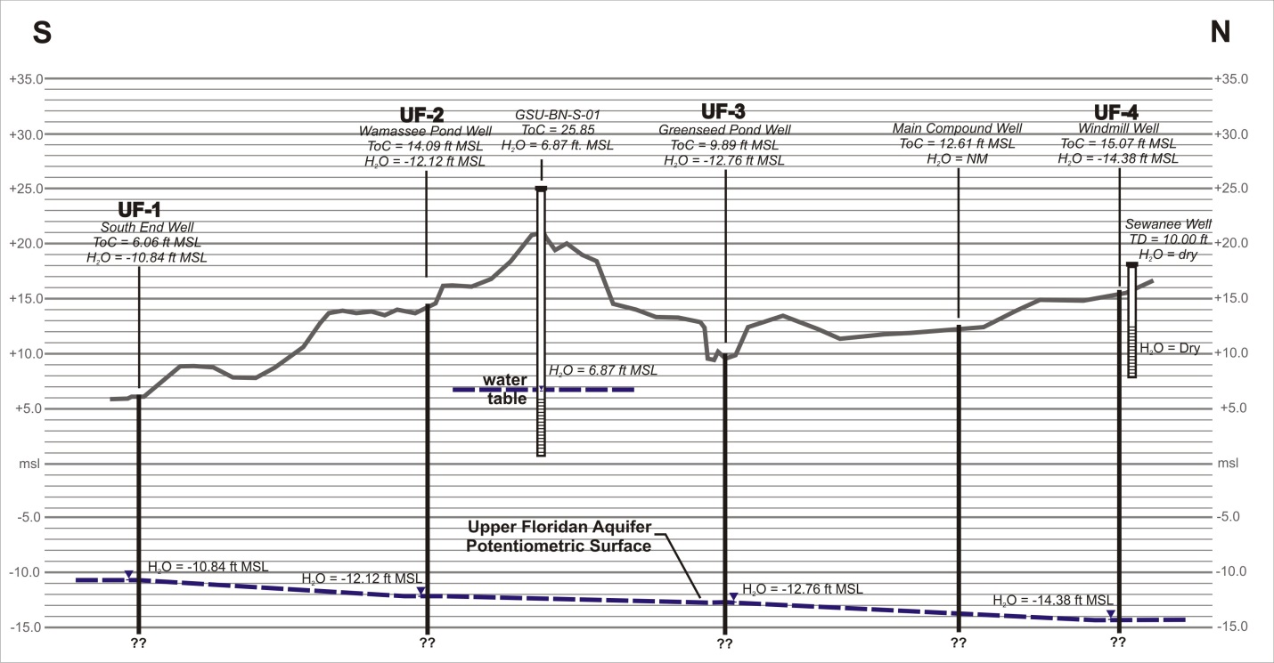
Na-Cl type water
Decreasing Cl
Notes:
1) Again, what we’re seeing is that chloride decreases along the flowpath within the Upper Floridan (show).
2) Because chloride doesn’t undergo chemical reactions, it’s declining concentration could be explained by dilution due to mixing with water from some other source, such as the surficial aquifer (SHOW), particularly since the vertical gradient here is downward.
3) We can rule out the surficial aquifer since its chloride concentrations are much higher than those of the Upper Floridan. If significant vertical mixing with the surficial aquifer was taking place, chloride would be increasing along the flowpath, not decreasing.
4) The other explanation is that we have saltwater intrusion taking place somewhere up-gradient (SHOW) of the island.

Slide 40
(Modified after Garza & Krause, 1997)
Notes:
1) An obvious up-gradient source would be modern seawater coming in through a breech in the confining layer in Sapelo Sound (SHOW), similar to what’s happening at Hilton Head.
2) Since the chemistry of modern seawater is well known, we can test this hypothesis quite easily.

Slide 41
Notes:
1) Recall that modern seawater plots over here (SHOW) on the piper diagram.
2) Since the saltwater source should plot somewhere on the up-gradient side of the Upper Floridan mixing line (SHOW), we can rule out modern sea water.

Slide 42
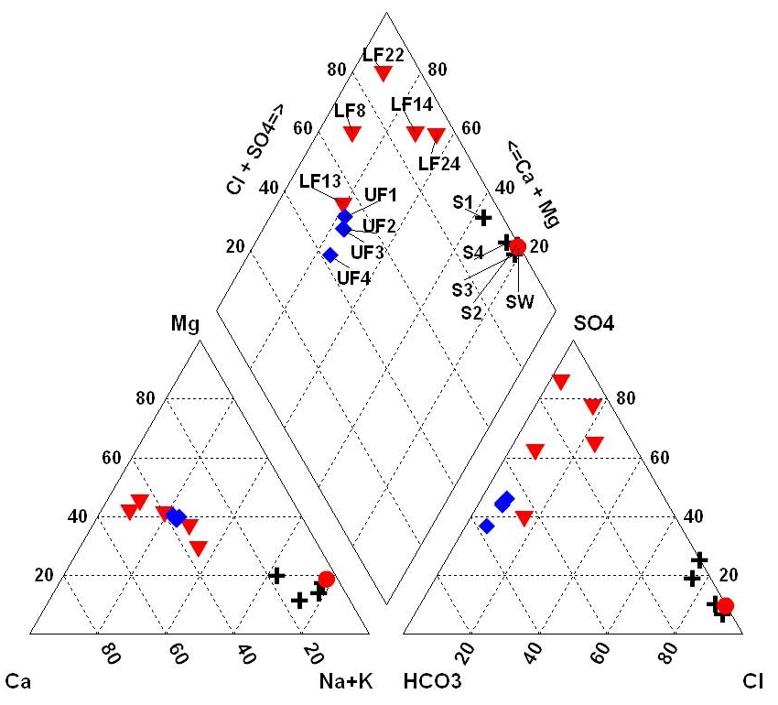
Notes:
1) What does plot up-gradient of the mixing line are Lower Floridan samples collected along the Georgia coast by Fred Falls and others (2005).

Slide 43
Brunswick
St. Catherines
Hilton Head
(USGS, 2001)
Notes:
Recall from the USGS work in the Brunswick area, deep hypersaline water is known to be moving into the Upper Floridan along a vertical conduit.
2) Our working hypothesis is that a similar conduit (SHOW) also exists just up-gradient of St. Catherines Island. Major pumping in the Upper Floridan in the Savannah area has increased the vertical gradient within the system, allowing more saline water to move upwards along this conduit and into the Upper Floridan.
3) The mixed waters then move laterally beneath St. Catherines Island and into the large cone-of-depression at Savannah.
4) Again, we hypothesize that vertical flow along faults and solution conduits is relatively common throughout the coastal plain sequence, and that the faulting is likely related to reactivated Mesozoic basement structures.

Slide 44
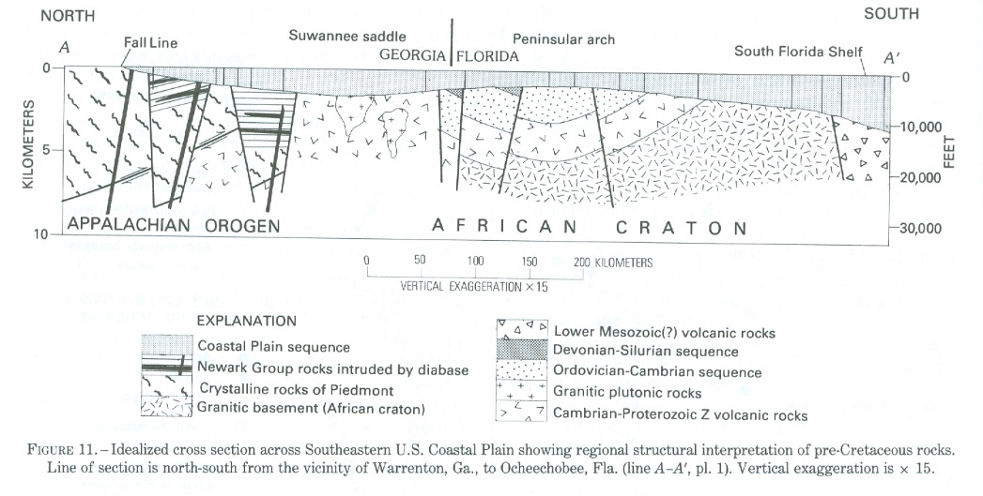
Conclusions
St. Catherines
Reactivated basement faulting is probably relatively common in the Georgia coastal plain.
Prior to major pumping, these vertical pathways would have created artesian springs.
Today, the pathways have the potential to accelerate vertical saltwater intrusion within the coastal plain.
Brunswick
Hilton Head
(USGS, 2001)
(Chowns and Williams, 1983)
Notes:
In conclusion……..

Slide 45
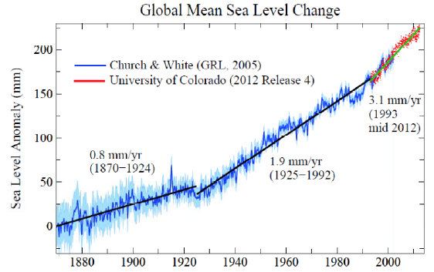
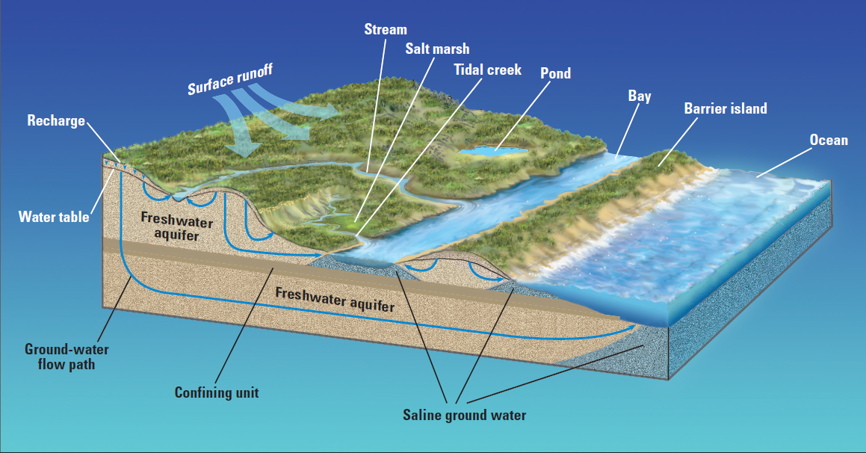
Conclusions
On barrier islands, faults and regional joints allow for more rapid lateral intrusion in the surficial aquifer.
Lateral intrusion is occurring in pulses, and will take place more frequently as sea level rise accelerates.
(NASA, 2015)
(USGS Circular 1262)
Notes:
Finally, on our barrier islands, faults and regional …….

Slide 46
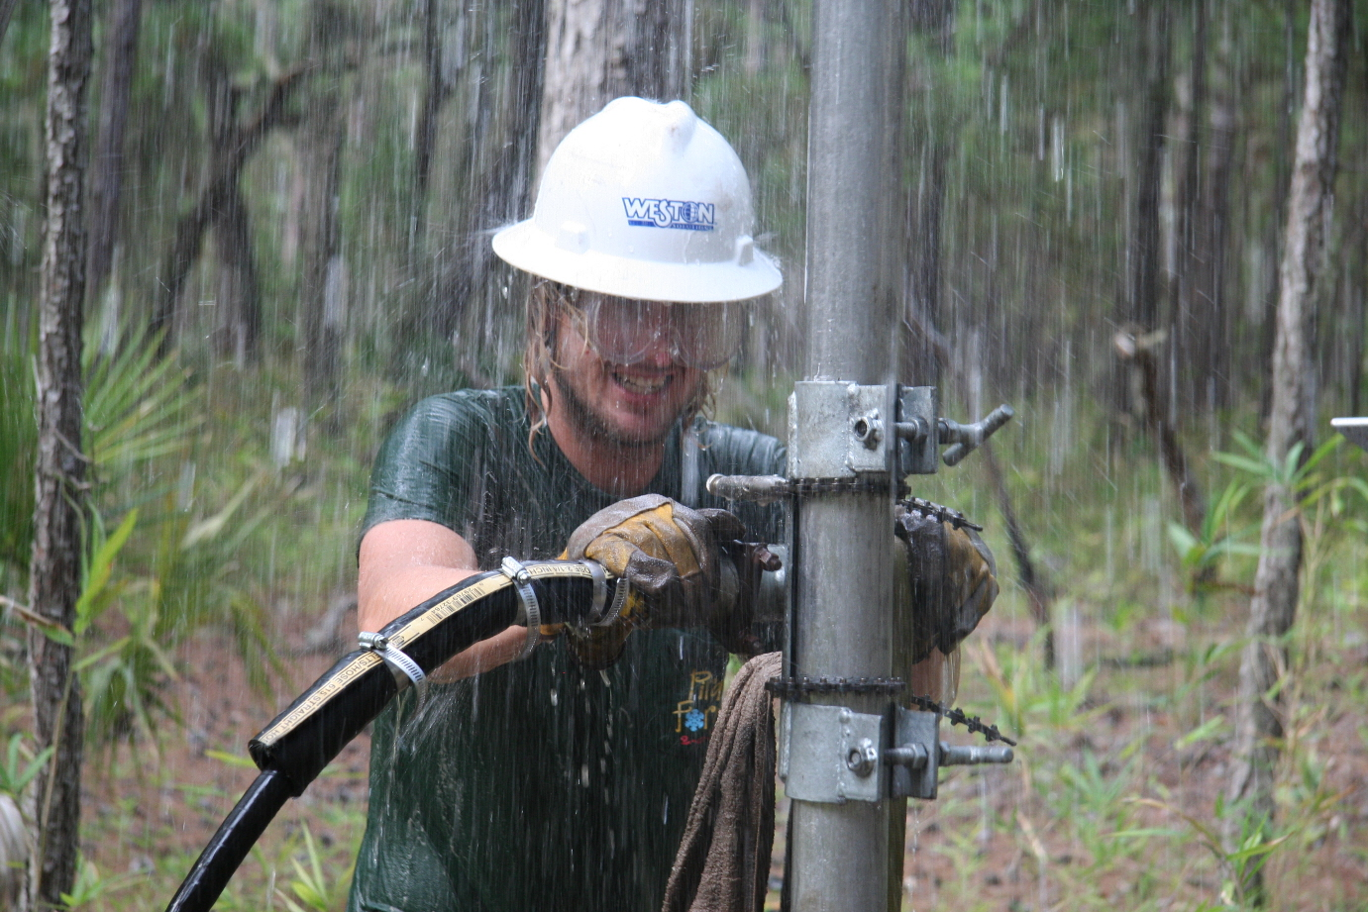
Questions?
Notes:
With that, are there any questions?

Slide 47
References
Falls, W. Fred Harrelson, Larry G., Conlon, Kevin J., and Petkewich, Matthew D. , 2005, Hydrogeology, Water Quality, and Water-Supply Potential of the Lower Floridan Aquifer, Coastal Georgia, 1999-­2002: Scientific Investigations Report 2005-5124, 98 p.
Chowns, T.M. and Williams, C.T., 1983, Pre-Cretaceous rocks beneath the Georgia Coastal Plain – Regional Implications, USGS Prof. Paper 1313-L.
Daniels, D.L., Zietz, I., and Popenoe, P., 1983, Distribution of Suburface lower Mesozoic rocks in the southeastern United States, as interpreted from regional aeromagnetic and gravity maps, USGS Prof Paper 1313-K.
Dillion, W. P., Klitgord, K.D., and Paull, C.K, 1983, Mesozoic development and structure of the continental margin of South Carolina, USGS Prof. Paper 1313-N.
Garza, R., and Krause, R.E., 1997. Water-Supply Potential of Major Streams and the Upper Floridan Aquifer in the Vicinity of Savannah, Georgia. U.S. Geological Survey Water-Supply Paper 2411, 38 p.
Krause, R.E., and Clarke, J.S., 2001. Coastal Ground Water at Risk - Saltwater Contamination at Brunswick, GA and Hilton Head Island, SC: U.S. Geological Survey Water Resources Investigations Report 01-4107, 1 oversize sheet.
Krause, R.E. and Randolph, R.B., 1989, Hydrology of the Floridan aquifer system in southeast Georgia and adjacent parts of Florida and South Carolina, USGS Prof. Paper 1403-D.
Meyer, B.K., Keith-Lucas, T., Bishop, G.A., Thomas, D.H., Hayes, R.H., Sanger, M., and Vance, R.K., 2009. Digital Atlas of St. Catherines Island, Georgia. St. Catherines Research Consortium Publication CD-1
Meyer B.K. (2013). Shoreline Dynamics and Environmental Change Under the Modern Transgression: St. Catherines Island, Georgia. PhD Dissertation, Georgia State University, Atlanta, GA
Miller, J.A., 1986, Hydrologic framework of the Floridan aquifer system in Florida, and in parts of Georgia, Alabama, and South Carolina, USGS Prof Paper 1403-B.
Notes:
In summary then, (read)

