Slide 1
Structural Controls on the Hydrology of Two Georgia Barrier Islands
R. Kelly Vance¹, Brian K. Meyer², James S. Reichard¹
              (1) Georgia Southern University
              (2) Georgia State University
Geological Society of America: Southeastern Section
65th Annual Meeting

Slide 2
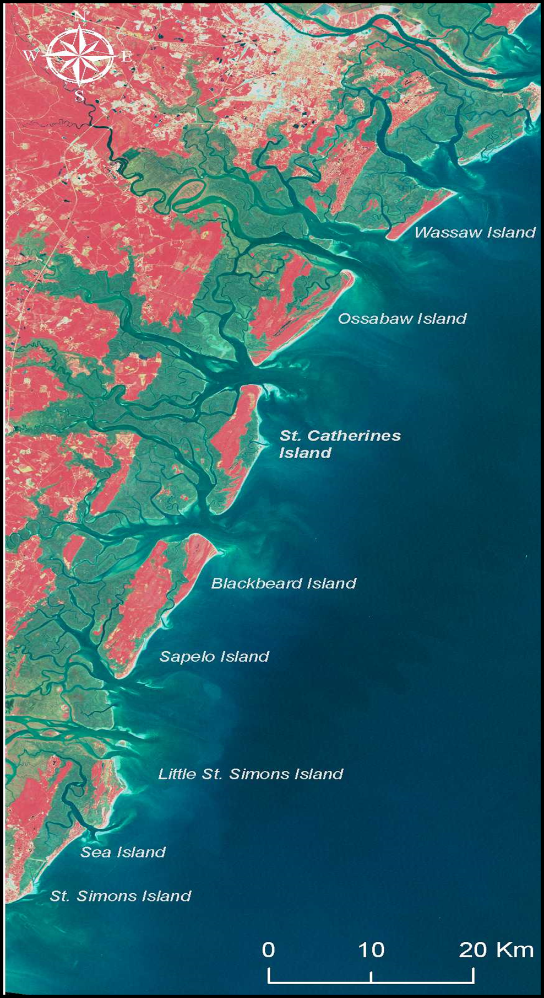
GA Coastal Plain and Barrier Islands
Savannah, GA
Isle of Hope
St. Catherines Island

Slide 3
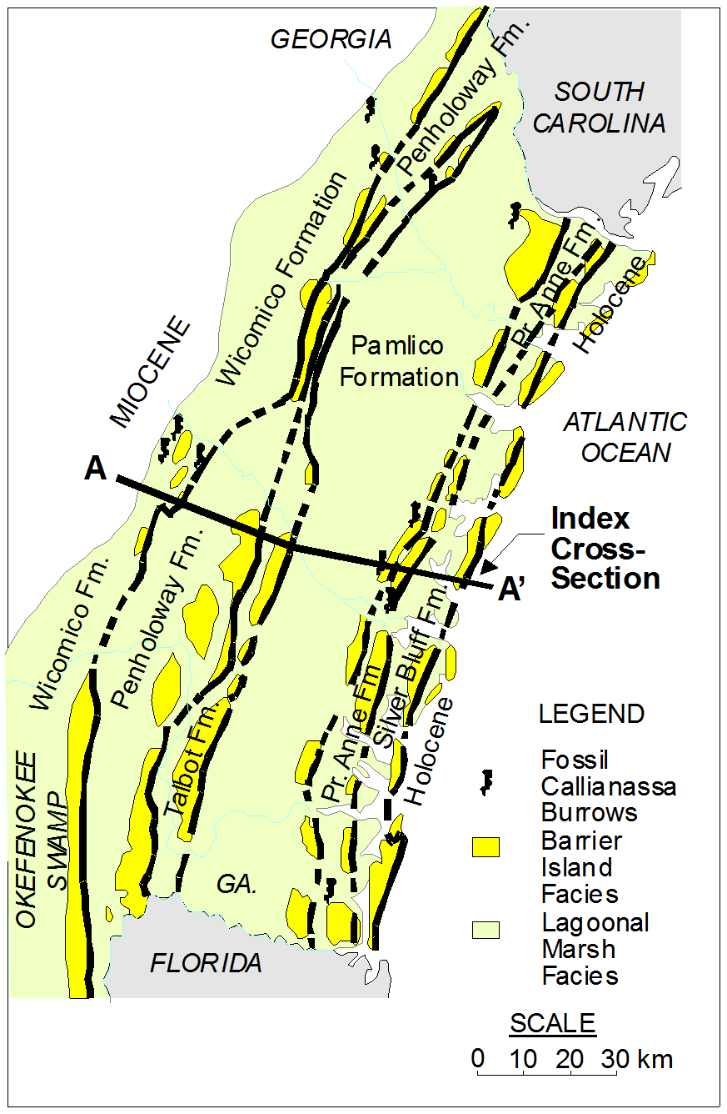
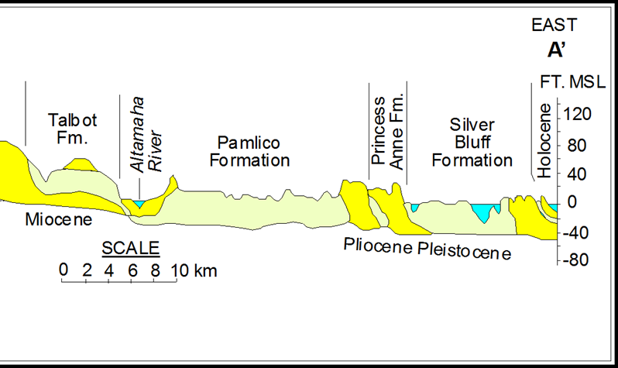
Geological Setting
Isle of Hope
(Wormsloe Historic Site host )
St. Catherines Island
(After Hoyt & Hails, 1968)
(After Hoyt & Hails, 1968)

Slide 4
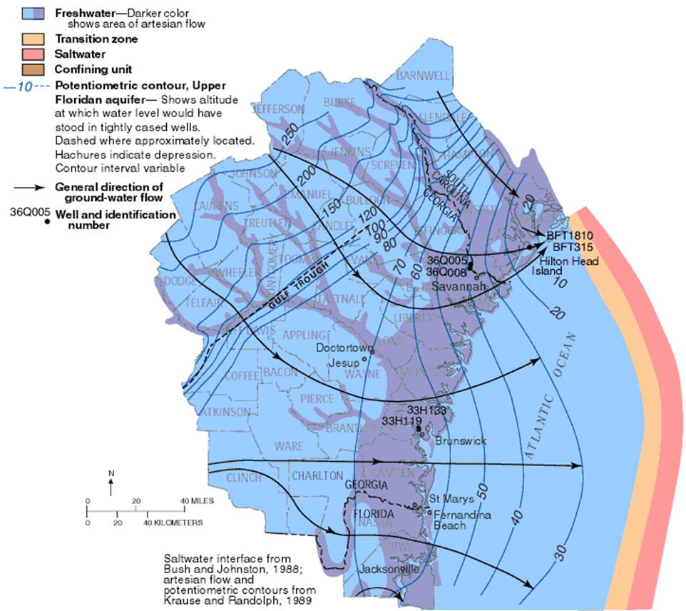
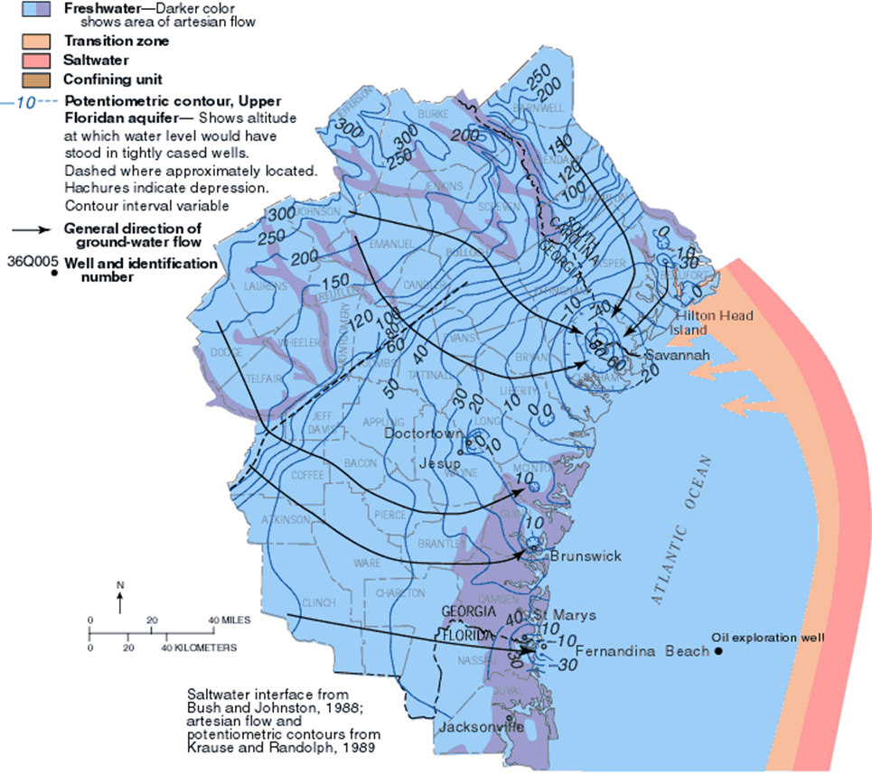
GA UPPER FLORIDAN AQUIFER – PAST AND PRESENT CONDITIONS
Pre-Industrial
← SCI Well log in 1909, “Flow at 432 ft in marl and rock, static head 42 ft above the surface” (W. J. Floyd)
Post-Industrial
SCI
SCI
SCI Today → Potentiometric surface of Floridan is 11 to 15 ft below MSL (Figures from Krause and Randolph, 1989)

Slide 5
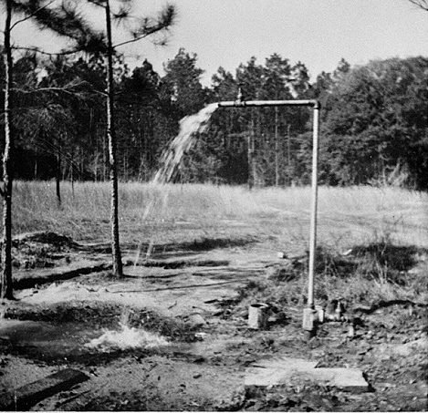
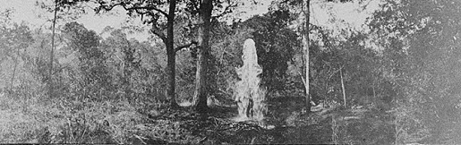
Artesian Wells
Flemington, Liberty County - 1951
Sapelo Island, between 1915 and 1934

Slide 6
Hydrologic History on St. Catherines Island
1753 journal of J. Bryan describes Artesian springs:
“…the middle of the island appears a perfect Meadow being a large Savannah of about a Mile or Mile and half wide and four or five miles long, and finely water’d with Springs…”
…”the cristial [crystal] Streams…”
Palynoflora from cores verifies former open wetlands.
Note: Artesian wells on SCI ceased flow by 1970.
(Hayes & Thomas, 2008; Ferguson, Rich, Vance, 2010)

Slide 7
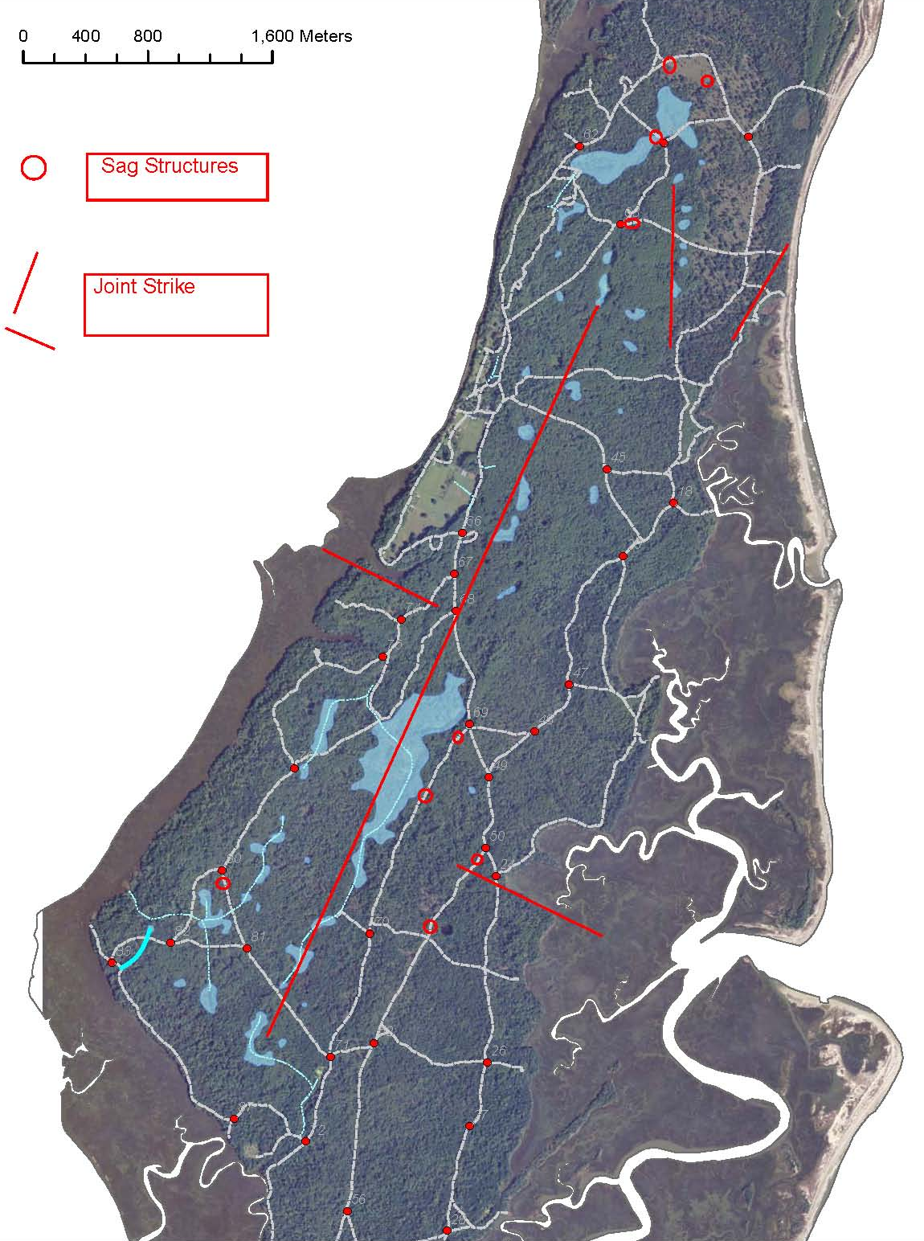
Coastal Plain joint trends after Bartholomew et al., 2007
H2
M2
Yellow Banks Joint Trend
EE1
N24ºE trend (M1) is same as interpreted Brunswick fault trend of Maslia and Prowell (1988)
E1
M1
Pre-1960 wetlands in blue overlay.

Slide 8
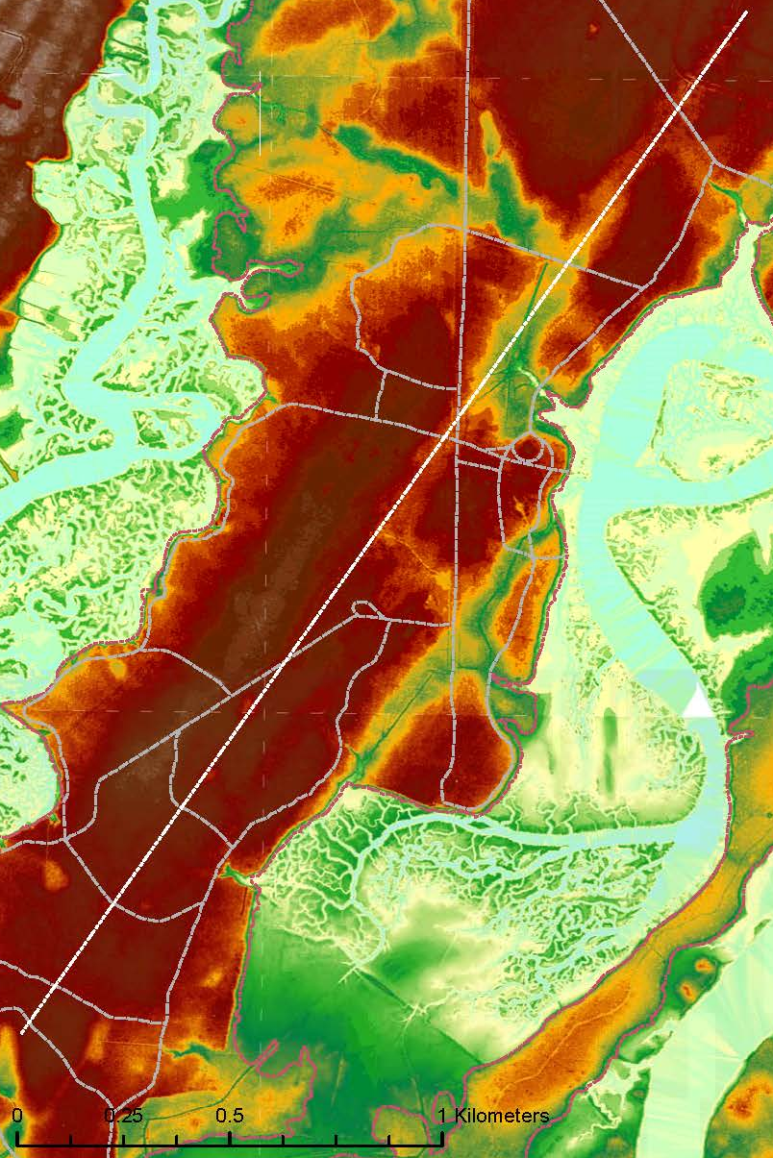
Wormsloe Historic Site
on the Isle of Hope
Linear Depressions

Slide 9
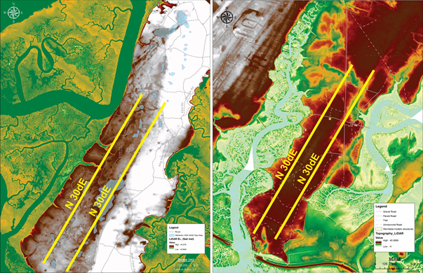
Lineament Trends
St. Catherines Island and Wormsloe Historic Site

Slide 10
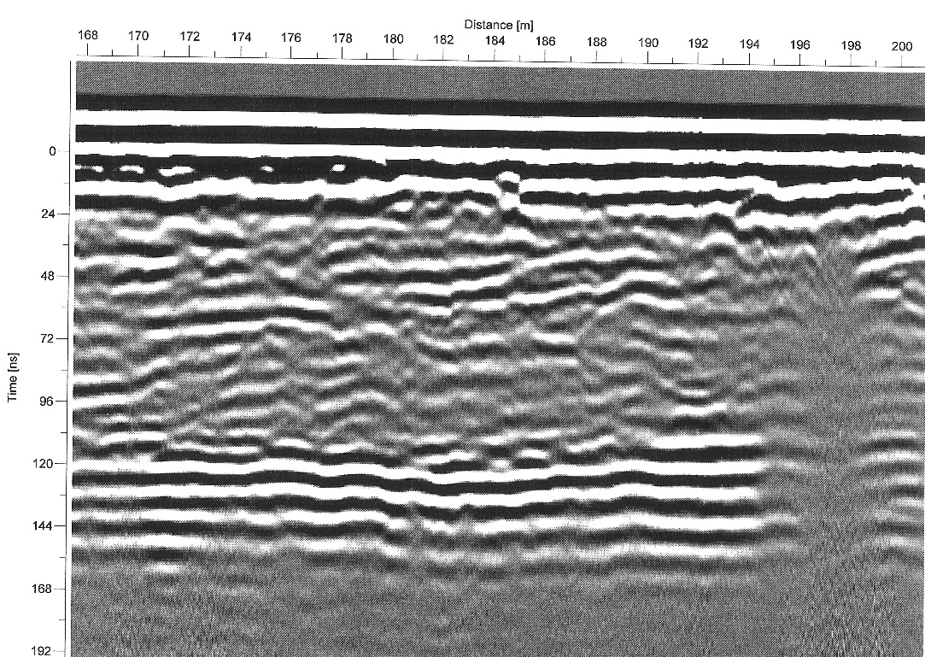
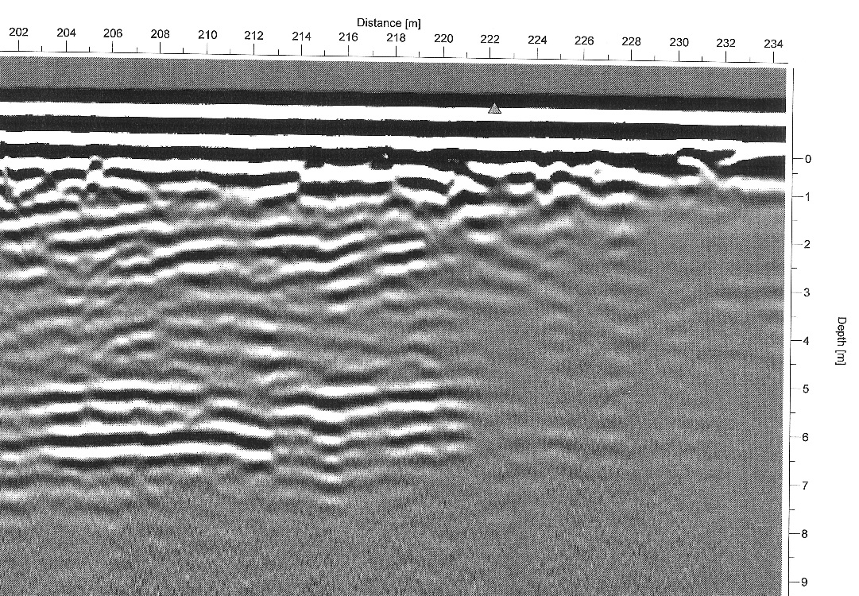
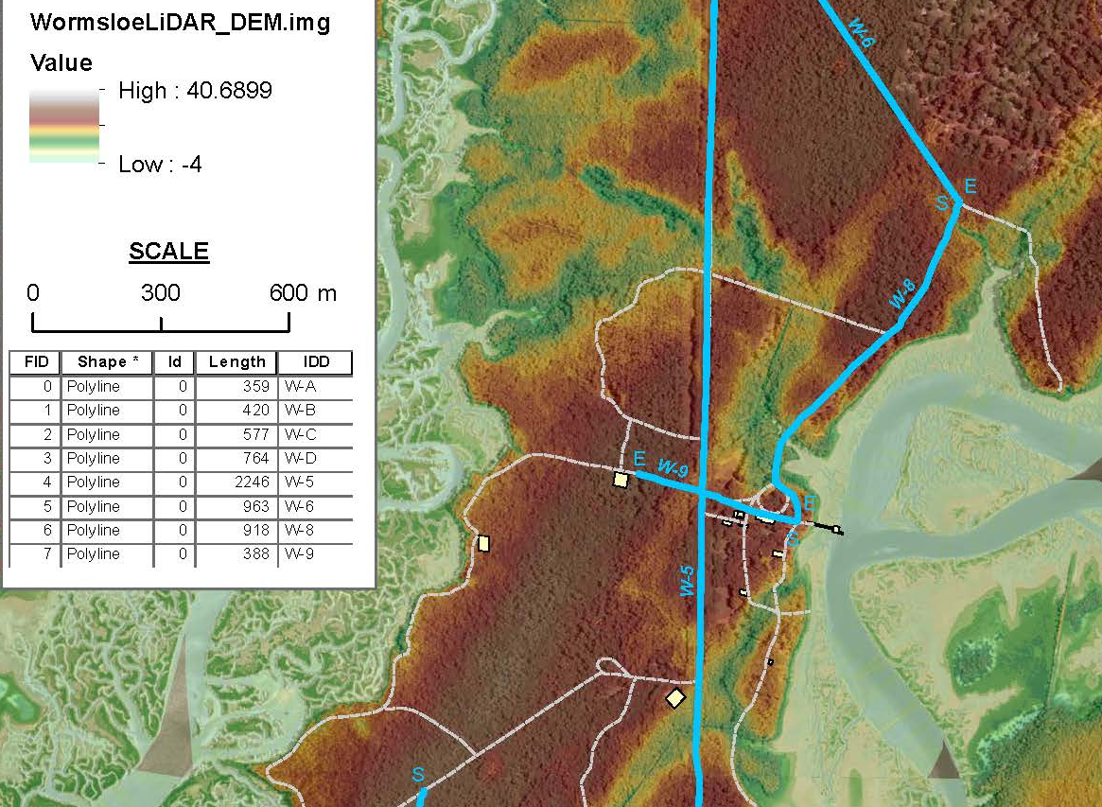
W-9 100 MHz GPR Profile crossing NE striking lineament
10 meters
48 ns
Abrupt signal attenuation suggests salt water saturation promoted by joint and or fault controlled permeability.

Slide 11
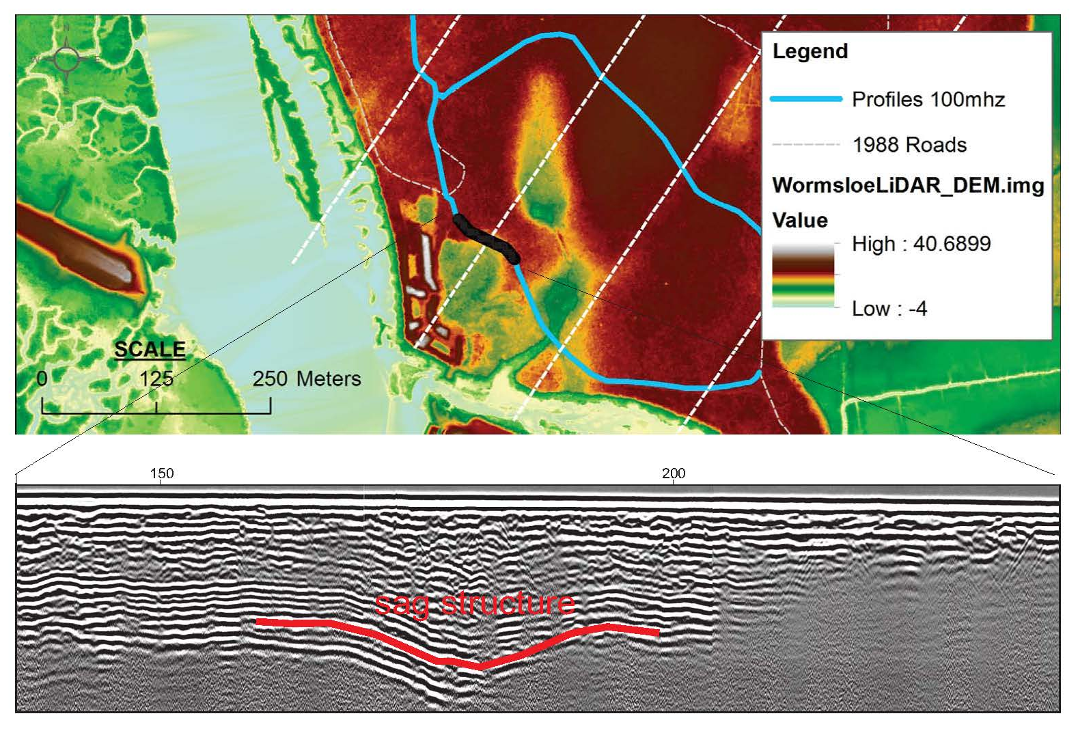
Isle of Hope: W-C 100 MHz GPR Profile

Slide 12
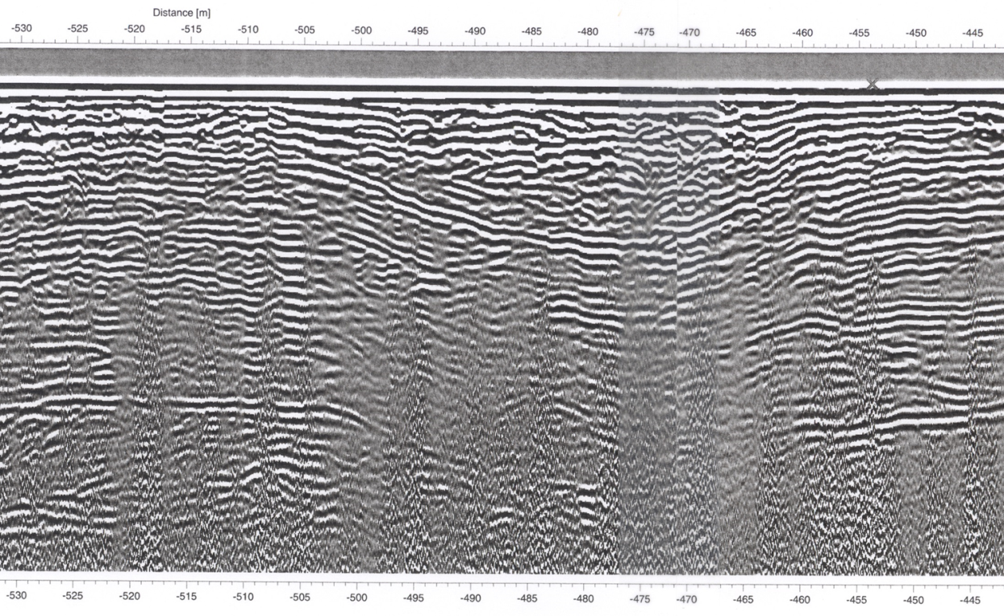
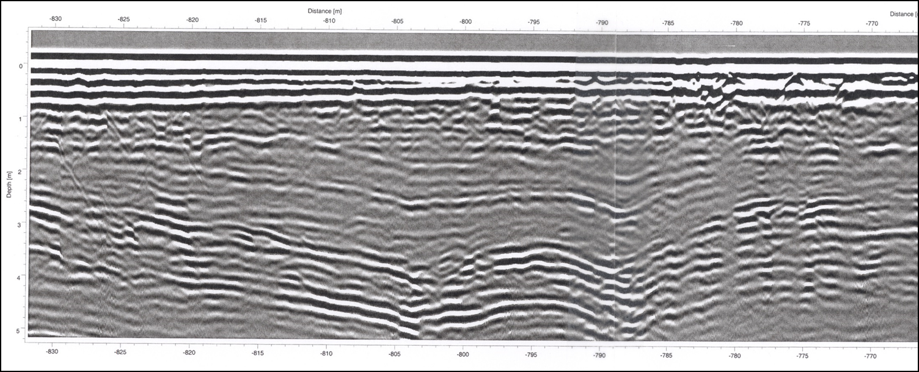
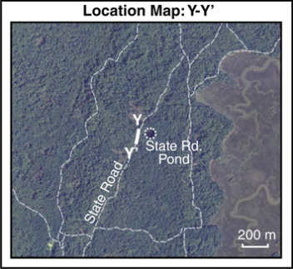
Sag Structures on 100 MHz GPR Profiles on St. Catherines Island.
~ 2 m
5 m
5 m
~2 m

Slide 13
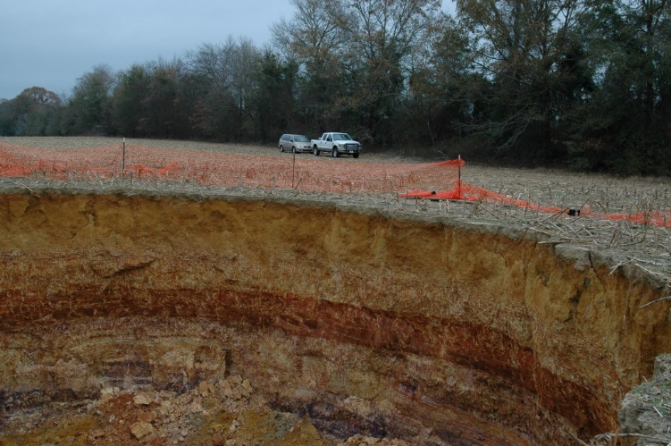
Sinkhole near Middleground Community, Bulloch County
Diameter ~ 26 meters, Depth to Upper Floridan carbonates > 300 ft

Slide 14
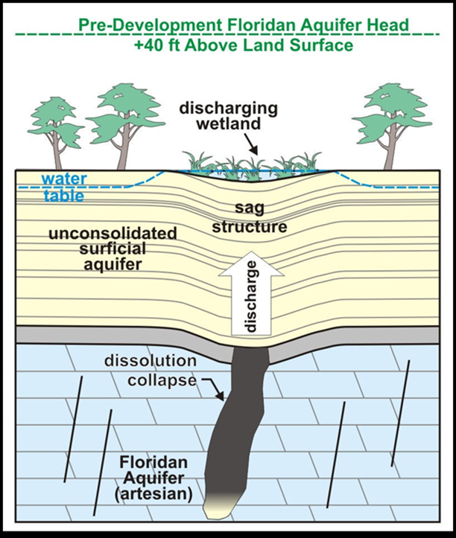
Sag structures, faults and SCI hydrologic system
Faults and joints focused dissolution of Floridan carbonate rock. Cavern collapse in aquifer and associated subsidence produce sags at surface.
The same faults allowed vertical communication to the surface as former Artesian springs, and at present, saline water contamination from below. Upward flow suggests hypogene karst.

Slide 15
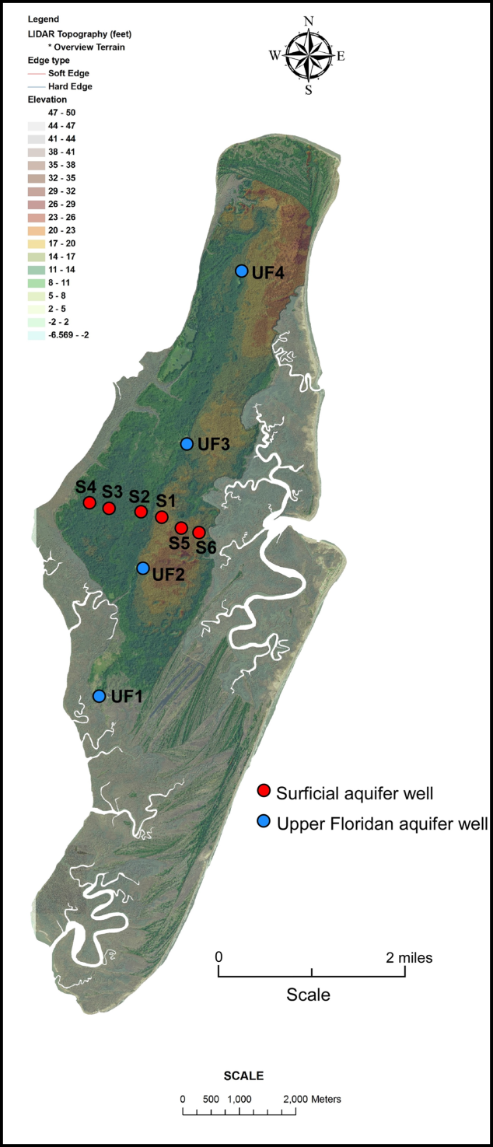
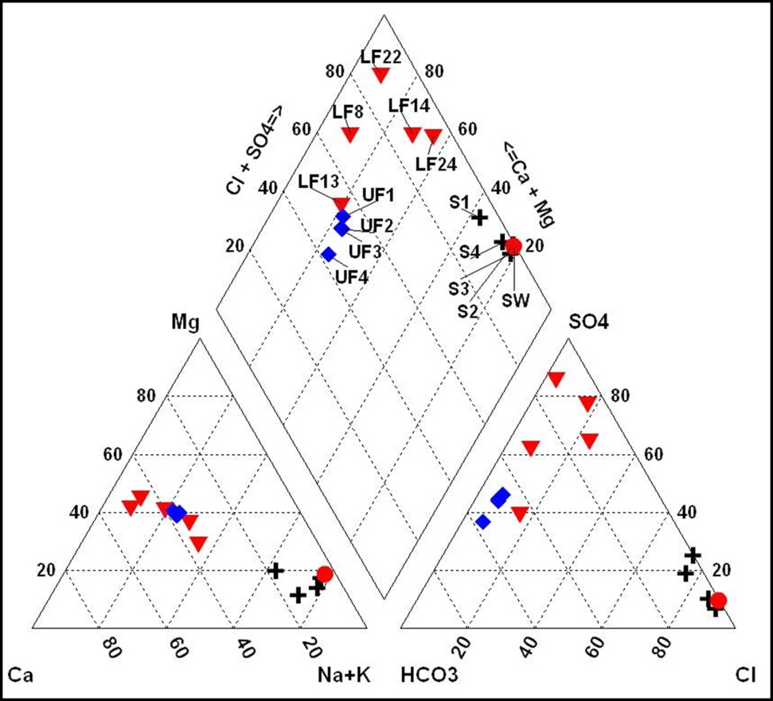
SCI: Upconing -Evidence of vertical communication
Piper diagram (above) showing the average water chemistry of 10 sets of samples collected from the surficial aquifer (black crosses labeled S) and Upper Floridan aquifer (blue diamonds labeled UF) on St. Catherines Island. Lower Floridan aquifer data (red triangles labeled LF) are from Falls and others (2005b); seawater data (red circle labeled SW) from Hem (1989). The observed Upper Floridan mixing line on SCI is believed to be due to the intrusion of more saline water from the Lower Floridan along vertical conduits. (Left - Well map)
(Reichard et al., 2014)

Slide 16
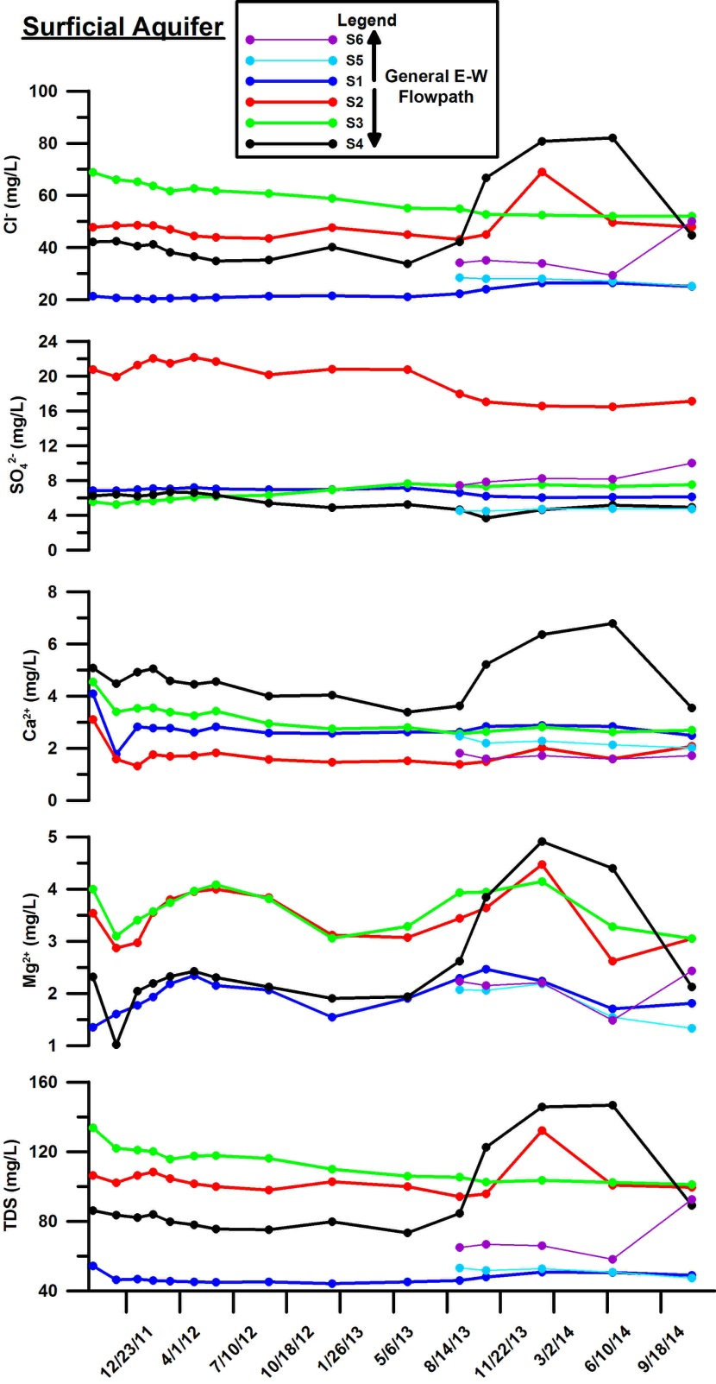
Evidence for lateral salt water intrusion on SCI:
Cl spikes in surficial aquifer during tidal peaks – structural and/or stratigraphic sea water incursion???
Will this shallow salt water enter the Upper Floridan aquifer?

Slide 17
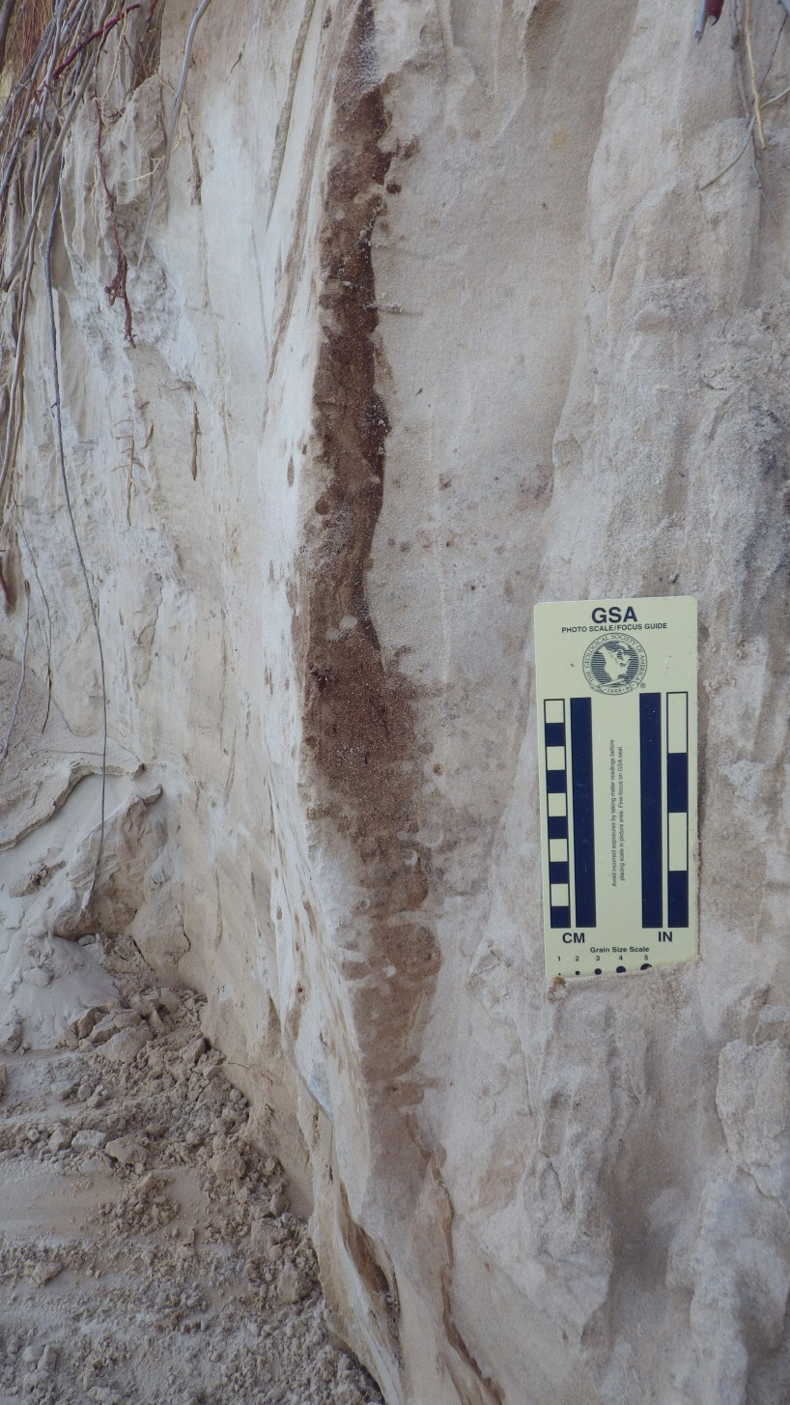
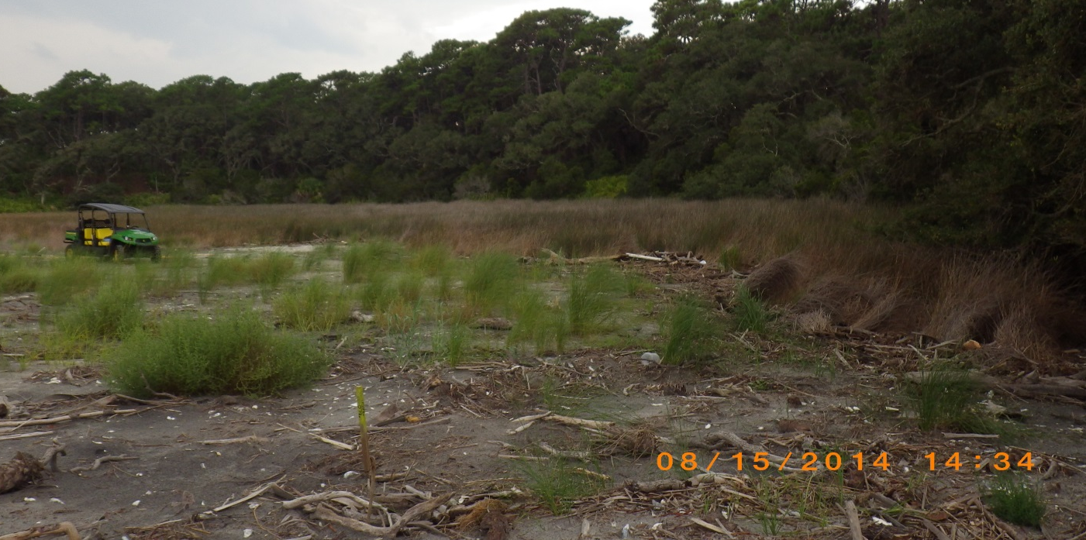
Shallow groundwater flow along joints:
Humate concentration along joint (N30ºE strike) exposed in Pleistocene strata at Yellow Banks Bluff.
Brackish water zone marked by Juncus south of Yellow Banks Bluff
Washover fan
Sea turtle nest site

Slide 18
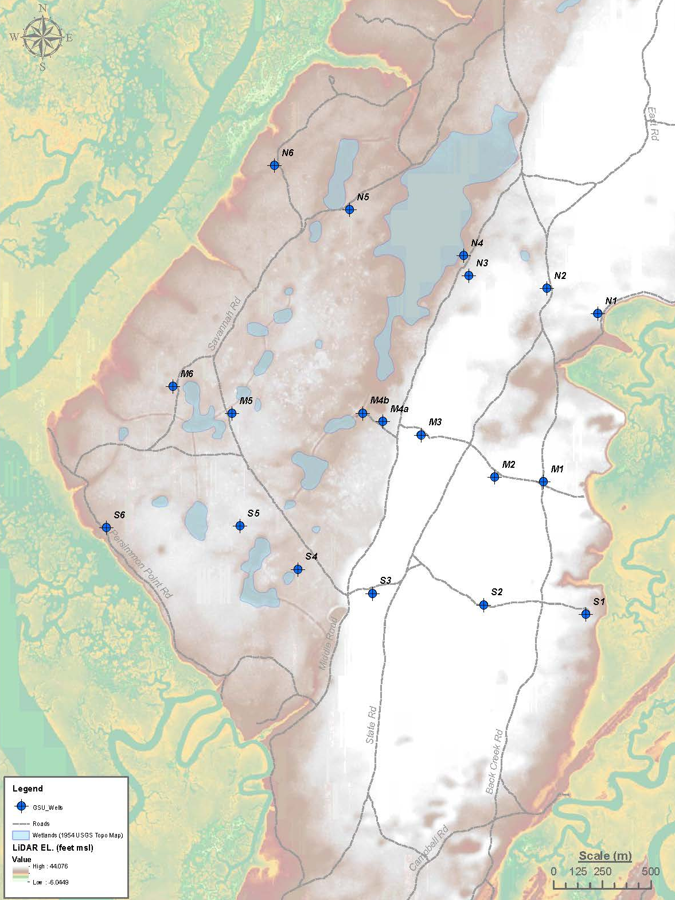
St. Catherines Island
(well grid and former wetlands)
Current focus:
*Determine shallow aquifer salt water intrusion pathways.
*Evaluate potential for communication with the Upper Floridan aquifer.
* Methods - Monitoring head, water chemistry, resistivity & GPR surveys, coring as needed.
Funding and support:
Georgia Sea Grant,
St. Catherines Island Research Foundation,
Georgia Southern University

Slide 19
Summary
Similar lineaments/structural trends occur on St. Catherines Island, Isle of Hope and Brunswick, GA.
Faults and joints are important controls on Coastal Plain Hydrology.
Faults and joints focused dissolution in the Upper Floridan, permitted former Artesian springs and now allow salt water intrusion via upconing.
The surficial aquifer also appears to be influenced by enhanced permeability along joints and faults.
How will structural features affect surficial and Upper Floridan aquifer as sea level rises???

