Slide 1
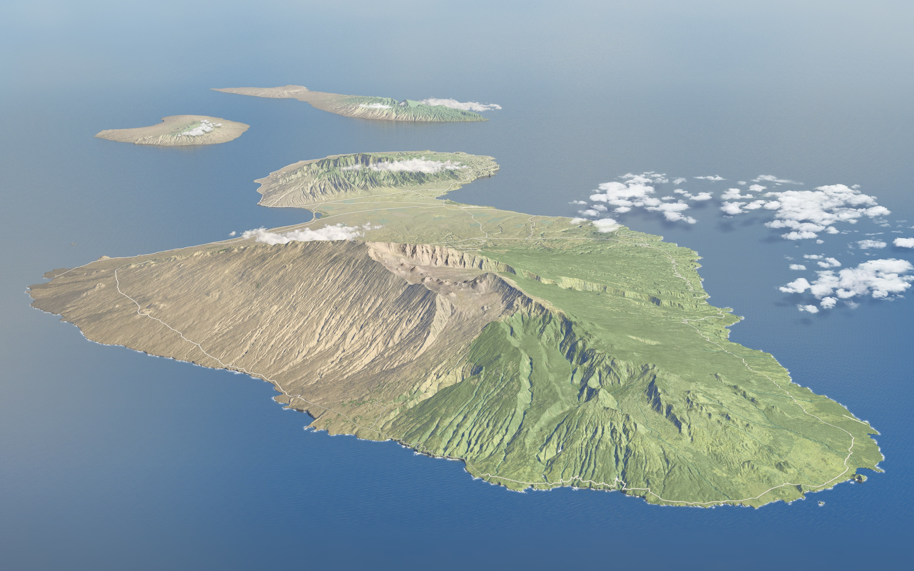
Evidence for a giant landslide on the northeastern subaerial flank of Haleakala volcano, Island of Maui, Hawaii
Kim M. Bishop
California State University, Los Angeles
Image from National Park Service

Slide 2
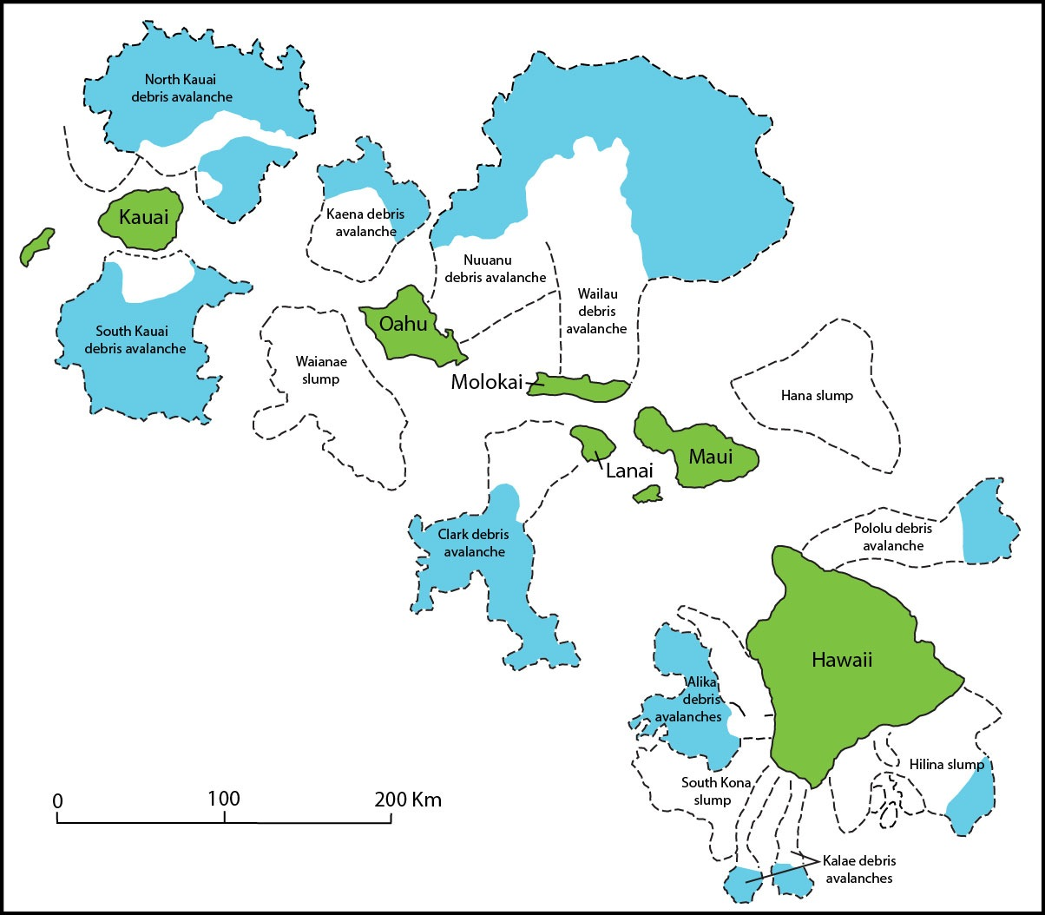
Re-drawn from Moore et al., 1989

Slide 3
Haleakala
“crater”
Southwest rift zone
North rift zone
Keanae
Valley
East rift zone
Kaupo
Valley
Kipahulu Valley
Image from National Park Service
Waihoi Valley

Slide 4
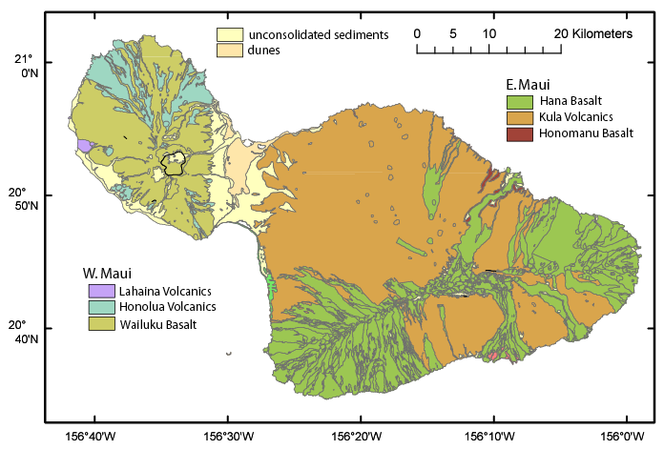
Image from National Park Service
Image from National Park Service
Drawn by D. Stinton

Slide 5
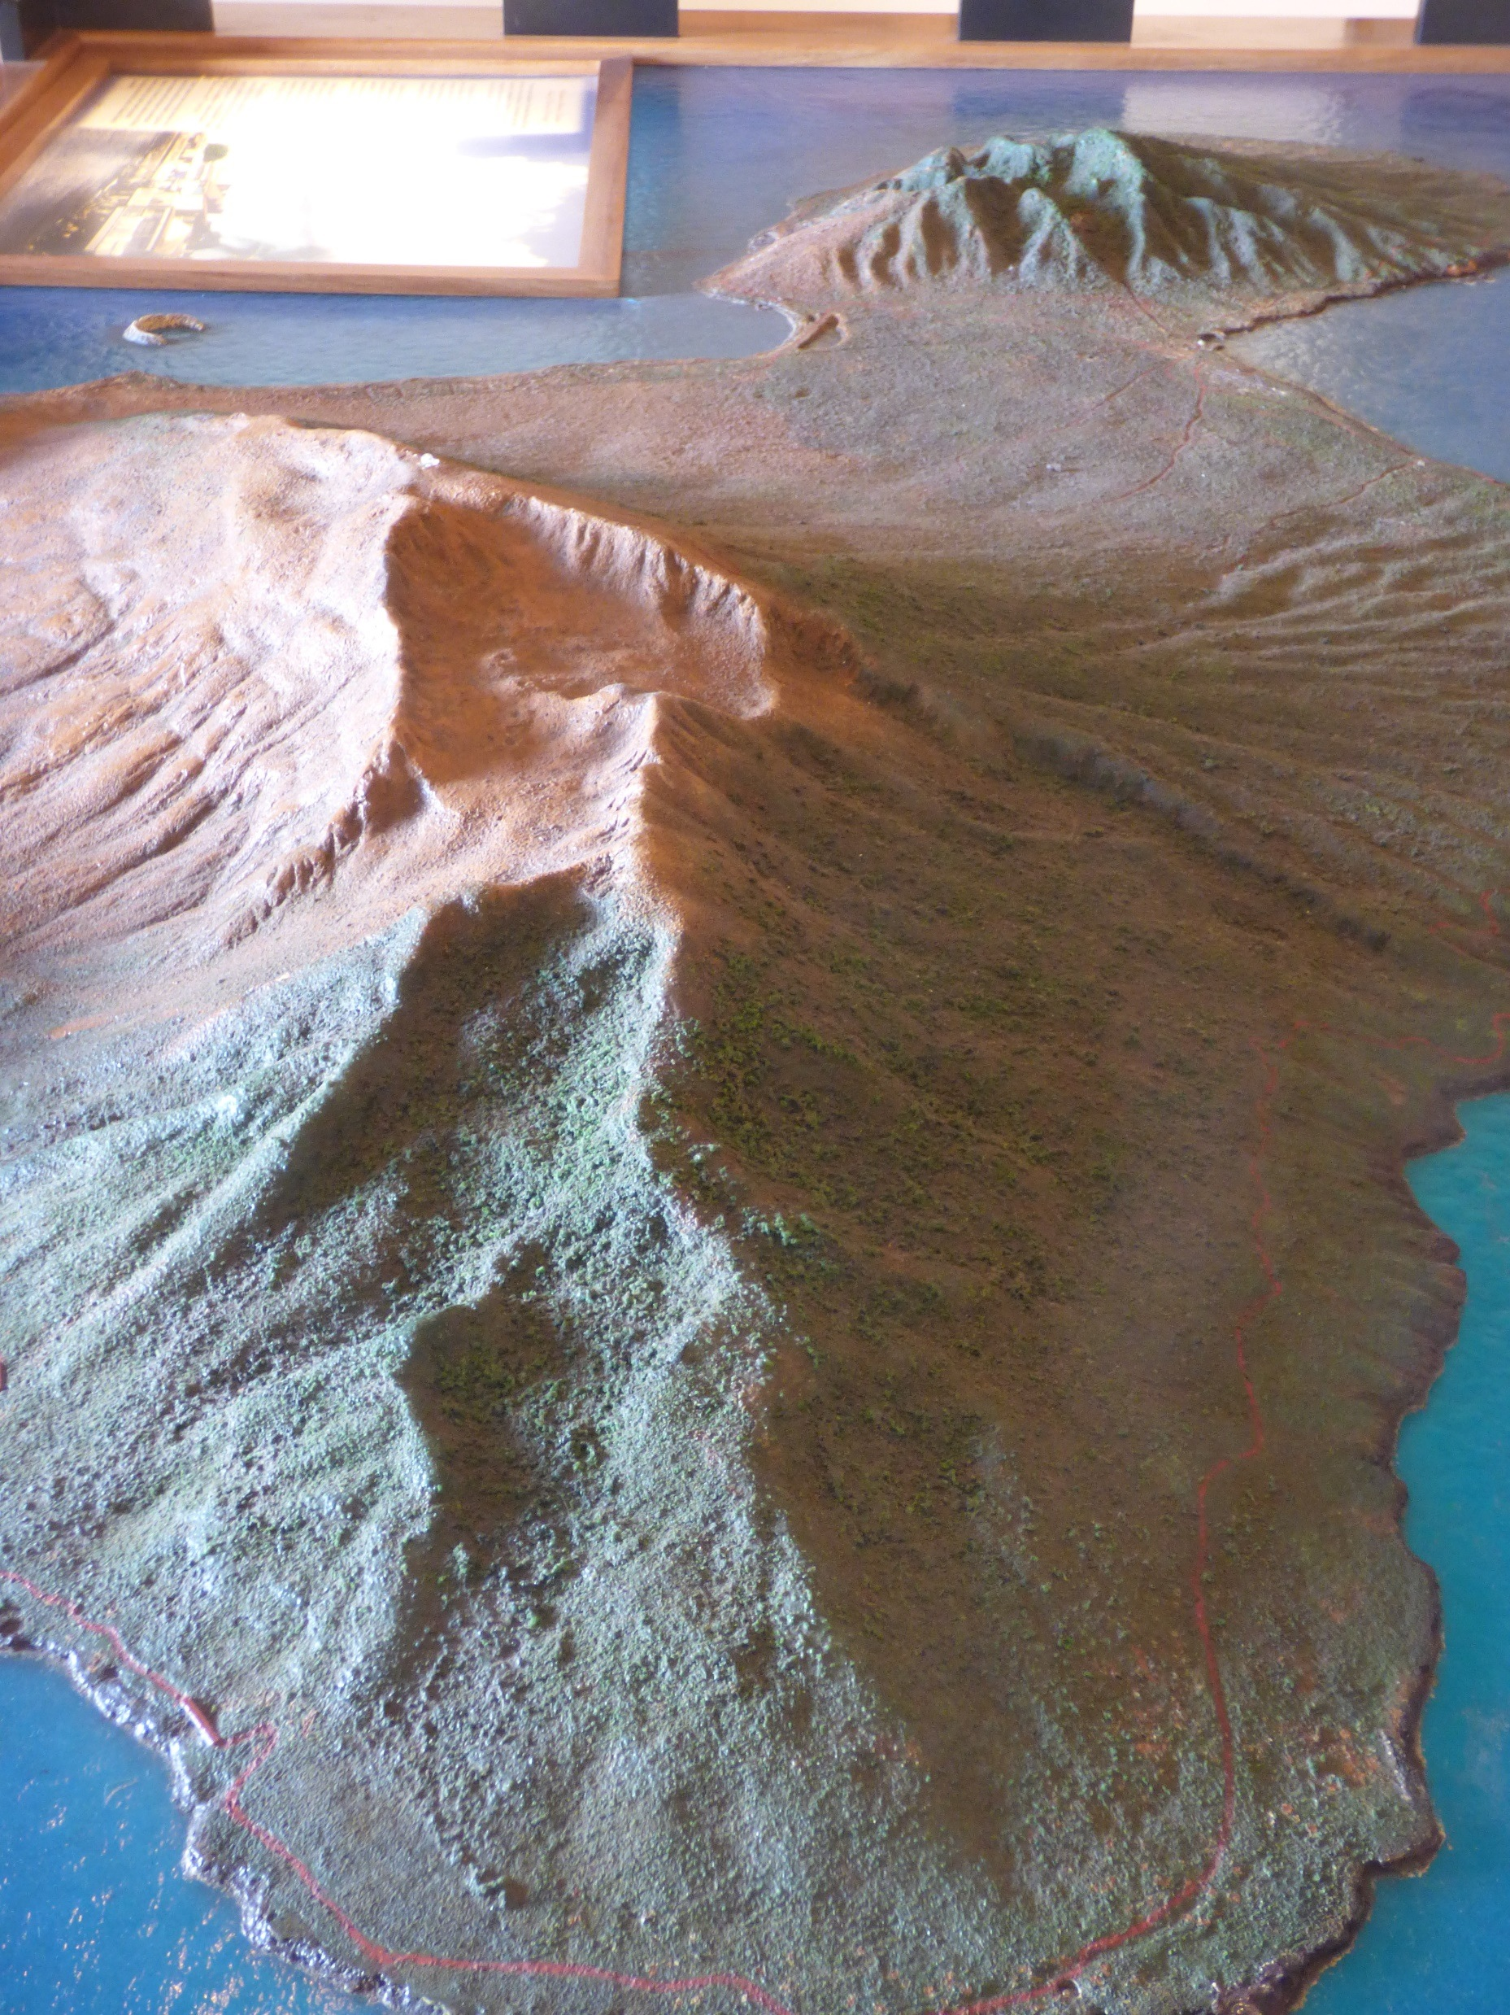
Relief map on display at Old Lahaina Courthouse, Maui

Slide 6
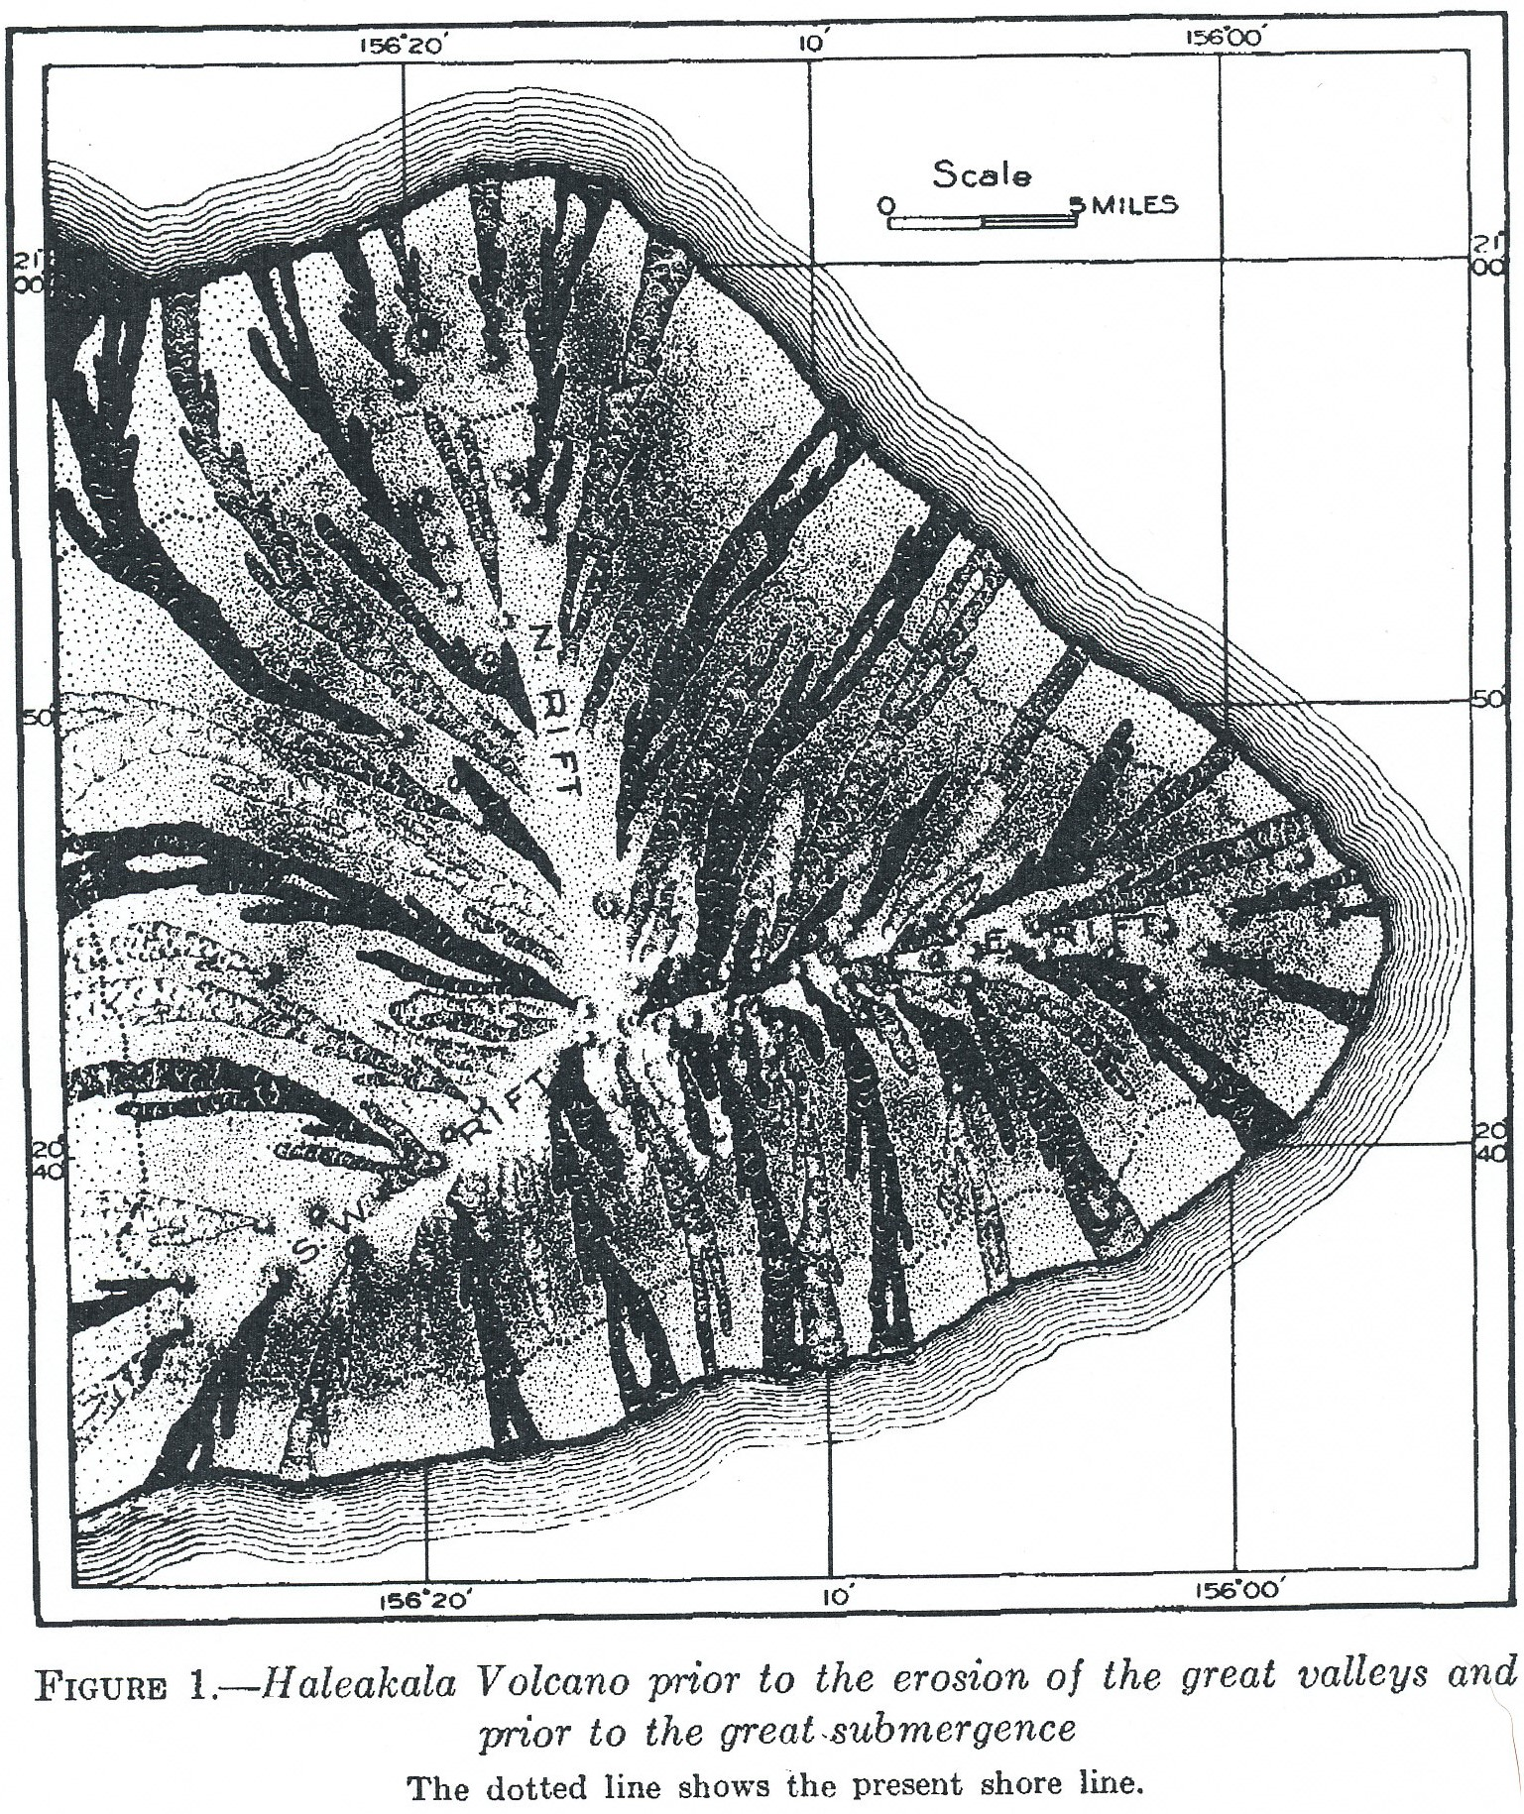
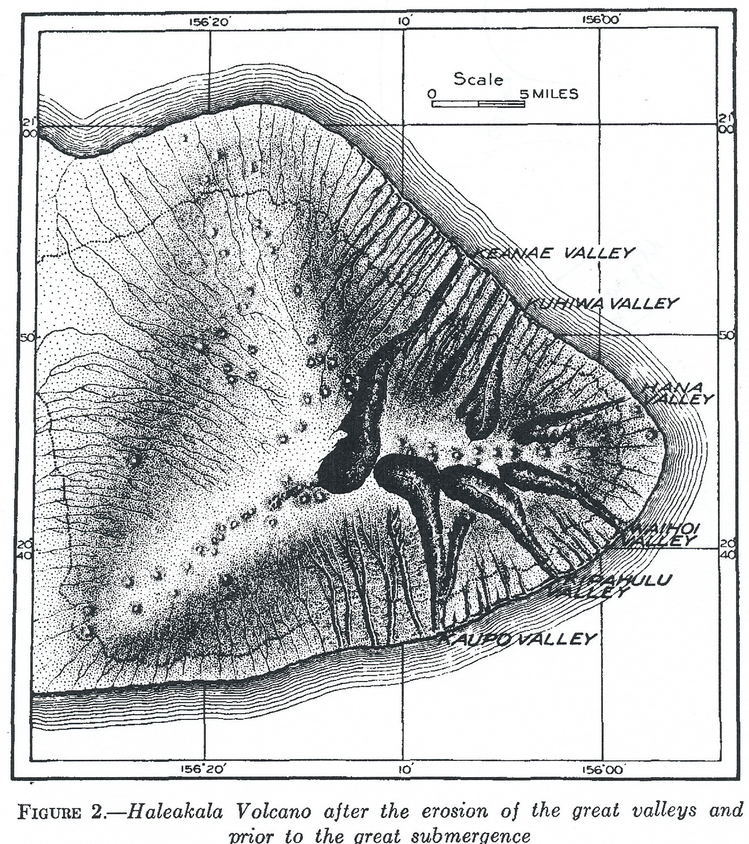
From Harold Stearns (1942)

Slide 7
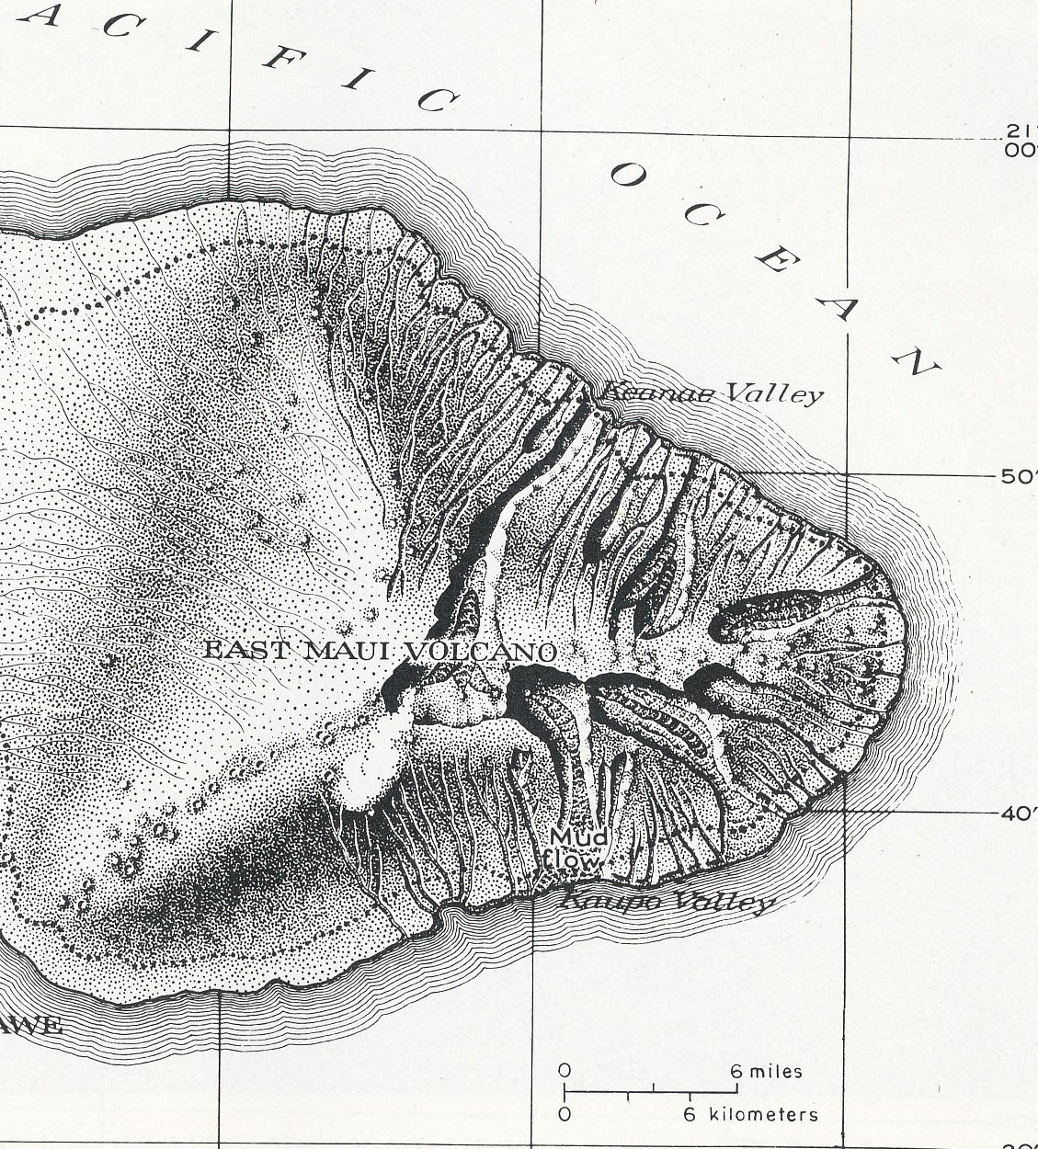
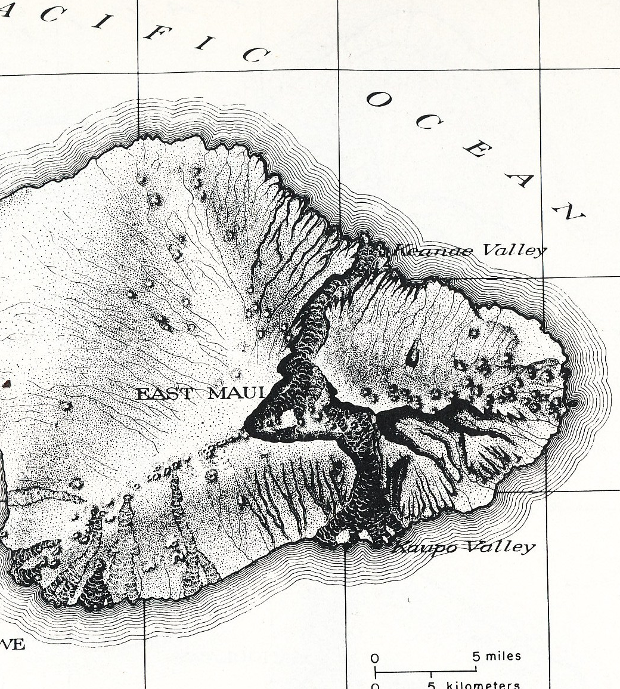
From MacDonald, G.A., Abbot, A.T., and Peterson, F.L., 1983

Slide 8
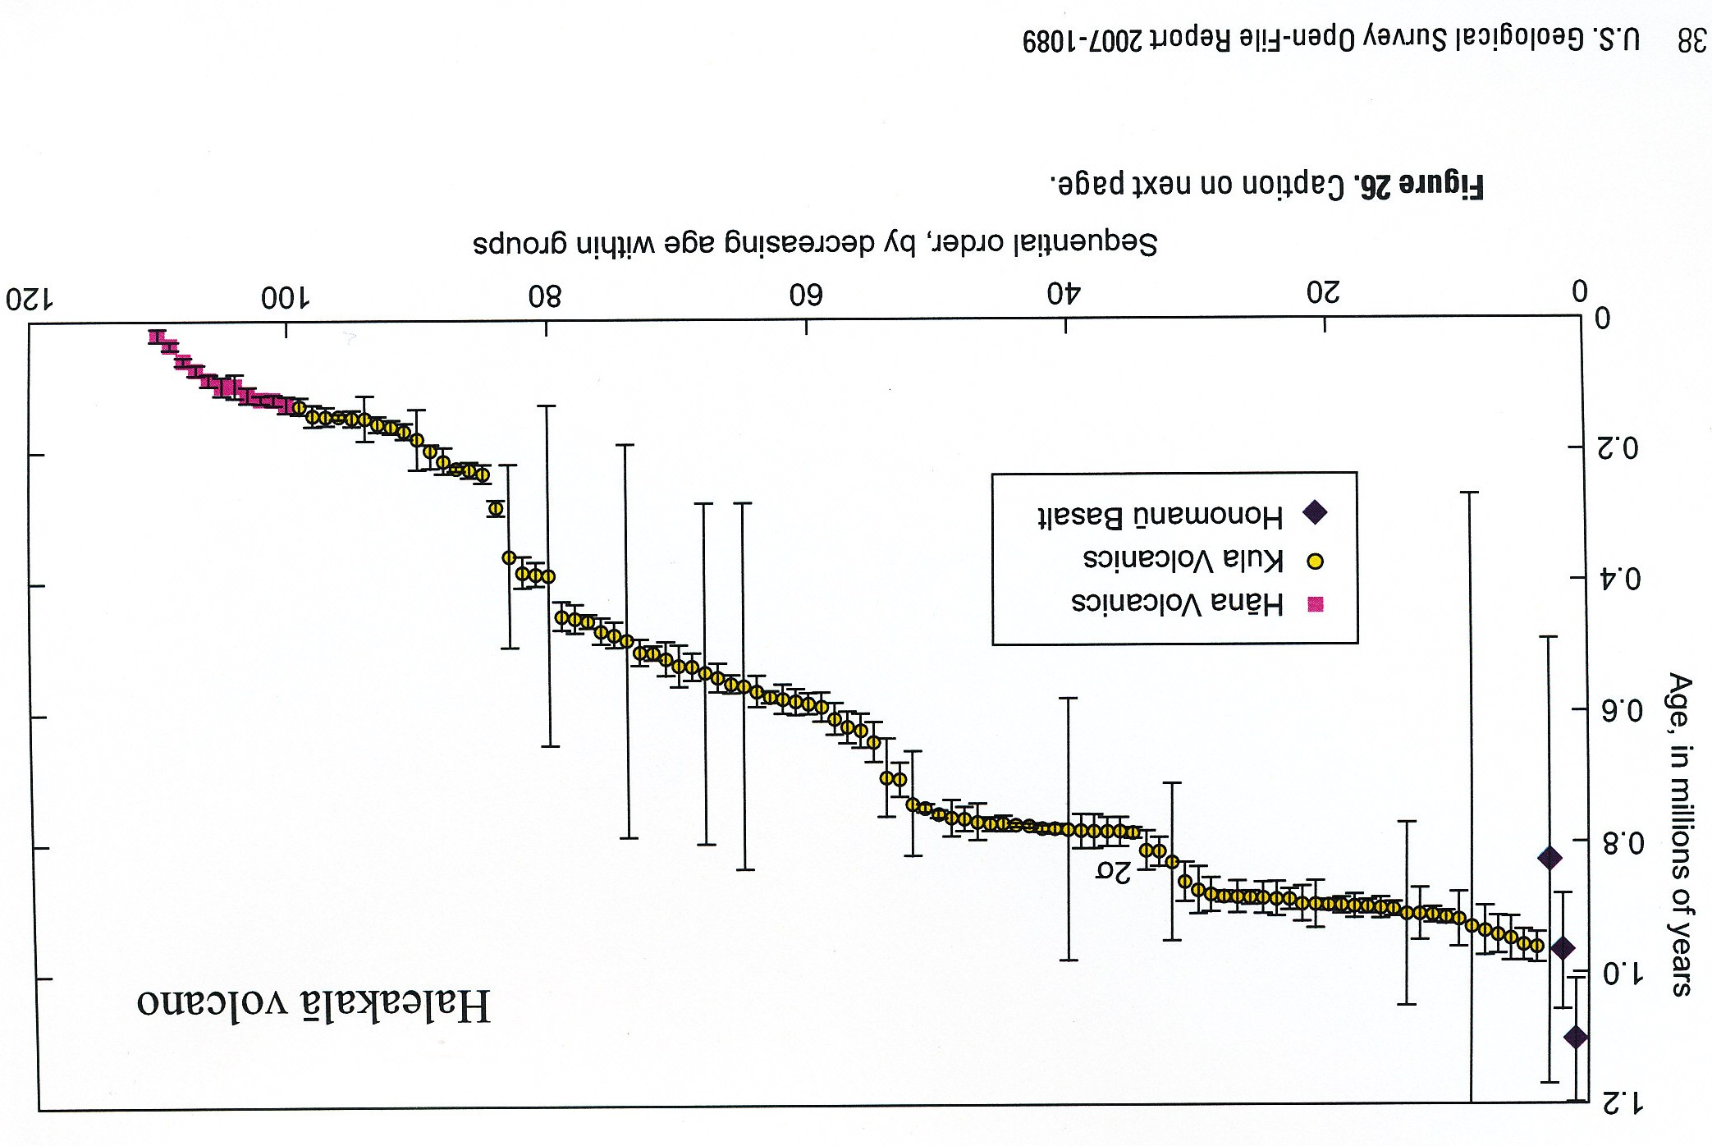
Sherrod, D.R., Sinton, J.M., Watkins, J.M., and Brunt, K.M., 2007

Slide 9
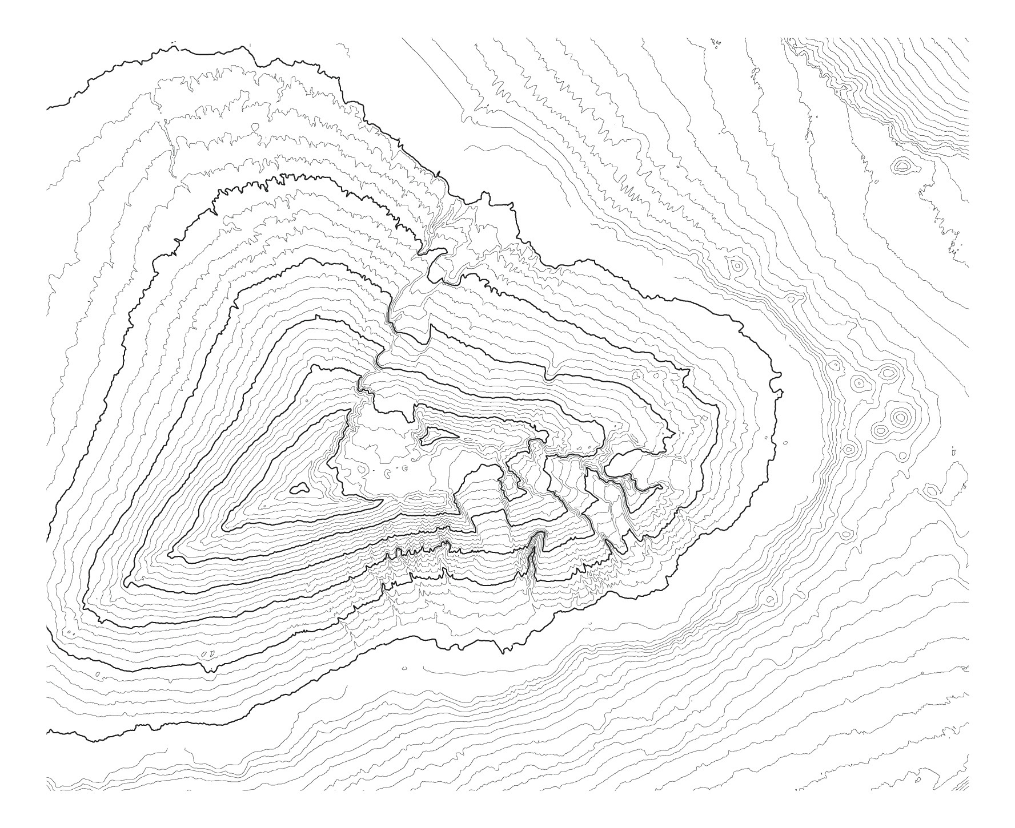
0
25 km
Map created from data of Univ. of Hawaii, School of Ocean and Earth Science and Technology
http://www.soest.hawaii.edu/HMRG/multibeam/bathymetry.php

Slide 10
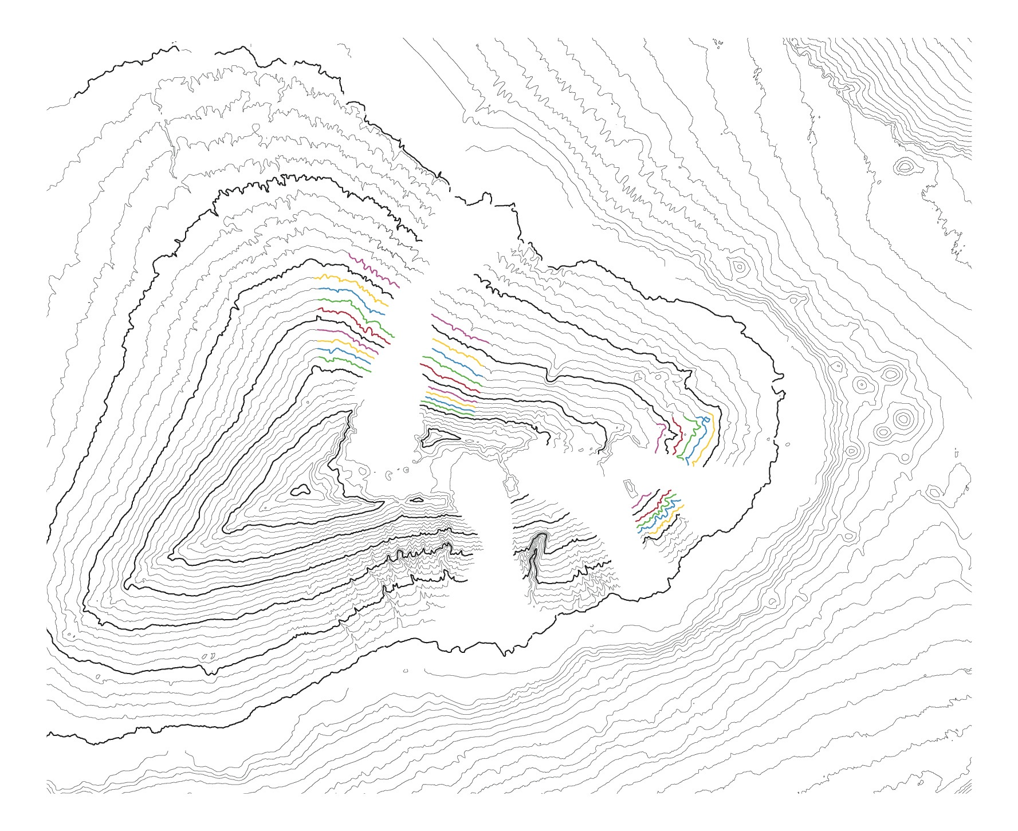
0
25 km
Map created from data of Univ. of Hawaii, School of Ocean and Earth Science and Technology
http://www.soest.hawaii.edu/HMRG/multibeam/bathymetry.php

Slide 11
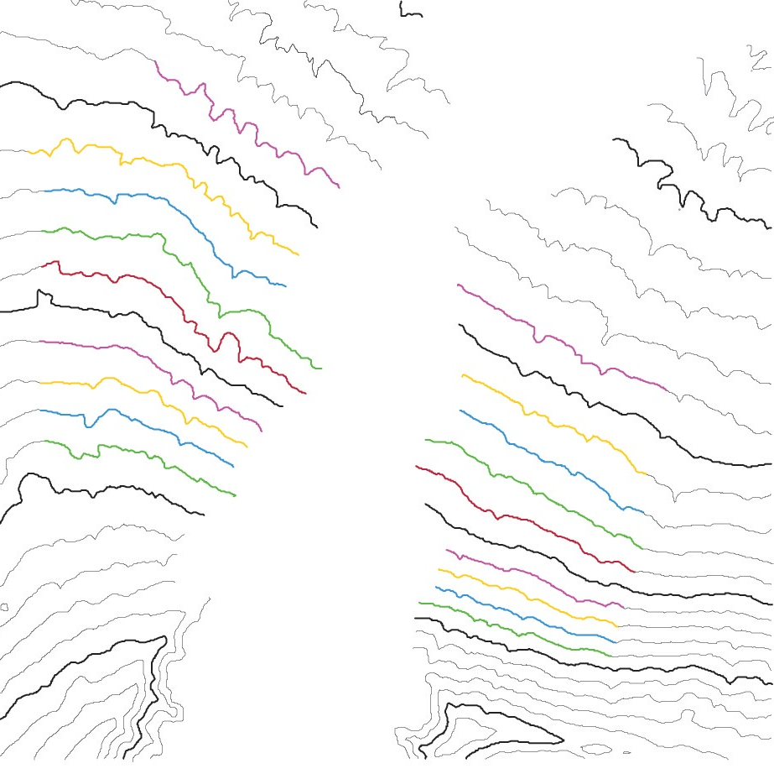
0
10 km
Map created from data of Univ. of Hawaii, School of Ocean and Earth Science and Technology
http://www.soest.hawaii.edu/HMRG/multibeam/bathymetry.php

Slide 12
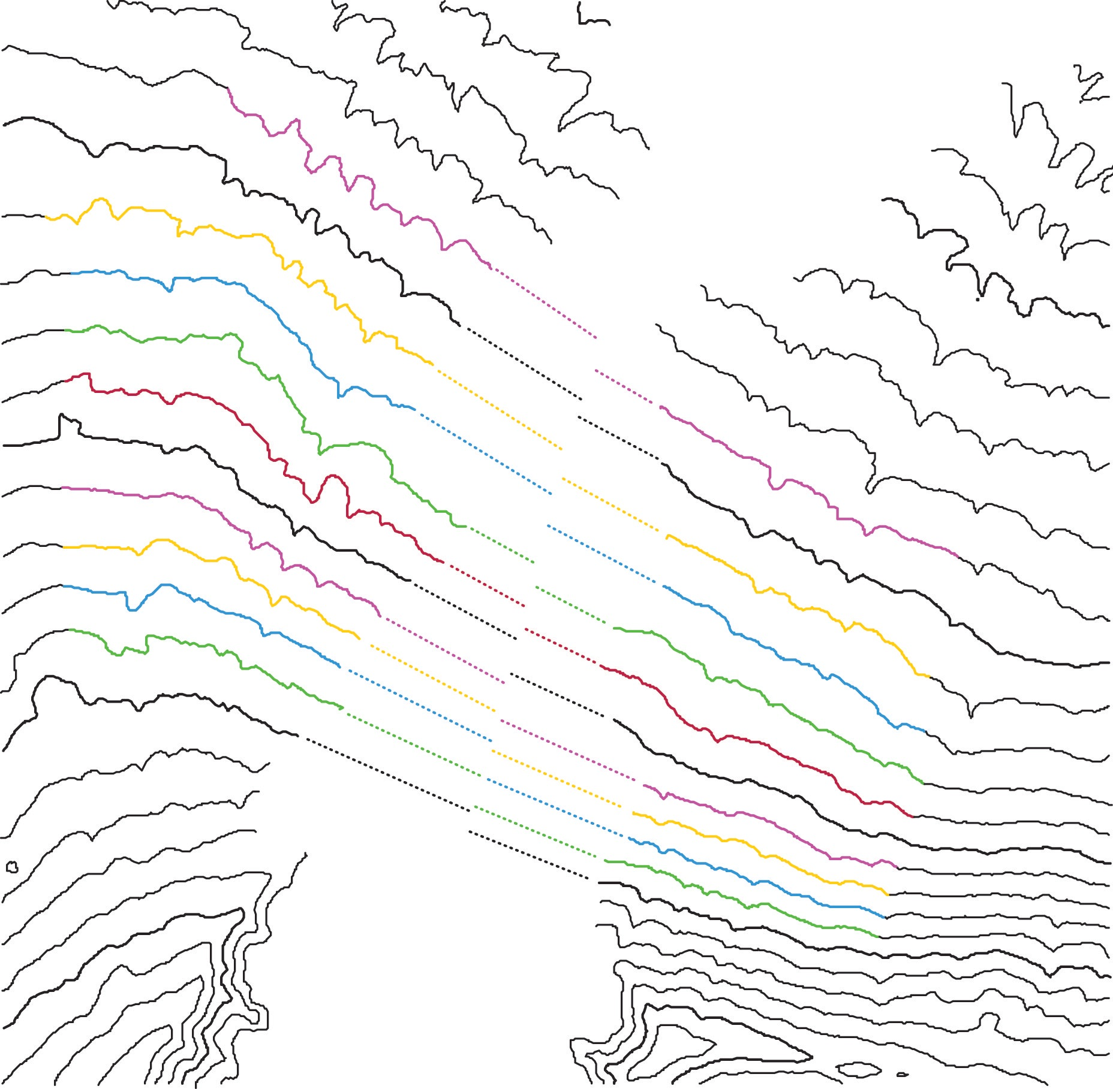
0
10 km
Map created from data of Univ. of Hawaii, School of Ocean and Earth Science and Technology
http://www.soest.hawaii.edu/HMRG/multibeam/bathymetry.php

Slide 13
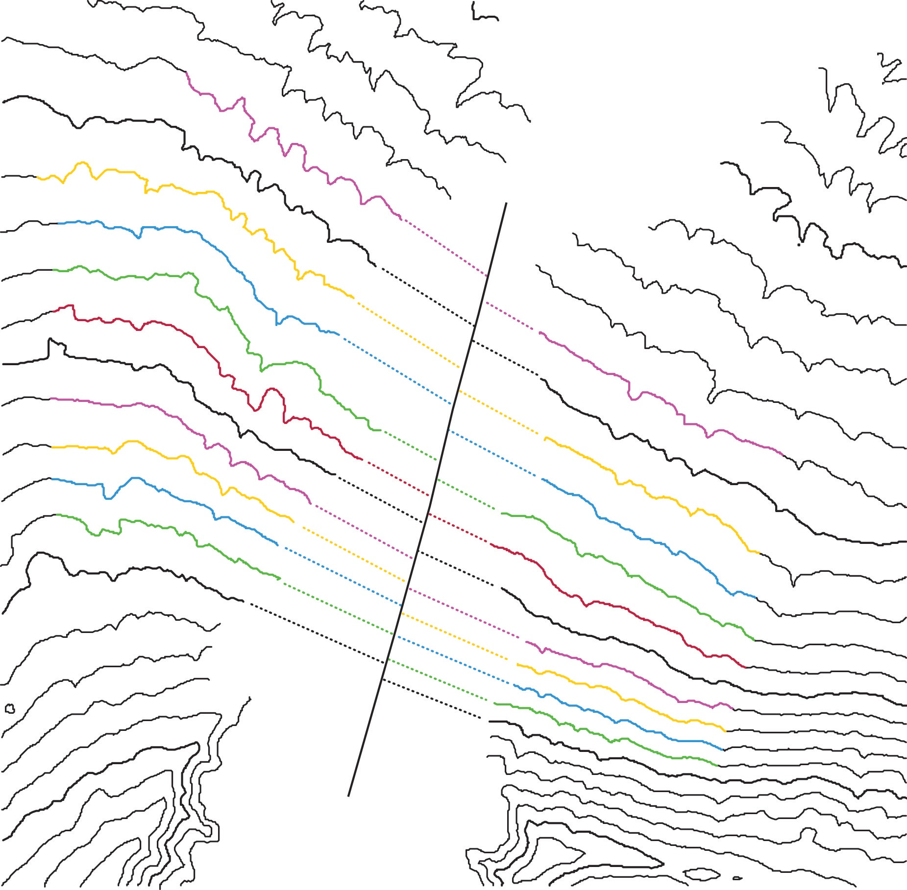
0
10 km
Map created from data of Univ. of Hawaii, School of Ocean and Earth Science and Technology
http://www.soest.hawaii.edu/HMRG/multibeam/bathymetry.php

Slide 14
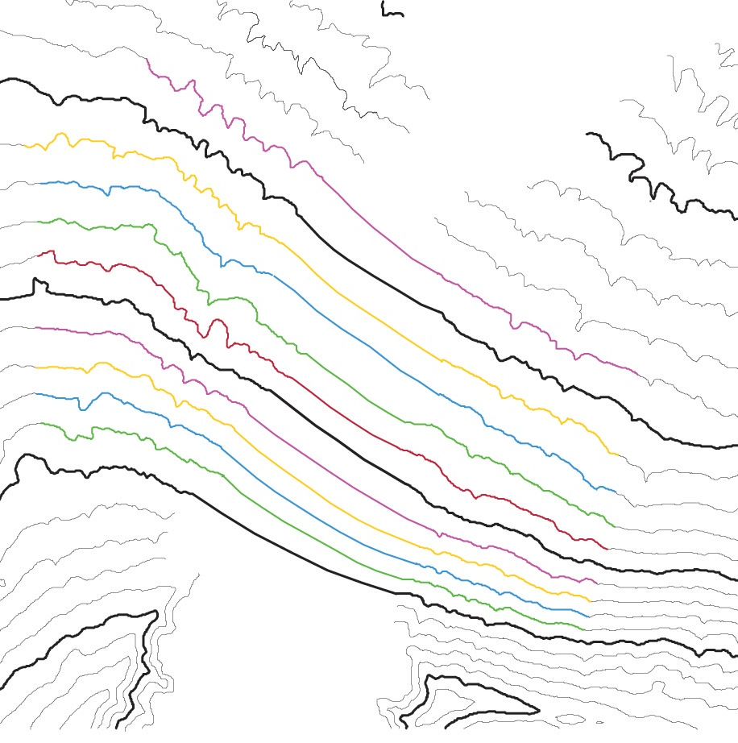
0
10 km
Map created from data of Univ. of Hawaii, School of Ocean and Earth Science and Technology
http://www.soest.hawaii.edu/HMRG/multibeam/bathymetry.php

Slide 15
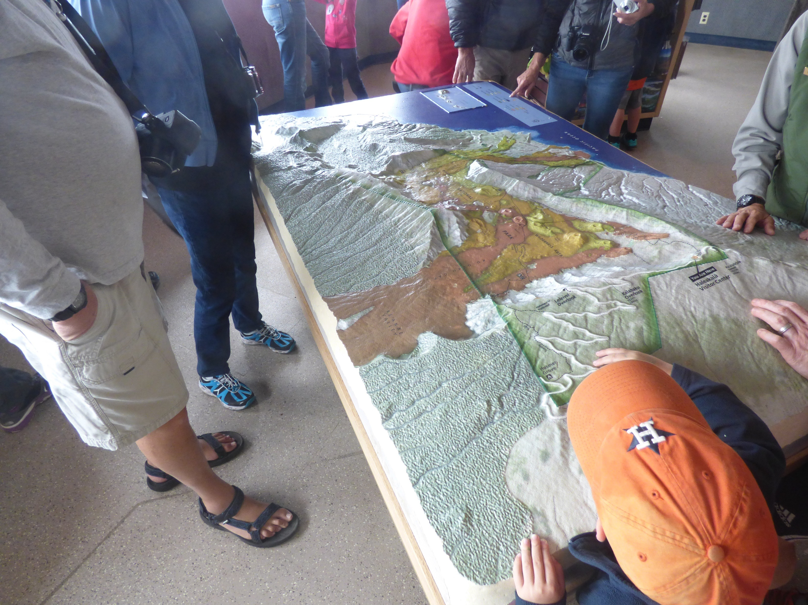

Slide 16
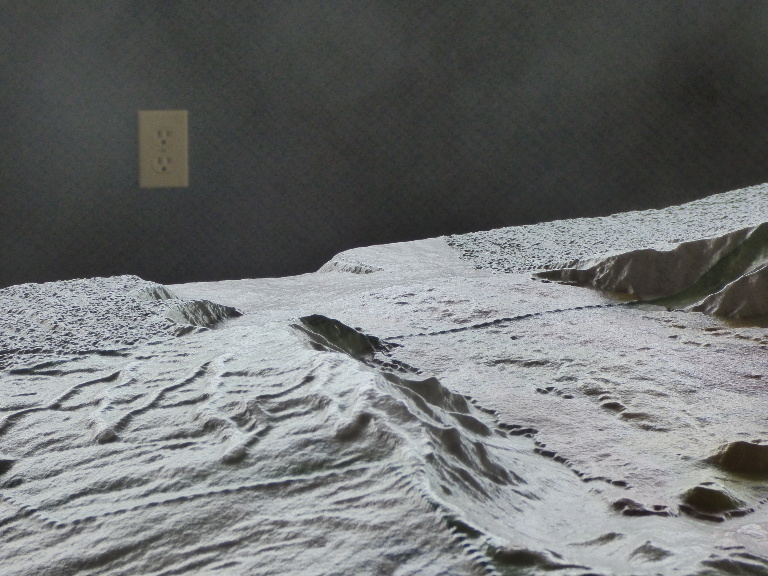

Slide 17
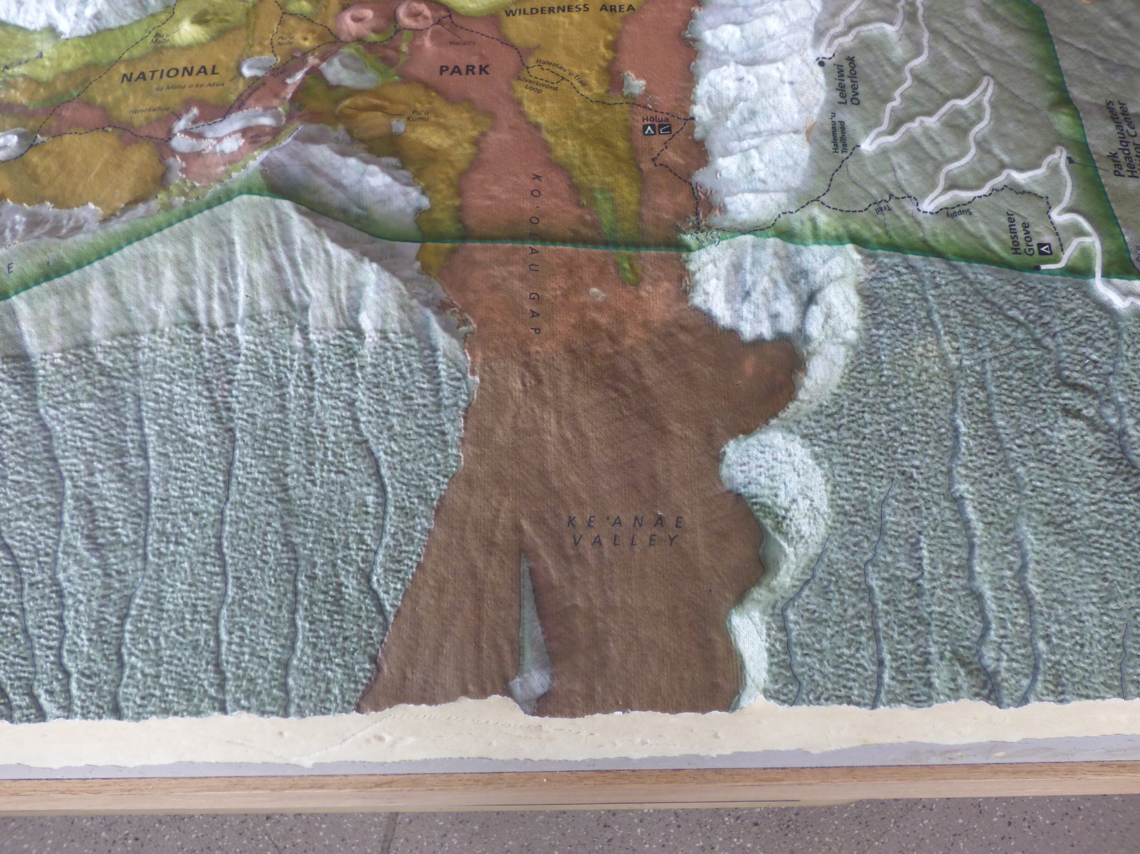
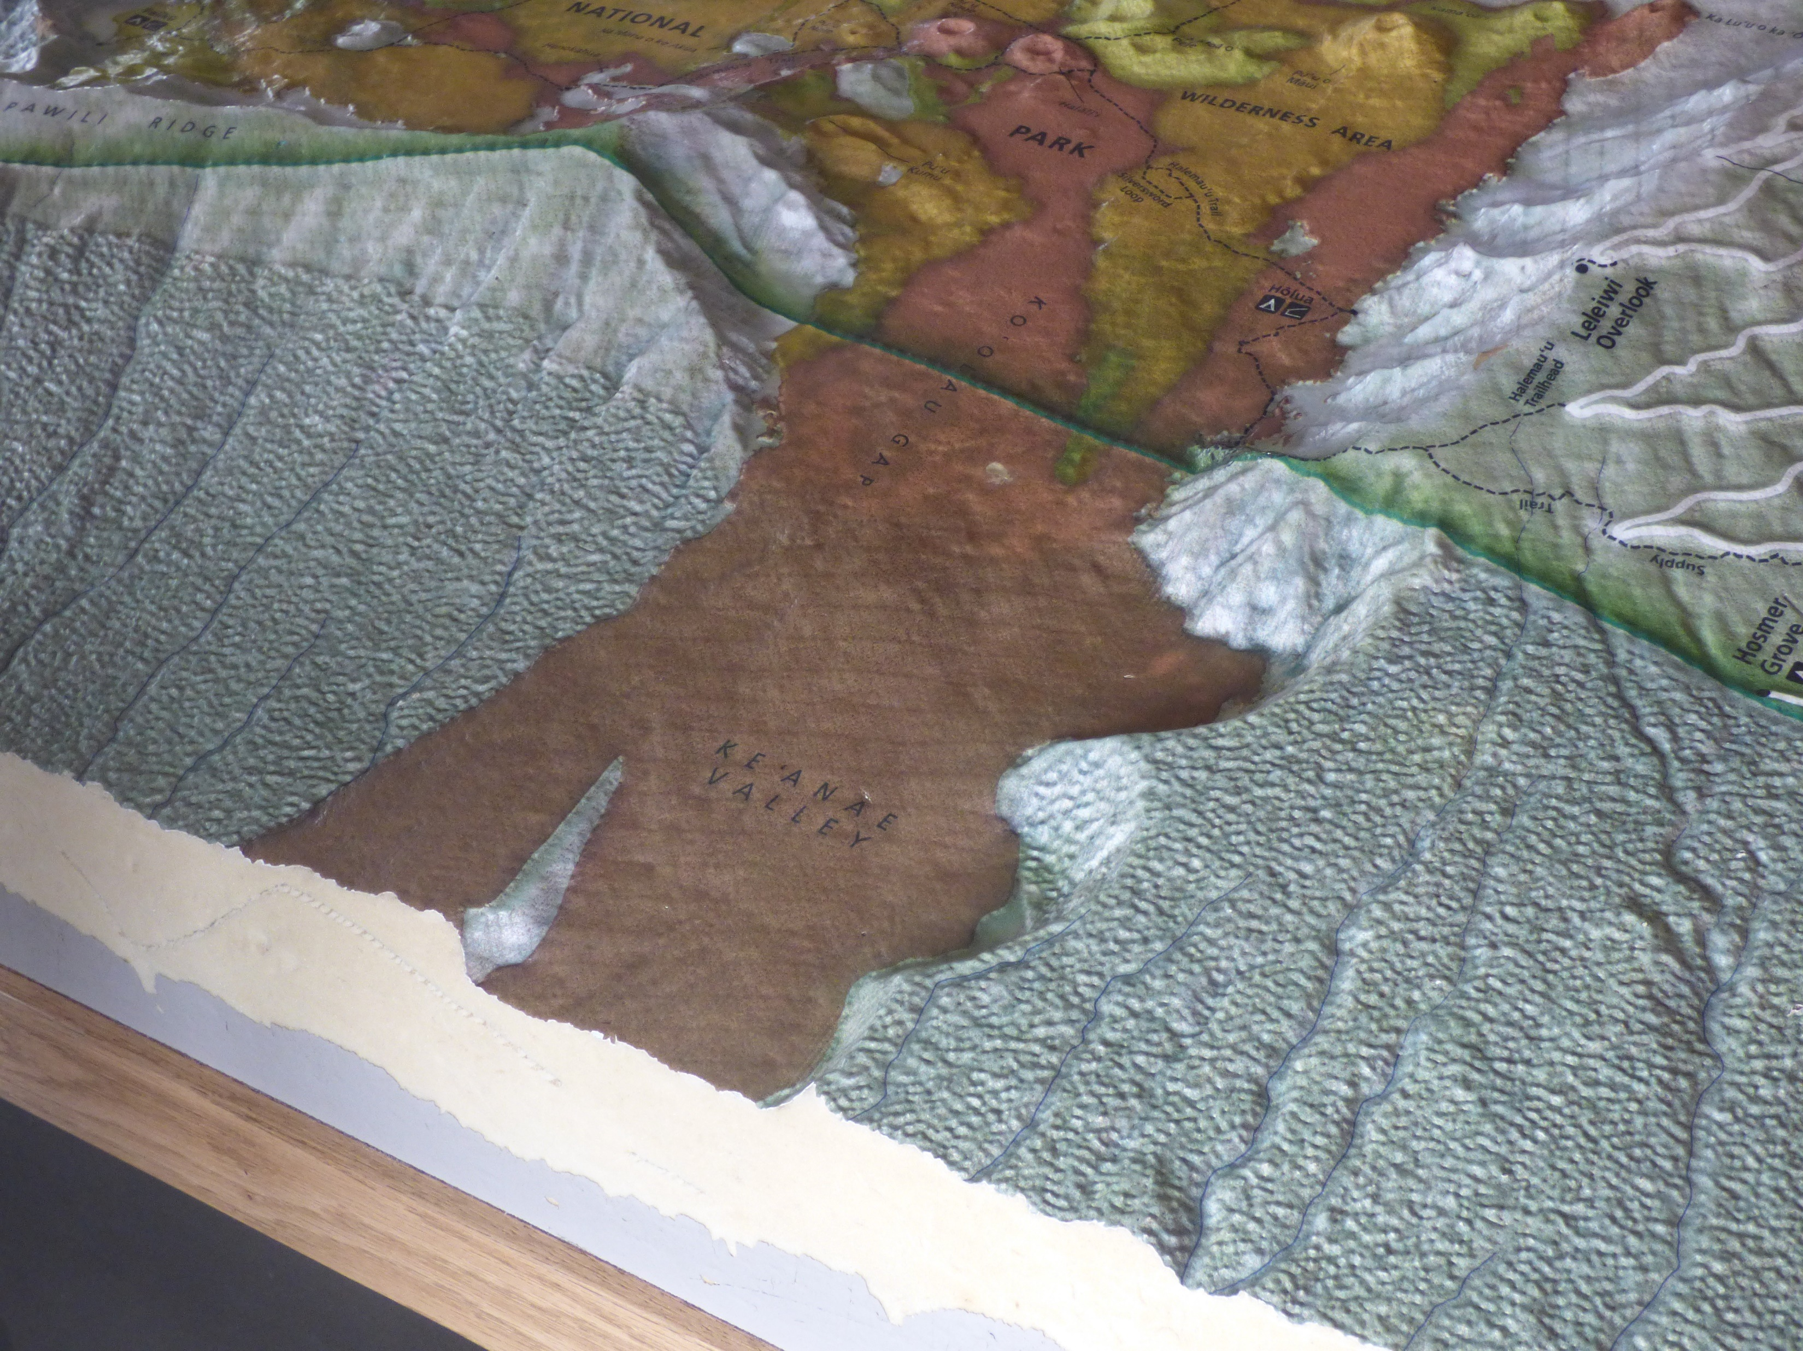

Slide 18
0
10 km
Map created from data of Univ. of Hawaii, School of Ocean and Earth Science and Technology
http://www.soest.hawaii.edu/HMRG/multibeam/bathymetry.php

Slide 19
0
25 km
Map created from data of Univ. of Hawaii, School of Ocean and Earth Science and Technology
http://www.soest.hawaii.edu/HMRG/multibeam/bathymetry.php

Slide 20
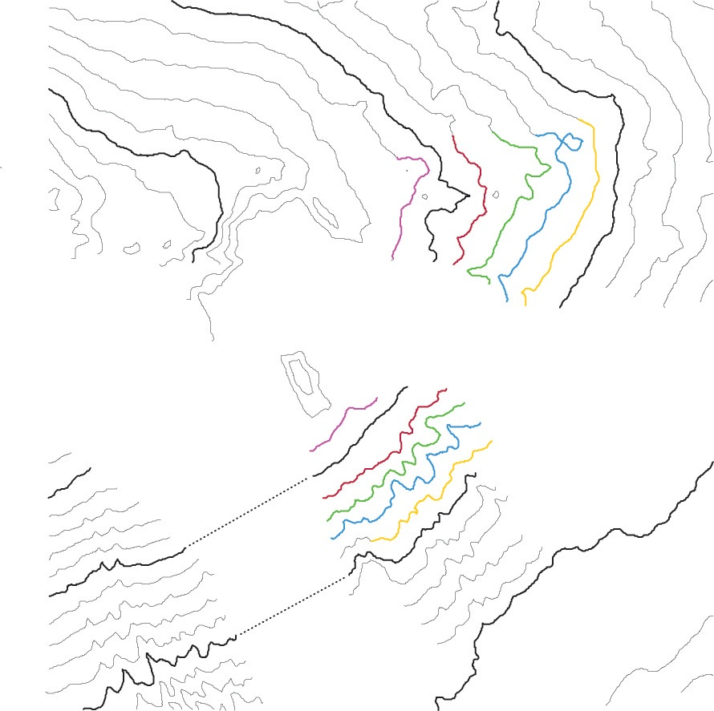
Map created from data of Univ. of Hawaii, School of Ocean and Earth Science and Technology
http://www.soest.hawaii.edu/HMRG/multibeam/bathymetry.php
0
10 km

Slide 21
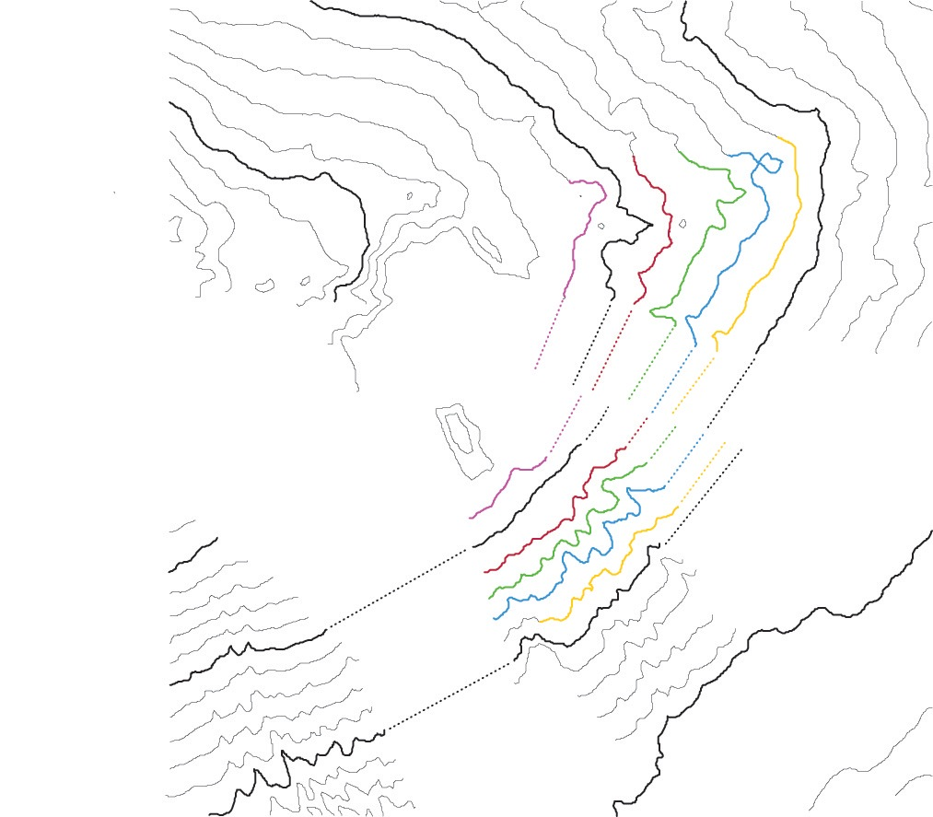
Map created from data of Univ. of Hawaii, School of Ocean and Earth Science and Technology
http://www.soest.hawaii.edu/HMRG/multibeam/bathymetry.php
0
10 km

Slide 22
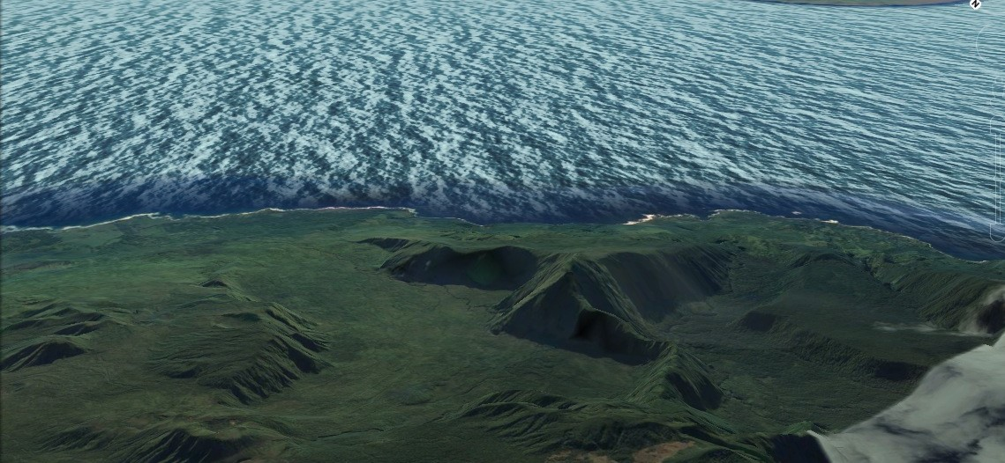
Image from Google Earth

Slide 23
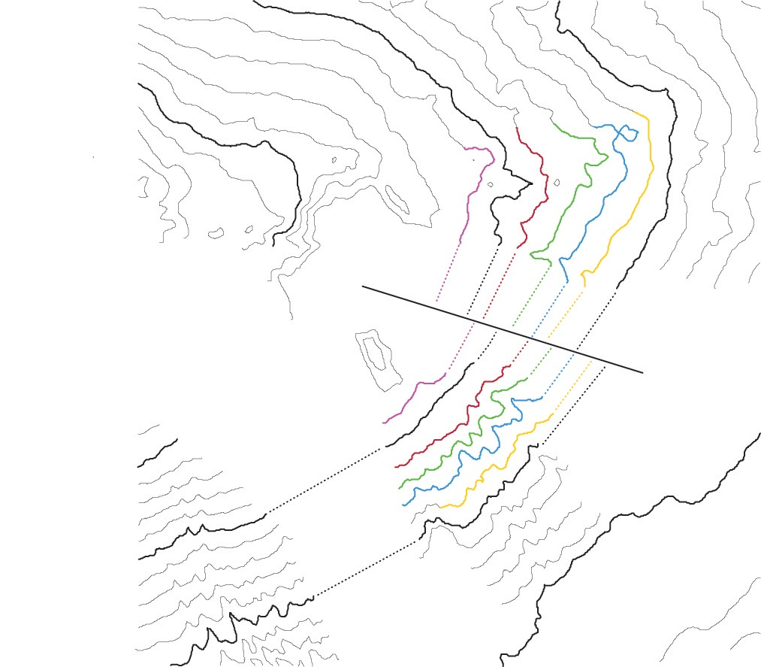
Map created from data of Univ. of Hawaii, School of Ocean and Earth Science and Technology
http://www.soest.hawaii.edu/HMRG/multibeam/bathymetry.php
0
10 km

Slide 24
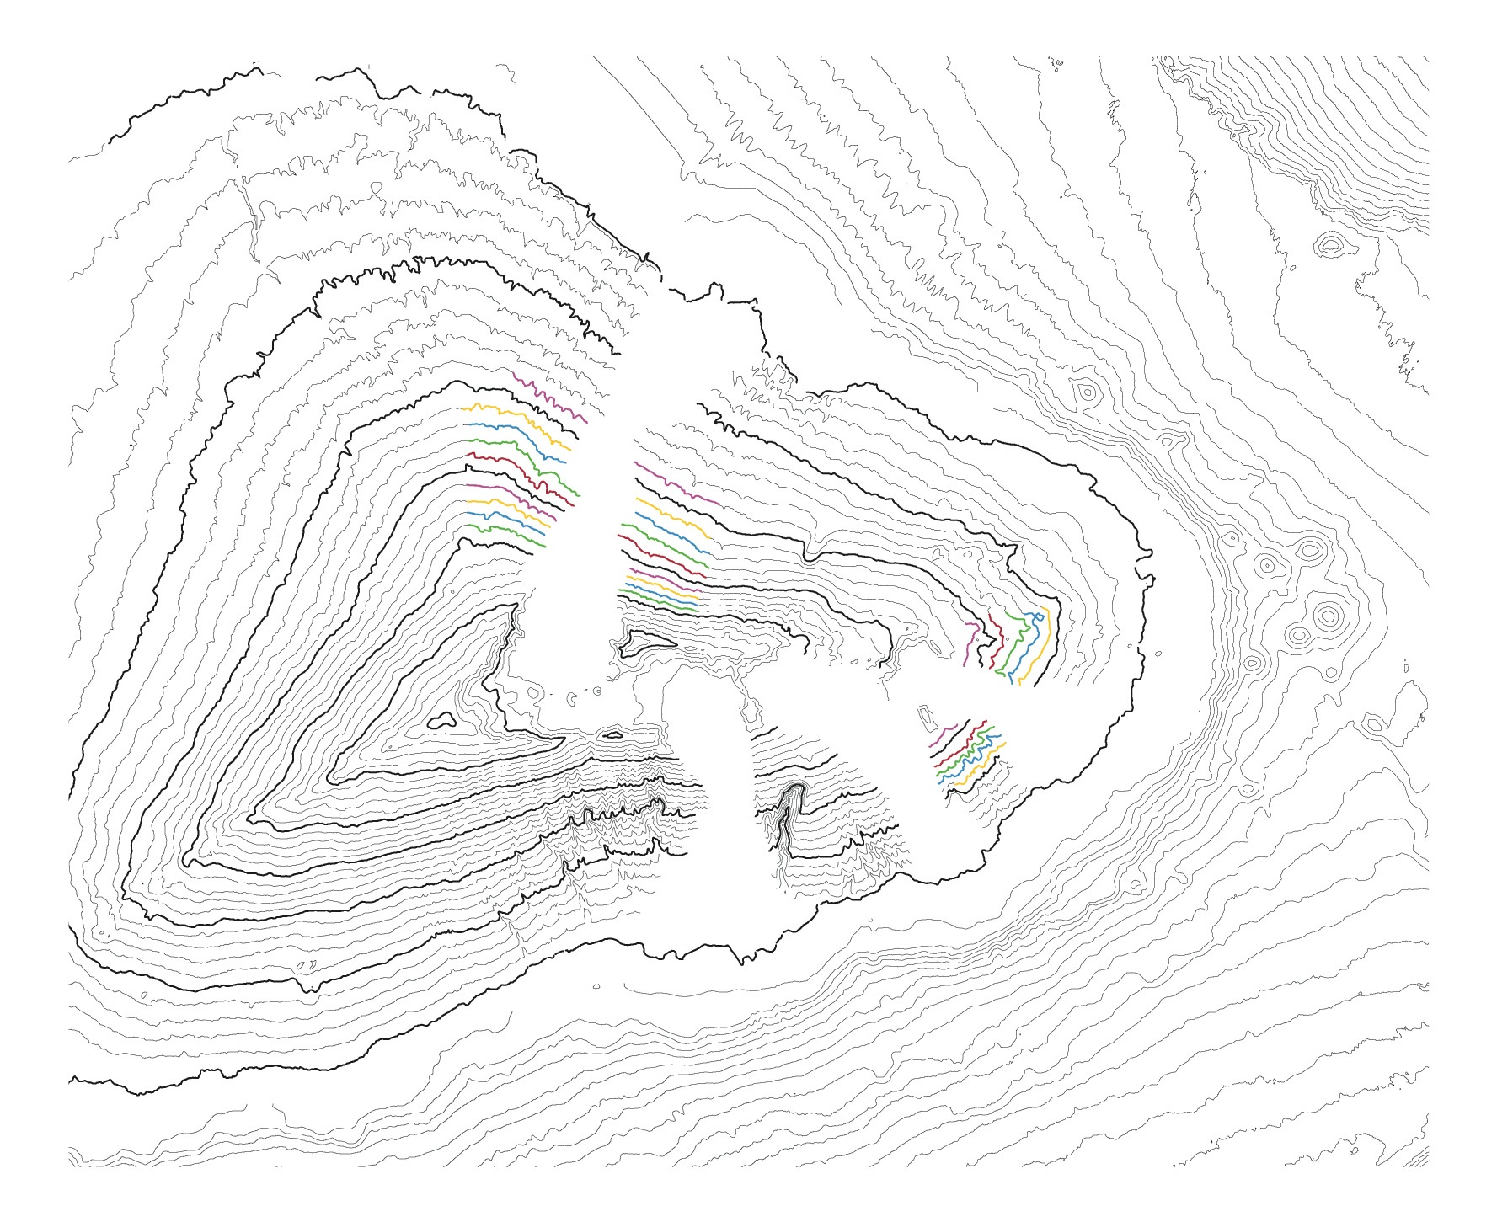
0
25 km
Map created from data of Univ. of Hawaii, School of Ocean and Earth Science and Technology
http://www.soest.hawaii.edu/HMRG/multibeam/bathymetry.php

Slide 25
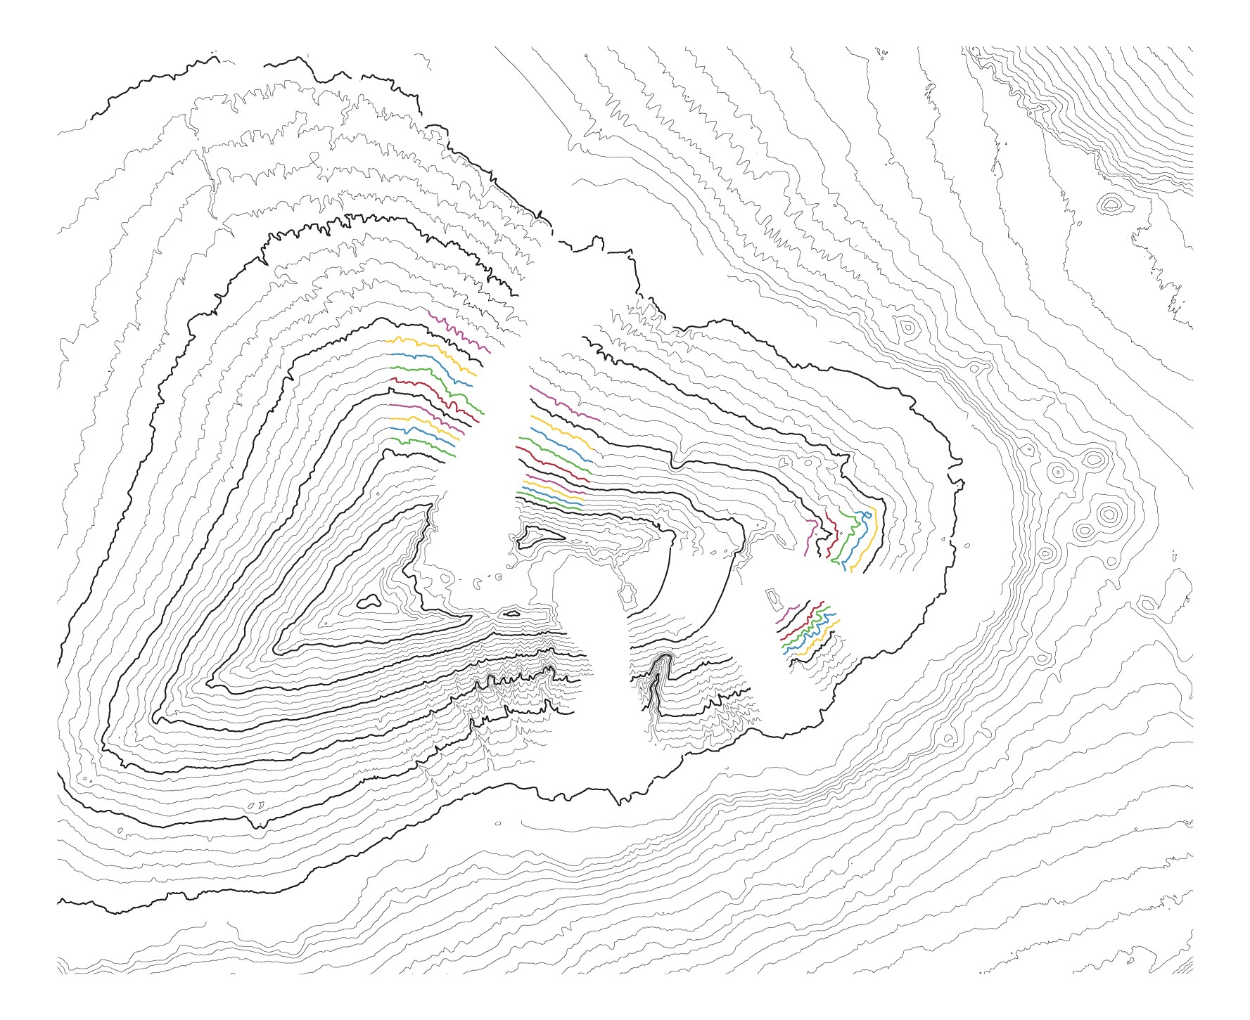
0
25 km
Map created from data of Univ. of Hawaii, School of Ocean and Earth Science and Technology
http://www.soest.hawaii.edu/HMRG/multibeam/bathymetry.php

Slide 26
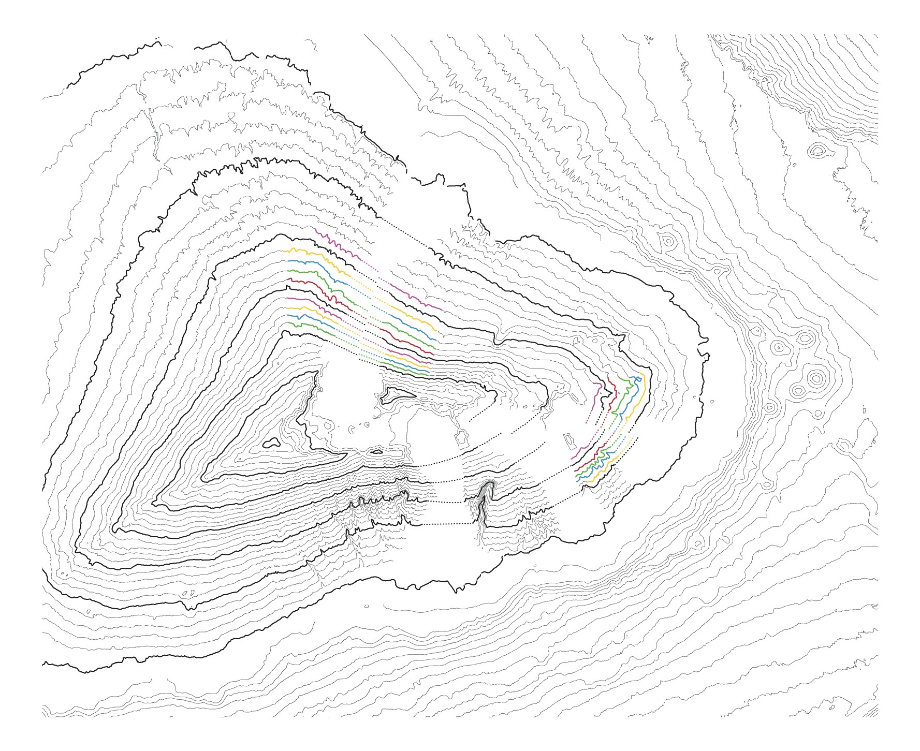
0
25 km
Map created from data of Univ. of Hawaii, School of Ocean and Earth Science and Technology
http://www.soest.hawaii.edu/HMRG/multibeam/bathymetry.php

Slide 27

0
25 km
Map created from data of Univ. of Hawaii, School of Ocean and Earth Science and Technology
http://www.soest.hawaii.edu/HMRG/multibeam/bathymetry.php

Slide 28

0
25 km
Map created from data of Univ. of Hawaii, School of Ocean and Earth Science and Technology
http://www.soest.hawaii.edu/HMRG/multibeam/bathymetry.php

Slide 29
Relief image from National Park Service

Slide 30
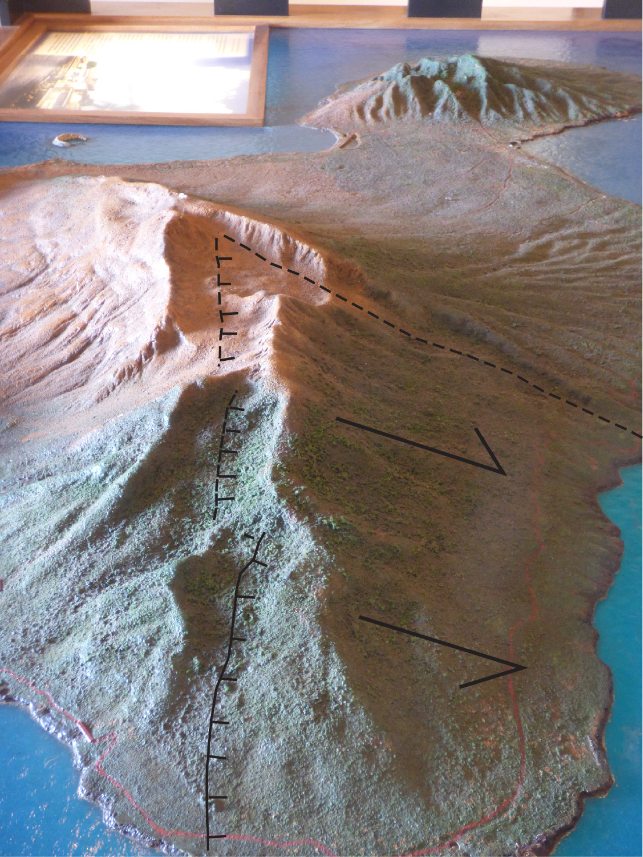
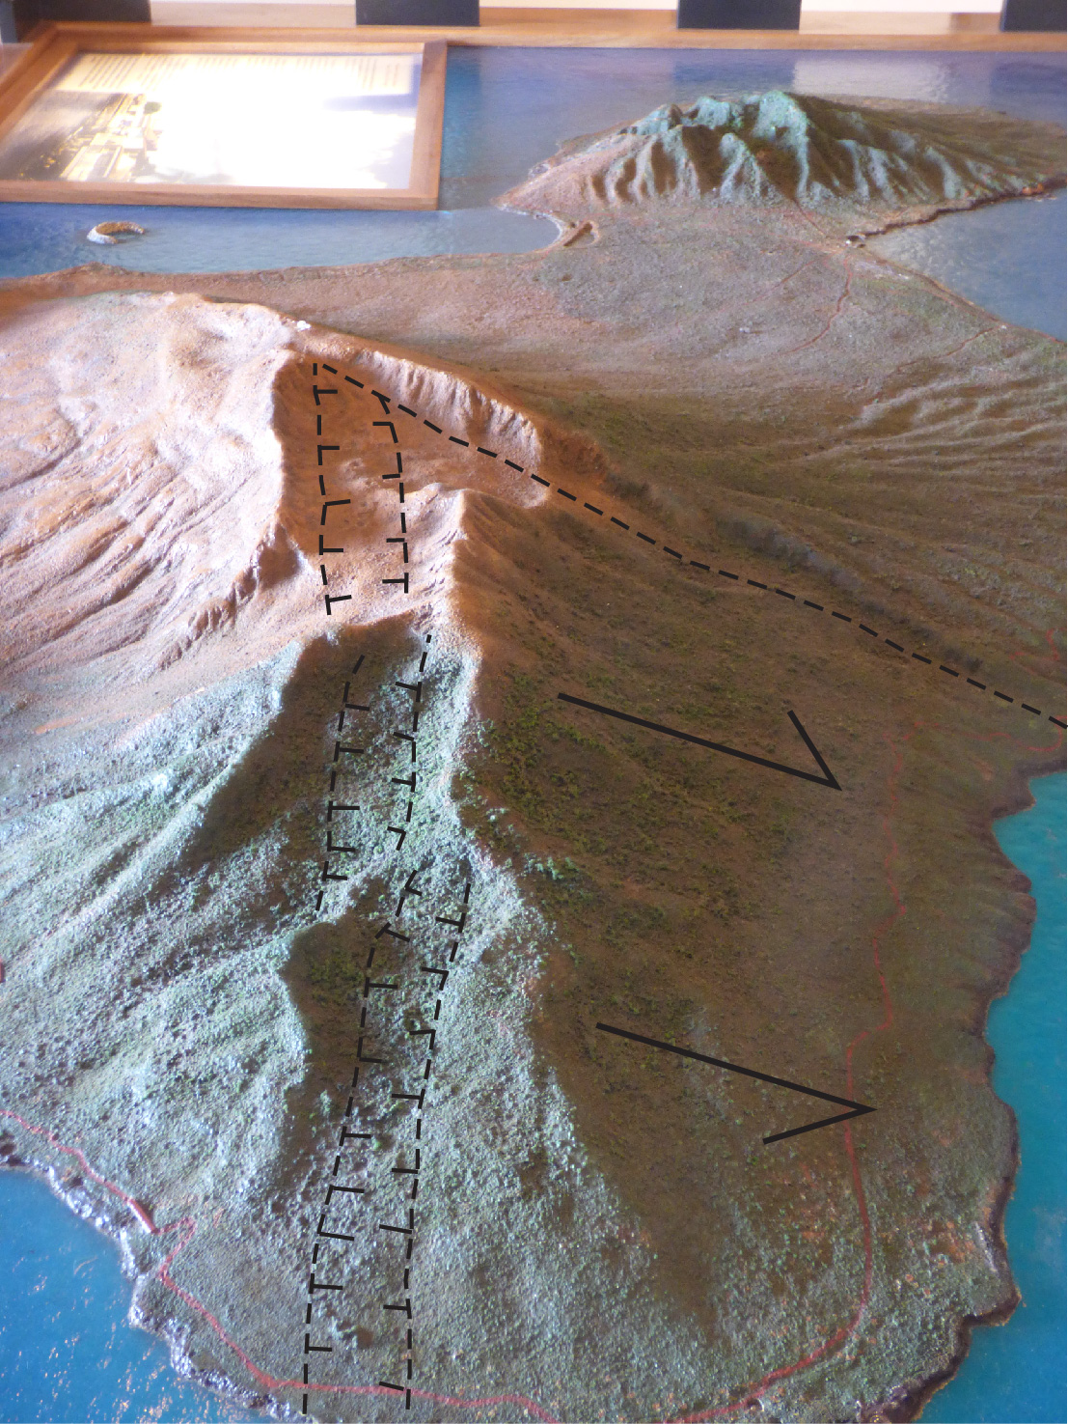

Slide 31
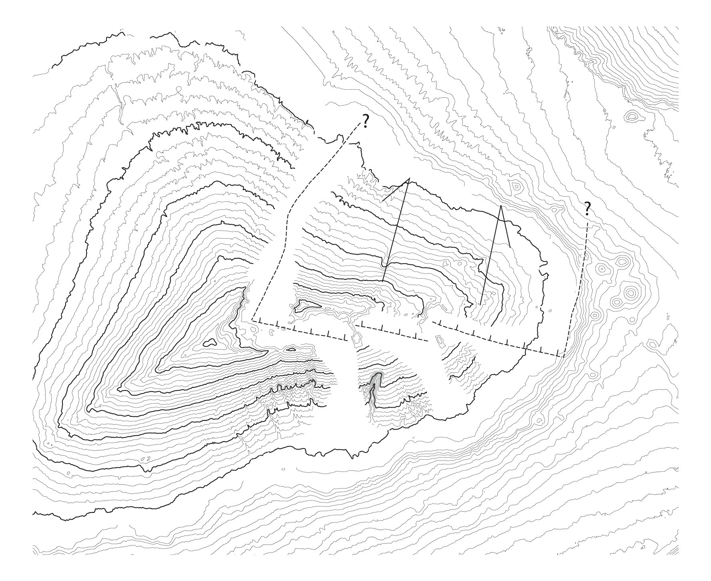
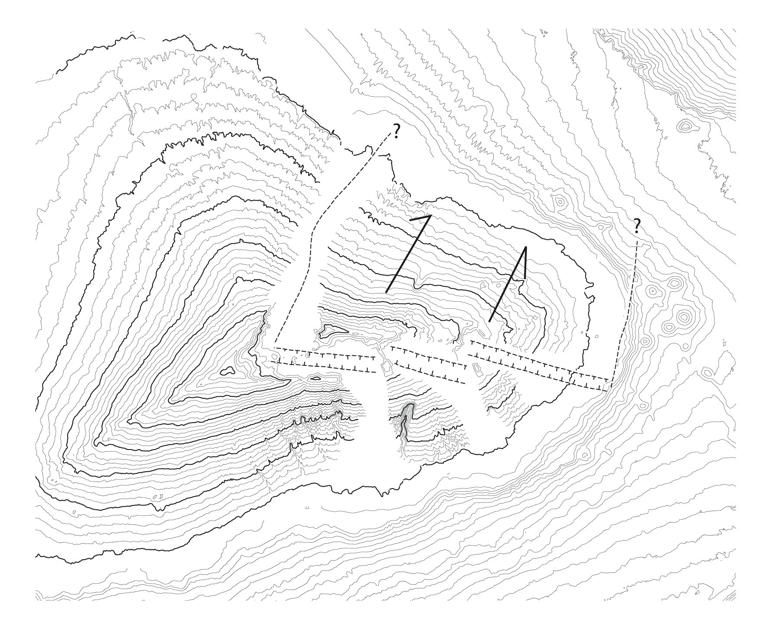
Maps created from data of Univ. of Hawaii, School of Ocean and Earth Science and Technology
http://www.soest.hawaii.edu/HMRG/multibeam/bathymetry.php

Slide 32
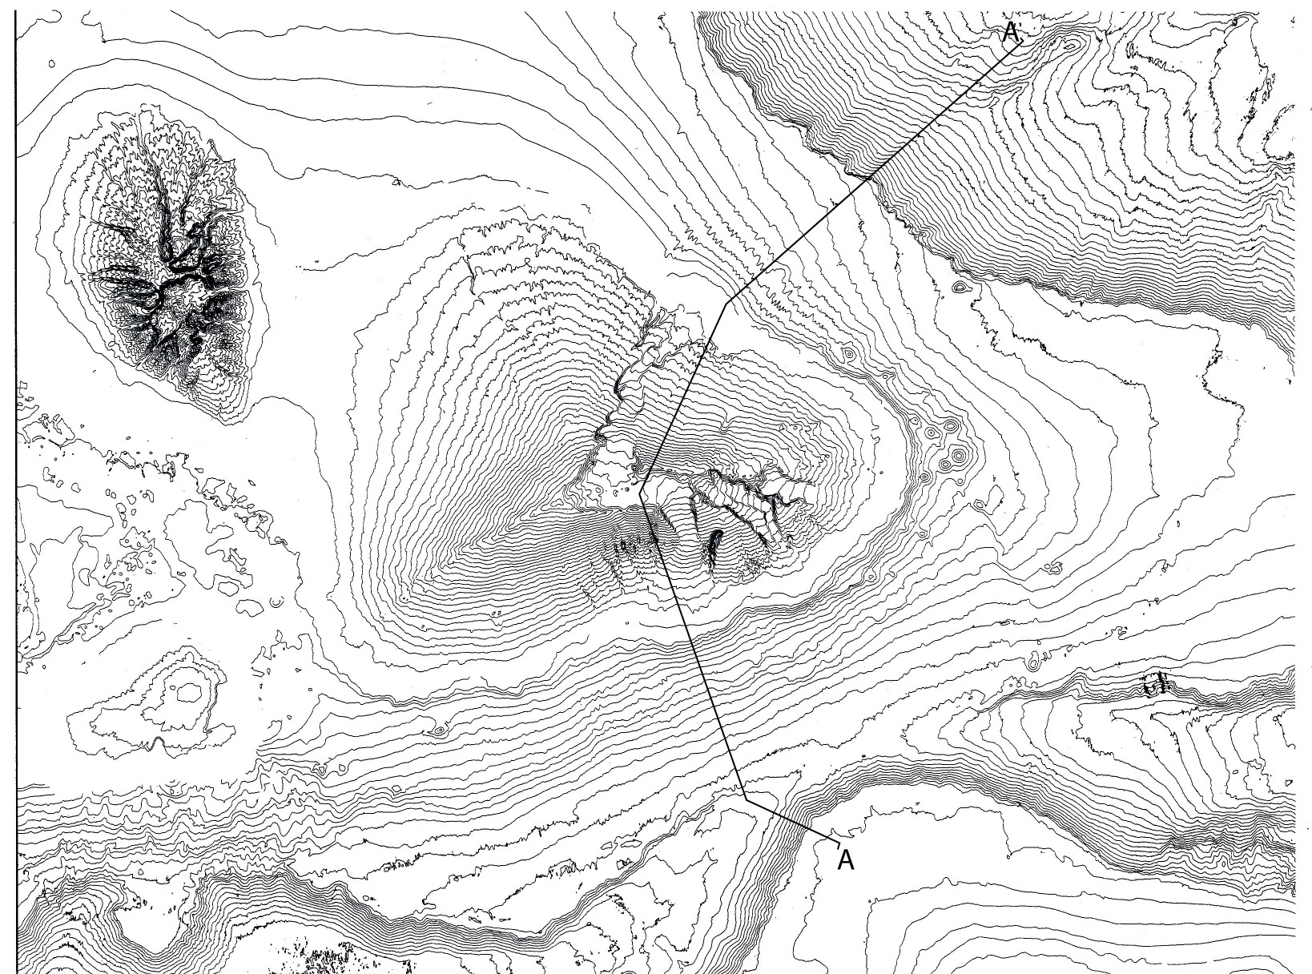
0
50 km
Map created from data of Univ. of Hawaii, School of Ocean and Earth Science and Technology
http://www.soest.hawaii.edu/HMRG/multibeam/bathymetry.php

Slide 33
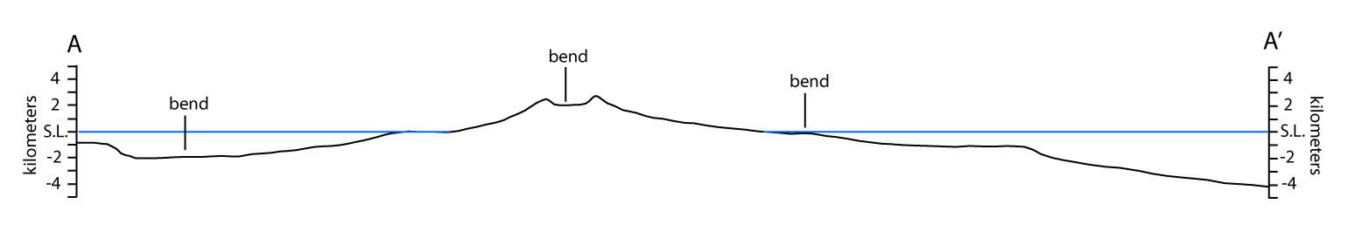
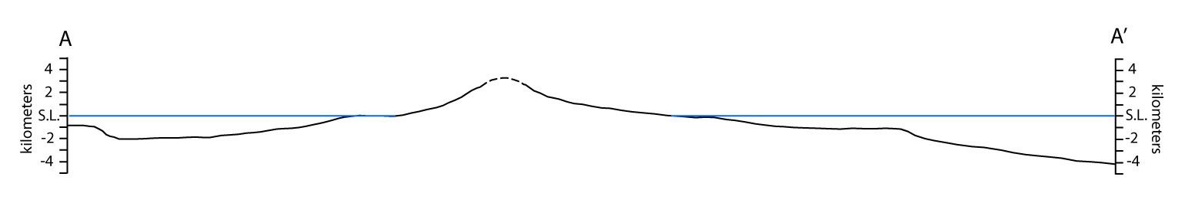

Slide 35
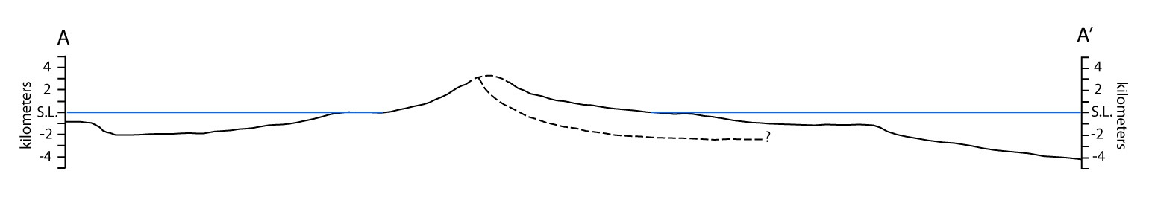
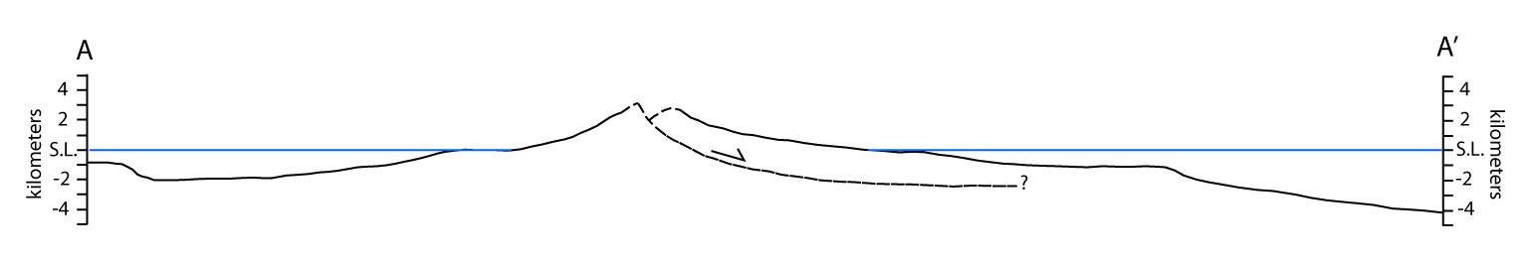

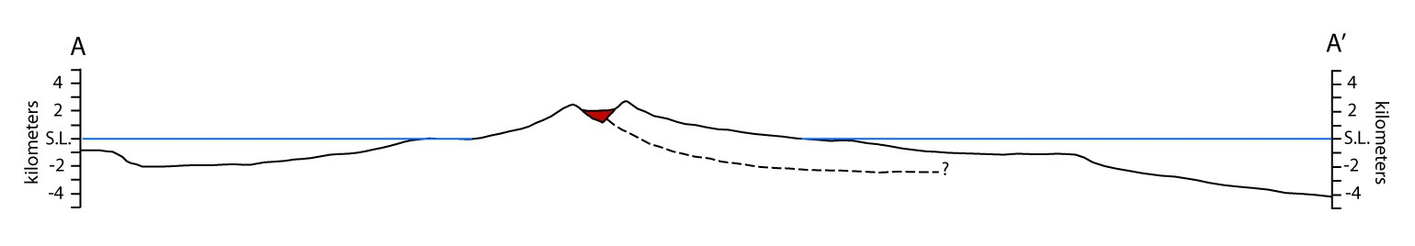

Slide 37
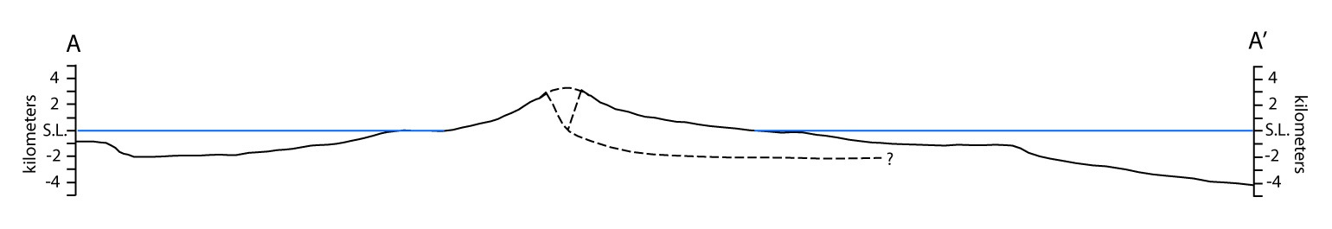


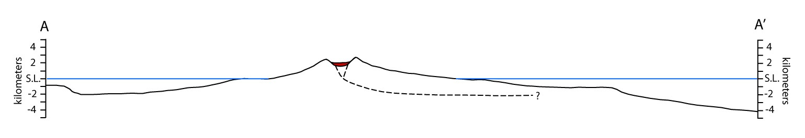

Slide 39
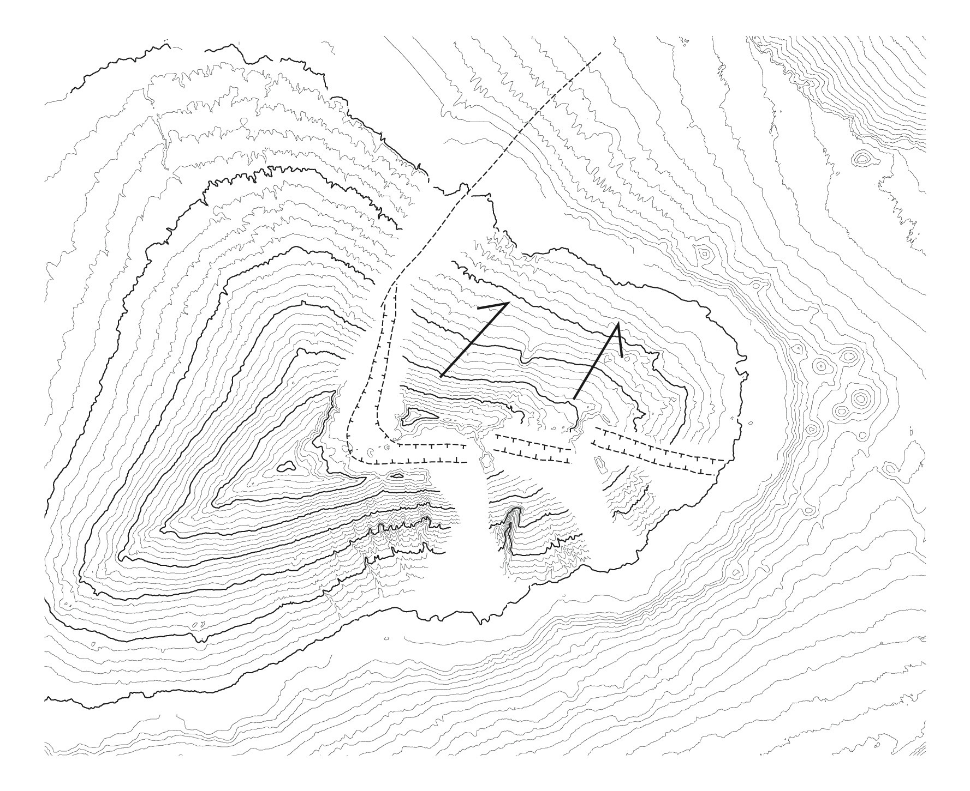

Slide 40


Slide 41
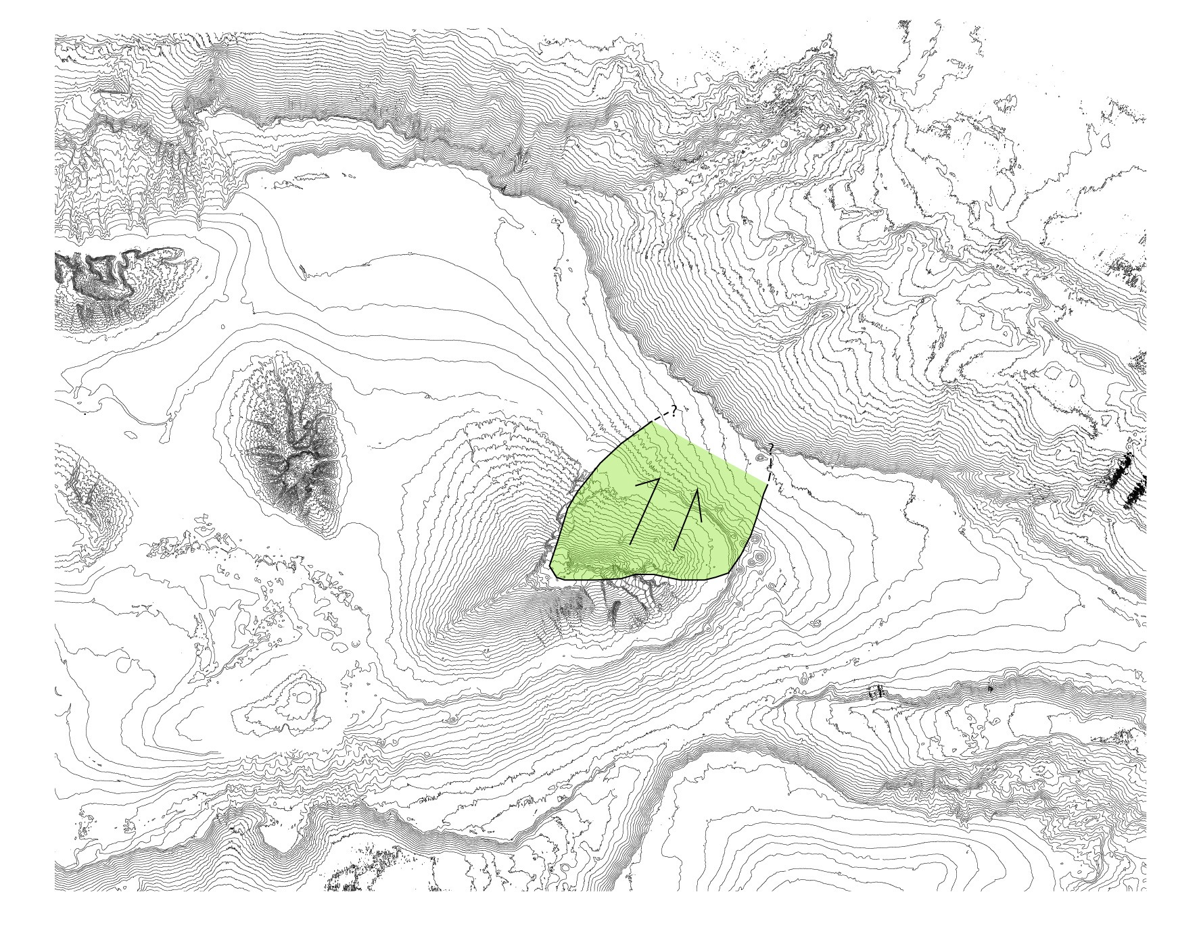

Slide 43
How much displacement?
2.5 km

Slide 44
Time of landslide movement - between 150 and 120 ka

Slide 45
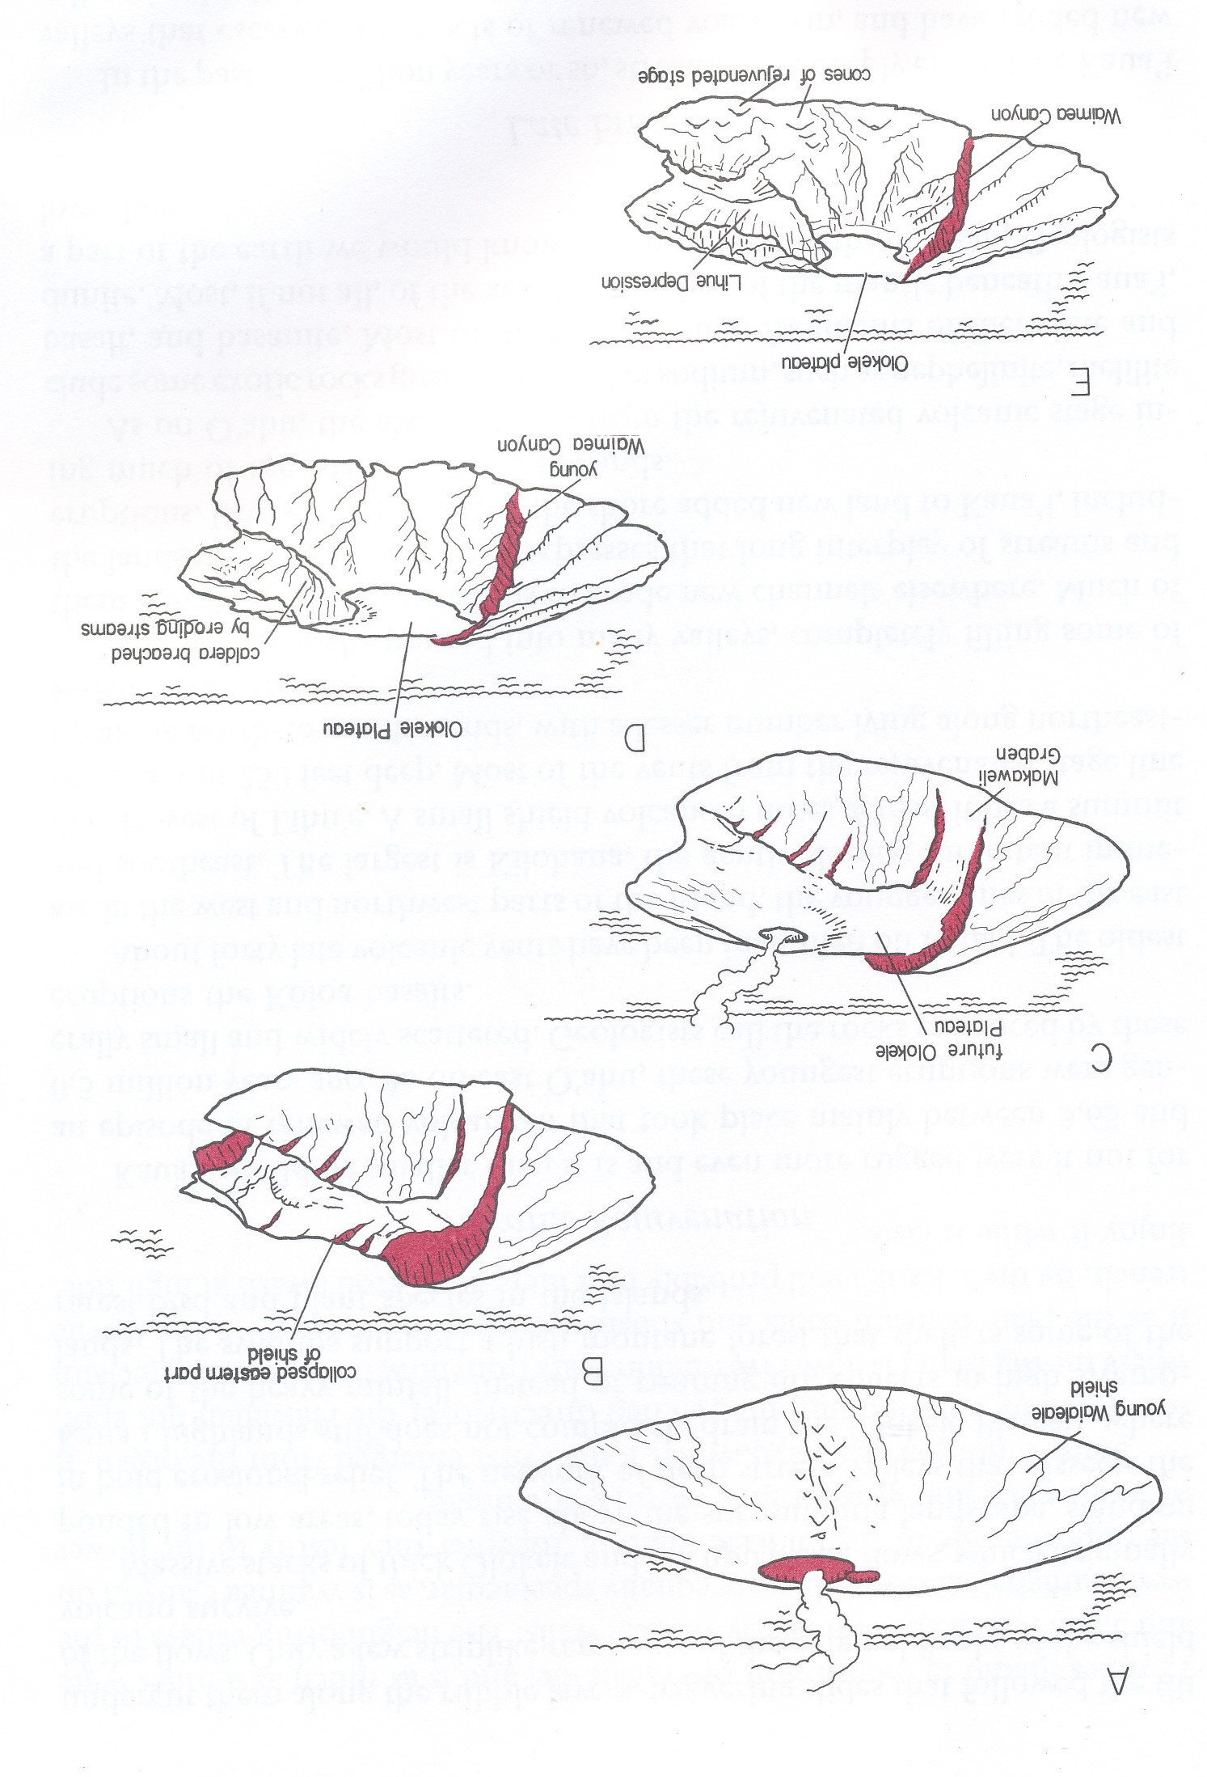
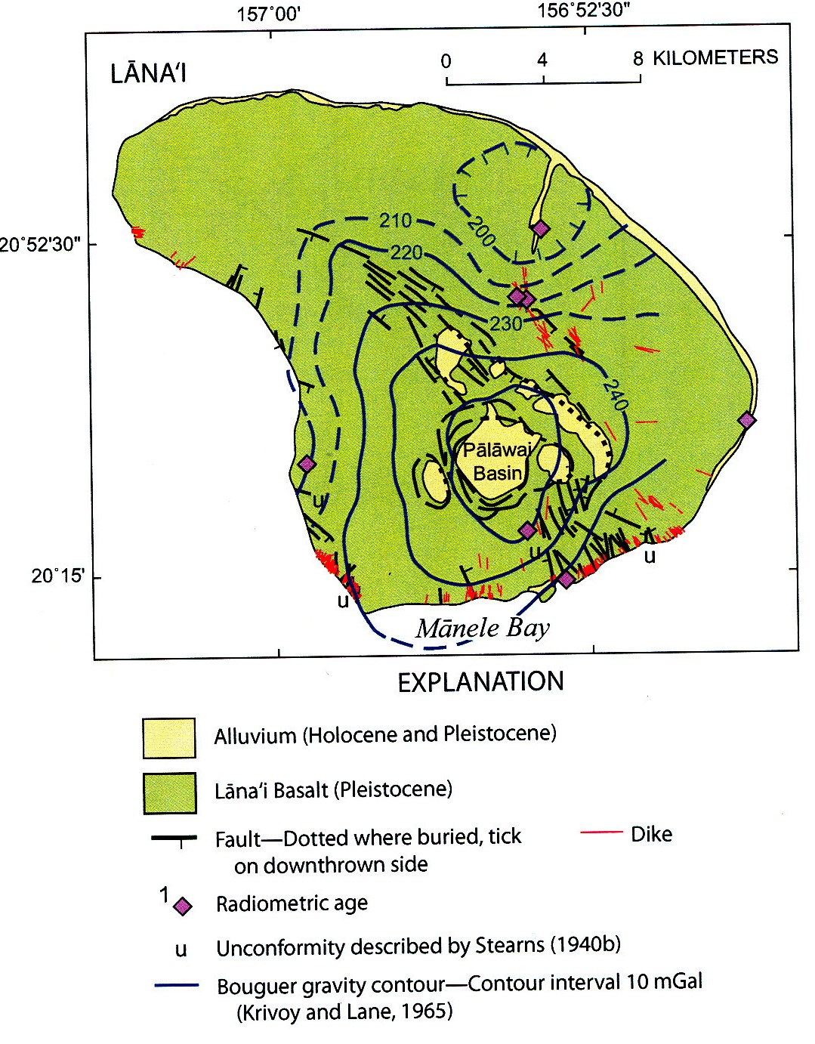
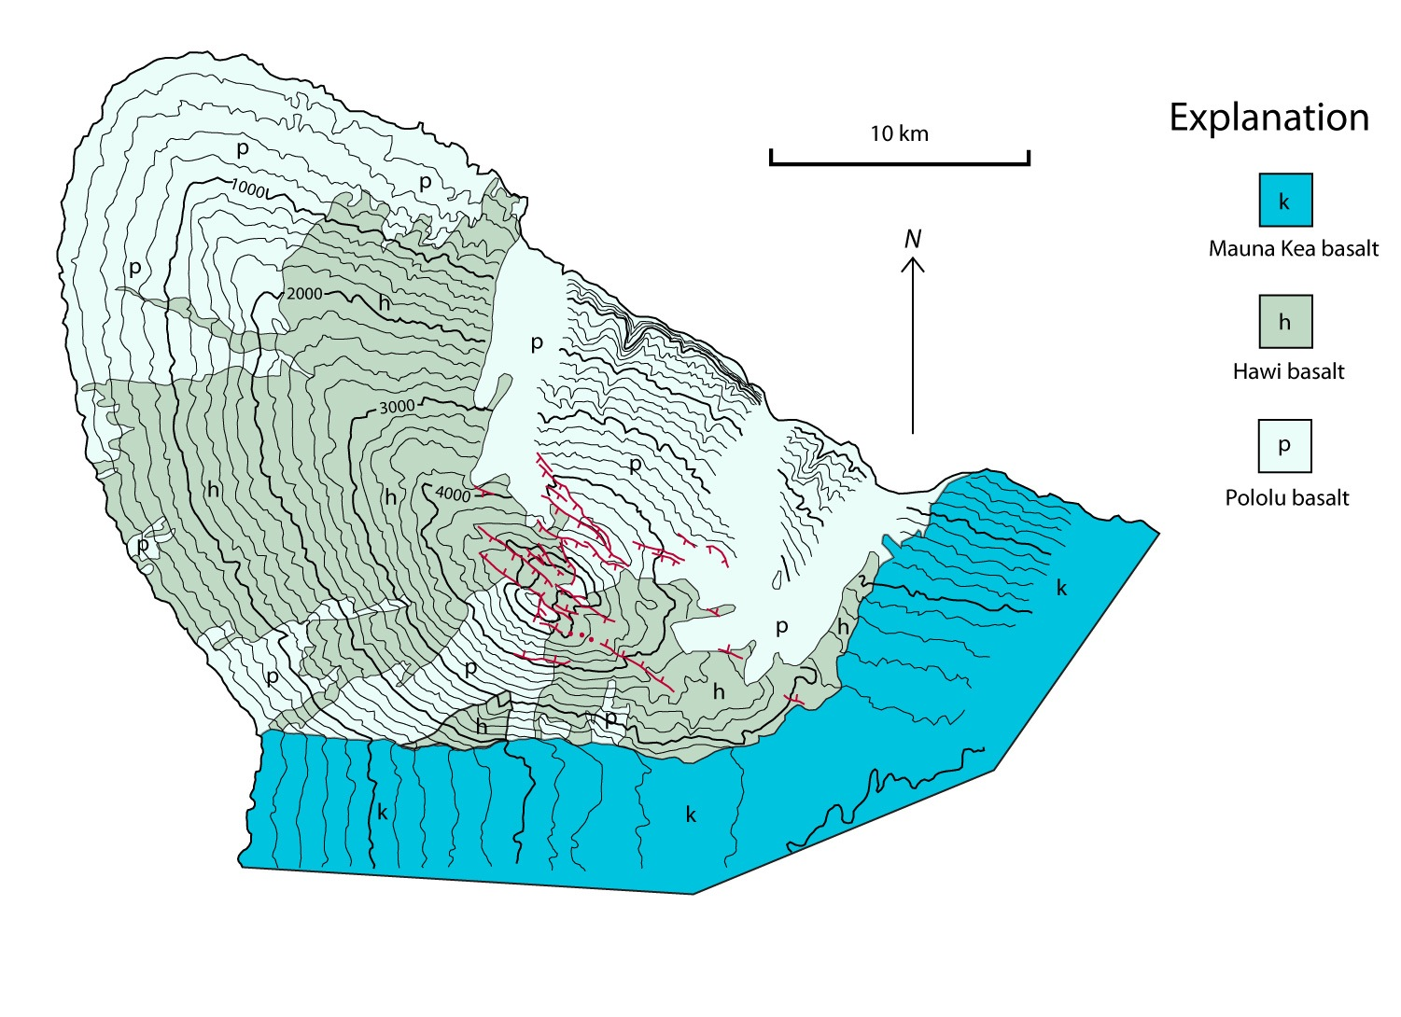
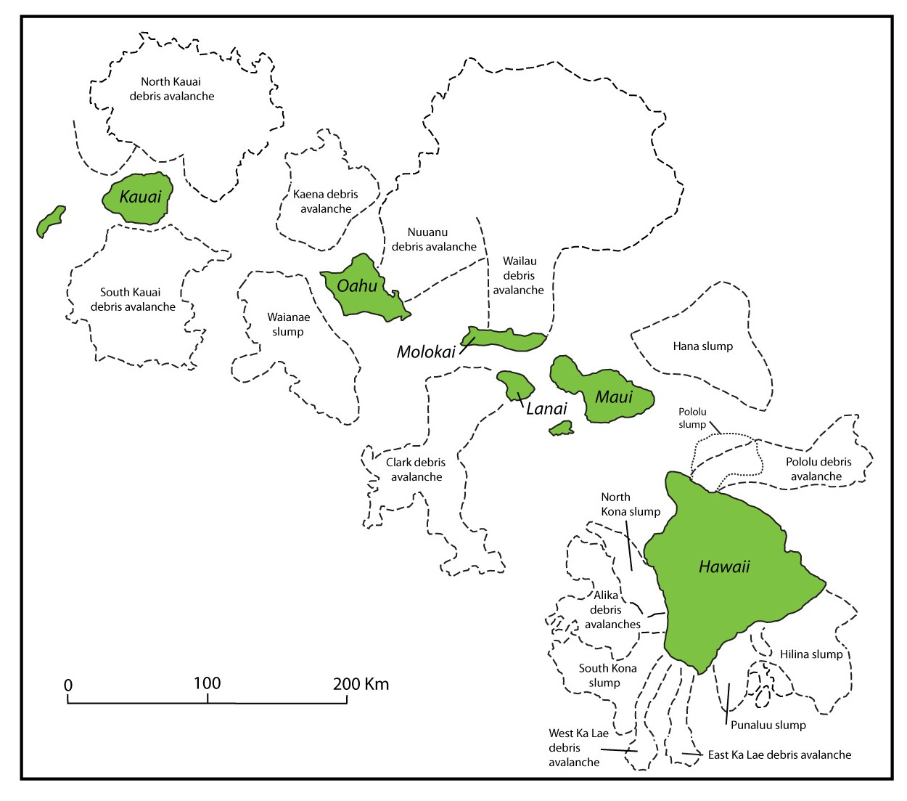
Sherrod, D.R., Sinton, J.M., Watkins, J.M., and Brunt, K.M., 2007
Re-drawn from Sherrod, D.R., Sinton, J.M., Watkins, S.E., and Brunt, K.M., 2007
Hazlett, R.W. and Hyndman, D.W., 1996
Re-drawn from Moore et al., 1989
Pololu slump from Smith et al., 2007

Slide 46

Special thanks to my colleague, Dr. Andre Ellis, for creating the contour map used in this study.
Questions?
Comments?

Slide 48
Proposed Name:
Keanae landslide

Slide 49
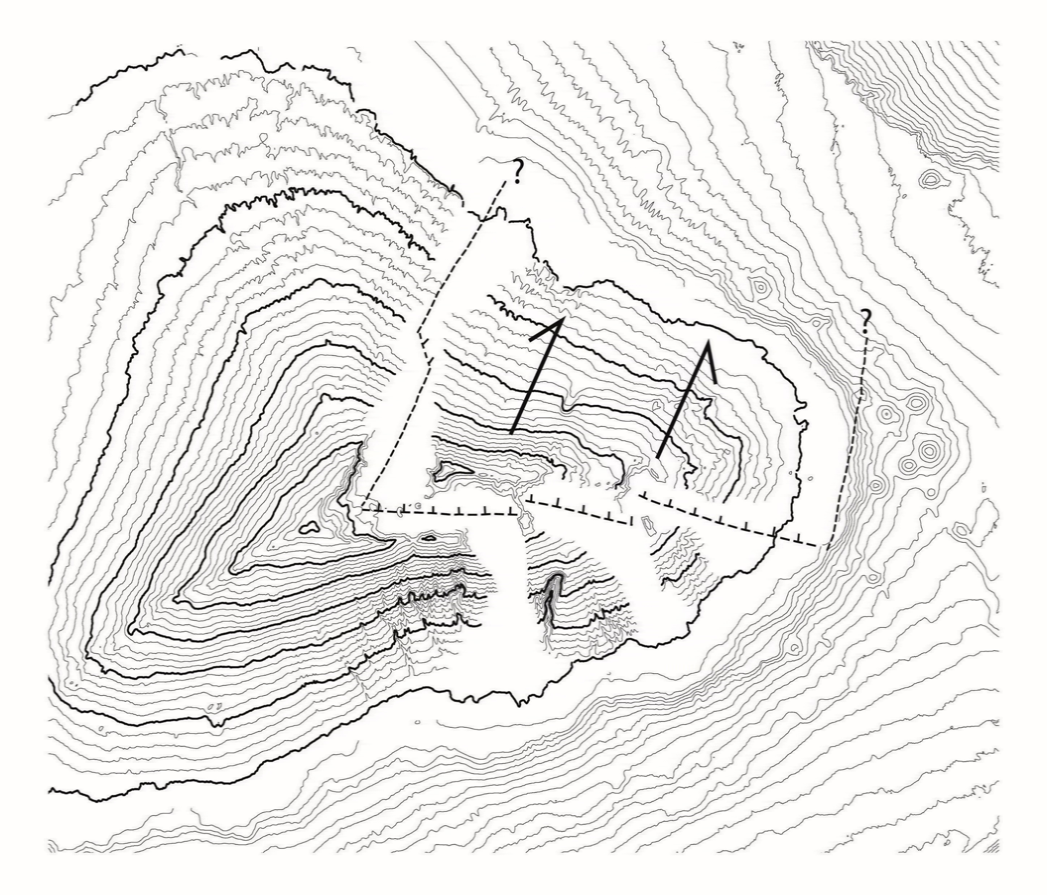
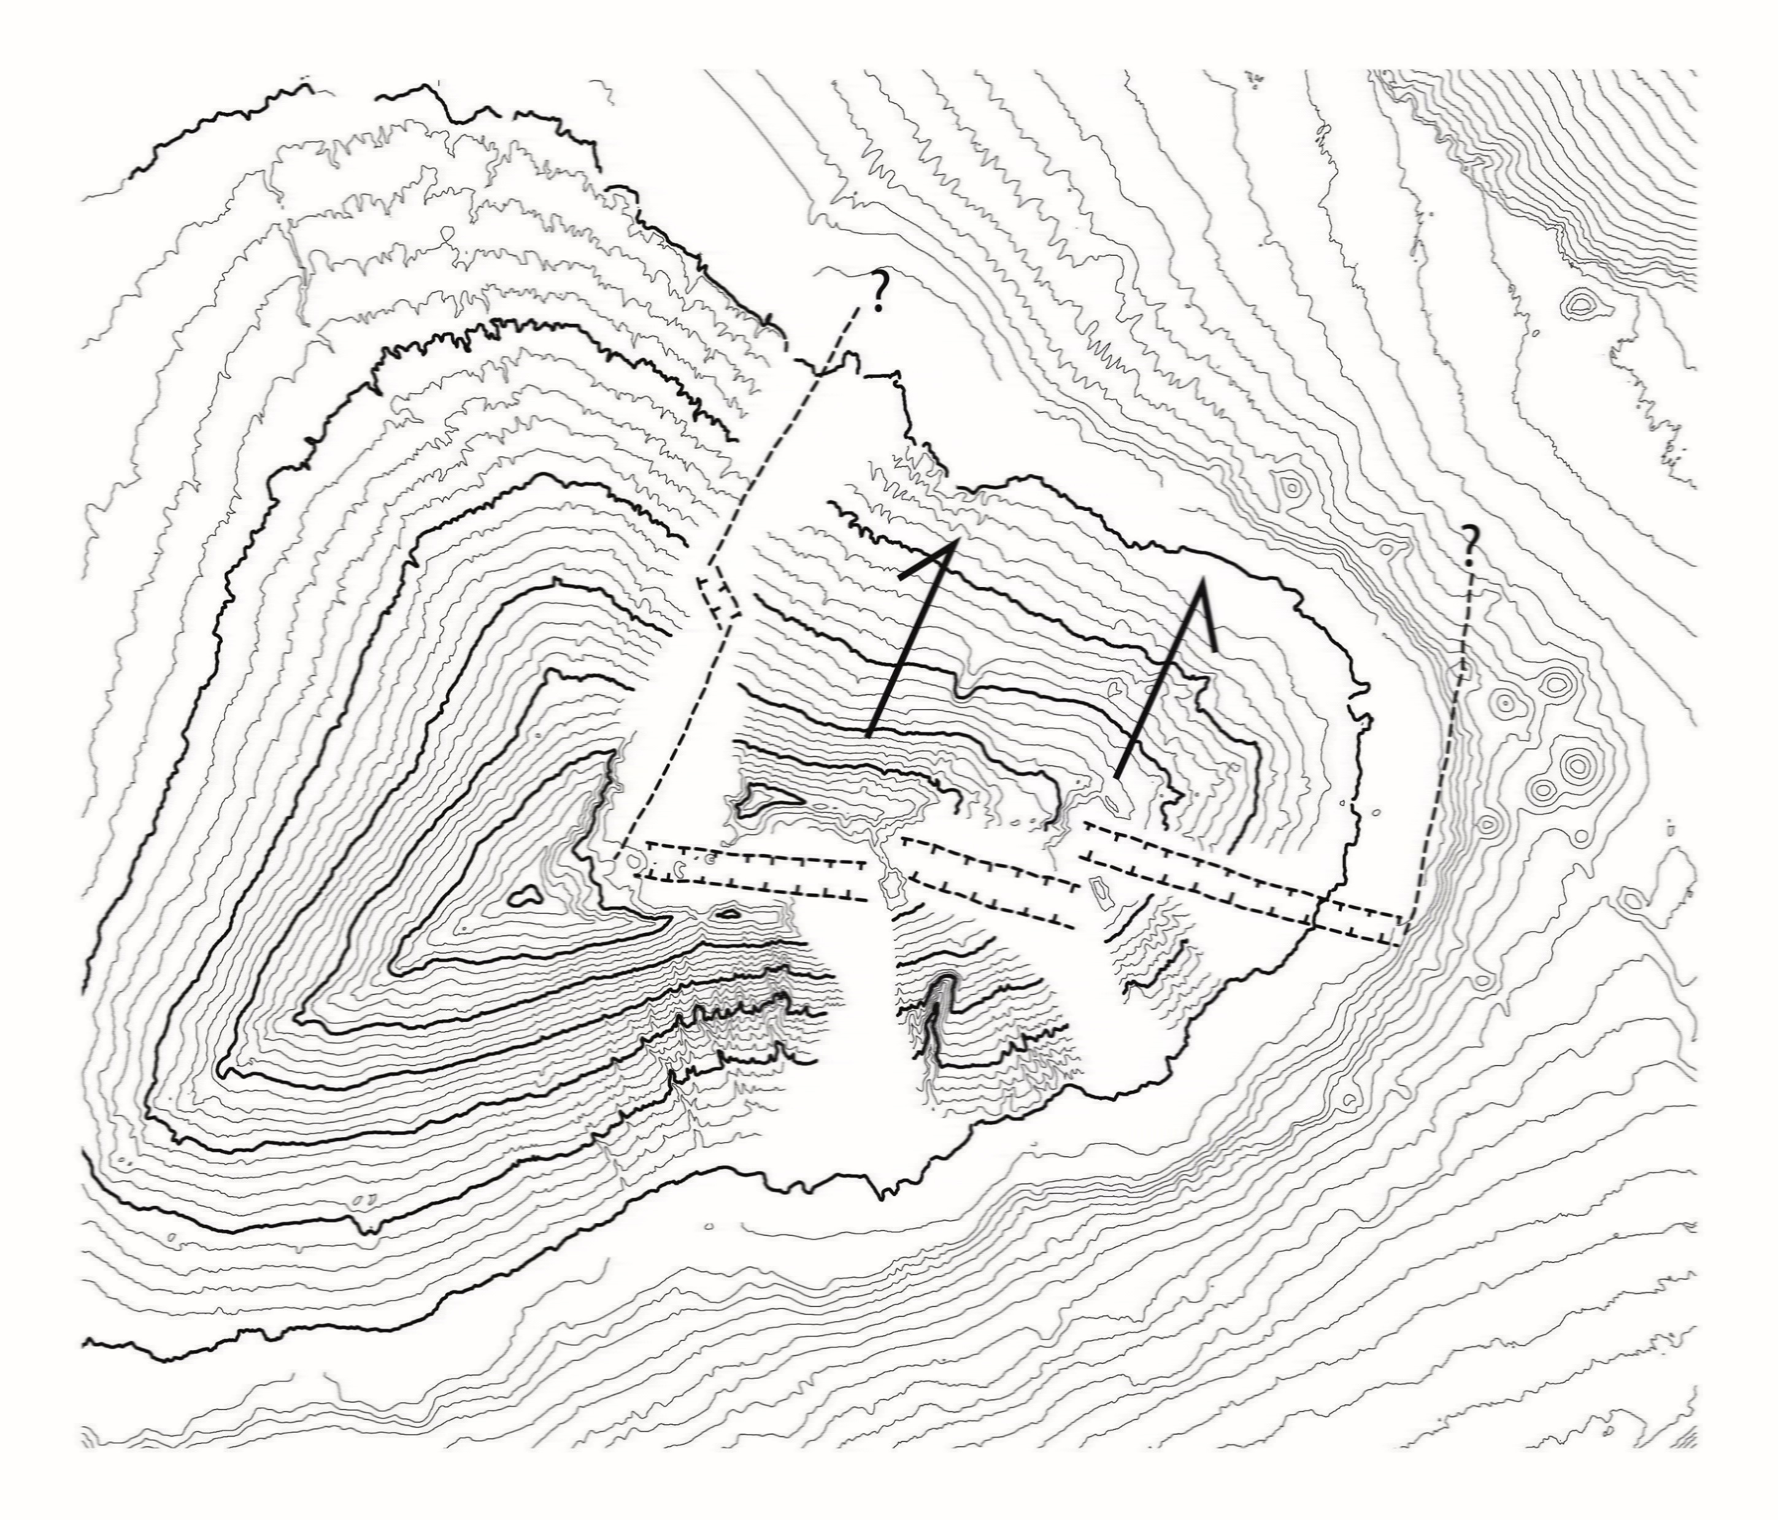

Slide 50


Slide 51
Is the en-echelon graben or single scarp structure reasonable?

Slide 52
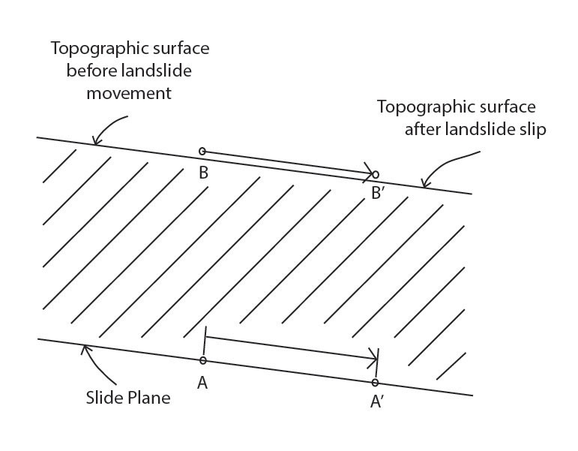

Slide 53
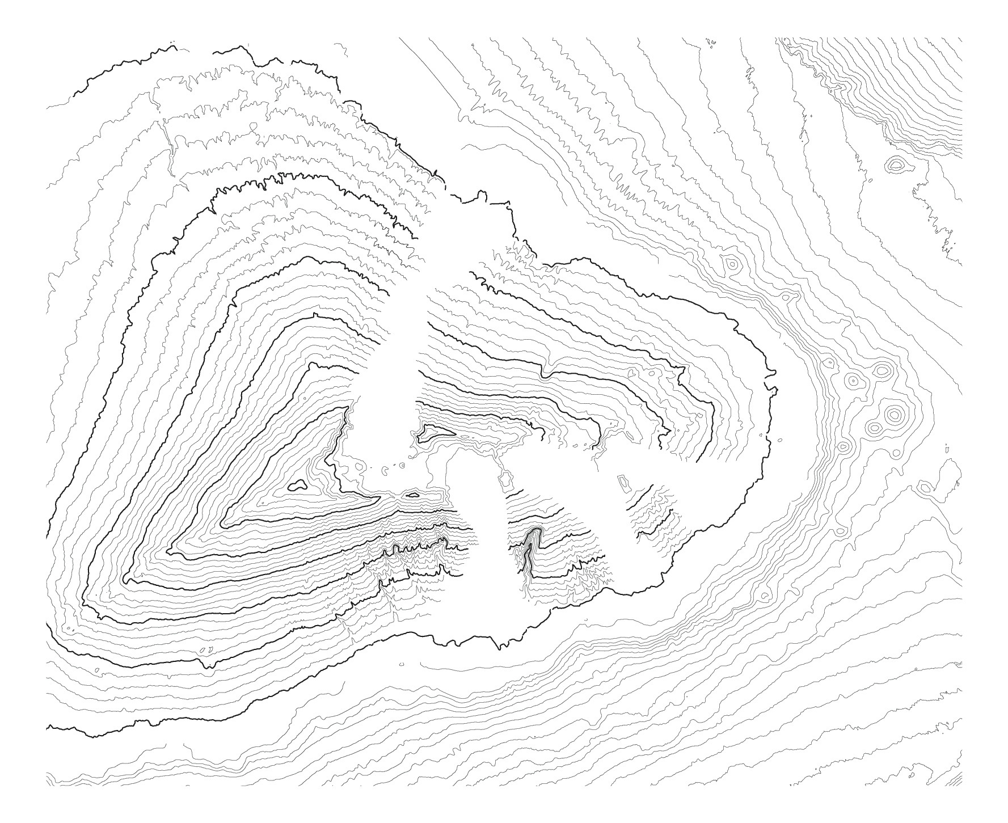
0
25 km
Map created from data of Univ. of Hawaii, School of Ocean and Earth Science and Technology
http://www.soest.hawaii.edu/HMRG/multibeam/bathymetry.php

Slide 54
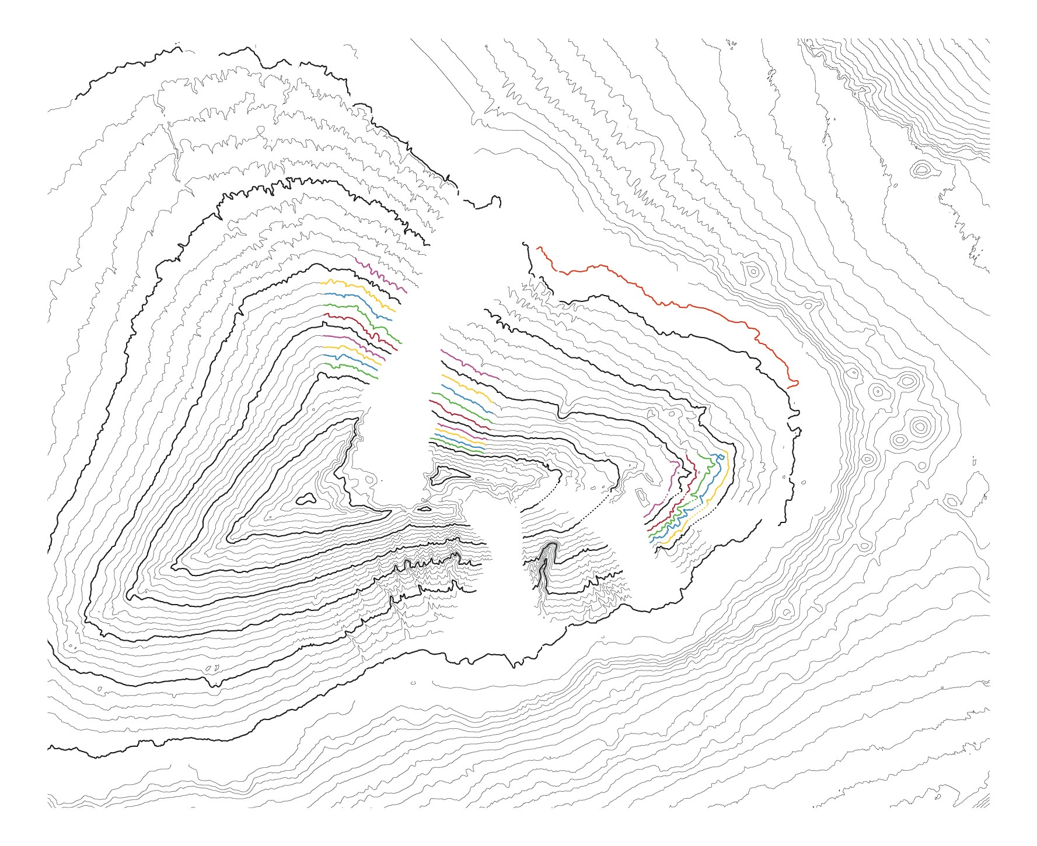
0
25 km

Slide 55
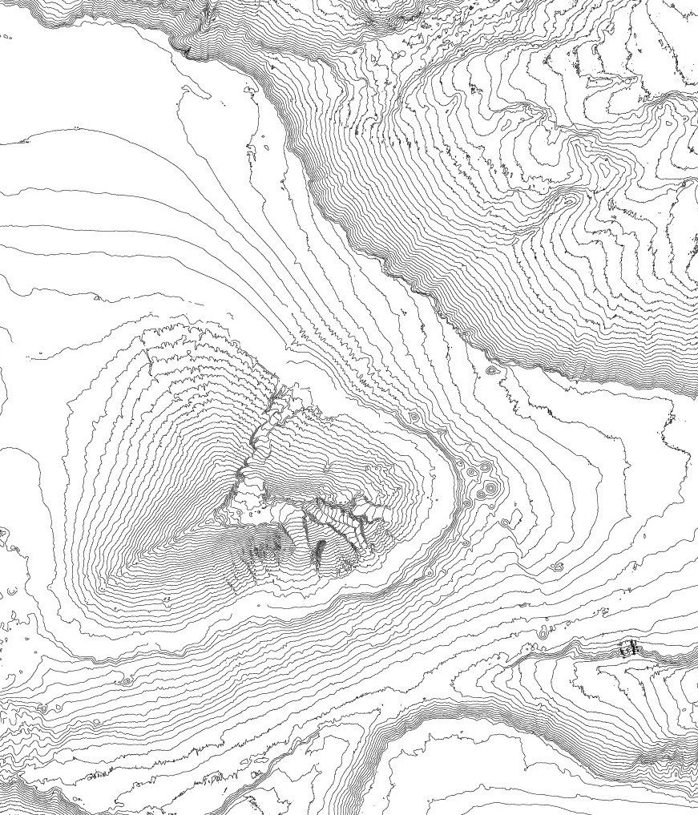

Slide 57

Eakins, B.W., and Robinson, J.E., 2006

