Slide 1
End of an era: the final explosive eruptions of Keanakāko‘i Tephra at Kīlauea
Don Swanson (USGS-HVO), Sebastien Biass and Mike Garcia (Univ. Hawai‘i)

Slide 2
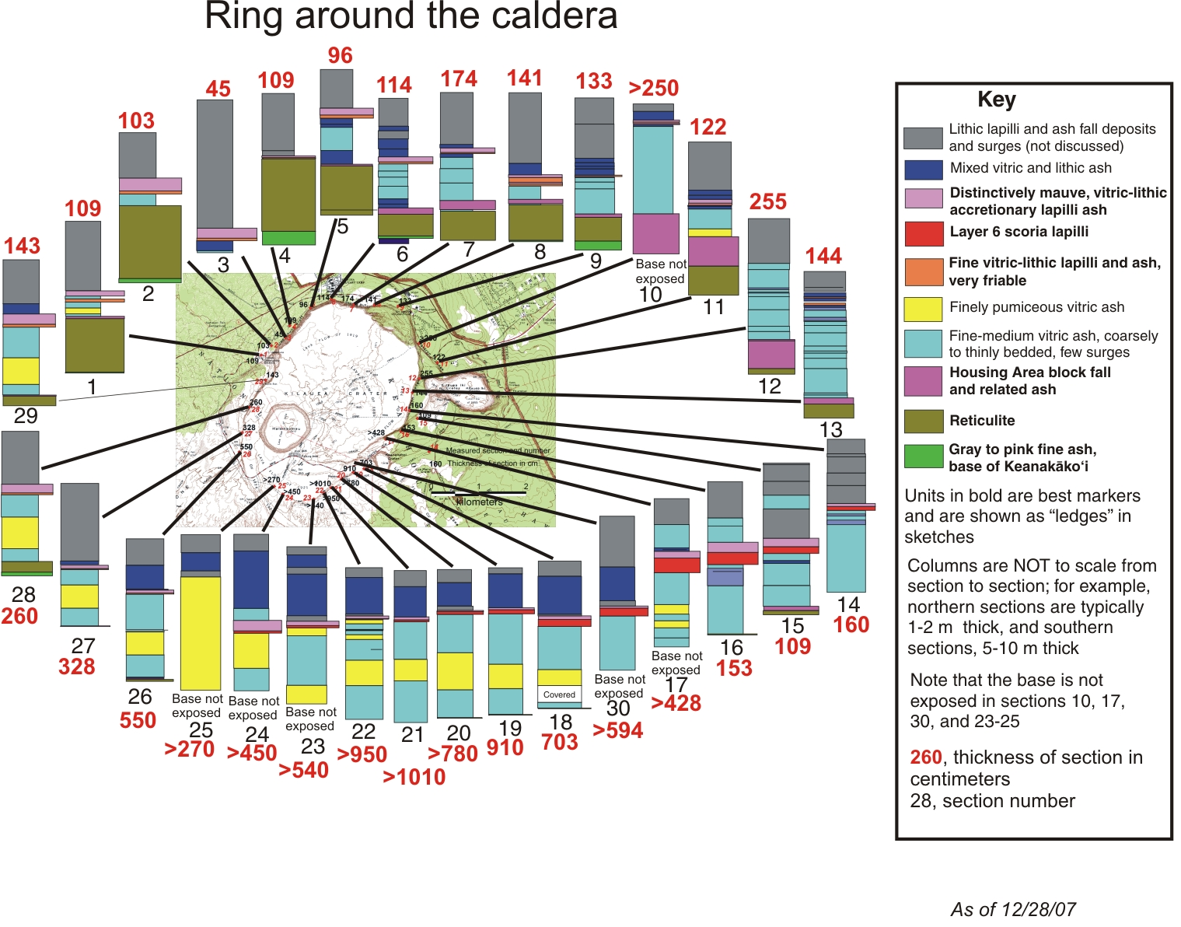

Slide 3
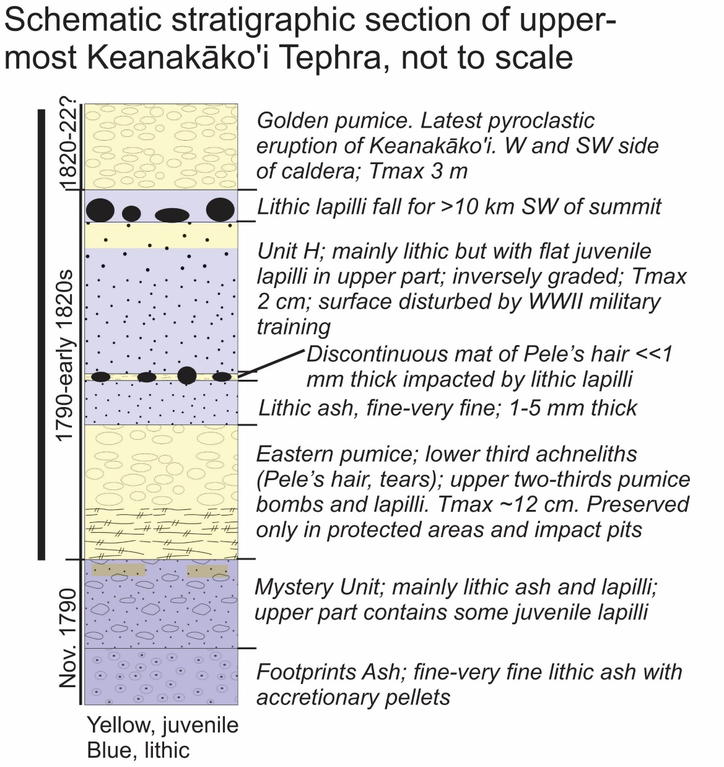
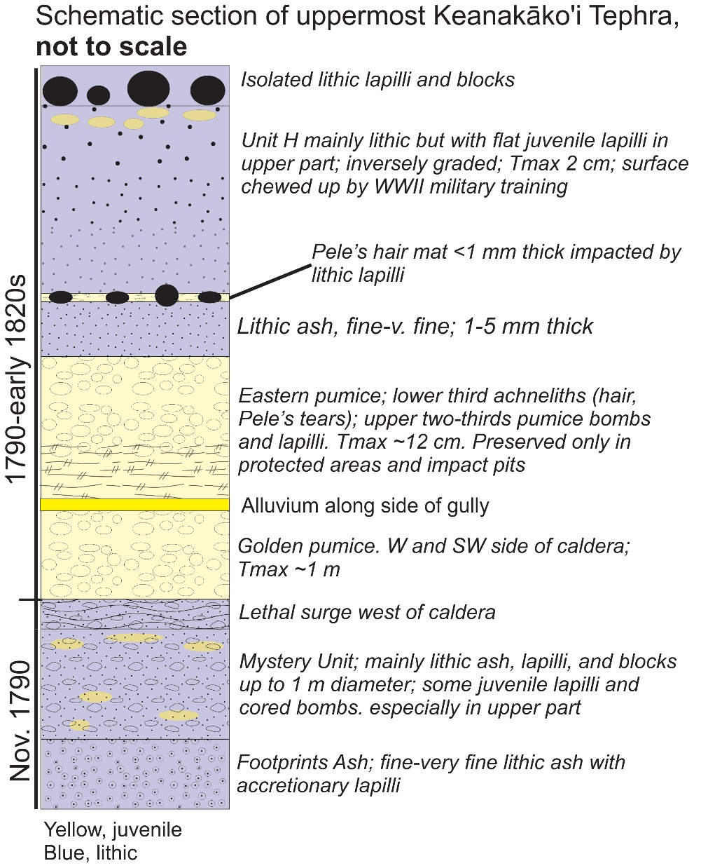

Slide 4
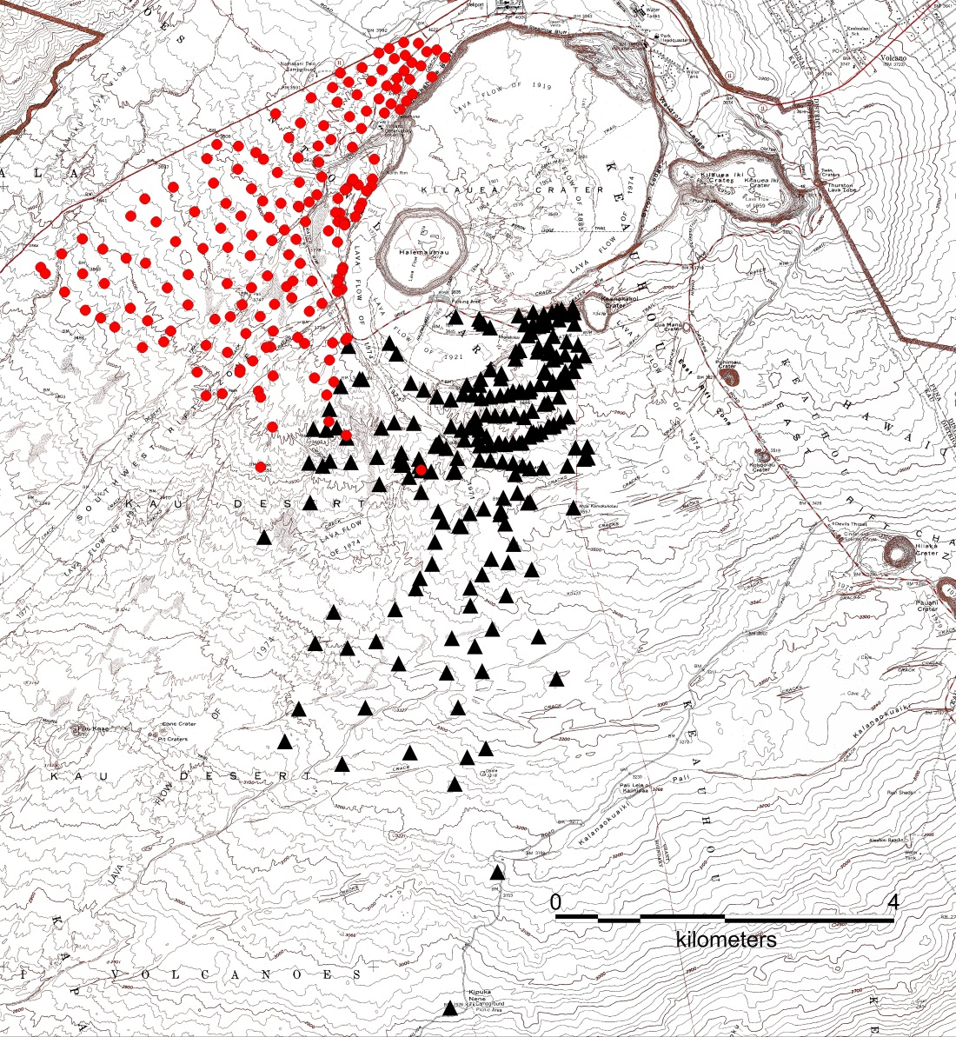
Localities of golden and eastern pumice
Golden pumice
Eastern pumice

Slide 5
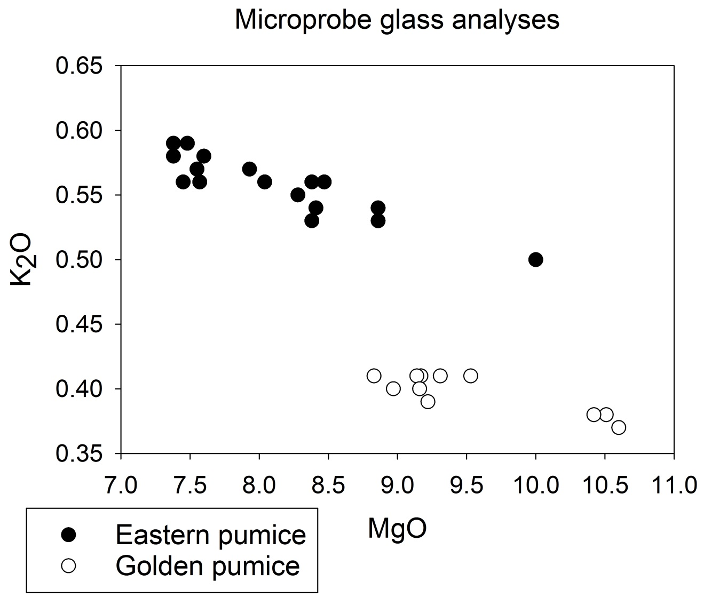

Slide 6
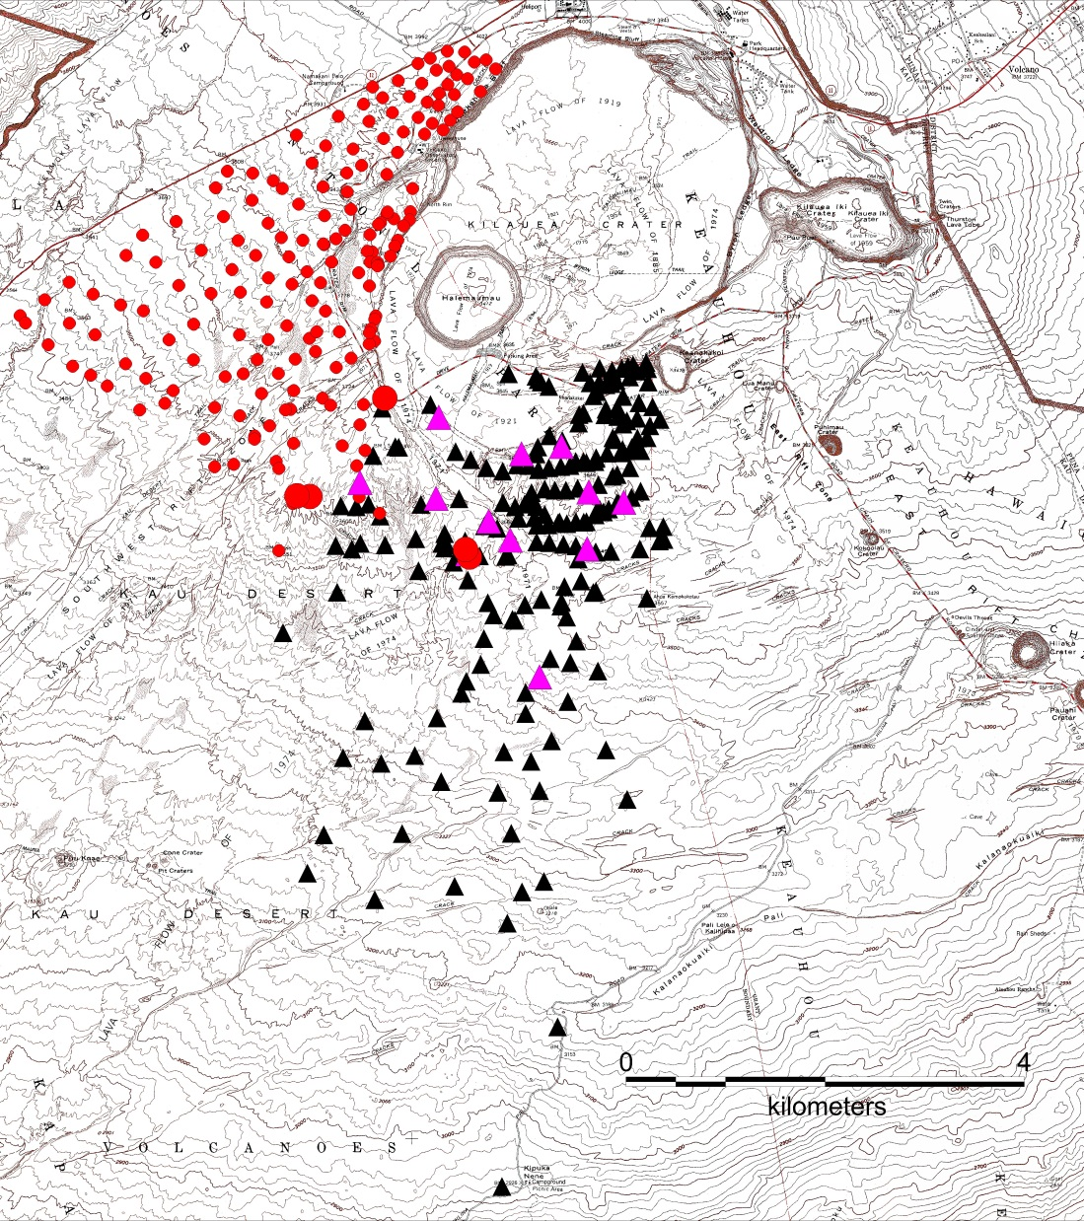
Golden pumice
Outcrop
Glass analysis
Eastern pumice
Outcrop
Glass analysis

Slide 7
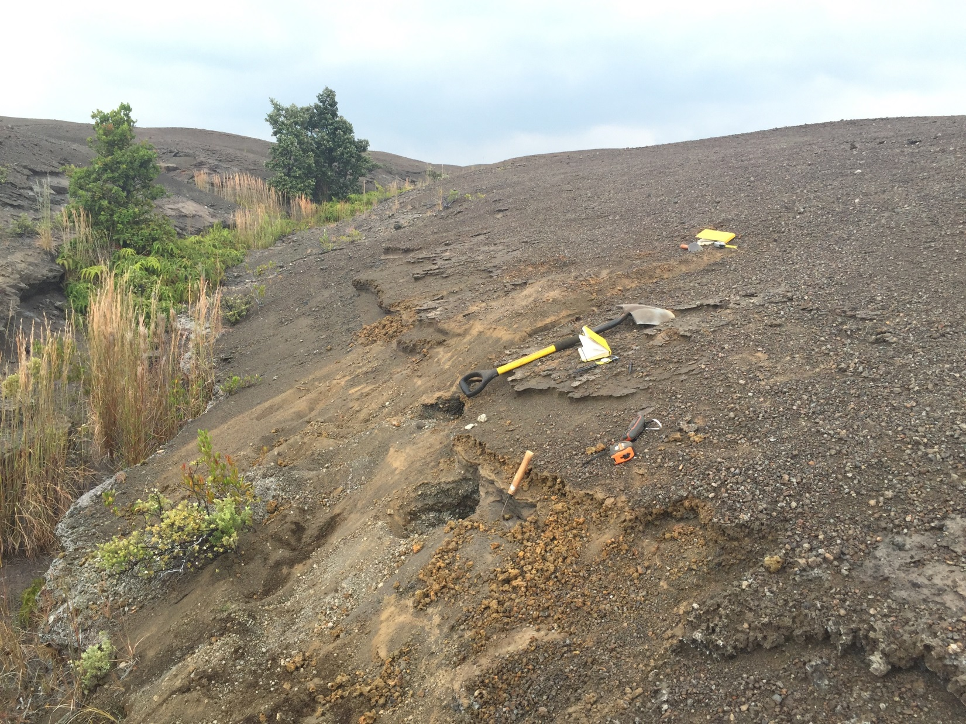

Slide 8
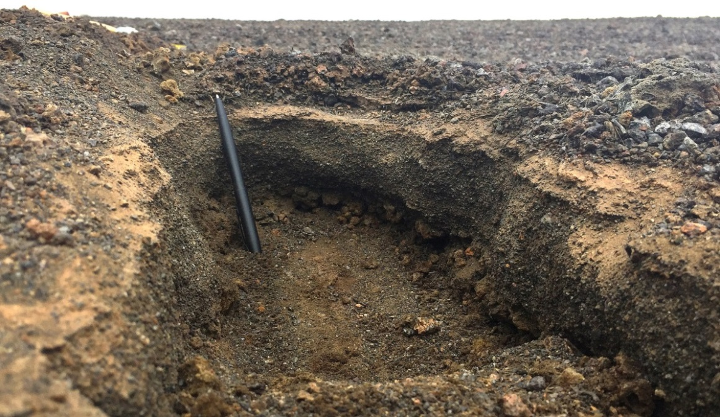
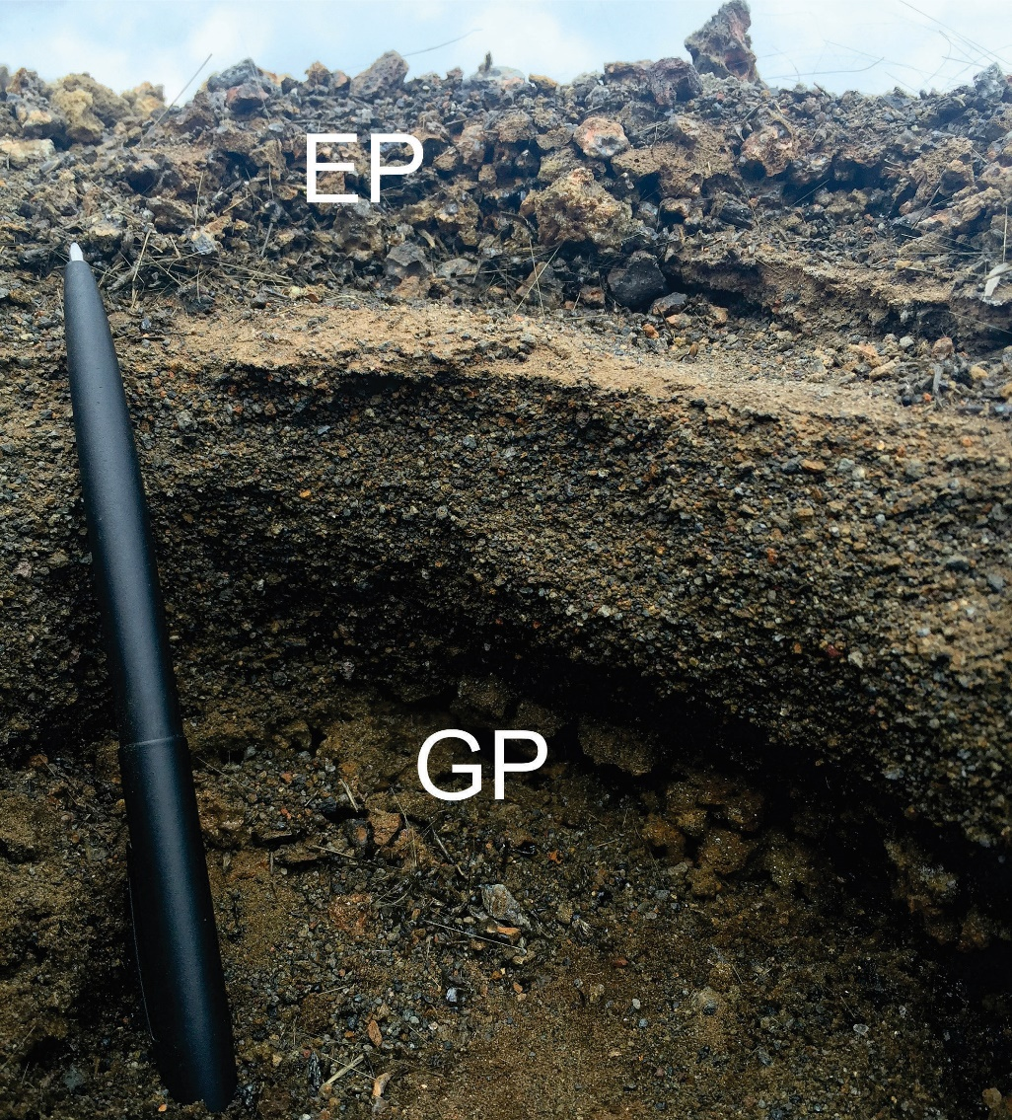
Eastern pumice (EP) separated from golden pumice (GP) by alluvium

Slide 9
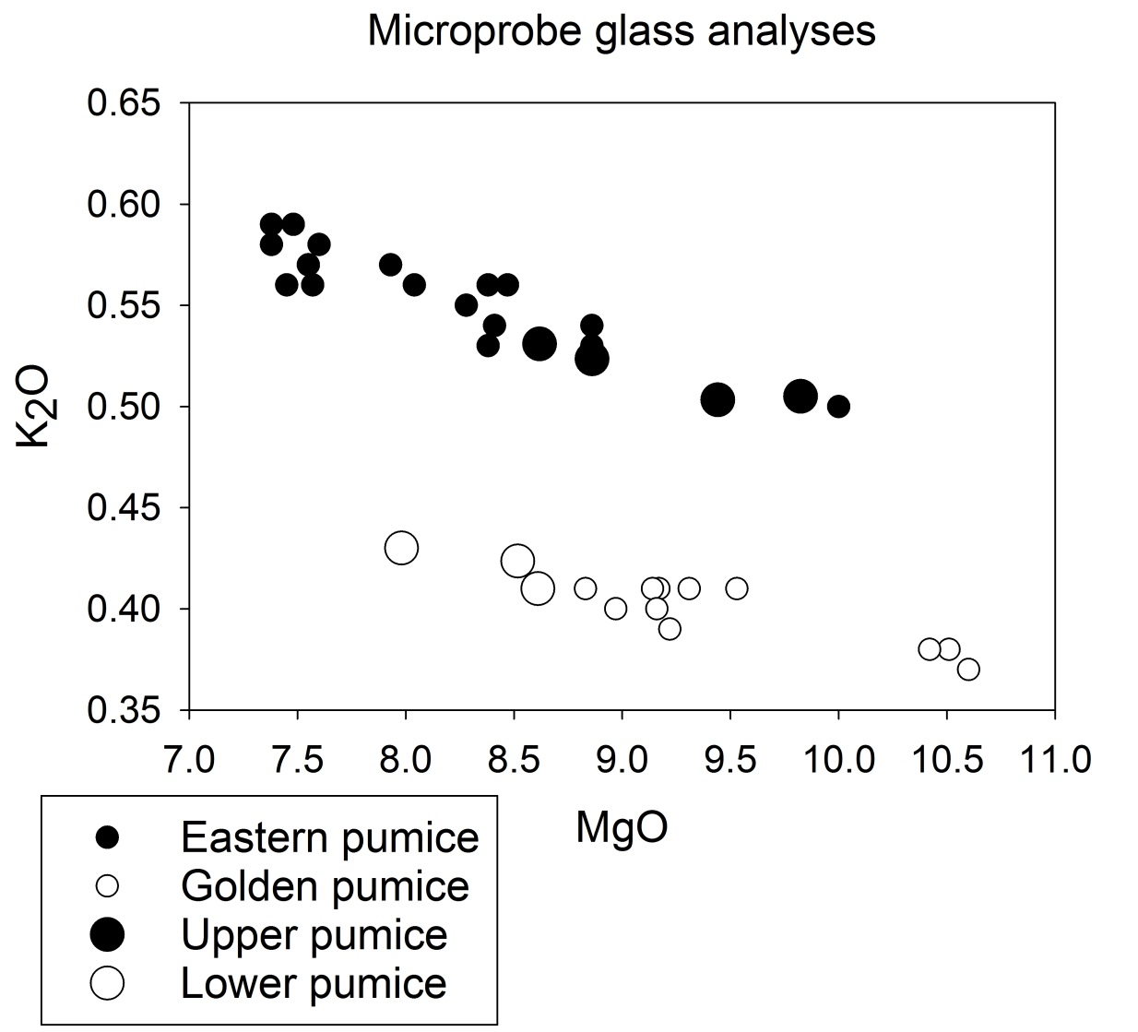

Slide 10
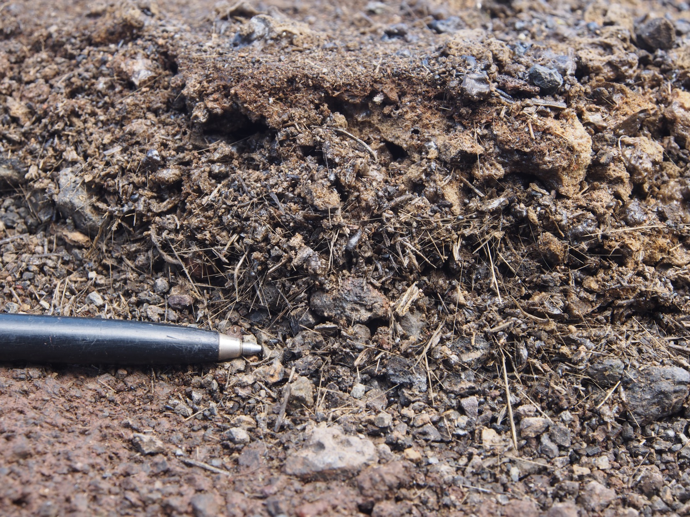

Slide 11
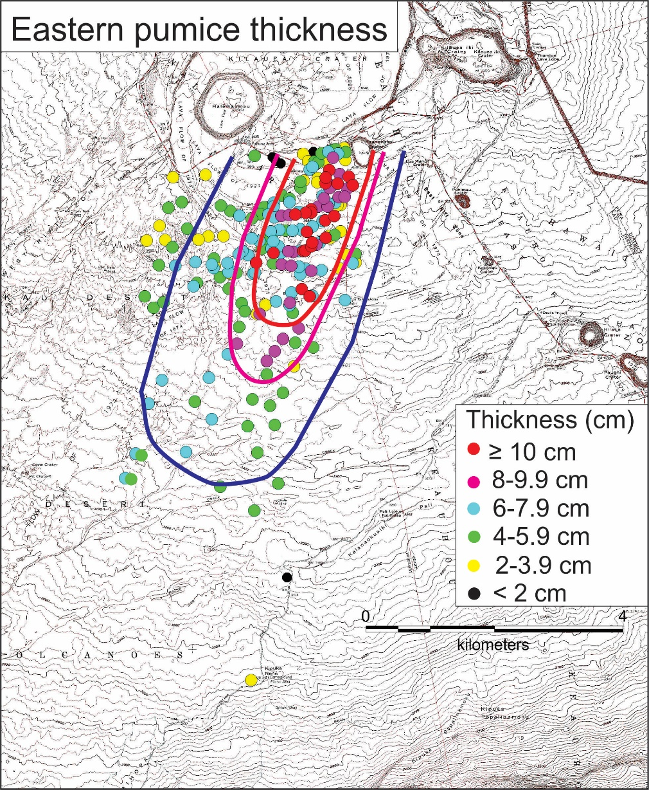
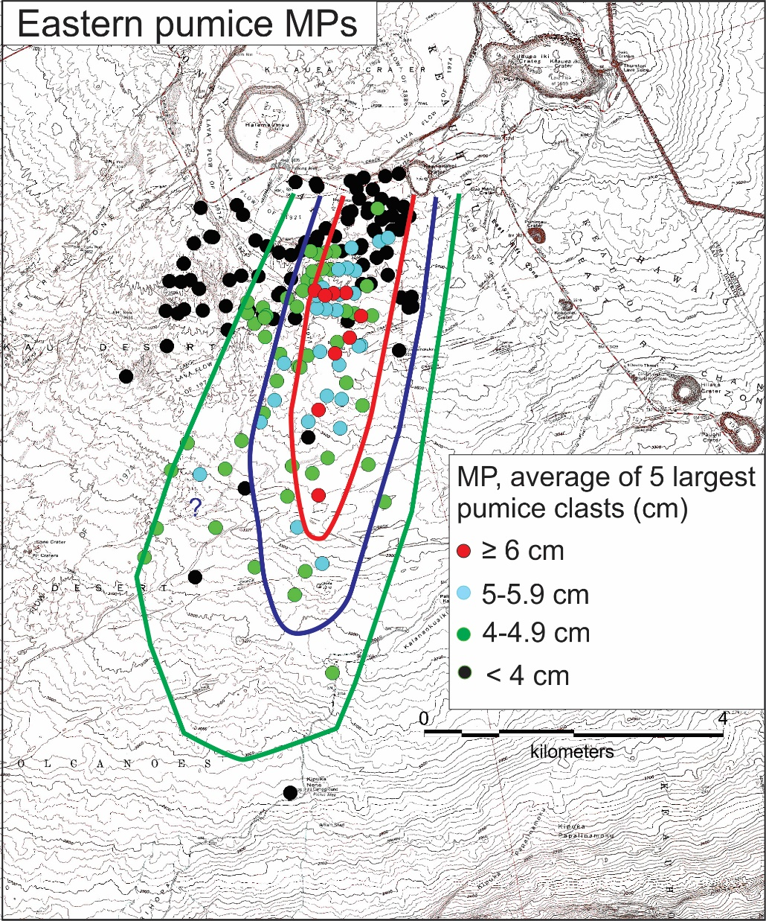

Slide 12
Volumes
Golden pumice, ca. 5 × 10⁶ m³
Eastern pumice, ca. 5 × 10⁶ m³
1959 Kīlauea Iki, ca. 2 × 10⁶ m³

Slide 13
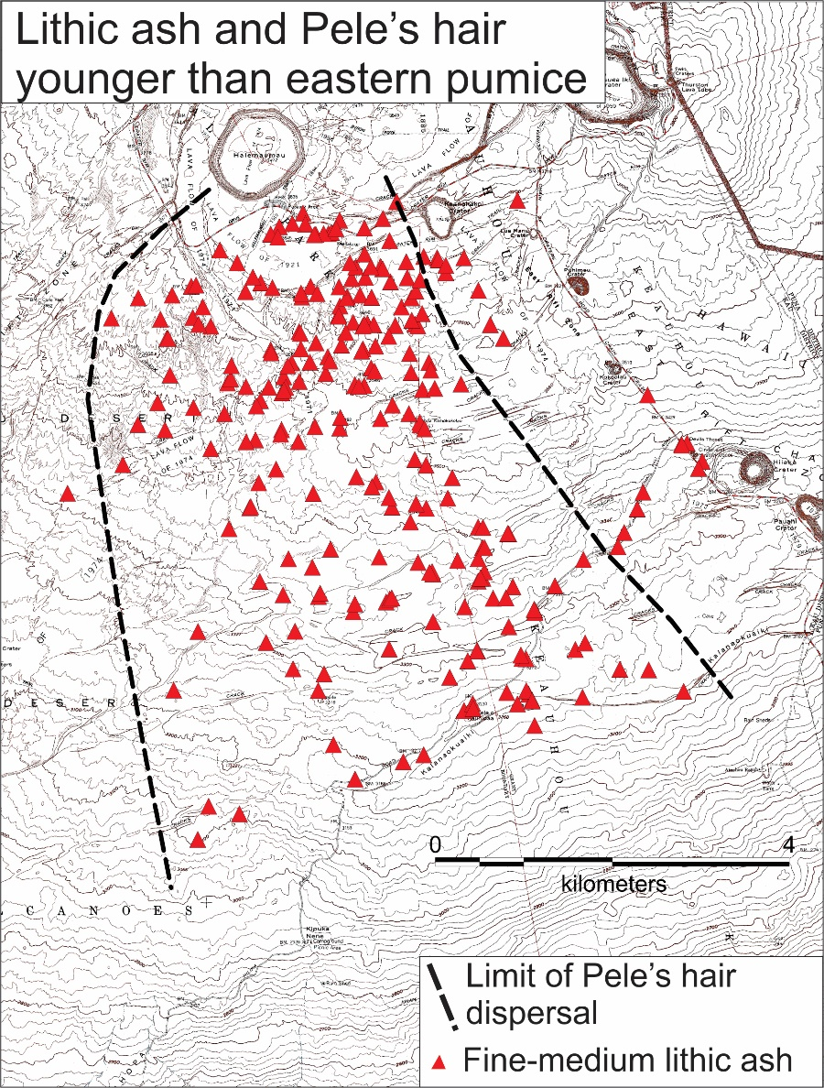
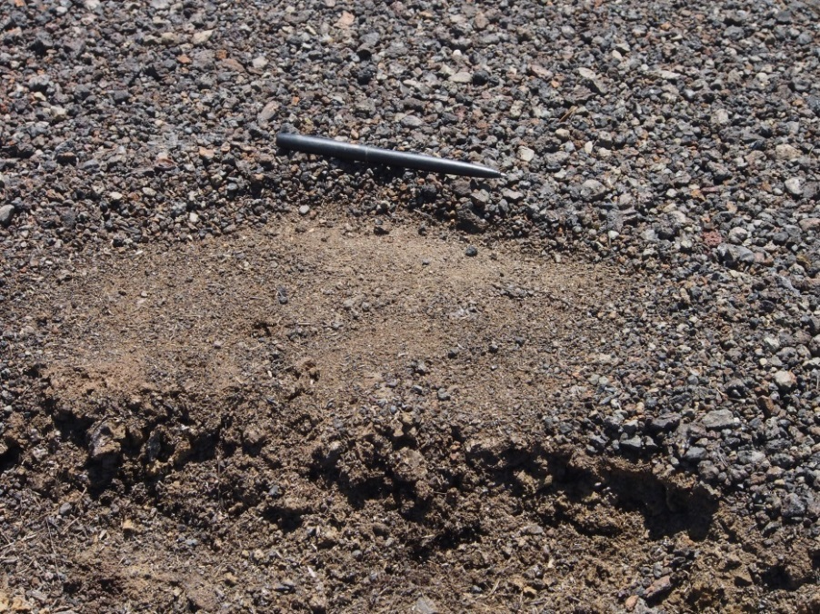
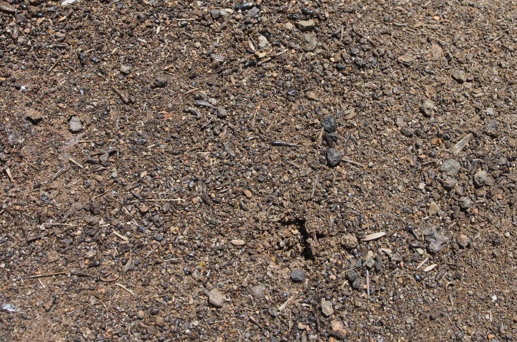
Unit H
Fine lithic ash
and Pele’s hair
Eastern pumice
Pele’s hair on fine-grained lithic ash

Slide 14
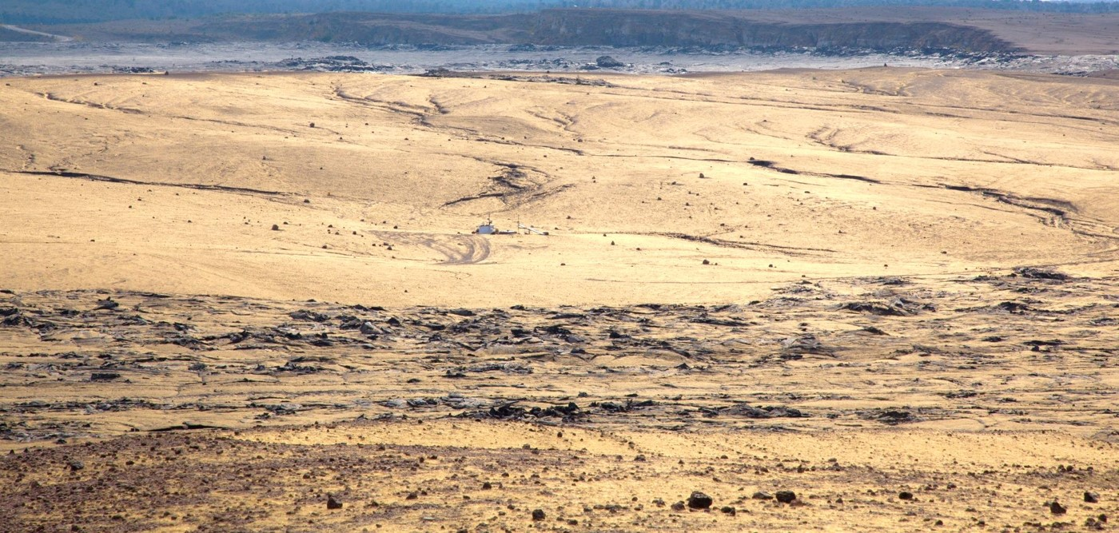
Pele’s hair from current lava lake accumulating in south caldera

Slide 15
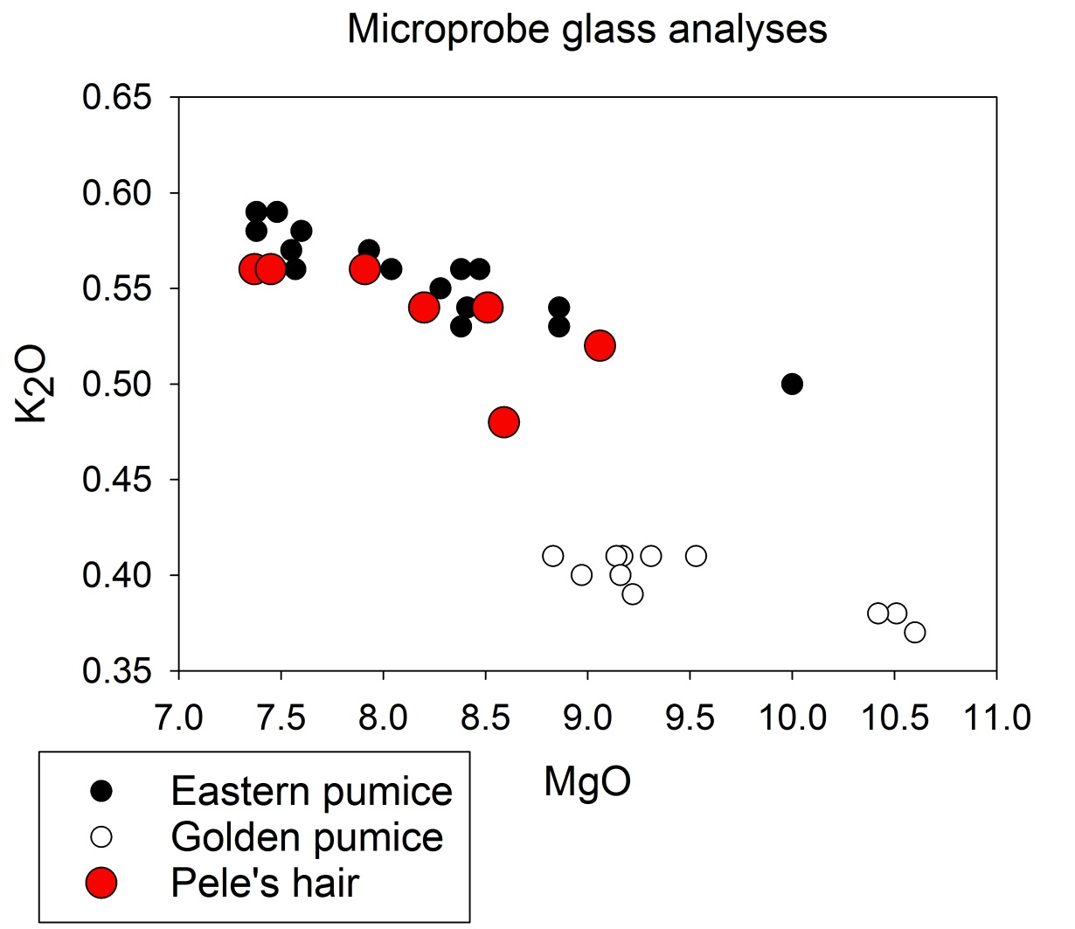

Slide 16
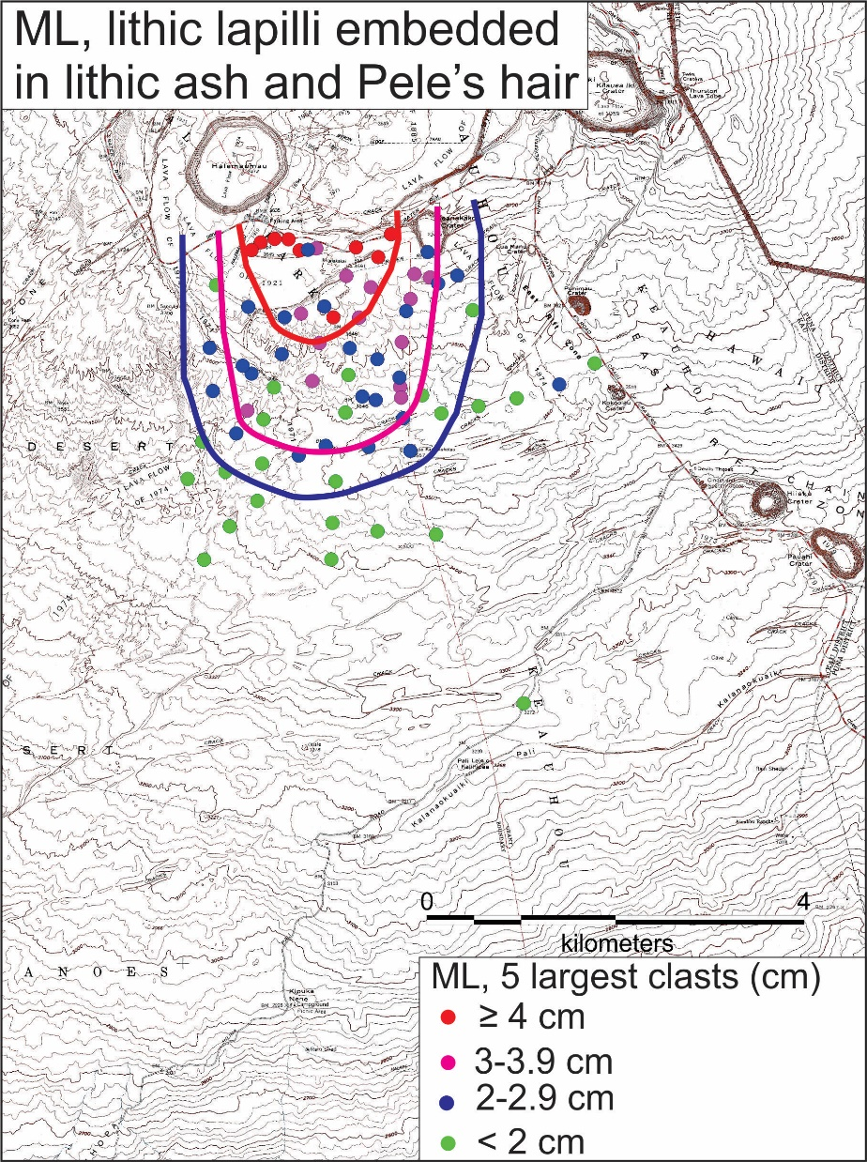

Slide 17
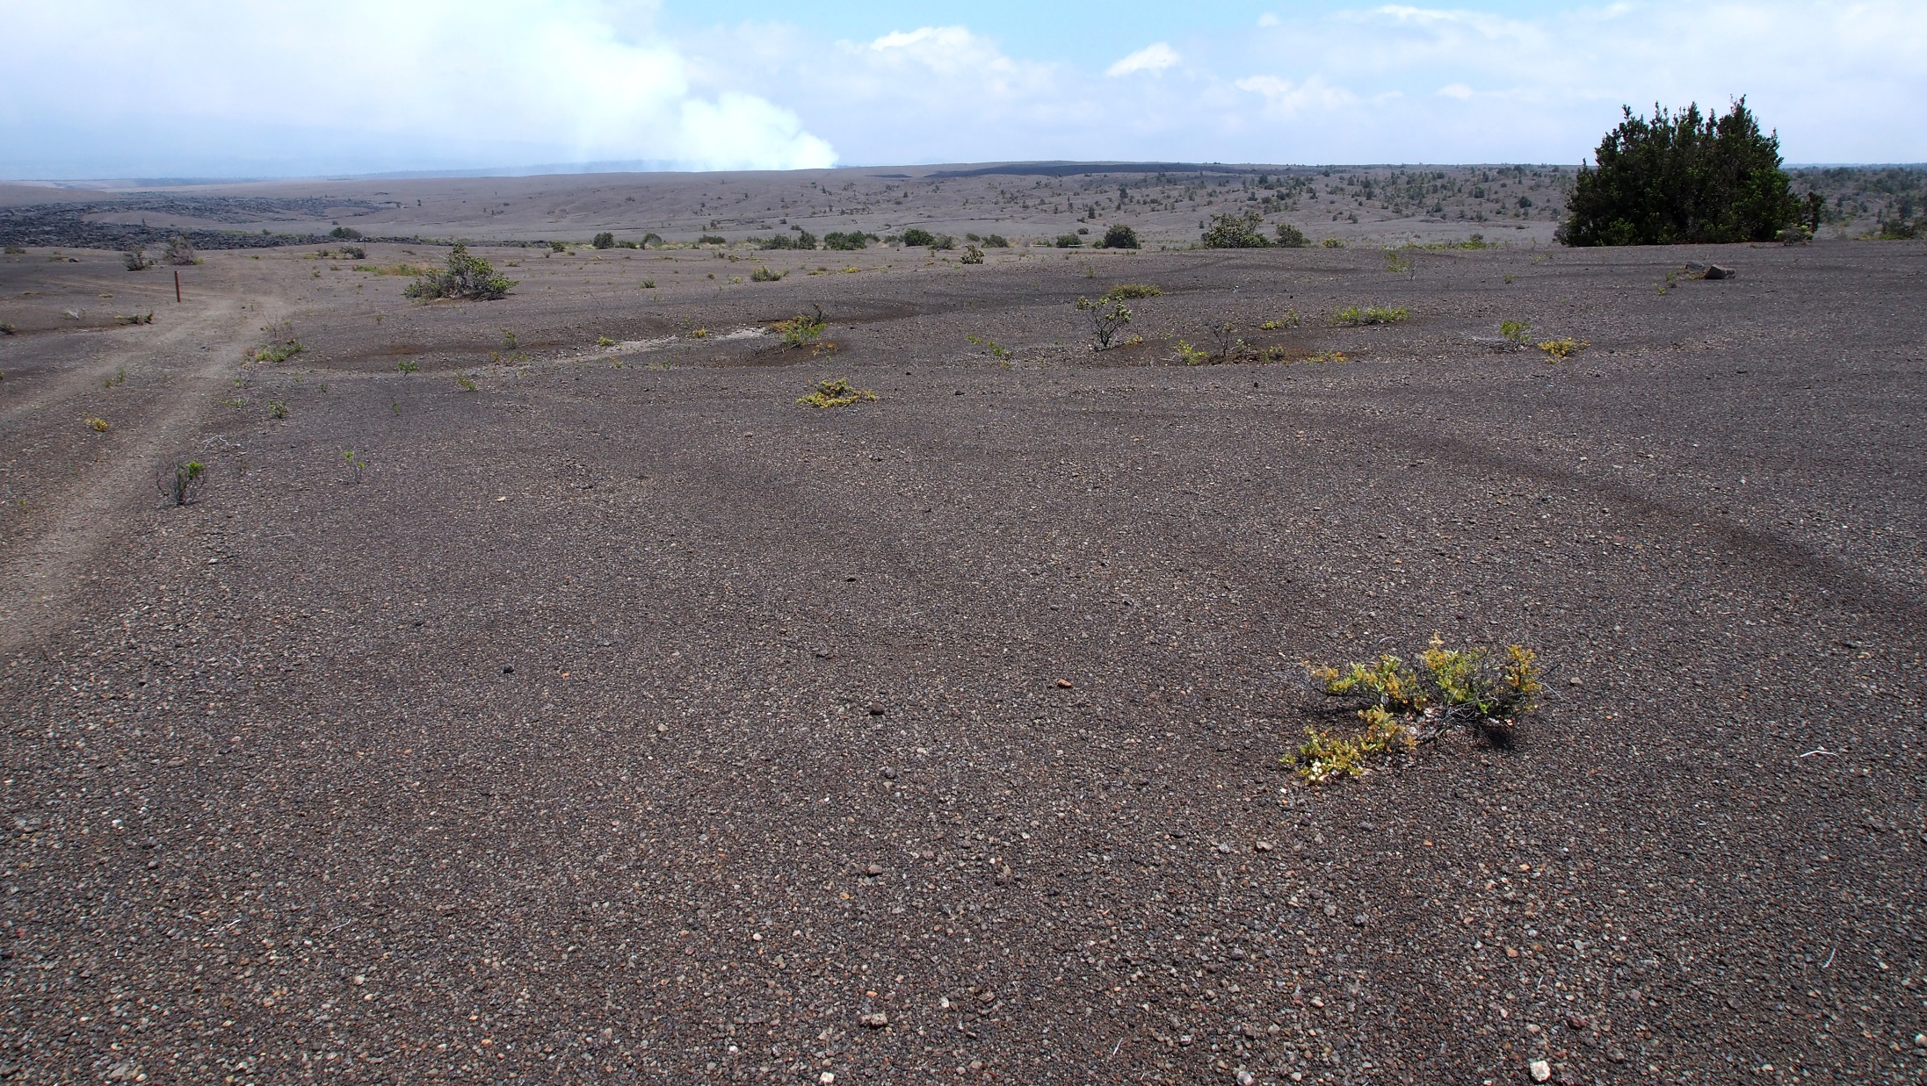

Slide 18
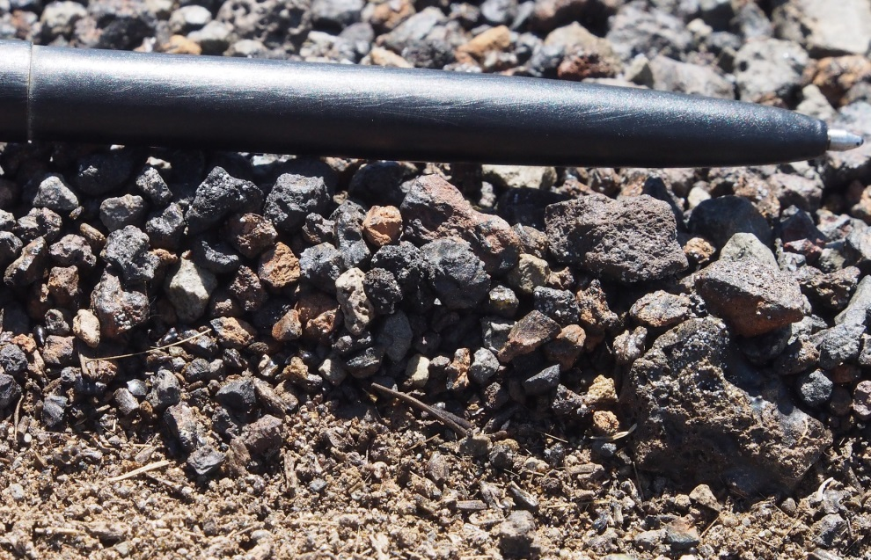
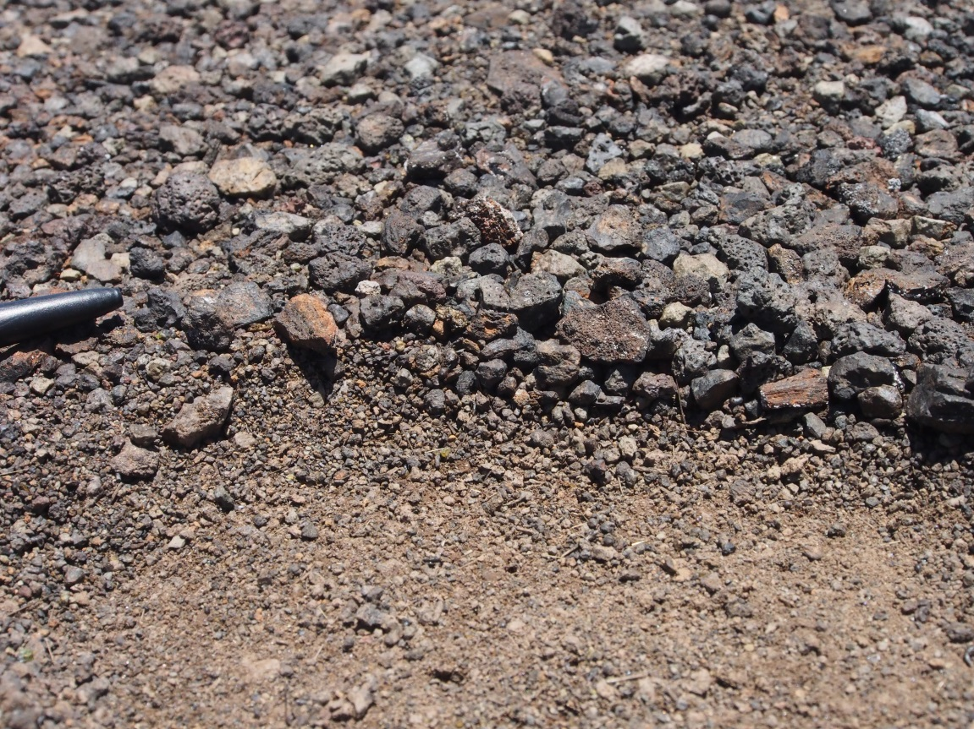
Inversely size-graded unit H lithic lapilli

Slide 19
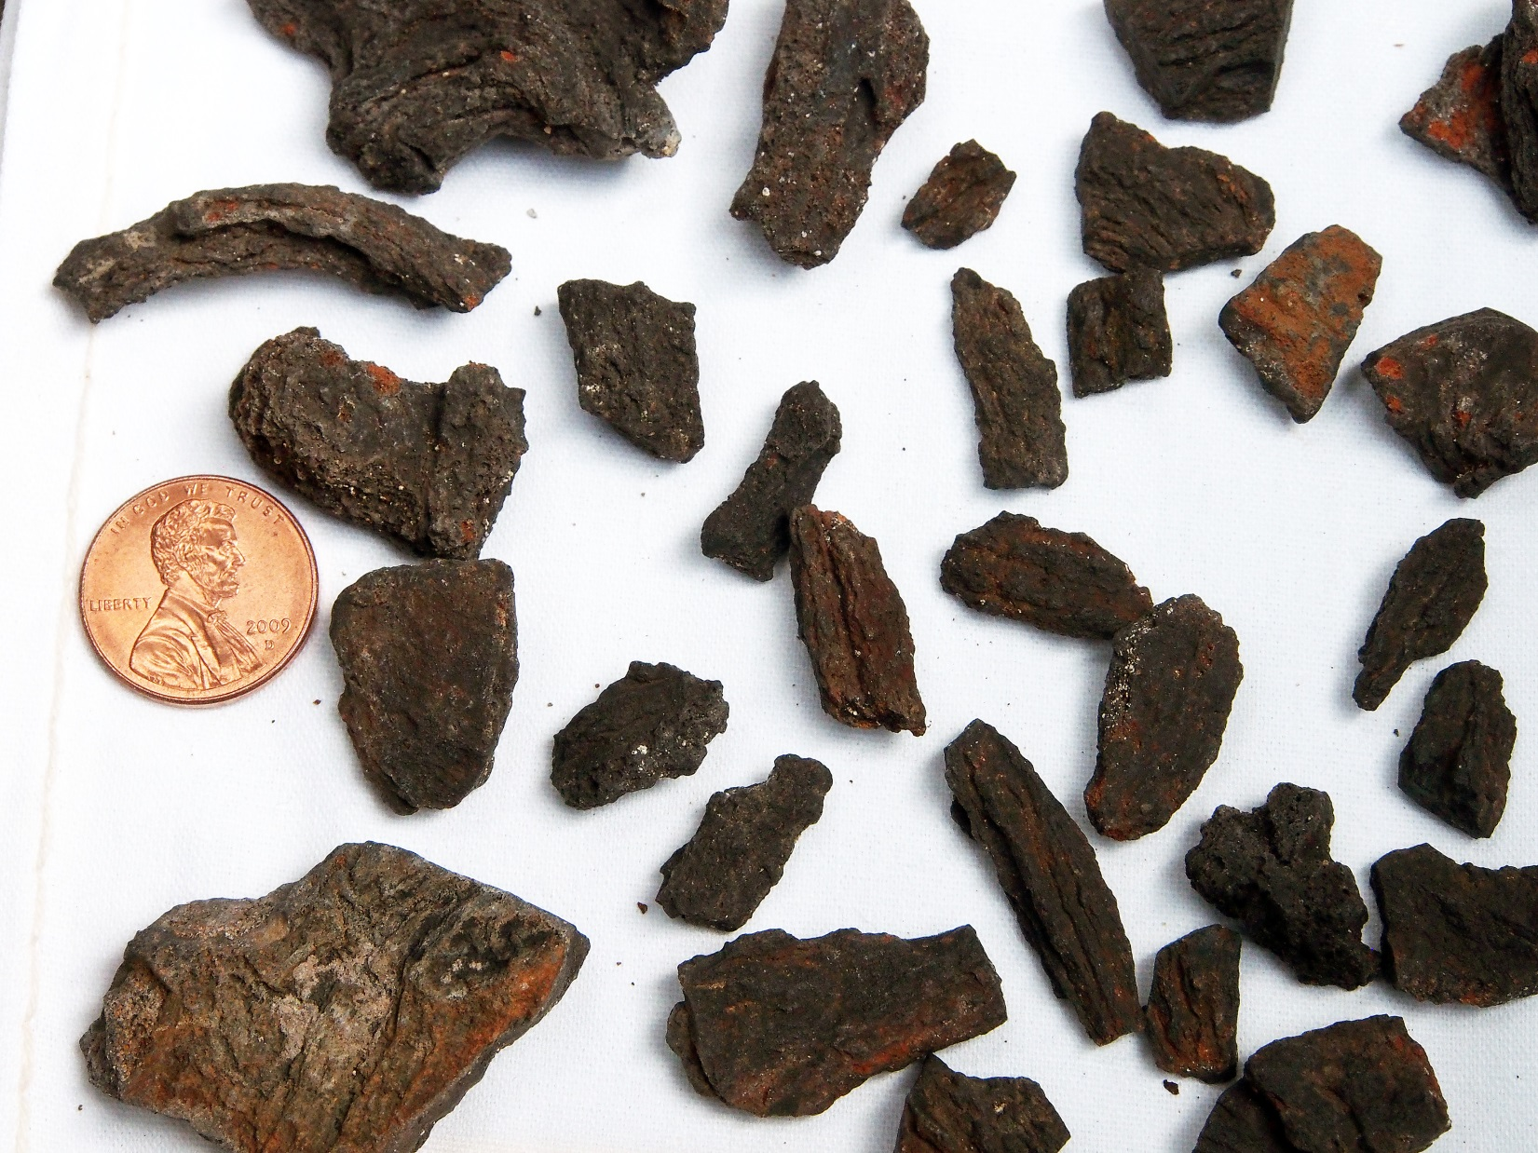
Fluidal juvenile lapilli from upper part of unit H

Slide 20
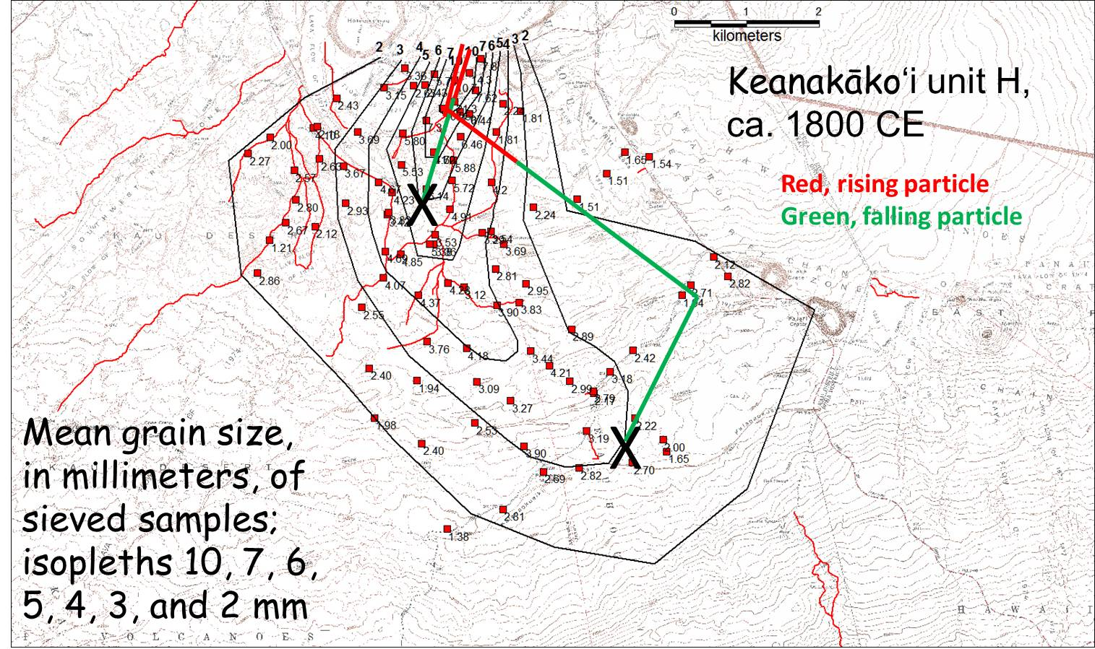
Trade wind direction below 4-5 km
Jet stream above 4-5 km
Dispersal of lithic lapilli in ca. 1800 CE fall. Particles >6 mm diameter remained below jet stream. Particles <6 mm reached jet stream and were carried SE before falling into trade wind and moving SW

Slide 21
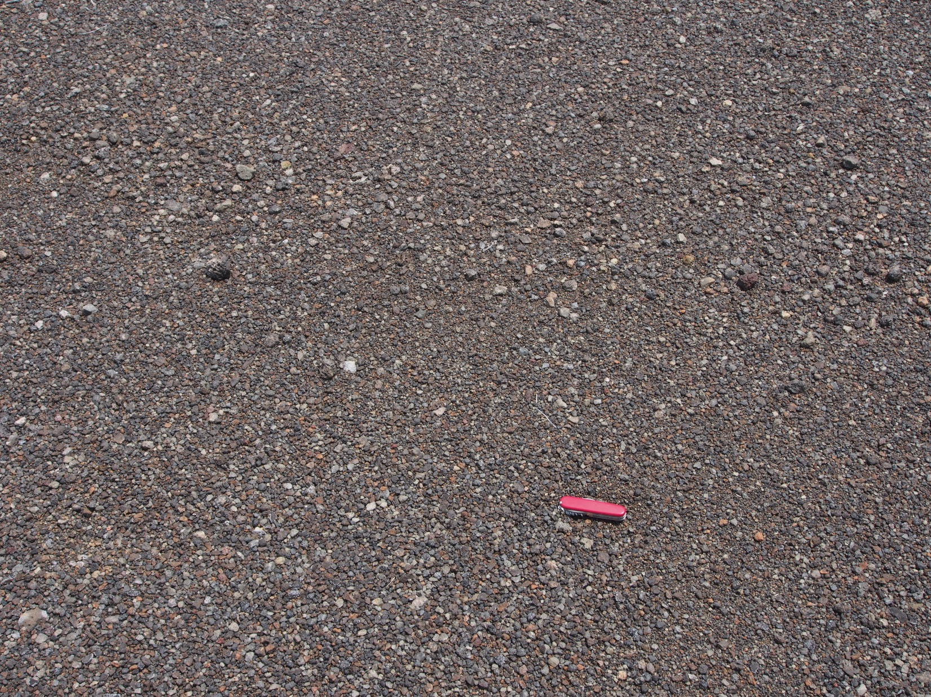

Slide 22
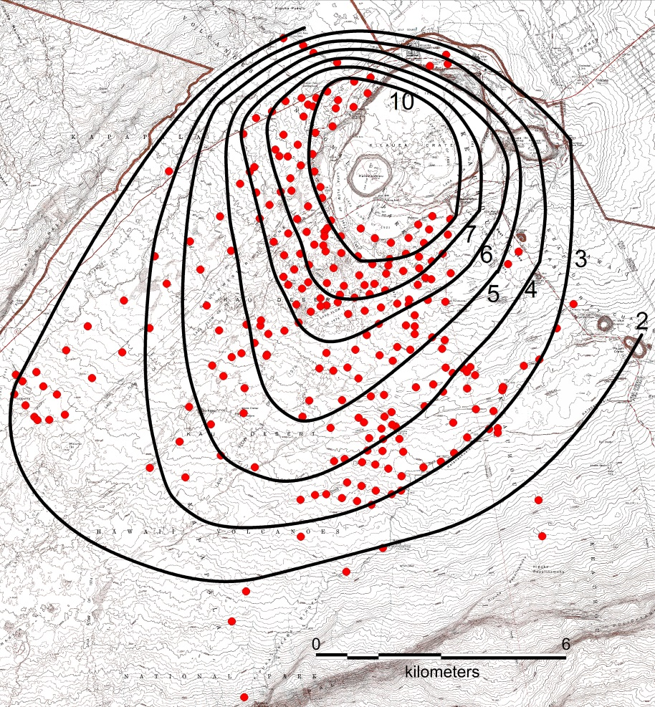
Distribution of maximum lithic lapilli (ML in cm) in youngest explosive deposit. Outermost isopleth is 2 cm, innermost 10 cm. All lapilli confined to trade-wind regime

Slide 23
Effusive period
Open
vent
Fountains
0
Percent juvenile
100

Slide 24
Timing
All that we can reasonably infer is that the golden pumice predates August 1, 1823
Most later tephra falls were south of caldera
This is an area infrequently visited (even today!)
Few western visitors came to the summit until late 1830s, and they came by standard routes that do not cross the south caldera

Slide 25
Localities of golden and eastern pumice
Trail
Golden pumice
Eastern pumice
Some of the post golden-pumice eruptions could have occurred well into the 1830s

Slide 26
Transition from low to high magma supply rate
Golden pumice first hint of increased supply rate at summit
Increased activity on SWRZ (after 1790 but earlier than 1823)
  Unpublished work by Rick Hazlett and Tim Orr
Eastern pumice continued the increased rate at summit
Then for next few years (maybe 2-3 decades?), intermittent supply rate to summit and repeated small collapses(?)
Bottom line: After ca. 300 years, change from low to high supply rate was not abrupt but lasted several decades, say from earliest 1800s to, possibly, 1830s

Slide 27
Was transition related to pulsing magma supply?
Today’s magma supply is pulsing slightly over periods lasting several months
  Lava-lake level positively correlates with changes in uplift rate as measured by GPS, when averaged over month-long intervals
Is such pulsing the norm, or is it a kind of “sputtering” in supply, characteristic of transition periods?
Perhaps such sputtering, increasing in intensity with time, characterized the transition into the effusive period
And, perhaps it is now tracking a transition to an explosive period

Slide 29
Timing
All that we can reasonably infer is that the golden pumice predates August 1, 1823
Most later tephra falls were south of caldera
This is an area infrequently visited
Few western visitors until late 1830s, and they came by standard routes that do not cross the south caldera
Some of the later explosions could post-date 1823

Slide 30


Slide 32
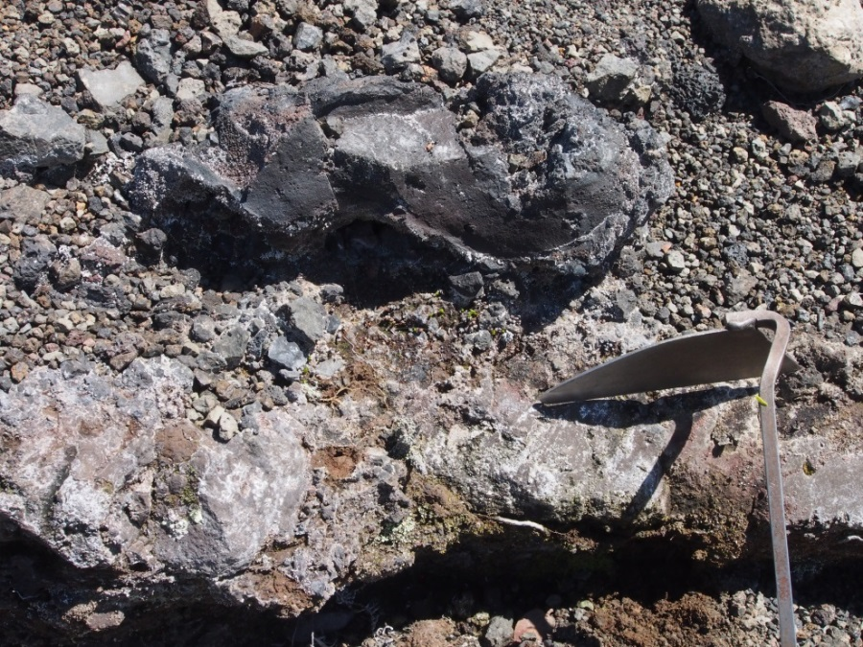
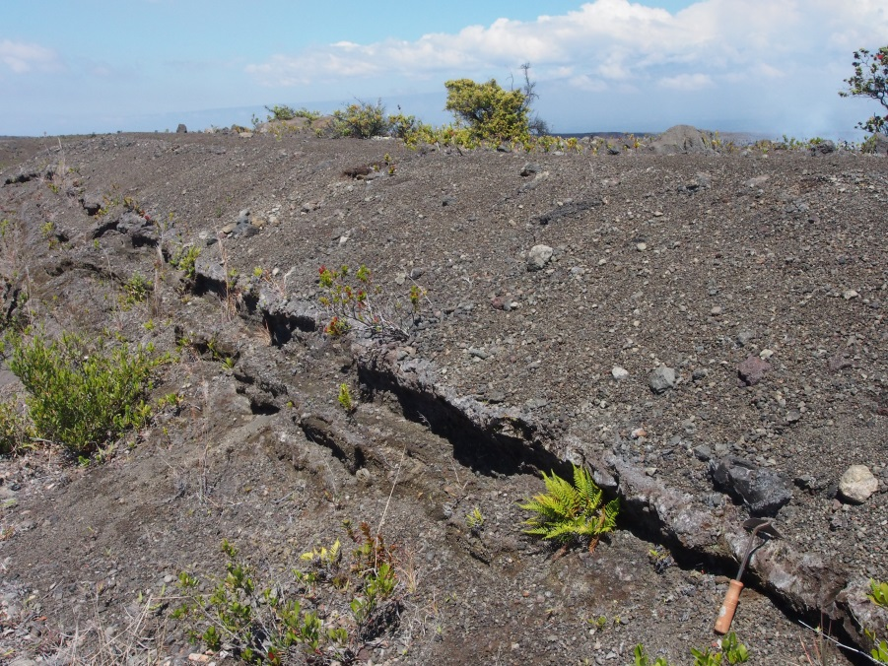
Mystery
Unit
Footprints
Ash
Juvenile cored bomb in lower part of Mystery Unit (1790)

Slide 33
Golden pumice
Outcrop
Glass analysis
Eastern pumice
Outcrop
Glass analysis

Slide 34
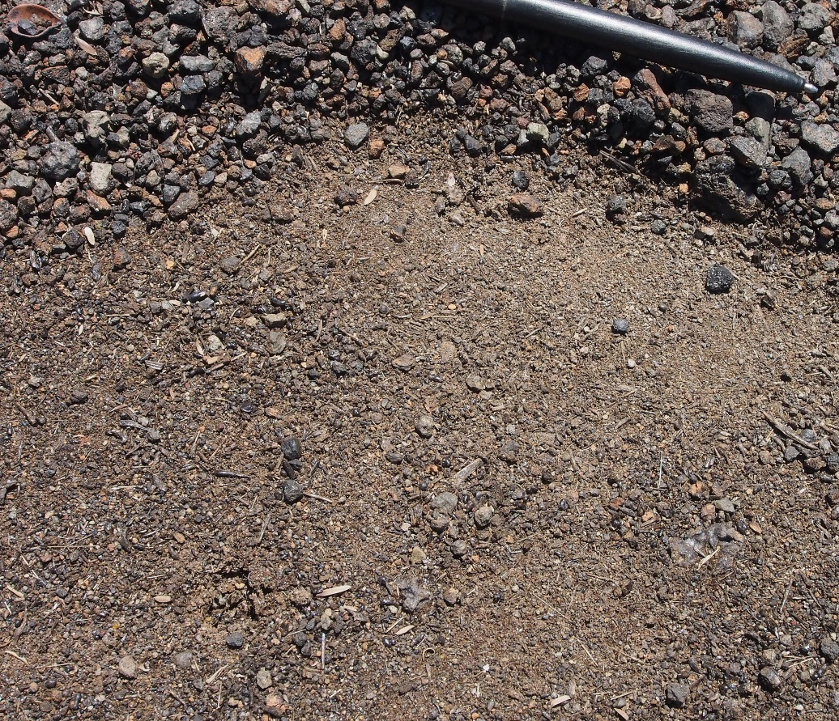
Unit H
Fine lithic ash
and Pele’s hair
Eastern pumice below ash
Fine lithic ash overlying eastern pumice and coated with Pele’s hair

