Slide 1
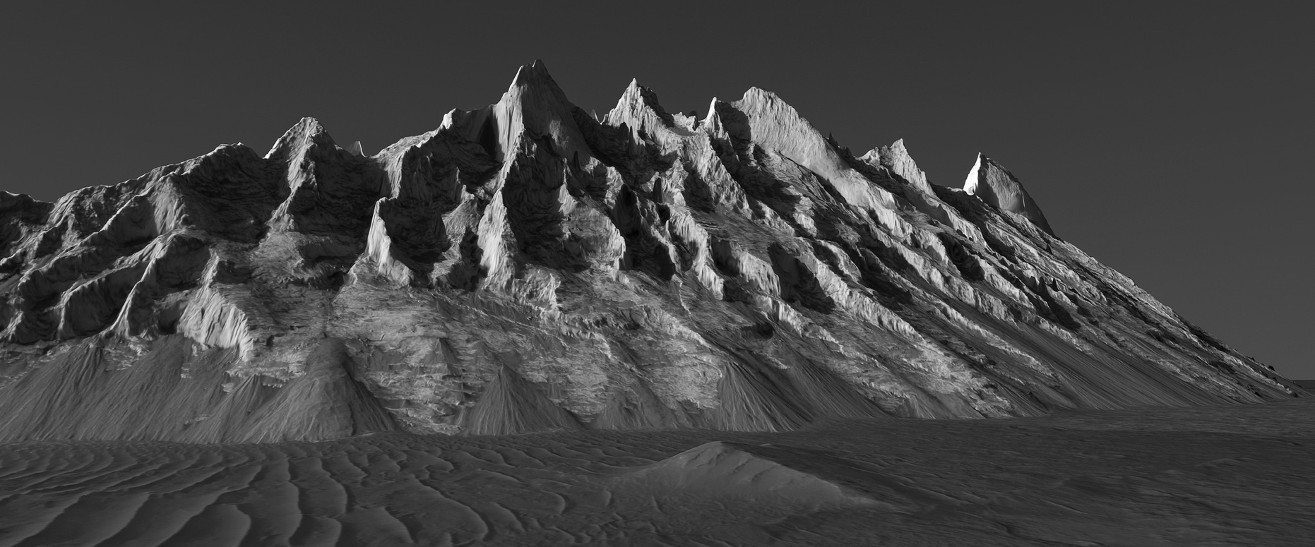
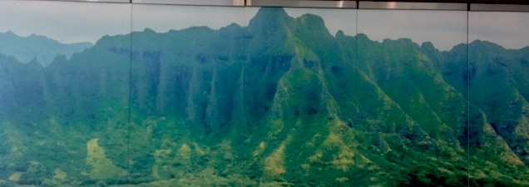
Mound in Ganges Chasm, Mars https://www.flickr.com/photos/136797589@N04/
Surprising Geologic Processes of Mars:
Earth-like geomorphologies may be deceiving
Alfred McEwen, University of Arizona
Ko’olau Mountains mural in Honolulu Convention Center

Slide 2
Changing Views of Present-Day Mars
Old View:
Surface largely inactive today
Thin martian atmosphere (~6 mbar) doesn’t have much effect on surface except for seasonal frost and blowing dust
New View:
Dunes, gullies, RSL, polar regions are actively changing
Topographic changes
Impact cratering has greater effects than expected
Thin martian atmosphere is surprisingly effective at modifying the surface:
Dunes and ripples moving today, at a high rate
Gully changes driven by seasonal CO₂
Up to 25% of the atmospheric mass condenses seasonally!
Recurring Slope Lineae (RSL) are puzzling
No known terrestrial analog
Surprising Geologic Processes of Mars: Earth-like geomorphologies may be deceiving

Slide 3
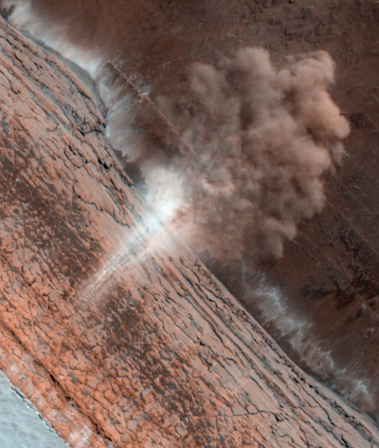
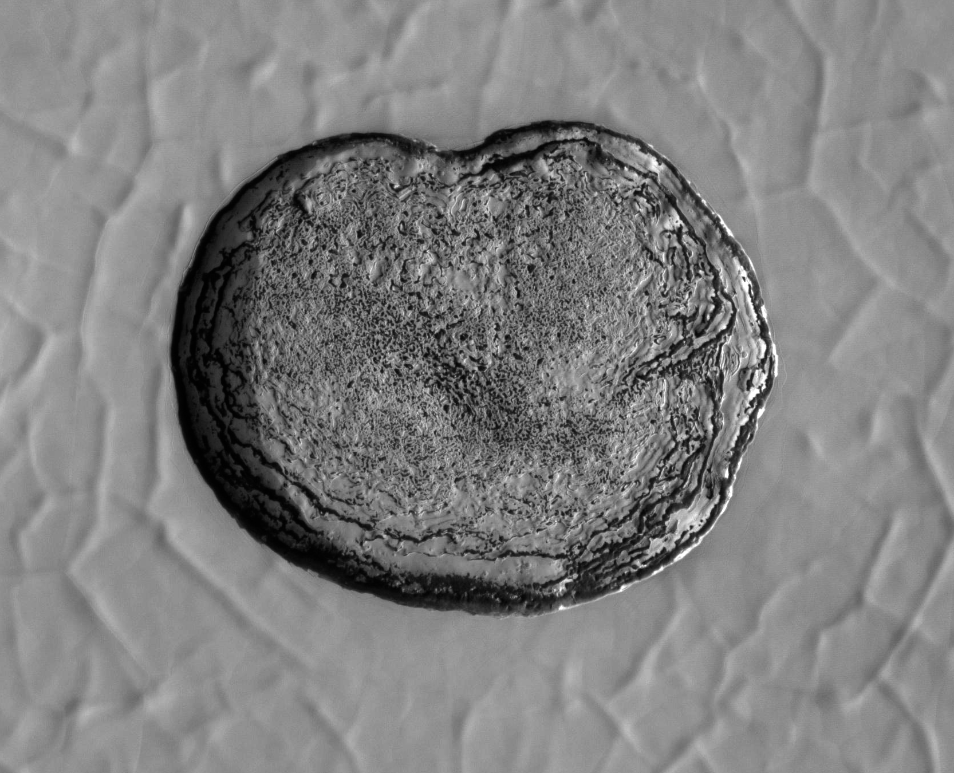
Present-Day Surface Activity on Mars
Seasonal deposition and sublimation of CO₂
Spots, fans, streaks
New spiders!
Dune and non-dune gully formation
Polar processes
Enlarging pits in SP residual cap
Seasonal avalanches
Periglacial Processes
New impacts
Crater-exposed ice
Aeolian processes
Blowing dust, dust devils
Moving sand dunes and ripples
Active slope processes
Ravines (large gullies), rock falls, dust avalanches (dry)
Recurring Slope Lineae (RSL) (maybe wet)
N Polar avalanches (top) and S polar residual cap (bottom_

Slide 4
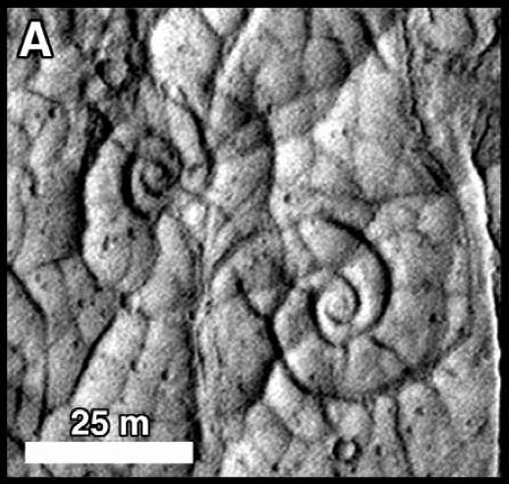
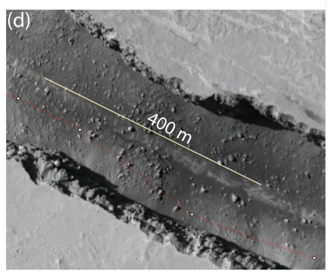
Activity that hasn’t been detected
Magmatism
No evidence unless atmospheric methane has a magmatic origin
Volcanism has happened within ~10 Ma, and will happen again
Tectonism
No topographic changes associated with active tectonics have been described
There must be active mass wasting of very steep (active?) scarps
Roberts, G. et al. (2012) JGR 117, E02009; Spagnuolo, M. et al. (2011) EPSL 312, 13; Taylor, J. et al. (2013) JGR 118, 2570.
InSight mission (launch in 2018) will measure current sesmicity
Lava coils, Ryan and Christensen 2012
Boulder concentrations in Cerberus Fossae, Roberts et al. 2012
Surprising Geologic Processes of Mars: Earth-like geomorphologies may be deceiving

Slide 5
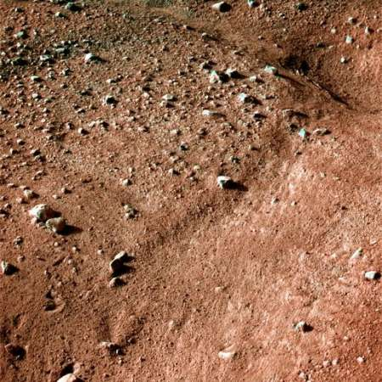
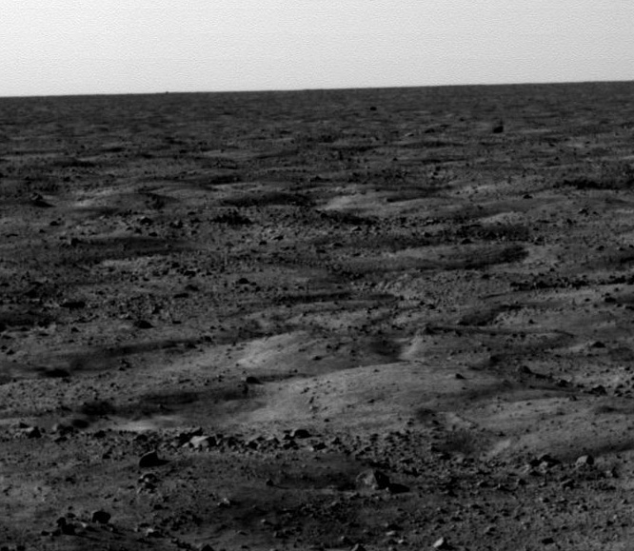
Glacial/periglacial activity
No direct detection of topographic changes
Polygons probably active but change is too slowly to be detected
Could ice sublimation cause detectable changes? (probably, next slide)
Could viscous flow of ice-rich deposits be measured? (probably not)
Strain rate = A σ^{n} d^{–p} exp (–E_{c}/RT ); at 210 K visible flow requires centuries
Polygons imaged by Phoenix lander

Slide 6
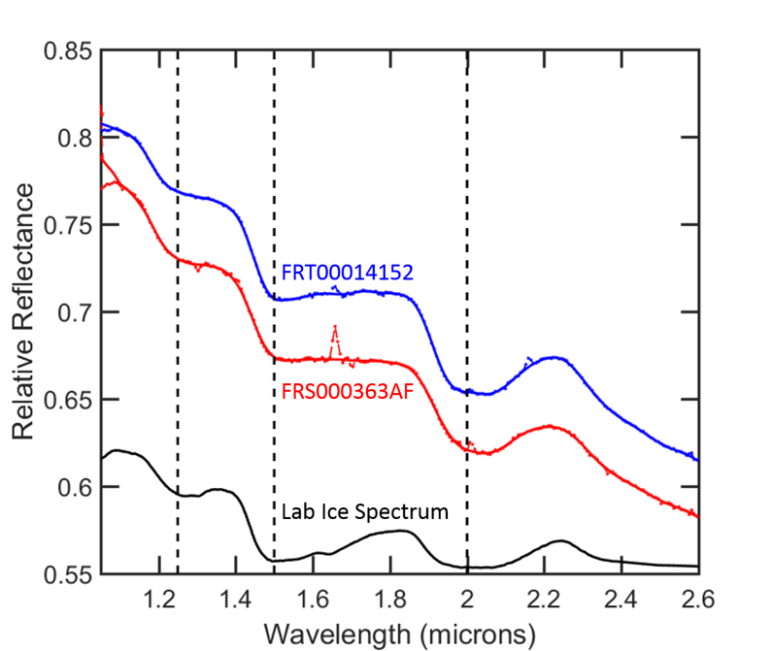
Scarps where ice exposed in mid latitudes should be sublimating
CRISM spectra show water ice

Slide 7
Monitoring shows this is not seasonal frost

Slide 8
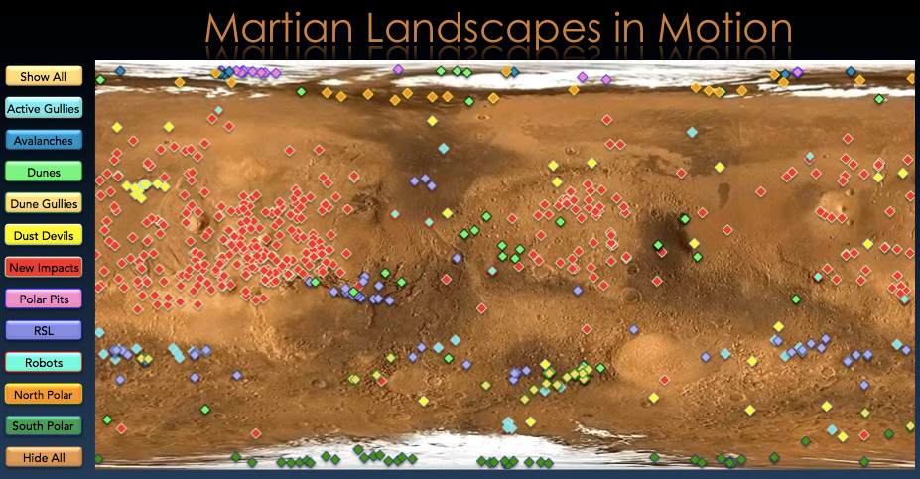
Where is the surface activity? (everywhere)
Surprising Geologic Processes of Mars: Earth-like geomorphologies may be deceiving

Slide 9
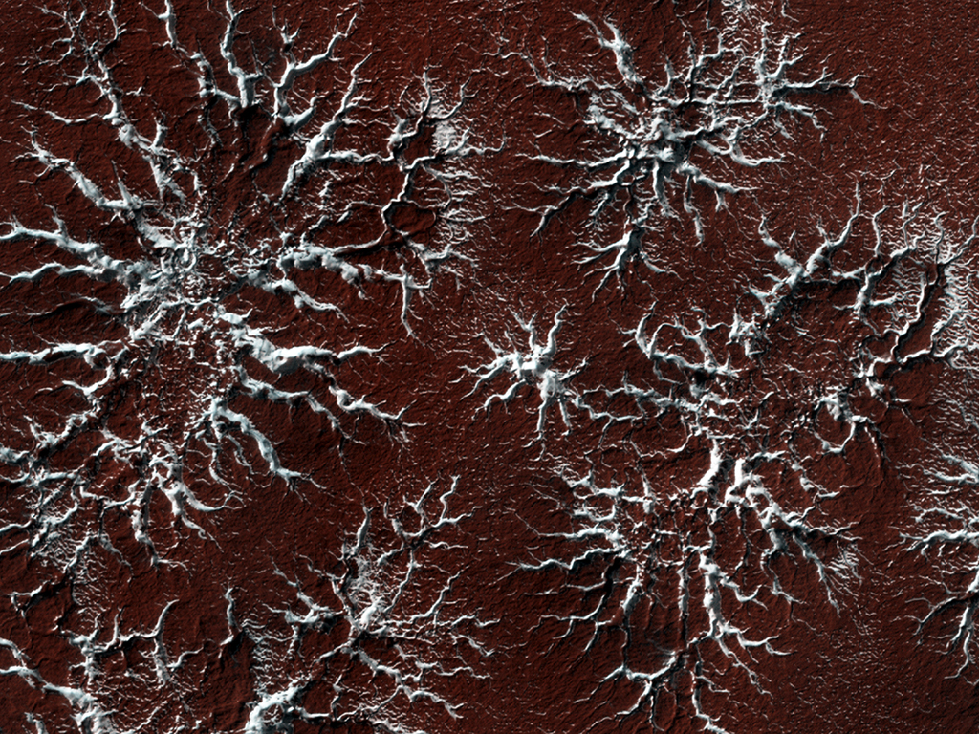
Spiders on Mars

Slide 10
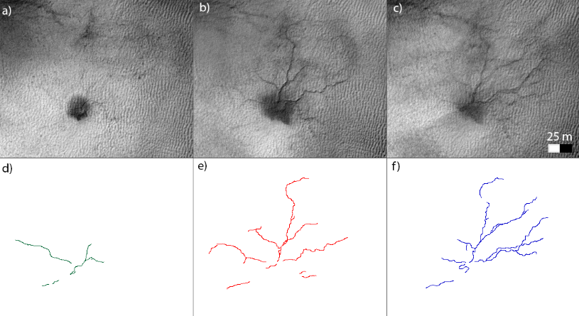
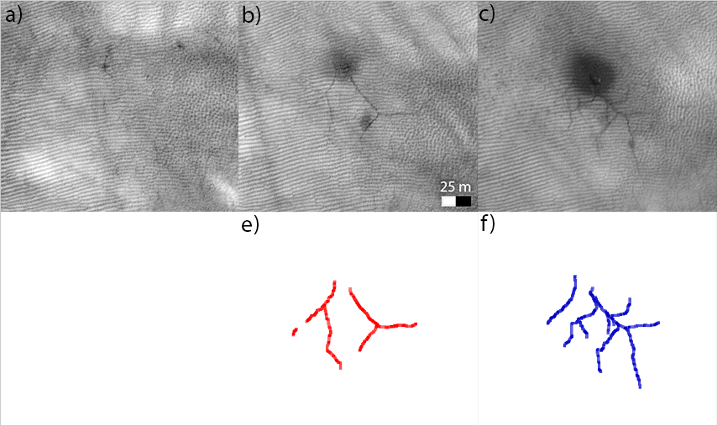
Cold CO₂ Jets Create New “Spiders” on Mars
MY 29
MY 30
MY 30
HiRISE detected new dendritic troughs during seasonal spring monitoring of the polar areas.
G. Portyankina et al. (2016), Icarus, Volume 282, 15 January 2017, Pages 93-103.
MY 30
MY 31
MY 32

Slide 11
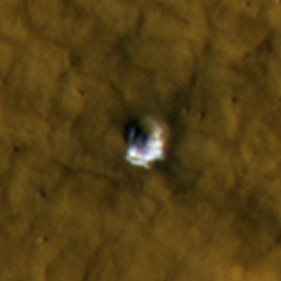
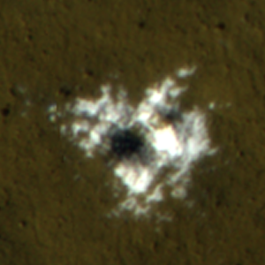
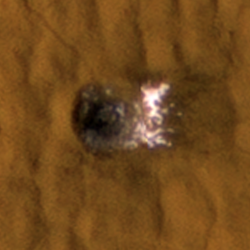
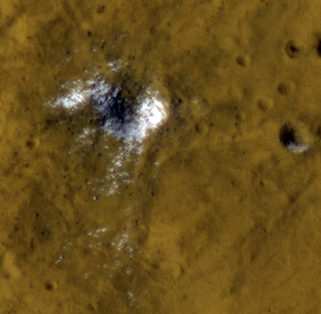
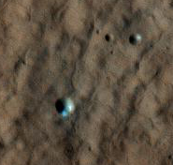
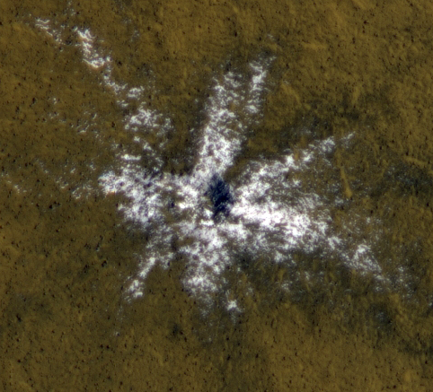
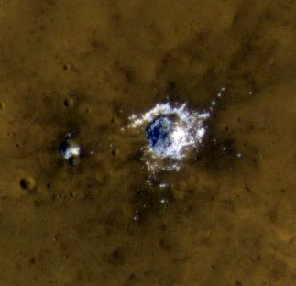
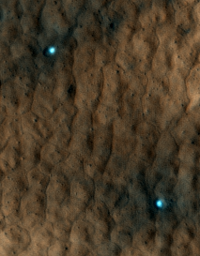
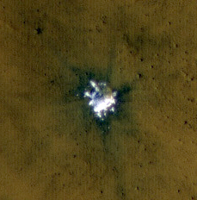
Ice Exposed by New Impacts
>500 new impact events documented
New impacts >39 N or 50 S show bright ice patches.
Consistent with model calculations for an atmosphere slightly more humid than present.
Sublimation modeling indicate that mm of ice sublimate before it fades, indicating clean ice. >99% pure ice!
[Byrne et al., 2009; Dundas et al., 2014]

Slide 12
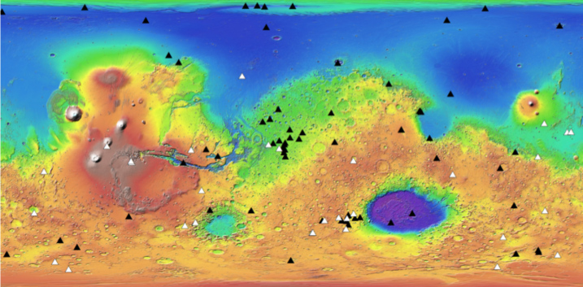

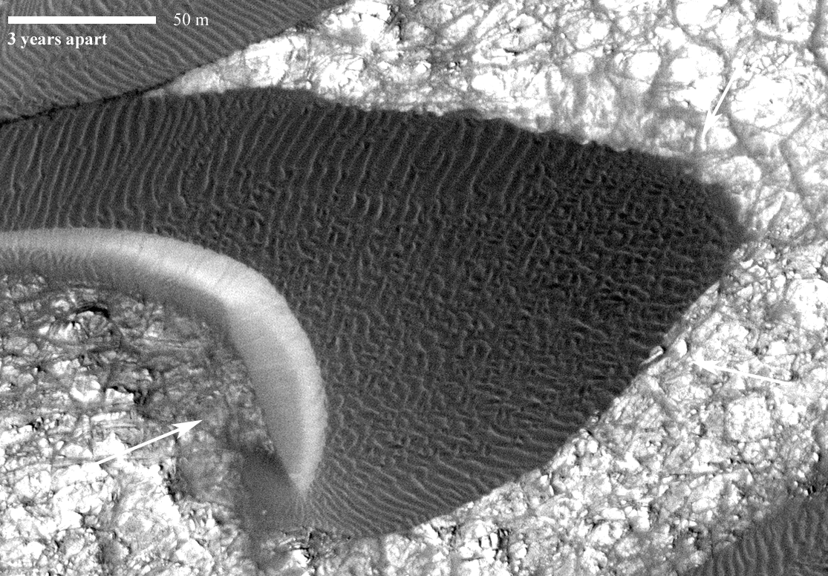
Windy Mars
Dune motion observed globally
Black = active
White = no activity observed (yet)
Active dunes are common [Nathan Bridges and colleagues]

Slide 13
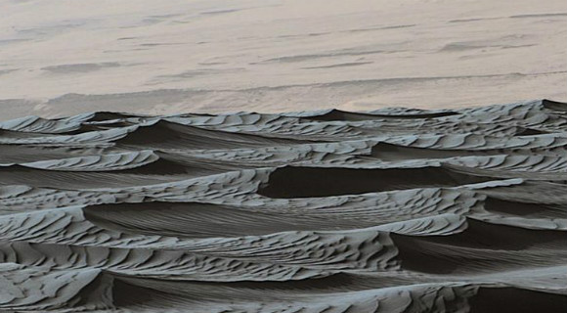
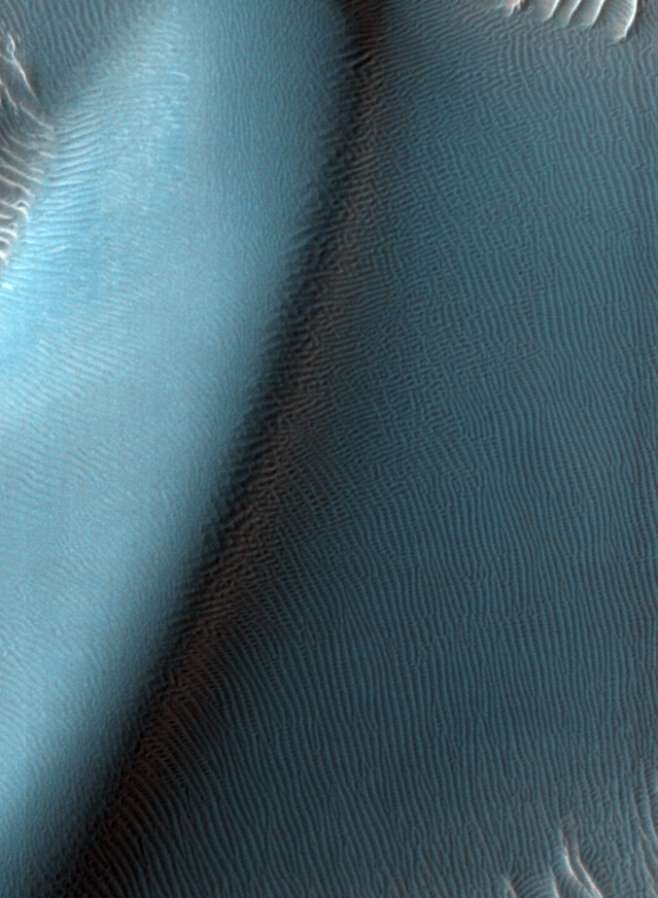
What is a “ripple”? Few-meter scale bedforms seen all over Mars by HiRISE (left) are seen by MSL (top) to be mini-dunes with much smaller ripples (same size as ripples on Earth)

Slide 14
Abrasion and Landscape Modification [Bridges et al., 2012, Nature]
At impact threshold conditions, the mass of basalt rock eroded vs. that colliding should be ~2x10⁻⁶ [Greeley et al., 1982]
For flux of 2.3 m³ m⁻¹ yr⁻¹ and saltation height of 1-5 cm, this implies abrasion rate of 1-46 µm yr⁻¹, depending on rock orientation.
In Victoria Valley, Antarctica, rates are ~30-50 µm/yr [Malin, 1986]
Young exposure age data in Gale crater near eroding scarp [Farley et al., 2014]
Fine-grained sediments erode much faster than basalt
Changed MSL (and 2020 rover) strategy for finding relatively well-preserved organics
Radiation exposure breaks organic bonds
Surprising Geologic Processes of Mars: Earth-like geomorphologies may be deceiving

Slide 15
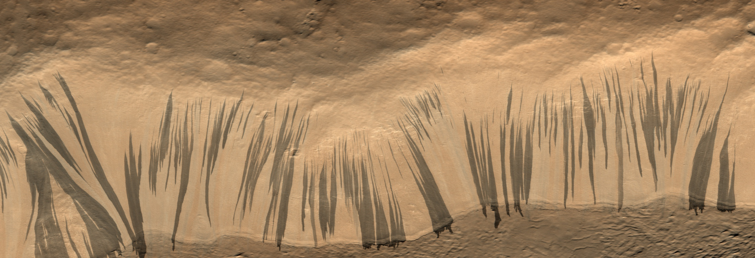
Thousands of new slope streaks form every year on steep dust-mantled slopes
All observations consistent with dust avalanches:
Where resolution and especially lighting angles are favorable, see that a thin layer has been removed.
Some streaks overtop obstacles and may run obliquely across slopes, so relatively high velocity.
No seasonality
Form at once, not gradual growth
Surprising Geologic Processes of Mars: Earth-like geomorphologies may be deceiving

Slide 16
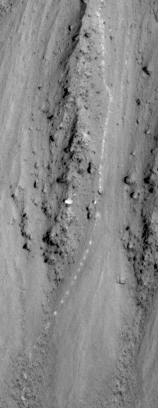
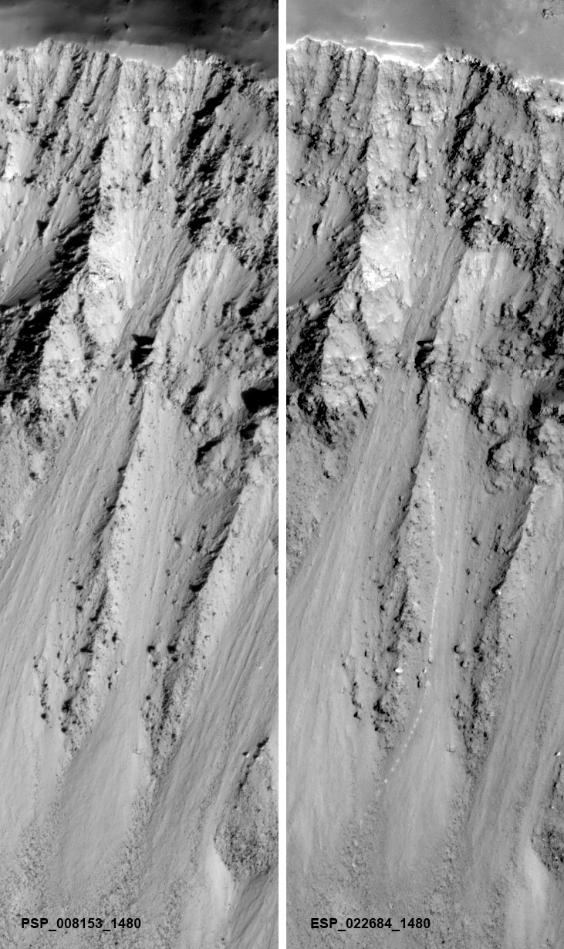
New bright boulder track (most new boulder tracks are relatively dark)

Slide 17
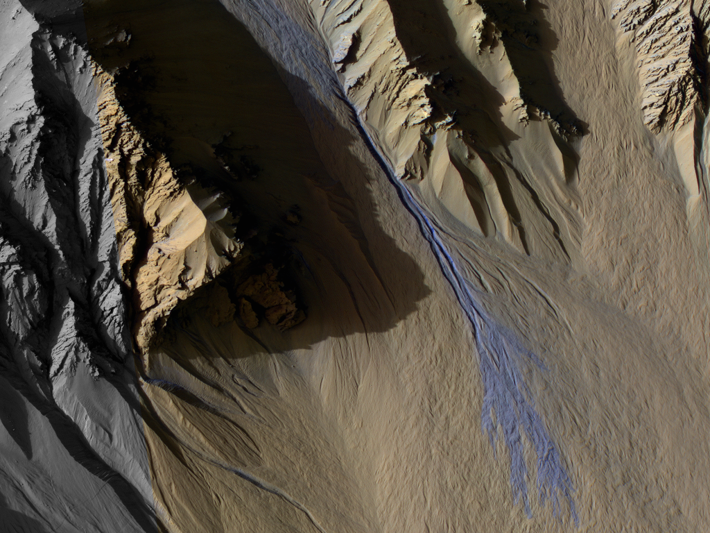
Present Day Gully Formation
Subsequent to MOC discovery, many workers have concluded that the gullies formed by water in a recent high-obliquity climate.
HiRISE sees substantial ongoing gully activity
Distinct seasonality--most activity correlates with seasonal frost.
Dundas et al., 2010; 2012; 2015; Diniega et al., 2010

Slide 18
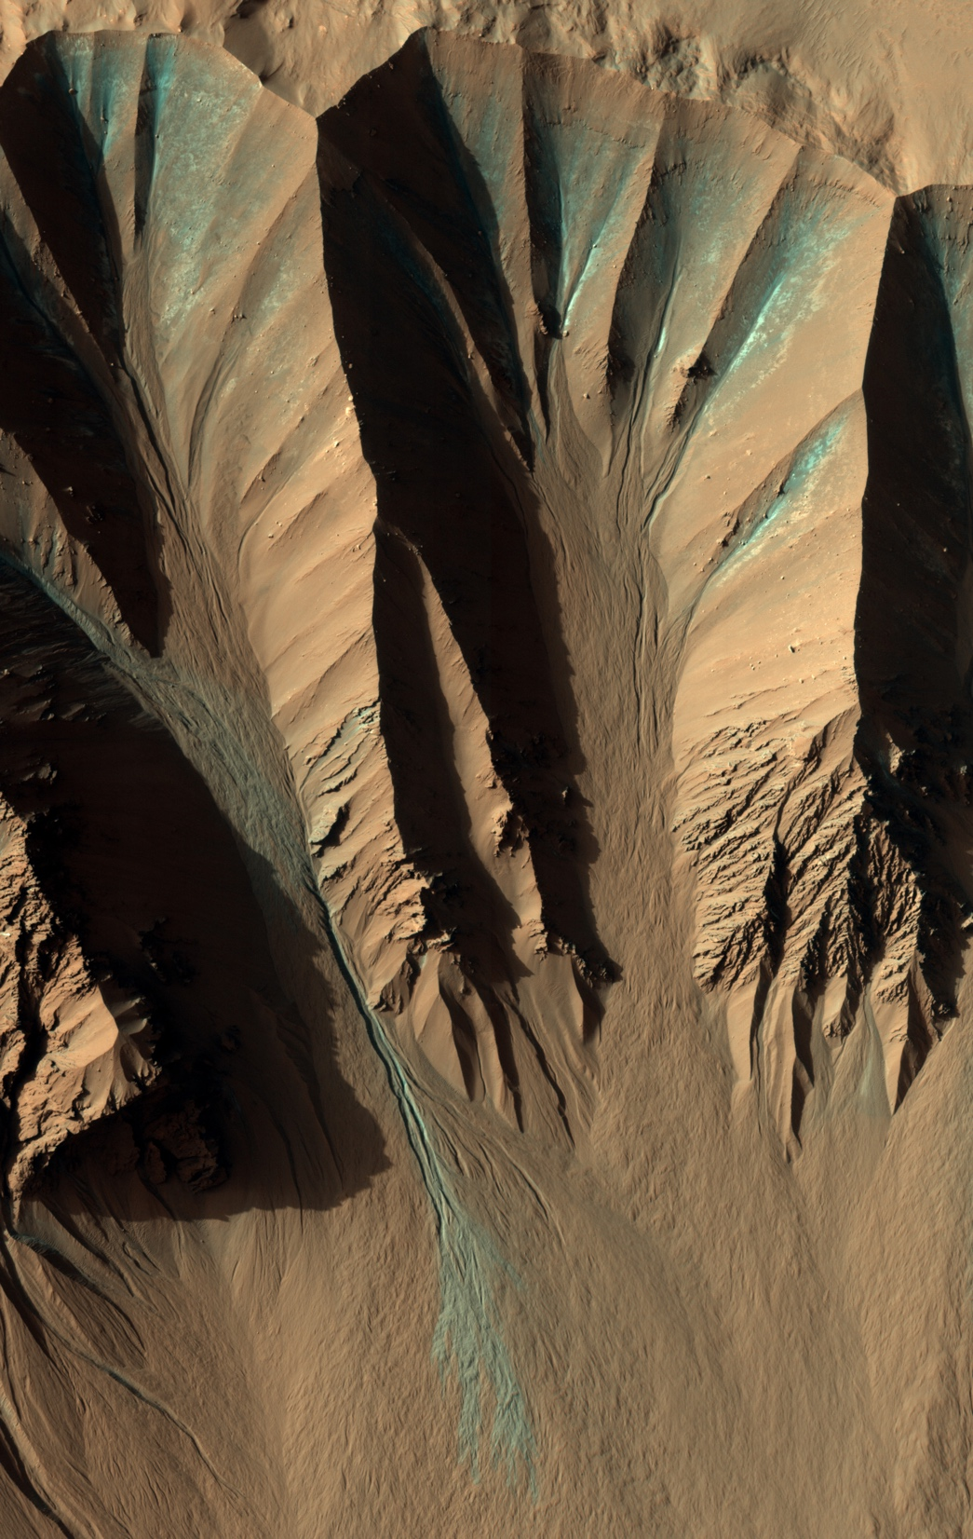
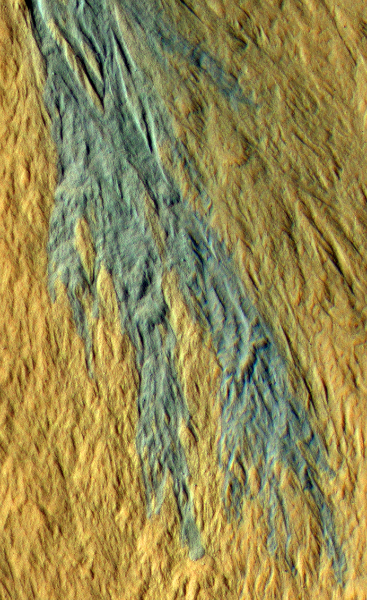
Image width ~1 km

Slide 19
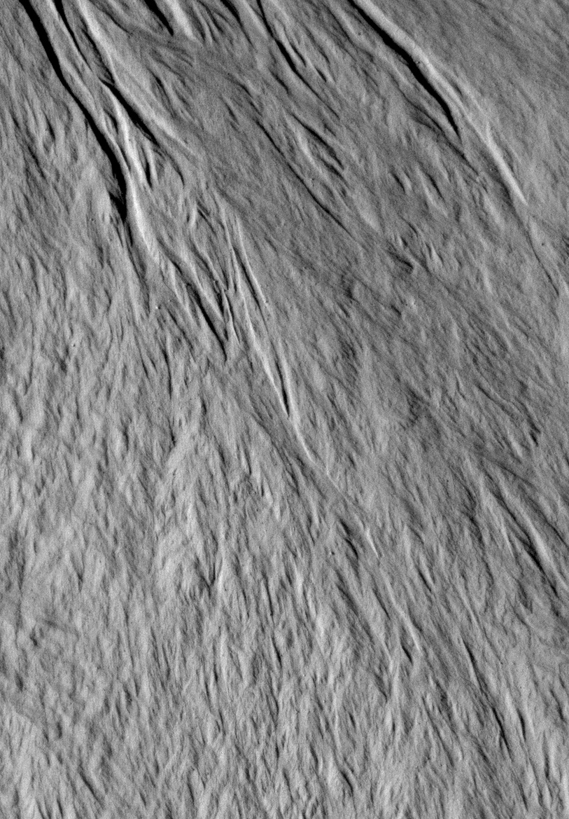
New debris lobes on a gully fan in Gasa crater
Step-1

Slide 20
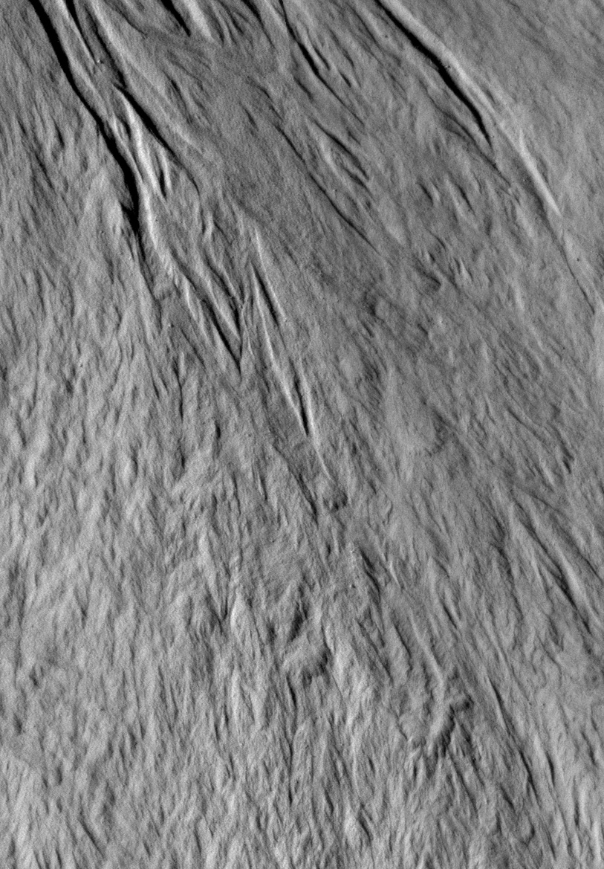
New debris lobes on a gully fan in Gasa crater
Step-2
(1 Mars year later)

Slide 21
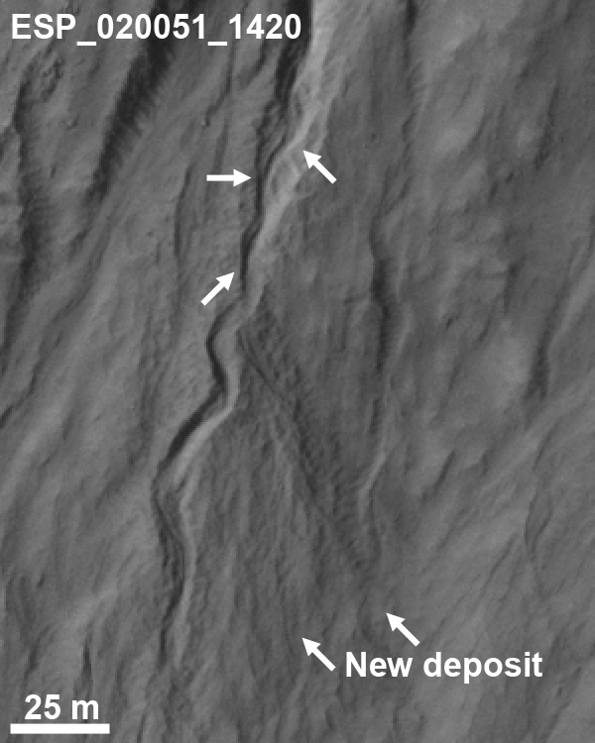
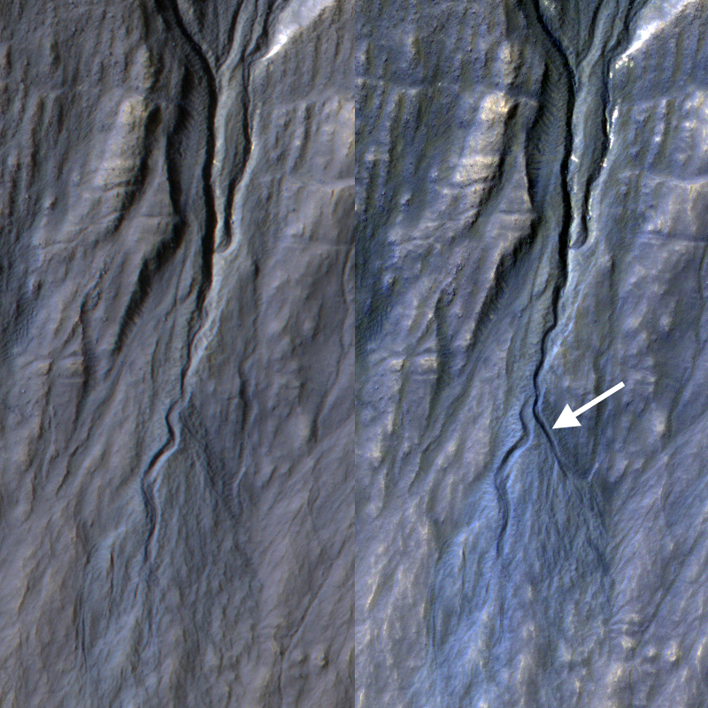
New channel incision; meandering doesn’t require liquid

Slide 22
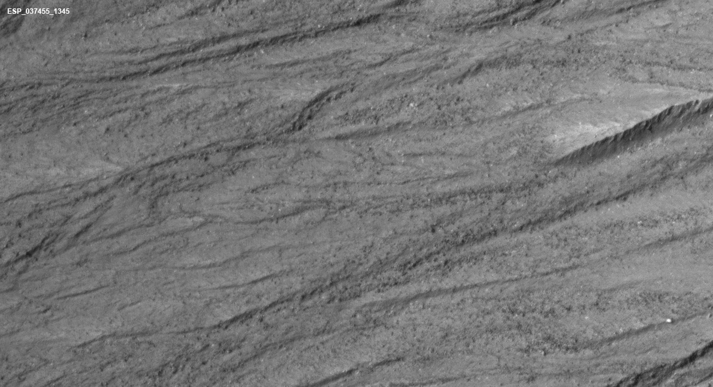
New gully and lobate deposits in Istok Crater
This is where de Haas et al. (2015, Nature Geoscience) concluded that these lobate deposits required centimeters of runoff during recent high obliquity period. These changes occurred by Ls 122, probably while frost was accumulating. (And we are not high obliquity.)

Slide 23
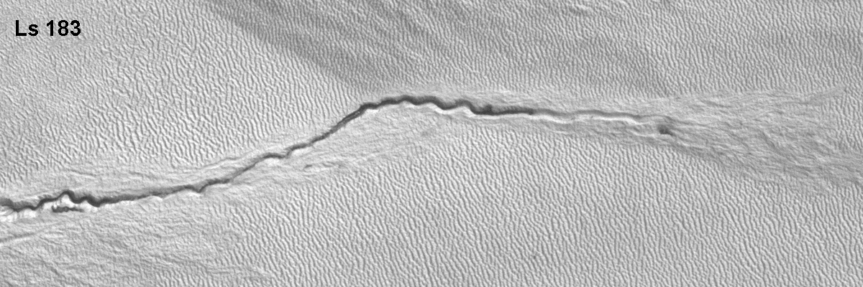
Dark material flowing down channel in springtime. Bright areas covered by CO₂ frost.
All gully morphologies have been seen to form in the past decade:
Alcoves, channels, fans
Including morphologies thought to require water:
Terraces, meanders, lobate deposits, concave profiles
Forming in winter – no liquid water

Slide 24
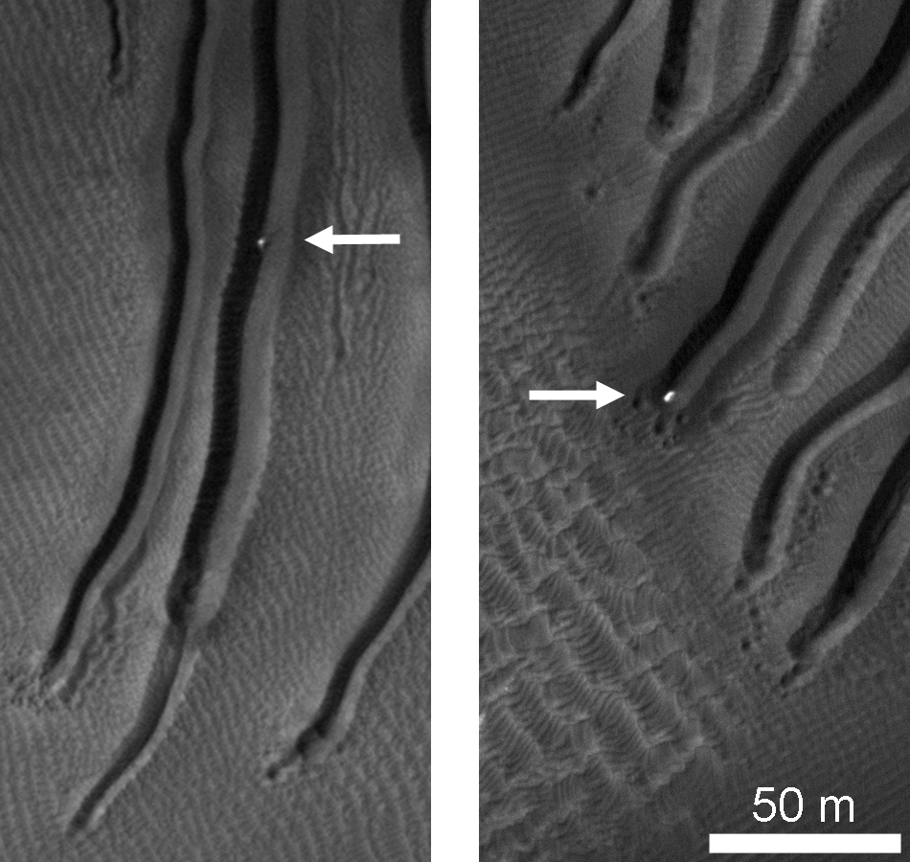
Gully Activity
Intensively monitored sites show strong correlation between gully activity and presence of seasonal frost (Dundas et al., 2012, 2015)
Bright ice blocks in linear gullies suggest new model for these features (Diniega et al., 2014)
Most of active sites are in S hemisphere—this may switch hemispheres with argument of perihelion.

Slide 25
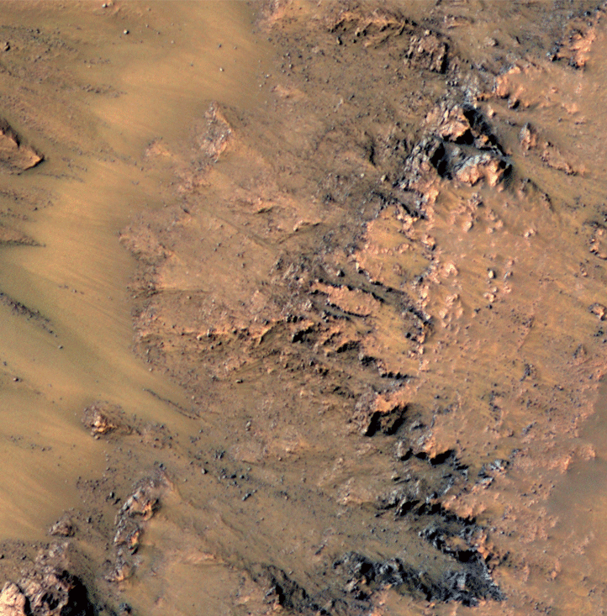
Seasonal Flows on Warm Martian Slopes (McEwen et al., Science, 5 Aug 2011)
Recurring Slope Lineae (RSL) are narrow (0.5-5 m), dark markings on steep slopes (>25°)
First found in southern hemisphere (32°S to 48°S), favoring equator-facing slopes.
Form and incrementally grow in late spring to summer, then fade or disappear in late summer to fall.
Reform at nearly same locations in multiple Mars years.
Extend downslope from bedrock outcrops or rocky areas; often associated with small gullies.
RSL active in seasons when peak temperatures > 250 K.

Slide 26
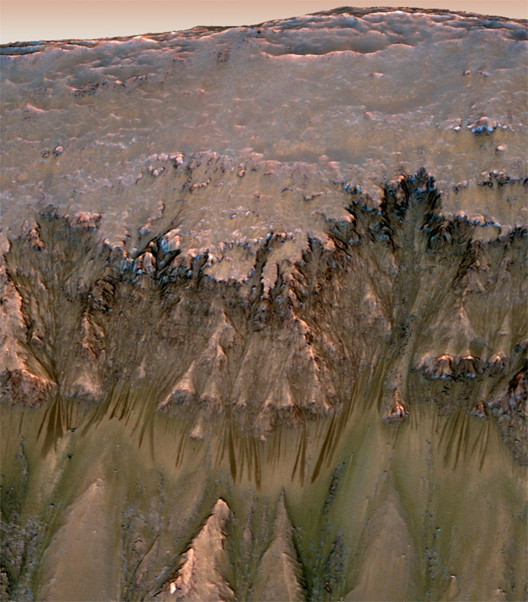
RSL begin near steep cliffs, flow over bedrock or very rocky ground, then flow onto bright fans (~30 deg. slopes)
Reprojected view from inside Palikir Crater. No vertical exaggeration.

Slide 27
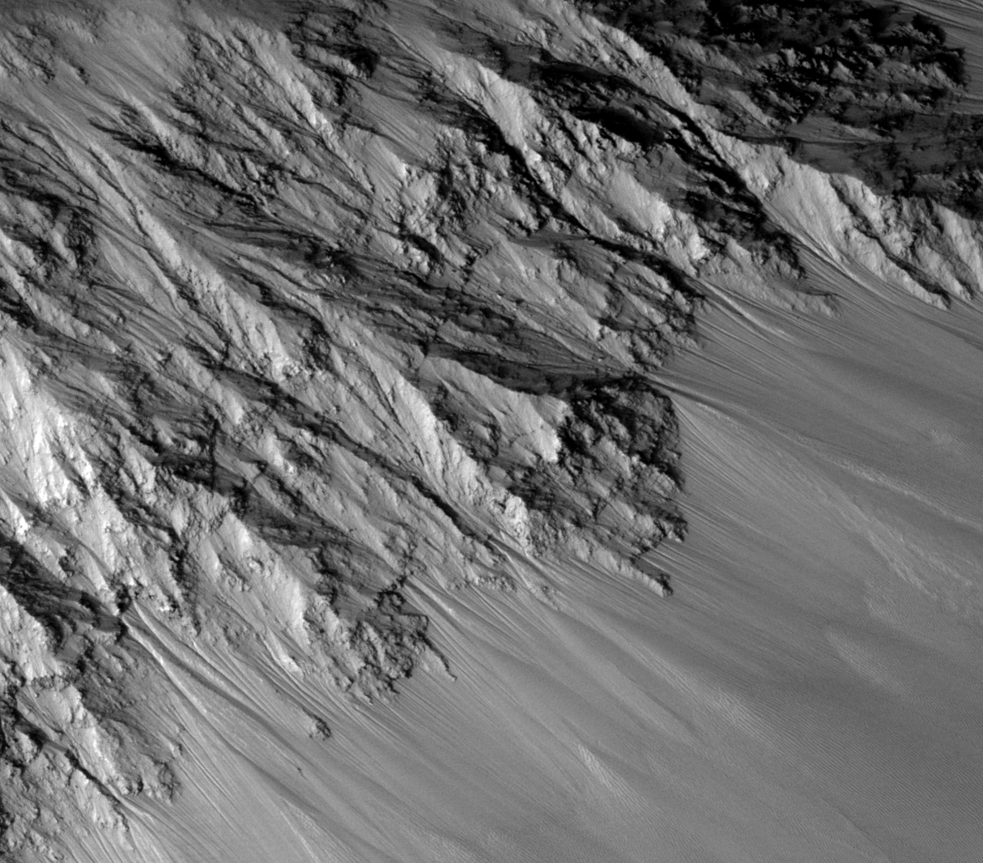
RSL also concentrated in Valles Marineris (VM) on all slope aspects, plus other equatorial and N hem. regions
In VM they form and grow in N spring/summer on N-facing slopes, S spring/summer on S-facing slopes
May be active most of year on E- and W-facing slopes
Longer RSL in VM, >1 km
McEwen et al., 2014
Surprising Geologic Processes of Mars: Earth-like geomorphologies may be deceiving

Slide 28
Global distribution of RSL sites and candidate sites

Slide 29
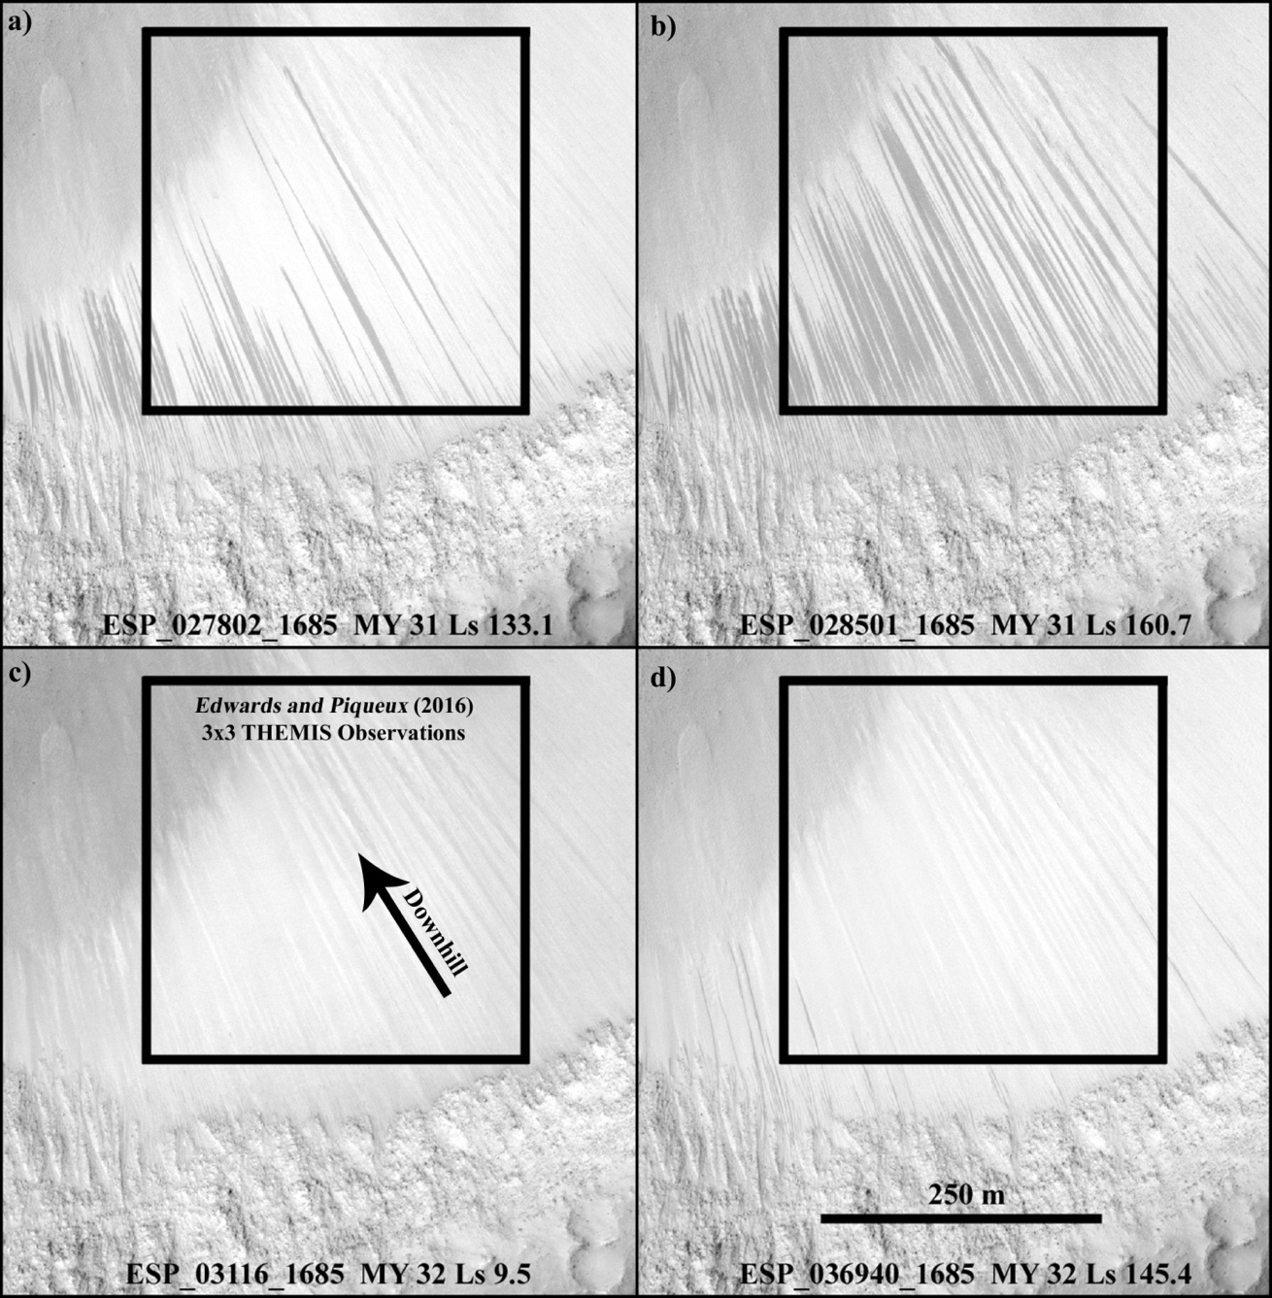
Garni RSL are dry based on thermal data [Edwards and Piqueux 2016] But they misunderstood the inter-annual variability (Stillman et al., 2017).
No THEMIS data acquired when top (MY31) images acquired.
Edwards and Piqueux (2016) assumed that RSL fill >40% of a THEMIS resolution element every year during the time period observed in MY 31. This assumption was certainly violated in MY 32, and is unknown in MY 26-30 as no high-resolution images exist.
Result is ambiguous: either RSL are dry or THEMIS didn’t observe when RSL were sufficiently active.

Slide 30
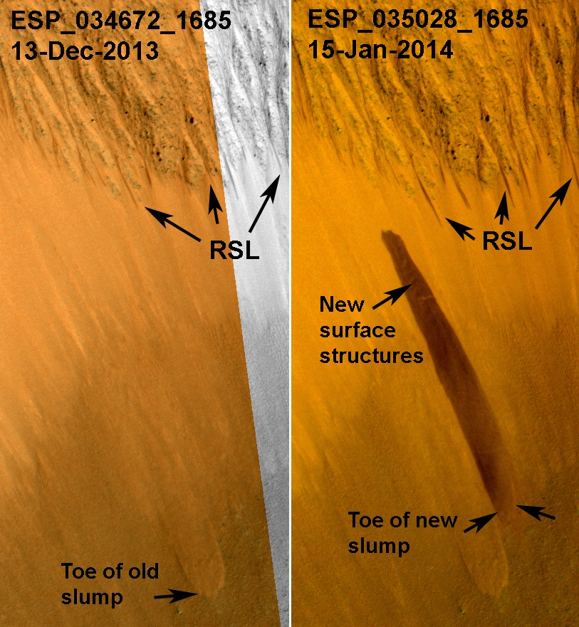
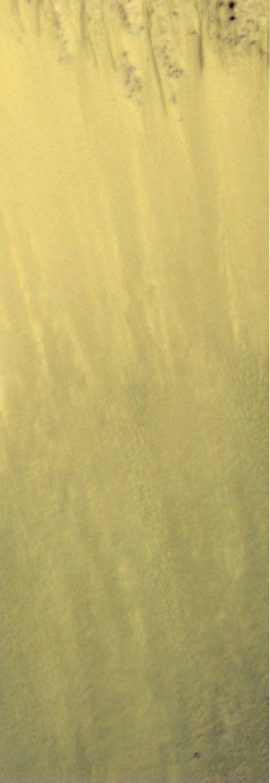
Slumping associated with RSL first seen in Garni crater

Slide 31
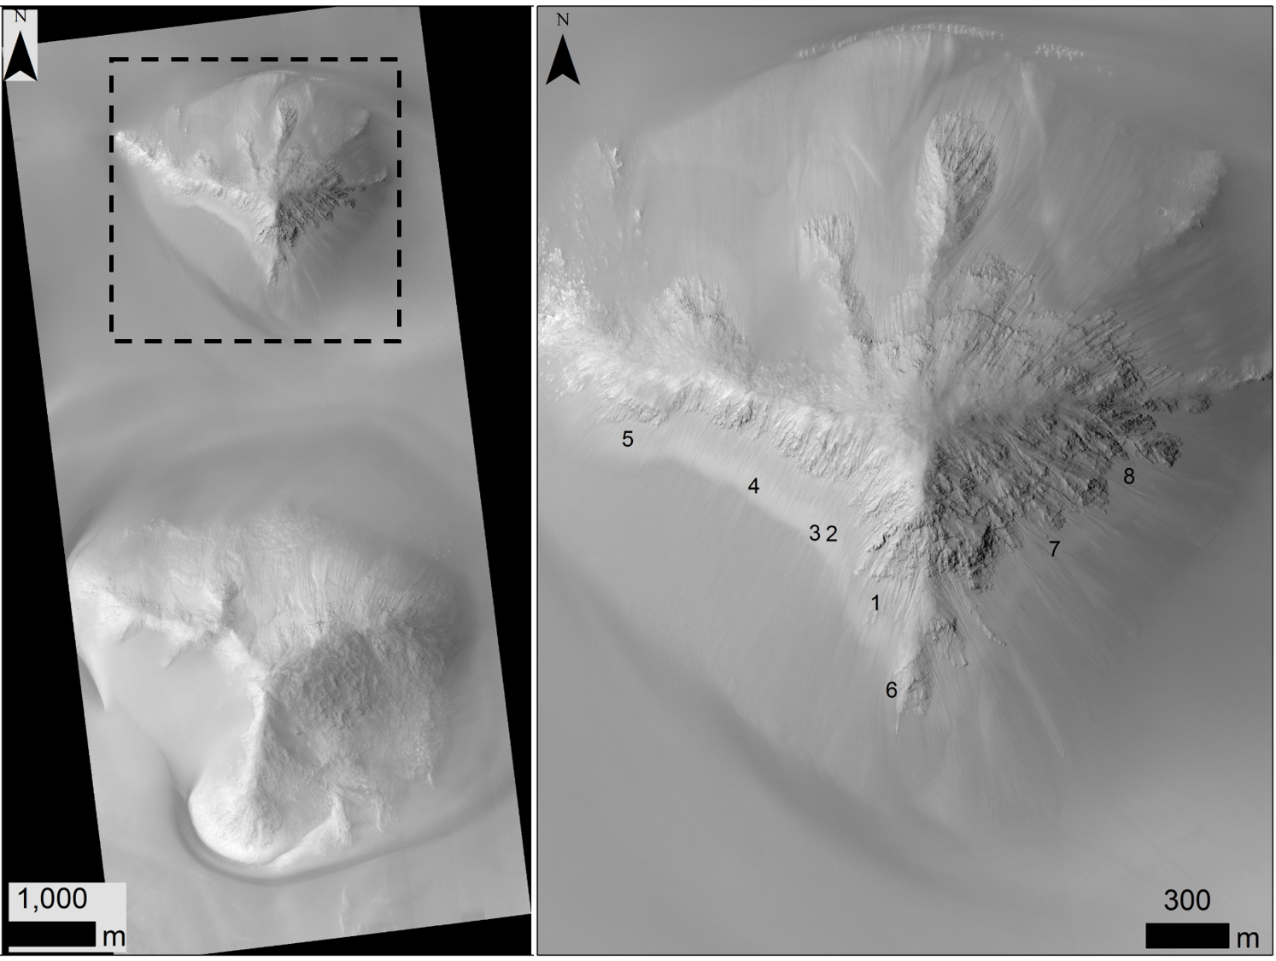
We have now seen 9 more slumps, 8 around one hill in Juventae Chasm (below). All 10 slumps in Valles Marineris occurred between Ls 0-100, Northern spring to early summer. That is the coldest time of year!
New slumps are dark, then fade over a few weeks like RSL, but RSL are active in the warmest season.
Surprising Geologic Processes of Mars: Earth-like geomorphologies may be deceiving

Slide 32
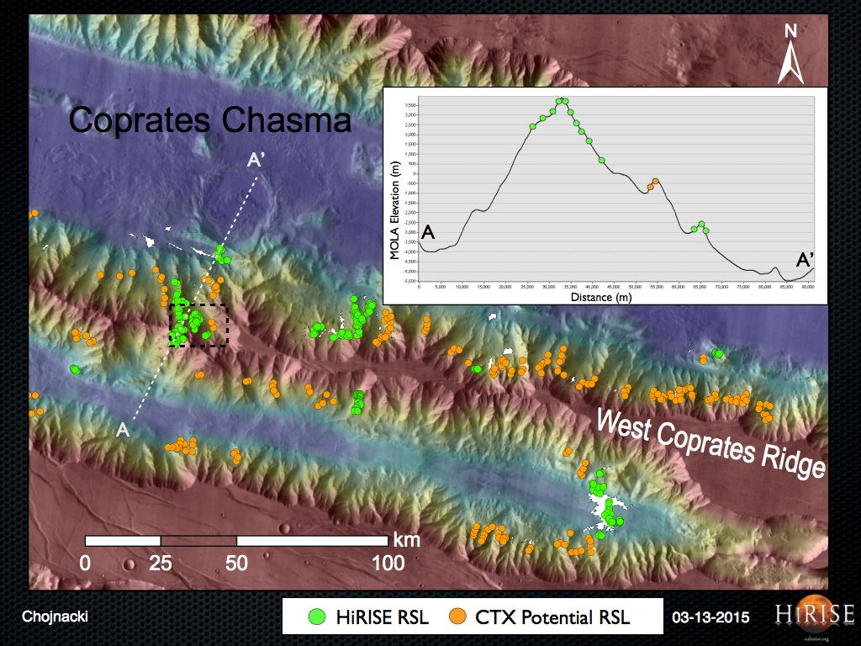
Not plausible for groundwater to commonly reach the tops of high ridges
Chojnacki et al., 2015

Slide 33
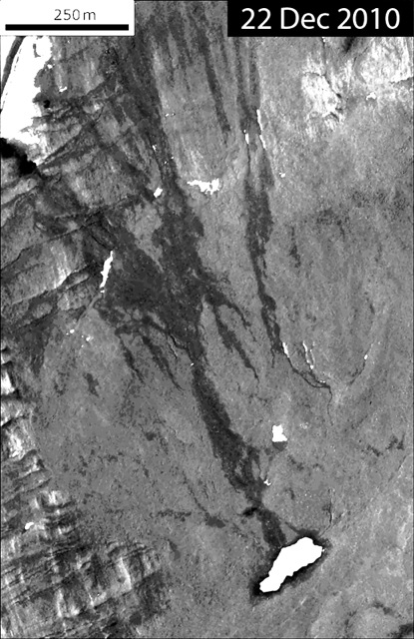
RSL are not Water Tracks
Water tracks in Antarctica form in part from deliquescence [Levy et al. 2012] .
Hypersaline wet patches form, mainly CaCl₂ and MgCl₂
Feed early activity of water tracks, later augmented by snowmelt
Deliquescence can explains RSL starting on tops of hills and ridges, and maybe on dunes
Problems:
Seasonal peaks in column abundance of water vapor does not correlate with RSL activity (McEwen et al., 2014)
“Dry” Antarctica air contains ~100X more water than Mars.
Morphology and slopes of water tracks differ from RSL

Slide 34
MRO/CRISM: Hydrated perchlorates at RSL sites (Ojha et al., 2015)
Hydrated perchlorates (or oxychlorine salts) seen from orbit only at NPLD, RSL sites, and at fresh impacts exposing ice (Ojha et al., submitted).
Not seen elsewhere that shallow subsurface is exposed (many non-icy new impacts, active gullies).
Detection of hydrated salt from orbit points to unusual water activity.
Palakir crater
Notes:
Fig 1. (a) ESP_024034_1380 (L_{s}: 359 MY: 30): Red orthorectified observation of RSL on steep equator facing slope of Palikir crater. (b) Concurrent CRISM observation FRT0002038F showing the same area as (a). Colored pixels correspond to spectra in (c). (c) Top: Infrared laboratory spectra of liquid water (17) on a basalt substrate at different times (T1 = 1 hour into dehydration, T4 = 4 hours into dehydration) showing the evolution of the spectral absorption features at 1.4 μm and 1.9 μm. Bottom: Spectra from 6 different colored ROIs shown in (b). Blue, green, and yellow pixels closest to wide RSL seen in HiRISE image show both ~1.4 μm and 1.9 μm absorption bands. The observed data are plotted with dashed color lines, and the smoothed data (smoothing function that assigns zero weight to data outside six standard deviations from the mean) are plotted in solid black color lines.

Slide 35
RSL as granular flows (Dundas et al., 2017)
slipface slopes of active dunes (Atwood-Stone and McEwen, 2013)
RSL terminal slopes are identical to Martian (and terrestrial) dune slipface slopes.
RSL length controlled by available steep slopes—highly unlikely relation for water seeps
Triggering of flow may be from small amounts of seasonal water.

Slide 36
RSL Conclusions
Water probably plays some role in RSL activity
Temperature dependence
Hydrated salts
Albedo changes
RSL are perfectly confined to slopes at or steeper than the “dynamic angle of repose” for cohesionless granular materials
Indicates that the basic flow mechanism is dry.
Water may trigger granular flow in some way
Boiling of small amounts of water triggers grain flows [Masse et al., 2016]
Changes in hydration affects cohesion
Subsurface deliquescence may destabilize overlying grains
Recurrence is difficult to explain in most models.
Something is being depleted that has to be replenished annually (ice, water, grains, salt)
More research needed
Surprising Geologic Processes of Mars: Earth-like geomorphologies may be deceiving

Slide 37
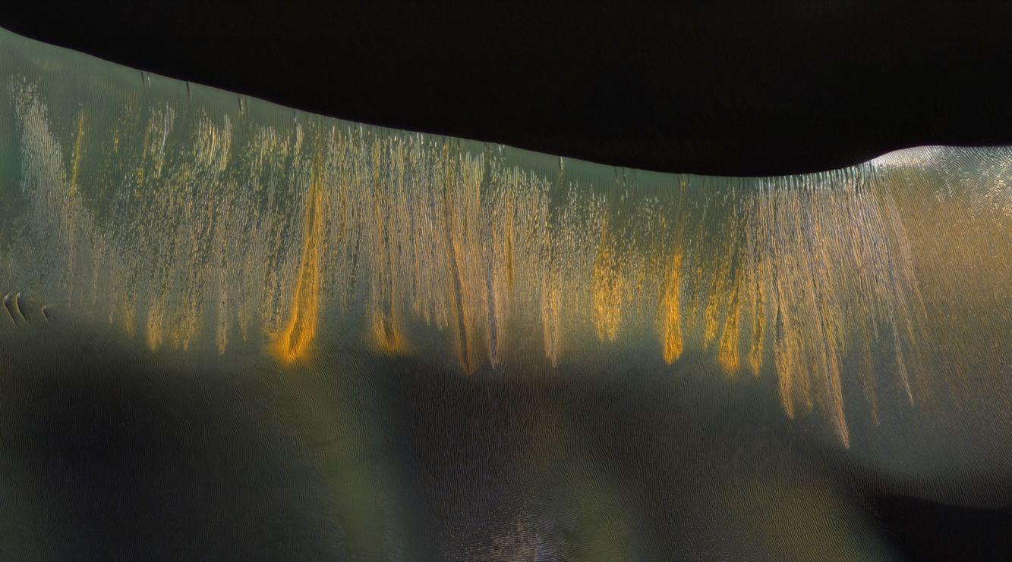
Summary
The present is the key to the recent past.
Large gullies are forming today at a high rate at times and places too cold for liquid water to play a role
The fact that they appear “remarkably similar” to terrestrial gullies formed by water is misleading
Active sand dunes seem highly analogous to terrestrial dunes, but the ubiquitous large ripples or small dunes are not found on Earth
RSL may involve water, but are not yet understood
Terrestrial analog provide insight, not direct answers
Surprising Geologic Processes of Mars: Earth-like geomorphologies may be deceiving
Glowing dune gullies in Kaiser crater

