Slide 1
Can we use nutrient concentrations during baseflow conditions to manage nonpoint source pollution?
Brian Haggard
Arkansas Water Resources Center
University of Arkansas

Slide 2
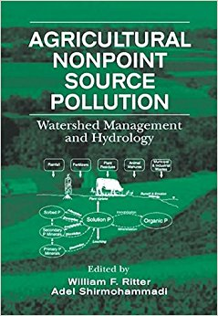
A couple decades ago watershed models became ‘sexy’ and were being used to address NPS pollution issues.
“Only two methods for tracking the environmental fate of chemicals and assessing the effectiveness of NPS management techniques…” (Shirmohammadi, Montas, Bergstrom, and Kinsel, 2000)
  Field monitoring
  Computer modeling

Slide 3
The reasons focused on the expense related to field monitoring – lots of samples, expensive equipment, etc.
“Only two methods for tracking the environmental fate of chemicals and assessing the effectiveness of NPS management techniques…” (Shirmohammadi, Montas, Bergstrom, and Kinsel, 2000)
  Field monitoring
  Computer modeling

Slide 4
Computer models provide users the opportunities to evaluate pollution sources, ‘what if’ scenarios, BMPs and even simulate future loads.
“Only two methods for tracking the environmental fate of chemicals and assessing the effectiveness of NPS management techniques…” (Shirmohammadi, Montas, Bergstrom, and Kinsel, 2000)
  Field monitoring
  Computer modeling

Slide 5


What goes into using a model?
Identify the Question
Select the Best Model
Database Compilation
Model Calibration
Model Validation
Parameter Sensitivity
Model Uncertainty
Notes:
Talk about what goes into developing watershed models

Slide 6
Watershed Modeling Options
  Chemicals, Runoff, and Erosion from Agricultural Management Systems (CREAMS)
  Areal Nonpoint-Source Watershed Environment Response Simulation (ANSWERS)
  Kinematic Runoff & Erosion Model (KINEROS)
  Groundwater Loading Effects of Agricultural Management Systems (GLEAMS)
  Agricultural Nonpoint-Source Model (AGNPS)
  Dynamic Watershed Simulation Model (DWSM)
  Erosion Productivity Impact Calculator (EPIC) Model
  Storm Water Management Model (SWMM)
  Hydrologic Simulation Package-Fortran (HSPF)
  Spreadsheet Tool for Estimating Pollution Load (STEPL)
  Pollution Loads for Watersheds (PLOAD)
  Long-Term Hydrologic Impact Assessment (L-THIA)
  Soil-Water Assessment Tool (SWAT)
  WHAT DID I MISS?

Slide 7
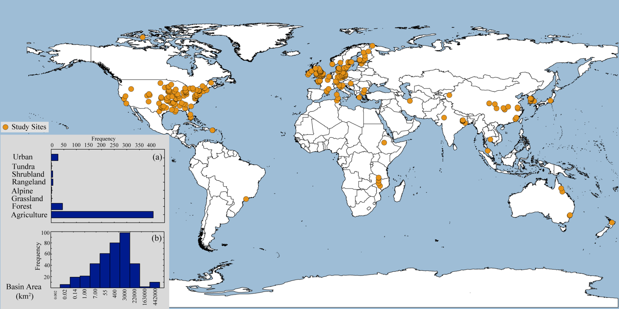
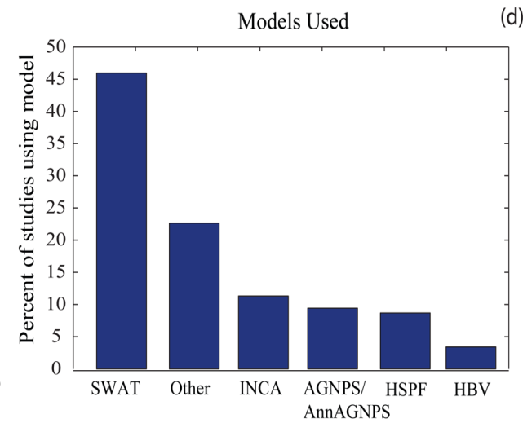
Watershed modeling is used globally.
The focus is typically on NPS pollution from anthropogenic sources, i.e. urban and agriculture.
The Soil Water Assessment Tool or SWAT model is by far the most commonly used.
Let’s remember: ALL MODELS ARE WRONG, BUT SOME ARE USEFUL!
Wellen et al. 2015

Slide 8
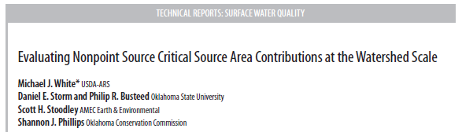
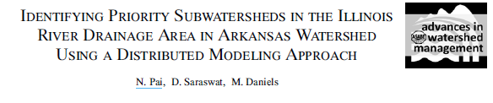
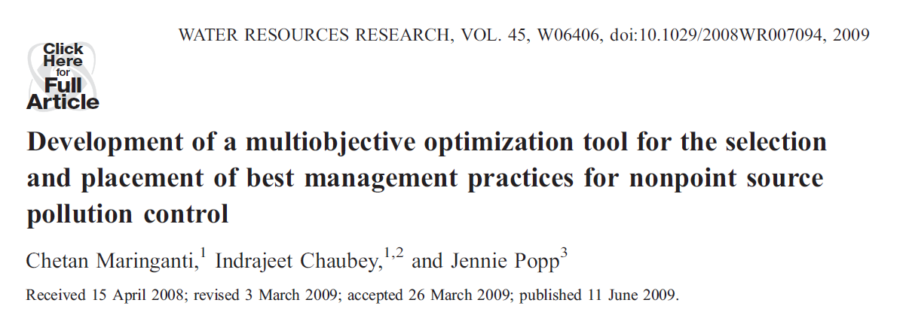
SWAT modeling is commonly used across the world, and there was even an application on a watershed in American Samoa in the Coastal Hydrology sessions on Tuesday.
In Arkansas and Oklahoma, SWAT is extremely popular – it is the model of choice by state agencies to evaluate BMP effectiveness, nutrient sources and even to prioritize where resources will be used to address NPS.
Notes:
SWAT modeling is commonly used to identify the subwatersheds in need of conservation, here are just a few examples of studies in Arkansas and Oklahoma that used SWAT modeling to prioritize subwatersheds.

Slide 9

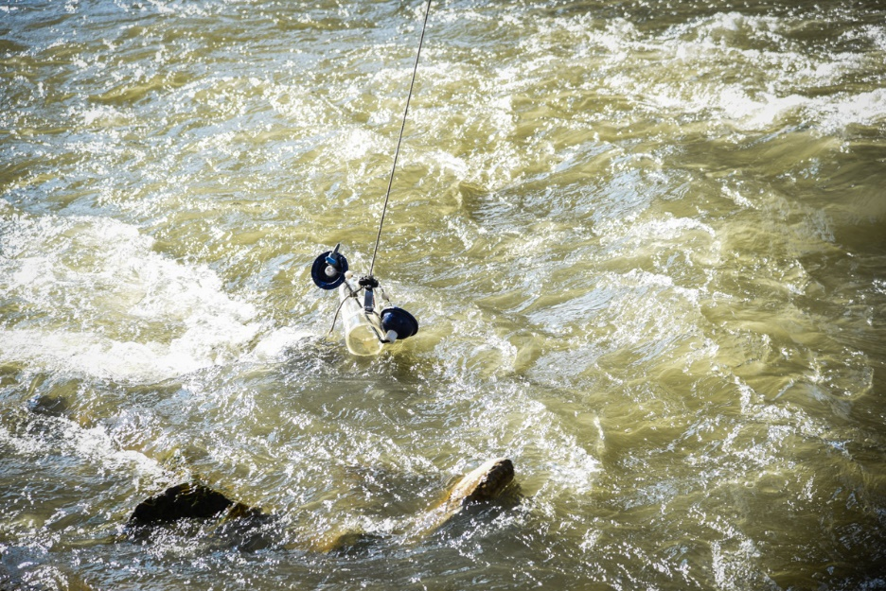

When using a model, you need DATA?
Identify the Question
Select the Best Model
Database Compilation
Model Calibration
Model Validation
Parameter Sensitivity
Model Uncertainty
Notes:
Talk about what goes into developing watershed models

Slide 10
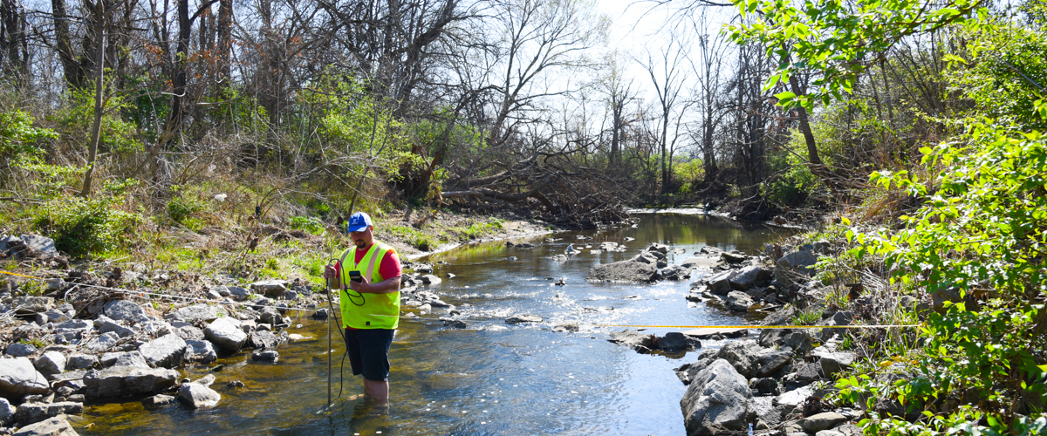
So, if we need nutrient concentrations and loads to calibrate and validate…
Could we redesign our WQ monitoring programs to help prioritize subwatersheds?
IN LIEU OF WATERSHED MODELING

Slide 11
Can we use nutrient concentrations during baseflow conditions to manage NPS and help prioritize where to invest resources to improve WQ?
I’m arguing yes we can, because we don’t need to know loads every where in the watershed.

Slide 12
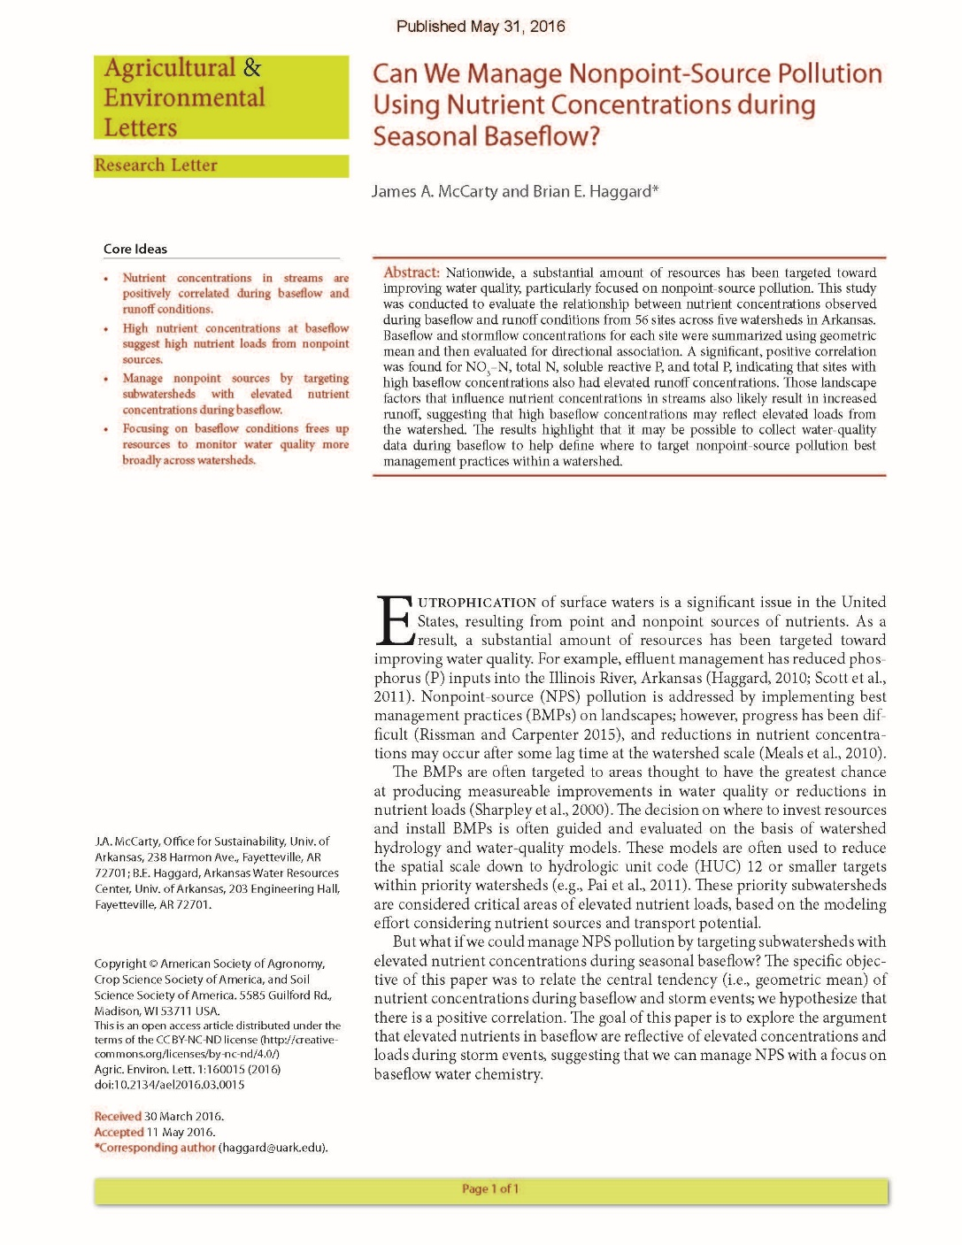
So, we think that high nutrient concentrations in baseflow reflects high load potential from watershed NPS.
BASEFLOW NUTRIENTS
ANTHROPOGENIC SOURCES
Local data and literature show that stream nutrient concentrations during baseflow increase with human land use, i.e. agriculture and urban areas in watersheds.

Slide 13

So, we think that high nutrient concentrations in baseflow reflects high load potential from watershed NPS.
BASEFLOW NUTRIENTS
ANTHROPOGENIC SOURCES
STORMWATER NUTRIENTS
BASEFLOW NUTRIENTS
Local data suggest that stream nutrient concentrations during baseflow and stormwater samples are positively related.

Slide 14
And, surface runoff potential increases with human land use.
This suggests that streams with elevated nutrients in baseflow likely have high NPS loading.
BASEFLOW NUTRIENTS
ANTHROPOGENIC SOURCES
STORMWATER NUTRIENTS
BASEFLOW NUTRIENTS
RUNOFF POTENTIAL
ANTHROPOGENIC SOURCES

Slide 15
So, how do we use stream nutrients during base flow to help prioritize subwatersheds where to invest resources to improve WQ?
We used CART and nCPA to evaluate threshold responses and hierarchical strucutre in baseflow nutrients with watershed characteristics (of local interest).

Slide 16
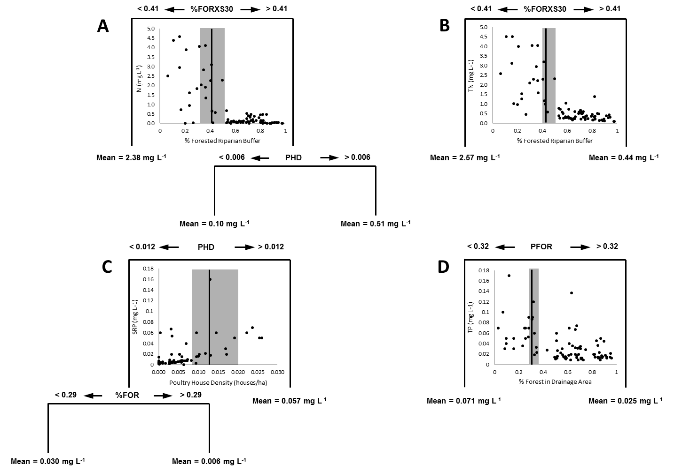

Slide 18
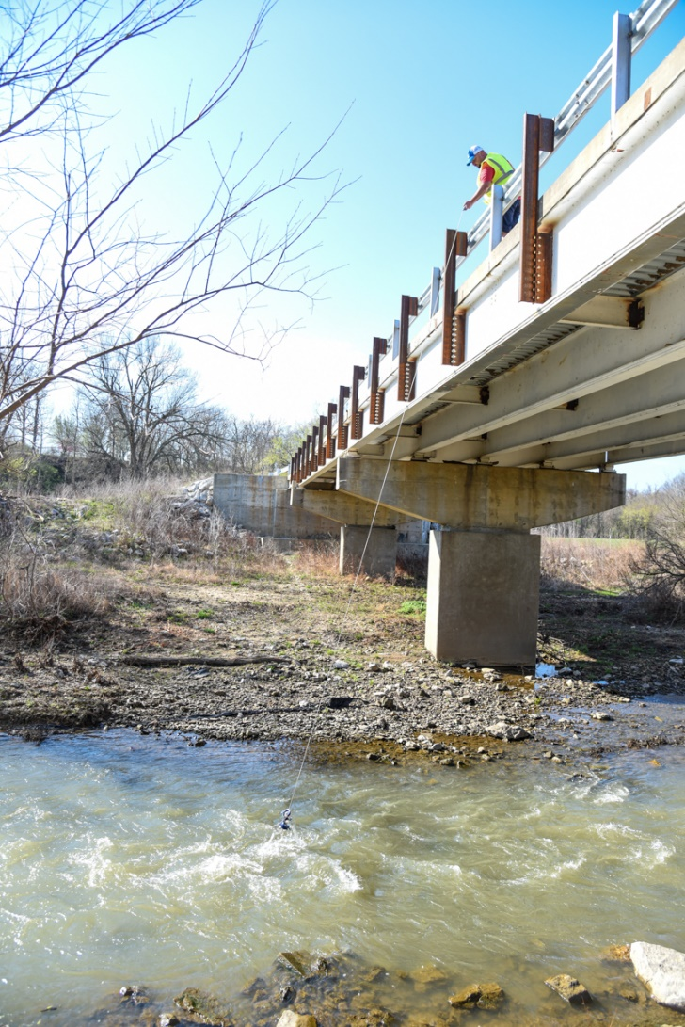
Based on these responses to key watershed characteristics…
We propose a decision framework to help guide where to focus resources to reduce NPS…
Less than 50% forested land use in watershed and riparian area
More than 40% pasture land in riparian area
More than 0.008 poultry houses per hectare in drainage area
A stream density that exceeds 0.005 meters per hectare in the drainage area
These subwatersheds have a tendency to have greater nutrient concentrations during base flow.

Slide 19
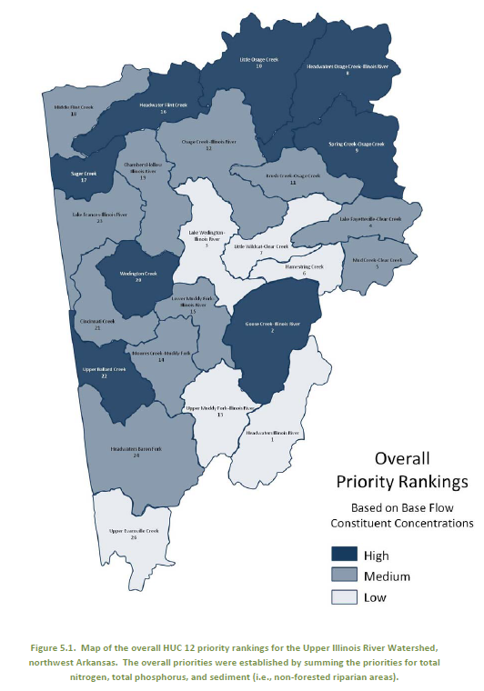
So, how could this be applied…
If the state or federal agency wants to prioritize HUC 12 subwatersheds, then…
You use HUC 12 geospatial information to evaluate criteria…
And, HUC 12s that exceed these criteria (especially more than one) have a higher priority for...
  Resource allocation
  BMP implementation
  WQ improvements

Slide 20

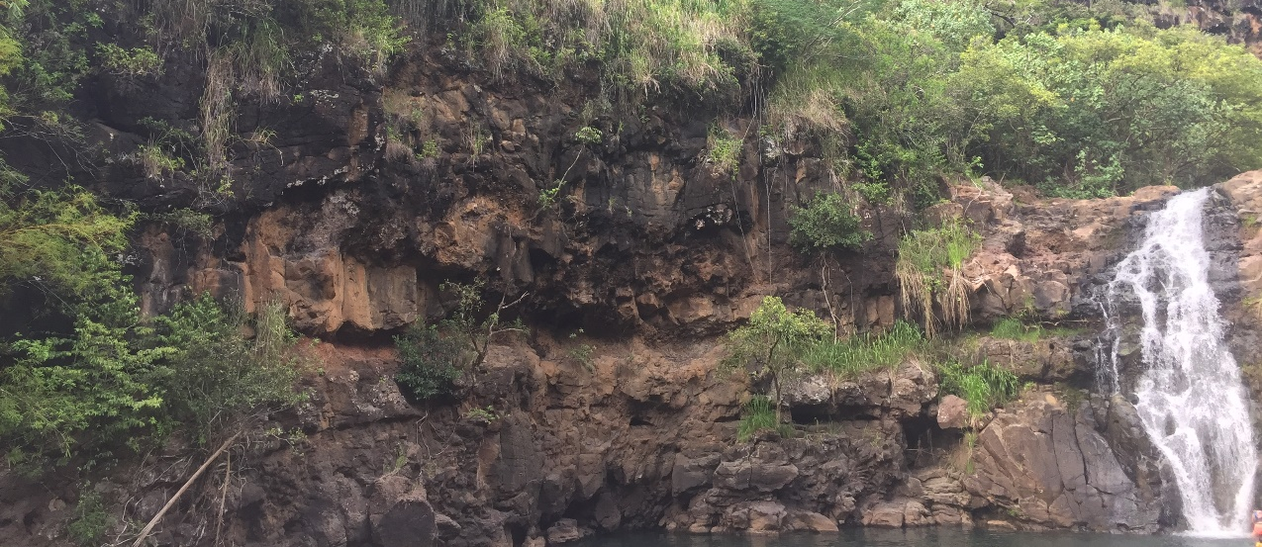

I realize we are in HAWAII not Arkansas…
The majority of the audience has a focus on integrated water resource management for coastal watersheds.
Your influencing watershed characteristics are different…
Agricultural practices
Soils
Topography
Hydrology (SMG, baseflow and surface runoff importance varies)
But, I can’t help but wonder if you can not take the same approach to help you identify subwatersheds of focus.
The ultimate goal would still be to reduce nutrient flux to your streams and eventually the coastal waters.

Slide 21

QUESTIONS?

