Slide 1


Contrasting Beach Dynamics in Abutting Littoral Cells with a Reef Boundary, Kaanapali Beach, Maui, Hawaii
The Geological Society of America
Cordilleran Section – 113th Annual Meeting
May 24th, 2017
LINSLEY, Derek P. and CONGER, Christopher L., Sea Engineering, Inc., Makai Research Pier, 41-305 Kalanianaole Hwy, Waimanalo, HI 96795
dlinsley@seaengineering.com
Notes:
Looking for candid discussion

Slide 2
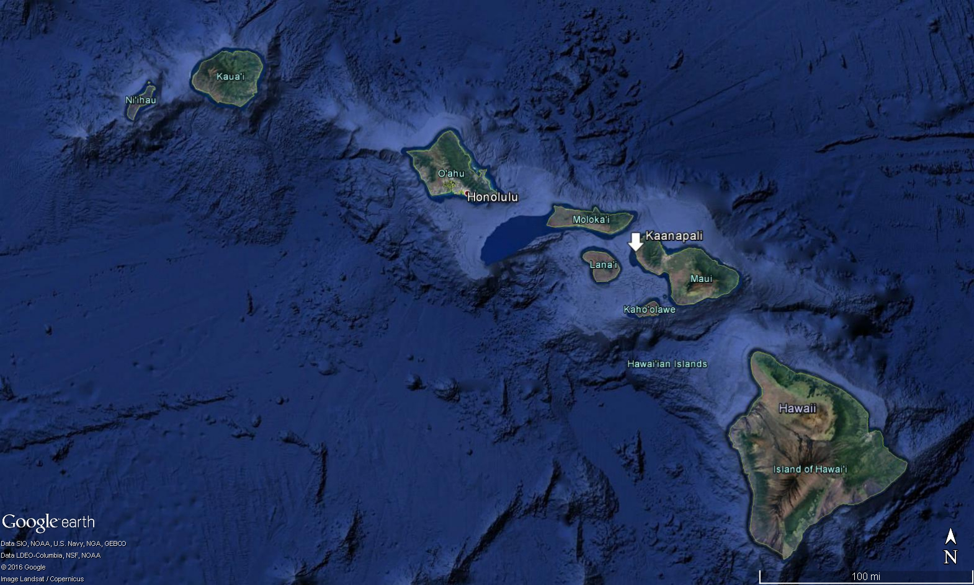
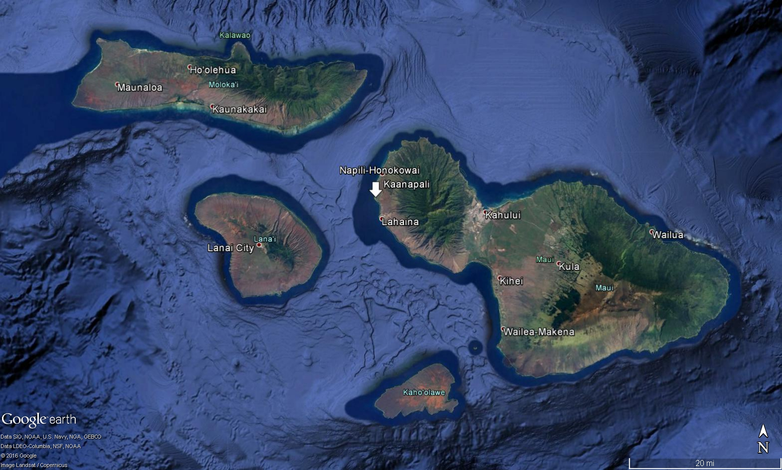
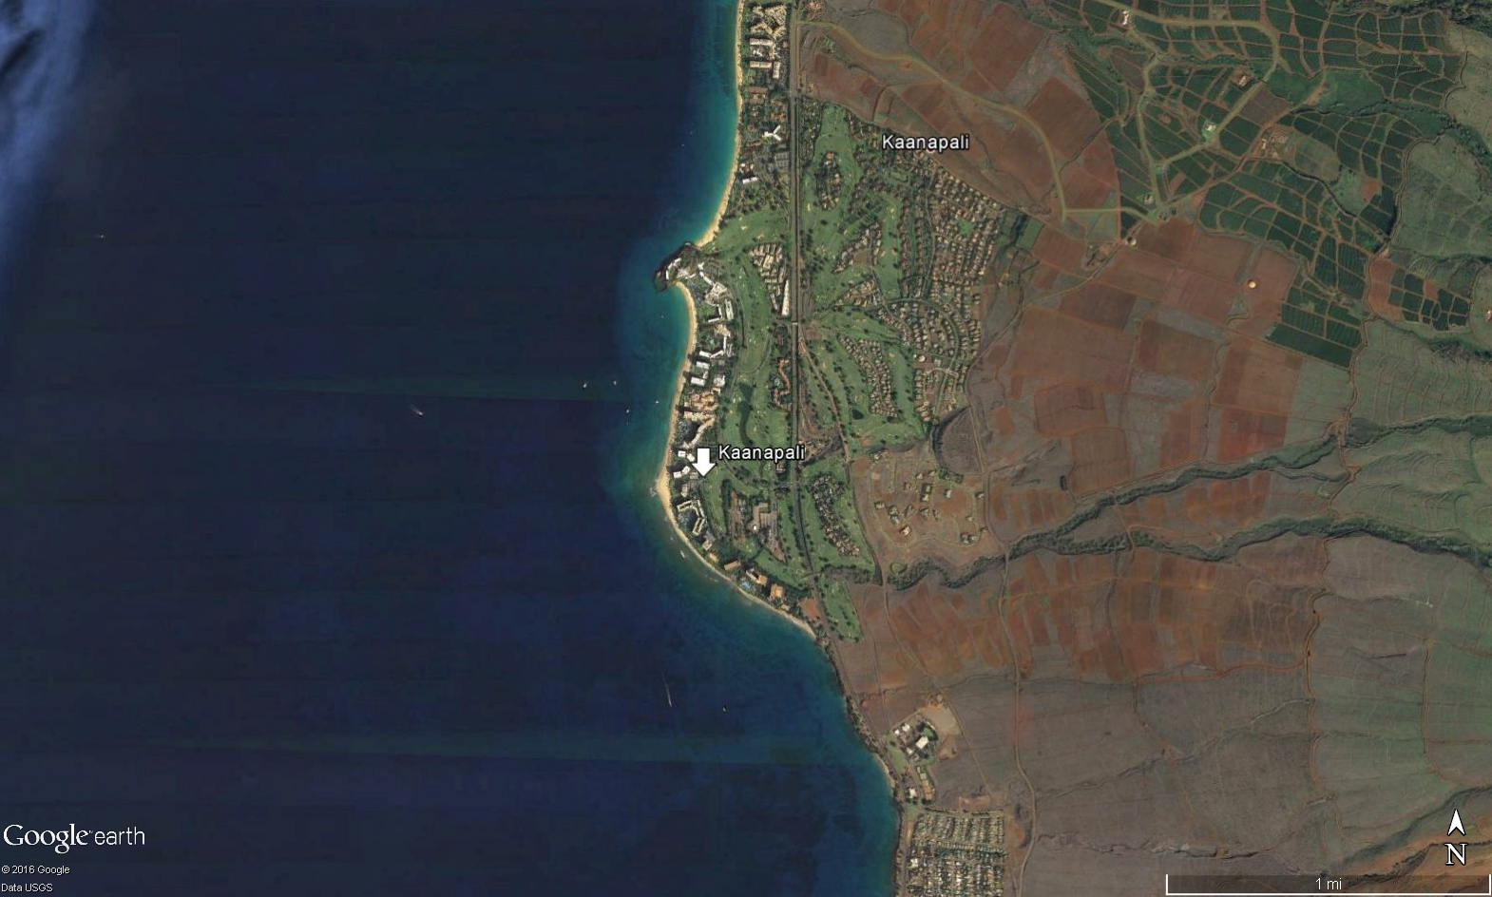
Kaanapali Beach, Maui, Hawaii

Slide 3
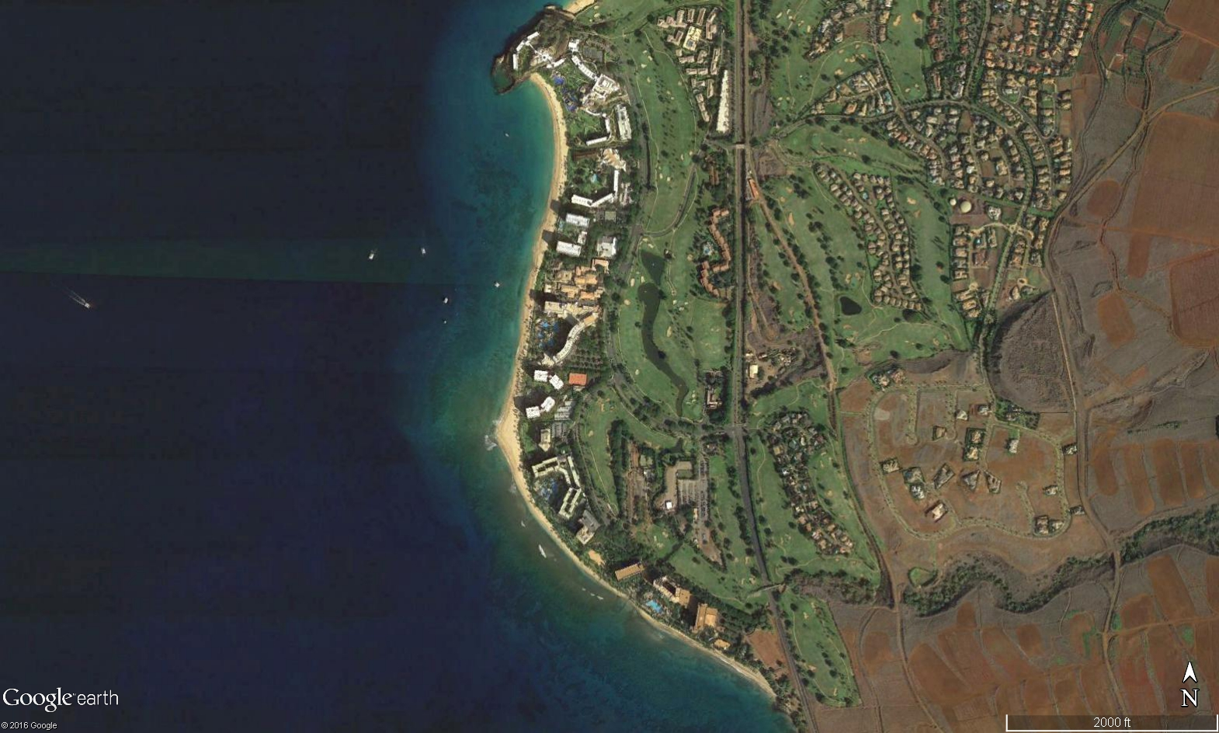
Kaanapali Beach, Maui, Hawaii
Puu Kekaa
(Black Rock)
Sheraton
Kaanapali Beach Hotel
Kaanapali Littoral
Cell (KLC)
Aston
Whaler’s Village
Westin
Kaanapali Alii
Hanakaoo Point
Marriott
Hanakaoo Littoral
Cell (HLC)
Hyatt
Hanakaoo Beach Park
Notes:
Billions of dollars worth of property generating billions of dollars in revenue within a couple hundred feet of the ocean.
Resort was developed BECAUSE of the coastline.

Slide 4
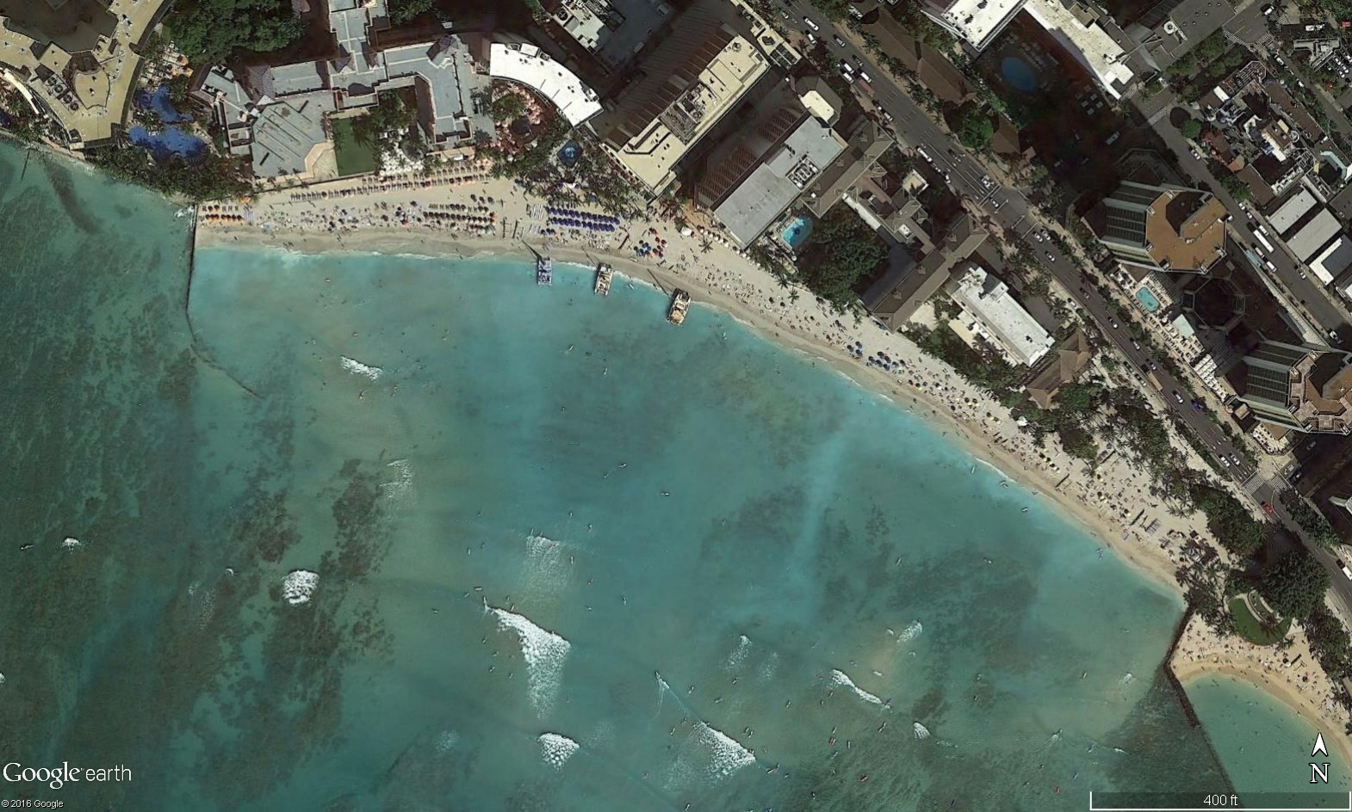
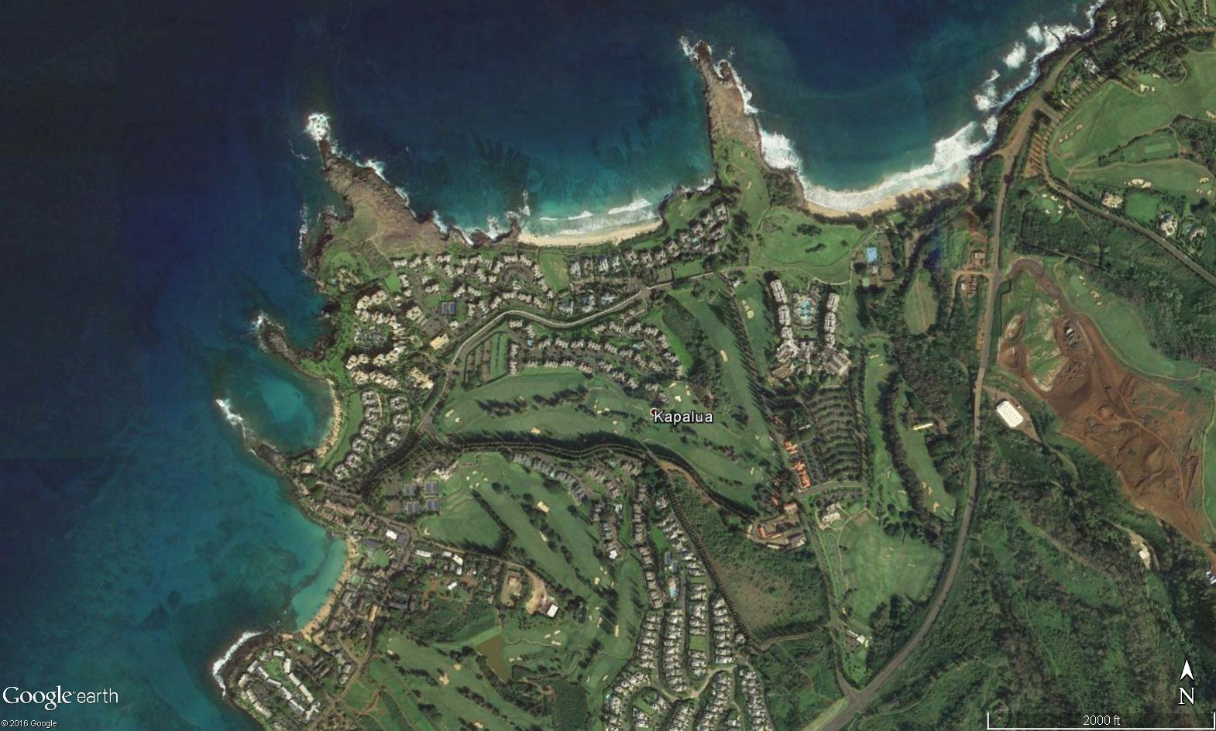
Littoral Cell
Segment of coastline that is more or less isolated sedimentologically from adjacent coastal segments
Often separated by a subaerial feature such as a rocky headland, groin, inlet, etc.
Groin
Littoral Cells
Groin
Royal Hawaiian Littoral Cell, Oahu, Hawaii
Kapalua Littoral Cells, Maui, Hawaii
Notes:
What is a littoral cell?
Sand within these littoral cells behaves very much like a fluid, influenced by waves and currents.
Waves breaking at an oblique wave angle to the shoreline will transport sand in that direction.

Slide 5
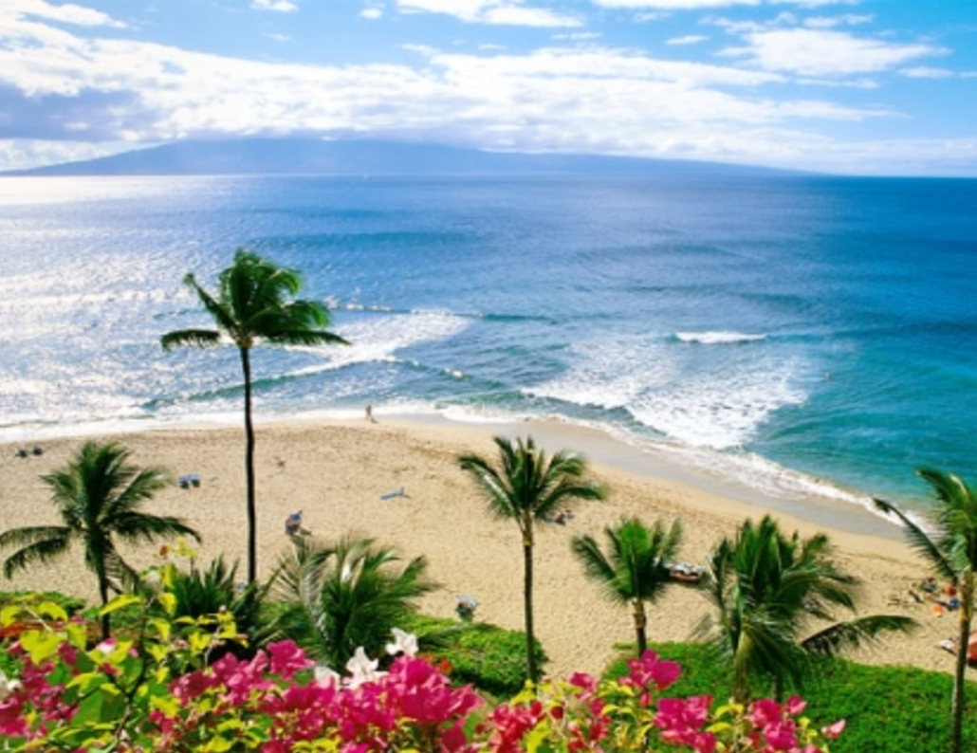
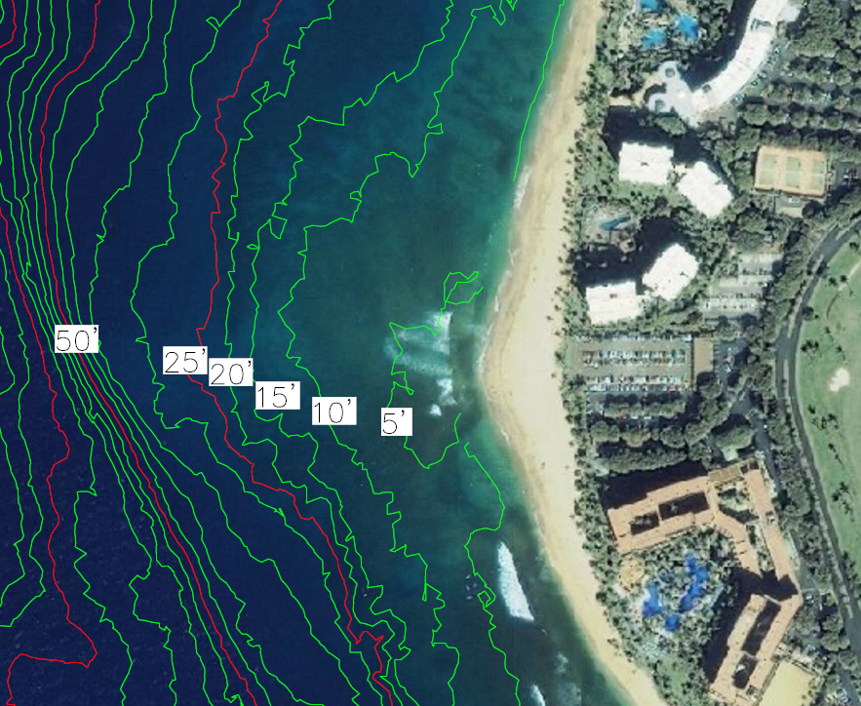
Hanakaoo Point
Boundary between the Hanakaoo and Kaanapali Littoral Cells
Submerged
Hanakaoo Point from the Kaanapali Alii
Hanakaoo Point Bathymetry
Notes:
Hanakaoo Point is the boundary between the Hanakaoo Littoral Cell to the south and the Kaanapali Littoral Cell to the north.
What makes Hanakaoo Point unique is that it is a submerged boundary. Sand, being fluid, only provides a temporary, seasonal barrier between the two littoral cells in the form of a sand point.

Slide 6
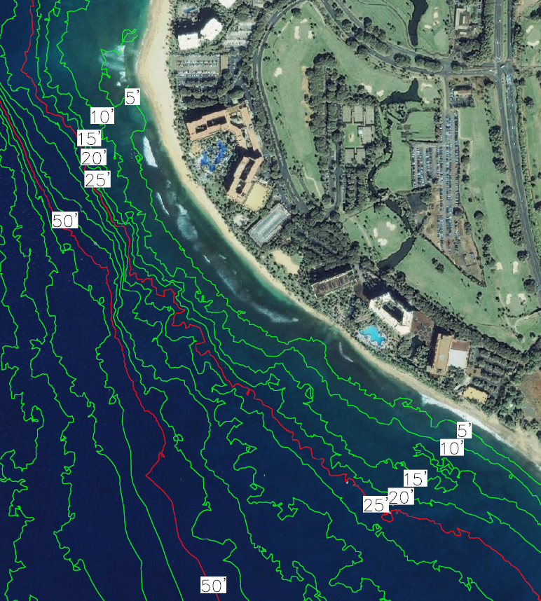
Hanakaoo Littoral Cell – Overview
3,600 feet of southwest-facing shoreline
Bounded by Hanakaoo Point (north) and Hankaoo Beach Park (south)
Shallow fringing reef offshore
Reef occasionally bisected by paleo stream channels
Hanakaoo Point
Paleo Channels
Reef
Hanakaoo Beach Park

Slide 7
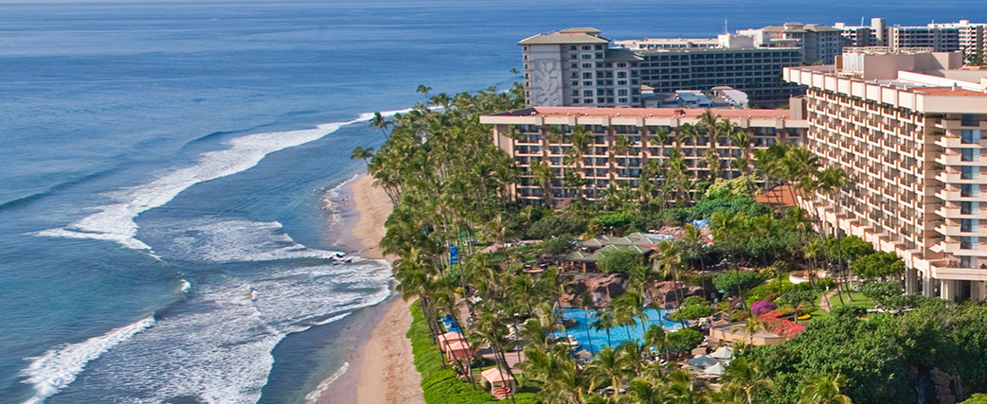
HLC – Coastal Processes
Directly exposed to southern hemisphere swell
Waves dissipate energy on the offshore reef
Sheltered from northern hemisphere swell
Minimal longshore sediment transport
Photo from Hyatt Regency Maui
Notes:
Beach takes the shape of the wave crest.

Slide 8
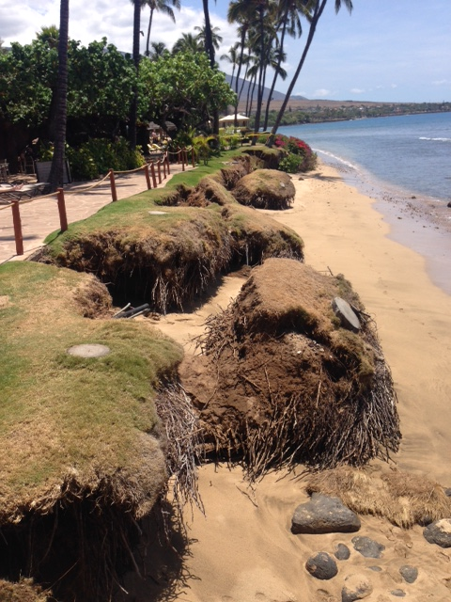
HLC – Erosion
Slowly diminishing sand budget leads to chronic erosion
Episodic events
Extended periods of southern swell combined with high water levels
Confined to erosion “hotspots”
Paleo channel fronting the Hyatt
April 2015 photo

Slide 9
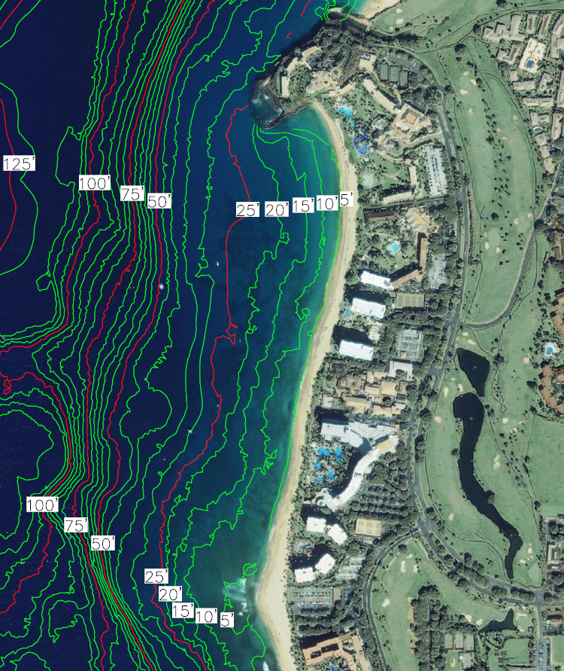
Kaanapali Littoral Cell – Overview
3,850 feet of west-facing shoreline
Bounded by Puu Kekaa (north) and Hankaoo Point (south)
No shallow fringing reef
Sandy nearshore

Slide 10
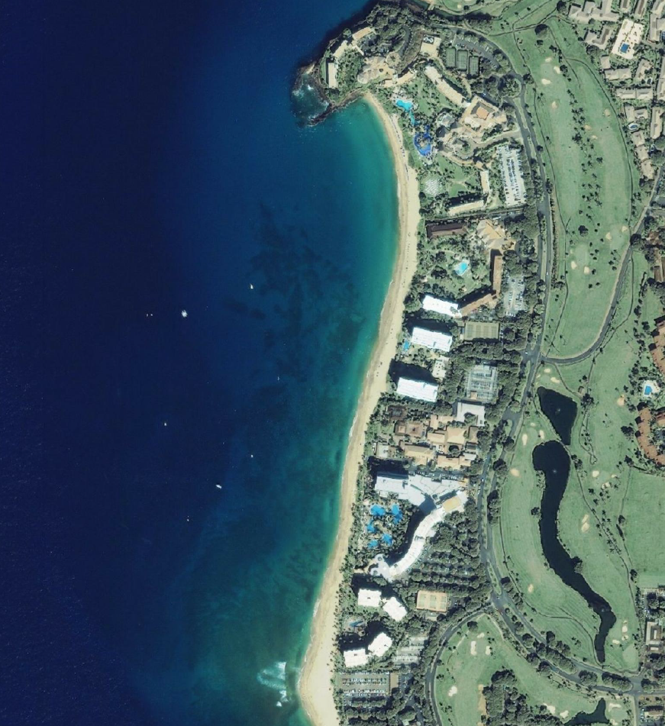
KLC – Coastal Processes
Exposed to refracted northern and southern hemisphere swell
Seasonal longshore sediment transport driven by oblique wave angle
50,000 – 73,000 cu yrds / season (1998)
1,350 – 2,700 cu yrds / day (2003)
North Pacific
Swell
Southern
Swell
Notes:
25,000 cu yards during a typical season.

Slide 11
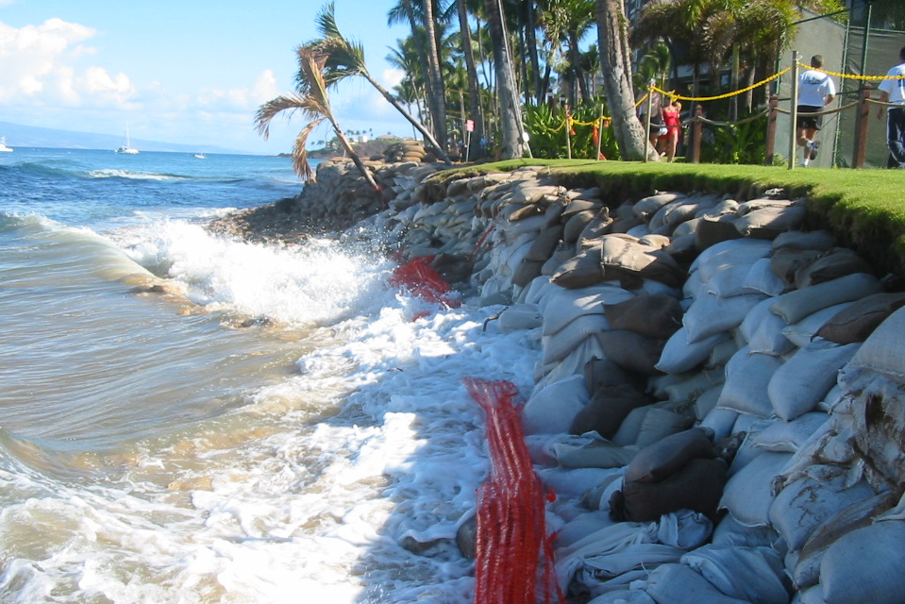
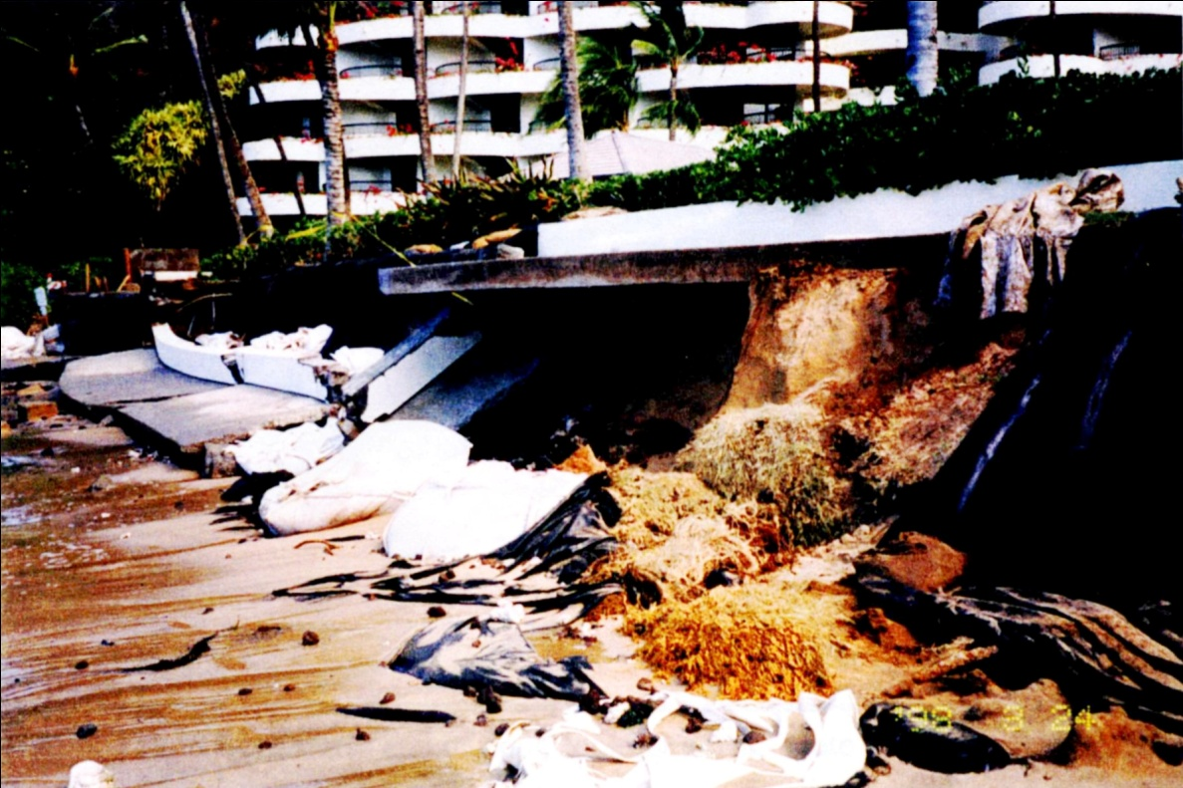
KLC – Erosion
Usually seasonal movement of sand proceeds without incident
Erosion occurs during stronger or weaker than average swell seasons
During/following El Niño years
Erosion confined to ends of the littoral cell
Puu Kekaa in the winter
Hanakaoo Point in the summer
Long term signal is erosive but very slight
Hanakaoo Point, 2003
Puu Kekaa, 1998
Notes:
Correlate with medium to strong El Nino years

Slide 12
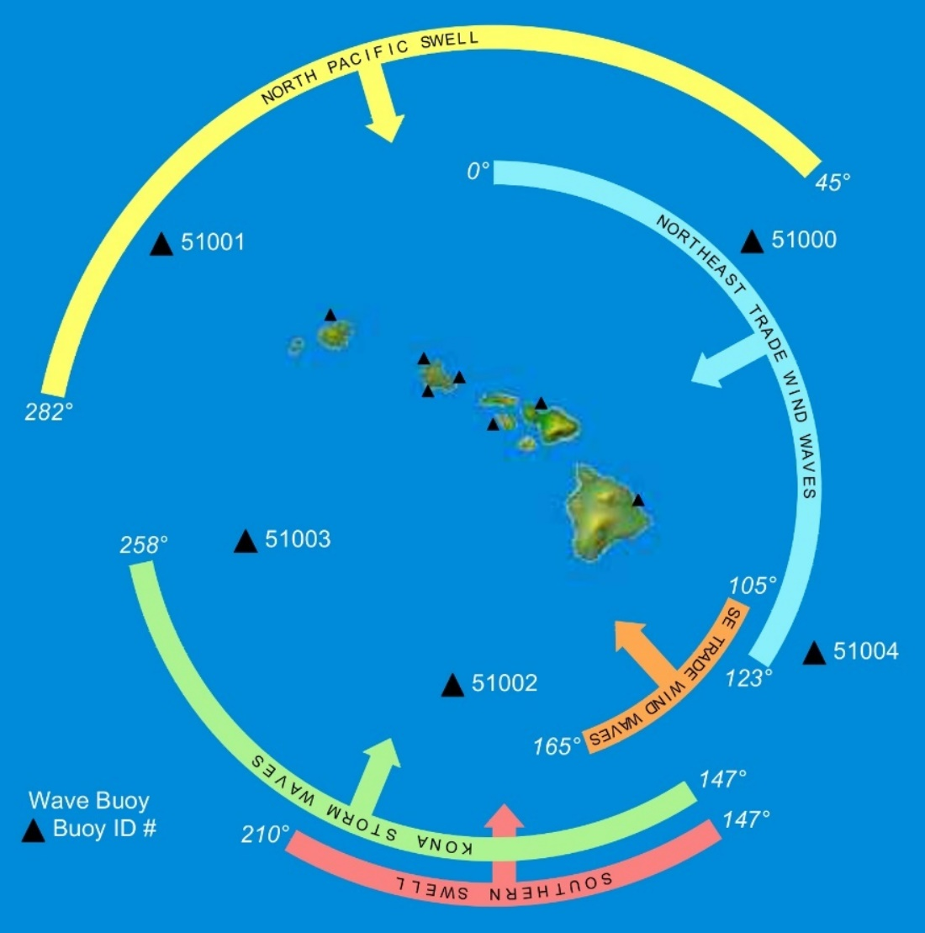
Offshore Wave Climate
Waves are the dominant driver of sediment transport along Hawaii’s beaches
Notes:
Being in the middle of the Pacific Ocean, Hawaii is exposed to waves from nearly every direction
For simplicity, I will limit discussion to north Pacific and southern swell
- While Kona storm waves play a roll in sediment transport along KLC, fairly infrequent occurance
- Sheltered from NE and SE trade wind waves
In the winter, large north Pacific storms send waves from the northwest with offshore wave heights reaching up to 25 feet
In the summer, waves generated by storms in the southern hemisphere can have deepwater wave heights up to about 5 feet
As you can see, Molokai blocks direct approach of north Pacific swells, while southern swells have a much more direct shot between Lanai and Kahoolawe

Slide 13
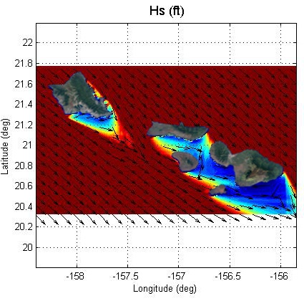
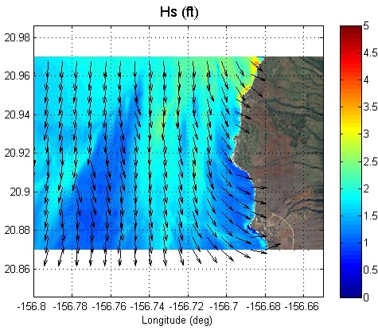
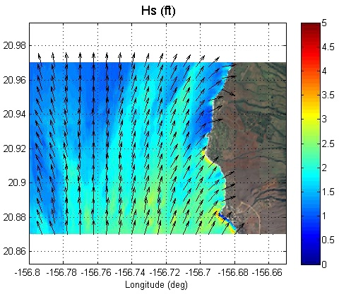
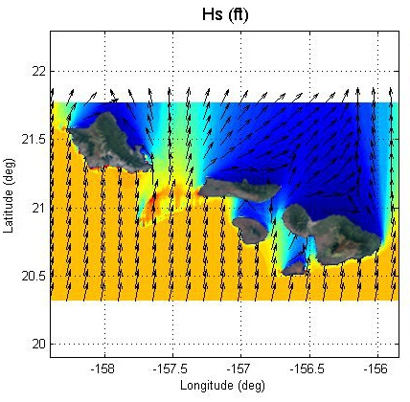
Wave Transformation
Kaanapali
KLC
KLC
Seasonal 1-month North Pacific Swell
Kaanapali
HLC
HLC
Seasonal 1-month North Pacific Swell
Seasonal 1-month South Pacific Swell
Seasonal 1-month South Pacific Swell
Notes:
Example of a seasonal 1-month wave, which is a wave height that you would expect on a monthly basis during that particular swell season, approaching Kaanapali
- Top shows a north Pacific swell while the bottom shows a southern swell
Notice the difference in deepwater (15 feet vs 3.5 feet) and the similarities in shallow water (about 2 feet once they reach shore)
A major reason Kaanapali exists as it does today is because of the island swell shadowing from Molokai

Slide 14
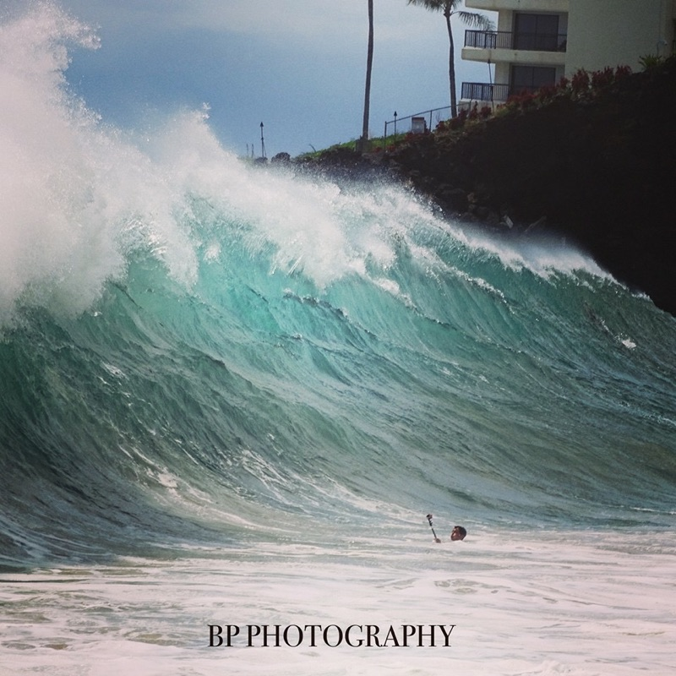
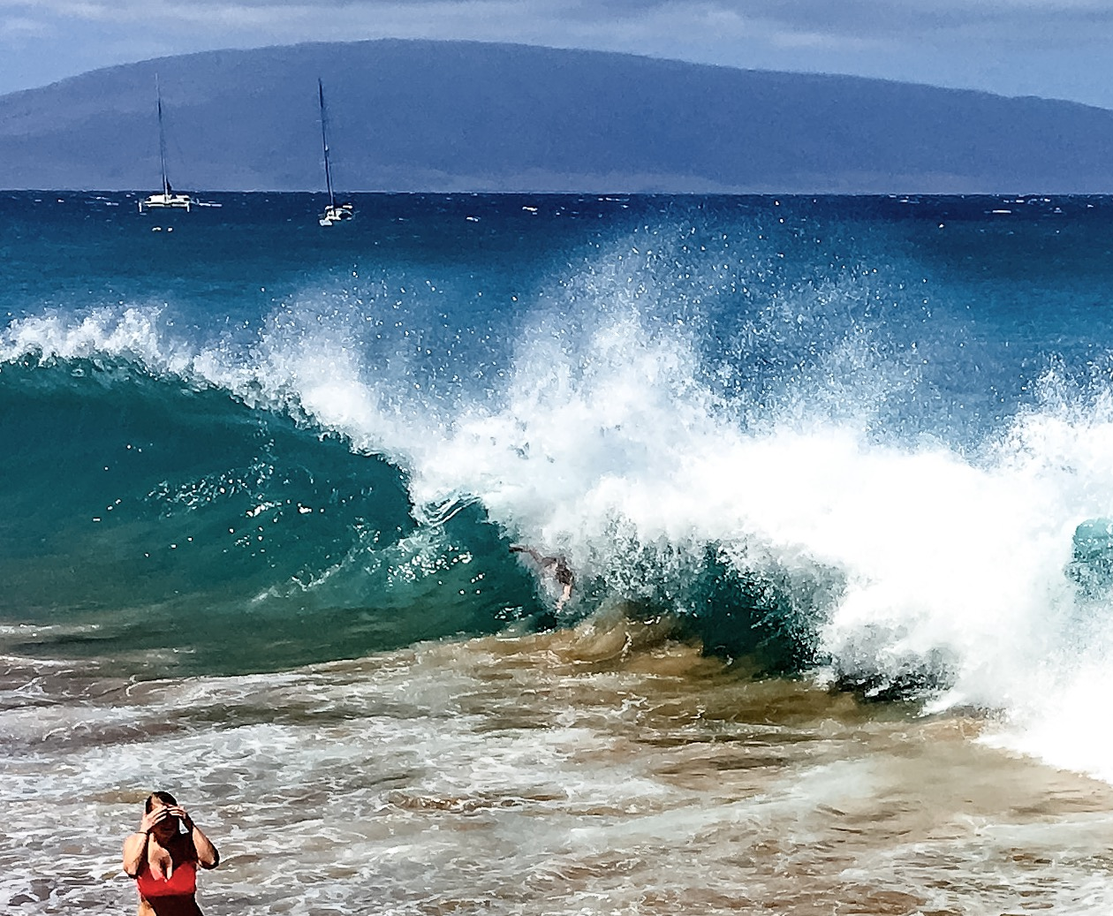
KLC Waves
2015 Southern Swell
2016 North Pacific Swell
Notes:
Now that we have some knowledge of the dominant wave regime in Kaanapali, I want to bring the discussion back to Hanakaoo Point.
As I mentioned earlier, this is the boundary between HLC to the south and KLC to the north; however, the sand point isn’t always present.
In fact, if you walked the beach here in September or October there is nothing that would indicate that you are walking between abutting littoral cells!
This area experiences 200 feet of landward/seaward migration of shoreline in a single swell season.

Slide 15
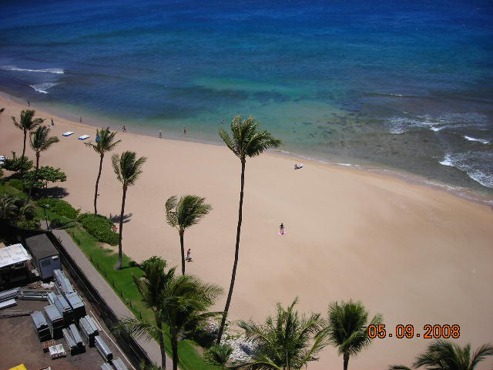
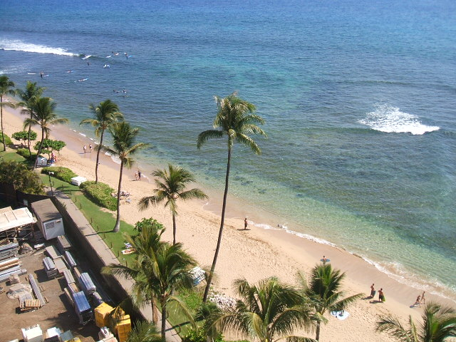
Hanakaoo Point
Boundary between the Hanakaoo and Kaanapali Littoral Cells
200 feet of landward/seaward migration of shoreline in one season
May 9, 2008
July 8, 2008
Notes:
Now that we have some knowledge of the dominant wave regime in Kaanapali, I want to bring the discussion back to Hanakaoo Point.
As I mentioned earlier, this is the boundary between HLC to the south and KLC to the north; however, the sand point isn’t always present.
In fact, if you walked the beach here in September or October there is nothing that would indicate that you are walking between abutting littoral cells!
This area experiences 200 feet of landward/seaward migration of shoreline in a single swell season.

Slide 16
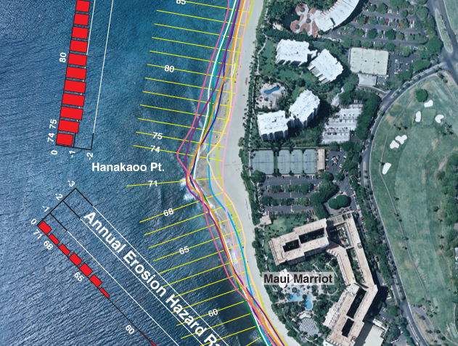
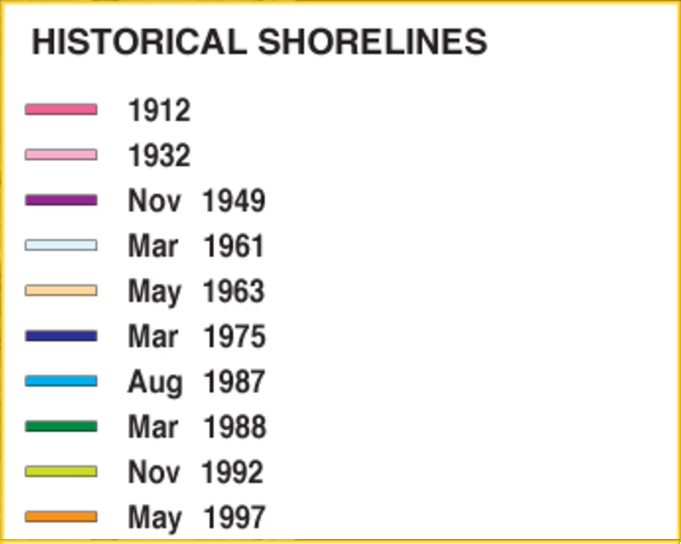
Hanakaoo Point
Historical aerial imagery shows sand point forming in same location every year
UH Coastal Geology Group Erosion Hazard Maps
Notes:
Historical shoreline locations can be traced from historical aerial imagery that dates back to 1949. These historical shorelines show Hanakaoo Point forming at roughly the same place every year, despite being completely wiped out after the summer swell season, which is quiet amazing when you consider suspended sediment’s almost fluid nature.
It’s clear what is stopping sand migration at the north end of the KLC (Puu Kekaa, aka Black Rock), but what is happening at Hanakaoo Point? Why isn’t sand moving down the beach into the HLC?

Slide 17
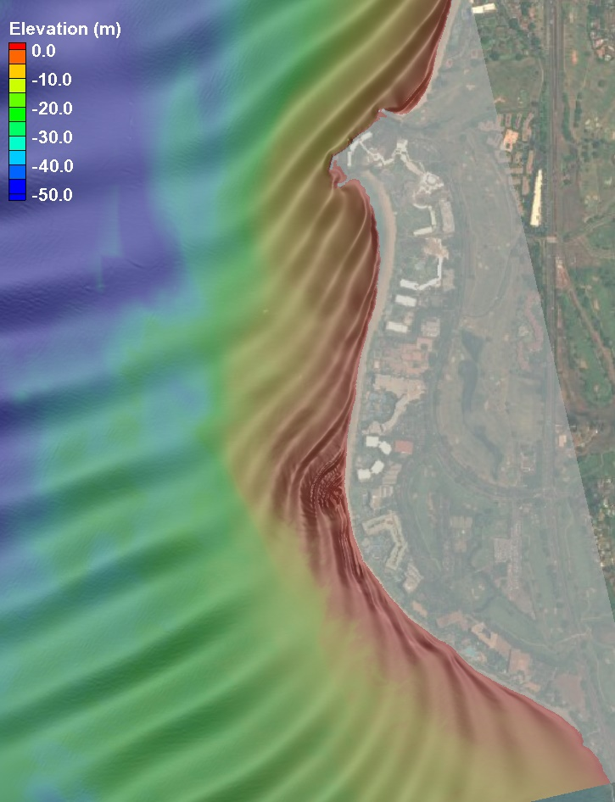
Hanakaoo Point - Growth
Boussinesq numerical wave model of north pacific swell
Fall bathymetry
Longshore sediment transport halted at Hanakaoo Point due to refracted wave
Notes:
To help explain what’s going on here, I’m going to turn to one of the fancy coastal engineering tools we have today: numerical wave modeling. We took that same, seasonal 1-month wave from earlier and used a Boussinesq numerical wave model to “bring the wave to shore”, or see how it behaves as it interacts with the nearshore bathymetry around Kaanapali.

Slide 18
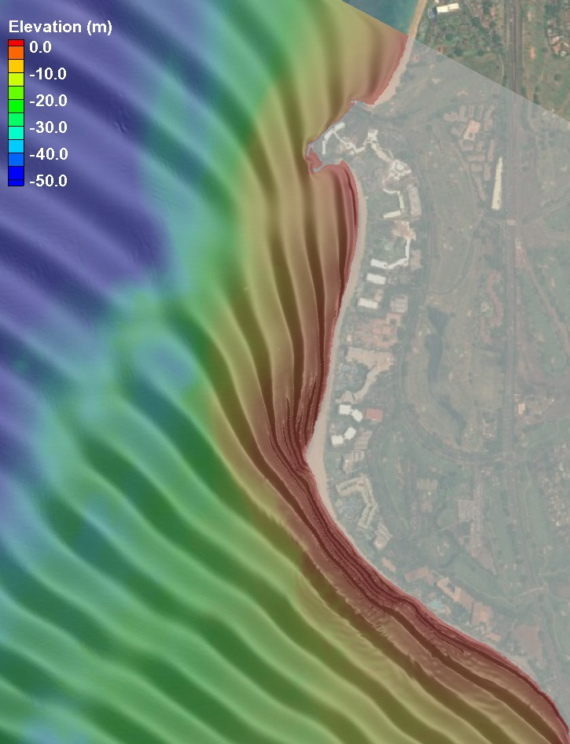
Hanakaoo Point - Erosion
Boussinesq wave model of south pacific swell
Spring bathymetry
Longshore sediment transport begins at Hanakaoo Point due to unrefracted wave

Slide 19
Hanakaoo Point – Leaky Boundary
All littoral cell boundaries are “leaky” to some degree
Offshore and around inlets and headlands
Through porous rock structures
Hanakaoo Point
Sand sharing between littoral cells during extreme years
Notes:
Leaky meaning there can be sand sharing between adjacent littoral cells

Slide 20
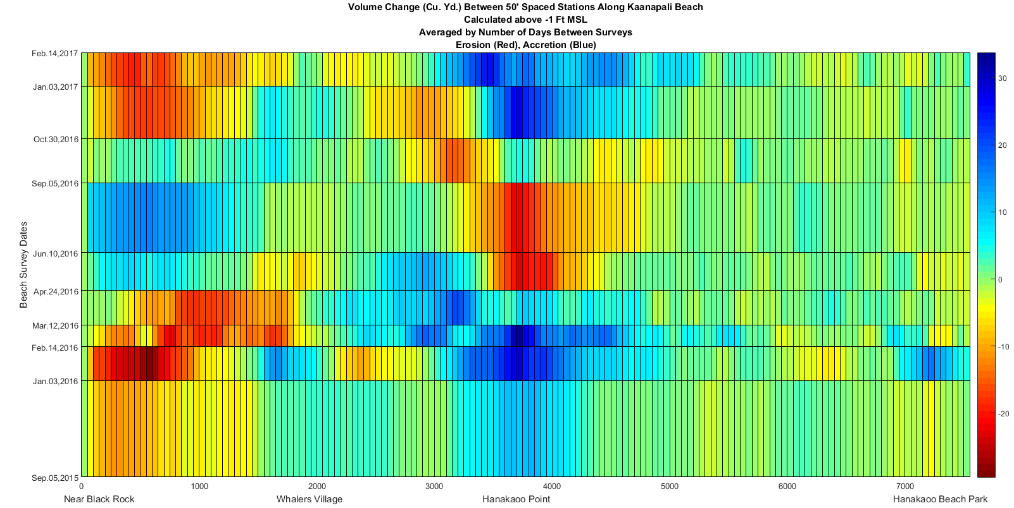
Strong North / Weak South
2015-2016 El Nino
Back-to-back stronger than average North Pacific swell seasons
2016 weaker than average South Pacific swell season
Ailana Surveying and Geomatics
Notes:
Describe figure:
- Geography
- Dates
- Colors
Two years of large north Pacific swell seasons sandwiched a weak southern swell season
Sand point grows so large that waves from the north are no longer being diffracted as shown earlier, therefore sand by-passes the point into HLC

Slide 21
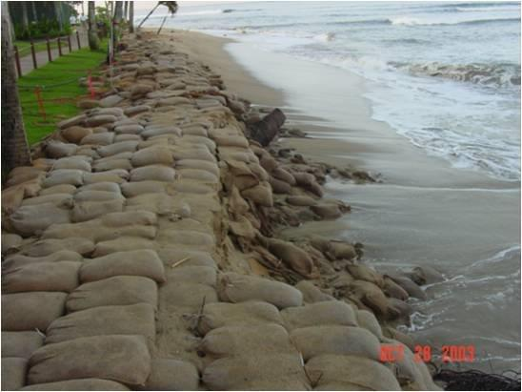
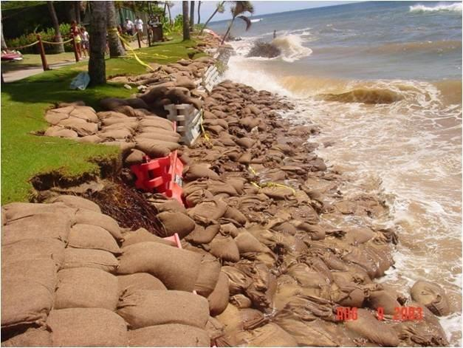
Strong South / Weak North
2003 – Hanakaoo Point depleted of sand due to large southern swells and elevated water levels
Sand leaked from Hanakaoo Littoral Cell into Kaanapali Littoral Cell
2003 Erosion Event
Notes:
In 2003, months of large southern swells combined with elevated water levels caused the point to become completely depleted of sand

Slide 22
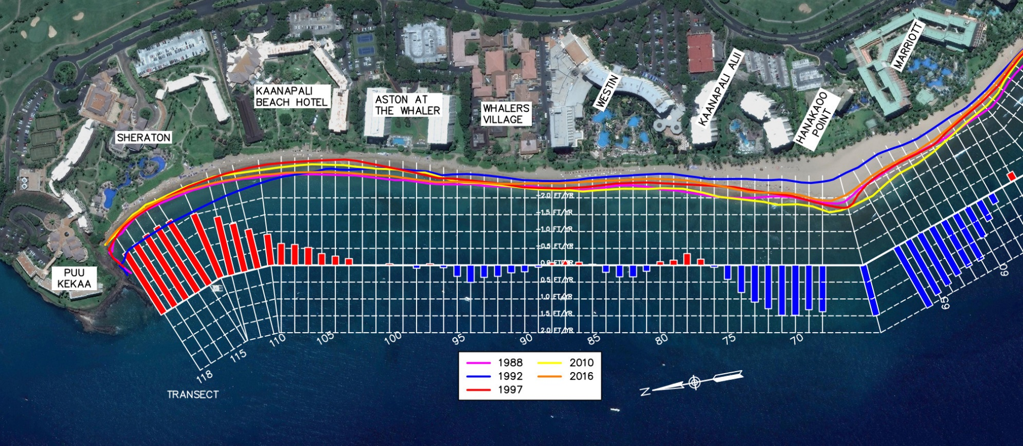
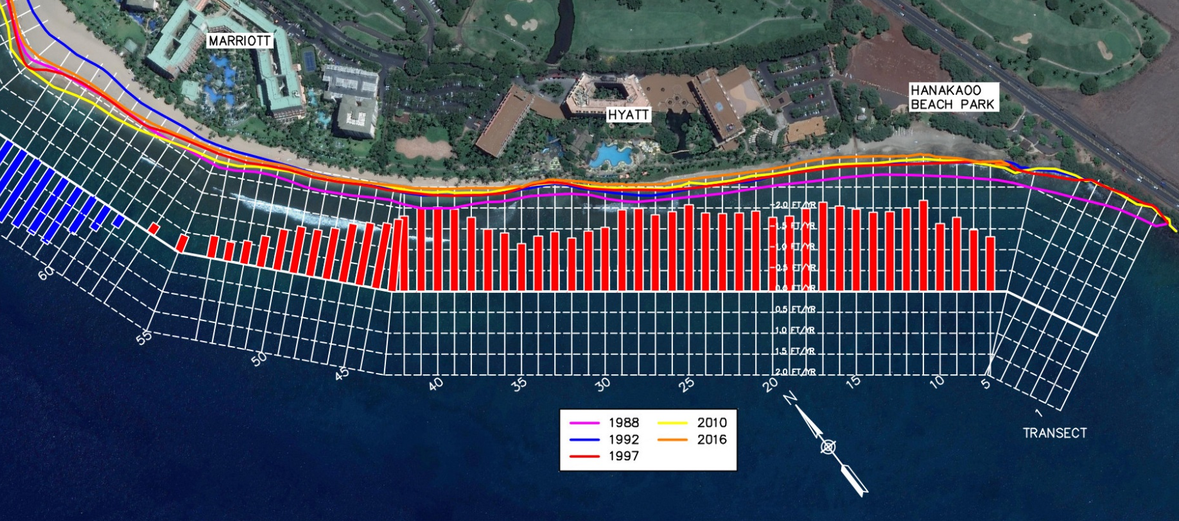
Bigger Picture
Two reaches of coastline have distinct coastal processes despite absence of a subaerial feature
Must be considered as part of development and conservation efforts in these environments
Erosion rate aliasing

Slide 23

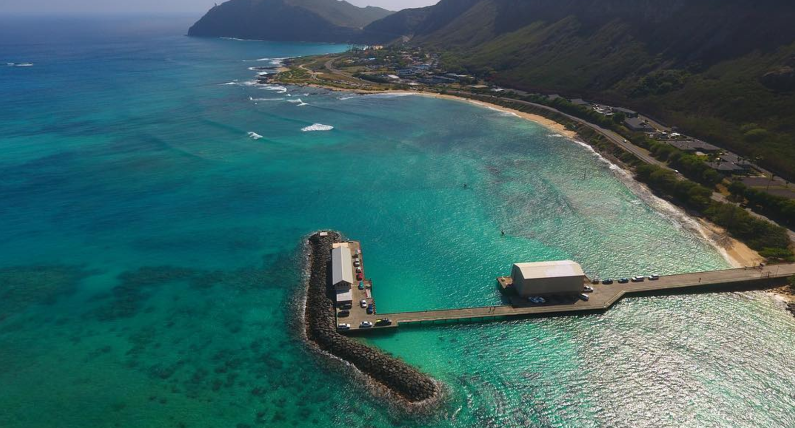
Questions?
Contact Information:
Derek Linsley Christopher Conger
Coastal Engineer Coastal Geologist
dlinsley@seaengineering.com cconger@seaengineering.com
Makai Research Pier
41-305 Kalanianaole Hwy
Waimanalo, HI 96795
(808) 259 - 7966

