Slide 1


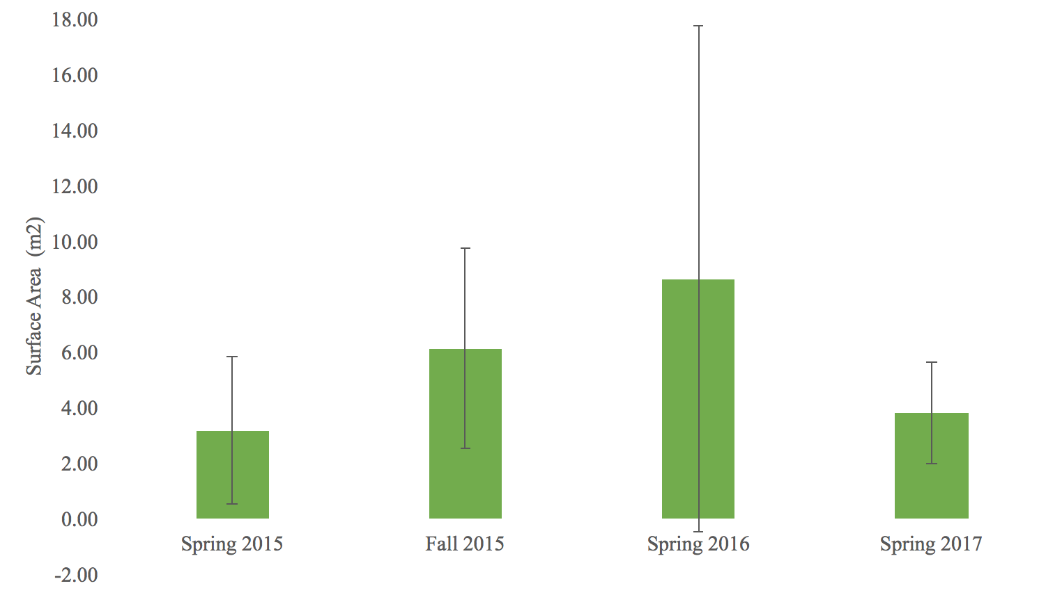
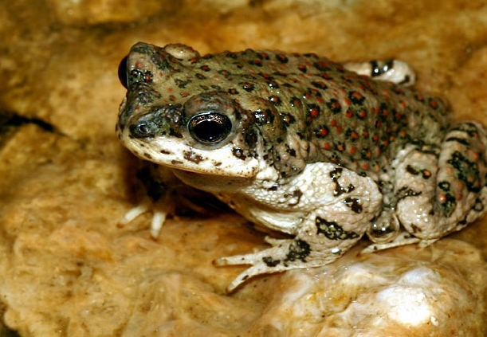
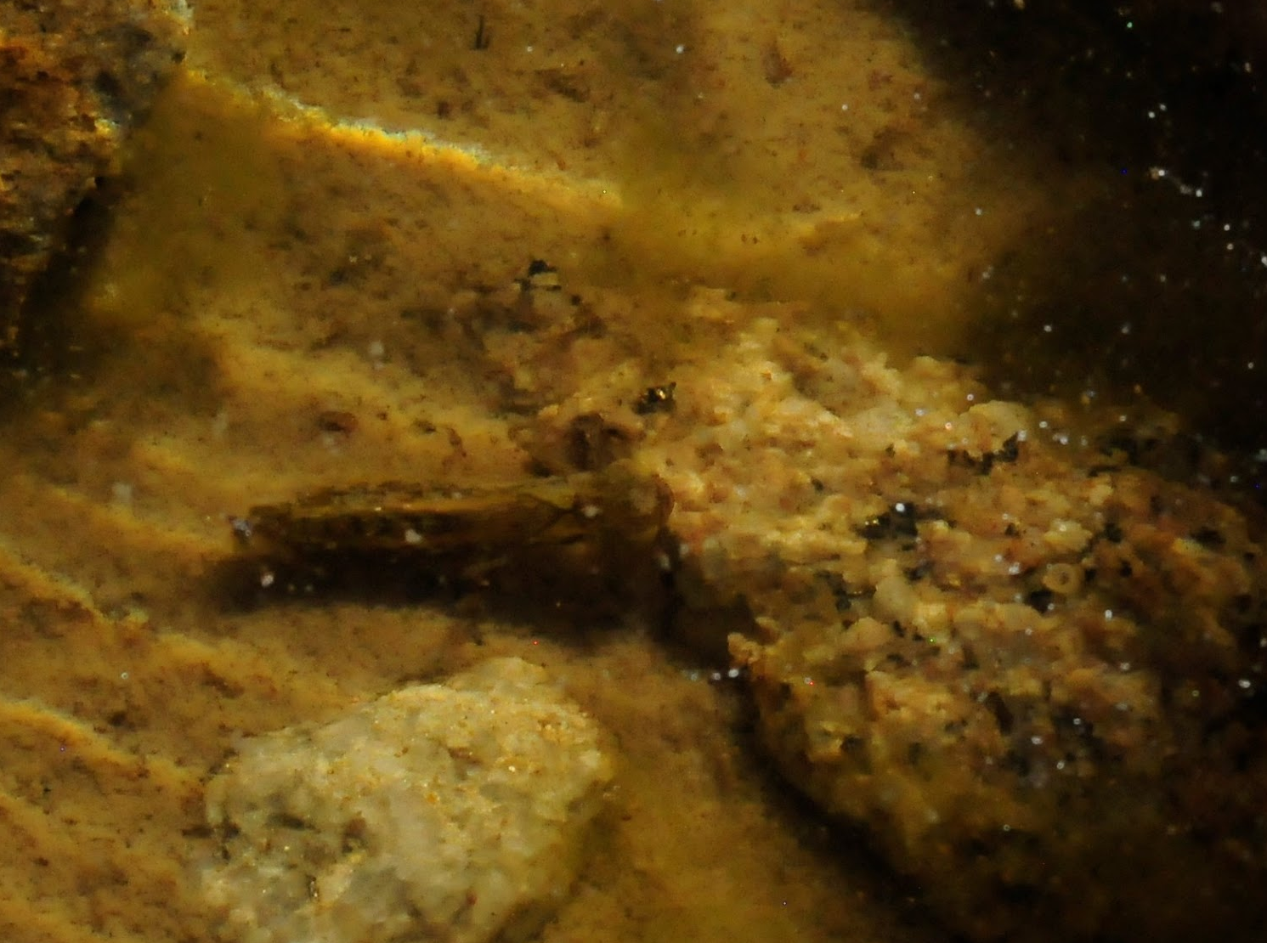
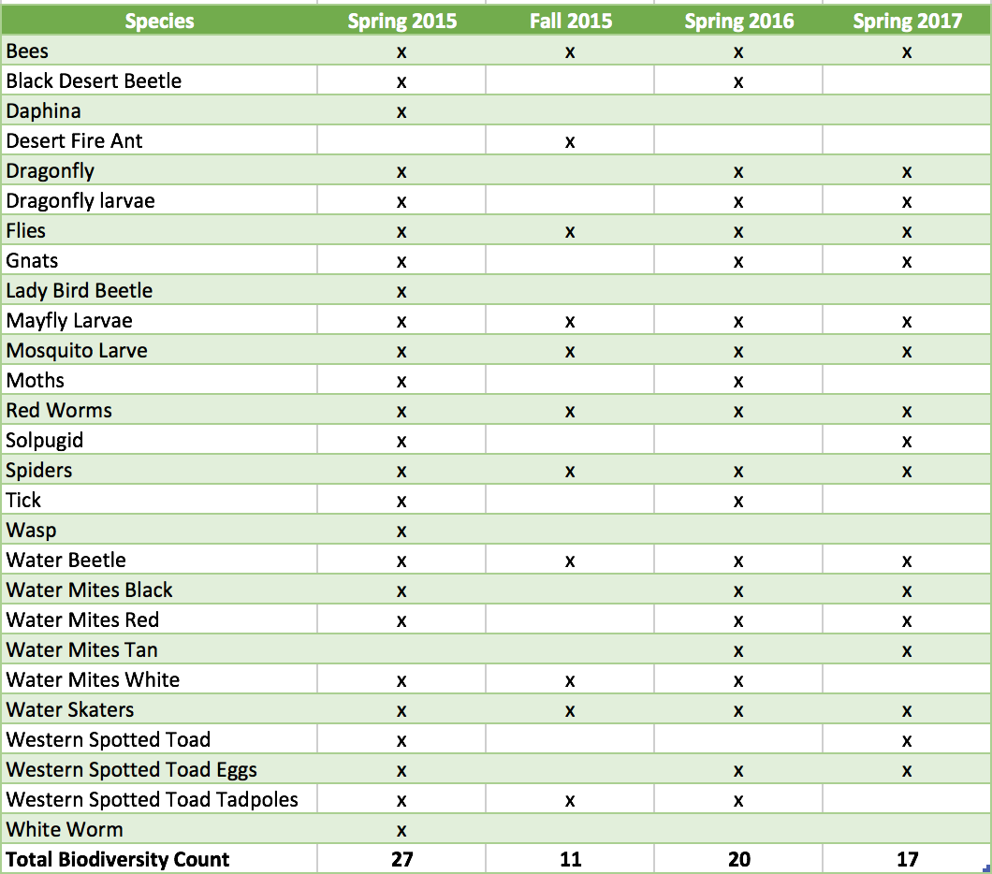
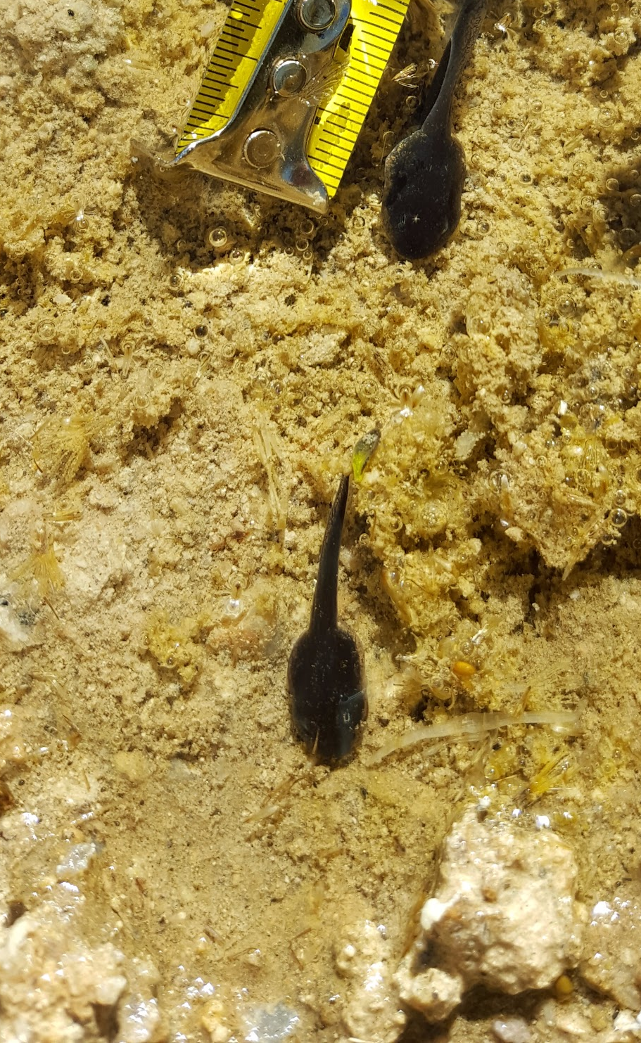
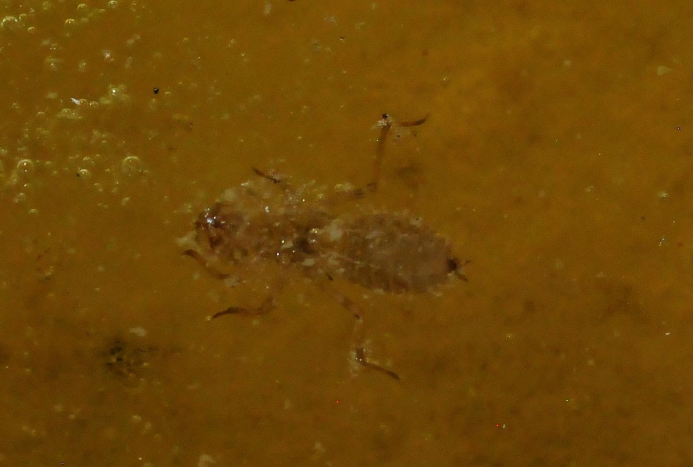
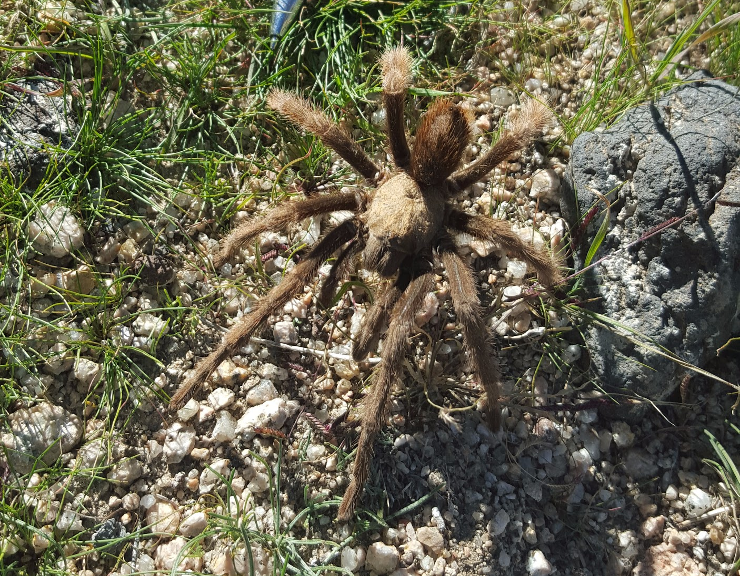
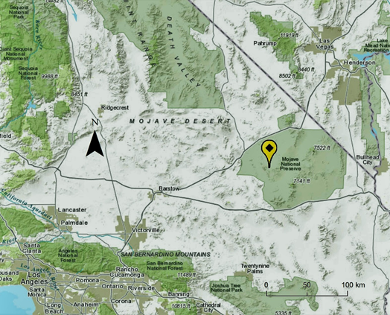
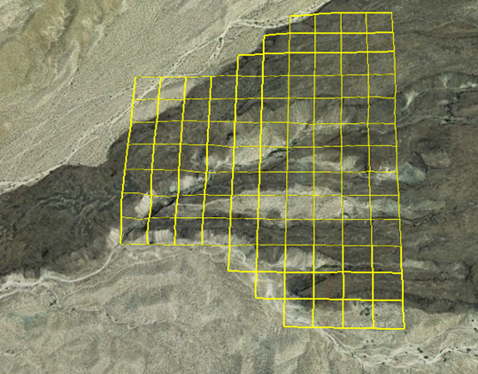
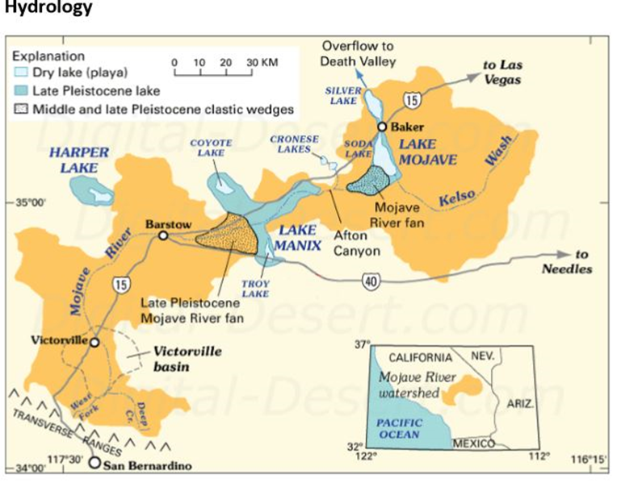
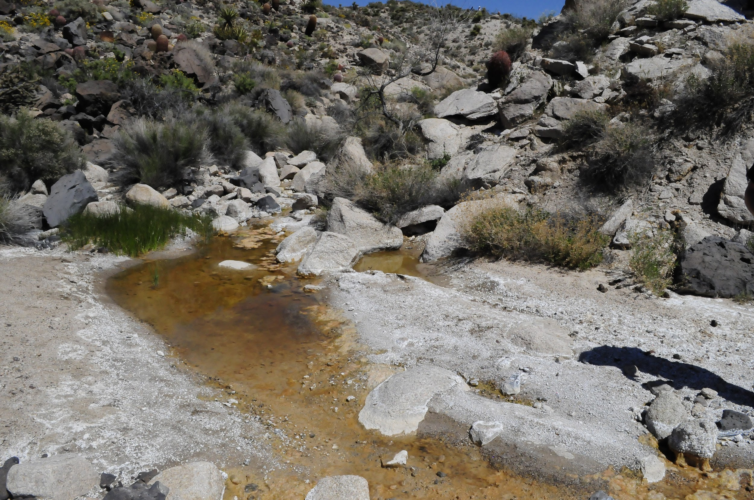
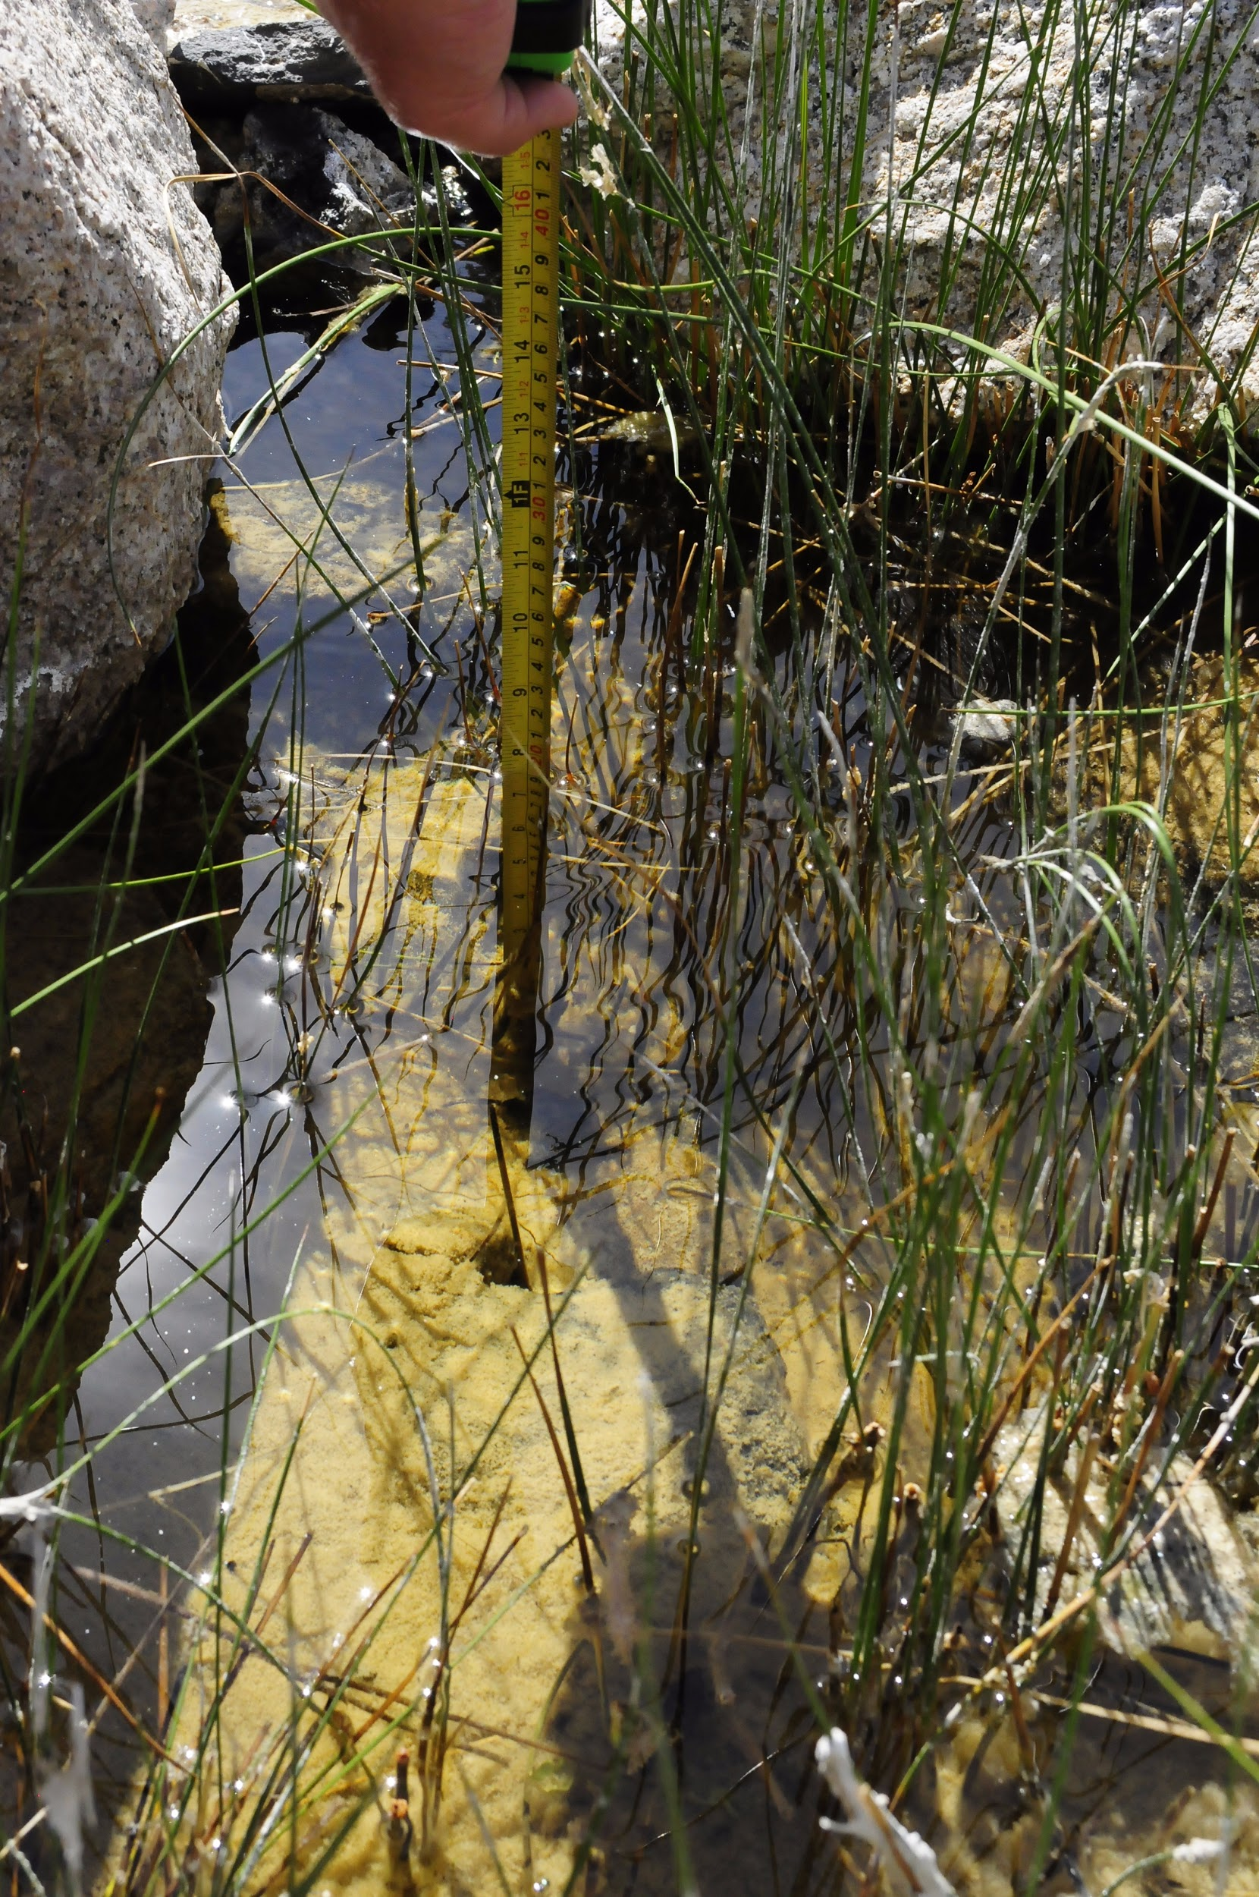
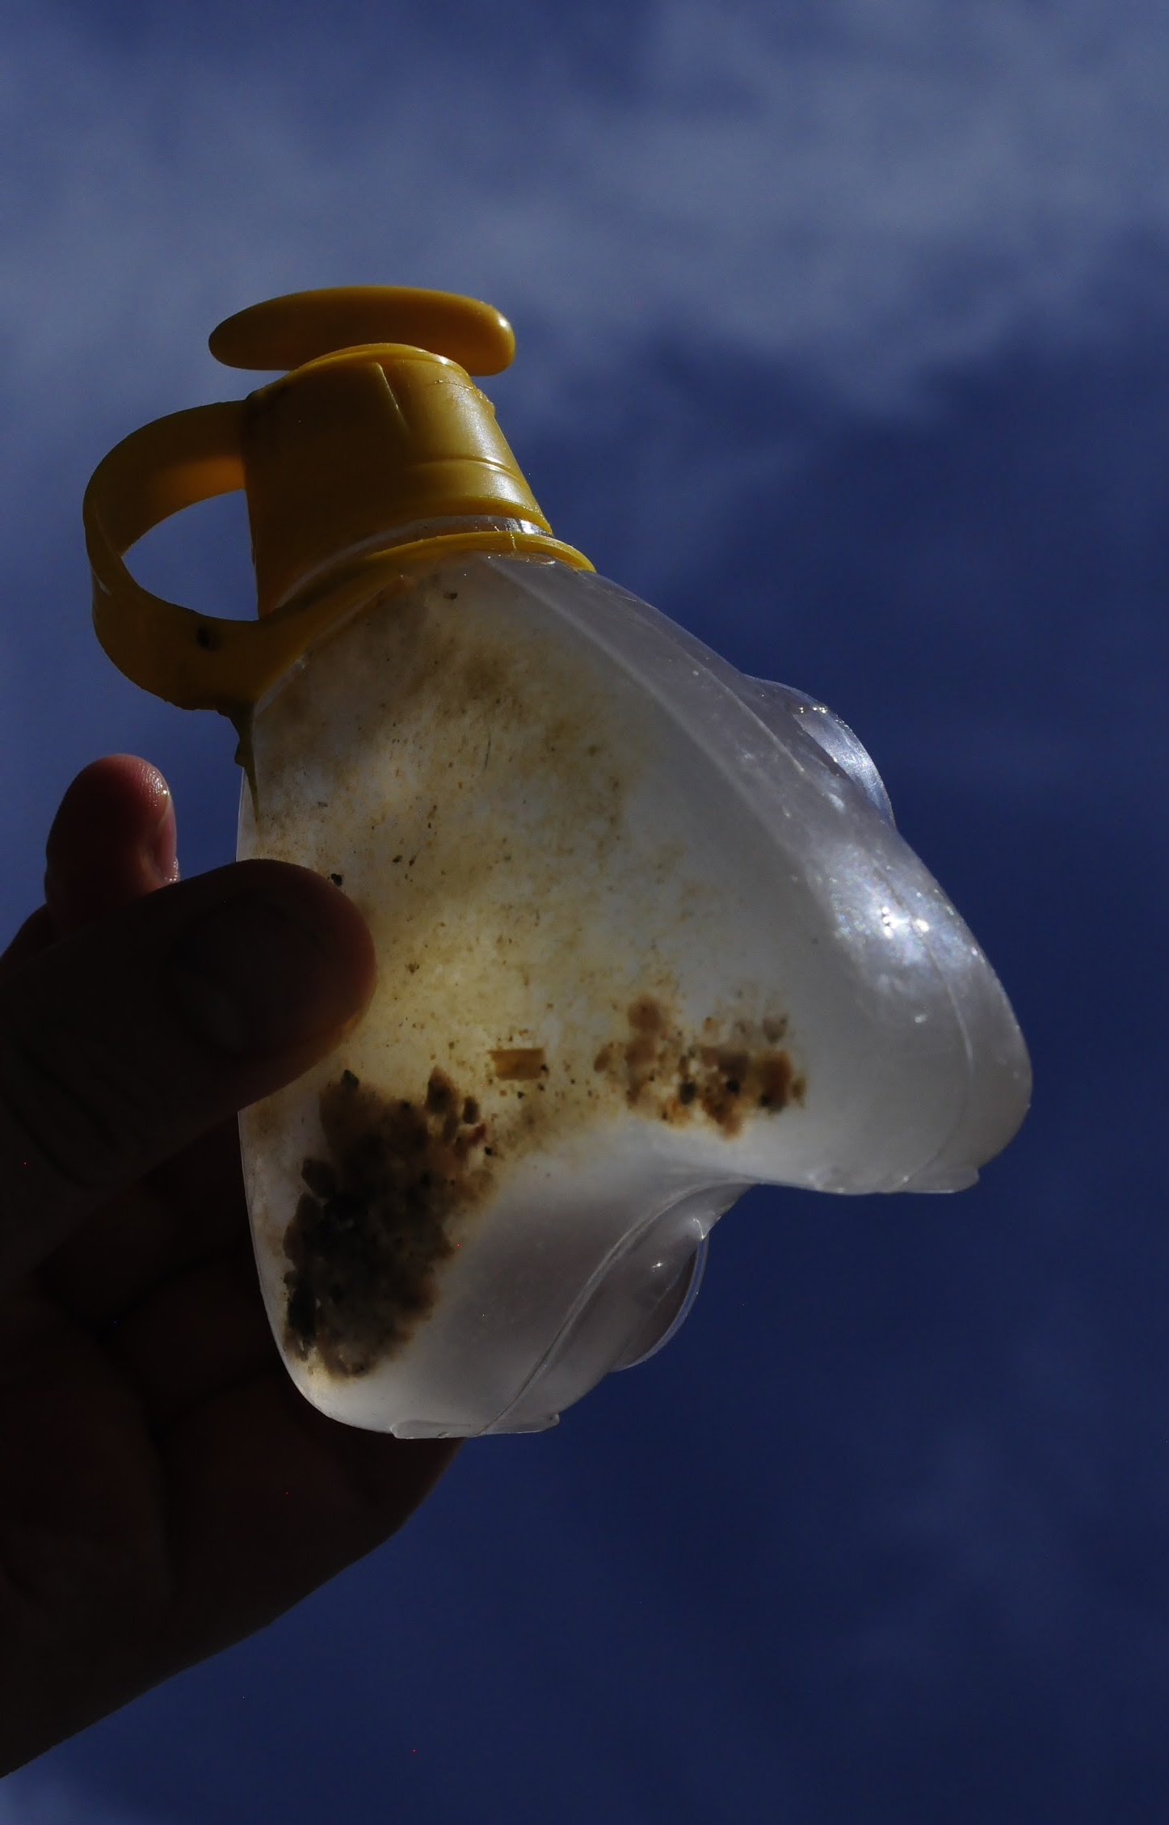
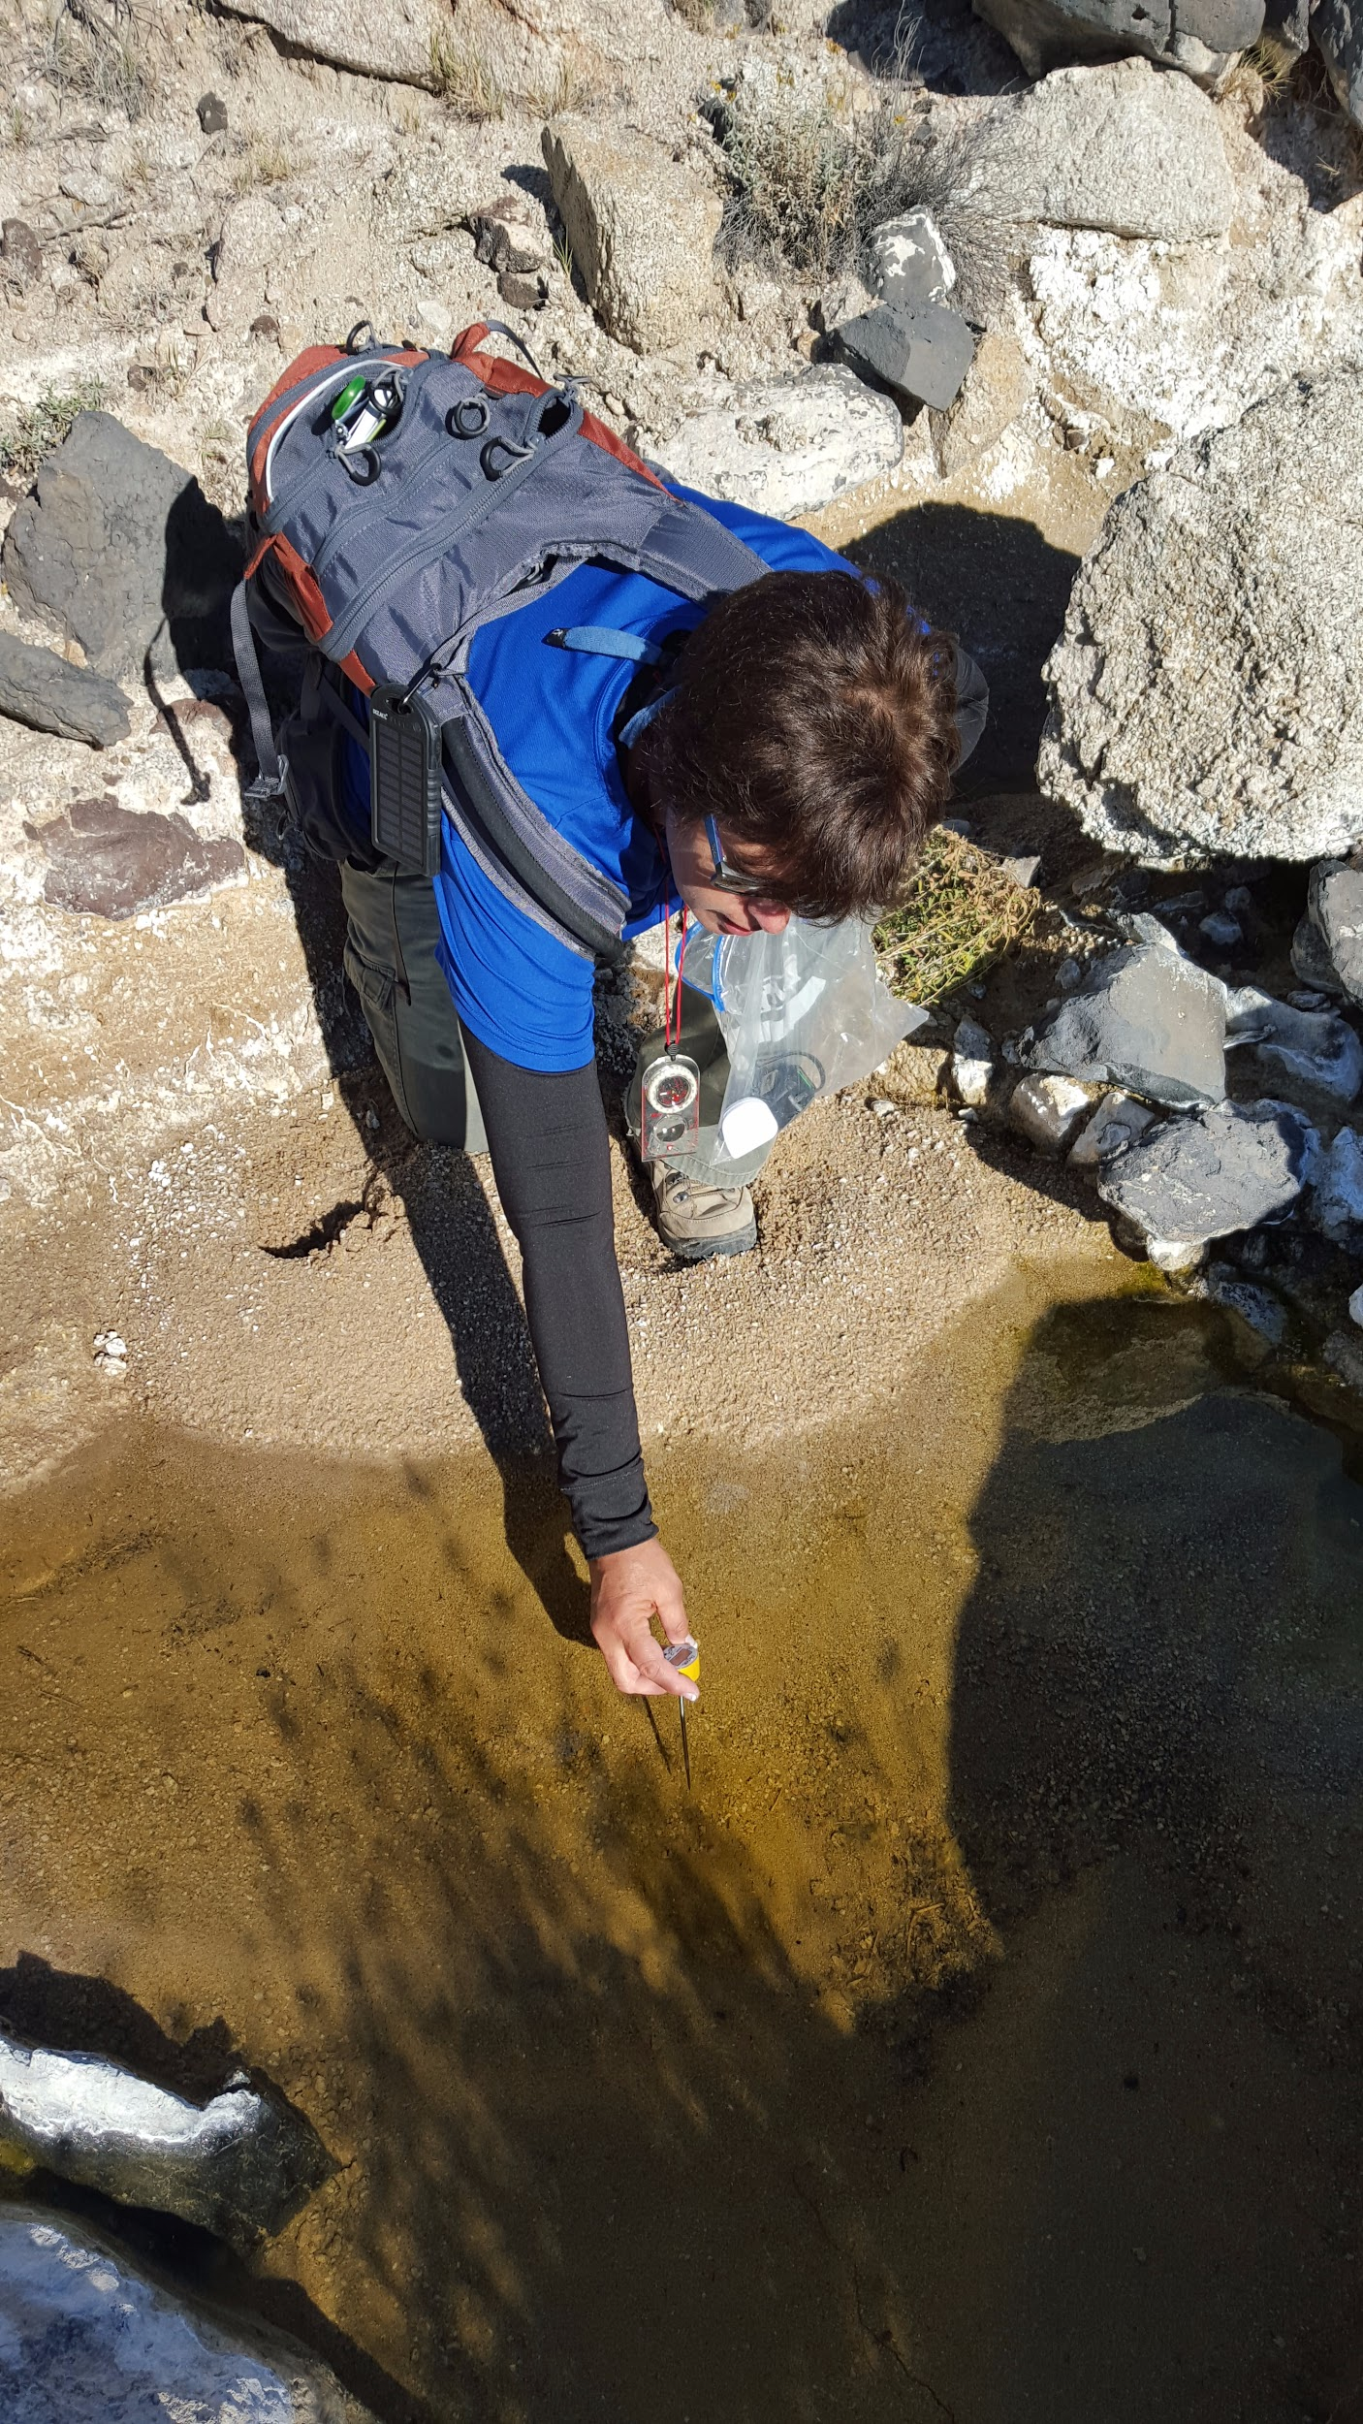
Analyzing the Effect of Water Constraints and Seasonal Fluctuations on Invertebrate Populations within an Interdisciplinary Framework
Teresa Cabrera Vera, Sheila McClure, Jess Pelaez Phoenix and Carlos Pelaez Phoenix
Abstract
One of the most significant ecological management issues in desert environments is interpreting the effects of water availability on the larger ecosystem. As one part of a larger interdisciplinary effort to understand the environment’s functioning as an active system, we have undertaken seasonal studies of aquatic invertebrates within 1 km^2 of the Mojave National Preserve. Study objectives are to understand the effects of water constraints and availability on invertebrate populations, particularly with respect to density and distribution. In the study area, water is most available during the late fall and winter seasons due to precipitation. Water dwelling invertebrates are able to thrive during these seasons due to the increased flow present in the area’s perennial springs. The spring network is more extensive than was thought prior to this study. We present new data about the spring and fall population distributions and densities of aquatic invertebrates. In addition, we present new aquatic invertebrate population distributions that correlate with heretofore unidentified perennial spring locations. This work represents the beginning of a novel interdisciplinary approach to water resources understanding in arid environments. Planned future data analysis will be performed with respect to area vertebrate and algal/microbial populations, and will include expanded hydrologic studies to identify additional seasonal controls and relationships between invertebrate populations and other elements of the larger ecosystem.
Field Area
Our field area shown here is a 1 sq km grid using the Cartesian coordinate system that is all within the Mojave National Preserve in California. The field area includes Cane Spring, and is part of the Cinder Cones National Natural Landmark area of the Preserve.
Methods
Student researchers are trained in standard field methodologies and supervised by senior scientists. Data, including the length, width, depth and temperature are recorded, as well as observations of invertebrates, algae and vegetation surrounding the water expression. The flow(or lack of flow) and direction are also included in the notes.
Results
Results
Discussion
The aims of this study were to compare surface area, temperature, depth and species biodiversity fluctuations between spring and fall surface water expressions.
Since the study was completely observational and surface water expession data was obtained haphazardly, data may provide inconclusive results but with expected trends. Figure 2 displays an incredible fluctuation in surface area size, this is due to the exceptional amount of precipitation occurring during early 2016. Species biodiversity was expected to increase during spring observations as compared to the fall.
USGS open file report did not mention any evidence of surface water expression in areas surrounding Cane Spring. The only National Park Service data for the Cane Spring system was for the west portion, mentioning it is a natural desert spring channel within a lava flow with a pH 8.48, Conductivity at 1588 micro seconds per cm, and TDS 791 mg per liter.
Future Studies
Acknowledgments
We would like to thank Southern California Edison, Qualcomm and all of the generous donors to Blueprint Earth.
Table 1. Displays invertebrate and vertebrate species biodiversity located within or near surface water expressions across varying time frames. Data was tallied as presence or absence.
Figure 2. Average surface area of surface water expression across varying time frames. Data displayed as mean ± SD.
Figure 3. Average temperature of surface water expression across varying time frames. Data displayed as mean ± SD.
Figure 1. Our hydrological research on the of the cane spring system focuses on different streams and seeps we have discovered that may be associated with it as well as the other sections that have not been researched or recorded.
Figure 4. Average depth of surface water expression across varying time frames. Data displayed as mean ± SD.

