Slide 1
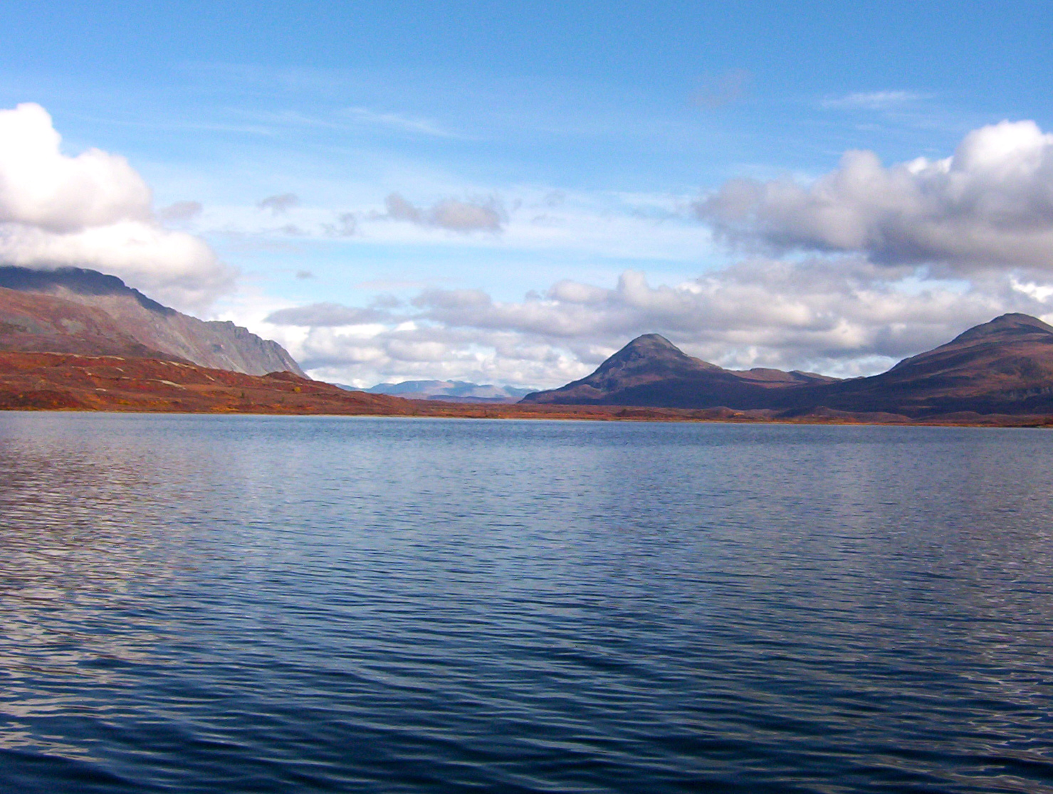

Missing Diatoms – How Lake Bathymetry Affects the Distribution of Diatom Assemblages and the Interpretation of Lake Level Variability in Small Alpine Lakes
Scott W. Starratt
US Geological Survey

Slide 2
Introduction
Ruby Mountains-East Humboldt Range
Lake variability
Downcore study
Conclusions and future studies

Slide 3
Introduction
Climate is the primary factor driving regional change in lake systems (maybe people play a role)
The expression of climate on aquatic systems is filtered by a number of factors
Catchment basin conditions (bedrock, soil, vegetation)
Lake characteristics (bathymetry, water chemistry, temperature, water source)
Ecosystem interactions (aquatic vegetation)
Therefore, different lakes respond differently to the same regional climate changes

Slide 4
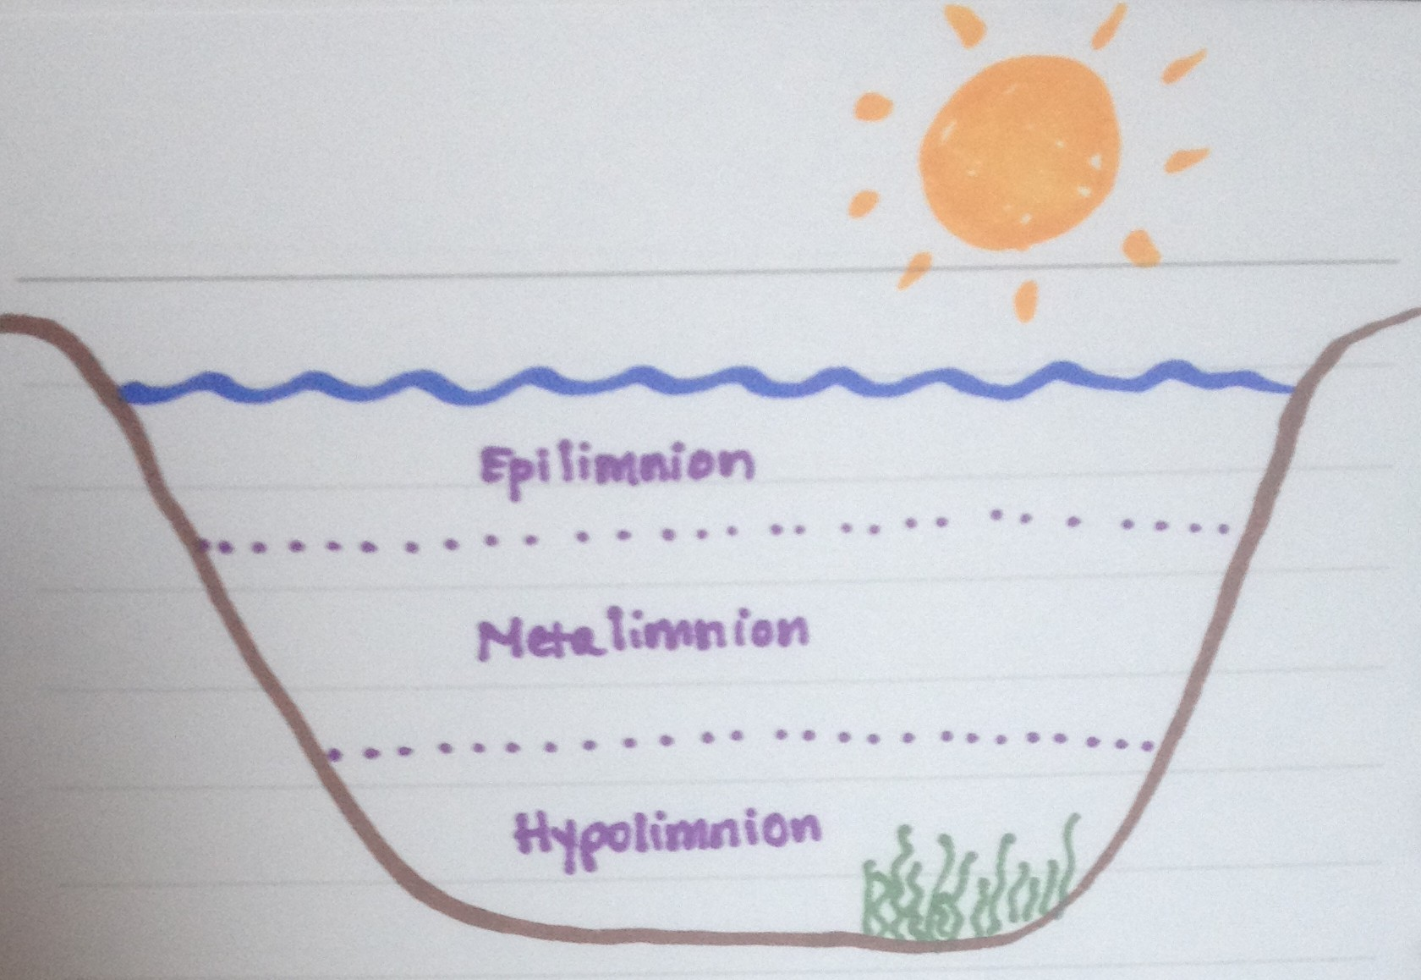

Slide 5
Diatoms
Rates of productivity controlled by anything that affects photosynthesis
Temperature
Lake level
Ice cover
Nutrient load
Water chemistry (pH, alkalinity, oxygen)

Slide 6
Potential Changes in Diatom Assemblage with Increasing Depth
All may be moderated by conditions in the water column (clarity, ice/ snow cover, zooplankton, etc.)
Diversity decreases from benthic to planktic assemblages

Slide 7
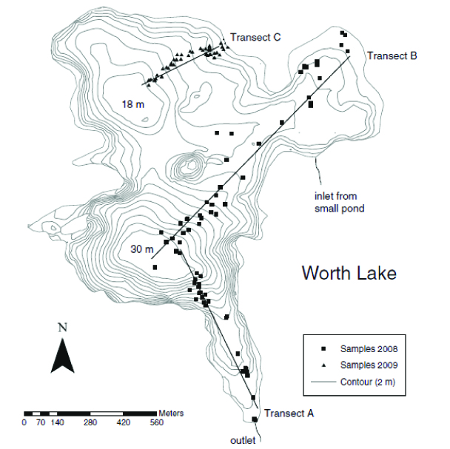
The impact of bathymetry (and everything that goes with it) on diatom distribution in Worth Lake, Ontario

Slide 8
Worth Lake, Ontario
Nearshore assemblage (<3 m) dominated by motile and epiphytic benthic species
Mid-depth assemblage (~3-9 m) comprised of motile benthic and small fragilarioid taxa
Deep water (>9 m) containing largely planktic species

Slide 9
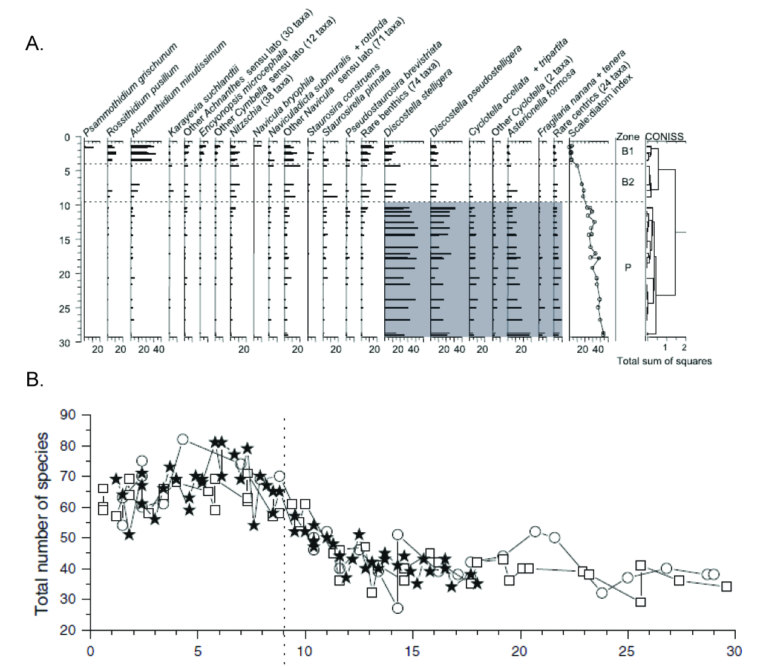

Slide 10
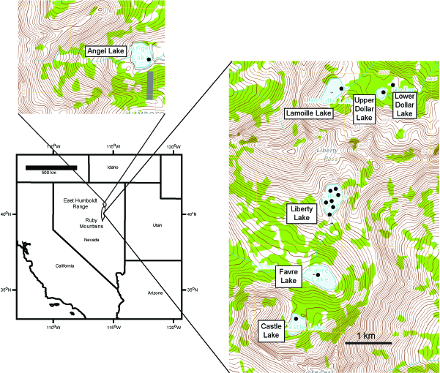
Ruby Mountains-East Humboldt Range

Slide 11
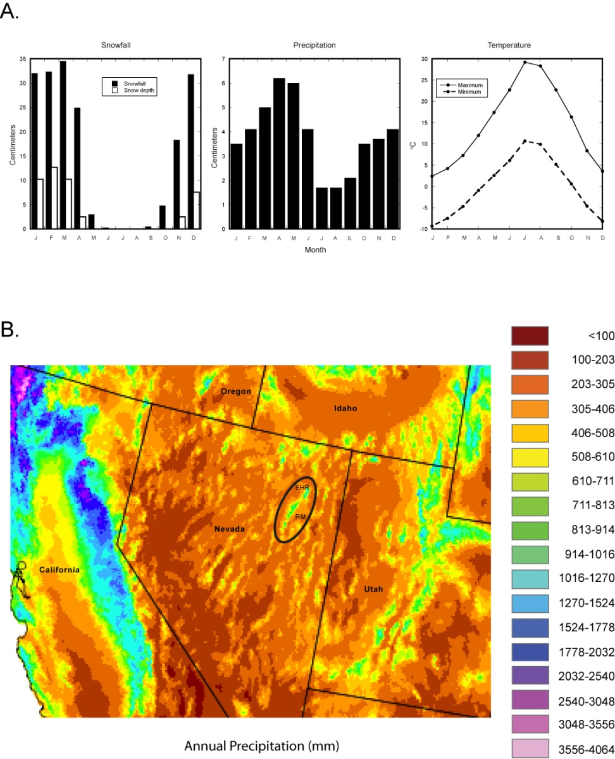
Regional Climate
Winter wet-summer dry, but with some precipitation during the summer
Due to size the RM-EHR is not is not as dry as most of the Great Basin

Slide 12
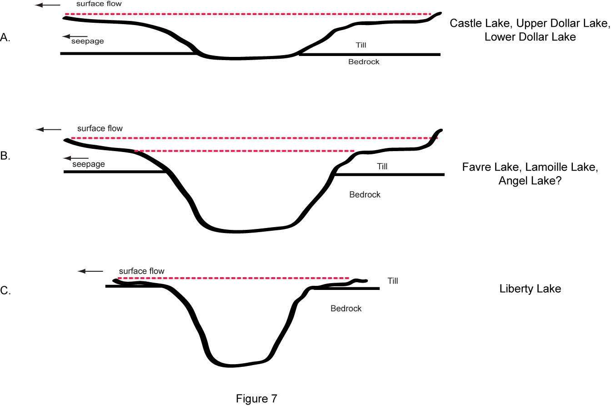
RM-EHR Lake Types
Type I – “upside down frisbee”
Type II – “upside down sombrero”
Type III – “upside down bowler”

Slide 13
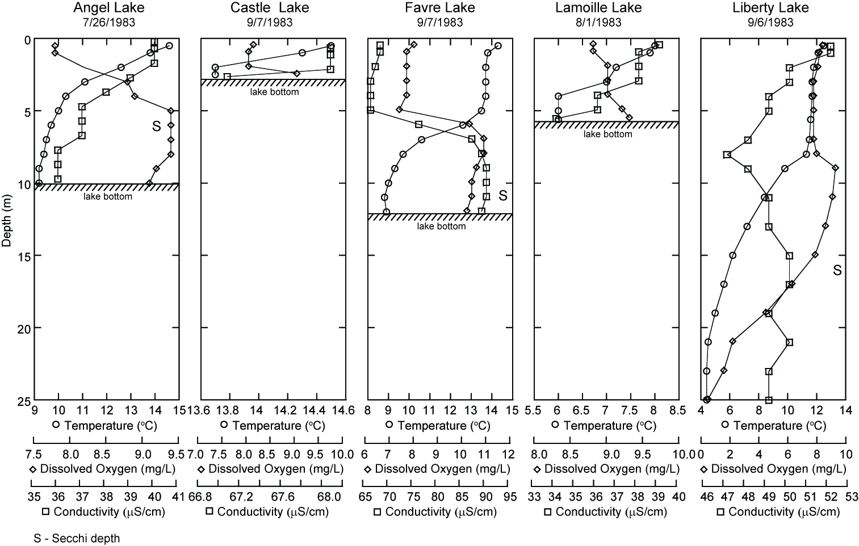

Slide 14
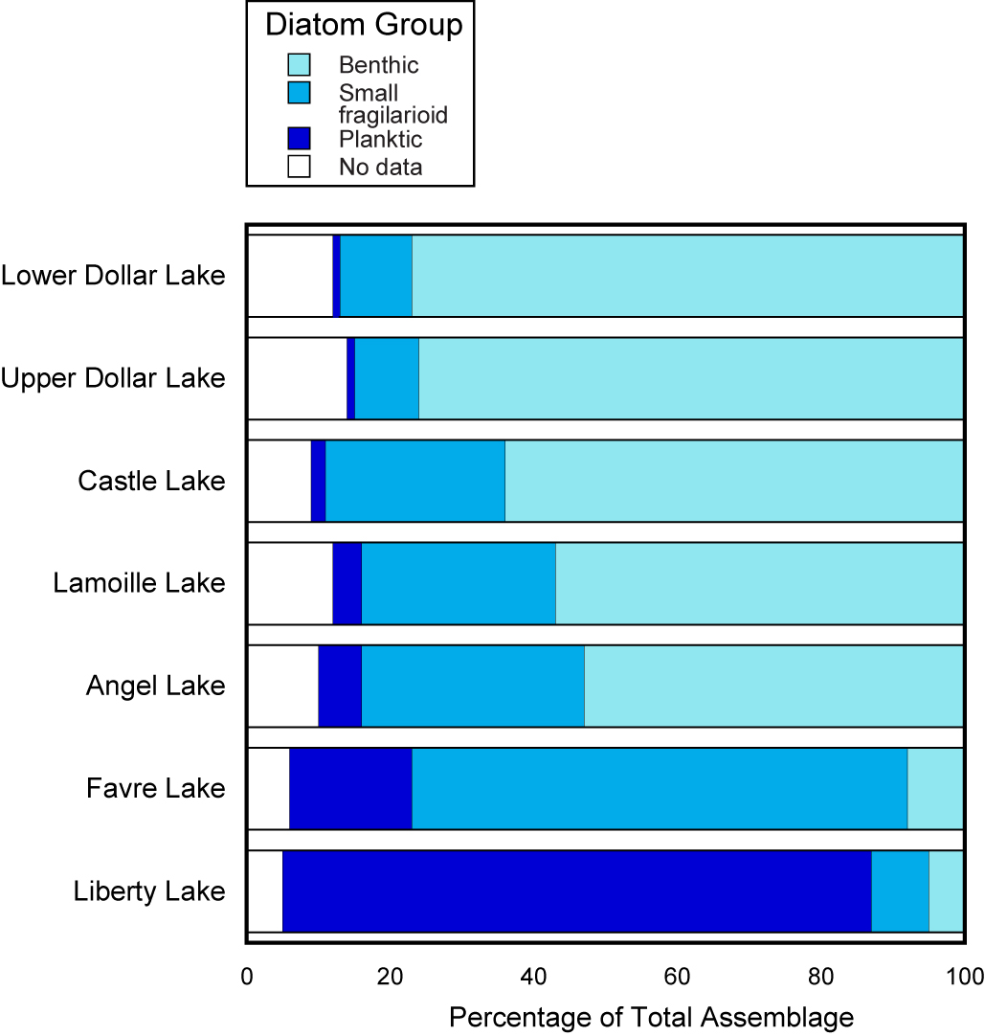
Diatom Abundance by Group

Slide 15
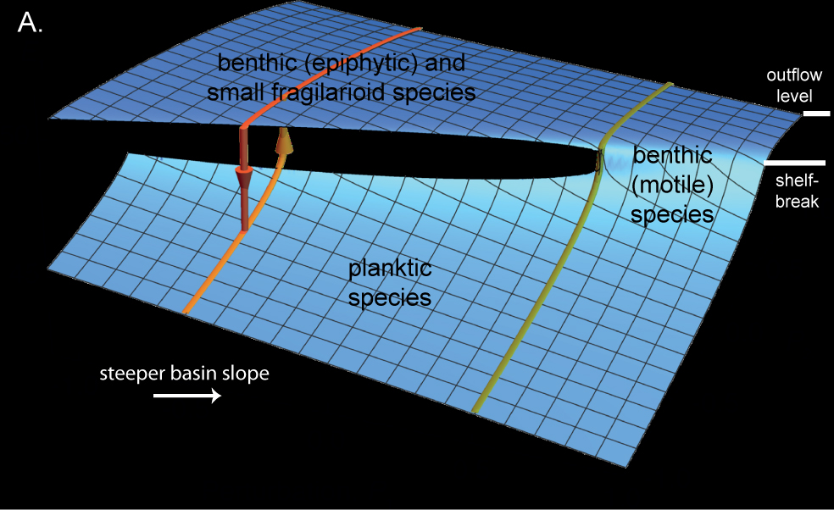
Role of Bathymetry in Diatom Group Distribution

Slide 16
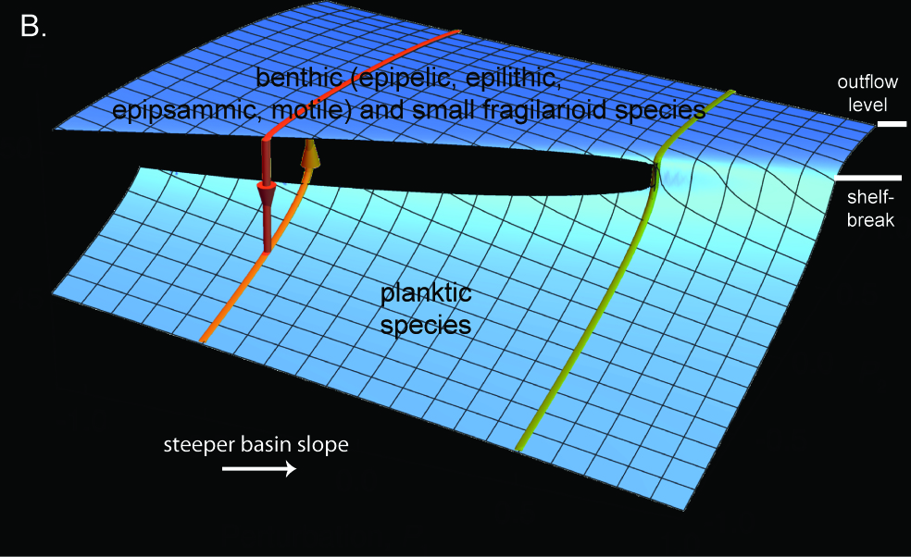
Role of Bathymetry in Diatom Group Distribution

Slide 17
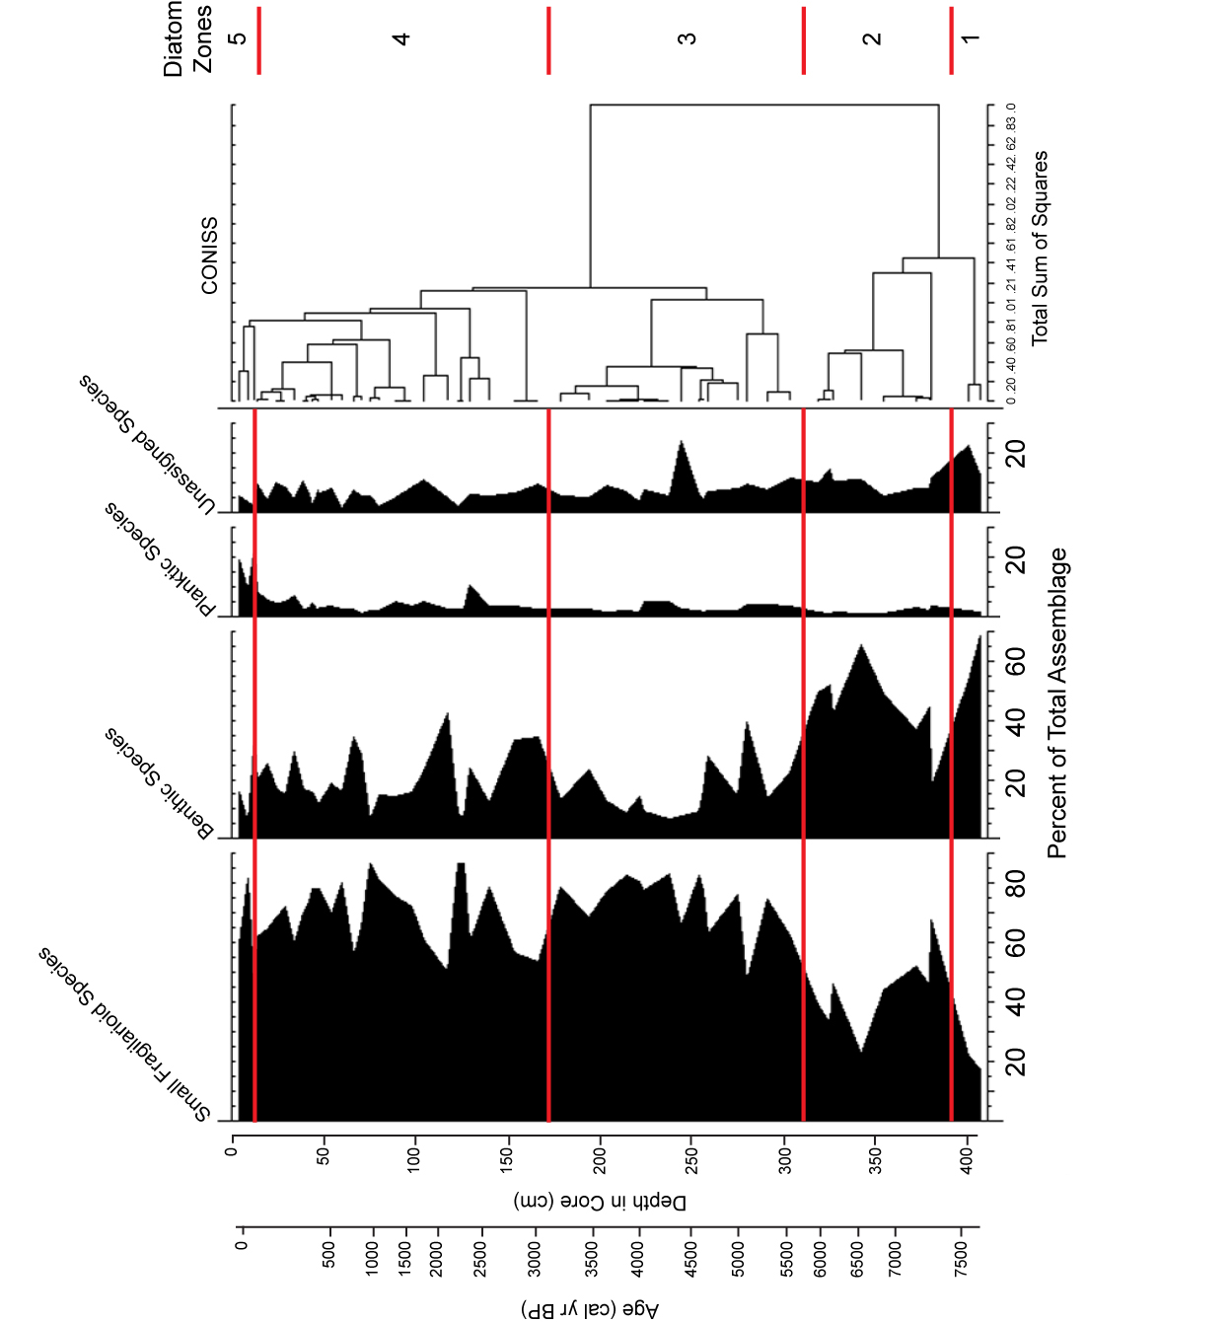
Favre Lake Holocene Record (Wahl et al., 2015)

Slide 18
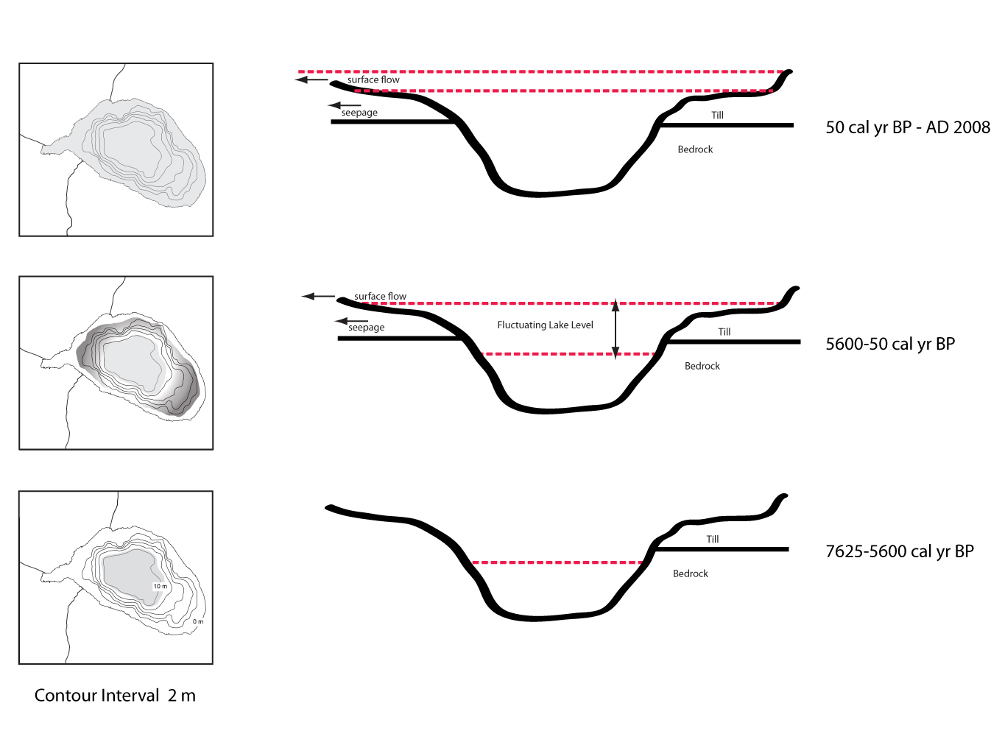
Lake Type Over Time
Type II
Type II
Type I

Slide 19
Conclusions
The study demonstrates that it is possible to use diatoms as indicators of lake level in small alpine lakes, given the right conditions.
Lakes can be divided into three categories based on general bathymetry. Lakes with a rapid change from shallow (<2 m)- to deep (>6 m)-water conditions are better sites for evaluating lake level changes during the Holocene.
Cores collected near in the ecotone near the planktic-benthic boundary provide the most robust evidence for lake level variation.
These records can be used by water resource managers to better plan for the natural variability in alpine lacustrine systems beyond the limits of short-term instrumental records.

Slide 20
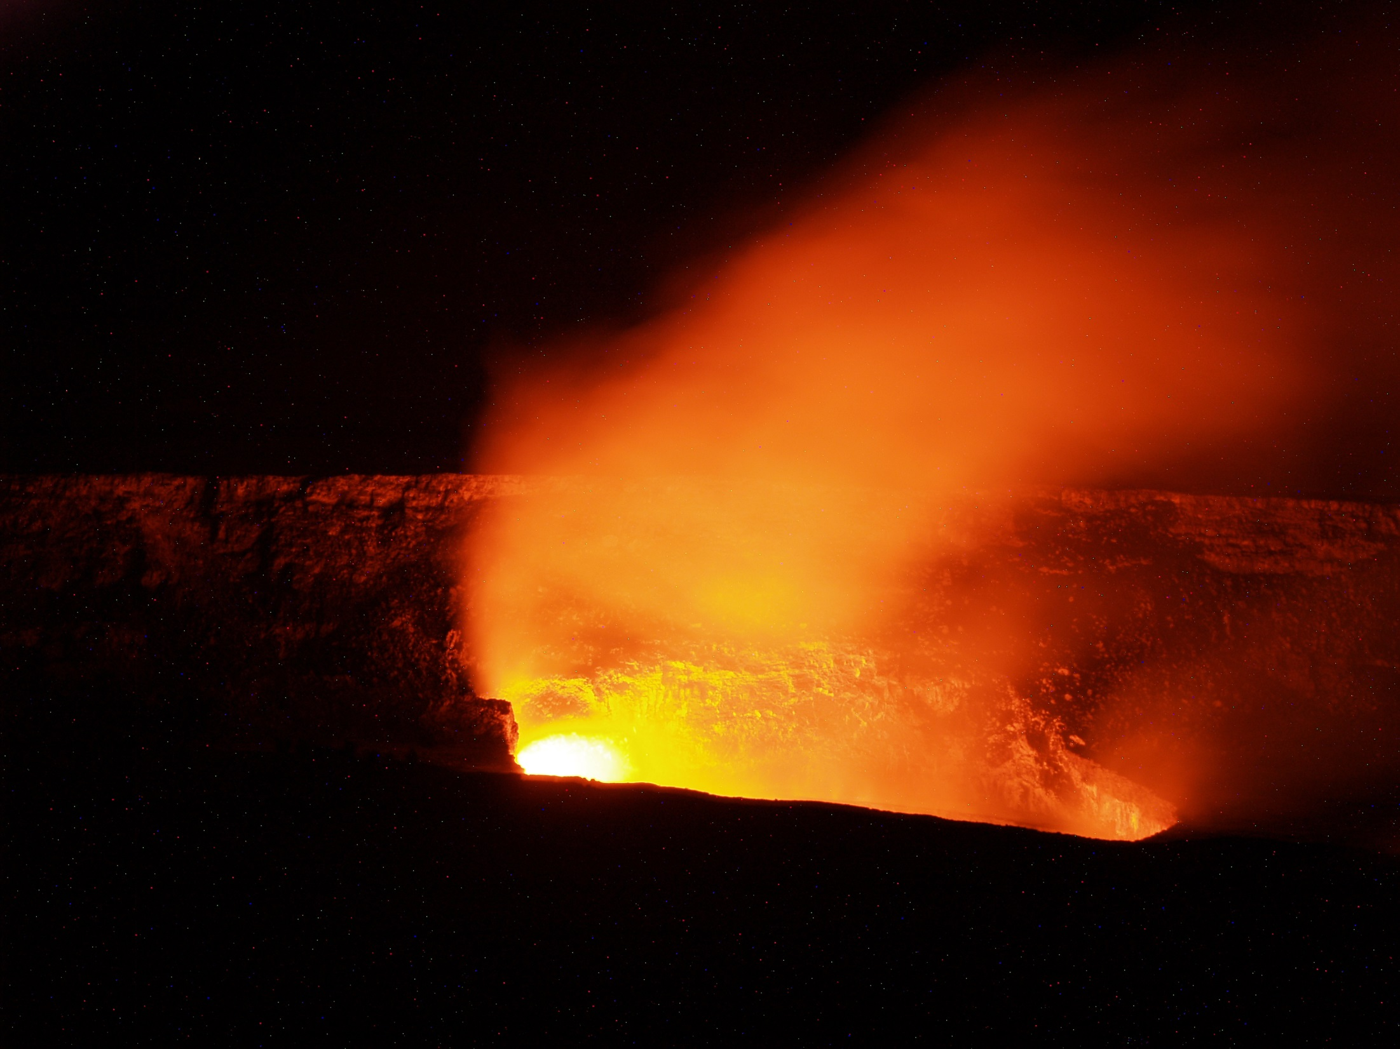
Questions?
Tales of another lake (much warmer) for another time

