Slide 1
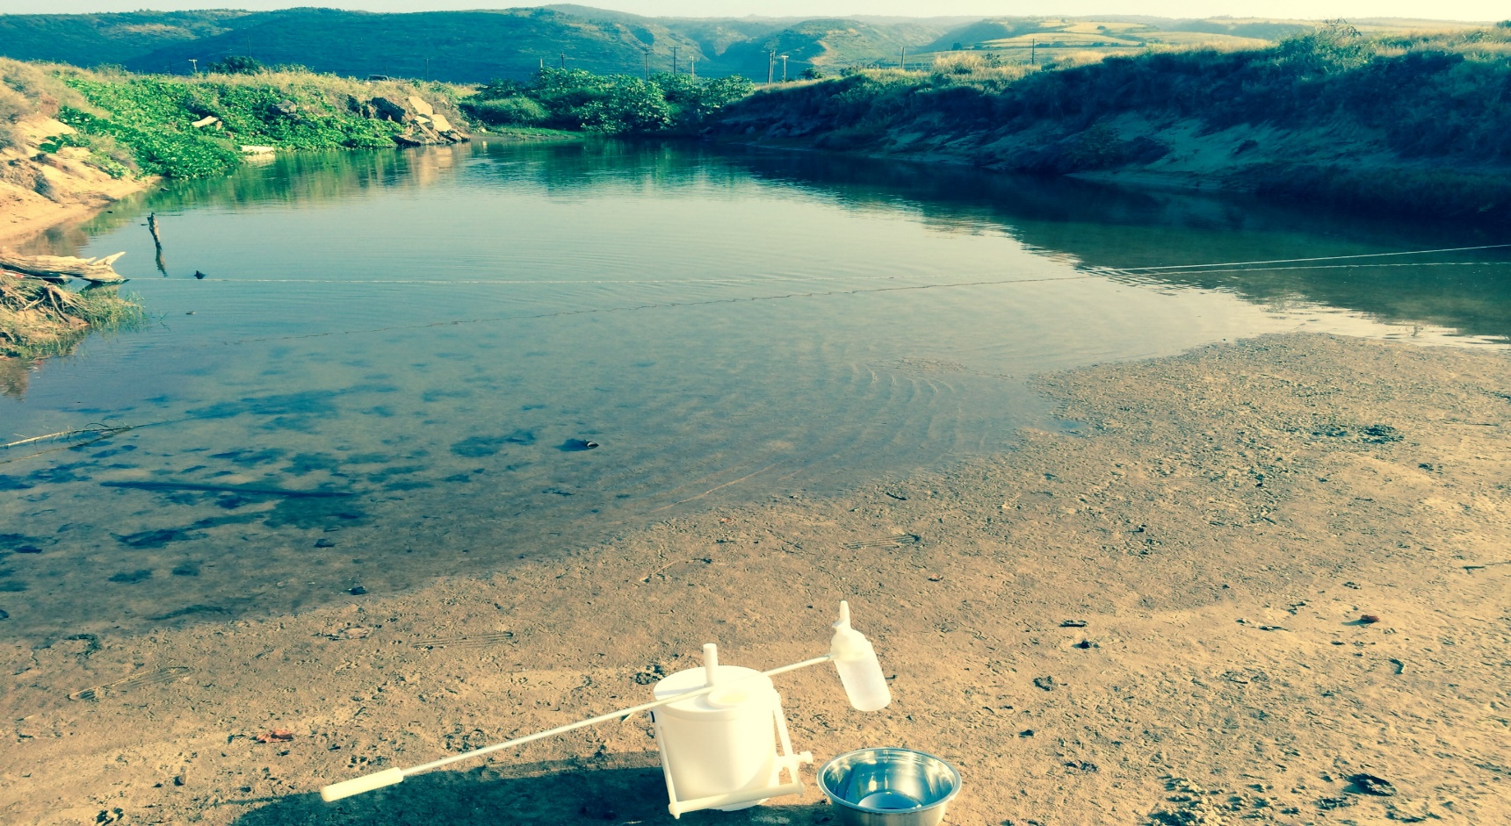
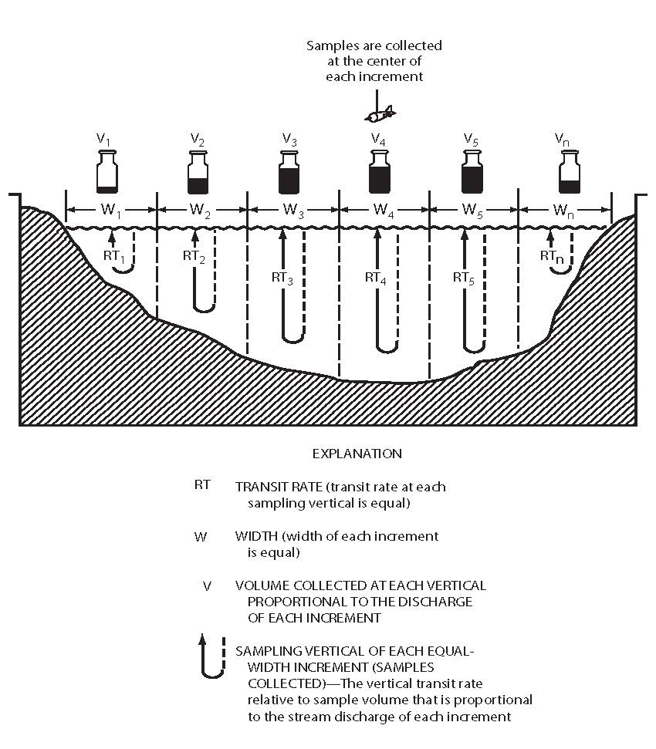
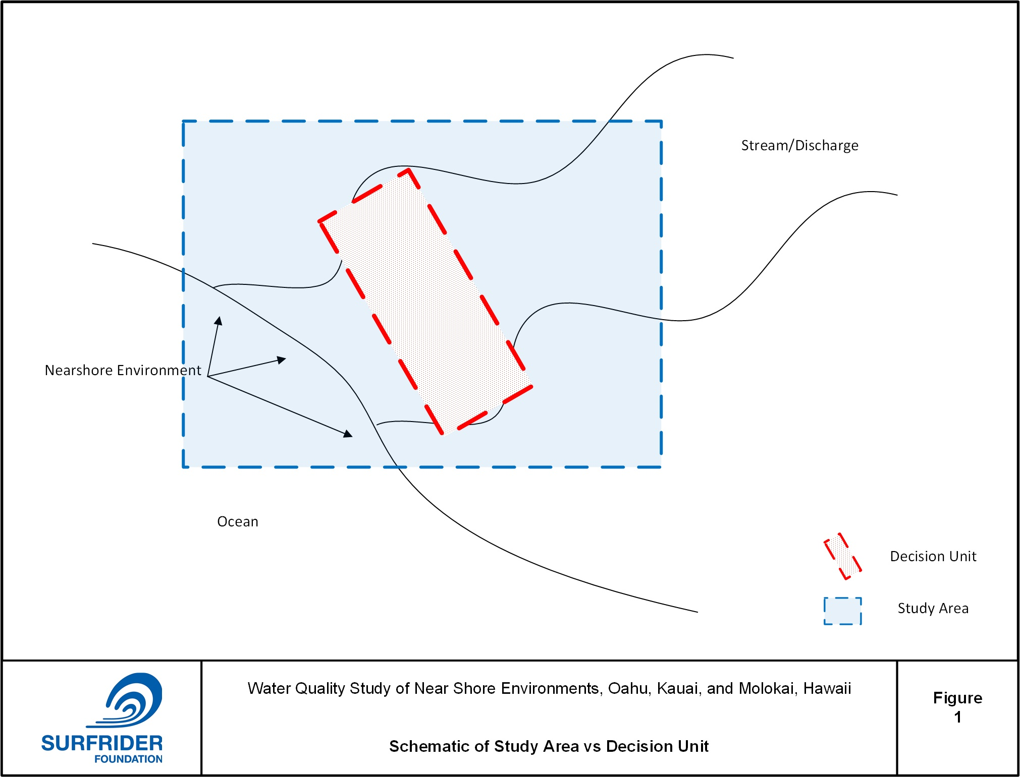
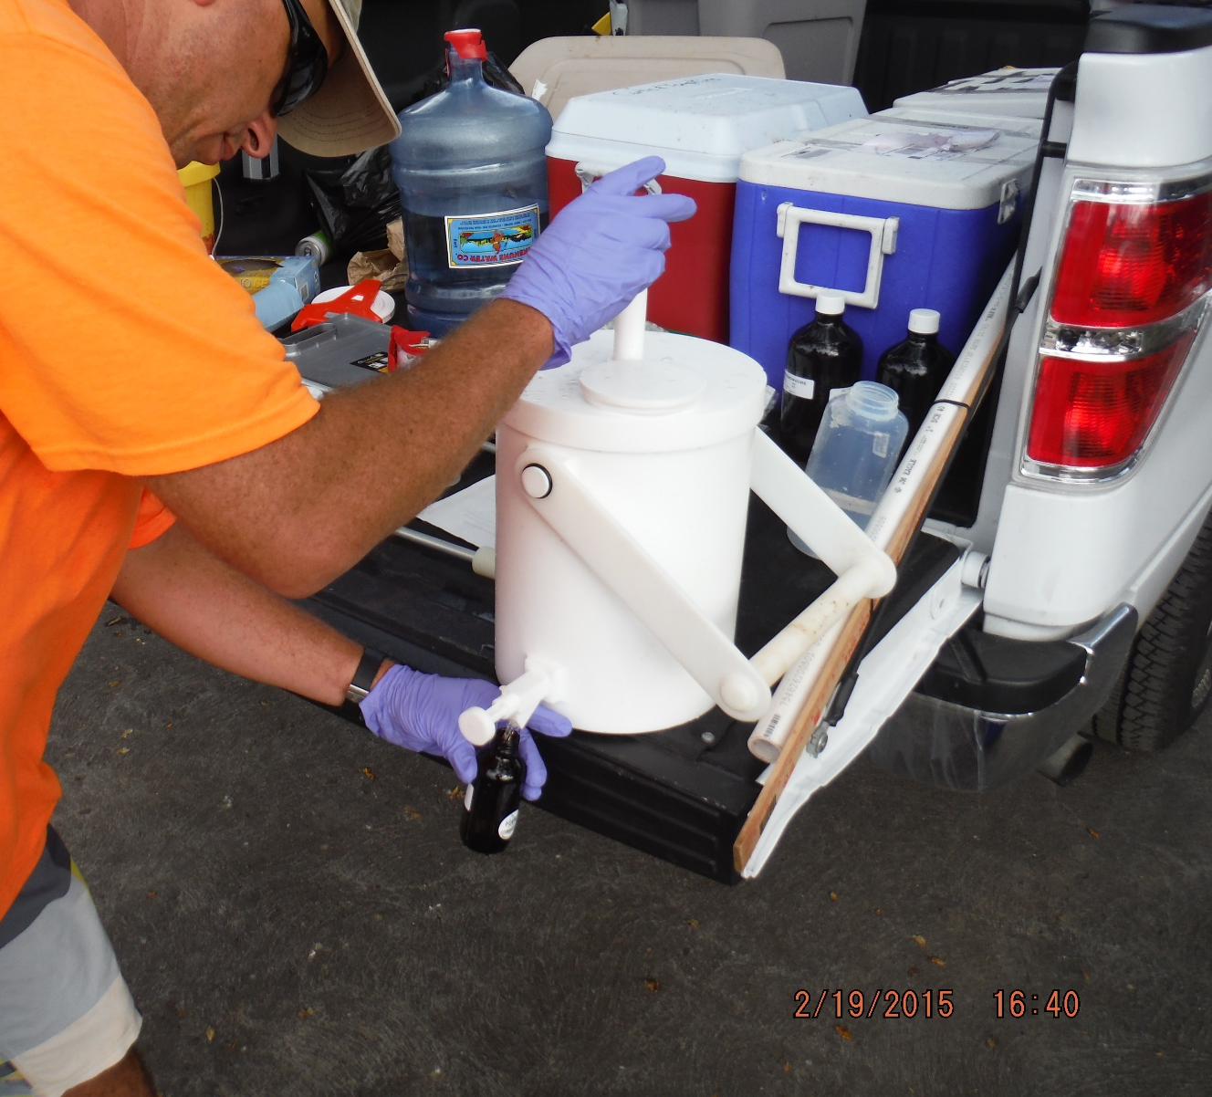
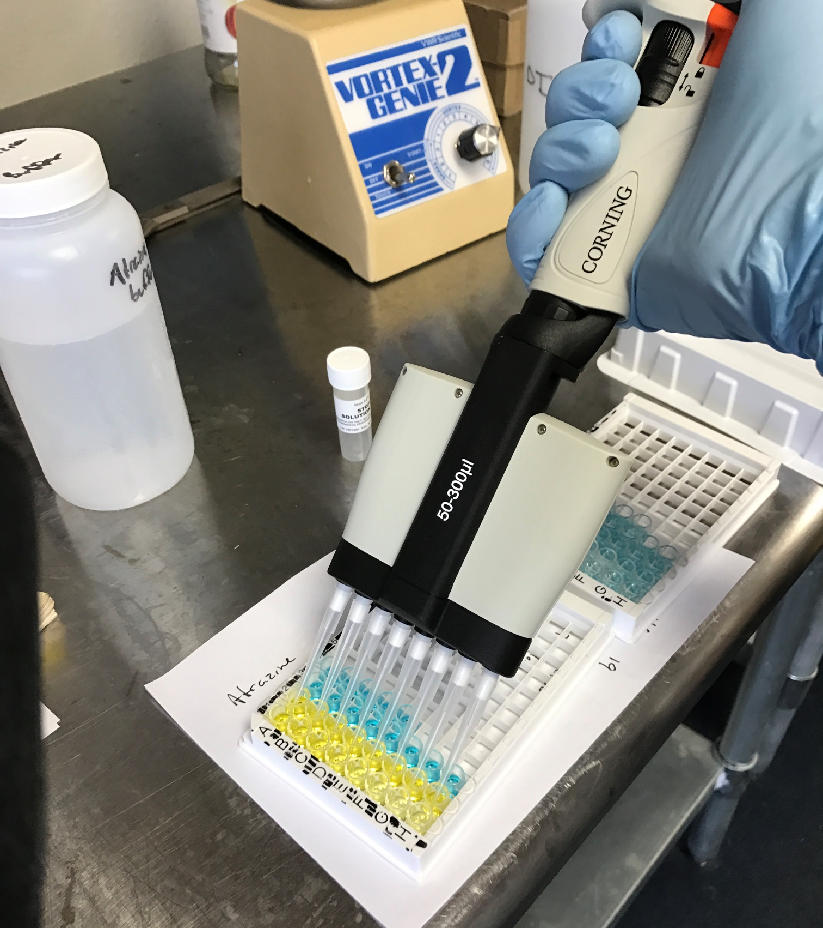
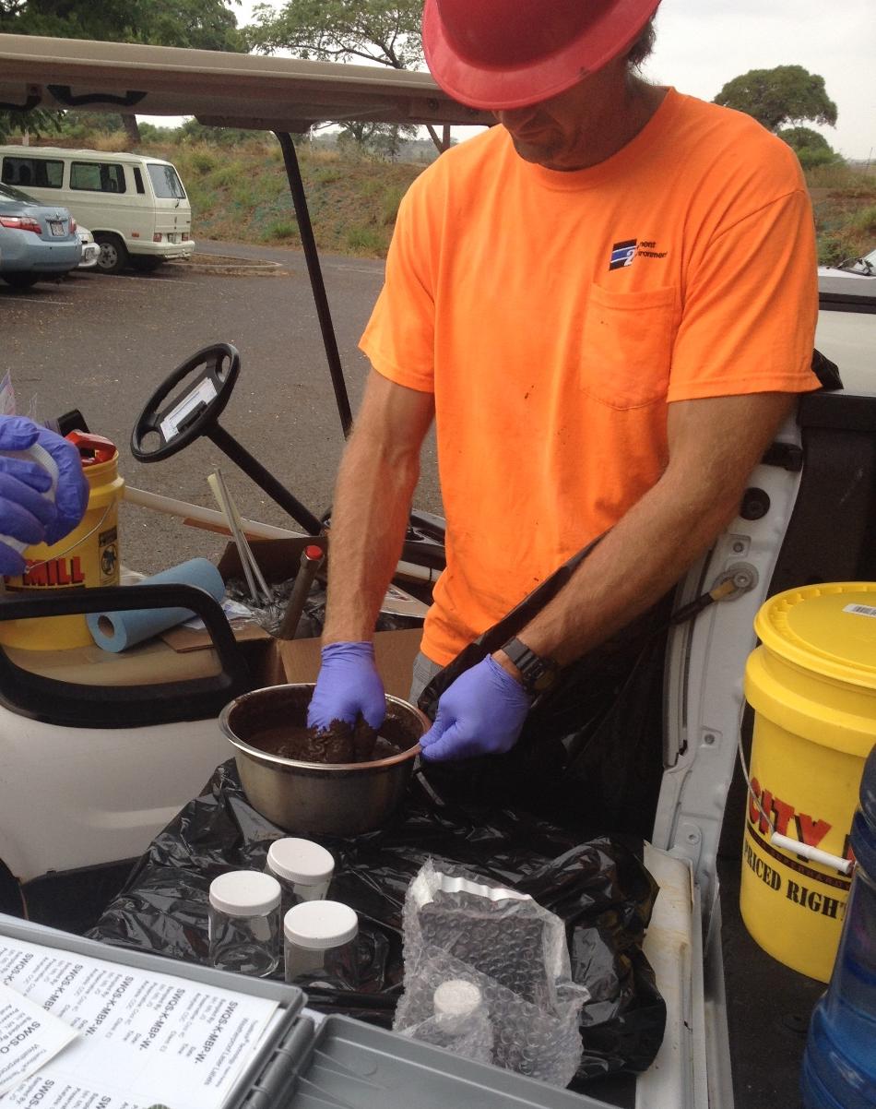
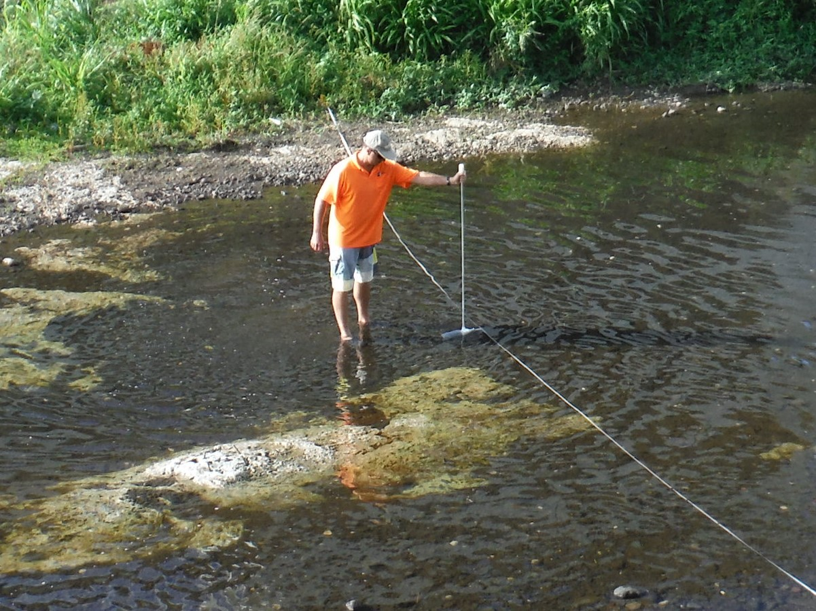
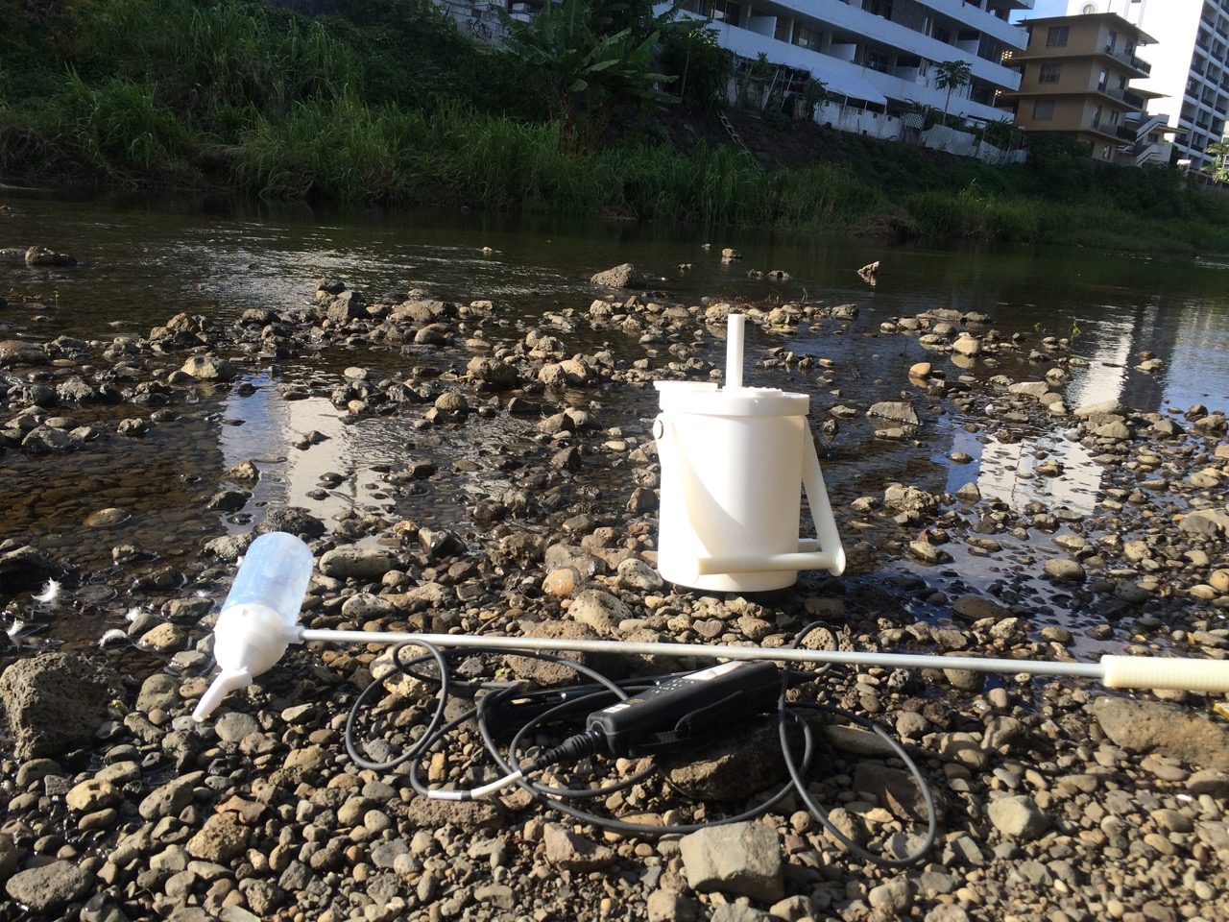
STUDY OF PESTICIDE IMPACTS TO SURFACE WATER AND SEDIMENTS IN THE NEAR SHORE ENVIRONMENTS OF OAHU AND KAUAI
Julia Gray (To The Field), Marvin Heskett (Element Environmental), for The Surfrider Foundation
With the increasing agricultural development and urban use of chemical pesticides and herbicides in the post sugar era, the Surfrider Foundation (SRF) is concerned about the potentially damaging impacts to both human health and ecological communities from these chemicals. As a result of this concern, this project was designed to study the presence and concentration of chemical pesticides in the nearshore marine environment of Kauai and Oahu. Low concentrations of 18 different pesticides were found throughout the study area.
Isokinetic and Multi-Incremental Sampling
Samples were poured into a Teflon churn to reduce heterogeneity before subsampling into containers.
Equal-Distance-Increment (EDI) method to collect the water sample (USGS, 2006)
Sediments were collected using a Multi-Incremental approach
Representative stream water samples were collected just upstream from the shoreline. Samples were sent to an analytical laboratory for the analysis of over 200 pesticides.
Samples were collected with a Teflon DH-81 to ensure sample representativeness. A YSI Pro Plus was used to monitor water quality parameters and ensure water was fresh or brackish.
ELISA was used to increase the frequency and sample count for Glyphosate, Atrazine and Metolachlor
Field Screening Using ELISA
Pesticide Detection Frequency

