Slide 1
Four Famous Historic Landslides
of the Pittsburgh Area
Jim Hamel, Ph.D., P.E., P.G.
Hamel Geotechnical Consultants
Monroeville, Pennsylvania

Slide 2
Pittsburgh Area has long been noted for Landslides
Results from Geology, Topography, Climate, History
Flat-lying, interbedded, strong and weak sedimentary rocks have been acted upon by Erosion, Stress Relief, Weathering, Creep, and Sliding to produce masses of
Marginally Stable Colluvium
These are often reactivated by heavy precipitation and by human activity, e.g., fill loading, toe excavation, surface and subsurface drainage changes
Also have Appalachian heritage of Fill on Slopes

Slide 3
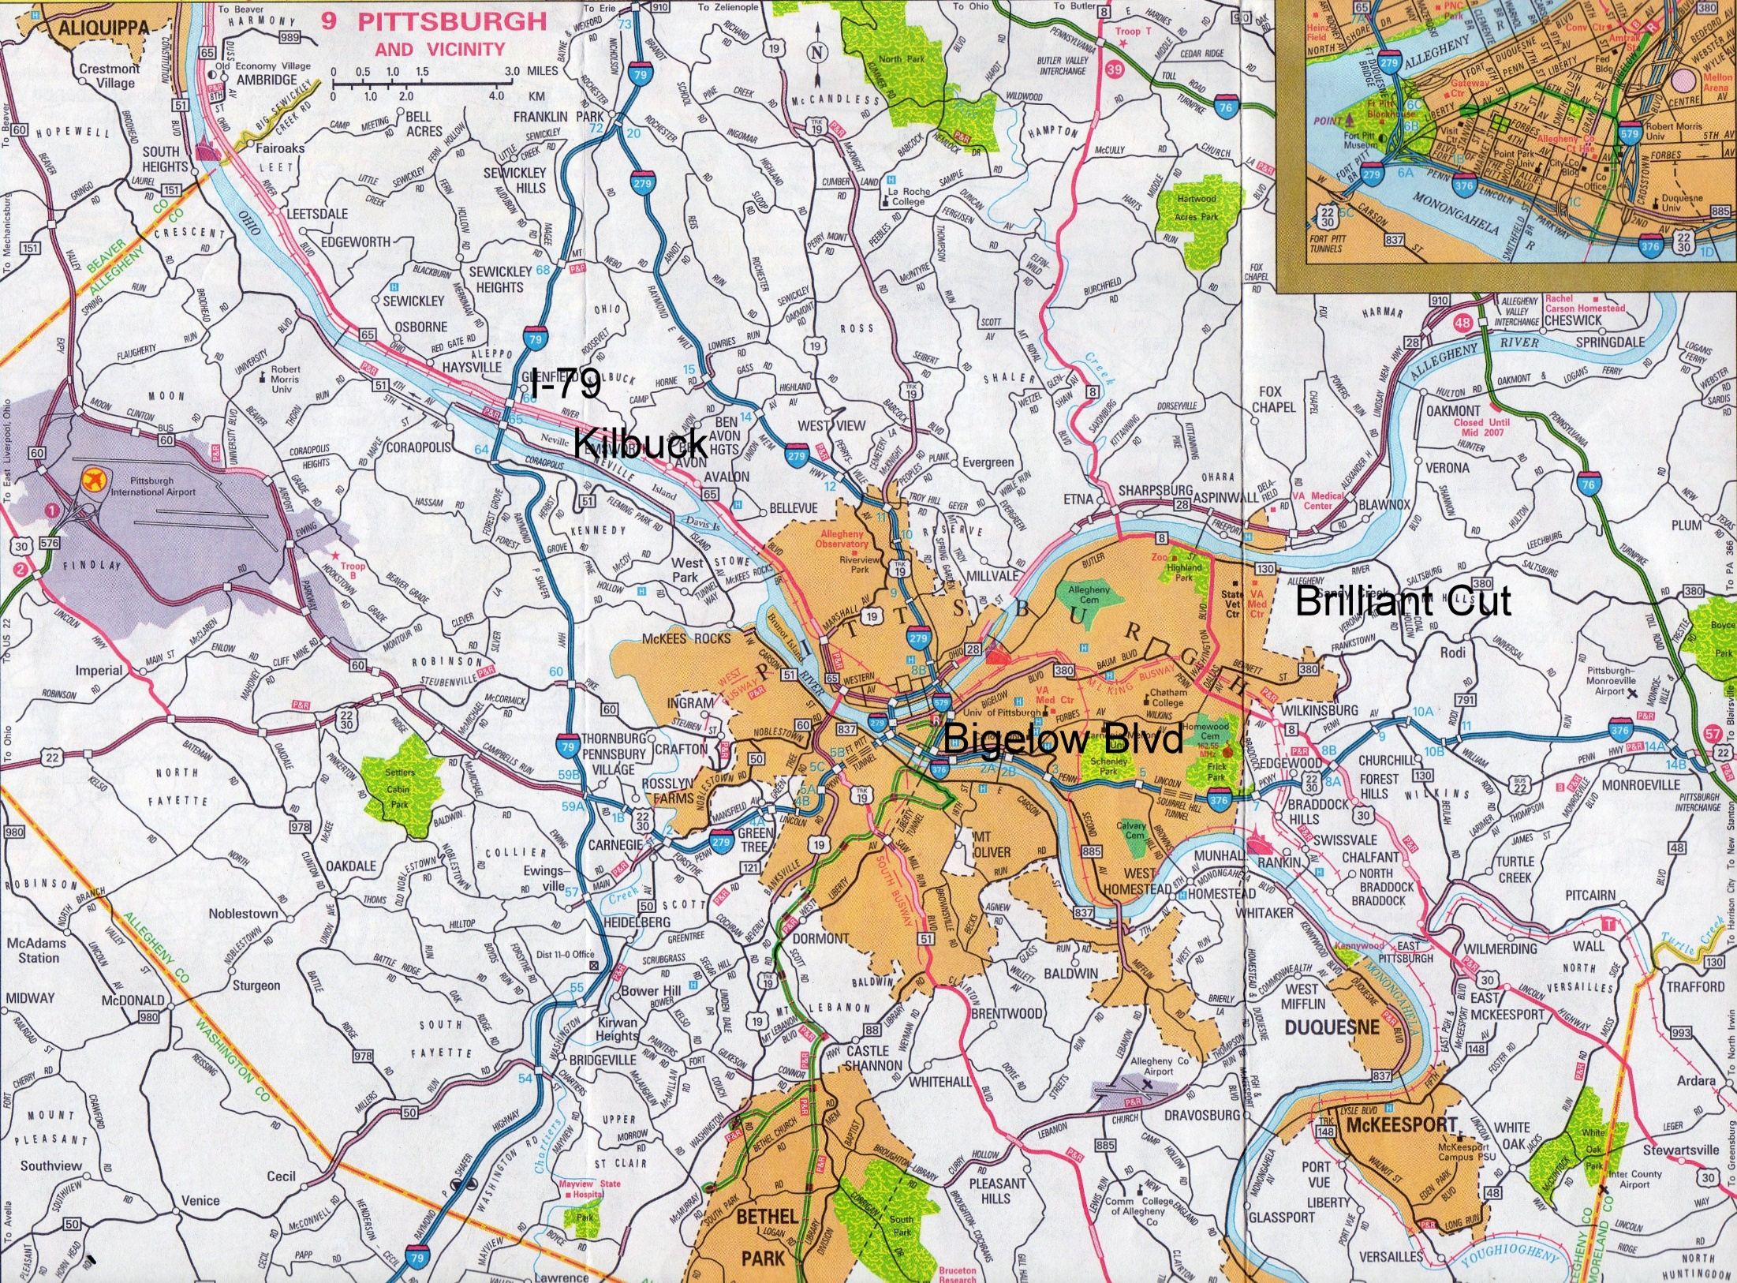

Slide 4
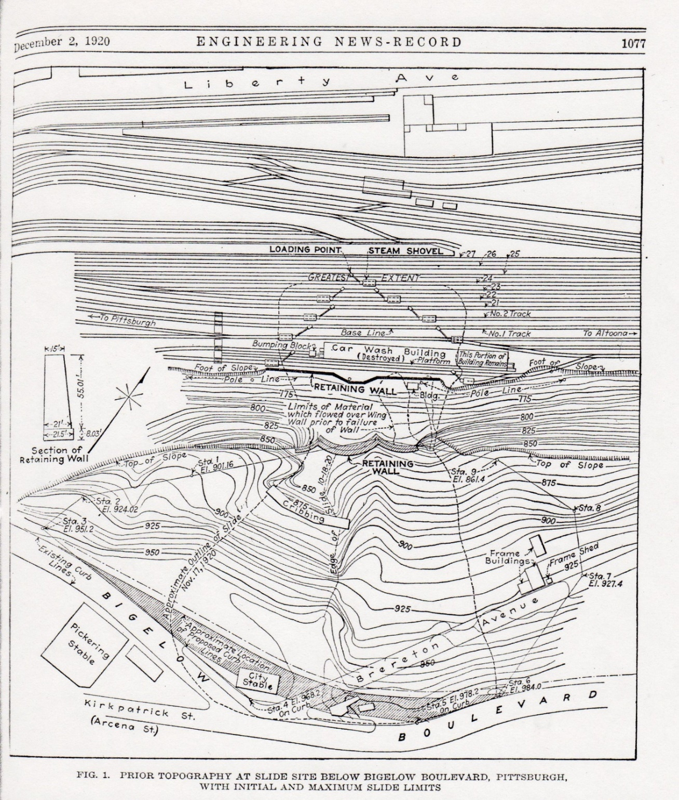

Slide 5
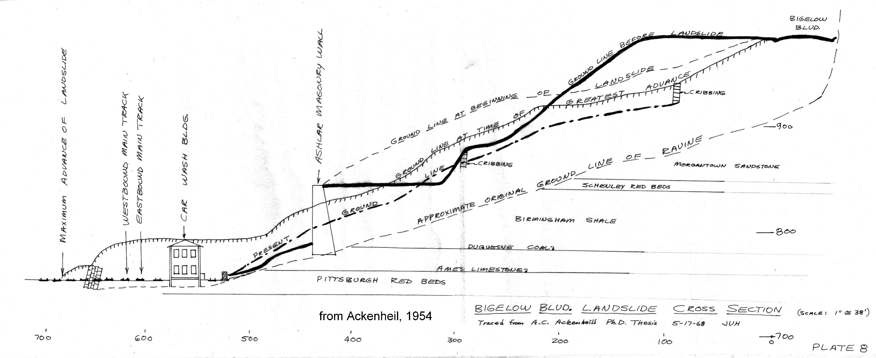
General Goethals (Panama Canal) “Let ‘er slide”

Slide 6
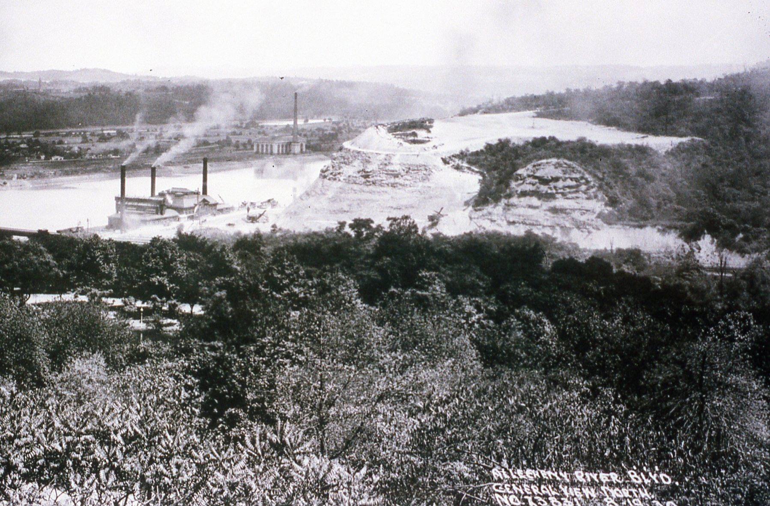
August 19, 1930

Slide 7
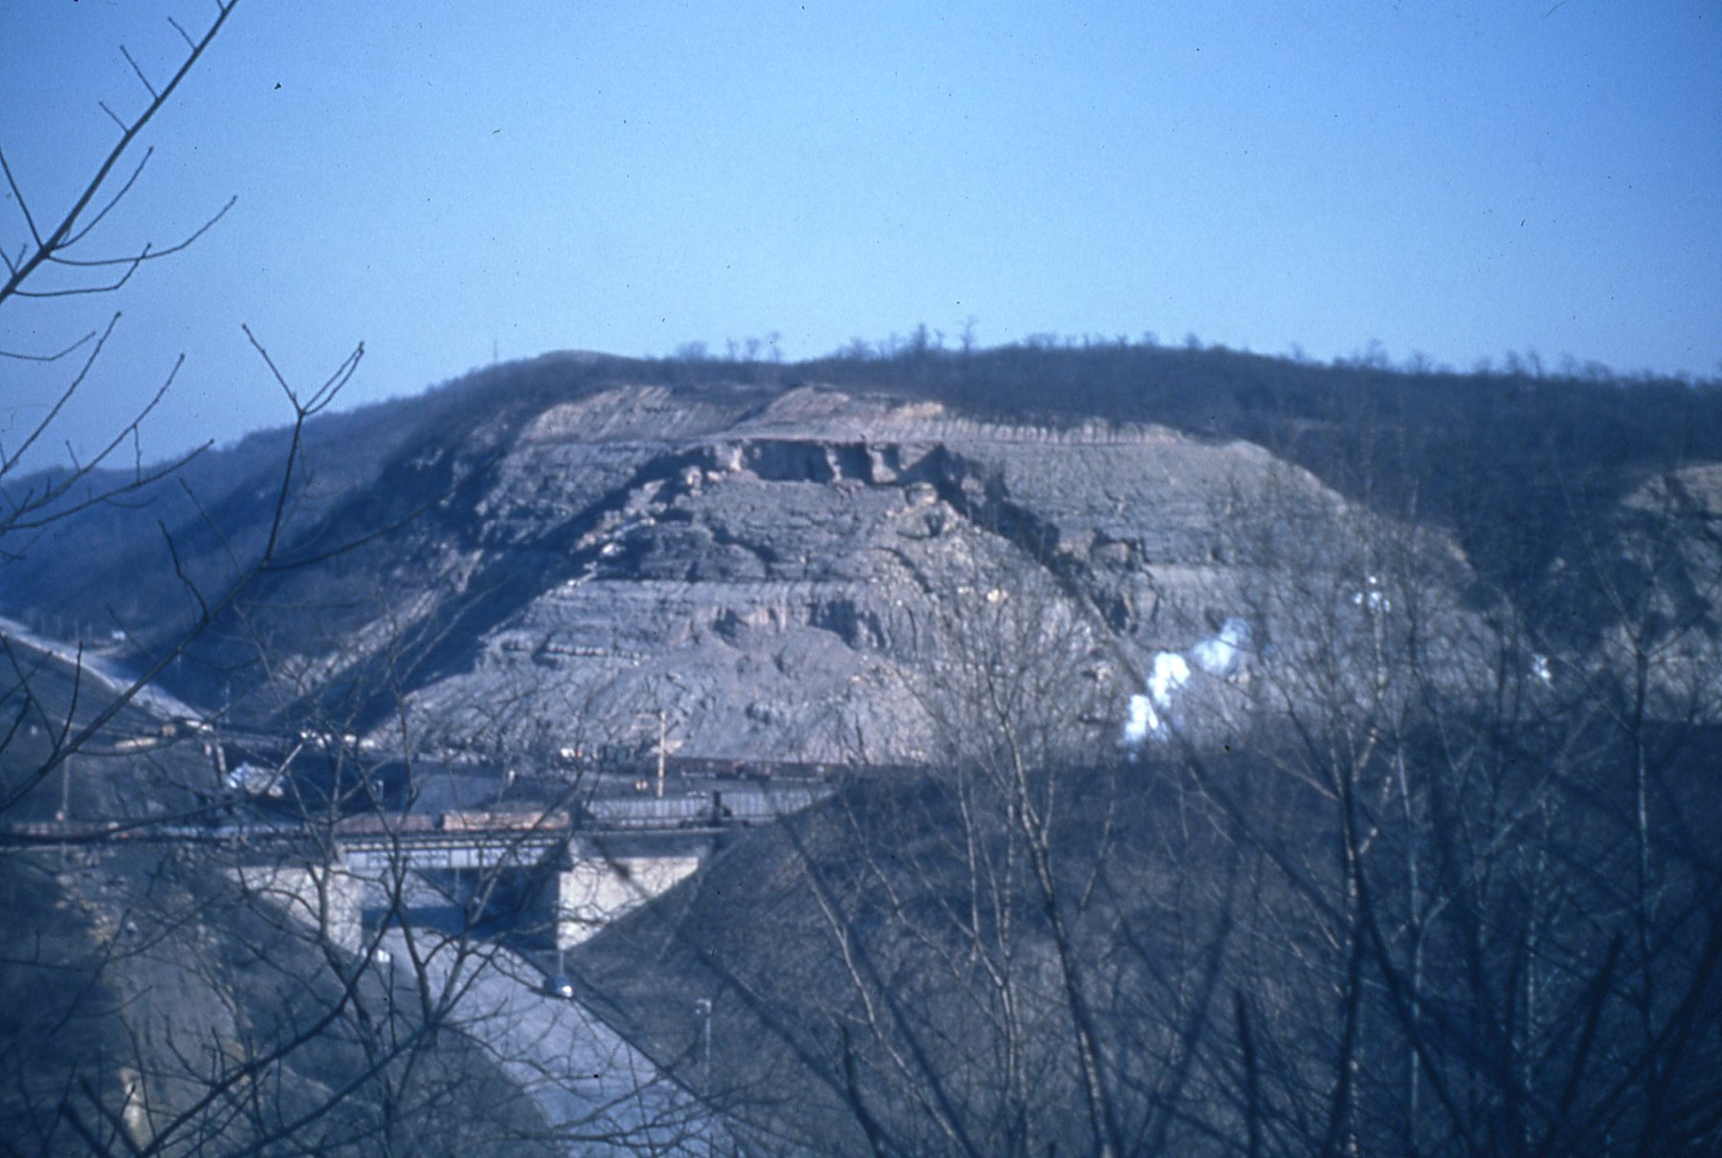
March 20, 1941

Slide 8
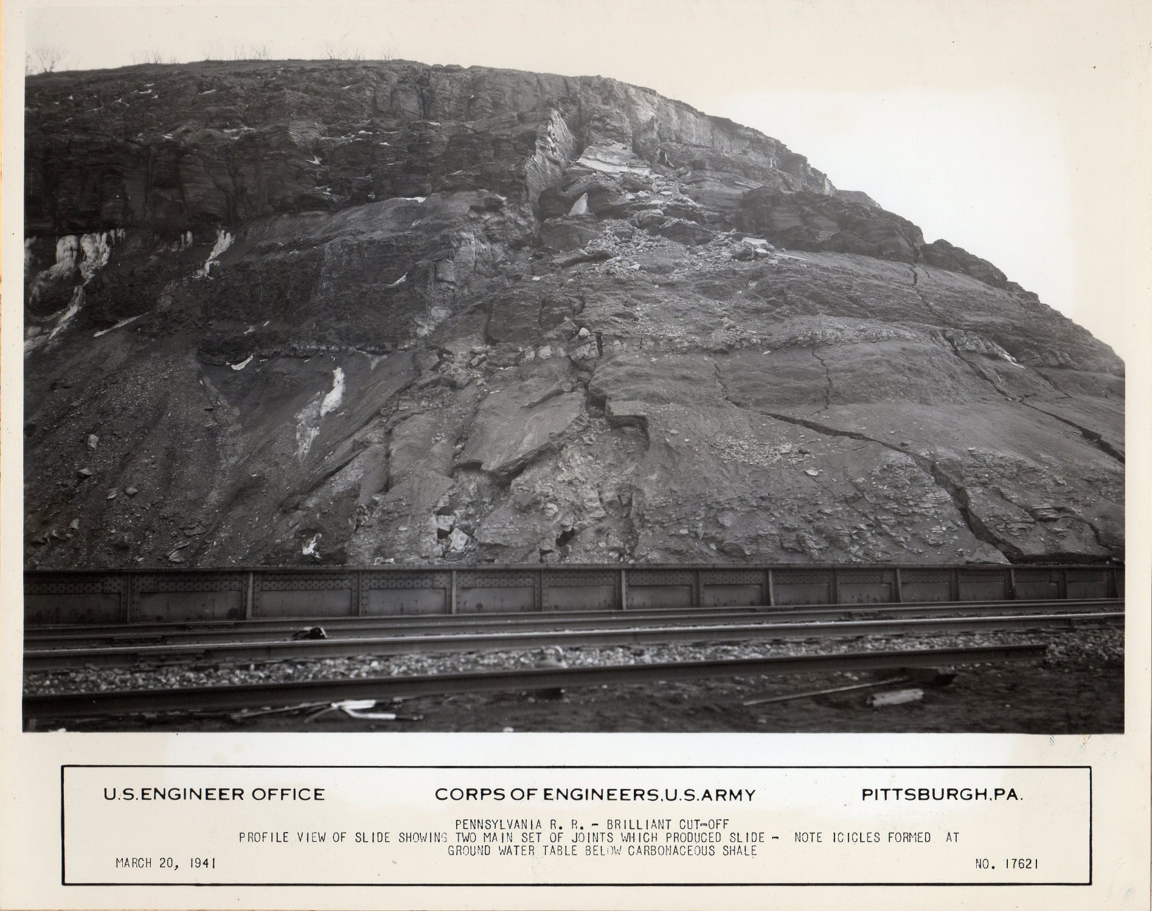

Slide 9
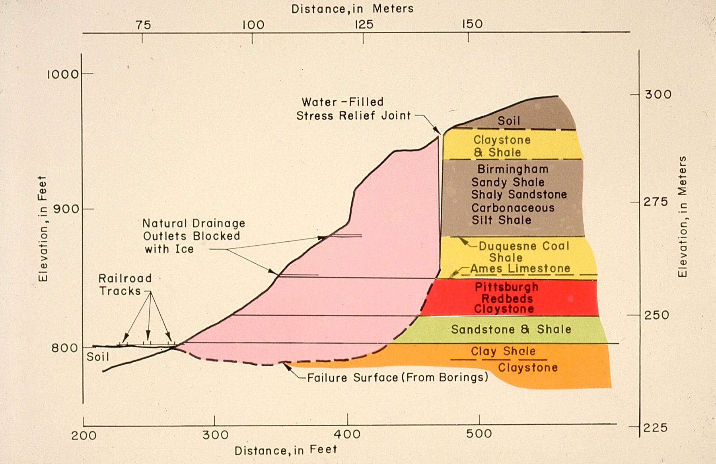

Slide 10
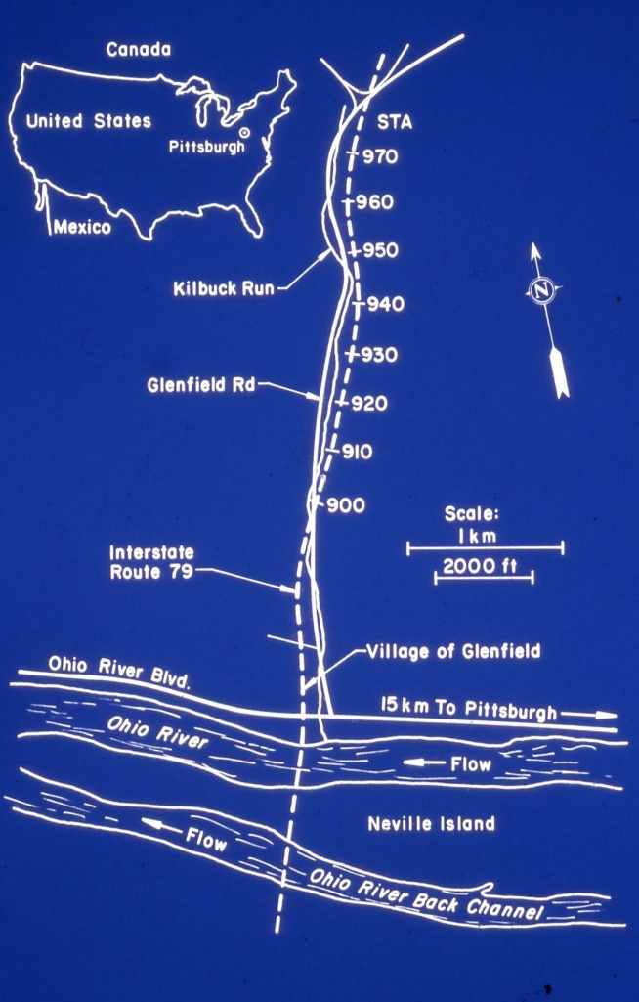

Slide 11
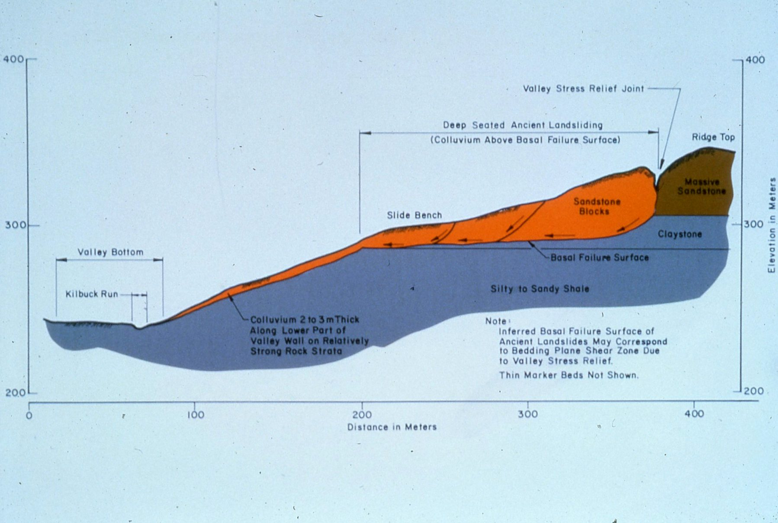

Slide 12
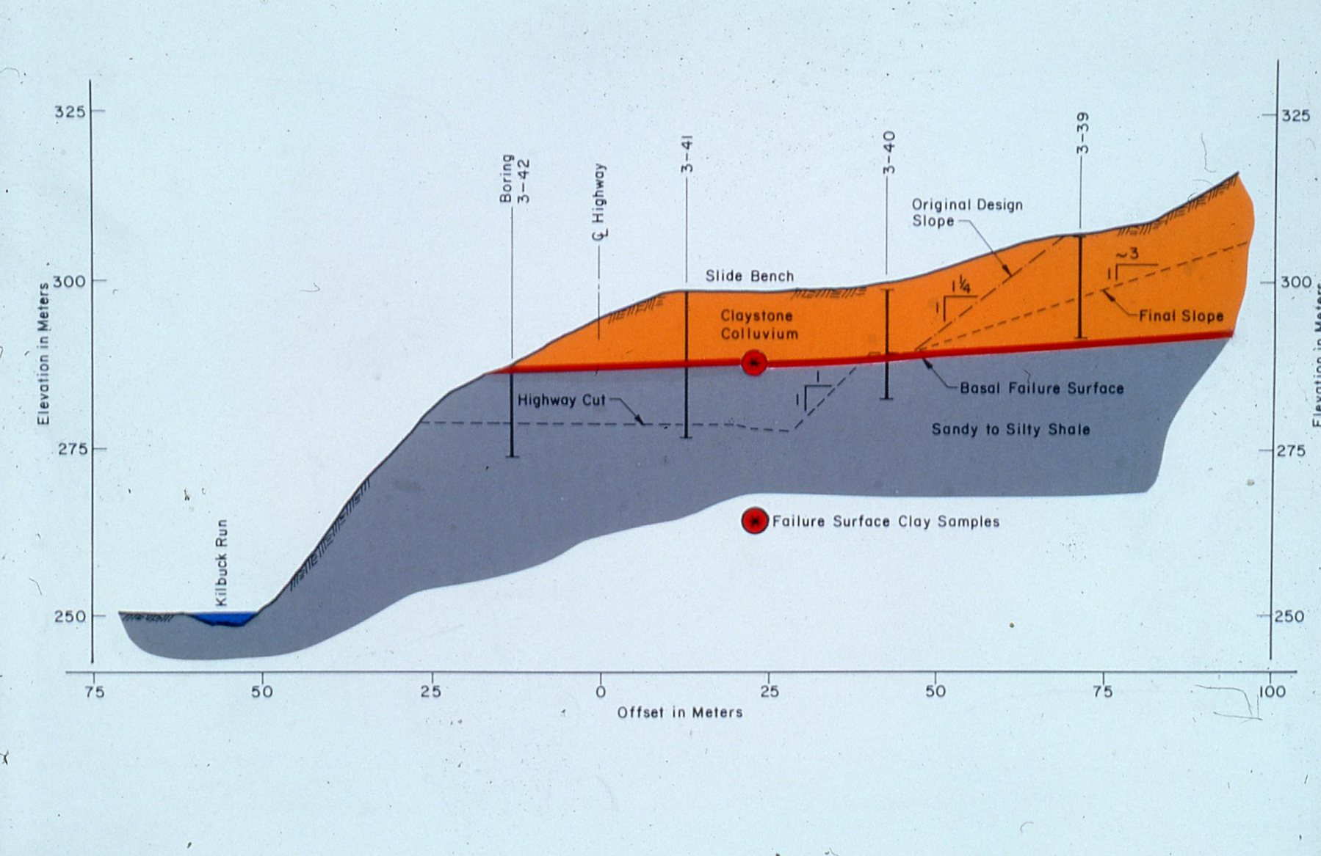

Slide 13
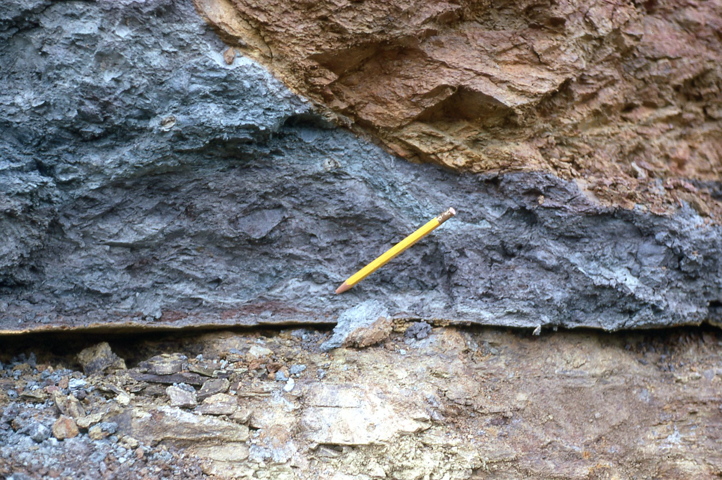

Slide 14


Slide 15
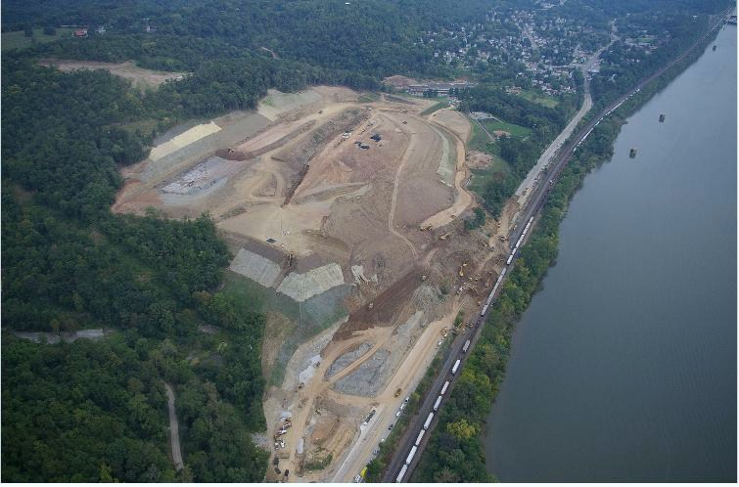

Slide 16
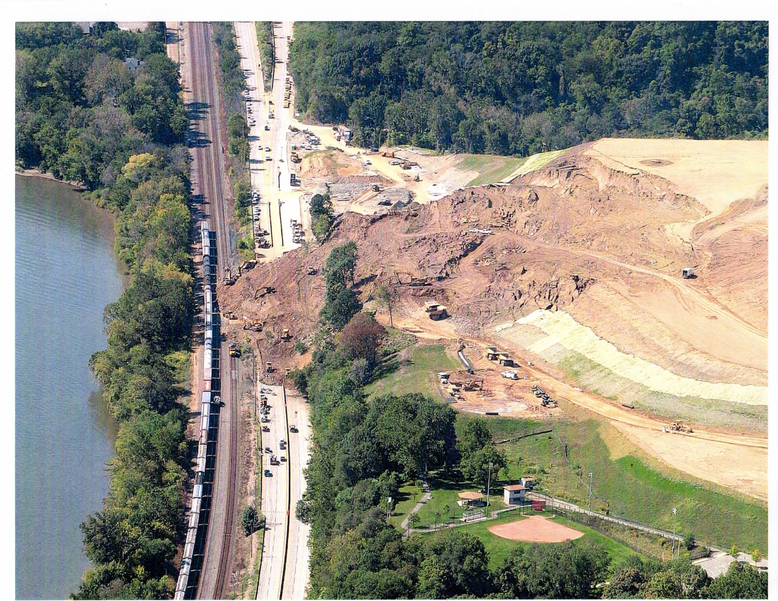

Slide 17
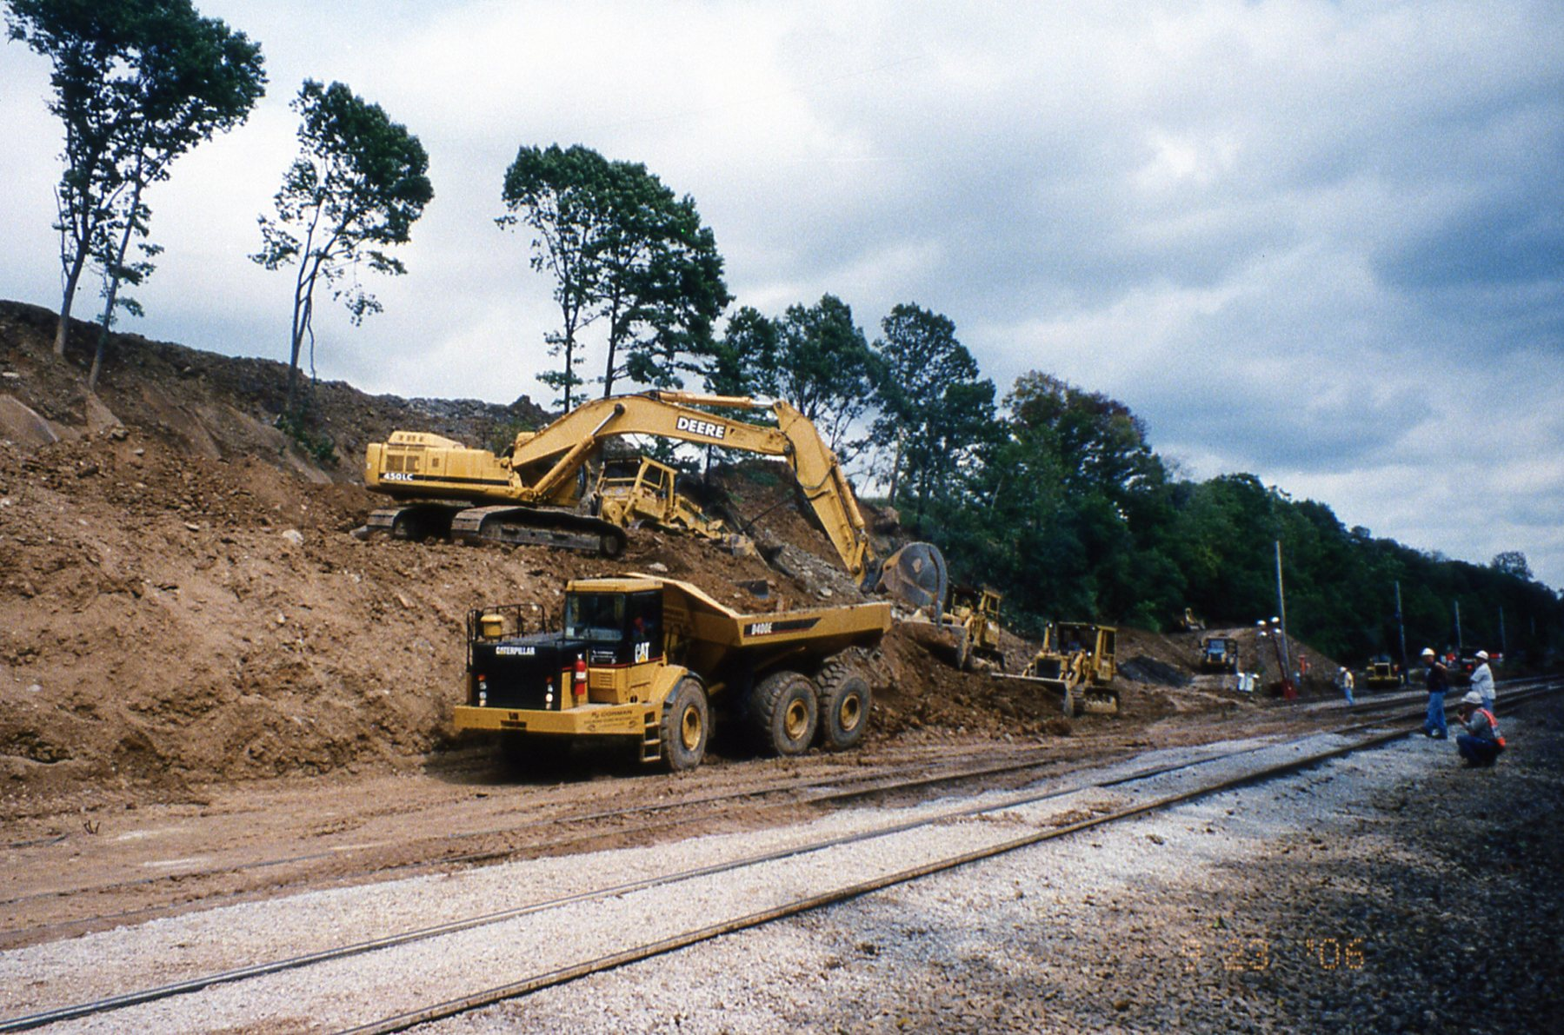

Slide 18

Questions?

