Slide 1
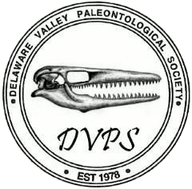


The Delaware Valley Paleontological Society:
A History of Advancing Paleontology for Everyone
Jason P. Schein
Executive Director
Bill Shankle
President
Delaware Valley Paleontological Society
www.DVPS.org
facebook.com/DVPSPaleo

Slide 2
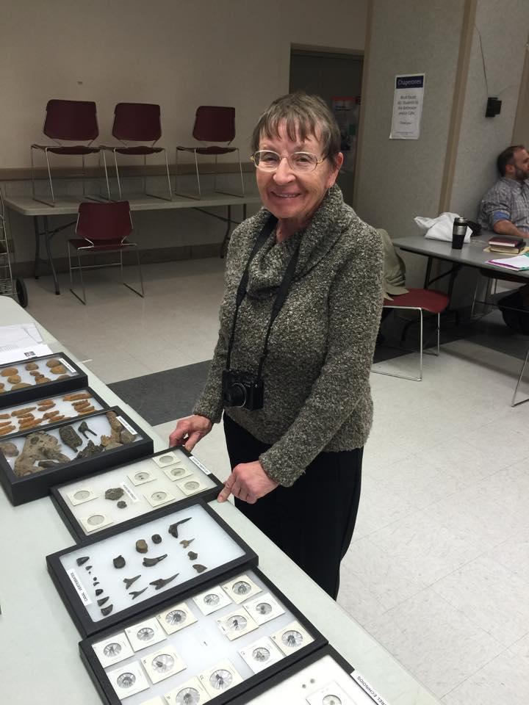
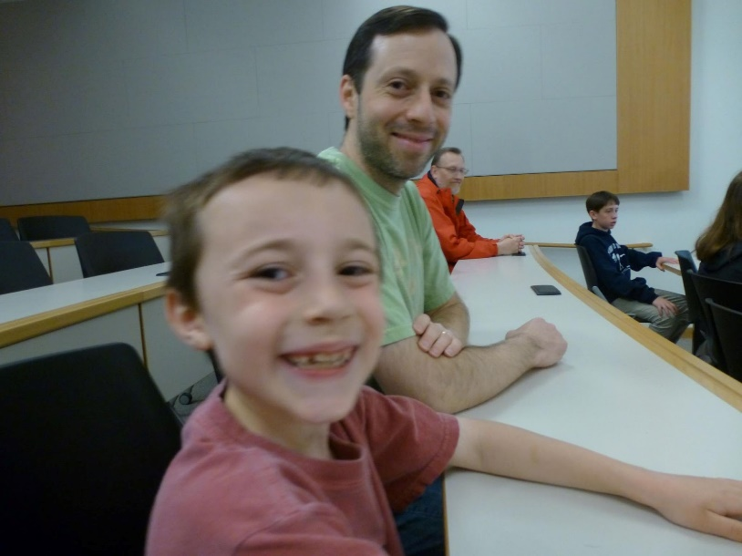
The Basics
Mission:
“ . . . a cooperative association of professional and amateur paleontologists. It’s purpose is to promote the gathering and dissemination of information related to paleontology.”
www.DVPS.org
facebook.com/DVPSPaleo

Slide 3
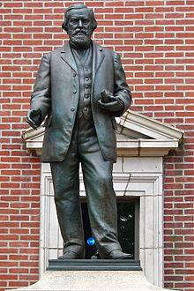
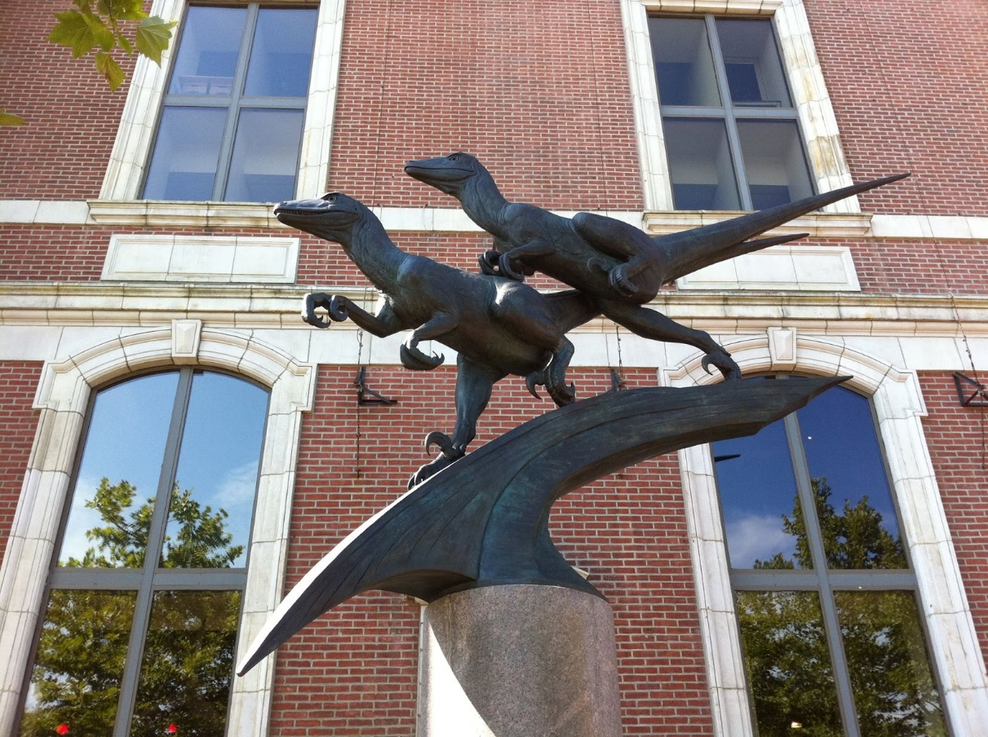
The Basics
First Organized
1978
Membership:
300+ members from across the tri-state Delaware Valley region
Avocational & professional paleontologists
Monthly meetings at the Academy of Natural Sciences of Philadelphia (Drexel University)
www.DVPS.org
facebook.com/DVPSPaleo

Slide 4
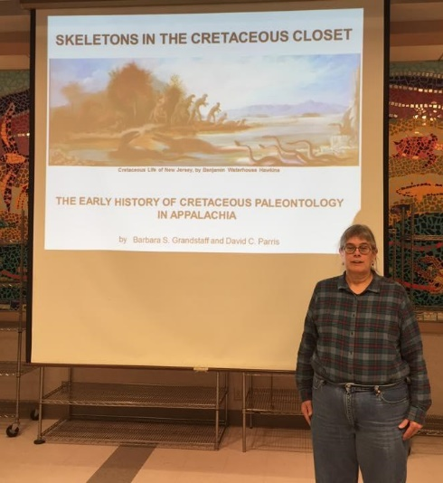
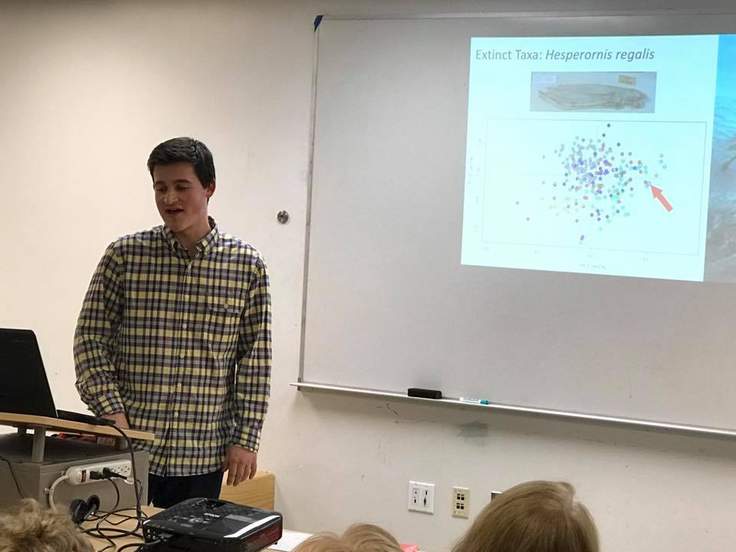
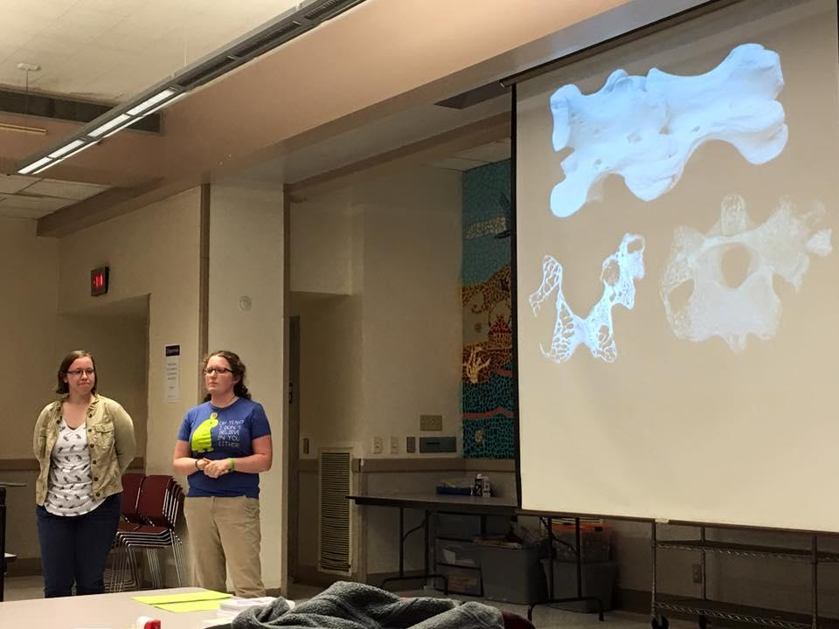
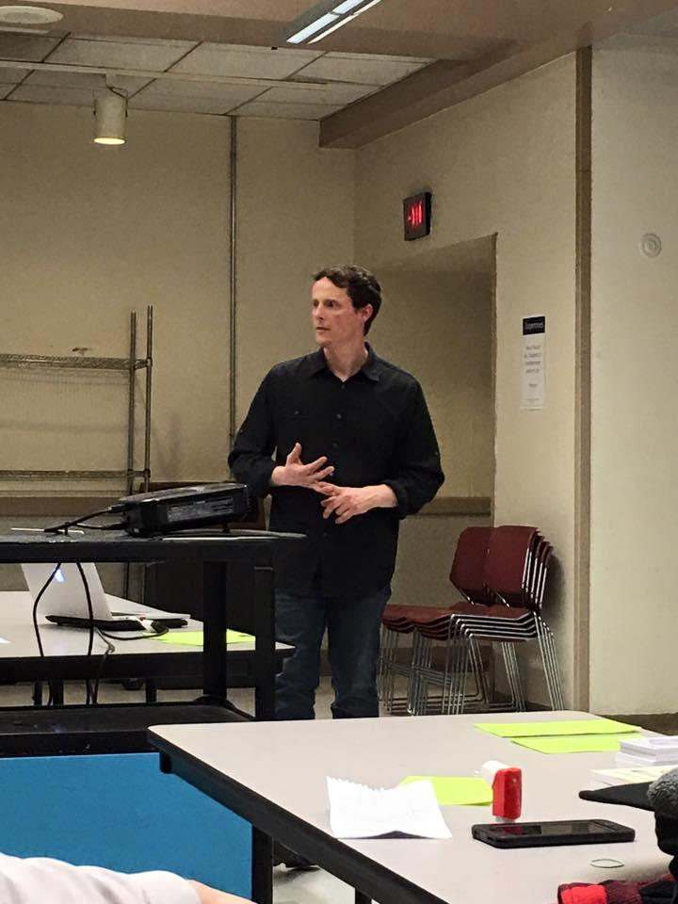
DVPS Activities
Meetings:
Feature a lecture by a professional paleontologist or knowledgeable DVPS member
Dr. Matt Lamanna
Dr. Jack Horner
Dr. Peter Dodson
Dr. Bill Gallagher
Dr. Hermann Pfefferkorn
Dr. David Weishampel
Dr. Kirk Johnson
Dr. Paul Sereno
Dr. Kenneth Carpenter
Dr. Tony Fiorillo
Dr. Don Baird
Dr. Barbara Grandstaff
www.DVPS.org
facebook.com/DVPSPaleo

Slide 5
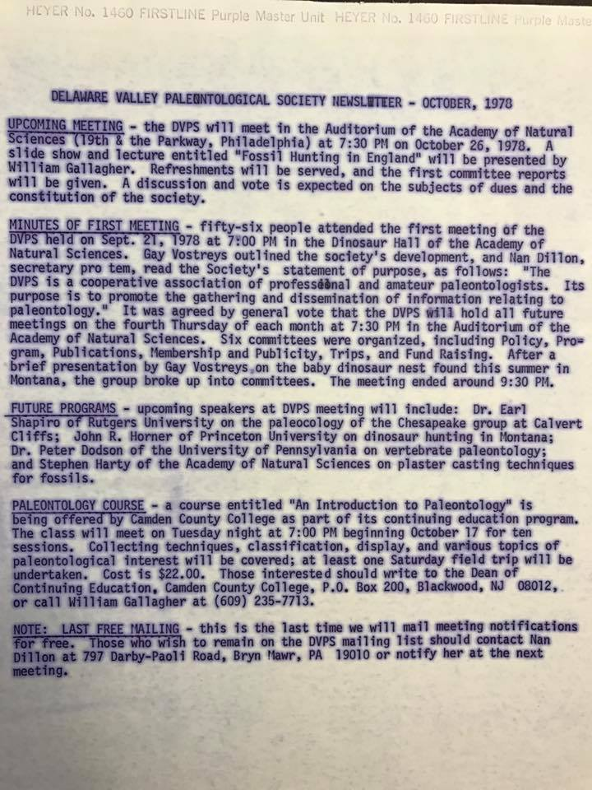
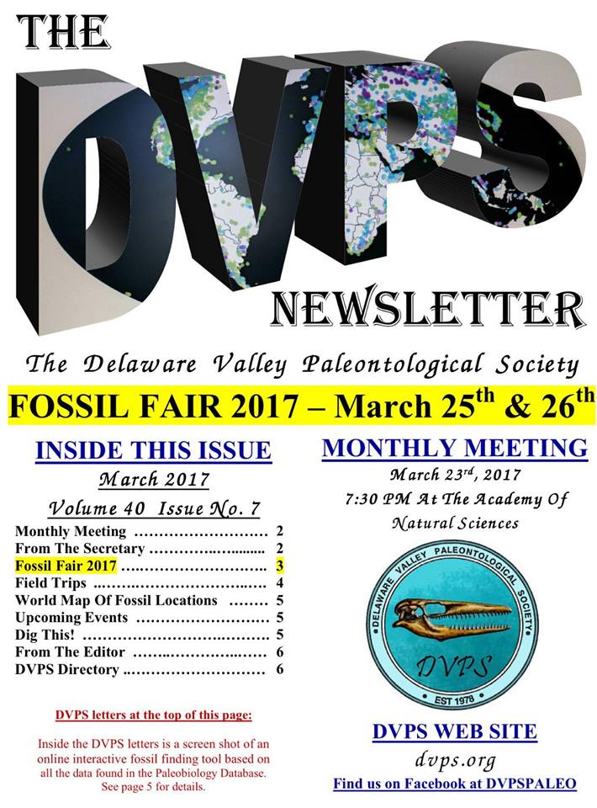
DVPS Activities
Newsletters
1st published in 1978
www.DVPS.org
facebook.com/DVPSPaleo

Slide 6
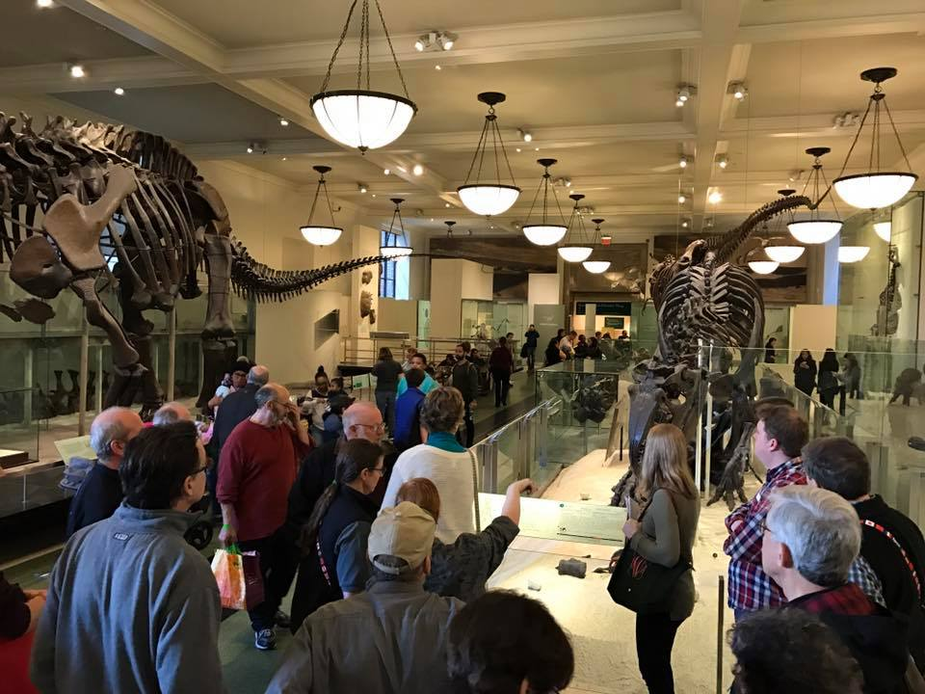
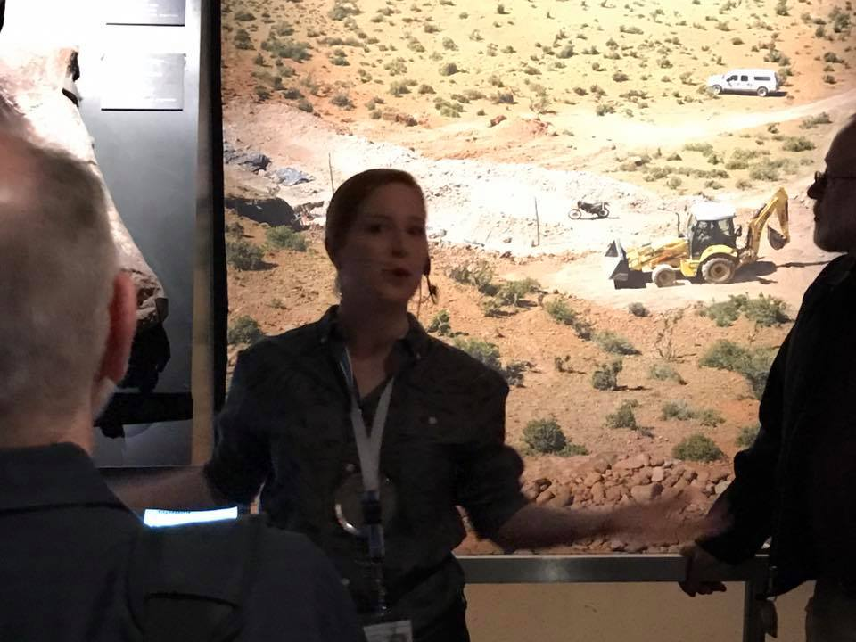
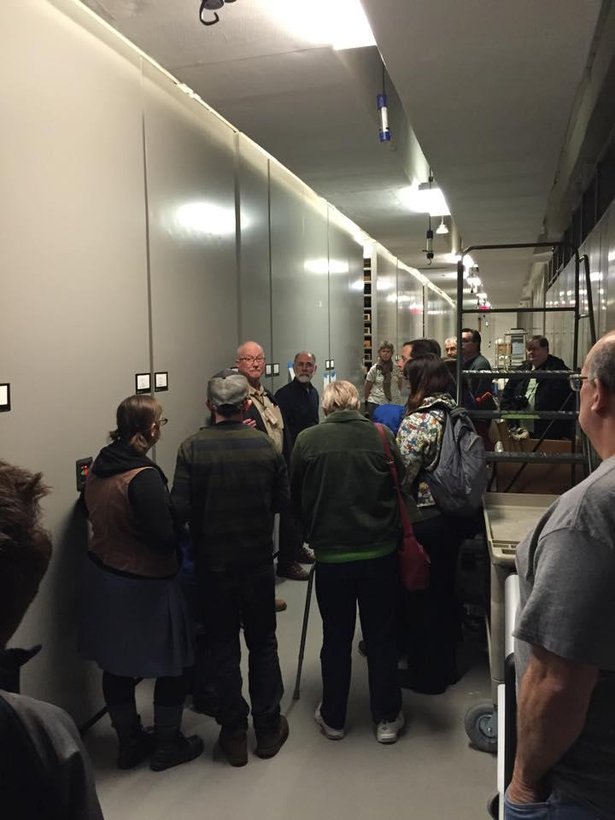
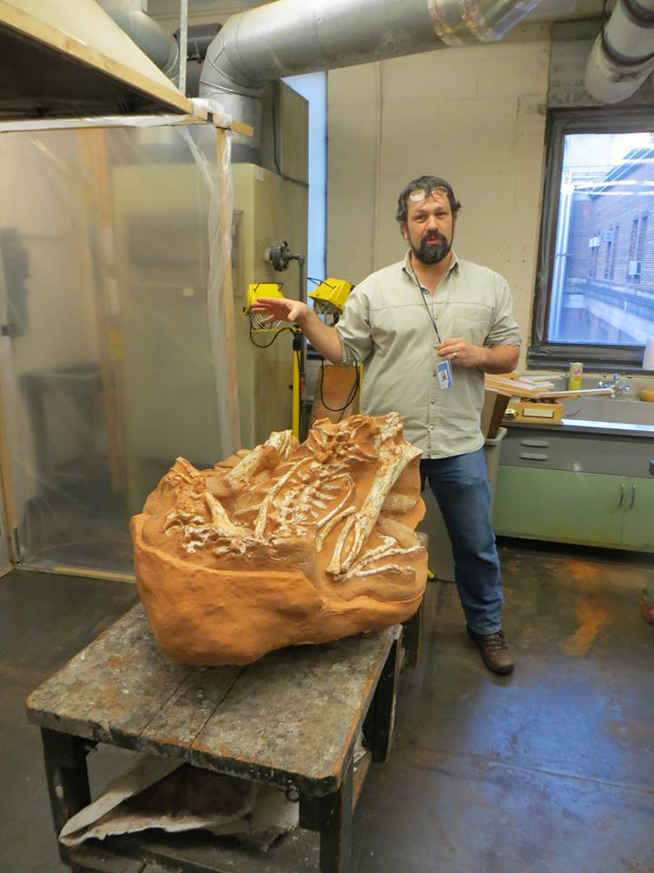
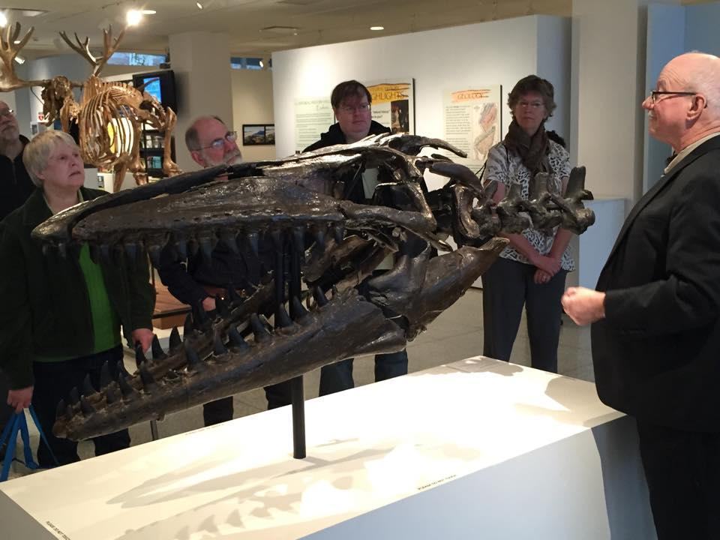
DVPS Activities
Field Trips
Museums
www.DVPS.org
facebook.com/DVPSPaleo

Slide 7
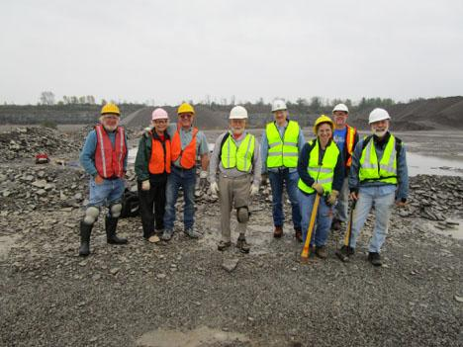
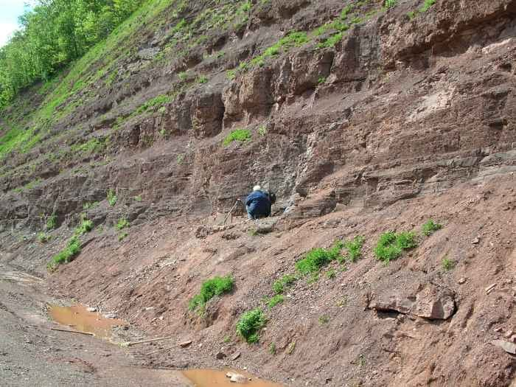
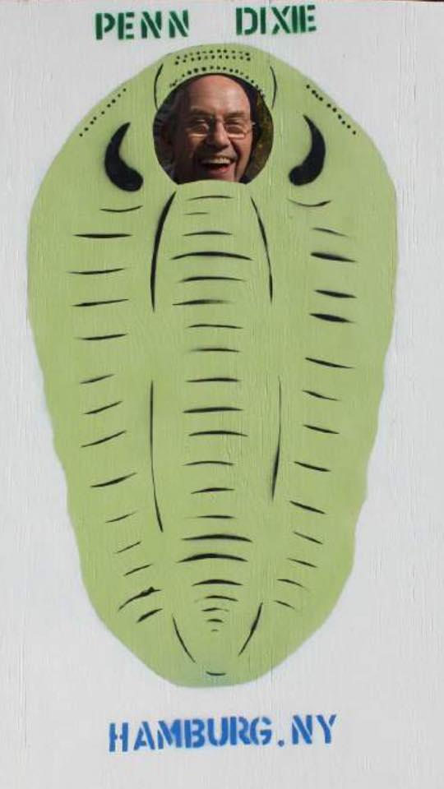
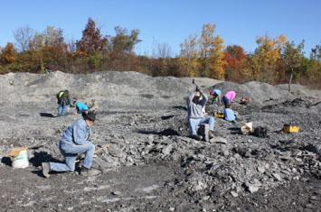
DVPS Activities
Field Trips
Collecting
www.DVPS.org
facebook.com/DVPSPaleo

Slide 8
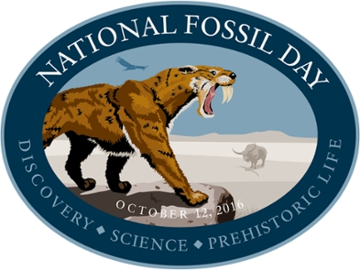
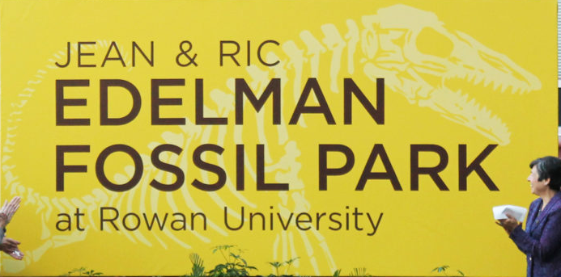
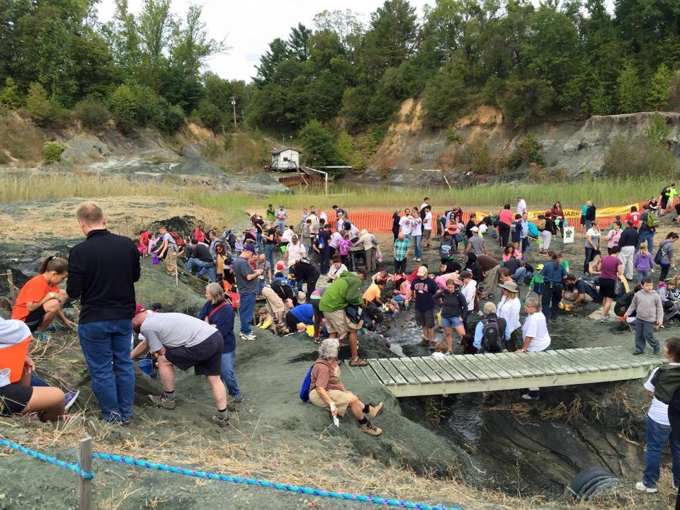
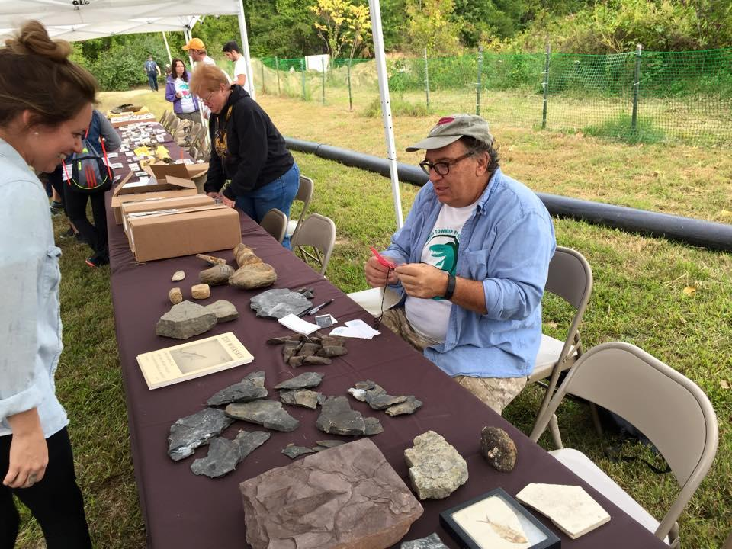

Outreach
Events
National Fossil Day
Philadelphia Science Festival
Rowan Fossil Park
www.DVPS.org
facebook.com/DVPSPaleo

Slide 9

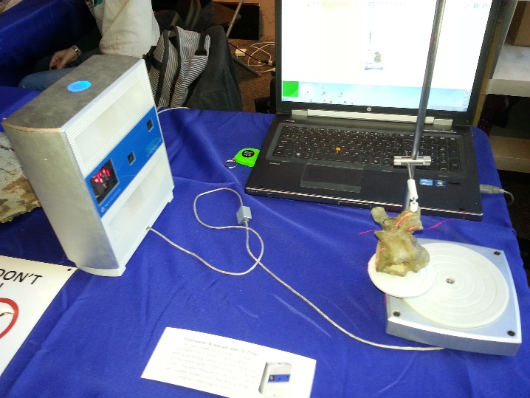
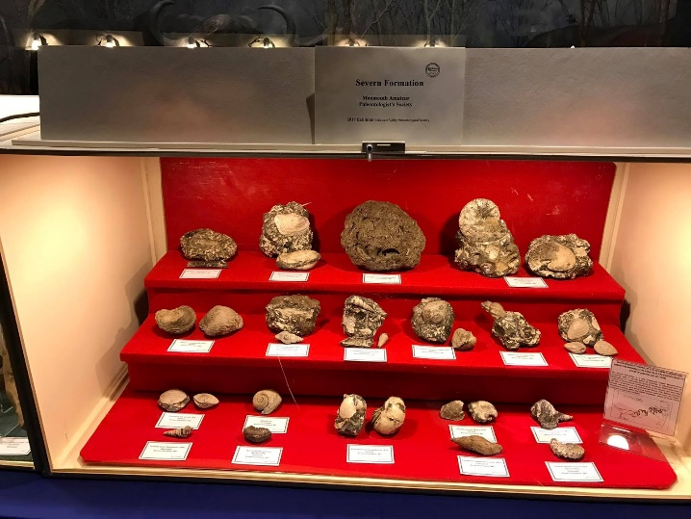
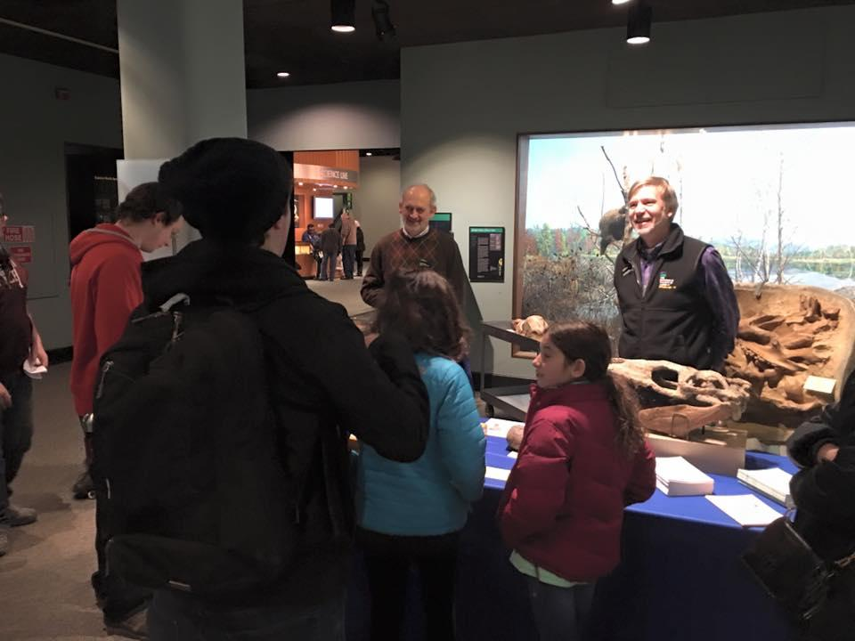
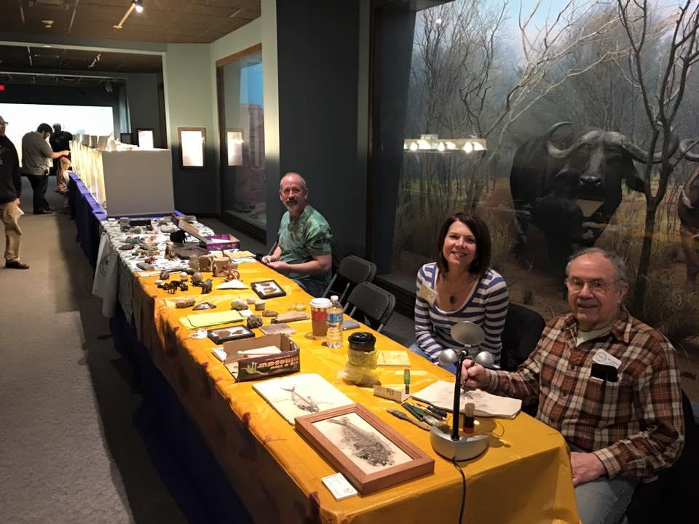
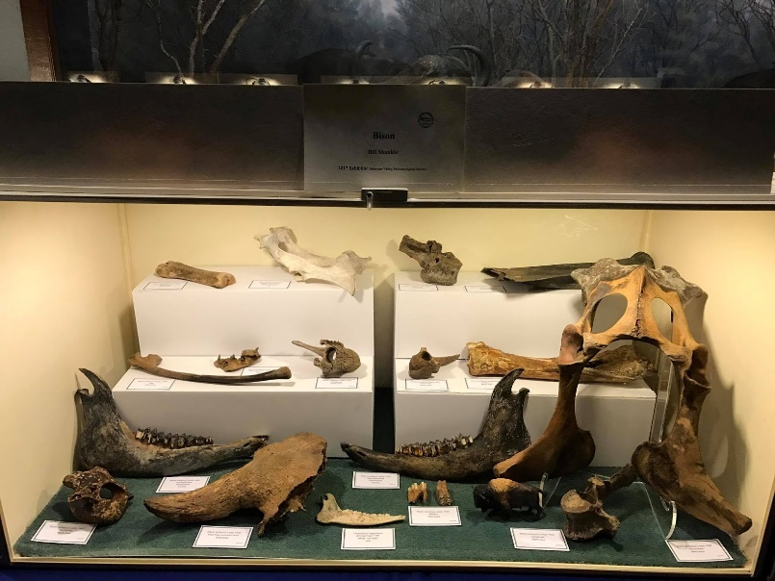
Outreach
Events
Paleopalooza
www.DVPS.org
facebook.com/DVPSPaleo

Slide 10
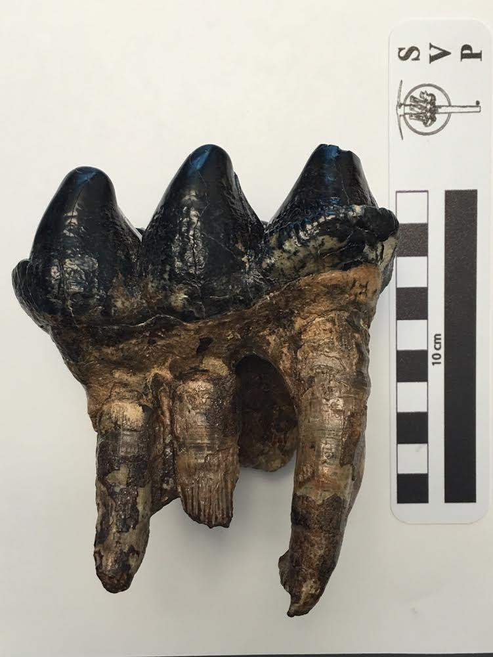
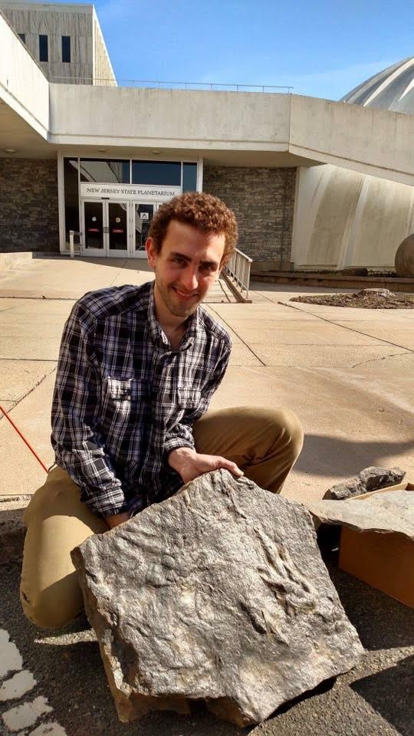
Scientific Contributions
Mastodon tooth
NJSM
(L. Schnatterly)
Primary Beneficiaries
American Museum of Natural History
Academy of Natural Sciences of Philadelphia (Drexel University)
New Jersey State Museum
National Museum of Natural History
Calvert Marine Museum
Major Collections (not pictured)
Kuehne Collection (AMNH & NJSM)
Cynthia Miller Collection (NJSM)
John Wolf Collection (AMNH)
Lauginiger C & D Canal Collection (NJSM)
Camburn Collection (NJSM)
Gallagher Collection (NJSM)
Tr/Ju Trackways
NJSM (Boyland & McCauley)
www.DVPS.org
facebook.com/DVPSPaleo

Slide 11
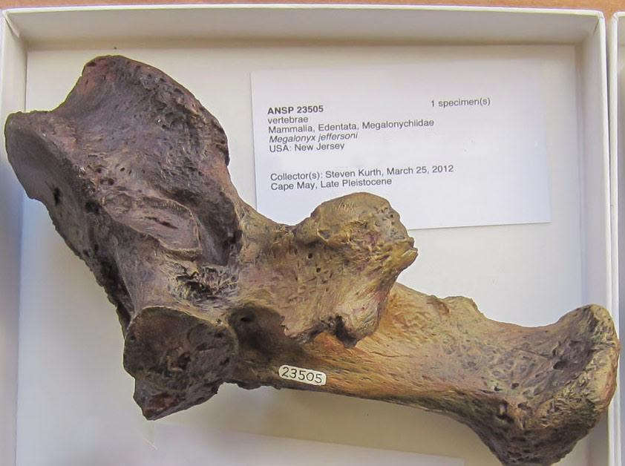
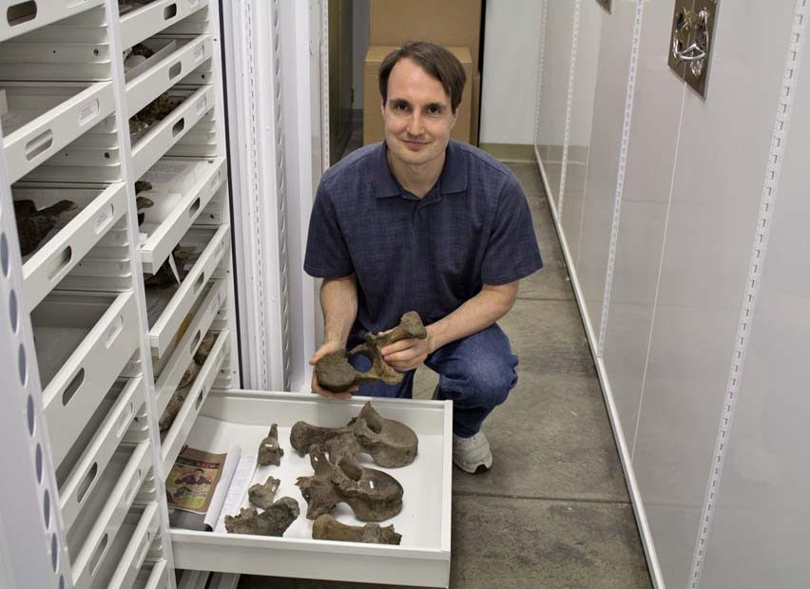
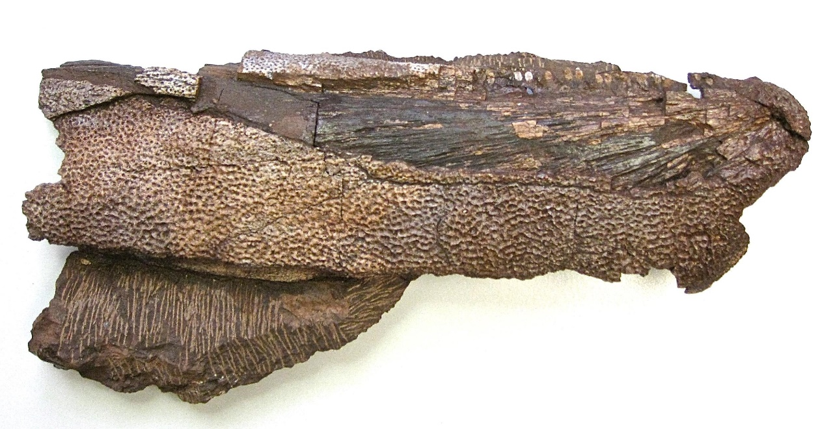
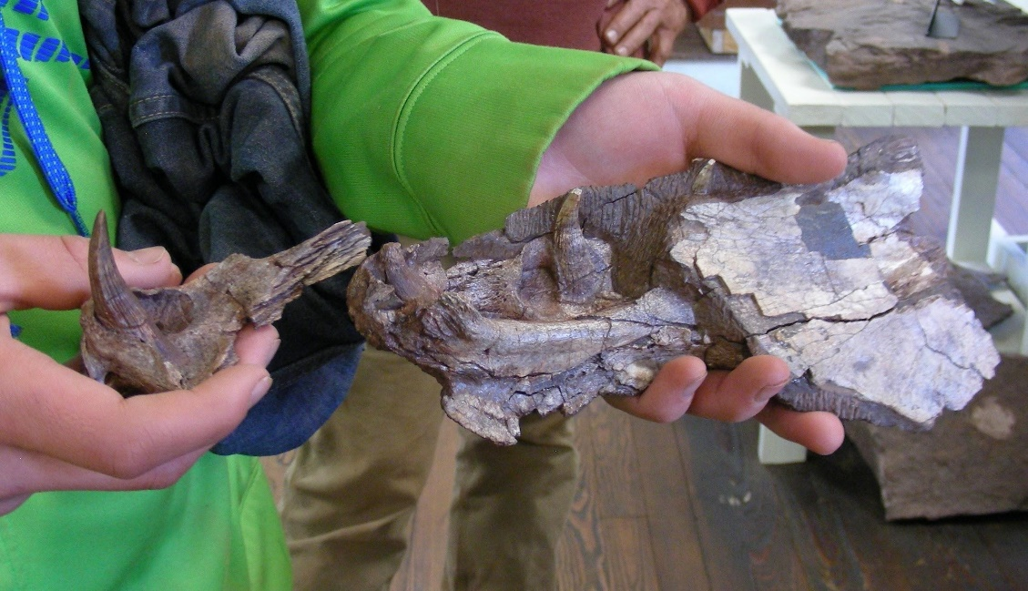
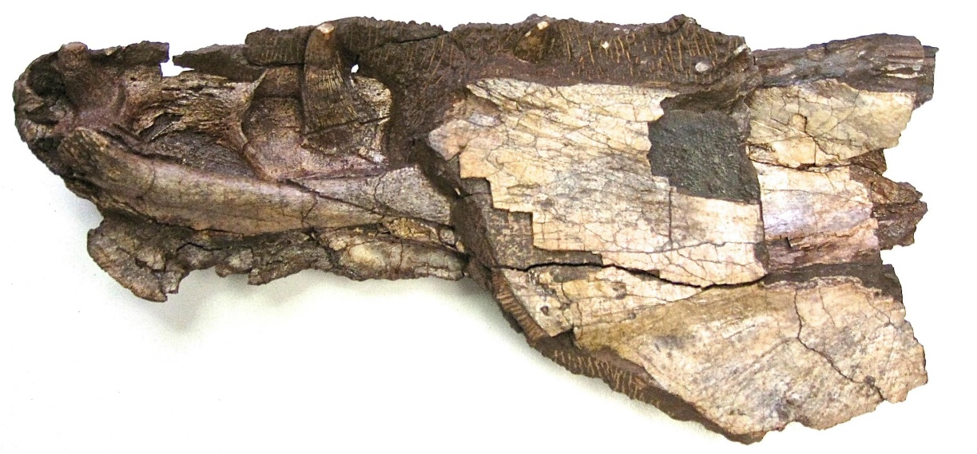
Contributions
Many, many specimens
Megalonyx jeffersoni
ANSP
(S. Kurth)
Hyneria
ANSP
(P. & I. Bourdon)
www.DVPS.org
facebook.com/DVPSPaleo

Slide 12
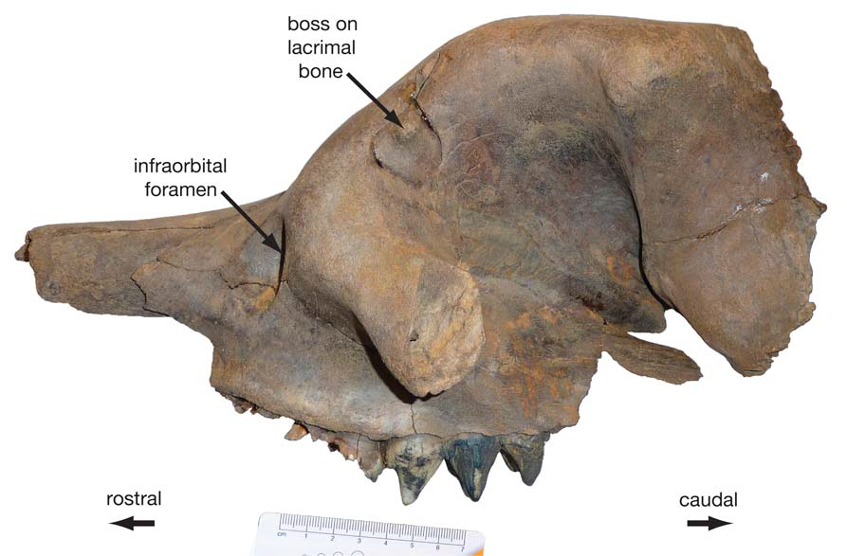
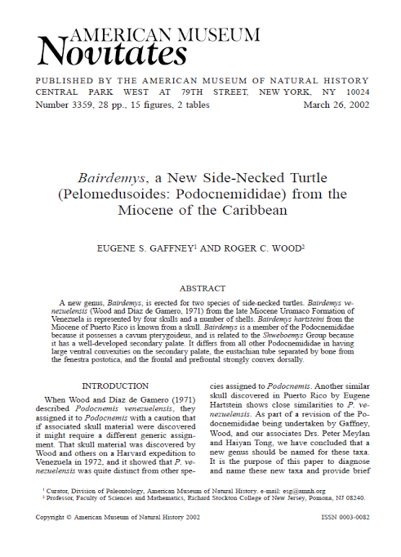
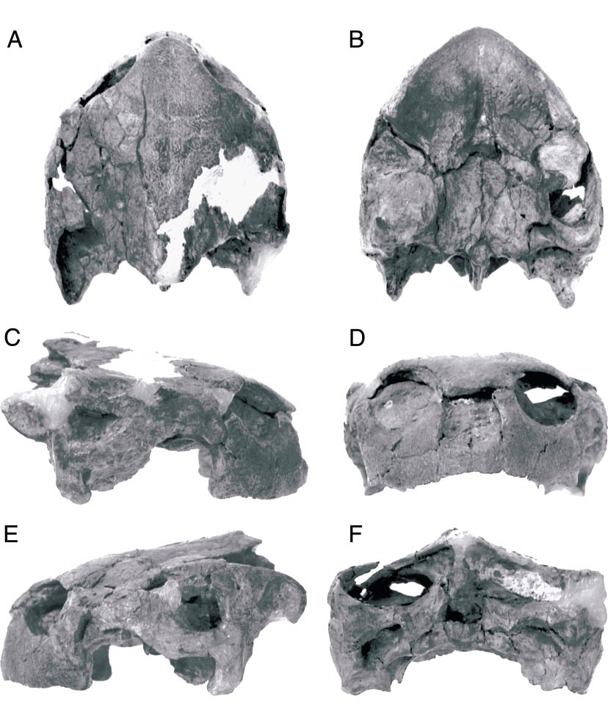
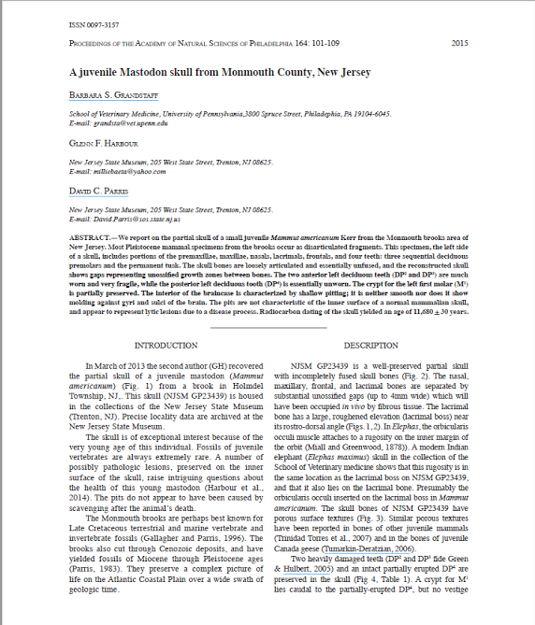
Contributions
Juvenile Mastodon Skull
NJSM
(S. Ballwanz)
Specimens & Publications
Bairdemys harsteini*
AMNH
(G. Hartstein**)
www.DVPS.org
facebook.com/DVPSPaleo

Slide 13
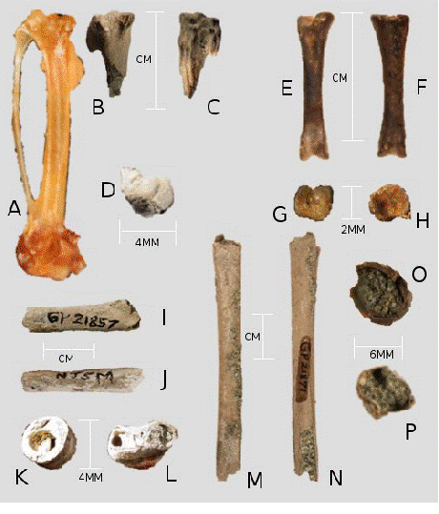
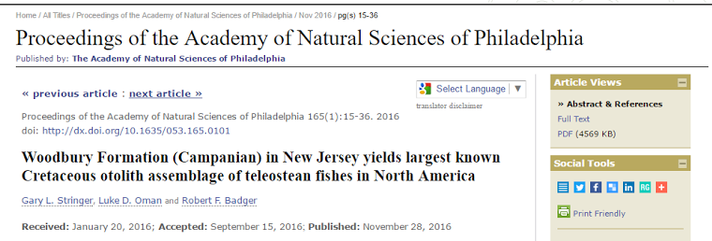
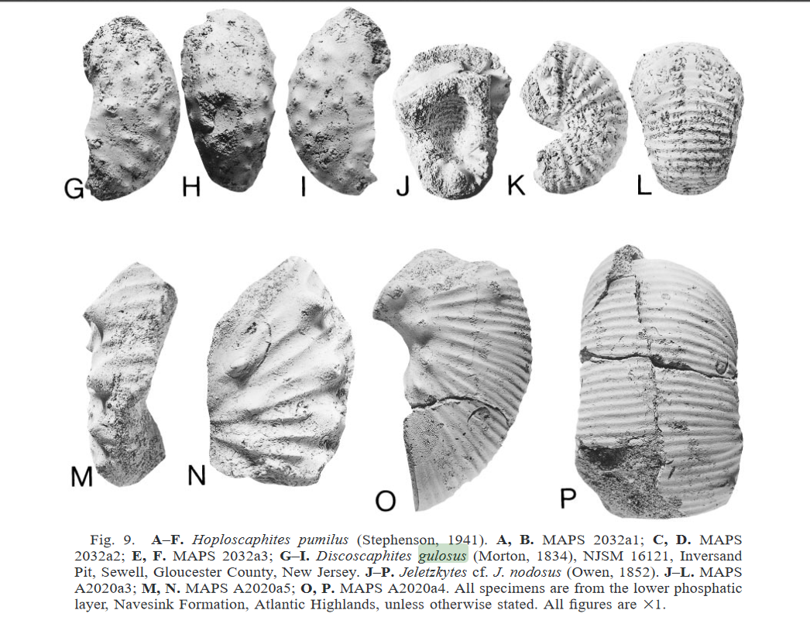
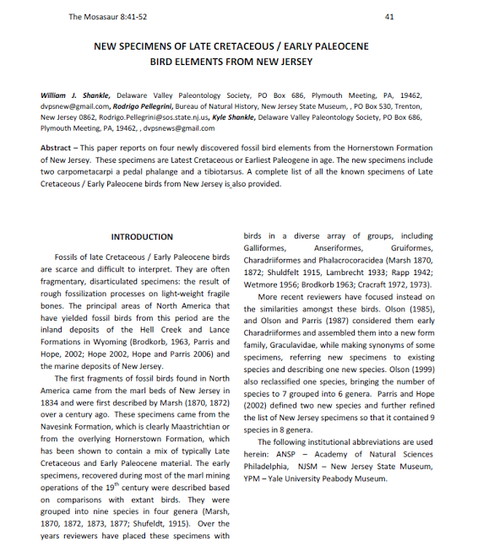
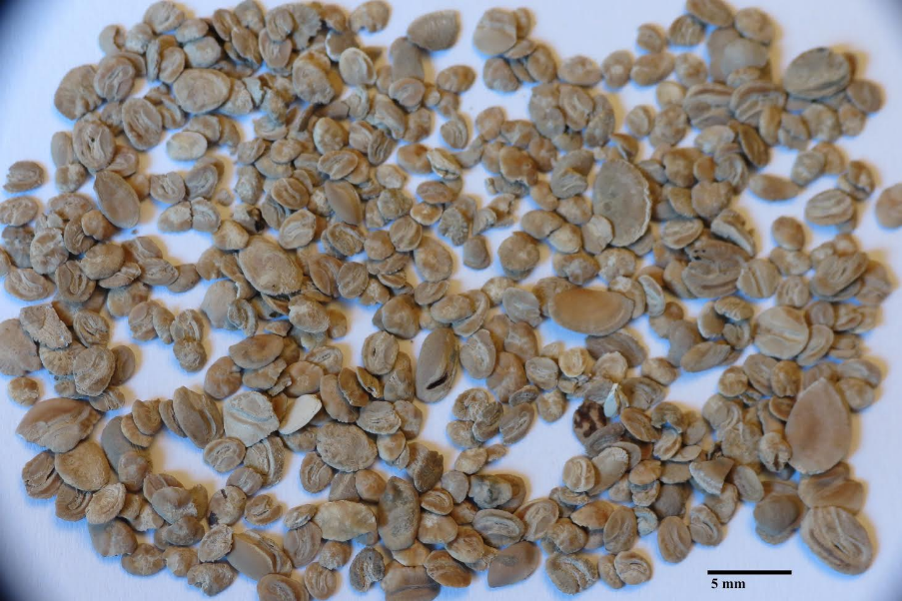
Contributions
K/Pg Bird Bones
NJSM
(B. & K. Shankle)
Specimens & Publications
Discoscaphites gulosus
NJSM (S. Kurth)
~3,500 otoliths
NJSM
(L. Oman)
www.DVPS.org
facebook.com/DVPSPaleo

Slide 14
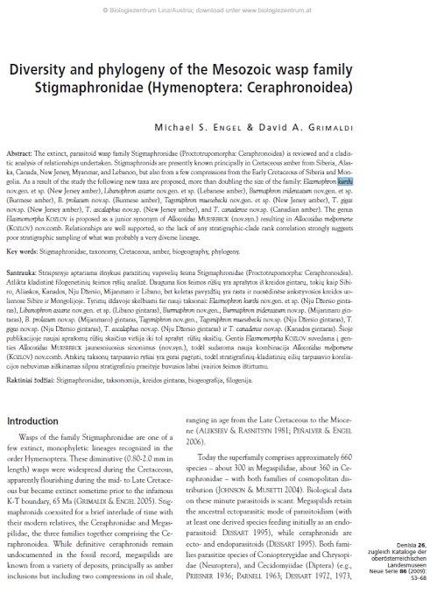
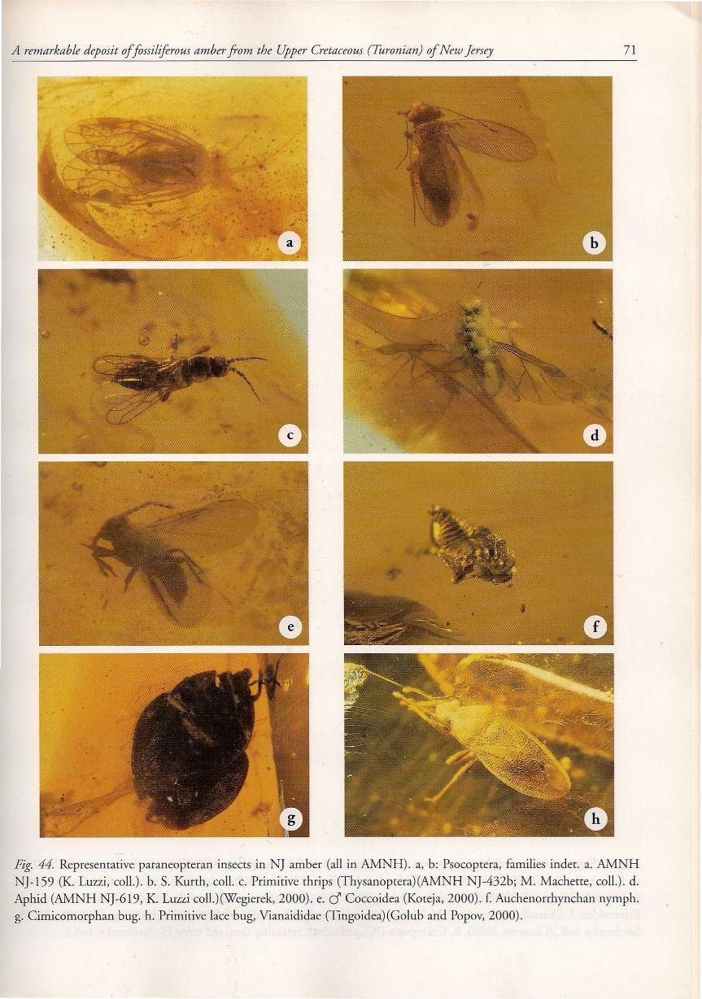
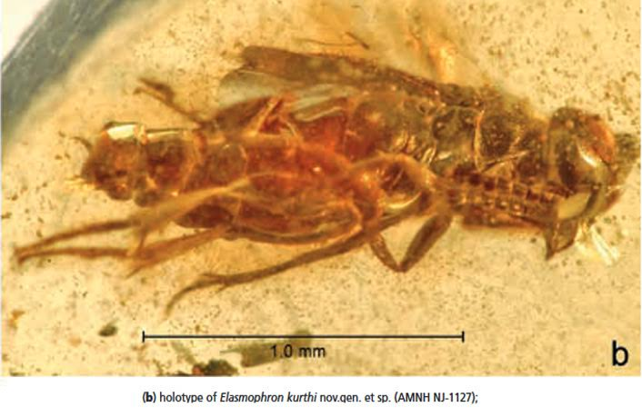
Contributions
Specimens & Publications
Insects in Amber (AMNH)
Elasmophron kurthi*
Jersicoccidae
Jersicoccus kurthi*
Stilobezzia kurthi*
Symmorphus senex
Jersococcus kurthi*
AMNH
(S. Kurth)
Elasmophron kurthi*
AMNH
(S. Kurth)
www.DVPS.org
facebook.com/DVPSPaleo

Slide 15
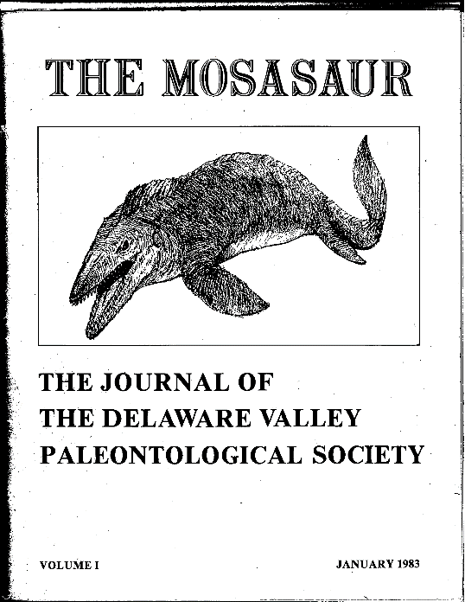
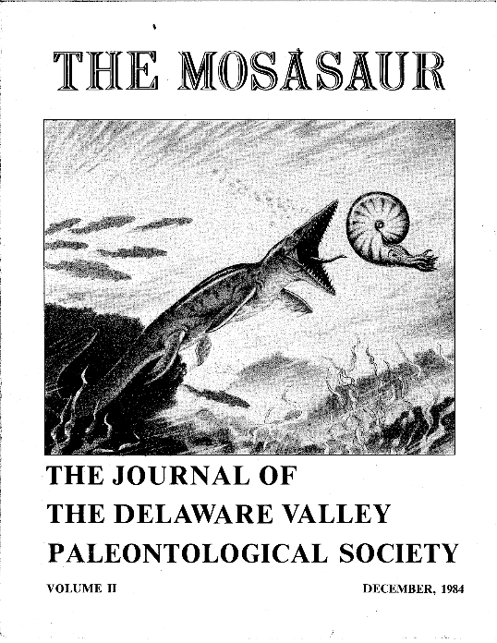







Publications
The Mosasaur
1st published in 1982
2016: 9th Volume
www.DVPS.org
facebook.com/DVPSPaleo
Notes:
92 articles

Slide 16



Fundraising
Dues
Fossil Fair
www.DVPS.org
facebook.com/DVPSPaleo

Slide 17




Fundraising
Paleopalooza
Holiday Party
Auction
www.DVPS.org
facebook.com/DVPSPaleo

Slide 18




Support
Grants
1983: Dr. Peter Dodson, U. of Pennsylvania: Recovery of the type species of Avaceratopsis lammersi in Montana
1999: Matt Lamanna and Josh Smith, University of Pennsylvania: Support a group from UPenn searching for dinosaurs in the Egyptian desert.
2001: Doug Rowe, Red Hill Museum, North Bend, PA: Purchase materials for museum ceiling
2002: Aurora Fossil Museum, Aurora, NC: Purchase materials for museum renovation
2009: Hamburg Natural History Society, Hamburg NY: Donation to their building fund
2010: Doug Rowe, Red Hill Museum, North Bend, PA: Purchase of camera equipment for the museum
2011: Friends of the NJ State Museum: Inversand Project – Cretaceous marl pit located in Mantua Twp, NJ
www.DVPS.org
facebook.com/DVPSPaleo

Slide 19



Support
Grants
2012: Dr. Kenneth Lacovara, Drexel University: Inversand Project – Cretaceous-aged marl pit located in Mantua Twp, NJ
2013: Dr. David Broussard, Lycoming College: Research fish scales found at the Red Hill site
2015: Rowan Fossil Park, support fossil day
2015: Waco Mammoth National Monument
2015: Experiment.com Crowdfunding Campaign, Bighorn Basin Dinosaur Project
2016: Waco Mammoth National Monument
2017: International Symposium on Paleohistology, New Jersey State Museum
www.DVPS.org
facebook.com/DVPSPaleo

Slide 20
Support
Grants
Totals:
~$12,000
13 initiatives
www.DVPS.org
facebook.com/DVPSPaleo

Slide 21

Support
Paul Bond Scholarship
Established in 1993
Managed by the Philadelphia Foundation
Purpose
Provides funds for tuition, field work, research or data analysis, etc., to a graduate student in the Delaware Valley region who is actively pursuing a graduate degree in paleontology.
Awards
Annual (one-time) award of $1,500
Awardee encouraged to be a featured speaker at a monthly meeting
www.DVPS.org
facebook.com/DVPSPaleo
Notes:
The Paul Bond Scholarship Fund was established by DVPS in 1994 in memory of Paul N. Bond to honor his commitment to paleontological study and to show the respect in which he was held by all that knew him. Paul was a charter member of the Society and served on the board of directors and as a vice-president.

Slide 22

Support
Paul Bond Scholarship
Awardees
Josh Smith (University of Pennsylvania); 1997 (Am. Institutes for Research)
Allison Tumarkin-Deratzin (University of Pennsylvania); 1998 (Temple University)
Katherine Davis (University of Delaware); 1998
David Cassenti (Rutgers University); 2000
William Gottobrio (Bryn Mawr College); 2001
Matt Lamanna (University of Pennsylvania); 2002 (Carnegie Museum of NH)
Merrilee Guenther (University of Pennsylvania); 2003 (Elmhurst College)
Doreena Patrick (University of Pennsylvania); 2004 (Stockton University)
Domenic D’Amore (Rutgers University); 2006 (Daemen College)
www.DVPS.org
facebook.com/DVPSPaleo

Slide 23

Support
Paul Bond Scholarship
Awardees
Emma Schachner (University of Pennsylvania); 2008 (LSU)
Eric Morschhauser (University of Pennsylvania); 2010 (Indiana U. of PA)
Joseph Frederickson (Temple University); 2012 (Student, U. of OK)
Zack Boles (Drexel University); 2014 (Rowan University)
Kristyn Voegele (Drexel University); 2016 (Rowan University)
Totals
$17,500 14 students
www.DVPS.org
facebook.com/DVPSPaleo

Slide 24


Into the Future
Electronic newsletters
Electronic journals
Live-streaming
Posting Speaker Slides
www.DVPS.org
facebook.com/DVPSPaleo
Notes:
15 paper newsleters.. 220 electronic. Mosasuaur 9 I rinsed about 50 paper. 8 we printed for everyone so 200 plus. 9 people had to cover printing costs and could get it online

Slide 25


Thank You
www.DVPS.org
facebook.com/DVPSPaleo

Slide 26
The Delaware Valley Paleontological Society:
A History of Advancing Paleontology for Everyone
Jason P. Schein
Executive Director
Bill Shankle
President
DVPS Board of Directors
www.DVPS.org
facebook.com/DVPSPaleo

