Slide 1

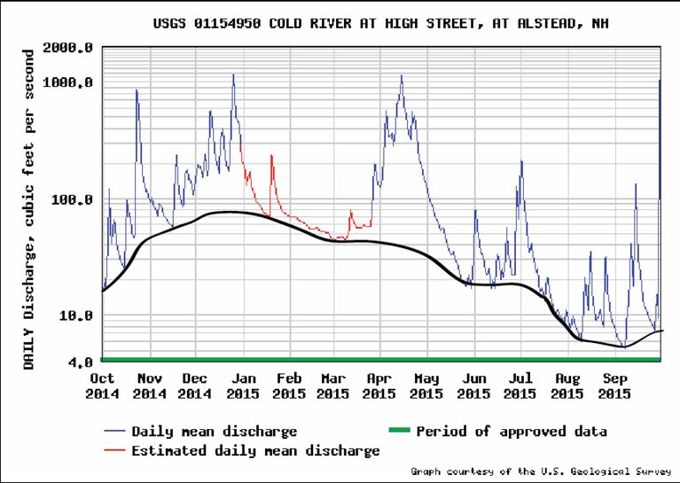
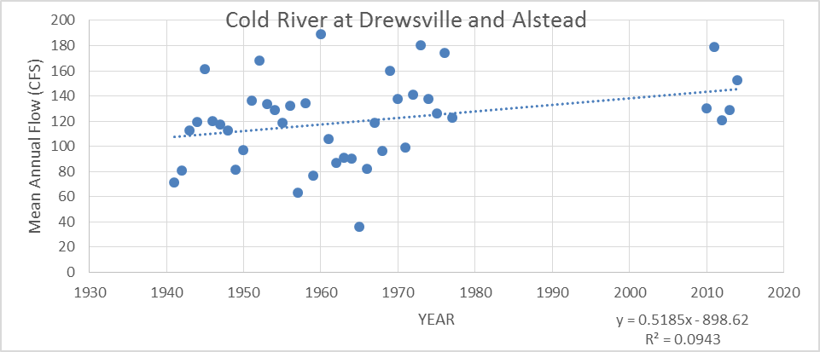
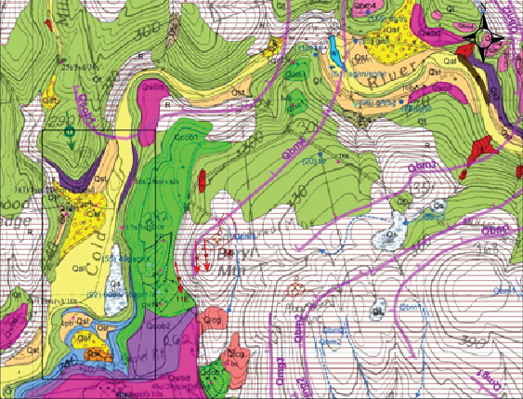

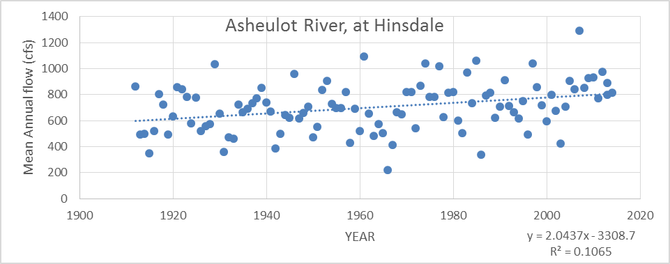
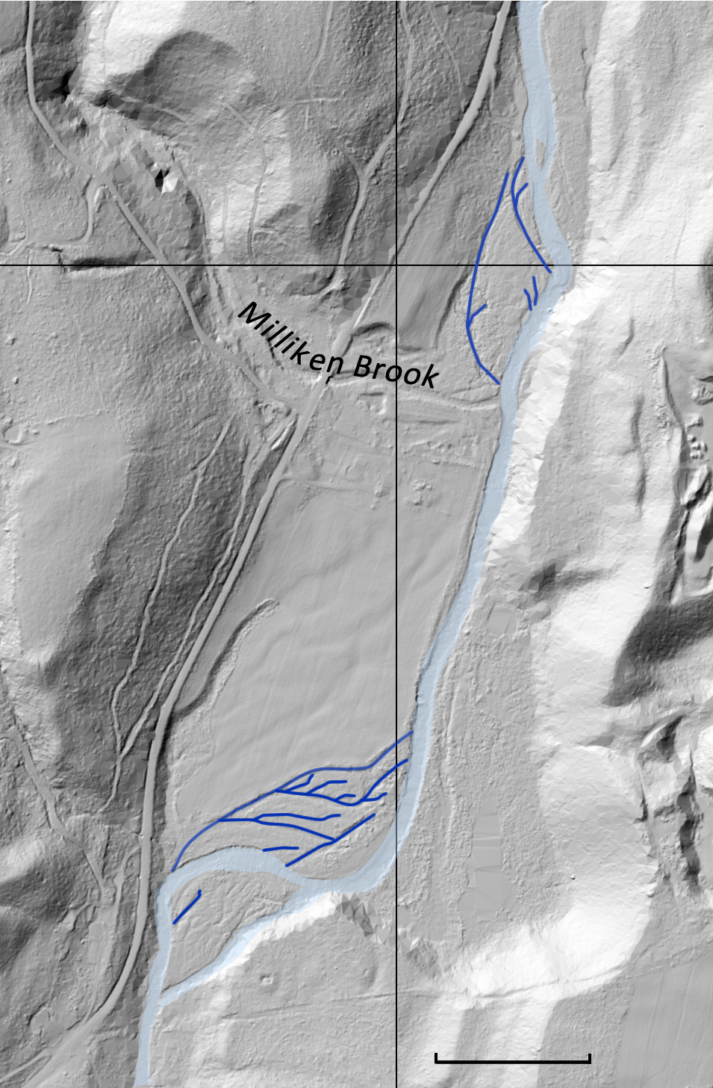
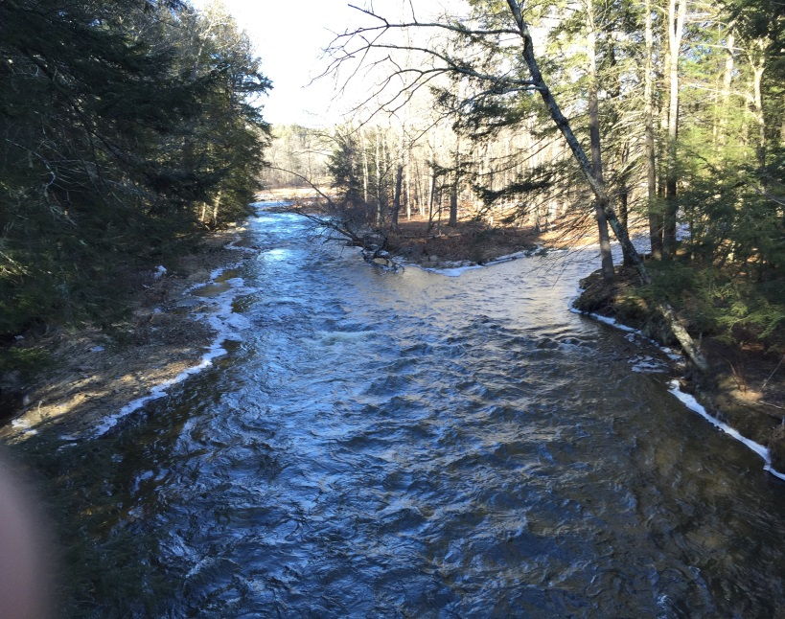
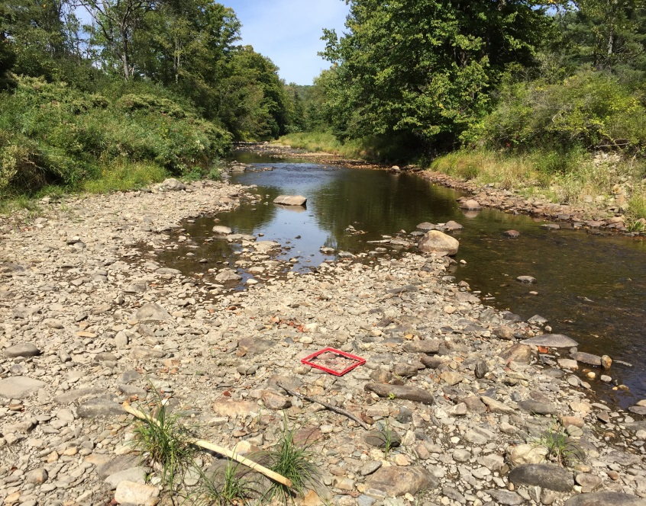
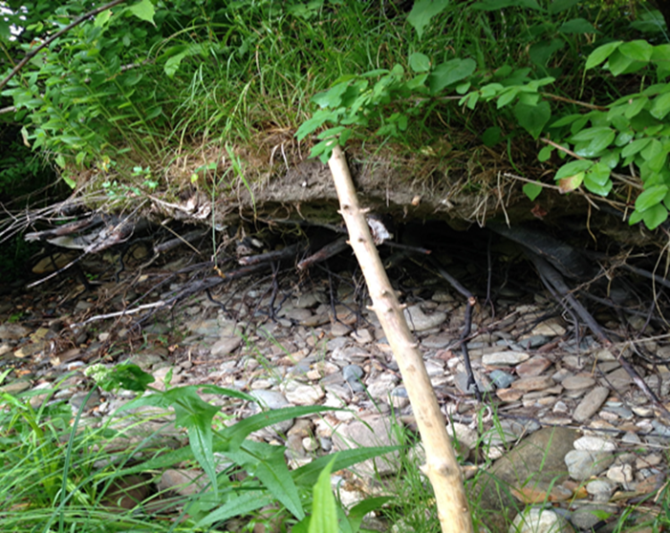
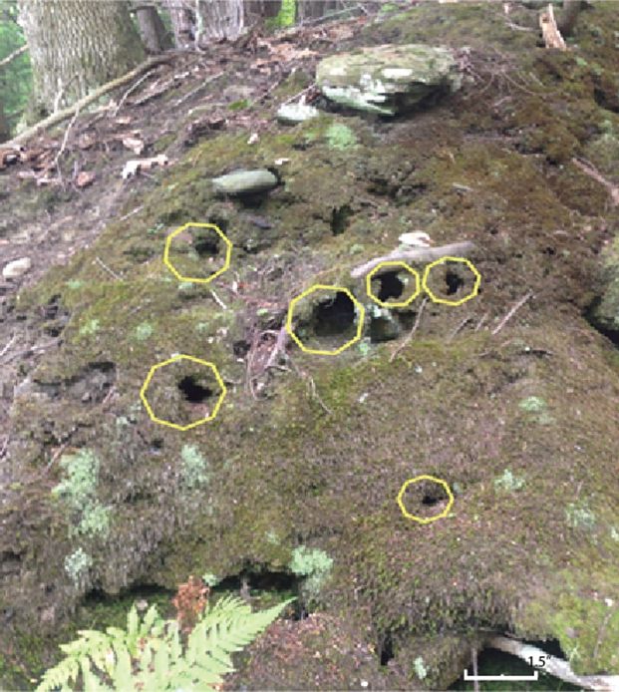
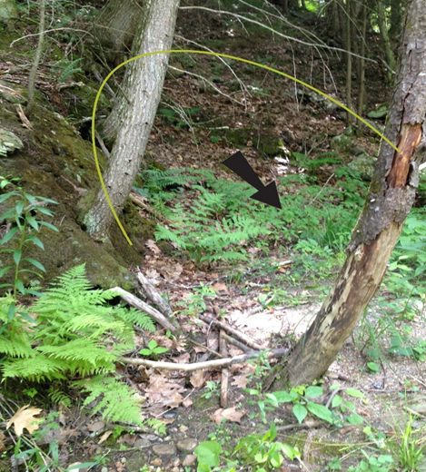
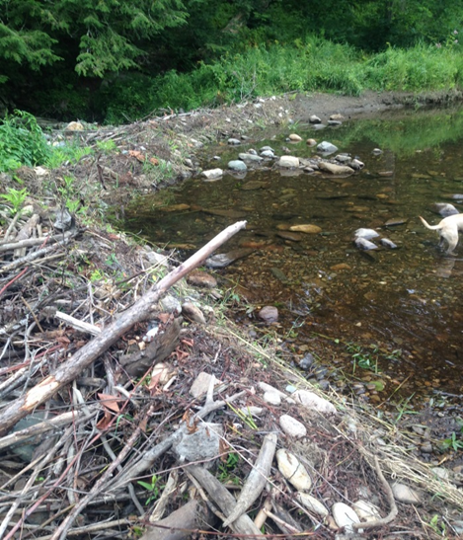
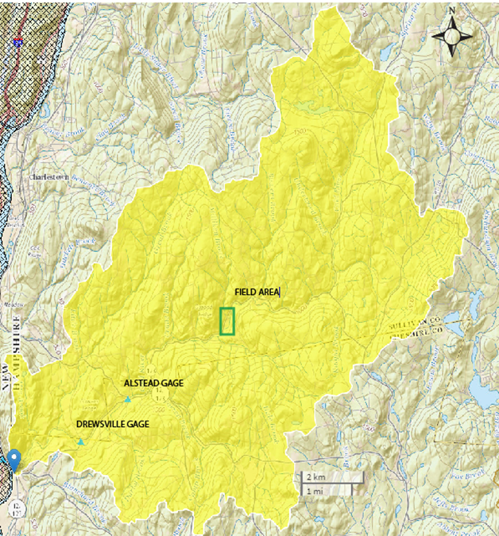
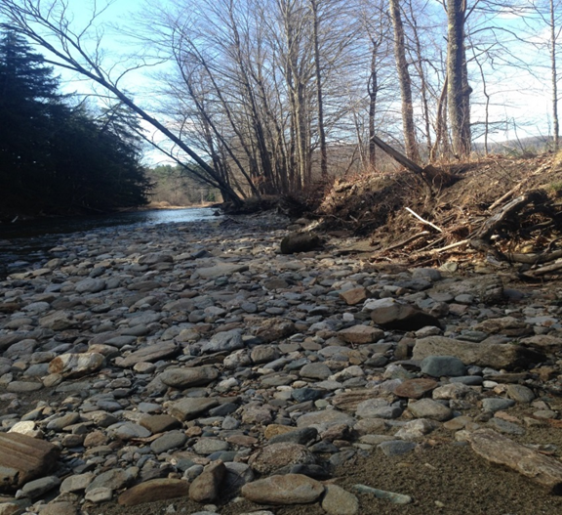
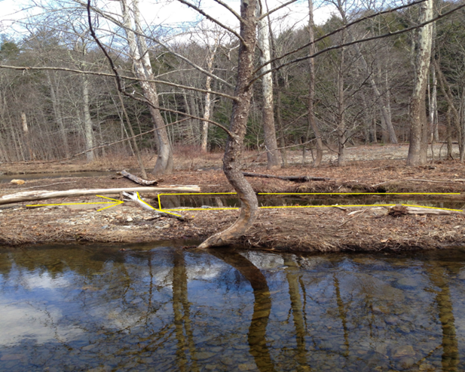
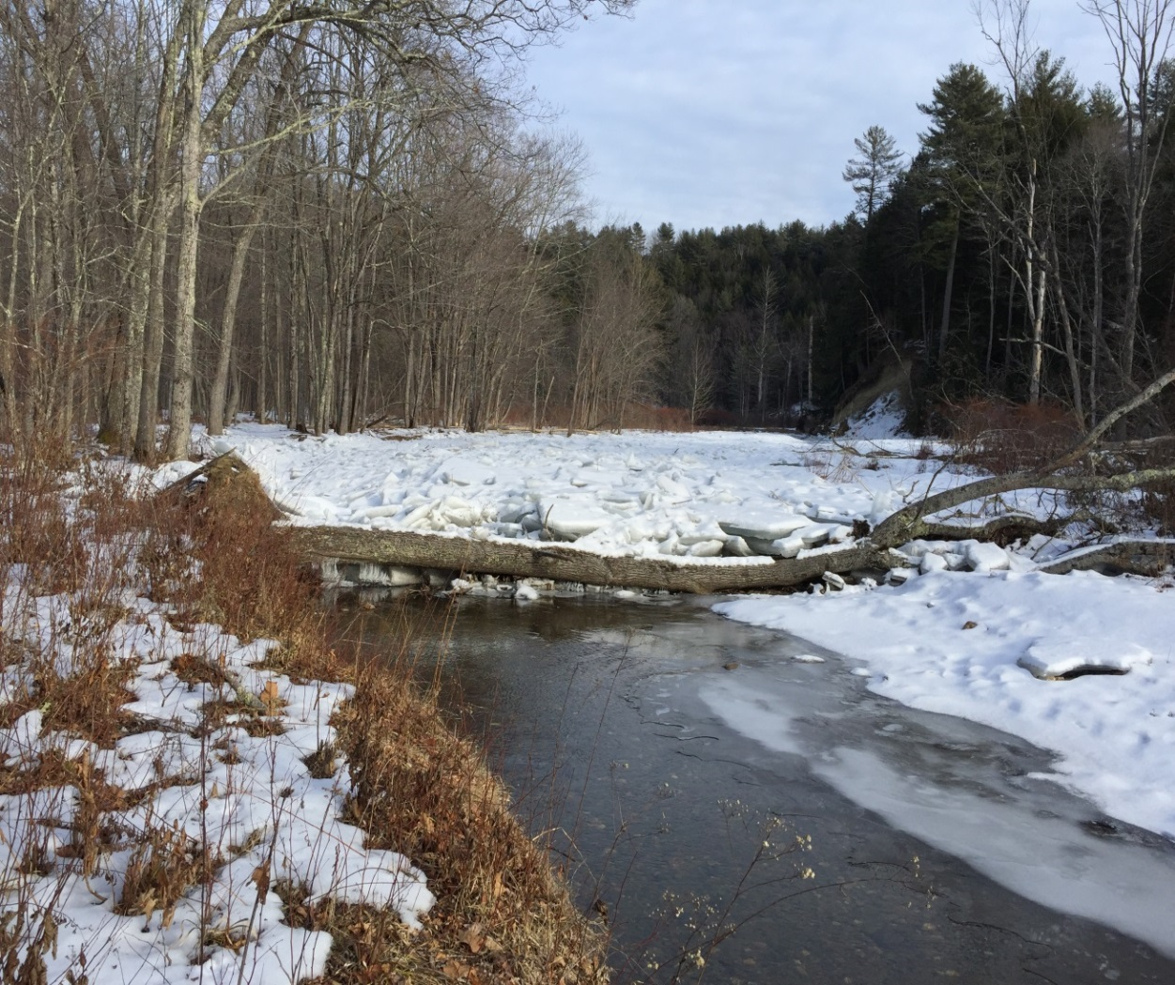
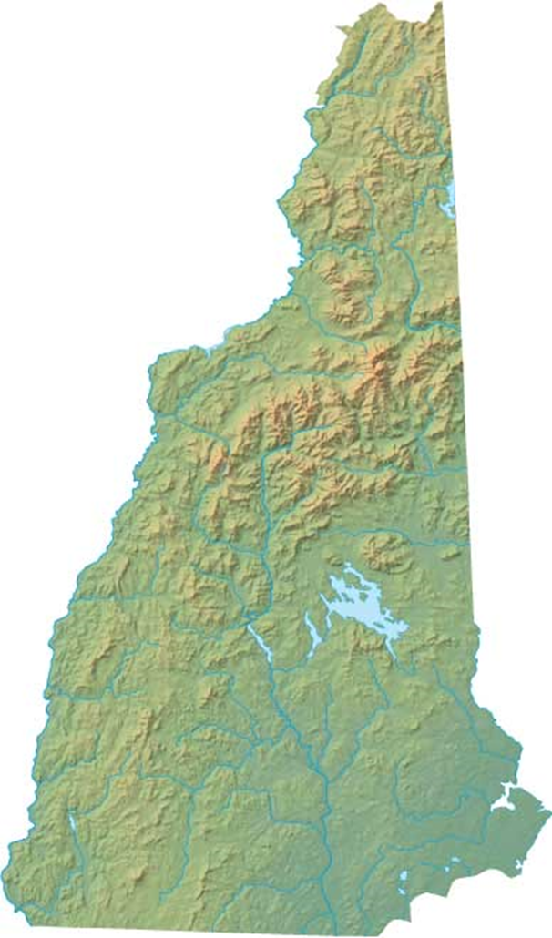
MECHANISMS OF EROSION AND AVULSION IN THE COLD RIVER IN RESPONSE TO CLIMATE CHANGE
Jeffrey D. Kelly and Dr. Lindley Hanson, Department of Geosciences, Salem State University, Salem, MA
ABSTRACT
BASIN GEOLOGY
RESULTS
The basin is underlain by crystalline igneous and metamorphic rock or the Bronson Hill Anticlinorium.
~75% of the drainage basin is underlain by impermeable till and bedrock (fig. 2) which has considerable impact on river hydrology. Steep slopes and poor permeability favor runoff, and groundwater recharged is limited.
The Cold River (Ad 102 mi²⁾ in southwestern New Hampshire flows 22 miles southwest from its source at Crescent Lake, (elev. 1213ft) through parts of Cheshire and Sullivan counties, discharging into the Connecticut River (elev. 774ft). In recent years, cursory observations indicate that the channel of the Cold River has been shifting and widening. This study attempts to document those changes, understand the driving causes, define the rivers current morphology for future studies, and predict adjustment that may be expected in the future with climate change.
The study area covers a half-mile, mid basin stretch of river that includes two meanders separated by a .3 mile straight stretch. The river hugs the steep, eastern valley wall, composed of 30-100 feet of glacial till and lacustrine sediments. Over a 10 month period, mechanisms of erosion and avulsion were observed as well as evidence of past channel adjustments. To evaluate the rivers hydraulic geometry and classification, profiles across the river at six locations, and along its length were completed, and bedload composition was quantified. Discharge from gages along the river and from neighboring rivers were evaluated to determine whether the observed channel changes might be resulting from increasing runoff related to climate change.
Records from stream gages indicate an increase in flow over the last 40 years. In addition, the intensity of storm events is increasing. In response, the Cold River is widening along straight stretches and developing a more anastomosing pattern along meander bends. Mechanisms for channel avulsion include damming induced by ice, beaver, slow moving debris flows, as well as trees introduced by undercutting and debris slides. Deflected flow escapes the channel and re-enters downstream where knickpoint erosion progressively creates new channels after repeated re-occupation. Slow moving but increasingly prevalent debris flows are progressively shifting the channel eastward, while deposition of coarse tributary flood deposits are locally forcing the channel westward. However, the bouldery bed of the river inhibits scouring and promotes channel widening and bank undercutting. Channel avulsion and widening of the Cold River will most likely continue if precipitation and the intensity of runoff events continue to increase.
STREAMFLOW DURING PERIOD OF STUDY
Mean Annual Flow: 129.25 cfc
Groundwater contribution: 41.43 cfs
68% of discharge was runoff
32% was baseflow
Poor basin permeability, steep slopes and increasing storm intensity result in the river’s low baseflow and flashy behavior.
Surficial Geology
Qt
Till
Exposed Till/Bedrock
All other colors represent glacial lake and stream terrace deposits along the valley. Basin uplands are underlain by glacial till and bedrock.
CHANNEL MORPOLOGY (Table 1):
Figure 5. Hydrograph and baseflow separation for the period of study, from October 2015, to October 2016.
Figure 2. Local surficial geology (Ridge, 2011)
Mueller’s (1968) equations: hydraulic and topographic sinuosity indices were .71, and .29 respectively, indicating that the majority of the sinuosity the Cold River experiences can be attributed to the interaction of hydraulic variables, rather than antecedent topography.
Rosgen (1998 ) classification: Type ‘B2’ (Table 1).
Nanson(1996)Classification: Anabranching, type 4.
Montgomery and Buffington (1997): step-pool, and pool-riffle morphology.
Table 1. Compares Rosgen’s B2 classification scheme against measured parameters from 6 profiles.
 | Rosgen’s B2 Parameters | Cold River - Measured Parameters
Slope | .02-.039 | .022
Sinuosity | >1.2 | 1.2
Entrenchment Ratio | 1.4-2.2 | 1.24
Width – Depth Ratio | >12 | 3.8
Dominant Particle Size | Cobble | Cobble/Boulder
HISTORIC STREAM FLOW :
Data obtained from two gages on the Cold River: (fig. 6)
River Street Gage, Drewsville: Period of record 1941-78, A_{d}=74.6 mi²
High Street Gage, Alstead: Period of record 2009-2017, A_{d}=82.7 mi²
Basin contribution to flow recorded by the Drewsville gage between 1945 and 1775 was 1.44 cfs/mi²
Basin contribution to flow recorded 40 years later by the Alstead gage is 1.56 cfs/mi².
If taken at face value this would indicate an 8% increase in basin contribution over the last 40 years
INTRODUCTION
Figure 6. Plots of mean annual discharges for the Cold and Asheulot Rivers. As gage data is discontinuous for the Cold River, neighboring streams were also evaluated (e.g. the Asheulot River shown above). The Cold River displays an increase of .51cfs/year, while the Asheulot displays an increase of 2 cfs/ year over its period of record.
GLOBAL WARMING AND A CHANGING CLIMATE:
Annual temperatures in the Northeast have risen 1.3°F since 1900. Since 1970, temperatures increased at a greater rate, by .5°F per decade (Frumhoff 2007).
Precipitation has increased 10% since 1900, and is expected to increase an additional 11%-17% by 2100 (Frumhoff 2007). Extrapolating from current trends, increased seasonal variability in precipitation is expected with dryer summers, and wet, warmer winters dominating. (Frumhoff 2007).
2” rainfall events have increased in their frequency and intensity since the 1950s. From 1983 to 2008, precipitation trends have shown a 7% increase in storm intensity from 1961-’79 values. (Hayhoe 2008).
Due to the increased intensity of precipitation, the infiltration capacity of the land is exceeded more often, yielding greater runoff, and increasing the flashiness of streams having impermeable drainage basins.
THIS STUDY IS AN ATTEMPT TO DOCUMENT CHANGES IN RIVER MORPHOLOGY IN RESPONSE TO LOCAL CLIMATE CHANGE ON THE COLD RIVER, SW NEW HAMPSHIRE
THE FIELD AREA:
Compared, yet not displayed, were the mean annual flows for the Sugar, William's, Saxons, and Connecticut Rivers. These neighboring rivers displayed a corresponding increase in discharge over time.
The increase in discharge has been coupled with an increase in storm intensity, and frequency over the last 50 years, it is the combination of these two phenomena which serve as catalysts for the observed mechanisms of erosion and avulsion.
A
B
OBSERVED MECHANISMS OF EROSION AND AVULSION:
A
B
C
Figure 8. Beavers were active in the field area, and constructed 5 dams during the duration of the study. This dam, along the lower reach, is ~16 ft. long and 3 ft high. During mid-summer the dam was abandoned because water was diverted into another eastern channel. The following month 1 new dam appeared across the main channel with 3 new dams across old flood channels in the upper reach.
UR
UR
C
Figure 3. Comparison of A) the river at bankfull stage (27 Feb 16), with B) low flow conditions (17 Sept 17). Note the coarse bedload exposed at low flow. Boulders and cobbles armor the bed promoting channel widening during floods.
MR
MR
The study area (figs. 1 and 4) includes a .5 mile long stretch of river, located in the middle of the basin, 1.5 miles SW of Acworth Village, and 4.6 miles NW of Alstead.
Field area consists of
1. Upper meandering reach (UR)
2. A middle straight stretch(MR)
3. Lower meandering reach (LR)
Lower reach contains two active channels. Both meandering reaches are also anastomosing.
C
THE COLD RIVER AND ITS BASIN:
D
E
F
CONCLUSION
LR
LR
Changing climatic conditions are reflected in the increased mean annual flows of the Cold River and adjacent rivers.
Higher peak flows and lower low flows show that precipitation is occurring more unevenly in concentrated storm events.
Increased intensity of storm events is resulting in increased anabranching, bank erosion and channel widening.
Increased flooding coupled with Ice dams, debris dams, beaver dams, tributary flood deltas, and debris flows contributed to anabranching along meander bends, while bank erosion coupled with an armored channel bed causes channel widening along straight stretches.
Increased anabranching and channel widening are likely to persist if precipitation and the intensity of runoff events continues to increase.
0 500 feet
Figure 4. LIDAR image of field area (courtesy of NH GRANIT) The Cold River at bankfull stage is light blue. Spring flood channels are dark blue.
METHODOLOGY
Figure 7. Mechanisms of erosion, channel deflection and avulsion observed in the study area. These include:
Over a 10 month period, mechanisms of erosion and avulsion were observed as well as evidence of prior channel adjustments.
The river’s hydraulic geometry and classification were evaluated by profiling across the river at six locations and along its length.
All beaver dams, landslide activity, bank erosion, channel formation and diversion, and knickpoint erosion during flooding were observed and recorded
Stream flow during the period of study was evaluated using data from the USGS gauge in Alstead, NH.
For the regional flow analysis, USGS discharge data from the Drewsville and Alstead gages and surrounding watersheds were compiled and analyzed.
Bedload composition was recorded along the entire reach studied.
Bank undercutting along straight and meandering stretches of the river. This bank is undercut several inches to >2 feet.
Piping across from Milliken Brook. These pipes are up to 1.5” in diameter. Piping is common along active slopes, and occurs where torn tree roots have rotted.
Soil creep, slumps, slides and debris/earth flows are common, particularly along the steep eastern valley wall, as seen here. The flows push the channel toward the west.
Coarse alluvium from Milikens Brook deposited during the 2005 flood pushed the main channel eastward. Cobbles inhibits lateral erosion of the western bank during low flow conditions, but promoted higher level erosion during flooding. Increased erosion on opposite (east) bank promoted earthflows.
Channel formation through headward erosion is common where the river flows over the western bank, and re-enters the river downstream. Here knickpoint erosion was halted by debris (fig. 4).
Debris and ice dams on the river. Ice scars on trees show a river ice thicknesses of >2ft above bankfull stage. River ice accumulated on meander bends, diverting flow onto the floodplain. New channels formed through knickpoint erosion, starting where the flow reentered the main channel.
.
Figure 1. Study area within the 102-sq.mi Cold River drainage basin. Green dots locate the Alstead and Drewsville stream gages. (image created using U.S.G.S streamstats 3.0: https://water.usgs.gov/osw/streamstats/).
REFERENCES CITED
From its source at Crescent Lake, (elev. 1213ft) the Cold River flows west 22 miles and discharges Connecticut River (elev. 774ft).
Approximately 4000 people live within the watershed (Heidorn 2009).
River gradient can be locally steep, the steepest gradients occur below dams and where bedrock ledges form waterfalls.
Segments of the river have variable channel characteristics depending on composition and local gradient. The channel bed is largely composed of boulders and cobble, with a minor component of finer gravel and coarse sand.
Frumhoff, P., McCarthy, J., 2007, Confronting Climate Change in the U.S. Northeast: Science, Impacts, and Solutions. Synthesis report of the Northeast Climate Impacts Assessment (NECIA) p.8-9
Hayhoe, K., 2008, Regional Climate Change Projections for the Northeast U.S.: Mitigation and Adaptation Strategies for Global Change, v. 13, p 425-436
Heidorn, M., 2009, Cold River Watershed Management Plan: Cold River Local Advisory Committee, Apr. 2009. Web. <http://des.nh.gov/organization/divisions/water/wmb/rivers/documents/management_plan_cold.pdf>.
Nanson, G., Knighton, A., 1996, Anabranching Rivers: their Cause, Character and Classification: Earth Surface Processes and Landforms, 21, 217–239.
Montgomery, D., Buffington, J., 1997, Channel-reach morphology in mountain drainage basins: Geological Society of America Bulletin 109, 596–611.
Mueller, J., 1968, An Introduction to the Hydraulic and Topographic Sinuosity Indices: Annals of the Association of American Geographers, Vol. 58, Issue 2, p371-385
Ridge, J., 2011, Surficial Geologic Map of Part of the Bellows Falls, NH-VT 7.5 x 15- minute Quadrangle: Dept. of Geology, Tufts University
Rosgen, D., 1998, A Field Guide to Stream Classification: Wildland Hydrology

