Slide 1
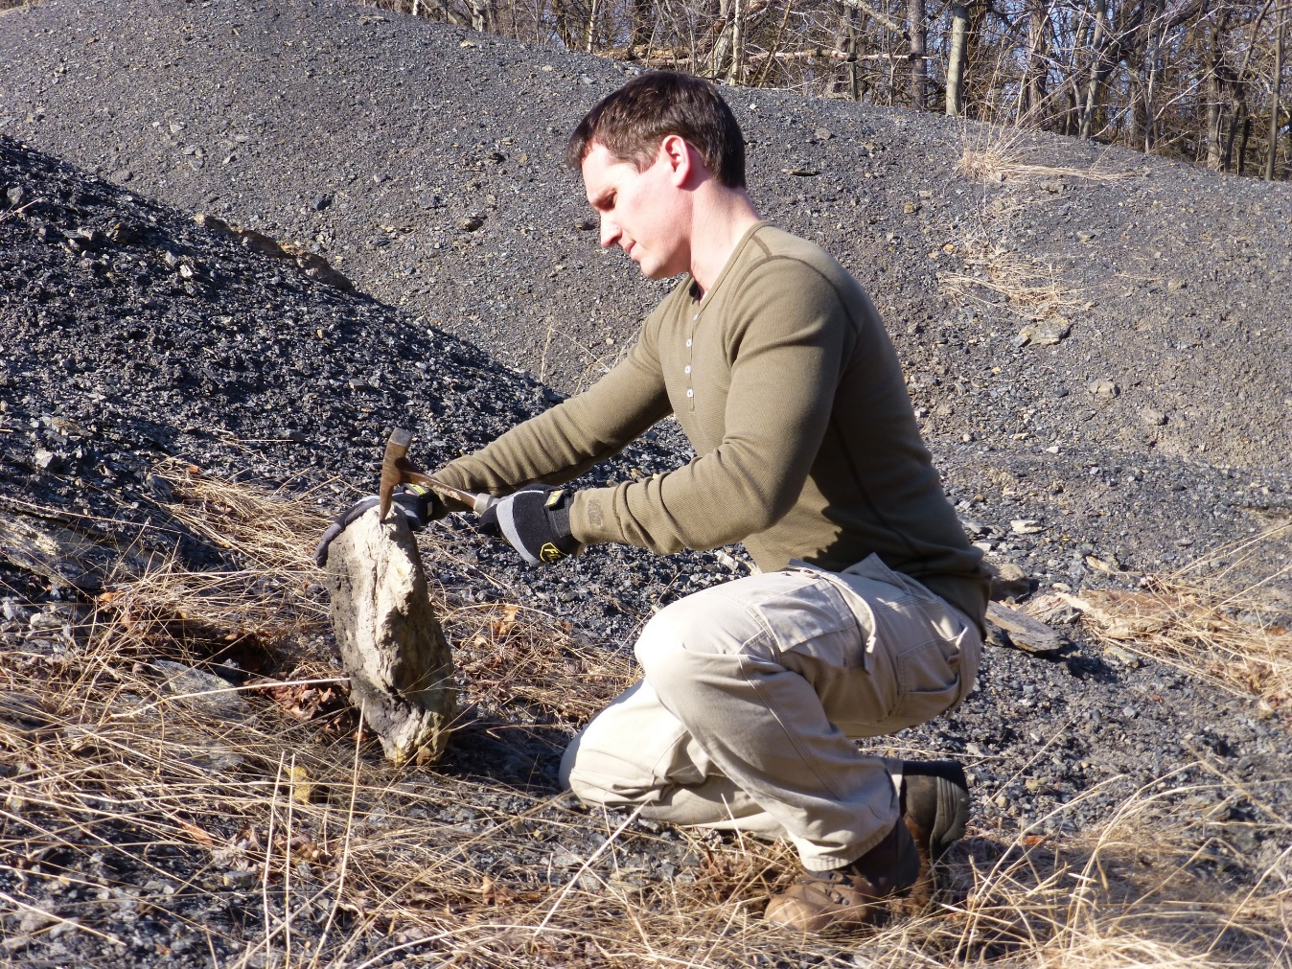
Digging Into the Data:
Examining Resource Use on an Amateur Paleontology Website
Social Traffic
Adjusted Bounce Rate
Ghost Bots
Keywords
(Not Provided)
Event Trackers
Scroll Behavior
Actionable Goals
Time on Site
User Engagement
Jayson Kowinsky

Slide 2
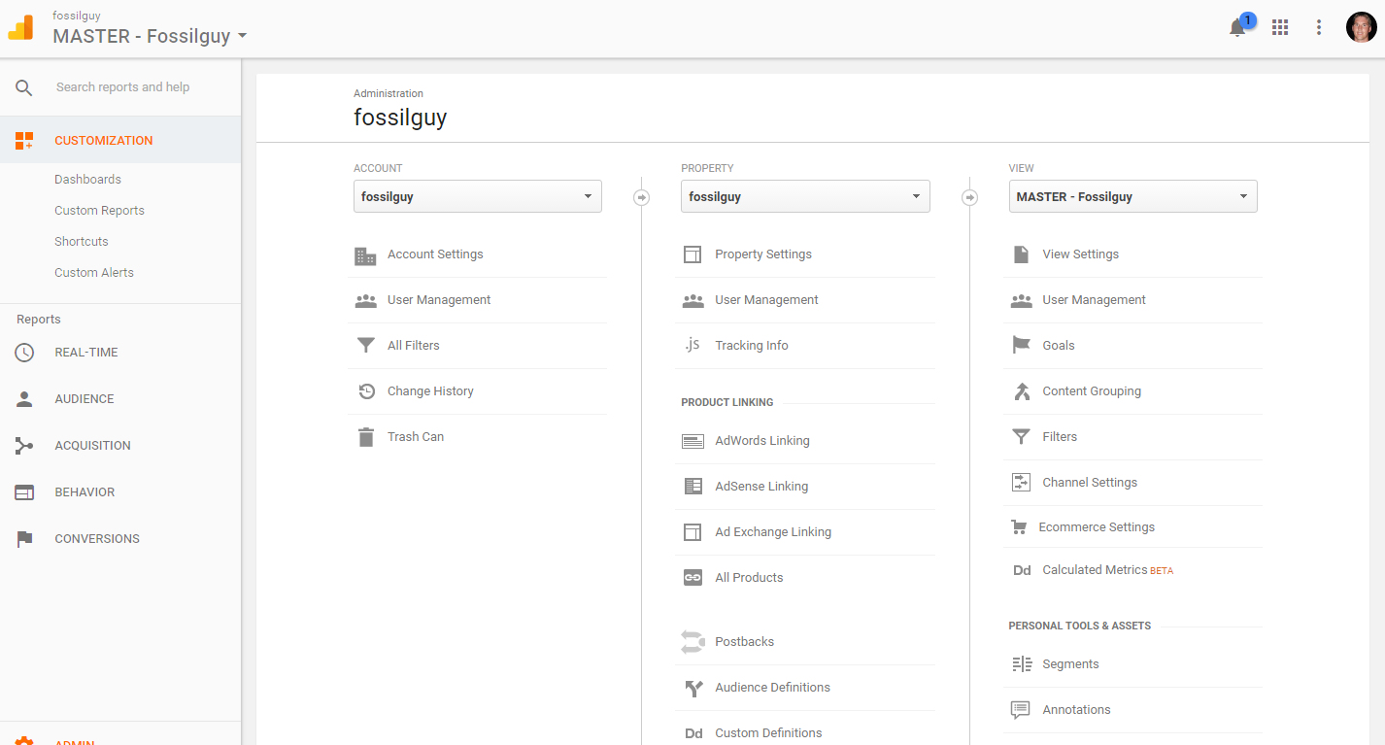
What is Google Analytics (GA)?
Google Analytics is the most popular online analytics service. It tracks various aspects of website traffic.
BuiltWith, using Quantcast data, estimates:
Top 10K 66.2% use GA
Top 100K 73.7% use GA
Top Million 69% use GA
(https://trends.builtwith.com/analytics/Google-Analytics)
It’s Free and VERY User Friendly

Slide 3
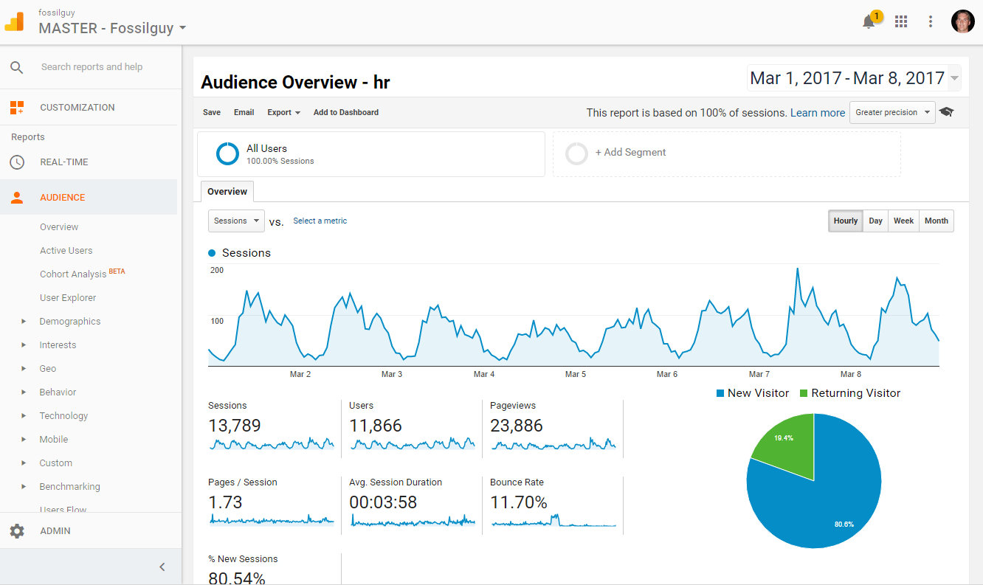
What is Google Analytics (GA)?
Google Analytics is the most popular web analytics service. It tracks various aspects of website traffic.
Audience Overview

Slide 4
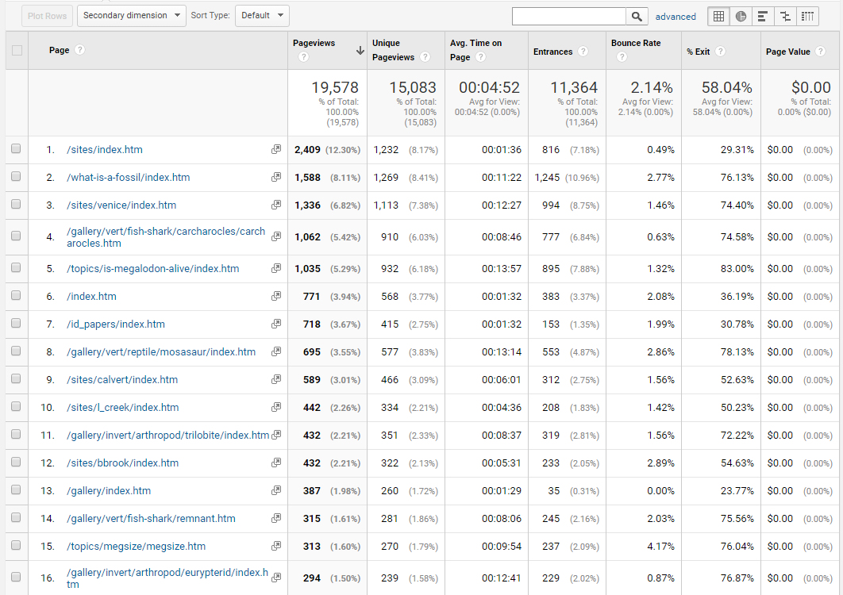
What is Google Analytics (GA)?
Google Analytics is the most popular web analytics service. It tracks various aspects of website traffic.
Top Content

Slide 5
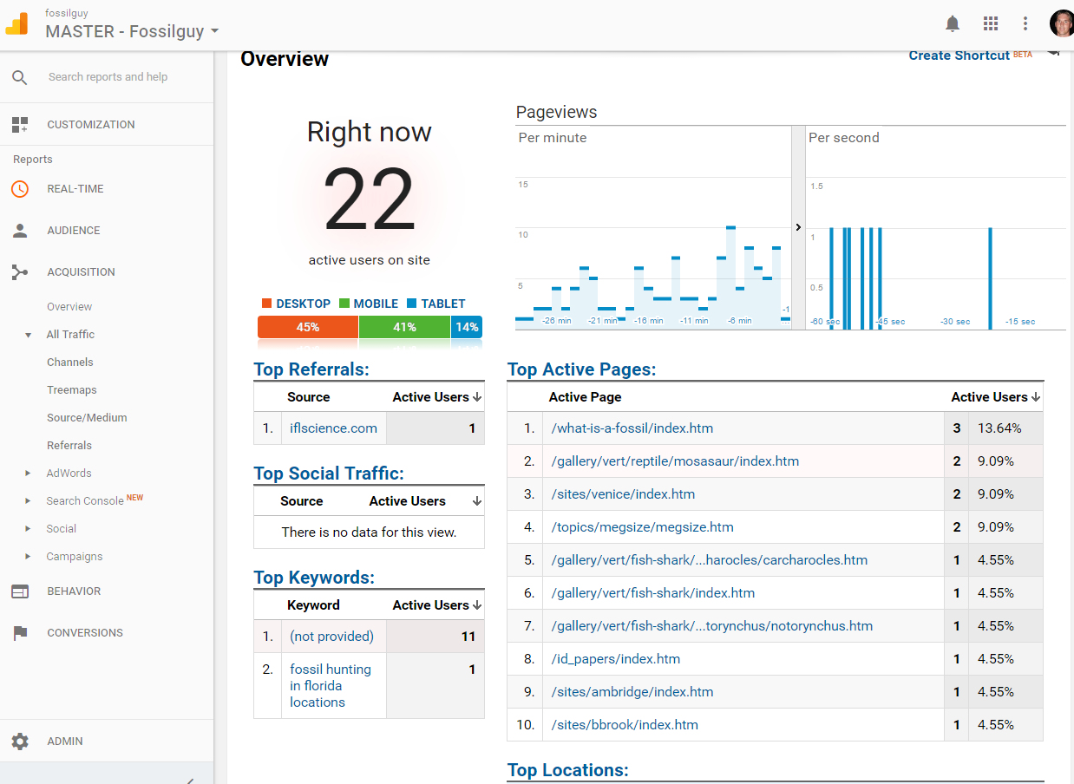
What is Google Analytics (GA)?
Google Analytics is the most popular web analytics service. It tracks various aspects of website traffic.
Realtime Overview

Slide 6
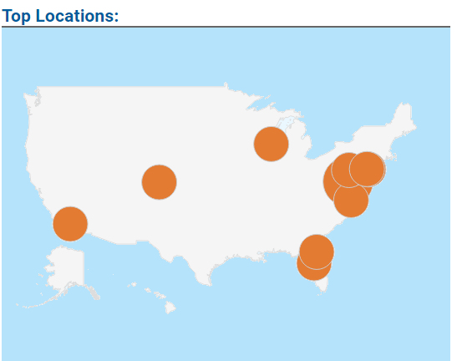
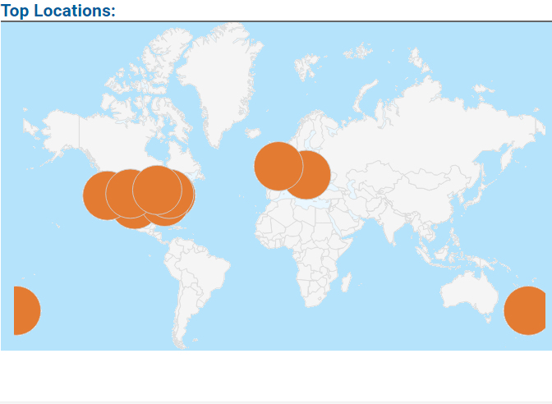
What is Google Analytics (GA)?
Google Analytics is the most popular web analytics service. It tracks various aspects of website traffic.
Visitor Locations

Slide 7
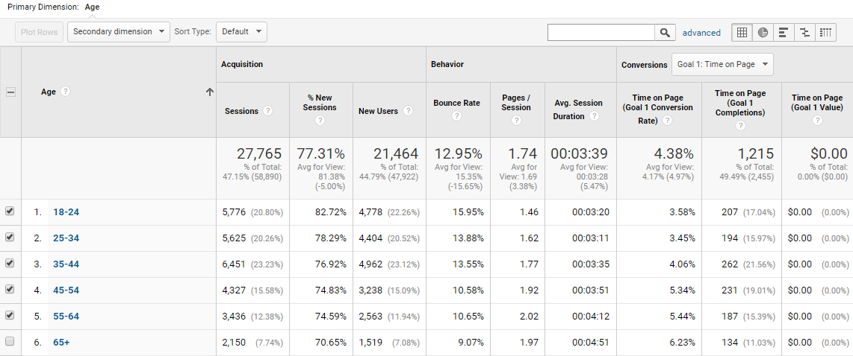
What is Google Analytics (GA)?
Google Analytics is the most popular web analytics service. It tracks various aspects of website traffic.
Age of Visitor

Slide 8
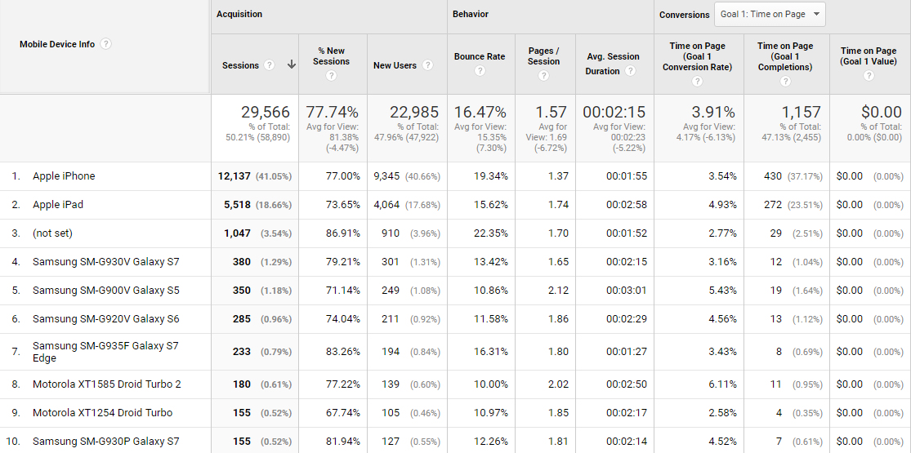
What is Google Analytics (GA)?
Google Analytics is the most popular web analytics service. It tracks various aspects of website traffic.
Type of Cell Phone Used

Slide 9

GA gives you too much information:
It’s a Data Puke – The data needs to be properly analyzed so that actionable website
goals can be reached.
User resource use cannot be analyzed if we don’t collect meaningful data

Slide 10
GA gives you too much information:
User resource use cannot be analyzed if we don’t collect meaningful data
Unfortunately:
GA is geared toward → commercial websites
Not → noncommercial / organization / information based websites
Development of GA:
Google Adwords: 2000 → Advertising for Large Companies
Google Adsense: 2003 → Advertising for individual websites
Google Analytics: 2005 → Website User Tracking (Clickthrough rate)

Slide 11
After 12 years of service, GA is still geared toward advertising
non commercial / organization / informational based websites need to measure:
USER ENGAGEMENT
Two goals of this presentation:
Correct Tools: How to “tweak” GA to view usable data - TRUE visitor Engagement
Digging into the Data: Actionable Goals based off TRUE visitor Engagement data

Slide 12
Correct Tools: How to “tweak” GA to view TRUE user Engagement
1. Only collect data on REAL visitors
2. Track the actual time a visitor is on your site
3. Track the amount a user scrolls down your page
*This data, along with a few default metrics will be the only data you need collect and analyze

Slide 13
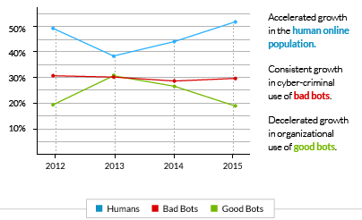
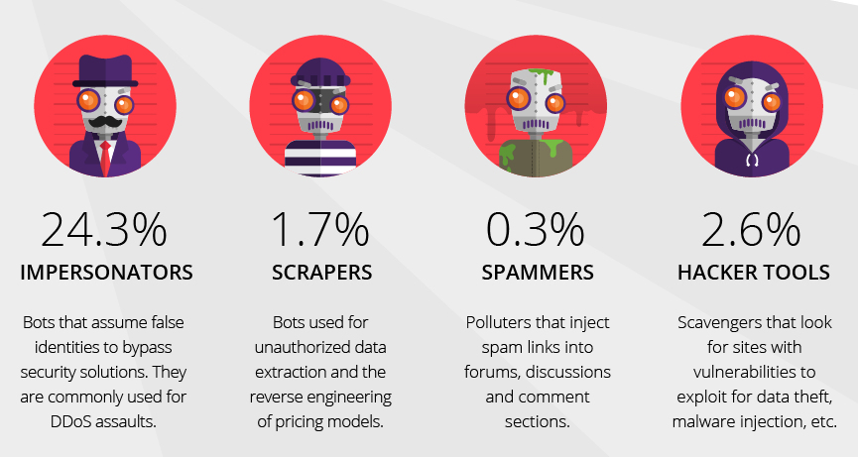
1. Only collect data on REAL visitors - FILTER OUT BAD ROBOTS
INCAPSULA Global Bot Traffic Report: 2016
(https://www.incapsula.com/blog/bot-traffic-report-2016.html)

Slide 14

1. Only collect data on REAL visitors - FILTER OUT BAD ROBOTS
Ghost Bot:
-Does not use website data (Hence the name ‘Ghost’)
-Creates a hit on analytics (Really Messes up Analytics)
lifehacĸer | motherboard.vice | buttonsforwebsites | free-share-buttons | exchangeit |
Google | site1 | event-tracking | guardlink | forum.topic | addons.mozilla | iloveitaly | …

Slide 15
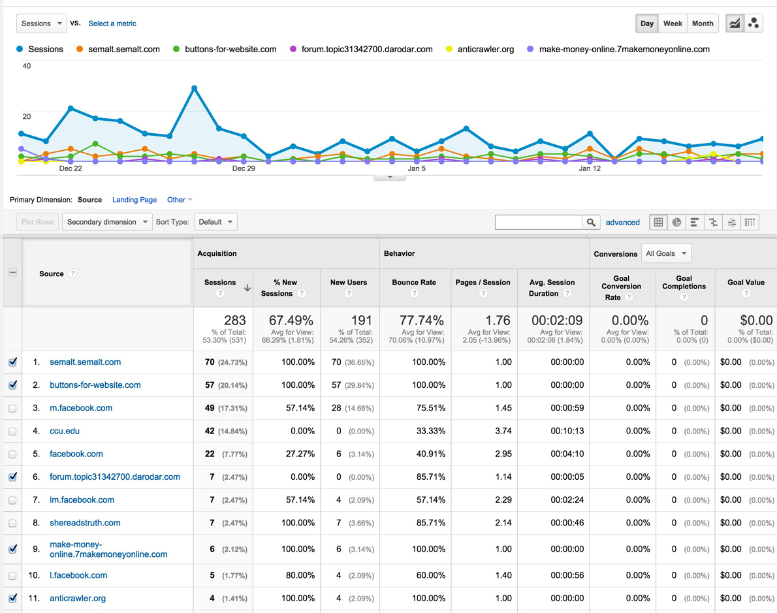
1. Only collect data on REAL visitors - FILTER OUT BAD ROBOTS
Around 10% - 60% of a websites traffic is Ghost Bot traffic
Newer websites can have up to 100% Ghost Bot traffic
THIS MESSES UP ANY ATTEMPT AT DATA ANALYSIS
(https://megalytic.com/blog/how-to-filter-out-fake-referrals-and-other-google-analytics-spam)

Slide 16
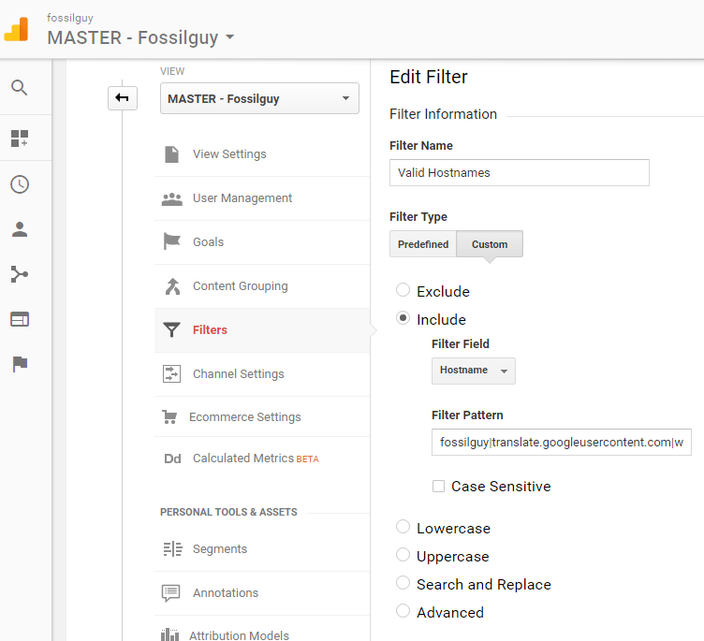
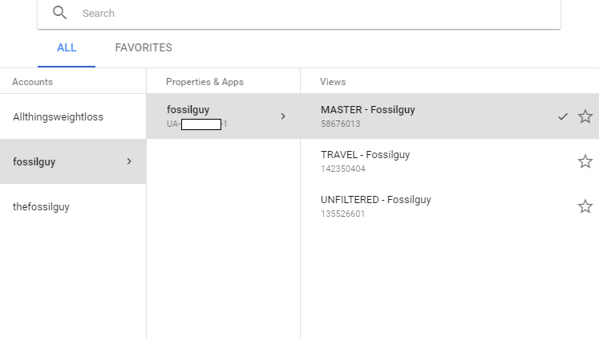
1. Only collect data on REAL visitors - FILTER OUT BAD ROBOTS
Easy Fix in the ADMIN Section:
Create an additional VIEW Property by copying your default view
Set up a custom “Include” Filter
Add your hostnames to the Filter
Click on BOT Filtering Exclusion Box

Slide 17
2. Track the actual time a visitor is on your site:
Adjust Bounce Rate and Tweak the GA code by adding non-action triggers
The default bounce rate and time is meaningless for studying User Engagement:
Bounce: A Bounce is created if only one interaction occurs in a session – Time on page is recoded as zero.
Time on Page: The time between the first action event and the last – If there is not a second action, the visit is a Bounce.
Example: A user goes onto the website (one interaction), reads the article for 10 minutes, then leaves the website (either closing the window or clicking on an external link). This is a Bounce AND it will be recorded as a time session of ZERO minutes.

Slide 18
2. Track the actual time a visitor is on your site:
Adjust Bounce Rate and Tweak the GA code by adding non-action triggers
The revised bounce rate and time is useful for studying User Engagement:
Revised Bounce: A Bounce is created if the user leaves the website within 20 seconds.
Revised Time on Page: A users time on the website is checked every 20 seconds and tallied.
How do we do this?
Add a little bit of code to your GA script:

Slide 20
2. Track the actual time a visitor is on your site:
Adjust Bounce Rate and Tweak the GA code by adding non-action triggers

Slide 21
2. Track the actual time a visitor is on your site:
Adjust Bounce Rate and Tweak the GA code by adding non-action triggers

Slide 22
2. Track the actual time a visitor is on your site:
Adjust Bounce Rate and Tweak the GA code by adding non-action triggers

Slide 23
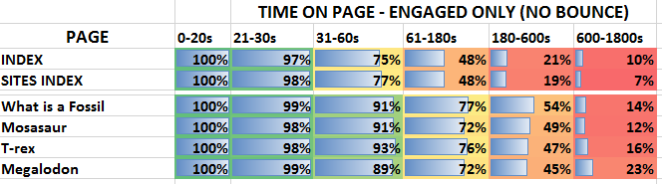
2. Track the actual time a visitor is on your site:
Adjust Bounce Rate and Tweak the GA code by adding non-action triggers

Slide 24
3. Track user Scrolling – It’s a great sign of user Engagement
Now that we can see how long a user is ACTUALLY on a page, we should see if they scrolled down the page.
If a user scrolls through the content of the webpage AND is on the page for a long time, the user is most likely engaged in the content and reading.
GA does not naturally track the amount a user scrolls down the webpage.
However, through Google analytics Tag Manager, it’s easy to set up scroll tracking.

Slide 25
3. Track user Scrolling – It’s a great sign of user Engagement
Now that we can see how long a user is ACTUALLY on a page, we should see if they scrolled down the page.
Setting up Scroll Tracking - It takes 15 minutes and it’s good forever
-New Tag
-2 Triggers
-5 Variables

Slide 26
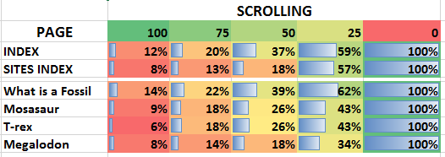
3. Track user Scrolling – It’s a great sign of user Engagement
Now that we can see how long a user is ACTUALLY on a page, we should see if they scrolled down the page.
Scroll Tracking Result – Data includes Bounces
*Pages with higher traffic have a higher bounce rate and naturally have less scrolling

Slide 27
Digging into the Data
Actionable Goals based off TRUE visitor Engagement data
1. Bounce Rate (Users that visit for less than 20 seconds)
Bounce rates for Informational websites are traditionally high.
Paleontology related sites fall under this category; they have a higher than average bounce rate compared to non-informational websites.
Recommendation: Don’t worry about the bounce, concentrate on keeping users engaged, this will naturally lower the bounce rate.

Slide 28
Digging into the Data
Actionable Goals based off TRUE visitor Engagement data
Popular Pages - What users like:
* Anything dealing with megalodon
* Famous Animals – mosasaurs, tyrannosaurs, …
* Fossil Hunting Sites that have megalodon teeth
* Fossil Hunting Sites / Identification
* Very general Paleontology topics (“What is a Fossil” “What are trilobites”)
GA SCREEEN GRAB
Recommendation: See what your page is lacking in the above list and add this content

Slide 29
Digging into the Data
Actionable Goals based off TRUE visitor Engagement data
The Results
Unpopular Pages:
What users don’t like:
* Any Fossil hunting blog type page
(fossil hunting stories, personal stories, look at what I found)
* Unpopular / lesser known animals - squalodon, eurhinodelphis, hemipristis, triarthrus,
** MAIN INDEX – Your Front Page is
often not one of the top 5 pages.

Slide 30
Digging into the Data
Actionable Goals based off TRUE visitor Engagement data
The Results
UnPopular Pages - What users don’t like:
Any Fossil hunting blog type page (fossil hunting stories, personal stories, look at what I found)
Recommendation:
Everyone likes to write about their fossil hunts. Almost no one cares. Therefore, don’t concentrate on / spend excessive time creating really cool fossil collecting stories / blogs.
2. Your MAIN INDEX page does not receive most of the traffic. If there is important information on that front page that you want users to see, put this information on other pages as well.

Slide 31
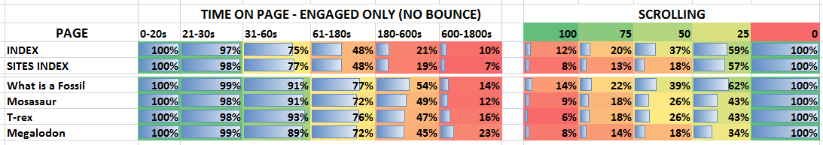
Digging into the Data
Actionable Goals based off TRUE visitor Engagement data
The Results
Engaged User Behavior
Behavior is different depending on the type of page:
Informational pages – High Time on Page, Medium Scrolling, Lower Bounce
Collecting Site pages – Medium Time on Page, Medium Scrolling, Lower Bounce
Main and Sub Index pages – Low Time on Page, Little Scrolling, Less Return Visits, Higher Bounce Rate

Slide 32
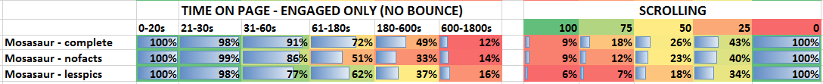
Digging into the Data
Actionable Goals based off TRUE visitor Engagement data
The Results
Engaged User Behavior
Users don’t like to read:
Recommendation: Users don’t like to read. Make sure there are plenty of graphics spread out on each page. Add a quick summary / main points to the top of the page – keep these a tweet or less in length.

Slide 33
Digging into the Data
Actionable Goals based off TRUE visitor Engagement data
www.fossilguy.com/analyzethat

