Slide 1



Primary Results of Petrographic Analysis & Geochemical Characterizations of Permian- Triassic Seven Devils Group, Western Idaho
FARAG, Adel; LANGE, Eric S and NICHOLSON, Kirsten N
Department of Geological Sciences, Ball State University, 2021 W Riverside Ave, Muncie, IN 47306

Slide 2

Introduction
Goals and Question to Consider
Location of the Study Area
Geological Background
Field Trip – Summer 2016
Methods
Thin Section Analysis
Powder Chemical Analysis
XRF Analysis
ICP-MS Analysis
Primary Results
Discussion & Conclusion
References

Slide 3
Introduction
During the Late Permian & Early Triassic, tectonics processes were dominated by the break up of the supercontinent Pangea (Murphy et al., 2009).
Volcanic arcs and continental fragments, which are geological features known as terranes (Caruthers & Stanley, 2008).
Why Seven Devils
Island-arc system (Sarewitz, 1982) that developed as a result of east- directed subduction of Pacific Ocean.
Few studies and no recent work.

Slide 4
Goals and Question to Consider
This study attempts to analyze the evolution of deformation, petrologic characterization, and the structural history of the Seven Devils Mountains with the primary goal being to determine the tectonic setting during formation of the Seven Devils Mountains.

Slide 5
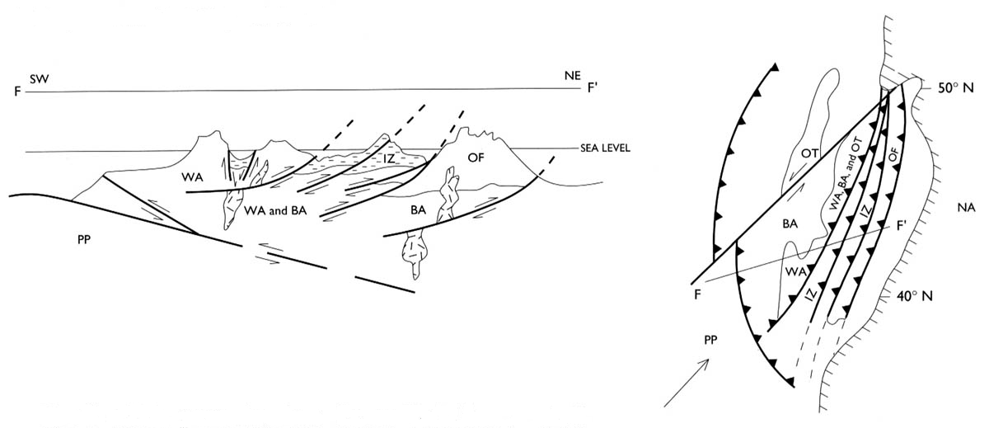
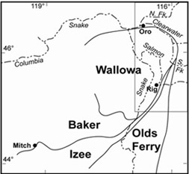
Vallier(1998).
McClelland (2000).
Sarewitz (1982).

Slide 6
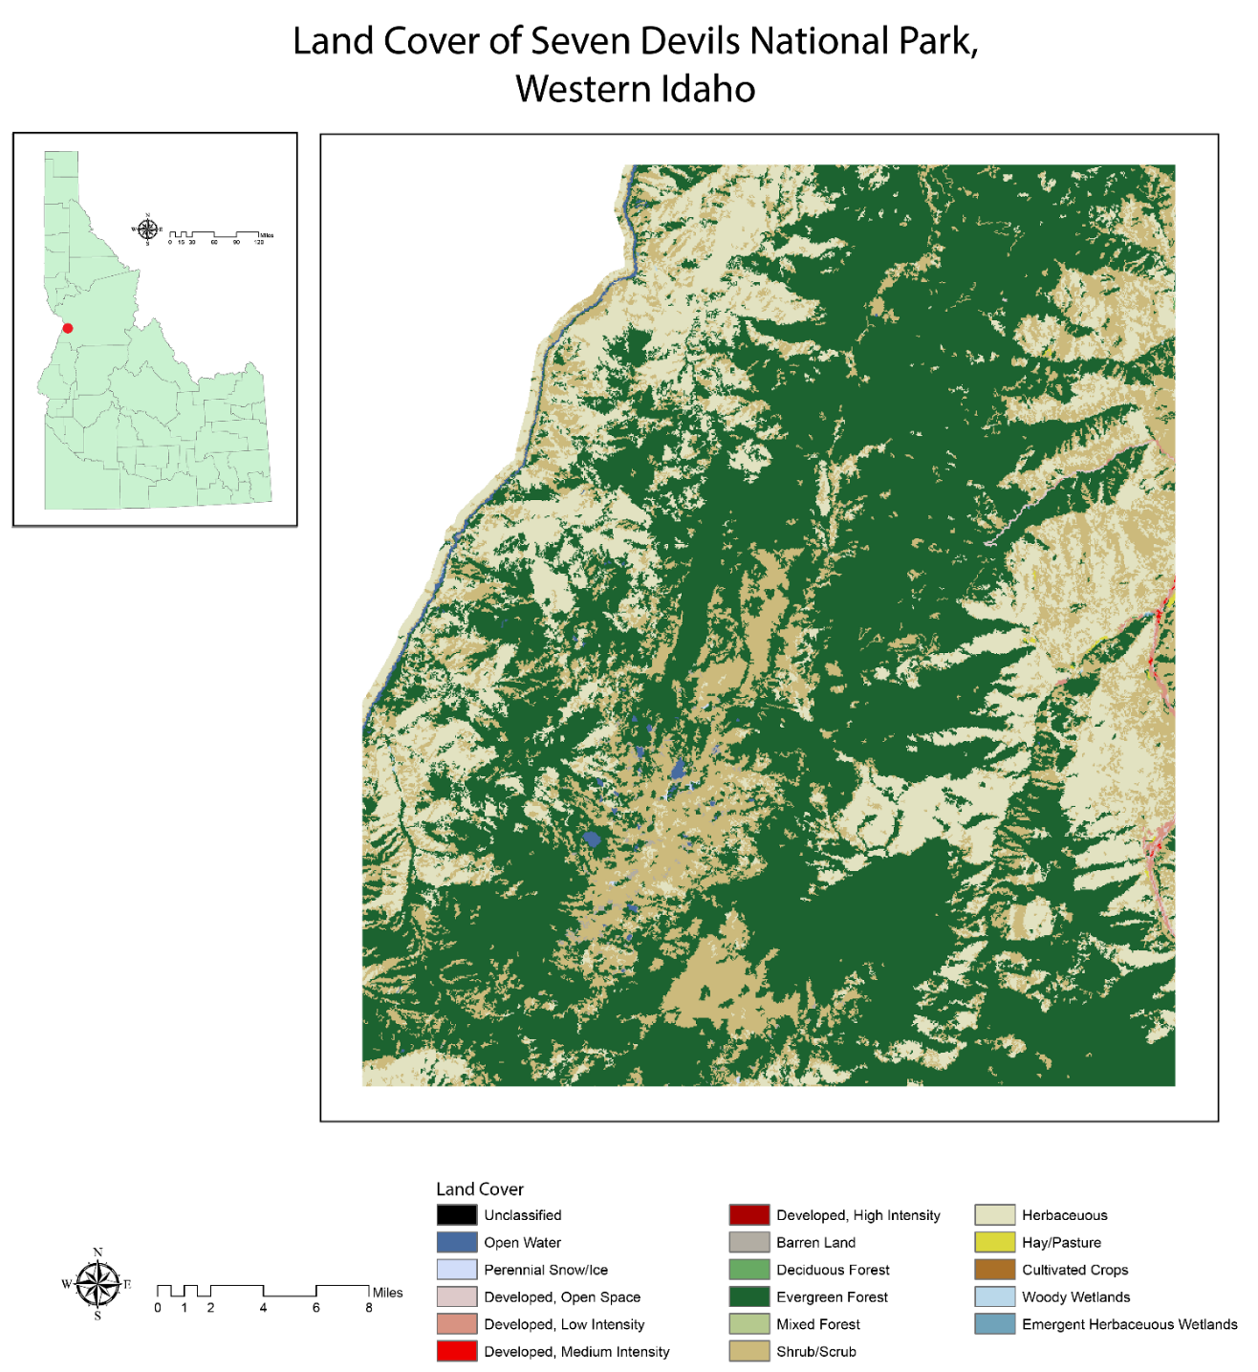
Location of the Study Area
The Seven Devils Mountains covers around 3,341 km², and they extend roughly 80 km along the border between Oregon and Idaho (Sarewitz, 1982). Those mountains are located above the east bank of the Snake River,

Slide 7
Geological Background
Permian and Triassic volcanogenic rocks dominant the province there.
Most of those rocks were result of volcanism, deformation, and sedimentation from volcanic arc at the convergent plate boundaries during the late Permian and Triassic periods.

Slide 8
Windy Ridge Formation, which relates to the Early Permian age.
Hunsaker Creek Formation belongs to the same age too.
Wild Sheep Creek Formation made up of Middle and Late Igneous Triassic rocks.
Doyle Creek Formation of Late Triassic age (Vallier, 1977).

Slide 9
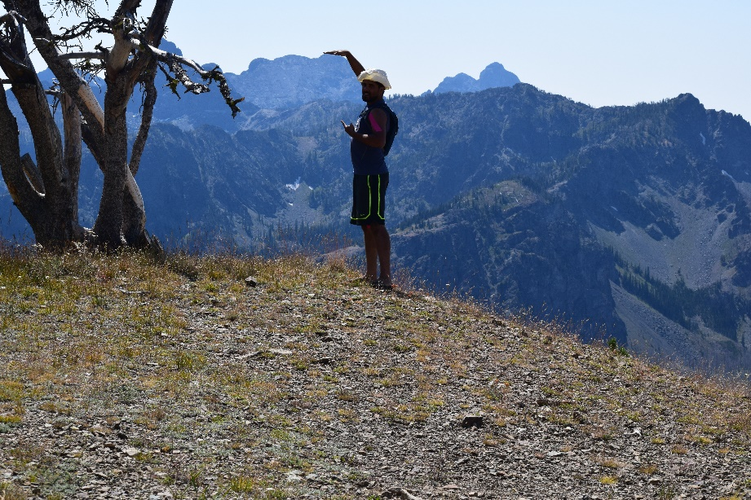
Field Trip – Summer 2016
Notes:
Make sure you mention 37 new samples in process of being analysed.

Slide 10
Methods
Thin Section Analysis
Powder Chemical Analysis
XRF Analysis
ICP-MS Analysis “SGS Company- an inspection, verification, testing and certification company, for professional geochemical analysis”
Major oxides will measure by lithium metaborate fusion inductively coupled plasma atomic emission spectroscopy (ICP-AES).
Trace elements will measure by lithium metaborate fusion inductively coupled plasma mass spectrometry (ICP-MS).
Samples 1SD-A to 1SD-K have been collected by Dr. Nicholson during summer 2004

Slide 11
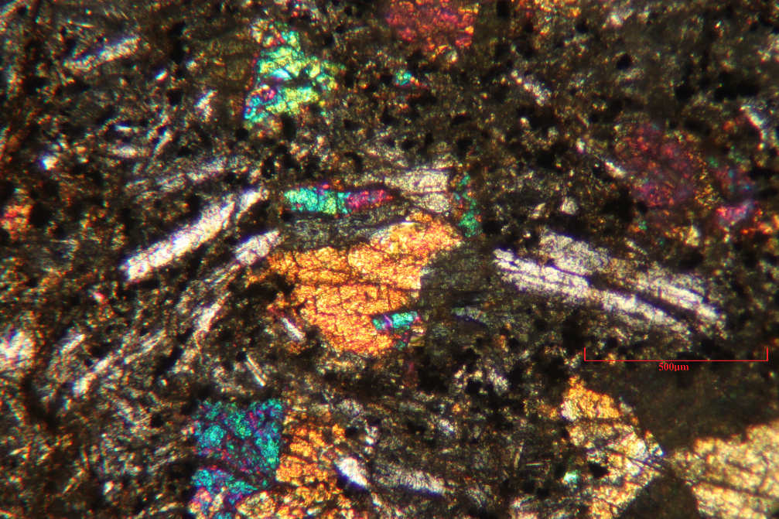
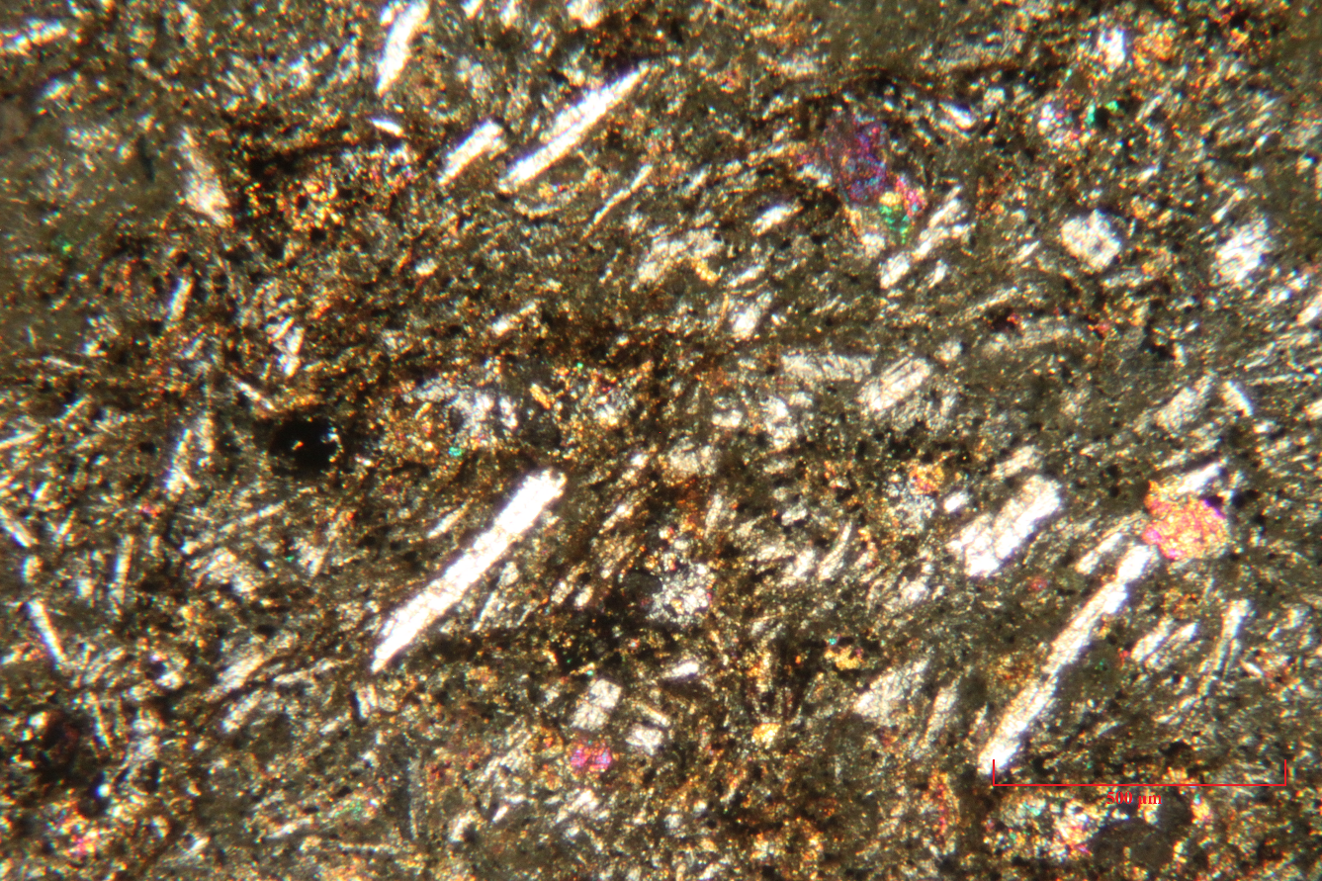
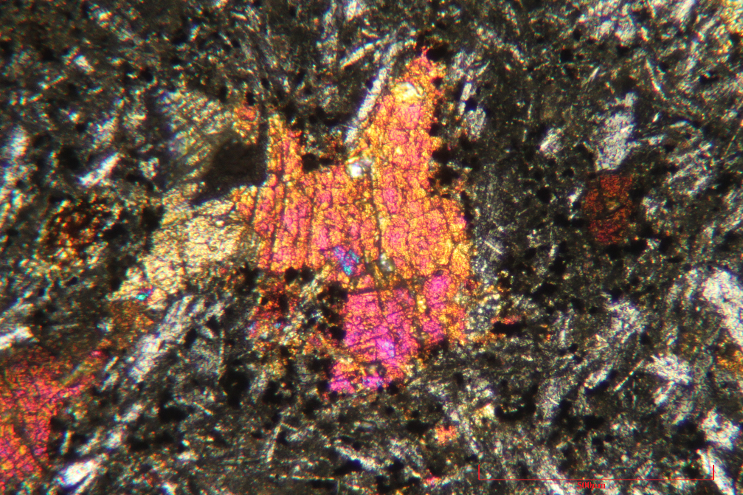
Primary Results (11 Samples)
Thin Section Description:
A
B
C
1SD-A
A, Plagioclase crystals. B & C show Hornblendes
Phenocrysts.
1mm

Slide 12
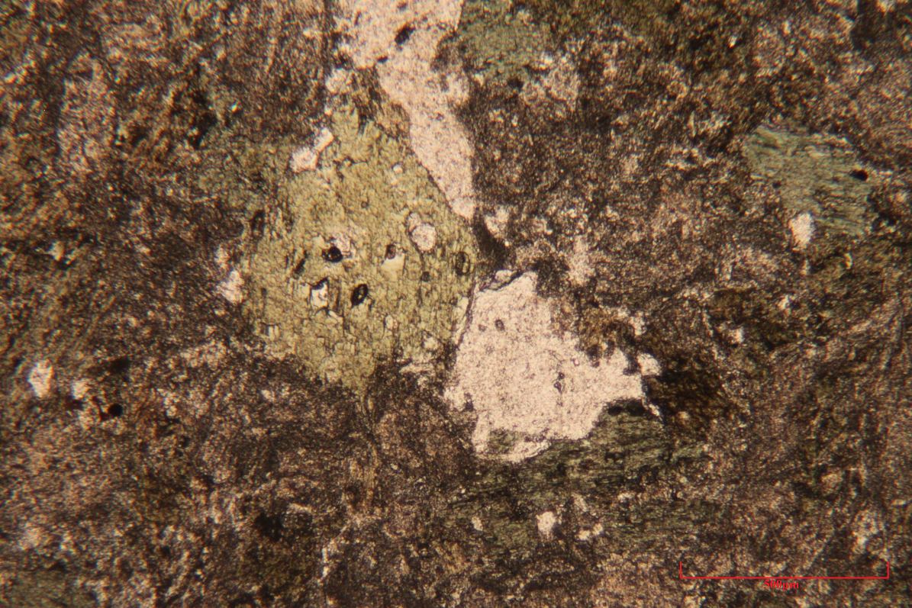
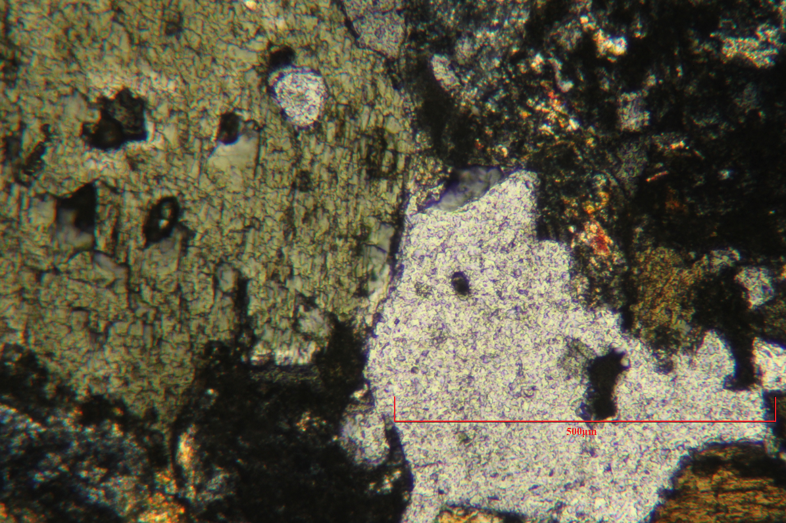
1SD-B Shows Hornblende crystals:
A, under 4X magnification
B, under 10X magnification

Slide 13
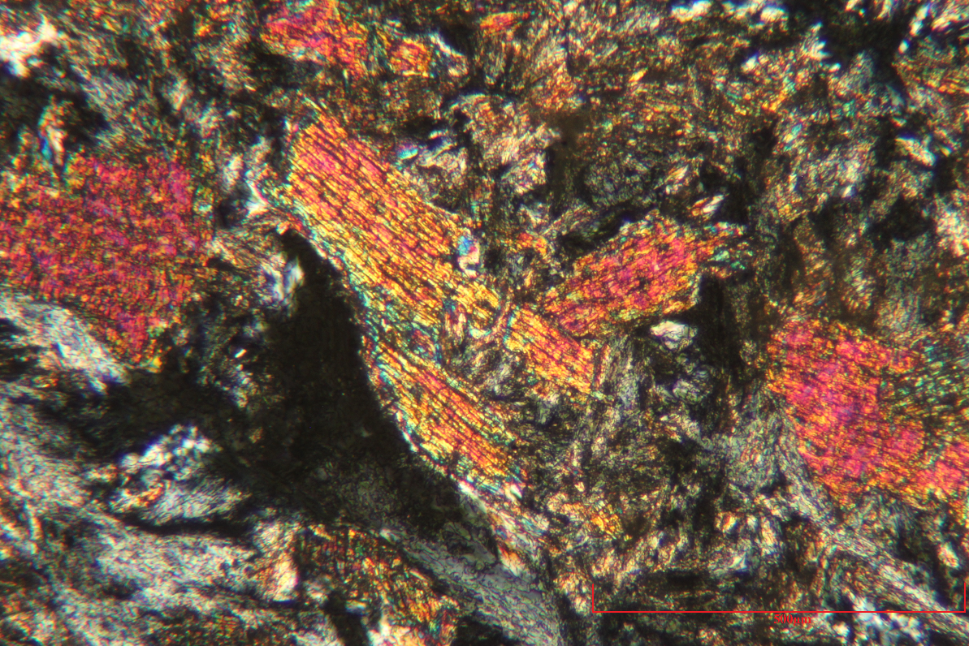
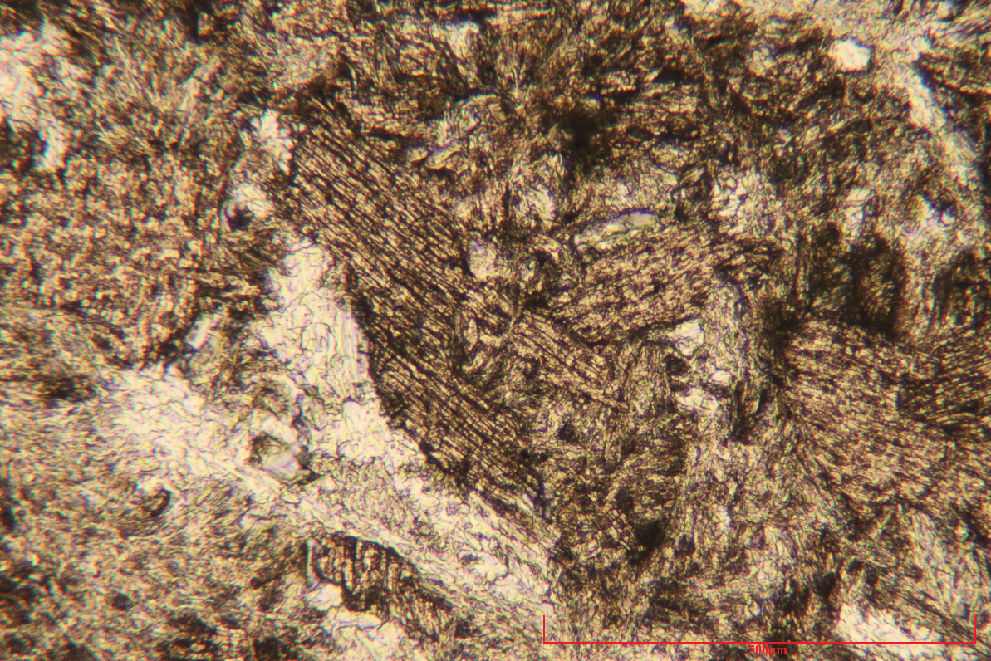
1SD-D Shows Orthopyroxene crystals in both XPL and PPl,
under 10X
magnification

Slide 14
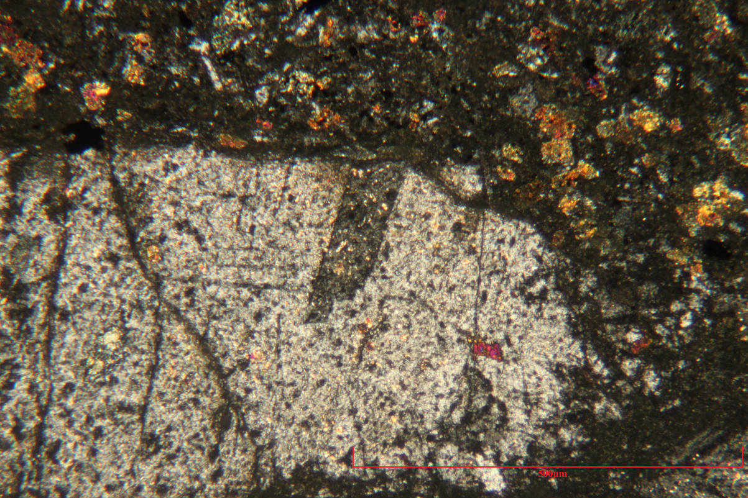
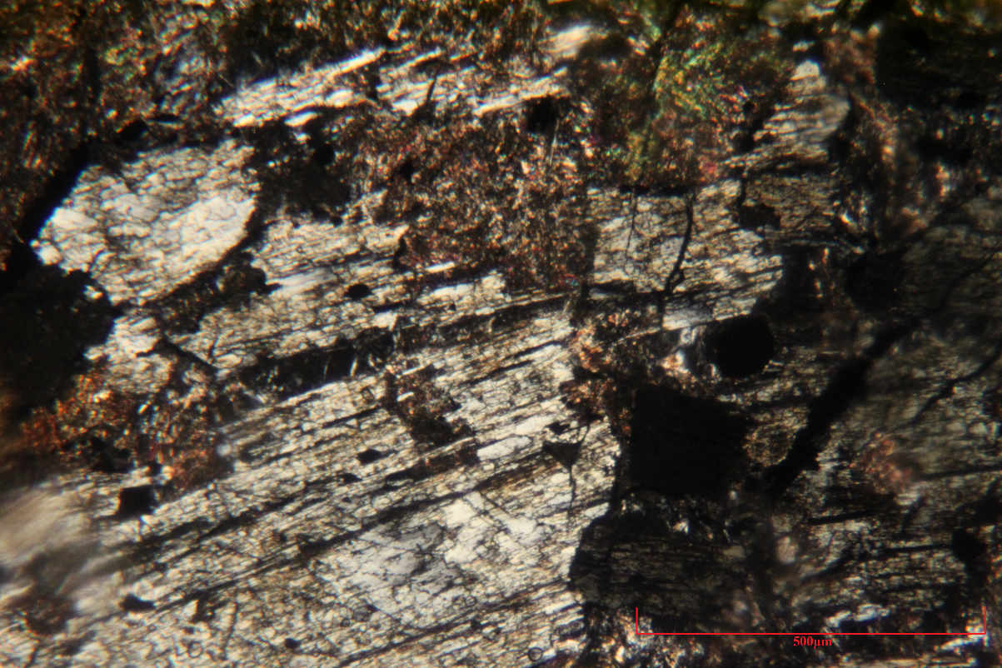
1SD-E Shows large Orthoclase crystal in XPL
under 4X magnification
1SD-I Shows Amphibole crystal in XPL
under 10X magnification

Slide 15
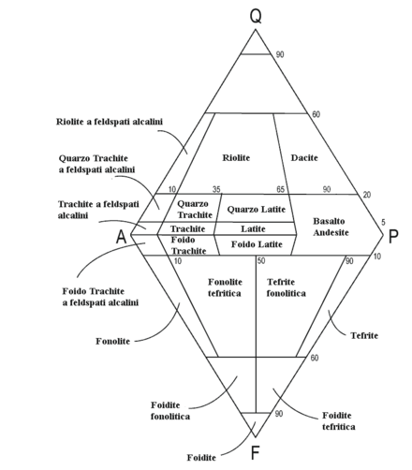
Generalized Basalt Petrography
Primary –
Plagioclase = 40-50%
Pyroxene = 40-60%
Olivine = 10%
Hornblende = 15-25%
Secondary –
Mica family = 10%
Quartz = 5%
Feldspar = less than 5%
Weak lower green schist alteration

Slide 16
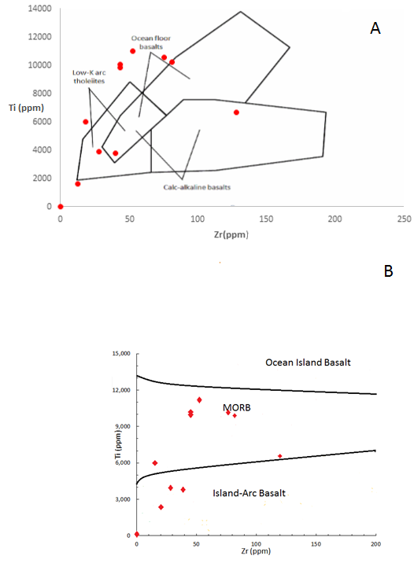
Geochemistry:
A- Zr- Ti tectonic discrimination discriminant diagram by Pearce and Cann (1973).
B- Zr-Ti tectonic discrimination diagram fields using linear analysis by Vermeesch (2006).

Slide 17
A- Ti-V discrimination diagram of Shervais (1982).
B- Ti-V discrimination diagram using linear analysis by Vermeesch (2006).

Slide 18
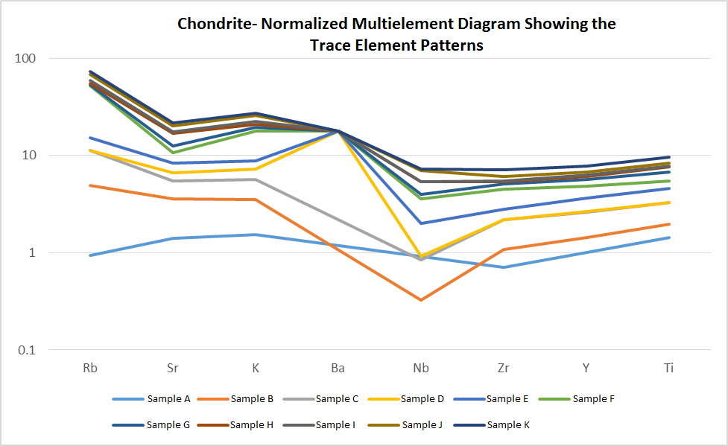
Geochemical Model:
By using the reference data of Sun &
McDonough (1989)

Slide 19
Conclusions and Discussion
Primarily two pyroxene basalts with lesser olivine and/or hornblende.
Both IAB and MORB chemical signatures represented by the first 11 samples?
Niobium element depletion is a good indicator for Island Arc system.
Current Work: How do we explain the chemical affinities of the magmas in terms of the regional tectonics evolution.

Slide 20
References
Debari, S. M., Anderson, R. G., & Mortensen, J. K. (1999). Correlation among lower to upper crustal components in an island arc: The Jurassic Bonanza arc, Vancouver Island, Canada. Rev. Can. Sci. Terre Revue Canadienne Des Sciences De La Terre Canadian Journal of Earth Sciences Can. J. Earth Sci., 36(8), 1371-1413.
Murphy, J. B., Nance, R. D., & Cawood, P. A. (2009). Contrasting modes of supercontinent formation and the conundrum of Pangea. Gondwana Research, 15(3-4), 408–420. doi:10.1016/j.gr.2008.09.005
McClelland, W.C., Tikoff, B., and Manduca, C.A., (2000). Two-phase evolution of accretionary margins; examples from the North American Cordillera : Tectonophysics, v. 326, no. 1-2, p. 37-55.
Sarewitz, D. R. (1982). Geology of a part of the Heavens Gate quadrangle, Seven Devils Mountains, western Idaho.
Sun, S.S., McDonough, W.F. (1989). Chemical and isotopic systematics of oceanic basalts; implications for mantle composition and processes. Geological Society Special
Publications, 42: 313-345.
Vallier, T. L. (1977). The Permian and Triassic Seven Devils Group, western Idaho and northeastern Oregon. Washington: U.S. Govt. Print. Off.
Vallier, T.L., (1995). Petrology of pre-Tertiary igneous rocks in the Blue Mountains region of Oregon, Idaho, and Washington; implications for the geologic evolution of a complex island arc, U.S. Geological Survey Professional Paper P1438: 125-209.
Vallier, T., (1998) Islands and Rapids: A geologic story of Hells Canyon, Confluence Press, Lewiston, ID, 151 p.
Vermeesch, P. (2006). Tectonic discrimination diagrams revisited. American Geophysical Union and the Geochemical Society, United States

Slide 21
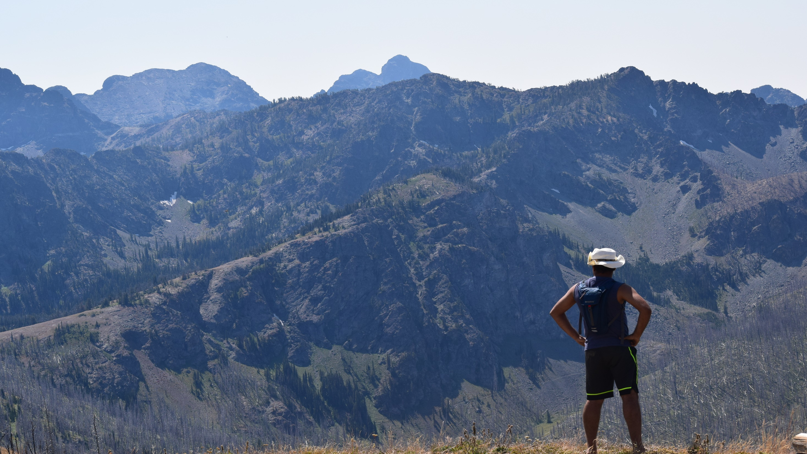
Questions!

