Slide 1

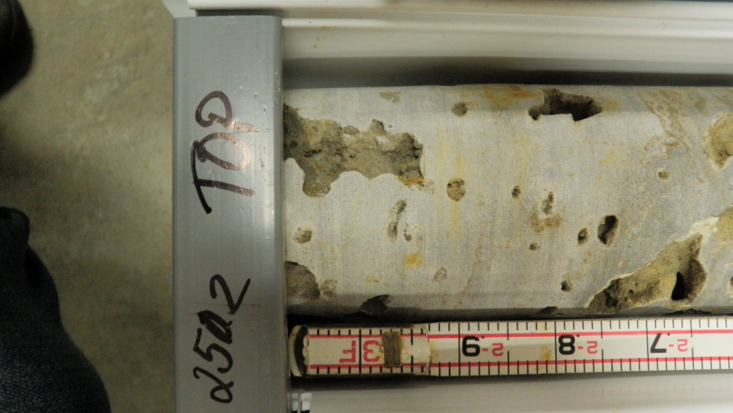
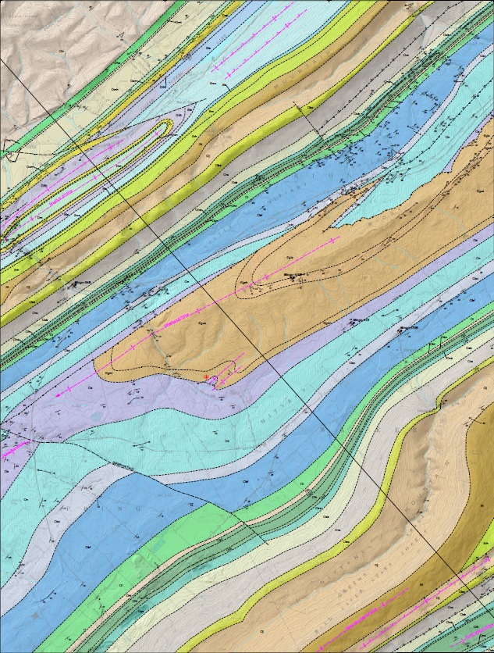
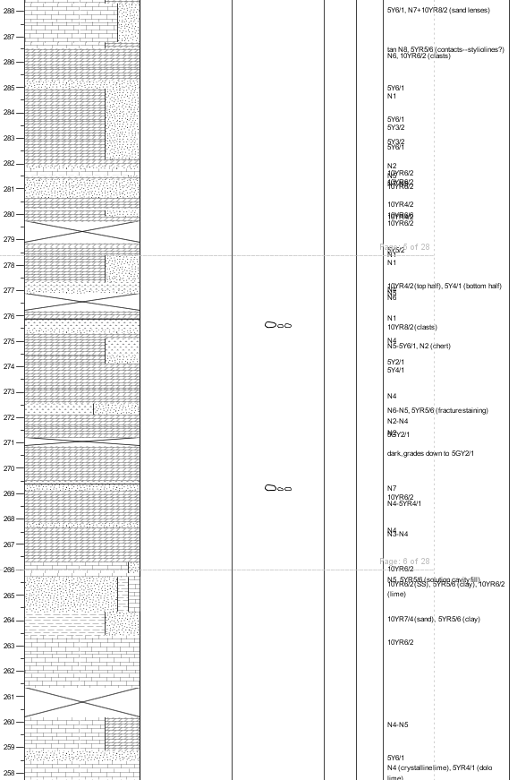
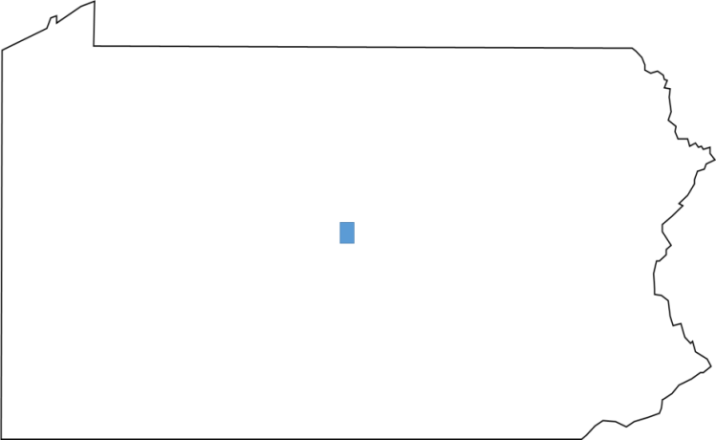
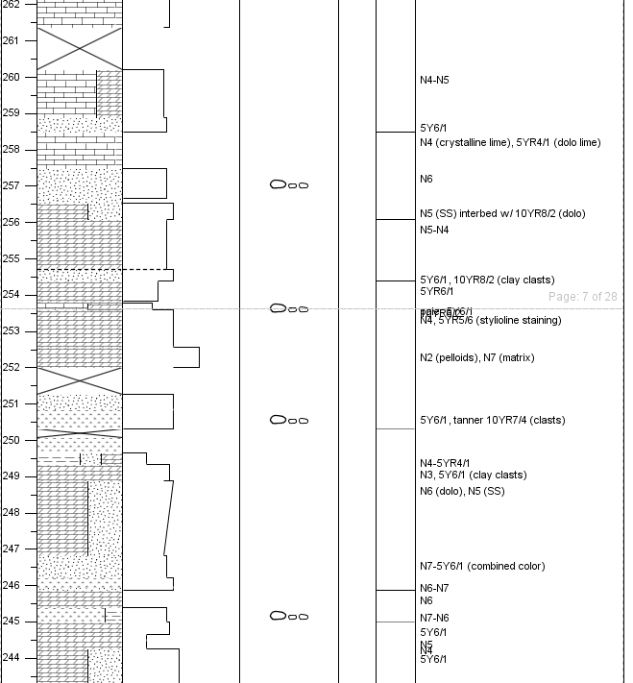
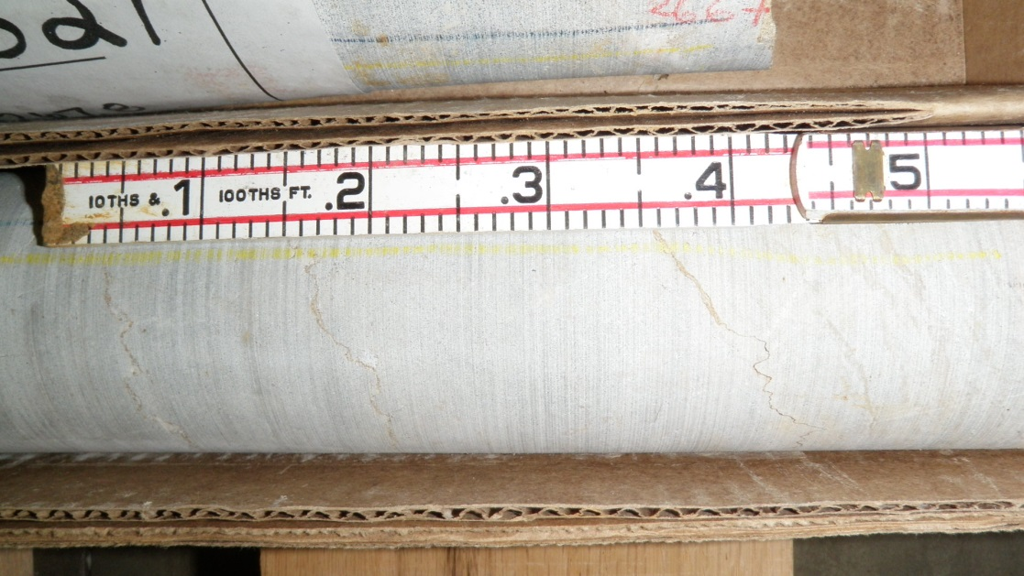
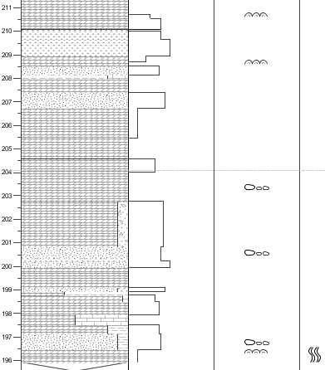
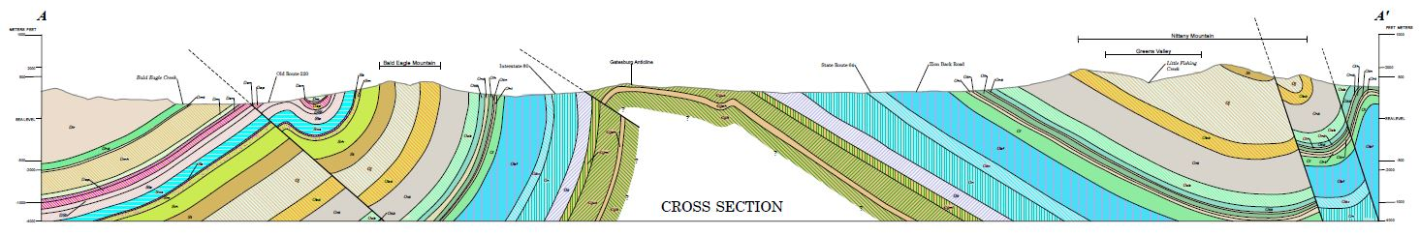
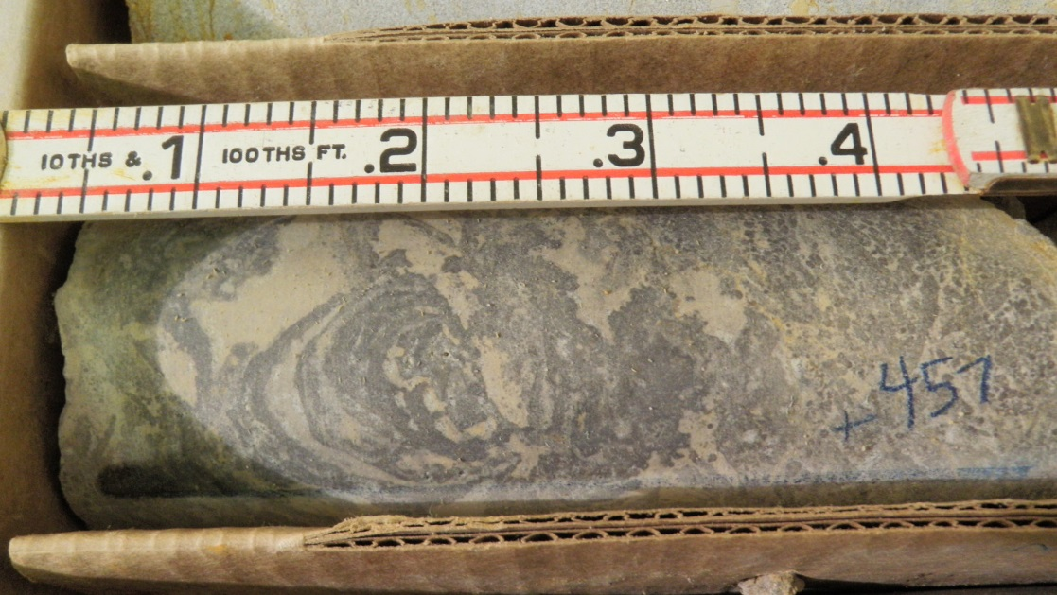
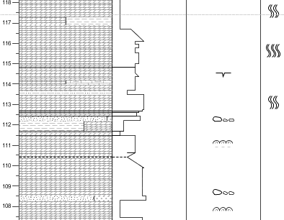
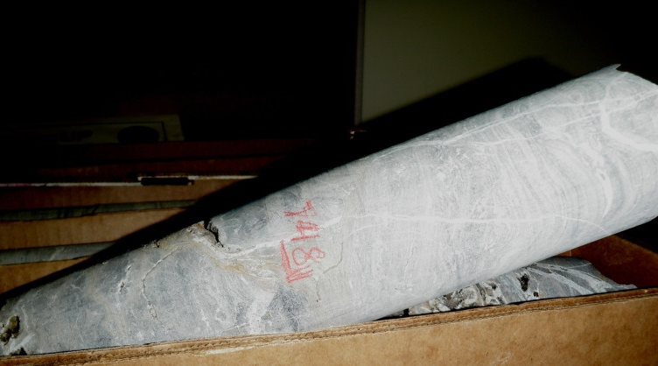
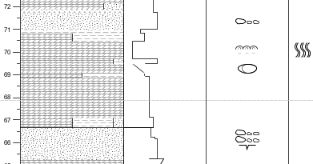
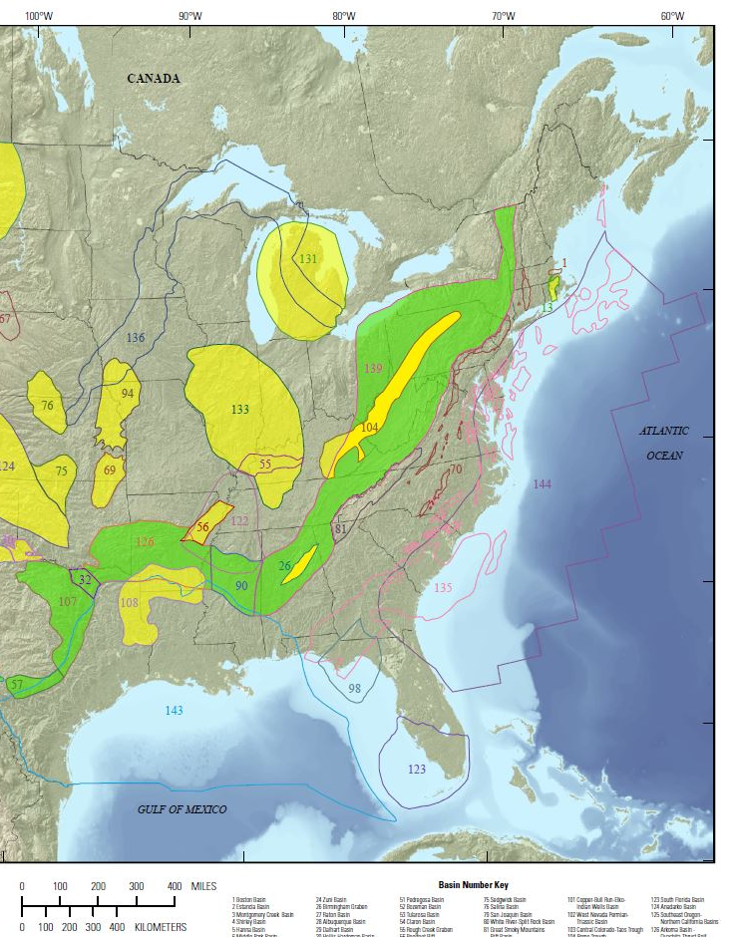
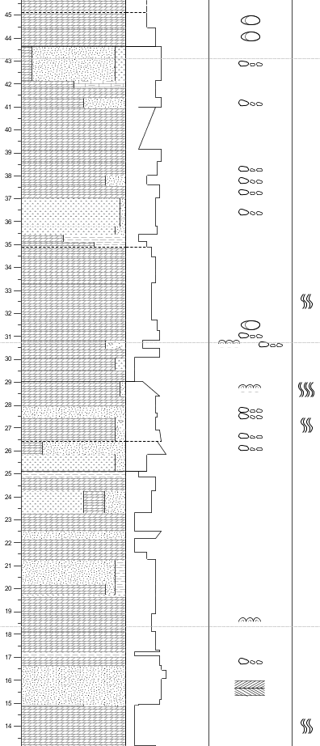

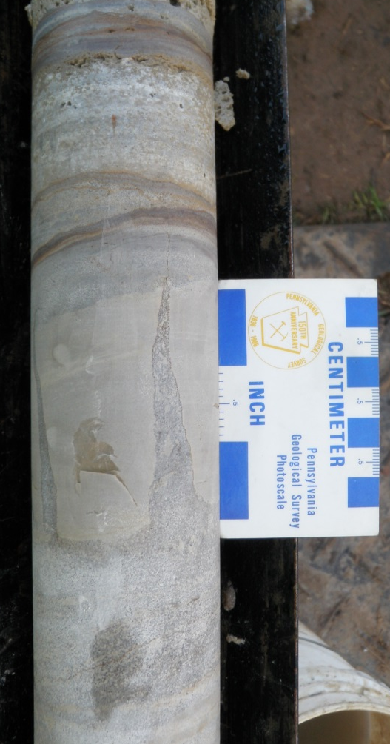
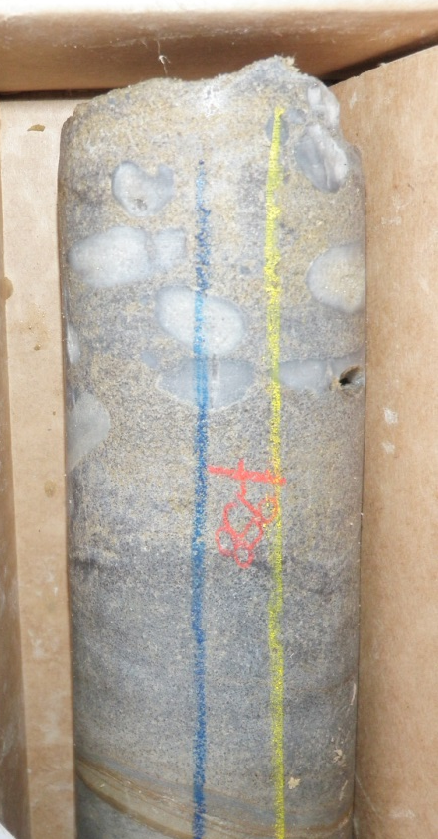
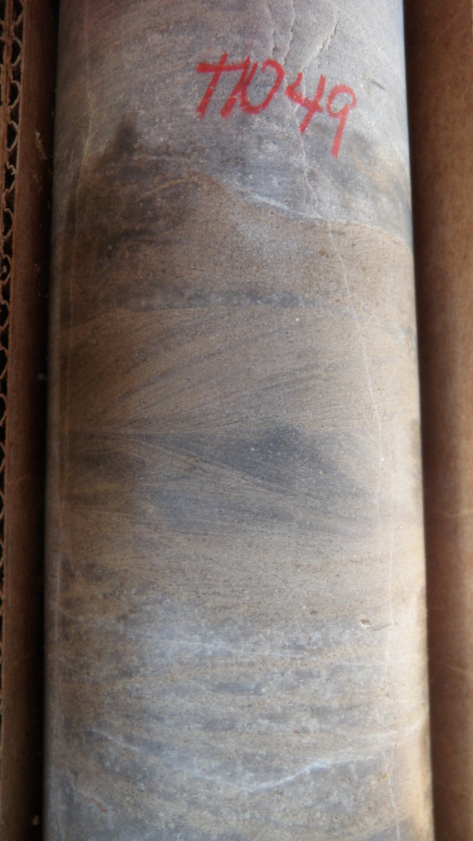
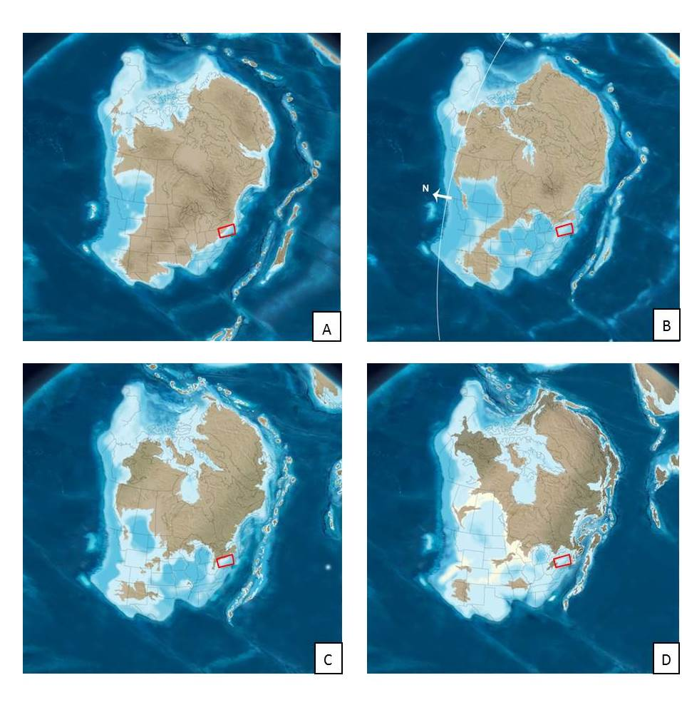
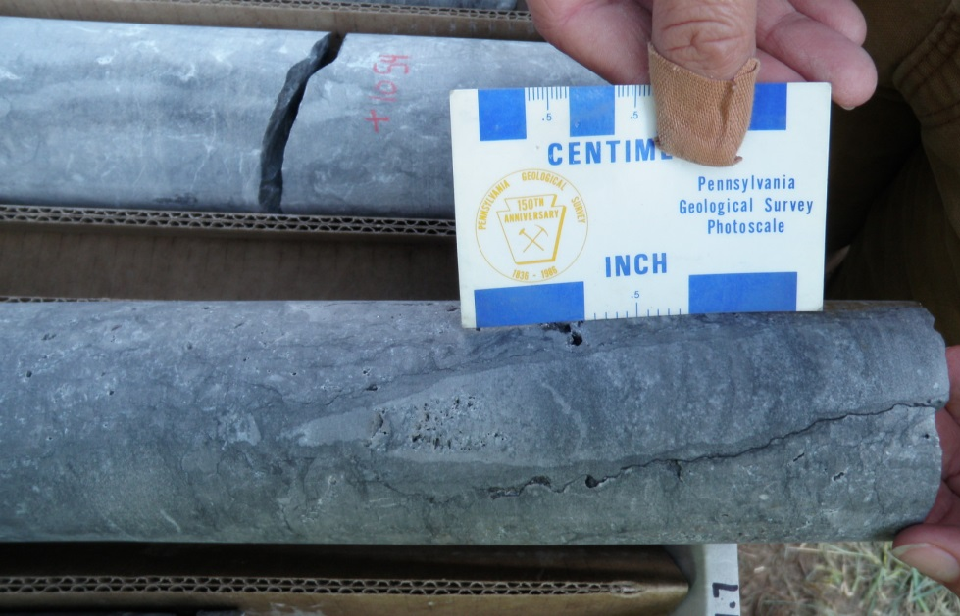
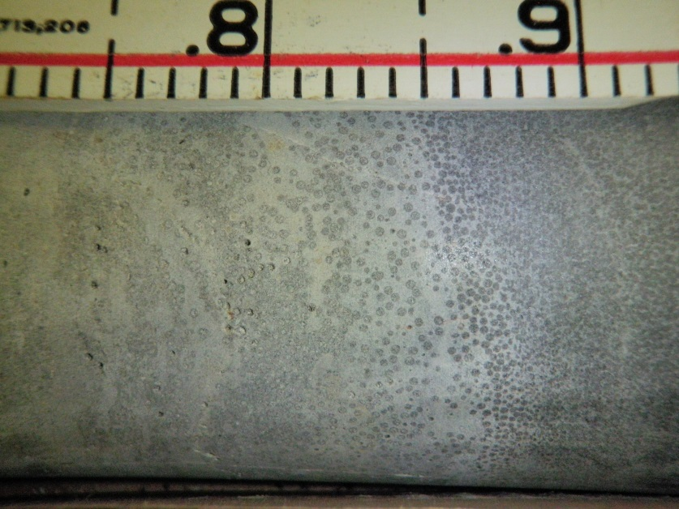
Stratigraphy of the Gatesburg Formation, Central Pennsylvania: The northeastern most extent of the Great American Carbonate Bank in the Central Appalachians
Ellen Fehrs and Kristen Hand
Department of Conservation and Natural Resources, Pennsylvania Topographic and Geologic Survey
Abstract
The Gatesburg Formation includes a suite of carbonate and interbedded siliclastic-carbonate rocks that were deposited in the Appalachian Basin portion of the Great American carbonate bank during the Upper Cambrian. The Gatesburg is composed of five primary members, which are (in descending order): the Mines, Upper Sandy, Ore Hill, Lower Sandy, and Stacy Members. The Mines, Ore Hill, and Stacy Members contain only carbonate lithologies in central Pennsylvania, while the Upper and Lower Sandy Members include a variation of interbedded dolostone and sandstone (Laughrey, 2012). The lithologic and stratigraphic investigations in this study are based on a rock core and field research in the Mingoville 7.5-minute quadrangle, Centre County, Pennsylvania.
Field data within the quadrangle were consistent with research done in surrounding areas. Due to the friable nature of certain facies within the formation, outcrops are often highly weathered and scarce. A core was drilled for stratigraphic correlation of the upper members of the Mines, Upper Sandy, and Ore Hill. The core revealed limestone units within the dolostones of the Mines and Upper Sandy Members and dolostones at the stratigraphic position of Ore Hill limestones found in outcrop less than a mile away. Stratigraphic work is therefore complicated by an incomplete understanding of the processes and mechanisms that controlled (and may continue to control) carbonate diagenesis within the Gatesburg Formation. The intention of this research is to create a model of dolomitization that better explains the characteristics of the Gatesburg dolomites as observed in the Mingoville core.
The Mingoville core shows vertical stacking of carbonate facies indicative of cyclical sea-level fluctuations. The low relief of the continental shelf and cyclic nature of these facies suggest that the features observed in this particular core are representative of shelf-wide sedimentation, as opposed to localized sedimentary accumulation. The repetition of algal growth, dolostones, and dolomitic sandstones demonstrates the shifting peritidal and adjacent (shallower) subtidal deposits. This core allowed for a better stratigraphic context to understand shelf-wide paleoenvironmental controls.
Field and Core Work
41°00'00“, -77°45'00"
41°00'00“, -77°37'30"
Lithology
Sedimentary Features
Cycles
Figure 3. Figure shows representative sections of the Mingoville core created by entering the combined core descriptions of K. Hand and A. Bierly (along with sectional analysis by the author) into SedLog software. Sections were chosen to emphasize the main reoccurring characteristics of the Gatesburg cycles: algal growth (frequently observed as stromatolites or bands of smaller algal stringers), bioturbation, dolostones, dolomitic sandstones, and conglomerates and clasts. Cycles are denoted here with arrows. Sections also show a general fining-upward progression of grain size, which has been associated with the Gatesburg cycles. A darkening-upward coloration (also associated with the Gatesburg cycles) can easily be seen in core. Coloration is based on Munsell’s rock-color chart. PA-DCNR photos taken by K. Hand: A. Vuggy section around 250.2 ft. B. Representative styliolines at a depth close to 266 ft. C. Same photo as B, but with some of the styliolines highlighted in black for clarity.
A
A
A
B/C
B
A’
40°52'30“, -77°45'00"
40°52'30“, -77°37'30"
Gatesburg Anticline
Figure 4. Geologic map and cross section modified to highlight area of study, stratigraphy, and structural features of the Gatesburg Formation in the Mingoville Quadrangle in Centre County, Pennsylvania. Gatesburg Formation in cross section has be outlined in red. Original map and cross section created by K. Hand and R. Behr (2013) based on their field observations and interpretations.
C
D. Dolostone exhibiting a mottled texture produced by bioturbation at about 457 ft. E. Cryptozoan stromatolites dolostone at a depth of roughly 748 ft. F. Yellowish gray (5Y7/2) coarse upper to fine lower sandstone with a large (~3’’) mudcrack at a depth of 883.7 ft. G. Chalcedony clasts at a depth of 958.2 ft. H. Well-cemented medium dark gray (N4) sandstone showing herringbone cross-stratification at a depth of 1049.1 ft. I. Dolostone with a lighter in-filled vertical burrow around 1056 ft deep. J. Oolitic dolostone, depth unknown.
D
Future Work
A detailed petrographic study would help to constrain the timing of the events and processes which influenced dolomitization and the role that dolomite played in the evolution of the Gatesburg lithologies. Future petrographic work should have some focus on establishing one or more dolomitization models to give further insight into the environmental factors that shaped the formation of the Gatesburg. However, the likelihood that the Gatesburg dolomites are the product of a single mechanism is doubtful; secondary dolomite production is usually associated with multiple models and influences.
Diagenic events thought to have influenced Cambrian-Ordovician carbonates of the central Appalachians include compactional deformation and dolomitization—the latter of which was likely (at least in part) effected by the former. The petrology of the Gatesburg Formation suggests an influx of fresh/aerated seawater (Pelto, 1942). Since the Gatesburg lithologies have been shown to be cyclic—with repeating algal growths, dolostones, and dolomitic sandstones—Pelto’s petrologic interpretation of an aerated, oxidizing environment makes sense. Further, the Gatesburg has definite examples of algal activity, stromatolites, and pyrite (Figure 3). The Gatesburg dolomites and associated diagenic processes therefore probably had a microbial/organogenic stimulus. Further, meteoric influence may be identified by the complexly-banded cements, which, as syndepositional features, could very easily explain the presence of both calcite and dolomite as identified in the Mingoville core.
D
FPC
E
Ribbon Carbonates
Area of Focus
F
Figure 1. Paleozoic sedimentary basins of the conterminous United States. The Appalachian Basin (labeled 139 by the United States Geological Survey) is outlined here in red. Both Pennsylvania and
E
G
Centre County, PA are outlined in black. Field site, from which the Mingoville core was taken, is denoted with a red star. Original map was produced by Coleman et al (2012) of the USGS.
Acknowledgments
The authors acknowledge the previous research, field assistance, and mentoring from the following individuals: David P. Gold, Arnold G. Doden, Edgar Meiser, Roger Pollok, Rose-Anna Behr, Aaron Bierly, Victoria Neboga, Matthew Yoder, and many others. Special thanks goes to Harry Hanshar for allowing the core drilling on his property; Bill and Joe Shaefer for facilitating water access for drilling; and Alvin Anderson and his drilling team from Cascade Drilling for exceeding our drilling expectations.
This project was funded in part by the USGS National Cooperative Geologic Mapping Program under award numbers G12AC20270 and G14AC00168.
F
G
H
References
Blakey, R., 2011, Paleogeography and Geologic Evolution of North America: Images that track the ancient landscapes of North America, http://jan.ucc.nau.edu/rcb7/nam.html (accessed August 25, 2016).
Coleman, J.L., Jr., and Cahan, S.M., 2012, Preliminary catalog of the sedimentary basins of the United States: U.S. Geological Survey Open-File Report 2012–1111, 27 p. (plus 4 figures and 1 table available as separate files) Available online at http://pubs.usgs.gov/of/2012/1111/.
Hand, K. L., and Behr, R, 2013, Bedrock Geologic Map of the Mingoville Quadrangle, Centre County, Pennsylvania: Bureau of Topographic and Geologic Survey in the Department of Conservation and Natural Resources, scale 1:24,000.
Laughrey, Christopher D., and John A. Harper, 2012, Upper Cambrian Gatesburg Formation of central and western Pennsylvania, in J. R. Derby, R. D. Fritz, S. A. Longacre, W. A. Morgan, and C. A. Sternbach, eds., The great American carbonate bank: The geology and economic resources of the Cambrian – Ordovician Sauk megasequence of Laurentia: AAPG Memoir 98, p. 1165 – 1194.
Pelto, C. R., 1942, Petrology of the Gatesburg Formation of central Pennsylvania: M.S. thesis, Pennsylvania State University, University Park, Pennsylvania, 60 p.
I-80
Figure 2. Paleogeographic maps of North America during the: A. Middle Cambrian (510Ma), B. Upper Cambrian (500Ma), and C. Lower Ordovician (485Ma)(Blakey, 2015). Figures were modified to show a generalized outline of Pennsylvania in red.
H
I
I
= portion of stratigraphic section not included
J

