Slide 1
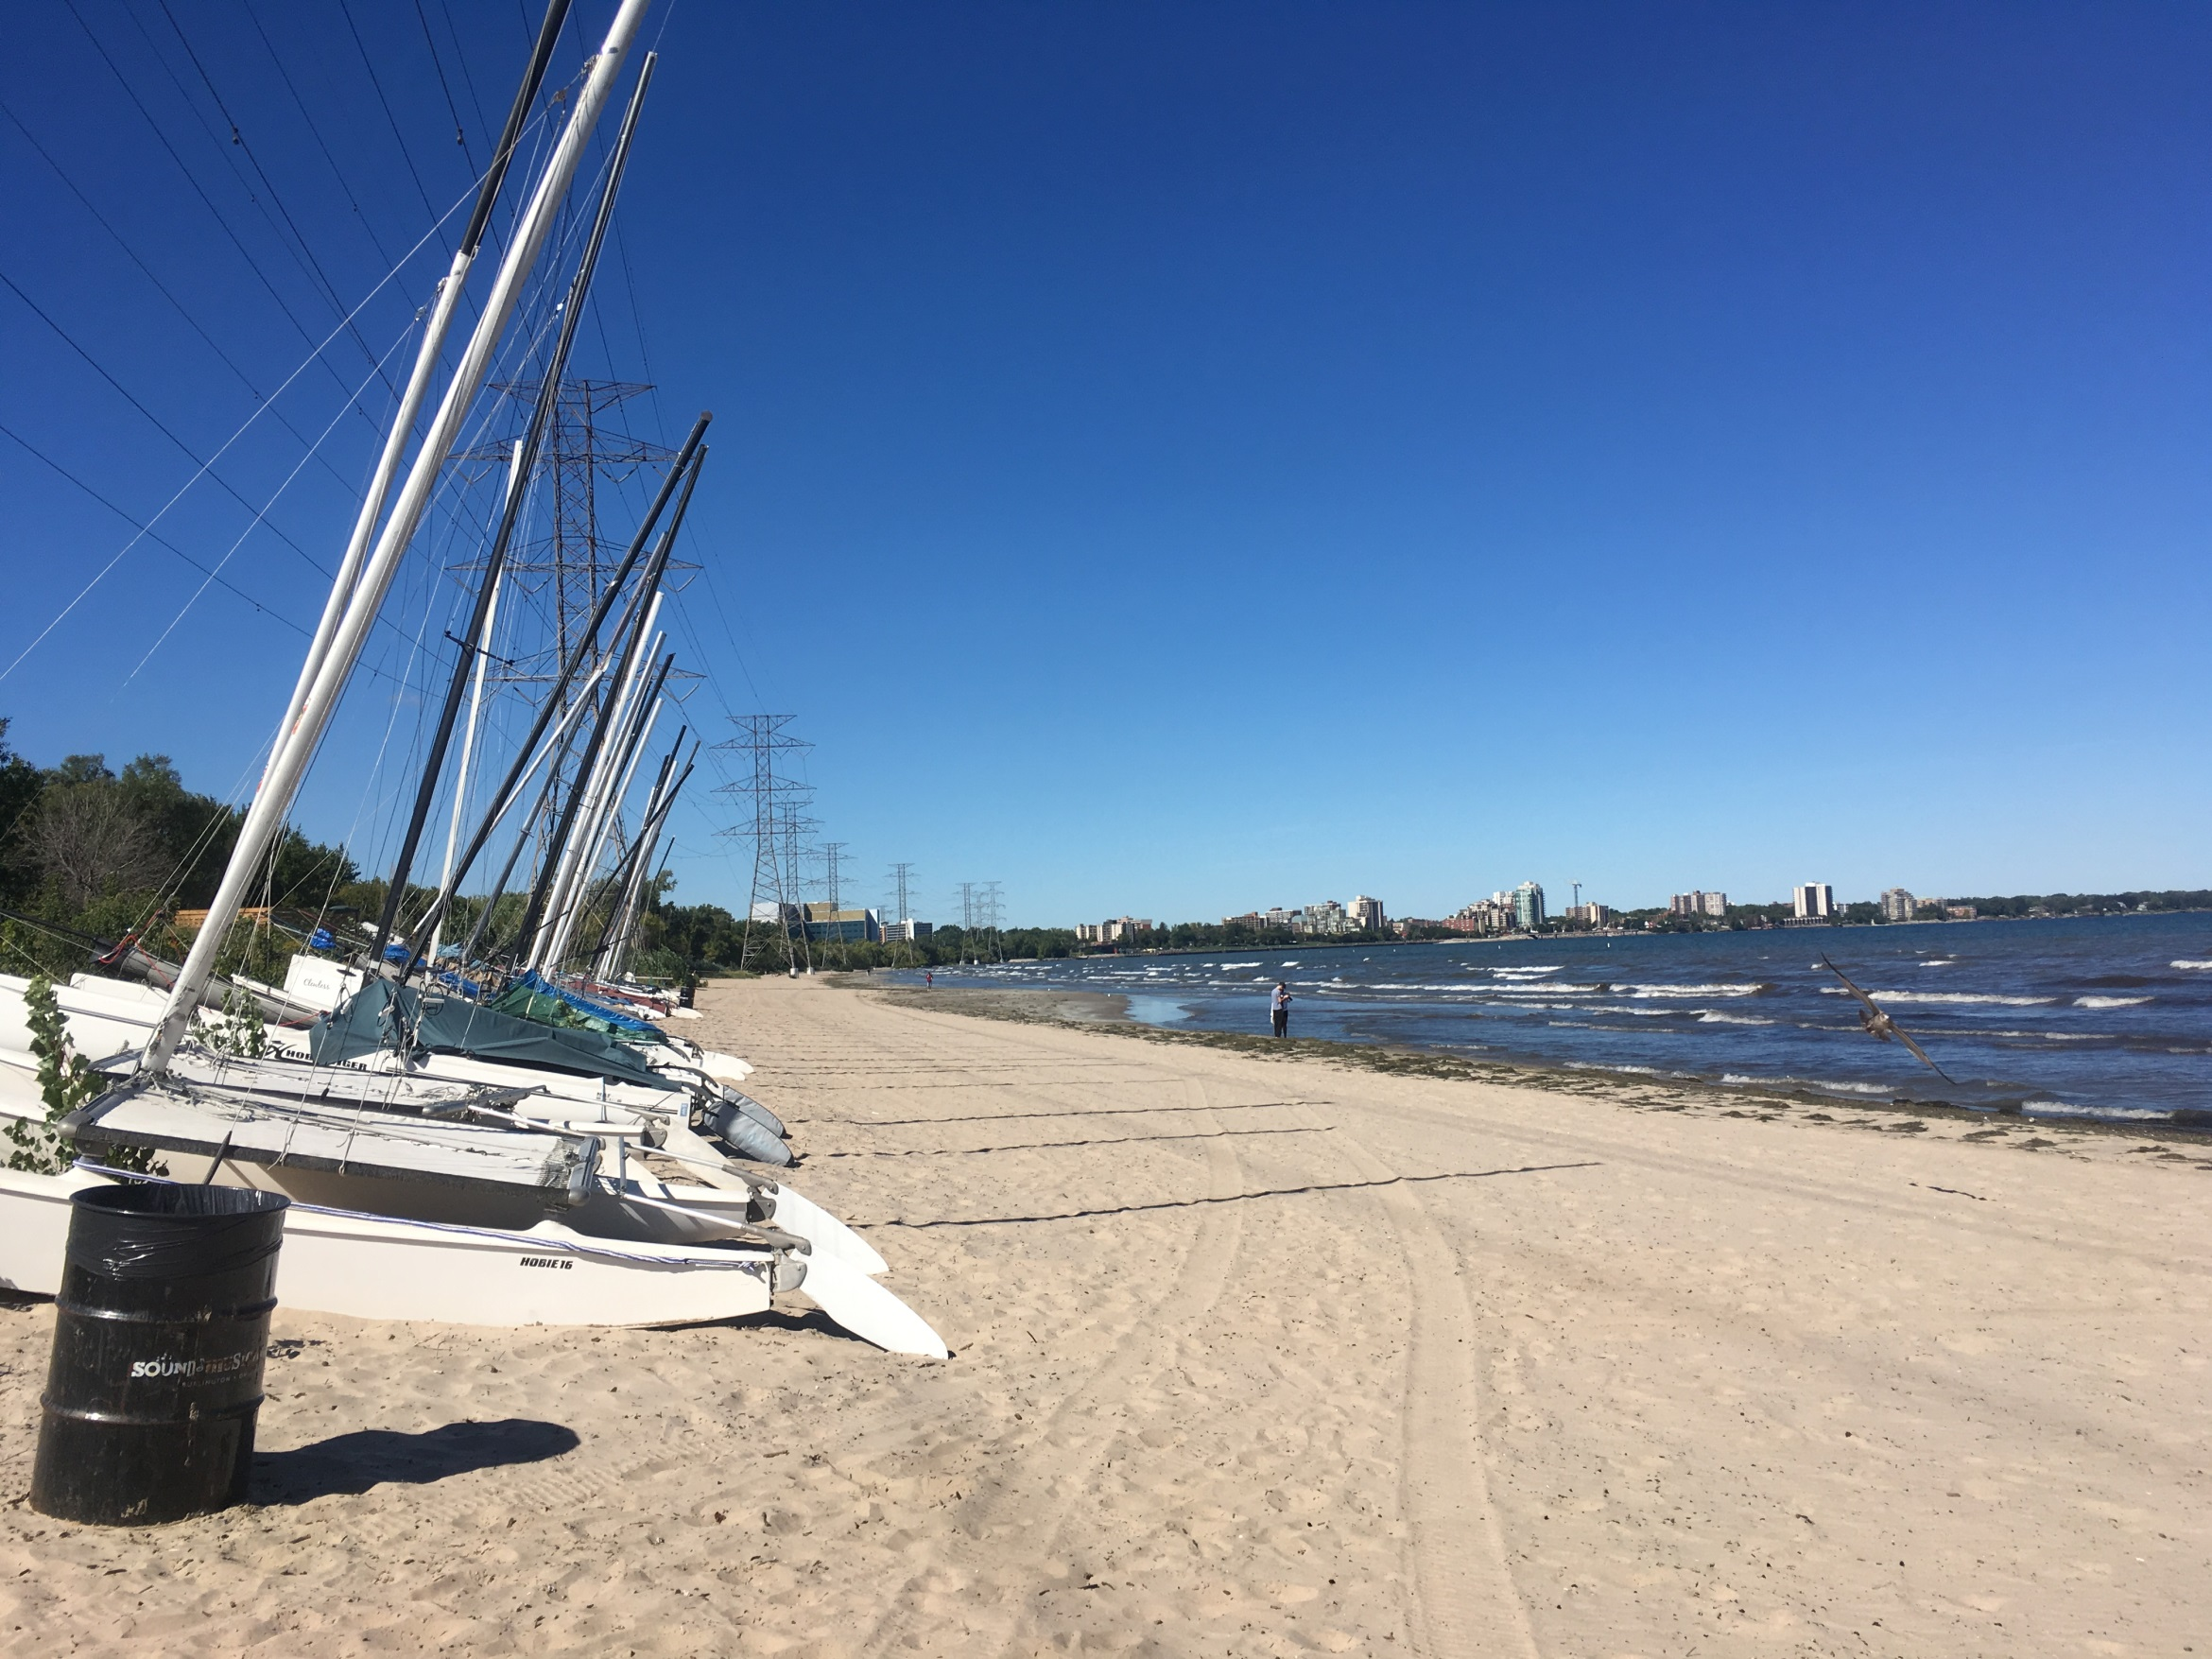

3-D Sediment Mapping on the
Niagara Peninsula
Abigail Burt

Slide 2

Outline
Project area
  Why here?
Geologic context
Data collection
  Geophysics
  Drilling
  Monitoring wells
Early results
  Stratigraphic units
  Cross-sections
What’s next?

Slide 3
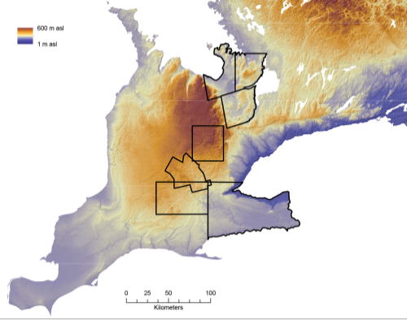
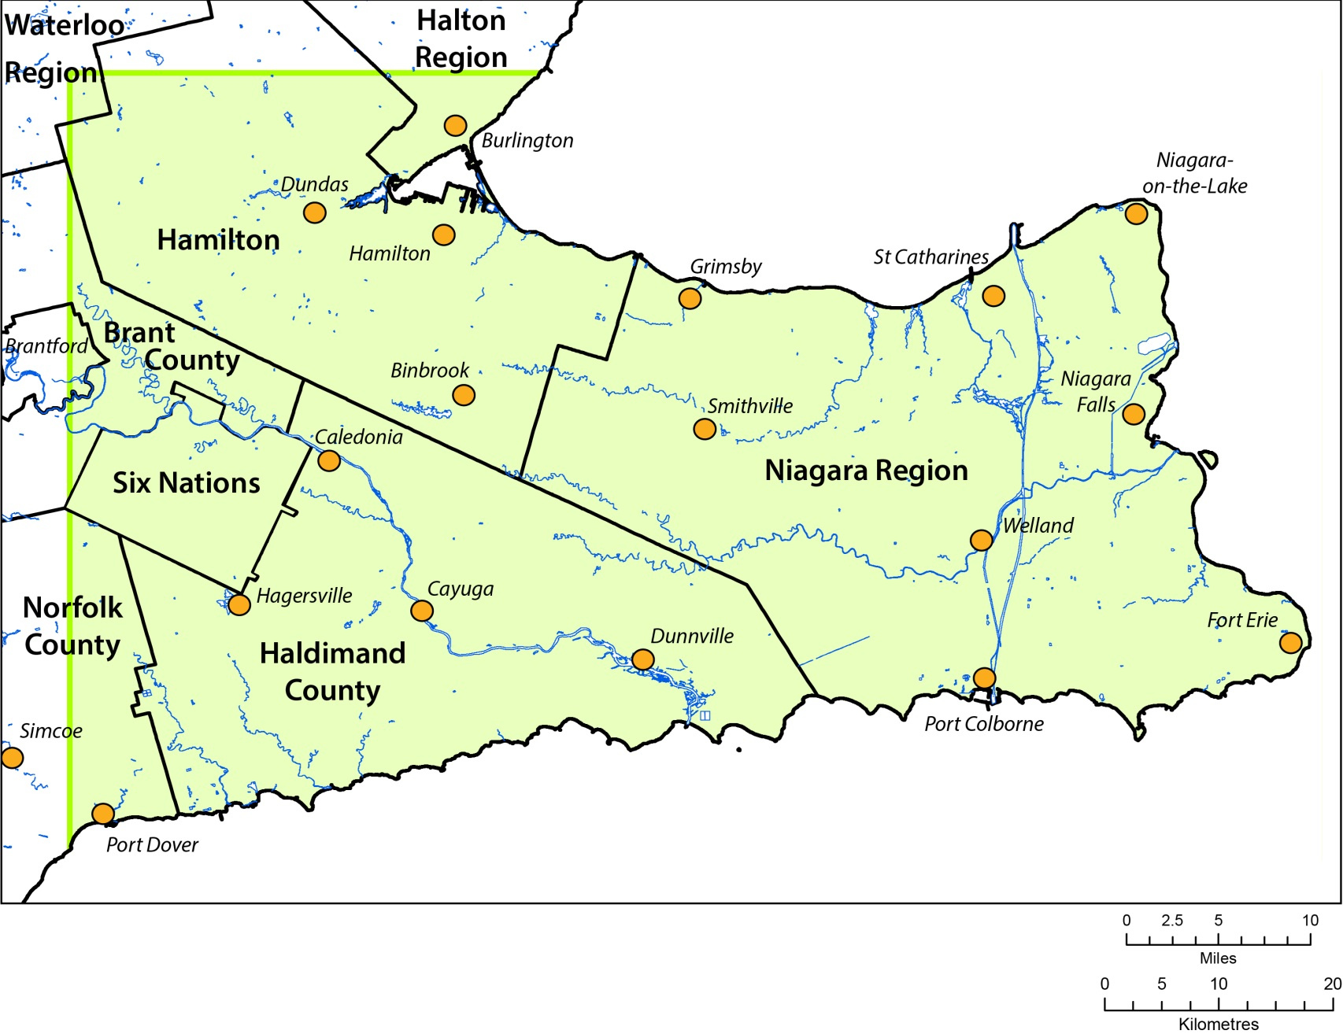
Project Area Location

Slide 4
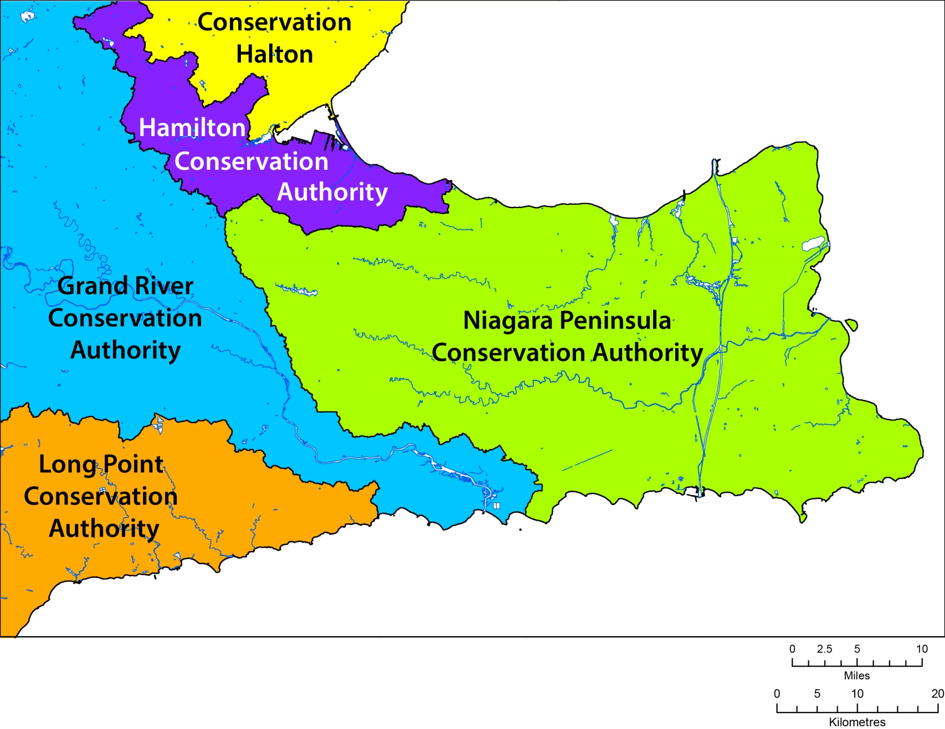
Conservation Authorities

Slide 5
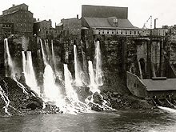
Why Here?
Gap analysis and project proposals from NPCA and Niagara Region
Inform:
  Policy development
  Aquifer sustainability and use
  Provincial instruments (e.g. Permits to Take Water)
  Management of contaminated sites
  Optimization of dewatering systems
  Management of conservation areas
  Protection of coastal wetlands
Rural needs:
  Agriculture (wineries)
  Golf courses
  Domestic supply
Lake Erie north shore area is a priority area for enhanced groundwater monitoring as part of a Canada-Ontario-Agreement Climate Change Monitoring Networks Review Project.
Buried bedrock valleys - hindered hydrogeological studies.
niagarafrontier.com

Slide 6
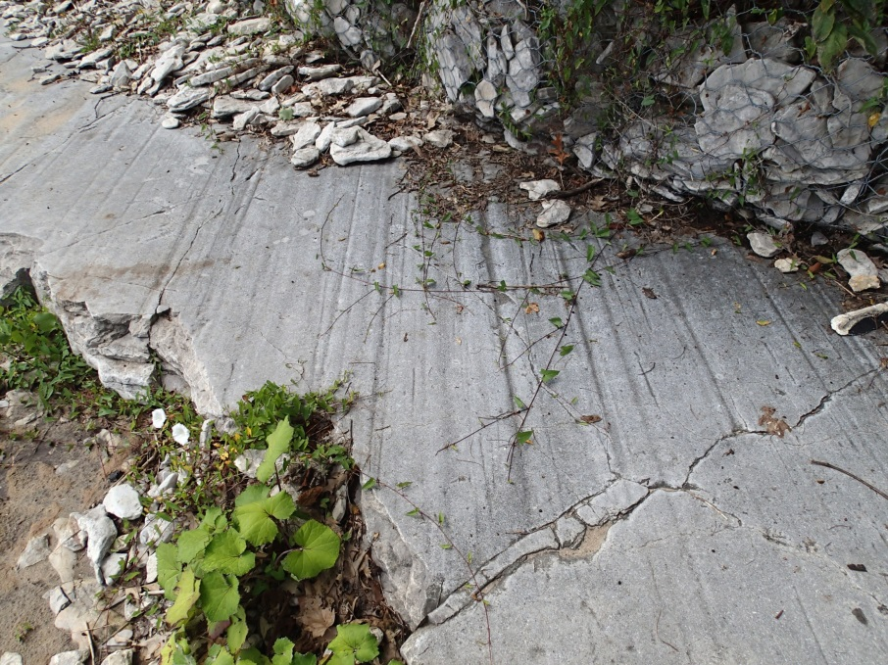
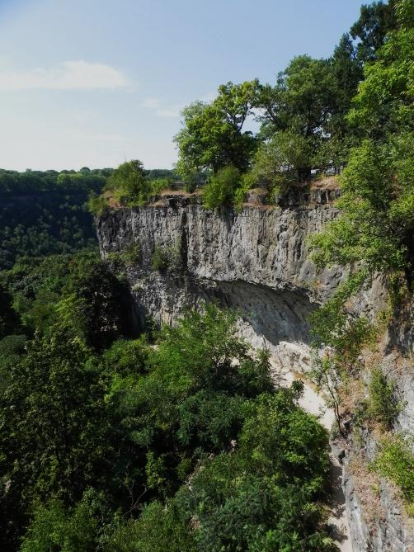
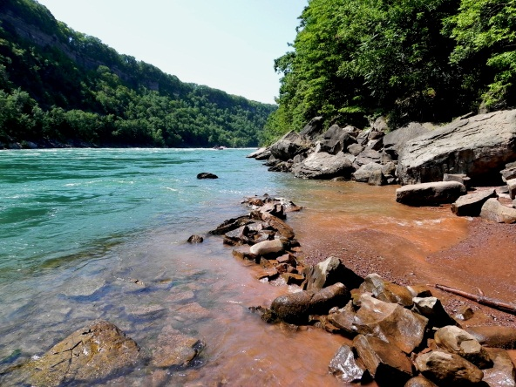

Slide 7
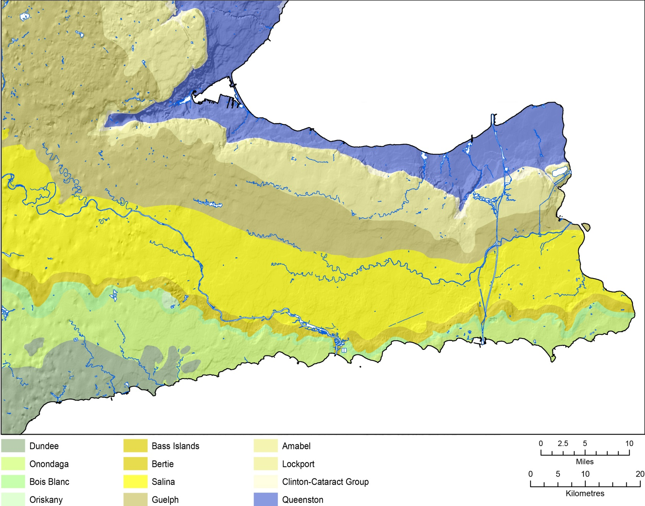
Bedrock Geology

Slide 8
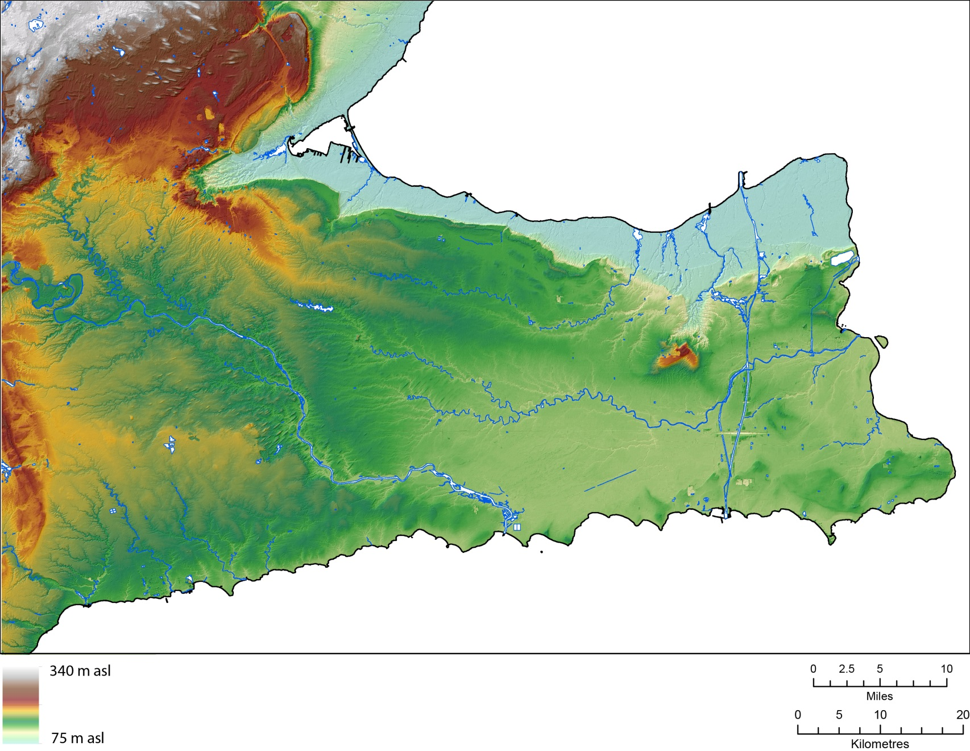
Topography

Slide 9
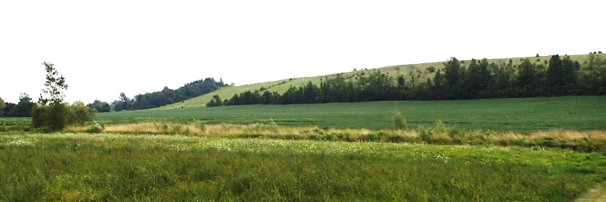
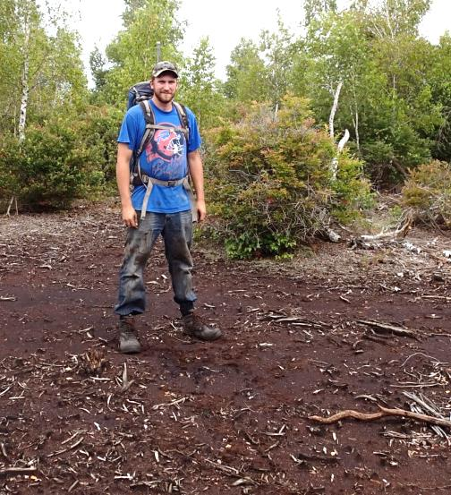
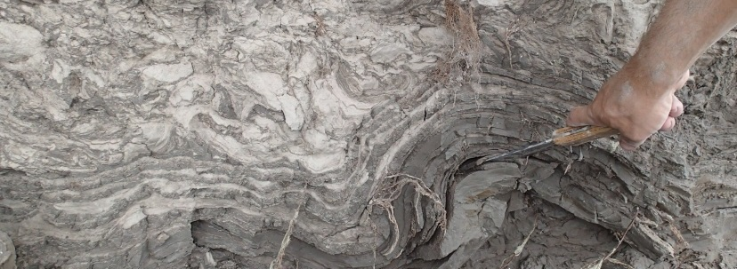
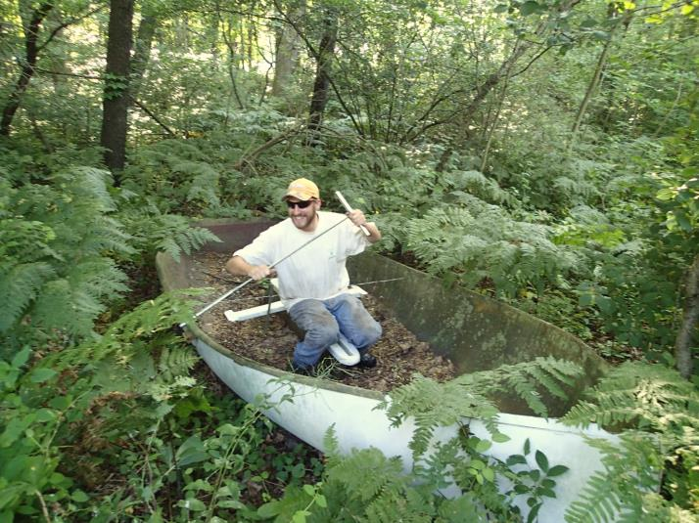
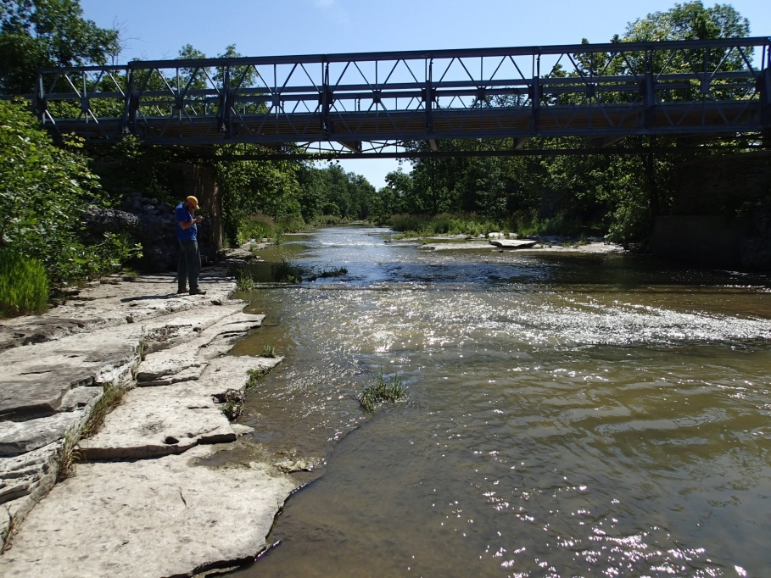
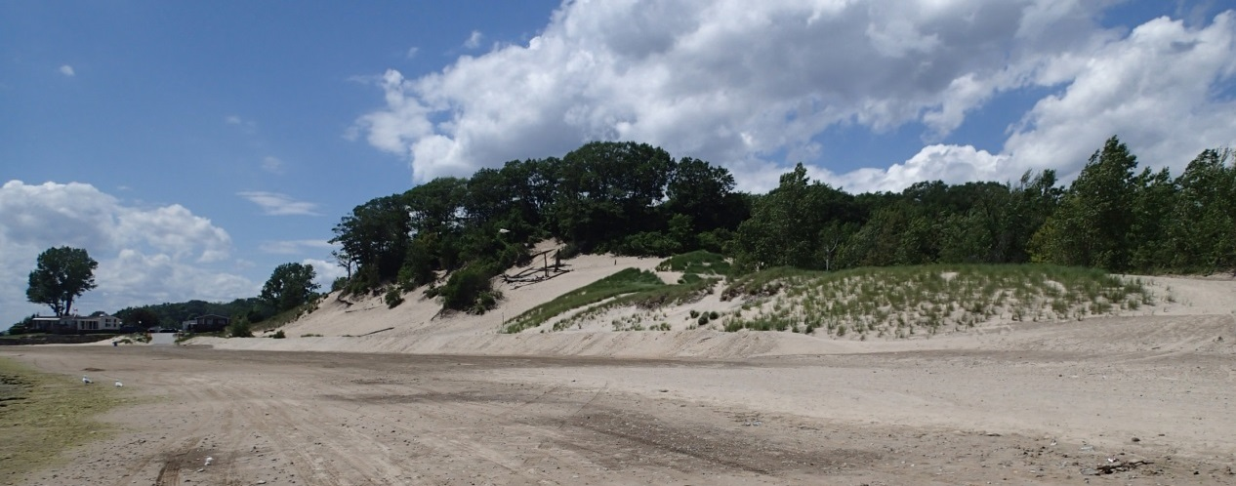

Slide 10
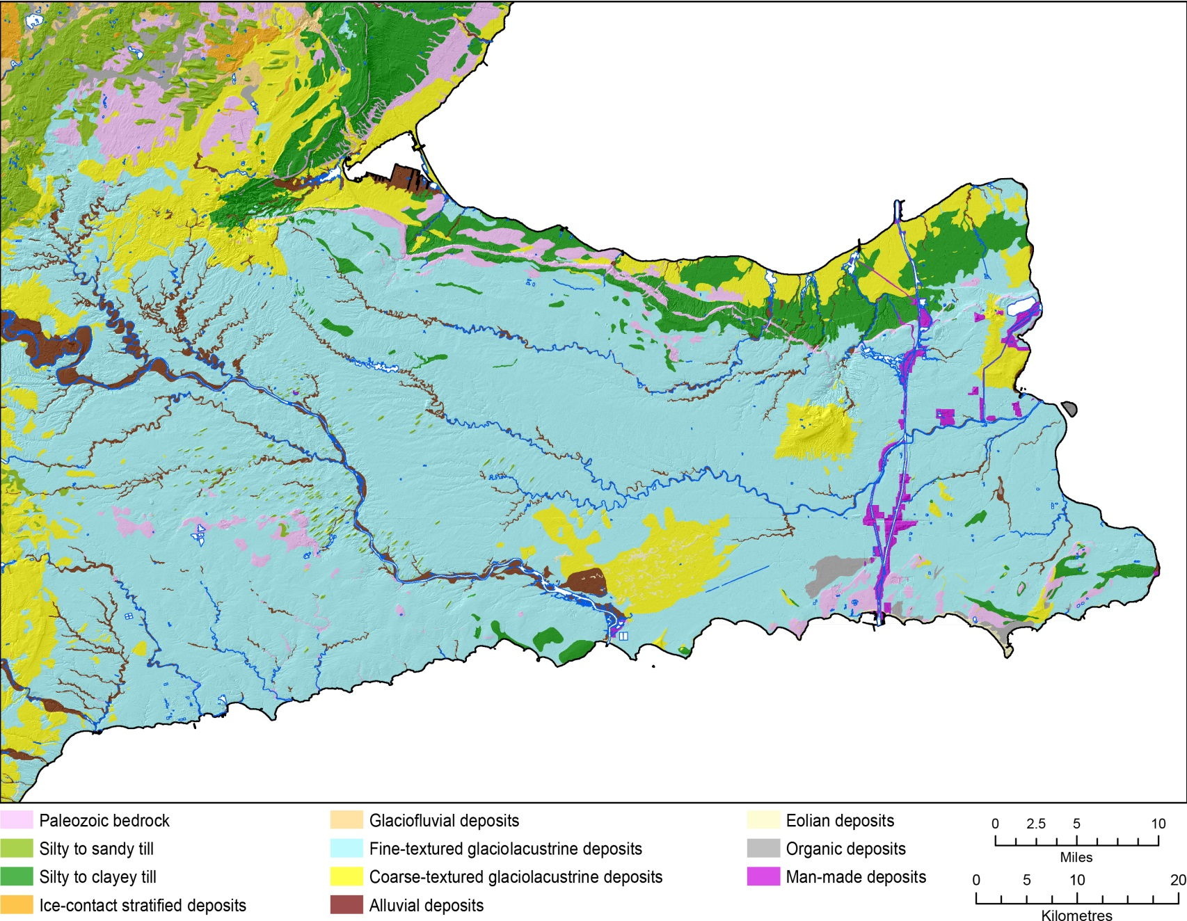
Surficial Geology

Slide 11
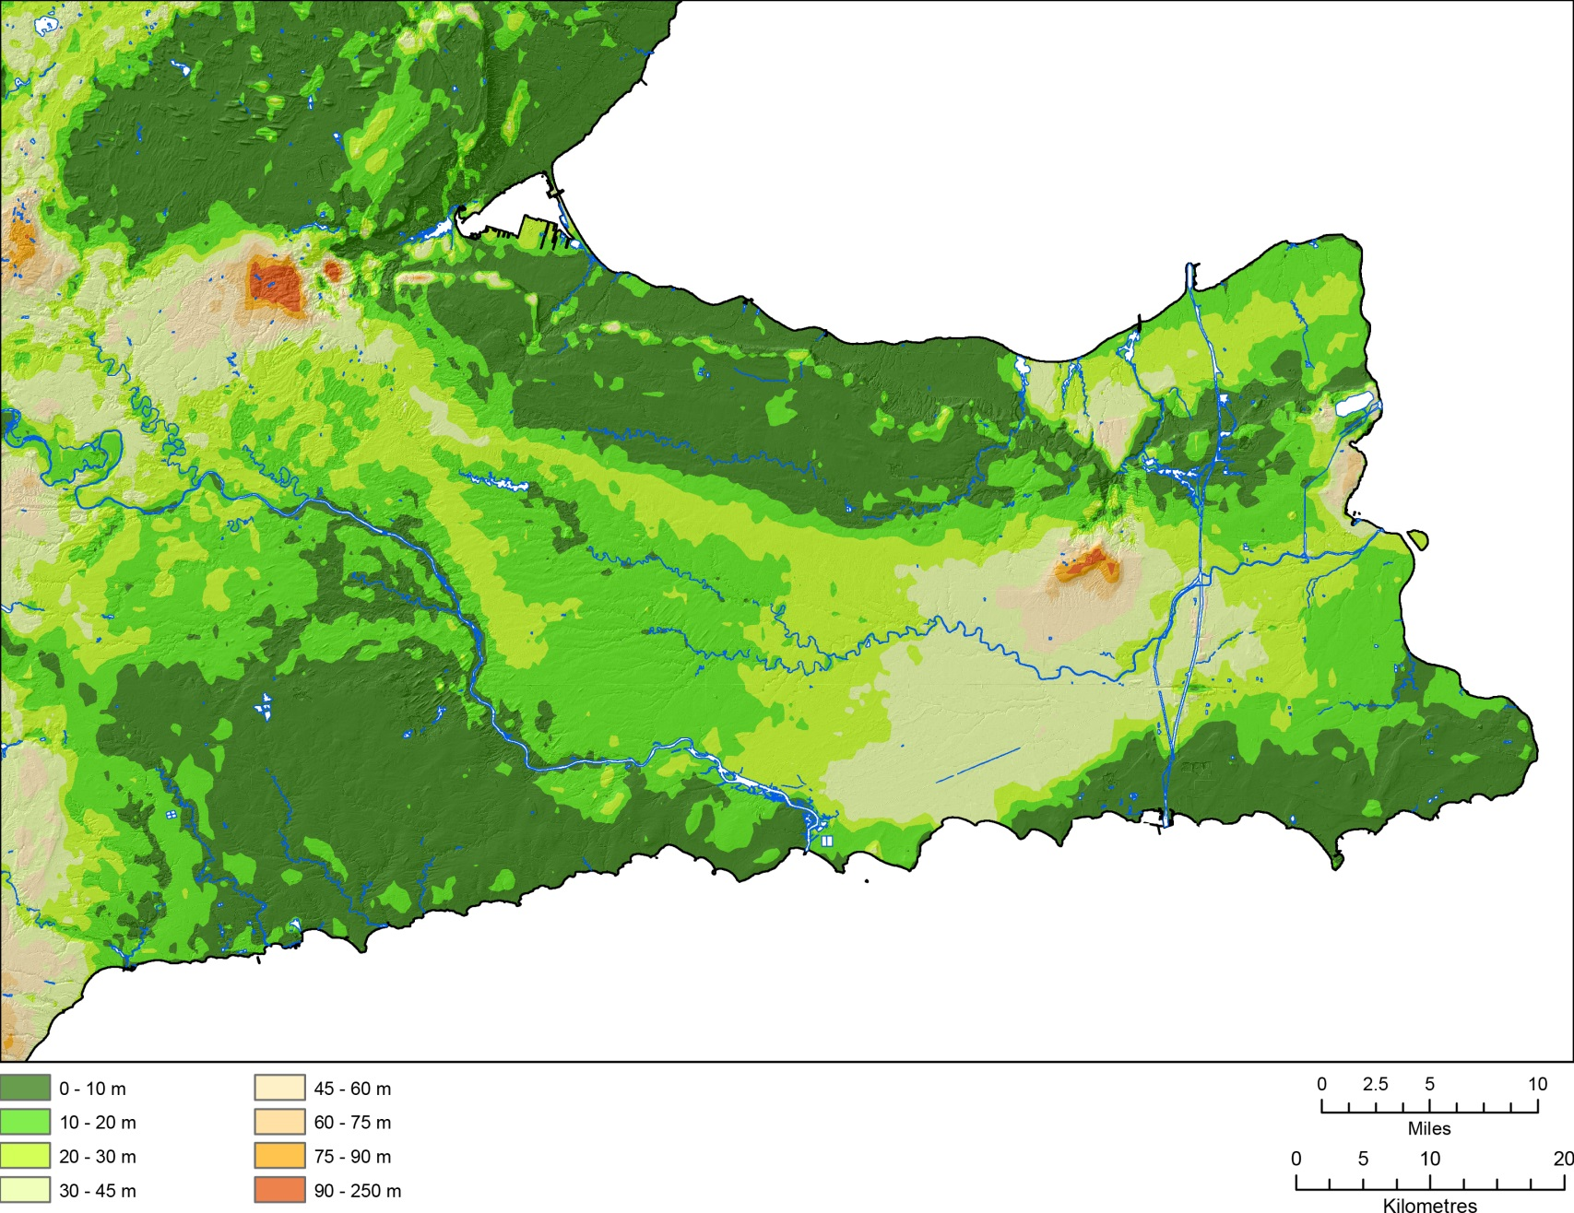
Drift Thickness

Slide 12
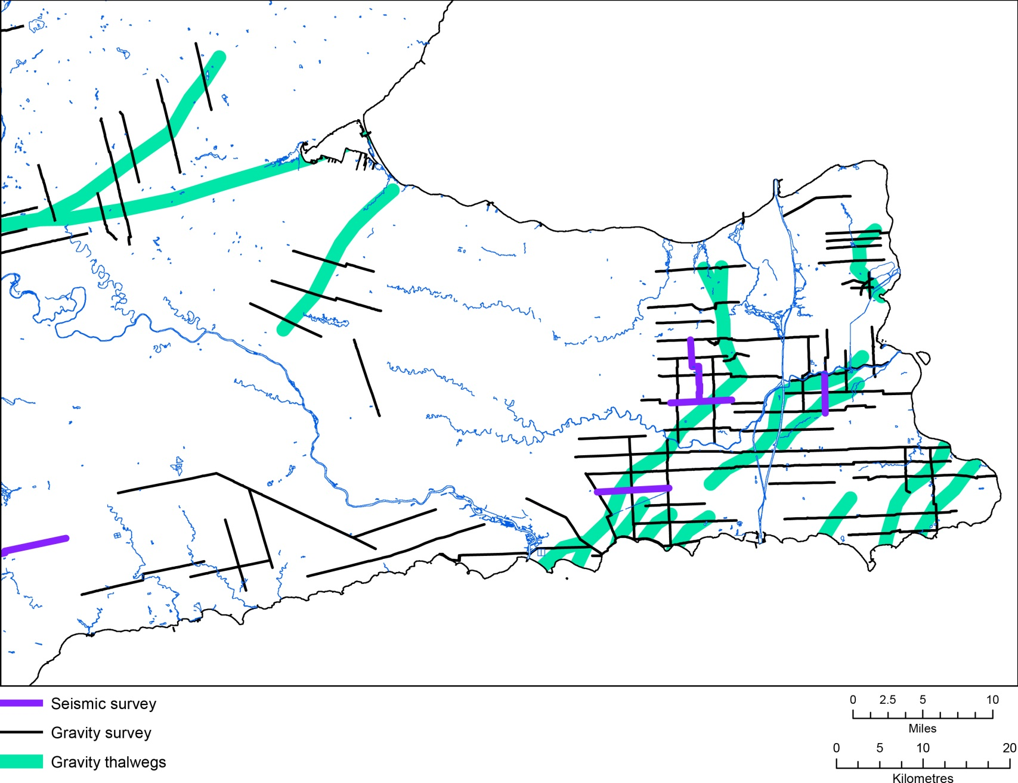
New Data - Geophysics

Slide 13
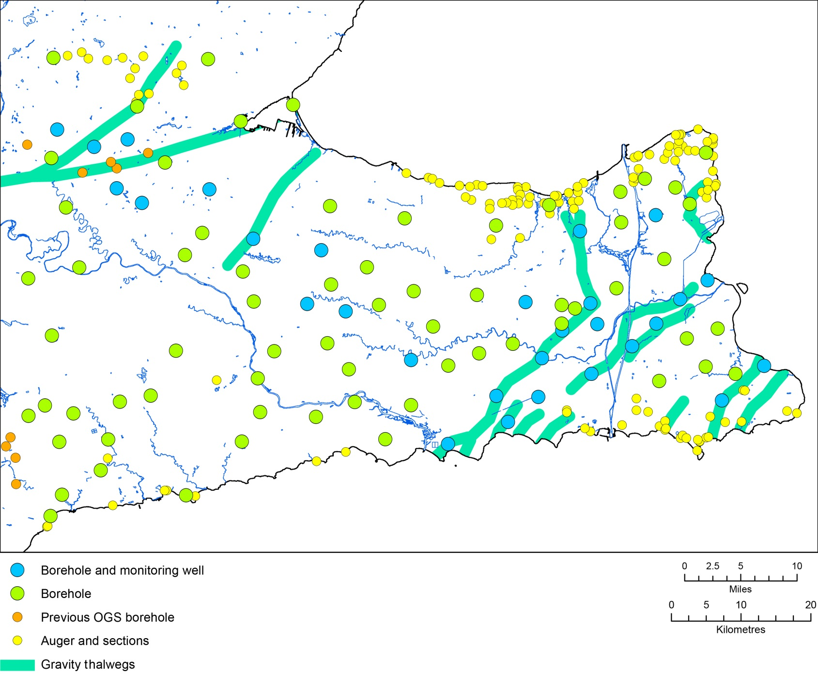
New Data – Drilling, Monitoring Wells

Slide 14
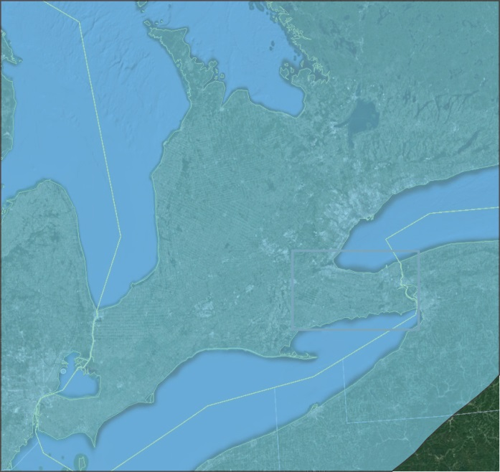
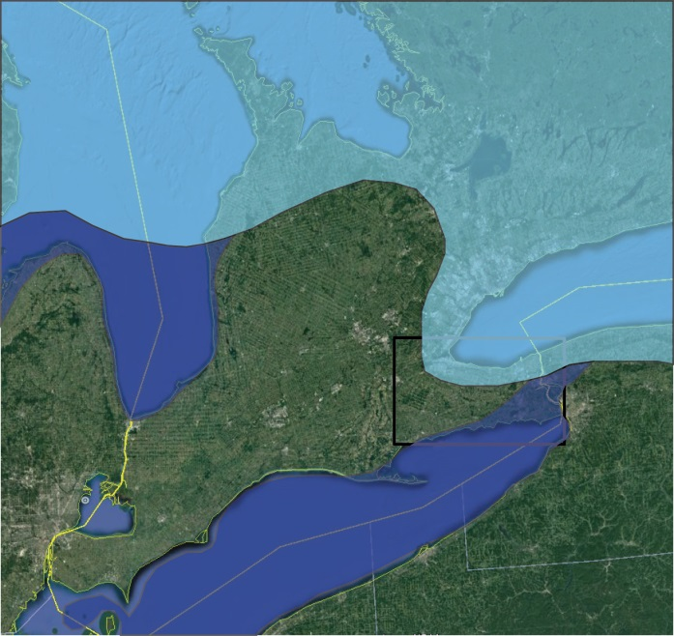
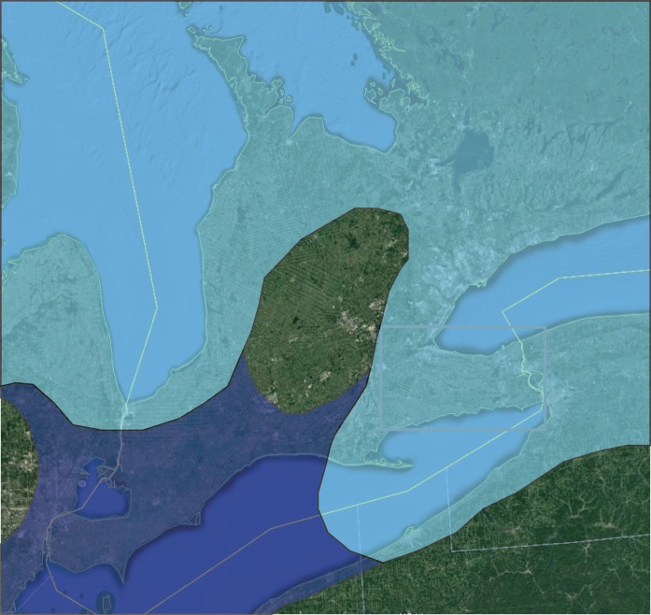
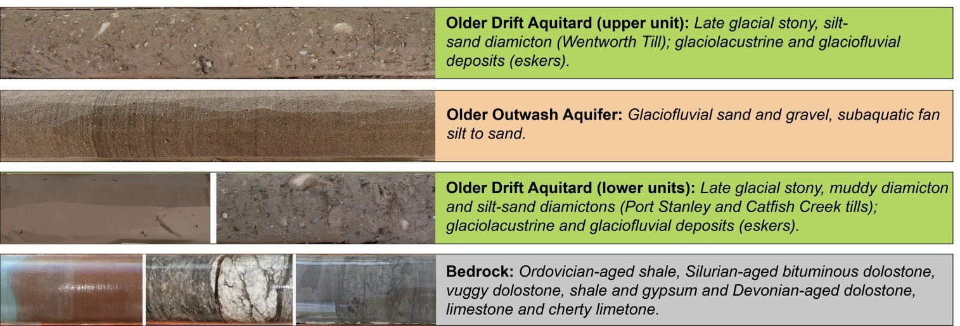
Late Glacial History and Sediments

Slide 15
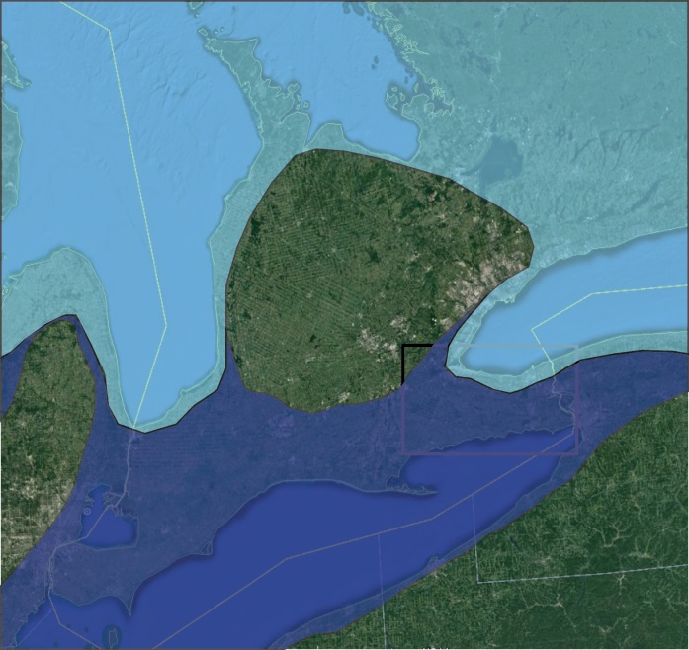
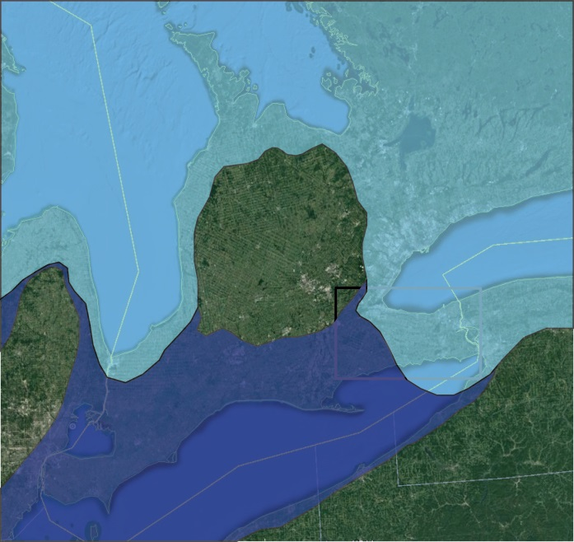
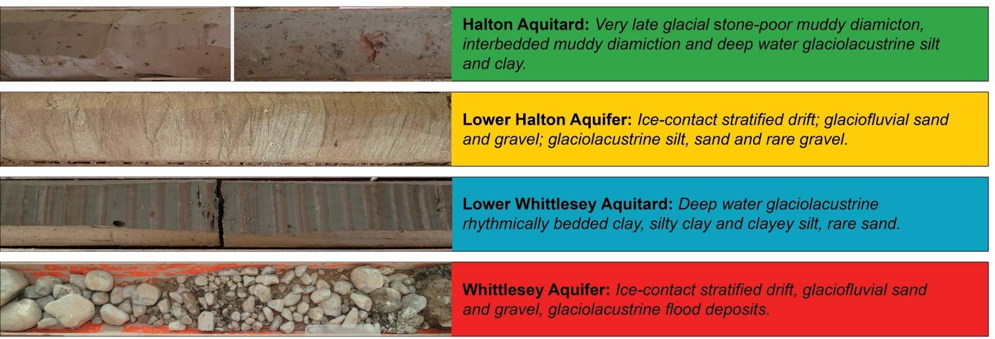
Late Glacial History and Sediments

Slide 16
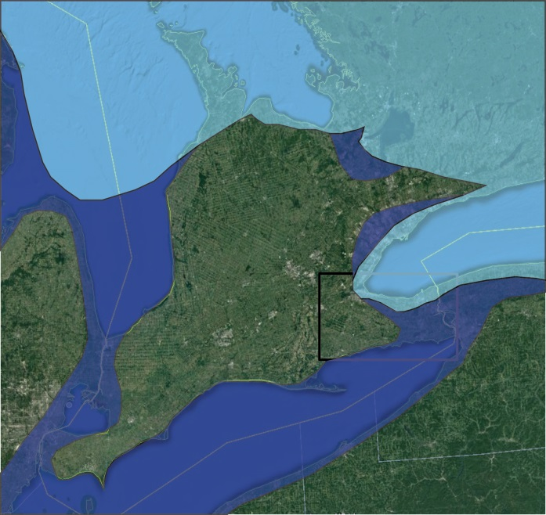
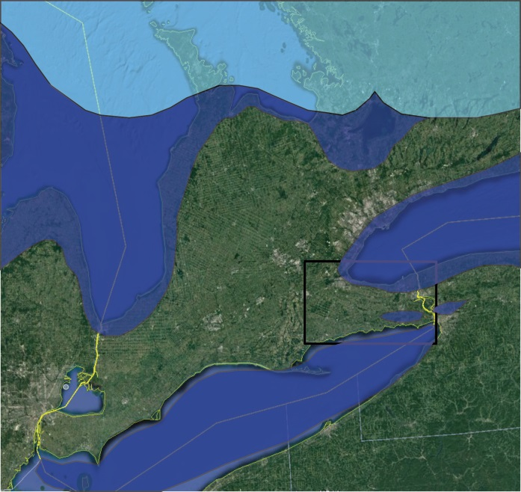
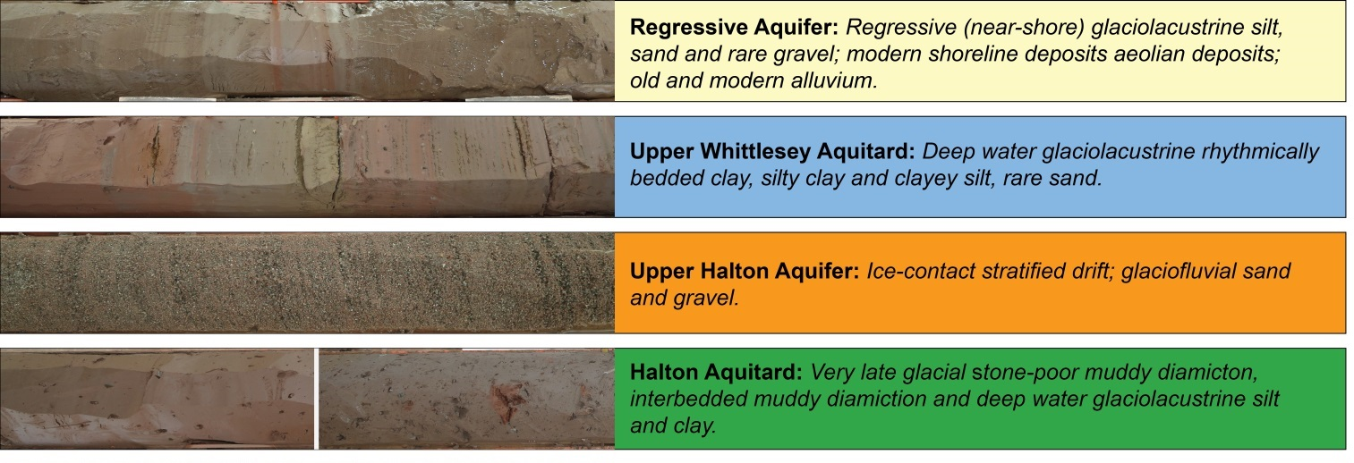
Late Glacial History and Sediments

Slide 17
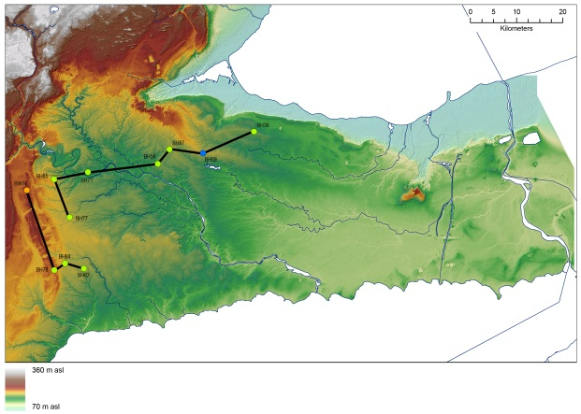
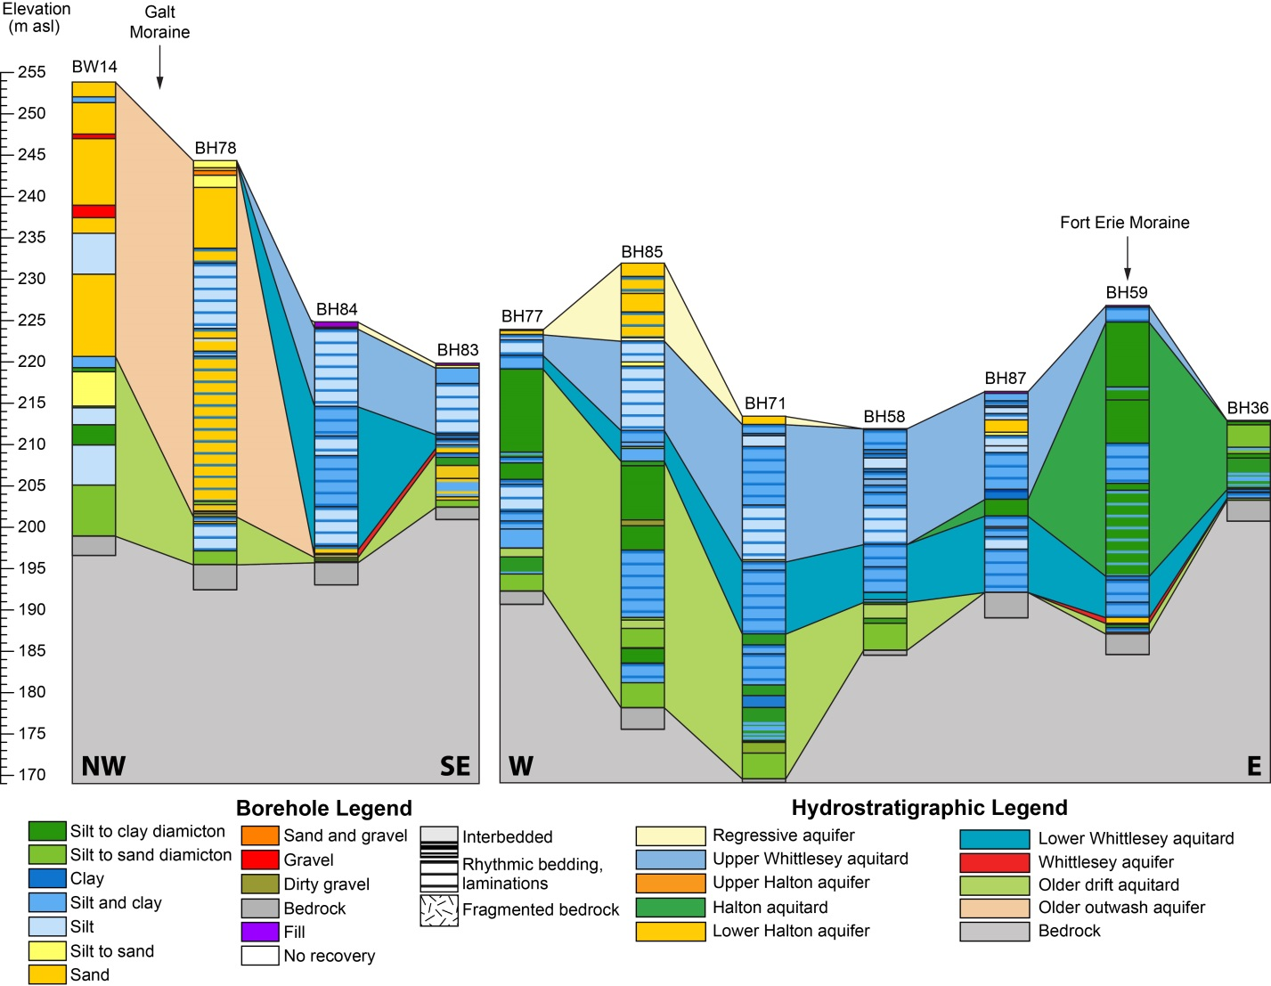
Western Area
A
B’
B
A’
A
A’
B
B’

Slide 18

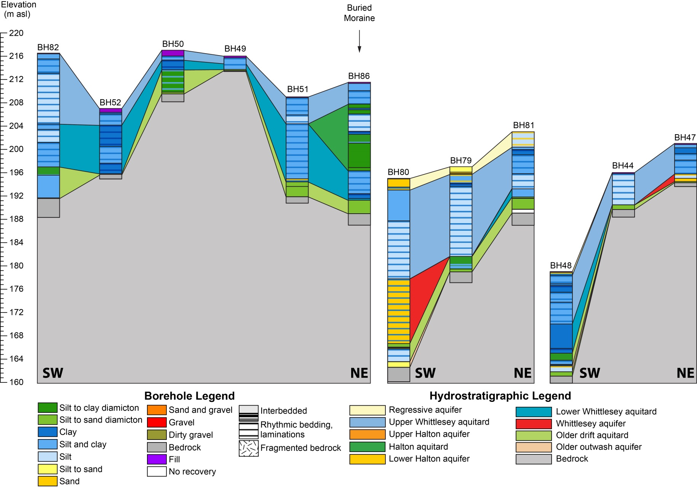
Port Dover Area
A’
C’
A
B’
B
C
A
A’
B
B’
C
C’

Slide 19

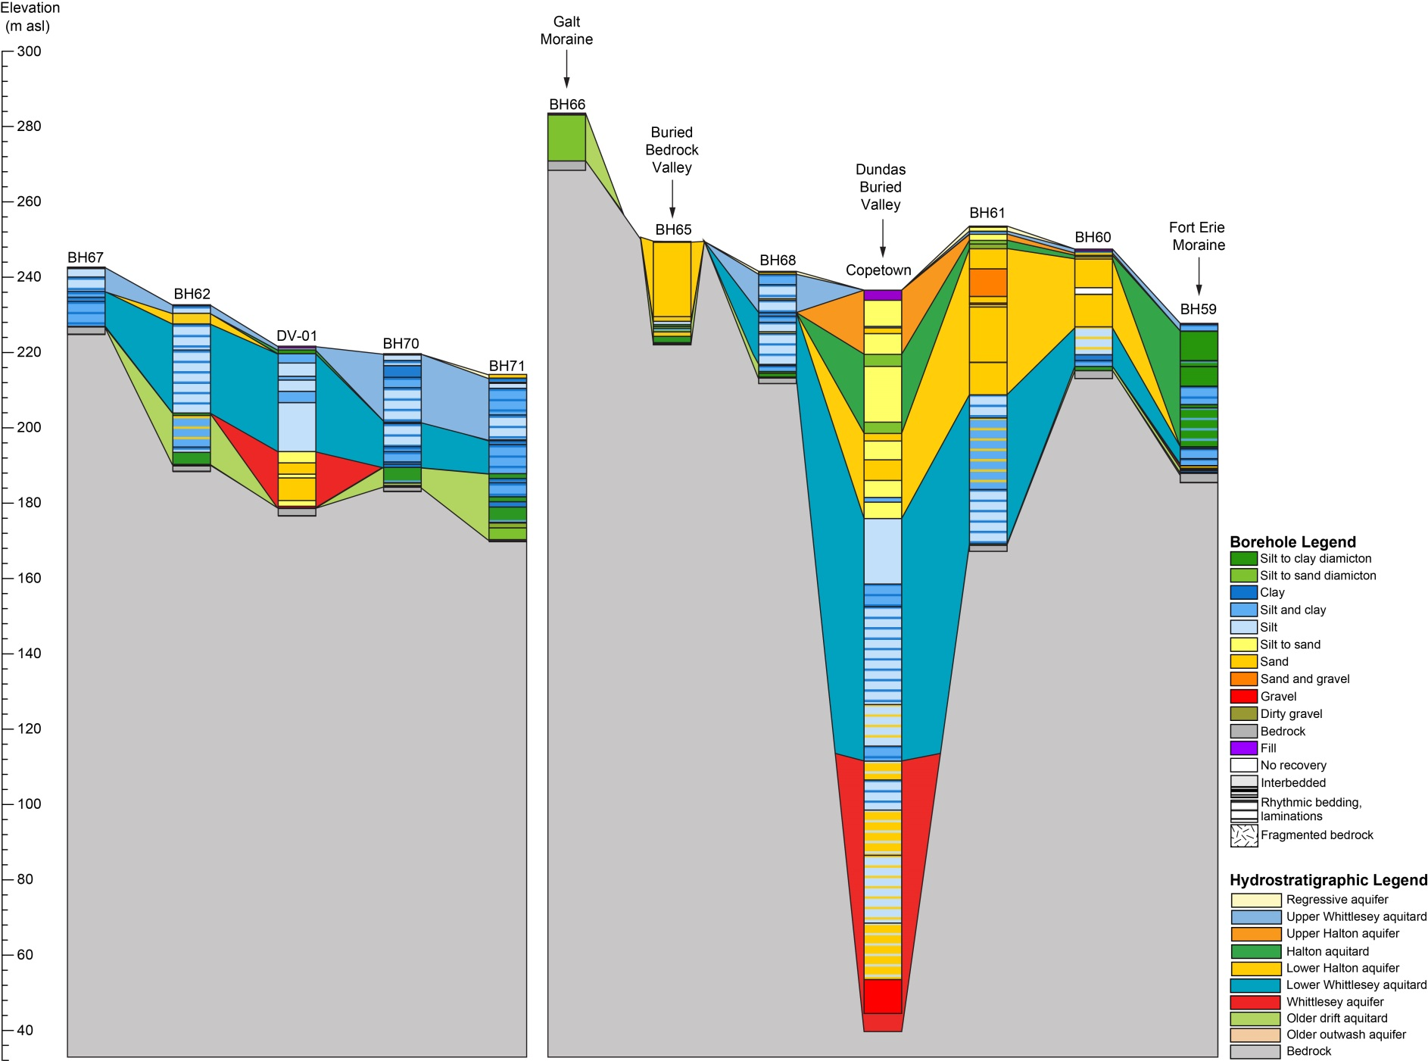
Dundas Valley Area
B
A
B’
A’
A
A’
B
B’
N
S
NW
SE

Slide 20
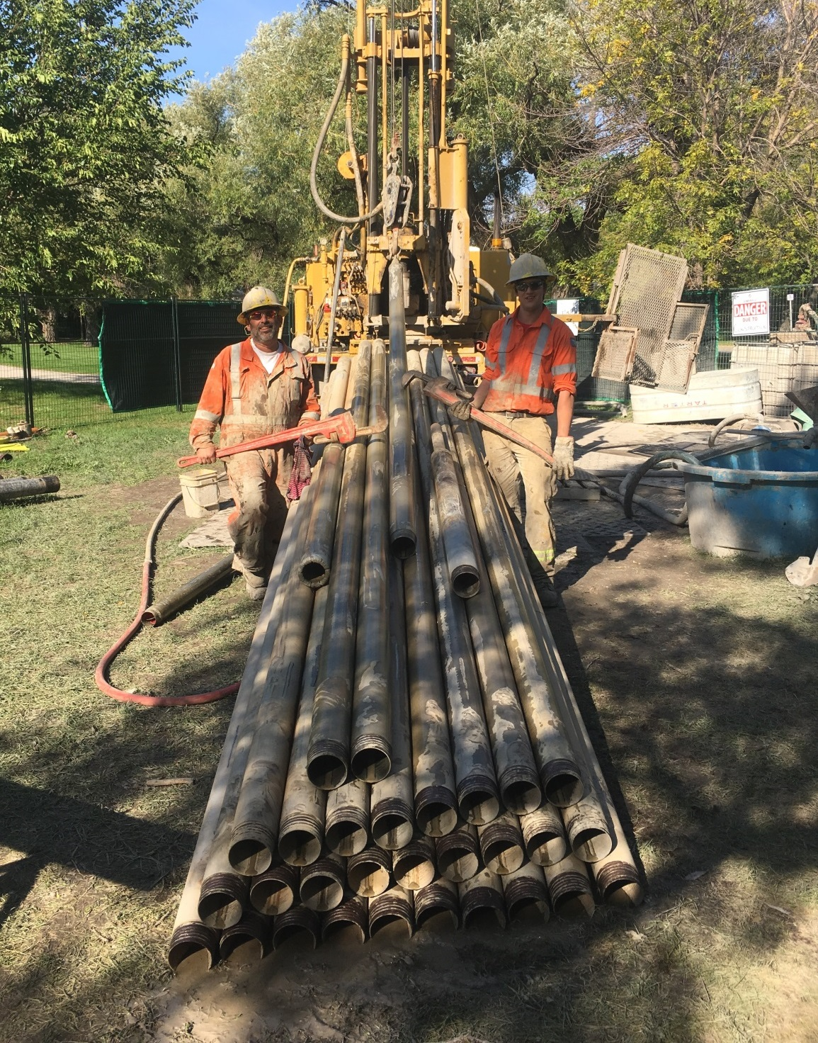

Slide 21

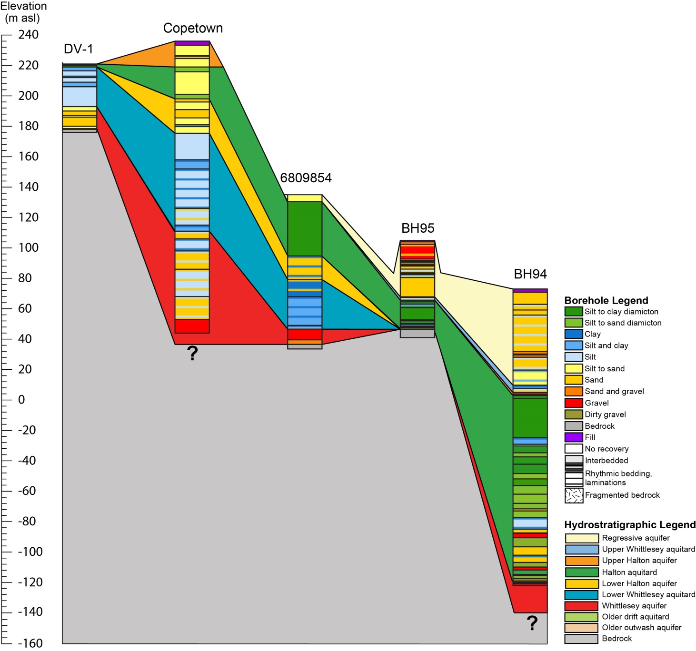
Dundas Valley Area
A’
A
A
A’
W

Slide 22

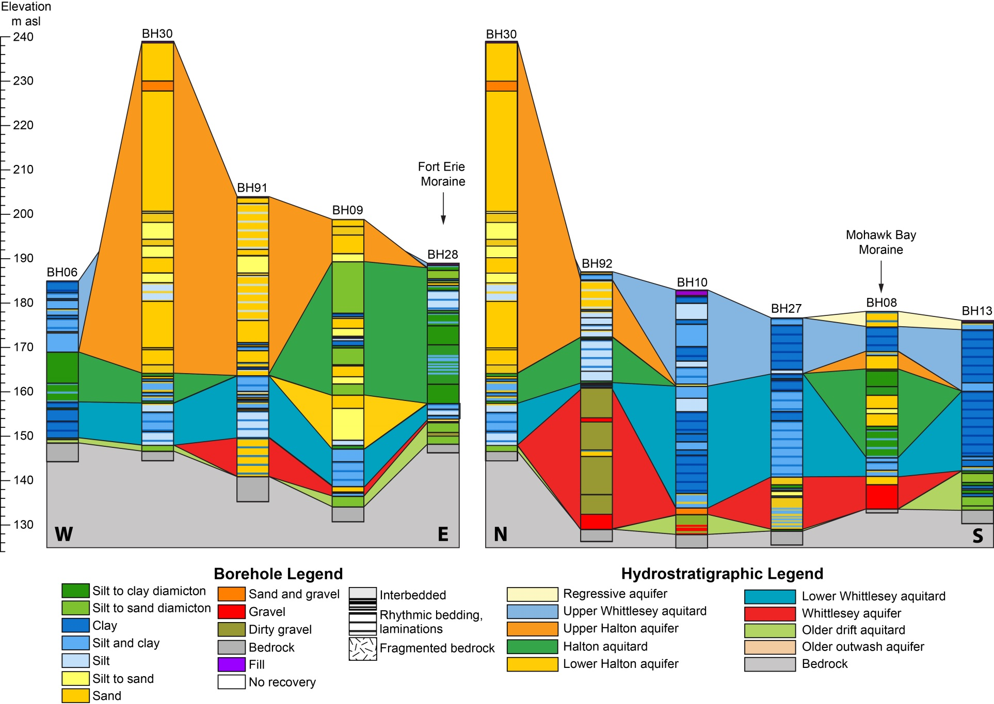
Fonthill Area
B
A
A’
B’
A
A’
B
B’

Slide 23
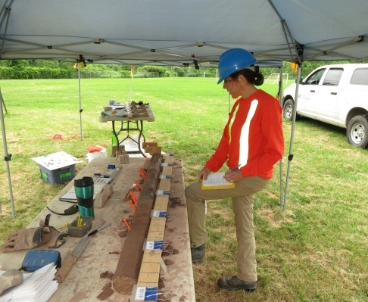
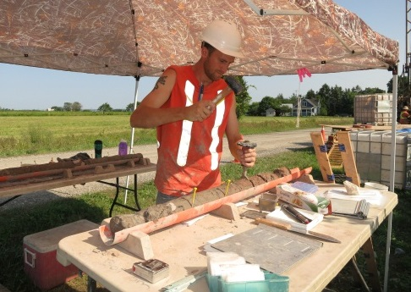
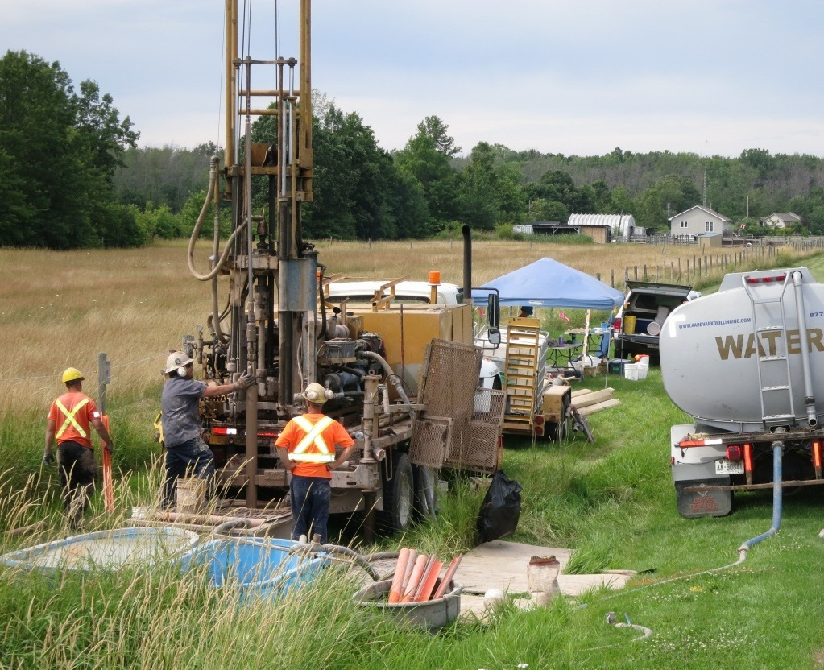
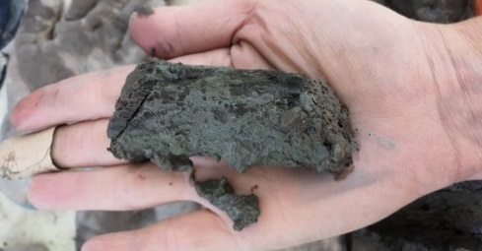
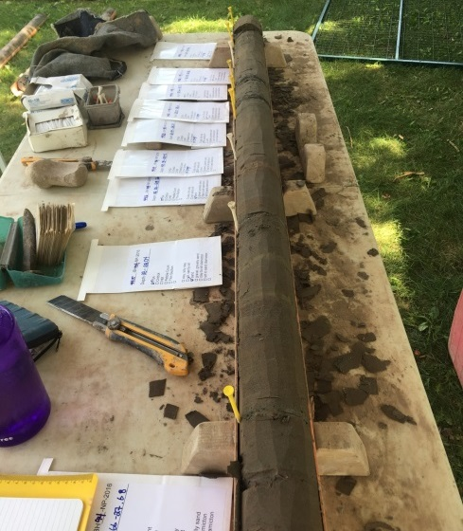
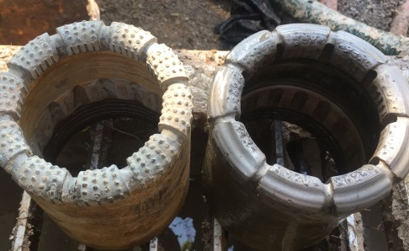
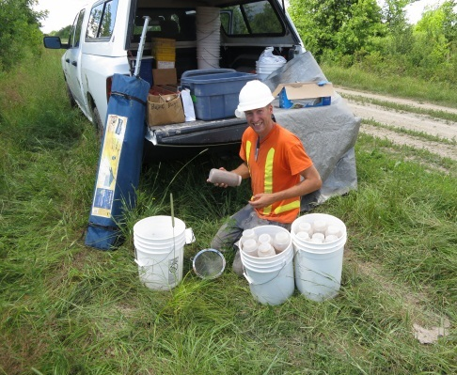
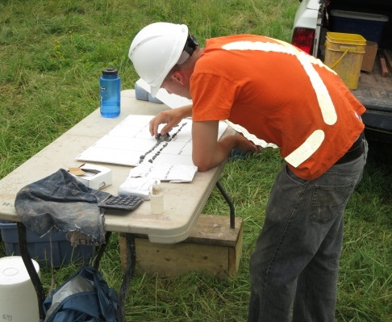
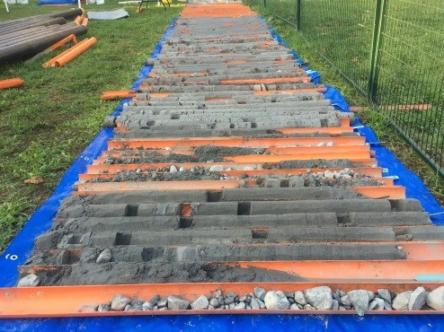
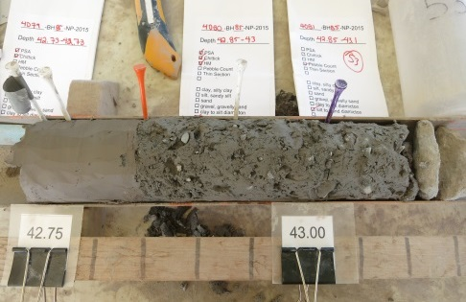
What’s Next? A Little More Drilling!

Slide 24
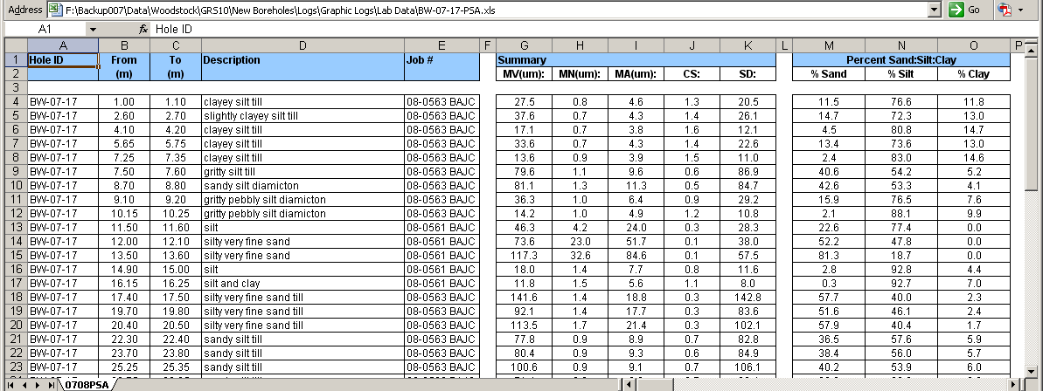
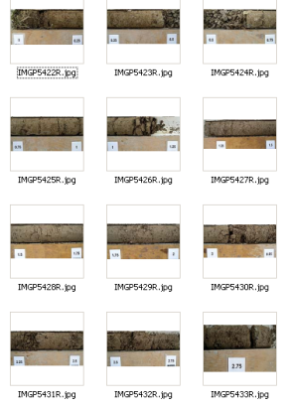
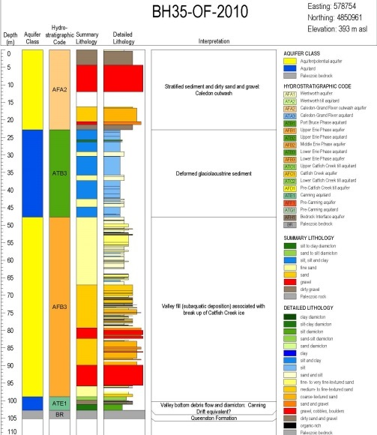


What’s Next? Interactive Drillhole Data and Map

Slide 25

What’s Next? Revised Bedrock Surface and Drift Thickness Map

Slide 26

What’s Next? Build a Model

Slide 27

Questions?

Slide 28






Bedrock
Queenston
Eramosa
Guelph
Salina
Bois Blanc
Onondaga

Slide 29





Older Drift Aquitard – Lower Unit
Stony silt-sand till (Catfish Creek Till, older till)
Stone-poor muddy till (Port Stanley Till)
Clay, silty clay
Regional ice flows
Erie-Ontario lobe ice
Proglacial lakes
Catfish Creek Till and Upper Till aquitards

Slide 30




Older Outwash Aquifer
Sand
Silt,
Rhythmically bedded sand, silt and clay
Minor gravel
Deltaic deposits
Outwash
Subaquatic fans
Grand River and Caledon Outwash aquifers

Slide 31




Older Drift Aquitard – Upper Unit
Stony silt-sand till (Wentworth Till)
Gravel
Interbedded diamicton and gravel
Minor silt and clay
Late glacial Erie-Ontario lobe ice
Glaciofluvial deposits (eskers)
Proglacial lakes
Wentworth Till Aquitard

Slide 32





Whittlesey Aquifer
Sand
Gravel, dirty gravel
Rhythmically bedded sand and silt
Diamicton
Ice-contact stratified drift
Glaciofluvial deposits (eskers, outwash)
Subaqueous fans - deltaic deposits (Simcoe delta)
Whittlesey Aquifer

Slide 33





Lower Whittlesey Aquitard
Rhythmically bedded silt and clay
  Silt in the west
  Clay in the east
Minor sand
Grit, ripped-up clay and diamicton
Bright colours
Proglacial lake deposits (Glacial Lake Whittlesey)
Debris flows
‘Crud’ washing in
Whittlesey aquitard

Slide 34





Lower Halton Aquifer
Sand
Silt
Minor gravel
Subaquatic fans
Ice-contact stratified drift
New unit

Slide 35





Halton Aquitard
Stone-poor to stony muddy diamicton (Halton Till)
Muddy diamicton with clayey laminations
Interbedded muddy diamicton, silt, clay and occasionally sand
Late-glacial Ontario lobe ice
Proglacial lake deposits
Debris flows
New unit

Slide 36





Upper Halton Aquifer
Sand
Minor gravel
Minor silt
Rare clay laminations
Ice-contact stratified drift
Glaciofluvial deposits
Deltaic deposits
New unit

Slide 37





Upper Whittlesey Aquitard
Rhythmically bedded silt and clay
Minor sand
Minor diamicton
Duller colours
Upper sediments oxidized, gypsum crystals
Proglacial lake deposits (Lakes Warren, Grassmere, Lundy, Algonquin, Dana, Dunnville, Iroquois)
Debris flows
Whittlesey aquitard

Slide 38






Regressive Aquifer
Sand
Silt
Minor gravel
Peat
Post glacial and modern nearshore and beach deposits
Dunes
Rivers deposits (alluvium)
Whittlesey regressive aquifer

