Slide 1
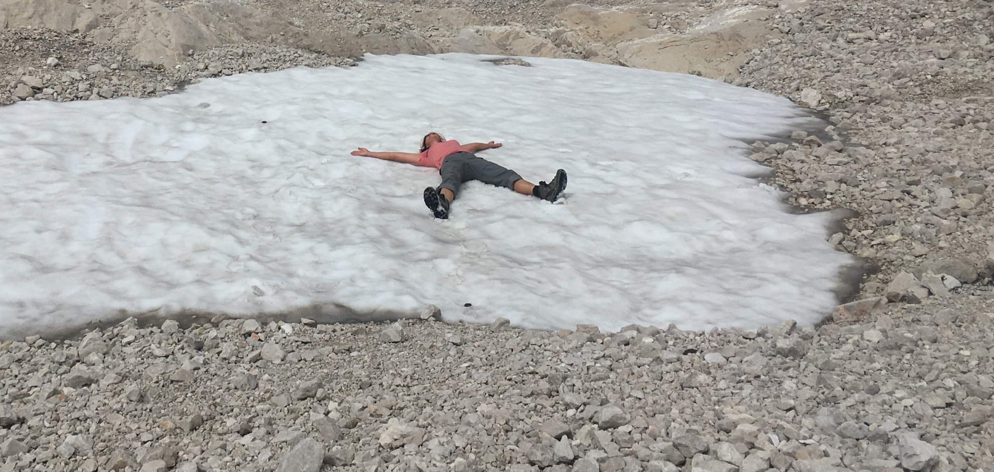

Late glacial Ontario lobe ice on the Niagara Peninsula: how far did it go?
Abigail Burt and Riley Mulligan

Slide 2
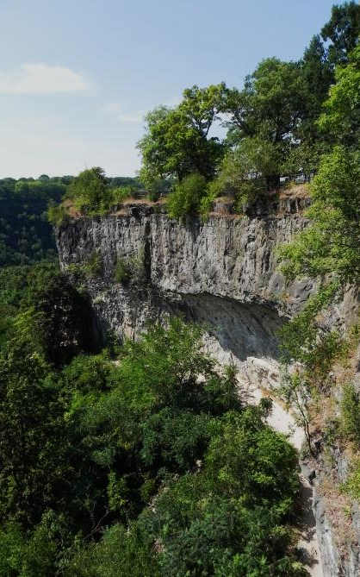

Today’s talk
Project area
LiDAR light….
New landform mapping
Subsurface data collection
Early results
Stratigraphic units
Cross-sections
Conclusions

Slide 3
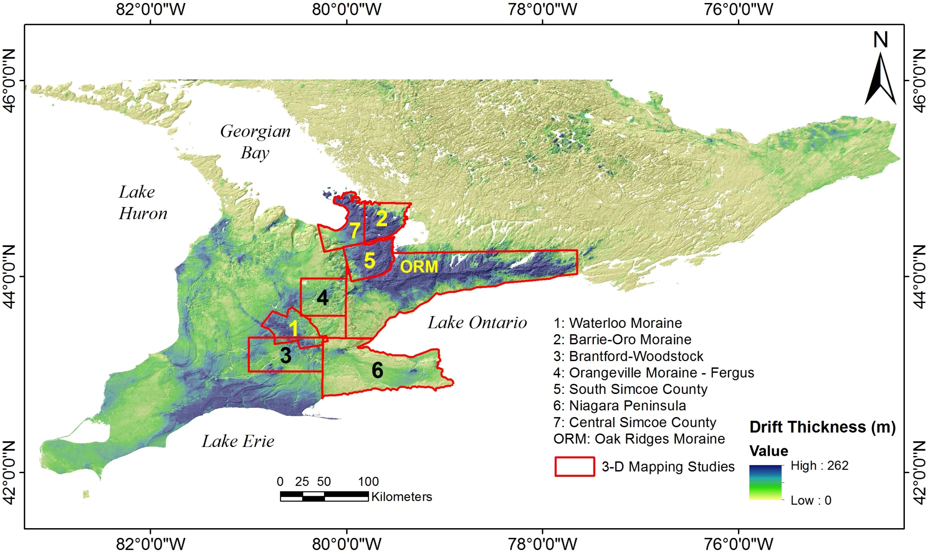
3-D sediment mapping in Ontario
OGS-GSC

Slide 4
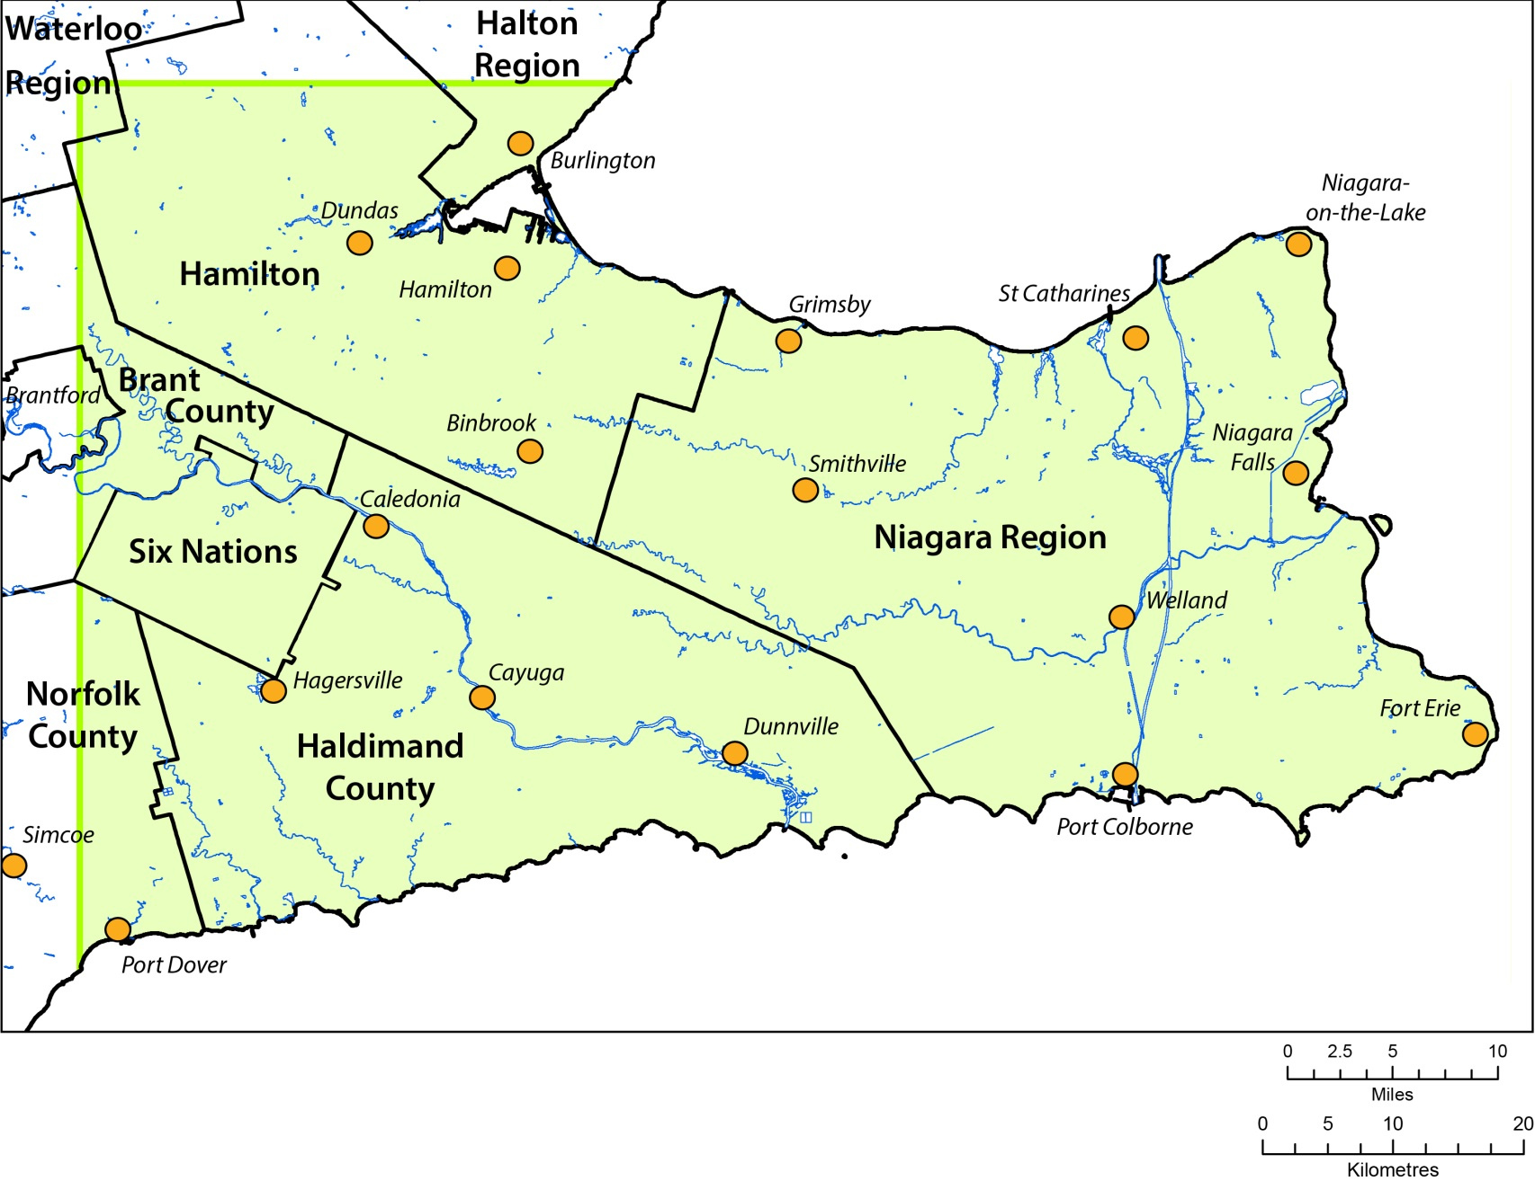
Project area

Slide 5
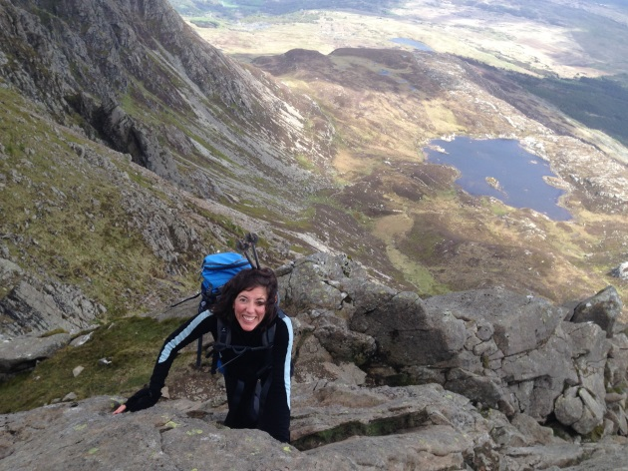
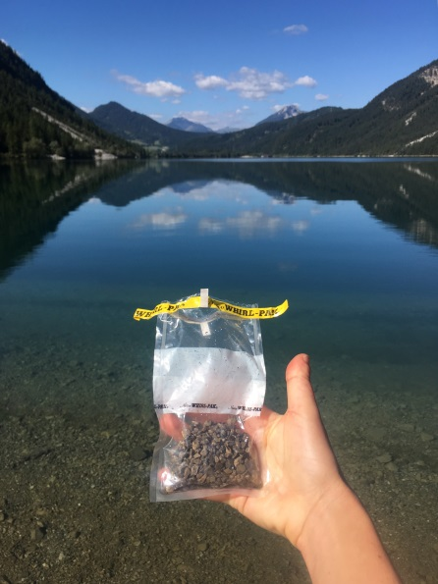
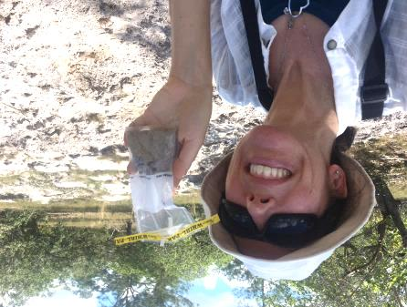
A little about me….

Slide 6
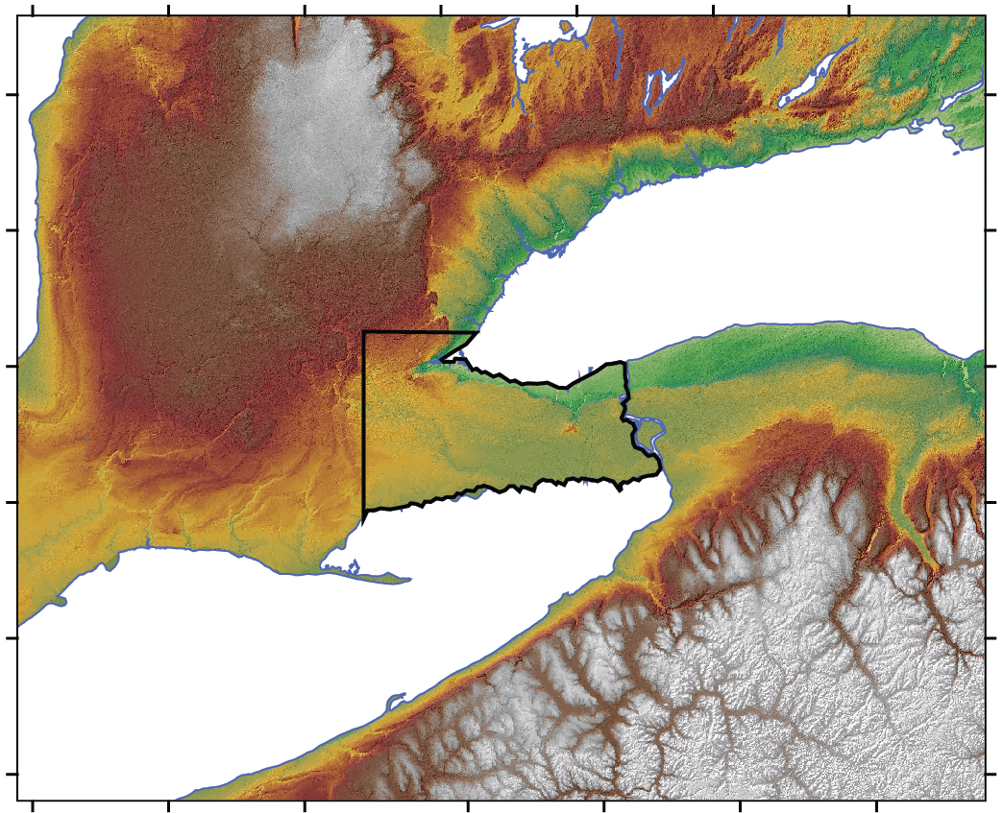
Topography
Flat, boring

Slide 7
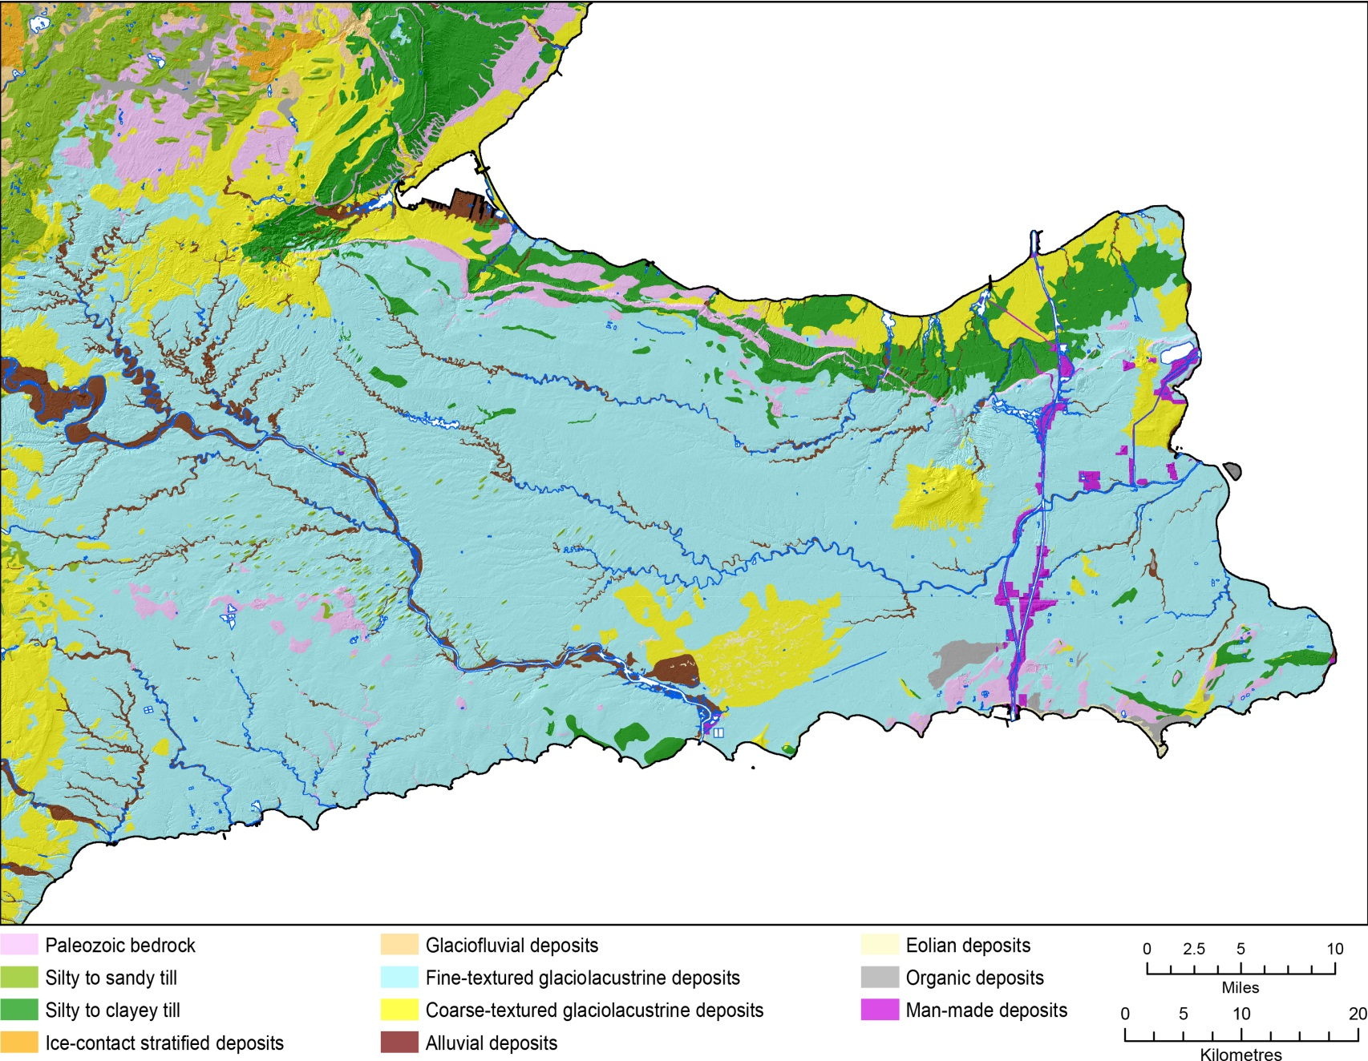
Surficial geology
…and clayey... ☹

Slide 8
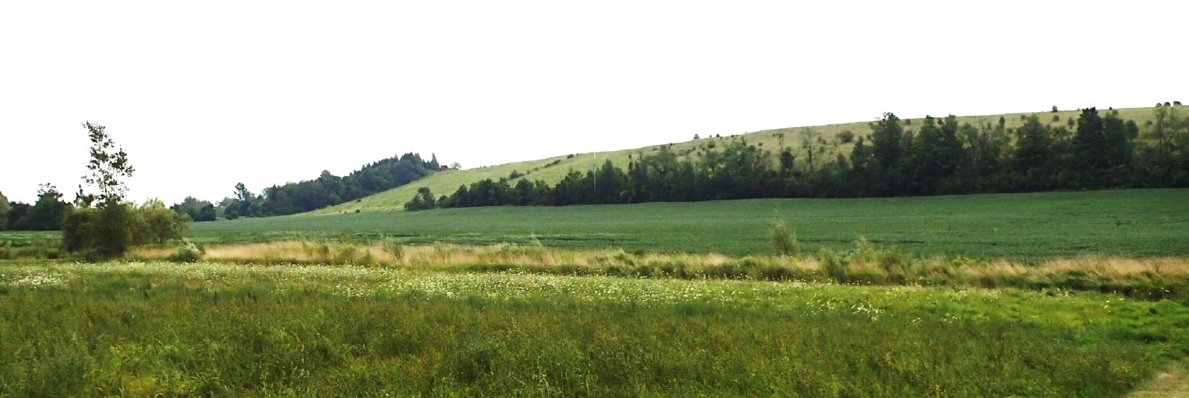
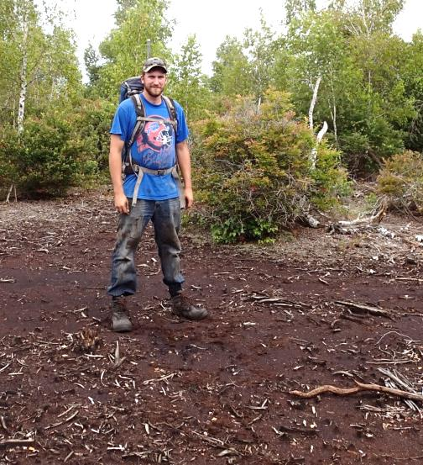
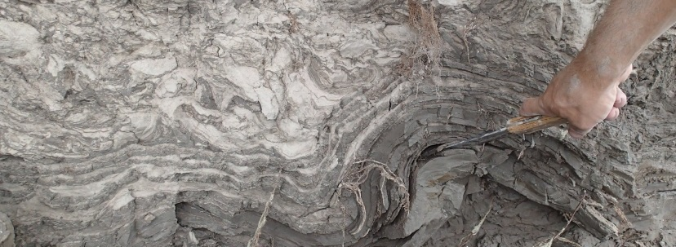
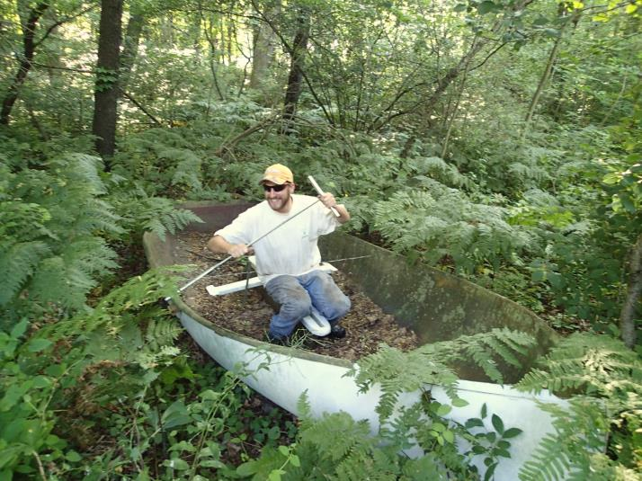
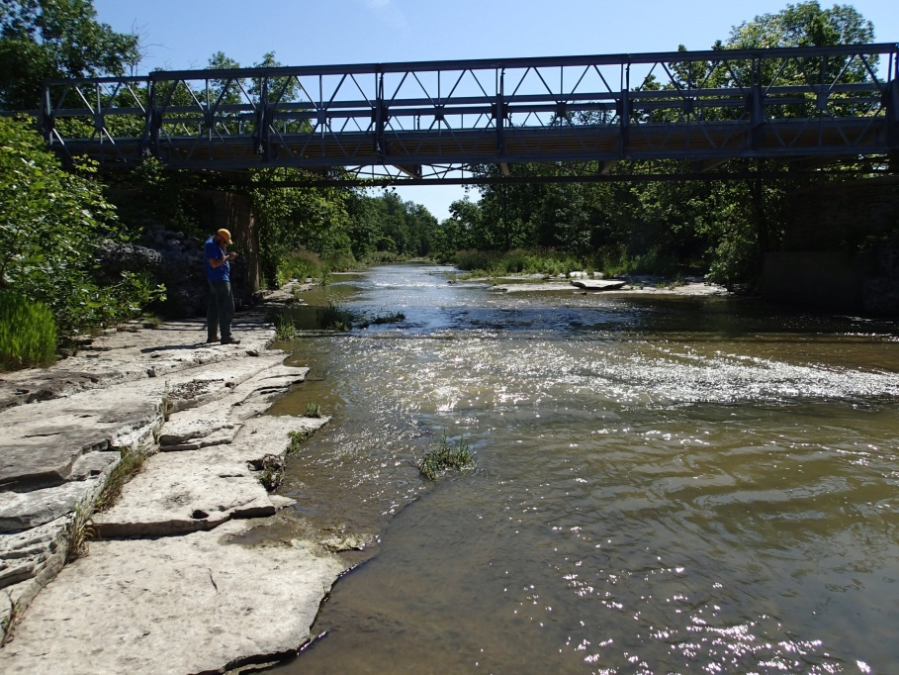
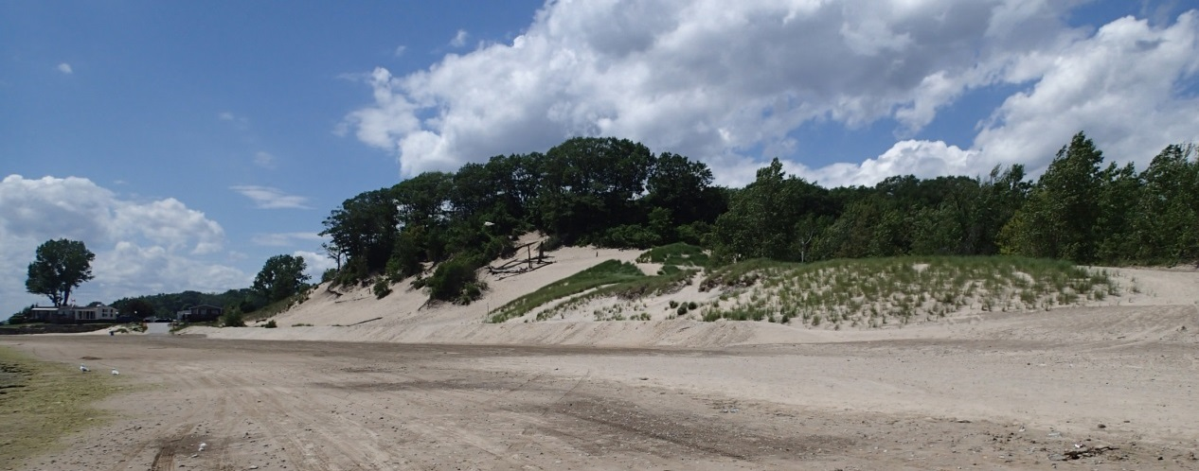

Slide 9
Our quest….
HOW FAR DID HALTON ICE GO?

Slide 10
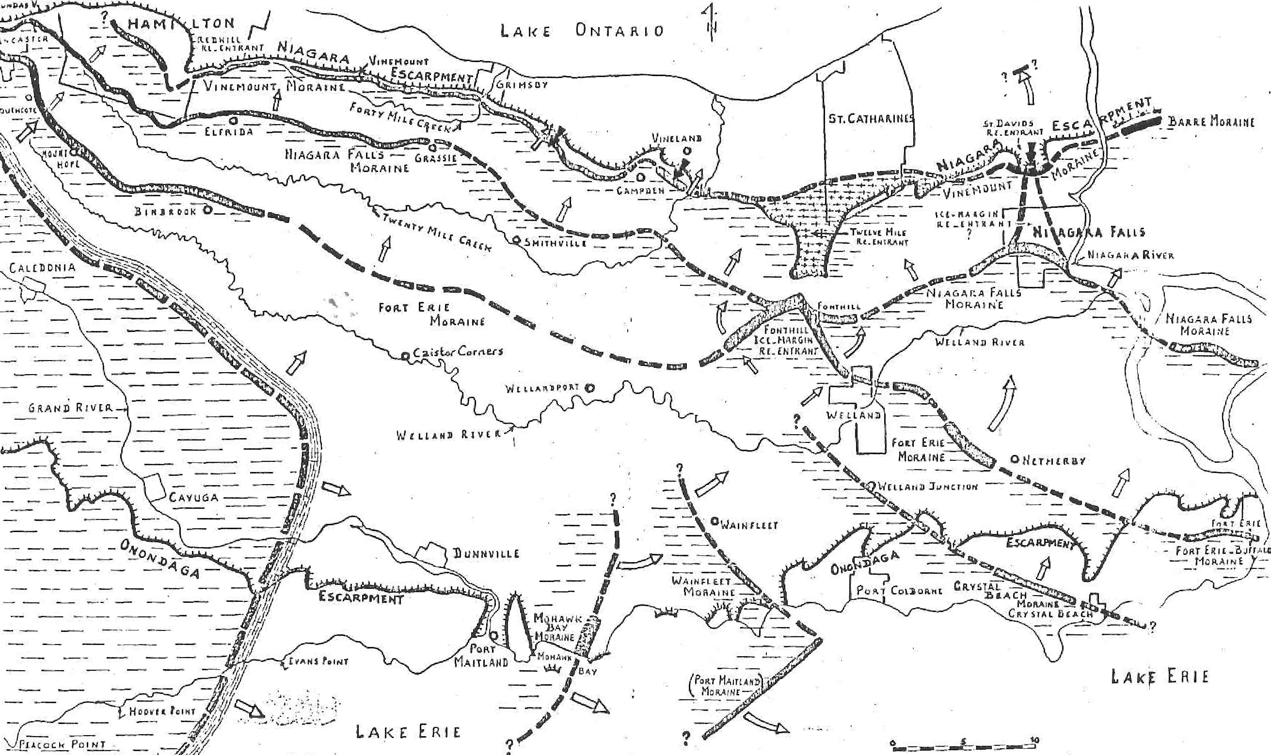
Starting point
Feenstra, 1981

Slide 11
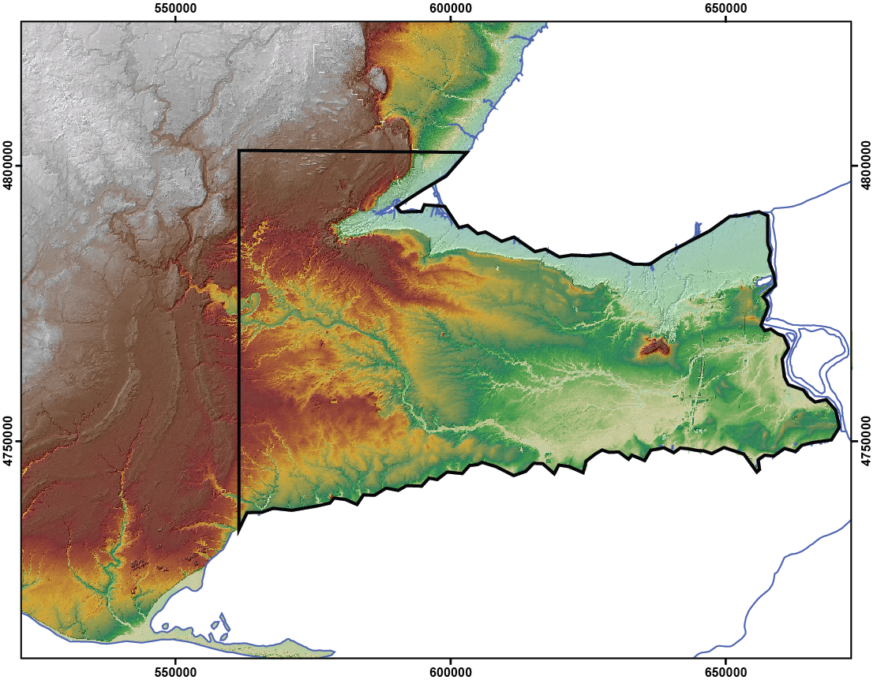
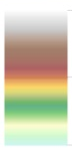
Regional landforms
Elevation (m asl)
440
75

Slide 12
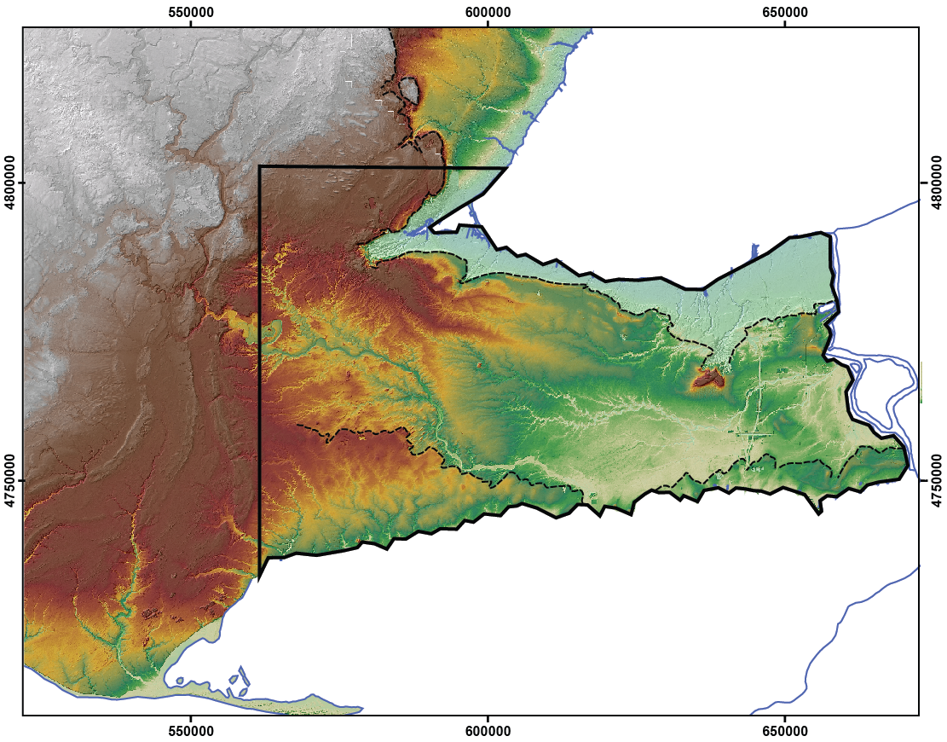
Bedrock escarpments
Elevation (m asl)
440
75

Slide 13
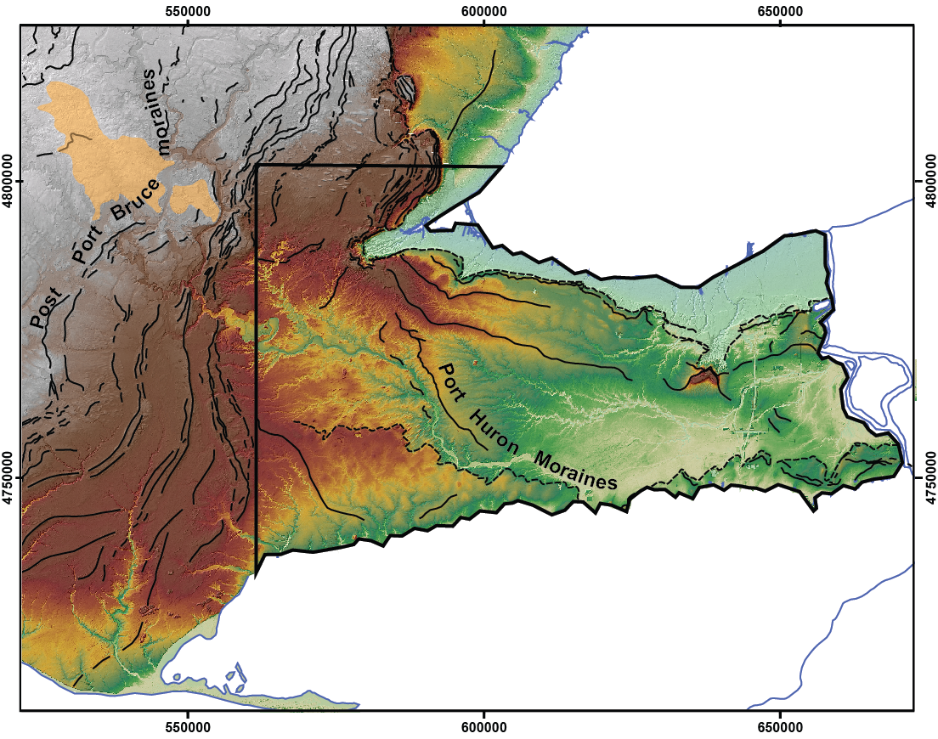
Moraines
Elevation (m asl)
440
75

Slide 14
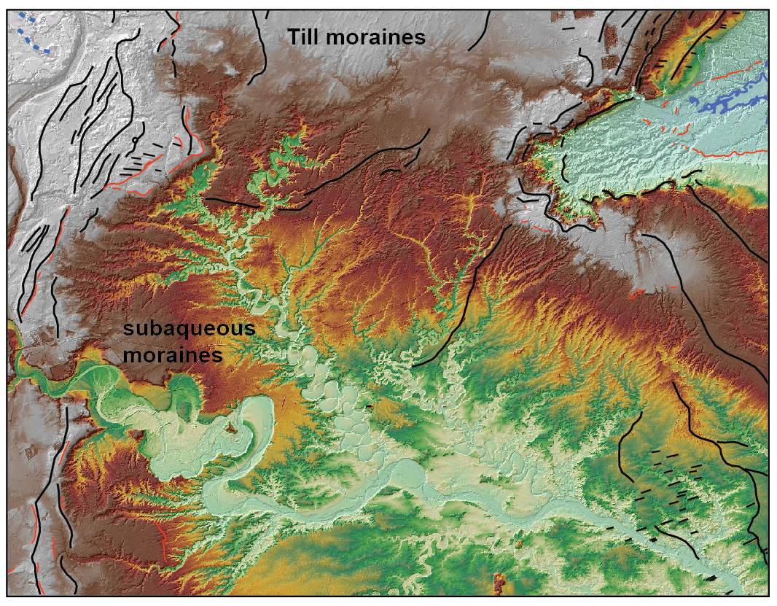
Moraines
Stony
sandy
till
Muddy
till
Silt &
sand

Slide 15
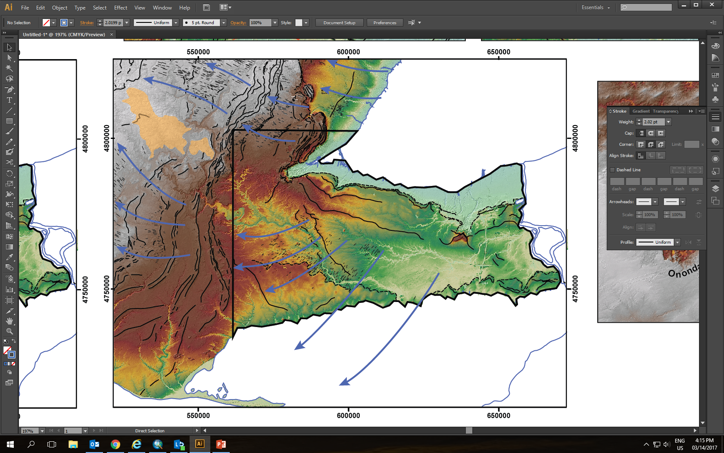
Drumlins, Flutes, Mega-Scale Glacial Lineations (big-ass flutes, for the rest of us)
Elevation (m asl)
440
75

Slide 16
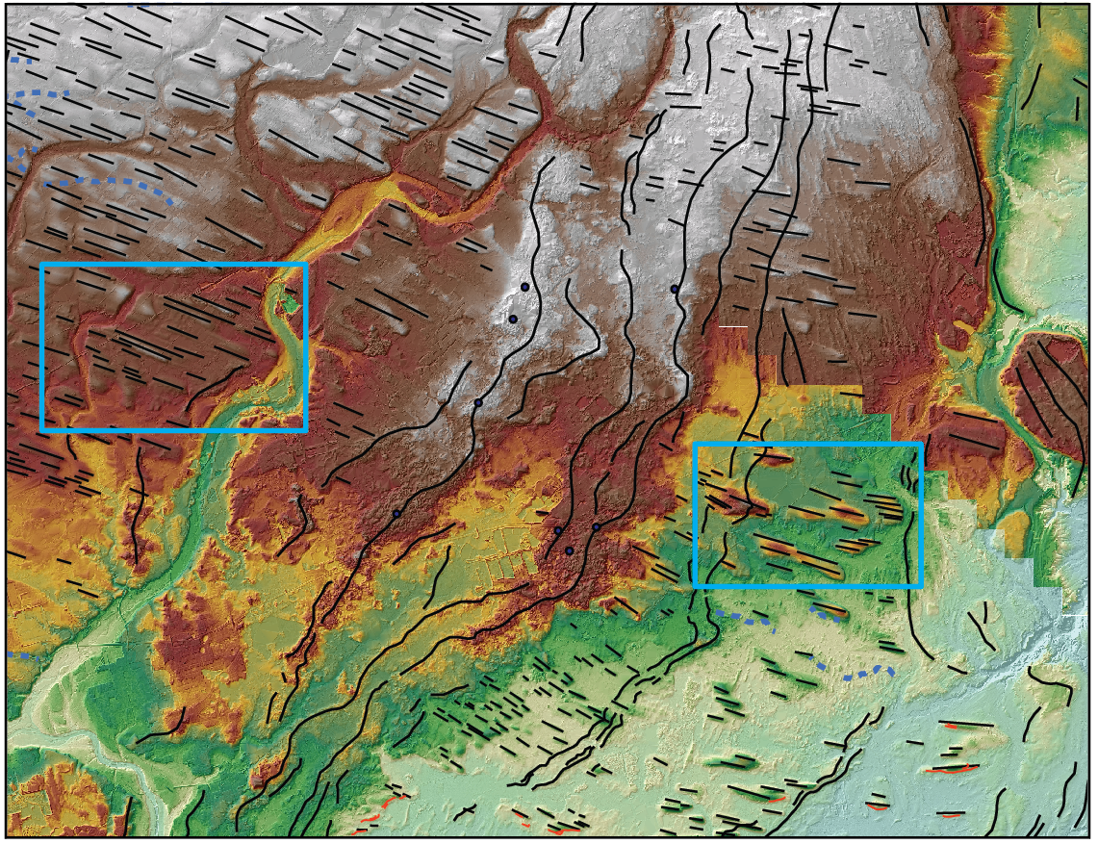
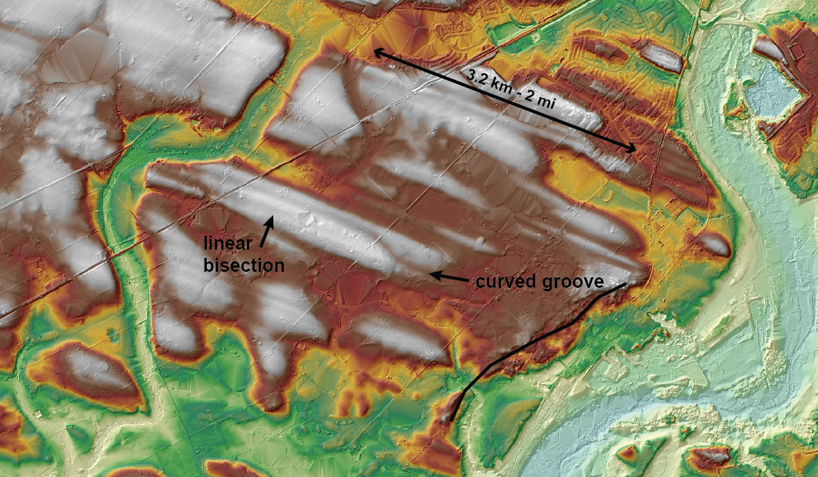
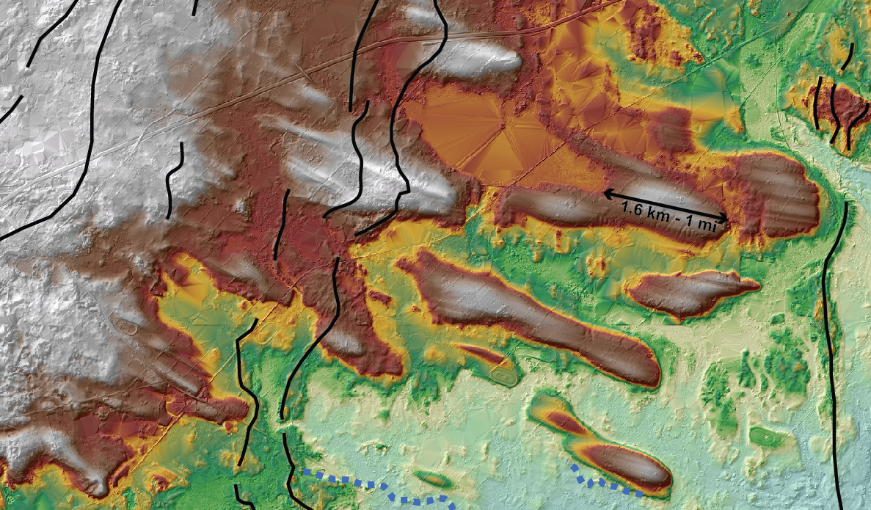
Drumlins, Flutes, MSGL

Slide 17
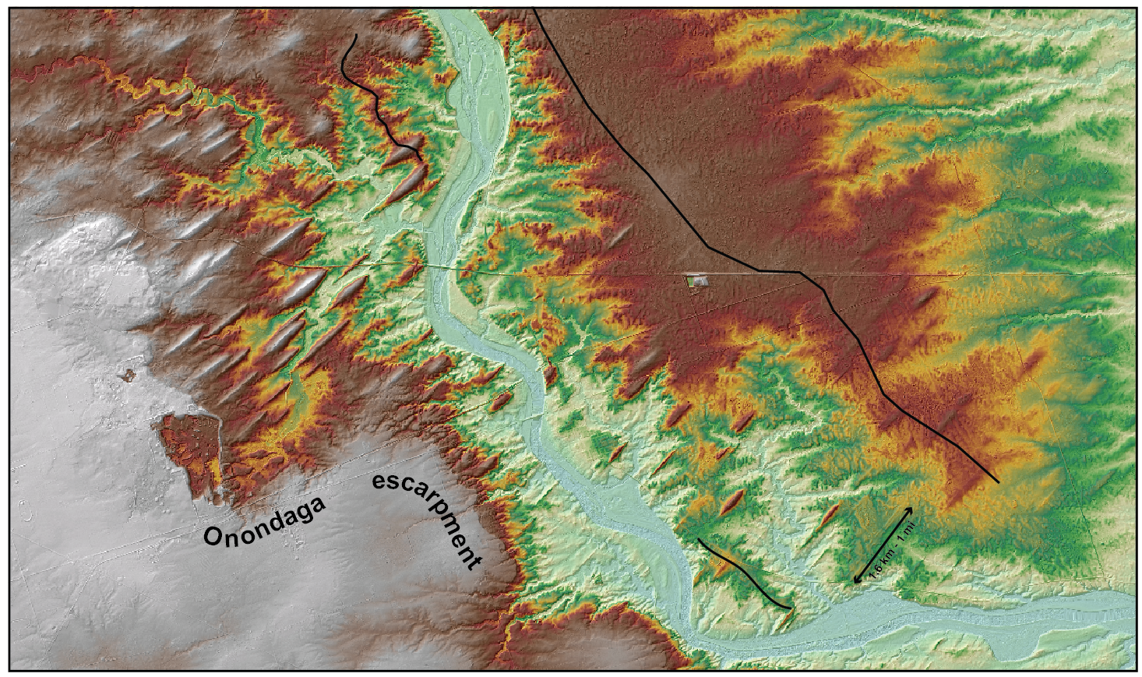
Drumlins, Flutes, MSGL

Slide 18
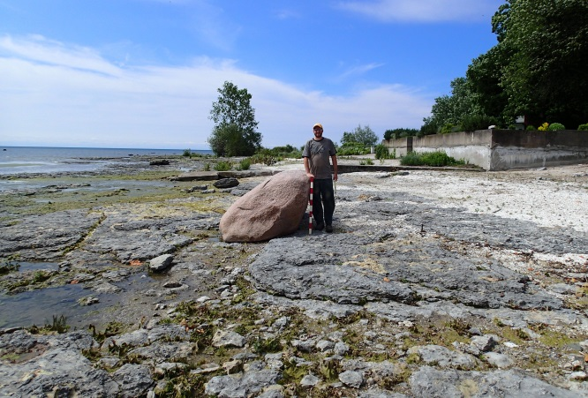
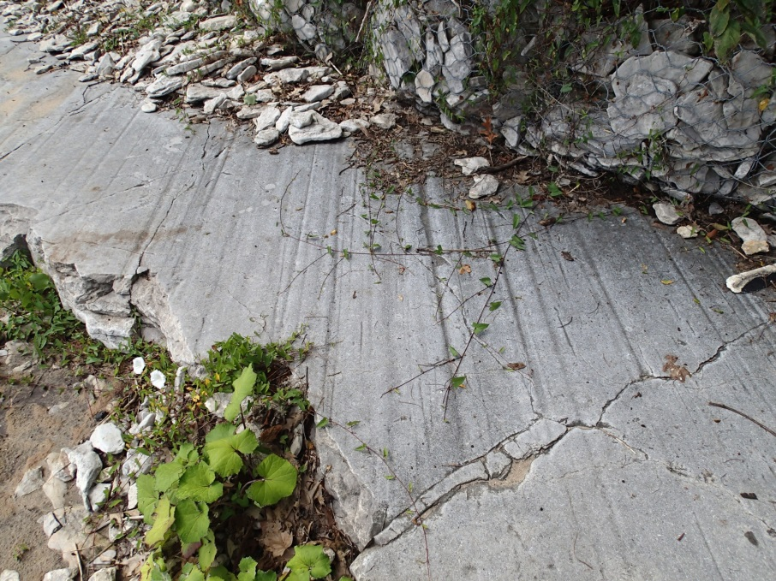
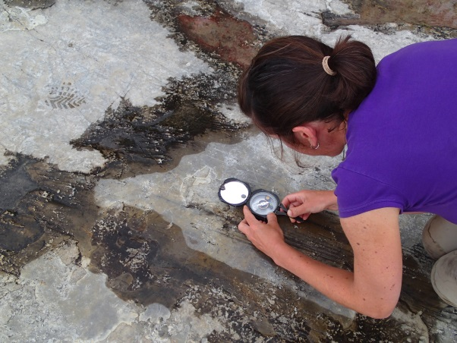
Striations…

Slide 19
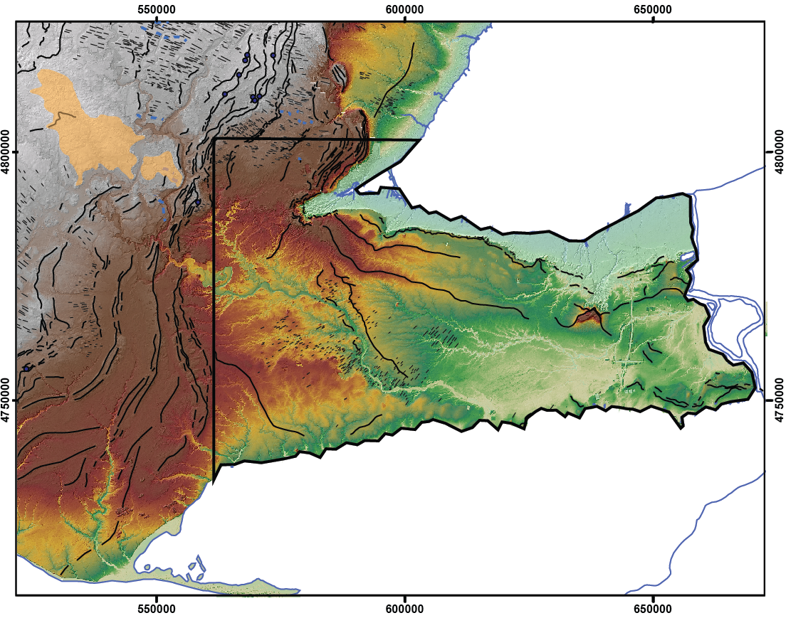
Eskers, ice-walled lakes
Elevation (m asl)
440
75

Slide 20
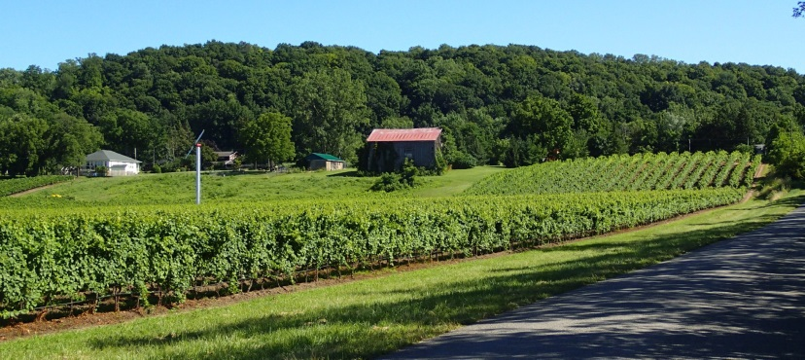
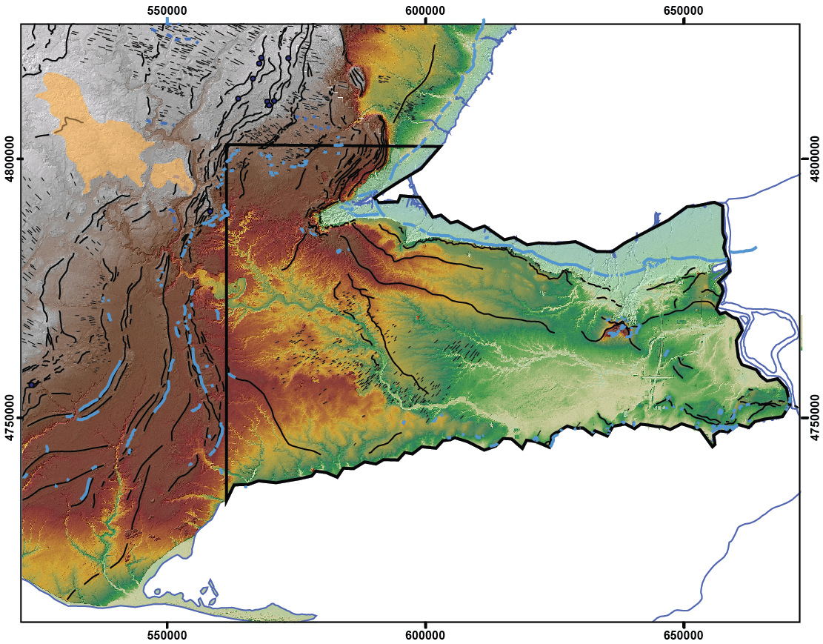
Glacial lakes
Elevation (m asl)
440
75

Slide 21
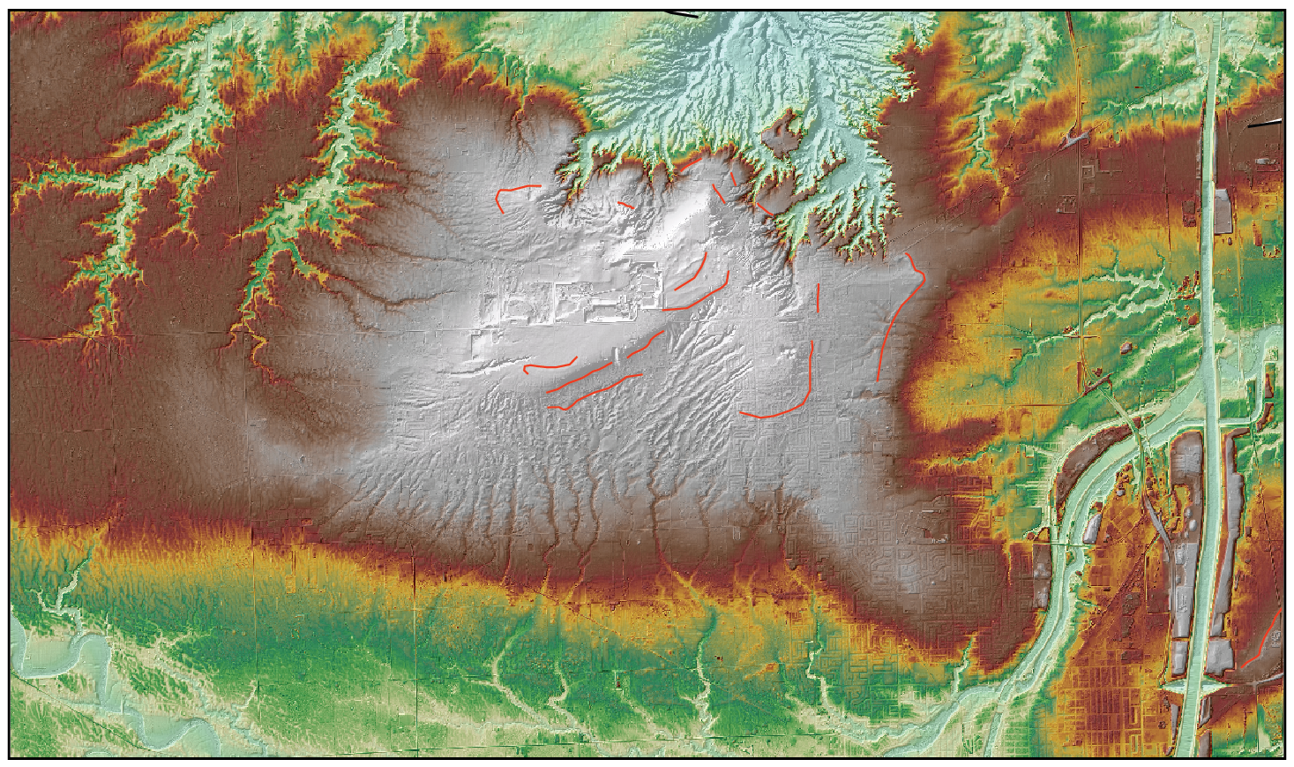
Fonthill kame delta

Slide 22
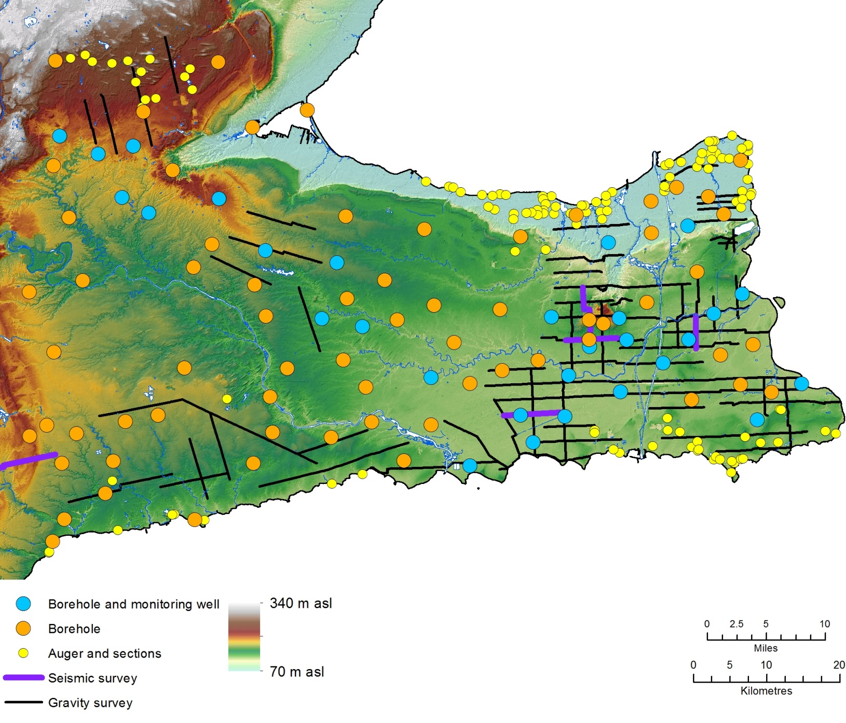
New data – geophysics, drilling, sections

Slide 23
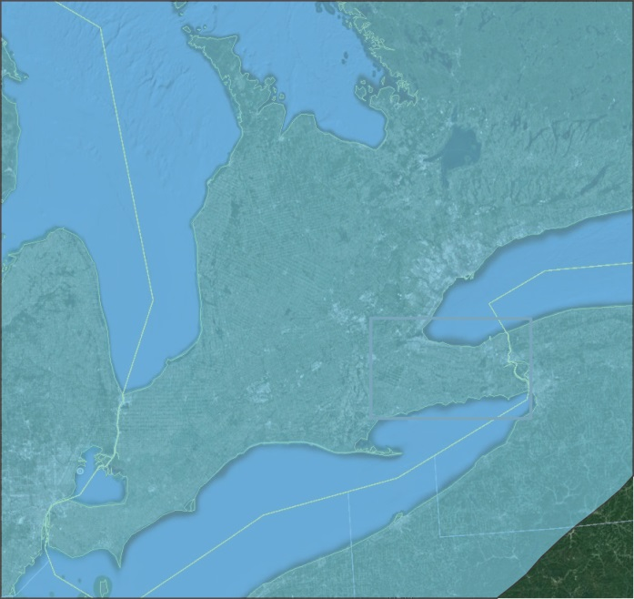
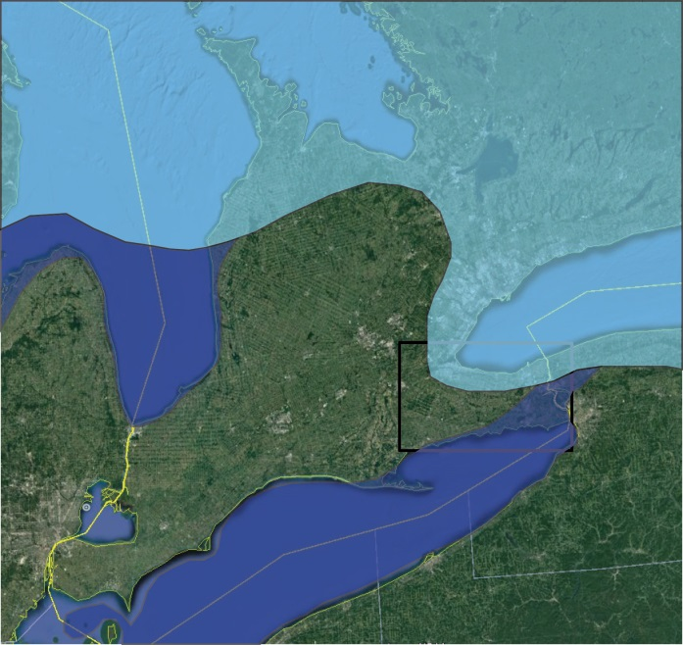
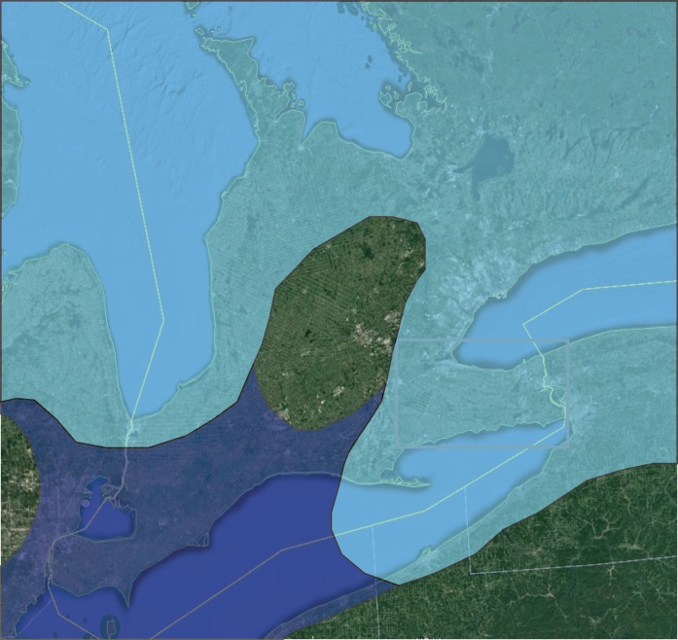
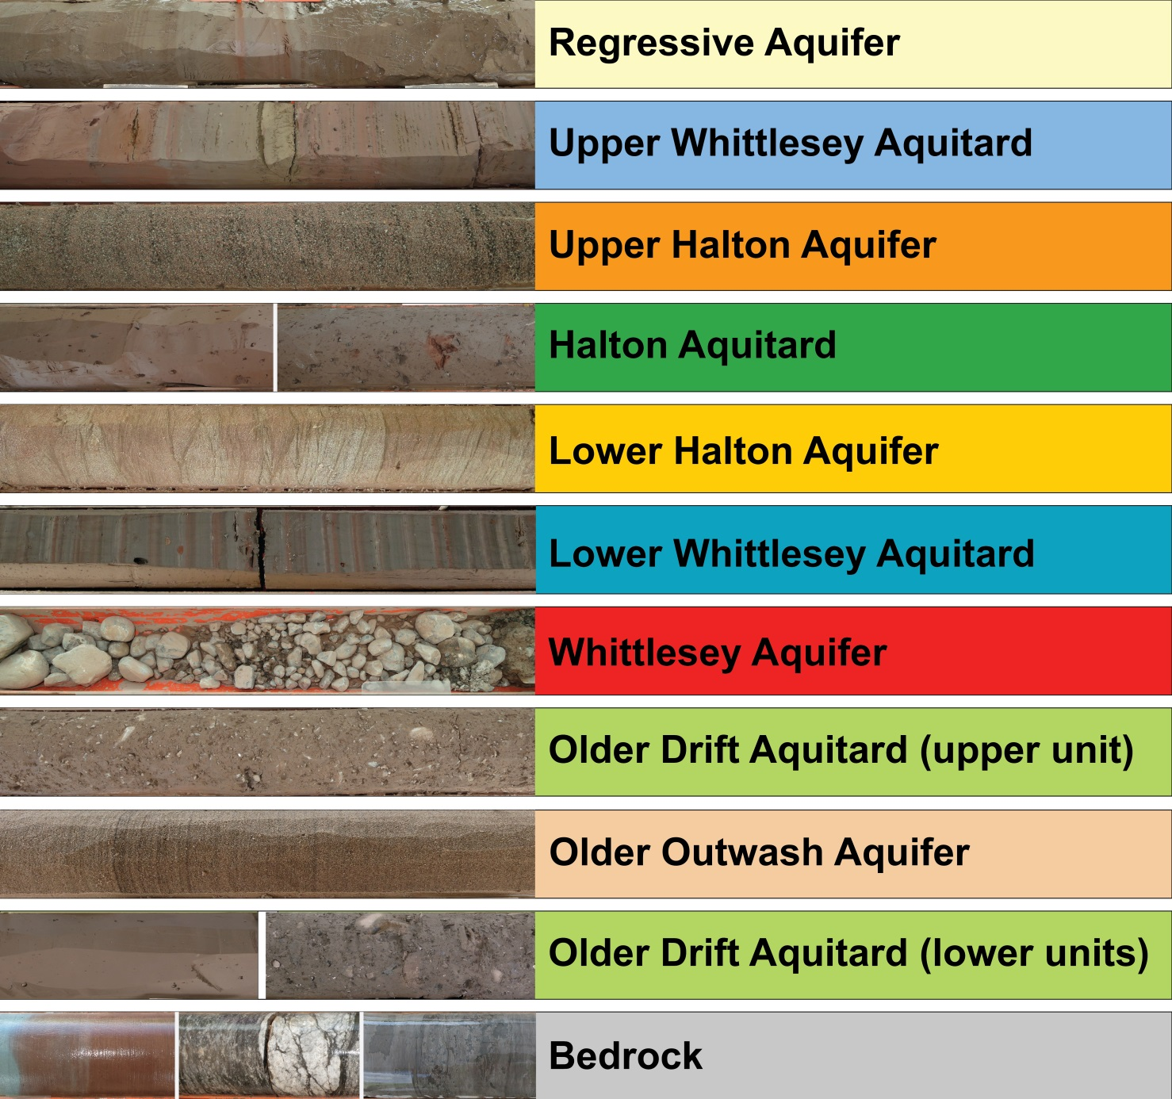
Late glacial history and sediments

Slide 24
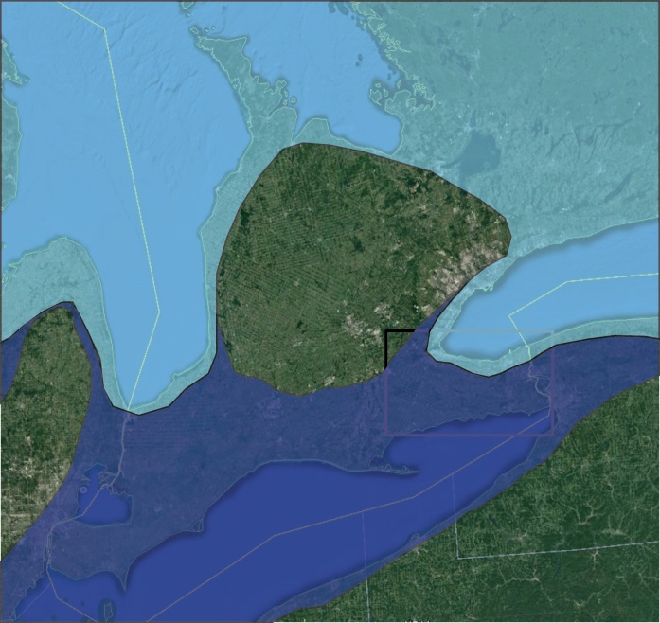
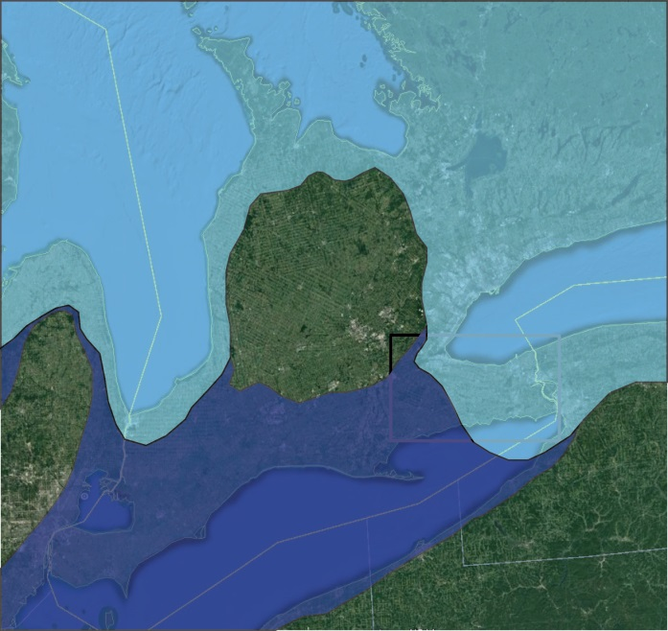
Late glacial history and sediments

Slide 25
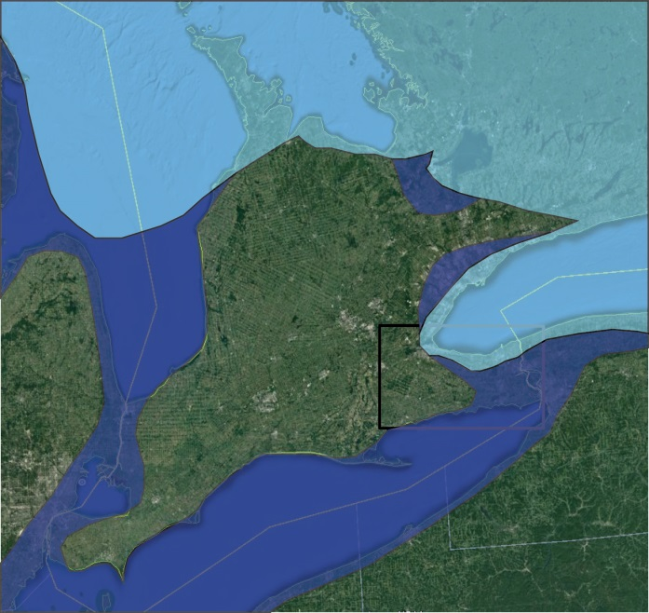
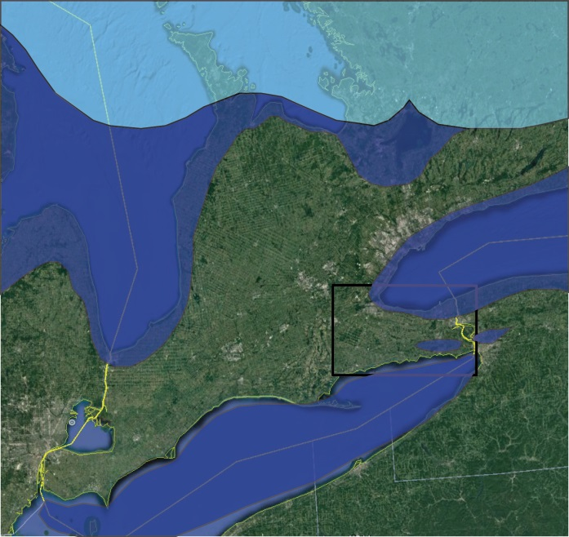
Late glacial history and sediments

Slide 26
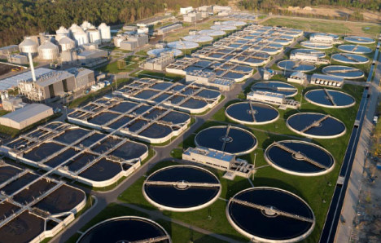
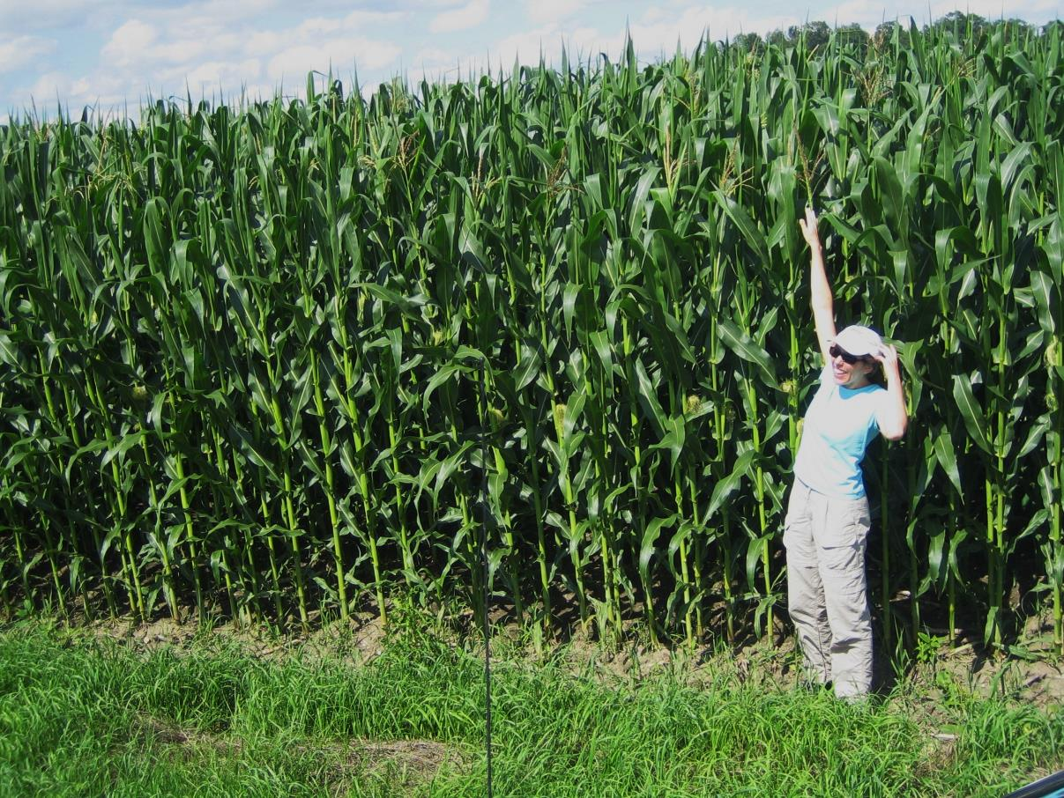
It sounds simple enough, but…
What’s the connection????

Slide 27
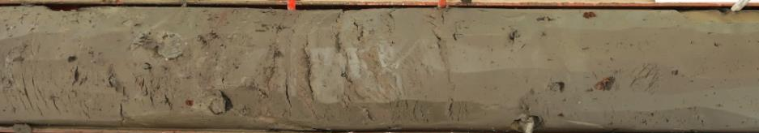
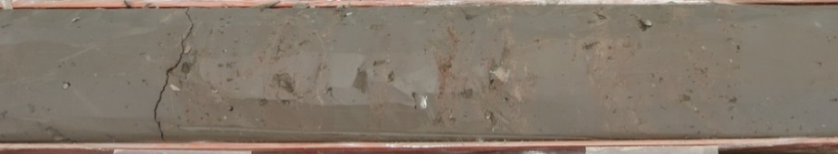
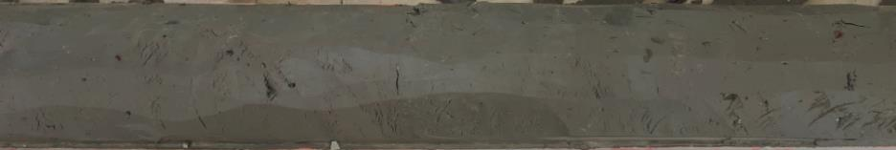
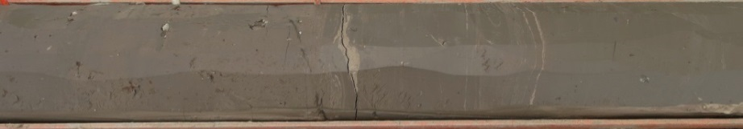
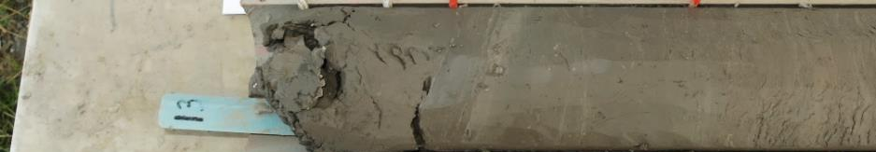
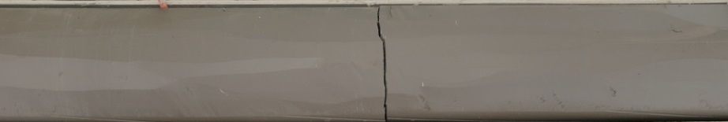








You are what you eat!
1
8
2
9
3
10
4
11
5
12
6
13
7
14

Slide 28



Older Drift Aquitard

Slide 29



Western Area
A’
A

Slide 30


More moraines!!!!
A’
A

Slide 31


Below the Onondaga
A
A’

Slide 32


Dundas valley
B
A
A’
B’

Slide 33

How far did the ice get?

Slide 34



Why did it stop?
Which would you rather slide on?

Slide 35

What about those moraines?

Slide 36

Old mapping ≠ bad mapping
Port Bruce
Port Huron

Slide 37

What’s Next? A Little More Drilling!

Slide 38

Questions?

