Slide 1


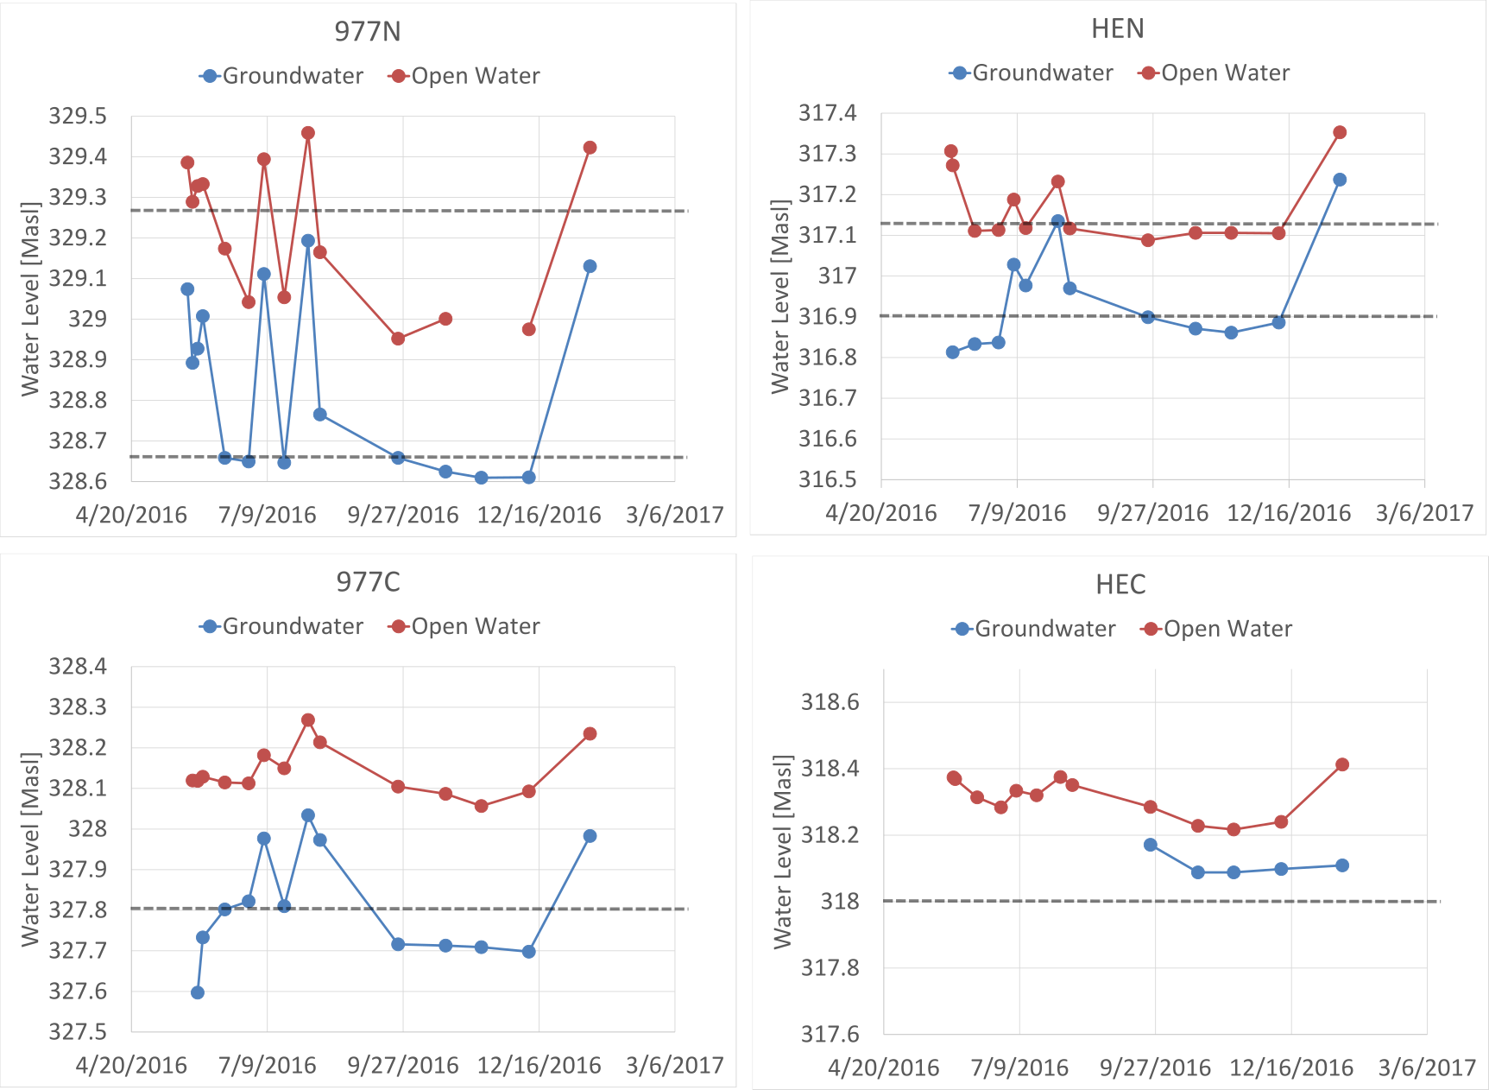
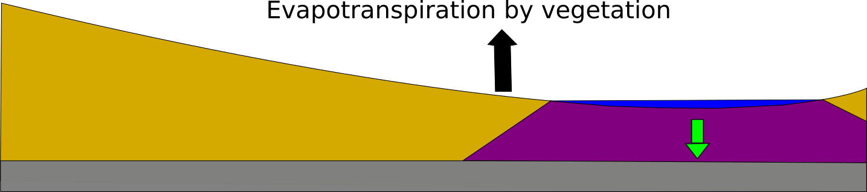
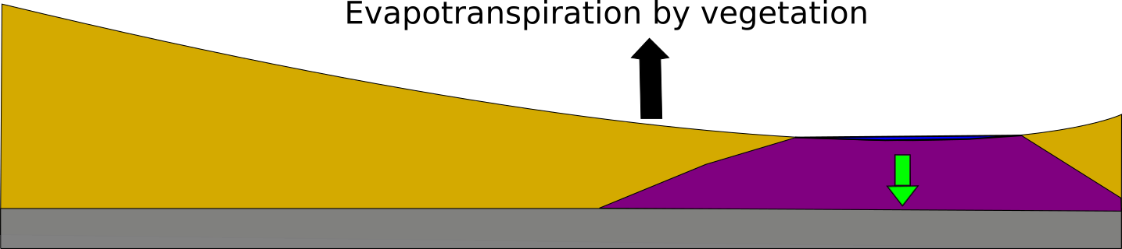
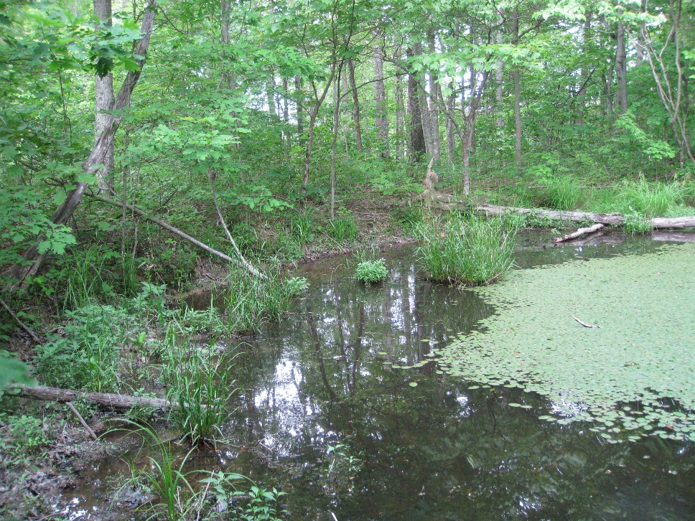
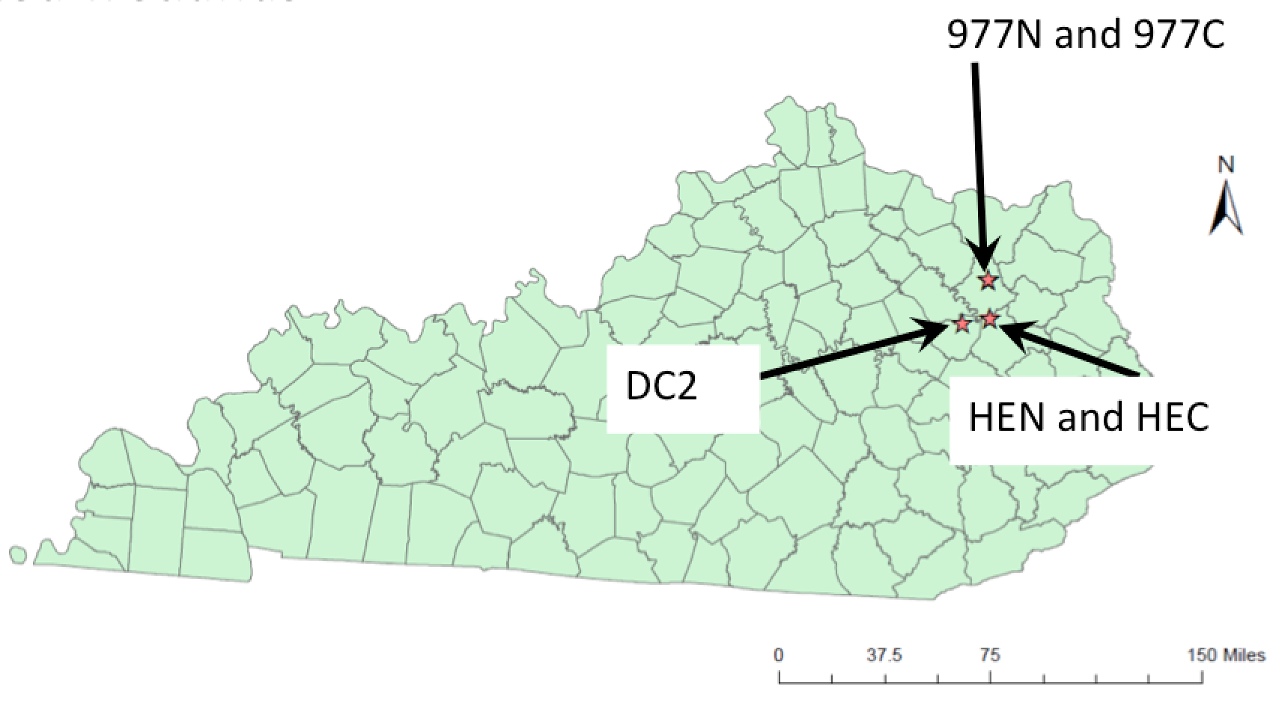
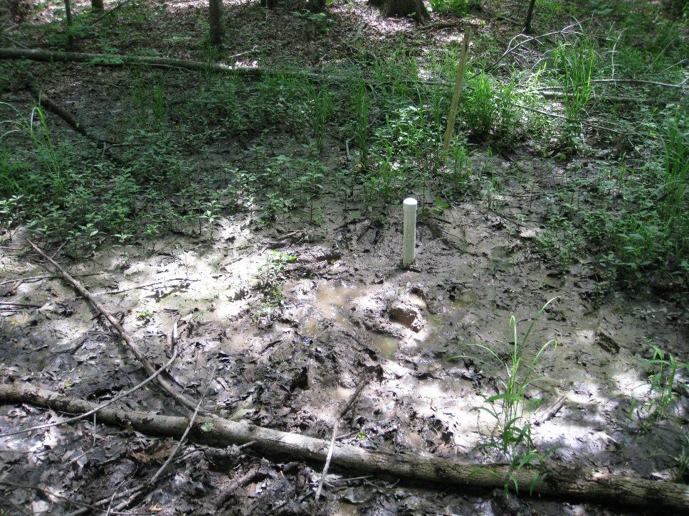
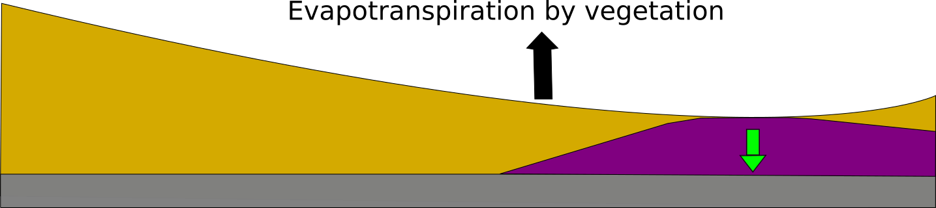
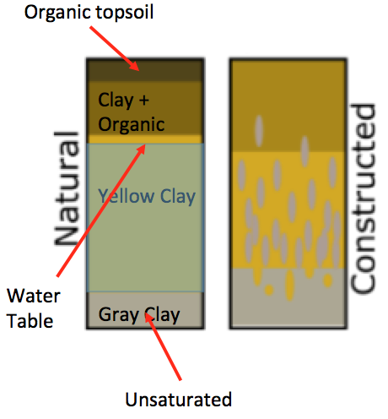
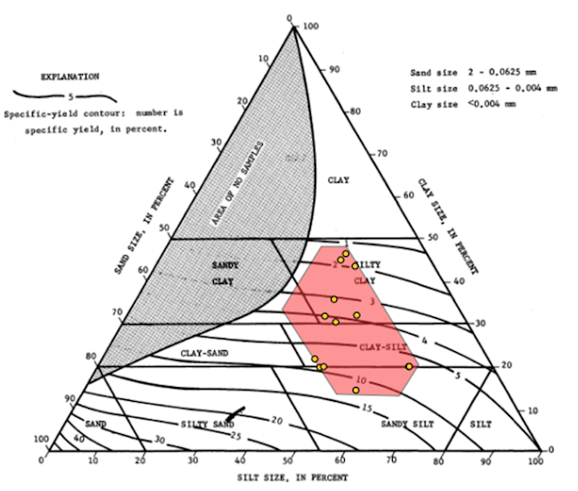
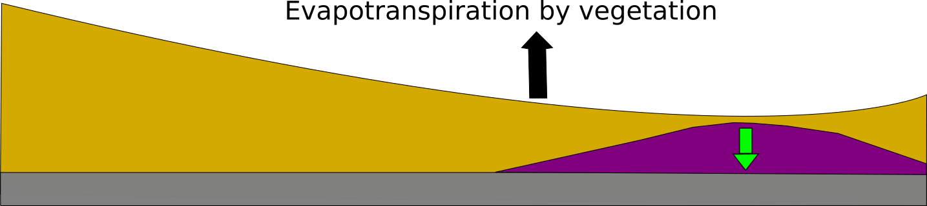
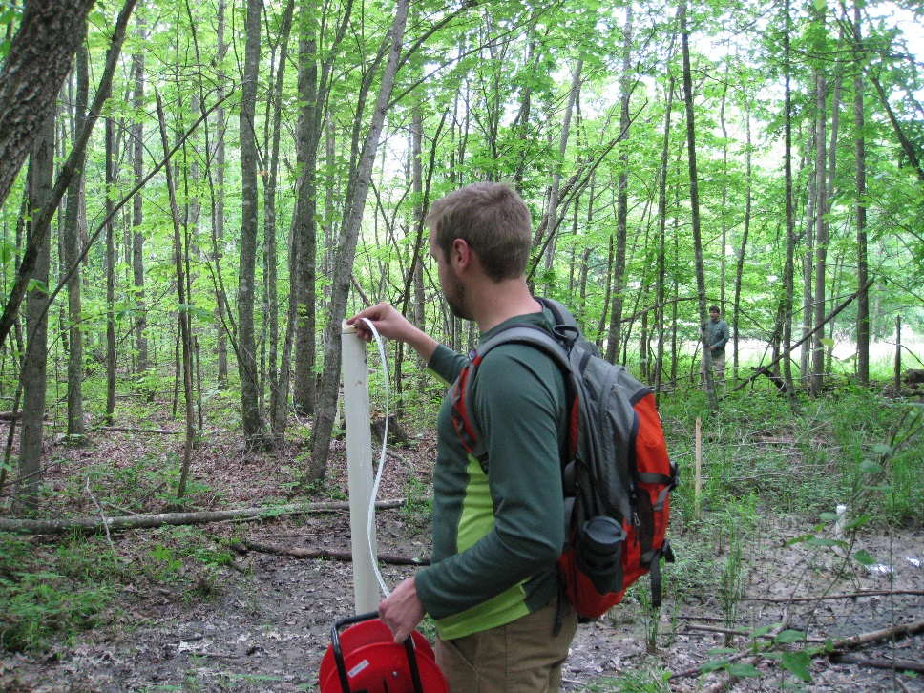
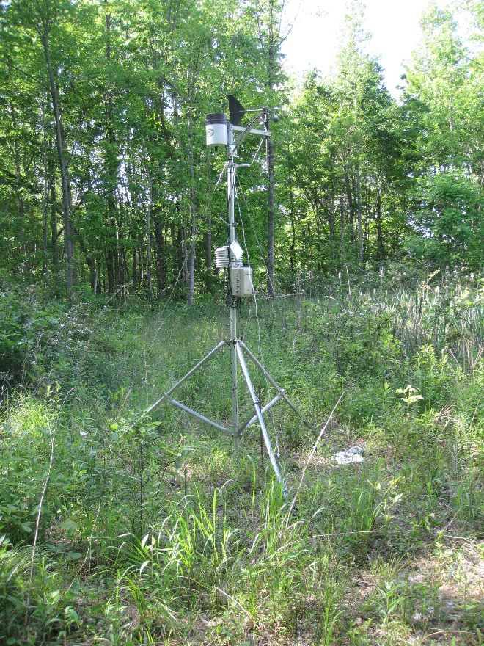
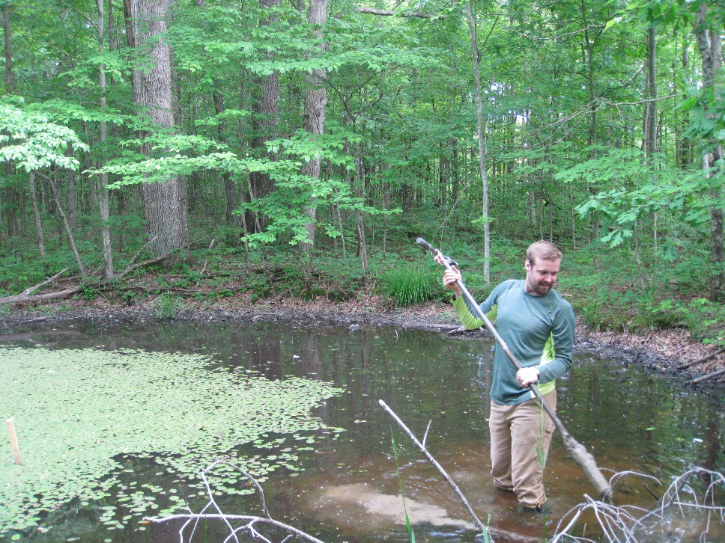
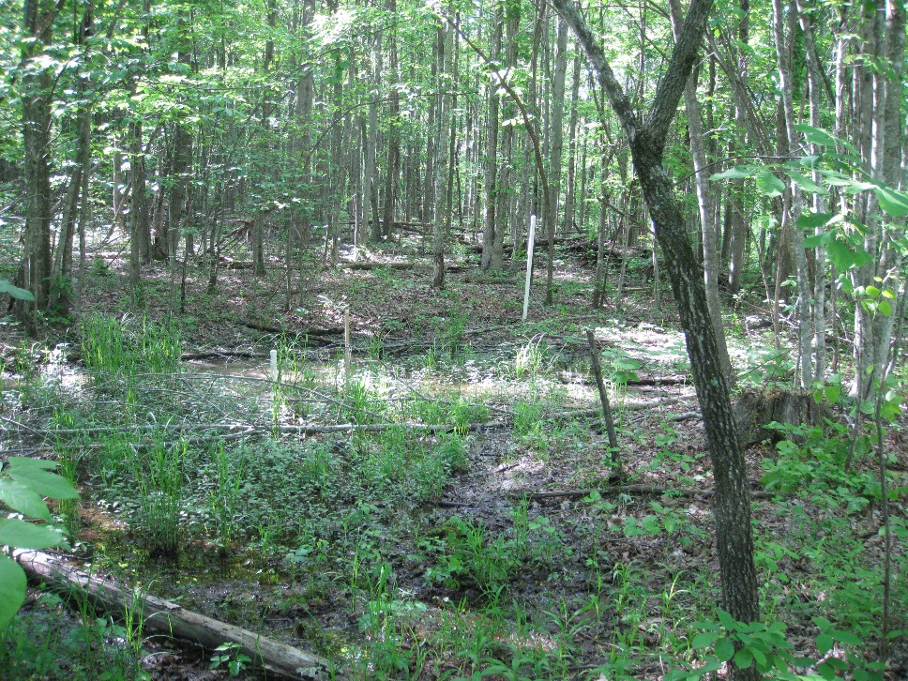
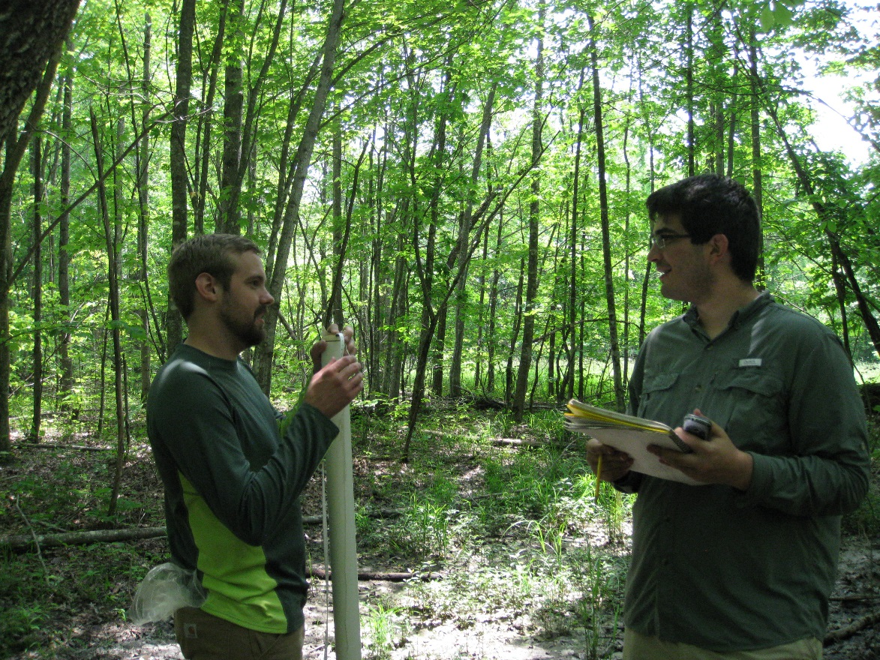
Determining the Hydrologic Processes and Physical Parameters of Ridge-top Wetlands to Make a Conceptual Model
Addison Bell¹, Jonathon Malzone¹
¹Eastern Kentucky University
Introduction
Results
Discussion and Conclusions
The United States Forest Service (USFS) wants to achieve better conservation and restoration practices of natural and constructed ridge-top wetlands. Quantifying the physical parameters and the hydrologic processes of these wetlands will provide a greater understanding of these wetlands and their groundwater surface water interaction. Our results will provide a well-quantified standard for future constructed ridge-top wetlands to replicate natural ridge-top wetlands. We monitored five ridge-top wetlands [2 constructed (977C and HEC) and 3 natural (977N, HEN, and DC2)] through the summer of 2016 and collected monitoring data and soil core samples to analyze in the laboratory. We will construct a conceptual model from our data.
Figure 19: First stage of the conceptual model. The pool is at its highest depth. Water is flowing from the pool (blue) and into the aquifer (purple). Evapotranspiration is pulling water from the aquifer. Evapotranspiration doesn’t occur during the winter season, so the water level of the pool increases over the winter.
Figure 20: Second stage of the conceptual model. The wetland is is the beginning stage of a drought. The aquifer has decreased in size, as well as the pool. Without precipitation, the vegetation depletes water from the aquifer.
Figure 10: We have water level measurements in meters above sea level on the y-axis and the date that the level was measured on the x-axis. Red is open water (pool) and blue is groundwater (outside of pool). The red line is always above the blue line. This relation shows us that the wetland pools are draining into the aquifers. The top two graphs are of natural wetlands and the bottom two are of constructed wetlands. The higher grey dashed line represents the bottom of the wetland pool and the lower grey dashed line represents the bottom of the screen interval in the well. The pool is dry when the blue line is under the grey line.
Figure 11: Water level in meters above sea level on the y-axis and the time in days on the x-axis. Red is the water level of the surface water (pool) and blue is the groundwater (outside of pool). These are water level measurements from the pressure transducer at DC2. The red line is always above the blue line. Showing us that the pool is feeding the aquifer. The drops represent drying periods and the spikes represents a rainstorm event.
Figure 1: Constructed perennial ridge-top wetland 977C.
Figure 2: The ridge-top wetland locations marked as stars in Morehead, KY. 977N, DC2, and HEN are natural wetlands. 977C and HEC are constructed wetlands.
Figure 3: Natural ephemeral ridge-top wetland 977N.
Figure 21: Third stage of the conceptual model. The wetland is in the mid-stage of a drought. Evapotranspiration continues to deplete the aquifer.
Methods
Wells were installed at each wetland. One well in the wetland pool and the other well located outside of the wetland pool. Water levels were taken with a water sounder at each wetland.
We conducted aquifer bail and recovery tests and permeameter tests to solve for hydraulic conductivity.
To solve porosity, we ran loss on ignition tests and compared the dried soil weight to the saturated soil weight.
Grain size analysis and particle settling velocity tests were conducted to determine grain size distribution and sand content.
A weather station with a tipping-bucket rain gage, with a ten minute sampling rate, was used to measure rainfall rate.
Infiltration rate was determined via a double ring infiltrometer test.
We compare the rainfall rate to infiltration rate to estimate runoff.
A pressure transducer was installed at a well in DC2. It collected 15 minute interval water level measurements. We used The White (1932) method to calculate evapotranspiration.
Figure 22: Fourth and final stage of the conceptual model. The wetland is at the end of the drought. The aquifer is at its lowest stage, due to evapotranspiration. When a rainstorm event occurs the wetland goes back to the first stage of the conceptual model.
Figure 12: Soil descriptions, natural on the right and constructed on the left. Natural has organic top soil (highest porosity) underlain by a mixture of organic and silt clay loam. Water table is in the yellow silt clay loam . The bottom grey silt clay loam is unsaturated. Constructed wetland’s layering is mottled with a mixture of silt clay loams. The grey silt clay loam is unsaturated.
Figure 13: Ternary diagram of soil texture with contours of specific yield modified from Johnson (1963). Soil core samples represented by the yellow dots. The pink area is a possible range of soil textures. We estimate a range from 0.03 to 0.05 for specific yield.
Figure 14: Slug tests conducted at 977N (blue) and DC2 (orange). Recovery from initial (fraction) is on the y-axis. Time in seconds is on the x-axis. Bouwer and Rice slug test method was used to calculate hydraulic conductivity. Slug tests provide a more accurate hydraulic conductivity for the aquifer. The hydraulic conductivity for DC2 is 0.18 meters per day. 977N has a hydraulic conductivity of 0.23 meters per day.
Ephemeral wetlands provide water to native amphibians and to native vegetation.
Ephemeral wetlands provide water to native vegetation during the summer, larger thunderstorms continuously recharge the aquifer for further evapotranspiration.
Even with the most intense rain storm of the summer, surface flow only took place for a few minutes, due to the highly porous top soil.
Evapotranspiration is the driving force to the drying of the natural ridge-top wetlands.
Hydraulic conductivity varies, with the constructed wetlands under the median and natural wetlands above the median.
Further research of these natural wetlands is needed to provide a better understanding of the wetland aquifers.
Figure 4: Wells in natural wetland DC2. Red is high elevation and green is low elevation. The black dots represent the location of the wells.
Figure 5: Measuring water levels at 977N.
Figure 6: Wells in constructed wetland 977C. Red is high elevation and green is low elevation. The black dots represent the location of the wells.
Figure 17: Hydraulic conductivity whisker and box plot. Hydraulic conductivity in meters per day on the y-axis. Permeameter tests provide more variability as we find the hydraulic conductivity of the soil core only. We have a range of different orders of magnitude. Median range is ~5e-02
Figure 16: Estimation of runoff. Rate in centimeters per seconds is on the y-axis and time in seconds is on the x-axis. 977C (blue), DC2 (orange), HEN (grey), and 7/28/16 storm event (yellow). As the slope of the wetlands flattens we have reached the infiltration rate of saturated soil. The yellow line has to be above the other lines for overland flow to take place.
Acknowledgements
Christina Wampler (United States Forest Service)
Funding from the United States Forest Service
Stephen Richter (Eastern Kentucky University Biology)
Rachel Fedders (Eastern Kentucky University Biology)
Ethan Sweet (Colleague)
Laura Kelly (Colleague)
Lee Minzenberger (Colleague)
Maggie Malzone (Photographer)
Junior Faculty Research Grant
R
Δs
Figure 7: Weather station, with tipping bucket rain gage, near 977N.
Figure 18: Evapotranspiration signal of DC2. A drop is the drying of the wetland through the day and a rise is the inflow rate of water through the night. We used the White (1932) method to estimate evapotranspiration.
Δs is the change in water level over one day. R is the inflow rate in meters per day. Time is t and one day. Specific yield is Sy (from Figure 13). Evapotranspiration is ETg.
Figure 19: Evapotranspiration of groundwater. Evapotranspiration rate in meters per day on the y-axis. Range of specific yield values on the x-axis. We estimate a range from 0.03 to 0.05 for specific yield. A specific yield of 0.04 gives us a evapotranspiration rate of 0.003 m/day. Evapotranspiration is the driving force of these natural ridge-top wetlands.
Figure 8: Well installation and soil description.
Figure 9:Wells at 977N, one well inside the pool and the other outside of the pool.

