Slide 1

The Pliocene Record of the Antarctic Sedimentation in the Jane Basin, Northwest Weddell Sea, ODP Site 697
Luna, Melissa; Carter, Eliza; Centeno, Eduardo; Kaufman, Zachary; Cullen, Kate; Spriggs, Noah; Newman, Illana; O’Connell, Suzanne

Slide 2
Summary
Why Study the Pliocene?
Antarctica
  Antarctic Water Masses
  Jane Basin
Summer 2016 Research
  C/N, Biosilica, IRD
Current and Future Work

Slide 3
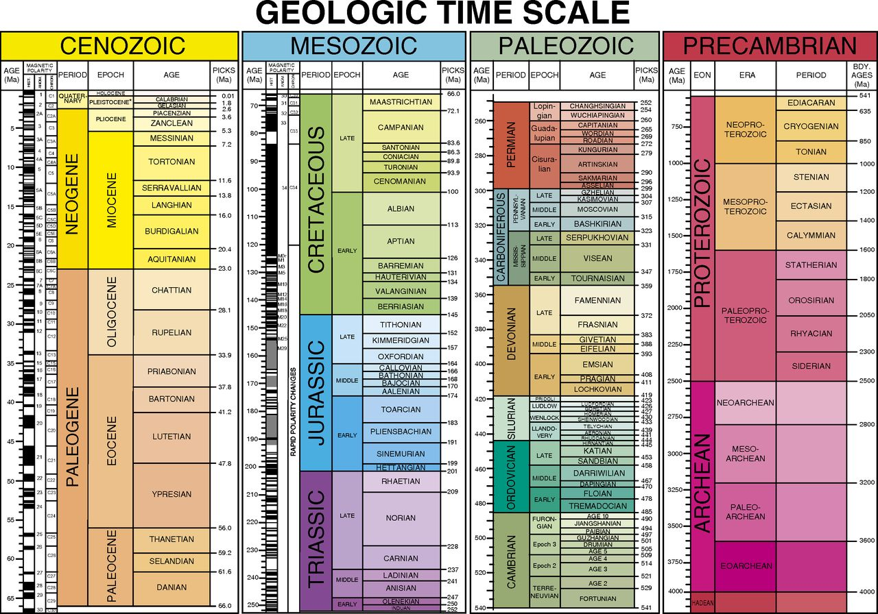
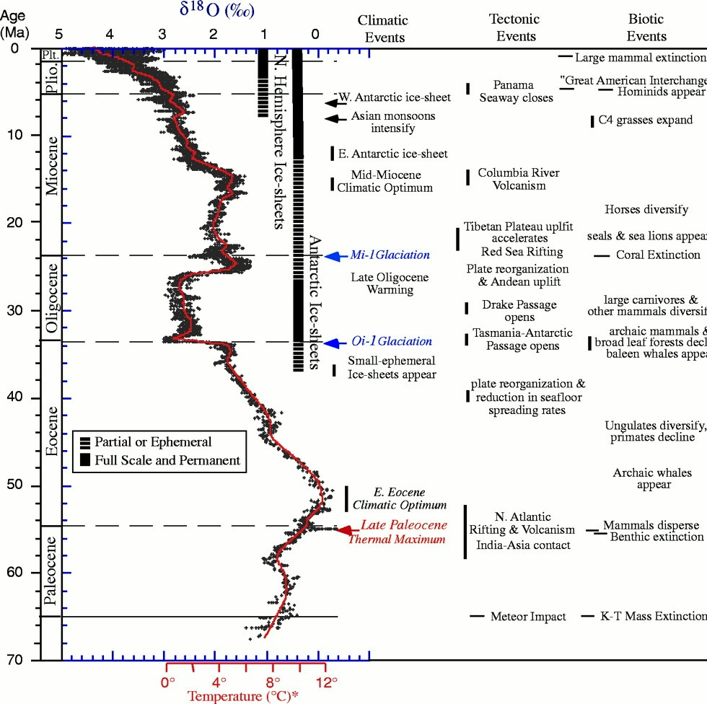
Why Study the Pliocene?
Climatic, tectonic, and biotic events correlated with the benthic delta O-18 record (Zachos et. al., 2001)

Slide 4
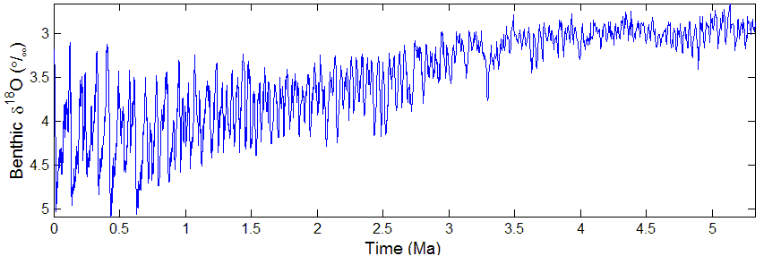
Why Study the Pliocene?
Lisiecki-Raymo Stack
Warmer
Colder
Benthic delta O-18 concentrations since the Pliocene as a proxy for paleo temperature

Slide 5
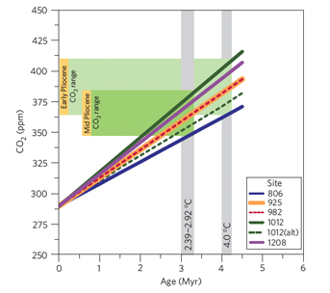
Why Study the Pliocene?
    Scanning Electron Microscope image of a cocolith (AGU, 2016)
    Carbon dioxide concentrations since the Pliocene obtained by the stable isotopic composition of aklenones (Pagani, 2010)
Notes:
Minor change in CO2 was associated with substantial global warming 4.5 mya (3-4 degrees celsius higher than pre-industrial)

Slide 6
Climate Change
Ice sheet dynamics
Water circulation
Analog for future climate model

Slide 7
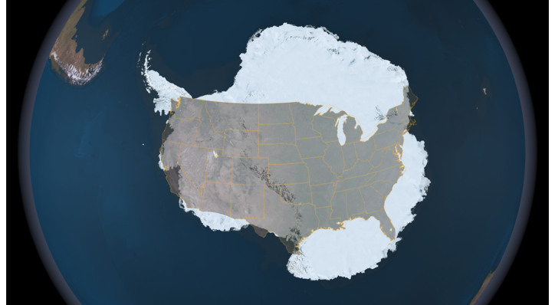
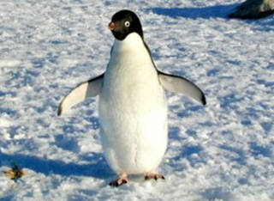
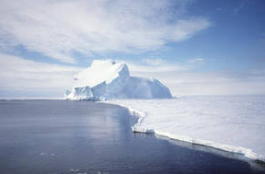
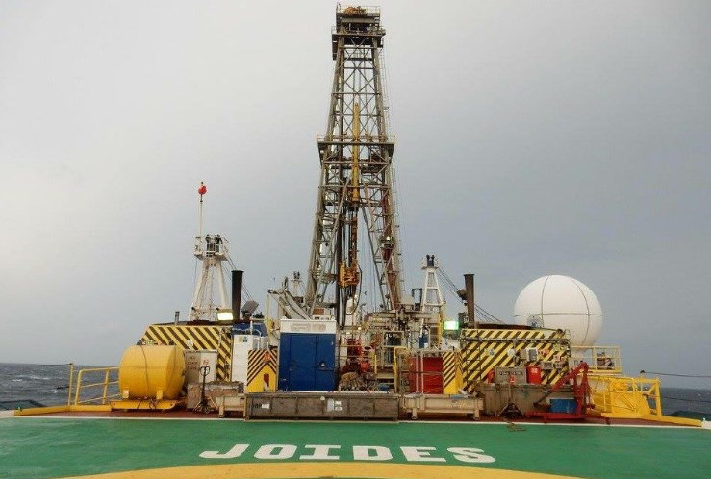
Antarctica!
Notes:
Earth’s 5th largest continent
Considered a desert
When there is precipitation, the snow does not melt and builds up to form ice sheets
Penguins have a small bill and feet to help conserve heat
JR leg 367 in south china sea rifted margin

Slide 8
Antarctic Water Masses
Antarctic Circumpolar Current
  Largest wind-driven current on Earth
  Connects 3 major ocean basins
  Extends to about 4000 meters depth
Weddell Sea Deep Water
Weddell Sea Bottom Water
Antarctic Bottom Water
Notes:
Vehicle for most flow between oceans
SV = Sverderp = 1 million cubic meters per second… Amount transported by ACC = 125 SV.. Amount transported by all rivers = 1.2 SV
Surface and deep currents moving in same direction .. Study surface currents with coarse fraction, study deep currents with grain size

Slide 9
Antarctic Water Masses
Antarctic Circumpolar Current
Weddell Sea Deep Water
  Mixture of Circumpolar Deep Water and dense shelf waters formed by brine rejection
Weddell Sea Bottom Water
Antarctic Bottom Water
Notes:
Brine rejection is when salt is pushed from ice to the surrounding water

Slide 10
Antarctic Water Masses
Antarctic Circumpolar Current
Weddell Sea Deep Water
Weddell Sea Bottom Water
  Most dense bottom layers of Southern Ocean due to low temperature and high salinity
Antarctic Bottom Water
Notes:
Forms because coastal polonyas are exposed to wind causing increased cooling of water and increasing density
Also salt rejected during ice formation concentrates in this area, further increasing density
0 degrees Celsius and salt content of shelf water 34.61 parts per thousand
http://curry.eas.gatech.edu/Courses/5225/ency/Chapter11/Ency_Oceans/Bottom_Water_Formation.pdf

Slide 11
Antarctic Water Masses
Antarctic Circumpolar Current
Weddell Sea Deep Water
Weddell Sea Bottom Water
Antarctic Bottom Water
  Weddell Sea Bottom Water that exits the Weddell Sea
Notes:
When WSBW leaves Weddell Sea, it flows north of the ACC and becomes the Antarctic bottom water

Slide 12
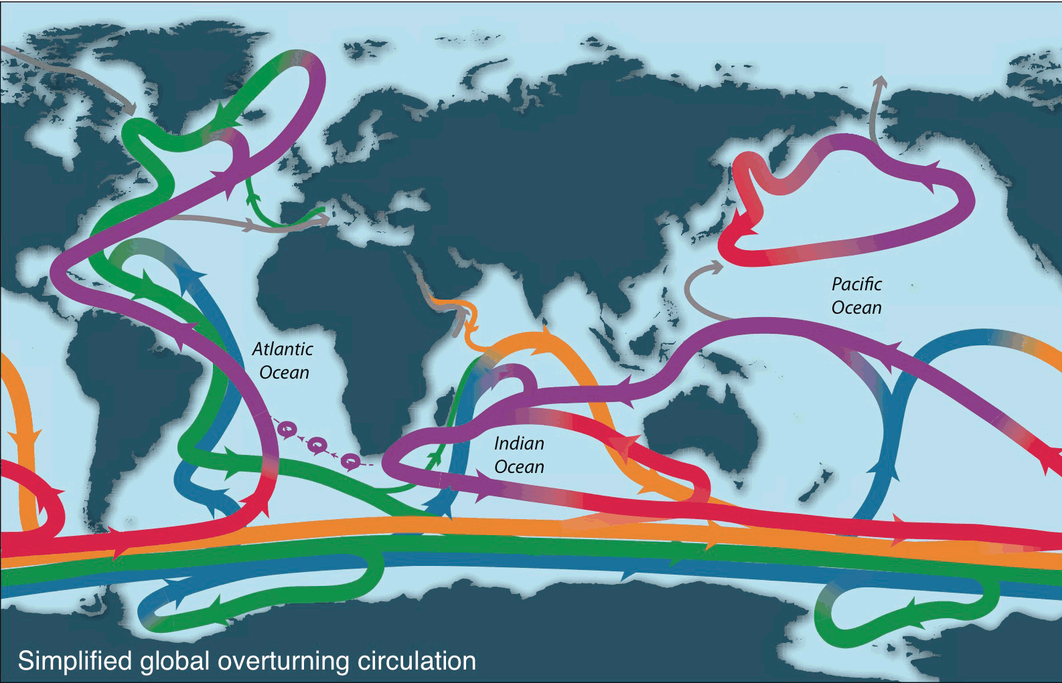
Antarctic Water Masses
Upper Ocean
North Atlantic Deep Water
Pacific and Indian Deep Water
Intermediate Water
Antarctic Bottom Water
Global overturning circulation of the ocean (Talley, 2013)
Notes:
: Talley 13.
Talley, L.D. 2013. Closure of the global overturning circulation through the Indian, Pacific, and Southern Oceans: Schematics and transports. Oceanography 26(1):80–97, http://dx.doi.org/10.5670/oceanog.2013.07

Slide 13
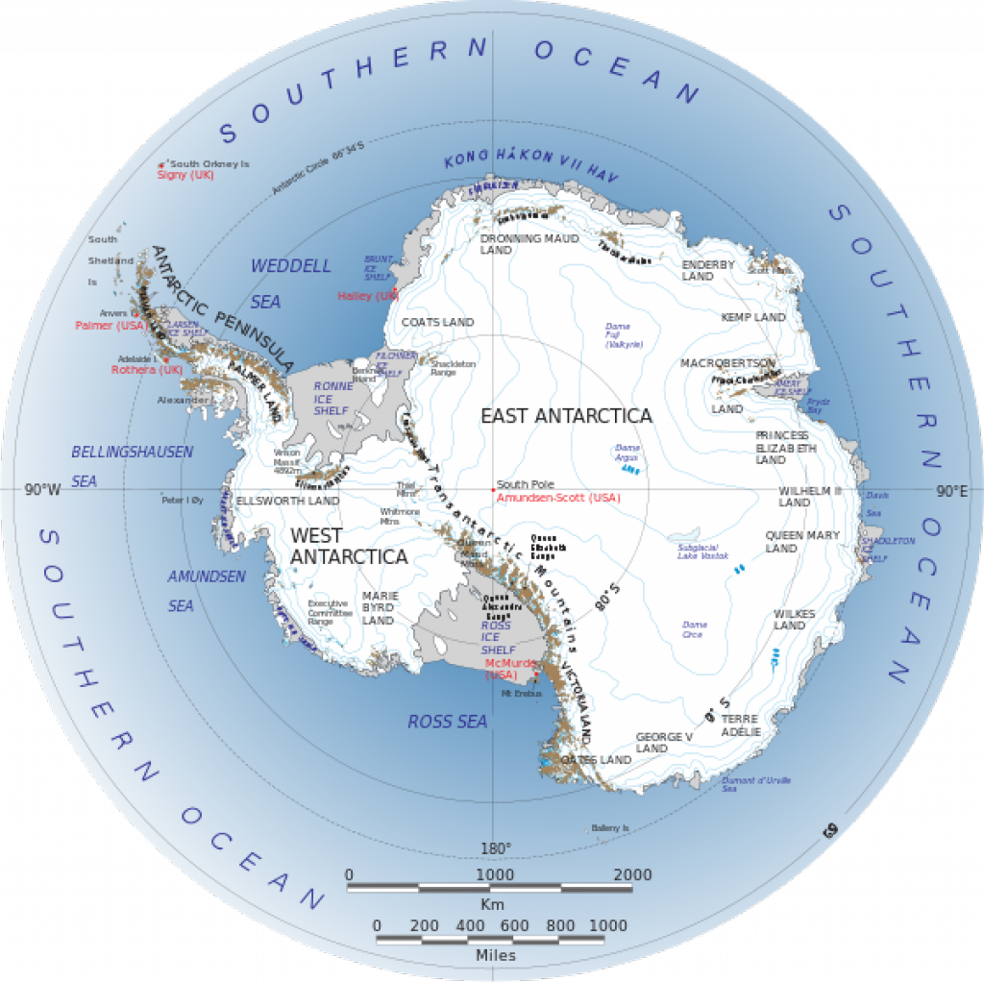
Site 697
Studied during Leg 113 of the JOIDES Resolution
Located within the Jane Basin
http://www.sciencepoles.org/interview/putting-antarcticas-ice-mass-loss-into-perspective
Notes:
4 objectives but most related to my study is: Wanted to figure out when marine glacial conditions developed to form AABW
Formed due to the subduction of weddell ocean crust below the southern portion of the south Orkney microcontinent
Back arc basin

Slide 14
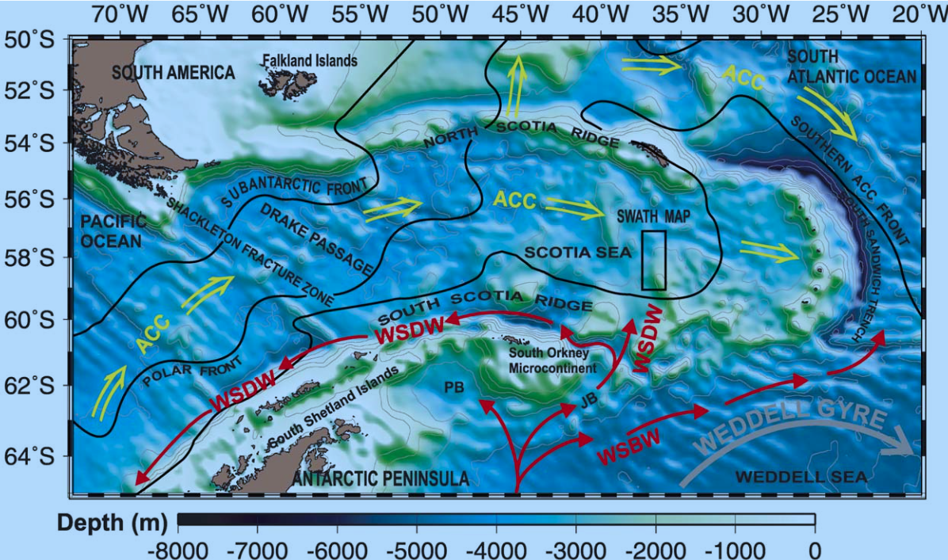
Site 697
(Maldonado, 2003)

Slide 15
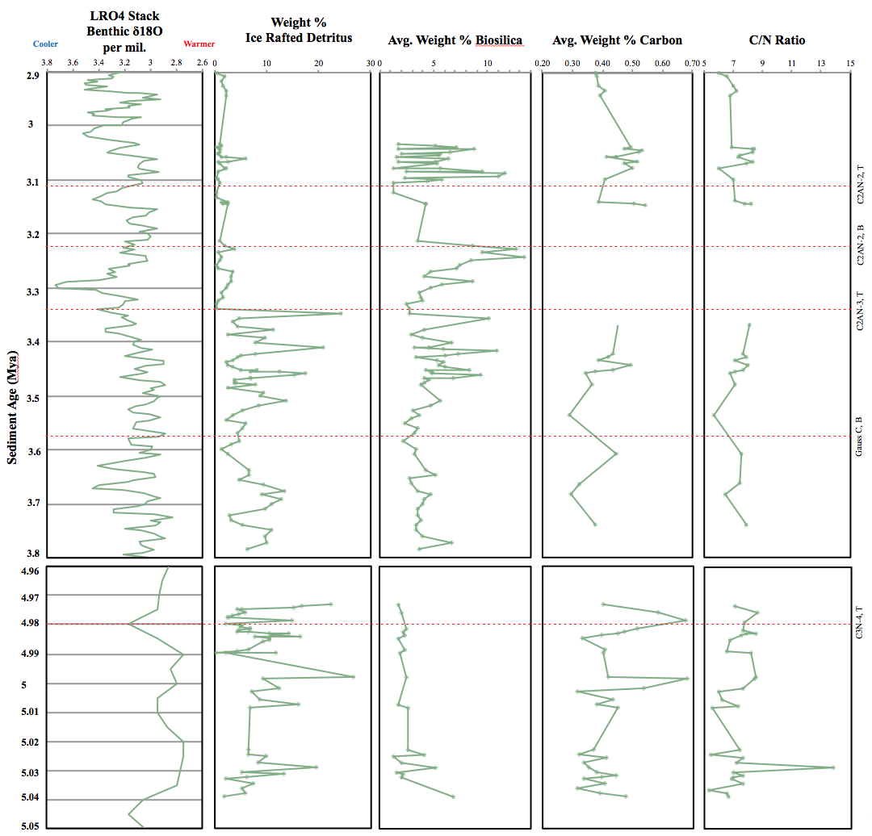
Summer 2016 Research
Analysis of weight percent of Ice-Rafted Detritus (IRD), biosilica, carbon, and carbon-nitrogen ratio and its correlation to the LRO4 Stack
Notes:
Weight % IRD, biosilica and carbon can all used as indicators of ice sheet advance and retreat. These red dotted lines indicate the places in the core where we have a good age model for the sediment. First we have the LRO4 stack which is used to show temperature within the pliocene. Low delta 18O values indicate warmer periods, while high delta 18O value indicate colder periods. Ice rafted detritus, or IRD, is deposited by floating icebergs. We would expect high amounts of IRD to be present when there was a lot of warming because lots of icebergs would be breaking off the ice sheet, melting, and depositing IRD on the seafloor. We also expect high biosilica when there was a lot of warming because there would be less ice sheet coverage. Biosilica is produced by photosynthetic organisms like diatoms that rely on sunlight. When there is less ice, there is more sun reaching the water and there will be more productivity, so more biosilica. We saw peaks in IRD and biosilica around the same time as each other which is what we expected to see. These peaks likely indicate large amounts of ice sheet melt. On the other hand, low biosilica could also be an indicator of warmer times because it could mean that there was a lot of ice sheet melt, which would produce a lot of icebergs, which would also block the sunlight. So it is very difficult to rely solely on biosilica to indicate ice sheet advance and retreat.
Weight percent carbon is similarly a proxy for productivity. With more carbon we would expect more productivity due to less sea ice, and therefor warmer temperatures. Lastly, the carbon/nitrogen tells us if the core is terrestrial or marine based. A low C/N ratio (around 4 to 10) would indicate marine, a higher C/N ratio would indicate terrigenous. There is only spike in our data that doesn't indicate a marine source, which is likely an error.

Slide 16
Current Research
Original Sample
<63 microns
Fine fraction
>63 microns
Coarse fraction
Sieve
Study bottom currents
Study surface currents
Remove biosillica
Pick biotite and hornblende to date (Ar-Ar) for provenance study
Grain size analysis
Spectrophotometry*
Notes:
Show grain size analysis plot to determine precision
Comparing sedigraph with malvern (assume sedigraph is more accurate)
Biosilica – productivity
Diatom species – warm loving or cold loving? Ice living
IRD – provenance
Assume 12 ma ice first formed in antarctica – oldest sedimentation processes … so since this happened that long ago, we are observing less major changes in sedimentation .. IRD tells how much ice is melting .. No IRD = open water or solid ice with no melting .. No IRDwith lots of diatom = open water and productivity

Slide 17
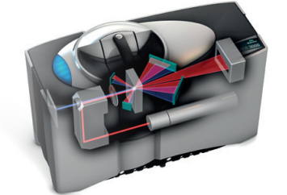
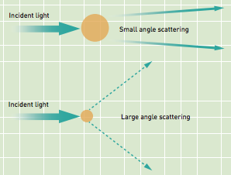
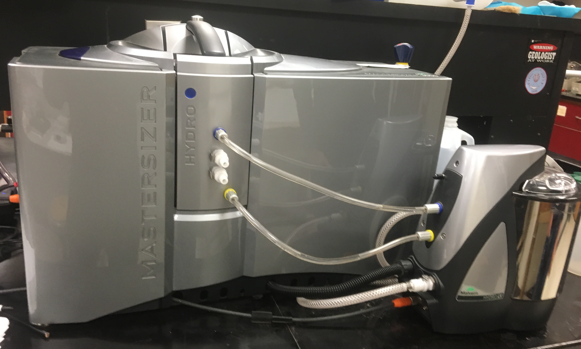
Current Research
Grain Size Analysis
  Laser diffraction
    Malvern Mastersizer 3000
Proxy for current speed
Analysis of sortable silt size range
Malvern Mastersizer 3000 at Central Connecticut State University

Slide 18
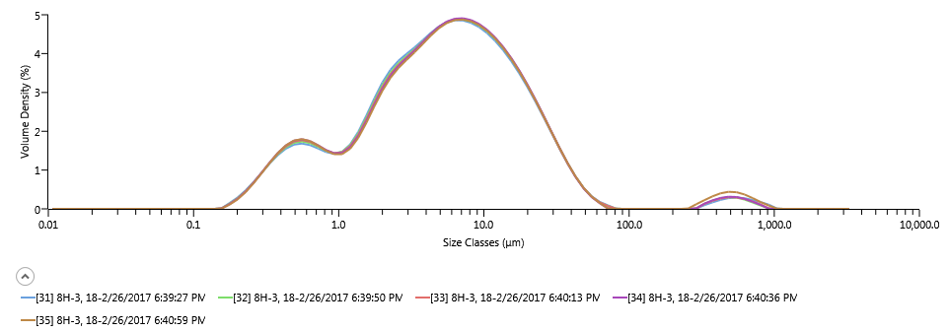
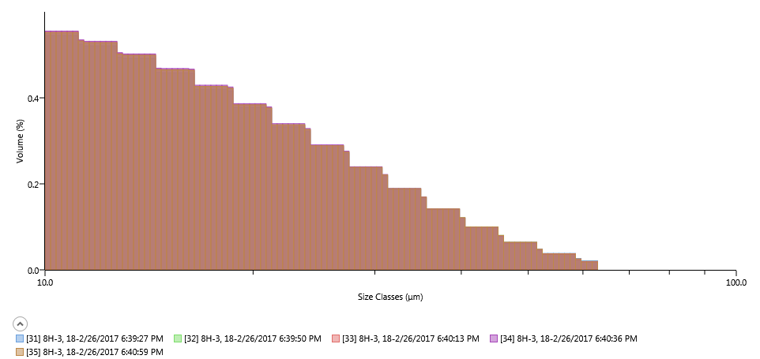
Current Research
Example data of grain size distribution from sample 697B, 8H-3, 18. The top figure is the overall distribution of the grain size and the bottom figure represents the distribution of the sortable-silt size range
Future Work: Particle size analysis using a Sedigraph and mineralogical analysis using spectrophotometry
Relationship of sample mass and laser obscuration based on amount of grinding during sample preparation

Slide 19
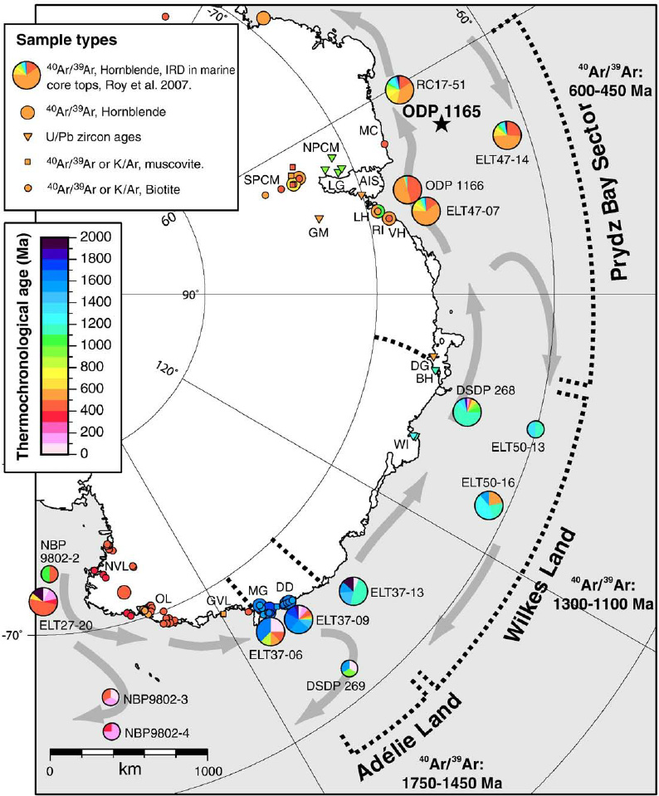
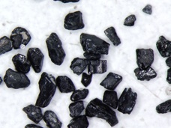
Current Research
Provenance of icebergs using IRD
Hornblend grains prepared for crystal-picking ranging from 63 to 150 microns in size
Image source: http://www.ldeo.columbia.edu/~epierce/Research.html
Provennance analysis of sediment collected along East Antarctica (Williams, 2010)
Notes:
My current research consists of finding out where the IRD in the sediment core came from, which means knowing where the icebergs traveled from. This is done by using the 150-500 fraction of the core and picking out hornblendes and biotite for Ar-Ar analysis. These grains have specific Ar-Ar ages which correspond to the ages of rock on Antarctica. This image from Williams et al. is an example of how provenance works. You can see that the ages on land are found and then comapred to cores at different sites. At each site you can see how much of that core comes from which part of Antarctica. Using Ar-Ar analysis you can see how far icebergs have traveled, which gives you an idea of how much the ice sheet melted.

Slide 20
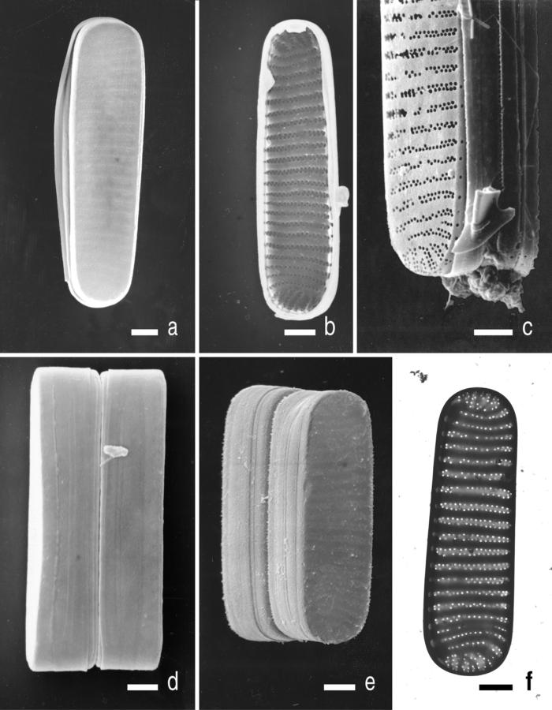
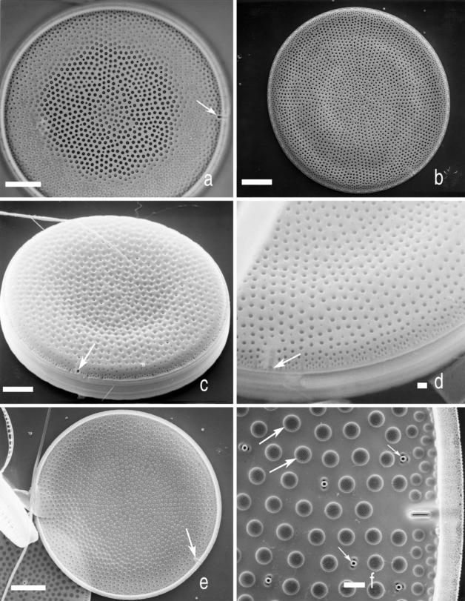
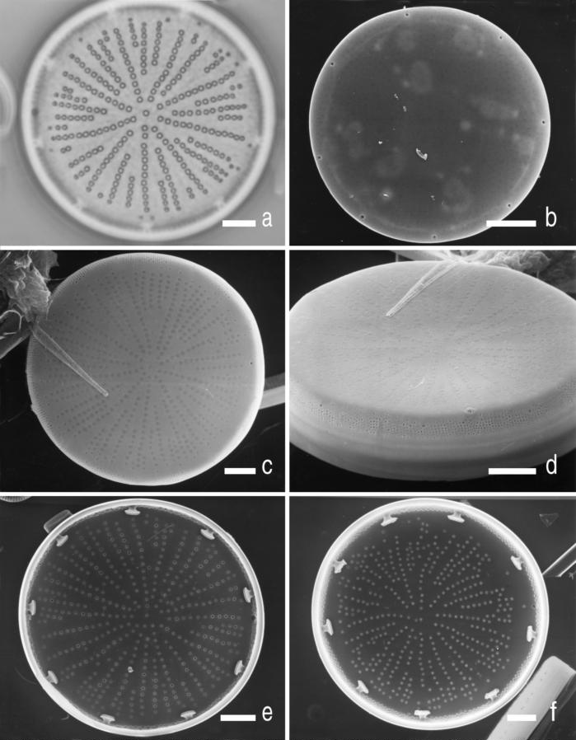
Current Research
Diatom identification
Notes:
Diatoms are a very useful for paleoclimate research as it is an effective proxy for climate change. This is due to their sensitivity to a variety of ecological conditions.
Changes in climate can be tracked by observing the changes in species abundance within a sediment. The ecological requirements are well known for a number of ‘indicator’ species.
The factors that contribute to changes in species include; precipitation, solar output, wind strength, and therefore upwelling and erosion.
Diatoms are quiet detailed in structure and can be identified to genus and, in most cases, species level, which allows for the reconstruction of past climate by analyzing the changes in the preserved diatom valves through time.
There are two main groups of diatoms that are distinguished by their structures:
Picture top right: (Thalassiosira Lentiginosa) arrows are pointing out the defining characteristics of the taxa. This is a common example of a centric diatom (think round cilindrical structures) that are in our samples.
(https://taxonomic.aad.gov.au/keys/diatoms/key/Antarctic%20Marine%20Diatoms/Media/Html/images/Thalassiosira_lentiginosa/Thalassiosira_lentiginosa.jpg)
Picture top center: (Fragilariopsis Curta) A common example of a pennate diatom (think more of an oval shape/ almost looks like a grain of rice) that we find in our samples.
(https://taxonomic.aad.gov.au/keys/diatoms/key/Antarctic%20Marine%20Diatoms/Media/Html/images/Fragilariopsis_curta/Fragilariopsis_curta.jpg)
Picture bottom left: (Actinocyclus Actinochilus) Another centric species of diatoms that we find in our samples

