Slide 1
Dirt Pile Dreams 3.0
Prologue or Final Act ?

Slide 2
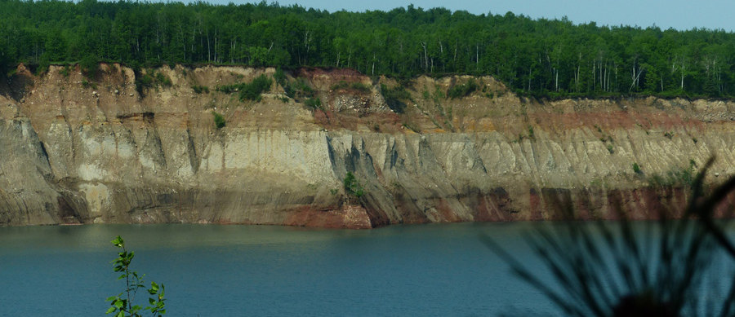
Hill Annex Paleontology Project
Brought to you by….

Slide 3
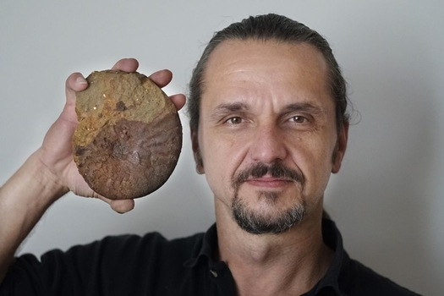
Background
Hill Annex Paleontology Project
Examining the Cretaceous soils of Minnesota
Since 2014
All VOLUNTEER research group
Based out of Science Museum of Minnesota
Funding support through volunteer grants, private donation, and corporate matching programs.
Field programs centered on Hill Annex Mine State Park in Calumet, MN.
Minnesota Department of Natural Resources – Parks and Trails

Slide 4
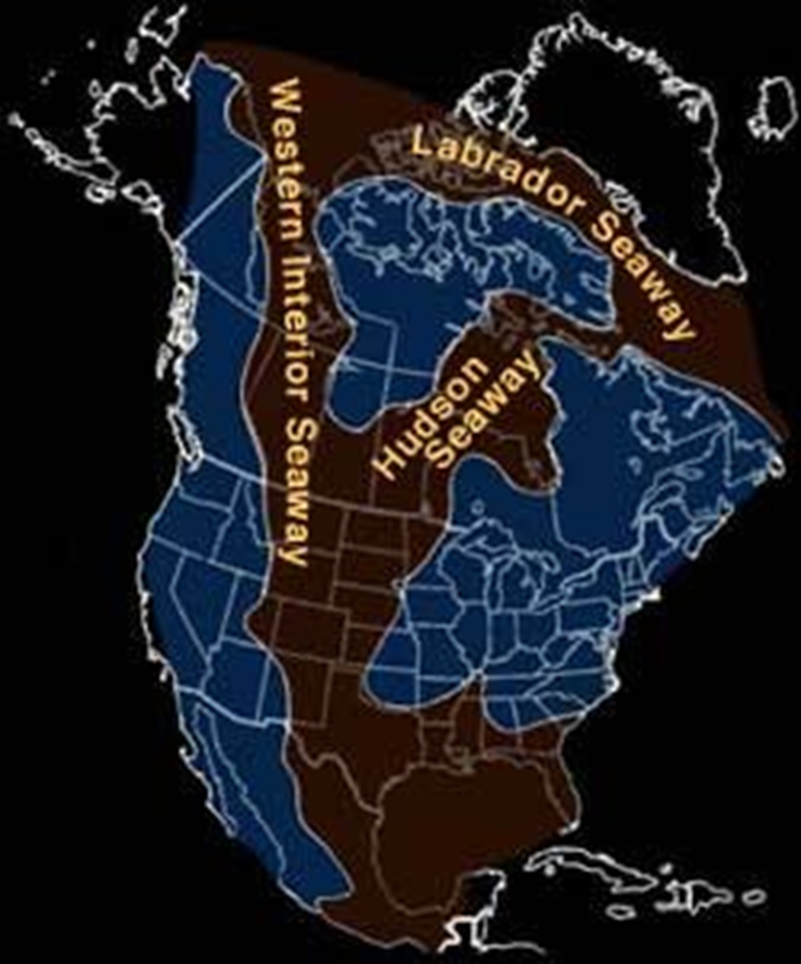
Prehistory
Coleraine Formation:
Roughly 110 – 80 mya.
Late Cretaceous period
Near eastern shore of Epicontinental Seaway.
Soils are conglomerates, sandstones, and shales.
Only known deposits of this geology in the U.S.
Rarely exposed without open pit mining.

Slide 5
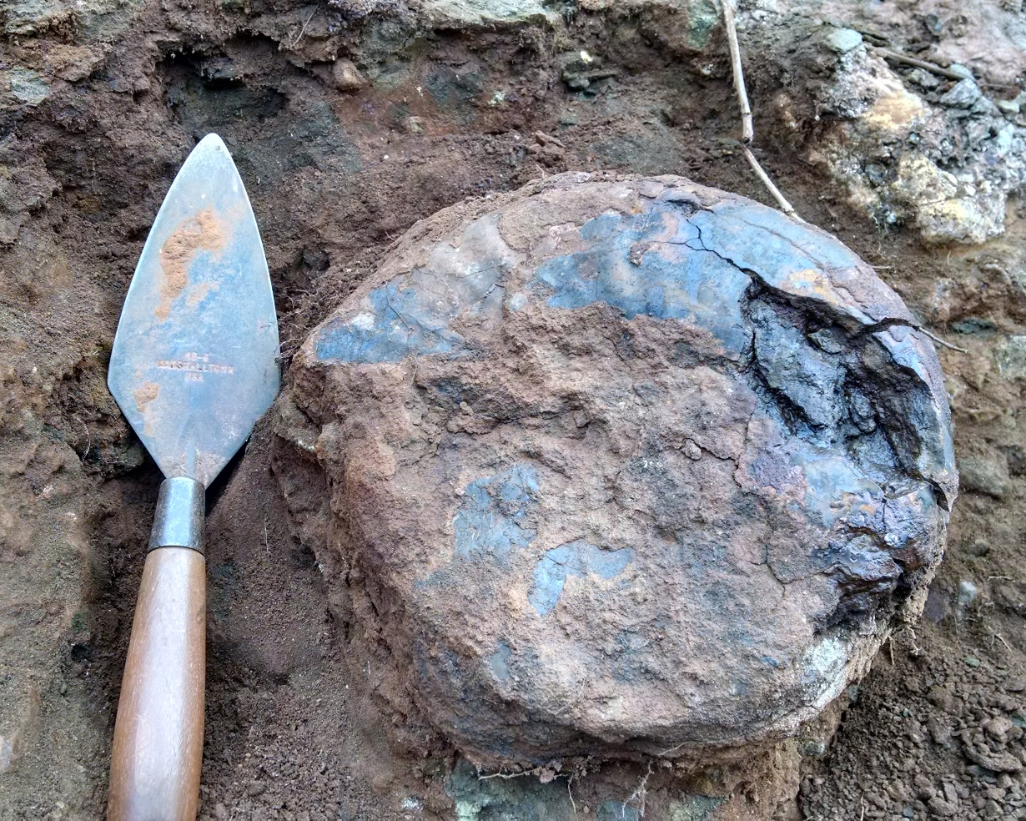
Prompts…
Loss of fossils
Weathering.
Improved industry utilizing low grade iron stockpiles.
Scattering of information due to public finds.
Rising water levels in the mine lake
Possible new fossil finds
Stratigraphic records lost or outdated
NEW sites with current mining
Historic Research:
“….deserves further attention….”
Who know about this prehistory?

Slide 6
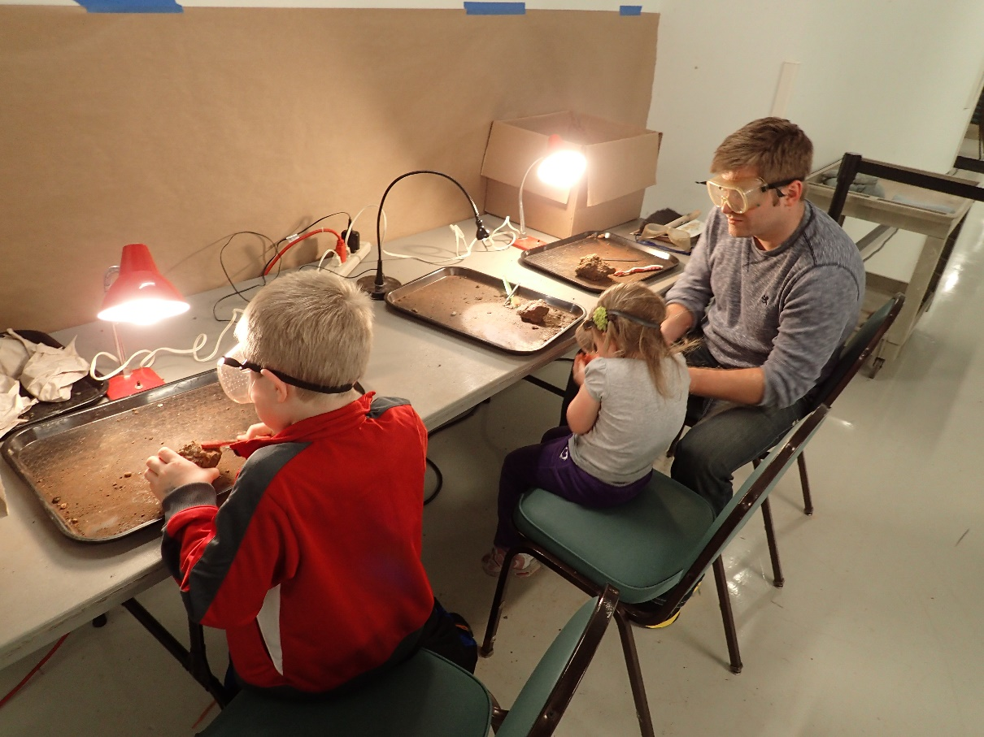
Goals
Fossil Evidence
Collect, preserve and document both new and private specimens.
Project partners
Cultivate relationships to build stronger interactions.
Volunteer enrichment
Provide enlightening and fulfilling opportunities.
Community Engagement
Seek means to increase involvement and awareness.
Public Outreach
Make ourselves available for interaction.

Slide 7
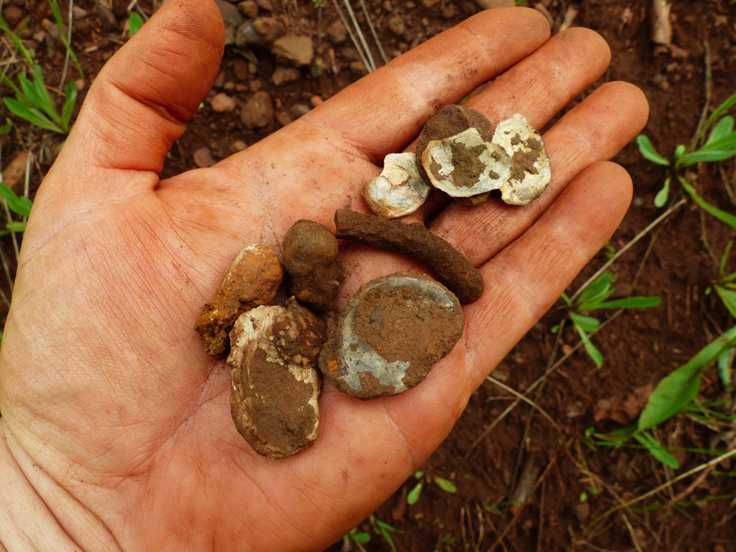
Since our date in Champaign…
Holding pattern
Science Museum of Minnesota
President departure
Building repairs
Bonding measure pending
Budget constraint
Funding suspension
Outreach limitations
Plan forward ??
2016 presentation viewable on Research Gate

Slide 8
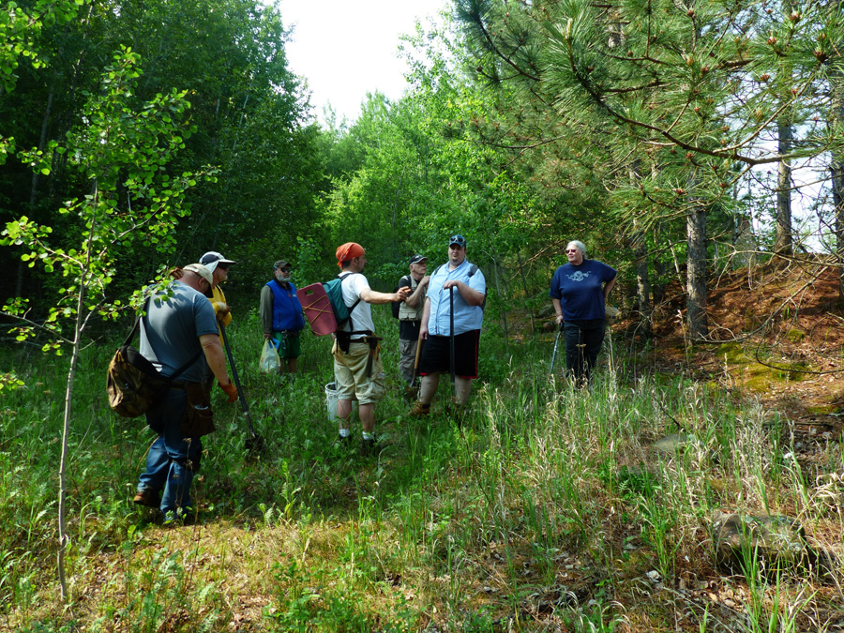
2016
Field Season proceeds !!
Budget sustained…
returning Donors
Contributions from public presentations.
Narrow Project focus to funding
Expanded site localities outside along Iron Range
Onsite Volunteer Interpreter Program pilot study at park

Slide 9
Community engagement.. ? Public outreach.. ?
Mesabi Range Geological Society
Minnesota Museum of Mining
Cuyuna Rock & Mineral Club
Geological Society of Minnesota field trip
Geological Society of America – North Central Regional Conference 2016 in Champaign-Urbana, Illinois
Geological Society of America – NC / NE Regional Conference 2017 in Pittsburgh, PA.
Minnesota Discovery Center – Family Discovery Days
Science Museum of Minnesota Research Lab open houses
Science Museum of Minnesota - Fossil Day celebrations
2016 Minnesota State Fair
You Tube video !
2016 Minnesota State Fair
You Tube video !
Hill Annex Mine State Park Fossil Tour Interpreter Pilot Study.
Grand Rapids Herald Review
Scenic Range News Forum
Hibbing Daily Tribune
KBJR-TV Duluth, MN.
Collaborations:
University of North Dakota
Macalester College
Minnesota Geographical Survey

Slide 10
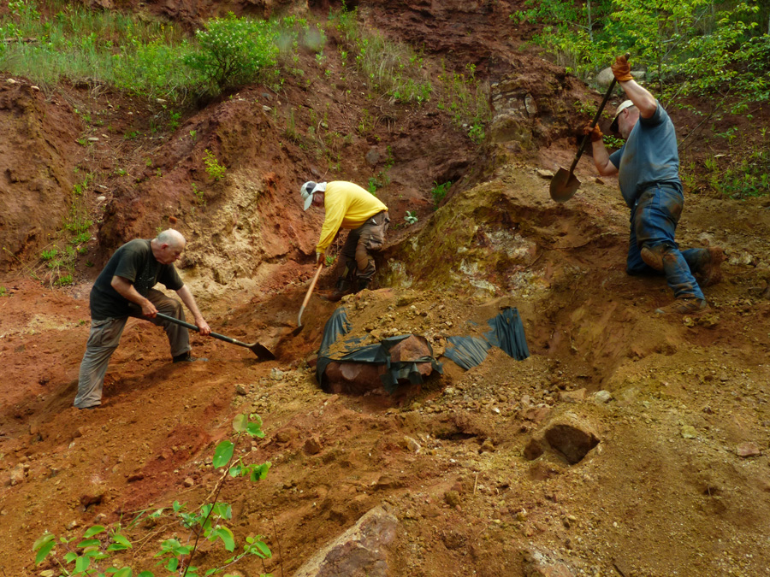
SMM volunteer enrichment.. ?
37 Field Crew volunteers.
47 days of field time
Estimated…. 1000+ volunteer hours
SMM Research Hall Open Houses
Year round presentations
State Fair 2016
Hill Annex Mine State Park
- Onsite Volunteer pilot study

Slide 11
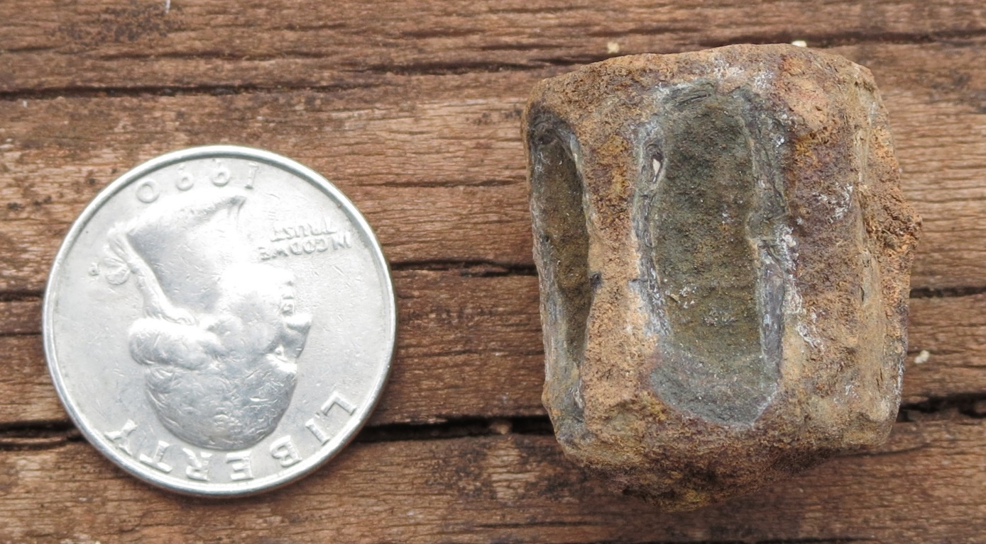
Fossil Evidence ??
Field sessions in 2016 collected more than an estimated1000 additional fossil specimens. (roughly 5000 piece collection to date)
New vertebra evidence of Icthyodectes sp. Fish.
New marine worm trace fossil evidence.
More crustacean evidence.
Additional “mystery” gastropod specimen.
Donations of private collections.
Eight (8) specimens have been accessioned
to SMM Paleontology Collection.

Slide 12
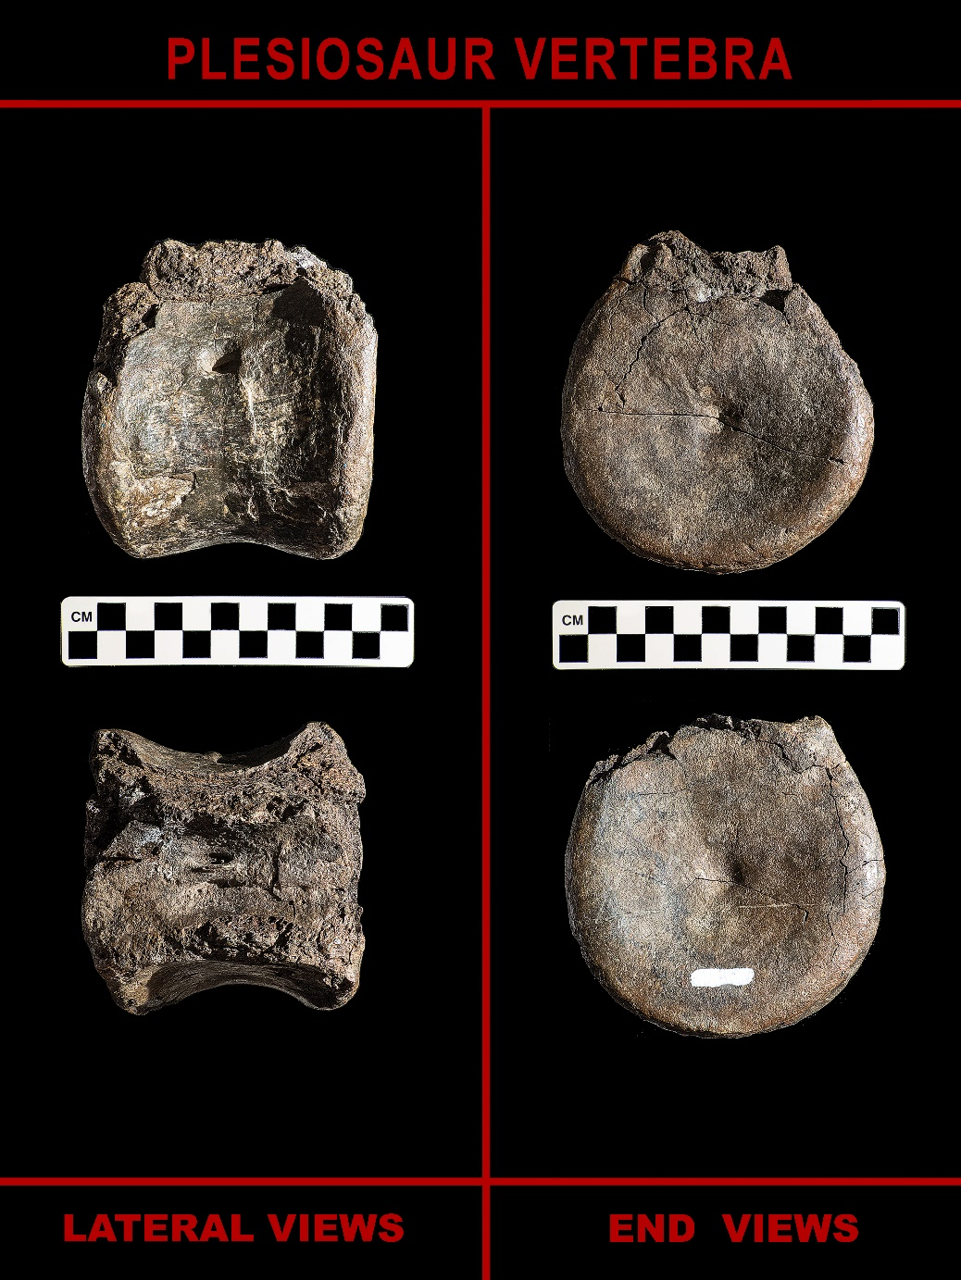
Donation: Art Norton
First confirmed fossil of a plesiosaur for the Coleraine.
Collected in 1987 on a private fossil tour at Hill Annex Mine State Park.

Slide 13
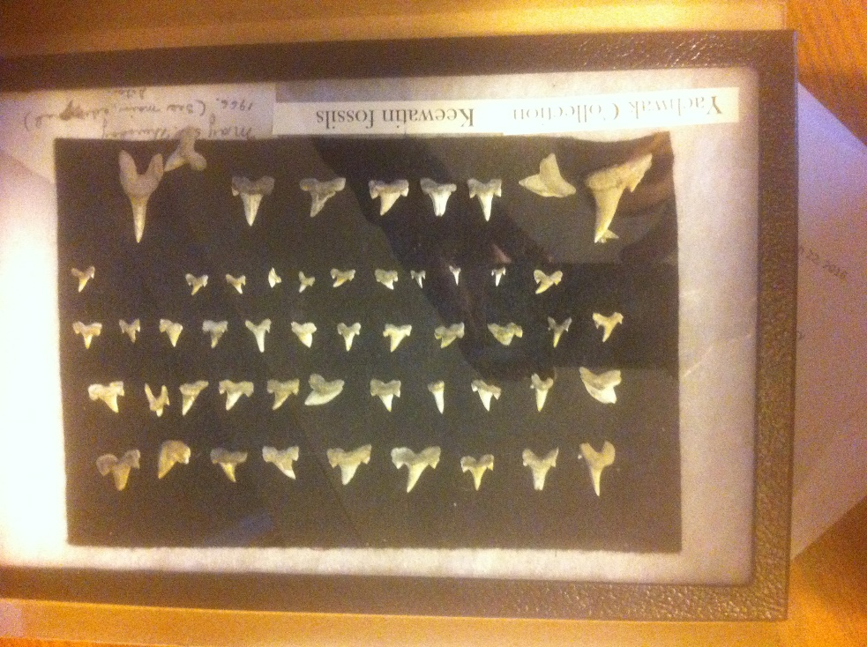
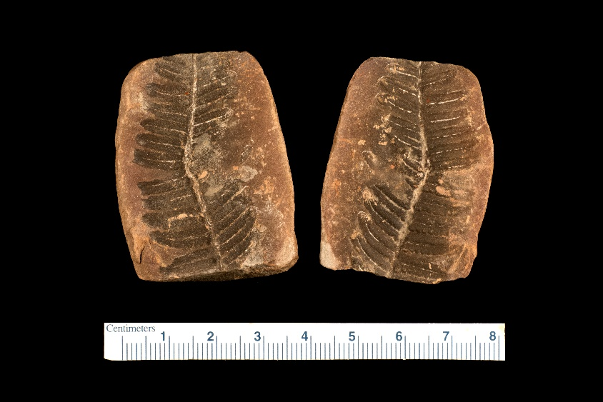
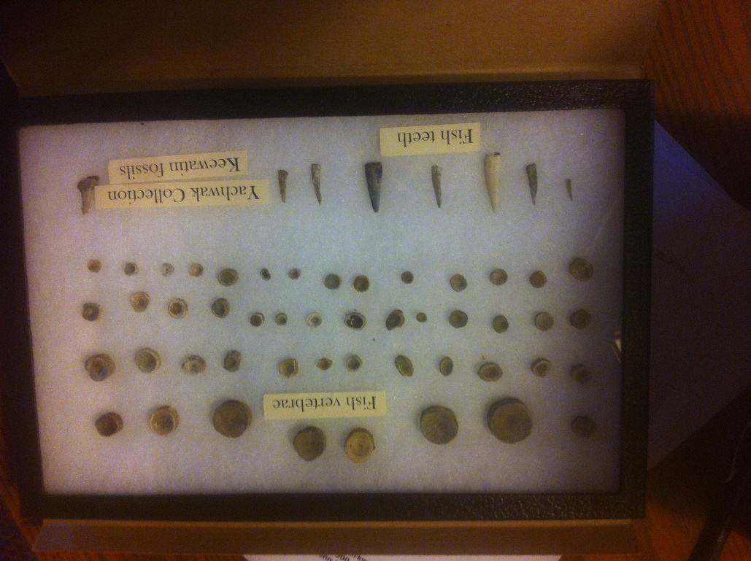
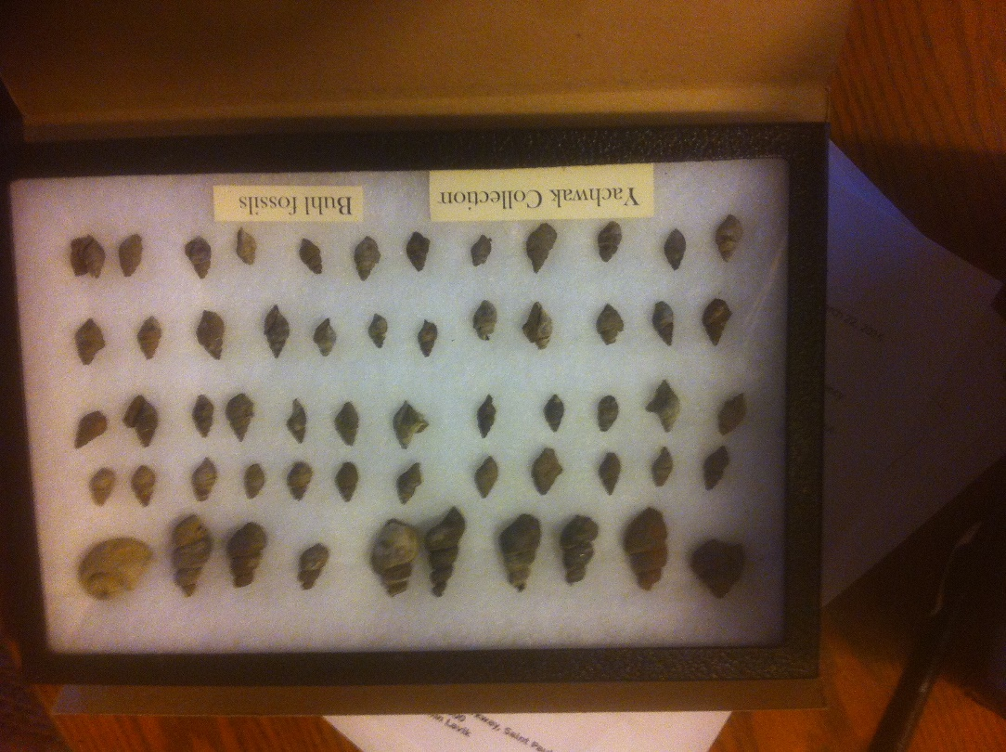
Donation: William Yachwak
An approximately 2500 piece collection of fossils and minerals concentrated mostly from the Mesabi Iron Range, including NEW leaves, ferns, pinecone, crustaceans, with many boxes still unpacked.

Slide 14


Cultivate a Project Partner ?
Minnesota Department of Natural Resources: Parks and Trails Division.
Park attendance up >10% this season
Onsite Interpreter Program
Minnesota Department of Natural Resources: Lands and Minerals Division.
State Fair exhibit 2015 & 2016… 2017 invite !
Mining Companies ??
Minnesota Discovery Center – The Museum of the Iron Range
- NEW Institutional Host
Build Paleontology Natural History Collection
Develop Public Programs and Field Trips
Cultivate Volunteer Base

Slide 15
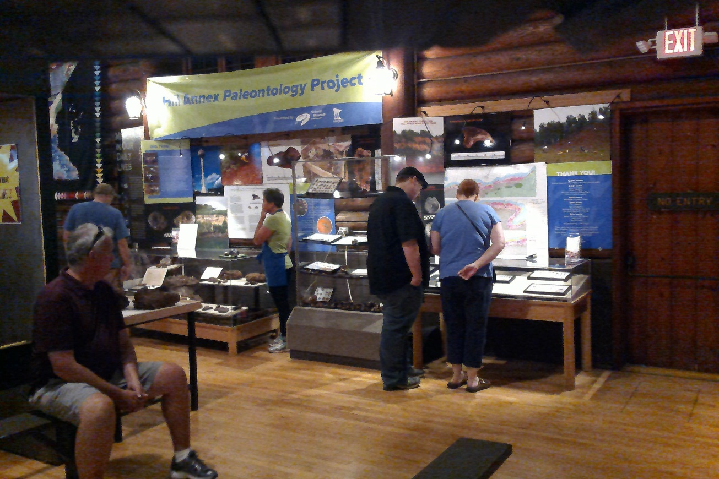
Minnesota State Fair 2016

Slide 16
2017 ??
Schedule of events already on calendar.
Central Minnesota Free Thinkers
Geological Society of Minnesota
Grand Rapids Area Library lecture series
2017 Minnesota State Fair
SMM Research Open Houses and Fossil Day Celebration
Iron Range Science and Engineering Festival
small grant to subsidize school visits.
Hill Annex Mine State Park - Fossil Tour Interpreter Program
Add new volunteers!
Nurture mining company relations.
Continue private collection discoveries.
Core Library and historic research exploration.

Slide 17

Acknowledgements
A special thank you to our supporting partners:
Minnesota Discovery Center
– Museum of the Iron Range
Science Museum of Minnesota
Minnesota Department of Natural Resources
Parks and Trails Division
Lands and Minerals Division
Forestry Division

Slide 18

Acknowledgements
myFOSSIL Project
Supporting our participation in GSA Regional 2017
All our private supporting donors
Marjorie Bolz-Allen Volunteer grant program
H.B. Fuller Foundation and RSM - US Foundation
Jordan Shaefer
Manager - Hill Annex Mines State Park
Mark Ryan
Photo credits Amitycreek.com

Slide 19
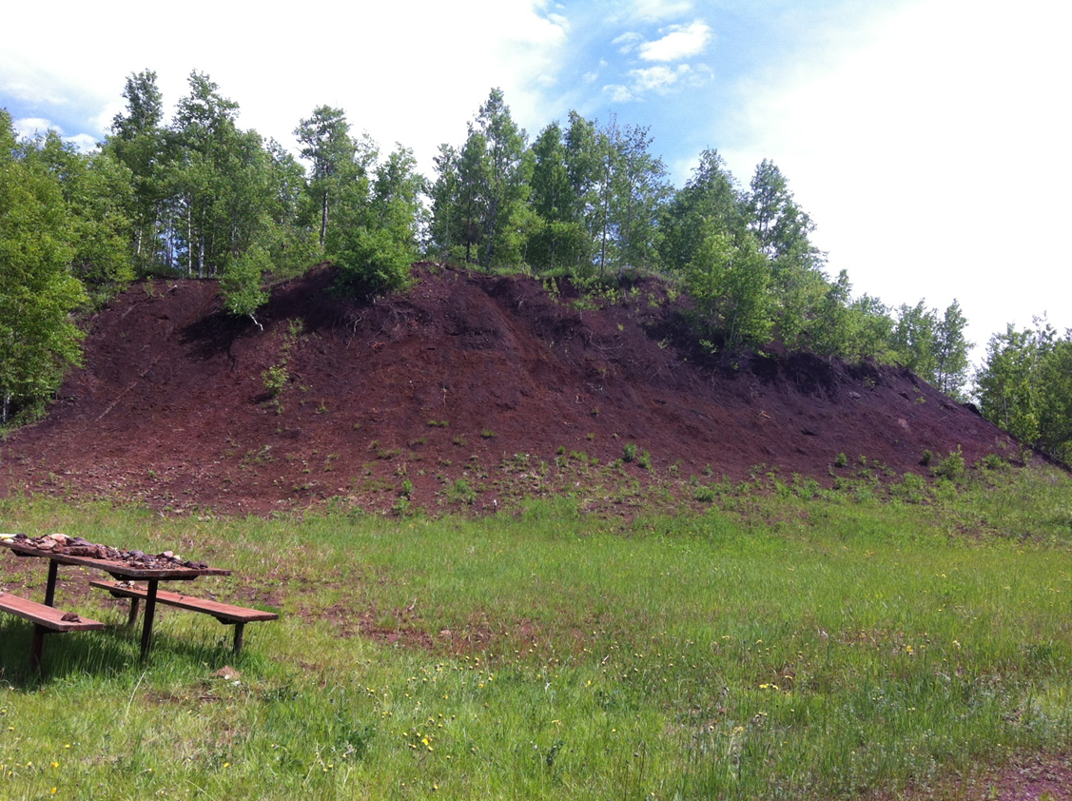
Thank you!!
Stay in touch with project developments and updates through our webpage….
smm.org/hill
Project briefings, updates, Contact Us options and
more are available at website…
…along with a link to our online donation vehicle.
GiveMN.org
Contact for project information: jwestgaard@smm.org

