Slide 1
Transmissivity of Fractured Shale in Response to Cyclic Stresses
Magdalena Gill, Johnathan Moore, Sarah Brown, Dustin Crandall, Matthew Stadelman
March 20, 2017
GSA Northeastern Northcentral Joint Section Meeting

Slide 2
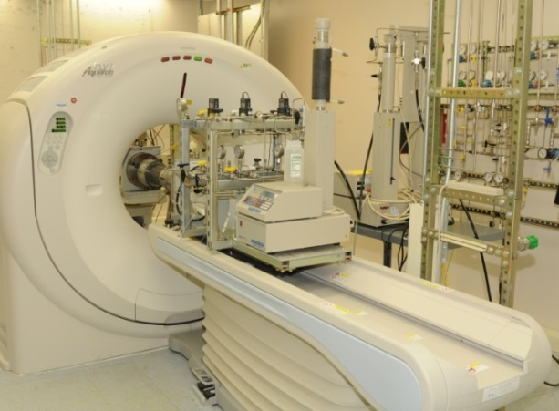
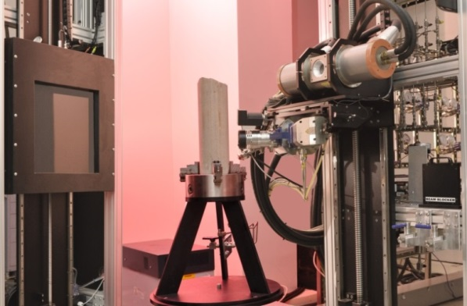
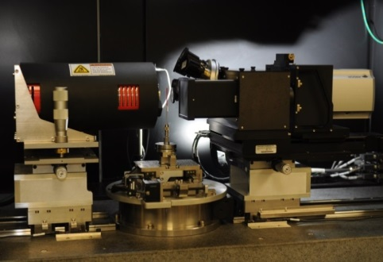
Computed Tomography
and Geomaterial Characterization
Porous and Fractured Media
Single and Multiphase Flow
Digital Core Characterization
Carbon Sequestration
Unconventional Resources
Large scale
Medical CT Scanner
Resolution 10⁻⁴ to 10⁻²m
430x430x500 µm pixel
Core scale
Pressure, temperature, and flow controls
Industrial CT Scanner
Micro CT Scanner
Small scale
Resolution 10⁻⁶ to 10⁻³m
3 -70 µm pixel size
Pore & core scale
Pressure & flow controls
Resolution:
10⁻⁷ to 10⁻⁵ m
Sub-micron pixel size
Pore scale
Pressure and flow controls

Slide 3
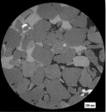
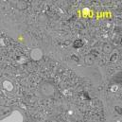
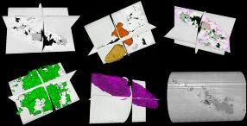



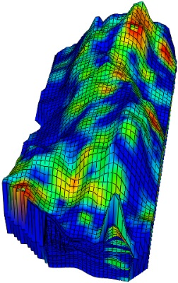
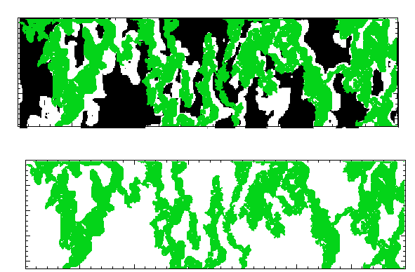
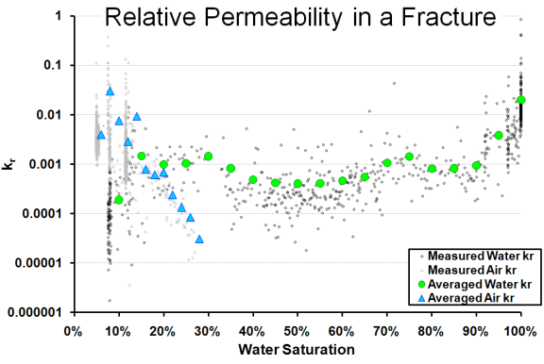

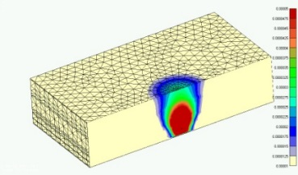
From Micro to Reservoir Scale
Micro-Scale Data Collection
(CT, SEM, Petrography)
Core Scale Characterization and Experiments
Data Conversion, Computational Fluid Dynamics
Reservoir-Scale Characterization
and Modeling
Multiscale Data Analysis
Flow in fractures and pore space

Slide 4
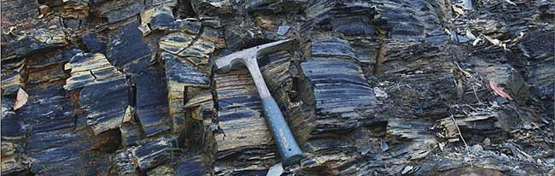
Fractured Shales
Fractures – flow super-highways in low-permeability media
Unconventional resource production
Reservoir seals
CO₂ sequestration
Fracture flow: morphology dependent
Aperture, roughness, tortuosity
In-situ stresses; changes due to fluid injection, production

Slide 5
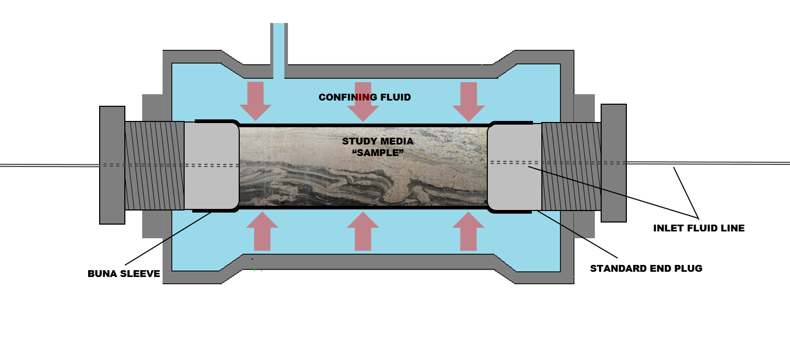
Experiment
Cores fractured with Brazilian technique
Hassler-style core holder
Cyclic confining (overburden) stress
North Star M-5000 Industrial CT Scanner
CT scanning at each pressure step 3D fracture morphology
Flow through experimental fracture transmissivity
Modeling insight into preferential flow path & channelization

Slide 6
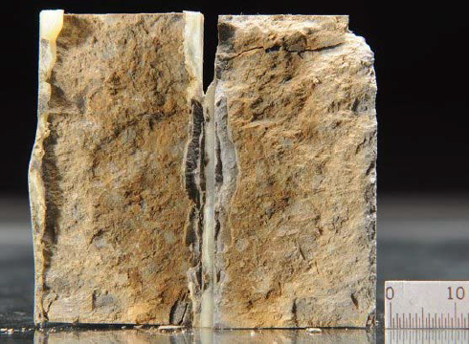
Test 1
NETL02 Sample
Core drilled locally on NETL site in Morgantown, WV
Calcareous mudstone
Pennsylvanian Conemaugh Group
1 inch diameter, 2 inch length core
31.6 um scan resolution
Flow data – pressure differential could not be measured during flow: no experimental transmissivity data
Image data – fracture shows distinct evolution through three pressurization cycles: hysteresis, asperity degradation, decreasing fracture apertures

Slide 7
Test 1

Slide 8
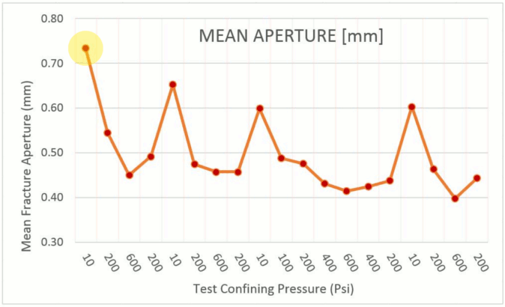
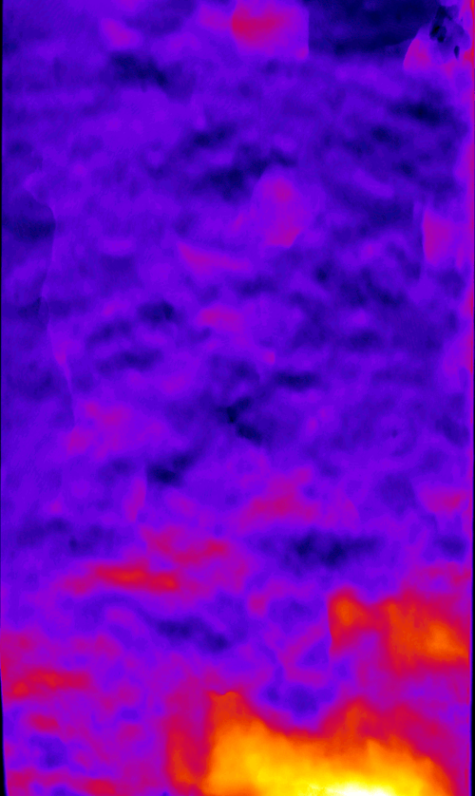
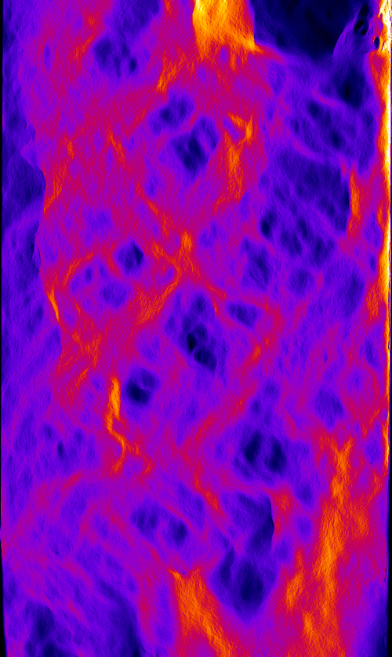
Test 1
Model:
Modified Local Cubic Law
Calculates the pressure distribution and flow through fracture
Assumes fracture is planar
Qualitative assessment
Image processing:
Software: ImageJ, ilastik
Fracture isolated from matrix
Vertical aperture measured
Aperture map created

Slide 9
Test 1
NETL02 Sample

Slide 10
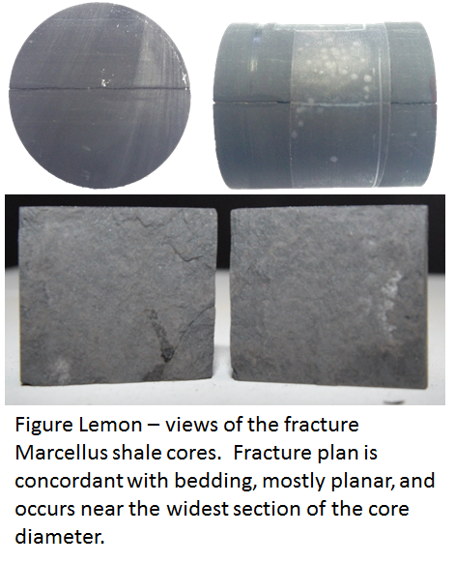
Test 2
Marcellus Shale sample
Outcrop sample, minimal weathering
Lower Marcellus Shale (Union Springs Member equivalent)
Bedford, Pa
X-Ray diffraction indicates very little swelling clays
1.5 inch diameter, 1.5 inch length sample
26.8 um scan resolution
Natural planar fracture
Cored parallel to bedding

Slide 11
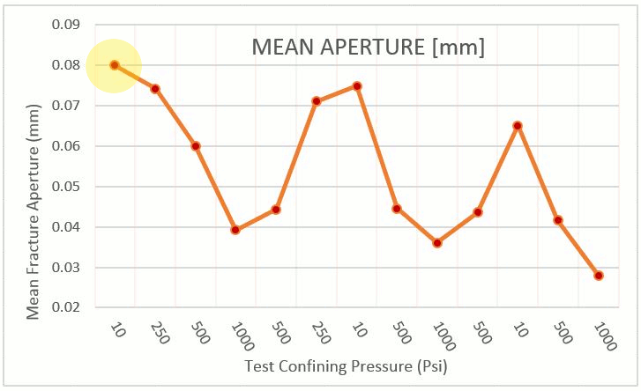
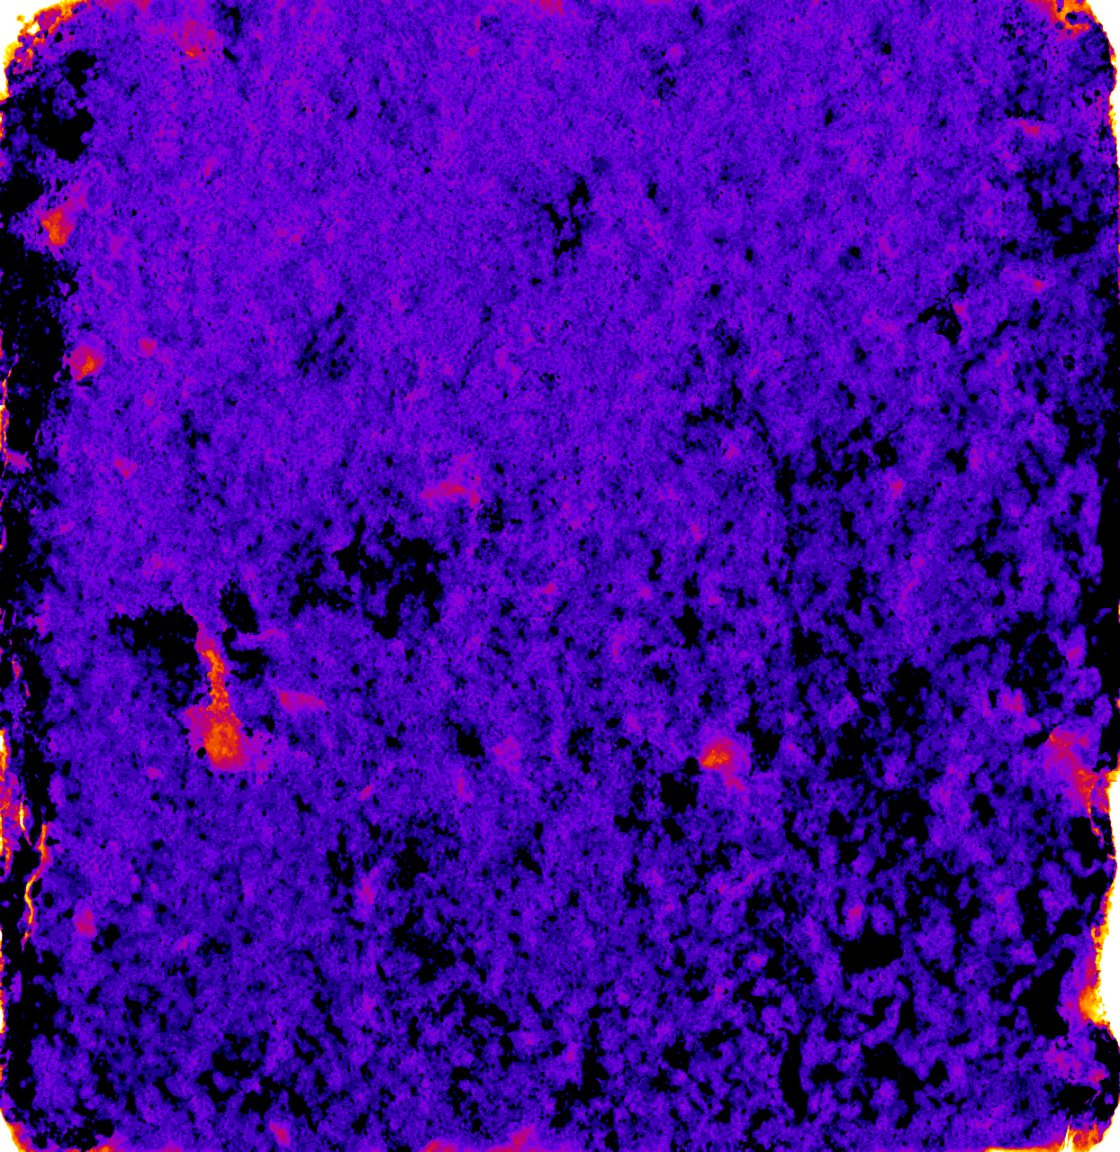
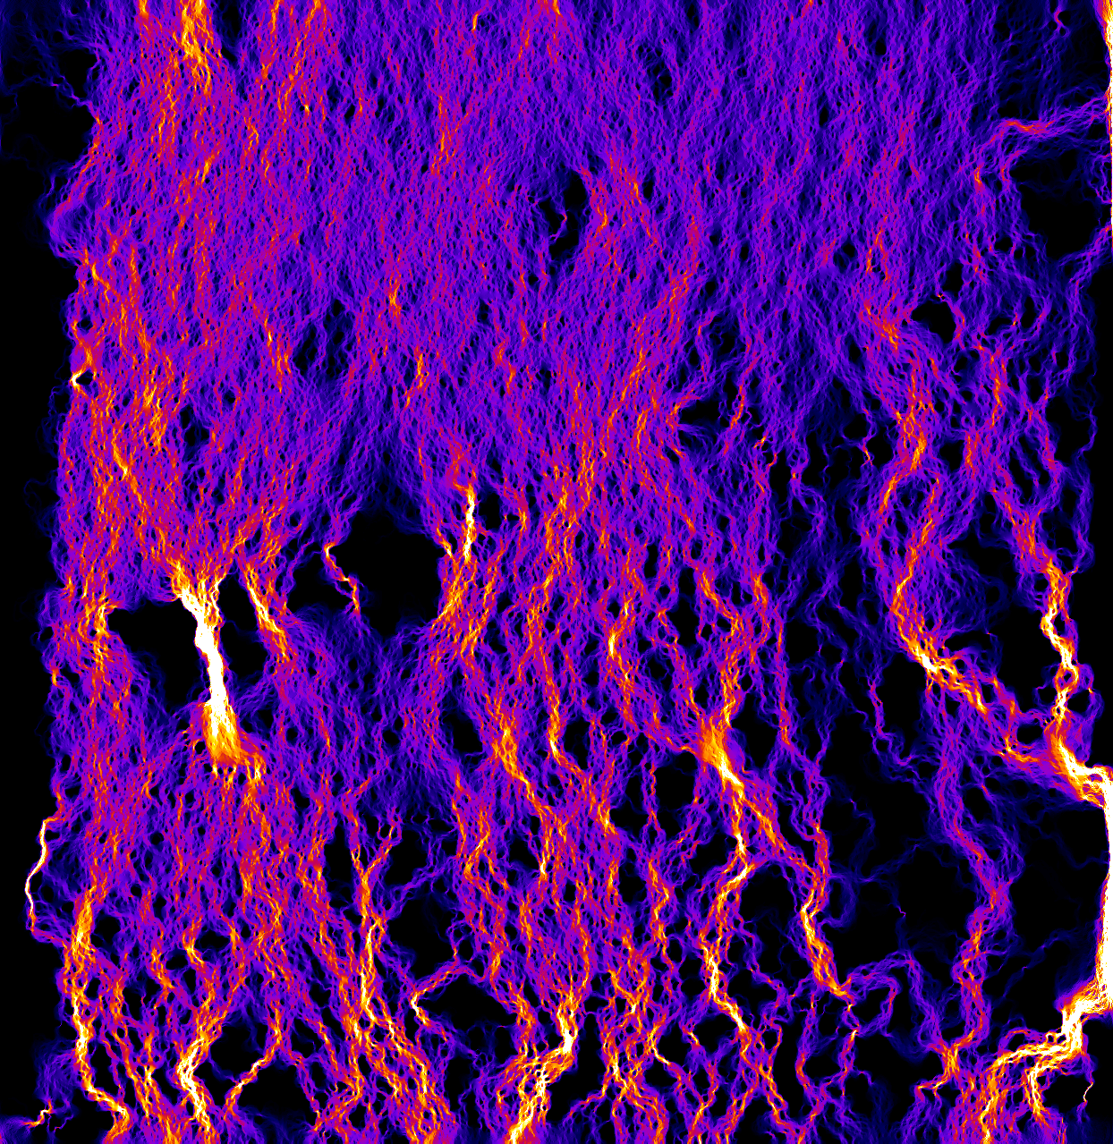
Test 2
Marcellus Shale Sample

Slide 12
Test 2
Marcellus Shale
10 psi 250 psi 500 psi 1000 psi 500 psi 250 psi 10 psi
500 psi 1000 psi 500 psi 10 psi
500 psi 1000 psi

Slide 13
Test 2
Marcellus Shale

Slide 14
Conclusions
Rapid initial changes with application of confining stress
More gradual response to increasing confining stress
Fracture undergoes hysteresis
Mean aperture alone cannot be used as a predictor of transmissivity
Zero aperture zones (where fracture walls meet) critical
Model overestimates flow for most open fractures
But underestimates for extremely tight ones
Issue:
Fracture aperture below scan resolution
Creation of artificial “zero aperture zones”
Future work:
Measure or estimate tight fracture zones
Incorporate measured/estimated zones into model → better representation of reality

Slide 15
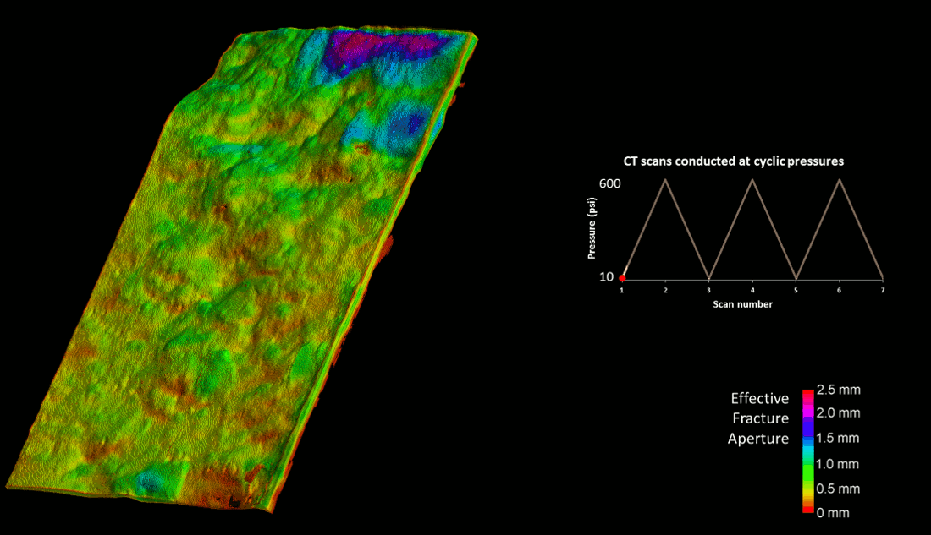
Test 1

Slide 16




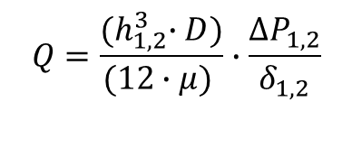


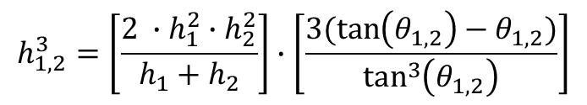

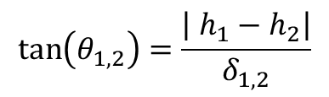

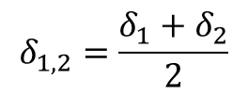
Modeling Approach
2-D Finite Difference Model of Local Cubic Law
Calculates the pressure distribution and flow through fracture
Stokes Tapered Plate Solution
Grid Block Transition:
Stokes Tapered Plate Correction:
$$D$$
$$δ_{1,2}=\frac{δ_{1}+δ_{2}}{2}$$
$$\tan\left(θ_{1,2}\right)=\frac{\left| h_{1}−h_{2}\right|}{δ_{1,2}}$$
i
i + 1
$$h_{2}$$
$$h_{1}$$
$$δ_{2}$$
$$h_{1,2}^{3}=\left[\frac{2 ∙h_{1}^{2}∙h_{2}^{2}}{h_{1}+h_{2}}\right]∙\left[\frac{3(\tan\left(θ_{1,2}\right)−θ_{1,2})}{\tan^{3}\left(θ_{1,2}\right)}\right]$$
$$δ_{1}$$
Local Cubic Law:
i
i + 1
$$h_{2}$$
$$Q=\frac{{(h}_{1,2}^{3}∙D)}{(12∙μ) }∙\frac{ΔP_{1,2}}{δ_{1,2}}$$
$$h_{1}$$
$$h_{1,2}$$
Brush, Thomson. April 3, 2003. “Fluid Flow in synthetic rough-walled fractures: Navier-Stokes, Stokes and local cubic law simulations.”

Slide 17


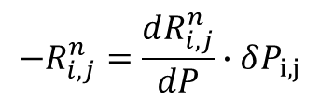



Computational Modeling Math
Local Cubic Law for a grid block in x or z direction:
$$Q_{x,i,j}=\frac{{(h_{x,i,j}}_{}^{3}∙Δz)}{(12∙μ) }∙\frac{ΔP_{i,j}}{Δx}$$
$$Q_{z,i,j}=\frac{{(h_{z,i,j}}_{}^{3}∙Δx)}{(12∙μ) }∙\frac{ΔP_{i,j}}{Δz}$$
$$T_{x,i,j}≝\frac{{(h_{x,i,j}}_{}^{3}∙Δz)}{(12∙μ∙Δx) }$$
$$T_{z,i,j}≝\frac{{(h_{z,i,j}}_{}^{3}∙Δx)}{(12∙μ∙Δz) }$$
Steady state constant density form of Continuity Equation:
$0=ρ\left(Q_{x,in}−Q_{x,out}\right)+ρ(Q_{z,in}−Q_{z,out})$
BTCS expansion of Continuity Equation:
$R_{i,j}^{n}=T_{x,i+1,j}\left(P_{i+1,j}−P_{i,j}\right)−T_{x,i,j}\left(P_{i,j }−P_{i−1,j}\right)+T_{z,i,j+1}\left(P_{i,j+1}−P_{i,j}\right)−T_{z,i,j}(P_{i,j }−P_{i,j−1})$
Solution method to calculate pressure change across grid:
$$−R_{i,j}^{n}=\frac{dR_{i,j}^{n}}{dP}∙δP_{i,j}$$
Crandall, D., Moore, J., Gill, M., Stadelman, M. “Hydrodynamic response of sheared fractures.” Submitted to the International Journal of Rock Mechanics and Mining Sciences. 2017. Stadelman, M., Bromhal, G. S., Moore, J., Gill, M., & Crandall, D. "Direct Measurement of Changes to a Sheared Shale Fracture." AGU Fall Meeting Abstracts. 2015.

