Slide 1


PRELIMINARY LOOK AT TRACE FOSSILS - LATE CRETACEOUS COLERAINE FORMATION; HILL ANNEX MINE STATE PARK, CALUMET, MINNESOTA
JOHN WESTGAARD, JASON KORF,
H. DOUGLAS HANKS and STEPHEN M. WILLGING

Slide 2
TABLE OF CONTENTS
INTRODUCTION
HISTORY OF RESEARCH ON THE COLERAINE FORMATION
GEOLOGY
TEREDOLITES
POSSIBLE WOOD-BORING GASTOPOD, OR NOT?
PARASITIC INTERACTION WITH MOLLUSKS
INVERTEBRATE BURROWS
POSSIBLE MYSTERY FOSSIL
WORK CITED
ACKNOWLEDGEMENTS

Slide 3
INTRODUCTION
Hill Annex Paleontology Project
Examining the Cretaceous soils of Minnesota.
Documenting evidence both public and private.
Building community engagement and public awareness.
Fostering informal STEM education.
smm.org/hill

Slide 4
HISTORY OF RESEARCH ON THE COLERAINE FORMATION
First reported in 1893 by Newton Horace Winchell
In 1944, Bergquist published his findings
Robert Sloan reports on Cretaceous Systems in Minnesota for the Minnesota Geologic Survey in 1964
Bruce Erickson publishes a monograph on Teleorhinus from the Iron Range in 1969
William Cobban & E.A. Merewether in 1983 reported on the Stratigraphy and Paleontology of the Cretaceous in Minnesota and Cobban worked on the Cretaceous Mollusk fauna

Slide 5
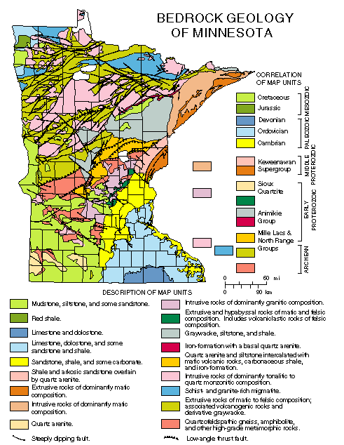
GEOLOGY
Morey, G.B. Bedrock Geology of Minnesota. Minnesota Geologic Survey, 1996

Slide 6
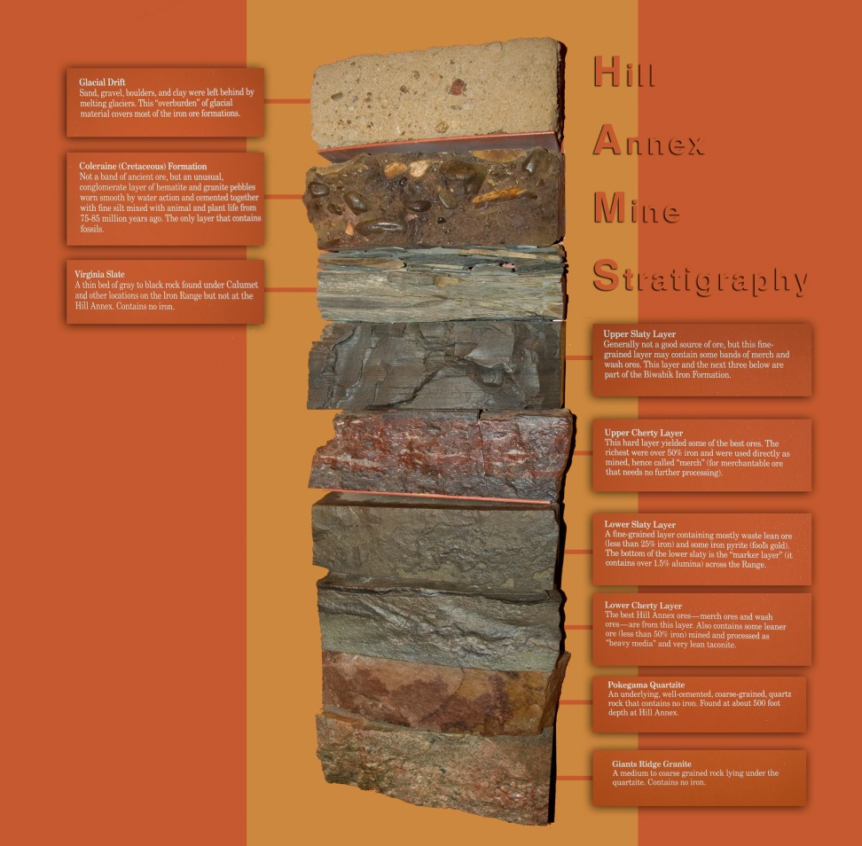
GEOLOGY
Coleraine formation
Iron - ore conglomerates, shales, and sandstones
Thickness varies throughout the formation
Cenomanian to Turonian in age
Transgressions and Regressions of the Western Interior Seaway
Paleoenvironment would be similar to Chesapeake Bay today

Slide 7
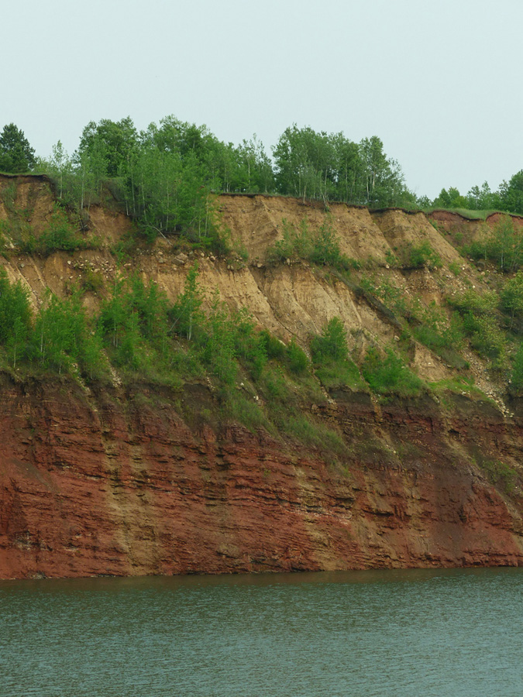
GEOLOGY
View of one of the Sidewalls in the Hill Annex Mine at Hill Annex Mine State Park, Calumet, MN.

Slide 8
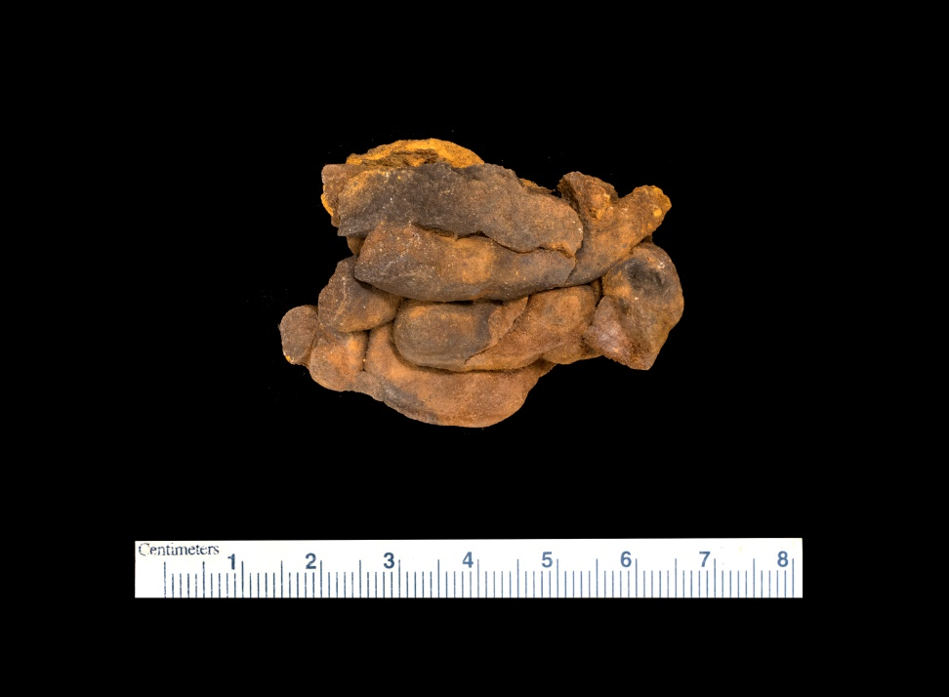
TEREDOLITES
Also called “Shipworms
Wood boring bivalve
Found in pieces of logs
Bergquist was the first to report them in 1944
Tubes filled in with sandstone

Slide 9
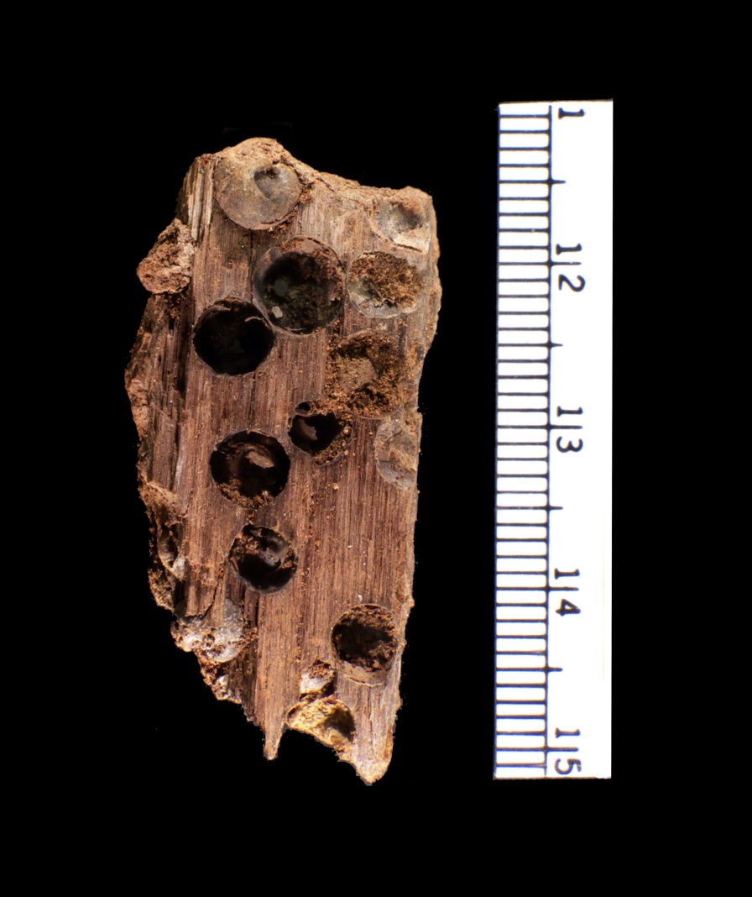
POSSIBLE WOOD BORING GASTROPOD OR NOT?
Initially Field ID as a possible Wood boring Gastropod
Under further investigation we were able to determine they are Pholas clams
There haven’t been any documented reports in the past on them in the Coleraine Fm.

Slide 10
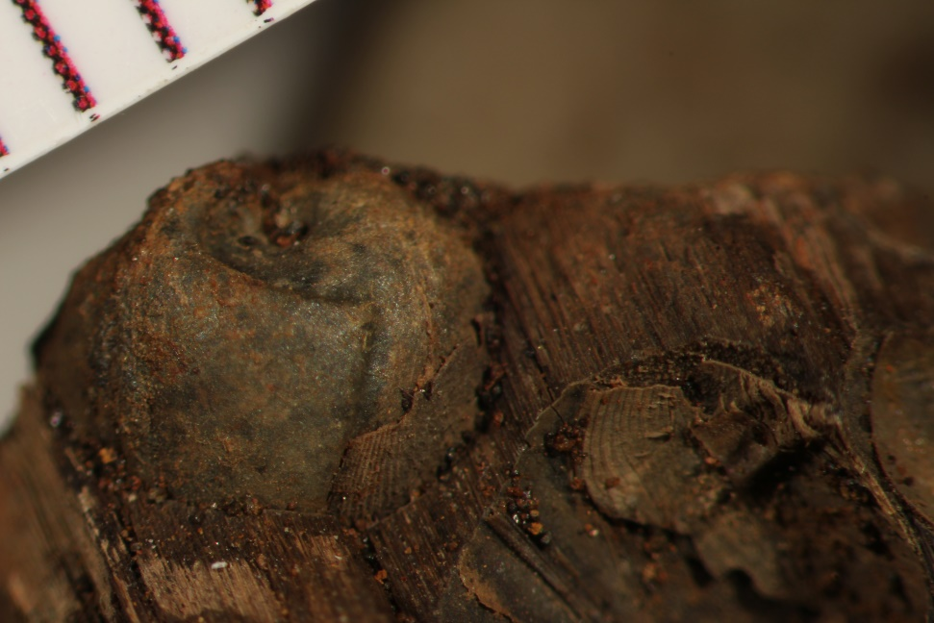
POSSIBLE WOOD BORING GASTROPOD OR NOT?
Up-close view of the shell and internal cast in the top left corner of the specimen viewed in the previous slide using a microscope.

Slide 11
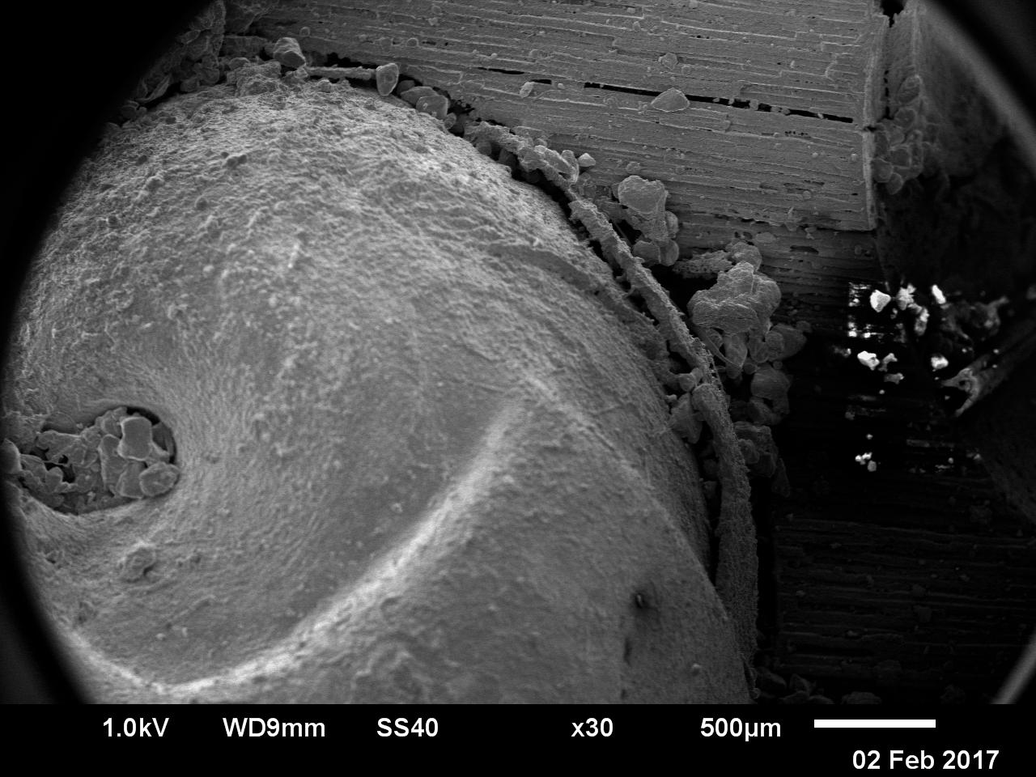
POSSIBLE WOOD BORING GASTROPOD OR NOT?
Up-close view of the internal cast of the specimen in the previous 2 slides using Scanning Electron Microscope (SEM) at 500 um.

Slide 12
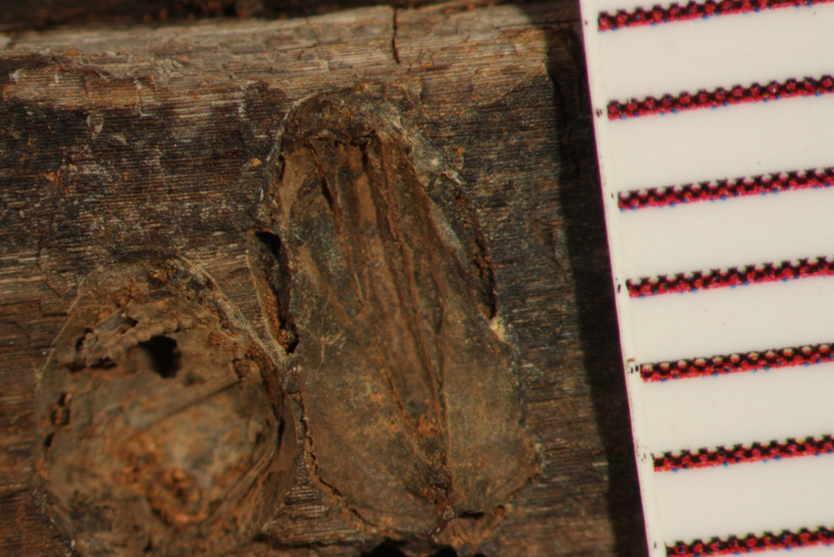
POSSIBLE WOOD BORING GASTROPOD OR NOT?
Up-close view of a Pholas clam in the side of the fossilized wood specimen seen in slide 9 using a microscope.

Slide 13
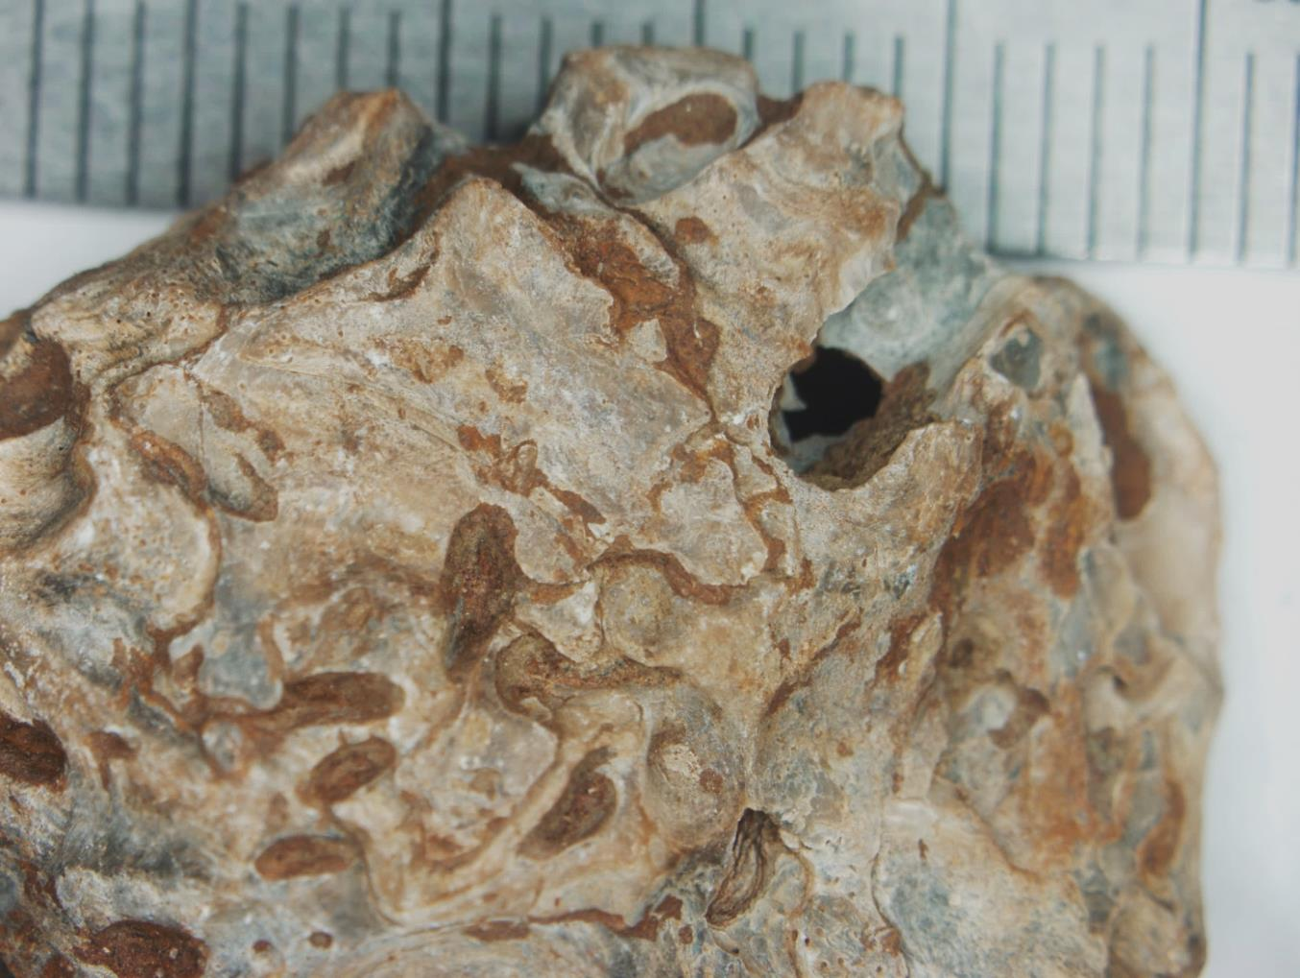
PARASITIC INTERACTION WITH MOLLUSKS
Up-close view using a microscope of a fossilized oyster shell found at Hill-Annex State Park with a boring in it in the top right area.

Slide 14
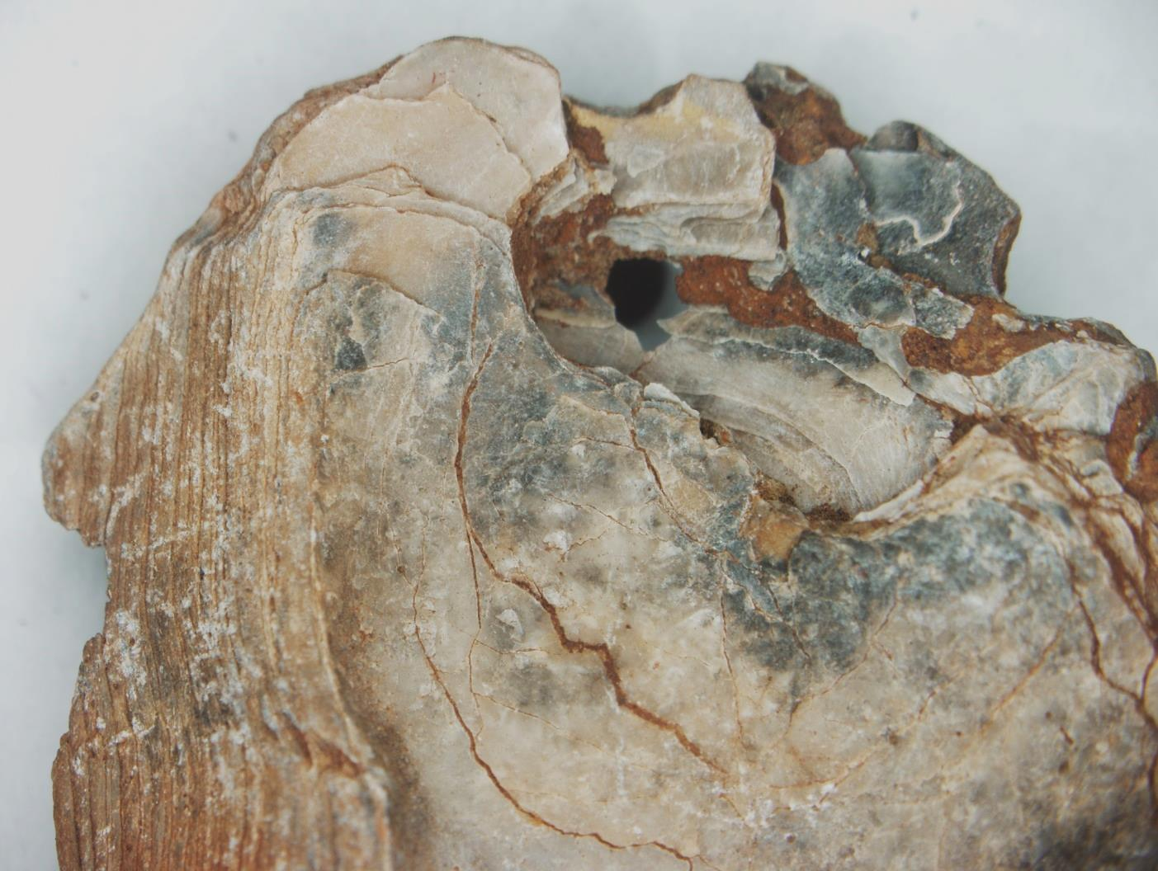
PARASITIC INTERACTION WITH MOLLUSKS
Up-close view using a microscope of the opposite side of the fossilized oyster shell found at Hill-Annex State Park with a boring in it in the top right area.

Slide 15
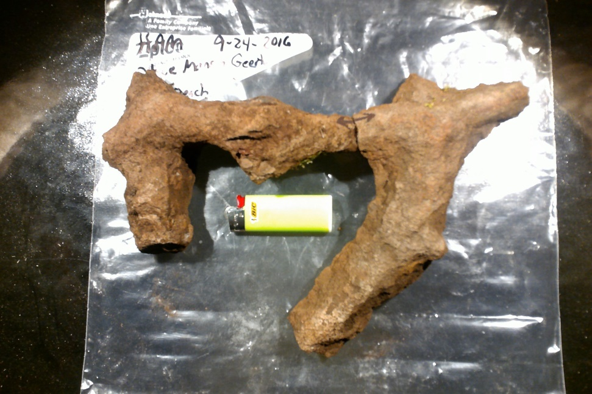
INVERTEBRATE BURROWS
Thalassinoides
Possible tracemakers are Crustaceans
Marine and Coastal facies
Cruziana Ichnofacies
Made up of immature angular sediments comprised of quartz grains, iron, and clays

Slide 16
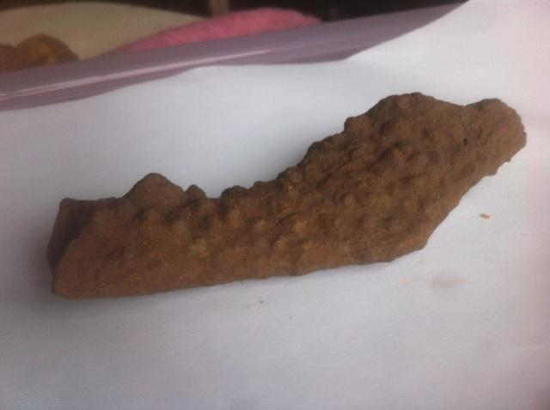
INVERTEBRATE BURROWS
Ophiomorpha
Trace makers are Decapod Crustaceans
Marine Environments
Skolithos Ichnofacies
Morphology is diverse
Lined with oval shaped pelletoidal sediments

Slide 17
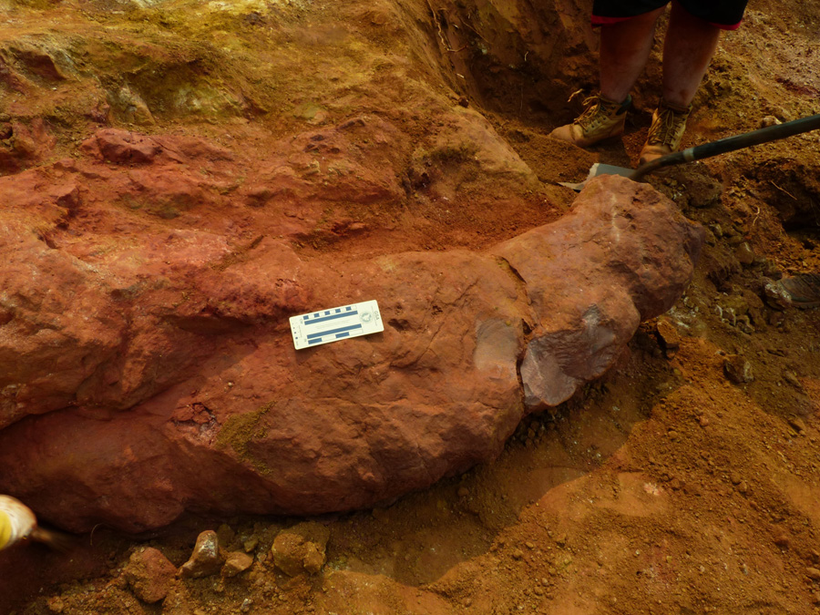
POSSIBLE MYSTERY FOSSIL
Up close view of a possible mystery fossil that was initially thought to possibly be the internal cast of a large Ammonite, but now is thought to possibly be a burrow from a vertebrate.

Slide 18
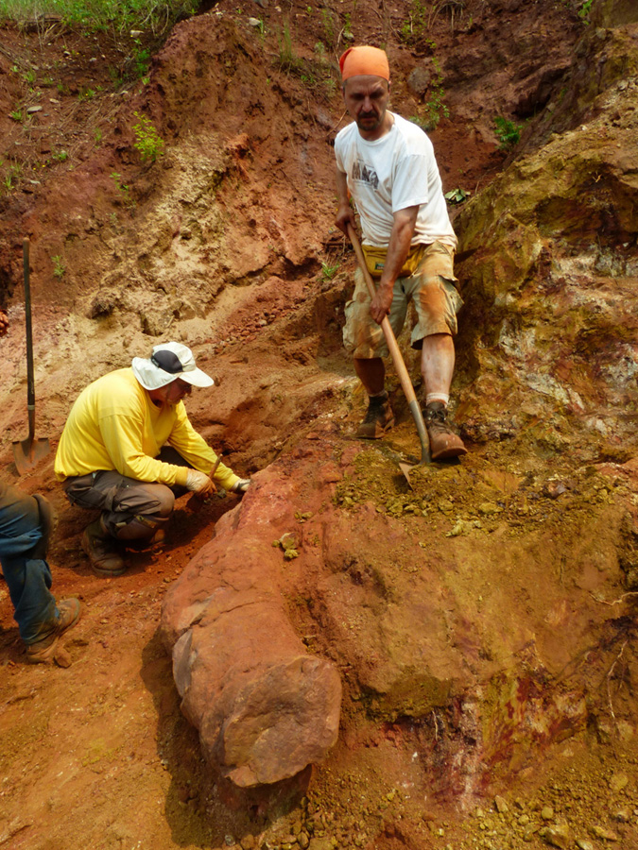
POSSIBLE MYSTERY FOSSIL
A different view of the possible mystery fossil. It was found in what seems to be a paleosol layer in the Coleraine Formation that had slumped.

Slide 19
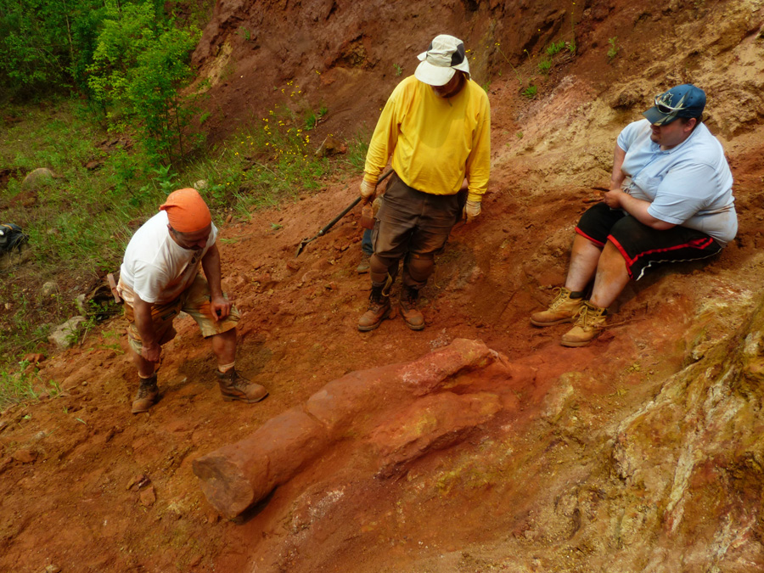
POSSIBLE MYSTERY FOSSIL
Almost overhead view of the possible mystery fossil.

Slide 20
WORK CITED
Bergquist, H. R., 1944, Cretaceous of the Mesabi iron range, Minnesota: Journal of Paleontology, v. 18, p. 1 – 30.
Erickson, B. R., and Sanders, A. E., 1991, Bioturbation Structures in Pleistocene Coastal Plain Sediments of South Carolina, North America: Scientific Publications of the Science Museum of Minnesota., v. 7, no. 2, p. 1 – 13.
Martin, A.J., & Project Muse 2013, Life Traces of the Georgia Coast Revealing The Unseen Lives of Plants and Animals: Revealing the unseen live of plants and animals. Bloomington: Indiana University Press
Sloan, R. E., 2005, Cretaceous: Minnesota Fossils and Fossiliferous Rocks, p. 167 – 202.
Winchell, N. H., 1893, Note on Cretaceous in northern Minnesota: American Geologist, v. 12, p. 220 – 223.

Slide 21


ACKNOWLEDGEMENTS
A special thank you to our supporting partners:
Minnesota Discovery Center
– Museum of the Iron Range
Science Museum of Minnesota
Minnesota Department of Natural Resources
Parks and Trails Division
Lands and Minerals Division
Forestry Division

Slide 22
ACKNOWLEDGEMENTS
Thank you to …
…all our donating contributors.
… Jeff Thole and Macalester College (SEM work).
… Minnesota Geological Survey.
Photos: Mark Ryan Amitycreek.com
smm.org/hill

