Slide 1
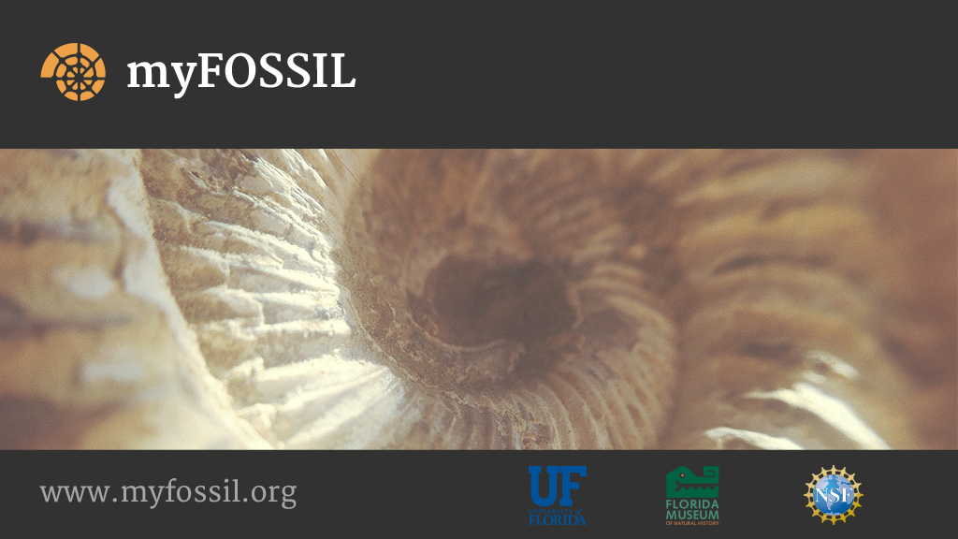
Describing social paleontology from an ecological perspective
Lisa Lundgren
Kent J. Crippen
University of Florida
College of Education

Slide 2

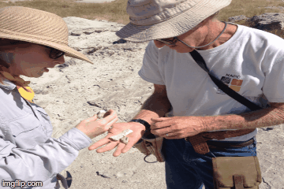
Background
Unite paleontologists, regardless of experience and/or expertise, in the shared practice of social paleontology.
  Community of Practice (Wenger, 2000; Wenger, McDermott, & Snyder, 2002; Wenger, White, & Smith, 2009)
    Domain: science of paleontology
    People: paleontologists (regardless of expertise)
    Practice: face-to-face and computer-supported collaborative inquiry of the natural world through the collection, preparation, and curation of fossils (Crippen, Dunckel, MacFadden, Ellis & Lundgren, 2015).
Notes:
A lot of you have heard me speak--you’re affiliated with the FOSSIL Project or you’ve heard Bruce MacFadden speak so the concept behind FOSSIL might not be foreign to you. To those who haven’t heard, welcome! FOSSIL’s goal is to unite paleontologists, regardless of experience or expertise, in the shared practice of paleontology. That’s the underlying theoretical principle of FOSSIL, the community of practice. A community of practice is defined by three components: the domain, the people, and the practice. For the FOSSIL Project, we define the domain as the science of paleontology. The people within the FOSSIL Project’s CoP are fossil clubs composed of paleontologists, most of whom are amateur paleontologists and professional paleontologists, but there are also commercial paleontologists, teachers, and others affiliated. The last piece, which is one of the bases of my talk, is the practice. So what is social paleontology? It is face-to-face and computer-supported collaborative inquiry of the natural world through the collection, preparation, and curation of fossils.

Slide 3
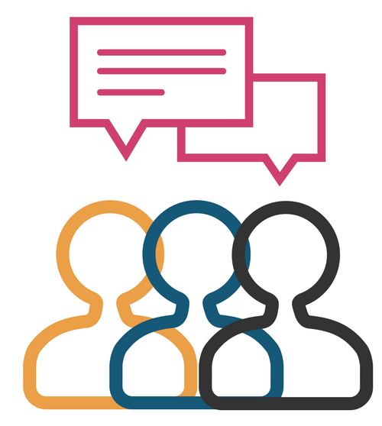
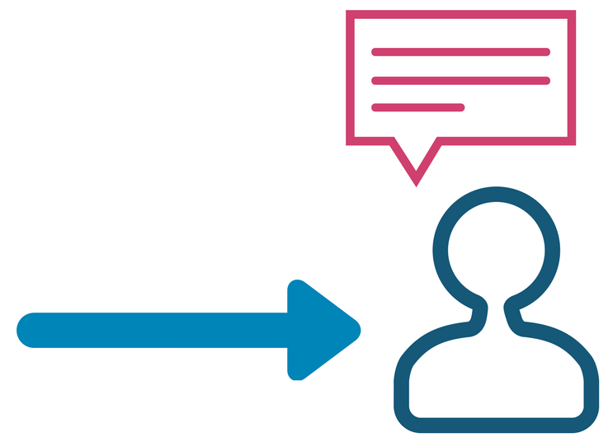
Ecological perspective on learning
College campuses
myFOSSIL
Twitter
Museums
Field trips
Conferences
Facebook
Fossil club meetings
From an ecological learning perspective, social paleontology is enacted across various habitats that exist within a larger ecosystem (Brofenbrener, 1978)
The social interactions between people allow for individual actions that occur only as a result of such interactions (Heft, 2013)
Notes:
My current research on FOSSIL asks questions related to that shared practice of social paleontology, wondering where the face-to-face and collaborative inquiry into the natural world takes place. This is where another theoretical construct comes in, that of the ecological learning perspective. In the ecological learning perspective, learners have interactions with one another that differ across settings, which Brofenbrener coined “habitats.” In traditional learning terms, these habitats would be interactions among family, interactions at work, school, etc. For FOSSIL, we postulate that the social paleontology habitats are specific places, which I’ll further break down in my next slide.
But what happens in these habitats that help learners learn? Social interactions between people. Heft postulates that these social interactions allow individual learners to think thoughts, create projects, or do any number of things that they would have be otherwise unable to do without the social interaction.

Slide 4
Which habitats are involved in social paleontology?
Physical habitats-offline social spaces
Digital habitats-online social spaces
College campuses
myFOSSIL
Twitter
Museums
Field trips
Conferences
Facebook
Fossil club meetings
College campuses
myFOSSIL
Twitter
Museums
Field trips
Conferences
Facebook
Fossil club meetings
Notes:
In terms of social paleontology, the physical habitats, or offline social spaces, where learners affiliated with the FOSSIL project engage in social interactions include, but are not limited to: college campuses, conferences, like this, field trips, fossil club meetings, and museums.
The digital habitats, online social spaces, that learners affiliated with the FOSSIL project engage in social interactions include: myFOSSIL and the social media sites of Facebook and Twitter.
For this talk, I’m going to exclusively focus on the digital habitats.

Slide 5
Research questions
What is the nature of participants expressed across the digital habitats of FOSSIL’s Facebook, Twitter, and myFOSSIL?
What forms of shared practice are expressed across these digital habitats?
Notes:
To that end, these are the research questions that I’m seeking to answer with this talk

Slide 6
Data Sources
Data from October 2015-December 2016
Sources
  Intake survey for user types
    Example question: “Are you currently or have you ever been employed as a professional paleontologist?”
  Publicly accessible social media data
  myFOSSIL user interaction data
Three data sources compiled and linked
Notes:
The data for this project was collated from the dates October 2015-December 2016. We used three specific sources of data, including three questions from the “intake survey” on the myFOSSIL website. Every myFOSSIL member with a username has completed this survey, as it’s required to get a username for the site! This survey Included in data only if: they had at least one connection in the myFOSSIL community.
We also compiled publicly accessible social media data in the form of Twitter profiles and peoples’ Facebook pages that are PUBLIC. Lastly, we used myFOSSIL’s backend site capabilities to pull information on friendship connections and group connections of myFOSSIL users. All data in this survey is de-identified.

Slide 7
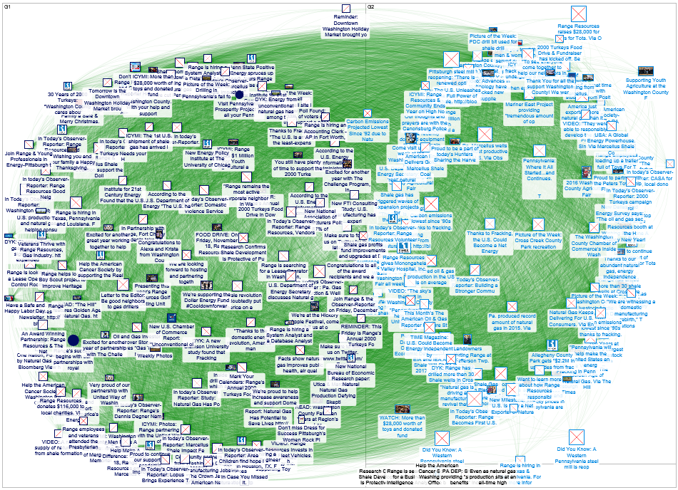
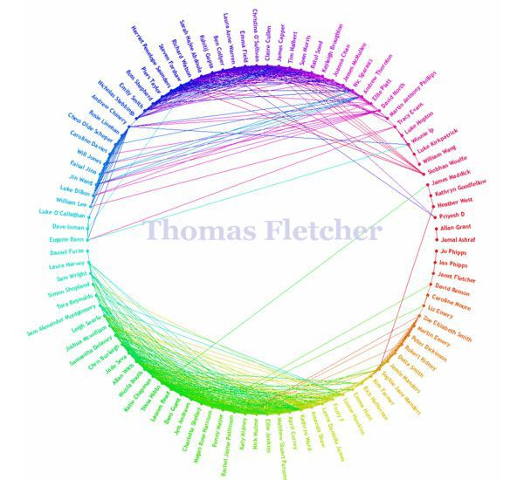
Method: Social Network Analysis
Social network analysis using NodeXL (Hansen, Shneiderman, & Smith, 2009)
Graph types
  Fruchterman-reingold graphs
      Force-directed graphs
  Circle graphs
      Shows connections between “clusters”
Notes:
To answer my research questions, I employed a data analysis method called social network analysis. In social network analysis, the numbers of connections between people can be visually mapped, and a software program calculates metrics to determine strength of connections between people within that network.
I used an excel add-in called NodeXL to analyze these data.
Some basics for social network analysis that might come in handy for this talk. There are a number of different graph types that can be created with NodeXL, one of the most popular is that of the F-R. In this graph type, which I’ve displayed here, connections are shown, and the point is to have the least amount of crossed connections as possible. In very dense networks such as the one shown, this is a challenge.
The second type of graph that is useful to know is that of the Circle graph. The circle graph shown here is from an app that used to be available on Faacebook called “Friend Wheel” It shows, colorfully, the connections between this Facebook user’s groups of friends, and the friends are clusters by their particular relationships. So, people from work could be in green, family in blue, etc.

Slide 8
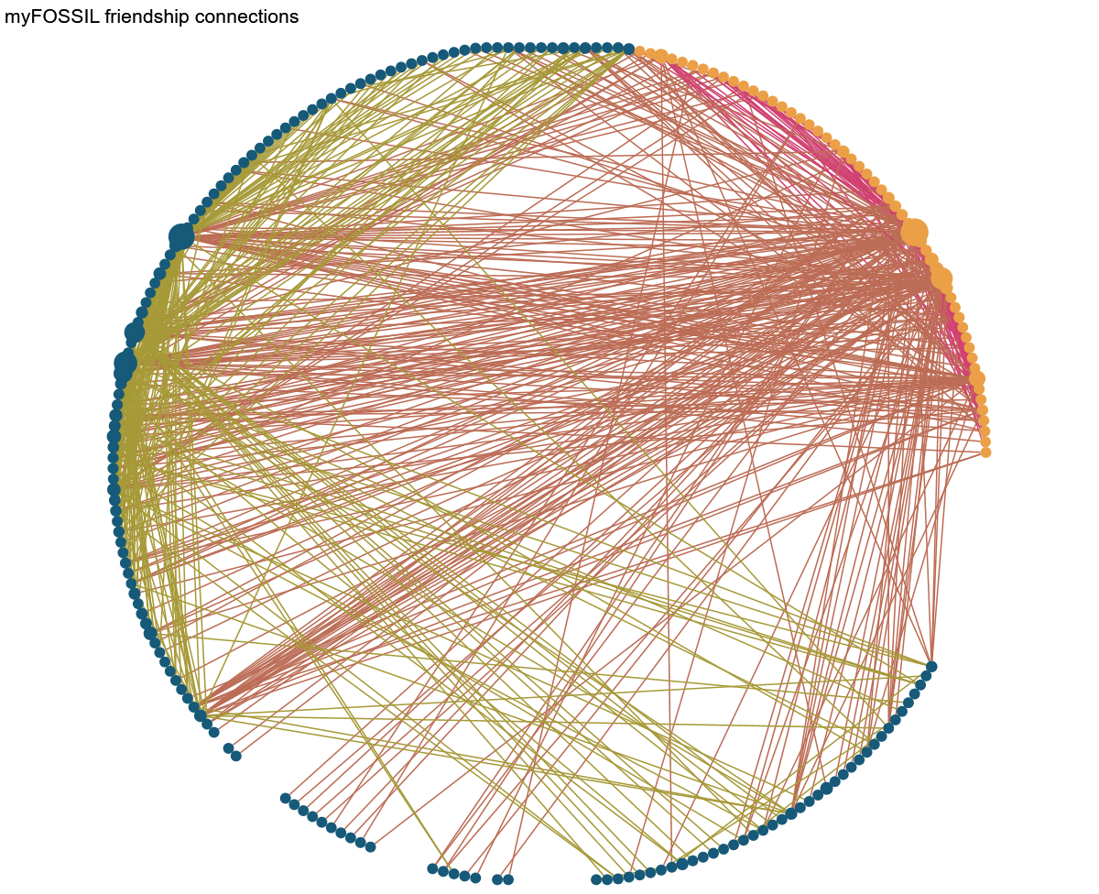
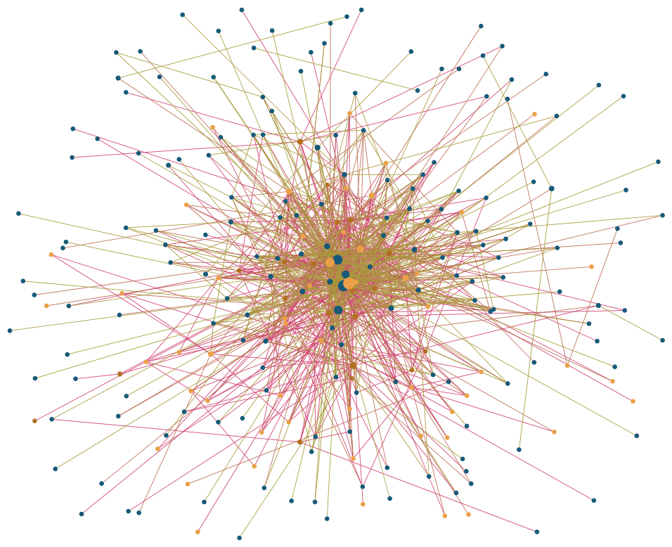


Results
What is the nature of participants expressed in the myFOSSIL digital habitat?
Amateur Paleontologist
Professional Paleontologist
Notes:
I started looking at the myFOSSIL community using a furtherman-reingold layout, which Victor also showed you an example of for the PaleoBlitz talk. However, things looked…messy. We can see that the center of the graph is “dense” But who’s dense? Why? So I changed the layout to be a circle layout.
This graph depicts 229 active myFOSSIL users. Each circle represents a single person. The circles, in social networking analysis terminology, are called nodes, which is how I will refer to them for the rest of this talk.
The blue nodes are amateurs. As you can see from this graph, 76% of the myFOSSIL community is made of amateur paleontologists. The orange nodes are professionals; which means that 24% of the myFOSSIL community is professional paleontologists.
You might notice that some of the nodes appear to be larger than others. That’s intentional. The size of the node indicates what is called “betweenness centrality” Betweenness centrality is comprised of two metrics—the number of direct connections that an individual has with others in myFOSSIL and the number of connections in which that node “shortens” communication (i.e. acts as a communication broker)
The connections between nodes are indicated on this graph with different colored lines. The color of the line denotes a particular type of connection within the myFOSSIL community, and I will explore this different types of connections next.
175 amateurs
54 professionals
229 active myFOSSIL users

Slide 9
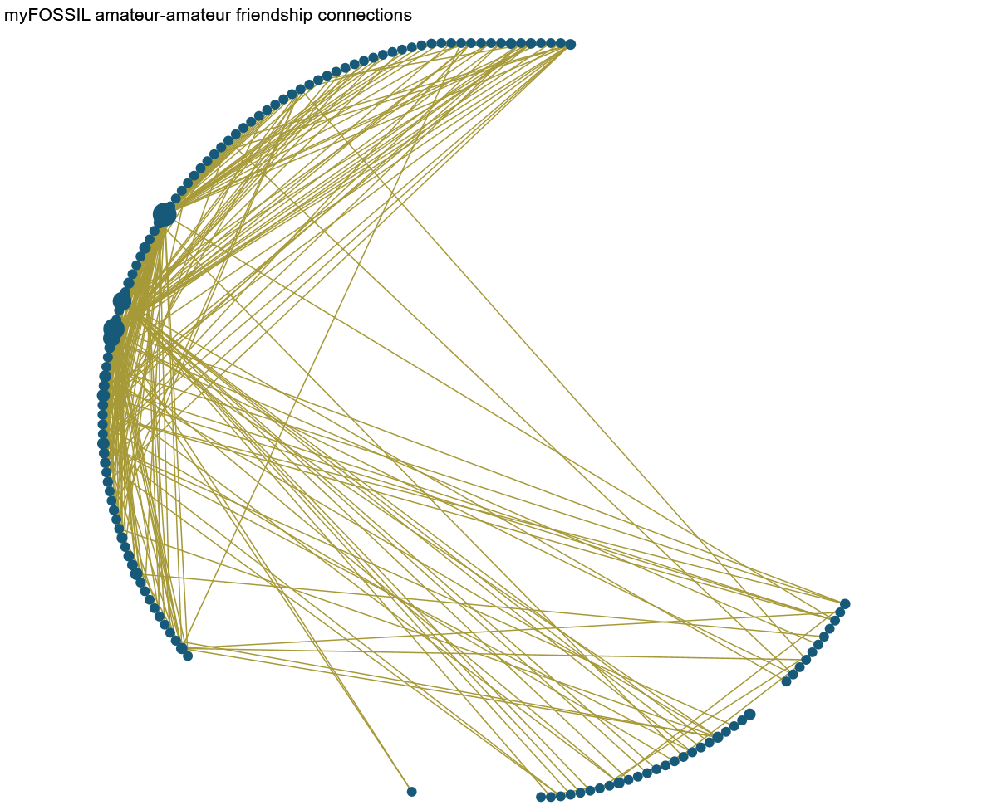
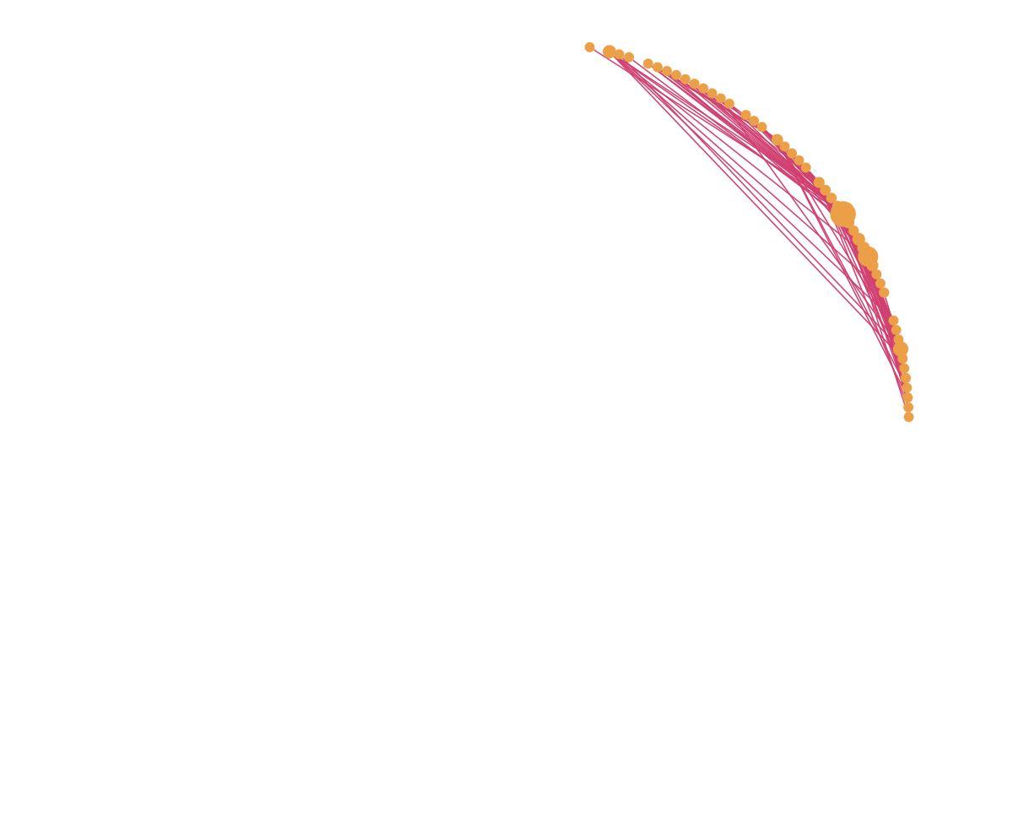
Results
What is the nature of the relationships created in the myFOSSIL digital habitat?
Amateur Paleontologist
Professional Paleontologist
Notes:
The first set of connections I’d like to highlight is the friendship connections that have been formed between the amateur paleontologists on myFOSSIL. As before, you’ll see that the amateur paleontologists are depicted in blue. I’ve dropped out all other colored nodes from this graph to focus on the amateurs on myFOSSIL. So what does particular piece of the graph show? The majority of amateur paleontologists on myFOSSIL have at least one friendship connection to another amateur paleontologist on myFOSSIL. However (GRAPHIC) there’s about 20 or so who are not friends with another amateur paleontologist on myFOSSIL. We’ll come back to where those missing pieces are making connections in a later graph.
So those are the amateurs. Let’s now shift to the friendship connections between professional paleontologists on myFOSSIL. This network is what social network folks like to call DENSE. This means that the great majority of the professionals on myFOSSIL are connected to one another through friendships. You can see this through the connection overlap and through the fact that few of the pros are missing from this section of the graph. The professionals are connected via friendships.
Now, let’s re-visit a concept from my last slide—that of the larger nodes having a higher “betweenness centrality.” For the amateurs’ connection group, there are two nodes who feature high betweenness centralities (GRAPHIC). This means that these particular nodes are both highly connected and act as communication brokers between others in the network.

Slide 10
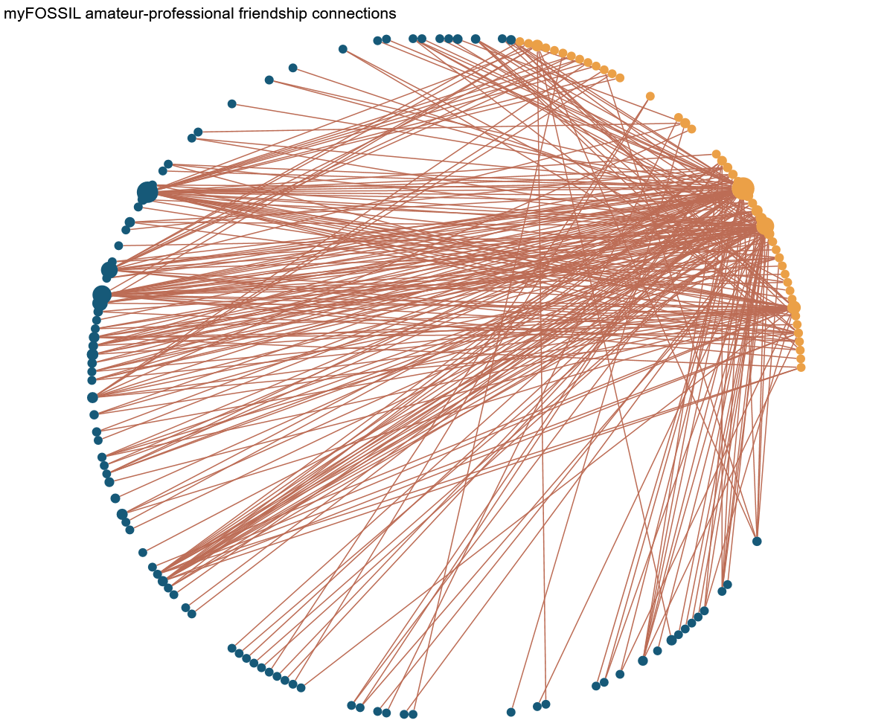
Results
myFOSSIL amateur-professional friendship connections
What is the nature of the relationships created in the myFOSSIL digital habitat?
Amateur Paleontologist
Professional Paleontologist
Notes:
This set of connections depicts the connections between amateur AND professionals. The connections in this graph show that the network between amateurs and professionals makes for a rather robust amount of connections in myFOSSIL. The connections are throughout the network, not only centered on one of two people, but what is interesting note about this graph is that professionals who are connected to amateurs are really connected to amateurs.

Slide 11
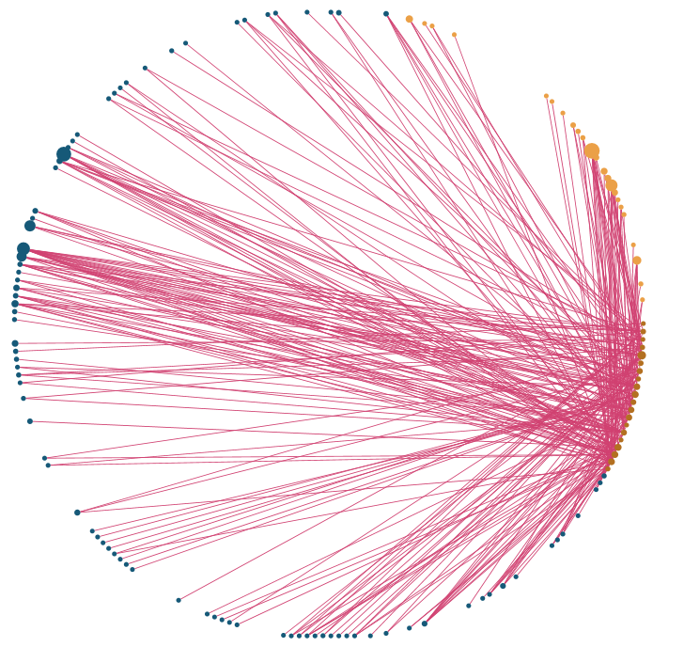
Results
myFOSSIL group connections
What forms of shared practice are expressed in the digital habitat of myFOSSIL?
Group
Amateur Paleontologist
Professional Paleontologist
Notes:
Just as the last graph showed the friendship connections between individual professionals and individual amateurs, this graph depicts connections
that are made due to membership in a group. Groups on myFOSSIL include the Phoebus Landing Fossils, Florida’s Fossils, SoCal Paleo, etc. These groups ensure that connections between amateurs and professionals are made across the group—not just single connections.

Slide 12
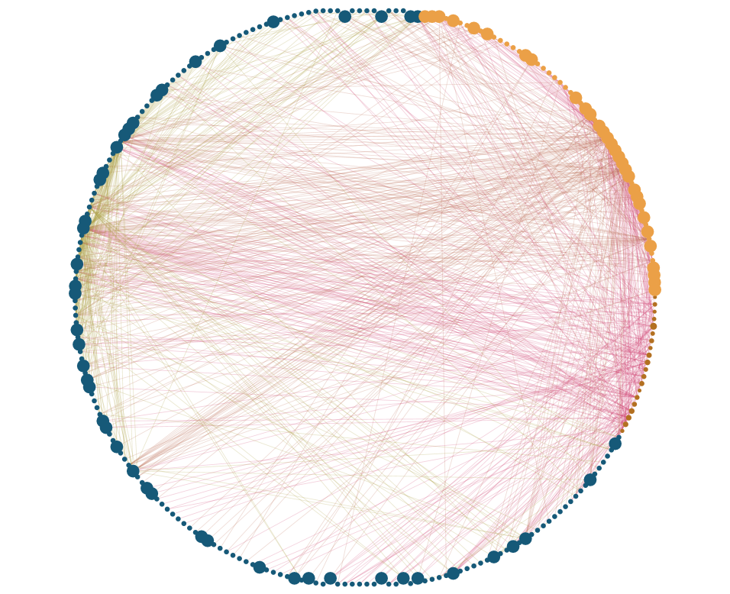
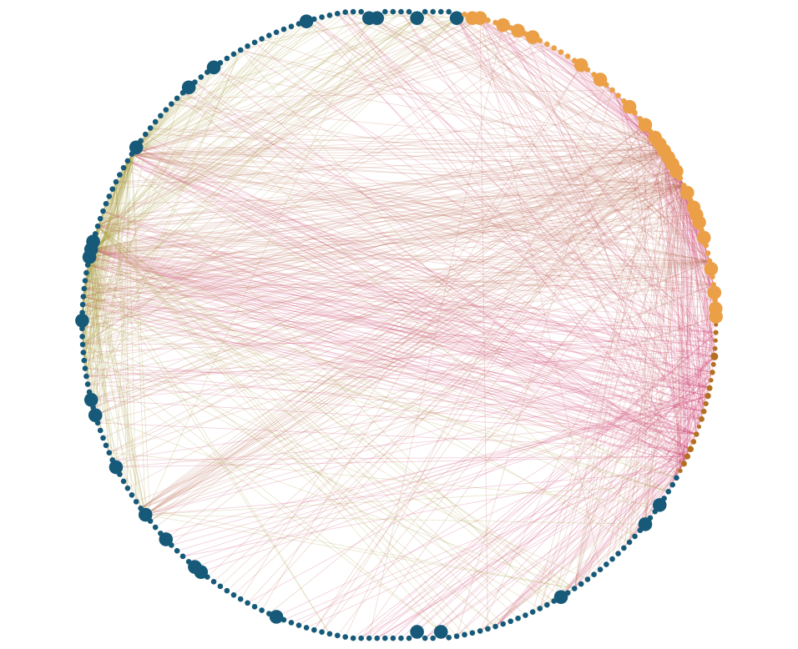
Results
Of the myFOSSIL community, who is participating in other digital habitats?
myFOSSIL Facebook users
myFOSSIL Twitter users
Amateur Paleontologist
Professional Paleontologist
Amateur Paleontologist
Professional Paleontologist
Notes:
The other digital habitats to which we are referring to are Facebook and Twitter. The size of the nodes in the graphs that I’ll show on this page depict merely if the users have a a social media account. If the node is large, they have a social media account.
So here’s the myFOSSIL Facebook users that we know of. Many of the professionals use Facebook, and so do many of the amateurs.
However, let’s check out the Twitter users. You won’t notice a huge difference between the myFOSSIL professionals who use Facebook and Twitter, but there’s definitely a difference between the number of amateurs who use Twitter. Less amateur paleontologists use Twitter.
More amateurs participate in both Facebook and myFOSSIL
More professionals participate in both Twitter and myFOSSIL

Slide 13
Results
College campuses
myFOSSIL
Twitter
Museums
Field trips
Conferences
Facebook
Fossil club meetings
What’s the nature of participants?
  Majority amateurs on myFOSSIL
The relationships among digital habitats
  Most everyone on Facebook
  More professionals on Twitter
What forms of shared practice exist?
  Use groups to connect, most professionals are connected 1+ amateur paleontologist on myFOSSIL
Notes:
So what are the takeaways from these social network analyses?
First: What is the nature of participants expressed across the digital habitats of FOSSIL’s Facebook, Twitter, and myFOSSIL?
Well that myFOSSIL consists of a majority of amateur paleontologists
Most myFOSSIL participants also use Facebook, but more professionals are on Twitter
Second: What forms of shared practice are expressed across these digital habitats?
myFOSSIL participants use groups to connect, and most professionals are connected to one or more amateur on myFOSSIL.

Slide 14
Conclusions
  We think about social paleontology…but
  Defining the learning ecology
    Provides evidence for learning within a community of practice
  Social network analysis
    Academic and practical value
      Data about “previously elusive social processes and can be leveraged to highlight important content and contributors.” (Smith et al, 2009)
Notes:
The use of digital habitats to communicate about and learn paleontology is widely considered yet poorly theoretically constructed; this research serves to further define the learning ecology within social paleontology. The ecological learning perspective allows for empirical measurement of the reach, diversity, and engagement levels within the FOSSIL Project’s digital habitats, providing evidence about the ways paleontologists learn from one another within a Community of Practice.

Slide 15



Join in social paleontology
Questions or comments?
lisa.lundgren@ufl.edu
@llundgren
TheFossilProject
@projectfossil
www.myfossil.org

Slide 16
References
  Crippen, K. J., Ellis, S., Dunckel, B. A., Hendy, A. J. W., & MacFadden, B. J. (2016). Seeking shared practice: a juxaposition of the attributes and activities of organized fossil groups with those of professional paleontology. Journal of Science Education and Technology, 25: 731. doi:10.1007/s10956-016-9627-3
  Hansen, D. Shneiderman, B. & Smith, M. A. (2009) Analyzing social media networks with NodeXL. Burlington, MA: Morgan Kaufmann.
  MacFadden, B. J., Lundgren, L. M., Crippen, K. J., Dunckel, B. A., & Ellis, S. (2016). Amateur paleontological societies and fossil clubs, interactions with professional paleontologists, and social paleontology in the United States. Palaeontologica Electronica, 19:2.1E, 1-19.
  Smith, M. A., Shneiderman, B., Milic-Frayling, N., Mendes Rodrigues, E., Barash, V., Dunne, C., … Gleave, E. (2009). Analyzing (social media) networks with NodeXL. In Proceedings of the fourth international conference on Communities and technologies - C&T ’09 (p. 255). New York, New York, USA: ACM Press. doi:10.1145/1556460.1556497
  Wegner, E. (1998). Communities of Practice: Learning, Meaning, and Identity. Cambridge, U.K.: Cambridge University Press.

