Slide 1
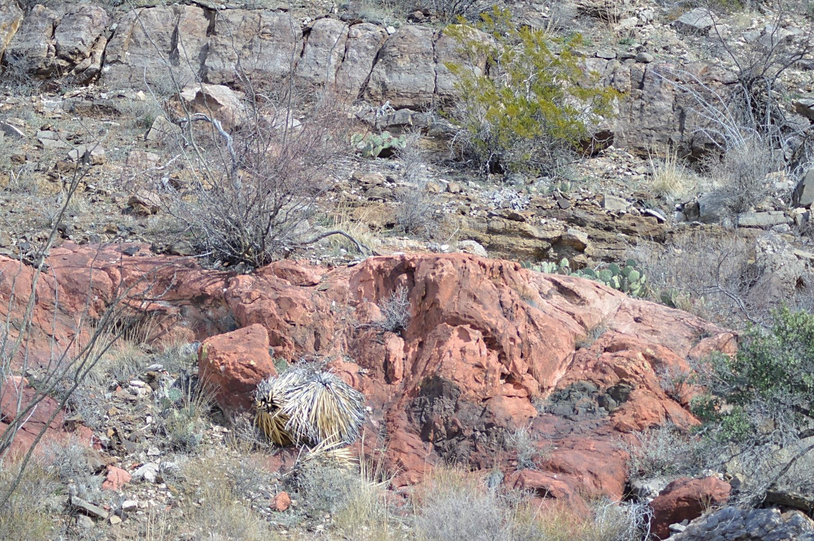




⁴⁰Ar/³⁹Ar Geochronology and Trace Element Geochemistry of Episyenites in Southern New Mexico
By Adam Smith

Slide 2
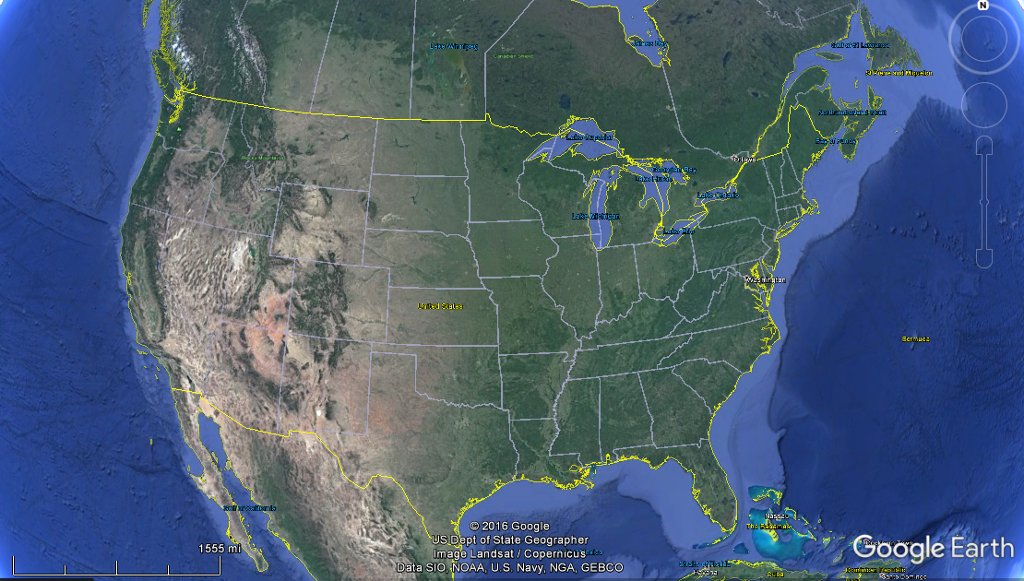
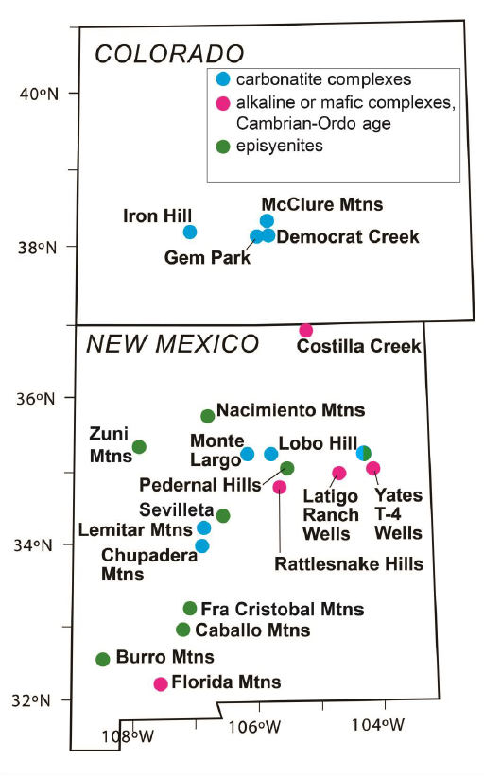
Episyenites
Hypothesis: Episyenites result of fenitization from fluids related to Cambro-Ordovician alkaline magmatism 525-457 Ma in NM and CO
Adapted from McMillan and McLemore, 2004

Slide 3
Purpose
To better define the timing of episyenite formation- Cambrian link?
To see if chemistry of alteration is indicative of Cambrian alkaline intrusive event
To determine what other fluid processes have affected episyenites

Slide 4
Methods
Ar/Ar geochronology
Primary and secondary generation feldspar were separated
Furnace step heating and laser step heating
Diffusion modelling
Whole rock geochemistry
Samples cleaned, sent for whole rock analysis
Correlation diagrams, mass balance calc.
Radiogenic isotopes
Feldspar separates and whole rock samples analyzed for Pb, Sr and Nd isotopes

Slide 5
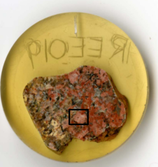
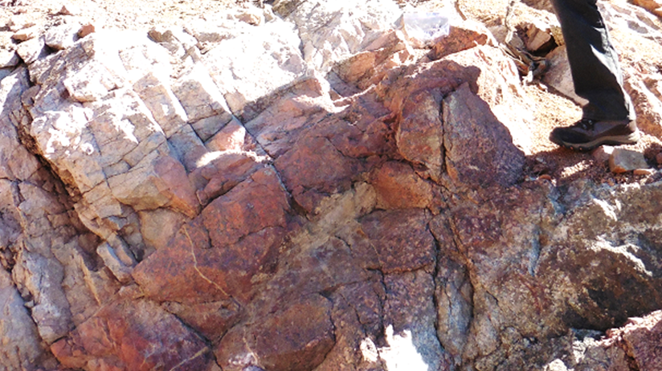
Episyenite- Caballo Mountains
Towards endmember orthoclase with minor chlorite/fluorite and oxides
Metasomatic- gradational contacts, replacement textures
Appears to follow structural weaknesses, lithology changes

Slide 6
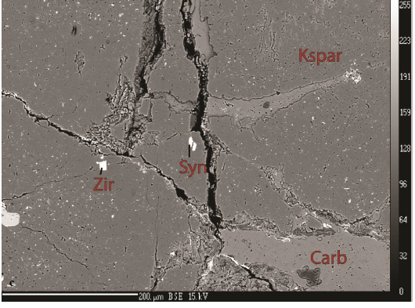
Episyenite- Caballo Mountains
Economic Interest- high concentrations of U, Th and REE (esp. HREE)
Trace element enrichments discontinuous
REE-phases
Bastnaesite, Synchysite
Aeschynite
Xenotime
U-Th-oxides
Zircon
After Riggins, 2014

Slide 7
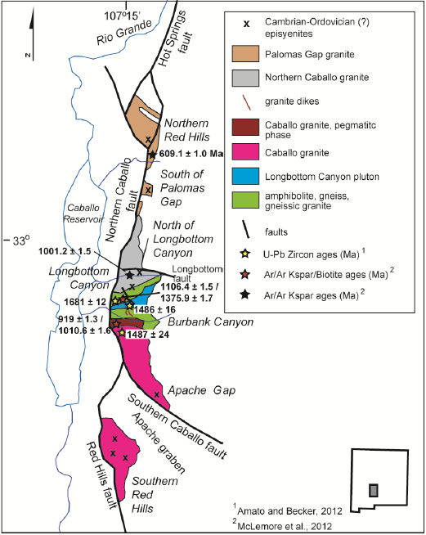
After Riggins, 2014

Slide 8
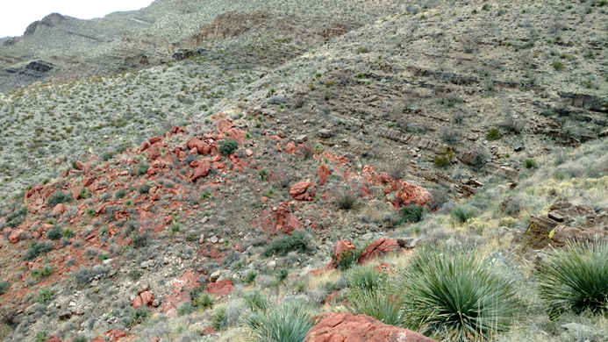
Episyenite
Overlain by Bliss Formation (~495-465 Ma)
Previous Ar/Ar geochronology- wide range of ages younger than Bliss
Bliss Formation
Episyenite

Slide 9
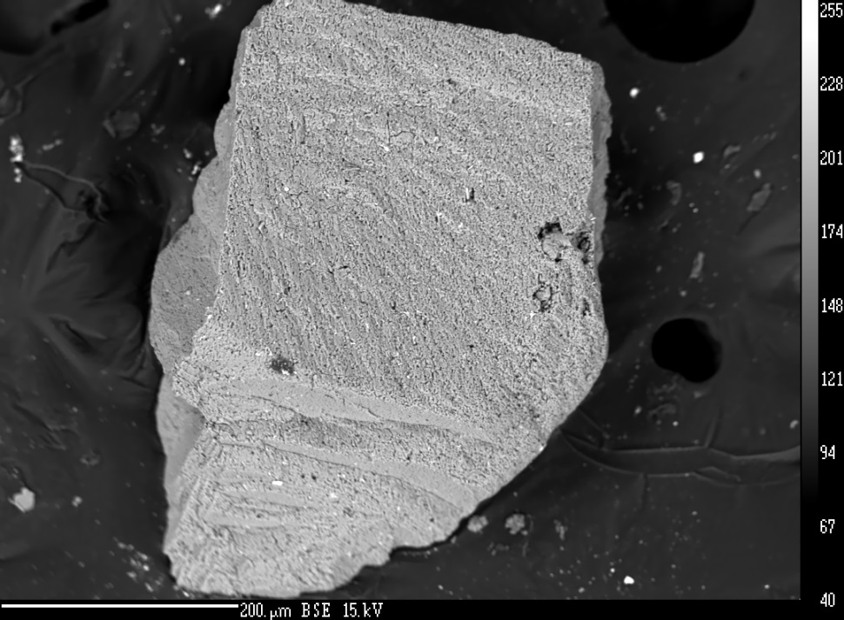
Caballo Mountains

Slide 10
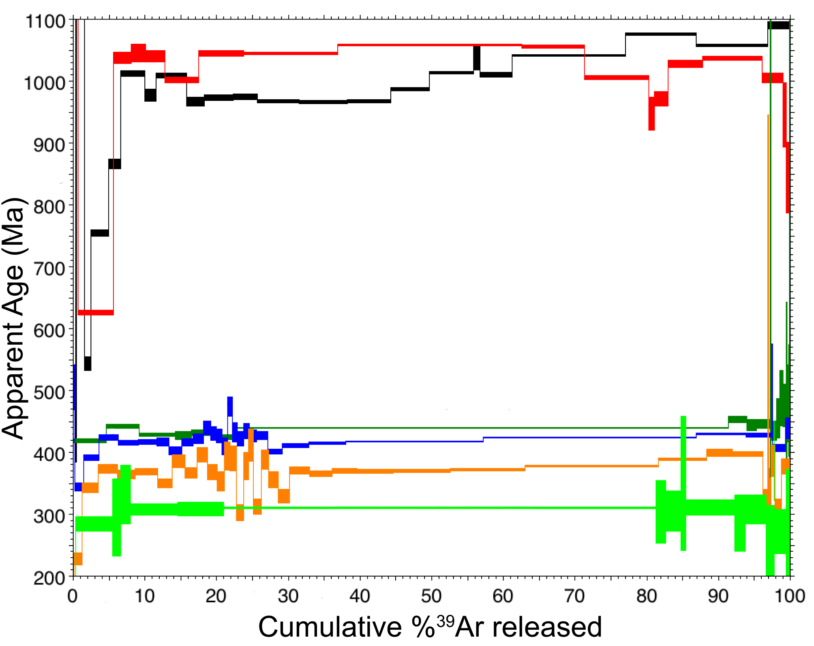
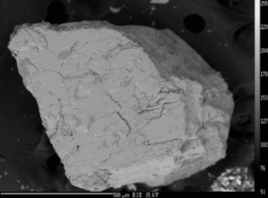
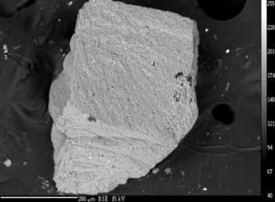
Primary K-feldspar
No major age reset regionally
Expected age
Secondary K-feldspar
Near plateau spectra Wide range in ages
Post-formation K-feldspar growth

Slide 11
Discussion
Secondary K-feldspar age spectra
Record crystallization age, not cooling age
Does not correspond to field relations
If episyenite formation was during Cambrian, younger ages likely due to another K-feldspar growth
Secondary feldspar granular and turbid, similar texturally to authigenic K-feldspar
100-200°C basinal brines

Slide 12
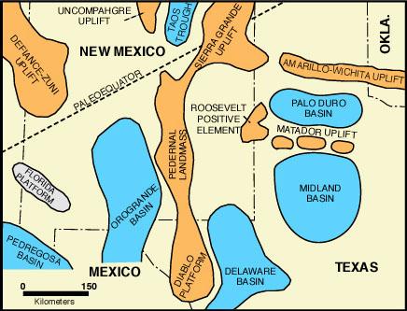
Discussion
Ancestral Rocky Mountain Uplift
Occurred during Pennsylvanian (310-270 Ma)
Caballo Mountains buried in Orogrande Basin
Basinal brine mechanism?
https://geoinfo.nmt.edu/tour/state/storrie_lake/home.html

Slide 13
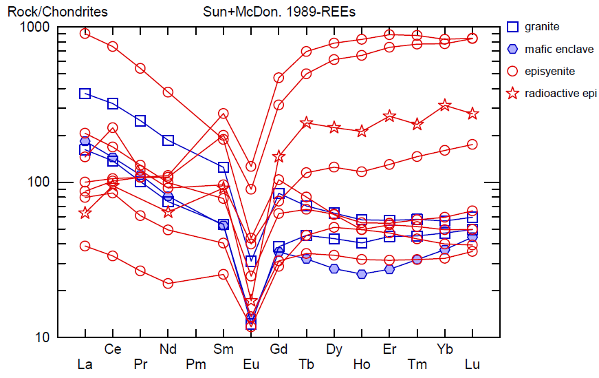
REE Geochemistry
Strong HREE enrichment
Negative Eu anomaly

Slide 14
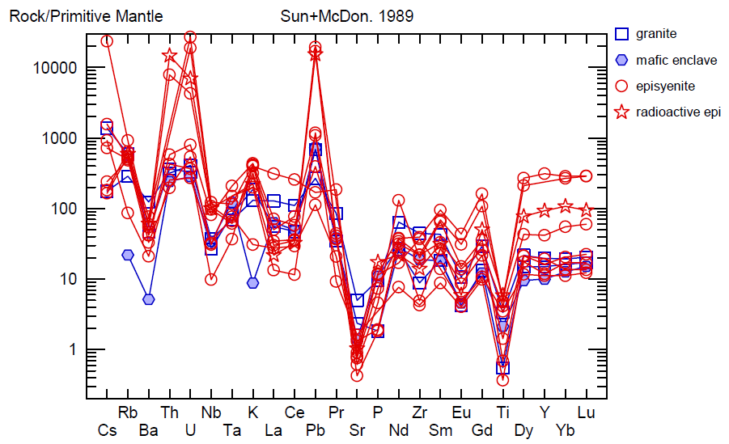
Trace Elements
Caballo Mtns.

Slide 15
Discussion
U, Th, and Y enrichment
Not a requirement for fenitization, but permissive
Moderate-low pH brines can mobilize U and Th at (120-200°C)
Lack of LILE (Ba, Sr, Cs, ±Rb) enrichment
Leaching in later event?
V shows increase in episyenite, but none of the other HFSE

Slide 16
Discussion
HREE element best correlate with Y and Th
HREE enrichments have been observed in laterites and supergene alteration
Alkali granite, carbonatite (SE China, Mt. Weld, Australia)

Slide 17
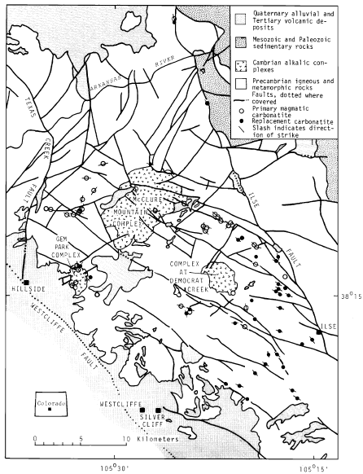
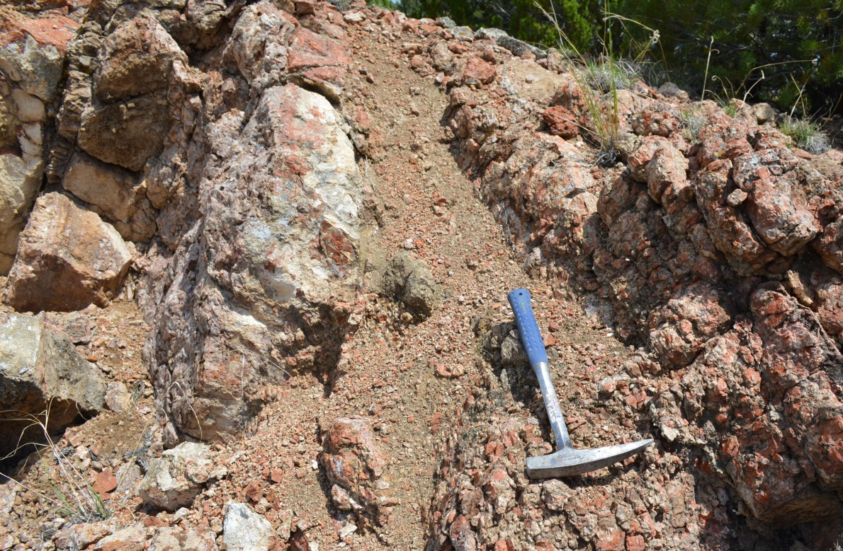
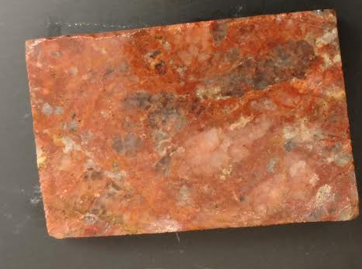
Alkaline Complexes- Wet Mountains
Alteration increasing
Carbonatite dike
Fenitized Zone
Armbrustmacher, (1979)

Slide 18
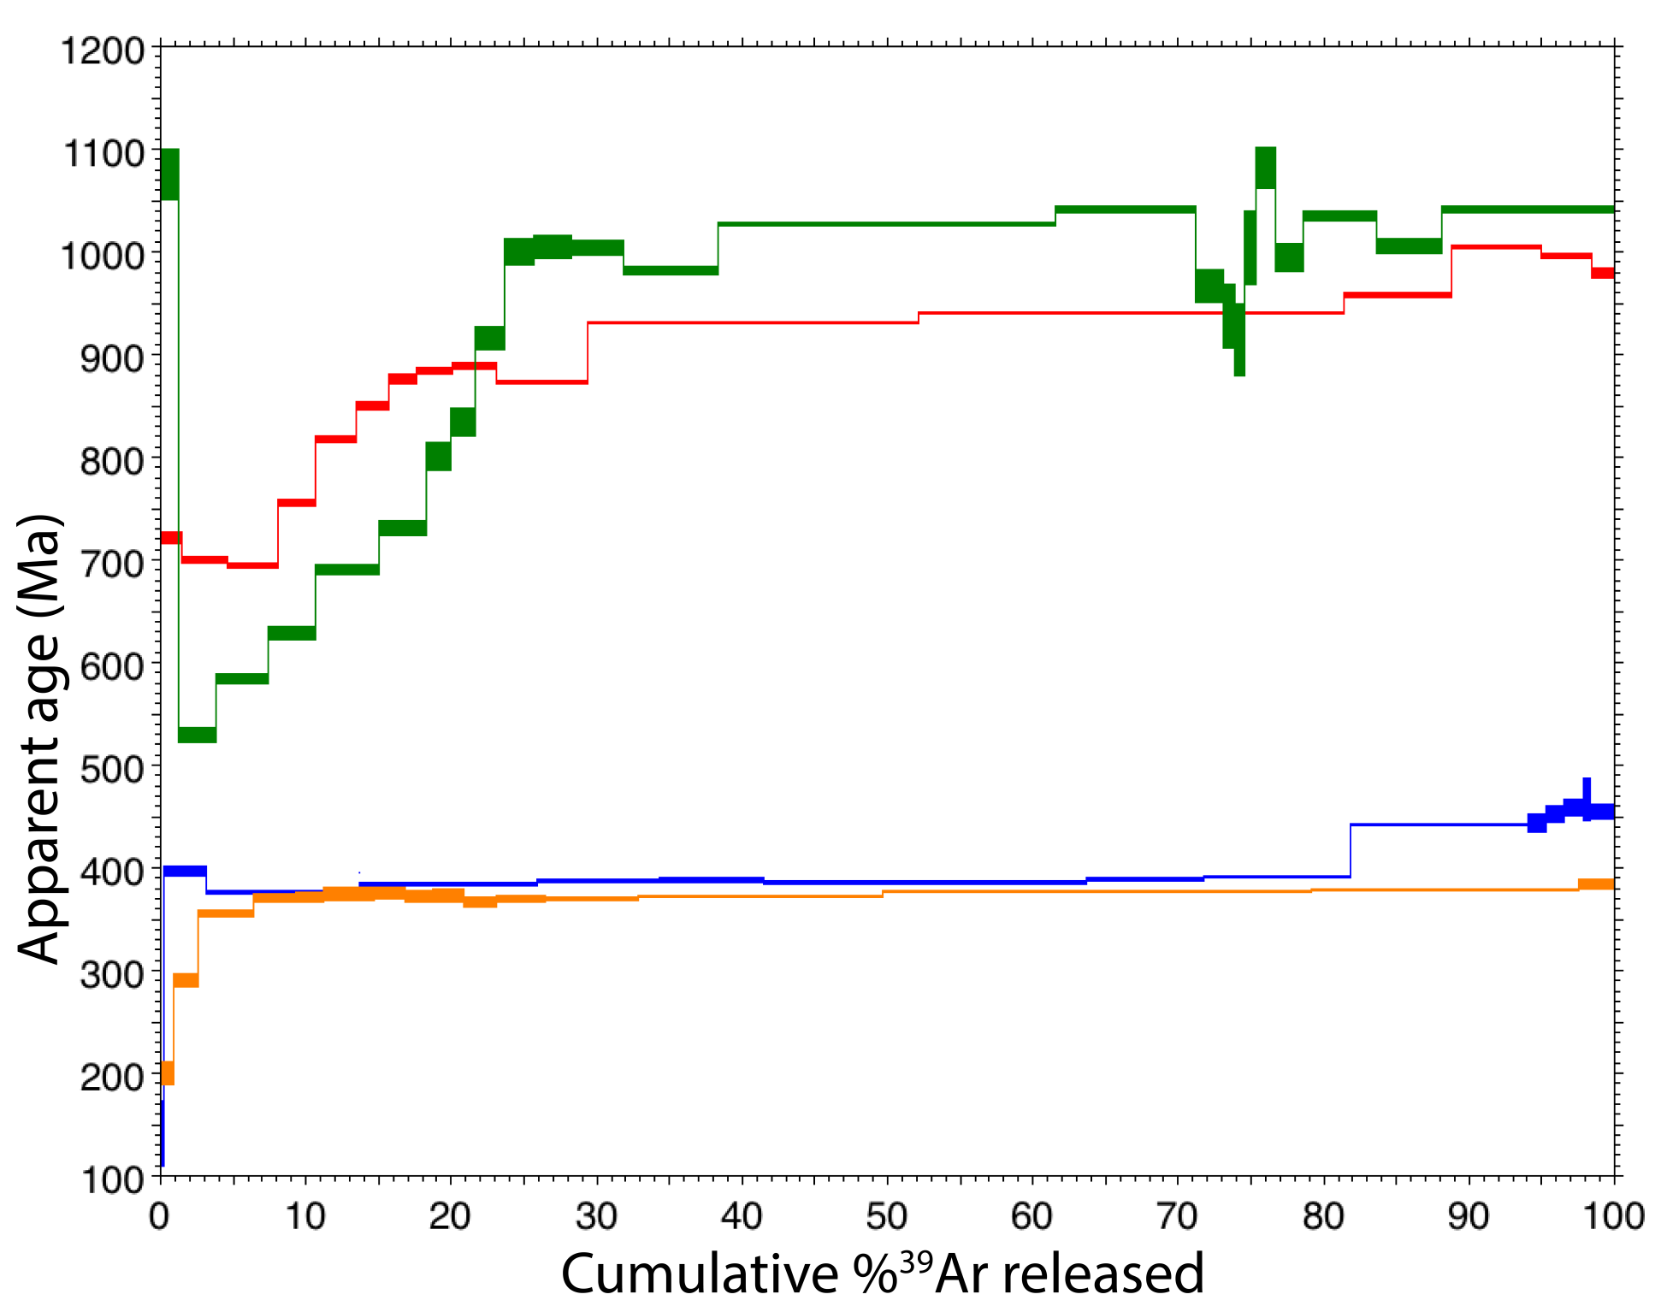
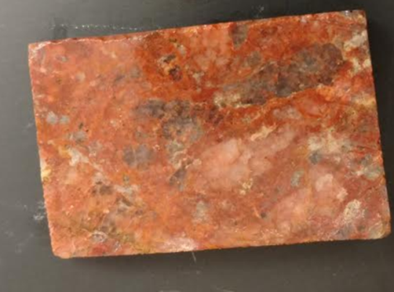
Primary
Expected age
Secondary
~Flat age spectra, with ages from 390-410 Ma

Slide 19
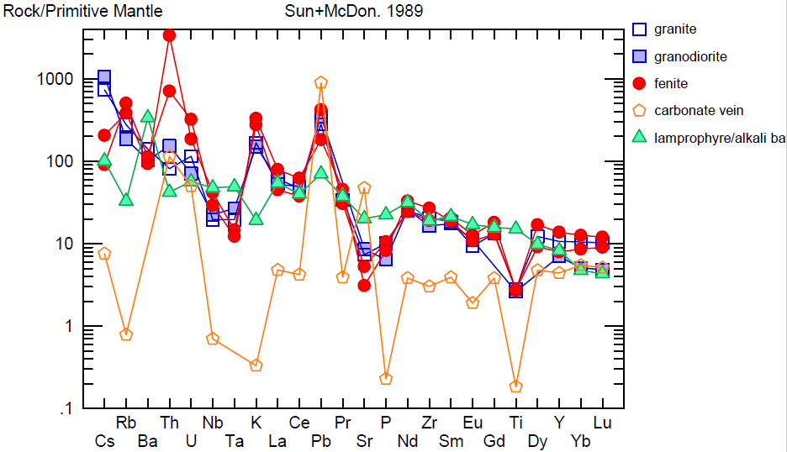
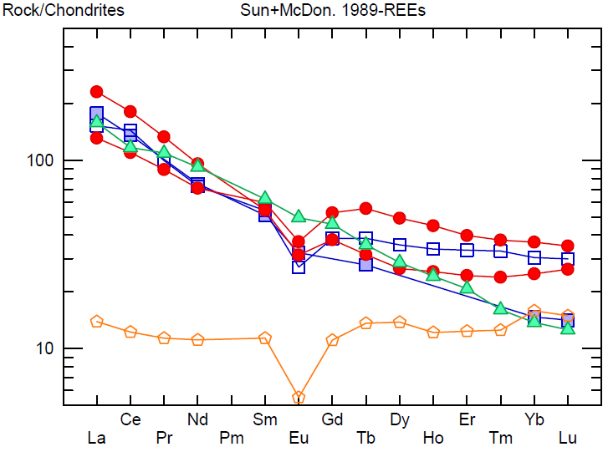
Trace Elements
granite
granodiorite
fenite
carbonate vein
lamprophyre

Slide 20
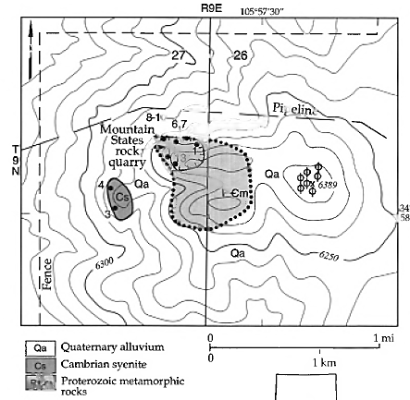
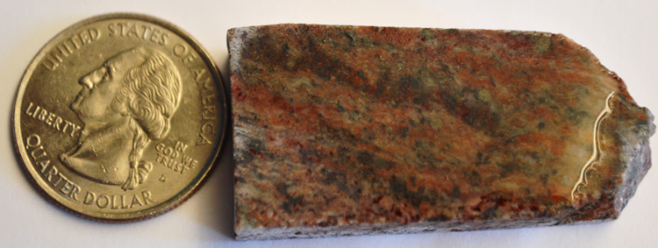
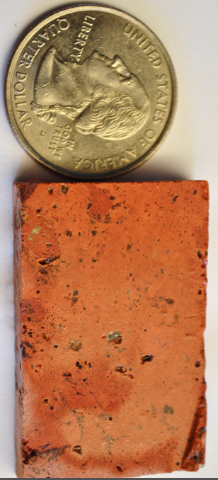
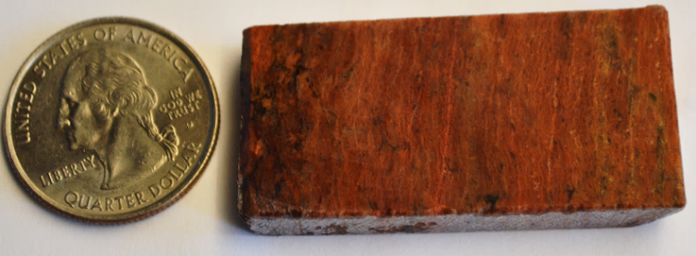
Lobo Hill
Small uplifted fault block exposing metamorphic basement
Intruded by thin dikes of syenite, lamprophyre and carbonatite
Age of biotite in alkaline rocks 518 Ma
Adapted from McLemore, 1999

Slide 21
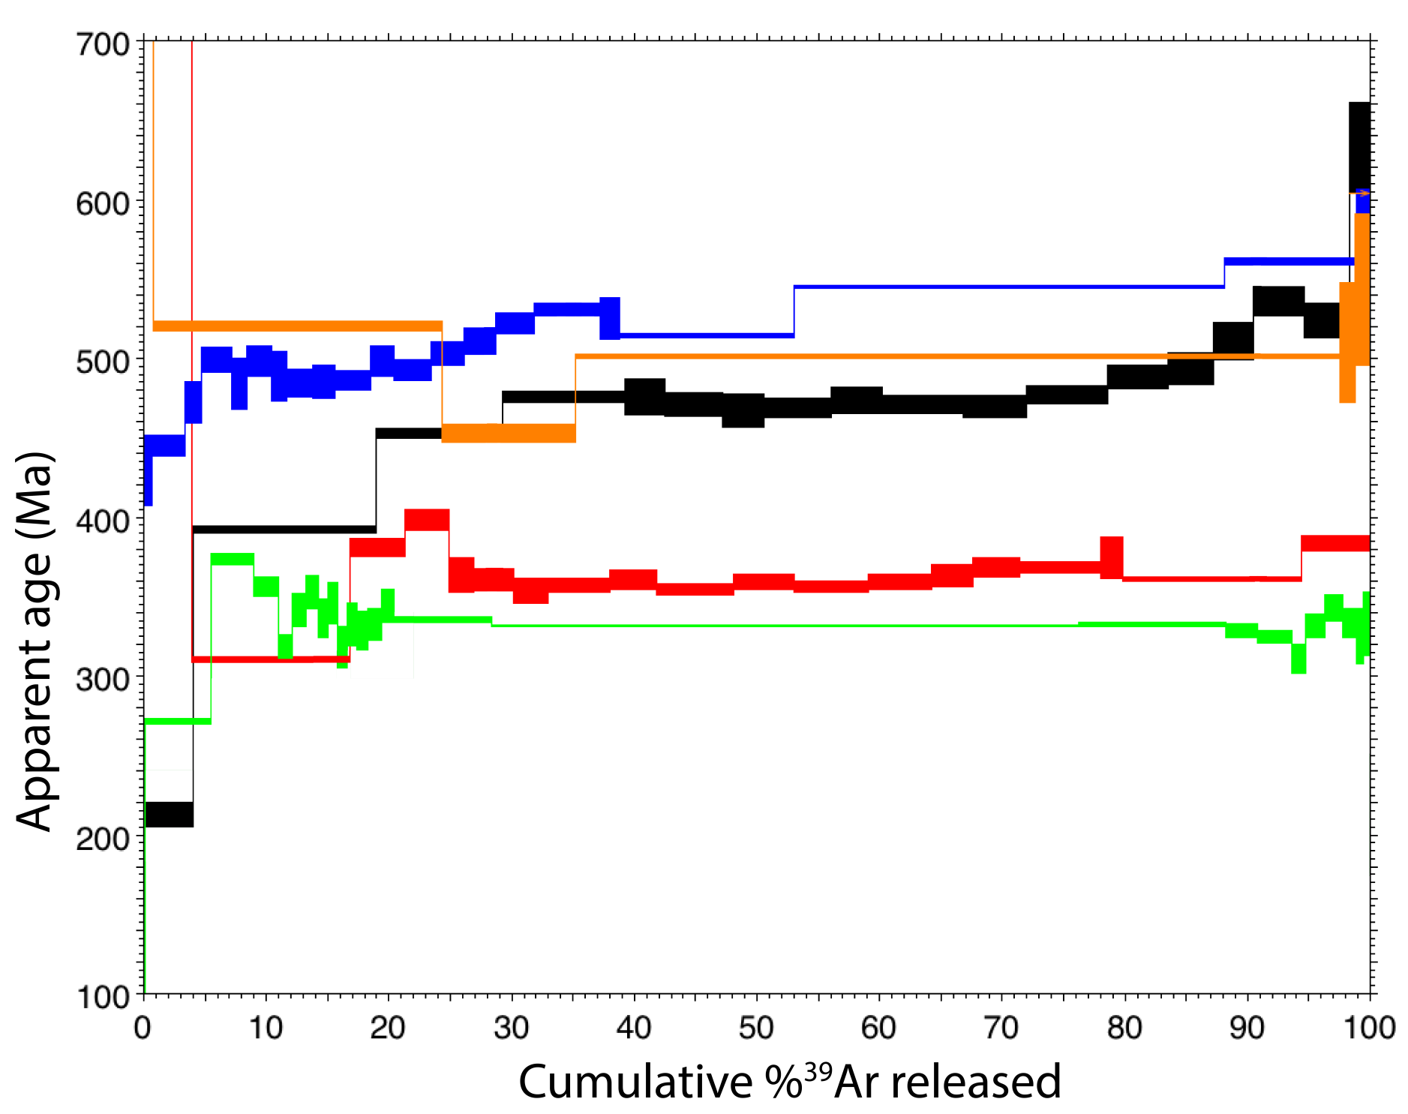
Lobo Hill, NM
Background feldspar reset, contact metamorphism
Expected age
Episyenite- variable range of ages

Slide 22
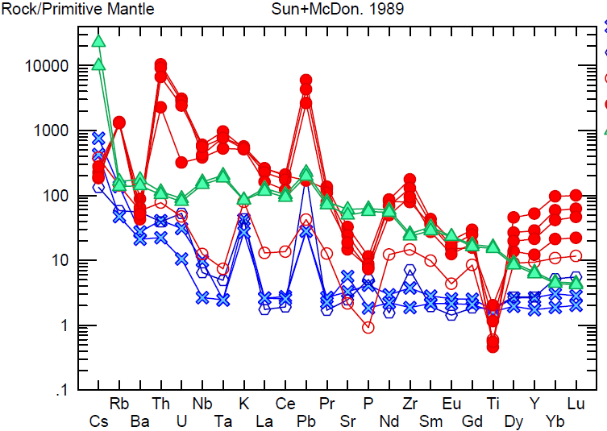
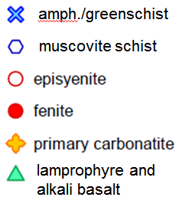
Spider Plot
Lobo Hill

Slide 23
Discussion
U and Th increase- like Caballo Mountains
Rb and Nb both show strong enrichment
Lack of Ba enrichment
HFSE (Zr, Ta, Hf and Y) increase dramatically
Low pH HCl-HF brines (250-400°C)

Slide 24
Conclusions
Some of the chemical markers permissive of fenitization
But lack of LIL, HFS enrichment in Caballo Mountains
If fenitization did occur, it is likely not the only alteration affecting episyenites
Basinal brines and supergene alteration/formation of laterite can explain chemical trends observed

Slide 25
Acknowledgements
Matt Heizler
Virginia McLemore
Kierran Maher
Frank Ramos
Society of Economic Geologists Fellowship
New Mexico Geological Society

Slide 26
References
White-Pinilla, K. C. (1997), Characterization of fenitizing fluids and processes involved in fenitization at the Iron Hill Carbonatite Complex, Gunnison, Colorado, 170 pp, Colorado School of Mines, Golden, CO.
McMillan, N. J., and V. T. McLemore (2004), Cambrian-Ordovician magmatism and extension in New Mexico and Colorado, New Mexico Bureau of Geology and Mineral Resources Bulletin, 160, 1-11.
Sindern, S., and U. Kramm (2000), Volume characteristics and element transfer of fenite aureoles: a case study from the Iivaara alkaline complex, Finland, Lithos, 51, 75-93.
Riggins, A. M. (2014), Origin of the REE-bearing episyenites in the Caballo and Burro Mountains, New Mexico, New Mexico Institute of Mining and Technology, Socorro, NM.
McLemore, V. T. (1999), Cambrian alkaline rocks at Lobo Hill, Torrance County, New Mexico: More evidence for a Cambrian-Ordovician aulacogen, New Mexico Geological Society Guidebook, 50th Annual Field Conference, 246-253.
McLemore, V. T. (1986), Geology, geochemistry, and mineralization of syenites in the Red Hills, Southern Caballo Mountains, Sierra County, New Mexico: preliminary observations, New Mexico Geological Society Guidebook, 37th Field Conference, 151-159.
Liu, J., R. L. Hay, A. Deino, and T. K. Kyser (2003), Age and origin of authigenic K-feldspar in uppermost Precambrian rocks in the North American Midcontinent, GSA Bulletin, 115(4), 422-433.
Castor, S. B., and J. B. Hendrick (2006), Rare Earth Elements, in Industrial Minerals and Rocks, edited, pp. 769-292, Society of Mining, Metallurgy and Exploration.
Jaireth, S., D. M. Hoatson, and Y. Miezitis (2014), Geological setting and resources of the major rare-earth-element deposits in Australia, Ore Geology Reviews, 62, 72-128.
Harrison, T. M. and McDougal, I. (1988). Geochronology and thermochronology by the 40Ar/39Ar method, 2nd Edition. Oxford University Press 1999, 271p.
Heizler, M. T. and Harrison, T. M. (1998). The thermal history of the New York basement determined from ⁴⁰Ar/³⁹Ar K-feldspar studies. Journal of Geophysical Research, 103 no. B12, 795-814.
Bauer, P. W., and R. P. Lozinsky (1986), Proterozoic geology of supracrustal and granitic rocks in the Caballo Mountains, Southern New Mexico, New Mexico Geological Society Guidebook, 37th Field Conference, 143-149.
Seager, W. R., and G. H. Mack (2003), Geology of the Caballo Mountains, New Mexico, New Mexico Bureau of Geology and Mineral Resources, Socorro, NM.
LeBas, M. J. (2008), Fenites Associated with Carbonatites, Canadian Mineralogist, 46, 915-932.
Vartiainen, H., and A. R. Woolley (1976), The petrology, mineralogy and chemistry of the fenites of the Sokli carbonatite intrusion, Finland, Geological Society of Finland, Bulletin 280, 1-87.
Armbrustmacher, T. J. (1984), Alkaline rock complexes in the Wet Mountains area, Custer and Fremont counties, Colorado, edited by D. o. t. Interior.
Armbrustmacher, T. J. (1988), Geology and resources of thorium and associated elements in the Wet Mountains area, Fremont and Custer counties, Colorado, edited by D. o. t. Interior, U.S. Geological Survey.
Bell, K., and A. Simonetti (2009), Source of parental melts to carbonatites–critical isotopic constraints, Mineralogy and Petrology, 98(1-4), 77-89.
Bell, K., and G. R. Tilton (2002), Probing the Mantle: the Story from Carbonatite, EOS, 83(25), 273-280.
Kramm, U., and S. Sindern (1998), Nd and Sr Isotope Signatures of Fenites from Oldoinyo Lengai, Tanzania and the Genetic Relationship between Nephelinites, Phonolites and Carbonatites, Journal of Petrology, 39(11-12), 1997-2004.
Dolníček, Z., M. René, S. Hermannová, and W. Prochaska (2013), Origin of the Okrouhlá Radouň episyenite-hosted uranium deposit, Bohemian Massif, Czech Republic: fluid inclusion and stable isotope constraints, Mineralium Deposita, 49(4), 409-425.
Recio, C., A. E. Fallick, J. M. Ugidos, and W. E. Stephens (1997), Characterization of multiple fluid-granite interaction processes in the episyenite of Avila-Béjar, Central Iberian Massif, Spain, Chemical Geology, 143, 127-144.
Gysi, A. P., and A. E. Williams-Jones (2013), Hydrothermal mobilization of pegmatite-hosted REE and Zr at Strange Lake, Canada: A reaction path model, Geochimica et Cosmochimica Acta, 122, 324-352.
McLemore, V. T. (1999), Cambrian alkaline rocks at Lobo Hill, Torrance County, New Mexico: More evidence for a Cambrian-Ordovician aulacogen, New Mexico Geological Society Guidebook, 50th Annual Field Conference, 246-253.

Slide 27
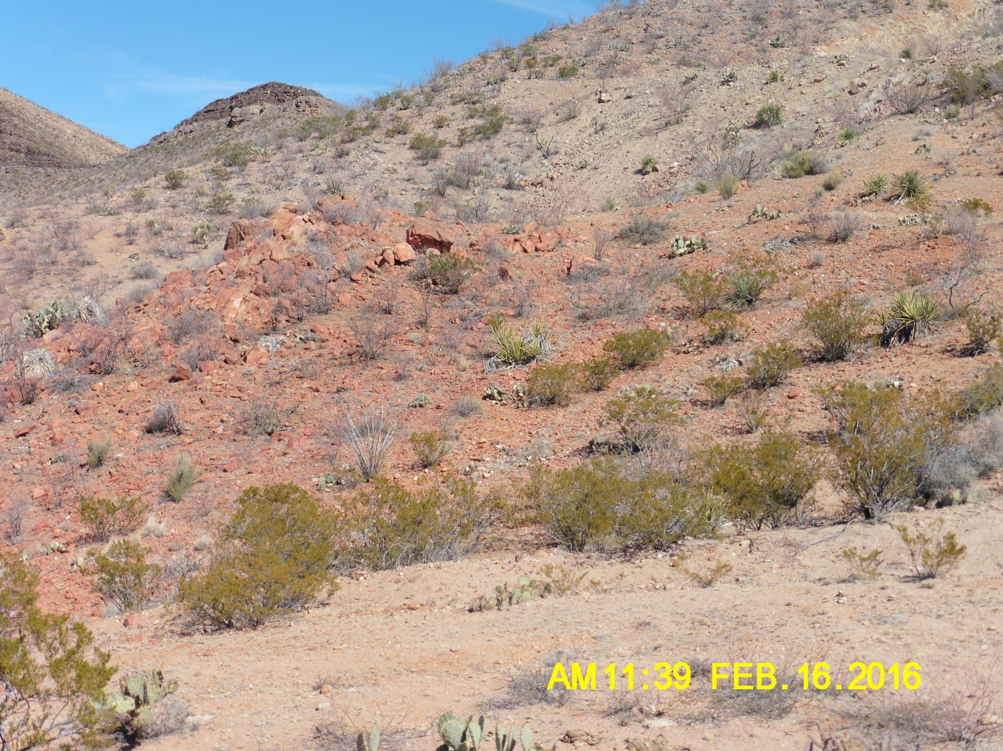
Questions?

